Slide 1

Past, Present, and Future of the U.S. Gravity for the Redefinition of the American Vertical Datum (GRAV-D) Project
Dru Smith
NSRS Modernization Manager
Gravity, Geoid and Height Systems 2
Copenhagen, Denmark
September 17-21 2018

Slide 2
Outline
  History and Background of GRAV-D
    Purpose
    Methods
  Current GRAV-D Operations
    Project Status
    Target Areas for 2018-2019
  Future of GRAV-D
    Completion of the Initial Phase (2022)
    Post-2022 Plans

Slide 3

NGS Mission Statement
To define, maintain and provide access to the National Spatial Reference System (NSRS) to meet our nation’s economic, social, and environmental needs.
The NSRS is a consistent coordinate system that defines latitude, longitude, height, scale, gravity, and orientation throughout the United States.

Slide 4
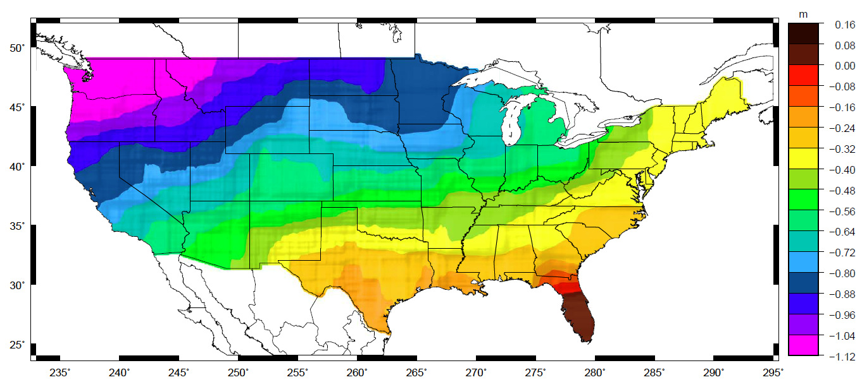
NAVD 88 Problems
Approximate mismatch between NAVD 88 (zero surface) and the global geoid (i.e. sea level)

Slide 5
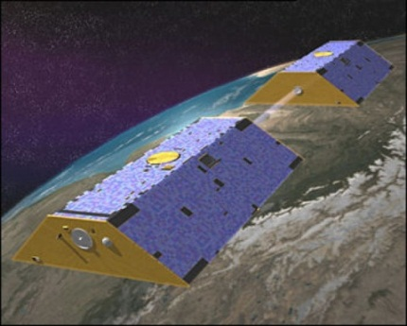
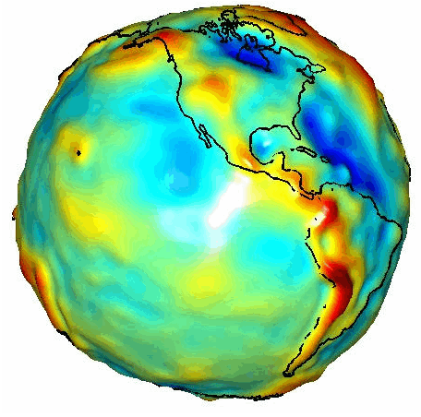
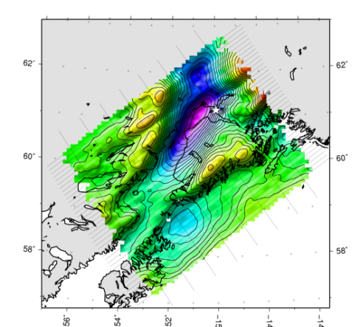
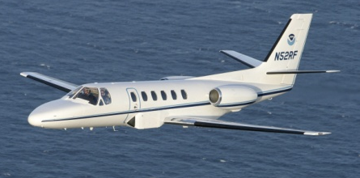
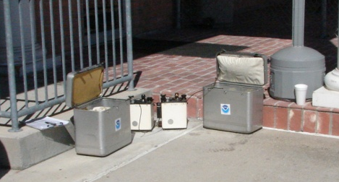
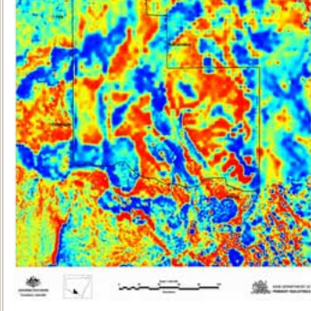
Building a Gravity Field
Long Wavelengths
(≥ 250 km)
GRACE/GOCE/Satellite Altimetry
+
Intermediate Wavelengths
(500 km to 20 km)
Airborne Measurement
+
Short Wavelengths
(< 100 km)
Surface Measurement and
Predicted Gravity from Topography

Slide 6
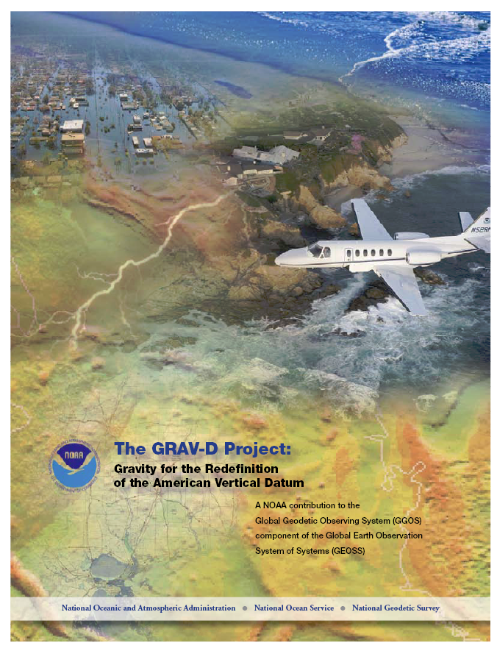
GRAV-D Project Overview
Overall Target: 2 cm accuracy orthometric heights from GNSS and a geoid model
GRAV-D Goal: Create gravimetric geoid accurate to 1 cm where possible using airborne gravity data
GRAV-D: Two thrusts of the project
  Airborne gravity survey of entire country and its holdings
  Long-term monitoring of geoid change
Leveraging partnerships to improve and validate gravity data
Notes:
Target is to be able to achieve 2 cm accuracy orthometric heights (where possible) using a GNSS receiver and a geoid model
Roughly 1 cm uncertainty from GNSS and 1 cm from the geoid model
GRAV-D
Phase 1: snapshot of the entire country to provide a consistent data set
Phase 2: long term monitoring of geoid change – in development
Work with partners to incorporate additional gravity data, particularly surface gravity data, validate existing data, and monitor change

Slide 7

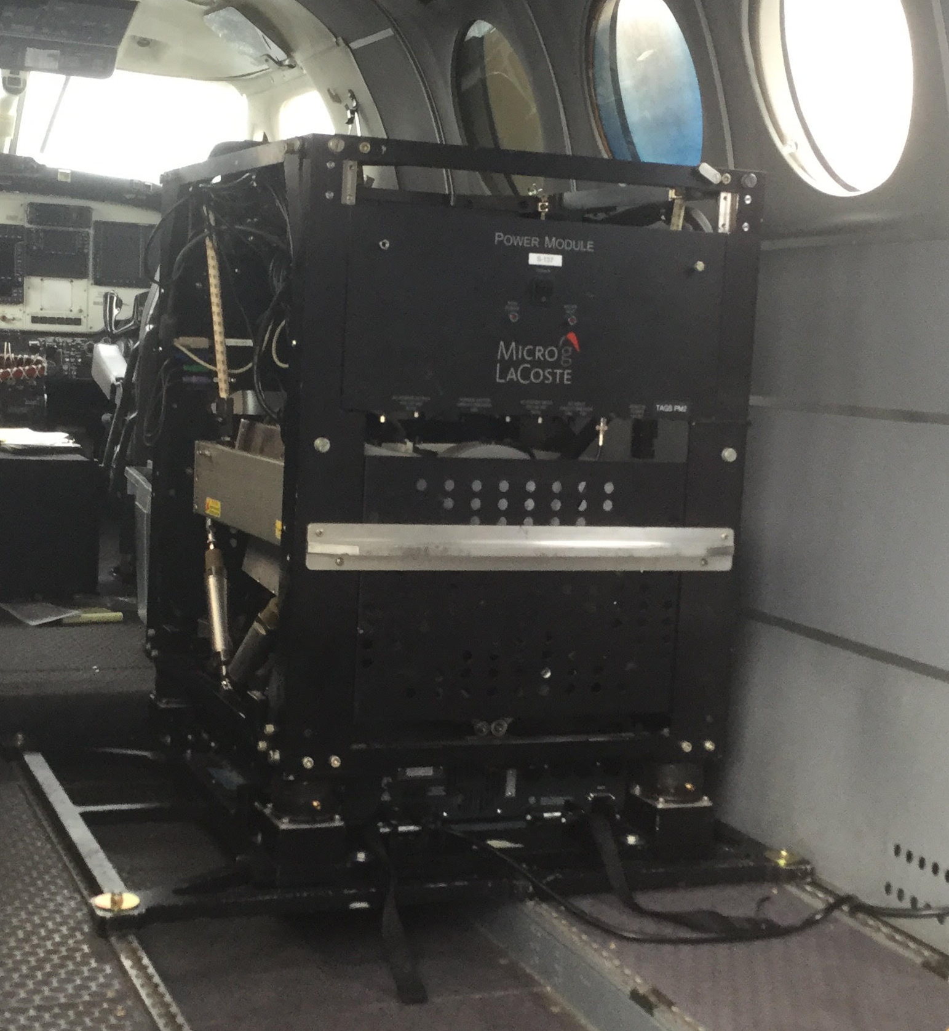
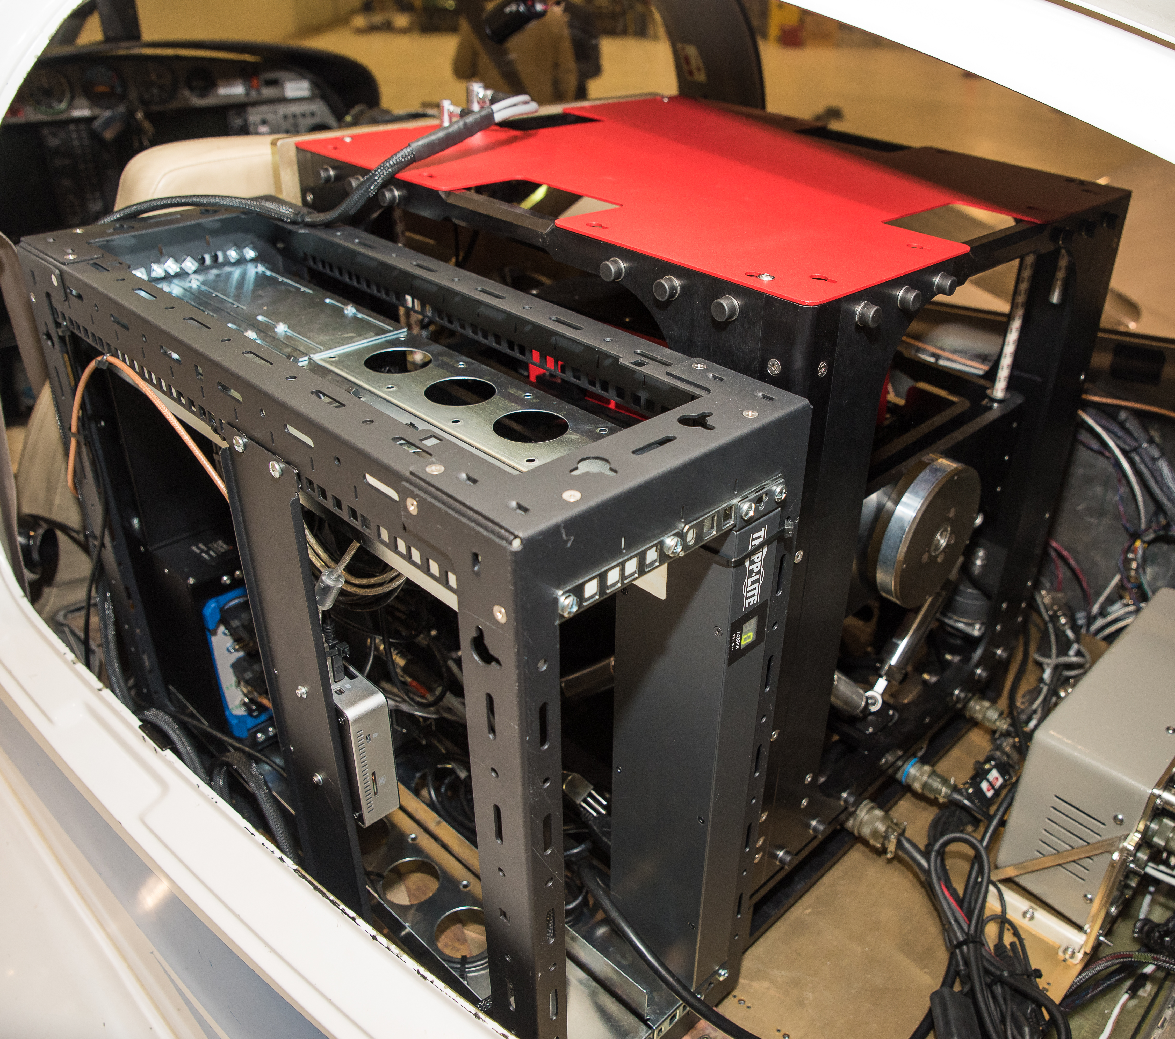
GRAV-D Methods
Survey Design
Altitude: ~20,000 feet
Spacing: 10 km line /
80 km cross line
Speed: variable
Equipment
Micro-g Lacoste TAGS (2) & TAGS 7 (1)
NovAtel IMU
Ground base stations for immediate quality control
Notes:
TAGS at top
TAGS 7 at bottom (installed on Centaur – optionally piloted)

Slide 8
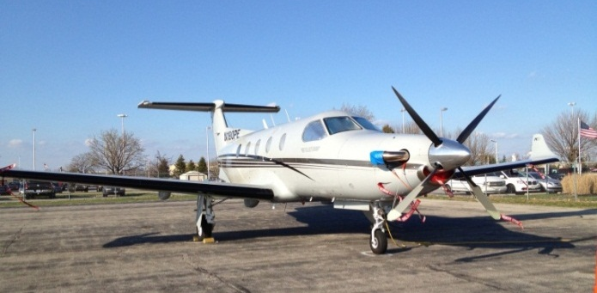
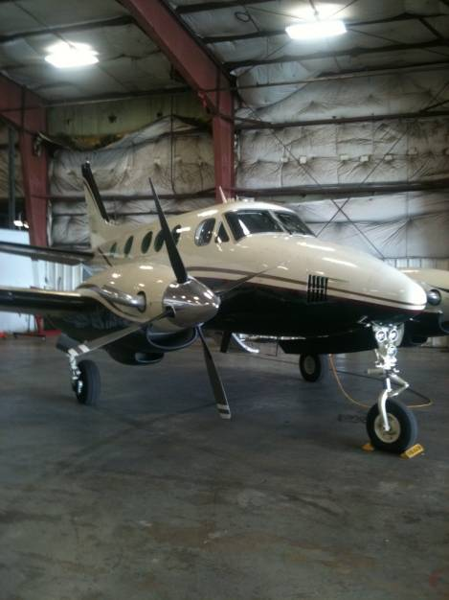

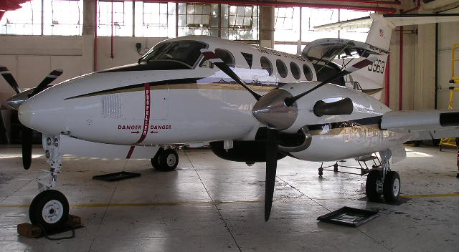
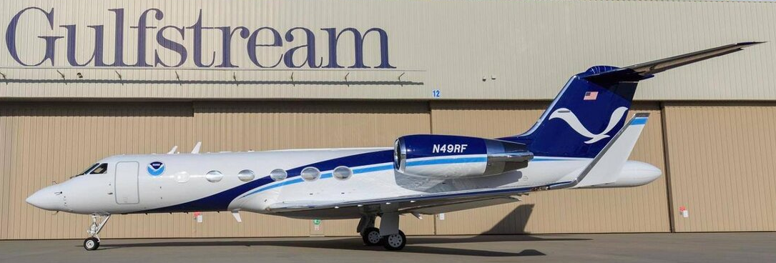
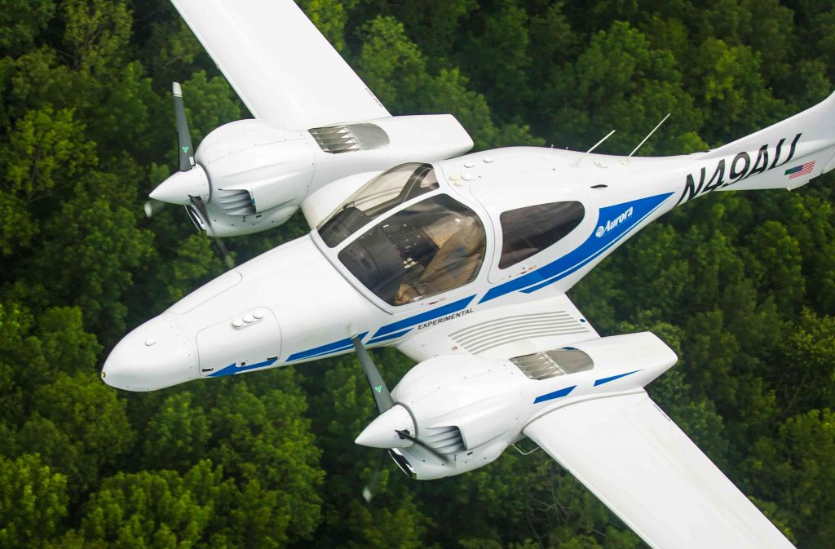
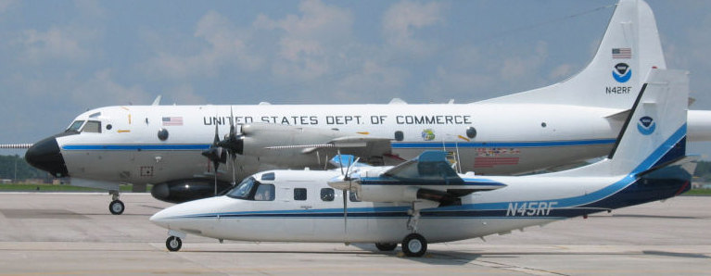
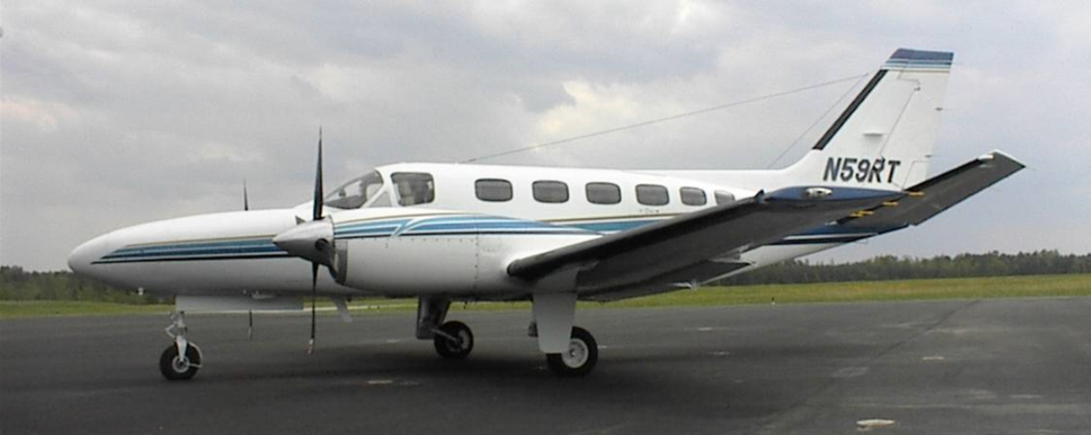
GRAV-D Aircraft
Bureau of Land Management Pilatus PC-12
Dynamic Aviation King Air 200T
Fugro King Air E-90A
NOAA Gulfstream IV-SP
Naval Research Laboratory
King Air RC-12
Aurora Flight Sciences Centaur Optionally Piloted Aircraft
NOAA P-3 (background)
NOAA Turbo Commander (foreground)
Fugro Cessna Conquest

Slide 9
Gravity Processing Method
Aircraft and Gravimeter Position
Gravity Measurements
General Processing Steps:
Calculate positions at every gravity measurement
  Calculate tightly-coupled Kinematic positions using GPS and IMU
  Recalculate the GPS solution to the location of the gravity meter
  Match times between gravimeter and GPS to pair positions and gravity measurements
Apply the ground absolute gravity tie to convert relative measurements to full field gravity
Apply corrections:
  Eotvos
  Off-level
Filter the data to remove high frequency noise
General Processing Steps:
Calculate positions at every gravity measurement
  Calculate tightly-coupled Kinematic positions using GPS and IMU
  Recalculate the GPS solution to the location of the gravity meter
  Match times between gravimeter and GPS to pair positions and gravity measurements
Apply the ground absolute gravity tie to convert relative measurements to full field gravity
Apply corrections:
  Eotvos
  Off-level
Filter the data to remove high frequency noise
Processing
Gravity Values
Green – NovAtel Inertial Explorer
Blue – NGS’ Newton Software
Newton is in the process of being updated to be more robust and flexible with documentation for public release

Slide 10
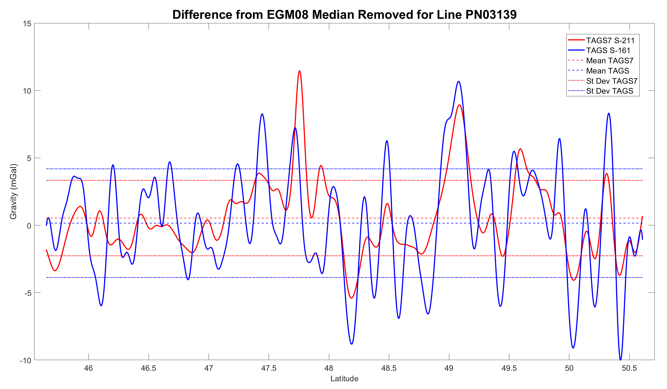
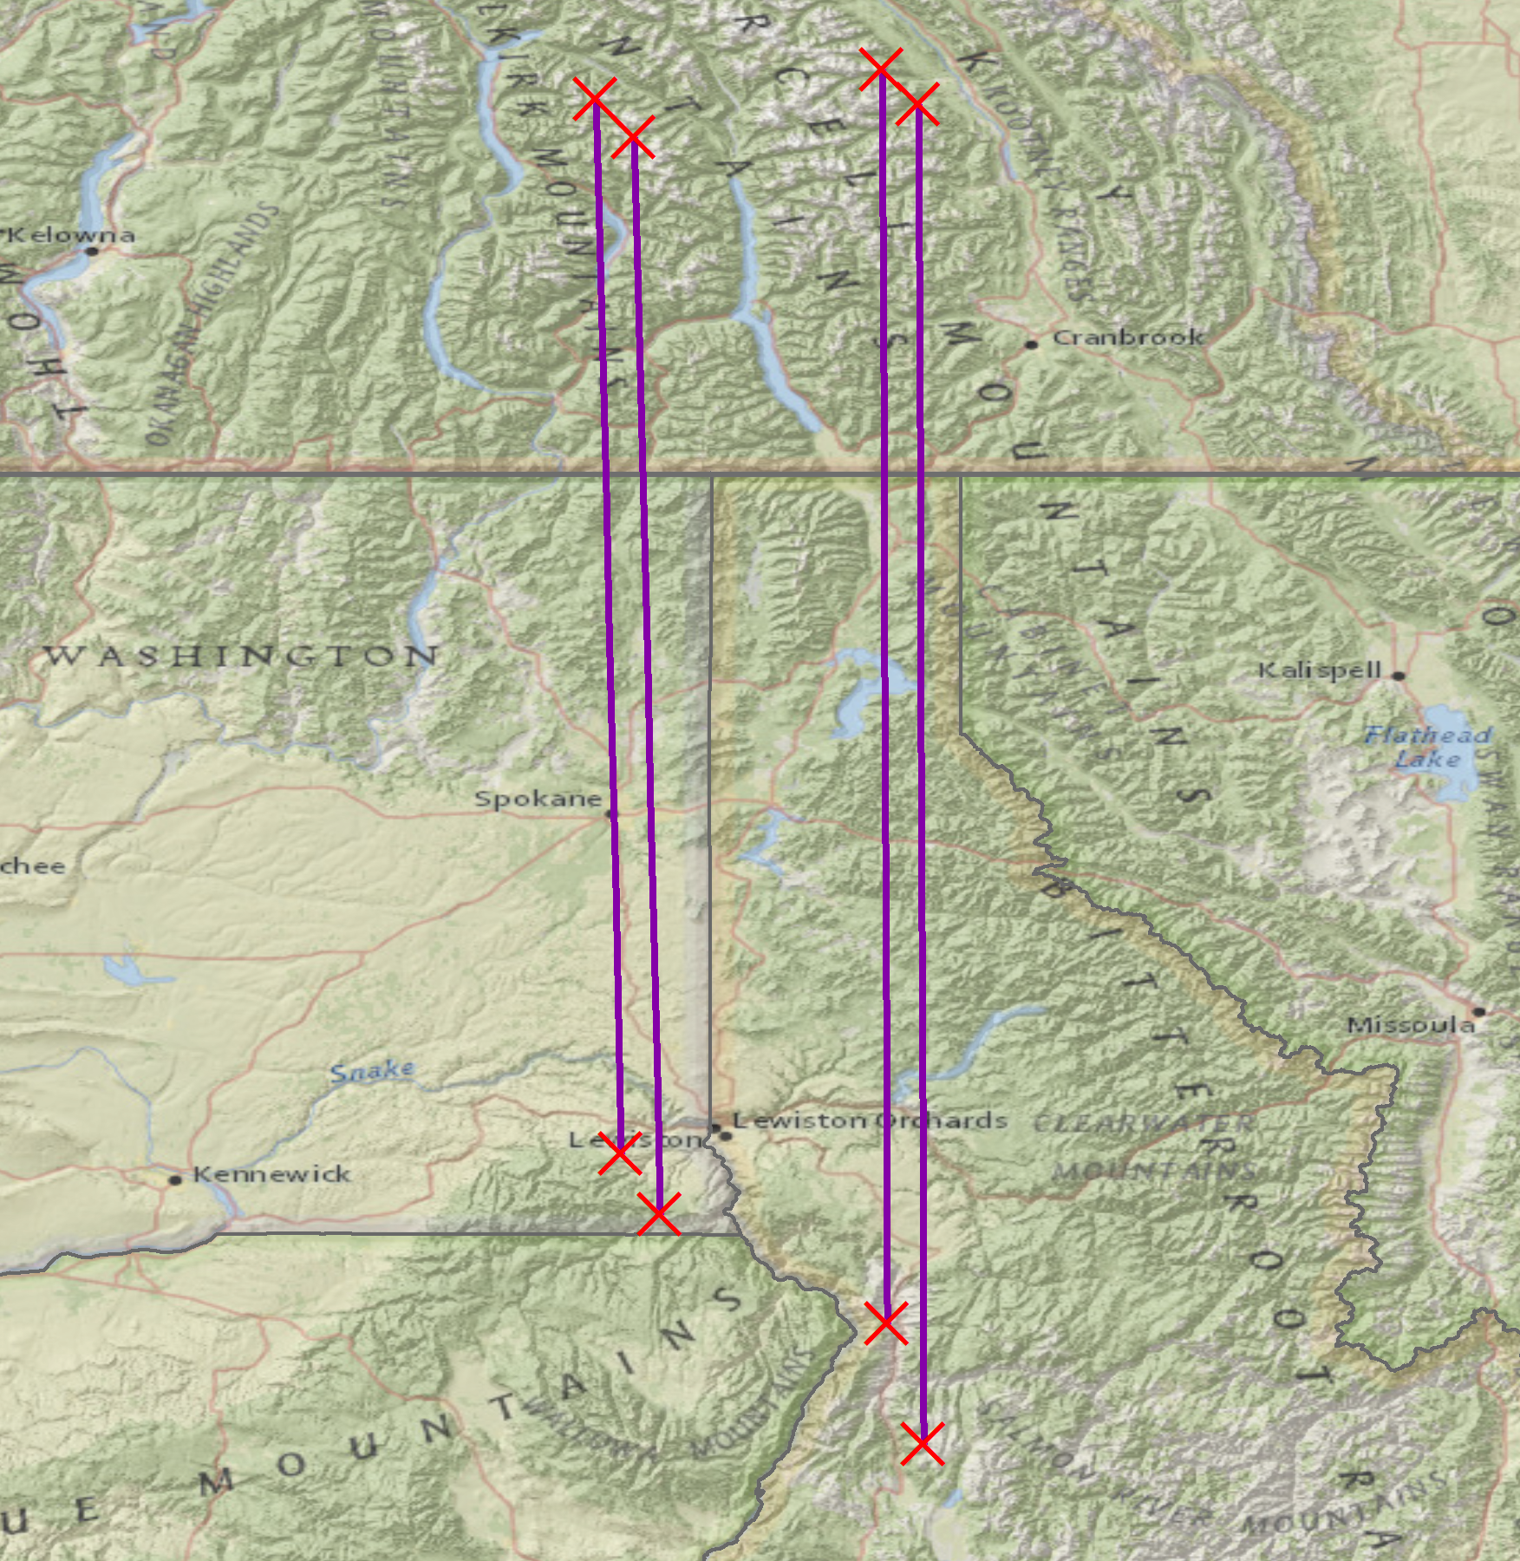
Comparison of TAGS & TAGS 7
Results
For PN03139 the standard deviation decreased 1.23 mGals with the TAGS 7
Average decrease in standard deviation (8 lines) of 0.462 mGals
  No difference in smooth, flat location
  0.927 mGals in mountainous location
Conclusion
TAGS 7 handles turbulent/mountainous conditions better than the TAGS
Survey
Pilatus PC-12 aircraft with both gravimeters installed
Total of 8 lines, split between mountains and plains
  Northwestern US (4 lines) November 2017
  Central US (4 lines) January 2018

Slide 11
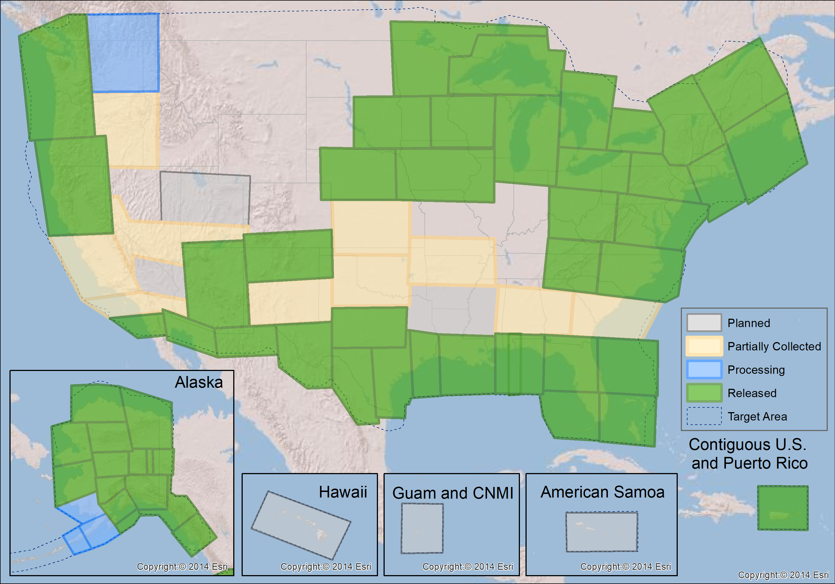
GRAV-D Status 8-31-18: ~72%
Target 2018-2022
Completed 2018
Target 2019
Target 2020

Slide 12
Hawaii
23 flights
(22 required, 1 planned re-flight)
156 flight hours
Hawaii
Flight Plan | Dist (NM) | Total Time
1 | 2555.0 | 7.30
2 | 2552.7 | 7.29
3 | 2550.0 | 7.29
4 | 2548.2 | 7.28
5 | 2545.5 | 7.27
6 | 2535.3 | 7.24
7 | 2535.2 | 7.24
8 | 2535.3 | 7.24
9 | 2536.7 | 7.25
10 | 2536.4 | 7.25
11 | 2555.5 | 7.30
12 | 2558.5 | 7.31
13 | 2561.3 | 7.32
14 | 2564.3 | 7.33
15 | 2567.4 | 7.34
16 | 2415.2 | 6.90
17 | 2411.2 | 6.89
18 | 2414.8 | 6.90
19 | 2425.5 | 6.93
20 | 2441.7 | 6.98
21 | 2185.1 | 6.24
22 | 2064.7 | 5.89
Totals | 54595.5 | 155.98

Slide 13
Guam
18 flights (17 required, 1 planned re-flight)
110 flight hours
Guam
Flight Plan | Dist (NM) | Total Time
1 | 2265.2 | 6.47
2 | 2262 | 6.46
3 | 2257.4 | 6.45
4 | 2254.5 | 6.44
5 | 2251.7 | 6.43
6 | 2242.4 | 6.41
7 | 2245 | 6.41
8 | 2448.9 | 6.42
9 | 2249.1 | 6.43
10 | 2251.5 | 6.43
11 | 2323.6 | 6.64
12 | 2106.3 | 6.65
13 | 2468.3 | 6.67
14 | 2342.4 | 6.69
15 | 2265.2 | 6.65
16 | 2078.5 | 5.94
17 | 2091.2 | 5.97
Totals | 38403.2 | 109.58

Slide 14
American Samoa
10 flights (9 required, 1 planned re-flight)
57 flight hours
American Samoa
Flight Plan | Dist (NM) | Total Time
1 | 2349.2 | 6.71
2 | 2349 | 6.71
3 | 2348.3 | 6.71
4 | 2348 | 6.71
5 | 2348.5 | 6.71
6 | 1915.9 | 5.47
7 | 1924.8 | 5.50
8 | 2248.1 | 6.42
9 | 2158 | 6.17
Totals | 19989.8 | 57.11

Slide 15
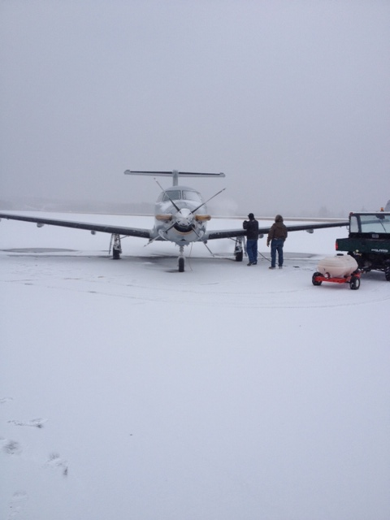
Completion in 2022
FY19 – Pacific Island Survey
This is our most risky survey of the project due to the expense, travel distance, and remoteness
Building in flexibility into the survey – significant communication and
Using the NOAA G-IV aircraft
FY20 – Aleutian Islands Survey
Also a challenging area being remote, but not as large an area as the Pacific Islands
May also be done with the NOAA G-IV
FY21-FY22
Weather is going to be the biggest challenge
Finding unique ways to be flexible with scheduling
Notes:
Weather is a problem because, as the final area to be covered gets smaller, the flexibility to “move away from the weather” is removed.

Slide 16
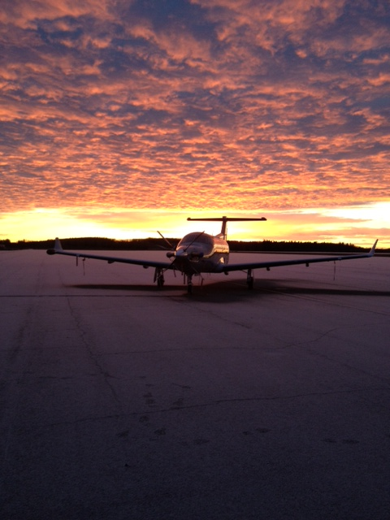
Post-2022
Monitoring and Validation
Target specific areas of interest with different survey designs (ex. Lower altitude)
Resurvey areas of uncertainty or change
Address any marginally acceptable areas identified as a priority for geoid modeling
Outside the United States
Target areas of interest that affect the U.S. geoid and support interests of NGA and neighbors
  Mexican mountains
  Canadian mountains
  Caribbean
  Extended areas in the Pacific

Slide 17
Summary
GRAV-D is currently at ~72% complete and on track to finish data collection in 2022
The addition of the TAGS 7 will improve data quality in mountainous areas and allow for potential UAS data collection
Future surveying includes a large survey in the Pacific Islands and after 2022 areas adjacent to the U.S.
Thank you for your attention!

Slide 18
Questions?

