Slide 1

Modernizing the National Spatial Reference System in 2022: Replacing NAD 83
Dru Smith
NSRS Modernization Manager
NOAA’s National Geodetic Survey

Slide 2
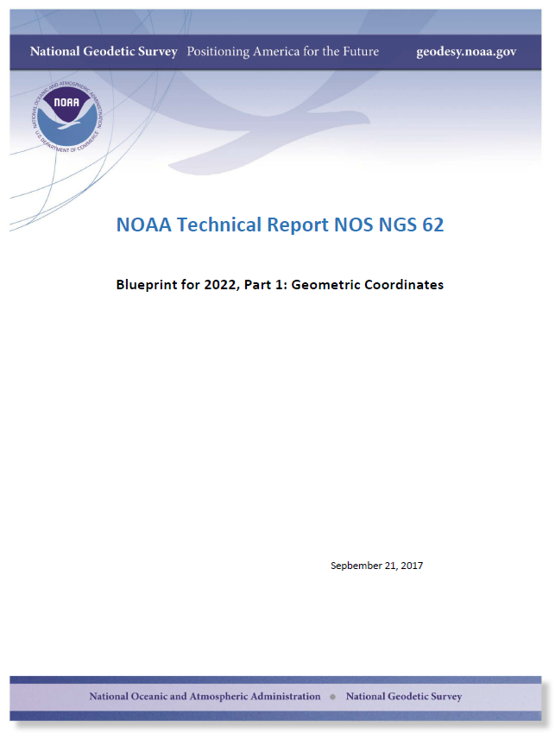
If you remember nothing else from this talk, remember
to just search for “Blueprint 2022” in any search engine

Slide 3
Overview
Why replace NAD 83?
What’s being replaced?
Four Terrestrial Reference Frames
Intra-Frame Velocity Model
Summary

Slide 4
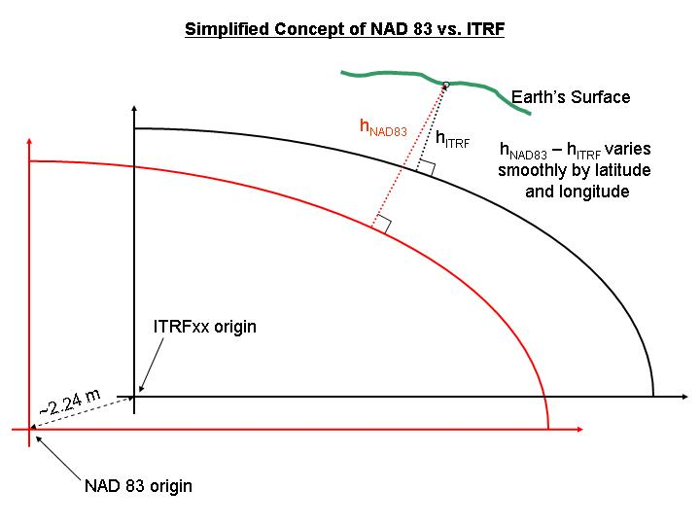
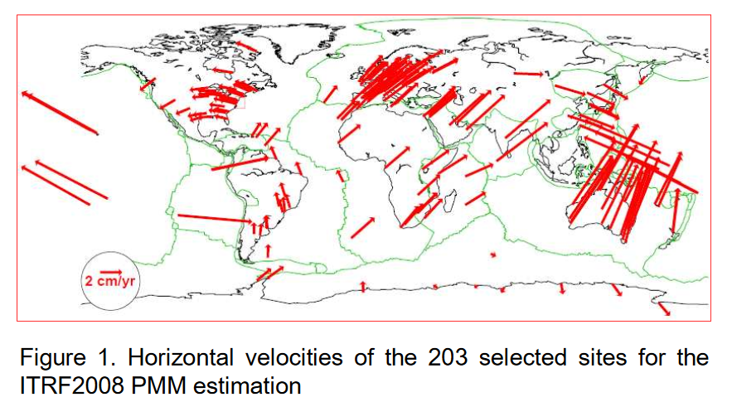
Why?
Non-Geocentricity
Dynamism

Slide 5
NSRS Modernization
The Old:
NAD 83(2011)
NAD 83(PA11)
NAD 83(MA11)
The New:
The North American Terrestrial Reference Frame of 2022
(NATRF2022)
The Caribbean Terrestrial Reference Frame of 2022
(CATRF2022)
The Pacific Terrestrial Reference Frame of 2022
(PATRF2022)
The Mariana Terrestrial Reference Frame of 2022
(MATRF2022)

Slide 6
Reference Frames
The NSRS in 2022 will contain four terrestrial reference frames
  Each one related to the IGS frame by a plate rotation model only
    This will leave residual velocities.
      Why?
        Because every point on Earth is moving for many reasons, and plate rotation, while large, is not the only thing happening to points.
    NGS will model those residual velocities in an Intra-Frame Velocity Model (IFVM)

Slide 7
The relation of five global reference
frames through time.
NATRF2022
MATRF2022
Rotations are not to scale
CATRF2022
Rotation of North American Plate
PATRF2022
Rotation of Pacific Plate
IGS frame
IGS frame through time
IGS frame
Rotation of Caribbean Plate
PATRF2022
CATRF2022
Rotation of Mariana Plate
NATRF2022
Time “t ” when
all four TRFs and the
IGS are identical.
(2020.00)
MATRF2022
0
t=t - Δt
(“the past”)
t=t + Δt
(“the future”)
0
0

Slide 8
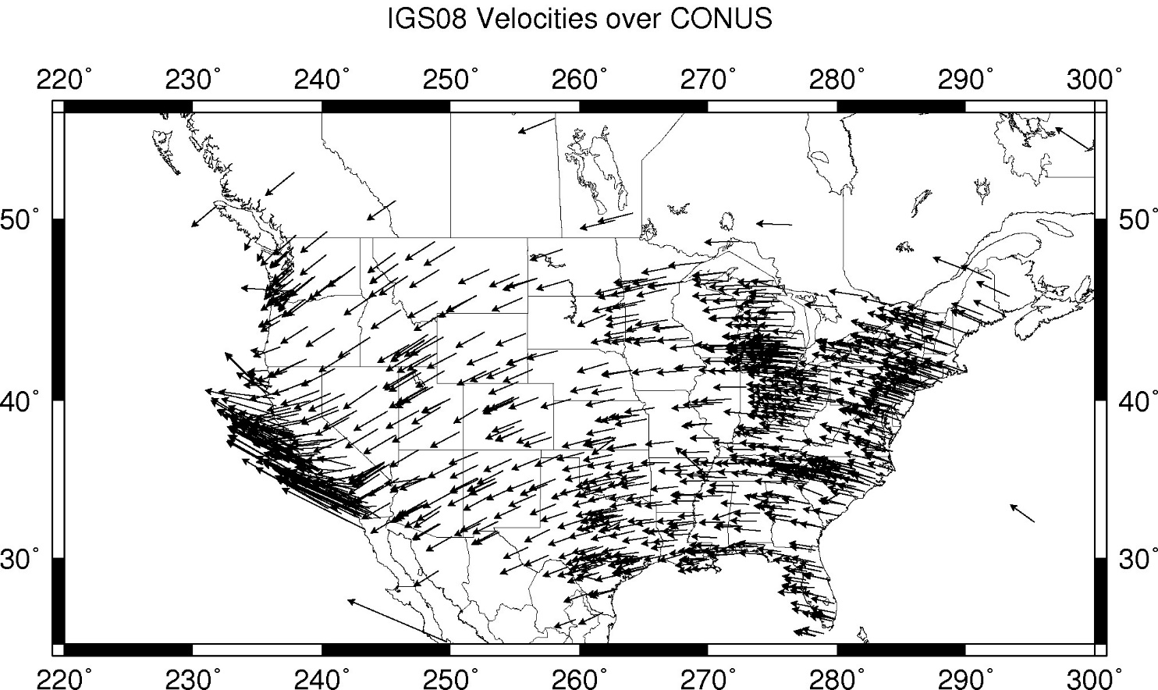
CORS Velocities – IGS08

Slide 9
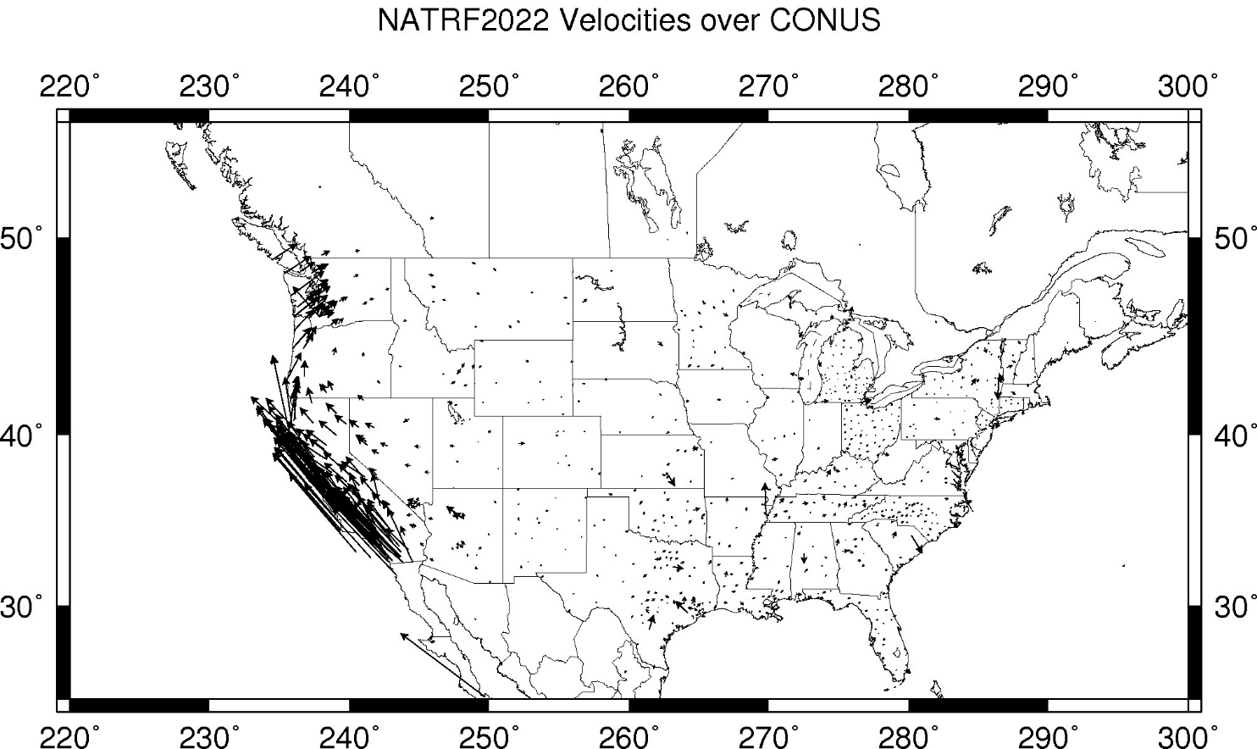
CORS Velocities – NATRF2022
Notes:
These velocities were arrived at by taking IGS08 velocities and removing the 3 parameter Euler Pole rotation of the North American plate as currently known (ITRF08 plate motion model).
These residual velocities will then be modeled into the IFVM for NATRF2022

Slide 10
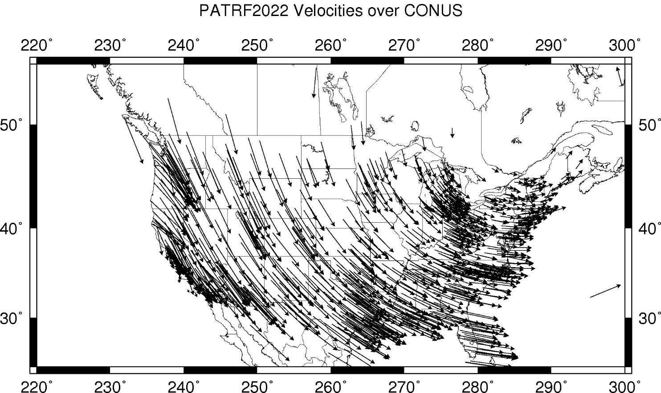
CORS Velocities – PATRF2022

Slide 11
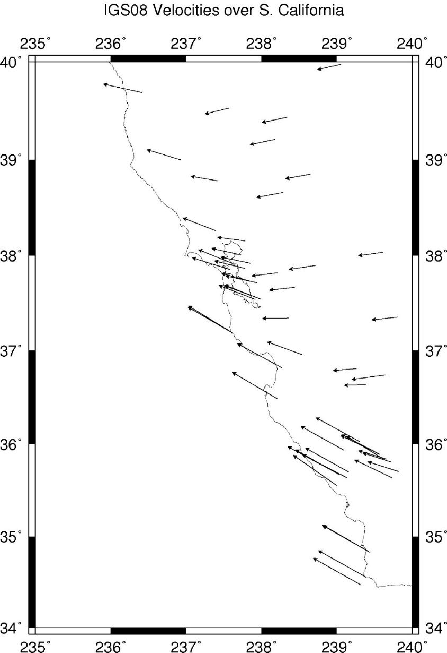
CORS Velocities – IGS08

Slide 12
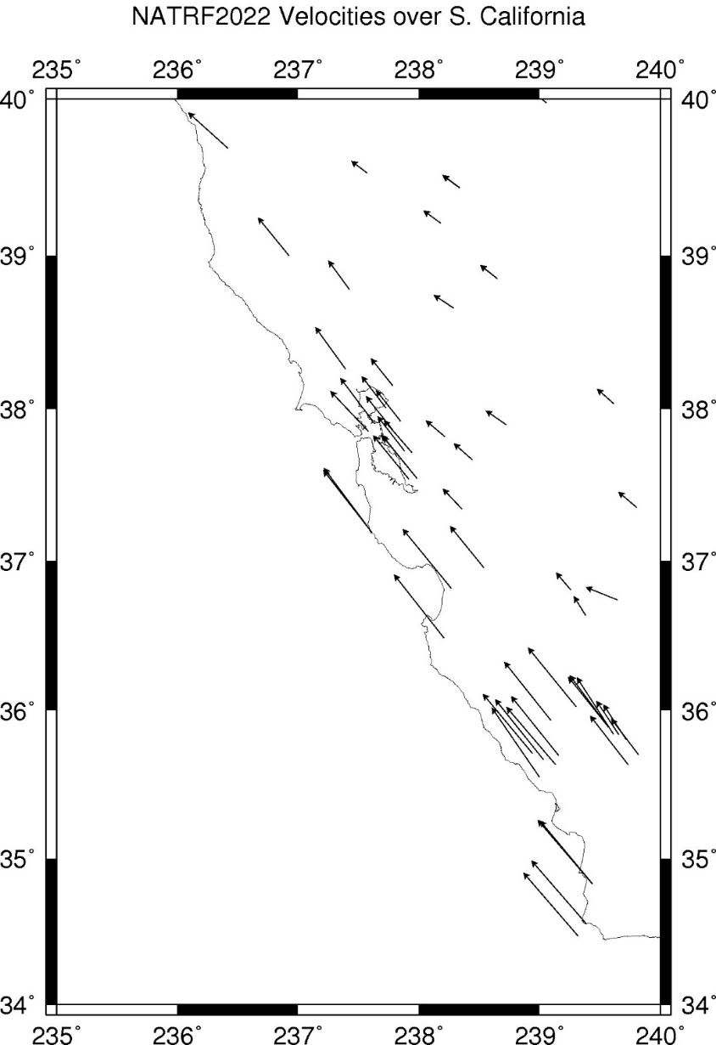
CORS Velocities – NATRF2022

Slide 13
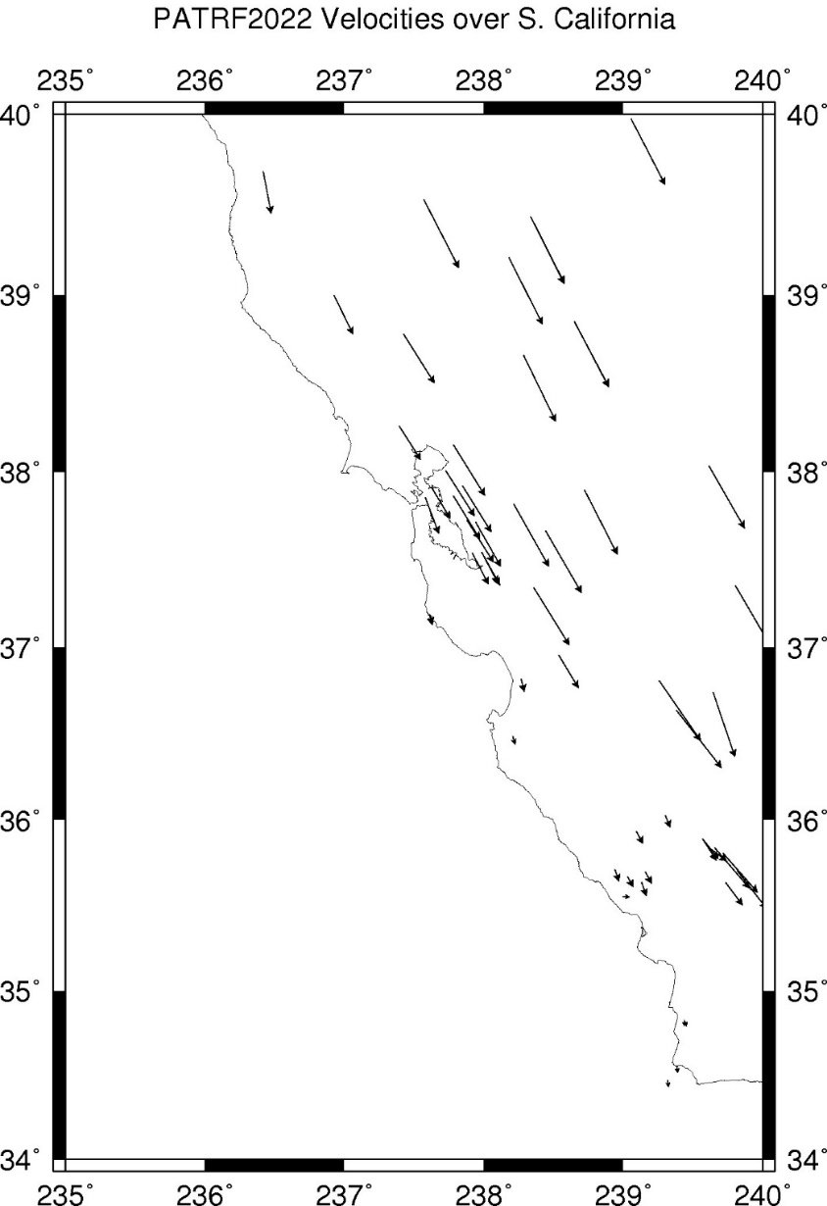
CORS Velocities – PATRF2022

Slide 14
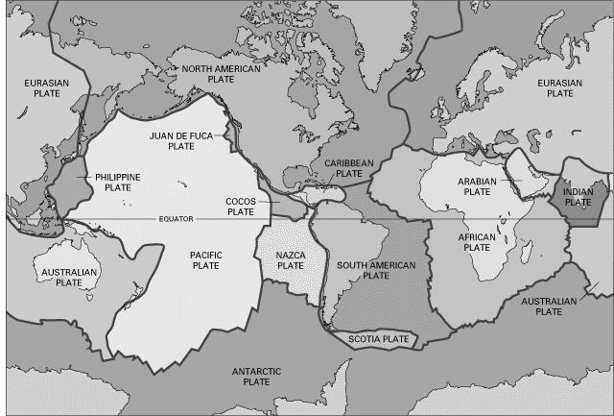
BSMK (North Dakota)

Slide 15
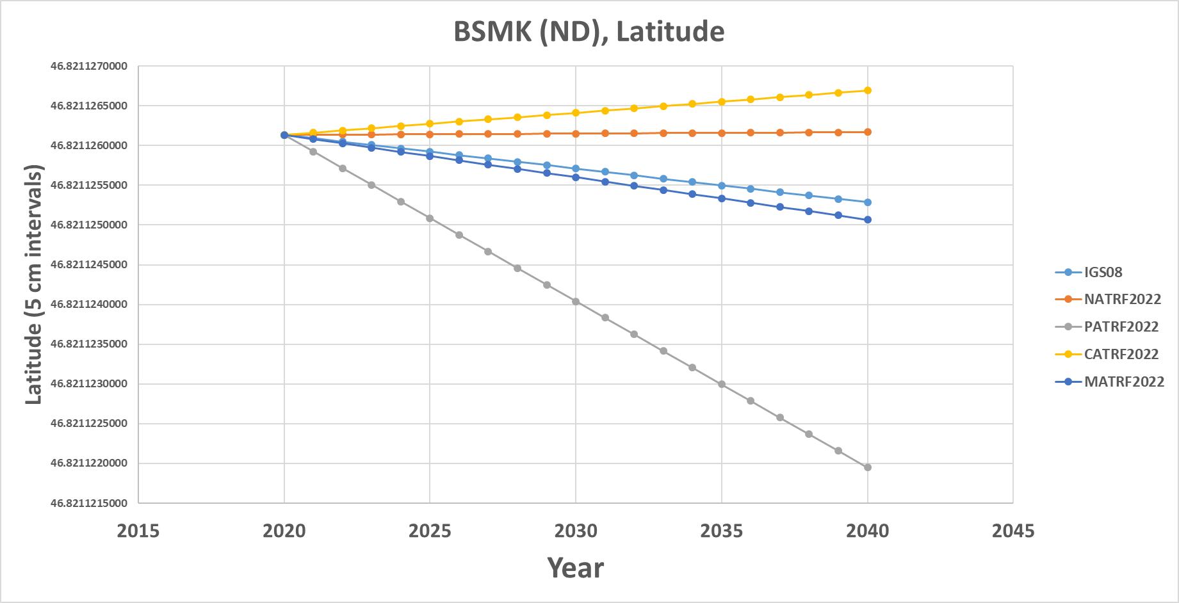
BSMK (North Dakota)
Note the time-dependent coordinate in latitude in NATRF2022 is stable! That means the NATRF2022 IFVM for latitude will be ZERO for this point.

Slide 16
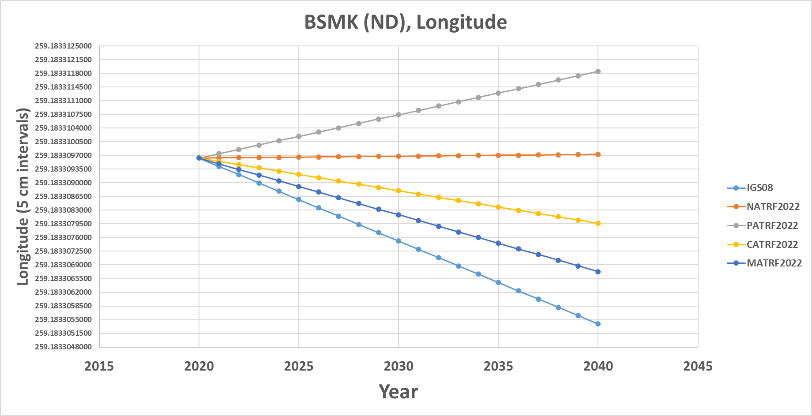
BSMK (North Dakota)
Similarly, the time-dependent coordinate in longitude in NATRF2022 is stable! That means the NATRF2022 IFVM for longitude will be ZERO for this point.

Slide 17
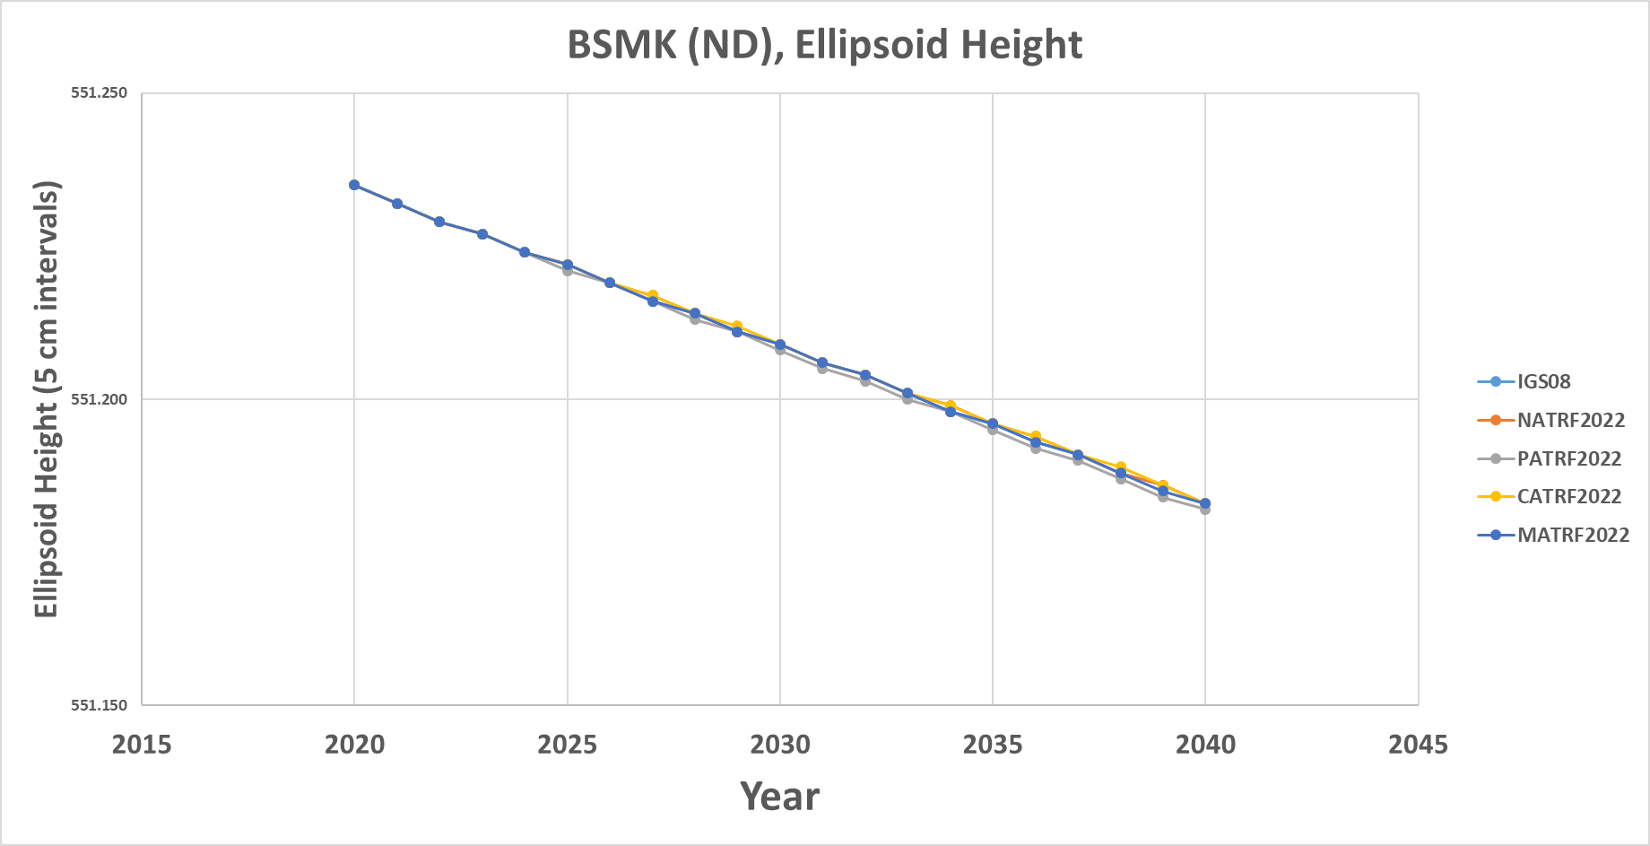
BSMK (North Dakota)
However, in every frame, this point is subsiding! That will be captured in the ellipsoid height component of the IFVM for each frame.

Slide 18
So…4 IFVMs?
Yes. An IFVM for each frame.
But here’s the trick: The same exact data will go into creating all 4 of them.
  It’s just that each one will be relative to the Euler Pole rotation of a particular plate.

Slide 19
Absolute motion
Thus the absolute motion of a point (within the IGS frame) at any location can be represented identically by:
  The EP rotation of the NA plate + the NA IFVM
  The EP rotation of the PA plate + the PA IFVM
  The EP rotation of the CA plate + the CA IFVM
  The EP rotation of the MA plate + the MA IFVM
Etc ad nauseum
  As the old saying goes, there are two kinds of people in this world:
    Those who can extrapolate from incomplete data

Slide 20
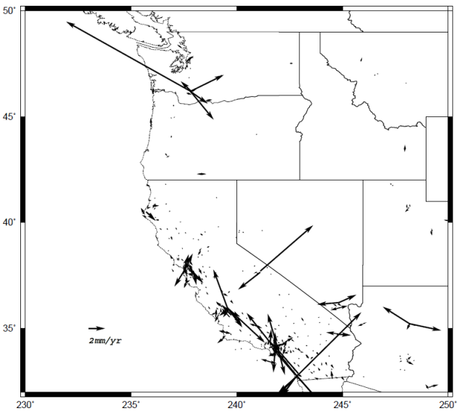
Can CORS alone serve as an IFVM?
Eastern CONUS will largely be resolved
Western CONUS has some anomalies

Slide 21
Coming Soon
Blueprint for 2022, Part 3: Using the Modernized NSRS
  Should address questions about how to work in a system that uses time-dependent geodetic control

Slide 22
Thank you!

Slide 23
Questions?

Slide 24
Extra Slides

Slide 25
Intra-Frame Velocity Models (IFVMs)
Why “Intra-Frame” and not “Intra-Plate”?
  Because each motion model will represent all velocities occurring inside one frame which are not due to the Euler Pole rotation of the plate for which the frame is named
  What???

Slide 26
Intra-Frame Velocity Models (IFVMs)
Consider “NATRF2022”
  It will be a global reference frame
    (In practice it can be applied anywhere, since it is a simple 3 parameter transformation from the global IGS frame)
  It is named after the North American plate
  The IFVM for NATRF2022 will be a global velocity model
    (Though, in practice, it will likely only have data in USA territories)
  It will reflect all motions on all points (globally) which are not due to the Euler Pole Rotation of the North American plate. Thus:
    All vertical motions, anywhere
    All horizontal motions not due to NA Euler Pole rotation
      Such as the small motion of points in Kansas relative to the stable North American plate
      Such as the horizontal manifestation of GIA relative to the stable North American plate
      Such as the motion of Hawaii points relative to the stable North American plate
      Such as the motion of S. California points relative to the stable North American plate

Slide 27
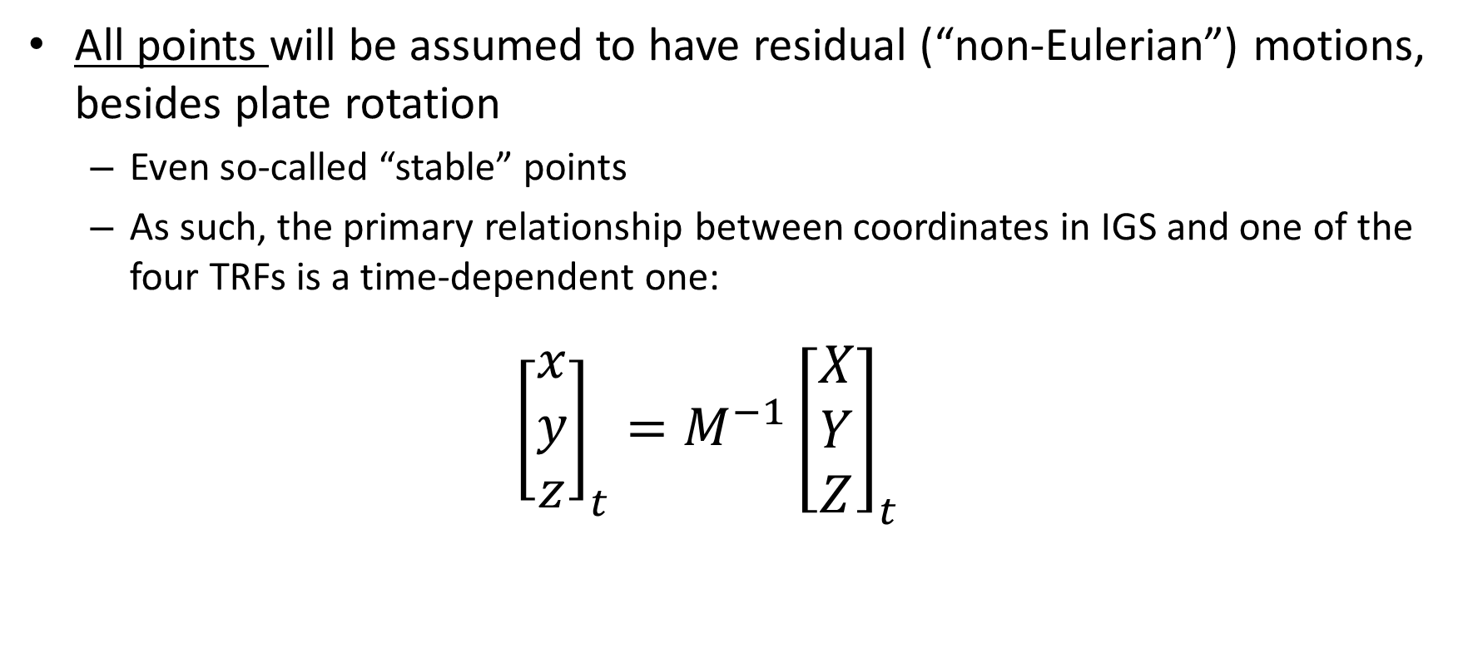
Content: Reference Frames
All points will be assumed to have residual (“non-Eulerian”) motions, besides plate rotation
  Even so-called “stable” points
  As such, the primary relationship between coordinates in IGS and one of the four TRFs is a time-dependent one:
${{{\left[\begin{matrix}x \\ y \\ z\end{matrix}\right]}_{t}=M}^{−1}\left[\begin{matrix}X \\ Y \\ Z\end{matrix}\right]}_{t}$
*TRF2022
coordinates
Plate rotation model
for plate *
IGS coordinates

Slide 28
Content: Reference Frames
Non-Eulerian motions at CORS
Note the obvious impact of the plate boundary in western CONUS
Note the non-zero nature of all vectors even in “stable North America”
Notes:
Potential outline and speaker assignments; can be adjusted as needed.

Slide 29
Some examples at CORS
Let’s look at the expression of coordinates at select CORS
Five frames (IGS + 4 TRFs)
Using IGS08 for now
Using the best known plate rotation models

Slide 30
Select CORS

Slide 31
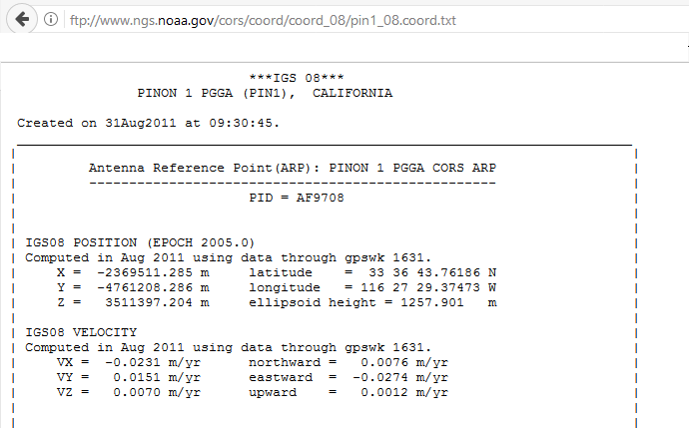
A word about CORS coordinates…
A typical “CORS coordinate
file” available from NGS
Just one set of coordinates
and just one set of
velocities

Slide 32
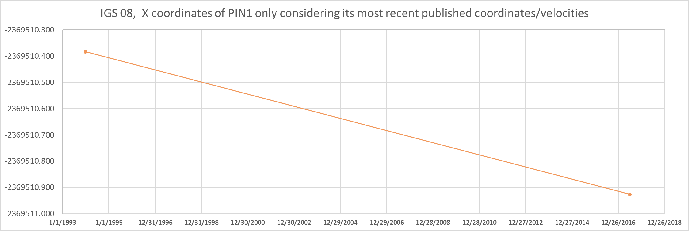
CORS Coordinates

Slide 33
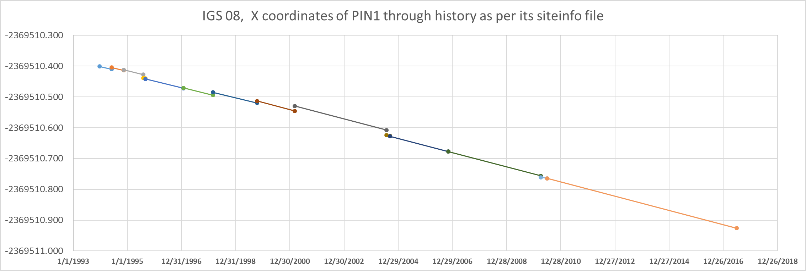
CORS Coordinates
CORS have complicated histories. This full history will be available on
CORS “datasheets” when the new NSRS database is up and running.

Slide 34
BSMK (North Dakota)

Slide 35

BSMK (North Dakota)

Slide 36

BSMK (North Dakota)

Slide 37

BSMK (North Dakota)

Slide 38
PIN1 (S. California)

Slide 39
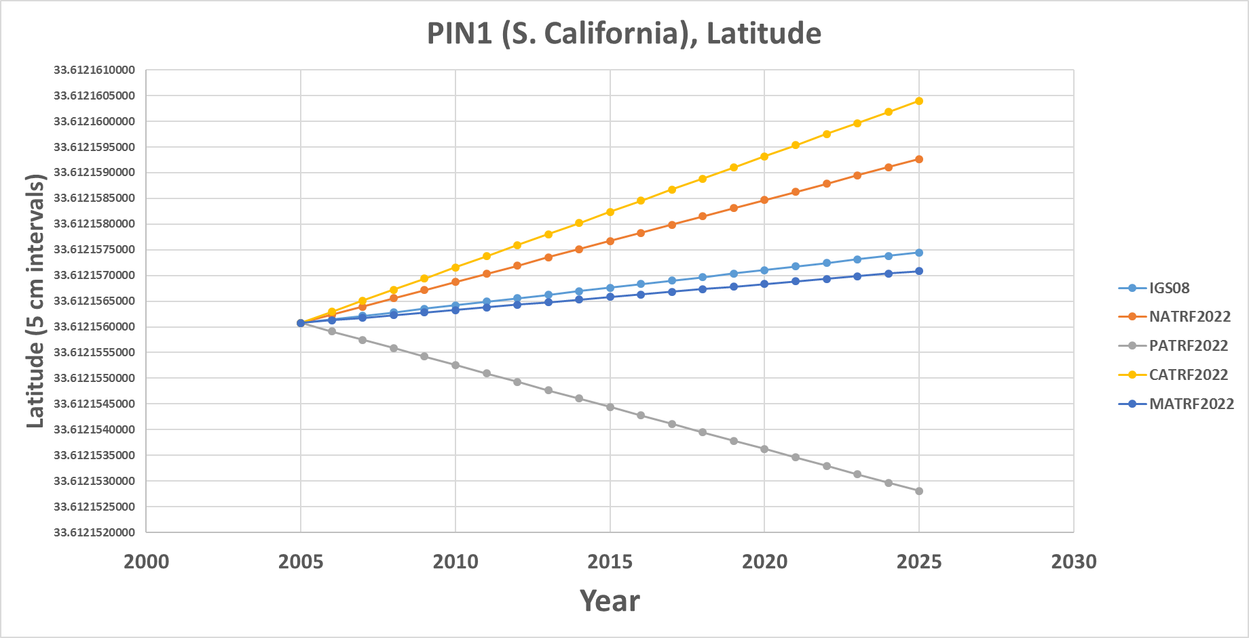
PIN1 (S. California)

Slide 40
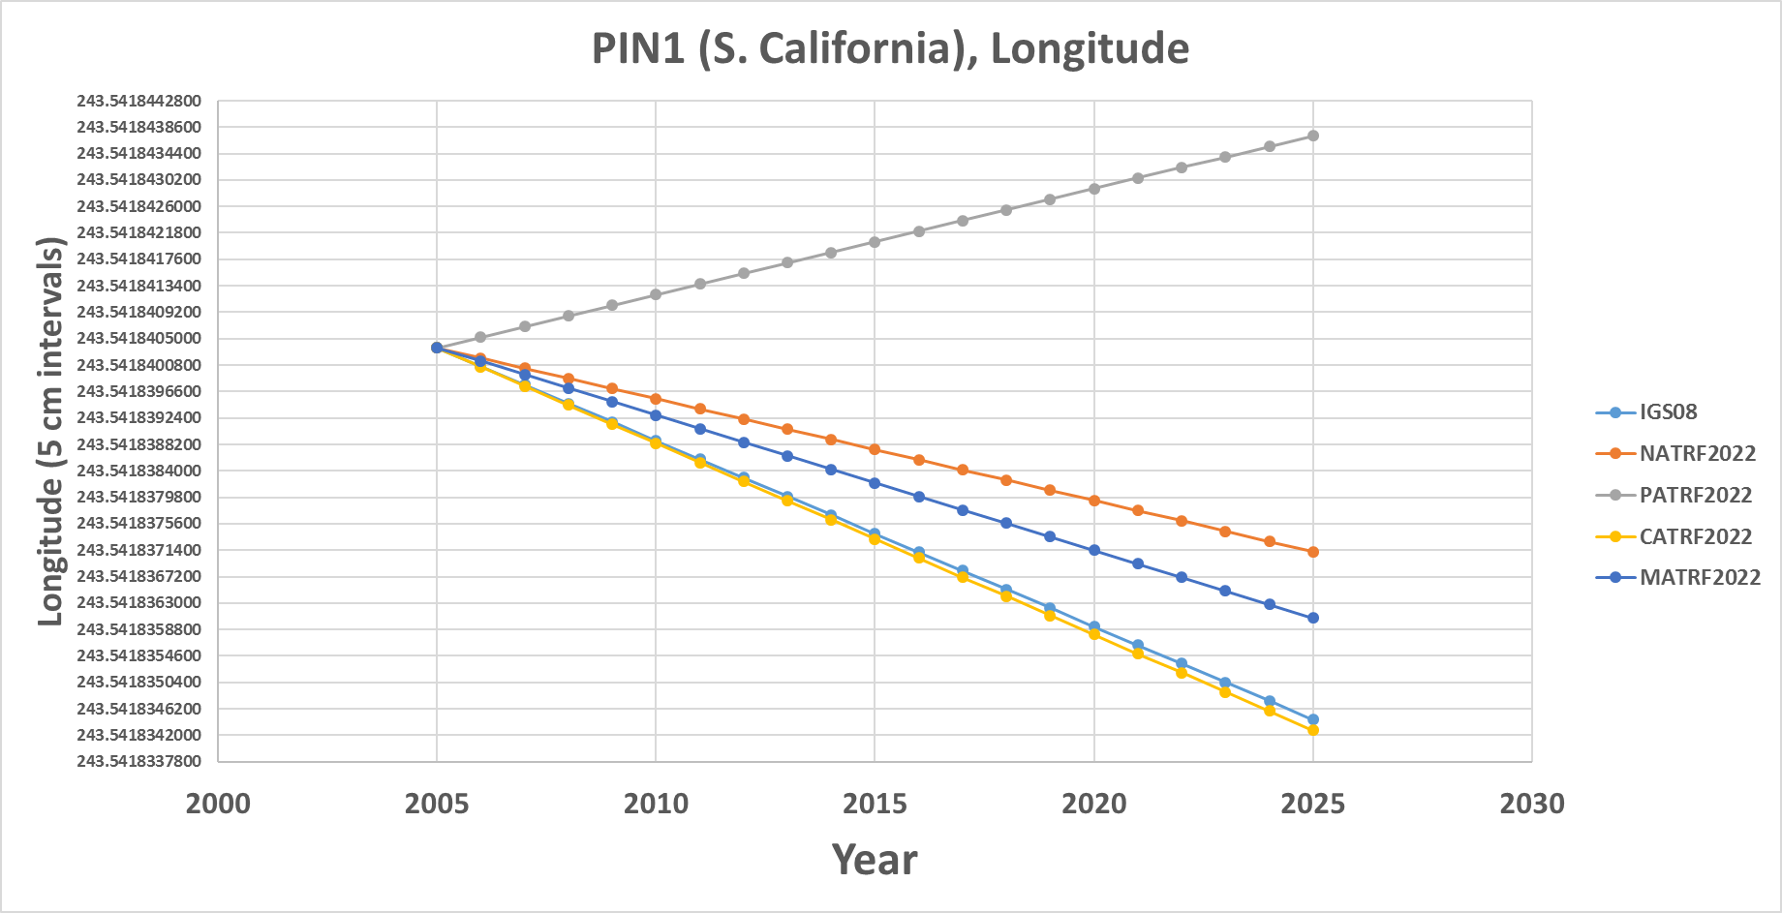
PIN1 (S. California)

Slide 41
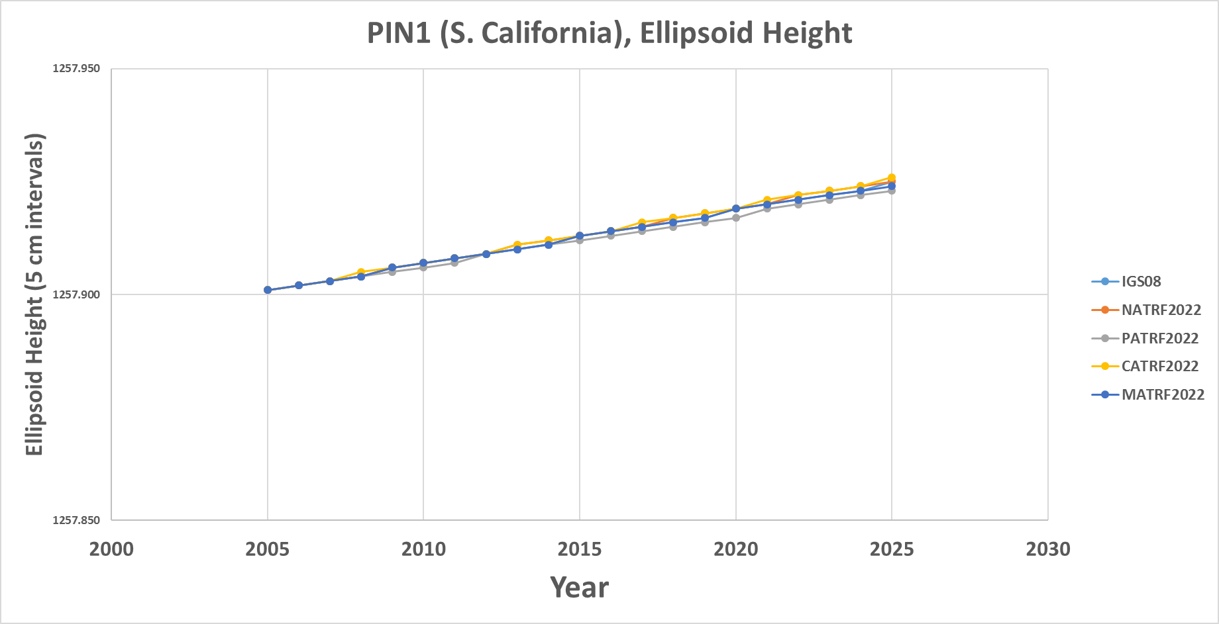
PIN1 (S. California)

Slide 42
Additional examples will be presented at the end if time allows

Slide 43
IFVM – How?
Intra-Frame Velocity Models must:
  Estimate non-Eulerian motions at any location
Three primary methods being investigated
  Interpolation from CORS
    Pro: Easy
    Con: Gets worse as CORS gets coarse
  Satellite IfSAR
    Pro: Covers vast areas
    Con: No IfSAR experts in NGS; data availability issues
  Geodynamic
    Pro: Like HTDP, so NGS has experience
    Con: Requires knowing why things move, rather than just measuring that they move (and requires “keeping up” with every event.)

Slide 44
Application to Passive Control

Slide 45
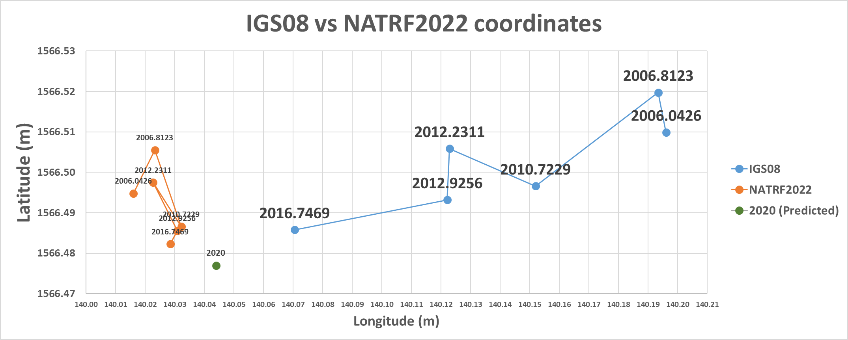
IGS08 vs NATRF2022
NATRF2022 coordinates will have the plate rotation removed, but still
exhibit their time-dependency, until
the Intra-frame velocity model is used to estimate a coordinate at some convenient reference epoch.
IGS08 coordinates are dominated by the primary motion associated with the North American Plate rotation, as manifest at this lat/lon:
12.9 mm/y West
1.1 mm/y South

Slide 46
Using the TRFs
Historically:
  Surveys at multiple epochs were “moved through time” using HTDP (skipping vertical in most cases) to adjust them all together at one common epoch
Future:
  Surveys will be adjusted to CORS at their own epoch and stand thus
  The IFVM will allow for comparisons across epochs, but will not “move surveys through time” to adjust things and get “one coordinate” on a point

Slide 47
Using the TRFs
User Supplied
GNSS Receiver File(t)
CORS data (t)
NGS Supplied
IAG Supplied
OPUS
Geodetic Control
High Accuracy
Fixed at true epoch
XYZ (t, IGS)
GRS-80
φλh (t, IGS)
4 Euler Poles, by plate:
NA, PA, CA, MA
Estimated cords
Medium Accuracy
Subject to updates
XYZ (t, NATRF2022)
XYZ (t, PATRF2022)
XYZ (t, CATRF2022)
XYZ (t, MATRF2022)
4 Intra-Frame Velocity Models, by frame:
NA, PA, CA, MA
Latest estimate of:
φλh (t0, NATRF2022)
φλh (t0, PATRF2022)
φλh (t0, CATRF2022)
φλh (t0, MATRF2022)
GRS-80
φλh (t, NATRF2022)
φλh (t, PATRF2022)
φλh (t, CATRF2022)
φλh (t, MATRF2022)
Most recent past reference epoch “t0”
Blueprint for 2022, Part 1: Geometric Coordinates

Slide 48
Using the TRFs
Further details on this change in the use of the reference frames will come in 2018
Blueprint for 2022, Part 3: Re-inventing Bluebooking

Slide 49
PRMI (Puerto Rico)

Slide 50
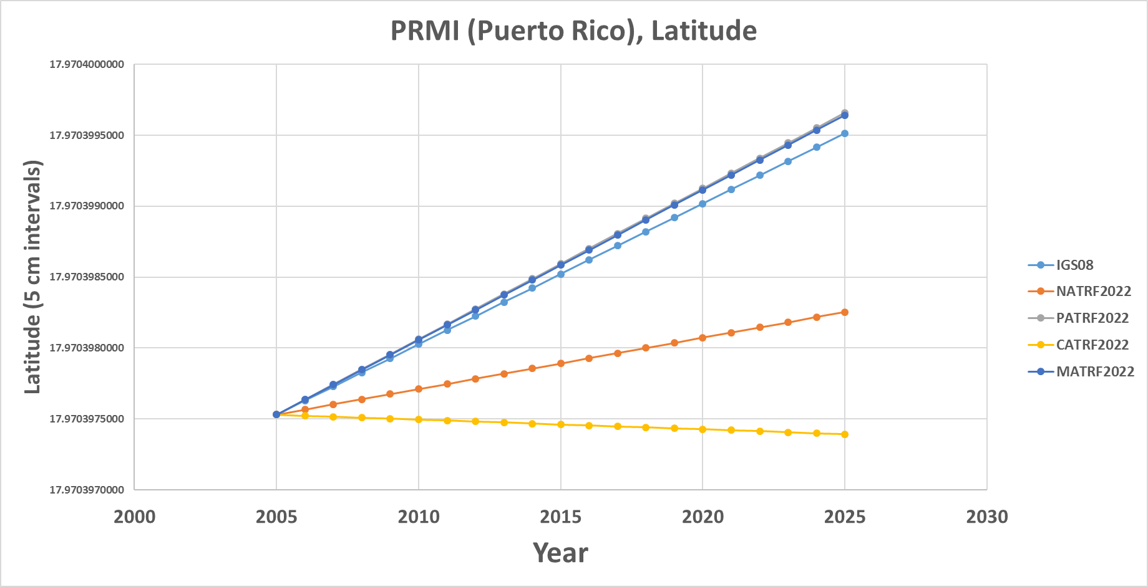
PRMI (Puerto Rico)

Slide 51
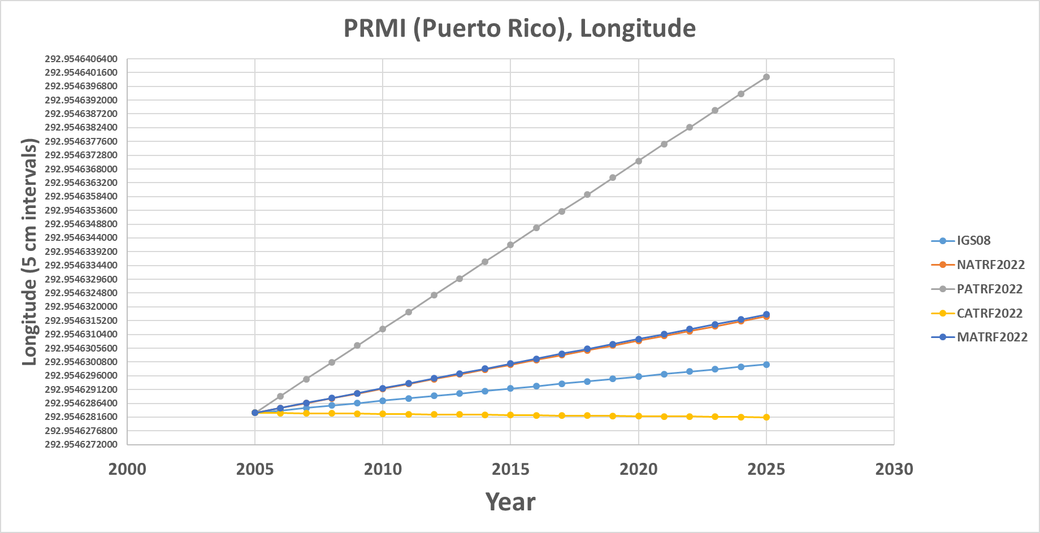
PRMI (Puerto Rico)

Slide 52
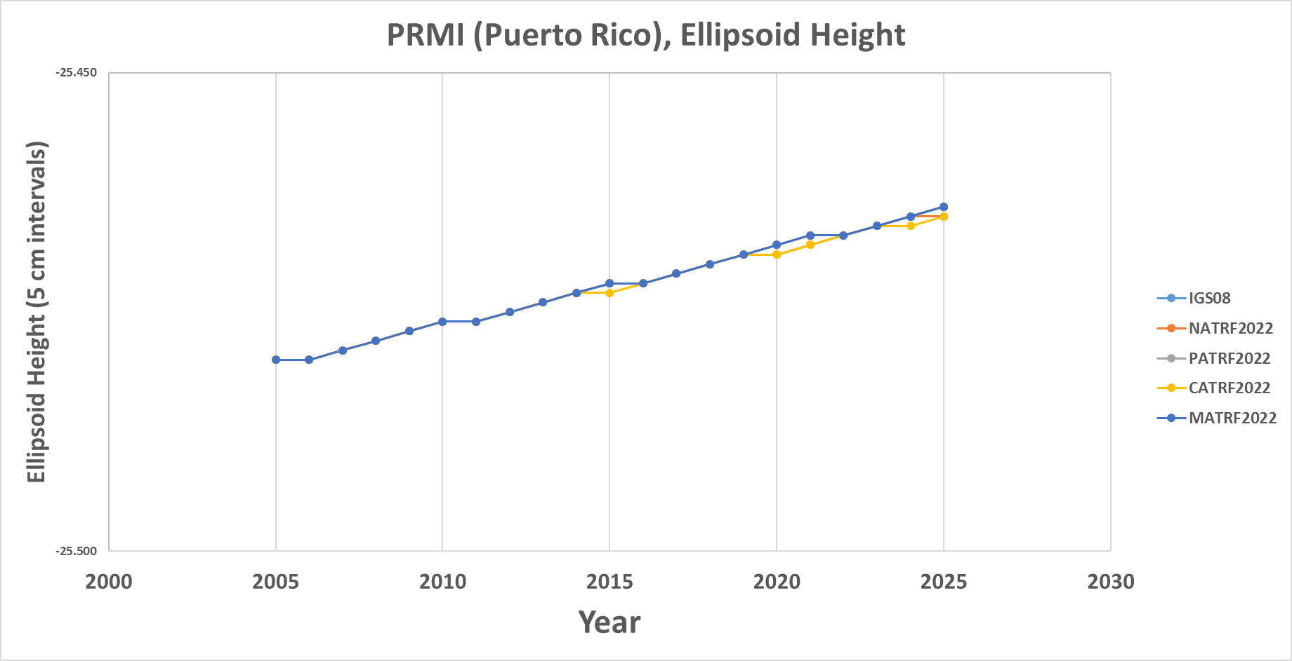
PRMI (Puerto Rico)

Slide 53
BRW1 (N. Alaska)

Slide 54
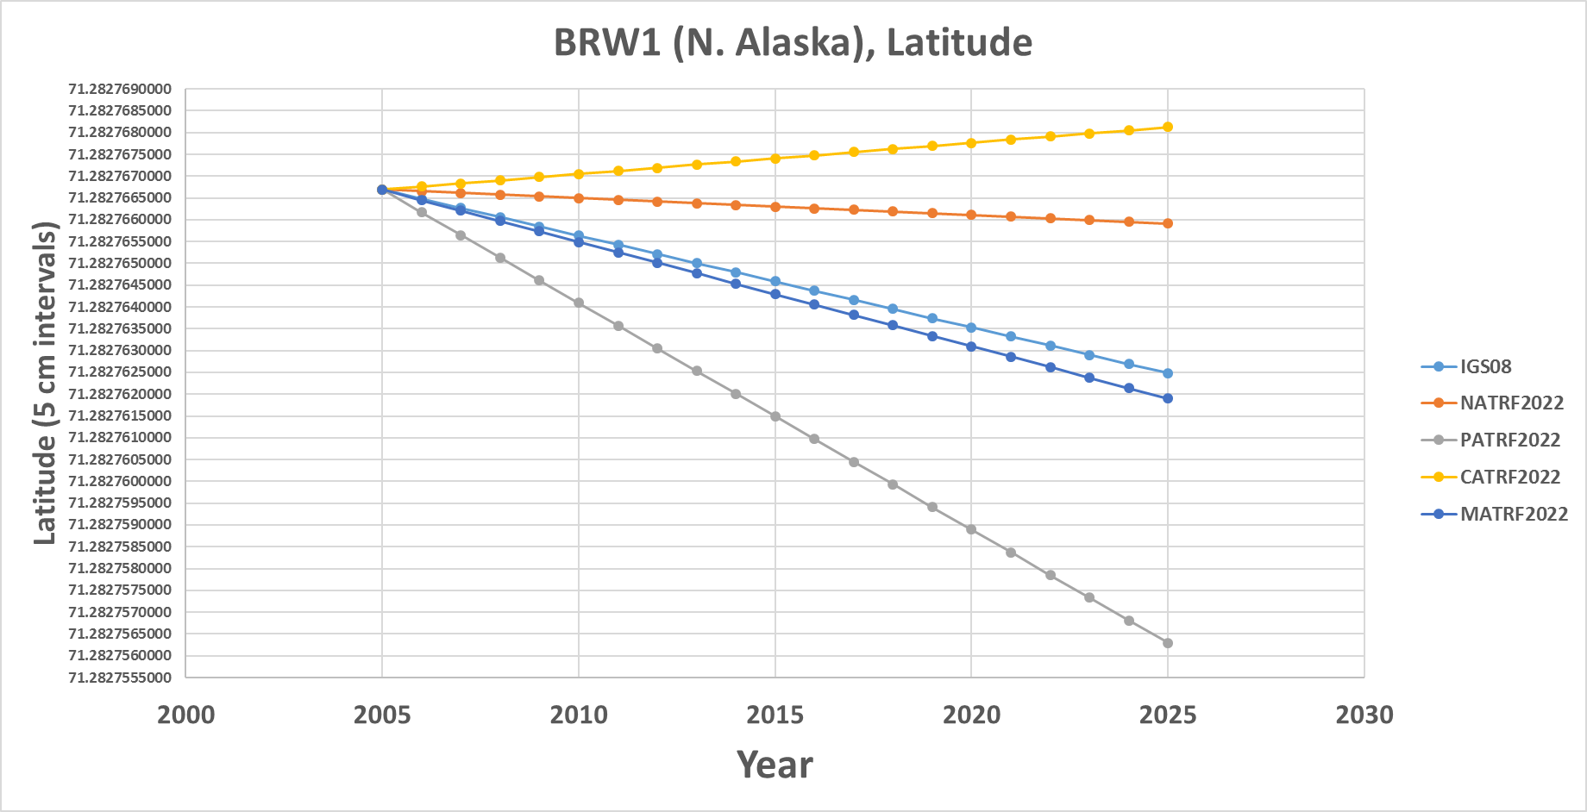
BRW1 (N. Alaska)

Slide 55
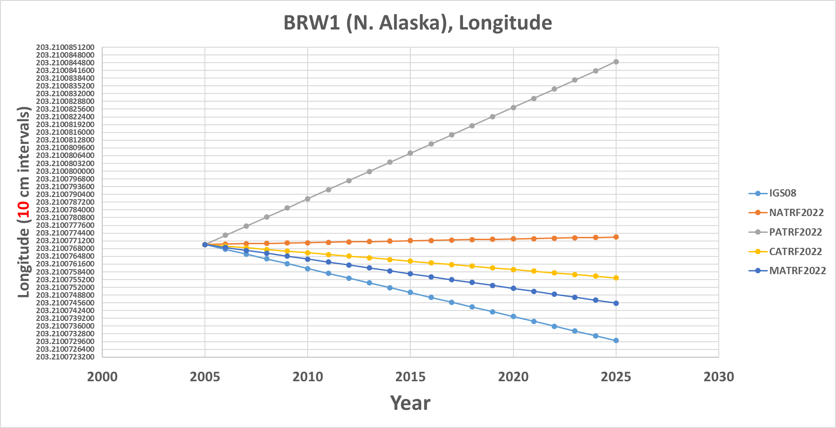
BRW1 (N. Alaska)

Slide 56
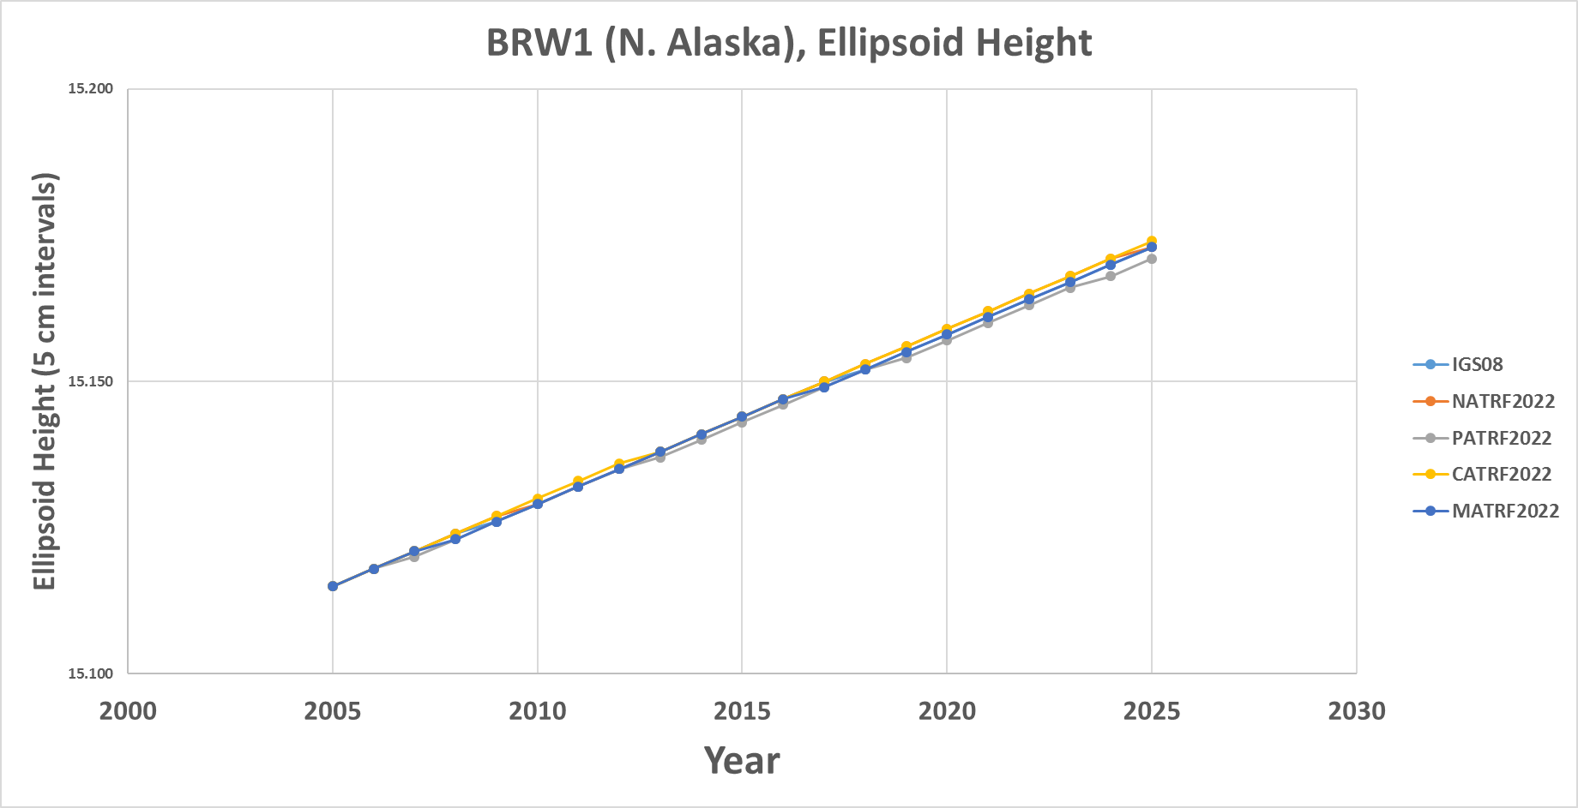
BRW1 (N. Alaska)

Slide 57
KOD6 (S. Alaska)

Slide 58
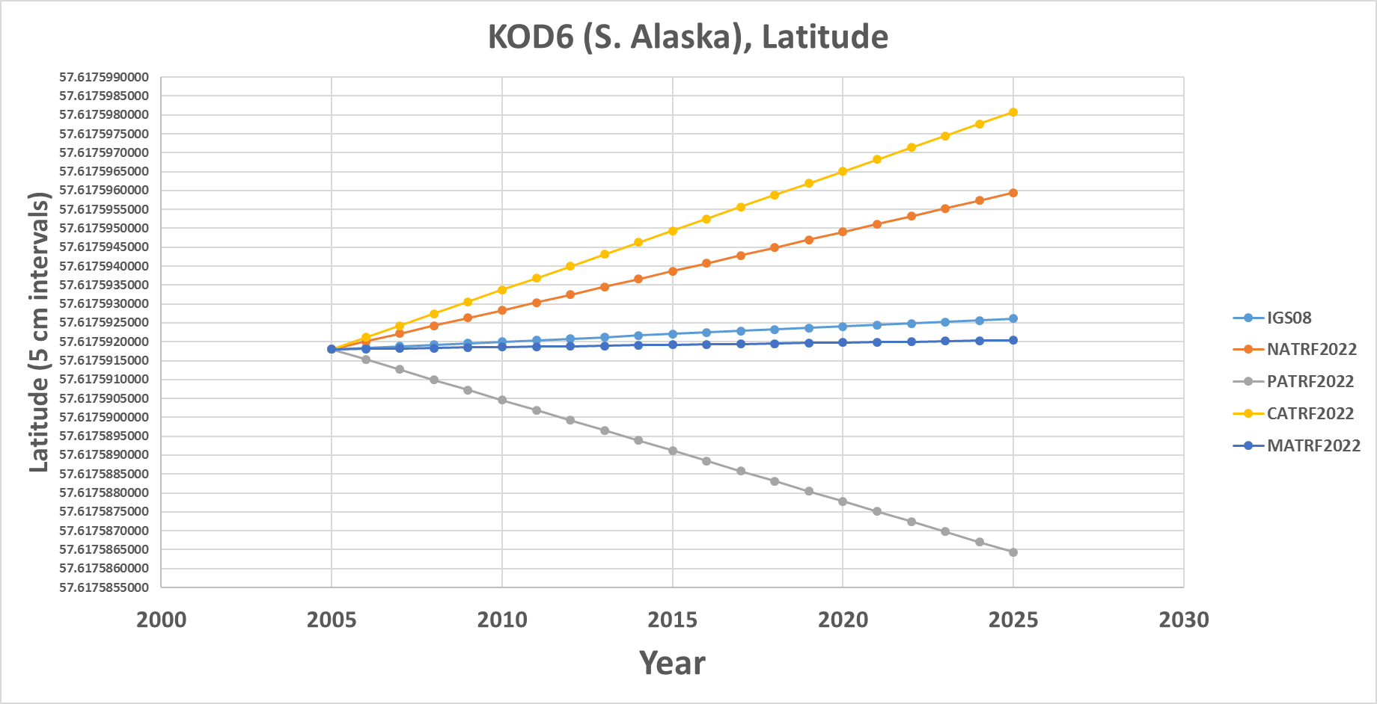
KOD6 (S. Alaska)

Slide 59
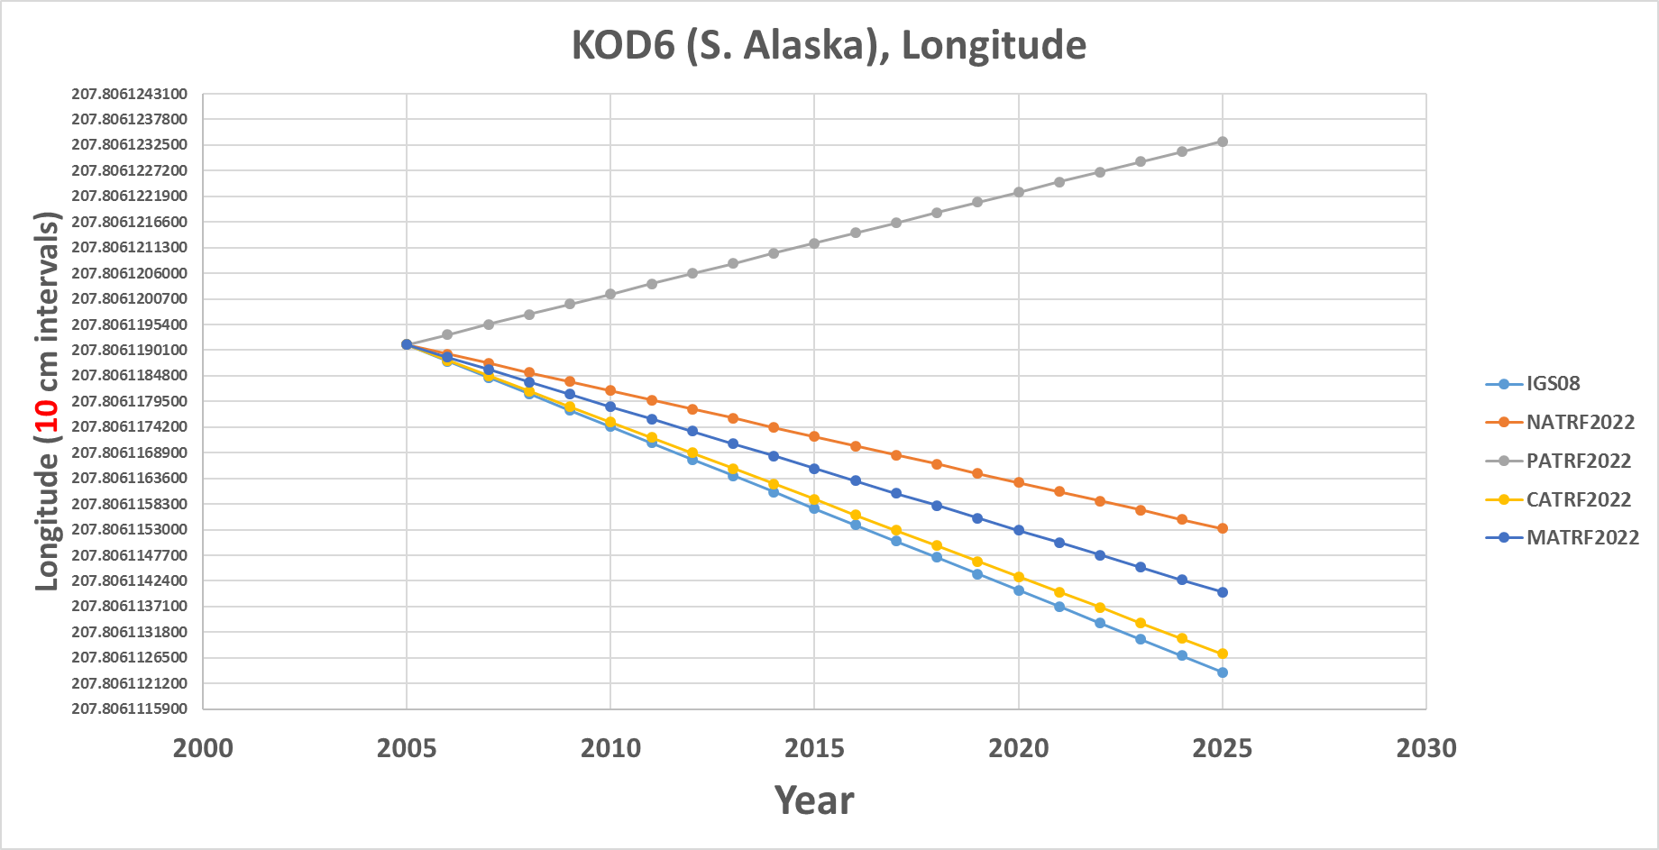
KOD6 (S. Alaska)

Slide 60
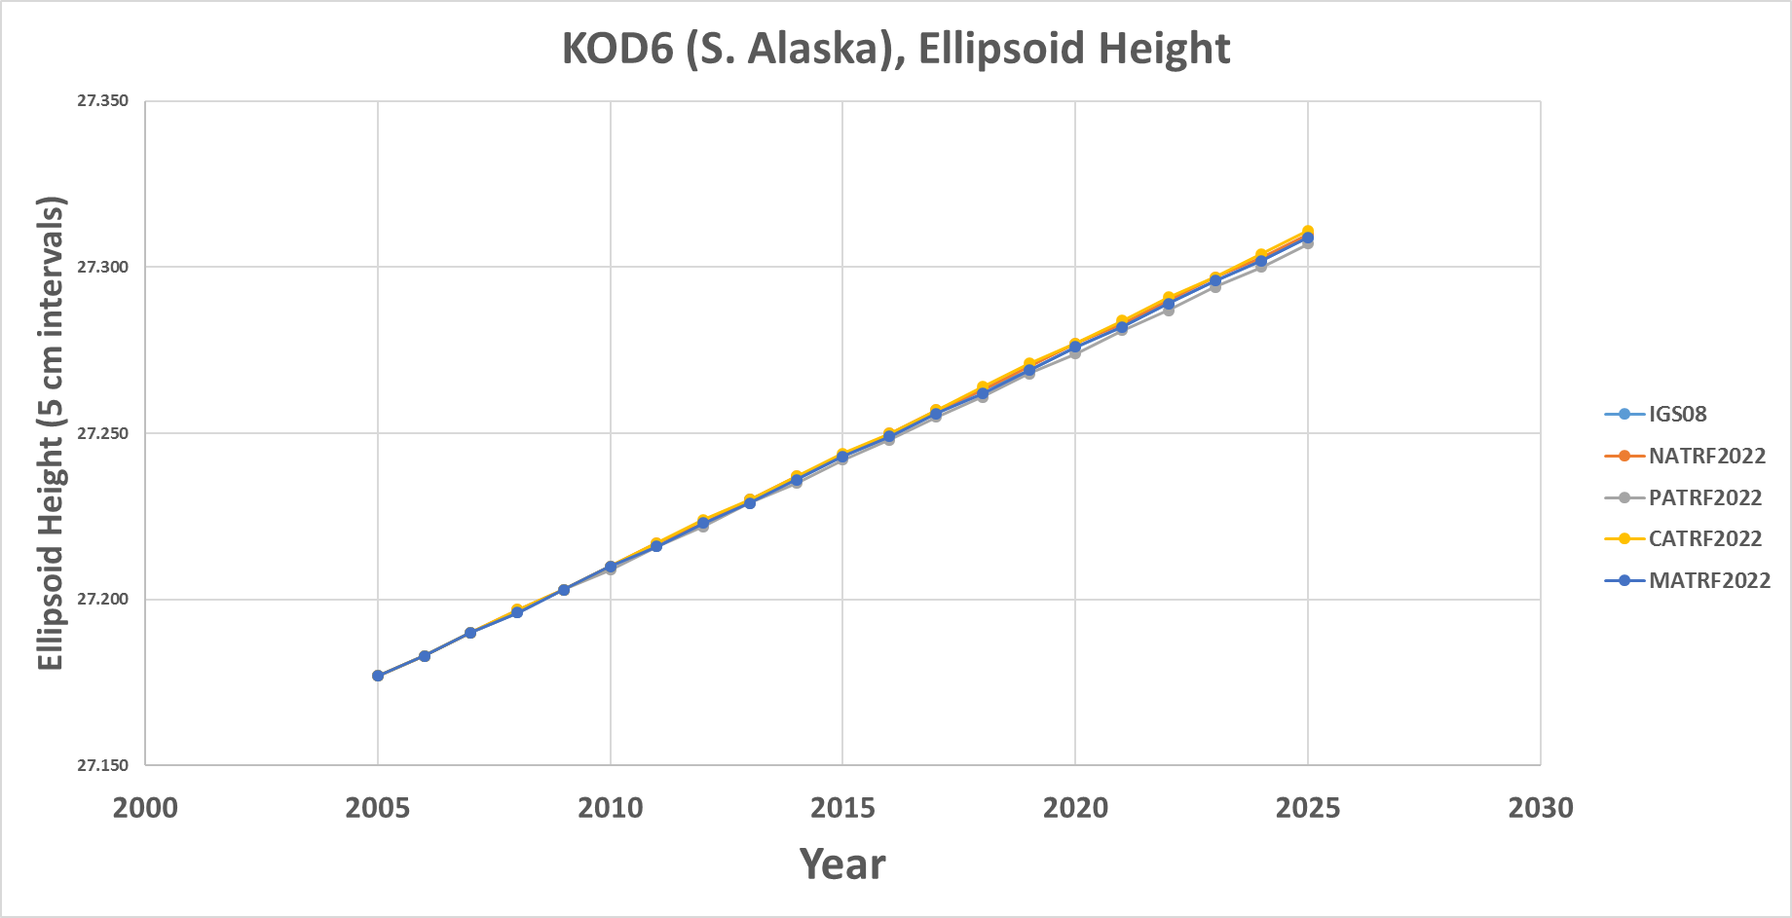
KOD6 (S. Alaska)

Slide 61
KOK5 (Hawaii)

Slide 62
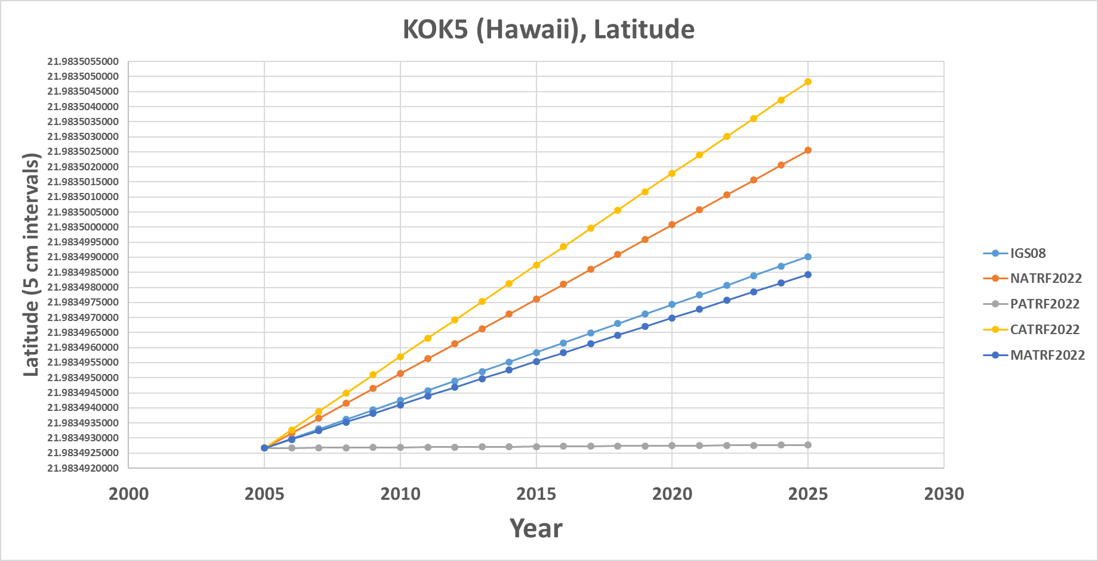
KOK5 (Hawaii)

Slide 63
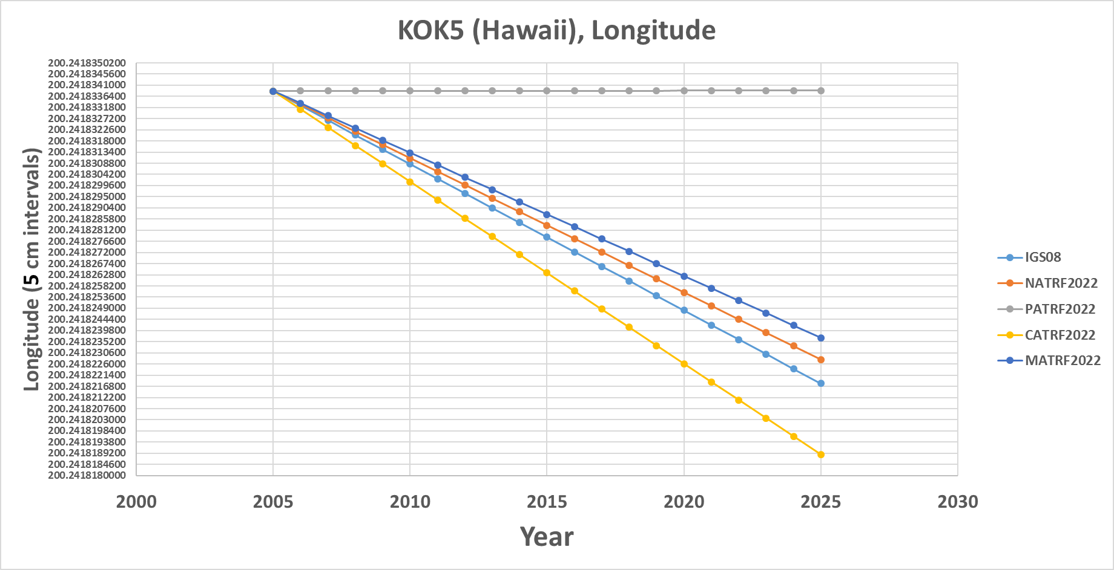
KOK5 (Hawaii)

Slide 64
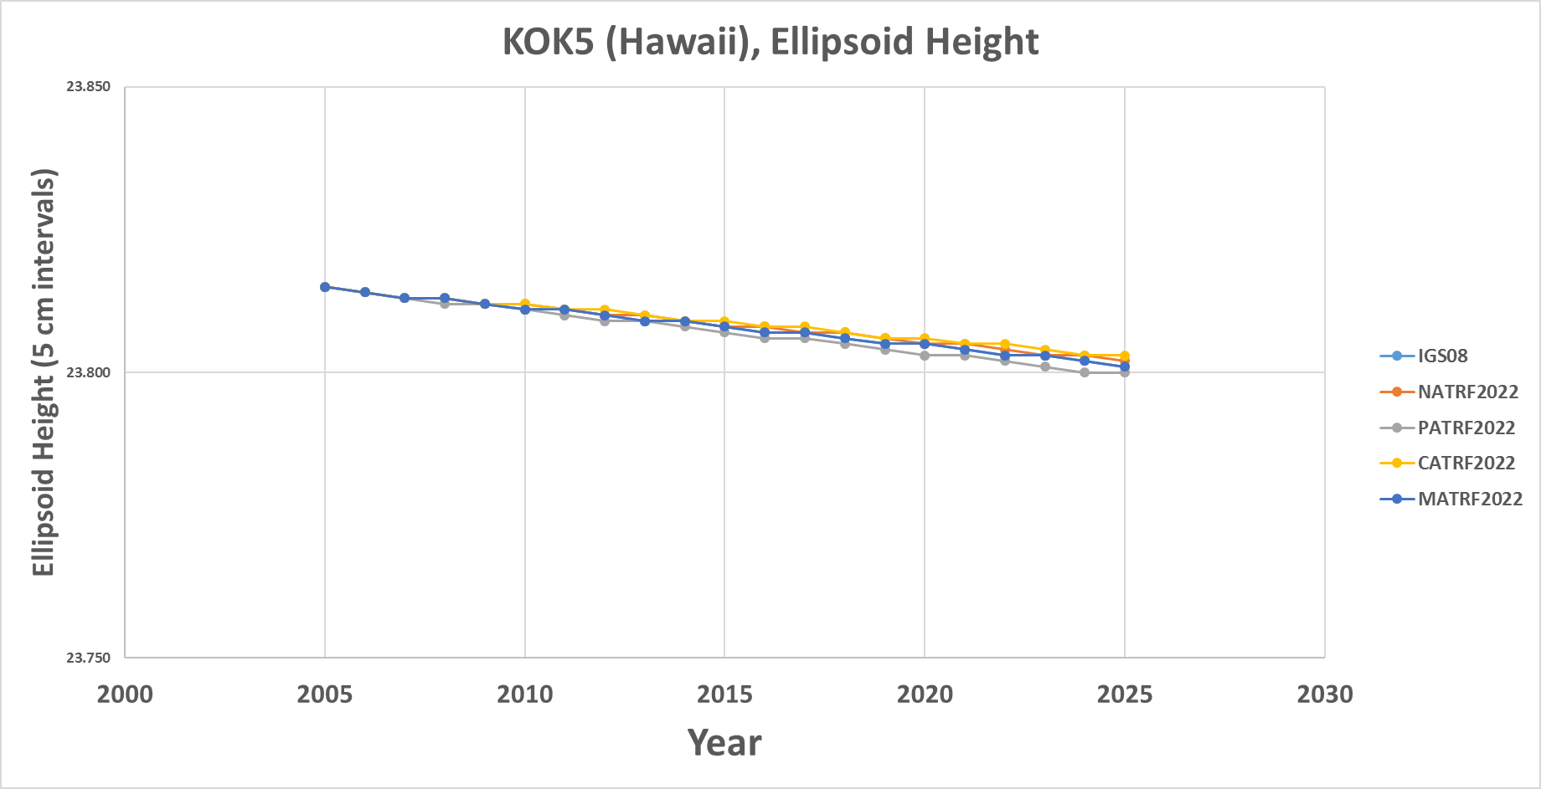
KOK5 (Hawaii)

Slide 65
ASPA (Am. Samoa)

Slide 66
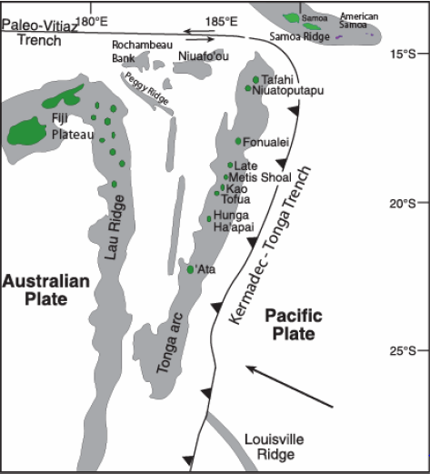
ASPA (Am. Samoa)

Slide 67
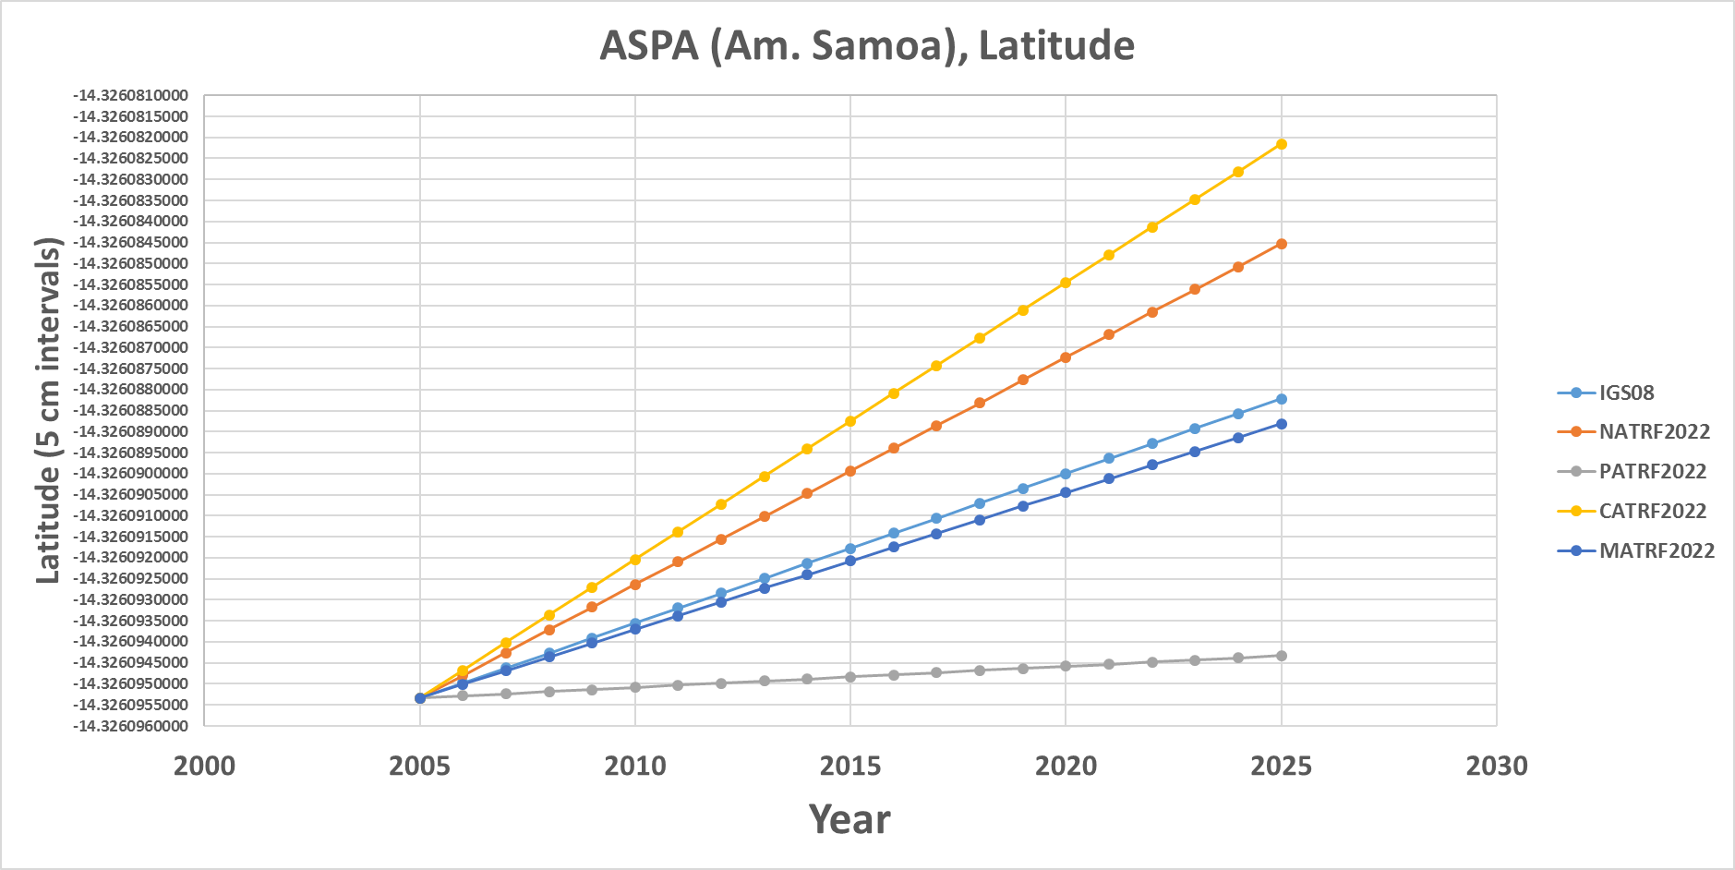
ASPA (Am. Samoa)

Slide 68
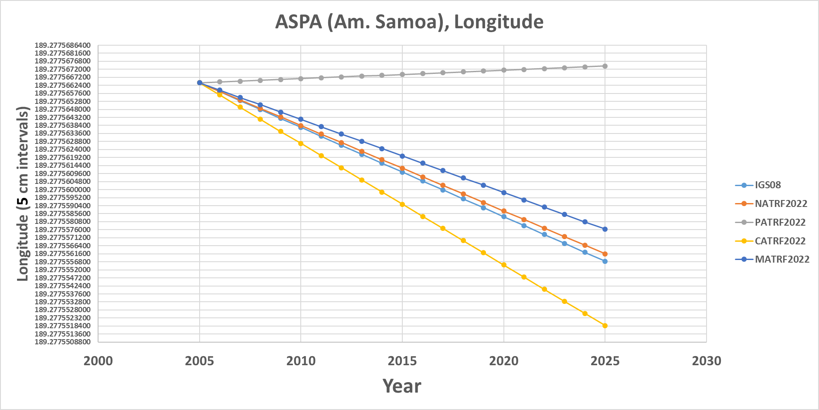
ASPA (Am. Samoa)

Slide 69
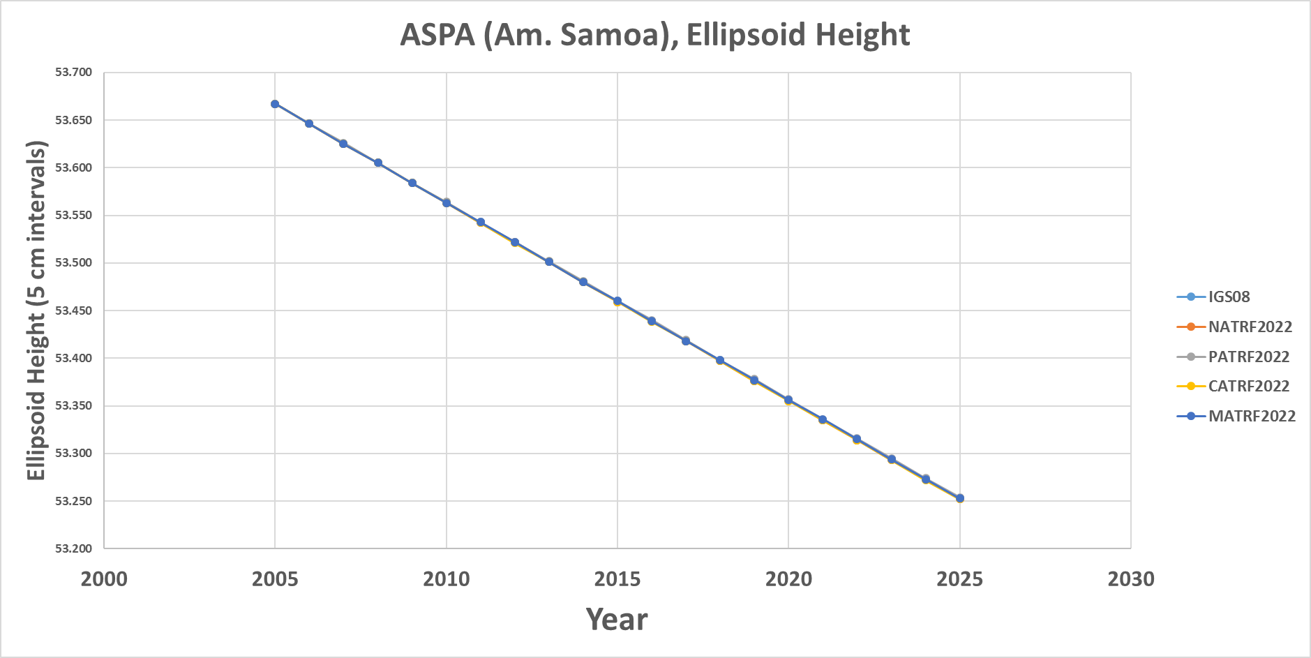
ASPA (Am. Samoa)

Slide 70
Mariana rotation
Snay (2003) used only one CORS (“GUAM”) to determine the Mariana rotation
  But 2 sites at a minimum are needed to uniquely determine a plate’s rotation
    “CNMI” (since decommissioned) was forced to equal “GUAM” to solve the problem
    Ill-posed, yet the values behave reasonably for GUAM.
    Less reasonable for newer CORS “CNMR”

Slide 71
GUAM (Guam)

Slide 72
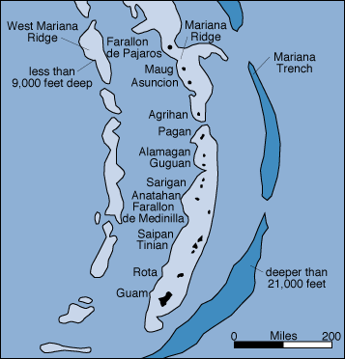
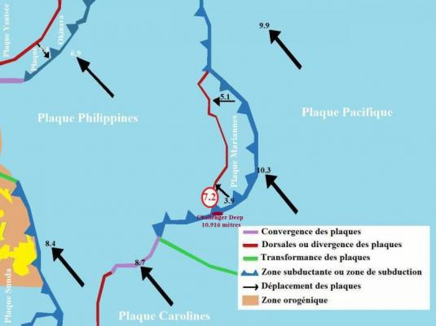
GUAM (Guam)

Slide 73
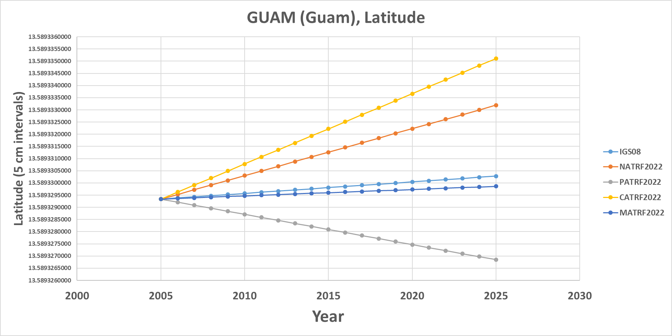
GUAM (Guam)

Slide 74
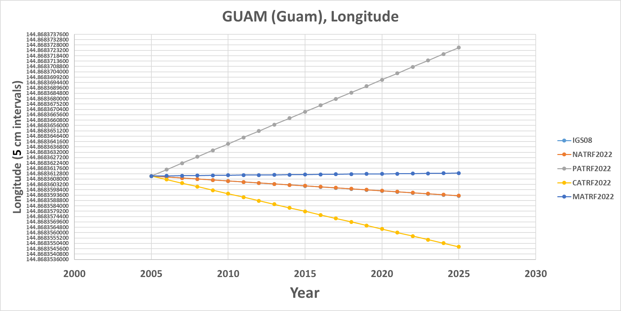
GUAM (Guam)

Slide 75
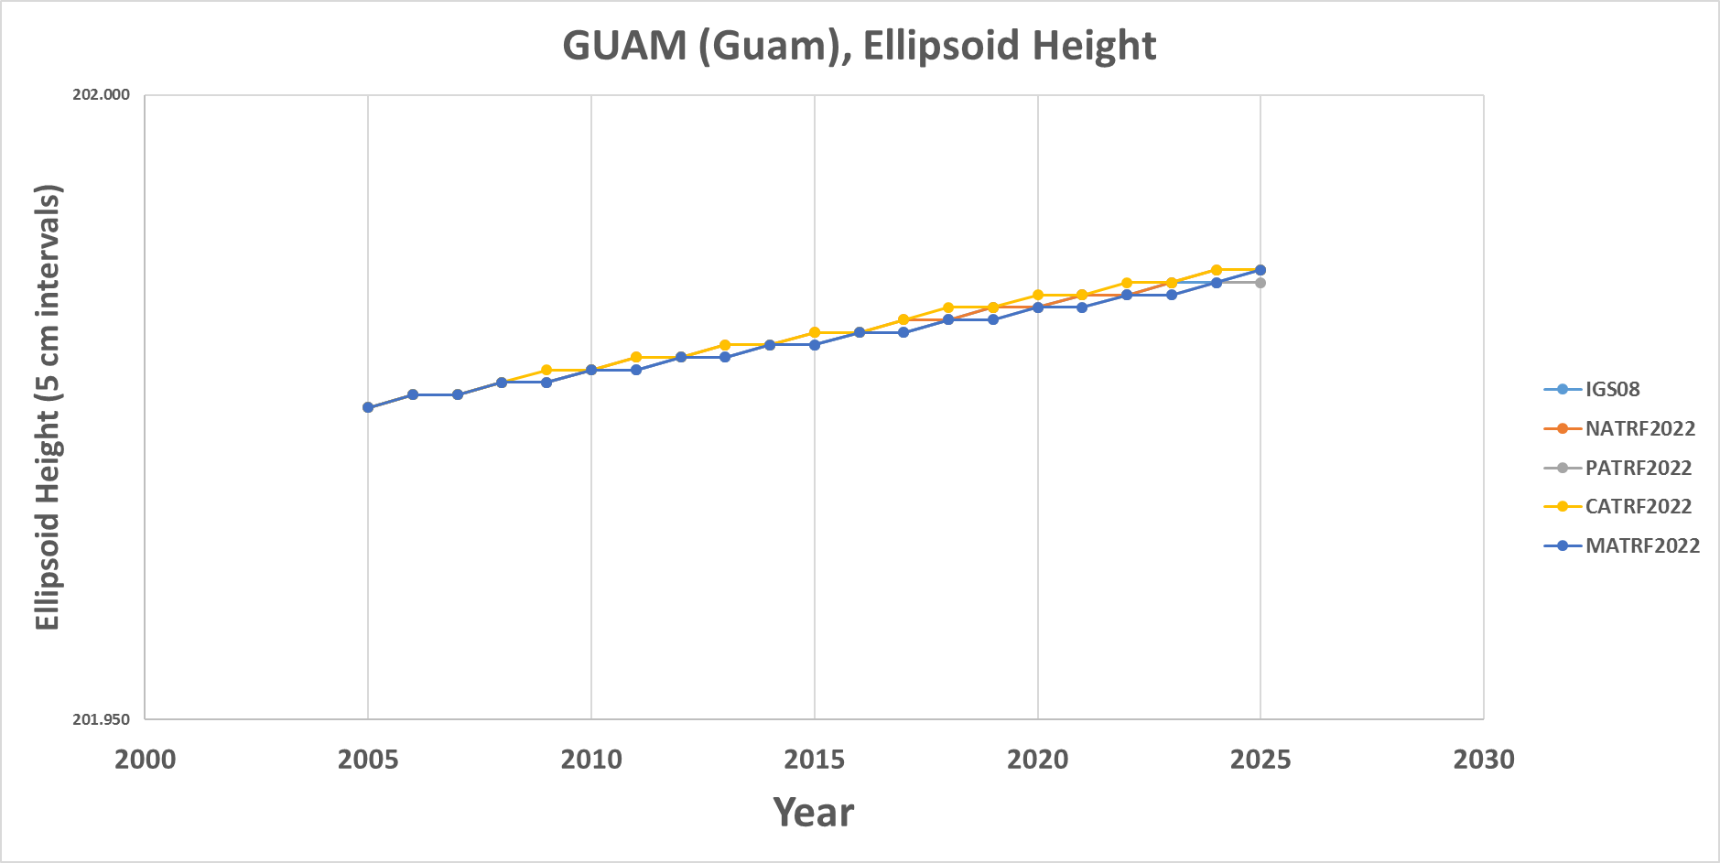
GUAM (Guam)

Slide 76
CNMR (CNMI)

Slide 77
CNMR (CNMI)

Slide 78
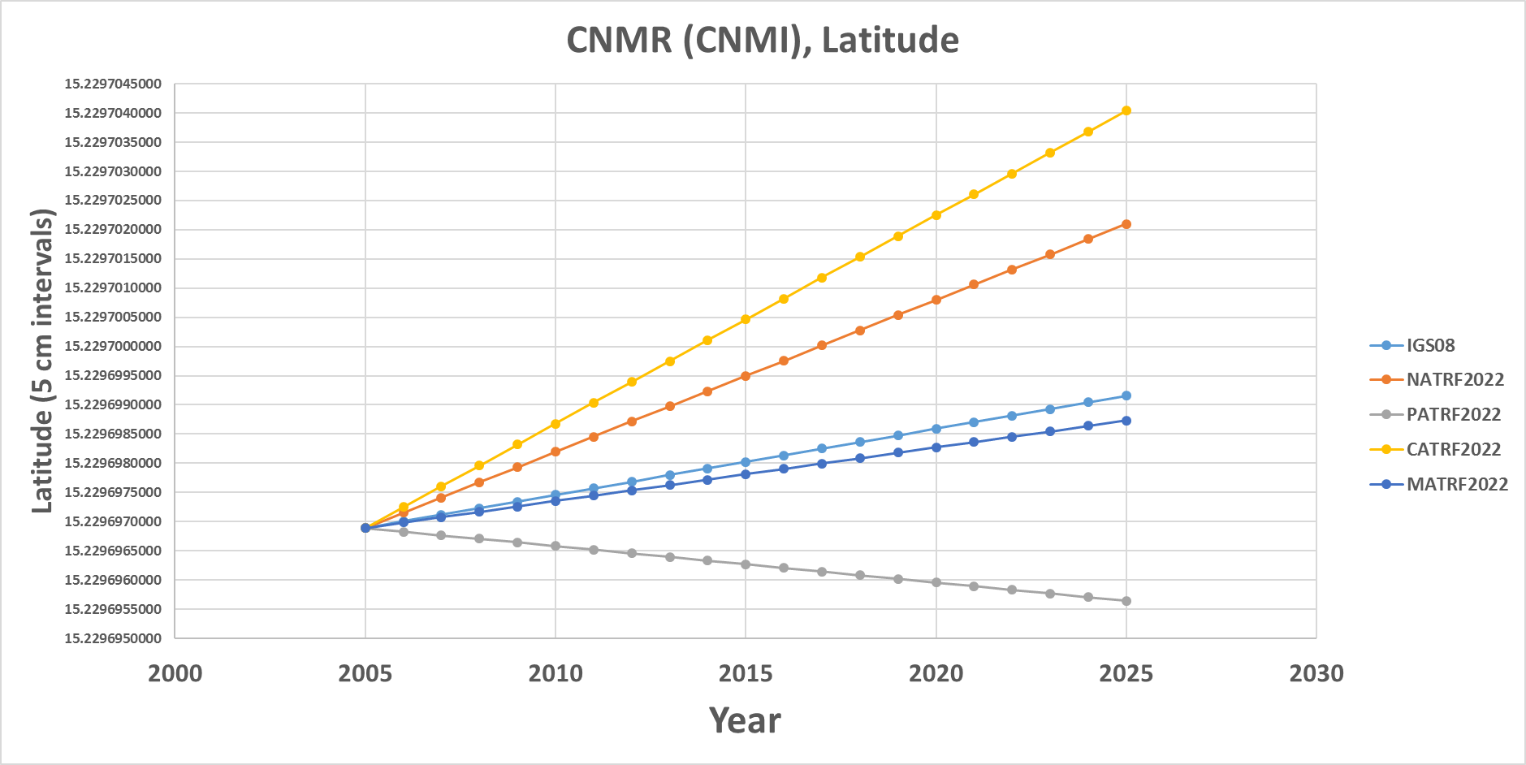
CNMR (CNMI)

Slide 79
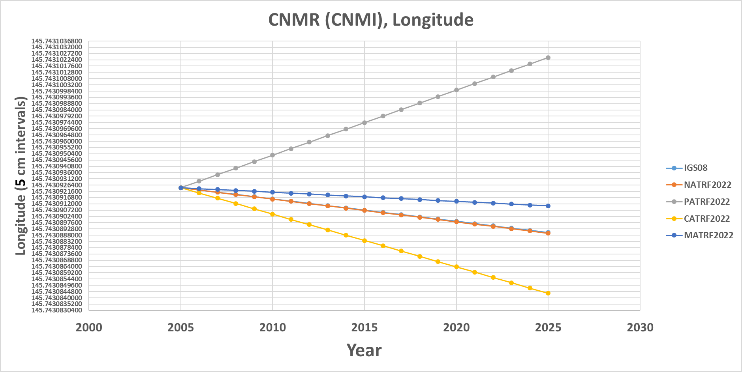
CNMR (CNMI)

Slide 80
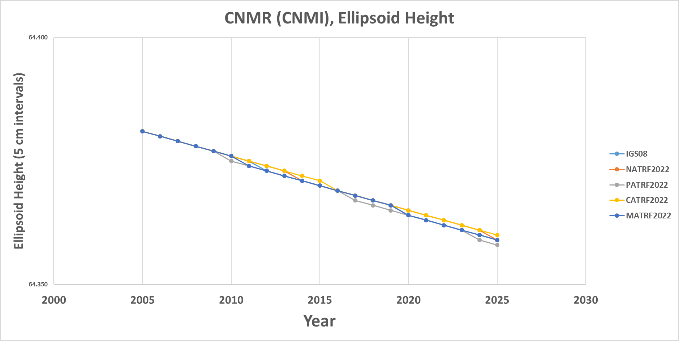
CNMR (CNMI)

