Slide 1
Modernizing the National Spatial Reference System
Juliana Blackwell
Director
NOAA’s National Geodetic Survey

Slide 2
The bottom line
If you do geospatial work in the United States and its territories,
and you work in the National Spatial Reference System,
then every product you’ve ever made…
every survey
every map
every lidar point cloud
every image
every DEM
… WILL have NEW coordinates in 4 years.
Let’s talk about what this means, why it is happening, and how you can prepare.

Slide 3
Who and What
The National Geodetic Survey, the federal agency responsible for establishing and maintain the positioning framework to support all federal civilian mapping and charting in the United States, is modernizing the National Spatial Reference System (NSRS).
What does this mean?
All horizontal and vertical datums in the NSRS (NAD 83, NAVD 88, etc.) will be updated with:
Four (4) new Terrestrial Reference Frames of 2022
North American-Pacific Geopotential Datum of 2022
New tools, products, services, and methodologies will be developed jointly to support the transition and access to an improved, modernized NSRS.

Slide 4
Why and When
Why?
The current national datums (NAD 83 and NAVD 88) were established in the 1980s, before GPS technology revolutionized surveying and positioning.
The current datums have errors exceeding 1 meter.
Modernization of the NSRS is driven by advancements in technology and is designed to support future growth. “Positioning America for the Future”
When? By December 31, 2022
Will it be an immediate or gradual change? Immediate

Slide 5
“Modernizing the NSRS” means…
Replacing the current horizontal datums (NAD 83)
Replacing the current vertical datums (NAVD 88)
Improving data submission and data access
Improving online tools
Updating survey methodologies

Slide 6
These are part of the NSRS*
Horizontal Datums and Geometric Reference Frames | Vertical Datums | Great Lakes Datums | Geoid Models | Transformations and Conversions
USSD | NGVD 29 | IGLD55 | GEOID90 | NADCON
NAD 27 | NAVD 88 | IGLD85 | GEOID93 | VERTCON
NAD 83 | PRVD02 |  | ALASKA94
 | ASVD02 |  | GEOID96 | SPCS 27
 | NMVD03 |  | GEOID99 | SPCS 83
 | GUVD04 |  | GEOID03
 | VIVD09 |  | GEOID06
 |  |  | GEOID09
 |  |  | GEOID12(A,B)
*This not a complete list.

Slide 7
These are not part of the NSRS*
Horizontal Datums and Geometric Reference Frames | Vertical Datums | Great Lakes Datums | Geoid Models | Transformations and Conversions
WGS 84 | IHRS |  | OSU91A | CORPSCON
ITRF |  |  | EGM96 | Appendix B.6 of DMA TR 8350.2 (WGS 84)
IGS |  |  | EGM2008 | Oregon Coordinate Reference System
 |  |  |  | The Kansas Regional Coordinate System
*This is not a complete list.

Slide 8
All coordinates and heights will change!

Slide 9
Effect on latitude and longitude

Slide 10
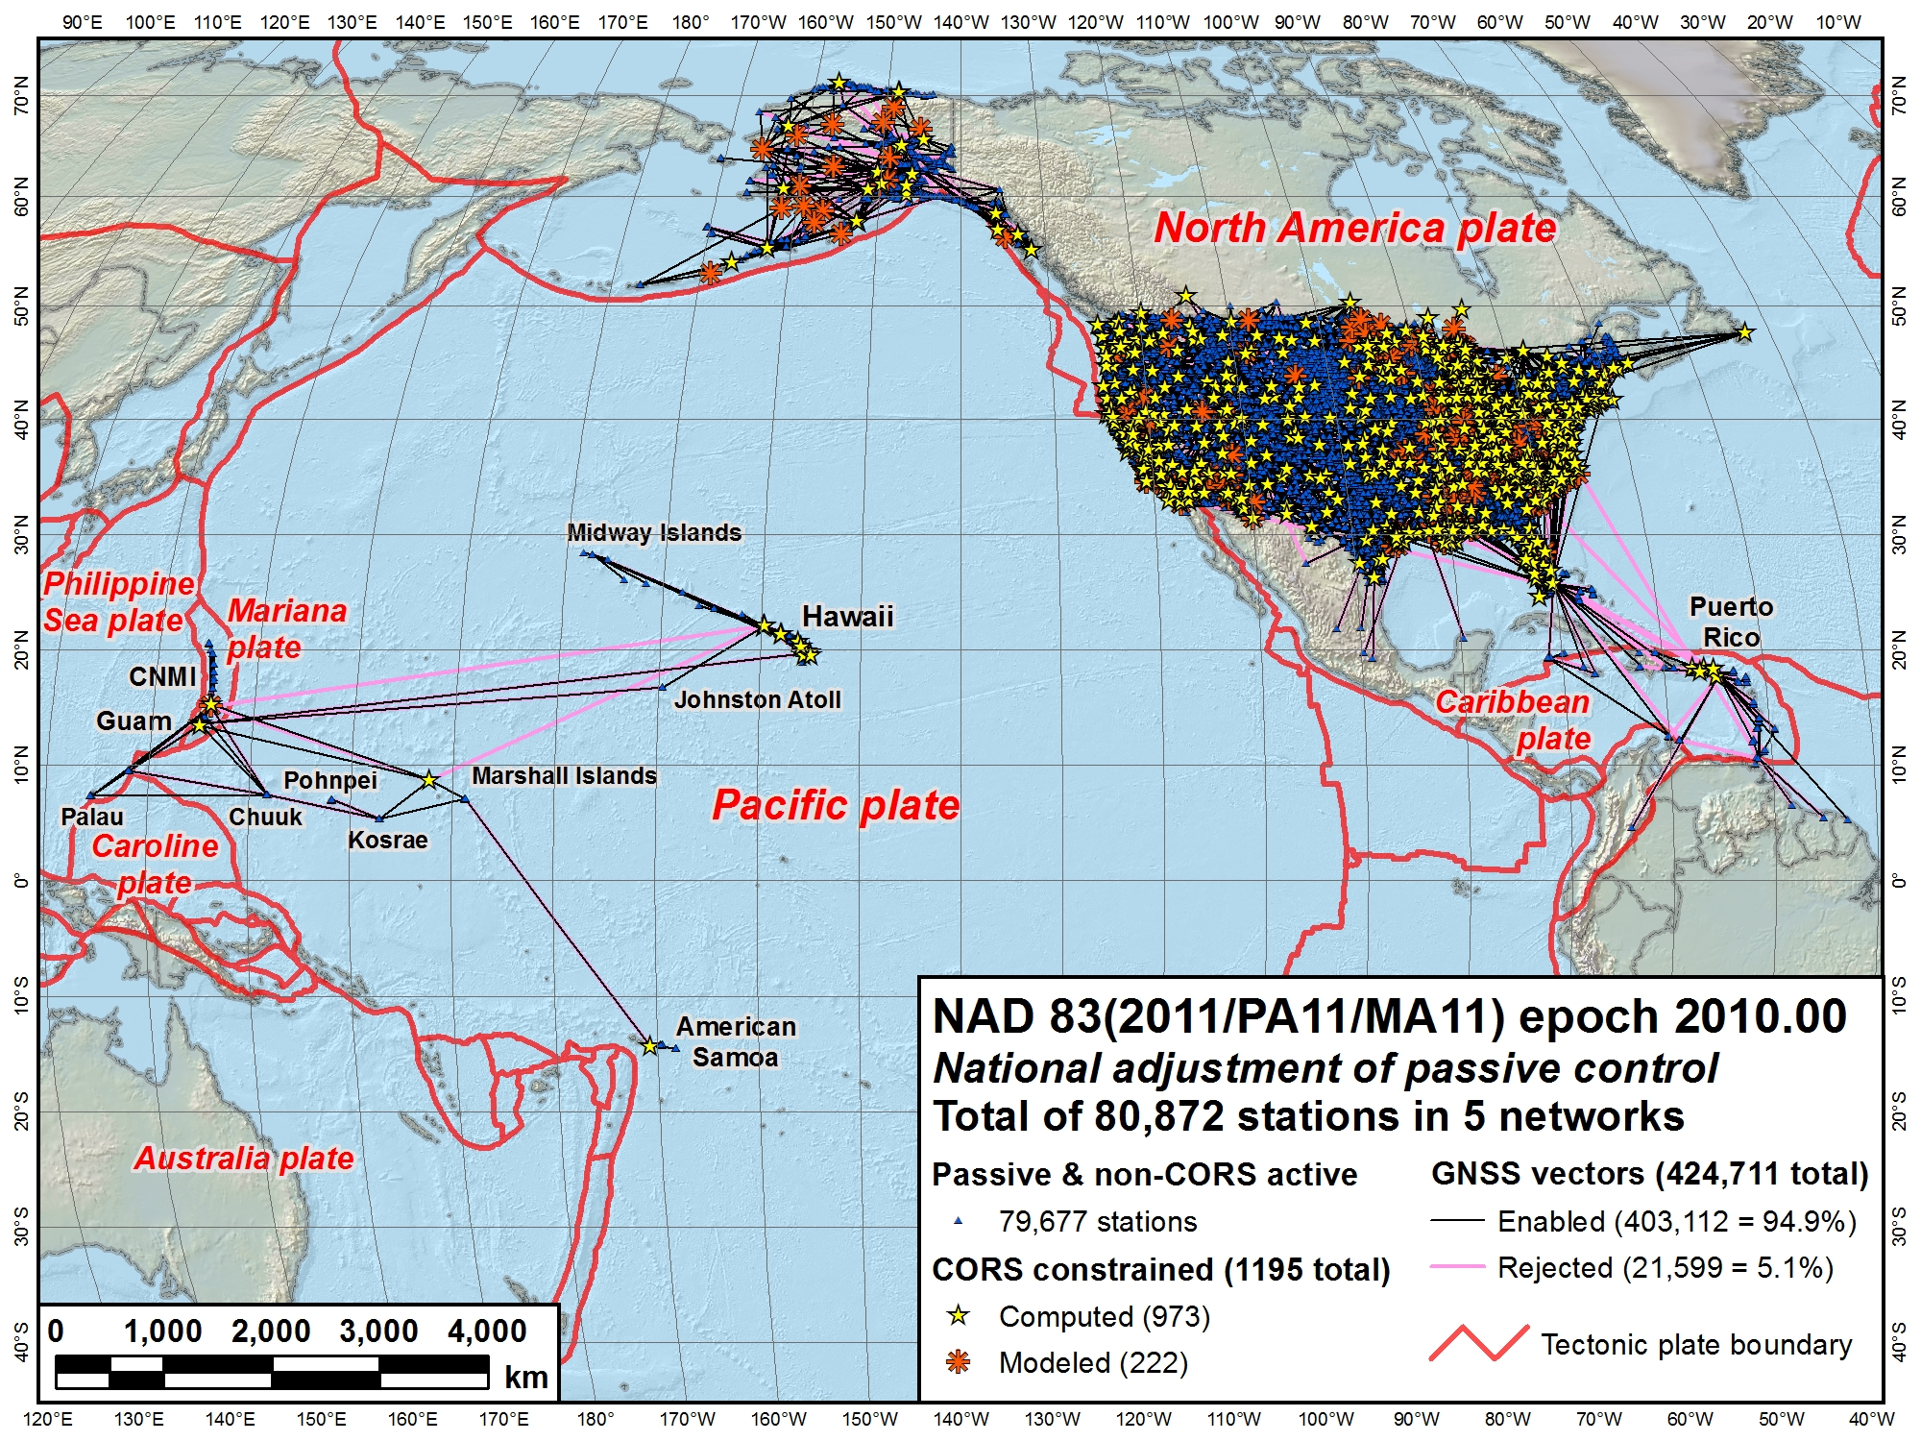
NAD 83 (2011)
NAD 83 (MA11)
NAD 83 (PA11)
North American Datum of 1983
Three frames:
NAD 83 (2011): North America and Caribbean plates
NAD 83 (PA11): Pacific plate
NAD 83 (MA11): Mariana plate

Slide 11
Geometric: Out with the old, in with the new
Four (4) plate-fixed frames:
North American
Caribbean
Pacific
Mariana
The Old:
NAD 83(2011)
NAD 83(PA11)
NAD 83(MA11)
The New:
North American Terrestrial Reference Frame of 2022
(NATRF2022)
Caribbean Terrestrial Reference Frame of 2022
(CATRF2022)
Pacific Terrestrial Reference Frame of 2022
(PATRF2022)
Mariana Terrestrial Reference Frame of 2022
(MATRF2022)

Slide 12
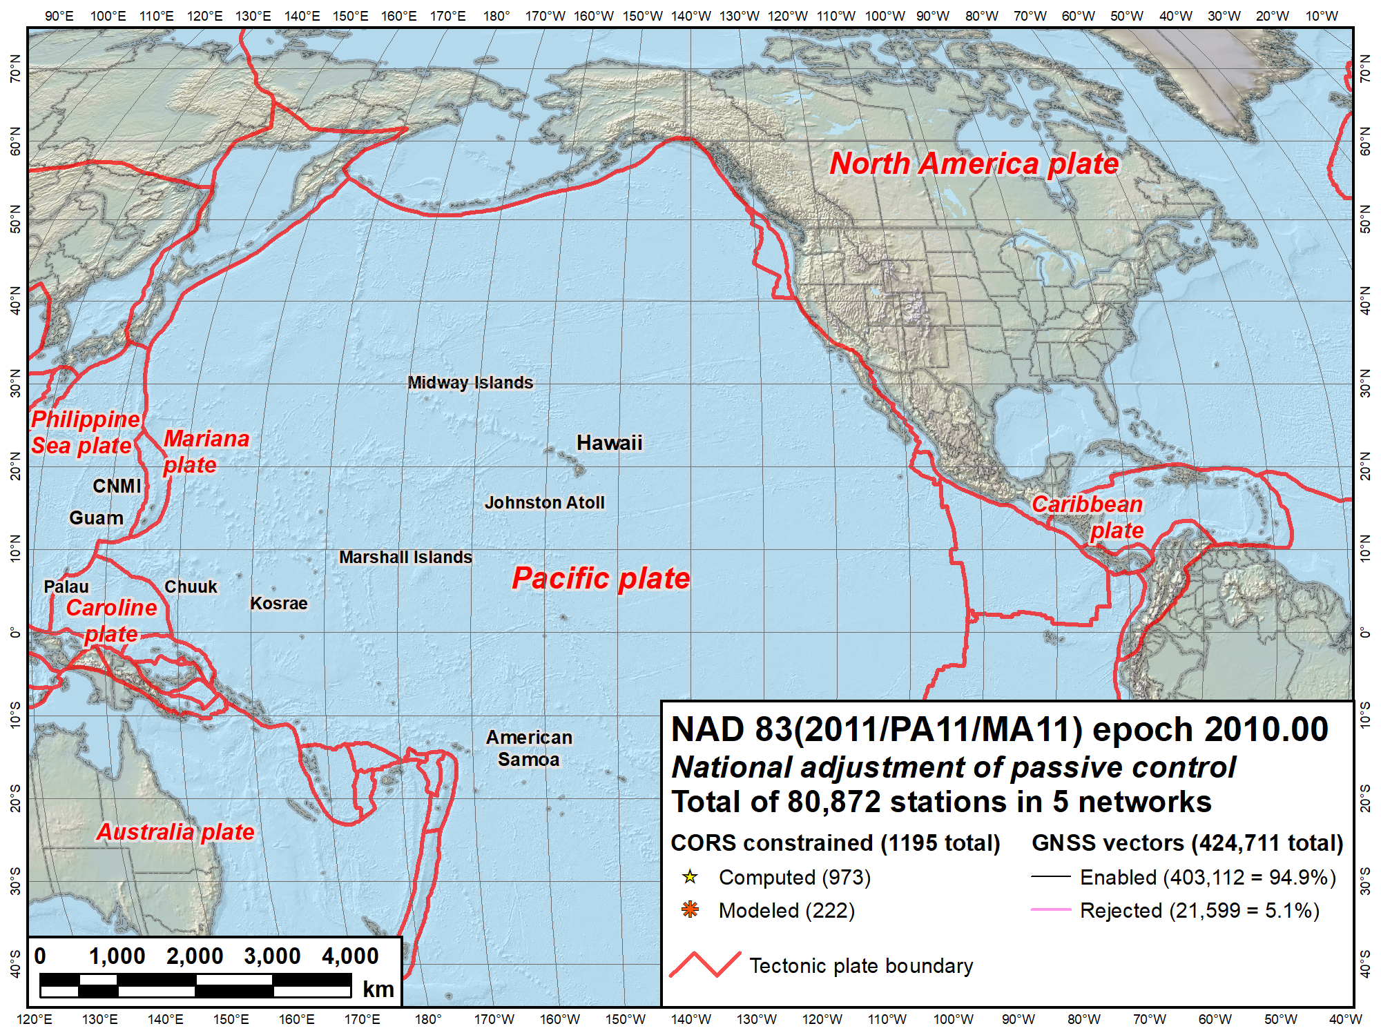
NAVD 88
IGLD 85
NAVD 88
PRVD02
NMVD03
VIVD02
GUVD04
Current vertical datums of the NSRS
ASVD02
NA and Caribbean
NAVD 88
IGLD 85
PRVD02
VIVD09
Pacific
GUVD04
NMVD03
ASVD02

Slide 13
Vertical: Out with the old, in with the new
The Old:
NAVD 88
PRVD 02
VIVD09
ASVD02
NMVD03
GUVD04
IGLD 85
IGSN71
GEOID12B
DEFLEC12B
The New:
The North American-Pacific Geopotential Datum of 2022 (NAPGD2022)
Will include GEOID2022 DEFLEC2022 SGRAV2022
Orthometric
Heights
One vertical datum from pole to equator
Normal
Orthometric
Heights
Dynamic
Heights
Gravity
Geoid Heights
Deflections of
the Vertical

Slide 14
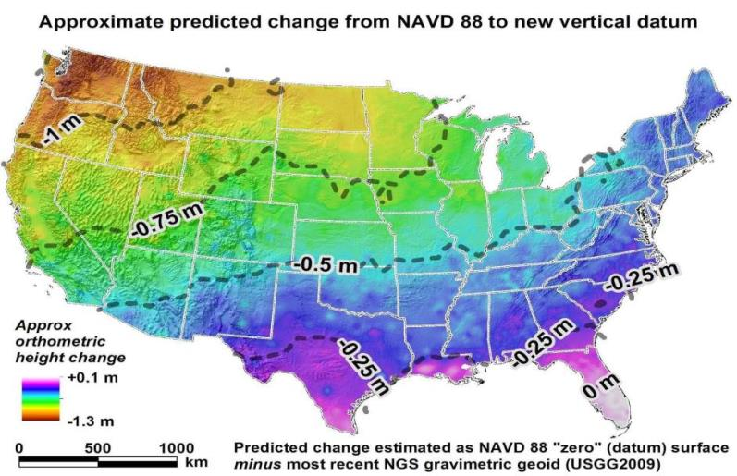
Expected changes to orthometric heights

Slide 15
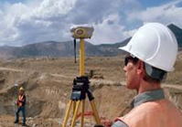
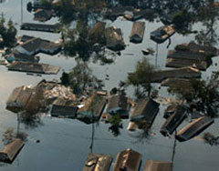
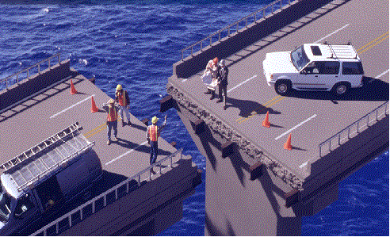
What life will be like in the future
Revolutionize professional surveying
No more need for installing and locating bench marks
Absolute, consistent positioning autonomously, anywhere
Impacts on infrastructure
Any application requiring precise positioning -- bridges, tunnels, railways, agriculture, navigation -- will be easier and more accurate
Vastly improved flood plain mapping
Water flows due to differences in gravity
Critically important in low-lying, flat communities
Fundamental support for new technologies
“Smart Highways” for autonomous vehicles

Slide 16
Impact
Every historic position (on a map, chart, survey, etc.) with an assumed accuracy of better than 1 meter will become obsolete.
This includes:
3DEP Elevation Datasets
National Hydrography Datasets
Flood Insurance Rate Maps

Slide 17
What can you do to prepare?
Learn more
Become familiar with NGS models and tools
Assess data workflows in collaboration with NGS
Provide feedback
Save original data (lidar point clouds)!

Slide 18
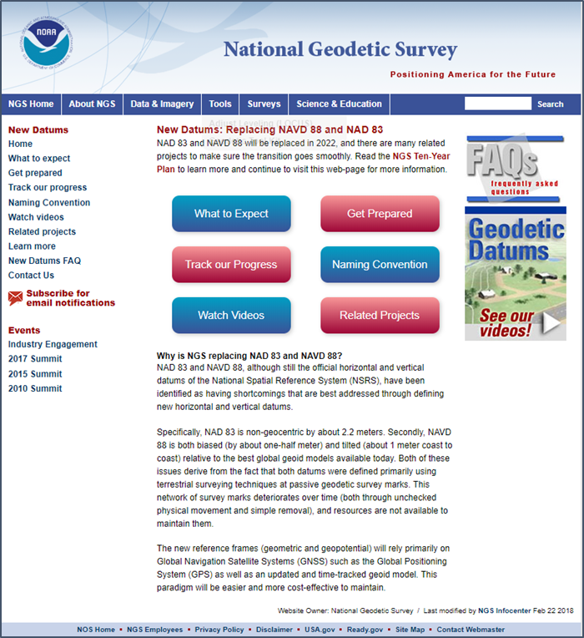
Information on “New Datums”
geodesy.noaa.gov/datums/newdatums/
What to expect
How to prepare
Track our progress
Related projects
Educational videos
Learn more
FAQs
Contact us
Sign up for updates

Slide 19
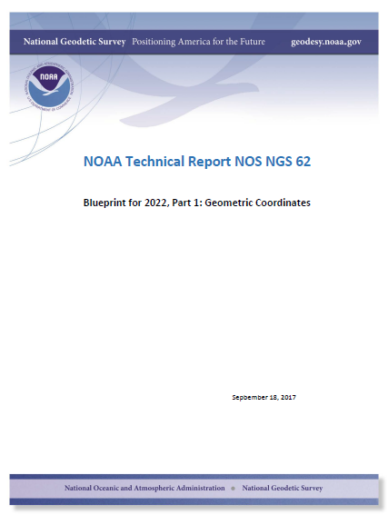
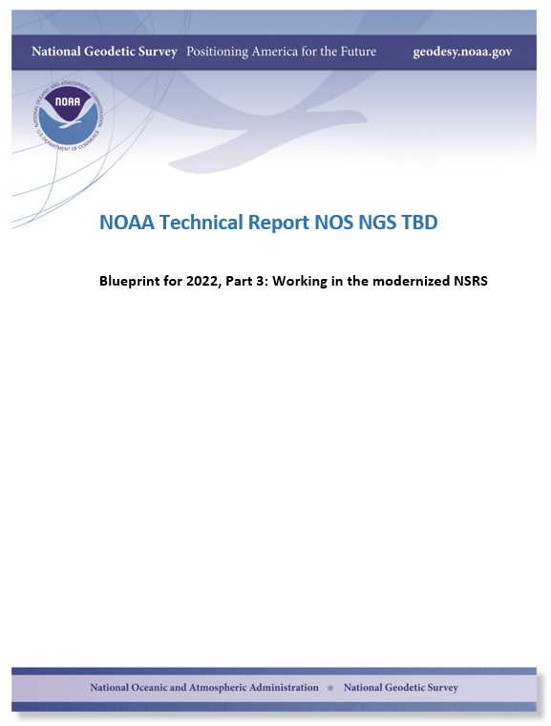
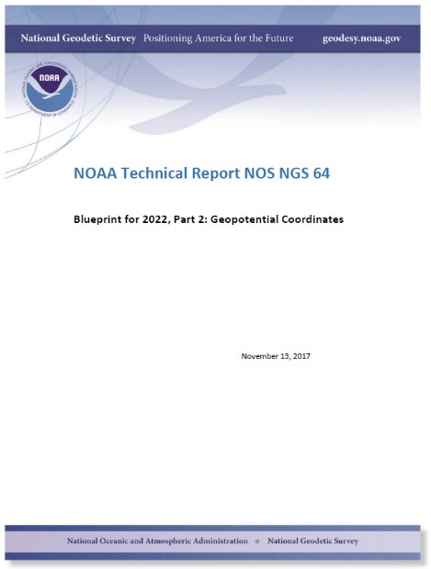
Modernizing the NSRS
The “blueprint” documents: Your best source for information

Slide 20
2019 Geospatial Summit
SAVE THE DATE!
Geospatial Summit
Dates: May 6 - May 7, 2019
Location: Silver Spring Civic Center
Invitees: NSRS users plus NGS Subject Matter Experts
Public announcement coming soon!

Slide 21
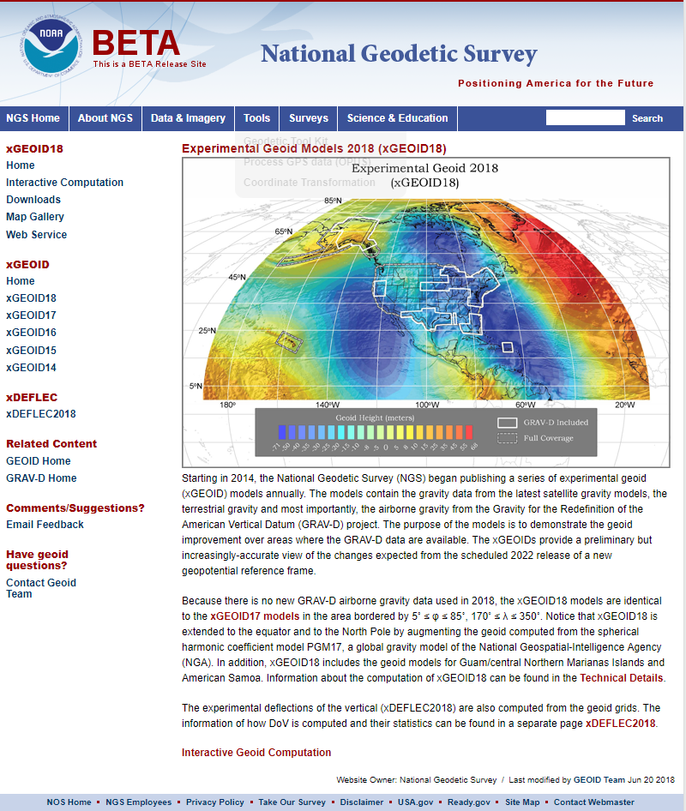
2018 Experimental Geoid Model
beta.ngs.noaa.gov/GEOID/xGEOID18/

Slide 22
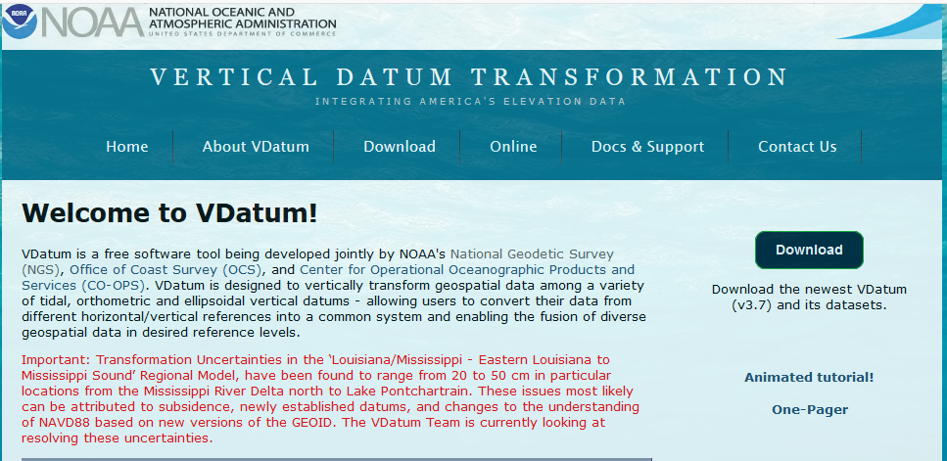
Coordinate Conversion and Transformation Tools
NGS Coordinate Conversion and Transformation Tool (NCAT) geodesy.noaa.gov/NCAT/
VDatum Tool (NCAT plus tidal datums) vdatum.noaa.gov
Both will run in three modes:
Web services
Browser interactive
Downloadable

