Slide 1
Modernizing the National Spatial Reference System
Dru Smith
NSRS Modernization Manager
NOAA’s National Geodetic Survey

Slide 2
Answers …
What is changing?
All horizontal datums and vertical datums in the NSRS
NAD 83 , NAVD 88 , etc
Why?
Predominantly to keep up with technology.
Global proliferation of real time cm-accuracy positioning (in the hands of people who have no understanding of geodesy, datums, plate tectonics, error sources or other subtleties) is rapidly approaching.
Many surveying, mapping and navigation professionals already enjoy this accuracy.
The current datums have systematic errors exceeding 1 meter.
When is it changing?
No later than December 31, 2022
Will it be an immediate or gradual change?
Immediate

Slide 3
Answers…
Possible impacts?
Every historic position (on a map, chart, survey, etc) with an assumed accuracy of better than 1 meter will become obsolete
Transformations will exist before 2022 to help
Every piece of navigating, mapping and surveying software will become obsolete
NGS is working with industry to get ahead of this
Will there be conversion tables from the old datum?
Not in the sense of “a book with pages and pages of numbers”. But there will be digital products available to transform from old to new.

Slide 4
Answers
Is WGS 84 updated too?
Not necessarily
WGS-84 is a military system. The military is not beholden to the civilian spatial reference system.
But NGS is in contact with NGA about co-defining the new system with the latest update to WGS-84
What involvement do you need from AJV-5 to make transition smooth?
Communication first.
Possible tests of prototype tools as we roll them out.

Slide 5
Reminder…
WGS-84 is not part of the NSRS
It is a military-controlled system
All civilian federal agencies are required to work in the NSRS (as per OMB A-16)
NAD 83 is part of the NSRS
The FAA should be using NAD 83 and never WGS-84
Replacing NAD 83 should impact the FAA

Slide 6
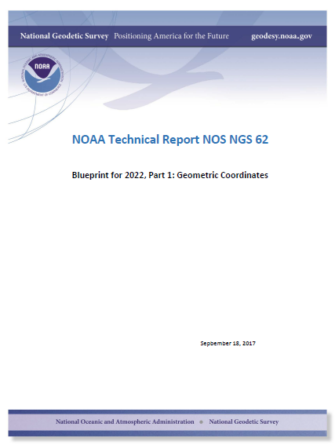
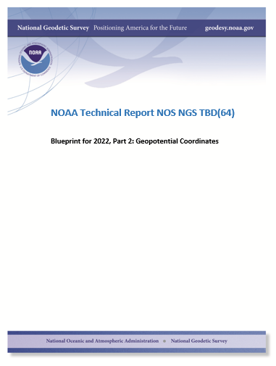
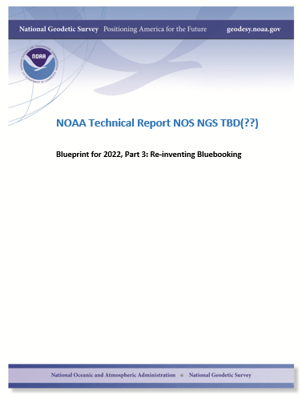
Modernizing the NSRS
The “blueprint” documents: Your best source for information
Geometric:
May 2017
(minor update Sep 2017)
Geopotential:
Planned: Oct 2017
Bluebooking:
Apr(?) 2018

Slide 7
Replacing the NAD 83’s
The Old:
NAD 83(2011)
NAD 83(PA11)
NAD 83(MA11)
The New:
The North American Terrestrial Reference Frame of 2022
(NATRF2022)
The Caribbean Terrestrial Reference Frame of 2022
(CATRF2022)
The Pacific Terrestrial Reference Frame of 2022
(PATRF2022)
The Mariana Terrestrial Reference Frame of 2022
(MATRF2022)

Slide 8
Replacing NAVD 88
The Old:
NAVD 88
PRVD 02
VIVD09
ASVD02
NMVD03
GUVD04
IGLD 85
IGSN71
GEOID12B
DEFLEC12B
Orthometric
Heights
The New:
The North American-Pacific Geopotential Datum of 2022 (NAPGD2022)
- Will include GEOID2022
Normal
Orthometric
Heights
Dynamic
Heights
Gravity
Geoid
Undulations
Deflections of
the Vertical

Slide 9
Q: When should I care?
A: When your accuracy needs are smaller than about 4 meters
Expected latitude/longitude changes:
1-2 meters CONUS
2+ meters Alaska
4+ meters Hawaii
Expected (“MSL”) height changes:
1-2 meters CONUS
2+ meters Alaska
Unclear Hawaii
Plus, time-dependent changes to all of these at ~few cm/year

Slide 10
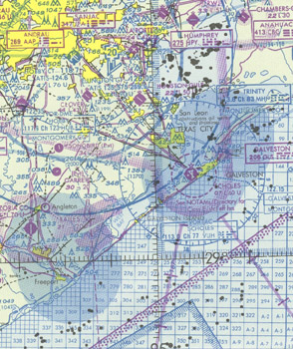
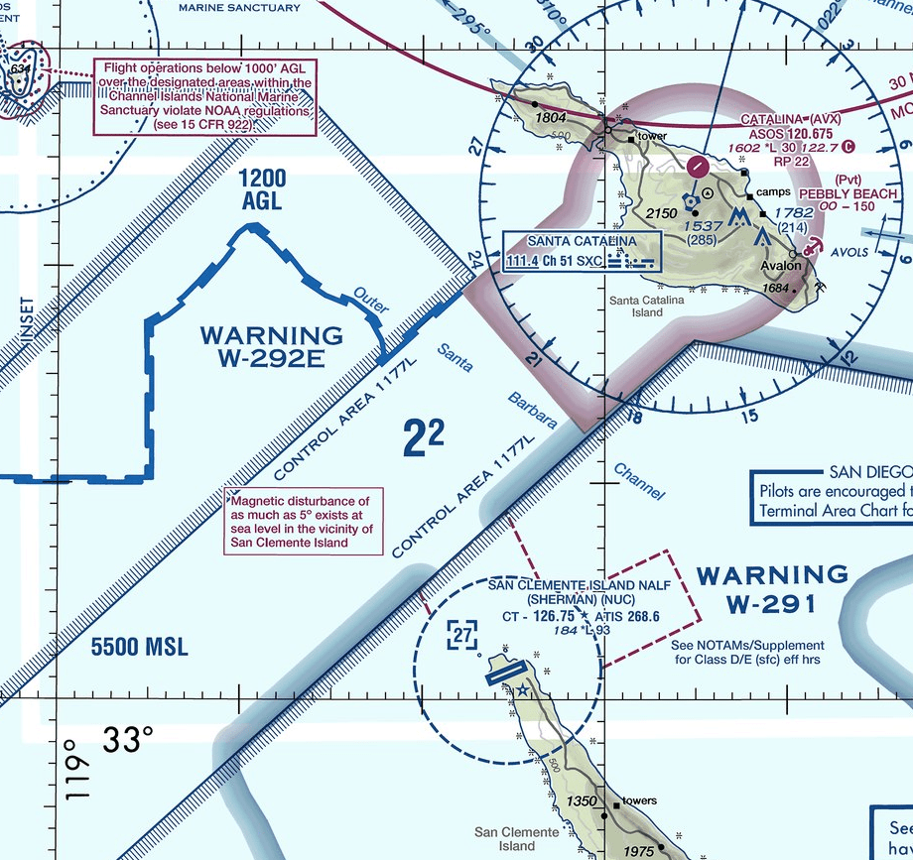
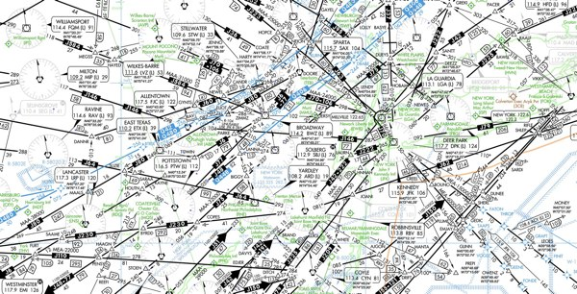
What to do with historic charts?
Is the accuracy expected to be better than a few meters?
No
Yes
Stop. You won’t likely gain much by transforming
Do you have trusted metadata which puts the chart in the NSRS? (Note, WGS 84 is not part of the NSRS)
Yes
No
Stop. Transformation tools only work in the NSRS and only if you trust the metadata
Use NADCON and VERTCON to update the datums in 2022

Slide 11
Transformation tools
NADCON
Latitudes, longitudes, ellipsoid heights
NAD 83 to the 2022 NSRS (IGS, NATRF2022, PATRF2022, MATRF2022, CATRF2022)
VERTCON
Orthometric (“MSL”) heights
NAVD 88 to the 2022 NSRS (NAPGD2022)

Slide 12
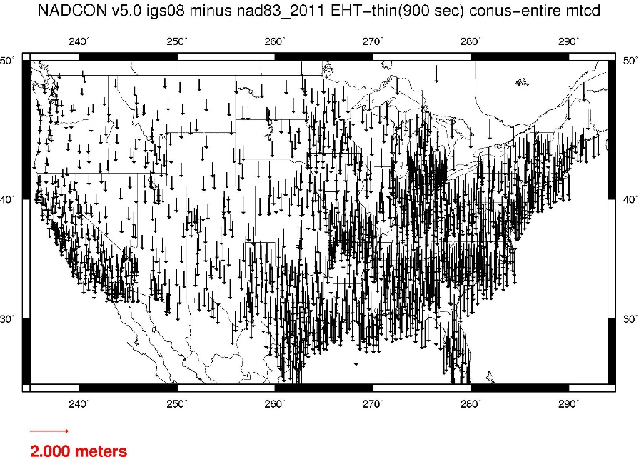
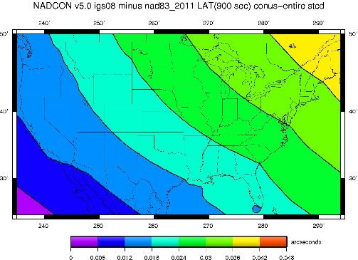
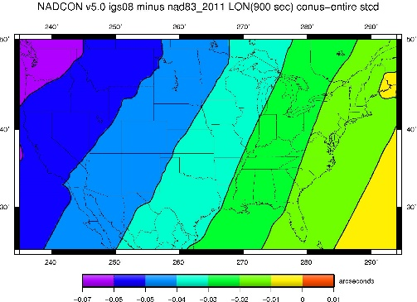
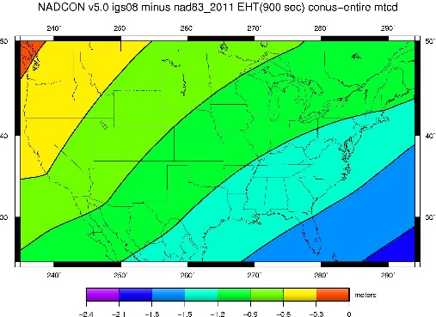
Fixed-Epoch Transformation NAD 83 to “2022”

Slide 13
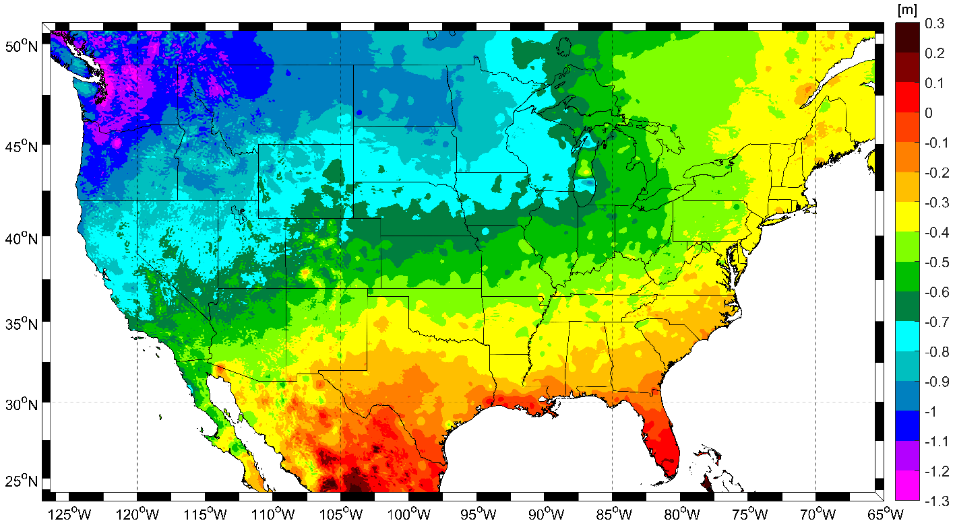
Expected changes to orthometric heights

Slide 14
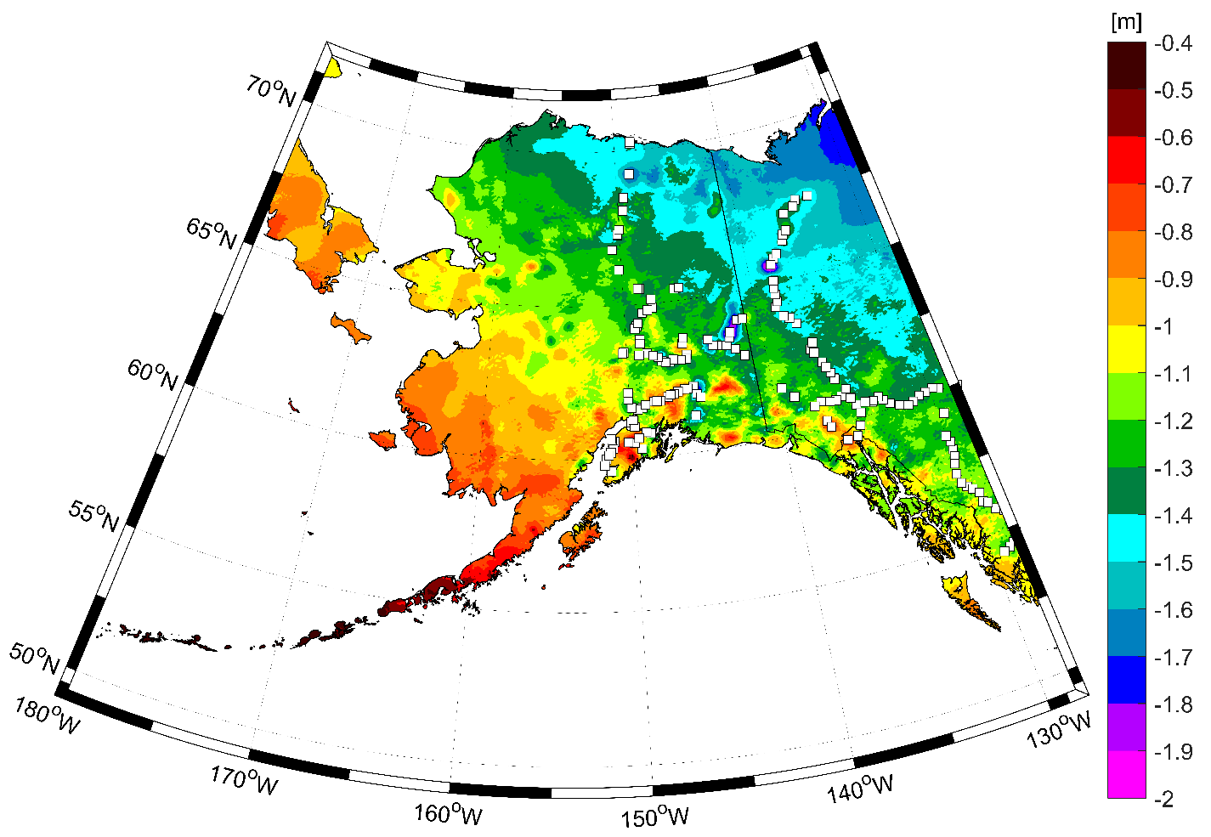
Expected changes to orthometric heights

Slide 15
Everything must shift

Slide 16
Everything must shift
Shifts ~1 meter
RED: NAD 83 coastline against NAD 83 imagery
GREEN: Coastline shifted into NATRF2022 but
the imagery remains on NAD 83

Slide 17
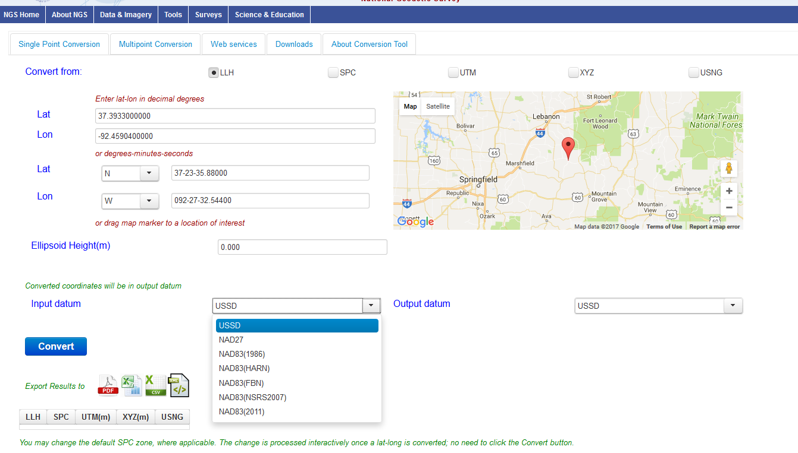
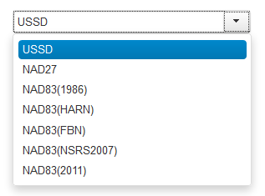
The new Geodetic Toolkit with NADCON 5.0
https://beta.ngs.noaa.gov/gtkweb/

Slide 18
X, Y, Z
φ, λ, h
φ, λ, h
Region: CONUS
NADCON 5 connections in RED
2022
X, Y, Z
SPC
UTM
USSD
USNG
UTM
φ, λ, h
φ, λ, h
NAD 27
NAD 83 (2011)
X, Y, Z
SPC
X, Y, Z
SPC
USNG
UTM
USNG
UTM
NAD 83 (NSRS2007)
φ, λ, h
NAD 83 (1986)
φ, λ, h
NAD 83 (FBN)
NAD 83 (HARN)
φ, λ, h
X, Y, Z
SPC
X, Y, Z
SPC
φ, λ, h
USNG
UTM
USNG
UTM
X, Y, Z
SPC
X, Y, Z
SPC
USNG
UTM
USNG
UTM

Slide 19
A radical idea…
The FAA should consider abandoning the plate fixed components of the NSRS
This obviously means updating OMB A-16…(see earlier)
In favor of the global, plate-independent “IGS” frame
NGS will support IGS positioning as well as four “plate fixed” frames in 2022
The IGS and WGS-84 are actually closely aligned to each other
Why?
Consider flying from Denver to Honolulu
In Denver, the NATRF2022 latitude/longitude will look constant in time
In Honolulu, the PATRF2022 latitude/longitude will look constant in time
But they don’t look constant when compared to each other
Why not just switch to a system which accepts and embraces the dynamic earth? : IGS

Slide 20
Questions?

