Slide 1

Blueprint for 2022, Part 1:
Geometric Coordinates
AKA “Replacing NAD 83”
Fairbanks, AK
July 25, 2017
Nic Kinsman
Alaska Regional Advisor, NGS
and
Rachel Eytalis
UAA Geomatics (Rising Senior)
April 2017 NGS Geospatial Summit
^content available online at https://www.ngs.noaa.gov/geospatial-summit/index.shtml

Slide 2
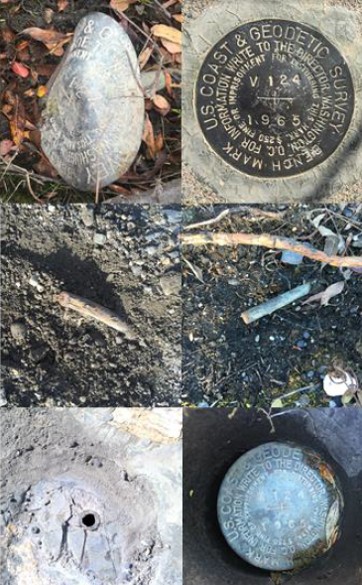
Why replace NAD83 (and NAVD88)?
ACCESS!
  easier to find the sky than a 60-year-old bench mark
  GNSS equipment is cheap and fast
ACCURACY!
  easier to trust the sky than a 60-year old bench mark
  immune to passive mark instability
GLOBAL STANDARDS!
  systematic errors of many meters across the US
  aligns with GPS (equipment), international efforts
  aligns with Canada, Mexico

Slide 3
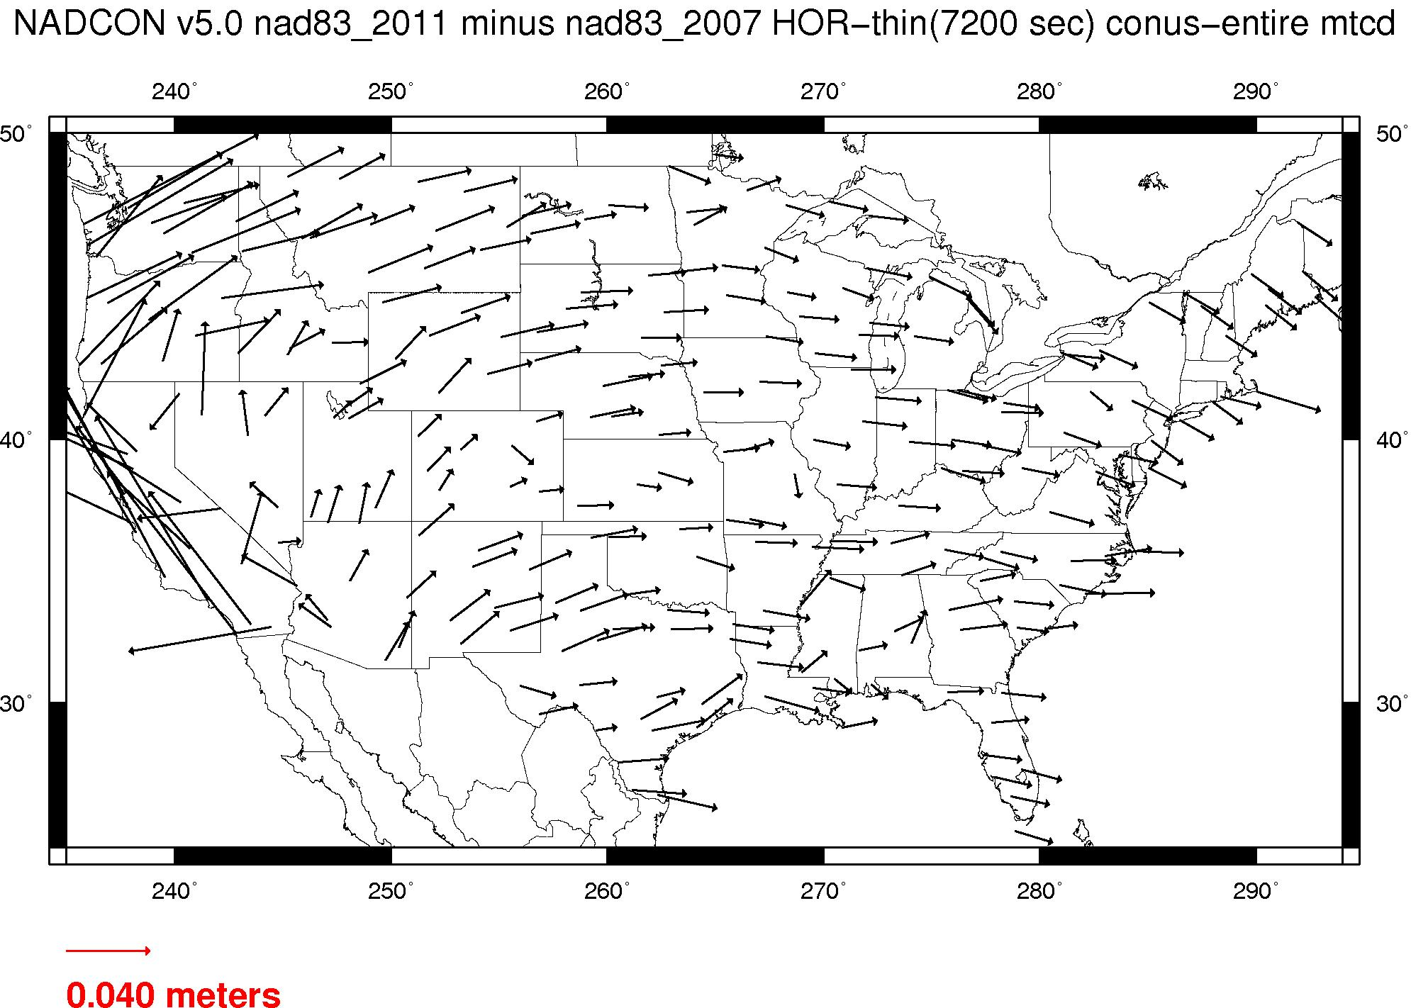
Plate-(pseudo)fixed frames
NAD 83(2011) minus NAD 83(NSRS2007)
NAD 83(NSRS2007)
Epoch 2002.0
NAD 83(2011)
Epoch 2010.0
If NAD 83 were truly “plate
fixed” then an 8 year
epoch change would not
yield the systematic
plate rotation seen here.

Slide 4
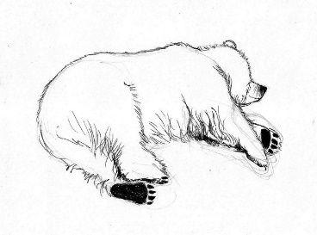


The Great Balancing Act of NSRS Modernization
Passive control moves with the earth’s crust
NGS sees value in acknowledging and presenting that movement through both measurements and models
NGS also recognizes the value in having semi-static coordinates, for comparison across years

Slide 5
Summary: The NSRS in 2022…
Four semi-dynamic reference frames
(Geoid/GPS based vertical datum) → Blueprint Part II
All data will be time tagged
All coordinates will come from GNSS surveys (OPUS)

Slide 6
Customer Concerns
control shouldn’t move!
a national terrestrial reference frame should minimize velocities, even if that means drifting away from ITRF over time.
don’t make us think!
provide vendor- and user-friendly transformation tools with modern programming
modernize datasheets and bluebooking
tell us more!
more updates, training, & tutorials
a formal publication describing the differences between NAD83 / NAVD88 and the new reference frames
help with legislation
NSPS distribute sample language to update state legislation that references NAD 83
Notes:
These high-level issues were all brought up in multiple presentations from our stakeholders at the Summit.
They are consistent with what is included in the Summit Report.
There were many other items that each stakeholder brought up that were more unique to his or her particular organization.

Slide 7
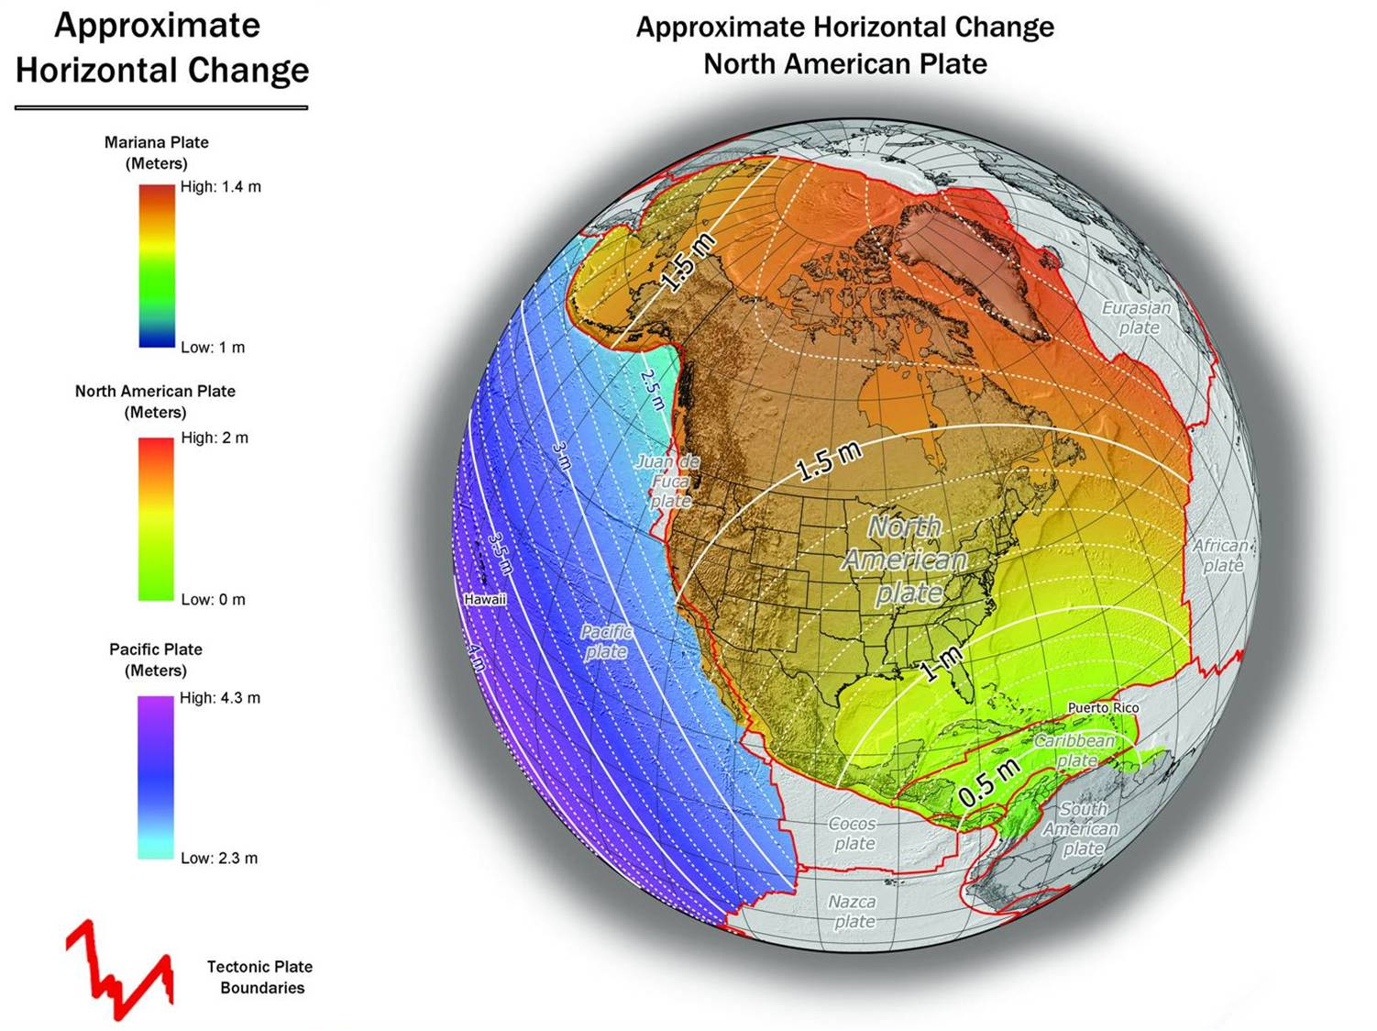
NAD 83(2011) to IGS08 at epoch 2022.0

Slide 8
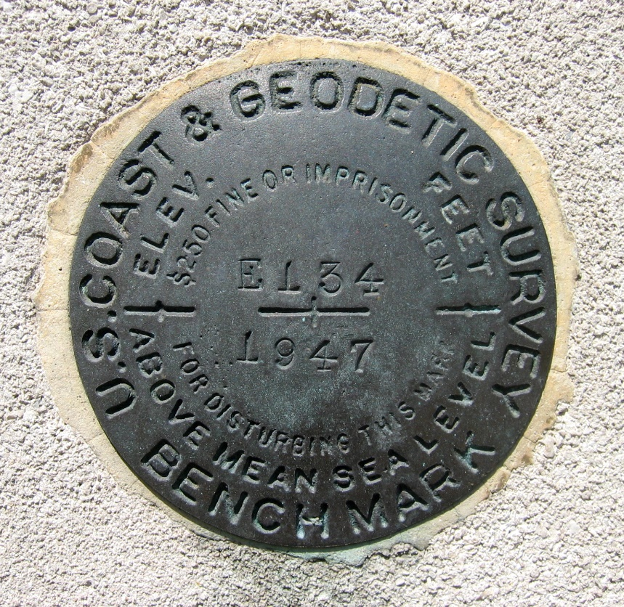
Continued Role of Passive Control
Calibration sites for GNSS technology, Real Time Network validation, and verification of datum transformation tool results.
Sites for monitoring motion to enhance Intra-Frame Velocity Model (via repeat/campaign GNSS occupations)
Convenience: passive control will continue to provide rapid access to NSRS positions for local projects, in areas with limited GNSS coverage (e.g. cities, forests), or in the event of GNSS failure (e.g. geomagnetic storms)
Notes:
Things are looking up! GNSS technologies simplify and improve access to and accuracy of our spatial reference system.
While we can continue to leverage this technology to maintain the old datums, it makes sense to adopt GRAV-D results in an unpolluted form, and align it to modern global standards.

Slide 9
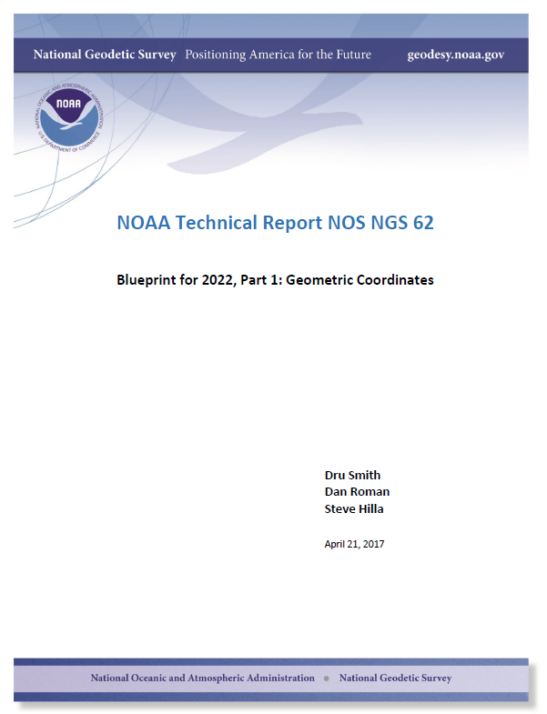
Executive Summary
An eloquent history of the definition of ‘Geodetic Control’
Tectonics 101
(Ideal + Plate-fixed Frame) * calculus fever dream
= illusion of stillness
The name game (NATRF2022)
14-parameters… to 3 (a proof)
The velocity ‘slop bucket’
… GIVE IT A GLANCE!
Notes:
(three shifts, , x y T T , and z T ; three differential rotations, , x y ε ε , and z ε ; and one
differential scale change s) + rates with respect to time

Slide 10
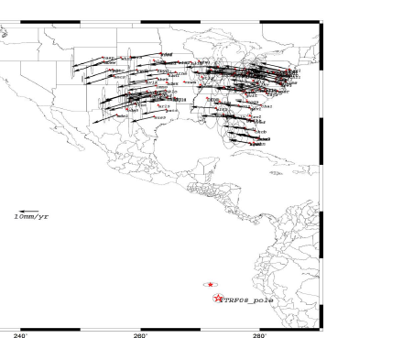
Euler Poles
NATRF2022 will be identical to the latest IGS reference frame (as available in 2022) at an epoch to be determined.
Away from that epoch, NATRF2022 will relate to the IGS frame through the definition of an Euler Pole rotation specific to that plate.
Each frame will
get 3 parameters
Euler Pole Latitude
Euler Pole Longitude
Rotation rate (rad/yr)

Slide 11
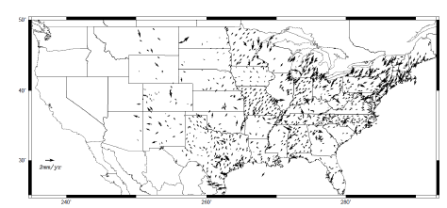
After…

Slide 12
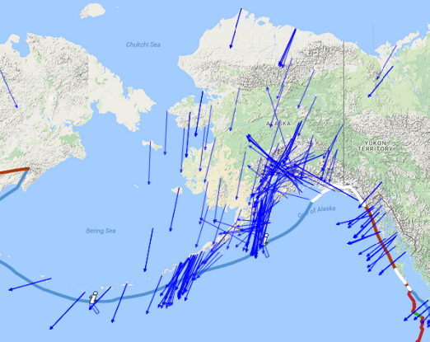
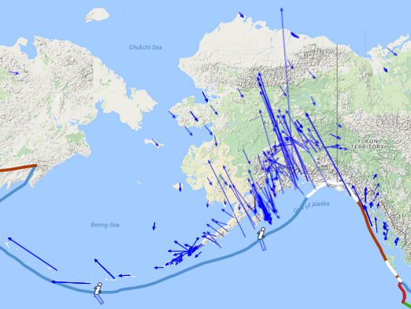

Meanwhile in Alaska…
Before…
… and After.

Slide 13
Review: Reference Frames
NGS can easily relate time-dependent IGS coordinates to time-dependent NATRF coordinates
  They will appear semi-stable in the parts of the plate that appear to be rigid and only rotating

Slide 14
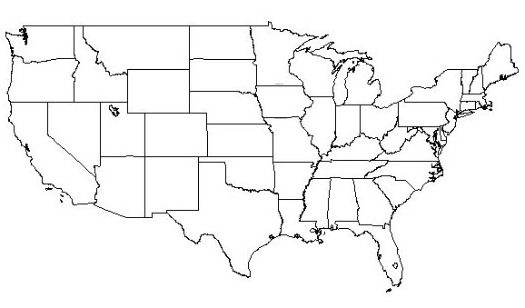
NATRF2022 frame is rigid and fixed to rigid part of the N.A. plate
Non-rigid part of the N.A. plate
(deformation)
area

Slide 15
NATRF2022 coordinates over time
(Remember: The NATRF2022 frame is rigid)
Point on deforming part of plate
Point on rigid part of plate
λ
λ
t
t

Slide 16
NATRF2022 coordinates over time
(Remember: The NATRF2022 frame is rigid)
Point on deforming part of plate
Point on rigid part of plate
λ
λ
t
t

Slide 17
NATRF2022 coordinates over time
(Remember: The NATRF2022 frame is rigid)
Point on deforming part of plate
Point on rigid part of plate
λ
λ
t
t

Slide 18
NATRF2022 coordinates over time
(Remember: The NATRF2022 frame is rigid)
Point on deforming part of plate
Point on rigid part of plate
λ
λ
t
t

Slide 19
Intra-frame velocities
This is the velocity of the
point in NATRF2022.
Rotation of plate removed.
It is not constant because
the point still suffers small
“intra-frame” velocities.
Such IFVs will be captured
in a model by NGS.
This is the velocity of the
point in ITRF. Includes all
movements, but the
dominant one is the
rotation of the N.A. Plate.

Slide 20
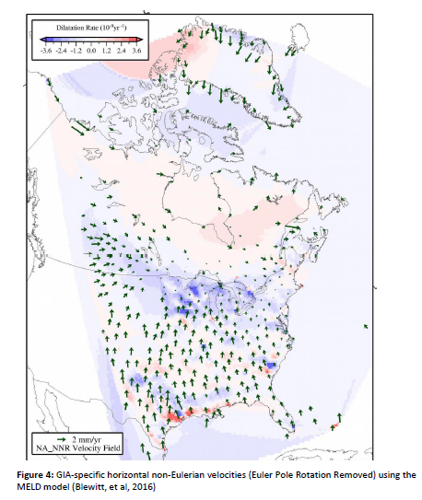
GIA

Slide 21
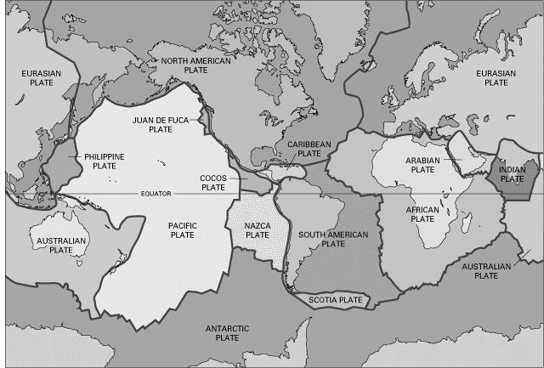
BSMK (North Dakota)

Slide 22
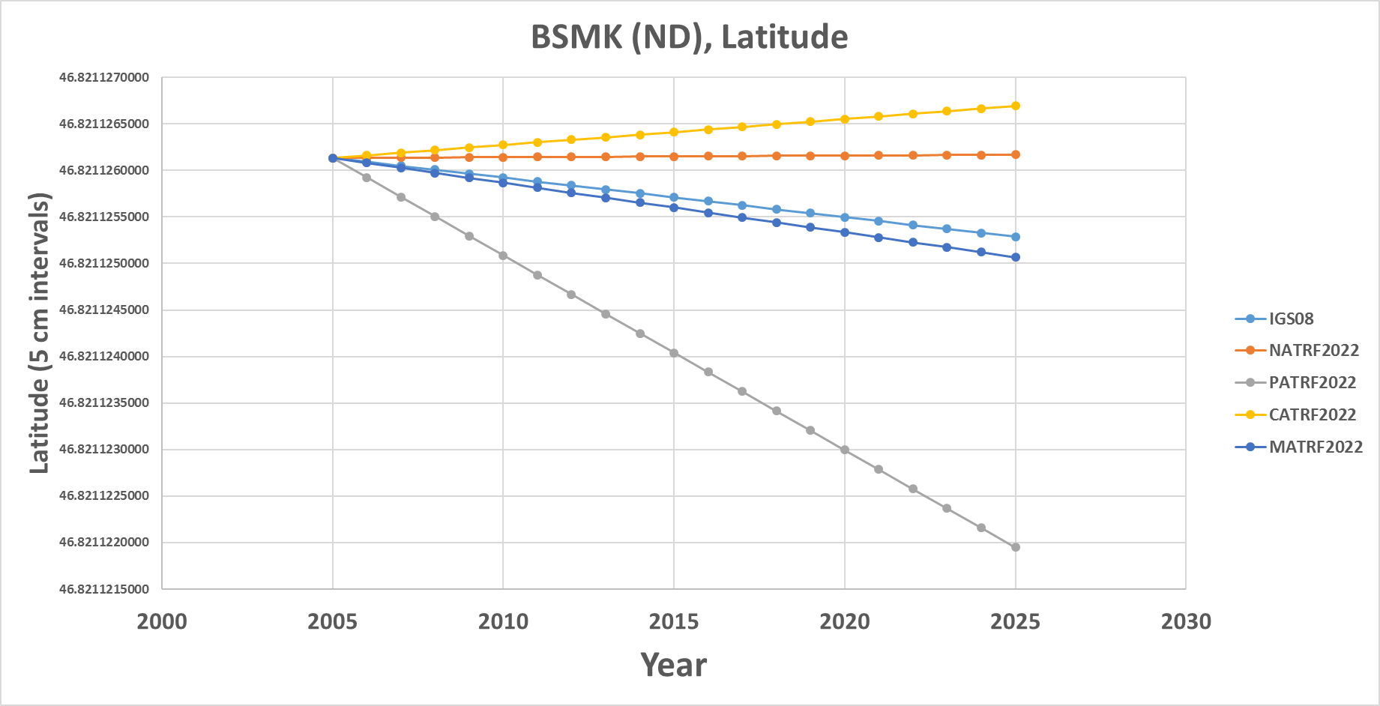
BSMK (North Dakota)

Slide 23
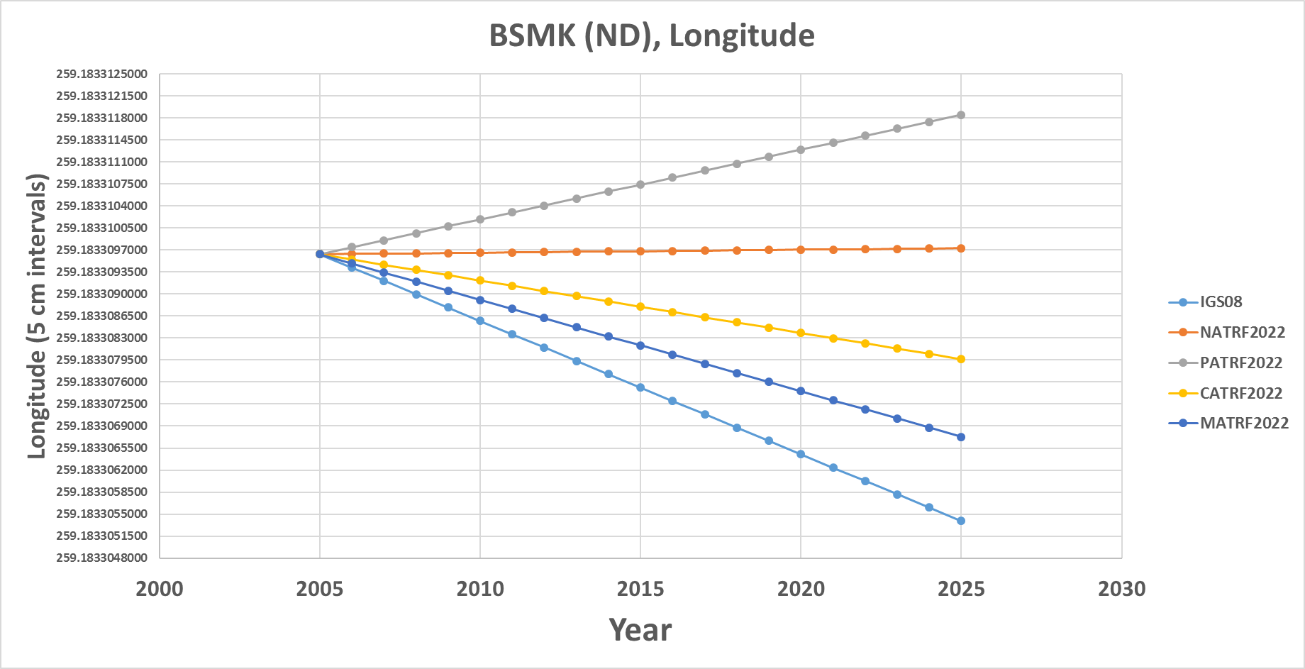
BSMK (North Dakota)

Slide 24
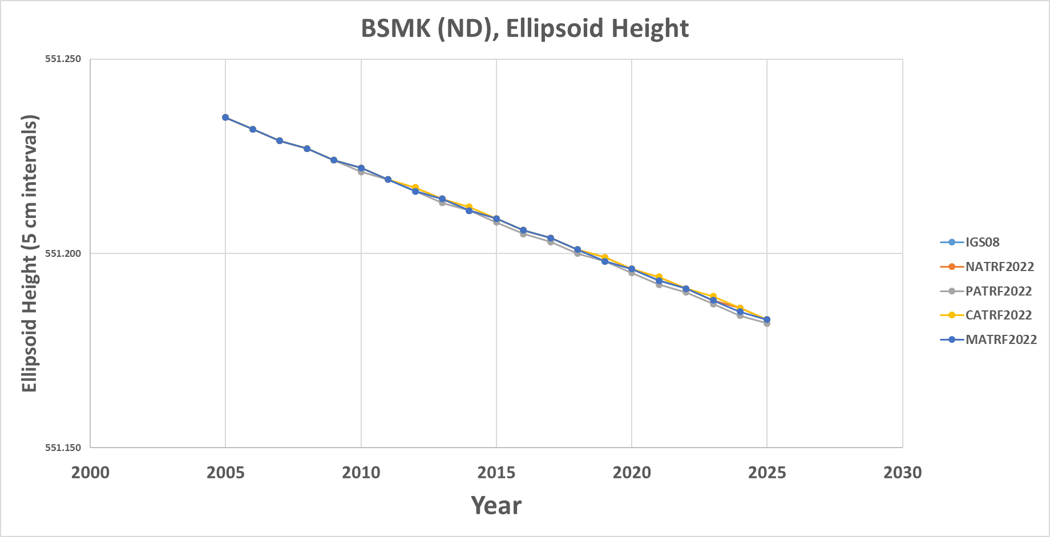
BSMK (North Dakota)

Slide 25
BRW1 (N. Alaska)

Slide 26
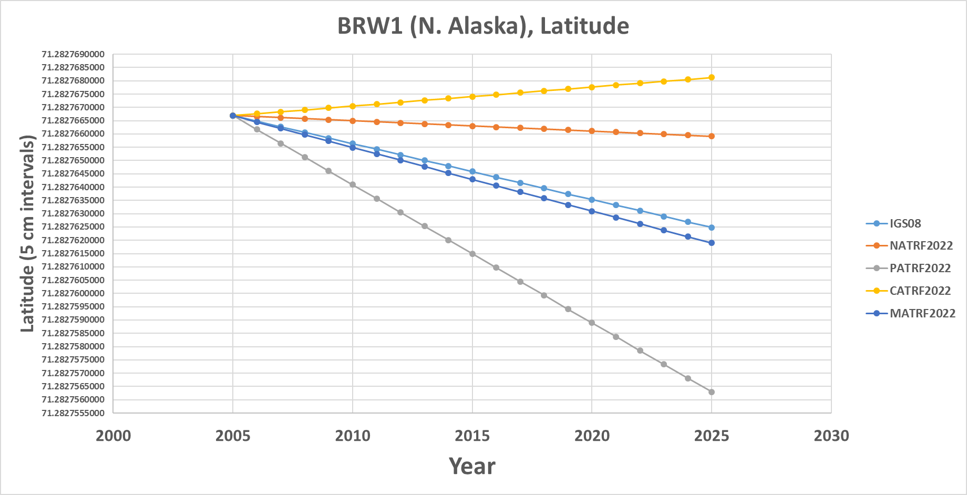
BRW1 (N. Alaska)

Slide 27
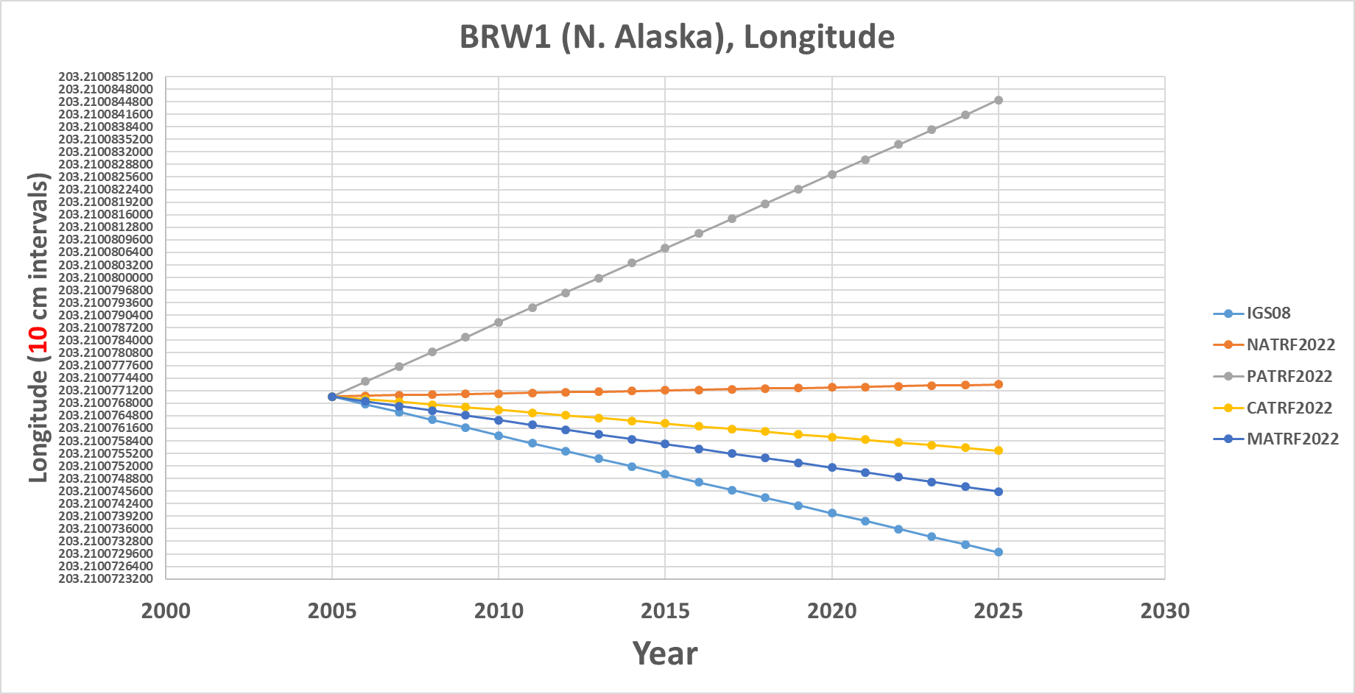
BRW1 (N. Alaska)

Slide 28
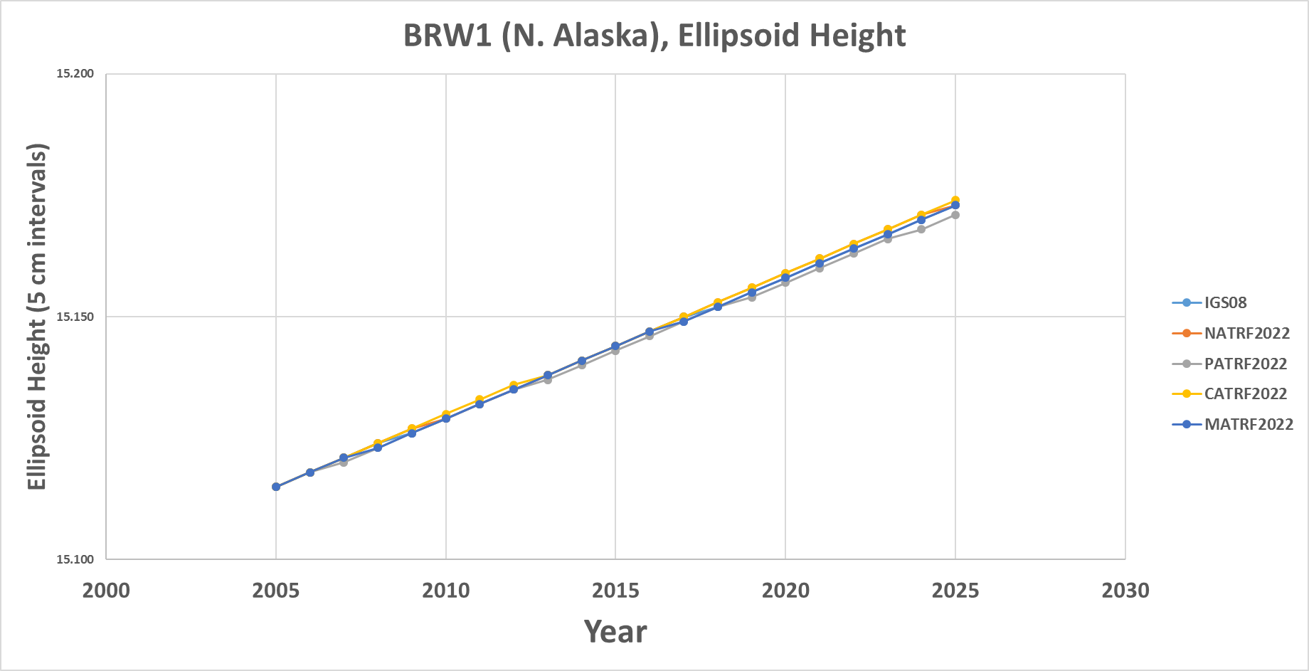
BRW1 (N. Alaska)

Slide 29
KOD6 (S. Alaska)

Slide 30
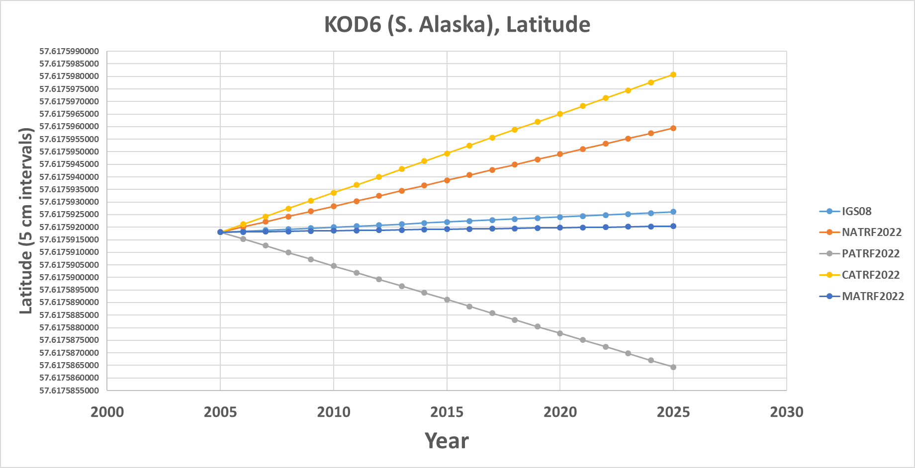
KOD6 (S. Alaska)

Slide 31
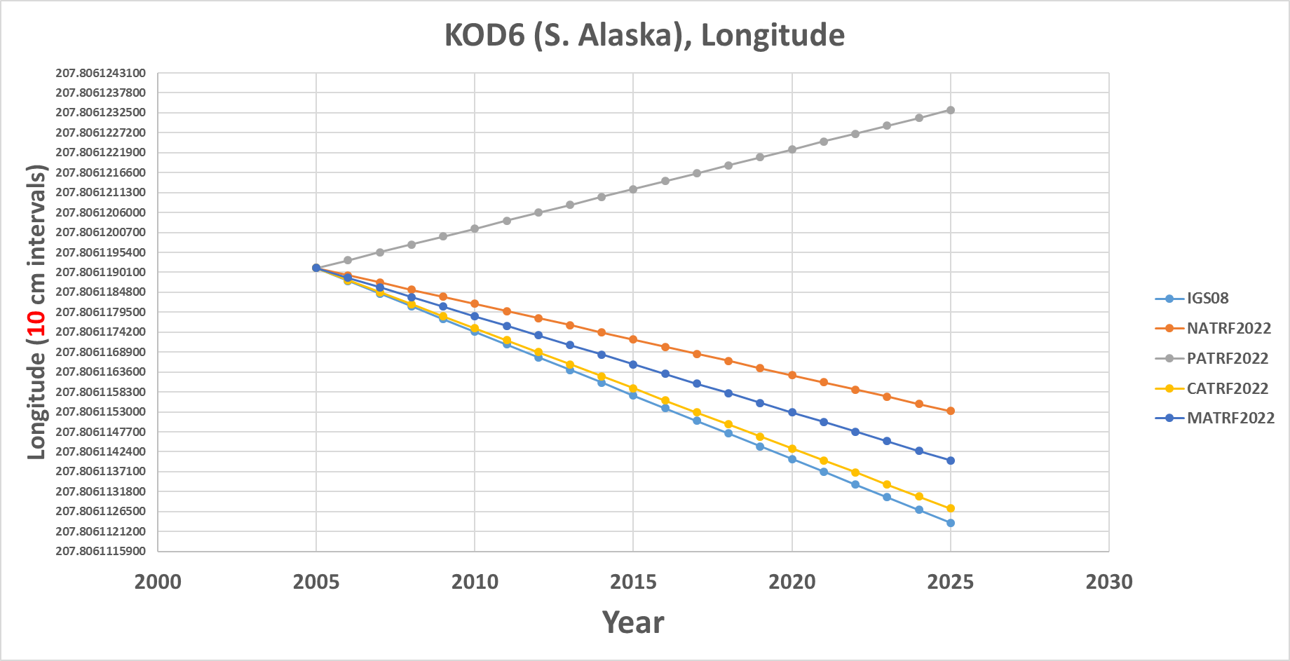
KOD6 (S. Alaska)

Slide 32
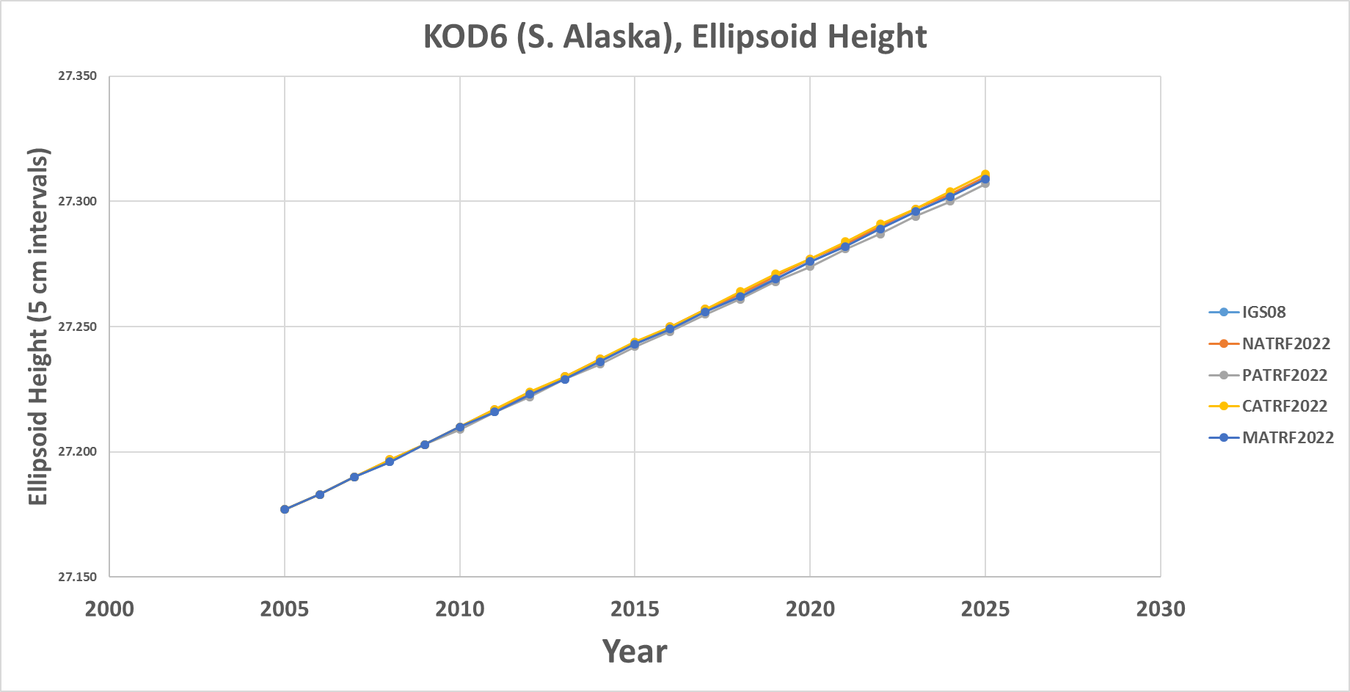
KOD6 (S. Alaska)

Slide 33
Intra-Frame Velocity Models (IFVMs)
Intra-Frame Velocity Models must:
  Estimate non-Eulerian motions at any location
Three primary methods being investigated
  Interpolation from CORS
    Pro: Easy
    Con: Gets worse as CORS gets coarse
  Satellite IfSAR
    Pro: Covers vast areas
    Con: No IfSAR experts in NGS; data availability issues
  Geodynamic
    Pro: Like HTDP, so NGS has experience
    Con: Requires knowing why things move, rather than just measuring that they move (and requires “keeping up” with every event.)

Slide 34
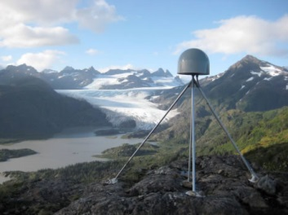
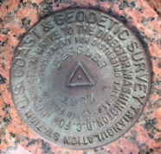
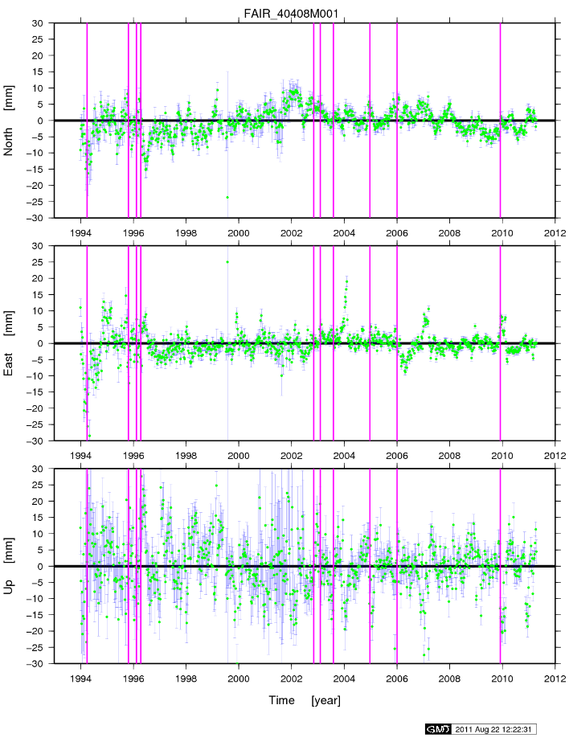
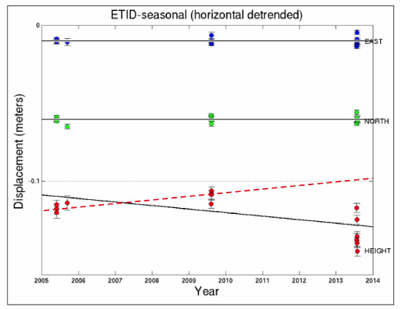
Our Part: Observing Motion Vectors
Continuous GNSS stations (such as CORS) track a continuous record of motion
Passive control allows for the re-observation of a fixed point on the earth’s surface at different epochs
https://www.ngs.noaa.gov/CORS/

Slide 35
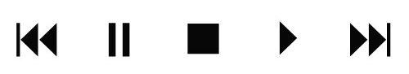
Using NATRF2022
Historically:
  Surveys at multiple epochs were “moved through time” using HTDP (skipping vertical except recently in Alaska) to adjust them all together at one common epoch
Future:
  Surveys will be adjusted to CORS at their own epoch and stand thus
  The IFVM will allow for comparisons across epochs, but will not “move surveys through time” to adjust things and get “one coordinate” on a point

Slide 36
In Practice:
User Supplied
GNSS Receiver File(t)
CORS data (t)
NGS Supplied
IAG Supplied
OPUS
Geodetic Control
High Accuracy
Fixed at true epoch
XYZ (t, IGS)
GRS-80
φλh (t, IGS)
4 Euler Poles, by plate:
NA, PA, CA, MA
Estimated cords
Medium Accuracy
Subject to updates
XYZ (t, NATRF2022)
XYZ (t, PATRF2022)
XYZ (t, CATRF2022)
XYZ (t, MATRF2022)
4 Intra-Frame Velocity Models, by frame:
NA, PA, CA, MA
Latest estimate of:
φλh (t0, NATRF2022)
φλh (t0, PATRF2022)
φλh (t0, CATRF2022)
φλh (t0, MATRF2022)
GRS-80
φλh (t, NATRF2022)
φλh (t, PATRF2022)
φλh (t, CATRF2022)
φλh (t, MATRF2022)
Most recent past reference epoch “t0”
Blueprint for 2022, Part 1: Geometric Coordinates

Slide 37
Applied Use:
Further details on this change in the use of the reference frames will come in 2018:
Blueprint for 2022, Part 3: Re-inventing Bluebooking

Slide 38
Thought Experiments
Interactive interview w/ DOT intern ☺
  What do you use geodetic control for?
  How do you set control?
  What if you have multiple coordinates?
  What will change today vs. 2022?
Notes:
Starting Points with known coordinates at the time a survey is performed
With some convenient way to compare surveys over time

Slide 39
The history of GPS and coordinates on PID DI4044 (Southern Louisiana)
A cautionary tale about passive control points and the dynamic crust in which they reside
Dru Smith
NSRS Modernization Manager
NOAA’s National Geodetic Survey
https://www.ngs.noaa.gov/geospatial-summit/presentations/implications-dynamic-world.shtml

Slide 40
Thank You

