Slide 1

Blueprint for 2022, Part 1:
Geometric Coordinates
AKA “Replacing NAD 83”
Dru Smith
NSRS Modernization Manager
NOAA’s National Geodetic Survey

Slide 2
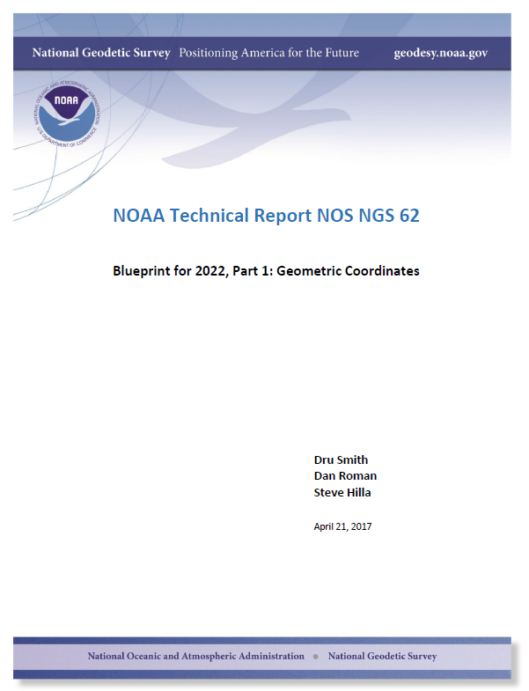

Slide 3
Overview
How and Why
Content : Geodetic Control
Content : Four TRFs
Content : IFVM
Using the TRFs
Summary

Slide 4
Why NGS wrote it…
2007 (1st Ten Year Plan) : “Replace NAD 83”
2012 (2nd Ten Year Plan) : “Replace NAD 83”
Details were lacking, and therefore outreach material couldn’t properly prepare the user community for 2022

Slide 5
How it came into being…
The idea of “blueprint” documents was fuzzy at first, but the need for details was clear
2014 : SRSD begins division meetings on replacing NAD 83
2015 : NSRS Modernization Manager calls meetings on “How NGS operates in the future”

Slide 6
How it came into being…
2016: Met with CGS and fleshed out a joint plan to replace NAD 83
Late 2016: Decision to put out a white paper, soon called a “blueprint” emerges from NGS technical meetings
  Part of a three-part release
  Geometric (Part 1) before the Geospatial Summit

Slide 7
Content: Geodetic Control
A description of the purpose of geodetic control is first presented
  Starting Points with known coordinates at the time a survey is performed
  With some convenient way to compare surveys over time

Slide 8
Content: Reference Frames
Ideal
  ITRF / IGS
  Not fixed to any plate
Plate-fixed
  Attempt to remove Euler Pole rotations of one rigid plate within the ideal frame
  Relatable to the Ideal frame through a plate rotation model
    3 parameter transformation

Slide 9
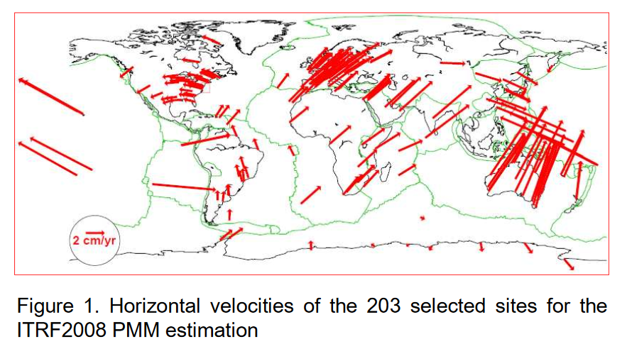
Velocities

Slide 10
Content: Reference Frames
The NSRS in 2022 will contain four terrestrial reference frames
Each one related to the IGS frame by a plate rotation model only
North American Terrestrial Reference Frame of 2022 (NATRF2022)
Pacific Terrestrial Reference Frame of 2022 (PATRF2022)
CaribbeanTerrestrial Reference Frame of 2022 (CATRF2022)
MarianasTerrestrial Reference Frame of 2022 (MATRF2022)

Slide 11
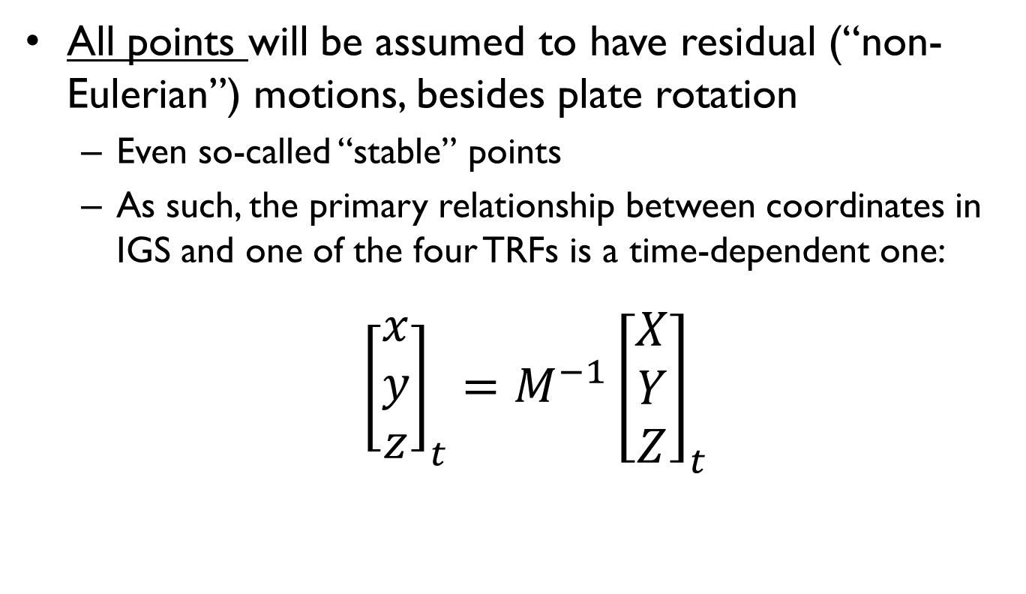
Content: Reference Frames
All points will be assumed to have residual (“non-Eulerian”) motions, besides plate rotation
  Even so-called “stable” points
  As such, the primary relationship between coordinates in IGS and one of the four TRFs is a time-dependent one:
${{{\left[\begin{matrix}x \\ y \\ z\end{matrix}\right]}_{t}=M}^{−1}\left[\begin{matrix}X \\ Y \\ Z\end{matrix}\right]}_{t}$
*TRF2022
coordinates
Plate rotation model
for plate *
IGS coordinates

Slide 12
Content: Reference Frames
Non-Eulerian motions at CORS
Note the obvious impact of the plate boundary in western CONUS
Note the non-zero nature of all vectors even in “stable North America”
Notes:
Potential outline and speaker assignments; can be adjusted as needed.

Slide 13
Content: Reference Frames
NGS can easily relate time-dependent IGS coordinates to time-dependent *TRF coordinates
  They will appear semi-stable in the parts of the plate that appear to be rigid and only rotating

Slide 14
Some examples at CORS
Let’s look at the expression of coordinates at select CORS
Five frames (IGS + 4 TRFs)
Using IGS08 for now
Using the best known plate rotation models

Slide 15
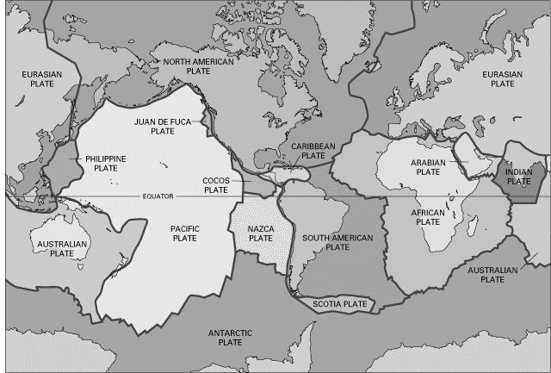
Select CORS

Slide 16
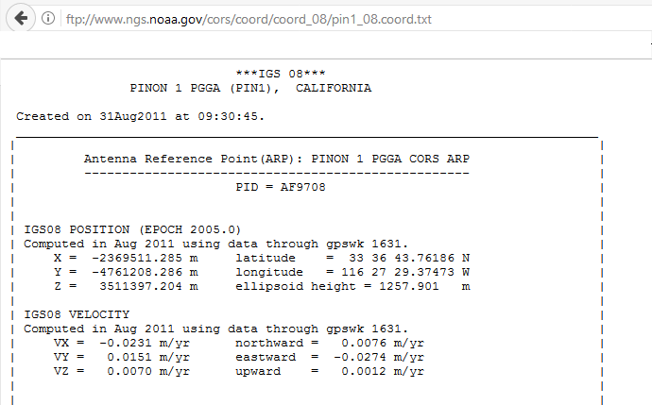
A word about CORS coordinates…
A typical “CORS coordinate
file” available from NGS
Just one set of coordinates
and just one set of
velocities

Slide 17
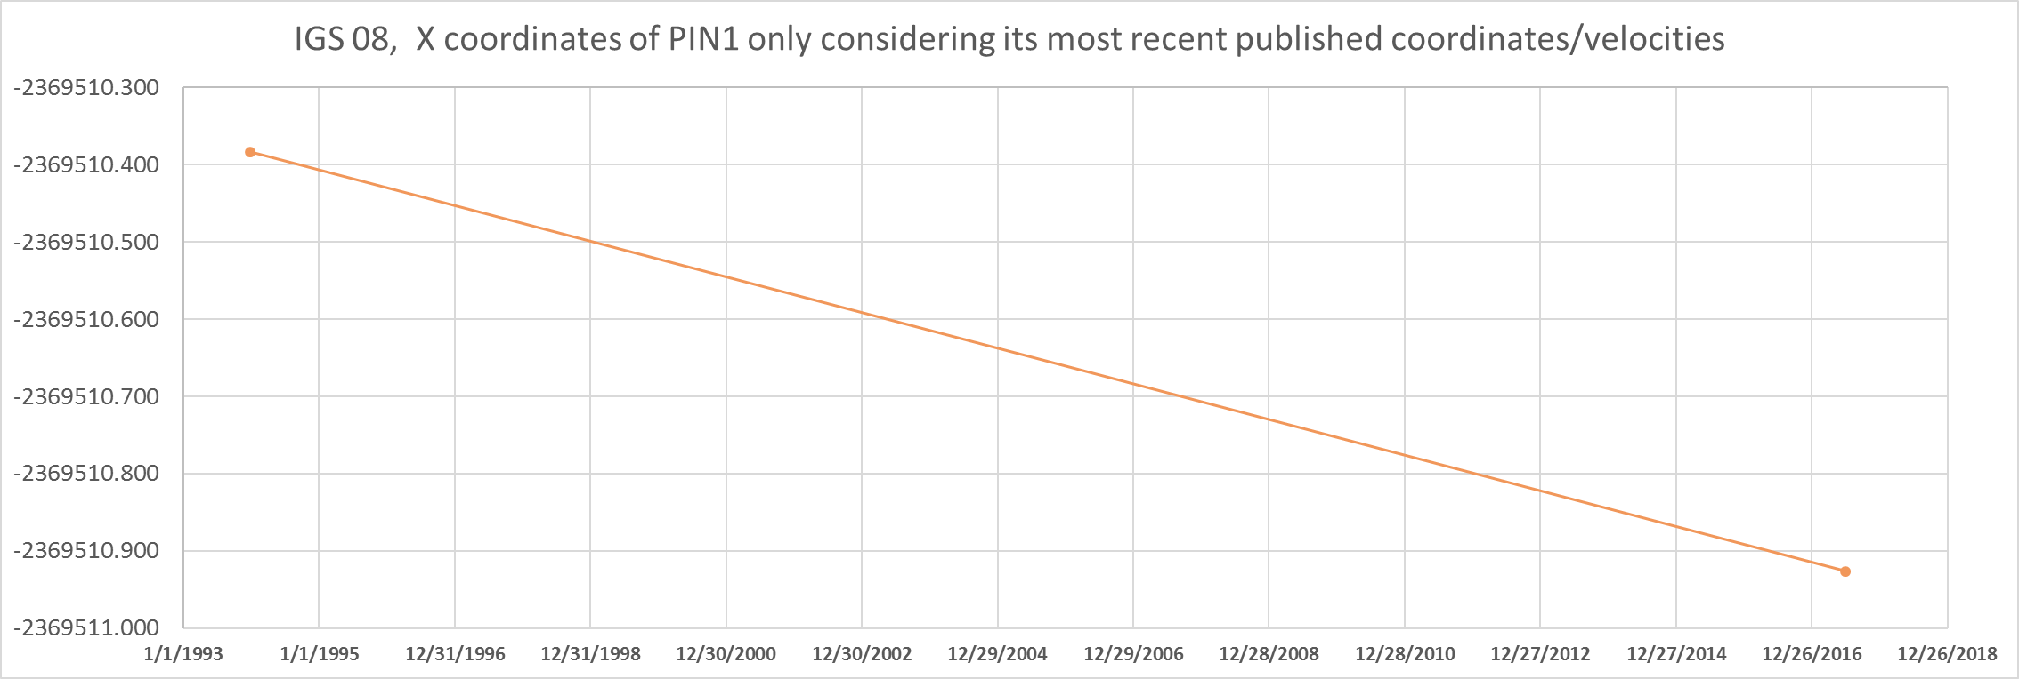
CORS Coordinates

Slide 18
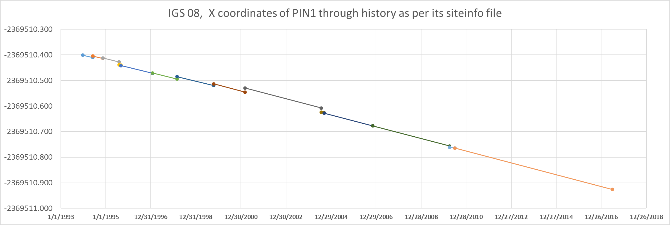
CORS Coordinates
CORS have complicated histories. This full history will be available on
CORS “datasheets” when the new NSRS database is up and running.

Slide 19
BSMK (North Dakota)

Slide 20
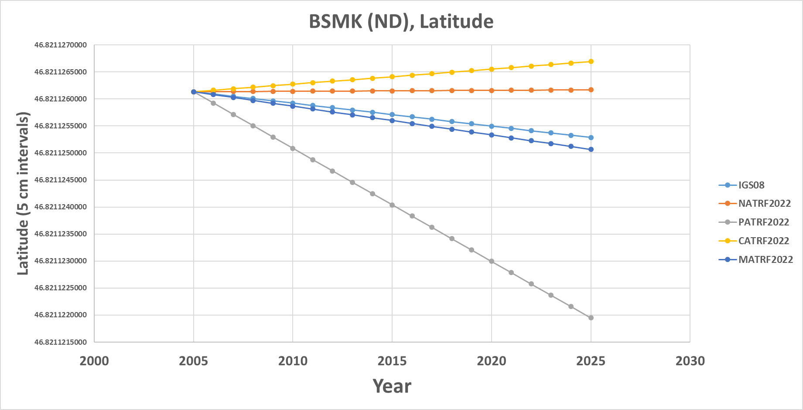
BSMK (North Dakota)

Slide 21
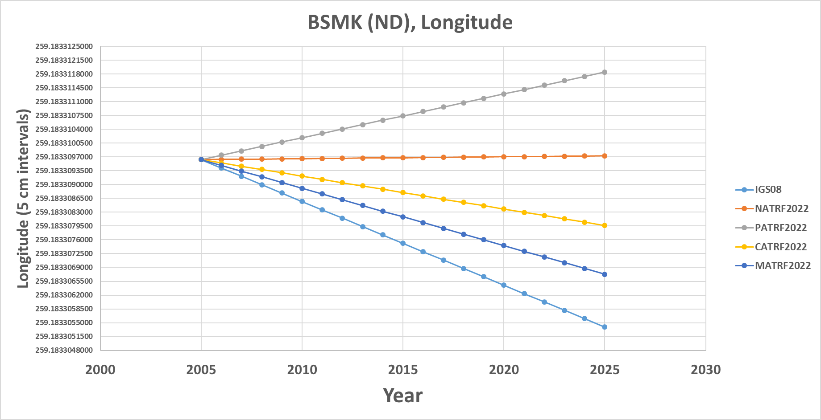
BSMK (North Dakota)

Slide 22
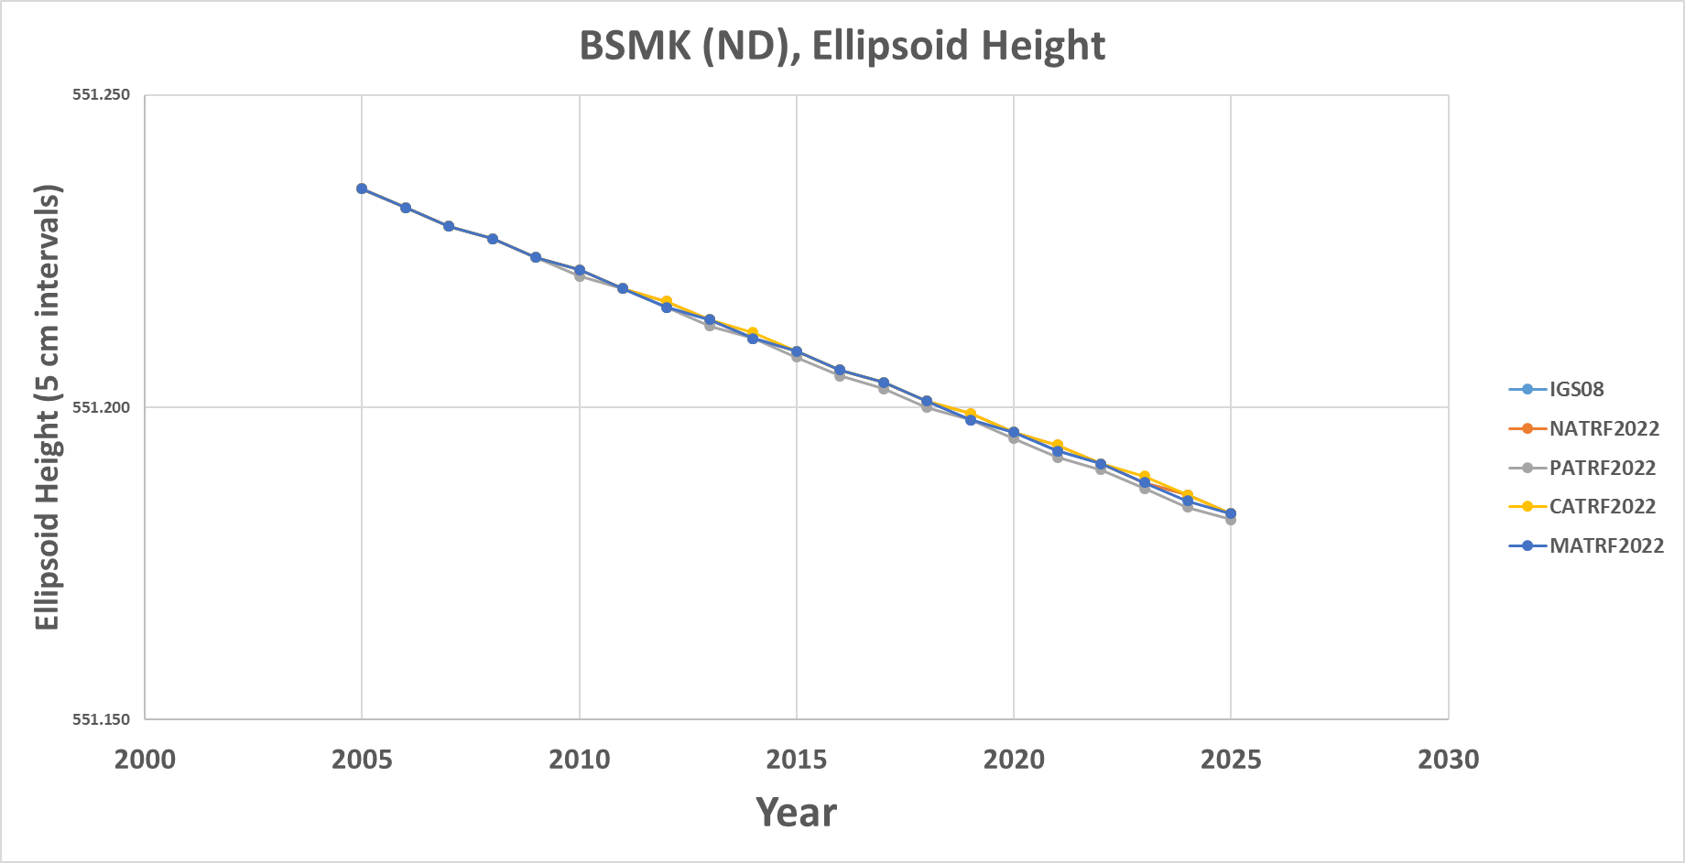
BSMK (North Dakota)

Slide 23
PIN1 (S. California)

Slide 24
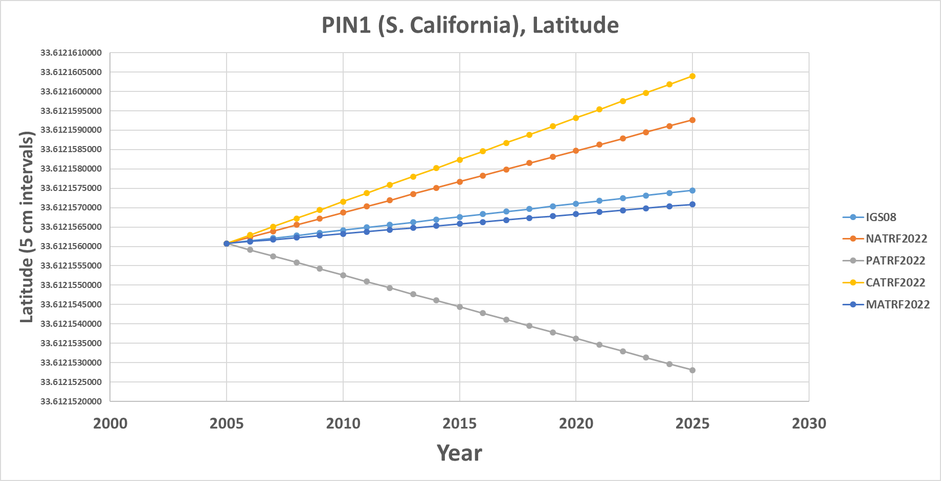
PIN1 (S. California)

Slide 25
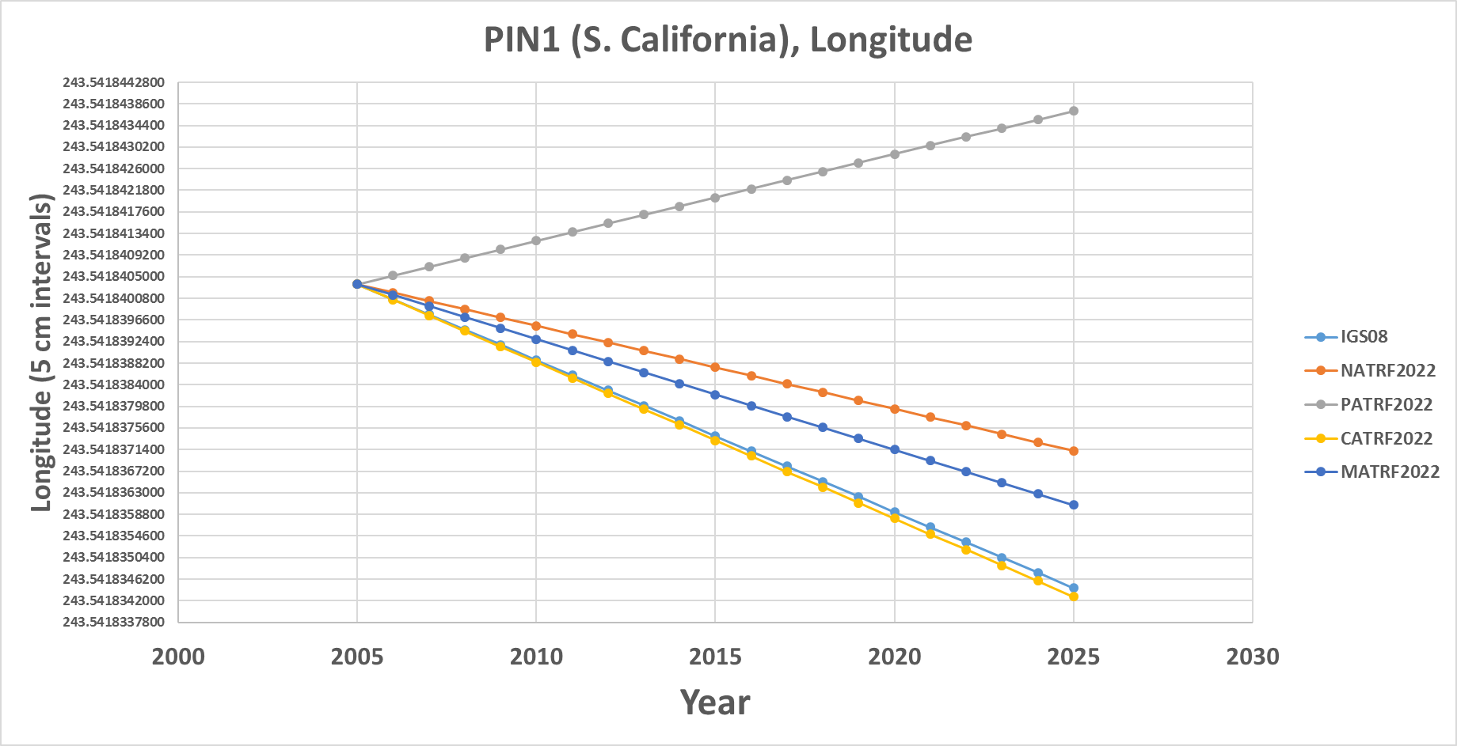
PIN1 (S. California)

Slide 26
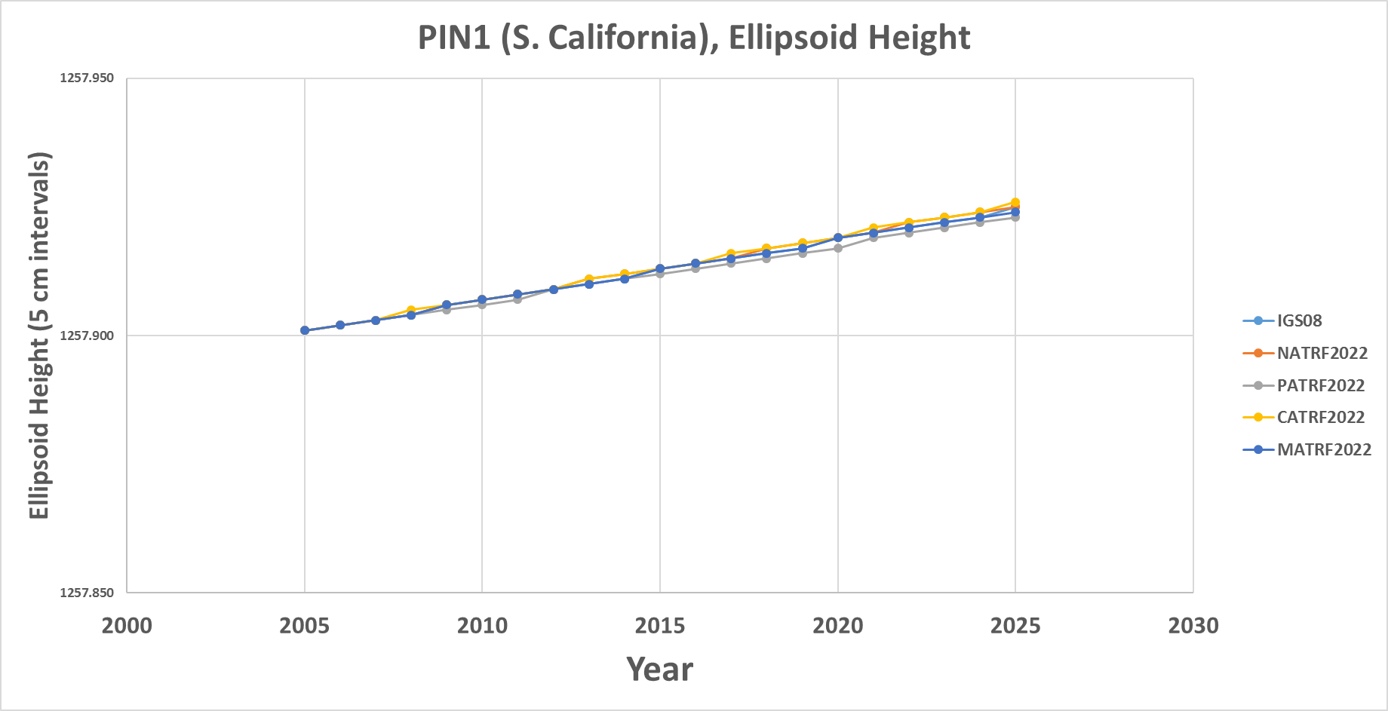
PIN1 (S. California)

Slide 27
Additional examples will be presented at the end if time allows

Slide 28
Content: Intra-Frame Velocity Models (IFVMs)
Why “Intra-Frame” and not “Intra-Plate”?
  Because each motion model will represent all velocities occurring inside one frame which are not due to the Euler Pole rotation of the plate for which the frame is named
  What???

Slide 29
Content: Intra-Frame Velocity Models (IFVMs)
Consider “NATRF2022”
  It will be a global reference frame
    (In practice it can be applied anywhere, since it is a simple 3 parameter transformation from the global IGS frame)
  It is named after the North American plate
  The IFVM for NATRF2022 will be a global velocity model
    (Though, in practice, it will likely only have data in USA territories)
  It will reflect all motions on all points (globally) which are not due to the Euler Pole Rotation of the North American plate. Thus:
    All vertical motions, anywhere
    All horizontal motions not due to NA Euler Pole rotation
      Such as the small motion of points in Kansas relative to the stable North American plate
      Such as the horizontal manifestation of GIA relative to the stable North American plate
      Such as the motion of Hawaii points relative to the stable North American plate
      Such as the motion of S. California points relative to the stable North American plate

Slide 30
So…4 IFVMs?
Yes. An IFVM for each frame.
But here’s the trick: The same exact data will go into creating all 4 of them.
  It’s just that each one will be relative to the Euler Pole rotation of a particular plate.

Slide 31
Absolute motion
Thus the absolute motion of a point (within the IGS frame) in Kansas can be represented identically by:
  The EP rotation of the NA plate + the NA IFVM
  The EP rotation of the PA plate + the PA IFVM
  The EP rotation of the CA plate + the CA IFVM
  The EP rotation of the MA plate + the MA IFVM
Etc ad nauseum
  As the old saying goes, there are two kinds of people in this world:
    Those who can extrapolate from incomplete data

Slide 32
IFVM – How?
Intra-Frame Velocity Models must:
  Estimate non-Eulerian motions at any location
Three primary methods being investigated
  Interpolation from CORS
    Pro: Easy
    Con: Gets worse as CORS gets coarse
  Satellite IfSAR
    Pro: Covers vast areas
    Con: No IfSAR experts in NGS; data availability issues
  Geodynamic
    Pro: Like HTDP, so NGS has experience
    Con: Requires knowing why things move, rather than just measuring that they move (and requires “keeping up” with every event.)

Slide 33
Application to Passive Control

Slide 34
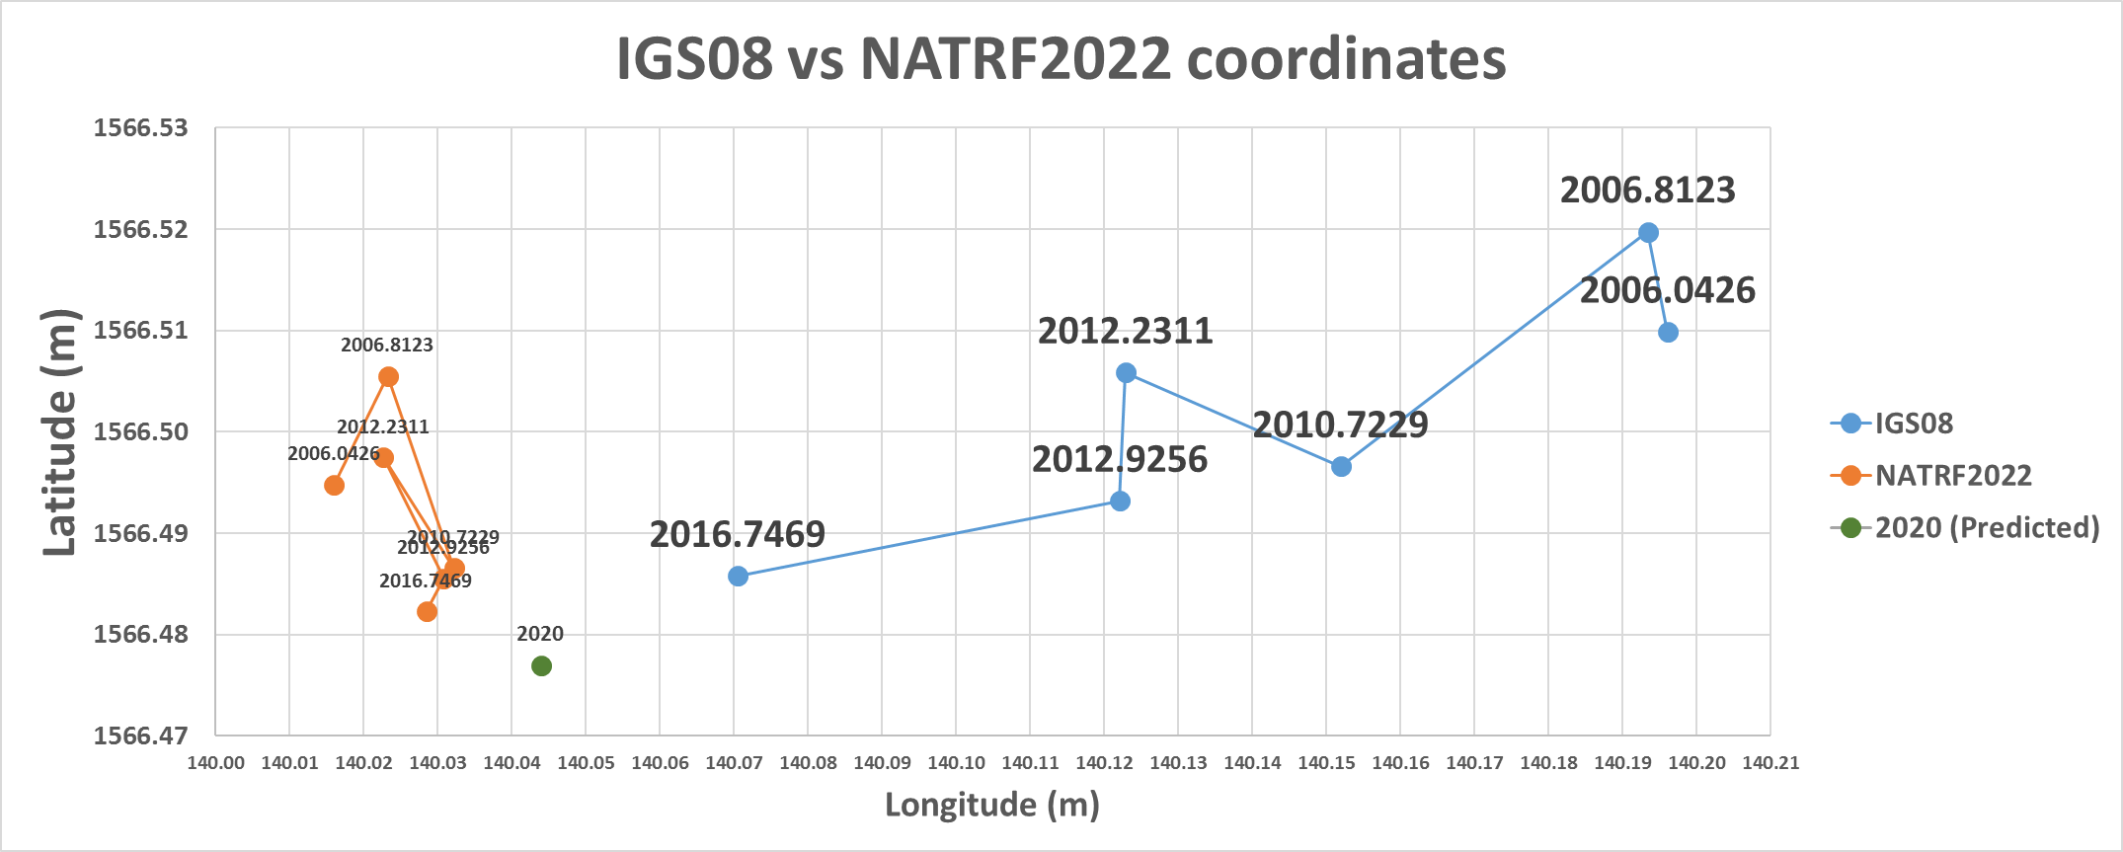
IGS08 vs NATRF2022
NATRF2022 coordinates will have the plate rotation removed, but still
exhibit their time-dependency, until
the Intra-frame velocity model is used to estimate a coordinate at some convenient reference epoch.
IGS08 coordinates are dominated by the primary motion associated with the North American Plate rotation, as manifest at this lat/lon:
12.9 mm/y West
1.1 mm/y South

Slide 35
Using the TRFs
Historically:
  Surveys at multiple epochs were “moved through time” using HTDP (skipping vertical in most cases) to adjust them all together at one common epoch
Future:
  Surveys will be adjusted to CORS at their own epoch and stand thus
  The IFVM will allow for comparisons across epochs, but will not “move surveys through time” to adjust things and get “one coordinate” on a point

Slide 36
Using the TRFs
User Supplied
GNSS Receiver File(t)
CORS data (t)
NGS Supplied
IAG Supplied
OPUS
Geodetic Control
High Accuracy
Fixed at true epoch
XYZ (t, IGS)
GRS-80
φλh (t, IGS)
4 Euler Poles, by plate:
NA, PA, CA, MA
Estimated cords
Medium Accuracy
Subject to updates
XYZ (t, NATRF2022)
XYZ (t, PATRF2022)
XYZ (t, CATRF2022)
XYZ (t, MATRF2022)
4 Intra-Frame Velocity Models, by frame:
NA, PA, CA, MA
Latest estimate of:
φλh (t0, NATRF2022)
φλh (t0, PATRF2022)
φλh (t0, CATRF2022)
φλh (t0, MATRF2022)
GRS-80
φλh (t, NATRF2022)
φλh (t, PATRF2022)
φλh (t, CATRF2022)
φλh (t, MATRF2022)
Most recent past reference epoch “t0”
Blueprint for 2022, Part 1: Geometric Coordinates

Slide 37
Using the TRFs
Further details on this change in the use of the reference frames will come in 2018
Blueprint for 2022, Part 3: Re-inventing Bluebooking

Slide 38
Thank you!

Slide 39
Questions?

Slide 40
Extra Slides

Slide 41
PRMI (Puerto Rico)

Slide 42
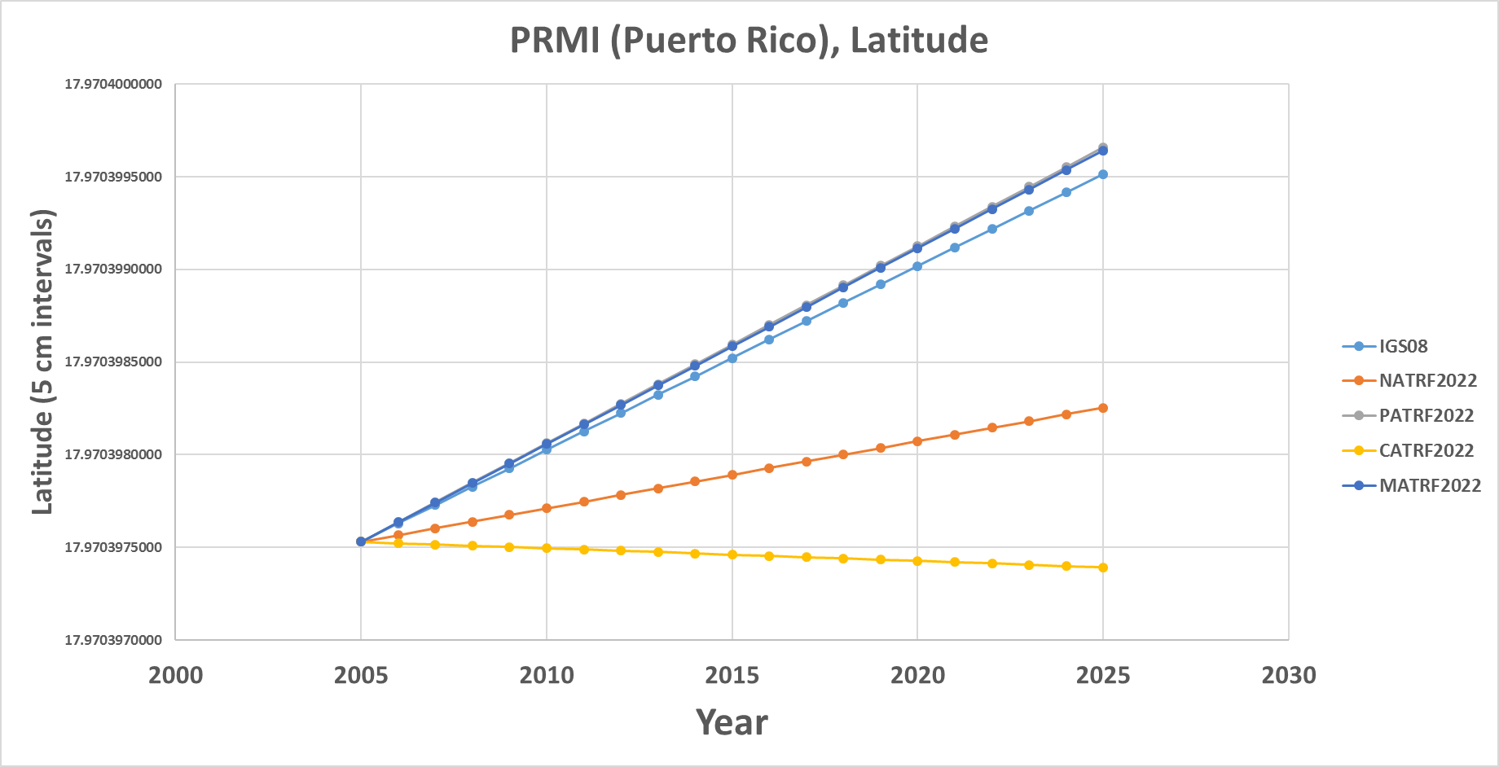
PRMI (Puerto Rico)

Slide 43
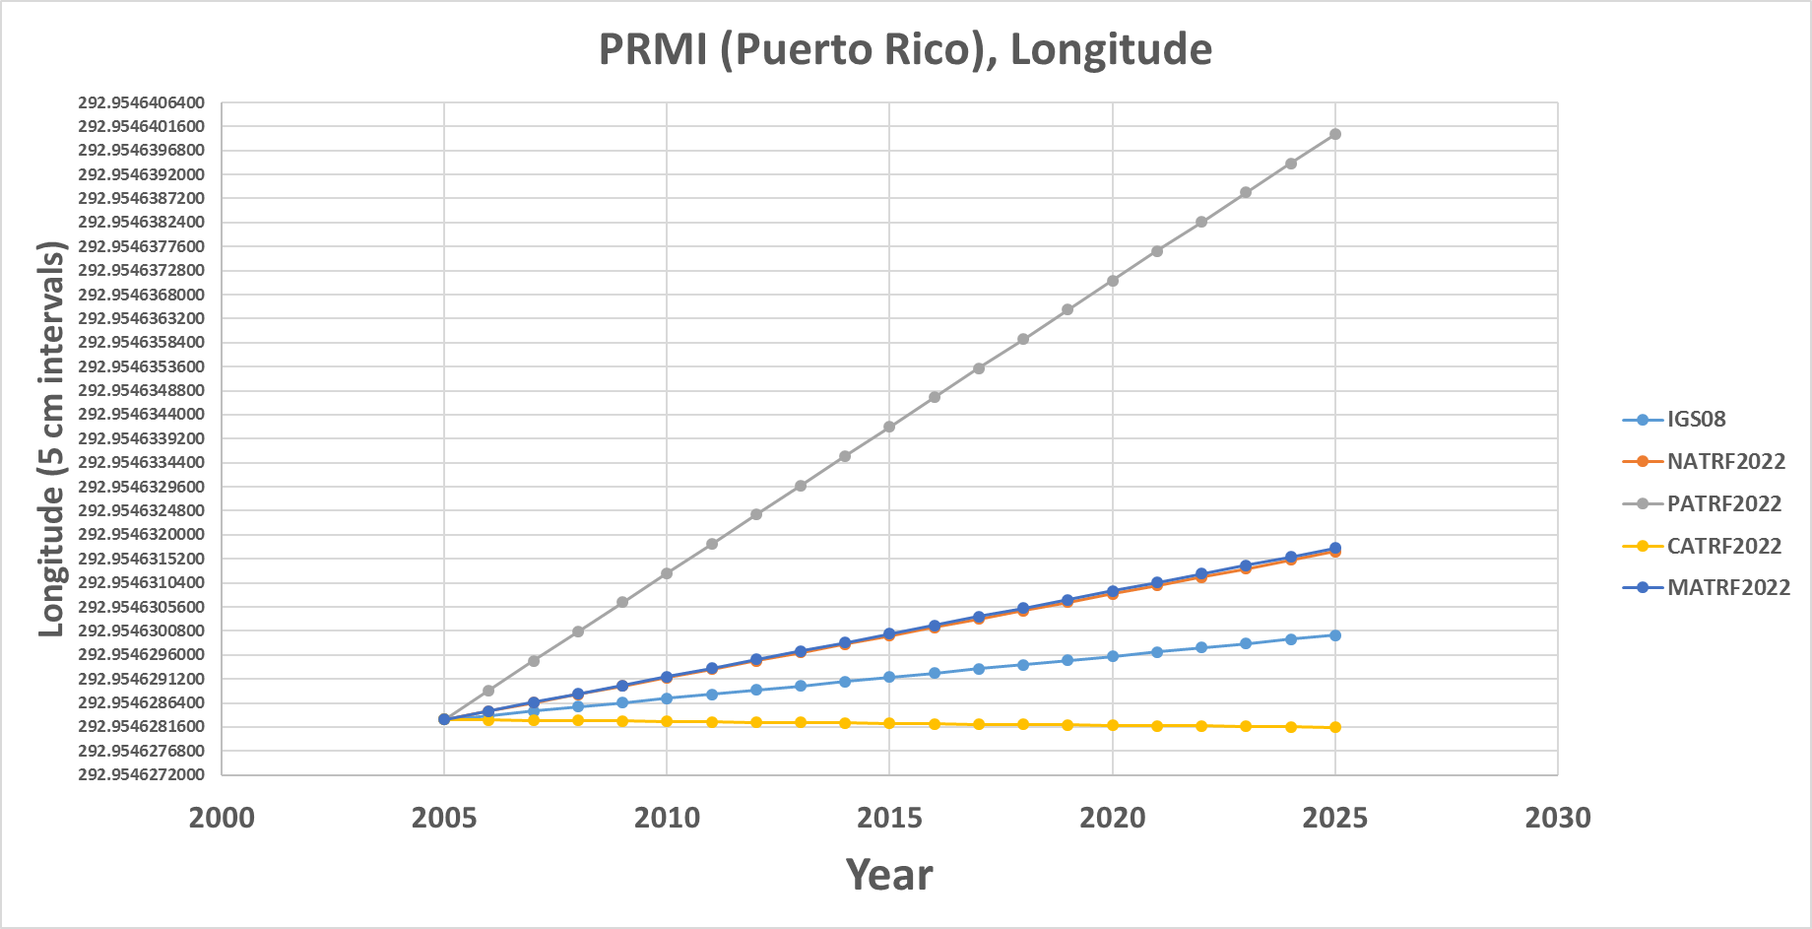
PRMI (Puerto Rico)

Slide 44
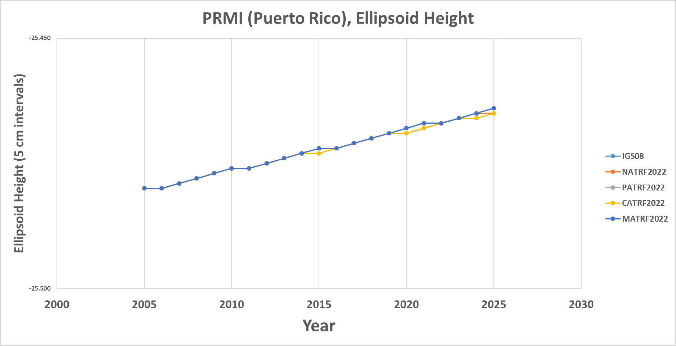
PRMI (Puerto Rico)

Slide 45
BRW1 (N. Alaska)

Slide 46
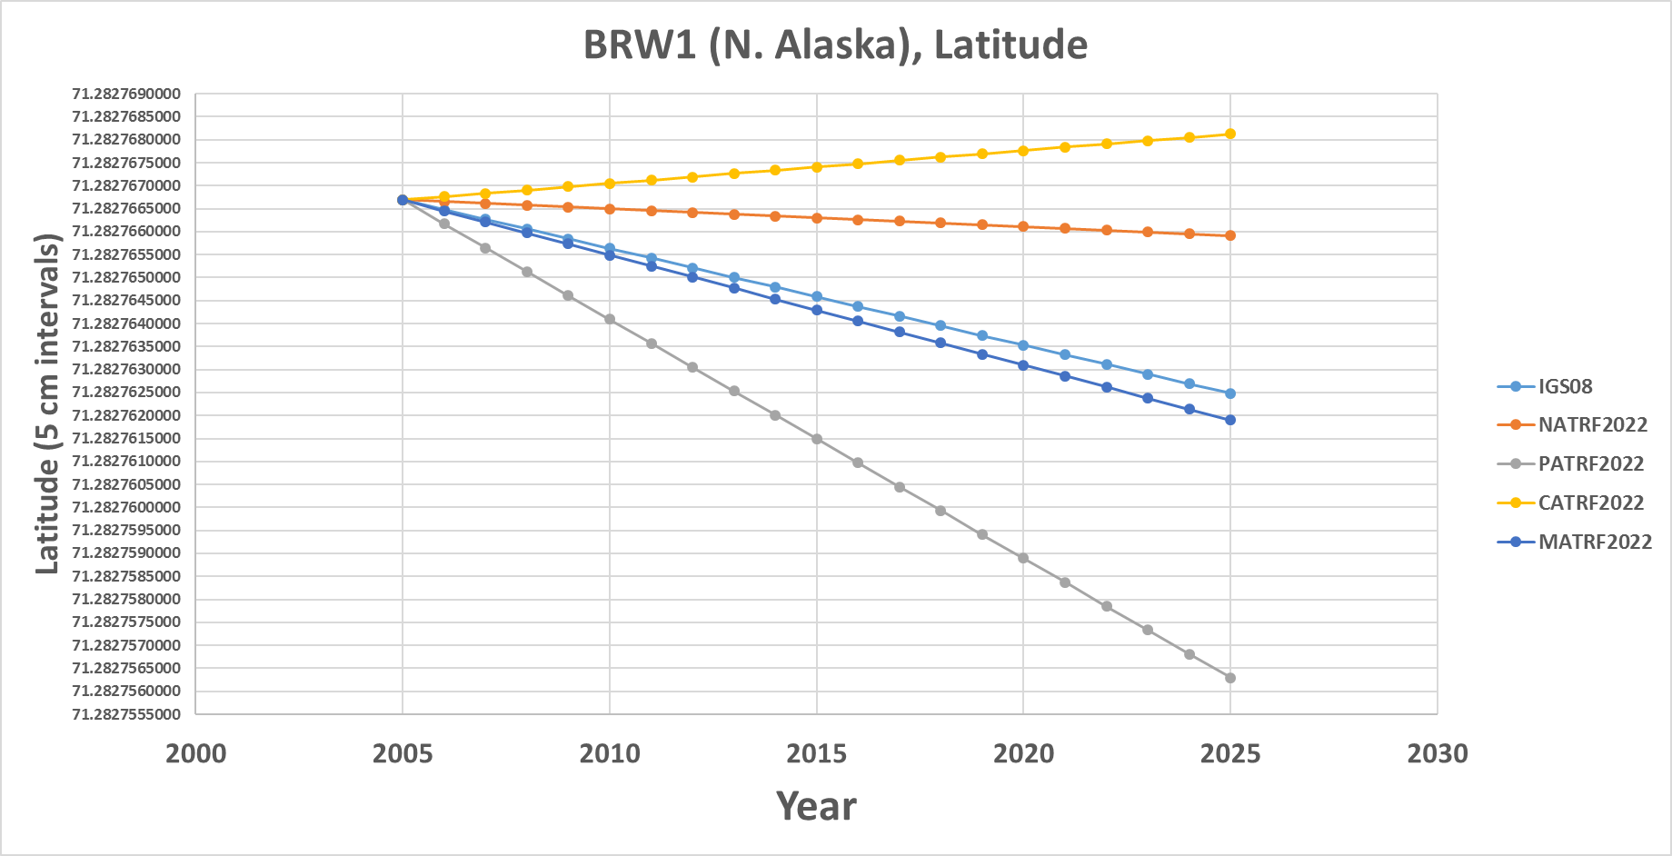
BRW1 (N. Alaska)

Slide 47
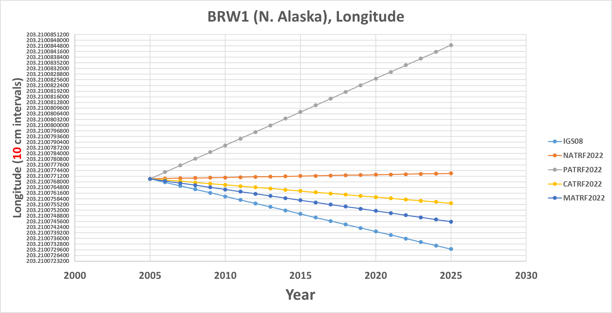
BRW1 (N. Alaska)

Slide 48
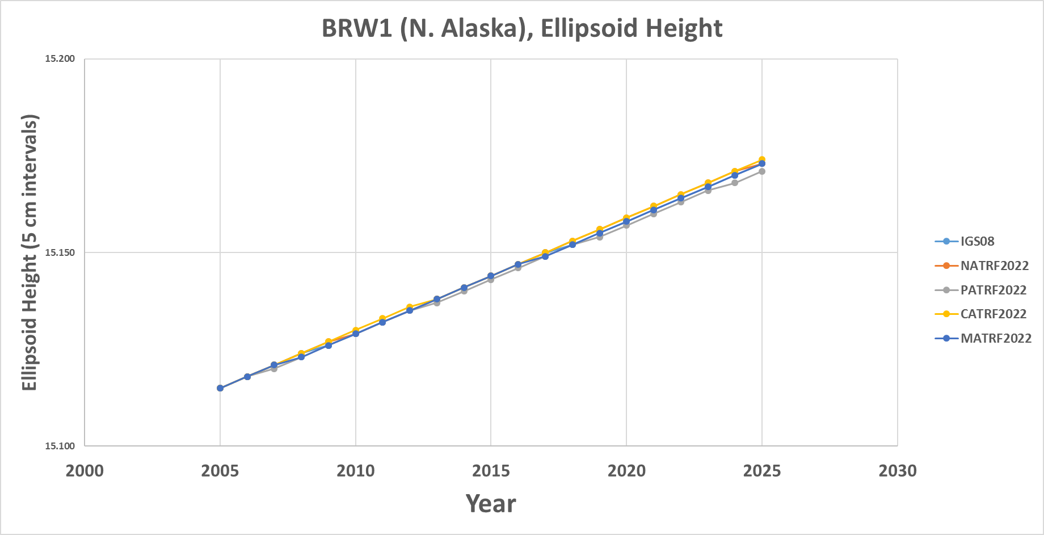
BRW1 (N. Alaska)

Slide 49
KOD6 (S. Alaska)

Slide 50
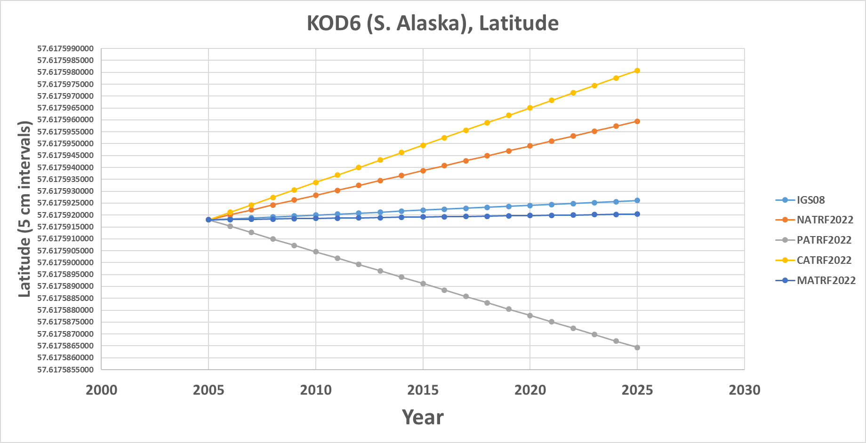
KOD6 (S. Alaska)

Slide 51
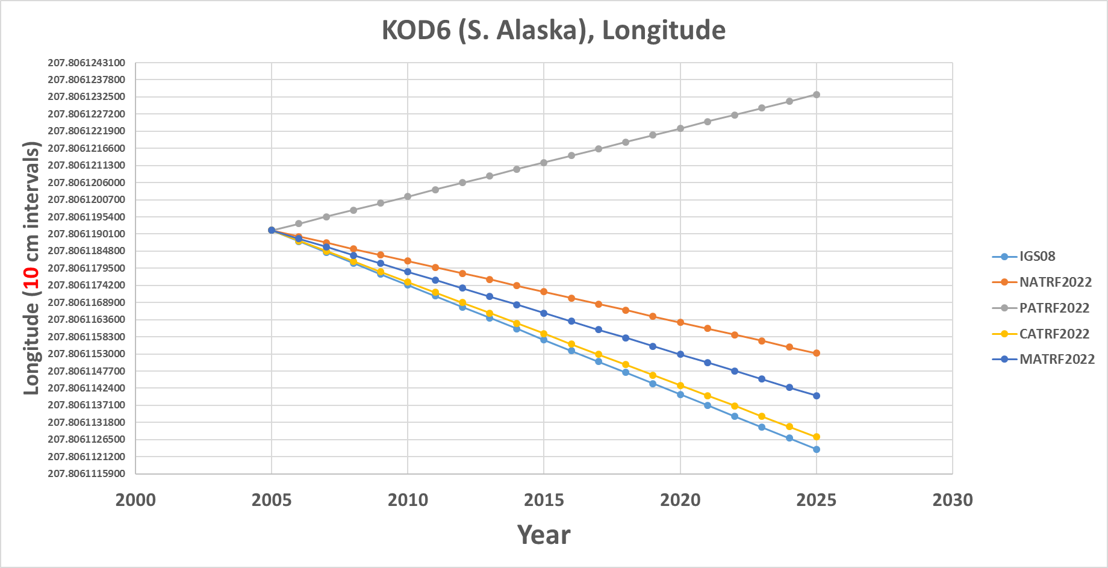
KOD6 (S. Alaska)

Slide 52
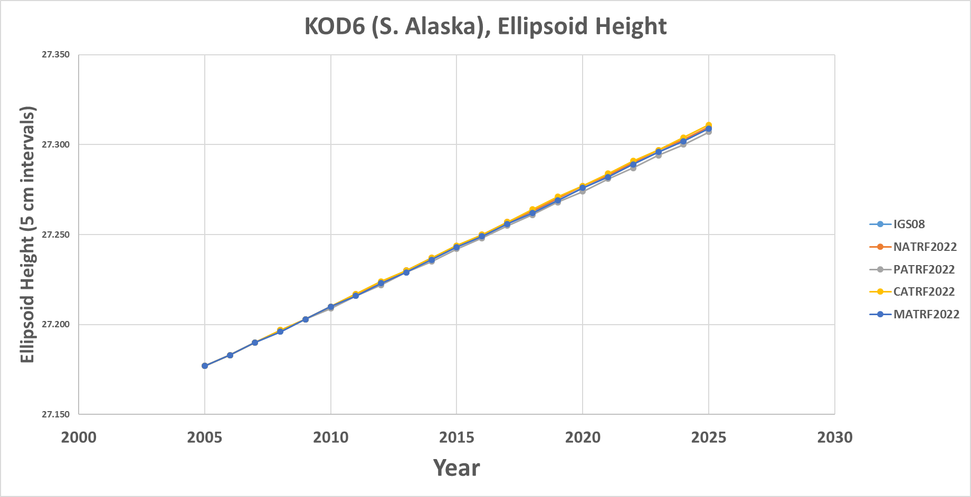
KOD6 (S. Alaska)

Slide 53
KOK5 (Hawaii)

Slide 54
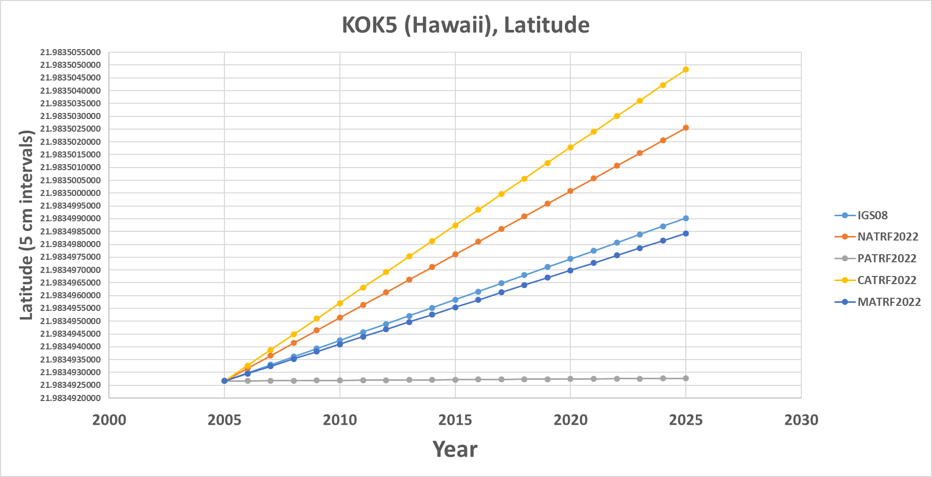
KOK5 (Hawaii)

Slide 55
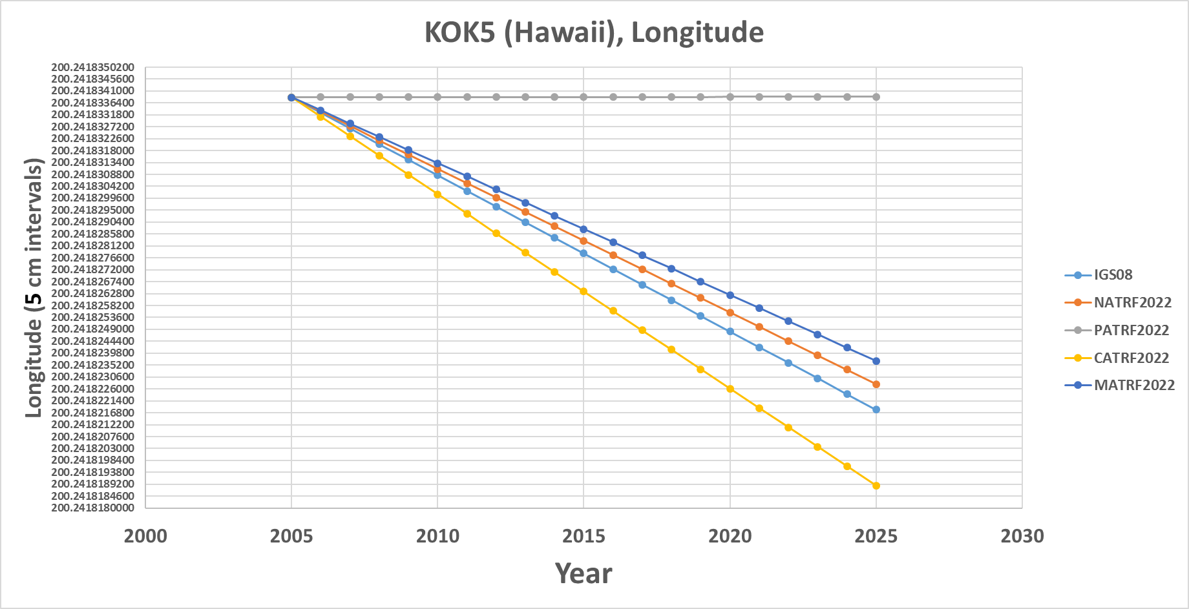
KOK5 (Hawaii)

Slide 56
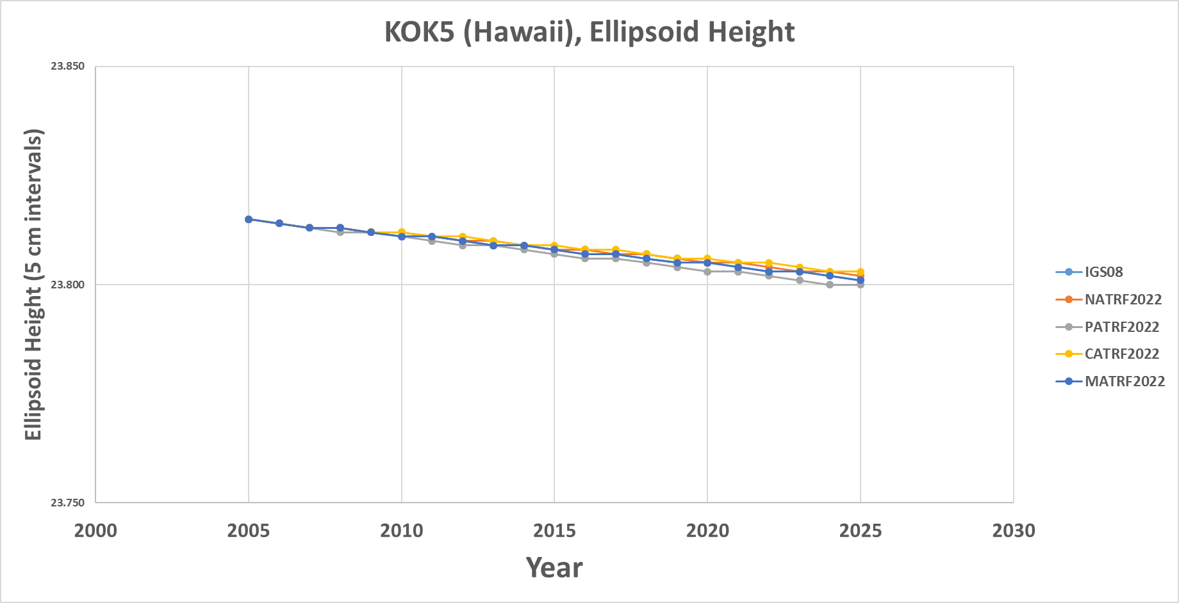
KOK5 (Hawaii)

Slide 57
ASPA (Am. Samoa)

Slide 58
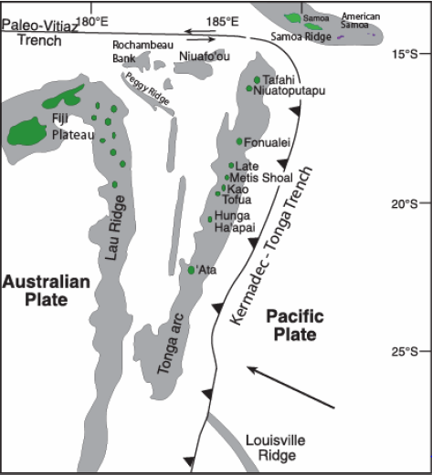
ASPA (Am. Samoa)

Slide 59
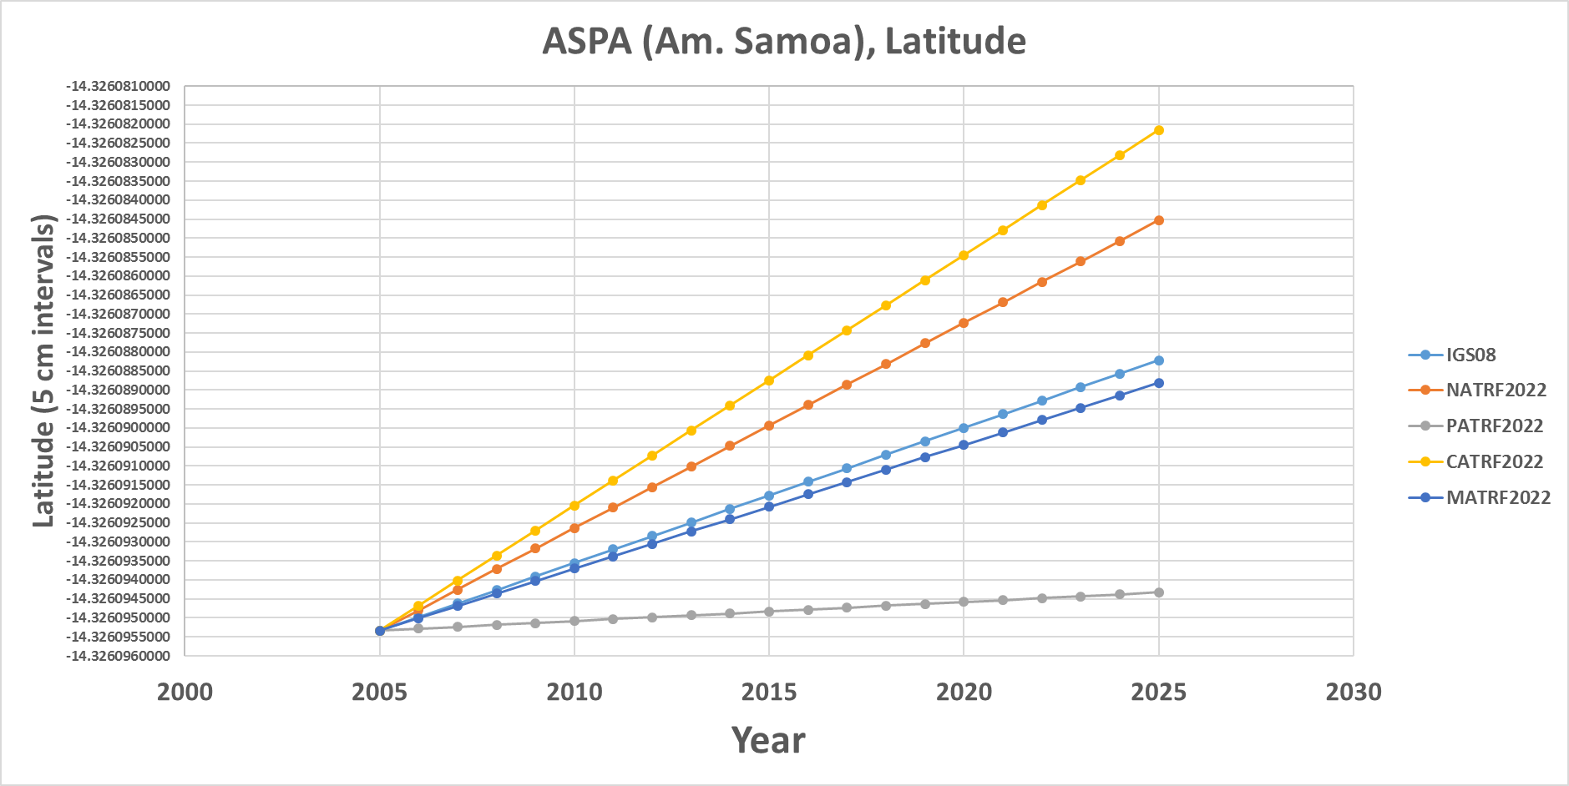
ASPA (Am. Samoa)

Slide 60
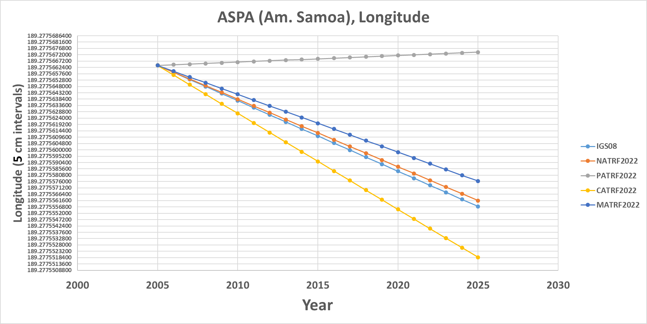
ASPA (Am. Samoa)

Slide 61
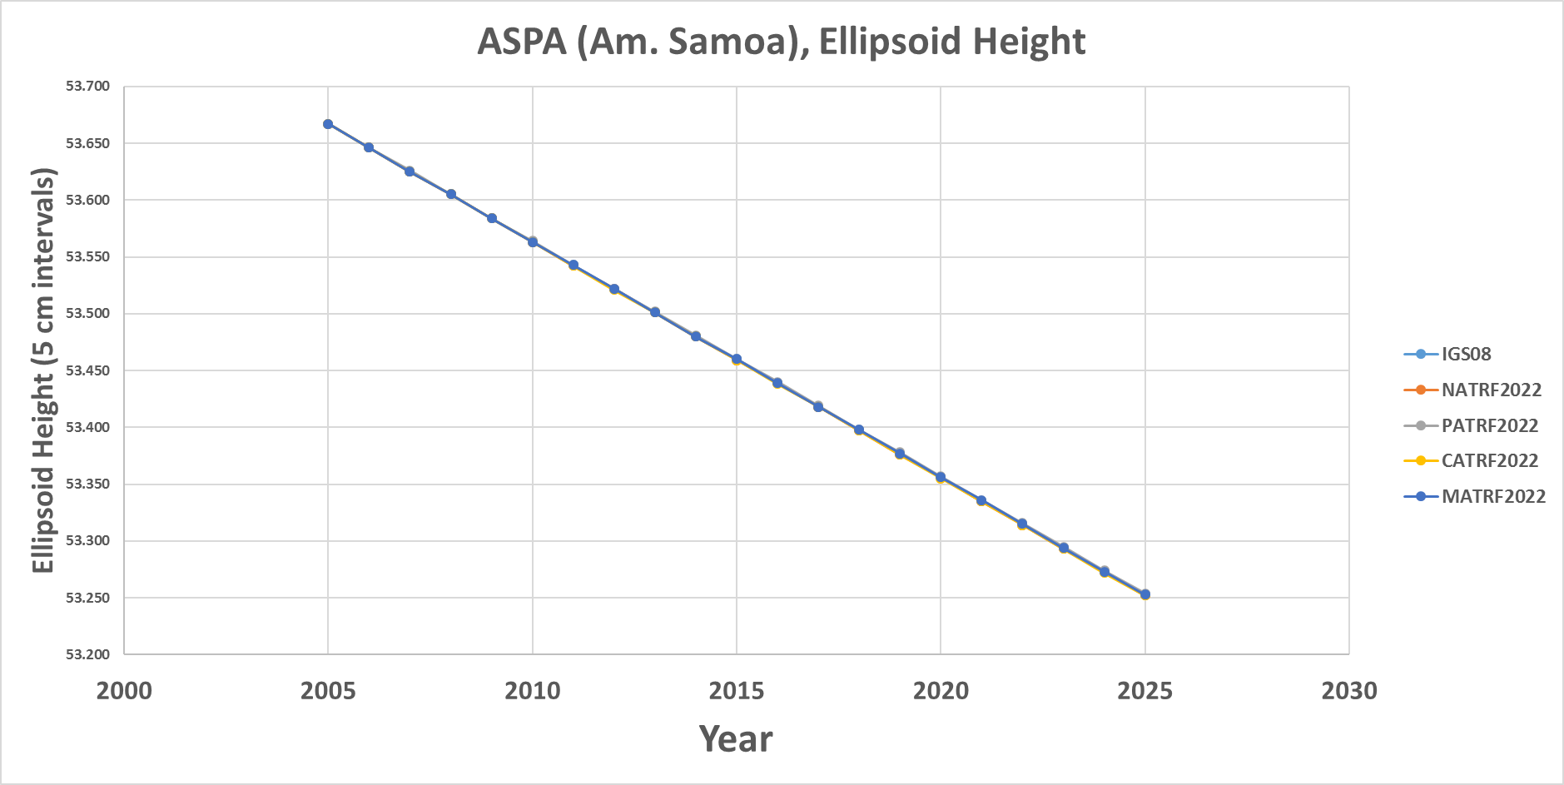
ASPA (Am. Samoa)

Slide 62
Mariana rotation
Snay (2003) used only one CORS (“GUAM”) to determine the Mariana rotation
  But 2 sites at a minimum are needed to uniquely determine a plate’s rotation
    “CNMI” (since decommissioned) was forced to equal “GUAM” to solve the problem
    Ill-posed, yet the values behave reasonably for GUAM.
    Less reasonable for newer CORS “CNMR”

Slide 63
GUAM (Guam)

Slide 64
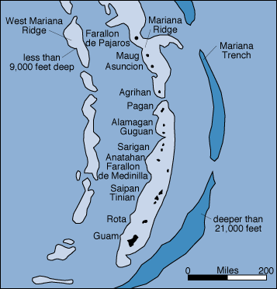
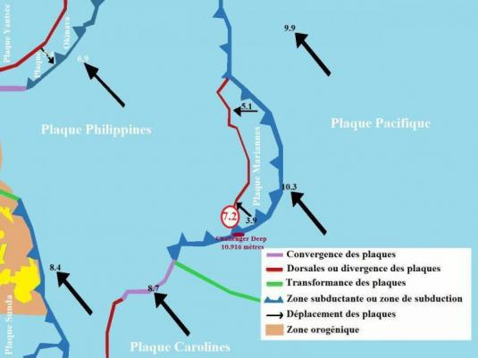
GUAM (Guam)

Slide 65
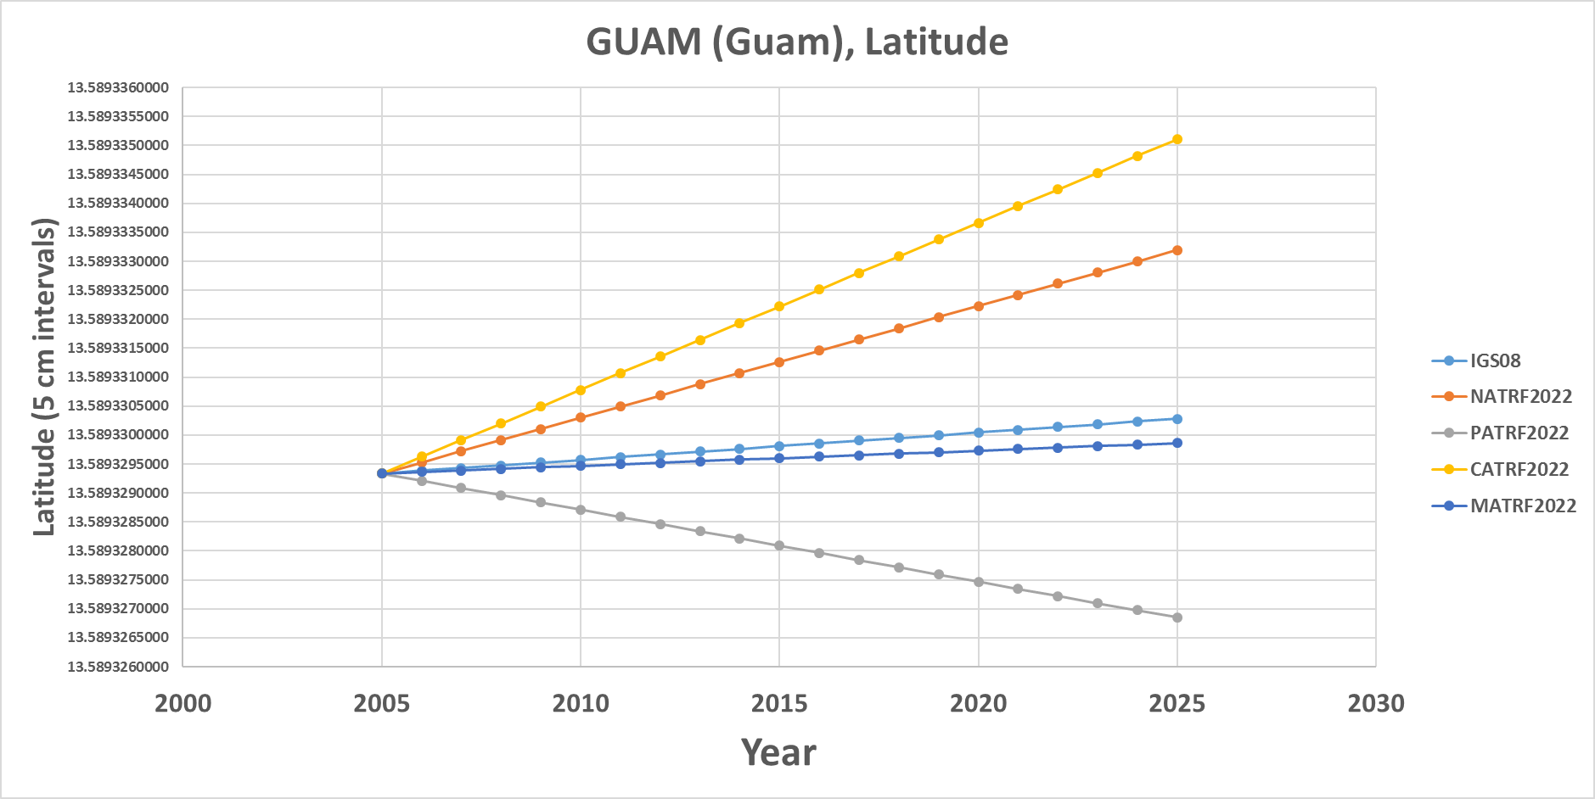
GUAM (Guam)

Slide 66
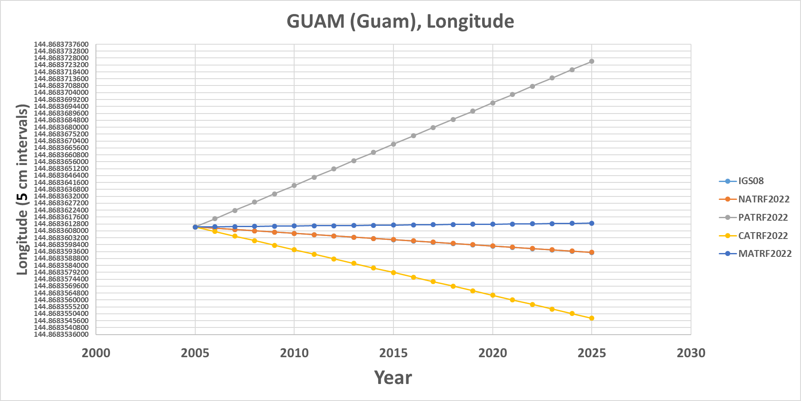
GUAM (Guam)

Slide 67
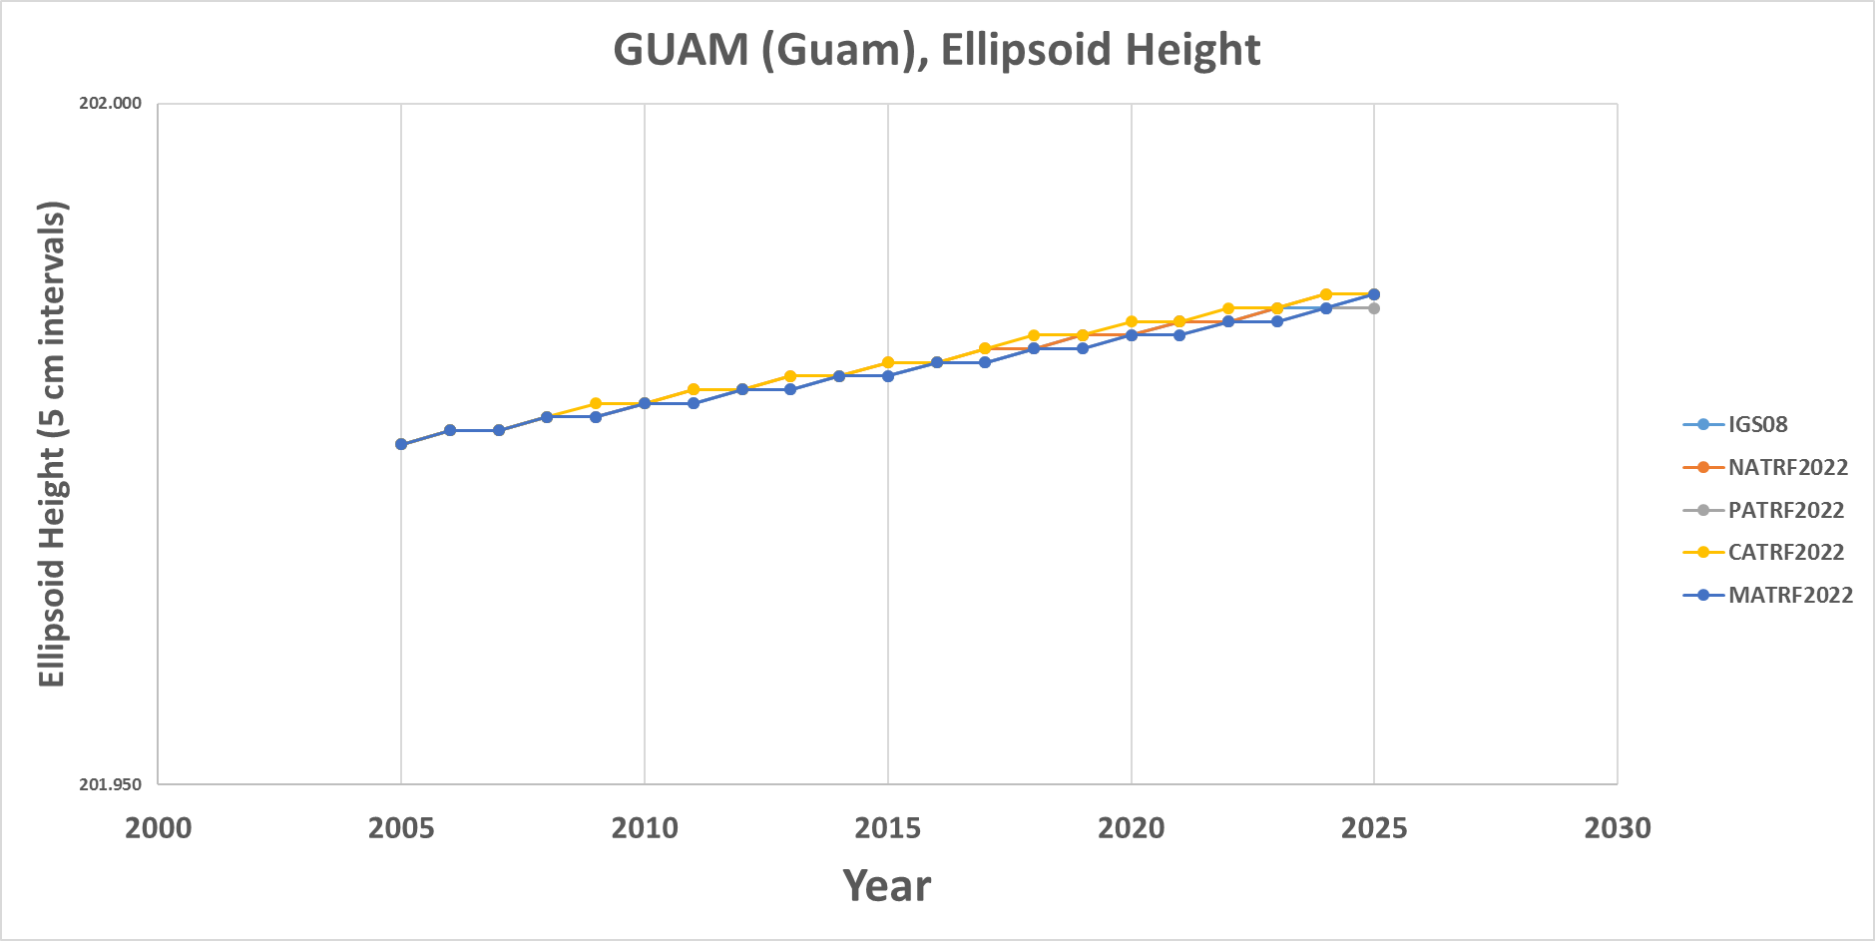
GUAM (Guam)

Slide 68
CNMR (CNMI)

Slide 69
CNMR (CNMI)

Slide 70
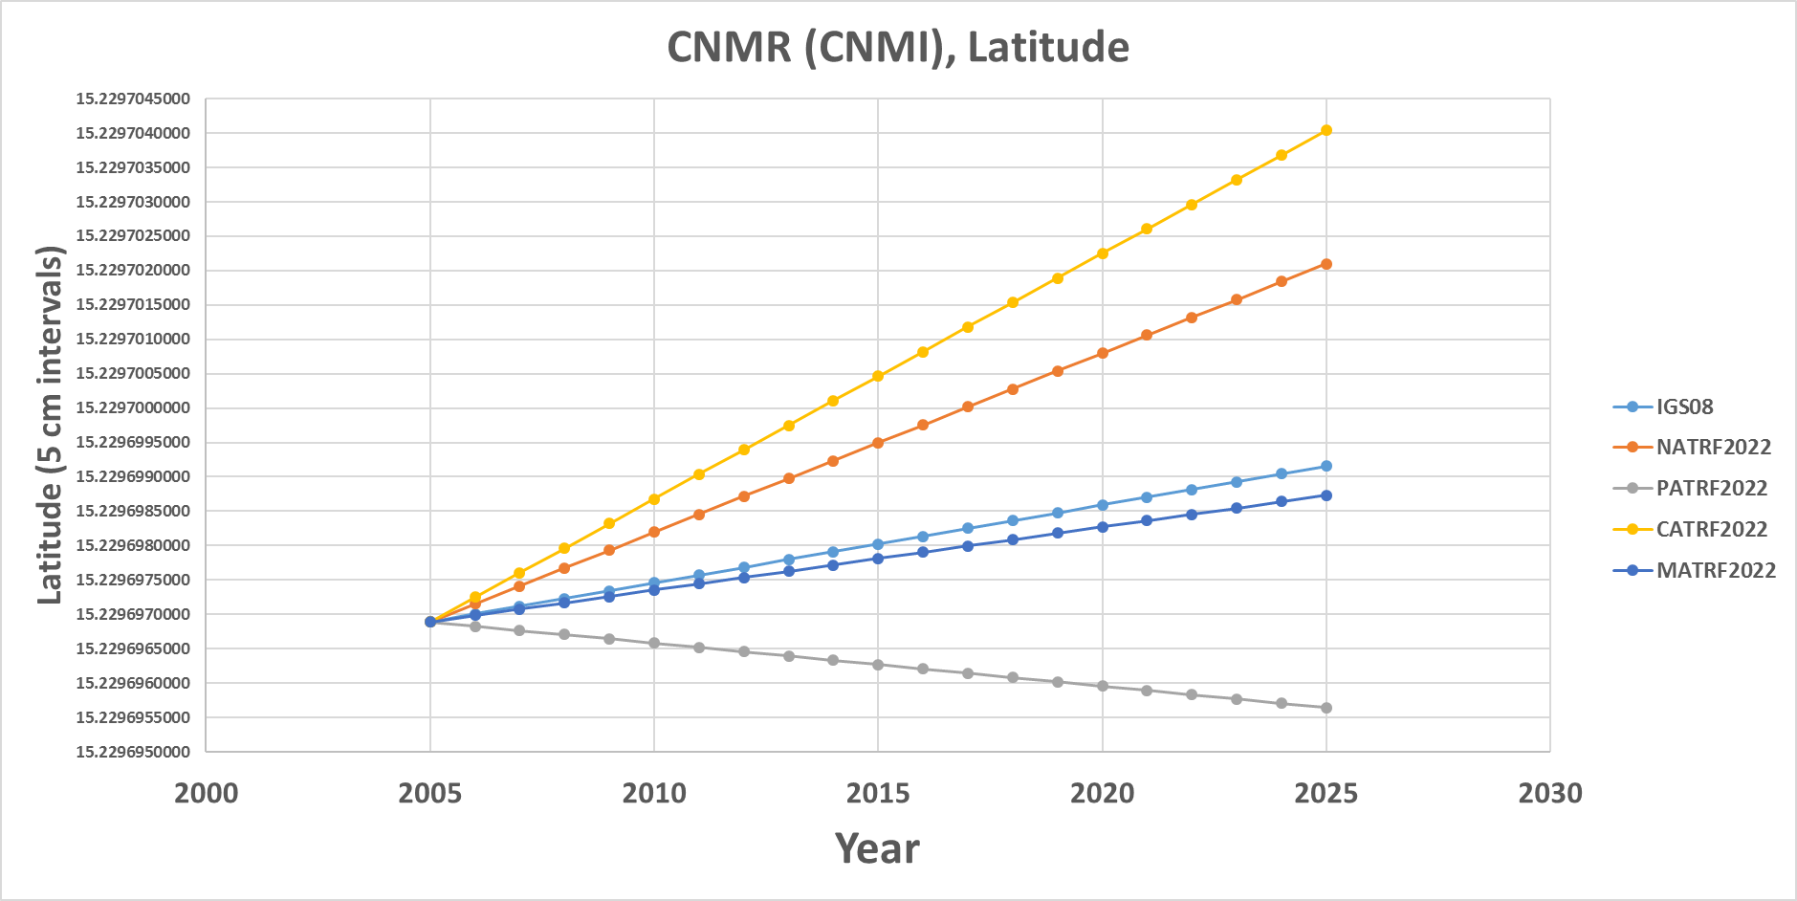
CNMR (CNMI)

Slide 71
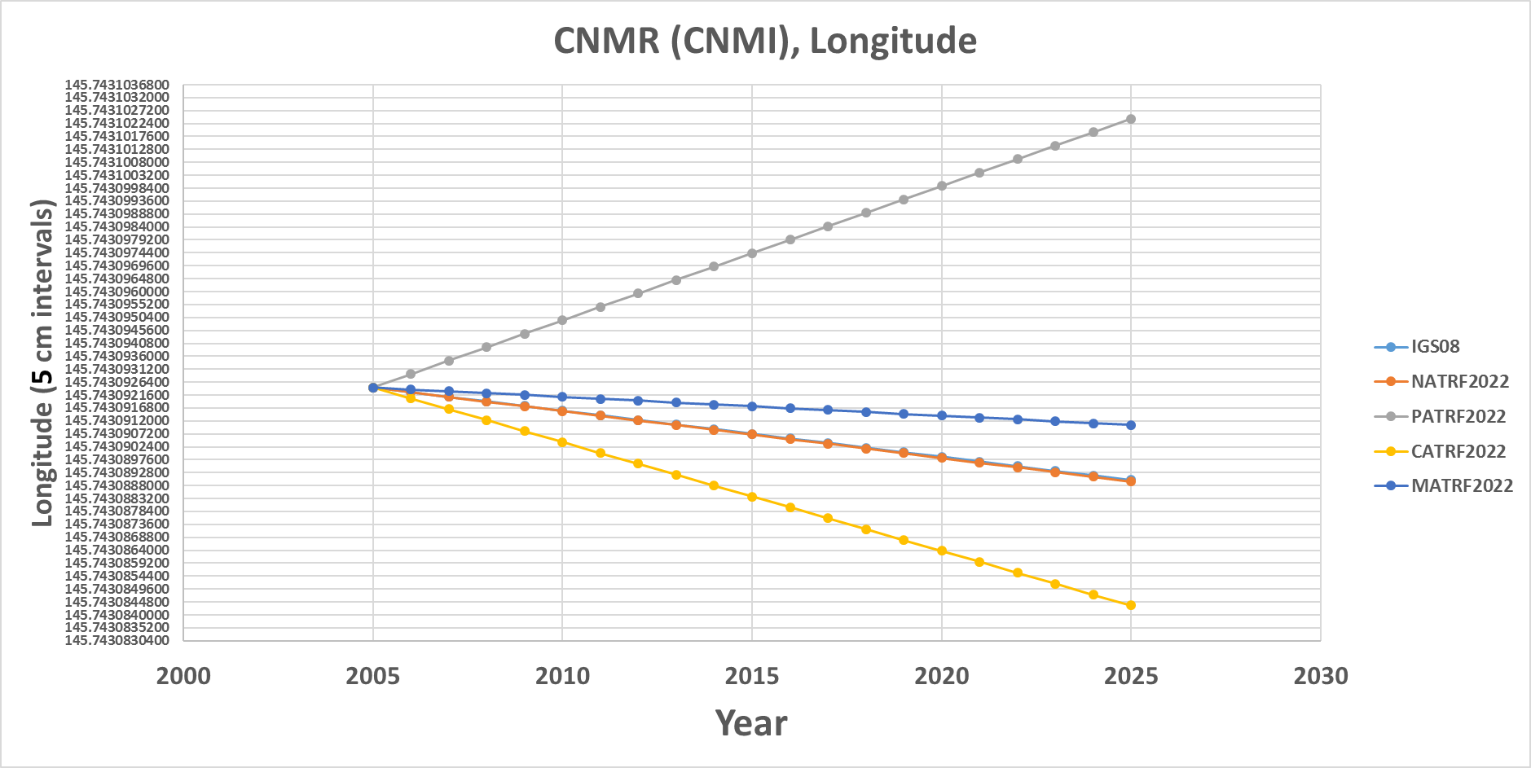
CNMR (CNMI)

Slide 72
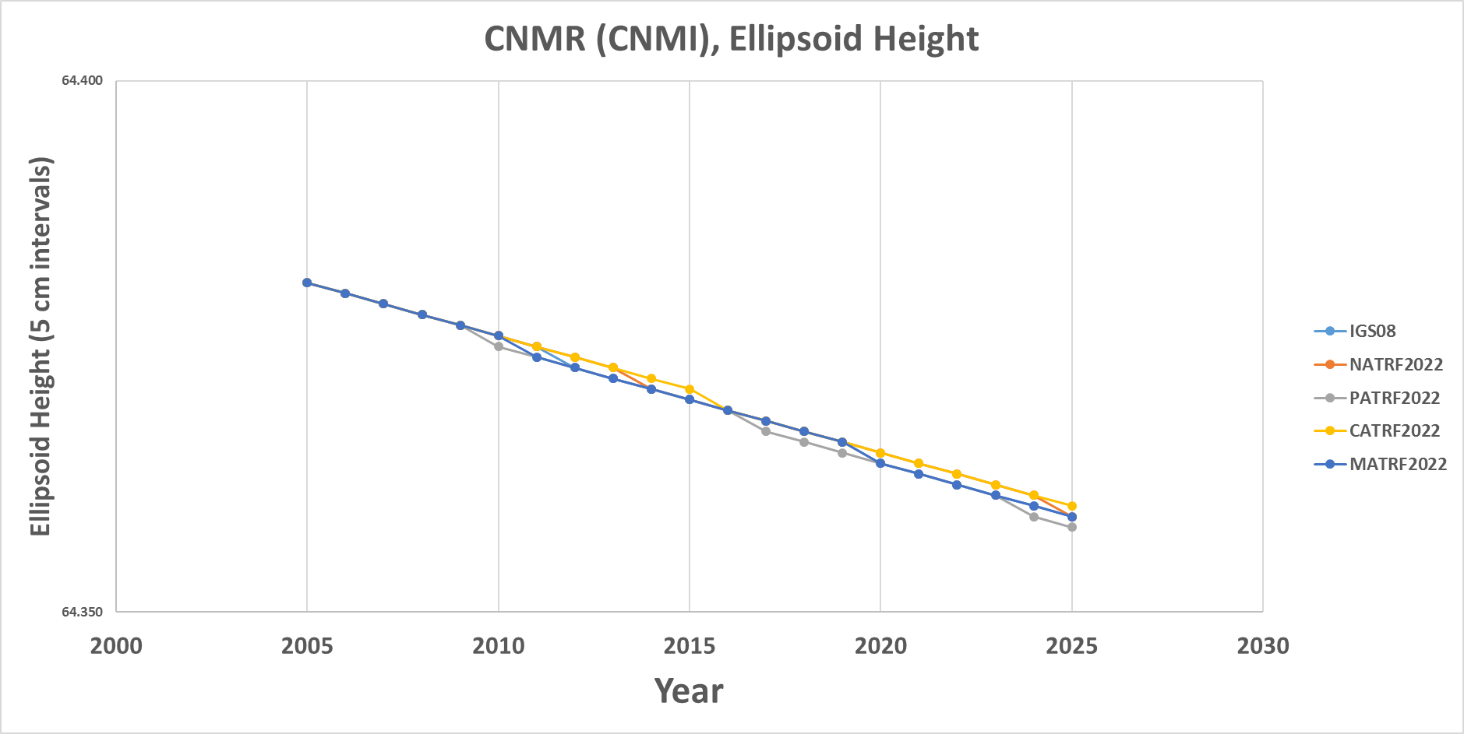
CNMR (CNMI)

