Slide 1

Modernizing the National Spatial Reference System
Dru Smith
NSRS Modernization Manager
NOAA’s National Geodetic Survey

Slide 2
NGS Ten Year Plan 2013-2023
Goal 2: Modernize and Improve the National Spatial Reference System.
Objective 1: Replace NAD 83
Objective 2: Replace NAVD 88
Objective 3: Re-invent Bluebooking
Objective 4: Fix the Toolkit
Objective 5: Better Surveying
Notes:
Potential outline and speaker assignments; can be adjusted as needed.

Slide 3
What will be replaced in 2022
What’s being replaced:
Horizontal Vertical
  NAD 83(2011)
  NAD 83(PA11)
  NAD 83(MA11)
  NAVD 88
  PRVD 02
  VIVD09
  ASVD02
  NMVD03
  GUVD04
  IGLD 85
Heights
Latitude
Longitude
Ellipsoid Height
State Plane Coordinates

Slide 4
Replacing the NAD 83’s
Three plate-(pseudo)fixed frames will be replaced with four plate-fixed reference frames
  N. Amer., Pacific, Mariana, Caribbean(new!)
Remove long-standing non-geocentricity of NAD 83 frames
All four : identical to IGSxx at a TBD epoch
  2020.00?
All four : differ from IGSxx by plate rotation only
  Updated Euler Pole determination for rigid plate only

Slide 5
NAD 83’s non-geocentricity
Earth’s Surface
h_{NAD83}
φ_{NAD83} – φ_{IGSxx}
λ_{NAD83} – λ_{IGSxx}
h_{NAD83} – h_{IGSxx}
all vary
smoothly by latitude
and longitude
h_{IGSxx}
IGSxx origin
same
GRS-80
ellipsoid
~2.2 m
NAD 83 origin

Slide 6
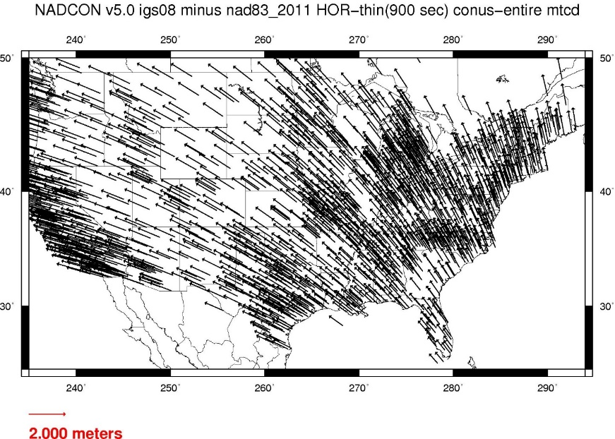
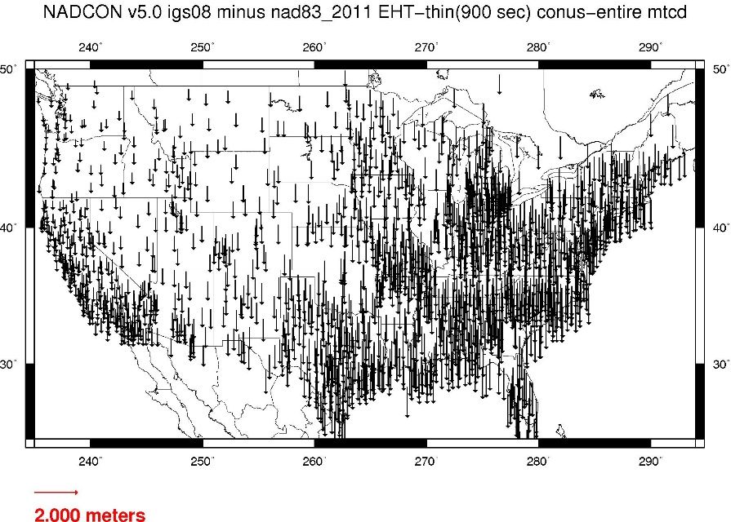
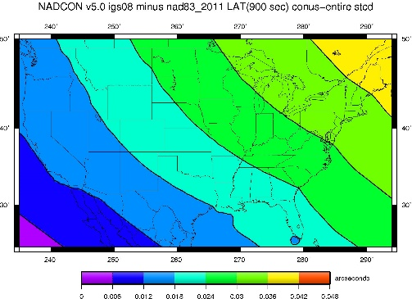
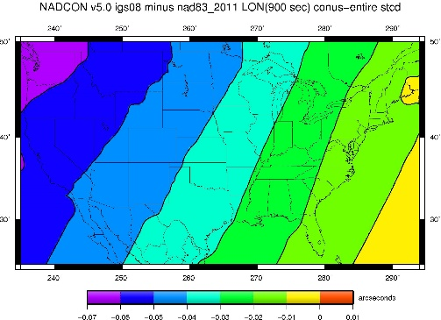
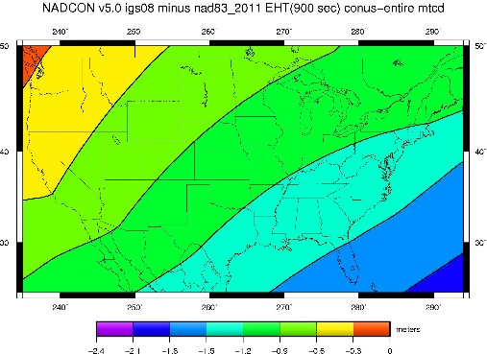
Fixed-Epoch Transformation
NAD 83 to “2022”

Slide 7
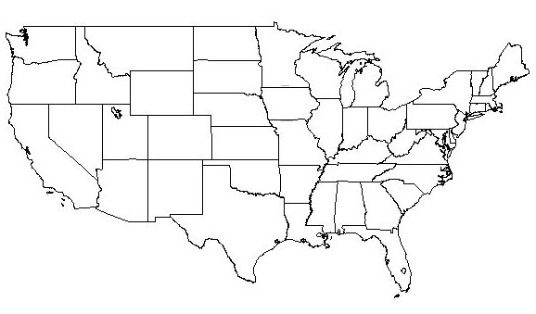
Frame is rigid and fixed to rigid part of plate
Non-rigid
(deformation)
area

Slide 8
Coordinates over time
Point on rigid part of plate
Point on deforming part of plate
λ
λ
t
t

Slide 9
Coordinates over time
Point on rigid part of plate
Point on deforming part of plate
λ
λ
t
t

Slide 10
Coordinates over time
Point on rigid part of plate
Point on deforming part of plate
λ
λ
t
t

Slide 11
Coordinates over time
Point on rigid part of plate
Point on deforming part of plate
λ
λ
t
t

Slide 12
Replacing NAVD 88 (et al)

Slide 13
Why isn’t NAVD 88 good
enough anymore?
Earth’s
Surface
H (NAVD 88)
H
NAVD 88 reference level
The Geoid
Errors in NAVD 88 : ~50 cm average,
100 cm CONUS tilt,
1-2 meters average in Alaska
NO tracking
Notes:
This slide shows what NGS now knows about the error in NAVD 88 itself. Using a continental geoid computed from the GRACE satellite, a bias and tilt in NAVD 88 has been computed using GPS derived ellipsoid heights on NAVD 88 bench marks. These are now known errors that exist in all NAVD 88 bench marks. This datum realization error, relative to the geoid, is over and above the errors from marks moving.

Slide 14
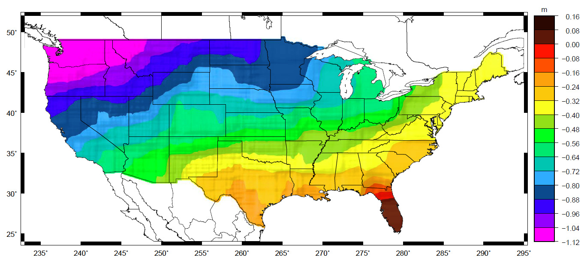
Why isn’t NAVD 88 good
enough anymore?
Approximate level of geoid mismatch known to exist in the NAVD 88 zero surface:
Notes:
This map reflects the sort of height changes that users could expect if NAVD 88 were replaced with a geoid-based vertical datum.
This is only a large scale approximation and should not be used as an absolute guide. Each benchmark might have its own level
Of mismatch, say from uplift or subsidence, not captured by this broad brush.
Also, this is the difference between the zero level of NAVD 88 and the actual geoid. The difference between NAD 83 ellipsoid heights and
ITRF/GRS-80 ellipsoid heights has NO influence on this graph and should not be part of the story.
Updated October 2010

Slide 15
Replacing NAVD 88 (et al)
Replacing leveling based datums with a gravimetric geoid model
  NAVD 88 (orthometric heights) and IGLD 85 (dynamic heights) are co-defined based on the same leveling-based geopotential numbers
Based on an improved gravity field model from airborne surveys (GRAV-D)
Foundation: New SHM of geopotential
  Spin off geoid, DoV, gravity, etc information to GNSS receiver surveys
Geoid will be time-dependent

Slide 16
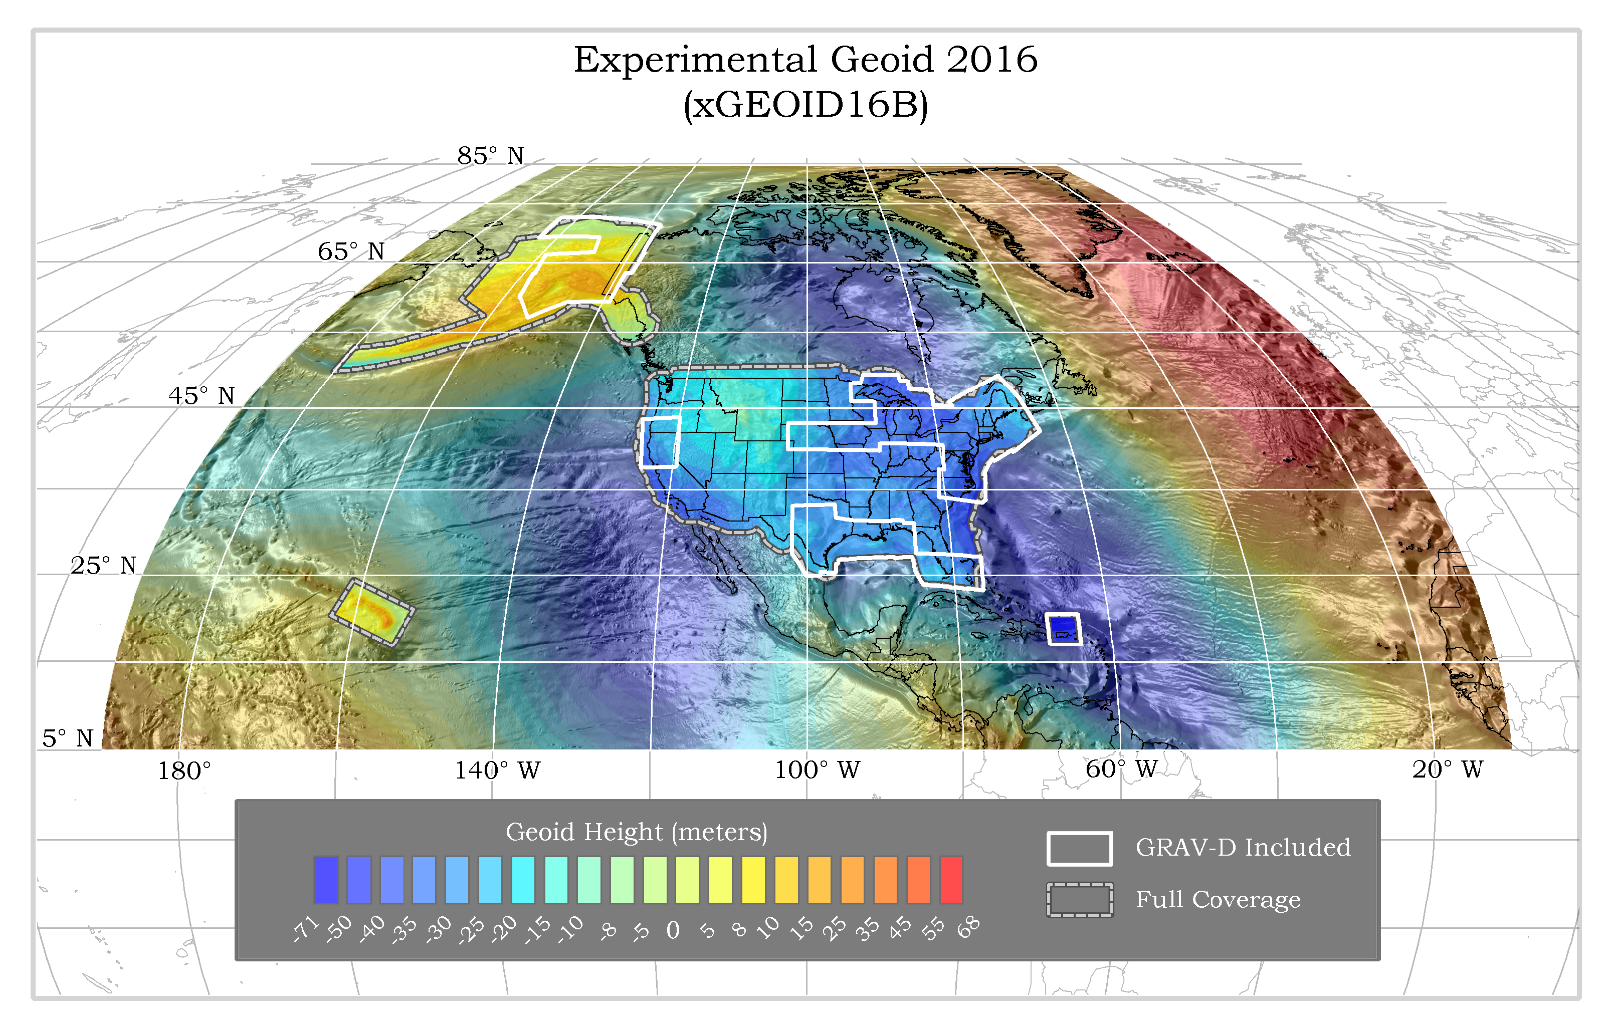
Gravimetric Geoid Span

Slide 17
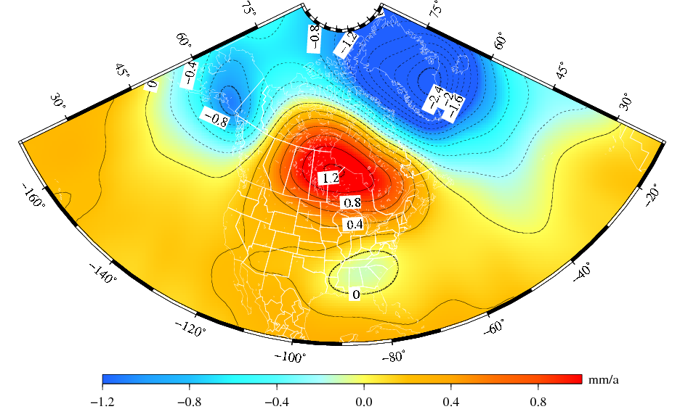
Time Dependency of Geoid
Deglaciation
The solution represents the effect due to total mass changes.
The solution uses a 400-km Gaussian filter.
Glacial Isostatic
Adjustment
Drought

Slide 18
Summary: The NSRS in 2022…
Four semi-dynamic reference frames
Geoid/GPS based vertical datum
All data will be time tagged
All coordinates will come from GNSS surveys

Slide 19
Questions?

Slide 20
Thank you!

