Slide 1
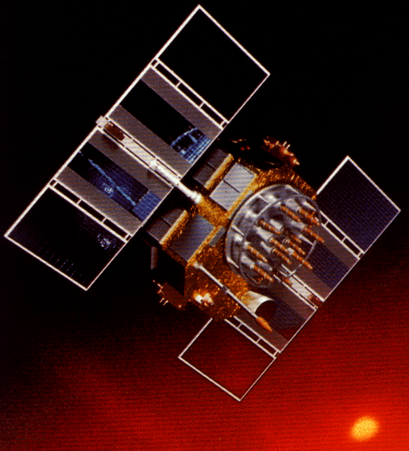
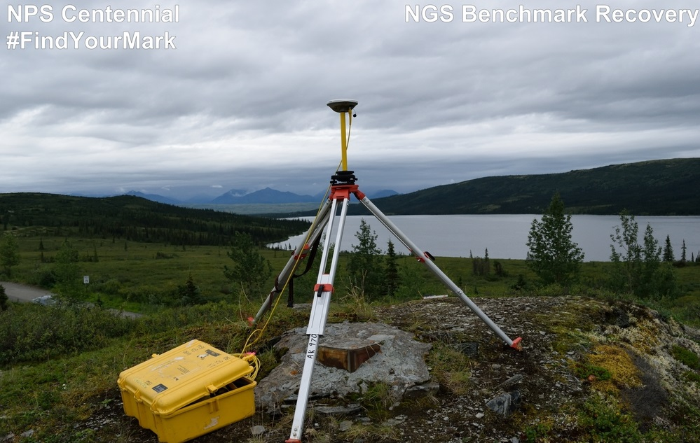
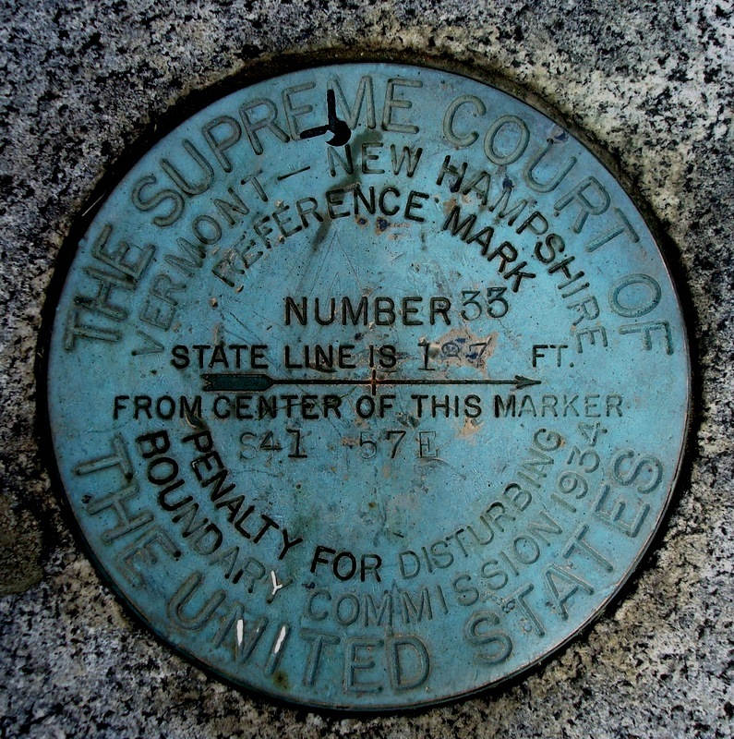
Understanding the Online Positioning User Service - OPUS

Slide 2
Understanding OPUS Agenda
OPUS Overview, Options and Alternatives – Dave
  Popularity over time
  Static vs rapid-static
  How they work
  Typical accuracies
OPUS Reports and Common Mistakes – Joe
  Explain formats, common error codes
Shared Solutions and OPUS Projects – Sathish, Kim, and Rick
Why, how, what’s been shared so far
Planned and Recent Upgrades – Weibing
Implications for OPUS and NSRS from IGS14 and 2022. - Mark S.
  “The world moves on”
Your questions answered! Send questions to ngs.opus@noaa.gov

Slide 3
DAVE’S SLIDES
OPUS overview, options and alternatives – Dave
  What is OPUS, how to upload
  What OPUS does
  popularity over time
  Static vs rapid-static vs PPP
OPUS reports and common mistakes – Joe
  explain formats, common error codes
  typical accuracies
OPUS projects and shared solutions - Rick, Sathish and Kim
  why, how, what’s been shared so far
planned and recent upgrades – Weibing
implications for OPUS and NSRS from IGS14 and 2022. - Mark S.
  “the world moves on”
Your questions answered! send questions to ngs.opus@noaa.gov

Slide 4
OPUS Overview, Options, and Alternatives
Notes:
What is OPUS? The Online Positioning User Service.
It is an internet-based software utility.
Users receive high-accuracy National Spatial Reference System coordinates via email.

Slide 5
The Many Faces or “Flavors” of OPUS
OPUS, the Online Positioning User Service, is a growing set of applications offering web-based access to the tools and resources provided by the NGS. OPUS is composed of:
OPUS Static . . . . . . . static processing
OPUS Rapid-Static . . rapid-static processing
OPUS Sharing . . . . data base and sharing
OPUS Projects . . . . multiple marks and occupations
OPUS Net . . . . . . . improved models and processing strategies

Slide 6
Notes:
OPUS Sharing: Approaching 1% of OPUS-S solutions.
OPUS-S: growing, reaching plateau?
OPUS-RS: holding steady.
Fiscal year 2017: based in this chart off of October 2016’s results.
(Source = JGE’s usage.xls file updated monthly)

Slide 7
OPUS requires Geodetic Quality Receivers
dual-frequency GPS receivers which track at least 12 channels.
program GPS receivers to collect L1, L2, C/A (C1) and P1, P2. Doppler and signal strength data are not needed.
Set receiver sampling rate to 1, 2, 3, 5, 10, 15, or 30 seconds.
Program receiver settings before session is scheduled to begin.
Receiver memory should be sufficient to collect several days worth of data.
Notes:
OPUS-S uses L1, L2, and either C1 or P1.
OPUS-RS uses L1, L2, P2, and either C1 or P1.
OPUS will not use other sampling rates other than those listed.

Slide 8
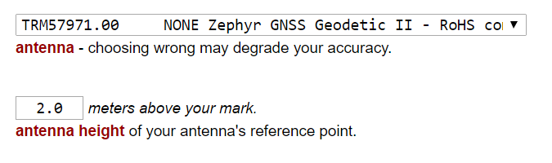
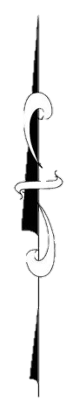
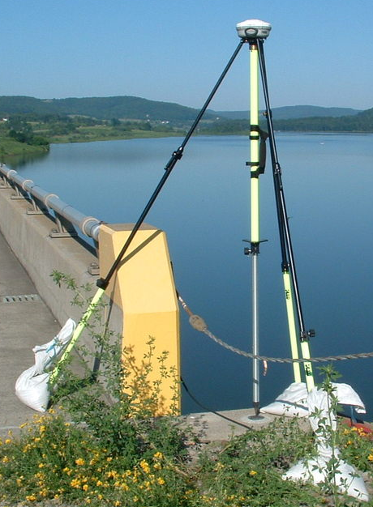
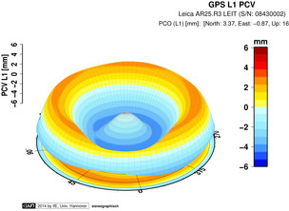
rotate NRP to face true north
ARP
antenna type & hgt are important for accurate results
antenna height
each type has unique biases
mark
For antenna calibrations, photos,
ARP and NRP diagrams, see geodesy.noaa.gov/ANTCAL/
JGE, 2015
Notes:
Antennas are the one area where OPUS users can force errors into their solutions.
Must be on approved list (e.g. calibrated).
Dual-frequency geodetic quality.
Phase center locations different, & that affects orthometric height.
Align North Reference Point to true north. Examples of NRP: face plate (as antenna above, antenna cable connector (for separate antenna/receiver), and north arrow on antenna.
ARP height measured vertically, NOT slant.
ANTENNA TYPE:
GNSS antennas aren’t like survey telescopes, which have a point (reticule) where all measurements take place. The “phase center” measuring points of an antenna will wander as each satellite’s azimuth and elevation changes. These variations are unique for each model of antenna. OPUS mixes data from across long distances and from different antenna types (rover + CORS) so this is a source of error. However, the GNSS community has measured these phase center variations for many antenna types, a process known as “calibration” which measures the variations with respect to an antenna’s reference point, or ARP. You tell OPUS where the ARP is, and it will do the rest.
ANTENNA HEIGHT:
The height of the antenna is measure vertically (not slant height) up from the from the mark, to the Antenna Reference Point which is almost always the center of the bottom-most, permanently attached piece of the antenna. Some antennas have a short removable pipe or extension to them, these are NOT part of the antenna, and must be considered part of the tripod height.
If in doubt you can find photos and diagrams of each antenna (that we have calibrated) at the URL shown.
So if you leave the antenna height as “0” this will be the height OPUS returns, of the antenna’s ARP.
Image posted as http://geodesy.noaa.gov/sitemsgs/OPUS/about/images/ant_hgt_BBBK23.png

Slide 9
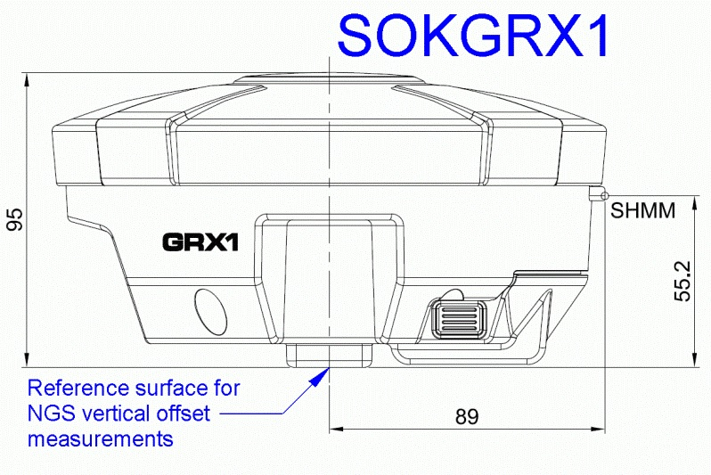
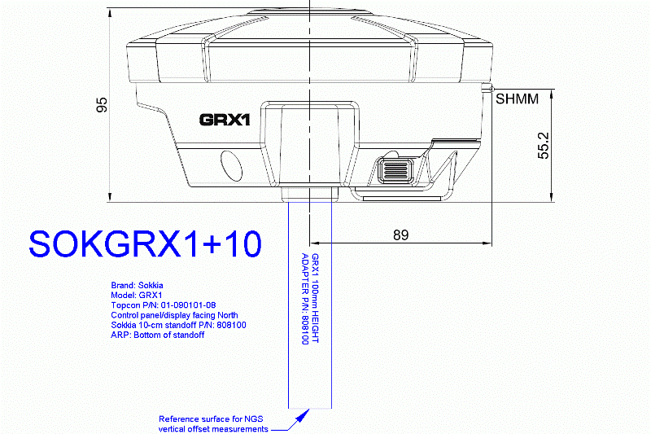
ARP Location
Notes:
If antenna ARP position is located similar to SOKGRX1 and a spacer is added, MUST include it the ARP height.
NOTE: The antenna at right is in apparent disagreement with statement at http://www.ngs.noaa.gov/sitemsgs/OPUS/non_conforming_antennas.shtml look for clarification

Slide 10
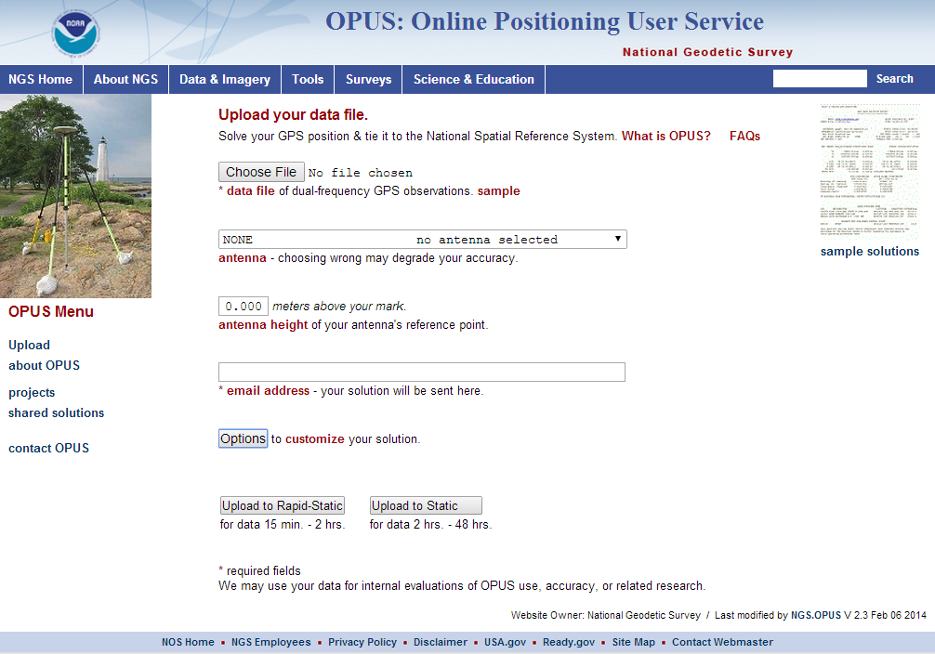
The OPUS Static Interface
This is the OPUS home page used to upload data to the processing queues.
To use OPUS Static, complete the four fields, then click the “Upload to STATIC” button. In a few minutes, an email arrives with the results.
http://geodesy.noaa.gov/OPUS/
Notes:
2-48 hrs crossing UTC midnight only once.
RINEX 2.XX or many raw files (e.g. Trimble *.dat).
GPS data used, no GLONASS or other constellations.
Works globally; however, areas where NGS geoid model not available won’t receive an orthometric height with their solution.
Max file size approx 55-60 MB.
If file size slightly above, decimate file to 30 second interval.
Multiple data sets uploaded at same time via Zip file. Max file size applies, and must use same antenna type & height. OPUS will process each file individually.

Slide 11
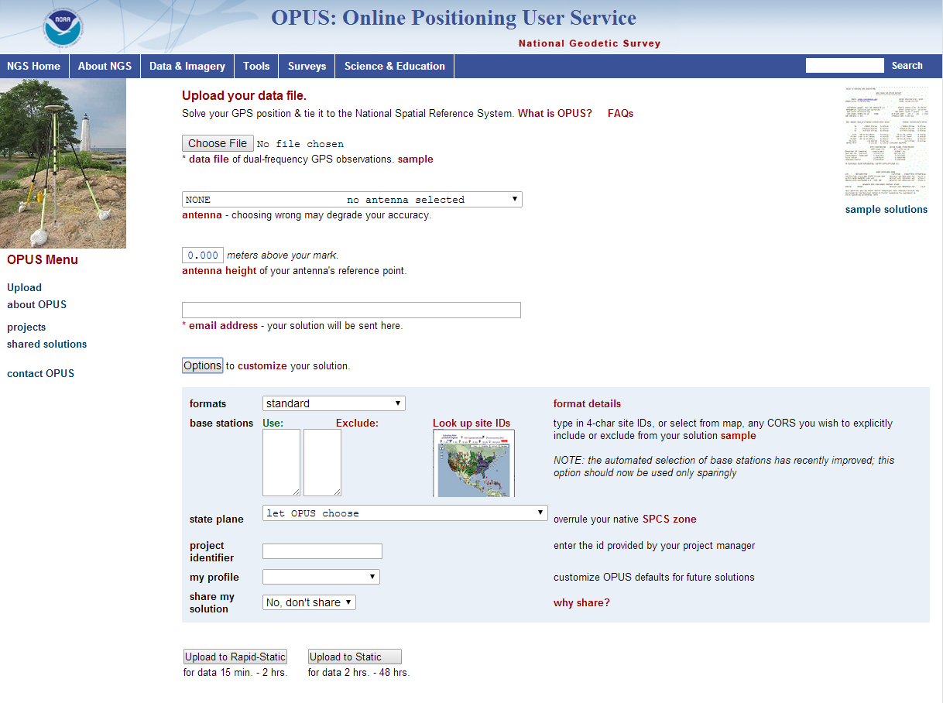
Notes:
Clicking “Options” will show you ways to change OPUS default processing and reporting choices
Format – Standard, Extended, or Standard + XML data.
State Plane – Useful in boundary areas if OPUS chooses the wrong zone.
Profile – Has caused many problems for users. Designed to always use over manually entered selections.
Share – Must meet standards.

Slide 12
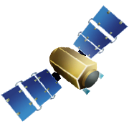

Static: OPUS determines your position with a differential GPS static solution, using hours of data.
This process is repeated 4x from other CORS.
baseline 5
baseline 4
baseline 1
baseline 3
baseline 2

Slide 13
How does OPUS-S Work?
OPUS computes an initial set of coordinates from the submitted data to calculate an approximate rover location.
OPUS then identifies all the nearby base stations, and chooses the best five to use in the final OPUS solution.
Closest distance base station can be to your position is 1 km.
The five base stations that are chosen are not necessarily the closest. Numerous quality control tests are performed on the base stations’ archived data to select the three best base stations.
Some of the quality control tests look at 1) data availability, 2) common time blocks, 3) distance, 4) geometric distribution, 5) redundancy, and 6) multipath.

Slide 14
How Good Can I Do With OPUS Static?
OPUS Static reliably addresses the more historically conventional requirements for GPS data processing. It typically yields accuracies of:
1 – 2 cm horizontally
2 – 4 cm vertically
However, there is no guarantee that this stated accuracy will result from any given data set. Confirming the quality of the OPUS solution remains your responsibility. That’s the “price” for automated processing.
Notes:
Peak to peak = Quality of GPS data; lower values are better.
RMS = How well GPS observations fit the model; lower values are better.

Slide 15
The OPUS Rapid-Static Interface
The same interface is used except one clicks the “Upload to RAPID-STATIC” button instead.
http://geodesy.noaa.gov/OPUS/
Notes:
15 minutes to 2 hours.
Works where CORS & IGS sites are dense enough to select a minimum of three and up to nine stations.
Available in most of the U.S. and parts of Canada, Mexico, and the Caribbean.

Slide 16

Rapid-static: OPUS first creates an atmospheric delay model from surrounding CORS data.
Your position is then quickly determined by differential GPS static solution.
Notes:
OPUS-RS performs two calculations.
Takes longer than OPUS-S.

Slide 17
How Does OPUS Rapid-Static Work?
OPUS Rapid-Static selects three to nine “best” CORS based upon:
    Having common satellite visibility with the user data.
    50 < distance <250 km from the user's mark.
    Orientation relative to the user's mark.
This is shown here graphically.
The star represents the user’s
mark; the triangles are CORS.
No CORS farther than 250 km
from the user's mark will be
included. A minimum of three, and
no more than nine CORS are used.
s
>250km
250km
Choi, 2010, personal communication.
Notes:
Base stations are chosen by quadrant.
Formerly chosen by distance. This created a problem where the rover might not be surrounded (see next slide).

Slide 18
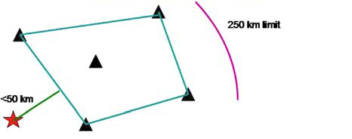
How Does OPUS Rapid-Static Work?
In addition, user's mark must be no more than 50 km from the (convex) polygon created by the selected CORS.
In this example, five CORS and their resulting polygon are shown. If the user’s mark is more than 50 km outside this
polygon, alternate CORS will be considered. If none can be found, the processing will abort.
Schwarz et al., “Accuracy assessment of the National Geodetic Survey's OPUS Rapid-Static utility”, 2009, GPS Solutions, 13(2), 119-132.
Notes:
If rover outside polygon from < 50 km, a warning will be placed at the top of the solution. Check Quality indicators and RMS to ensure a good solution.
If rover outside polygon >50 km, will receive Convex Hull error and will not receive solution.

Slide 19
How Good Can I Do With OPUS Rapid-Static?
Typical estimated and empirical accuracies from OPUS Rapid-Static within the continental U.S. are comparable to OPUS Static.
Although OPUS Rapid-Static can produce quality results from more challenging “short” data sets, it is slightly more restrictive in the data sets allowed. Because of these restrictions, the NGS created the “OPUS Rapid-Static Accuracy and Availability” tool (Choi, NGS).
Always remember, the estimated accuracies suggested by this tool are just that - estimates. Confirming the quality of the OPUS solution remains your responsibility.
Notes:
- OPUS-RS Accuracy and Availability tool useful for planning.

Slide 20
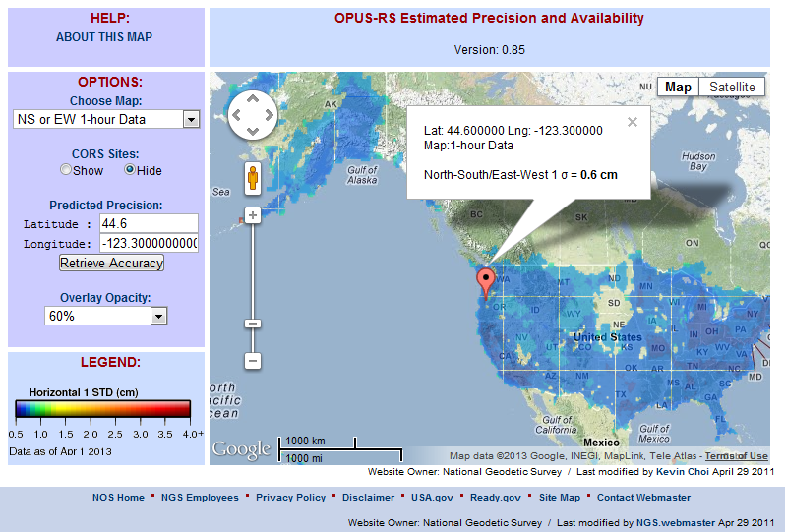
The OPUS Rapid-Static Accuracy and Availability Tool
http://geodesy.noaa.gov/OPUSI/Plots/Gmap/OPUSRS_sigmap.shtml
Notes:
SD and NE not as bad as shown in this slide.
Tool is very useful for planning.
As of December 2016 still uses old method of selecting base stations (by distance not quadrant).

Slide 21
OPUS Static vs. Rapid Static
 | Static | Rapid Static
Input (dual-frequency GPS) | 2-48 hours | 15 minutes-2 hours
Output | normal, extended, XML sharing, projects | normal, extended, XML
Accuracy (95%confidence) | 1-2 cm horizontal 3-6 cm ellipsoidal height | 1-2 cm horizontal 4-8 cm ellipsoidal height
Network Geometry | 3 CORS, preferably within 1000 km of rover | 3-9 CORS, surrounding & within 250 km of rover
Availability | global | 90% of CONUS (subject to geometry, above)

Slide 22
Precise Point Positioning (PPP)
Not offered by NGS or in current plans
Uses the precise orbit and clock data from satellites to obtain a position – no base stations required
Provides solutions globally
Single or dual-frequency receivers
Static or kinematic
0.01 m – 0.1 m solutions from one dual-frequency receiver.
< 1 cm position static mode

Slide 23
JOE’S SLIDES
OPUS overview, options and alternatives – Dave
  typical accuracies, popularity over time
  Static vs rapid-static vs projects vs net vs PPP
  how they work
OPUS reports and common mistakes – Joe
  explain formats, common error codes
OPUS projects and shared solutions - Rick, Sathish and Kim
  why, how, what’s been shared so far
planned and recent upgrades – Weibing
implications for OPUS and NSRS from IGS14 and 2022. - Mark S.
  “the world moves on”
Your questions answered! send questions to ngs.opus@noaa.gov

Slide 24
OPUS Reports and Common Mistakes

Slide 25
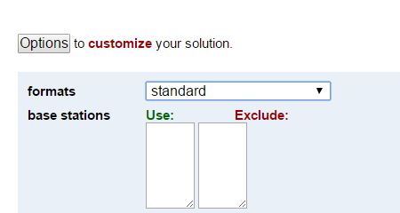

NGS OPUS SOLUTION REPORT
========================
All computed coordinate accuracies are listed as peak-to-peak values.
For additional information: https://www.ngs.noaa.gov/OPUS/about.jsp#accuracy
USER: joe.evjen@noaa.gov DATE: December 05, 2016
RINEX FILE: 5947299r.16o TIME: 18:45:47 UTC
SOFTWARE: page5 1209.04 master95.pl 160321 START: 2016/10/25 17:14:00
EPHEMERIS: igs19202.eph [precise] STOP: 2016/10/25 21:49:00
NAV FILE: brdc2990.16n OBS USED: 11436 / 12254 : 93%
ANT NAME: TRM57971.00 NONE # FIXED AMB: 82 / 83 : 99%
ARP HEIGHT: 2.0 OVERALL RMS: 0.010(m)
REF FRAME: NAD_83(2011)(EPOCH:2010.0000) IGS08 (EPOCH:2016.8164)
X: -2833371.235(m) 0.013(m) -2833372.332(m) 0.013(m)
Y: -1541100.973(m) 0.015(m) -1541099.963(m) 0.015(m)
Z: 5484647.219(m) 0.026(m) 5484647.459(m) 0.026(m)
LAT: 59 42 33.45847 0.003(m) 59 42 33.44896 0.003(m)
E LON: 208 32 32.07518 0.007(m) 208 32 31.98492 0.007(m)
W LON: 151 27 27.92482 0.007(m) 151 27 28.01508 0.007(m)
EL HGT: 503.684(m) 0.032(m) 504.134(m) 0.032(m)
ORTHO HGT: 494.346(m) 0.055(m) [NAVD88 (Computed using GEOID12B)]
UTM COORDINATES STATE PLANE COORDINATES
UTM (Zone 05) SPC (5004 AK 4)
Northing (Y) [meters] 6620045.124 636606.995
Easting (X) [meters] 586771.176 417957.136
Convergence [degrees] 1.33177427 -1.25880956
Point Scale 0.99969227 0.99998247
Combined Factor 0.99961346 0.99990364
US NATIONAL GRID DESIGNATOR: 5VNG8677120045(NAD 83)
BASE STATIONS USED
PID DESIGNATION LATITUDE LONGITUDE DISTANCE(m)
DM7460 AC61 CHICKENM61AK2006 CORS ARP N640145.332 W1420432.948 688041.0
DP9272 MCES MCNEIL CANYON ELE CORS ARP N594445.882 W1511528.107 11973.1
DL7665 AC39 SHUYAKISSPAK2006 CORS ARP N583634.993 W1522338.579 133691.6
NEAREST NGS PUBLISHED CONTROL POINT
UW5506 LOOKOUT MTN N594233.480 W1512727.891 0.8
Notes:
OPUS will normally send you a one-page which includes all the most important information.

Slide 26
NGS OPUS SOLUTION REPORT
========================
All computed coordinate accuracies are listed as peak-to-peak values.
For additional information: https://www.ngs.noaa.gov/OPUS/about.jsp#accuracy
USER: joe.evjen@noaa.gov DATE: December 05, 2016
RINEX FILE: 5947299r.16o TIME: 18:45:47 UTC
SOFTWARE: page5 1209.04 master95.pl 160321 START: 2016/10/25 17:14:00
EPHEMERIS: igs19202.eph [precise] STOP: 2016/10/25 21:49:00
NAV FILE: brdc2990.16n OBS USED: 11436 / 12254 : 93%
ANT NAME: TRM57971.00 NONE # FIXED AMB: 82 / 83 : 99%
ARP HEIGHT: 2.0 OVERALL RMS: 0.010(m)
REF FRAME: NAD_83(2011)(EPOCH:2010.0000) IGS08 (EPOCH:2016.8164)
X: -2833371.235(m) 0.013(m) -2833372.332(m) 0.013(m)
Y: -1541100.973(m) 0.015(m) -1541099.963(m) 0.015(m)
Z: 5484647.219(m) 0.026(m) 5484647.459(m) 0.026(m)
LAT: 59 42 33.45847 0.003(m) 59 42 33.44896 0.003(m)
E LON: 208 32 32.07518 0.007(m) 208 32 31.98492 0.007(m)
W LON: 151 27 27.92482 0.007(m) 151 27 28.01508 0.007(m)
EL HGT: 503.684(m) 0.032(m) 504.134(m) 0.032(m)
ORTHO HGT: 494.346(m) 0.055(m) [NAVD88 (Computed using GEOID12B)]
UTM COORDINATES STATE PLANE COORDINATES
UTM (Zone 05) SPC (5004 AK 4)
Northing (Y) [meters] 6620045.124 636606.995
Easting (X) [meters] 586771.176 417957.136
Convergence [degrees] 1.33177427 -1.25880956
Point Scale 0.99969227 0.99998247
Combined Factor 0.99961346 0.99990364
US NATIONAL GRID DESIGNATOR: 5VNG8677120045(NAD 83)
BASE STATIONS USED
PID DESIGNATION LATITUDE LONGITUDE DISTANCE(m)
DM7460 AC61 CHICKENM61AK2006 CORS ARP N640145.332 W1420432.948 688041.0
DP9272 MCES MCNEIL CANYON ELE CORS ARP N594445.882 W1511528.107 11973.1
DL7665 AC39 SHUYAKISSPAK2006 CORS ARP N583634.993 W1522338.579 133691.6
NEAREST NGS PUBLISHED CONTROL POINT
UW5506 LOOKOUT MTN N594233.480 W1512727.891 0.8
Notes:
Here we’ve highlighted a few information types
-- in green, OPUS repeats back the information you gave it (email, receiver and antenna info)
-- in red, your OPUS position in both NAD83 and ITRF reference frames, in both ECEF (XYZ) Cartesian coordinates as well as latitude, longitude, and height, and projected SPCS and UTMs.
-- in orange, your OPUS accuracy metrics. These values (REF FRAME and below) are all solution ranges, aka “peak-to-peaks” as explained on the next slide.

Slide 27

“peak to peak” error ranges, explained:
LAT: 59 42 33.45847 0.003(m)
W LON: 151 27 27.92482 0.007(m)
EL HGT: 503.684(m) 0.032(m)
ORTHO HGT: 494.346(m) 0.055(m)
baseline 5
position:
averaged from the 3 most coherent baselines
ranges:
a bounding box enclosing 3 most coherent baselines
LON range
for ORTHO HGT, geoid model uncertainty is added
LAT range
ORTHO HGT range
CORS baseline 1
EL HGT range
=
baseline 3
baseline 4
baseline 2
2 outermost baselines are ignored
JGE, 2015
Notes:
As explained earlier, an OPUS solution is actually an average of three independent, single-baseline solutions, each computed by double-differenced, carrier-phase measurements from one of three nearby CORS. While they are “independent” meaning they are run separately, they could all suffer from any single-point-of-failure buried within your data file, metadata, or orbit/tropo/other models or tools.
OPUS attempts 5 solutions, chooses the 3 which form the smallest “peak-to-peak” box and discards the other two. ⬅ explain, is this smallest in a 3D sense, or is horizontal only?
To provide orthometric height accuracy, we add to the ellipsoid height range a slop factor from the geoid model.

Slide 28
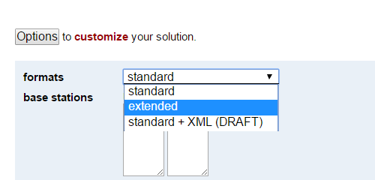
BASE STATION INFORMATION
STATION NAME: ac61 a 1 (ChickenM61AK2006; Chicken, Alaska United States)
MONUMENT: NO DOMES NUMBER
XYZ -2209480.5269 -1721530.0262 5711814.2289 MON @ 2005.0000 (M)
XYZ -0.0186 -0.0040 -0.0083 VEL (M/YR)
NEU -0.0000 0.0000 0.0083 MON TO ARP (M)
NEU 0.0012 0.0008 0.0860 ARP TO L1 PHASE CENTER (M)
NEU 0.0006 -0.0006 0.1184 ARP TO L2 PHASE CENTER (M)
XYZ -0.2198 -0.0473 -0.0981 VEL TIMES 11.8163 YRS
XYZ -0.0029 -0.0022 0.0075 MON TO ARP
XYZ -0.0284 -0.0231 0.0778 ARP TO L1 PHASE CENTER
XYZ -2209480.7780 -1721530.0988 5711814.2161 L1 PHS CEN @ 2016.8164
XYZ -0.0000 -0.0000 -0.0000 + XYZ ADJUSTMENTS
XYZ -2209480.7780 -1721530.0988 5711814.2161 NEW L1 PHS CEN @ 2016.8164
XYZ -2209480.7496 -1721530.0757 5711814.1383 NEW ARP @ 2016.8164
XYZ -2209480.7468 -1721530.0735 5711814.1308 NEW MON @ 2016.8164
LLH 64 1 45.33033 217 55 26.94422 745.4942 NEW L1 PHS CEN @ 2016.8164
LLH 64 1 45.33029 217 55 26.94417 745.4082 NEW ARP @ 2016.8164
LLH 64 1 45.33029 217 55 26.94417 745.3999 NEW MON @ 2016.8164
STATION NAME: mces a 1 (McNeil Canyon Elem. Scho; Homer, AK USA)
MONUMENT: NO DOMES NUMBER
XYZ -2824840.8189 -1549258.4719 5486650.1678 MON @ 2005.0000 (M)
XYZ -0.0232 -0.0041 -0.0130 VEL (M/YR)
NEU -0.0000 0.0000 0.0083 MON TO ARP (M)
NEU 0.0012 0.0008 0.0860 ARP TO L1 PHASE CENTER (M)
NEU 0.0006 -0.0006 0.1184 ARP TO L2 PHASE CENTER (M)
XYZ -0.2741 -0.0484 -0.1536 VEL TIMES 11.8163 YRS
XYZ -0.0037 -0.0020 0.0072 MON TO ARP
XYZ -0.0367 -0.0210 0.0749 ARP TO L1 PHASE CENTER
XYZ -2824841.1335 -1549258.5434 5486650.0963 L1 PHS CEN @ 2016.8164
XYZ -0.0000 -0.0000 -0.0000 + XYZ ADJUSTMENTS
XYZ -2824841.1335 -1549258.5434 5486650.0962 NEW L1 PHS CEN @ 2016.8164
XYZ -2824841.0967 -1549258.5223 5486650.0214 NEW ARP @ 2016.8164
XYZ -2824841.0931 -1549258.5203 5486650.0142 NEW MON @ 2016.8164
LLH 59 44 45.87320 208 44 31.80206 430.7278 NEW L1 PHS CEN @ 2016.8164
LLH 59 44 45.87317 208 44 31.80201 430.6418 NEW ARP @ 2016.8164
LLH 59 44 45.87317 208 44 31.80201 430.6335 NEW MON @ 2016.8164
STATION NAME: ac39 a 1 (ShuyakIsSPAK2006; Shuayk Island, AK United States
MONUMENT: NO DOMES NUMBER
XYZ -2951218.9388 -1543248.7520 5421552.8890 MON @ 2005.0000 (M)
XYZ -0.0217 -0.0021 -0.0123 VEL (M/YR)
NEU -0.0000 0.0000 0.0083 MON TO ARP (M)
NEU 0.0012 0.0008 0.0860 ARP TO L1 PHASE CENTER (M)
NEU 0.0006 -0.0006 0.1183 ARP TO L2 PHASE CENTER (M)
XYZ -0.2559 -0.0242 -0.1452 VEL TIMES 11.8163 YRS
XYZ -0.0038 -0.0020 0.0071 MON TO ARP
XYZ -0.0385 -0.0210 0.0740 ARP TO L1 PHASE CENTER
XYZ -2951219.2370 -1543248.7992 5421552.8248 L1 PHS CEN @ 2016.8164
XYZ 0.0000 -0.0000 0.0000 + XYZ ADJUSTMENTS
XYZ -2951219.2370 -1543248.7992 5421552.8248 NEW L1 PHS CEN @ 2016.8164
XYZ -2951219.1986 -1543248.7782 5421552.7508 NEW ARP @ 2016.8164
XYZ -2951219.1947 -1543248.7762 5421552.7437 NEW MON @ 2016.8164
LLH 58 36 34.98418 207 36 21.33266 157.2528 NEW L1 PHS CEN @ 2016.8164
LLH 58 36 34.98414 207 36 21.33261 157.1668 NEW ARP @ 2016.8164
LLH 58 36 34.98414 207 36 21.33261 157.1585 NEW MON @ 2016.8164
NGS OPUS SOLUTION REPORT
========================
All computed coordinate accuracies are listed as peak-to-peak values.
For additional information: https://www.ngs.noaa.gov/OPUS/about.jsp#accuracy
USER: joe.evjen@noaa.gov DATE: December 05, 2016
RINEX FILE: 5947299r.16o TIME: 18:45:47 UTC
SOFTWARE: page5 1209.04 master95.pl 160321 START: 2016/10/25 17:14:00
EPHEMERIS: igs19202.eph [precise] STOP: 2016/10/25 21:49:00
NAV FILE: brdc2990.16n OBS USED: 11436 / 12254 : 93%
ANT NAME: TRM57971.00 NONE # FIXED AMB: 82 / 83 : 99%
ARP HEIGHT: 2.0 OVERALL RMS: 0.010(m)
REF FRAME: NAD_83(2011)(EPOCH:2010.0000) IGS08 (EPOCH:2016.8164)
X: -2833371.235(m) 0.013(m) -2833372.332(m) 0.013(m)
Y: -1541100.973(m) 0.015(m) -1541099.963(m) 0.015(m)
Z: 5484647.219(m) 0.026(m) 5484647.459(m) 0.026(m)
LAT: 59 42 33.45847 0.003(m) 59 42 33.44896 0.003(m)
E LON: 208 32 32.07518 0.007(m) 208 32 31.98492 0.007(m)
W LON: 151 27 27.92482 0.007(m) 151 27 28.01508 0.007(m)
EL HGT: 503.684(m) 0.032(m) 504.134(m) 0.032(m)
ORTHO HGT: 494.346(m) 0.055(m) [NAVD88 (Computed using GEOID12B)]
UTM COORDINATES STATE PLANE COORDINATES
UTM (Zone 05) SPC (5004 AK 4)
Northing (Y) [meters] 6620045.124 636606.995
Easting (X) [meters] 586771.176 417957.136
Convergence [degrees] 1.33177427 -1.25880956
Point Scale 0.99969227 0.99998247
Combined Factor 0.99961346 0.99990364
US NATIONAL GRID DESIGNATOR: 5VNG8677120045(NAD 83)
BASE STATIONS USED
PID DESIGNATION LATITUDE LONGITUDE DISTANCE(m)
DM7460 AC61 CHICKENM61AK2006 CORS ARP N640145.332 W1420432.948 688041.0
DP9272 MCES MCNEIL CANYON ELE CORS ARP N594445.882 W1511528.107 11973.1
DL7665 AC39 SHUYAKISSPAK2006 CORS ARP N583634.993 W1522338.579 133691.6
NEAREST NGS PUBLISHED CONTROL POINT
UW5506 LOOKOUT MTN N594233.480 W1512727.891 0.8
REMOTE STATION INFORMATION
STATION NAME: 5947 1
MONUMENT: NO DOMES NUMBER
XYZ -2833373.6381 -1541099.5299 5484646.1624 MON @ 2016.8162 (M)
NEU -0.0011 0.0003 2.0000 MON TO ARP (M)
NEU 0.0011 -0.0003 0.0668 ARP TO L1 PHASE CENTER (M)
NEU 0.0001 0.0007 0.0578 ARP TO L2 PHASE CENTER (M)
XYZ -0.8869 -0.4827 1.7264 MON TO ARP
XYZ -0.0289 -0.0154 0.0582 ARP TO L1 PHASE CENTER
XYZ -2833374.5539 -1541100.0280 5484647.9470 L1 PHS CEN @ 2016.8164
BASELINE NAME: ac61 5947
XYZ 1.3009 -0.4407 1.3082 + XYZ ADJUSTMENTS
XYZ -2833373.2529 -1541100.4687 5484649.2552 NEW L1 PHS CEN @ 2016.8164
XYZ -2833373.2240 -1541100.4533 5484649.1970 NEW ARP @ 2016.8164
XYZ -2833372.3372 -1541099.9706 5484647.4706 NEW MON @ 2016.8164
LLH 59 42 33.44892 208 32 31.98518 506.2152 NEW L1 PHS CEN @ 2016.8164
LLH 59 42 33.44888 208 32 31.98520 506.1484 NEW ARP @ 2016.8164
LLH 59 42 33.44892 208 32 31.98518 504.1484 NEW MON @ 2016.8164
BASELINE NAME: mces 5947
XYZ 1.3044 -0.4324 1.3009 + XYZ ADJUSTMENTS
XYZ -2833373.2495 -1541100.4604 5484649.2479 NEW L1 PHS CEN @ 2016.8164
XYZ -2833373.2206 -1541100.4451 5484649.1897 NEW ARP @ 2016.8164
XYZ -2833372.3337 -1541099.9623 5484647.4633 NEW MON @ 2016.8164
LLH 59 42 33.44899 208 32 31.98483 506.2054 NEW L1 PHS CEN @ 2016.8164
LLH 59 42 33.44896 208 32 31.98484 506.1386 NEW ARP @ 2016.8164
LLH 59 42 33.44899 208 32 31.98483 504.1386 NEW MON @ 2016.8164
BASELINE NAME: ac39 5947
XYZ 1.3138 -0.4255 1.2820 + XYZ ADJUSTMENTS
XYZ -2833373.2400 -1541100.4535 5484649.2290 NEW L1 PHS CEN @ 2016.8164
XYZ -2833373.2111 -1541100.4382 5484649.1708 NEW ARP @ 2016.8164
XYZ -2833372.3243 -1541099.9554 5484647.4444 NEW MON @ 2016.8164
LLH 59 42 33.44901 208 32 31.98473 506.1832 NEW L1 PHS CEN @ 2016.8164
LLH 59 42 33.44897 208 32 31.98475 506.1164 NEW ARP @ 2016.8164
LLH 59 42 33.44901 208 32 31.98473 504.1164 NEW MON @ 2016.8164
G-FILES
Axx20161025 161025
B201610251714 1610252148 1 page5 v1209.04IGS 126 1 2 27NGS 201612 5IFDDPX
IIGS08_1918 IGS 20161009
C00090005 6238915904 10-1804301029 6 2271666602 18 X2996A5947X2996AAC61
D 1 2 7774339 1 3 -8228384 2 3 -8825965
Axx20161025 161025
B201610251714 1610252148 1 page5 v1209.04IGS 126 1 2 27NGS 201612 5IFDDPX
IIGS08_1918 IGS 20161009
C00090004 85312406 11 -81585580 6 20025510 18 X2996A5947X2996AMCES
D 1 2 6928518 1 3 -9013819 2 3 -8288560
Axx20161025 161025
B201610251714 1610252148 1 page5 v1209.04IGS 126 1 2 27NGS 201612 5IFDDPX
IIGS08_1918 IGS 20161009
C00090002-1178468705 9 -21488208 5 -630947006 17 X2996A5947X2996AAC39
D 1 2 8393794 1 3 -8142151 2 3 -8599565
POST-FIT RMS BY SATELLITE VS. BASELINE
OVERALL 02 05 07 08 09 10 11 13
ac61-5947| 0.010 ... 0.013 0.012 0.009 ... 0.007 0.012 0.017
15 16 18 20 21 24 25 26 27
ac61-5947| 0.011 0.008 0.007 0.008 0.017 ... 0.015 0.009 0.008
28 29 30 31 32
ac61-5947| ... 0.009 ... 0.014 0.026
OVERALL 02 05 07 08 09 10 11 13
mces-5947| 0.010 ... 0.012 0.015 0.011 ... 0.009 0.015 0.019
15 16 18 20 21 25 26 27 28
mces-5947| 0.014 0.009 0.008 0.008 0.016 0.013 0.006 0.009 ...
29 30 31 32
mces-5947| 0.010 ... 0.015 0.015
OVERALL 02 05 07 08 10 11 13 15
ac39-5947| 0.010 ... 0.013 0.014 0.008 0.007 0.016 0.017 0.014
16 18 20 21 25 26 27 28 29
ac39-5947| 0.008 0.008 0.009 0.017 0.011 0.006 0.008 ... 0.008
30 31 32
ac39-5947| ... 0.010 0.013
OBS BY SATELLITE VS. BASELINE
OVERALL 02 05 07 08 09 10 11 13
ac61-5947| 3756 ... 191 126 235 ... 289 20 231
15 16 18 20 21 24 25 26 27
ac61-5947| 317 409 339 413 50 ... 58 343 393
28 29 30 31 32
ac61-5947| ... 244 ... 56 42
OVERALL 02 05 07 08 09 10 11 13
mces-5947| 3783 ... 192 126 235 ... 292 53 185
15 16 18 20 21 25 26 27 28
mces-5947| 317 458 363 388 57 49 353 411 ...
29 30 31 32
mces-5947| 226 ... 59 19
OVERALL 02 05 07 08 10 11 13 15
ac39-5947| 3897 ... 190 126 235 299 40 231 300
16 18 20 21 25 26 27 28 29
ac39-5947| 457 366 412 58 59 366 411 ... 248
30 31 32
ac39-5947| ... 57 42
Covariance Matrix for the xyz OPUS Position (meters^2).
0.0000005444 0.0000000277 -0.0000000893
0.0000000277 0.0000001911 -0.0000000499
-0.0000000893 -0.0000000499 0.0000021000
Covariance Matrix for the enu OPUS Position (meters^2).
0.0000002485 0.0000001155 -0.0000000665
0.0000001155 0.0000008121 0.0000006550
-0.0000000665 0.0000006550 0.0000017750
Horizontal network accuracy = 0.00187 meters.
Vertical network accuracy = 0.00261 meters.
Derivation of NAD 83 vector components
Position of reference station ARP in NAD_83(2011)(EPOCH:2010.0000).
Xa(m) Ya(m) Za(m)
AC61 -2209479.69965 -1721531.10138 5711813.88119 2010.00
MCES -2824840.00682 -1549259.54388 5486649.77518 2010.00
AC39 -2951218.11931 -1543249.81594 5421552.49908 2010.00
Position of reference station monument in NAD_83(2011)(EPOCH:2010.0000).
Xr(m) Yr(m) Zr(m)
AC61 -2209479.69675 -1721531.09918 5711813.87369 2010.00
MCES -2824840.00312 -1549259.54188 5486649.76798 2010.00
AC39 -2951218.11551 -1543249.81394 5421552.49198 2010.00
Velocity of reference station monument in NAD_83(2011)(EPOCH:2010.0000).
Vx (m/yr) Vy (m/yr) Vz (m/yr)
AC61 -0.01860 -0.00400 -0.00830
MCES -0.00160 -0.00350 -0.00400
AC39 -0.02170 -0.00210 -0.01230
Vectors from unknown station monument to reference station monument
in NAD_83(2011)(EPOCH:2010.0000).
Xr-X= DX(m) Yr-Y= DY(m) Zr-Z= DZ(m)
AC61 623891.53825 -180430.12618 227166.65469 2010.00
MCES 8531.23188 -8158.56888 2002.54898 2010.00
AC39 -117846.88051 -2148.84094 -63094.72702 2010.00
STATE PLANE COORDINATES - U.S. Survey Foot
SPC (4400 VT)
Northing (Y) [feet] 826052.623
Easting (X) [feet] 1548980.583
Convergence [degrees] -0.24791702
Point Scale 0.99997383
Combined Factor 0.99995830
********** New Reference Frame Preview **********
We are replacing the nation’s NAD 83 and NAVD 88 datums, to improve access and accuracy of the National Spatial Reference System. More at https://geodesy.noaa.gov/datums/newdatums/
Below are approximate coordinates for this solution in the new frames:
APPROX ORTHO HGT: 493.329 (m) [PROTOTYPE (Computed using xGeoid16B,GRS80,IGS08)]
This position and the above vector components were computed without any
knowledge by the National Geodetic Survey regarding the equipment or
field operating procedures used.
8002 Did you observe at LOOKOUT MTN?
https://geodesy.noaa.gov/cgi-bin/ds_mark.prl?PidBox=UW5506
8002 To help maintain the NSRS database, please consider sharing either your
8002 -- data & recovery notes (see https://geodesy.noaa.gov/marks/sharing/ )
8002 -- recovery notes only (see https://geodesy.noaa.gov/marks/recovery/ )
Notes:
If you select Options > format > Extended
OPUS will append to your one page report many pages of detail regarding HOW the solution came about.

Slide 29
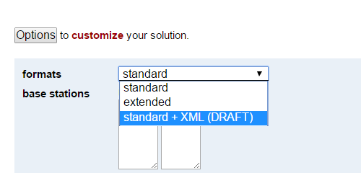
NGS OPUS SOLUTION REPORT
========================
All computed coordinate accuracies are listed as peak-to-peak values.
For additional information: https://www.ngs.noaa.gov/OPUS/about.jsp#accuracy
USER: joe.evjen@noaa.gov DATE: December 05, 2016
RINEX FILE: 5947299r.16o TIME: 18:45:47 UTC
SOFTWARE: page5 1209.04 master95.pl 160321 START: 2016/10/25 17:14:00
EPHEMERIS: igs19202.eph [precise] STOP: 2016/10/25 21:49:00
NAV FILE: brdc2990.16n OBS USED: 11436 / 12254 : 93%
ANT NAME: TRM57971.00 NONE # FIXED AMB: 82 / 83 : 99%
ARP HEIGHT: 2.0 OVERALL RMS: 0.010(m)
REF FRAME: NAD_83(2011)(EPOCH:2010.0000) IGS08 (EPOCH:2016.8164)
X: -2833371.235(m) 0.013(m) -2833372.332(m) 0.013(m)
Y: -1541100.973(m) 0.015(m) -1541099.963(m) 0.015(m)
Z: 5484647.219(m) 0.026(m) 5484647.459(m) 0.026(m)
LAT: 59 42 33.45847 0.003(m) 59 42 33.44896 0.003(m)
E LON: 208 32 32.07518 0.007(m) 208 32 31.98492 0.007(m)
W LON: 151 27 27.92482 0.007(m) 151 27 28.01508 0.007(m)
EL HGT: 503.684(m) 0.032(m) 504.134(m) 0.032(m)
ORTHO HGT: 494.346(m) 0.055(m) [NAVD88 (Computed using GEOID12B)]
UTM COORDINATES STATE PLANE COORDINATES
UTM (Zone 05) SPC (5004 AK 4)
Northing (Y) [meters] 6620045.124 636606.995
Easting (X) [meters] 586771.176 417957.136
Convergence [degrees] 1.33177427 -1.25880956
Point Scale 0.99969227 0.99998247
Combined Factor 0.99961346 0.99990364
US NATIONAL GRID DESIGNATOR: 5VNG8677120045(NAD 83)
BASE STATIONS USED
PID DESIGNATION LATITUDE LONGITUDE DISTANCE(m)
DM7460 AC61 CHICKENM61AK2006 CORS ARP N640145.332 W1420432.948 688041.0
DP9272 MCES MCNEIL CANYON ELE CORS ARP N594445.882 W1511528.107 11973.1
DL7665 AC39 SHUYAKISSPAK2006 CORS ARP N583634.993 W1522338.579 133691.6
NEAREST NGS PUBLISHED CONTROL POINT
UW5506 LOOKOUT MTN N594233.480 W1512727.891 0.8
<?xml version="1.0" encoding="UTF-8"?>
<OPUS_SOLUTION>
<USER_INFORMATION>
<USER_EMAIL> joe.evjen@gmail.com </USER_EMAIL>
<SOLUTION_DATE> February 19, 2008 </SOLUTION_DATE>
<SOLUTION_TIME> 01:16:22 UTC </SOLUTION_TIME>
<RINEX_FILE_NAME> zzyy1500.07o </RINEX_FILE_NAME>
</USER_INFORMATION>
<DATA_INFORMATION>
<SOFTWARE>
<PAGES_VERSION> page5 0612.06 </PAGES_VERSION>
<OPUS_VERSION> master3.pl </OPUS_VERSION>
</SOFTWARE>
<EMPHEMERIS> igs14293.eph [precise] </EMPHEMERIS>
<NAV_FILE> brdc1500.07n </NAV_FILE>
<ANTENNA_NAME> TRM41249.00 NONE </ANTENNA_NAME>
<ARP_HEIGHT> 0.0 </ARP_HEIGHT>
<START_TIME> 2007/05/30 00:00:00 </START_TIME>
<END_TIME> 2007/05/30 23:59:00 </END_TIME>
<OBS_USED>
<NUMBER_USED> 52955 </NUMBER_USED>
<TOTAL_OBS> 55069 </TOTAL_OBS>
<PERCENTAGE> 96 </PERCENTAGE>
</OBS_USED>
<FIXED_AMB>
<NUMBER_FIXED> 218 </NUMBER_FIXED>
<NUMBER_AMB> 242 </NUMBER_AMB>
<PERCENTAGE> 90 </PERCENTAGE>
</FIXED_AMB>
<OVERALL_RMS UNIT="m"> 0.021 </OVERALL_RMS>
</DATA_INFORMATION>
<POSITION>
<REF_FRAME> NAD_83(CORS96) </REF_FRAME>
<EPOCH> 2002.0000 </EPOCH>
<COORD_SET>
<RECT_COORD>
<COORDINATE AXIS="X" UNIT="m" UNCERTAINTY="0.003"> -496255.901 </COORDINATE>
<COORDINATE AXIS="Y" UNIT="m" UNCERTAINTY="0.022"> -5510741.494 </COORDINATE>
<COORDINATE AXIS="Z" UNIT="m" UNCERTAINTY="0.017"> 3162058.243 </COORDINATE>
</RECT_COORD>
<ELLIP_COORD>
<LAT>
<DEGREES> 29 </DEGREES>
<MINUTES> 54 </MINUTES>
<SECONDS> 48.44070 </SECONDS>
<UNCERTAINTY> 0.003 </UNCERTAINTY>
<UNCERTAINTY_UNIT>m </UNCERTAINTY_UNIT>
</LAT>
<EAST_LONG>
<DEGREES>264 </DEGREES>
<MINUTES>51</MINUTES>
<SECONDS>15.31122</SECONDS>
<UNCERTAINTY>0.002</UNCERTAINTY>
<UNCERTAINTY_UNIT>m</UNCERTAINTY_UNIT>
</EAST_LONG>
<EL_HEIGHT>
<VALUE>-7.199</VALUE>
<UNCERTAINTY>0.027</UNCERTAINTY>
<UNCERTAINTY_UNIT>m</UNCERTAINTY_UNIT>
</EL_HEIGHT>
</ELLIP_COORD>
</COORD_SET>
</POSITION>
<POSITION>
<REF_FRAME>ITRF00 (EPOCH:2007.4096)</REF_FRAME>
<EPOCH>2007.4096</EPOCH>
<COORD_SET>
<RECT_COORD>
<COORDINATE AXIS="X" UNIT="m" UNCERTAINTY="0.003">-496256.585</COORDINATE>
<COORDINATE AXIS="Y" UNIT="m" UNCERTAINTY="0.022">-5510740.027</COORDINATE>
<COORDINATE AXIS="Z" UNIT="m" UNCERTAINTY="0.017">3162058.057</COORDINATE>
</RECT_COORD>
<ELLIP_COORD>
<LAT>
<DEGREES>29</DEGREES>
<MINUTES>54</MINUTES>
<SECONDS>48.45813</SECONDS>
<UNCERTAINTY>0.003</UNCERTAINTY>
<UNCERTAINTY_UNIT>m</UNCERTAINTY_UNIT>
</LAT>
<EAST_LONG>
<DEGREES>264</DEGREES>
<MINUTES>51</MINUTES>
<SECONDS>15.28092</SECONDS>
<UNCERTAINTY>0.002</UNCERTAINTY>
<UNCERTAINTY_UNIT>m</UNCERTAINTY_UNIT>
</EAST_LONG>
<EL_HEIGHT>
<VALUE>-8.505</VALUE>
<UNCERTAINTY>0.027</UNCERTAINTY>
<UNCERTAINTY_UNIT>m</UNCERTAINTY_UNIT>
</EL_HEIGHT>
</ELLIP_COORD>
</COORD_SET>
</POSITION>
<ORTHO_HGT UNCERTAINTY="0.037" UNIT="m" SOURCE="[Geoid03 NAVD88]">20.154</ORTHO_HGT>
<PLANE_COORD_INFO>
<PLANE_COORD_SPEC TYPE="UTM" ZONE="15">
<NORTHING UNIT="m">3311130.625</NORTHING>
<EASTING UNIT="m">292843.826</EASTING>
<CONVERGENCE UNIT="deg">-1.07044705</CONVERGENCE>
<SCALE>1.00012949</SCALE>
<CF>1.00013062</CF>
</PLANE_COORD_SPEC>
<PLANE_COORD_SPEC TYPE="SPC" ZONE="4204(TXSC
)">
<NORTHING UNIT="m">4236668.327</NORTHING>
<EASTING UNIT="m">972105.452</EASTING>
<CONVERGENCE UNIT="deg">1.88824726</CONVERGENCE>
<SCALE>0.99991407</SCALE>
<CF>0.99991520</CF>
</PLANE_COORD_SPEC>
<USNG>15RTP9284411131(NAD 83)
</USNG>
</PLANE_COORD_INFO>
<BASE_STATION_USED>
<PID>DE5999</PID>
<STATION_ID>ADKS</STATION_ID>
<DESIGNATION>ADDICKS 1795 CORS ARP</DESIGNATION>
<LATITUDE>N294727.47185</LATITUDE>
<LONGITUDE>W0953511.04262</LONGITUDE>
<DISTANCE>44692.309</DISTANCE>
</BASE_STATION_USED>
<BASE_STATION_USED>
<PID>DJ8995</PID>
<STATION_ID>ROD1</STATION_ID>
<DESIGNATION>ROD1 CORS ARP</DESIGNATION>
<LATITUDE>N300420.45377</LATITUDE>
<LONGITUDE>W0953136.45801</LONGITUDE>
<DISTANCE>40769.489</DISTANCE>
</BASE_STATION_USED>
<BASE_STATION_USED>
<PID>DH3612</PID>
<STATION_ID>TXLI</STATION_ID>
<DESIGNATION>LIBERTY CORS ARP</DESIGNATION>
<LATITUDE>N300321.18092</LATITUDE>
<LONGITUDE>W0944615.67967</LONGITUDE>
<DISTANCE>39457.656</DISTANCE>
</BASE_STATION_USED>
<NGS_PUBLISHED_CONTROL_POINT>
<PID>AA9861</PID>
<DESIGNATION>LAKE HOUSTON 2050 CORS L1 PHS </DESIGNATION>
<LATITUDE>N295448.44005</LATITUDE>
<LONGITUDE>W0950844.68949</LONGITUDE>
<DISTANCE>0.000</DISTANCE>
</NGS_PUBLISHED_CONTROL_POINT>
<NOTE> This position and the above vector components were computed without any
knowledge by the National Geodetic Survey regarding the equiqment or
field operating procedure used. </NOTE>
</OPUS_SOLUTION>
Notes:
If you select Options > format > XML
OPUS will append to your one page report a computer-friendly version suitable for downstream applications.

Slide 30
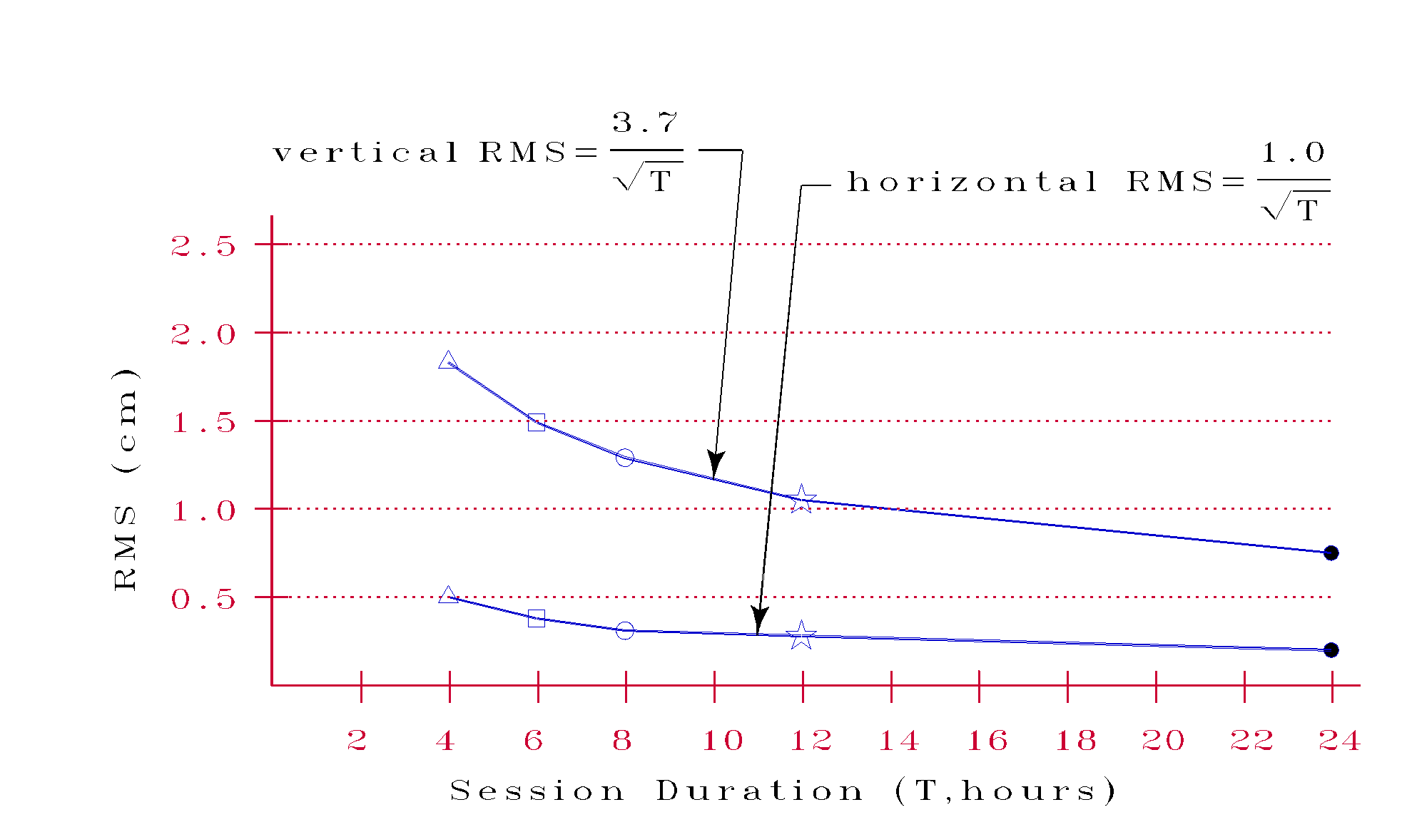
Positioning Error vs.
Duration of the Observing Session
Notes:
Studies performed in 1999 indicate that the standard error of computed horizontal coordinates, expressed in centimeters, may be approximated by the mathematical expression: one divided by the square root of the length of the observing session in hours. Similarly, these studies indicate that the standard error of computed vertical coordinates, again in centimeters, may be approximated by the mathematical expression: 3.7 divided by the square root of the length of the observing session in hours. Newer studies of achievable accuracies are now being conducted, and these studies indicate that the same level of accuracy can be obtained with shorter observing sessions, when the atmospheric conditions measured at CORS sites are interpolated to the location where the user collected his/her data.

Slide 31
Notes:
Here is a distribution of OPUS solution precision from the accumulated solutions at 1,057 marks, each with more than one shared OPUS-S solution.
For each, the latitude, longitude, ellip hgt, and ortho hgt value difference frequencies are shown, individually (bar chart) and cumulatively (Pareto line chart.)
This suggests that for data files of 4+ hours duration, an OPUS user can usually agree with an earlier user at the cm level, particularly in the horizontal.

Slide 32
Notes:
Here is a distribution of OPUS solution “accuracy” for # each OPUS-S solutions shared on marks with existing NGS datasheet values of similar or higher accuracy.
For each, the latitude, longitude, ellip hgt, and ortho hgt value difference frequencies are shown, individually (bar chart) and cumulatively (Pareto line chart.)
This suggests that for data files of 4+ hours duration, an OPUS solution approximates most NGS datasheets within a few centimeters, though with a longer tail, suggesting some datasheets are difficult to reproduce accurately using OPUS.
As compared to the earlier graph, you can see the contribution of any alignment difference between the passive (datasheet) and active (CORS) networks.

Slide 33
Notes:
Here is a distribution of how well OPUS “says” it does for the earlier solutions.
Here we see that OPUS is optimistic in its ability to estimate the true accuracy of any solution.

Slide 34
SATHISH, KIM’S SLIDES
OPUS overview, options and alternatives – Dave
  typical accuracies, popularity over time
  Static vs rapid-static vs projects vs net vs PPP
  how they work
OPUS reports and common mistakes – Joe
  explain formats, common error codes
OPUS projects and shared solutions - Rick, Sathish and Kim
  why, how, what’s been shared so far
planned and recent upgrades – Weibing
implications for OPUS and NSRS from IGS14 and 2022. - Mark S.
  “the world moves on”
Your questions answered! send questions to ngs.opus@noaa.gov

Slide 35
OPUS Shared Solutions

Slide 36
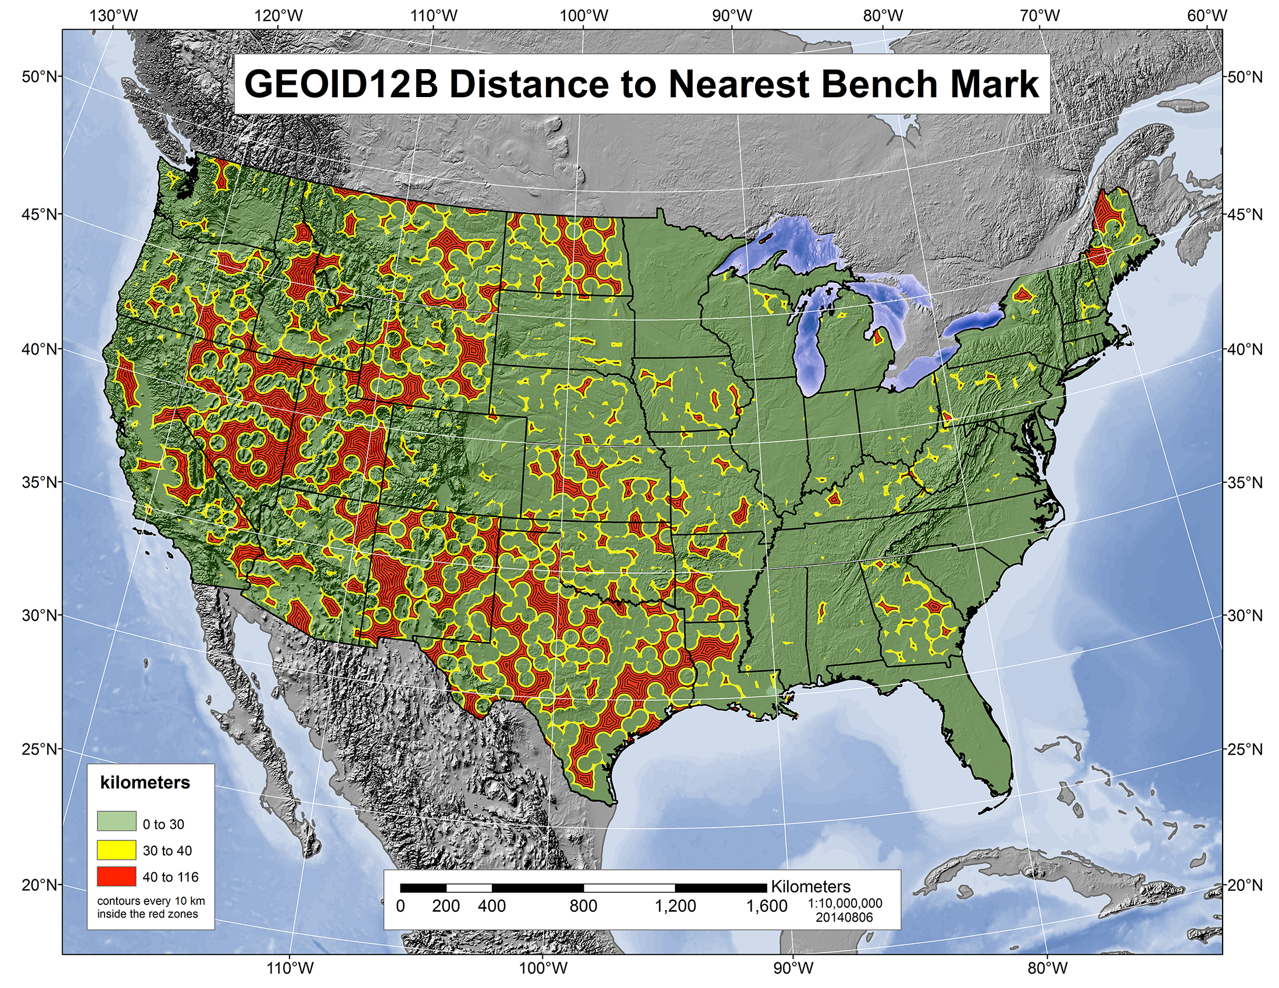
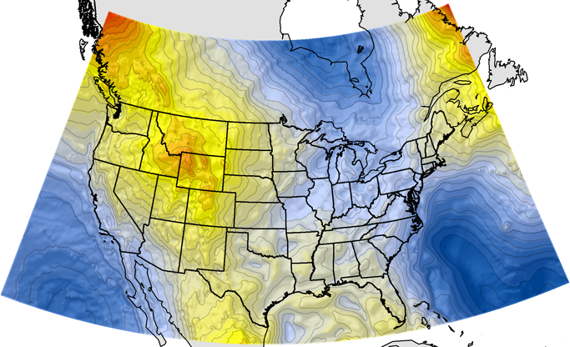
Why share your data?
Fast, easy, convenient
  Choose the ‘share’ option when uploading to OPUS
  Minimal user input
  Results delivered by email
Contribute, update, and improve NSRS
Help create maps used in various industries such as infrastructure planning, transportation, and environmental management
Help create geodetic models depicting geophysical processes
Help local surveying community by updating mark positions, condition, and description
Notes:
-OPUS-Share is easy and fast
-Great way to provide data to public
-Assist NGS with goals of improving NSRS and creating accurate geoid models

Slide 37
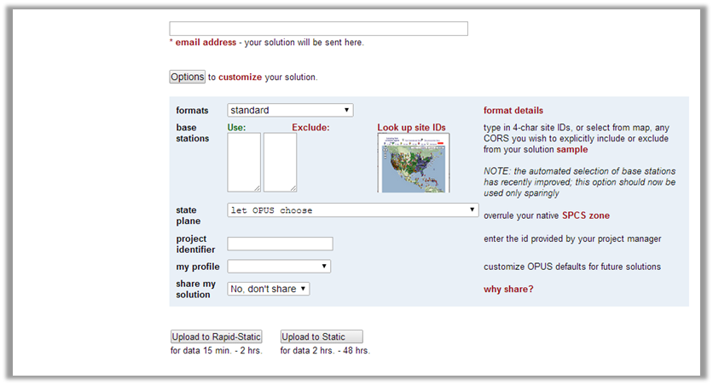
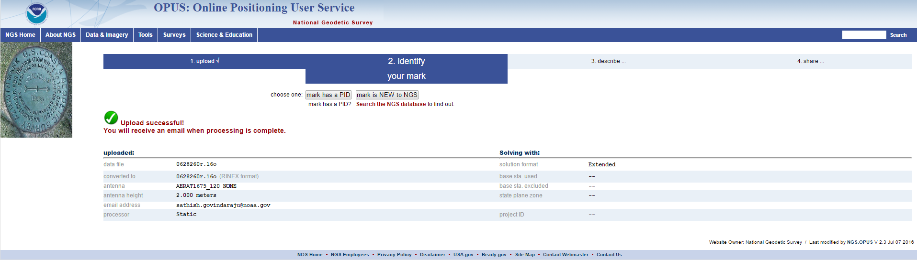
How to Share
Click “Options” on OPUS home page, then “yes, share”
Notes:
-Select yes, share then “Upload to Static”
-If upload successful, select whether mark has PID or is new to NGS

Slide 38
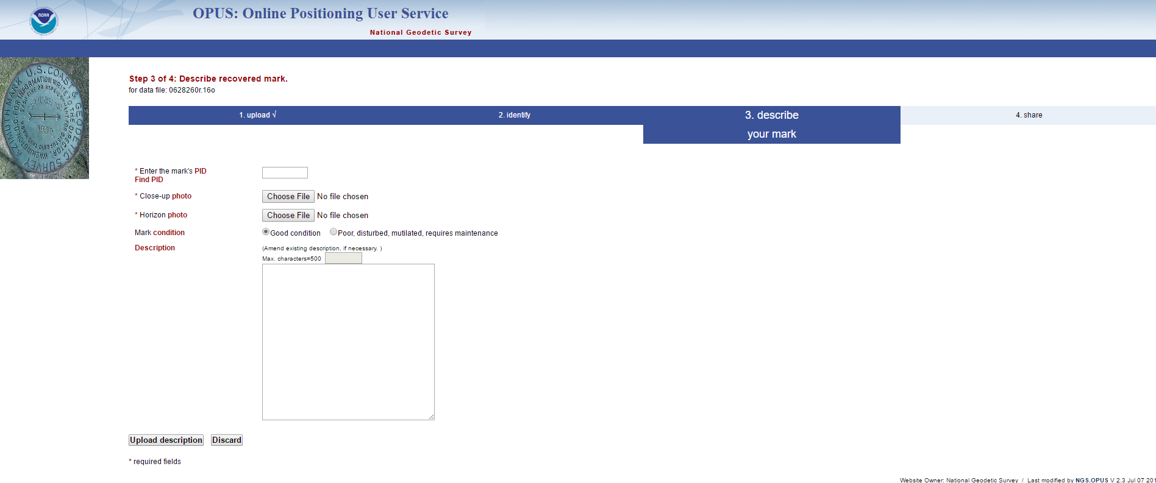
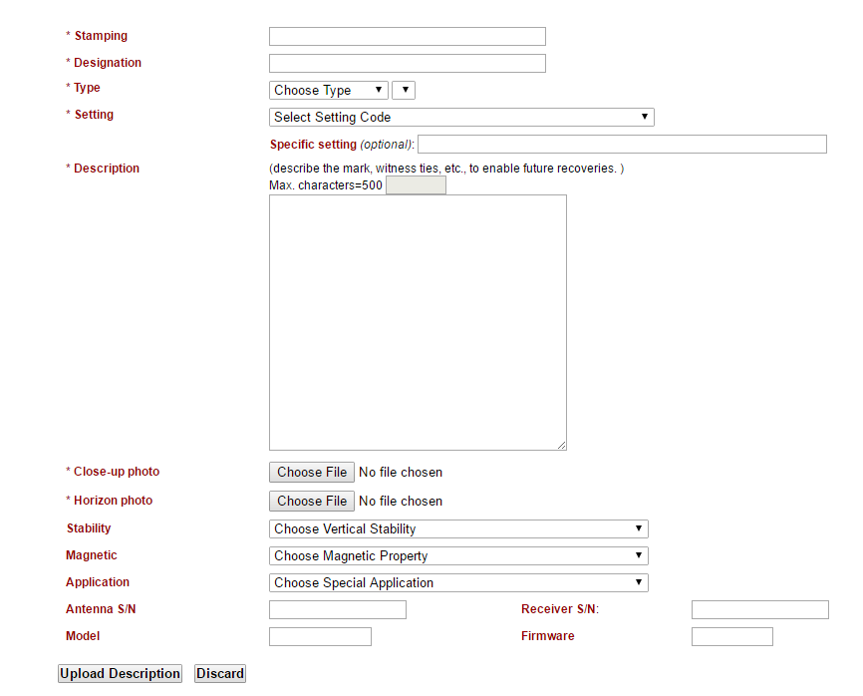
Recovered vs. New Description Screens
Recovered marks:
PID, photos, condition, description (if necessary)
New marks:
Stamping, designation, type, setting, description, photos, etc.
Notes:
-Fields with “*” are required
-Marks with PID takes users to page on the left, new marks takes users to page on the right
-Select “Upload Description” after filling out fields

Slide 39
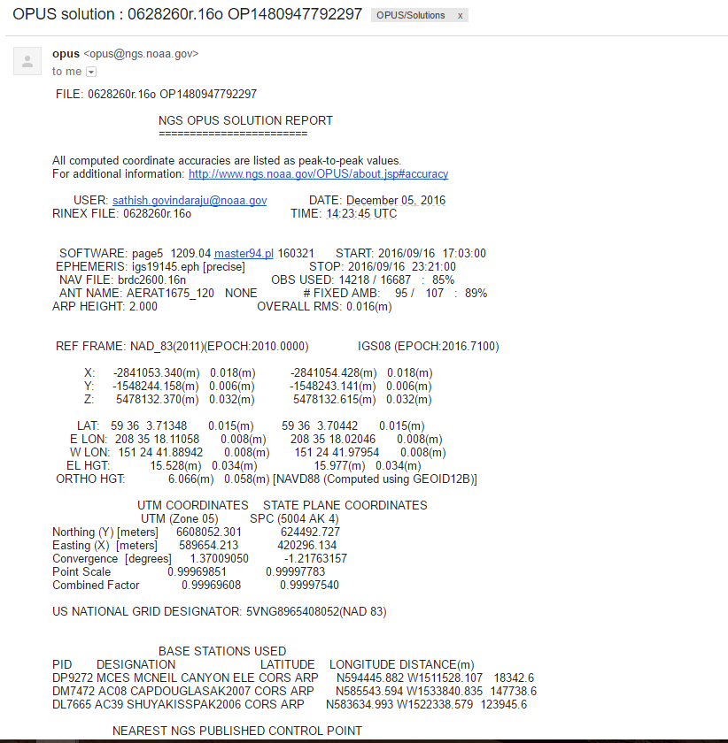
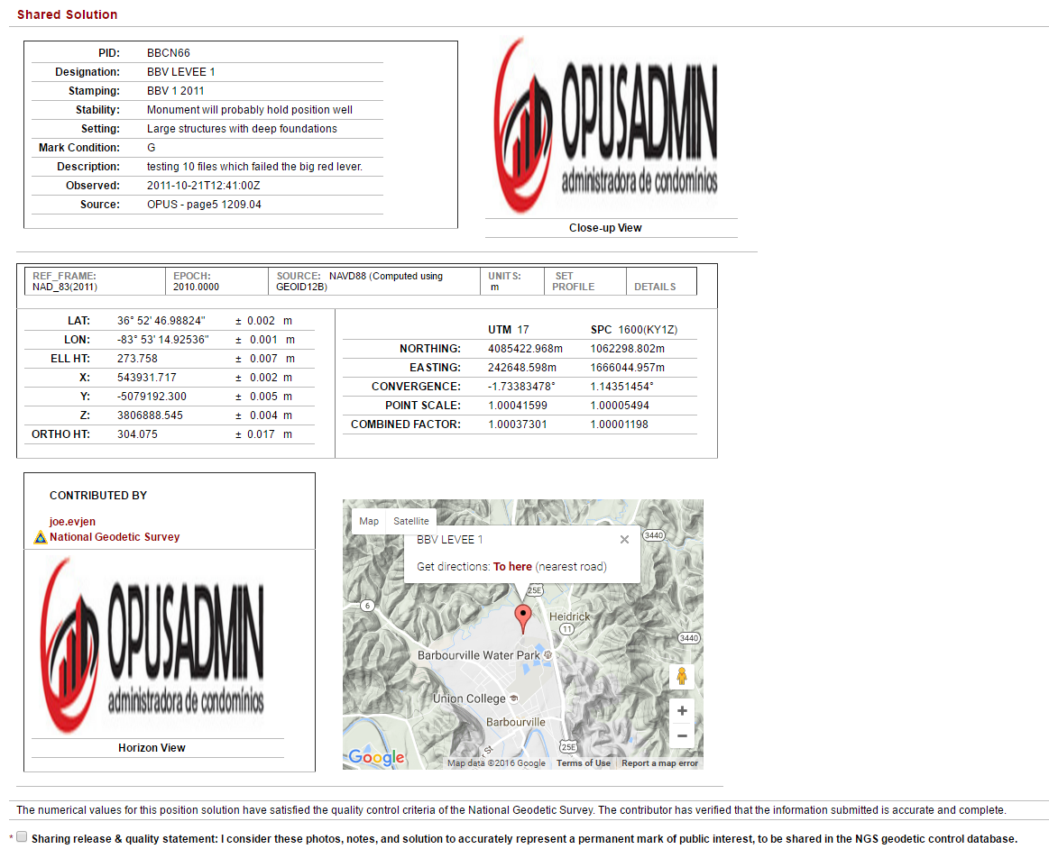

Notes:
User receives 3 e-mails:
-1st e-mail: OPUS solution report shown on left
-2nd e-mail: Draft of OPUS data sheet shown on right. Can EDIT any mistakes or DISCARD completely. Select checkbox and SHARE to share solution after confirming information is correct
-3rd e-mail: After OPUS team member does final QC, mark is loaded to OPUS-Share-DB. User receives confirmation that mark is shared and link to the final draft of OPUS datasheet

Slide 40
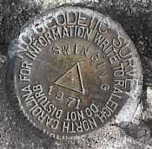
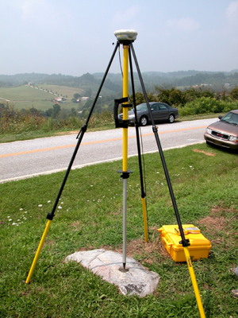

Shared solutions: describe the mark to share it.
Located in the SW corner of a 2 ft square concrete pad projecting 0.3 ft above ground, 3.3 ft S from S edge of sidewalk …
Requires 4+ hours on a permanent mark of public interest
Provide detailed description of how to locate mark (distance/direction to at least 3 reference objects)
Ensure your antenna height and type values are accurate and reflect what is seen in the horizon photo
http://geodesy.noaa.gov/marks/sharing/
Notes:
- We keep the minimum session time at 4 hours for OPUS share
- Longer sessions = better probability of fixing ambiguities and cancelling some errors in GNSS
Incorrect antenna height is often the cause of an inaccurate orthometric height
Example description at the top

Slide 41
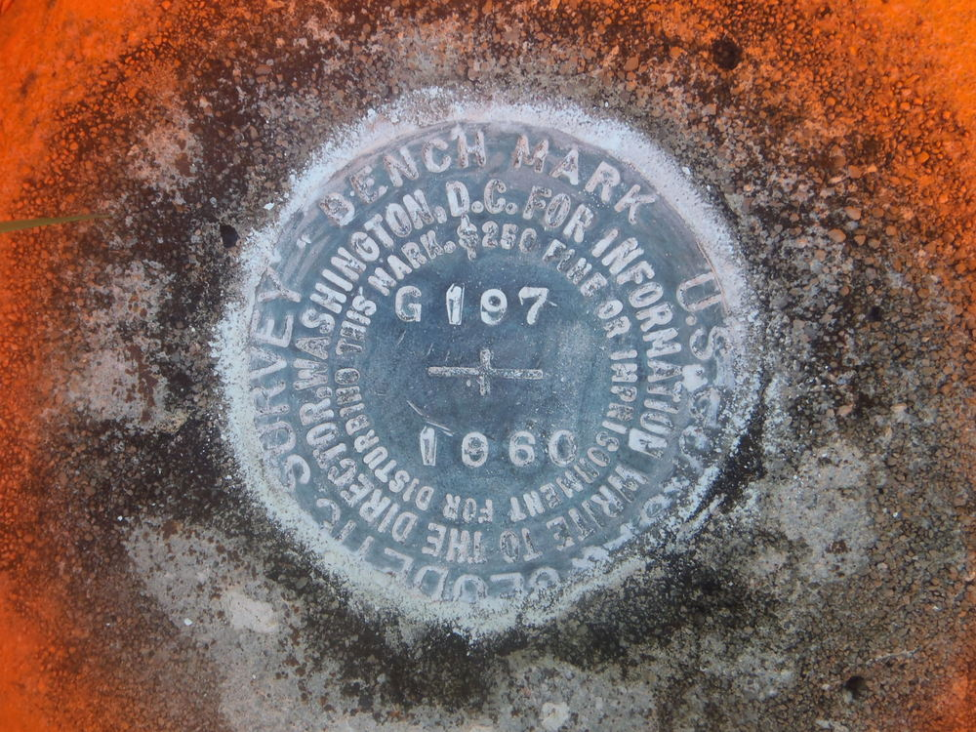
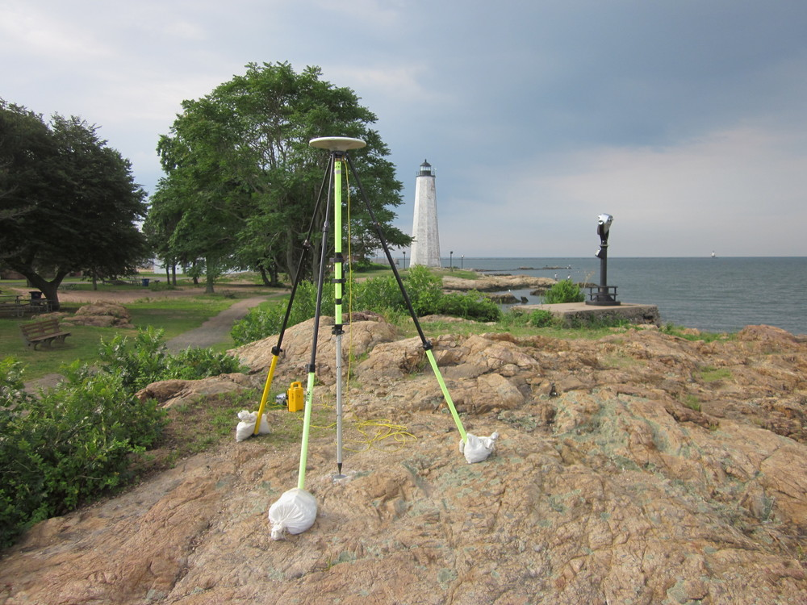
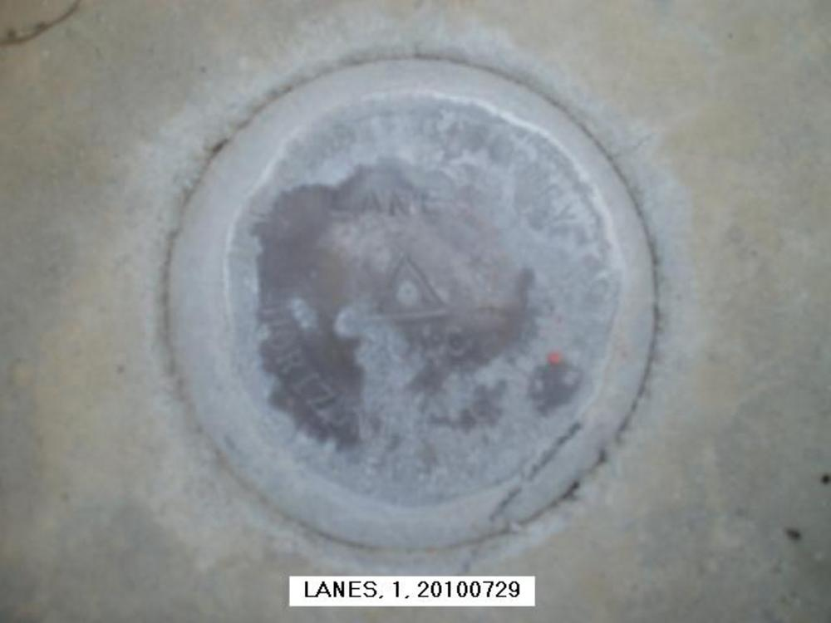
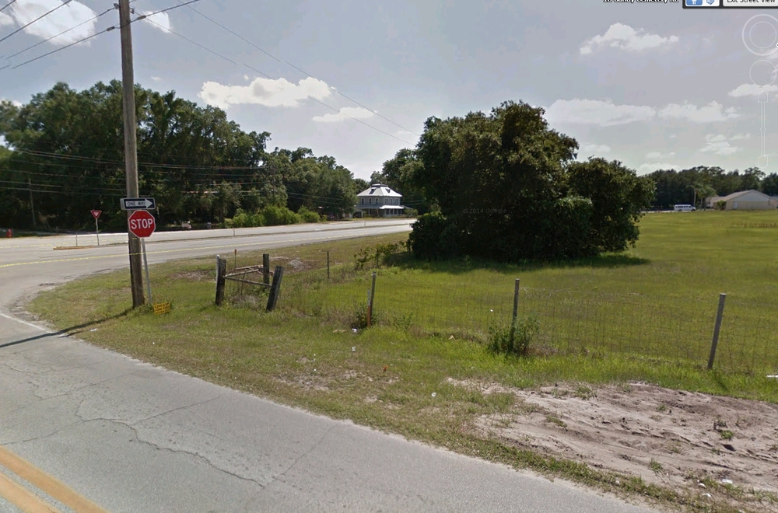
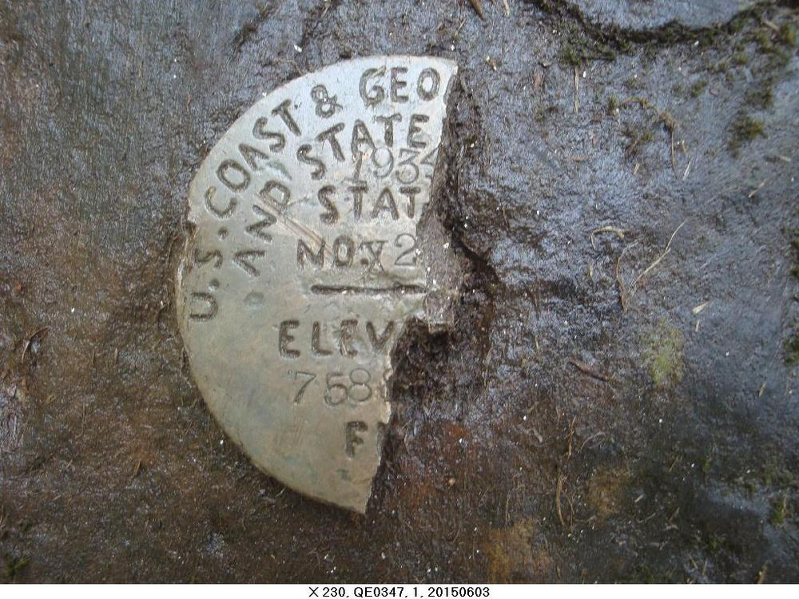
Best and Worst Practices
Best:
Clear, distinct close up and horizon photos
Stamping clearly visible, no blur, avoids shadows
Equipment shown, location clear, mark distinct
Worst:
Equipment blocking stamping
Photo is blurry, stamping is difficult to read
Location of mark not clear
Notes:
The best photos are clear and are good indicators of the mark location
- close up: clear stamping, no equipment, no debris or shadows
- horizon: equipment shown, mark location distinct

Slide 42
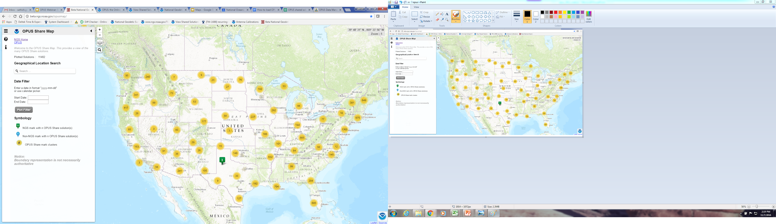
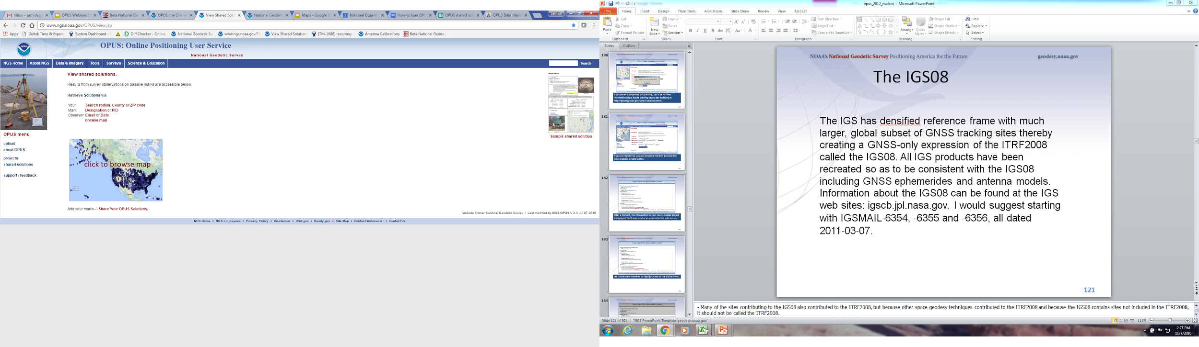
Finding Shared Solutions
Finding shared solutions across the country is simple and convenient:
  http://beta.ngs.noaa.gov/opusmap/
  This map allows you to search by location or filter by a range of dates
  Shows number of solutions in the area and provides link to all datasheets available for the mark
  http://www.ngs.noaa.gov/OPUS/view.jsp
  Tool allows you to search by PID, designation, location, user e-mail, and date
  Provides all datasheets available for the mark
  Solutions provided in HTML, XML, and
  shapefile format
Notes:
OPUS Beta Map:
- search by location or date
- Map is highly functional and responsive
OPUS tool:
- More search options, solutions in HTML, XML and shapefile

Slide 43
RICK’S SLIDES
OPUS overview, options and alternatives – Dave
  typical accuracies, popularity over time
  Static vs rapid-static vs projects vs net vs PPP
  how they work
OPUS reports and common mistakes – Joe
  explain formats, common error codes
OPUS projects and shared solutions - Rick, Sathish and Kim
  why, how, what’s been shared so far
planned and recent upgrades – Weibing
implications for OPUS and NSRS from IGS14 and 2022. - Mark S.
  “the world moves on”
Your questions answered! send questions to ngs.opus@noaa.gov

Slide 44
OPUS Projects
Notes:
Slides provided by Mark Armstrong, NGS’s NW Region Geodetic Advisor

Slide 45
What is OPUS Projects?
OPUS Projects offers Web-based access to simple visualization, management and processing tools for multiple marks and multiple occupations. Some of its advantages include:
Data uploading through OPUS.
Processing using the PAGES software.
Graphical visualization and management aids.
Limited support of bluebooking.

Slide 46
  OPUS-projects:
  first, run OPUS to harvest all project data
  OPUS automatically forms sessions from simultaneously observed marks, enabling multi-baseline processing and adjustment of redundant observations.
Improved solutions for simultaneous or repeated observations
harvest data from multiple observers
share upload & processing tasks
customize your processing using PAGES
simple data quality analysis
improve survey accuracy
constrain to local networks
publishing support (limited)

Slide 47
OPUS Projects for Managers
OPUS Projects (OP) is part of the OPUS suite of programs.
OP is NGS cloud software for baseline processing and adjustment of GPS observations on multiple marks in multiple sessions. Ideal for GPS control networks.
OP may be used to align geodetic networks to the National Spatial Reference System (NSRS). This is realized using the NGS CORS network.
The NSRS is a consistent coordinate system that defines latitude, longitude, height, scale, gravity, and orientation throughout the United States.

Slide 48
OPUS Projects for Managers Classes
OP is accessed through your Internet browser. You must be trained as an OP Manager and then your email address will allow you to create projects.
OPUS Projects for Managers training is available…
To sign up for a class see the NGS training web page here:
    http://www.ngs.noaa.gov/corbin/calendar.shtml
    Many OP trainers are NGS Geodetic Advisors
      (NGS Geodetic Services Division)
There maybe other agency or private trainers
You may have to travel to get training
Class is 1.5 days long (certificates provided - normally 12 pdh)

Slide 49
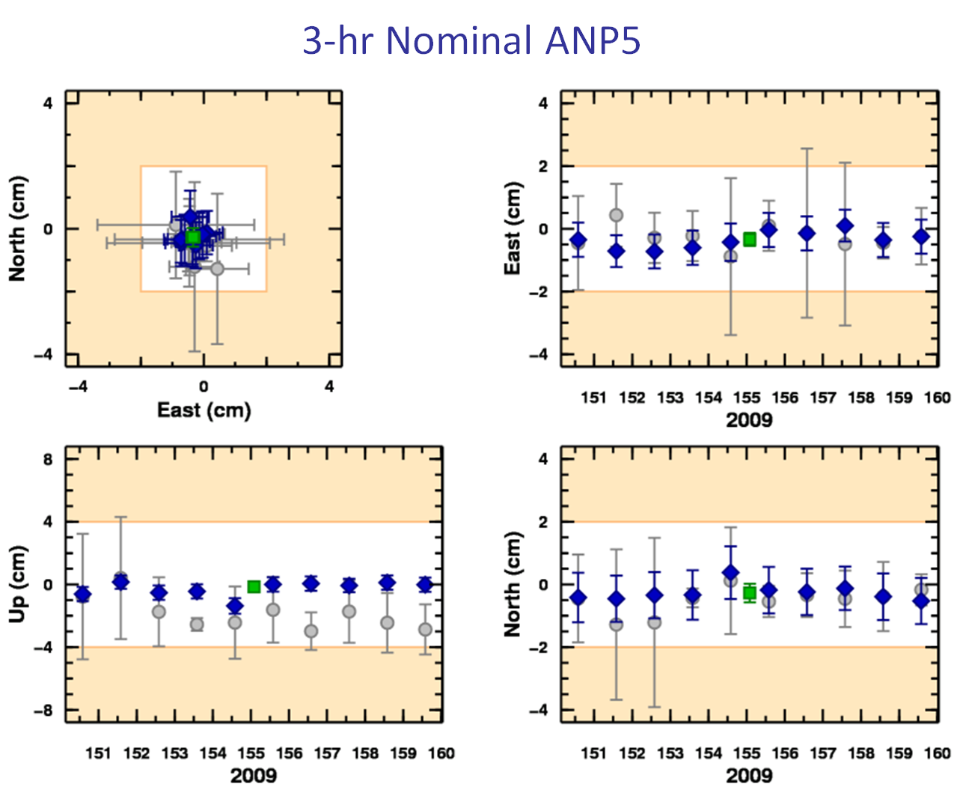
What’s in it for me?
OPUS solutions = pretty good, but each treated as independent and assumes “perfect” CORS.
Sessions = simultaneously-observed marks processed together in sessions increases consistency.
Adjustments = interlinking sessions through network adjustments increases accuracy.
Notes:
Note: “normal” +- 2cm. horizontal accuracy, +- 2cm vertical accuracy.

Slide 50
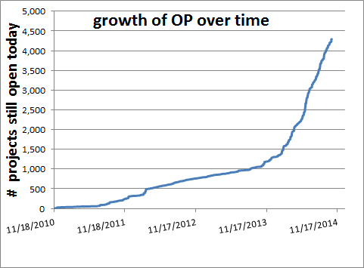
Growth of OPUS Projects
OP operational version was announced on the NGS website on 1-28-2014
Beta Use
Operational Use
Notes:
Steep growth, but just a small fraction of all OPUS runs

Slide 51
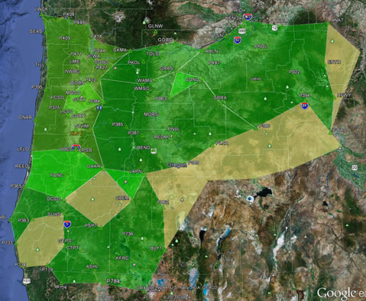
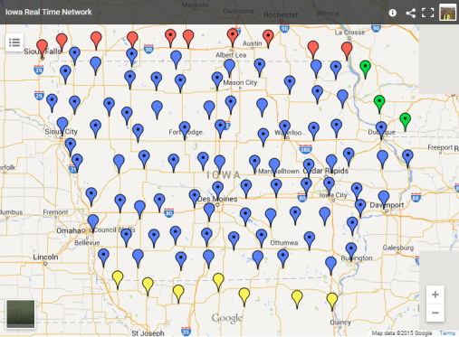
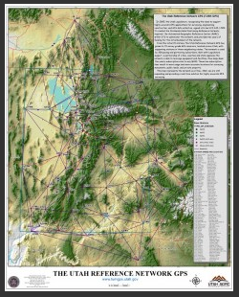
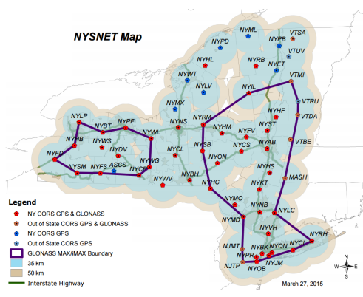
Real-Time Networks aligned with the NSRS using OP
Oregon (ORGN) ~93 stations
Iowa (laRTN) ~98 stations
New York (NYSnet) ~63 stations
Utah (TurnGPS) ~73 stations
Minnesota (MnCORS) ~136 stations
  and many more.
  NGS NSRS validation still
  developing…
  (NOS 2015 Milestone)
Notes:
RTN validation currently in Developmental mode. Should become Beta in early to mid 2017.

Slide 52
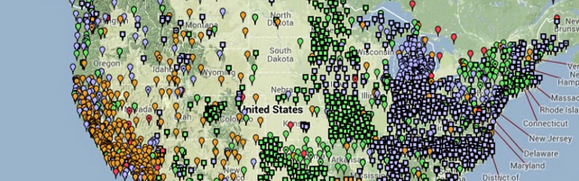
State DOT’s with trained OP Manager(s)
OR, NY, IA, MN, MT, VT, NC, SC, FL, WI, NH, WA, AK, CA, AR, NM, AL, LA, MI, VA, MS, UT, & more
GPS static survey control for transportation projects…
Bridges, highway construction, rights of way, paving, lidar, mobile scanning, terrestrial scanning, photogrammetry, roadside inventory, signing, machine control, GIS…all aligned with the National Spatial Reference System. NSRS

Slide 53
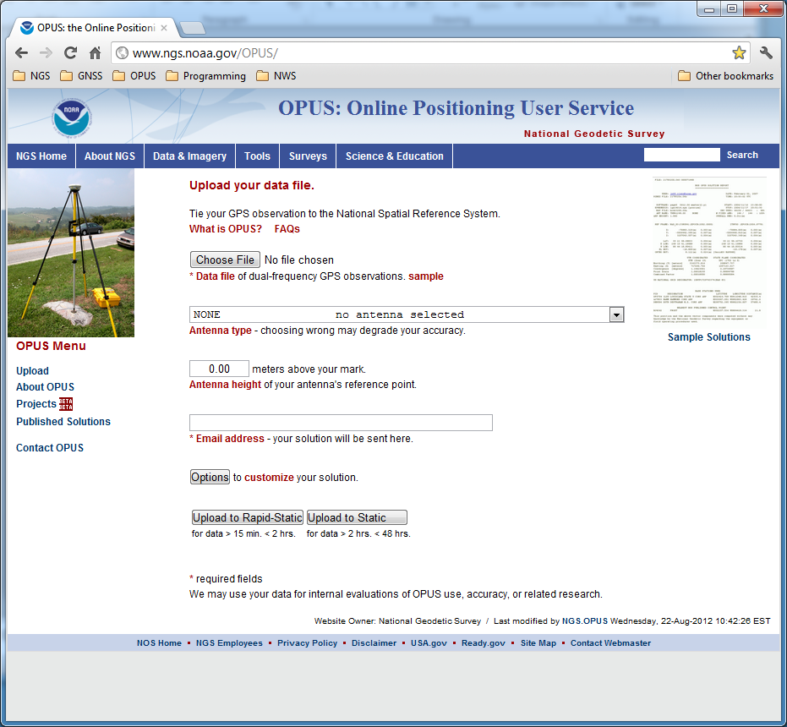

OPUS PROJECTS
QUESTIONS?
The OPUS upload page is the access point for all things OPUS.
2016-12-08
Notes:
The OPUS gateway page is found at http://geodesy.noaa.gov/OPUS/.
OPUS Projects will only work for trained personnel. See http://geodesy.noaa.gov/corbin for class details.

Slide 54
Future developments
In early to mid 2017, there is a plan to have an option for OPUS Projects where the results can be entered into the NGSIDB (Integrated Database). This option is currently in development.
There is also a future plan to allow OPUS Projects be entered into OPUS Sharing.
If you want to learn more about OPUS Projects without first taking the 1 ½ day class, you can look through the OPUS Projects Manual http://www.ngs.noaa.gov/corbin/online_learning.shtml (the link is at the bottom of the page).
Also, NGS’s Northeast Regional Geodetic Advisor, Dan Martin, created the following one hour presentation so interested parties can get a better feel about if the training class will fit their needs: http://www.ngs.noaa.gov/corbin/class_description/What_is_OPUS_Projects.shtml .
Notes:
OP-NGSIDB should be available in early to mid 2017.
OP-Sharing is in the planning stages.

Slide 55
WEIBING’S SLIDES
OPUS overview, options and alternatives – Dave
  typical accuracies, popularity over time
  Static vs rapid-static vs projects vs net vs PPP
  how they work
OPUS reports and common mistakes – Joe
  explain formats, common error codes
OPUS projects and shared solutions - Rick, Sathish and Kim
  why, how, what’s been shared so far
planned and recent upgrades – Weibing
implications for OPUS and NSRS from IGS14 and 2022. - Mark S.
  “the world moves on”
Your questions answered! send questions to ngs.opus@noaa.gov

Slide 56
Planned and Recent Upgrades

Slide 57
OPUS Upgrades and Improvements
Install xGeoid16B grids in OPUS-S and OPUS-RS extended solution report in place of USGG2012.
Use Inverse program to obtain ellipsoidal distance to replace previous sphere distance at NEAREST CONTROL POINT section distance between control point and user site.
Are able to process RINEX3 datafiles through OPUS suite.
Filter out the L1 PHASE CENTER marks for public nearest control points .
Applying cc2noncc to improve RMS values for OPUS-RS. This remove (P1 - C1) biases for many OBS files with only C1 no P1.
XML output for RS solution layout is fixed and now same as OPUS-S one.

Slide 58
OPUS Upgrades and Improvements
Adding +C2 and max_rx_SVs 50 options to TEQC. These add more L2C data and more satellite data in RINEX files for user and CORS station in OPUS-S and OPUS-RS.
Implement balance loading algorithm to threads to minimize load of similar email users to wait longer in the queue.
Fix data file time duration limit for OPUS-RS and OPUS-S. For OPUS-S, the OBS time is longer than 1 hour 55 mins. For OPUS-RS the OBS time is shorter than 2 hour and 5 mins.
For OPUS-RS, switch reference stations selection method to QUADBASE. This improves RMS and standard deviation.
Consolidate Upload scripts and OPUS-S and OPUS-RS for common shared codes.

Slide 59
OPUS future plans
Linux-OPUS will be developed and easily maintain. This is preliminary task for Cloud-OPUS.
New IGS14 Reference Frame test version to be released.
OPUS-NET to be revised to compare with OPUS-S.

Slide 60
MARK’S SLIDES
OPUS overview, options and alternatives – Dave
  typical accuracies, popularity over time
  Static vs rapid-static vs projects vs net vs PPP
  how they work
OPUS reports and common mistakes – Joe
  explain formats, common error codes
OPUS projects and shared solutions - Rick, Sathish and Kim
  why, how, what’s been shared so far
planned and recent upgrades – Weibing
implications for OPUS and NSRS from IGS14 and 2022. - Mark S.
  “the world moves on”
Your questions answered! send questions to ngs.opus@noaa.gov

Slide 61
ITRF2014, IGS14, and NAD 83

Slide 62
ITRF2014.
The “gold standard” for the very highest accuracy geodesy and geophysics surveying is the International Terrestrial Reference Frame (ITRF). The ITRF is produced by the International Earth Rotation and Reference System Service (IERS).
Many organizations participate in this effort by contributing results from various technologies including GNSS.
(see https://www.iers.org for more information).
This year, 2016, the IERS released an updated realization for the ITRF called the ITRF2014.

Slide 63
Densification.
The ITRF2014 is expressed through the coordinates and velocities of 158 marks plus supporting information.
Other organizations can take this information, add data from their own marks, perform their own adjustment and align it to the ITRF2014. This is called densifying the reference frame.
While these densification variants are formally consistent with the ITRF2014, they are unique from the ITRF2014 in the strictest sense; therefore, they are given unique names.

Slide 64
IGS14
The International GNSS Service (IGS) participates in the IERS and produces densified, GNSS-only realizations of the ITRF. Its current version is the IGb08 (“b” indicates that this is an updated version of the original IGS08 and the “08” indicates it corresponds to the ITRF2008), but is in the process of preparing the IGS14 for release in February 2017(?).
The IGS14 will include coordinates and velocities for 252 sites, but should also be thought of as including updated GNSS ephemerides, antenna models and other supporting information. As release date nears, information will be made available by the IGS (see http://www.igs.org/).

Slide 65
CORS
NGS is in the process of densifying the IGS14 to include the CORS network. This process should be completed early next year (2017).
Changing from the IGb08 to the IGS14 might seem “scary”, but it is merely a necessary annoyance:
Necessary in that it clearly delineates a switch to updated models, and the use of years more data in the definition of the coordinates and velocities of the included sites.
An annoyance in that the change is negligible for most applications.

Slide 66
OPUS
Shortly after the release of CORS IGS14 coordinates and velocities, OPUS is planning to offer the option of receiving results in the IGS08 or IGS14.
This option will be available for several months giving you the opportunity to prepare for this change and perform tests using your own data if you desire.
You might recall that we did something similar for the change to the IGS08.

Slide 67
NAD 83 (2011) and Passive Marks
Although a final decision is pending, I (MSS) believe NGS will not change the NAD 83 (2011) or coordinates for passive marks because:
The differences between the IGb08 and IGS14 are essentially negligible, so the global reference frame change does not justify an update to the national datum.
The time and effort needed can be better spent preparing for the replacement of the NAD 83 in 2022 or there abouts.
For more information about the replacement of the NAD 83, see:
“NSRS Modernization Update”, Dru Smith, November, 2016.
http://geodesy.noaa.gov/web/science_edu/presentations_library/files/cbl_presentation.ppt

Slide 68
IGS14 vs IGb08
We’ve stated that the differences between the IGS14 and IGb08 are essentially negligible. What is our proof?
The comparison between the ITRF2014 and ITRF2008: a couple millimeters of change for the geocenter, effectively zero for the scale and rotations.
Mark-by-mark comparisons reveal sub-centimeter changes for sites with “long” histories, but there are larger changes for sites considered to have short histories when their IGS08 coordinates were defined.
 | T1 | T2 | T3 | D | R1 | R2 | R3
 | mm | mm | mm | 10-9 | mas | mas | mas
 | 1.6 | 1.9 | 2.4 | -0.02 | 0.000 | 0.000 | 0.000
+/- | 0.2 | 0.1 | 0.1 | 0.02 | 0.006 | 0.006 | 0.006
http://itrf.ign.fr/ITRF_solutions/2014/tp_14-08.php

Slide 69
Questions

