Slide 1
NADCON 5
Andria Bilich
Dru Smith
NOAA’s National Geodetic Survey

Slide 2
Outline
Historical Overview
NADCON 5

Slide 3
Part 1

Slide 4
History: NADCON

Slide 5
Historical Overview: NADCON 1.0
1989 : NAD 83(1986) released
1990: NADCON v1.0 released
“NAD 27 to NAD 83”
Actually:
NAD 27 to NAD 83(1986) in CONUS
NAD 27 to NAD 83(1986) in Mainland & Aleutian Alaska
PR40 to NAD 83(1986) in Puerto Rico
OHD to NAD 83(1986) in Hawaii
SG1952 to NAD 83(1986) in St. George Island
SP1952 to NAD 83(1986) in St. Paul Island
SL1952 to NAD 83(1986) in St. Laurence(sp) Island

Slide 6
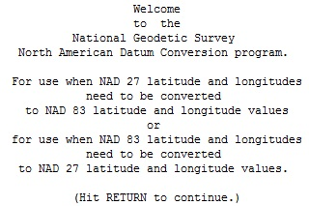
Historical Overview: NADCON 1.0
DOS based
FORTRAN executable

Slide 7
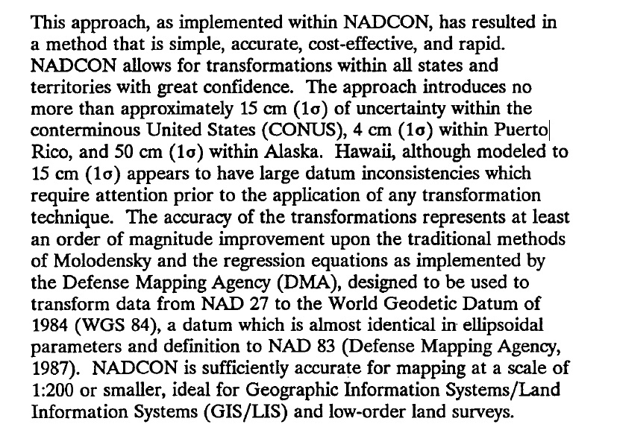
Historical Overview: NADCON 1.0
Region | Accuracy lat/lon
CONUS | 16 cm / 15 cm
Puerto Rico | 4 cm / 5 cm
Alaska | 48 cm / 46 cm
Hawaii | 22 cm / 15 cm
St. George | 3 cm / 2 cm
St. Laurence | 3 cm / 2 cm
St. Paul | 17 cm / 10 cm
Gulf of Mexico (offshore) | 1-3 meters

Slide 8
Historical Overview: NADCON 2.1
1990 through 1997: HARNs released, state-by-state
NADCON expands (v2.10) to include state-by-state transformations
“NAD 83(HPGN) to NAD 83(1986)”
State-by-state (sometimes sub-state, sometimes multi-state):
AK, AL, FL, TN, WI, LA, CO….
WA/OR, MD/DE, PR/VI, ME/VT/NH/CT/RI
CA (north) , CA (south)
TX (west), TX (east)
American Samoa (west), American Samoa (east)

Slide 9
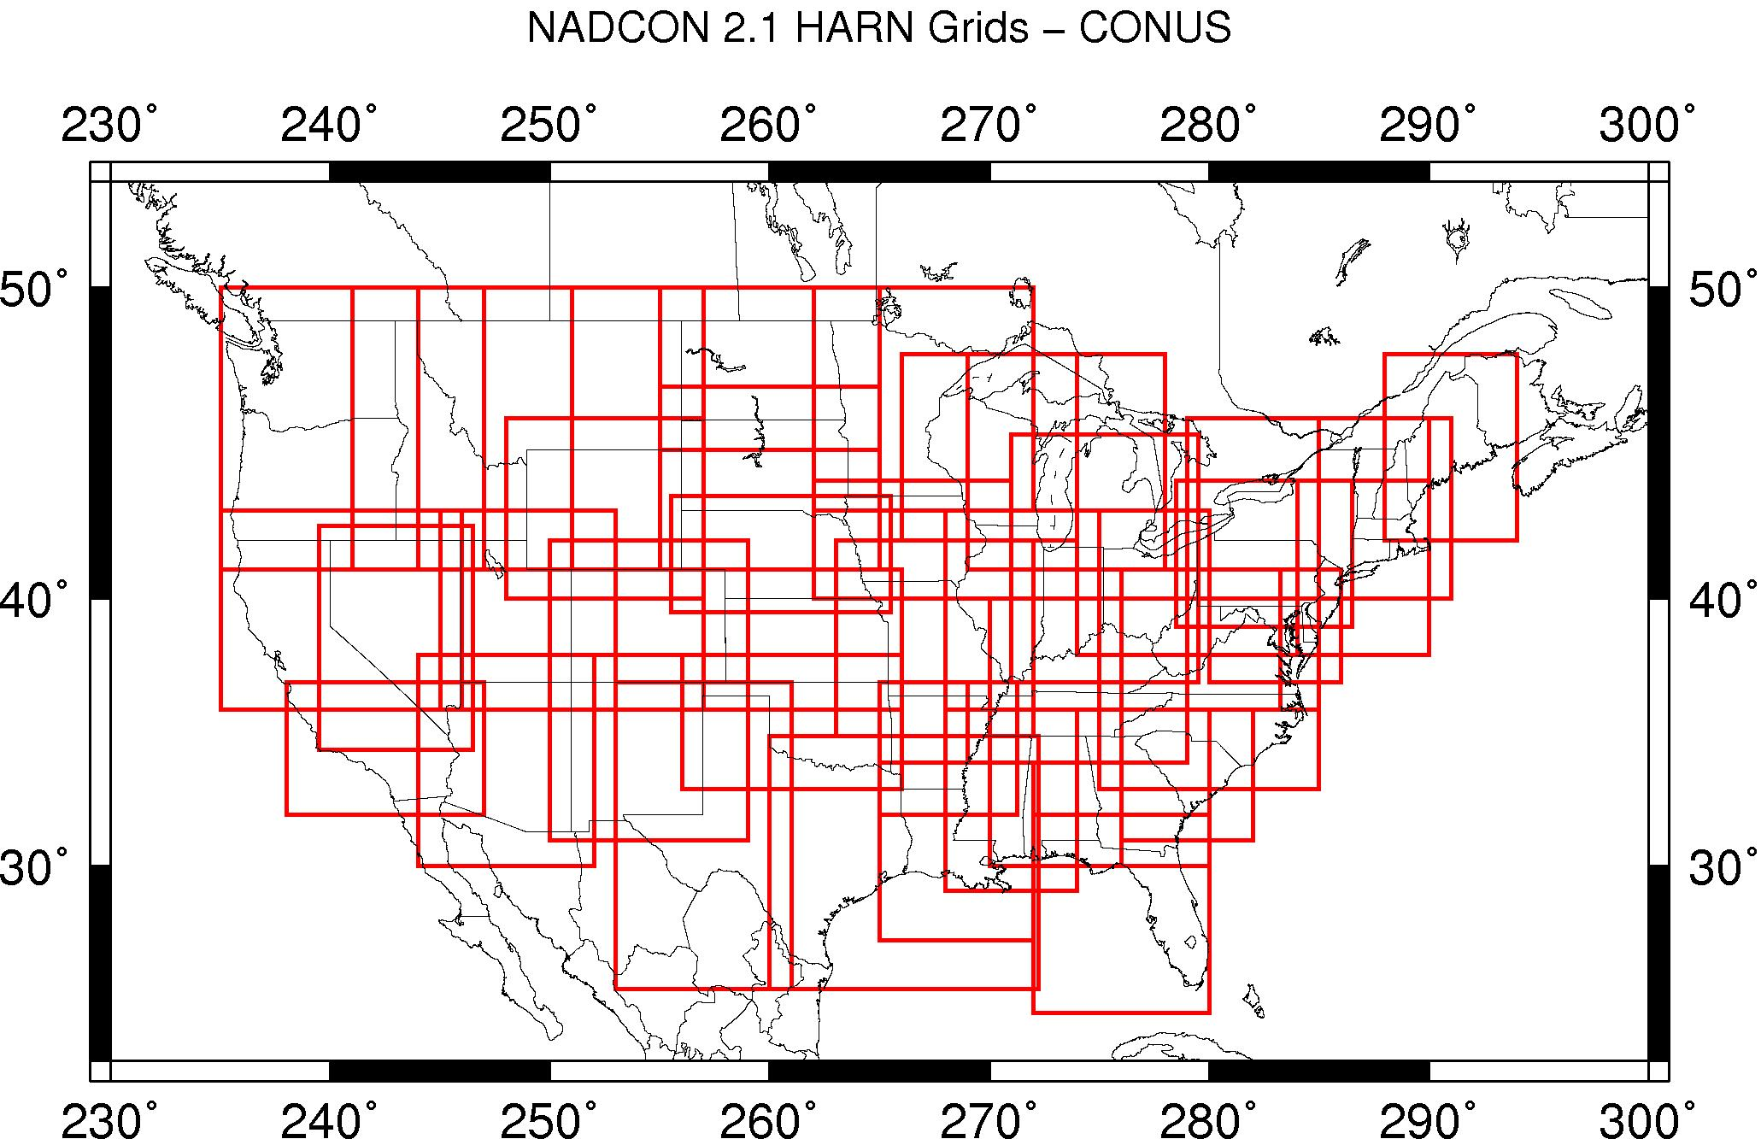
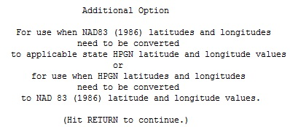
Historical Overview: NADCON 2.1
DOS based
FORTRAN executable

Slide 10
Historical Overview: NADCON 2.1
1997 through 2005: FBNs released, state-by-state
Only 19 states saw significant changes from the HARN to have a new “datum tag”
Examples:
Wisconsin has NAD 83(1991) and NAD 83(1997) in the IDB
Ohio has only NAD 83(1995)
NADCON v2.10 continued to expand through these years.
It is not clear if whether all grids called “hpgn” in NADCON 2.10 are actually HARN or whether some are FBN.
There is effectively no documentation of the process.

Slide 11
Historical Overview: NADCON 4.2
Around 2004 or so, NGS contracted out to have NADCON updated
JAVA based, downloadable, menus/windows driven
Released as NADCON 4.2
Difficult to install, errors in hindsight
In 2005 NGS agreed to build a USSD to NAD 83(1986) expansion to NADCON
“Leaping over” the NAD 27 to NAD 83(1986) transformation

Slide 12
History: GEOCON & GEOCON11

Slide 13
Historical Overview: GEOCON 1.0
2007: Nationwide Adjustment of all GPS vectors
Customers began calling for a “HARN to 2007” expansion of NADCON
NGS resisted, indicating the scale of the changes was so small as to be “gridding noise”
Hired Dennis Milbert to investigate
Plenty of signal, but at about the same magnitude as the noise
A nationwide transformation program built: GEOCON v1.0
Tied “the last pre-2007, post-1986 published coordinate” on a point to its 2007 coordinate
Mix of HARN and FBN without distinction
DOS based FORTRAN executable
NGS expanded that to an online computation page

Slide 14
Historical Overview: GEOCON11
2011: Nationwide Adjustment of all GPS vectors
Expanded Dennis Milbert’s contract to build a 2007 to 2011 expansion to GEOCON: GEOCON 11
A nationwide transformation program
DOS based FORTRAN executable
NGS expanded that to an online computation page

Slide 15
Historical Overview: GEOCON / GEOCON11 v1.1
2012: Began work on GEOCON v1.1 and GEOCON11 v1.1
Fixed a few bugs
Combined a few manuals
Allowed free-format, not just Bluebook, input/output

Slide 16
Historical Overview: GEOCON v2
2014: GEOCON v2.0 released
Complete overhaul of GEOCON and GEOCON v1.1
Combined both into 1 program
Rigorously defined “supported” transformations in each state/territory
No more “mix of HARN and FBN” for any transformation
HARN to FBN: State-by-State (Like NADCON’s 83/HPGN)
FBN to 2007: Nationwide
2007 to 2011: Nationwide
Also supported 1993/1997/2002 realizations in Puerto Rico

Slide 17
Historical Overview: Problems
To transform from NAD 27 to NAD 83(2011) in Kansas
Run NADCON 4.2 to compute
NAD 27 to NAD 83(1986) grid (nationwide)
NAD 83(1986) to NAD 83(HPGN) grid (statewide)
Run GEOCON 2.0 to compute
HARN to FBN grid (statewide)
FBN to 2007 grid (nationwide)
2007 to 2011 grid (nationwide)
Add everything up yourself
Have a nice day

Slide 18
Historical Overview: Problems
Multiple DOS based programs
Lack of documentation
Inconsistent decision making
Accuracy reporting
State vs nationwide grids
Skipping over transformations
“Missteps” made by NGS…
Too many to list and that would just be airing dirty laundry
If you care, read the report.

Slide 19
Part 2

Slide 20
What is NADCON v5.0?
Transformations and error estimates for any point within a regional boundary, provided through biquadratic interpolation off of a grid
Lat/lon in arcseconds
Ellipsoidal height in meters
How?
Fresh pull of IDB
New suite of analysis tools
New grids from scratch
Skip no realizations
Make available through Geodetic Toolkit

Slide 21
Regional Approach
CONUS
Alaska (+ St. islands)
Hawaii
Puerto Rico and US Virgin Islands
American Samoa
Guam and Commonwealth of Northern Mariana Islands
No state-wide realizations (e.g. HARN)
USSD to NAD83(1986) not supported [must go through NAD27]
NAD83_HARN and NAD83_FBN are groupings of HARN and FBN

Slide 22
Included Datums
Region | Datums
CONUS | USSD, NAD27, NAD83(1986), NAD83(HARN), NAD83(FBN), NAD83(2007), NAD83(2011)
Alaska | NAD27, NAD83(1986), NAD83(1992), NAD83(2007), NAD83(2011)
Alaska – Saint islands
Hawaii | OHD, NAD83(1986), NAD83(1993), PA11
Puerto Rico and US Virgin Islands | PR40, NAD83(1986), NAD83(1993), NAD83(1997), NAD83(2002), NAD83(2007), NAD83(2011)
American Samoa | AS62, NAD83(1993), NAD83(2002), PA11
Guam/CNMI | GU63, NAD83(1993), NAD83(2002), MA11
31 transformations

Slide 23
NADCON5 Process (1/2)
Pull from IDB
one record for every instance that a latitude, longitude, or an ellipsoid height was loaded into the NGS IDB
Outlier Removal
~6000 outliers in all transformations
Thin the Data
Most outliers: NAD83(HARN) to NAD83(FBN) [2590]
ID’d by statistical and “eyeball” methods
Coordinate Differences
Grid the Data
Vector = new_datum minus old_datum
Plots of vectors, coverage
Error analysis

Slide 24
NADCON5 Process (2/2)
Pull from IDB
Outlier Removal
Thin the Data
Grid the Data
Use a median filter to separate data into “thinned” and “dropped”
Thinned (transformation) vs dropped: (error formulation)
Requires choosing a cell size
Fit a surface under tension to thinned data
Surface expressed as grid (lookup table)
Error analysis
Build error grid (lookup table)
All vectors used in error formulation
Coordinate Differences

Slide 25
Pull from IDB
Examples:
USSD to NAD27
US Standard Datum | NAD 27
AA9371 TX 453 N301622.34000 W0974420.01000 N/A | N301622.45000 W0974419.16000 N/A
AA9372 TX 453 N301626.15000 W0974420.01000 N/A | N301626.24000 W0974419.16000 N/A
AB0076 TX 061 N255754.23000 W0971201.91000 N/A | N255754.37580 W0971200.95657 N/A
AB0225 TX 061 N260619.42900 W0971915.79500 N/A | N260619.57300 W0971914.85300 N/A
AB0289 TX 061 N260845.57000 W0972809.47200 N/A | N260845.77867 W0972808.60964 N/A
AB0338 TX 061 N260341.34400 W0971609.71700 N/A | N260341.48900 W0971608.77400 N/A
AB0917 TX 215 N260507.70300 W0975157.70400 N/A | N260507.83900 W0975156.76000 N/A
AB0992 TX 261 N263645.56300 W0974517.08600 N/A | N263645.69300 W0974516.14900 N/A
AB1366 TX 061 N255728.87000 W0971516.23000 N/A | N255729.02000 W0971515.29000 N/A
Notes:
Adjusted only
Chronologically back to back

Slide 26
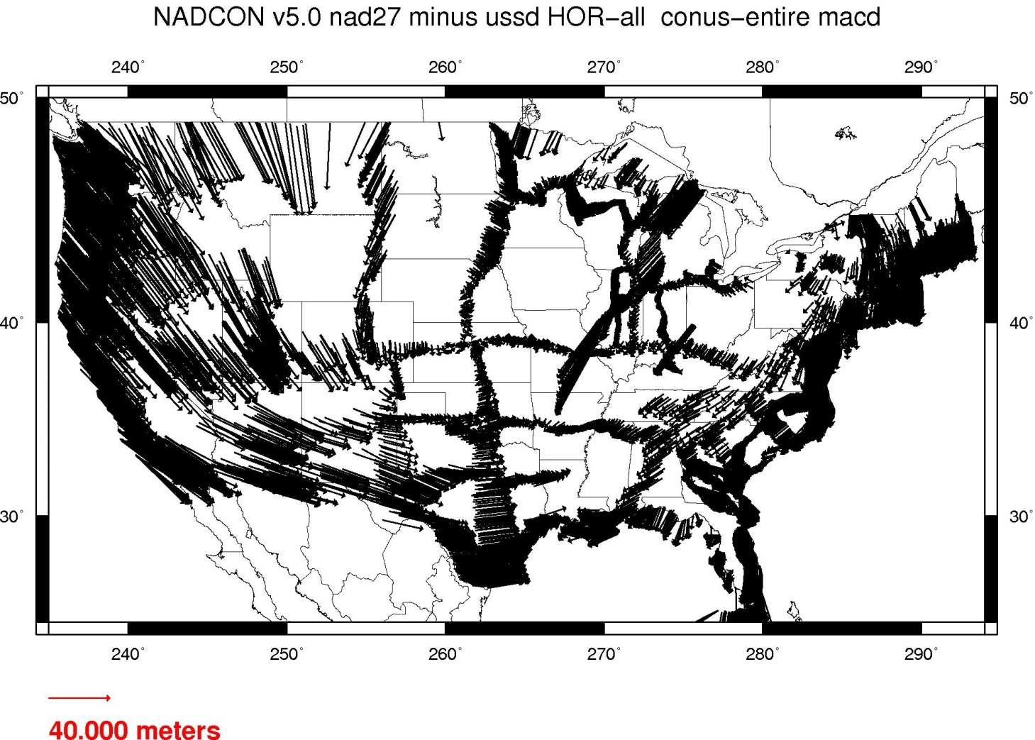
Coordinate Differences
New datum, minus old datum
Creates a vector
Note: lat and lon are separate transformations

Slide 27
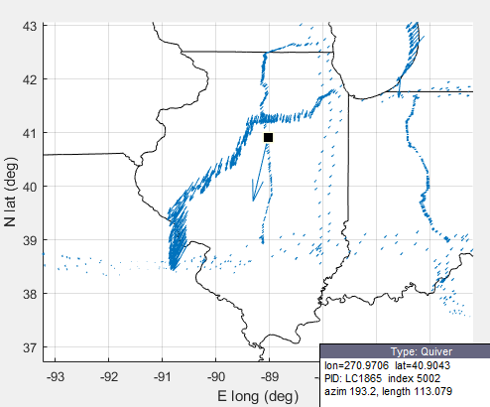
Outlier Removal
GEOCON 1.0: all coord pairs should be reflected in transformation (grid or accuracy estimates)
NADCON5: Outliers are…
Disruptive to creation of grid
So far outside norm that any good surveyor would have rejected these points from their work
We identify reasons for outliers in ASCII file

Slide 28
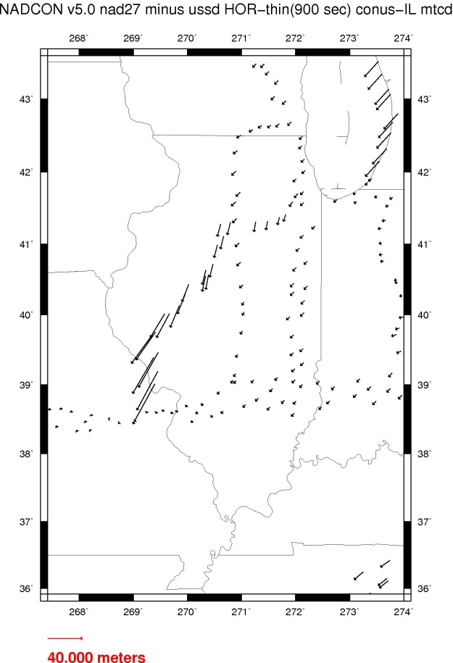
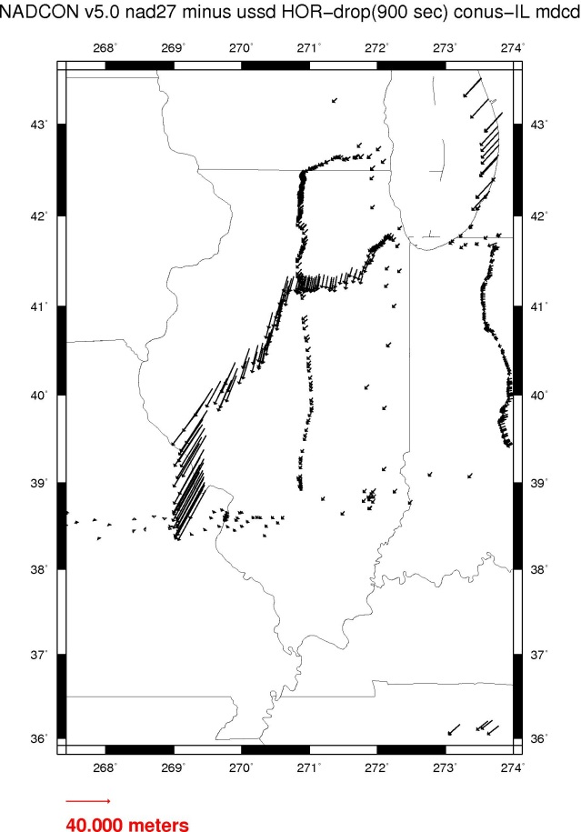
Thin the Data
Vectors are separated using a median filter:
Thinned – one per cell, used for transformation
Dropped – everything else, retained for error estimates

Slide 29
Aside: Selecting Cell Size
Thinned vs. dropped requires geographically binning the data
Best cell size:
Coarsest grid which represents the data
Uniform distribution of vectors (no gaps, clusters)
How did we choose?
Ran a range of grids (1’ to 30’)
Points per cell
Residuals of grid vs thinned/dropped vectors
Notes:
31 transformations each got the analysis of 1’ through 30’

Slide 30
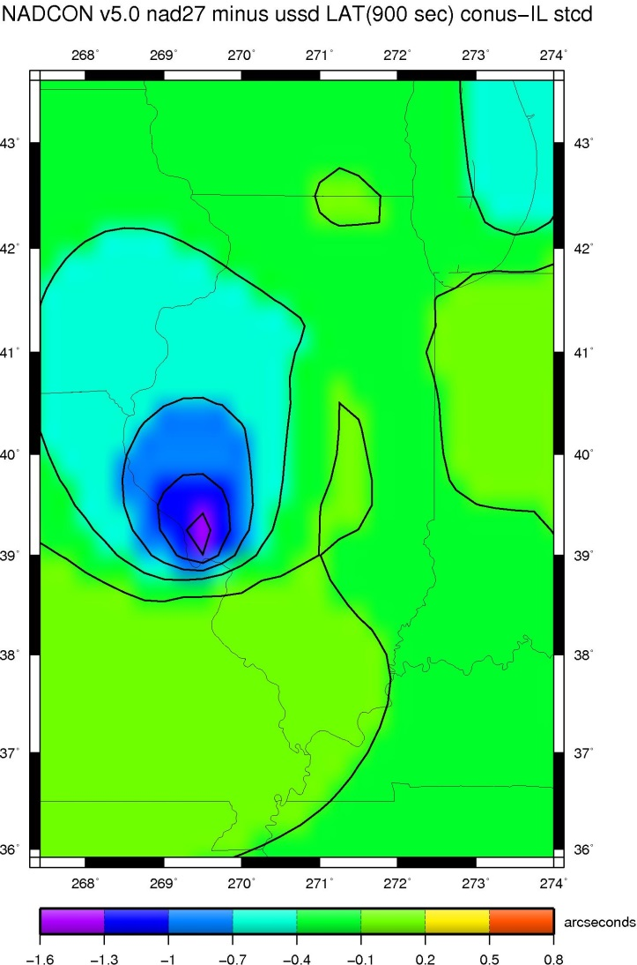
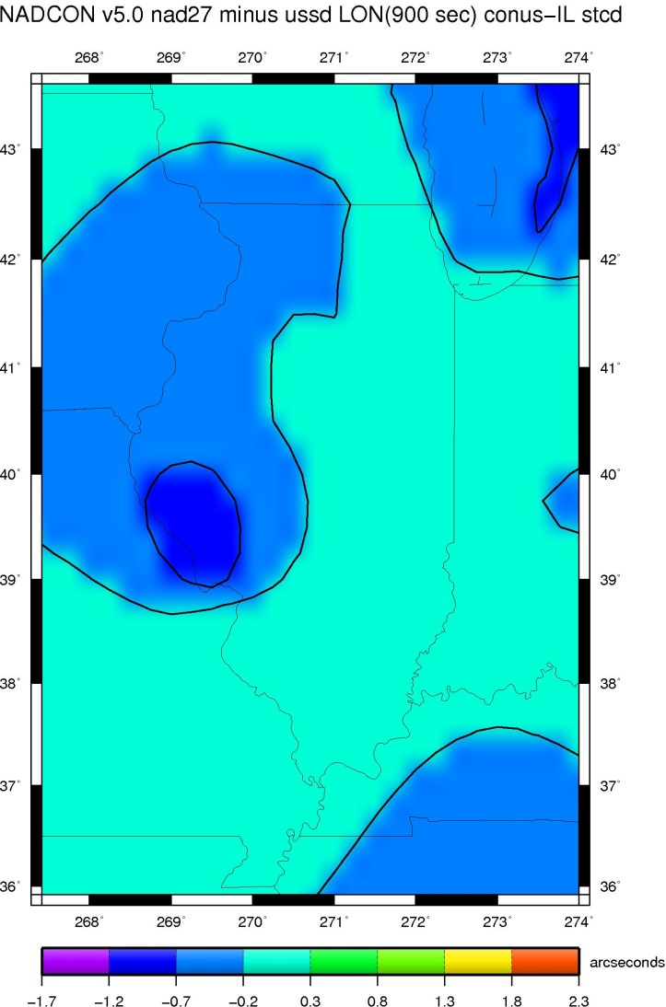
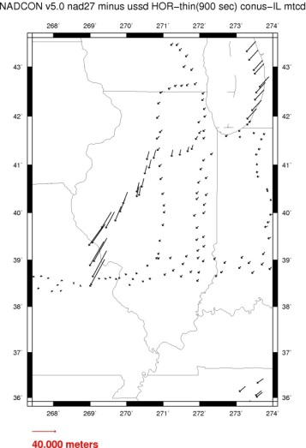
Grid the Data
Fit a surface under tension to the thinned data
Express the surface as a grid
Notes:
Transformation Grid : T = 0.4

Slide 31
Aside: Generic Mapping Tools (GMT) surface
Routine to fit a surface under tension
Tension varies:
0.0: minimum curvature solution (undesired oscillations and false local max/min)
1.0: harmonic surface (no local max/min except at data pts)
NADCON5 grids: 0.4
Notes:
Why 0.4? Because “experience shows” that coord diffs work well under that tension. Milbert chose it for GEOCON.

Slide 32
Error Analysis
Total error
Method Noise
Data Noise
Disagreement between transformation grid and original vectors
GMT surface
Two types of errors
Sources

Slide 33
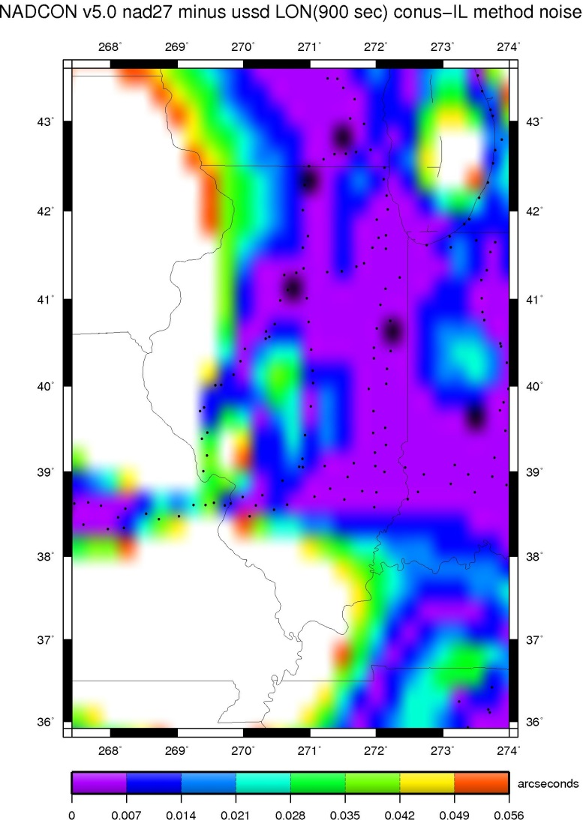
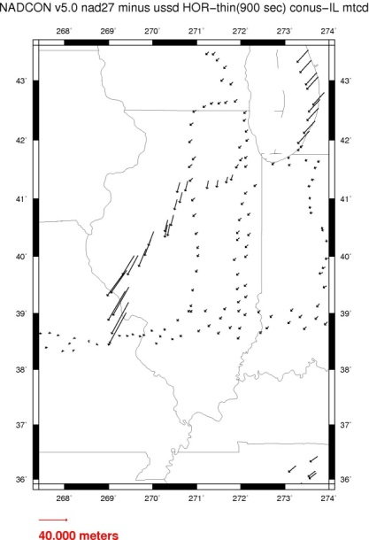
Method Noise
GMT surface: tension varies 0.0 (min curvature) to 1.0 (harmonic surface)
How to summarize range of possible values?
Schwarz et al: Std of large sample = difference of high/low values of 3-element sample * 0.59070
Our 3-element sample: grids at 0.0, 1.0 and 0.4 tensions

Slide 34
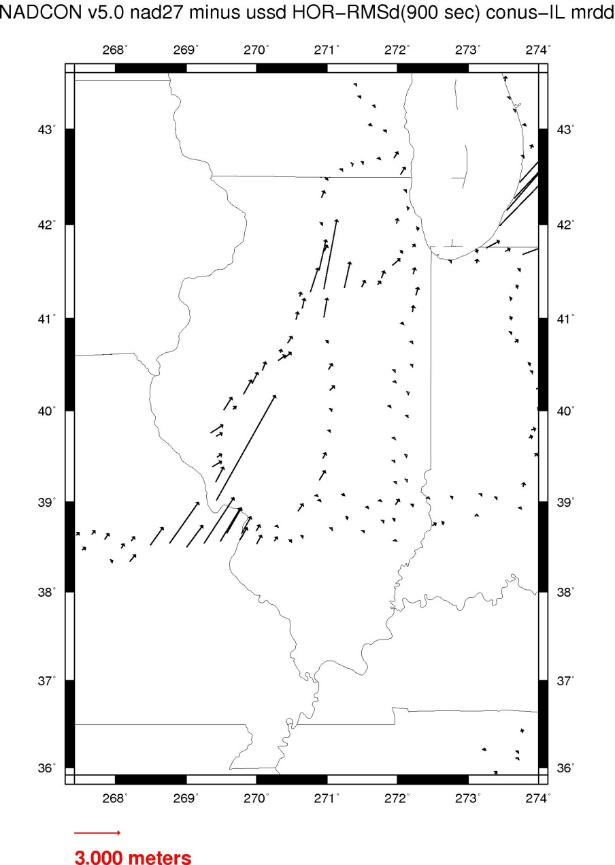
Data Noise: disagreement between grid and data
Residuals of final transformation grid (surface = 0.4) relative to original coordinate differences
In each cell, take RMS of residuals
Grid the RMSs (tension = 0.9)

Slide 35
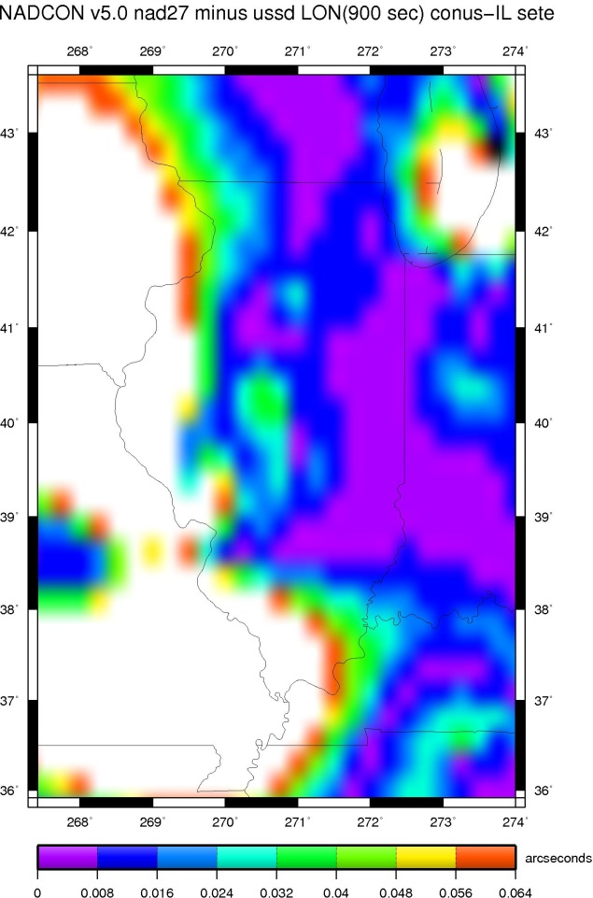
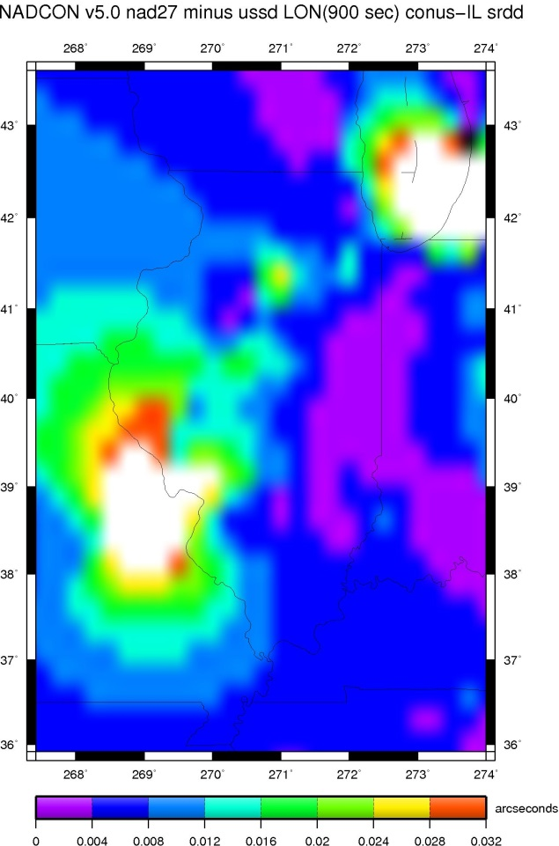
Error Grid
Total error
Method Noise
Data Noise
RMS combination

Slide 36
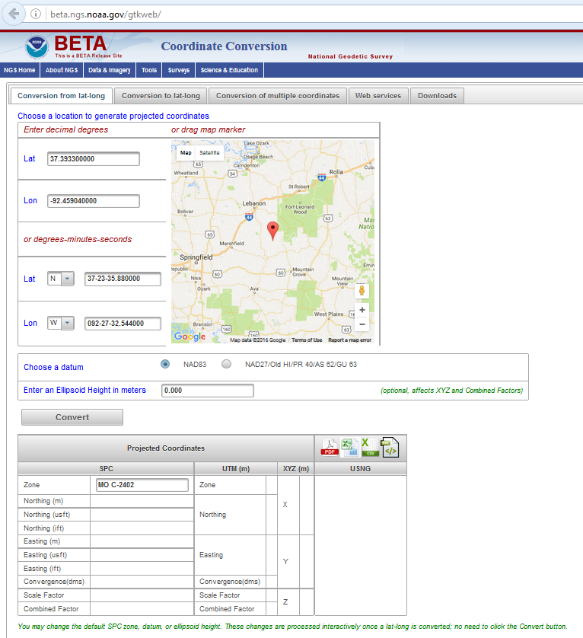
NADCON5 in the Geodetic Toolkit
http://beta.ngs.noaa.gov/gtkweb/

Slide 37
NAD 83 (2011)
Allowable Regions:
CONUS
Alaska
Hawaii
PR/VI
AS
Guam/CNMI
St. Paul
St. George
St. Lawrence
Notes:
φ, λ, h
xyz2plh
plh2xyz
SPC83
a,f (GRS 80)
NAD 83
X, Y, Z
SPC
USNG
NAD 83
UTMS
a,f (GRS 80)
USNG
UTM
USNG
NAD 83

Slide 38
X, Y, Z
φ, λ, h
φ, λ, h
Region: CONUS
NADCON 5 connections in RED
2022
X, Y, Z
SPC
UTM
USSD
USNG
UTM
φ, λ, h
φ, λ, h
NAD 27
NAD 83 (2011)
X, Y, Z
SPC
X, Y, Z
SPC
USNG
UTM
USNG
UTM
NAD 83 (NSRS2007)
φ, λ, h
NAD 83 (1986)
φ, λ, h
NAD 83 (FBN)
NAD 83 (HARN)
φ, λ, h
X, Y, Z
SPC
X, Y, Z
SPC
φ, λ, h
USNG
UTM
USNG
UTM
X, Y, Z
SPC
X, Y, Z
SPC
USNG
UTM
USNG
UTM

Slide 39
Questions?

