Slide 1

OPUS-Projects Versus Published Coordinates Comparisons
Mark Schenewerk
816-994-3067
mark.schenewerk@noaa.gov

Slide 2
OP to IDB overview.
The full project title is: “Deriving a valid path for OPUS-Projects GPS projects to be loaded to the NGS IDB”.
That title is a mouthful so we call it “OP to IDB”.
The project plan and other documents are on GeoPro.
We also keep terse weekly reports, team meeting notes and other documents in Google Drive.

Slide 3
What’s the purpose of the project?
The project’s name is largely self-explanatory: find a way to make OPUS-Projects work for submitting projects to the IDB as correctly and completely as possible.
“Clean up” any issues.
“One button” submission if possible.
Demonstrating this in a beta version of OPUS-Projects.
We’re focused on the near future, but also considering the far future. Read “far future” as after the release of our new database and datum.
2016-06-30
OP to IDB : Comparisons

Slide 4
Speaking of the future ...
This project should be thought of as a first step. Others will follow.
If approved, take the OPUS-Projects variant we produce from beta to production.
Later:
Adapt it to redesigned bluebooking.
Adapt it to the new database.
Adapt it to the new datum.
Adapt it to the new GNSS processing software.
Generalize OPUS-Projects’ capabilities and uses.
2016-06-30
OP to IDB : Comparisons

Slide 5
The OP to IDB schedule.
Approved by the PRB on July 27, 2015.
Really started working in September, 2015.
Initially scheduled to close out the project in December, 2016. Realistically, we’re running two to three months long now.
FY16
FY17
Sep
Oct
Nov
Dec
Jan
Feb
Mar
Apr
May
Jun
Jul
Aug
Sep
Oct
Nov
Dec
Jan
Feb
Mar
Load/Process Projects
Load/Process Projects
OP 2 IDB Evaluation/Comparison
OP 2 IDB Evaluation/Comparison
E/C Report
E/C Report
NGS Presentation
Dev OP
Comment
Public Presentation
Beta OP
Comment
PSC
PSC
FGCS Presentation
Training webinar
Close out
2016-06-30
OP to IDB : Comparisons

Slide 6
Who is on the project team?
Mark Schenewerk (NGS)
Dru Smith (NGS)
Julie Prusky (NGS)
Dave Zenk (NGS)
Mark Huber (USACE)
2016-06-30
OP to IDB : Comparisons

Slide 7
The first task: OP vs IDB.
The first task in this project is a comparison of OPUS-Projects results to the corresponding published coordinates.
This is the foundation for and justification of all subsequent work.
These comparisons will also serve as a baseline for evaluating any change made to OPUS-Projects.
2016-06-30
OP to IDB : Comparisons

Slide 8
The first task: OP vs IDB.
This task was broken down into the following steps:
Select a reasonable set of published GPS survey projects.
Load them into OPUS-Projects.
Process them in OPUS-Projects.
Compares the OPUS-Projects results to the published coordinates for the included marks.
Investigate outliers and systematic differences.
2016-06-30
OP to IDB : Comparisons

Slide 9
Select a reasonable set of GPS survey projects.
The team decided that ~30 projects would be adequate.
Sample different types of surveys.
Sample different types of environments.
Complete original submission “packages” with data.
Satisfy the OPUS-Projects restrictions.
L1+L2+C1/P1 observations.
Antennas with measured patterns.
At least 2 hrs of data.
Only recent surveys (< 10 year old data).
No surveys with known issues.
2016-06-30
OP to IDB : Comparisons

Slide 10
What survey projects were selected.
We have 37 projects in hand at this moment:
28 primary projects
5 FAA airport surveys.
Several HtMod-like surveys.
Urban/rural, coastal/inland, … surveys.
2 with occupations 1 - 2 hrs in duration.
5 “mimics” (CORS data windowed 2 hrs).
2 held for testing beta with more to come(?).
2016-06-30
OP to IDB : Comparisons

Slide 11
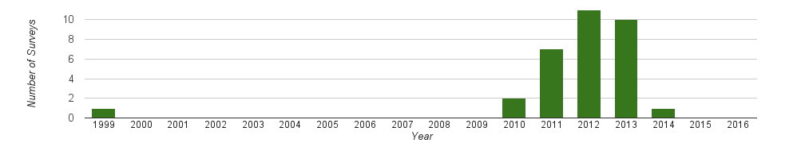
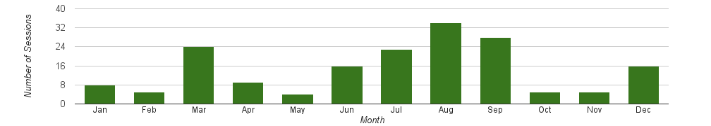
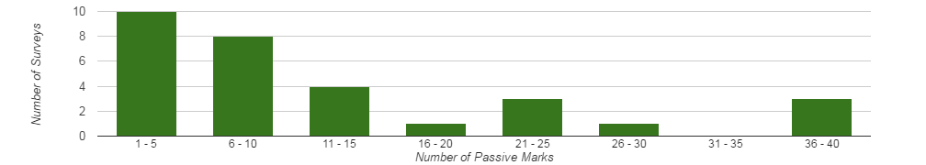
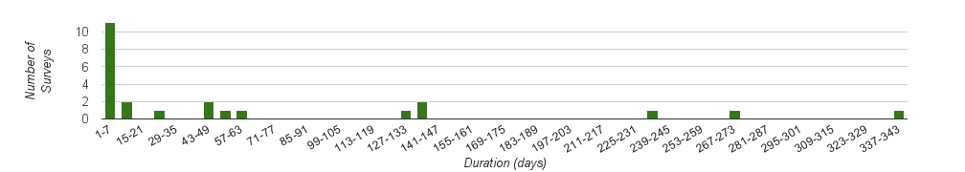
What survey projects were selected (cont).
Most surveys were done in 2011 - 2013.
All seasons are sampled.
Number of passive marks in a survey ranged from 1 to 40.
Total survey durations ranged from 1 - 340 days with a median of 4 days.
2016-06-30
OP to IDB : Comparisons

Slide 12
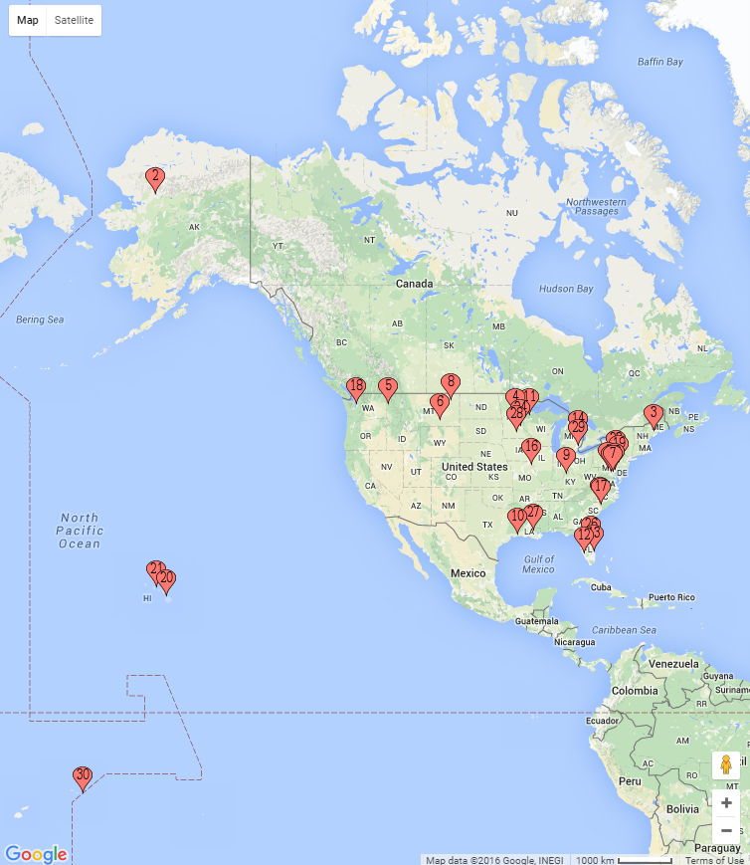
What survey projects were selected (cont).
11 Atlantic.
3 Great Lakes.
2 Midwest.
5 Great Plains.
2 mountain West.
0 Southwest.
3 Gulf coast.
1 in Alaska.
3 in the Pacific.
© Google INEGI. © Copyright 2016 Ursus Software, LLC.
2016-06-30
OP to IDB : Comparisons

Slide 13
Load the surveys into OPUS-Projects.
Loading into OPUS-Projects was automated.
Non-CORS RINEX or converted raw data files.
Files ≪ 2 hr were excluded.
If an upload aborted in OPUS-S, only one attempt was made to load manually.
Recall: 2 projects include 1 - 2 hr data files.
Hardware information was taken from the b-file, field log or RINEX header.
Serfil (directly or reconstructed from b-file).
Mark descriptions if a d-file was recognized.
Script warnings and errors were investigated manually.
2016-06-30
OP to IDB : Comparisons

Slide 14
Process the surveys in OPUS-Projects.
Every survey was processed by two team members.
All processing followed recommended OPUS-Projects guidelines (Mader, 2014).
One nearby hub common to all session processing.
One distant CORS (≳ 1000 km).
7200 s, piecewise linear tropo correction.
15° elevation cutoff.
NORMAL constraint weight.
Problematic marks were excluded at the team member’s discretion.
2016-06-30
OP to IDB : Comparisons

Slide 15
Compare OPUS-Projects results to IDB.
Identification of published marks, retrieval of their datasheets, and the computation of coordinate differences was automated.
Spreadsheets were created holding:
OPUS-Projects - published coordinate differences. NAD 83 (2011) epoch 2010 was always used
Passive mark occupation times.
CORS repeatabilities (OPUS-Net).
2016-06-30
OP to IDB : Comparisons

Slide 16
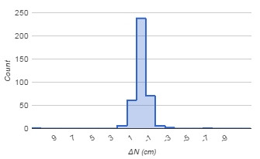
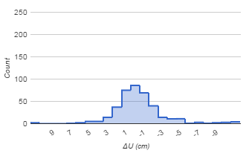
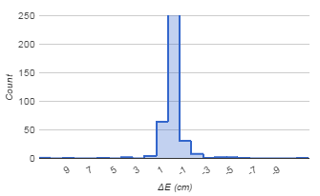
OP - IDB.
For the 386 passive marks in the 30 surveys, the mean coordinate differences are:
ΔN: -0.1±1.0 cm ΔE: 0.0±1.7 cm ΔU: -0.4±3.4 cm
2016-06-30
OP to IDB : Comparisons

Slide 17
OP - IDB (cont).
For the 386 passive marks in the 30 surveys, the mean coordinate differences are:
ΔN: -0.1±1.0 cm ΔE: 0.0±1.7 cm ΔU: -0.4±3.4 cm
2016-06-30
OP to IDB : Comparisons

Slide 18
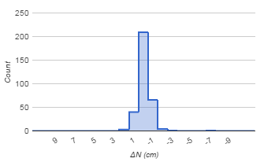
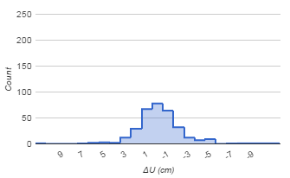

OP - IDB (cont).
Excluding the 2 surveys with only short occupations, the means for the remaining 324 passive marks are:
ΔN: -0.1±0.7 cm ΔE: 0.1±1.0 cm ΔU: -0.2±2.3 cm
Excluding the 2 surveys with only short occupations, the means for the remaining 324 passive marks are:
ΔN: -0.1±0.7 cm ΔE: 0.1±1.0 cm ΔU: -0.2±2.3 cm
2016-06-30
OP to IDB : Comparisons

Slide 19
Survey comparison reviews.
Every mark was examined:
Antenna types and offsets from monuments were confirmed as best possible using field logs, b-file, RINEX headers and, in a few cases, processing results.
The marks’ local environments were subjectively evaluated. (datasheets, Google Maps/Google Earth™)
OPUS-Projects repeatabilities were examined.
2016-06-30
OP to IDB : Comparisons

Slide 20
Detailed investigations.
Marks received detailed investigations if they exceeded pre-defined criteria:
Any mark’s coordinate difference exceeded the 1σ estimated accuracy defined by Eckl et al. (2001). Recall that Eckl et al. estimated the GPS-derived coordinate accuracies for a mark based upon its occupation duration.
Any survey displayed biases in its differences.
2016-06-30
OP to IDB : Comparisons

Slide 21
Issues found from the detailed investigations.
Description errors.
Out-of-date CORS information.
Processing quality control.
Integer fixing.
Data processing for surveys in remote locations.
Biases.
2016-06-30
OP to IDB : Comparisons

Slide 22
Interesting surveys: description errors.
At least 5 surveys appeared to have incorrect or inconsistent information in their b-files.
Most submission packages contained field logs and a few included GPS data processing files. Those were used to identify and correct problems.
Typical problems included:
Inconsistent antenna type.
Inconsistent antenna height.
Non-standard ARP to L1 phase center offset.
2016-06-30
OP to IDB : Comparisons

Slide 23
Interesting surveys: out-of-date CORS information.
2 surveys used out-of-date CORS information in their GPS data processing.
In both cases, the antenna had been replaced a few weeks or months prior to the survey.
Both were significant:
Replacement by a dissimilar antenna.
The afflicted CORS was a hub implying the antenna error at the CORS affected the results for other marks.
2016-06-30
OP to IDB : Comparisons

Slide 24
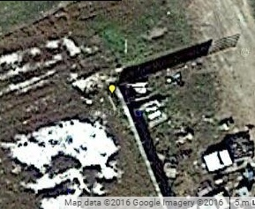
Interesting surveys: processing quality control.
Possible issues were found in both the original submissions and our OPUS-Projects results.
Occupation of questionable marks.
Retention of questionable results.
These decisions are often subjective.
Project specs must be followed.
People make mistakes.
0.8 METER (2.5 FT) SOUTHWEST OF A FENCE CORNER.
2016-06-30
OP to IDB : Comparisons

Slide 25
Interesting surveys: integer fixing.
One incorrect integer pair in OPUS-Projects processing was explicitly identified; a few others are suspected.
In benign conditions, the automated integer fixing is very reliable, but not perfectly reliable. In challenging conditions, the reliability drops.
Uploading through OPUS-S “pre-filters” for success.
In OPUS-Projects, most integer fixing errors are trapped and excluded by the processing software.
But with 300+ marks occupied multiple times … even assuming a 99 % reliability implies ~5 marks would suffer one incorrectly fixed integer pair.
44
100
2016-06-30
OP to IDB : Comparisons

Slide 26
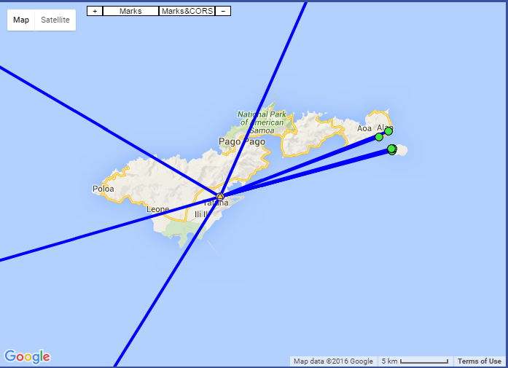
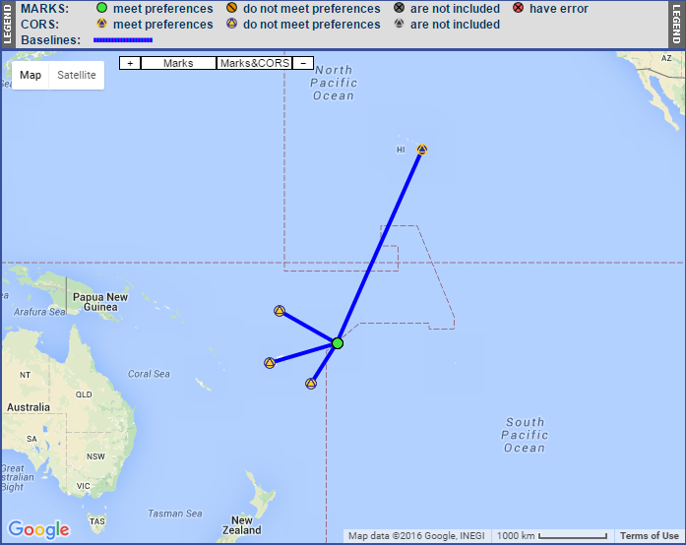
Interesting surveys: surveys in remote locations.
Remote locations are inherently challenging for the recommended OPUS-Projects processing strategy - not just in the Pacific, but in any region with few CORS.
CORS are either very close or very far.
The loss of a CORS is critical.
Training emphasizes uploading and processing ASAP, but how when connectivity “limited”?
2016-06-30
OP to IDB : Comparisons

Slide 27
Interesting surveys: biases.
We found 6 surveys with non-trivial biases.
Recall that in the initial OPUS-Projects processing for these tests, we constrained to the CORS only.
In the original submissions for these 6 surveys, a mix of CORS and passive marks were constrained (e.g. HtMod-like surveys).
However, a similar “mix” was used in some surveys that do not display biases.
2016-06-30
OP to IDB : Comparisons

Slide 28
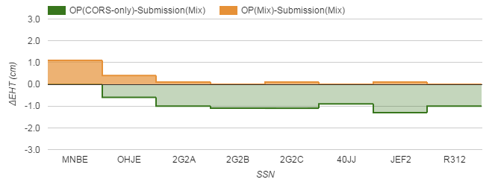
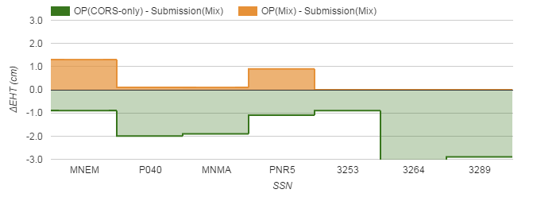


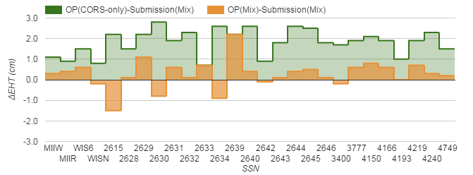

Interesting surveys: biases (cont).
Applying the mix of constraints in OPUS-Projects or the CORS-only constraints in the published surveys reduced the biases.
2016-06-30
OP to IDB : Comparisons

Slide 29
Lessons learned from the detailed investigations.
Description errors.
Out-of-date CORS information.
Processing quality control.
Integer fixing.
Data processing for surveys in remote locations.
Biases.

Slide 30
Lessons learned from the detailed investigations.
Description errors.
Hardware, ARP height, occupation time errors will be impossible in OPUS-Projects.
Human errors!?!
Out-of-date CORS information.
Processing quality control.
Integer fixing.
Data processing for surveys in remote locations.
Biases.

Slide 31
Lessons learned from the detailed investigations.
Description errors.
Out-of-date CORS information.
Impossible in OPUS-Projects.
Processing quality control.
Integer fixing.
Data processing for surveys in remote locations.
Biases.

Slide 32
Lessons learned from the detailed investigations.
Description errors.
Out-of-date CORS information.
Processing quality control.
We have some ideas and user suggestions for tables and statistics that could help.
Still a subjective aspect.
Integer fixing.
Data processing for surveys in remote locations.
Biases.

Slide 33
Lessons learned from the detailed investigations.
Description errors.
Out-of-date CORS information.
Processing quality control.
Integer fixing.
We have a “newer” strategy proven to help on longer baselines with several hours of data. Preliminary tests suggest it will help generally including ≲ 2 hrs.
We have other some ideas and user suggestions.
Data processing for surveys in remote locations.
Biases.

Slide 34
Lessons learned from the detailed investigations.
Description errors.
Out-of-date CORS information.
Processing quality control.
Integer fixing.
Data processing for surveys in remote locations.
We have some ideas, but no clear way forward.
Biases.

Slide 35
Lessons learned from the detailed investigations.
Description errors.
Out-of-date CORS information.
Processing quality control.
Integer fixing.
Data processing for surveys in remote locations.
Biases.
Match the constraints and the biases are reduced.
Use ADJUST and the biases are reduced.

Slide 36
What next?
Jul: Finish the mark comparisons and report.
Sep: Complete OPUS-Projects dev.
Oct: OPUS-Projects dev release for NGS comment.
Oct: PSC OK to go to beta.
Nov: Catch my breath. Work on documentation and training materials.
Jan: OPUS-Projects beta release for public comment.
FY16
FY17
Sep
Oct
Nov
Dec
Jan
Feb
Mar
Apr
May
Jun
Jul
Aug
Sep
Oct
Nov
Dec
Jan
Feb
Mar
Load/Process Projects
Load/Process Projects
OP 2 IDB Evaluation/Comparison
OP 2 IDB Evaluation/Comparison
E/C Report
E/C Report
NGS Presentation
Dev OP
Comment
Public Presentation
Beta OP
Comment
PSC
PSC
FGCS Presentation
Training webinar
Close out
2016-06-30
OP to IDB : Comparisons

Slide 37
What will be different about the next OPUS-Projects?
Technical issues
ADJUST for GPSCOM.
Integer fixing.
Session definition and construction.
Others (survey type; TRI network design).
Bluebooking.
“Finish” the b- and g-files.
Edit/upload a serfil.
Upload(/create?)/edit a description file.
Create a submission “package”.
Recommended processing strategies (documentation).
Outstanding user requests.
2016-06-30
OP to IDB : Comparisons

