Slide 1
National Geodetic Survey
OPUS Projects (OP)
Users & Statistics
NOAA’s National Geodetic Survey
geodesy.noaa.gov
Mark L. Armstrong, PLS, WRE
Oregon State Geodetic Advisor
mark.l.armstrong@noaa.gov
2015 FGCS Meeting, Crystal City, VA

Slide 2
OPUS Projects for Managers
OPUS Projects (OP) is part of the OPUS suite of programs.
OP is NGS cloud software for baseline processing and adjustment of GPS observations on multiple marks in multiple sessions. Ideal for GPS control networks.
OP may be used to align geodetic networks to the National Spatial Reference System (NSRS). This is realized using the NGS CORS network.
The NSRS is a consistent coordinate system that defines latitude, longitude, height, scale, gravity, and orientation throughout the United States.

Slide 3
OPUS Projects for Managers Classes
OP is accessed through your Internet browser. You must be trained as an OP Manager and then your email address will allow you to create projects.
OPUS Projects for Managers training is available…
To sign up for a class see the NGS training web page here:
http://www.ngs.noaa.gov/corbin/calendar.shtml
Many OP trainers are NGS Geodetic Advisors
(NGS Geodetic Services Division)
There maybe other agency or private trainers
You may have to travel to get training
Class is 1.5 days long (certificates provided - normally 12 pdh)

Slide 4
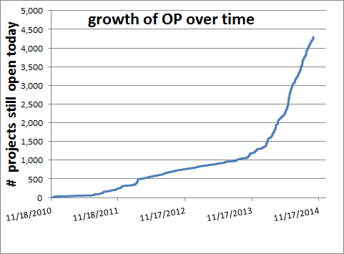
Growth of OPUS Projects
OP operational version was announced on the NGS website on 1-28-2014
Beta Use
Operational Use

Slide 5
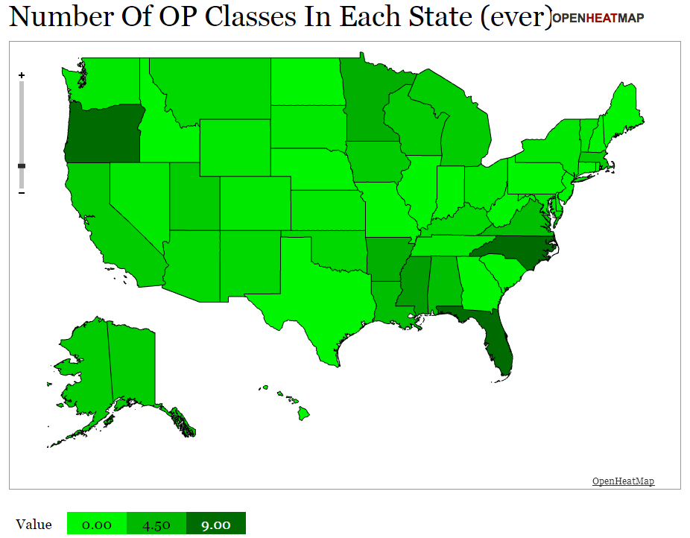
April, 2015
1
2
5
13
1
3
1
1
3
1
1
3
3
2
1
1
3
1
1
2
4
1
3
2
1
9
2
2
5
6
4
1
1
4
3
15
Puerto Rico -2
Heat Map of OP classes given per State since Dec. 2010

Slide 6
OPUS Project General Statistics
OPUS Project for Managers classes ~112
Total OP Managers trained ~2,850
Total # OP Projects ~5200
OP Trainers ~15 (includes ~10 NGS Advisors)
DOC/NOAA people trained ~161

Slide 7
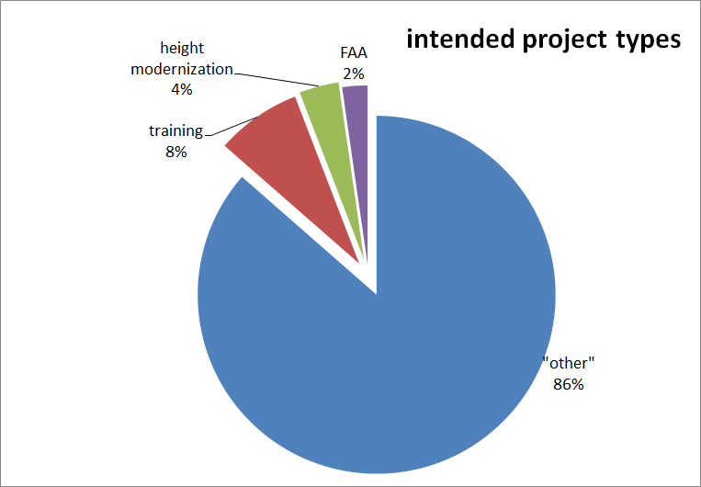
OPUS Project Types
Meta-data project type selected when created

Slide 8
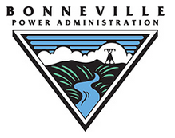
FED GOV OP Users
NOAA/NOS/NGS
USACE
USGS
US Fish and Wildlife
National Park Service
Bonneville Power Administration
And ~ 26 more…

Slide 10
72% Private Surveying Comp.
17% State
7% Federal
3% Academic
1% International

Slide 11
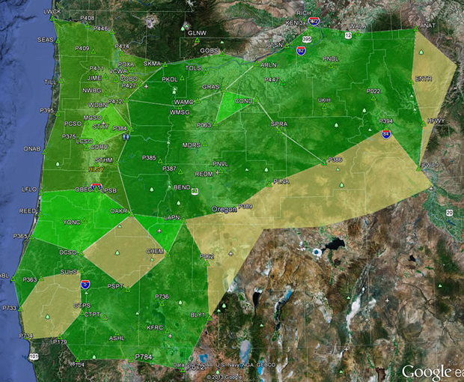
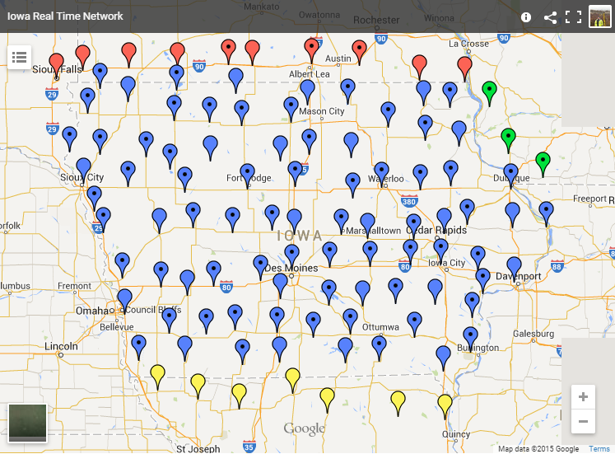
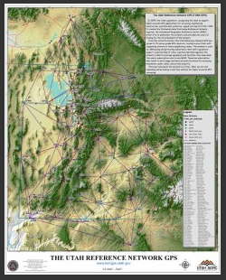
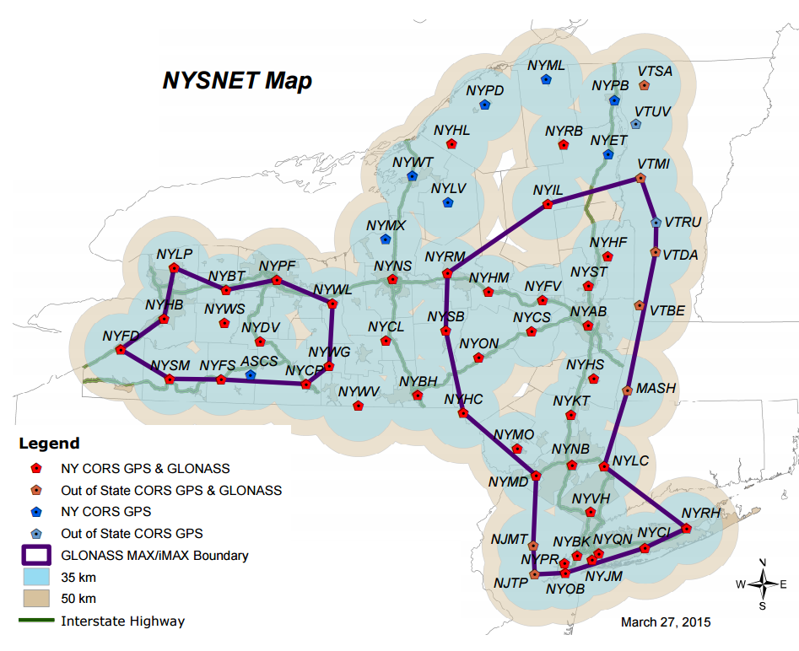
Real-Time Networks aligned with the NSRS using OP
Oregon (ORGN) ~93 stations
Iowa (laRTN) ~98 stations
New York (NYSnet) ~63 stations
Utah (TurnGPS) ~73 stations
Minnesota (MnCORS) ~136 stations
and many more.
NGS NSRS validation still
developing…
(NOS 2015 Milestone)

Slide 12
State DOT’s with trained OP Manager(s)
OR, NY, IA, MN, MT, VT, NC, SC, FL, WI, NH, WA, AK, CA, AR, NM, AL, LA, MI, VA, MS, UT, & more
GPS static survey control for transportation projects…
Bridges, highway construction, rights of way, paving, lidar, mobile scanning, terrestrial scanning, photogrammetry, roadside inventory, signing, machine control, GIS…all aligned with the National Spatial Reference System. NSRS

Slide 13
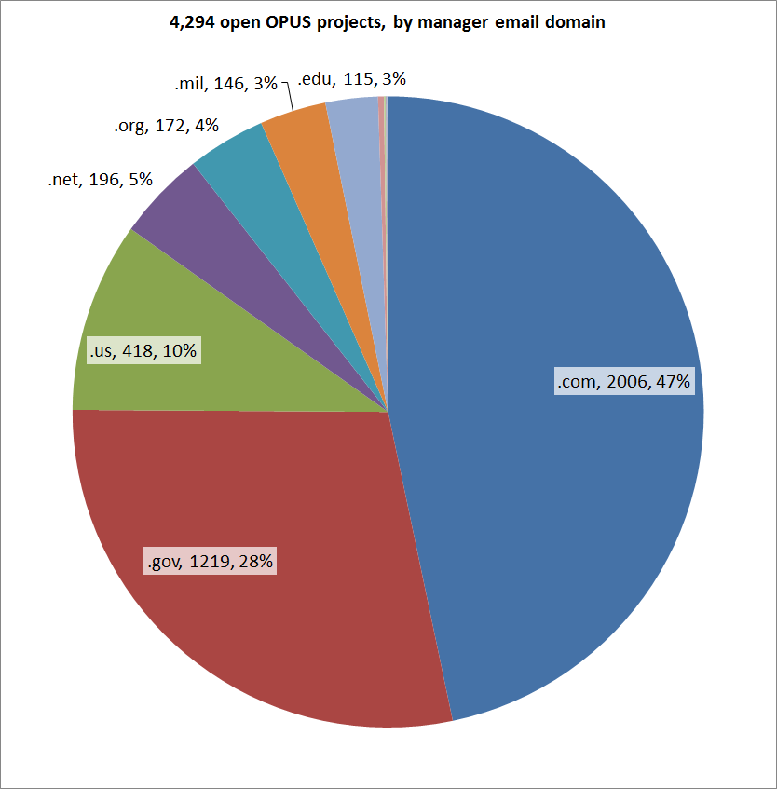
OPUS Projects Manager Email Domain
.com = 47%
.gov = 28%
.us = 10%
.net = 5%
.org = 4%
.mil = 3%
.edu = 3%

Slide 14
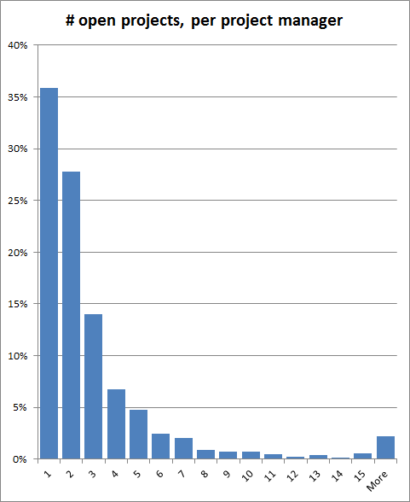
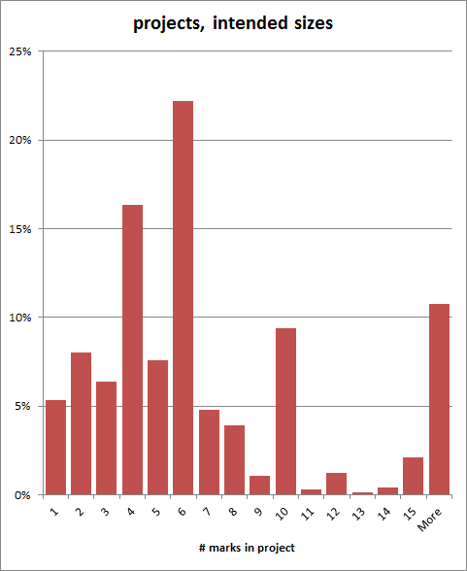
OP Survey Projects
36% of Managers have just one project while 5% have 5 projects.
Some managers have more than 20 projects.
22% of all projects contain 6 marks.
5% contain only 1 mark.
10% contain more than 15 marks.
A few contain over 100 marks.

Slide 15
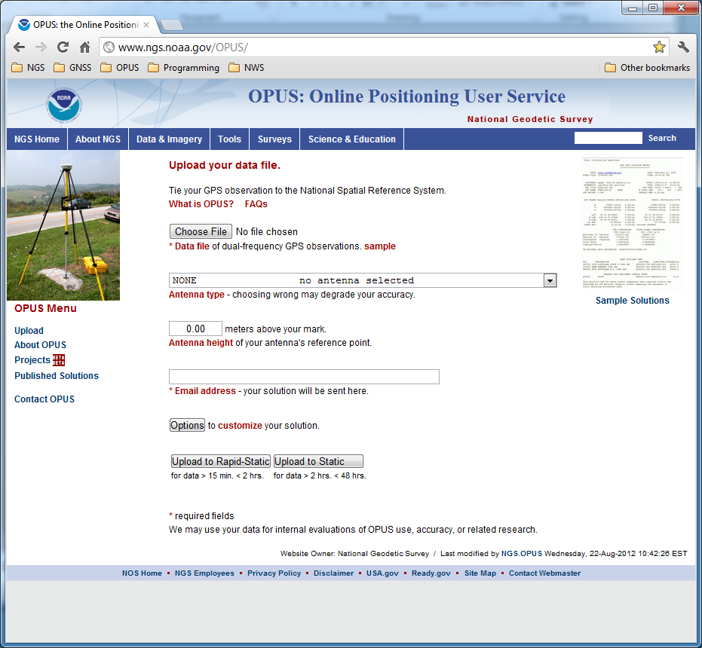
OPUS PROJECTS
QUESTIONS?
The OPUS upload page is the access point for all things OPUS.
2013-08-14
Notes:
The OPUS gateway page is found at http://geodesy.noaa.gov/OPUS/.

