Slide 1
NGS Status Report to GGOS Bureau for Networks and Communications: 2014
Dru Smith
Kendall Fancher
Charles Geoghagan
Steve Breidenbach

Slide 2
2014 Activities
Completed a local site survey of the Kauai, HI ITRF site in 2014 (VLBI, DORIS, GPS)
First Foundation CORS installed in Richmond, Florida
New geodetic control marks installed at TMGO in preparation for 2015 survey

Slide 3
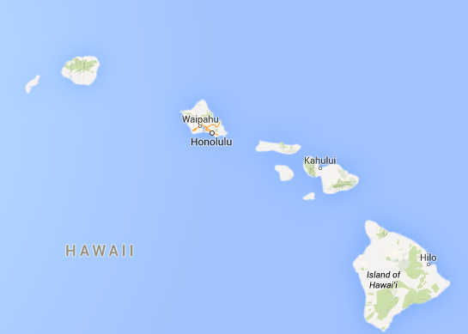
2014 Kauai Survey

Slide 4
2014 Kauai Survey – SINEX issue
SINEX file given to IERS contained VCV matrix which would not invert
Discussions with Geosciences Australia about a possible issue with the AXIS software
NGS will work with GA and correct Kauai SINEX and re-submit in 2015

Slide 5
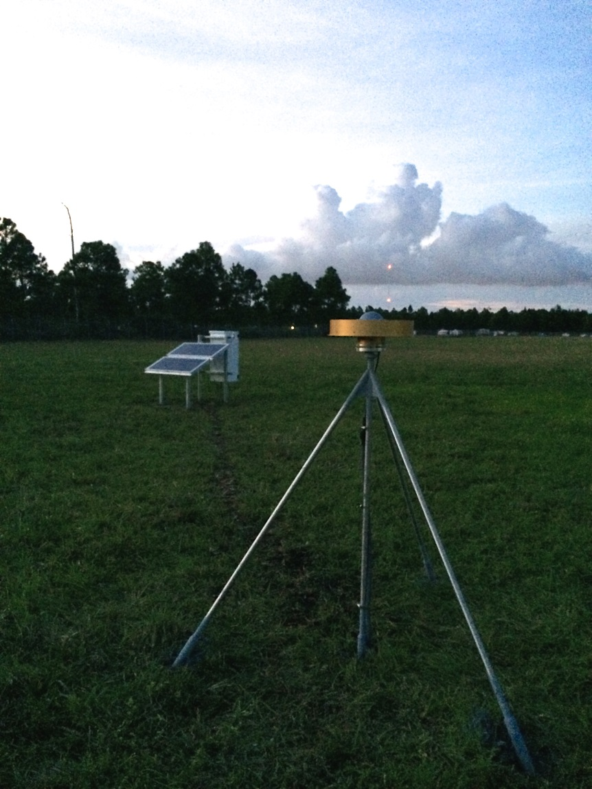
Foundation CORS at Richmond FL

Slide 6
Proposed 2015 Activities
Conduct local site surveys at:
  Mauna Kea, HI ITRF site
    VLBI and GPS
  Table Mountain Geophysical Observatory (TMGO) in Longmont, CO
    GPS, Absolute Gravity, Superconducting Gravity
  NRL calibration pier site in Stafford, VA
    SLR and associated calibration piers

Slide 7
Proposed 2015 Kauai Survey

Slide 8
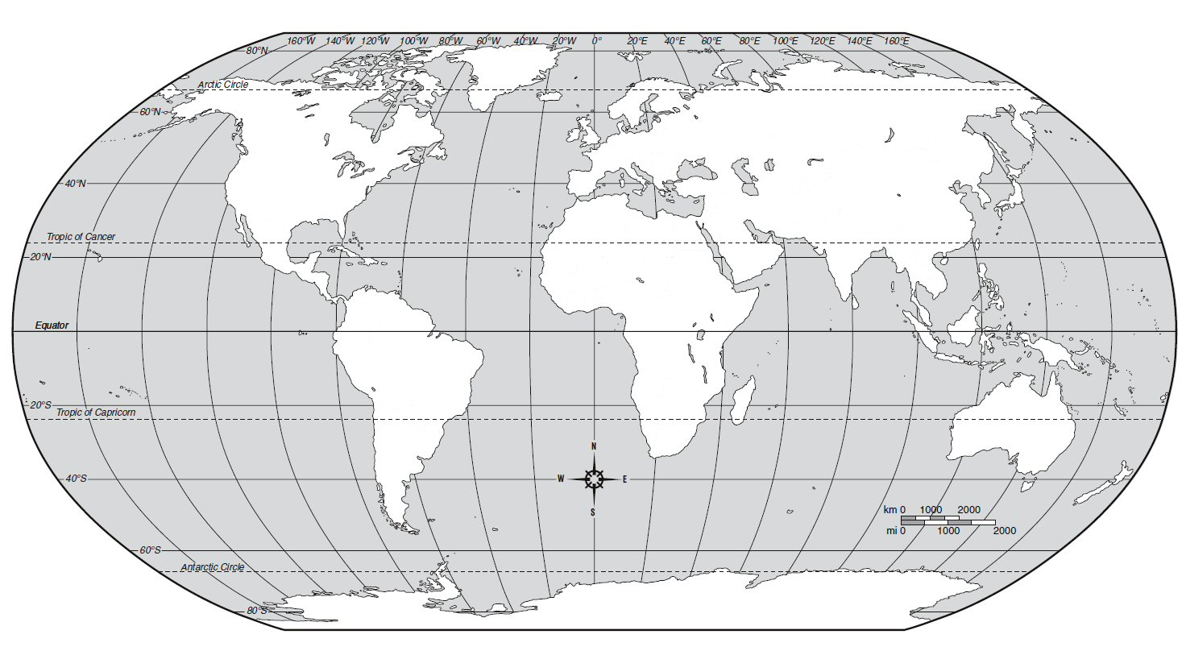
Proposed 2015 TMGO Survey

Slide 9
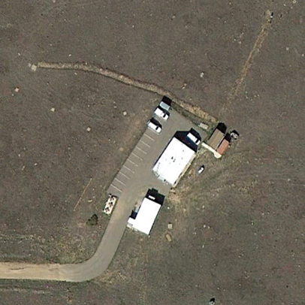
= mark-to-mark sighting
“A TMGO”
= mark-to-door sighting
= mark-to-CORS sighting
= Absolute Gravity Pier (inside)
= Superconducting Gravimeter (inside)
= TMGO CORS
= Concrete pillar suitable for mounting GNSS antenna
= Control Mark
= Door into observatory
“Well Head”
“ECKL 2014”
“CG”
TMGO overview – 11 Interior marks on gravity piers will be
positioned as part of the survey

Slide 10
IERS Site Survey Reports
NGS site survey reports and associated data products are available for download at the NGS ISS program website:
http://www.ngs.noaa.gov/corbin/iss/index.shtm

