Slide 1
Recent IERS Site Survey of Multiple Co-located Geodetic Techniques by NGS
Kendall Fancher, Dru Smith, Steve Breidenbach, Jeff Olsen, Nagendra Paudel
NOAA’s National Geodetic Survey, U.S.A.

Slide 2
Outline
Relation between national datums and ITRF
Need for co-location site surveys
GGAO survey by NGS
Future activities

Slide 3
National datums and the ITRF
2-D Horizontal datum?
3-D Geometric Reference System!
Many countries adopt a frame tied to ITRF
USA:
14 parameter Helmert Transform.
ITRF 96
NAD 83 (CORS96)
Notes:
Many countries have officially adopted geometric reference frames that rely (directly or indirectly) upon some realization of the International Terrestrial Reference System (ITRS). For example, both the United States and Canada have jointly adopted a realization of the North American Datum of 1983 (NAD 83) which is defined in terms of a 14-parameter transformation from the International Terrestrial Reference Frame of 1996 (ITRF96) [Craymer et al., 2000]. In the United States, the frame is called NAD 83 (CORS96); in Canada, NAD 83 (CSRS). Both NAD 83 (CORS96) and NAD 83 (CSRS) are related to subsequent ITRS realizations via the composition of the transformation from them to ITRF96 followed by the adopted 14-parameter transformation from ITRF96 to each subsequent ITRS realization.

Slide 4
Reliance on IERS
National Geodetic Authorities:
Define national reference systems (datums)
Have resources
Rely on IERS to provide the ITRF
IERS
Updates the ITRF
Is a voluntary international organization

Slide 5
Resources vs. Reliance
My recent pitch to NGS policy makers:
“It is the duty of those agencies with both resources and a reliance on ITRF to apply some of those resources to the improvement and maintenance of the ITRF”
Currently in NGS policy debate for 2010

Slide 6
Co-location Site Surveys
ITRF realizations are the combination of four space geodetic techniques
VLBI, SLR, GNSS, DORIS
Each contributes differently to ITRF
Co-locating these techniques allows for their combination.
Examples of co-location:
Space (SLR reflectors on GNSS satellites)
Ground (GNSS antennas near VLBI antennas)

Slide 7
Ground co-location
Antennas “near” one another is not enough
Must know 3-D geometric vector from ERP to ERP*
* Electronic Reference Point
Co-location surveys only yield PRP to PRP*
*Physical Reference Point
Notes:
The determination of the electronic-to-physical offsets is complicated and generally considered the responsibility of the particular service of the International Association of Geodesy (IAG) which pertains to that technique (being the International VLBI Service or IVS; the International Laser Ranging Service or ILRS; the International GNSS Service or IGS; and the International DORIS Service or IDS). However, the determination of the physical-to-physical offsets can be done with terrestrial surveying techniques, though the party responsible for performing those surveys is not clear.

Slide 8
ERP ( ) vs PRP ( )
ERP for VLBI
Offset vector
responsibility: IVS
ERP for GPS
(e.g. L1 Phase Center)
PRP for VLBI
Offset vector
responsibility: IGS
Surveyed Vector
PRP for GPS
(e.g. ARP)
Note: PRP need not be “touchable”, just geometrically determinable
(e.g. VLBI = intersection of two orthogonal spin axes)

Slide 9
GGAO Survey
Anticipating a policy shift, NGS engaged in re-training employees in co-location survey techniques
Goddard Geophysical and Astronomical Observatory, Maryland, U.S.A.
PRP-to-PRP only

Slide 10
GGAO

Slide 11
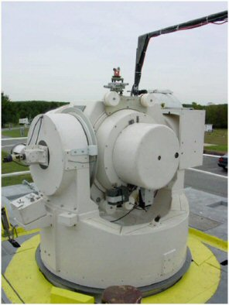
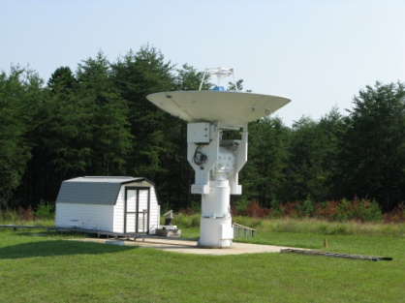
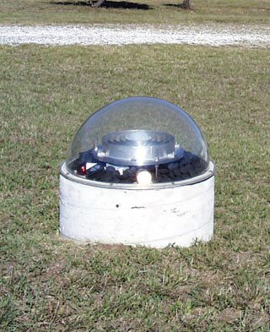
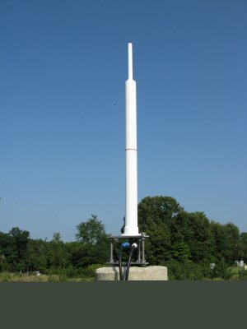
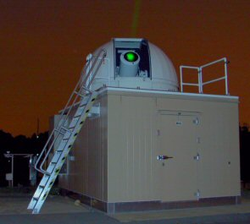
GGAO

Slide 12
GGAO Control Network
Notes:
A network of control points, already in existence at GGAO, were used to establish the PRP/PRP vector ties to each of the five observation stations.

Slide 13
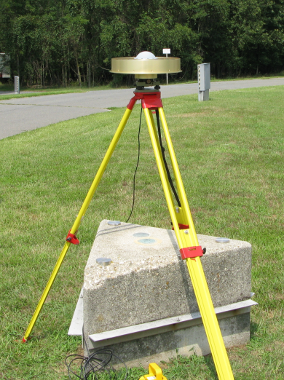
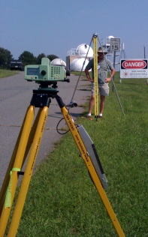
GGAO Survey Equipment
GPS
Trimble R7 GNSS receivers
Javad Ringant-DM GNSS antenna
Leveling
Leica DNA03 digital level
2-meter Invar staff
Angles and Distances
Leica TDMA 5005 total station
Leica GPH1P precision reflectors

Slide 14
Status of GGAO Project
GPS data analysis completed
Tie vector data analysis is near completion
A project report will be delivered to the IERS in the format proposed by the IERS Site Survey and Co-location Working Group

Slide 15
NGS Future Work
Planning other IERS site surveys
Brewster (Washington State, USA, VLBI/GNSS) planned for 2010
Debating total resource allocation for future years
Engaged in IERS Site Survey and Co-location Working Group

Slide 16
NGS Future Work
Evaluating external software (Sarti , Johnston) for future operational use
Training additional employees on site survey techniques

Slide 17
FIG Future Work
Efficiency is gained if the IERS has site surveys performed by local persons at local sites
Think globally, act locally
NGS will likely work with other international agencies to develop training and workshops to encourage more international participation on IERS site surveys…we all benefit!

Slide 18
Questions?

