Slide 1
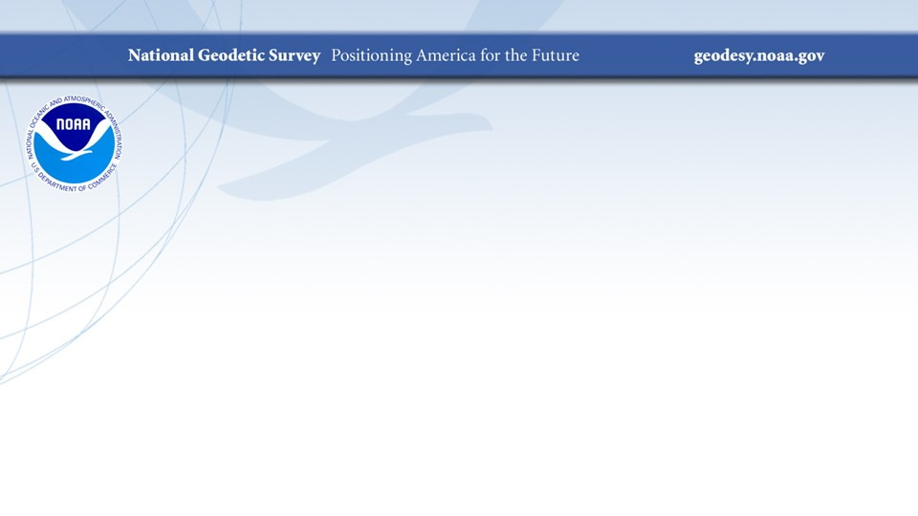
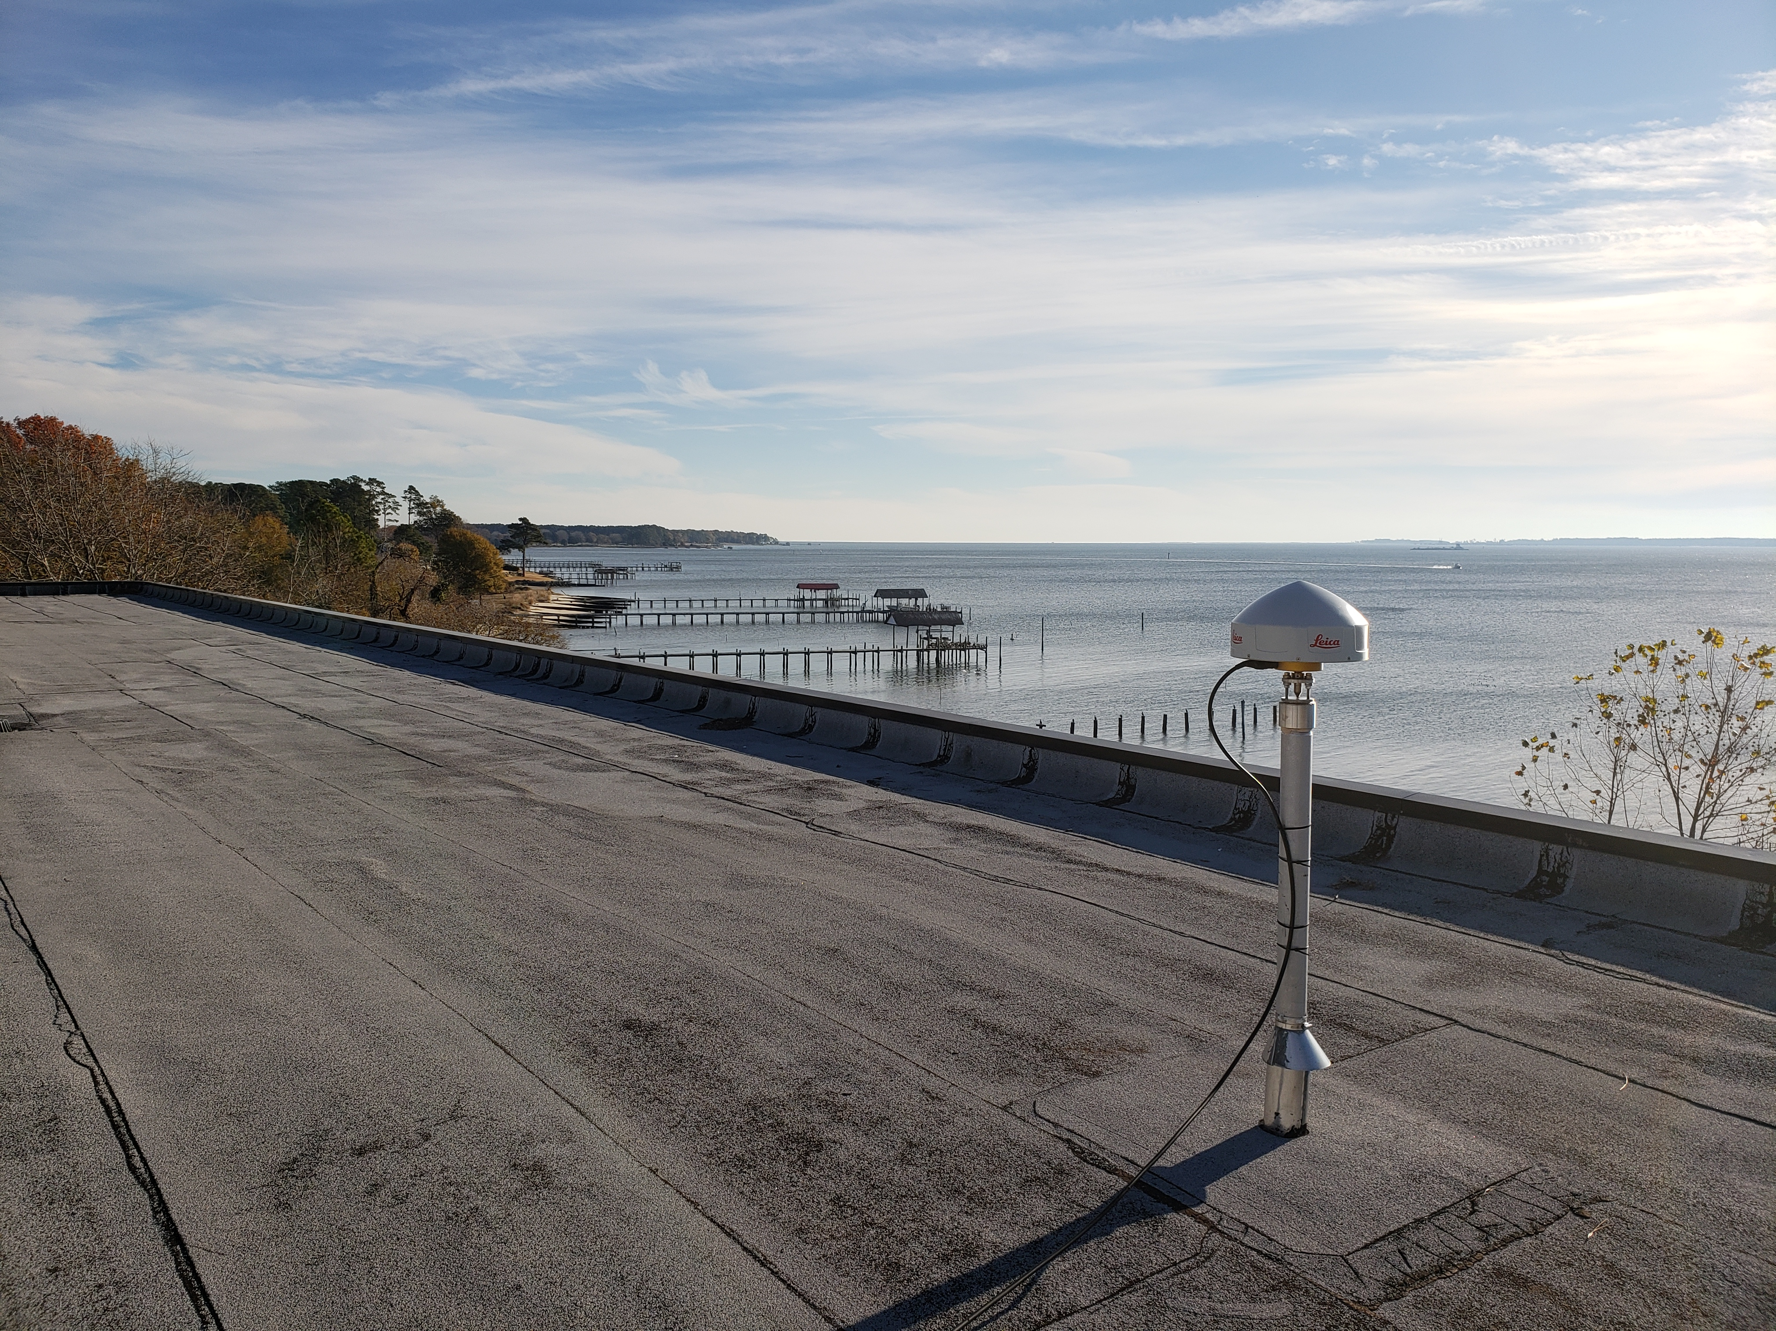
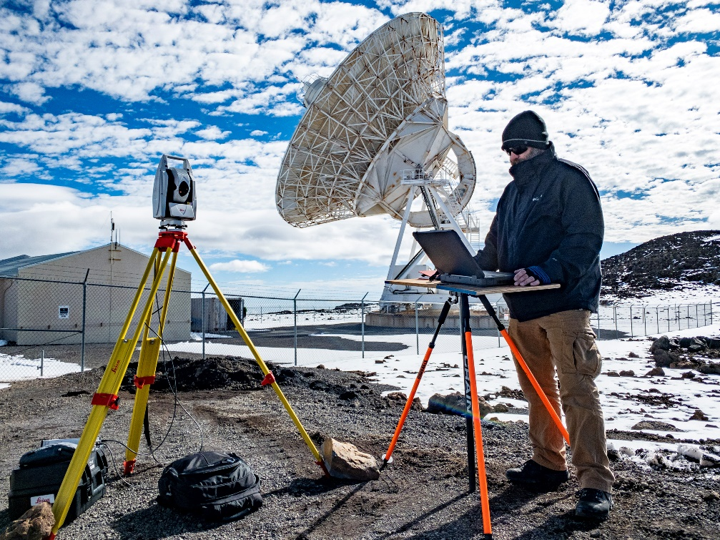
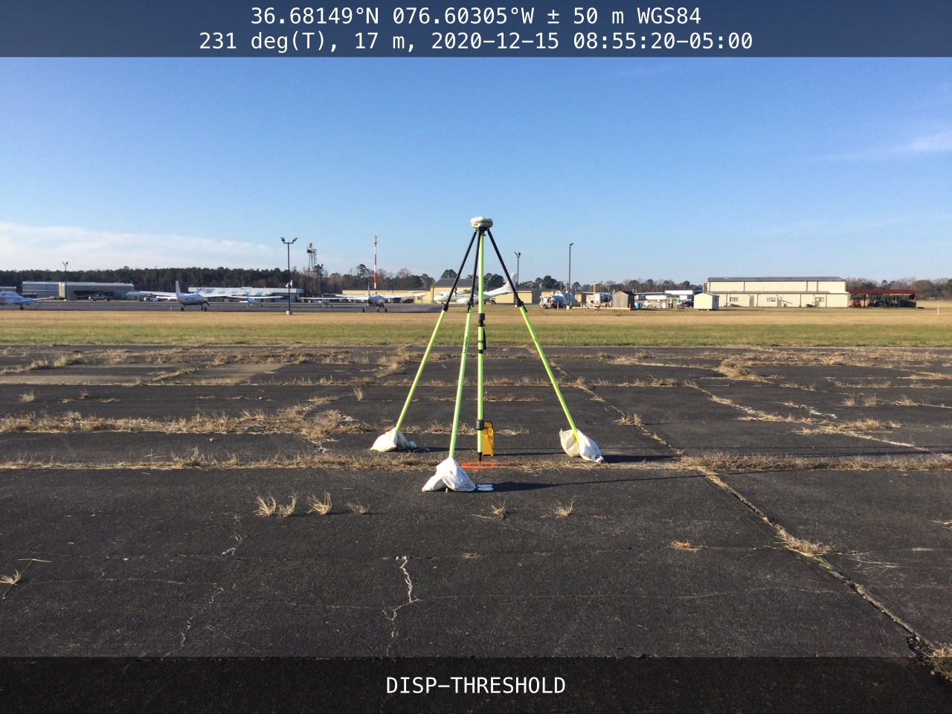
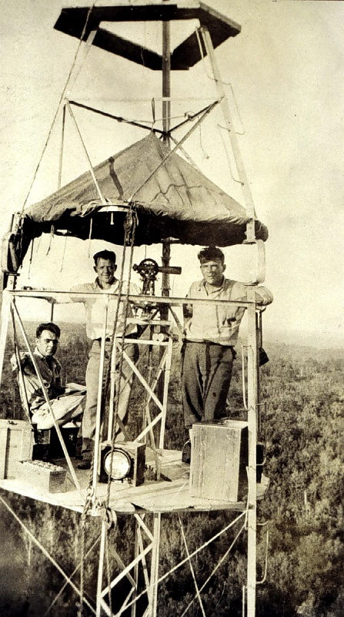
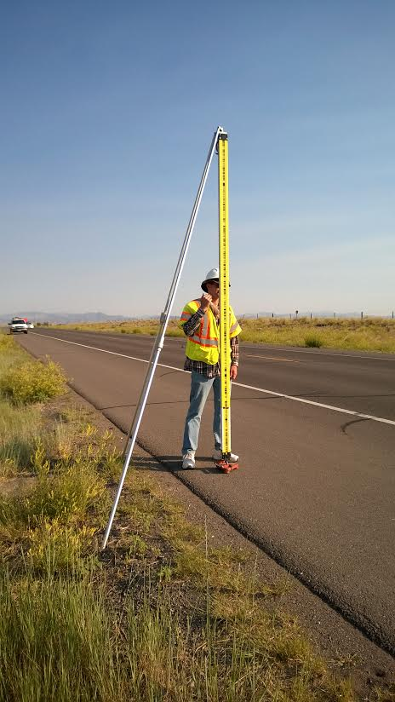
NGS Field Operations Modernizing in Many Ways
FIG Working Week 2023
May 31, 2023
Ryan Hippenstiel, PLS
NGS Field Ops Branch Chief

Slide 2

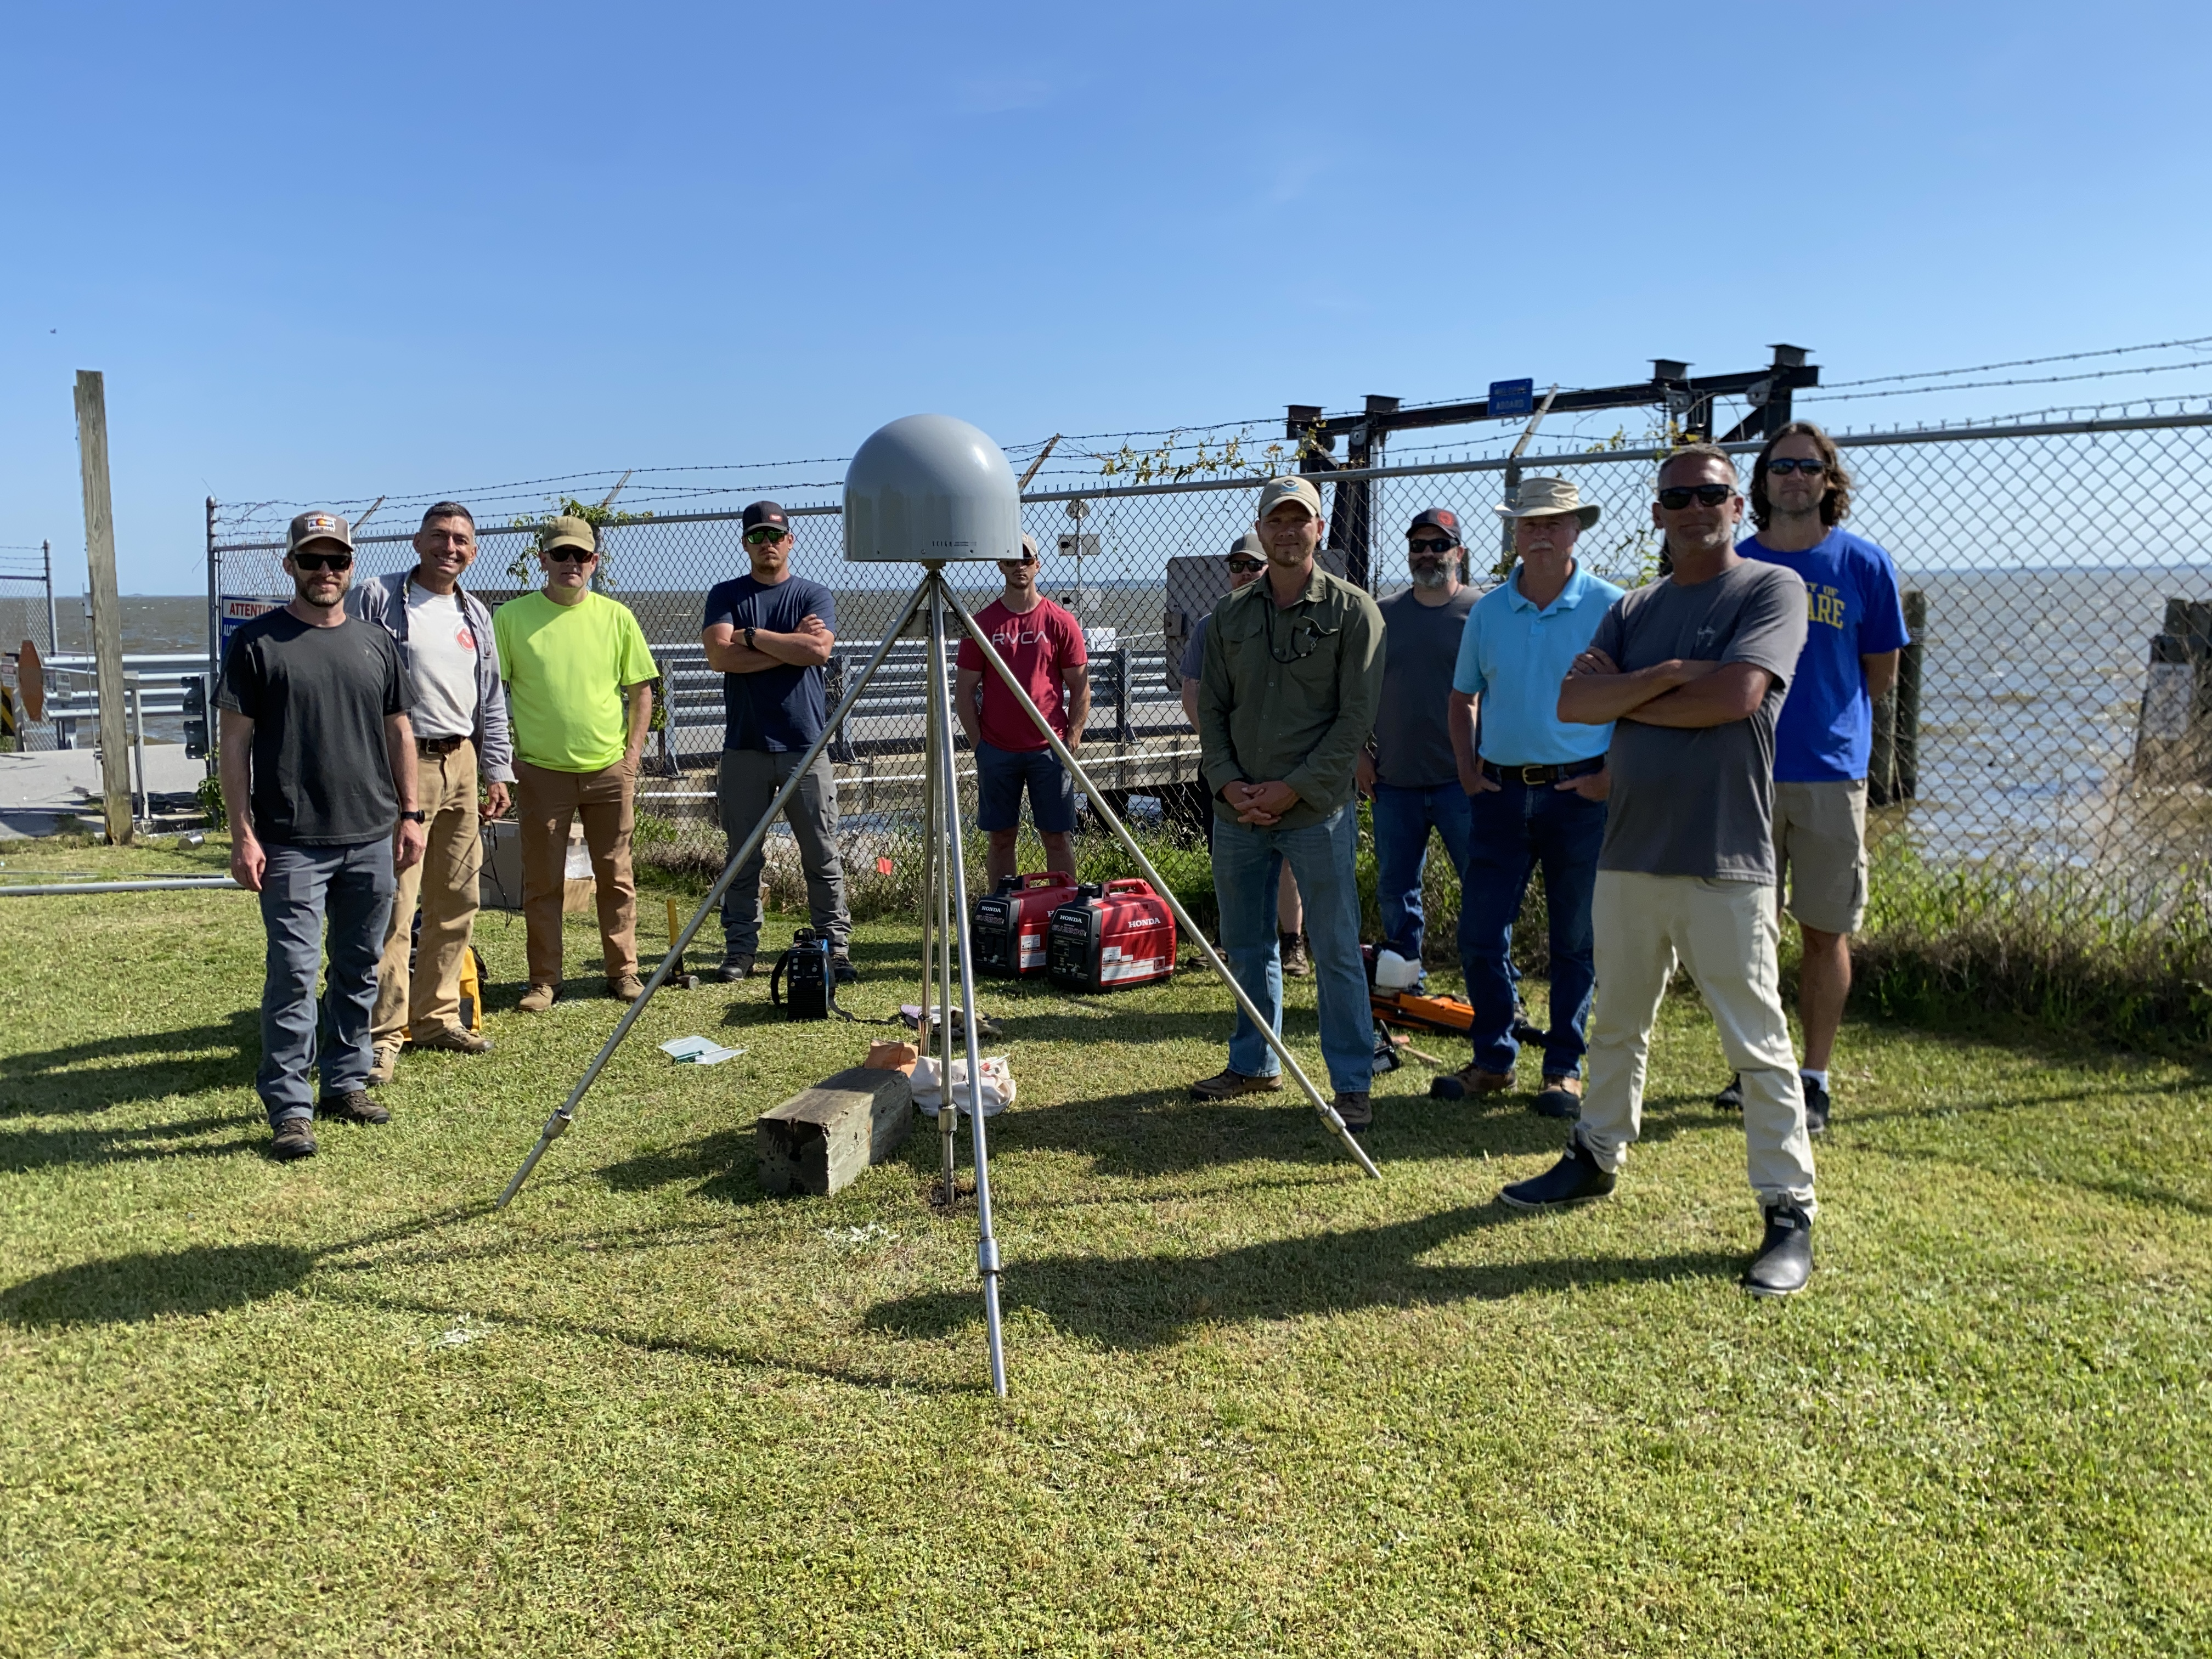
Standard Work
Responsible for the collection and processing of surveying data for various NOAA missions.
  Coastal Mapping Program ground support
  GNSS observations for to support VDATUM
  FAA/NGS Aeronautical Survey Program (ASP)
  Campaign Surveys (GSVS, IGLD, ChesBay, GeMS)
  Grav-D and NOAA Vessel Support
  IERS & Foundation CORS local tie surveys
  Support of technical manuals and survey protocols

Slide 3
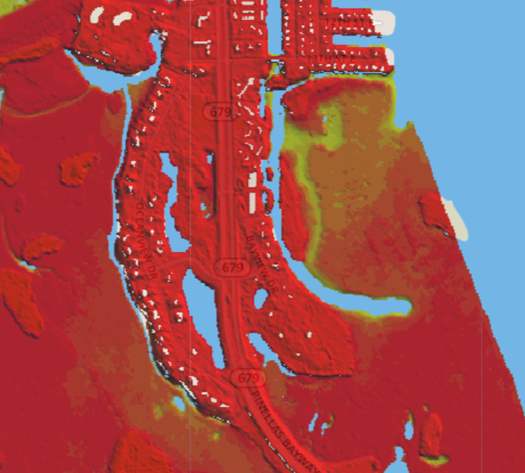
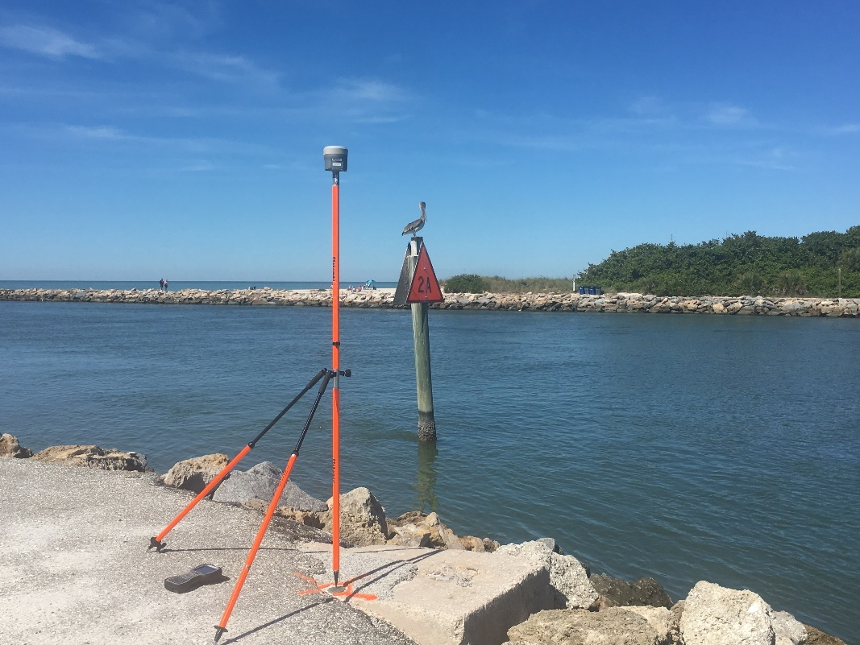
Existing Products
NGS utilizes real-time GNSS for QA/QC on collection of remotely sensed data

Slide 4
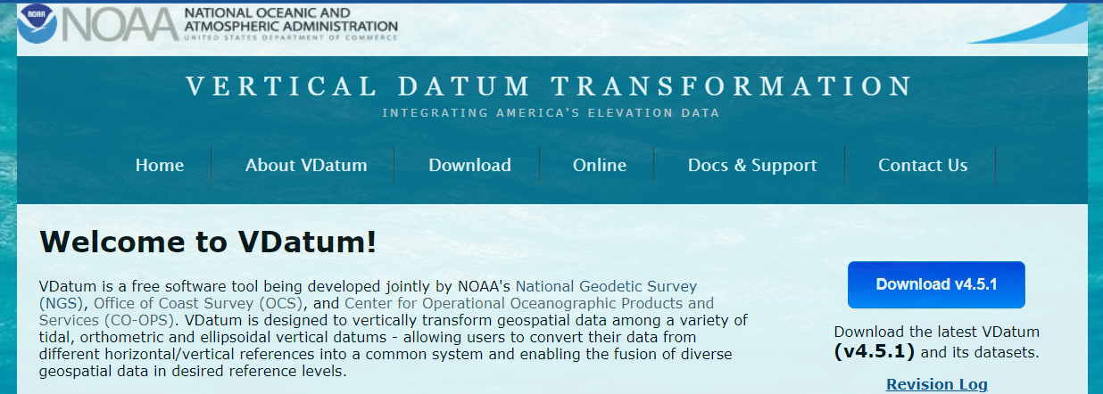
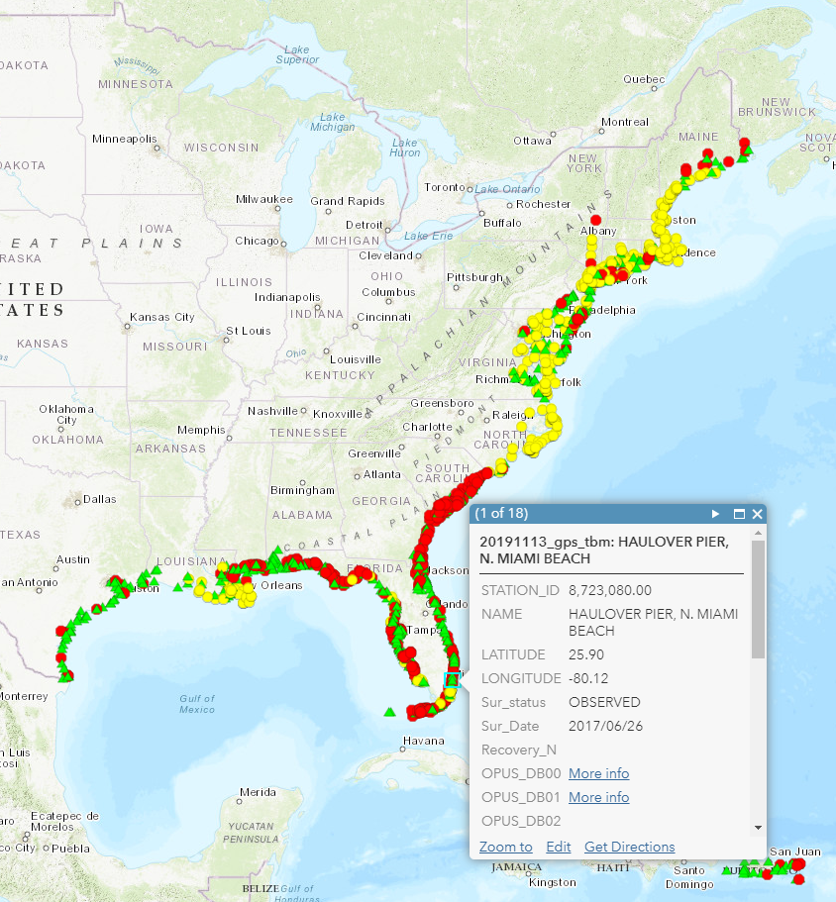
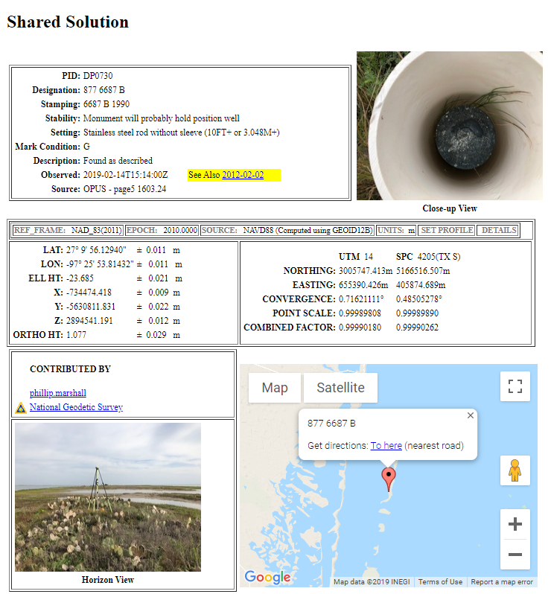
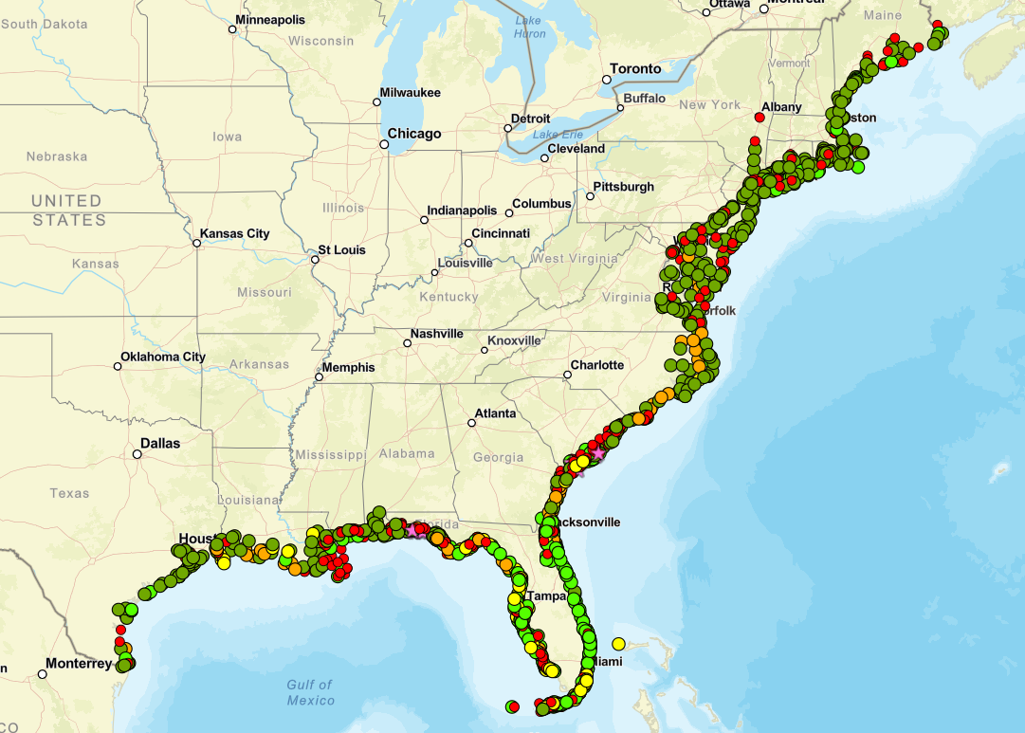
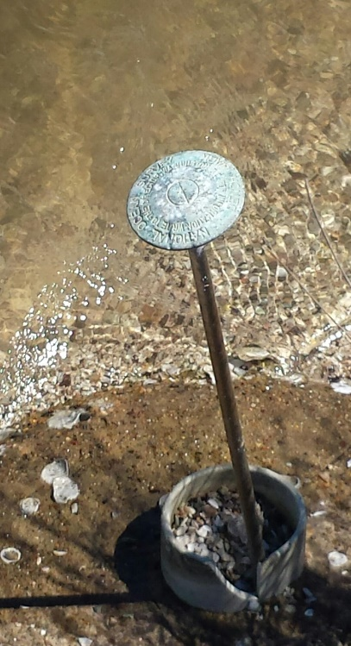
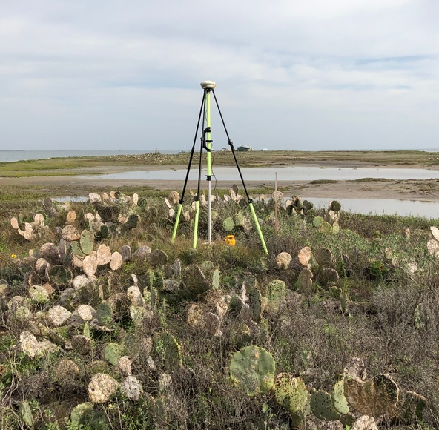
Transformation Tools
Thousands of marks at tidal stations have been recovered and shared

Slide 5
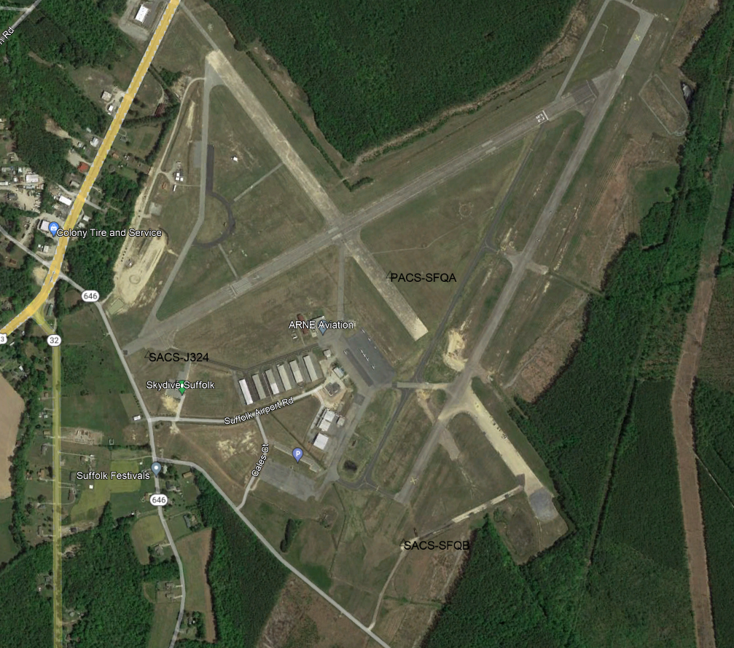
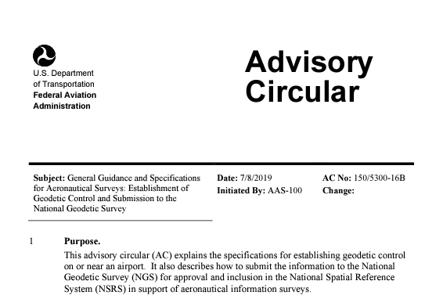
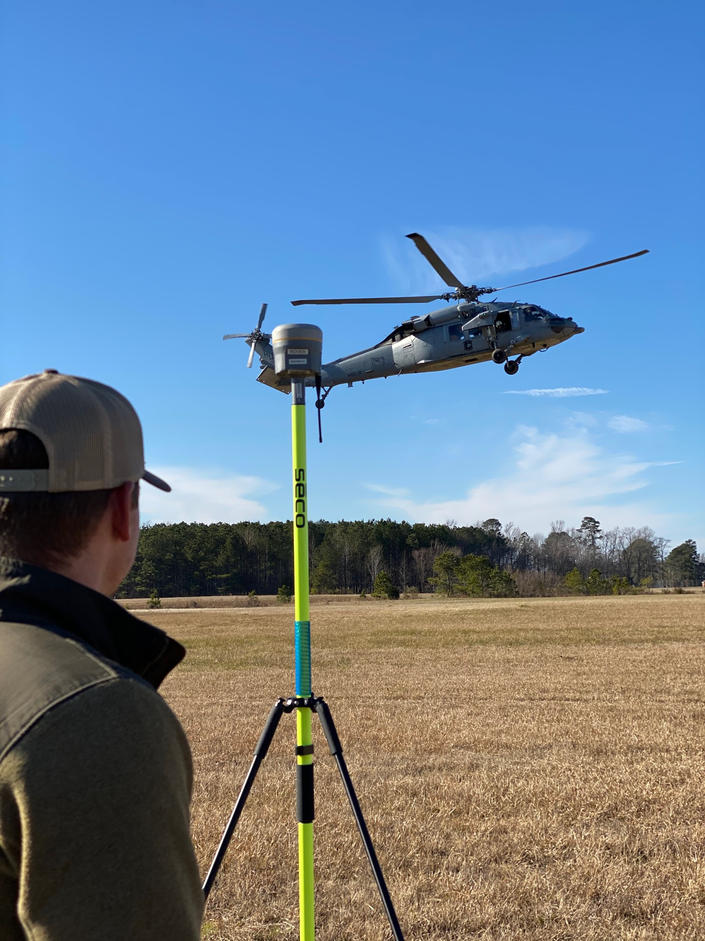
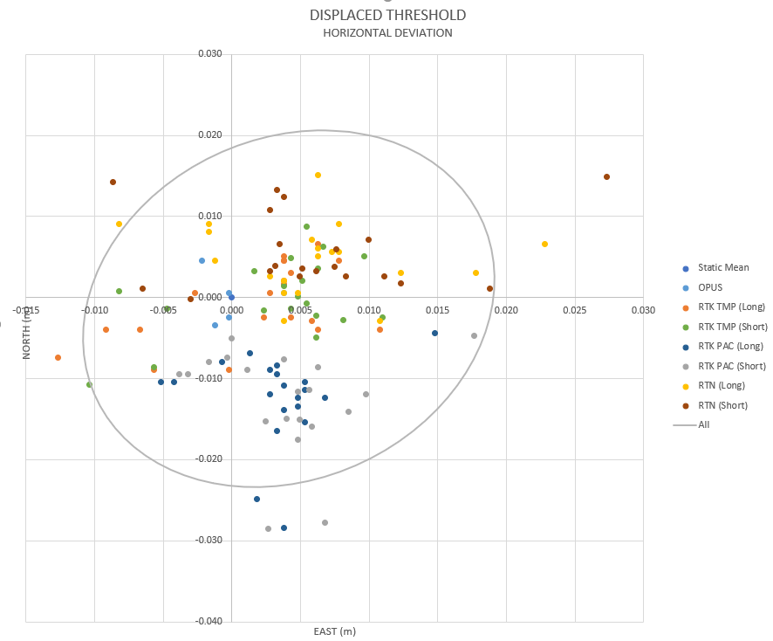
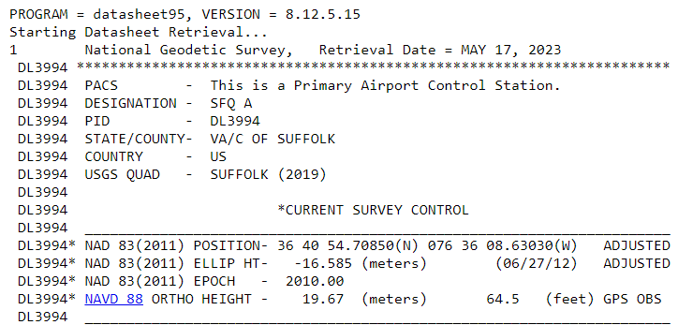
ASP
Updating specs/processes with FAA
  OPUS Projects implementation
  Use of modern technology
  Reporting on database thresholds
  Advising on development of real-time protocols

Slide 6
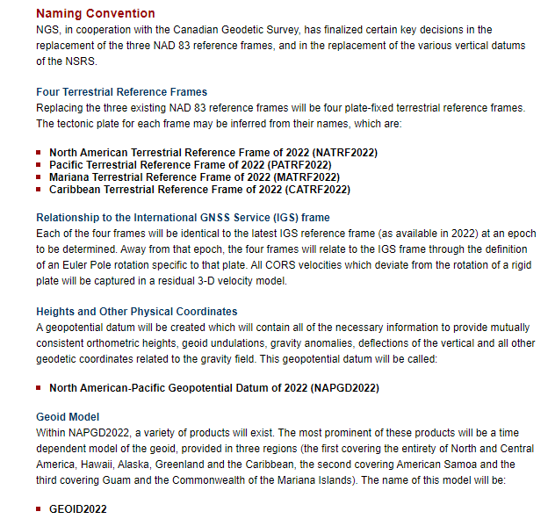
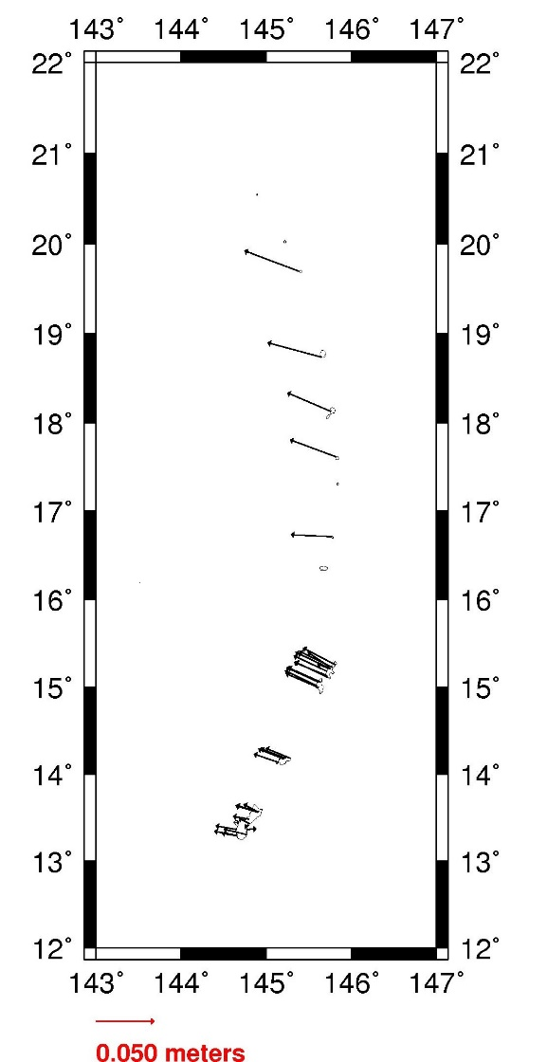
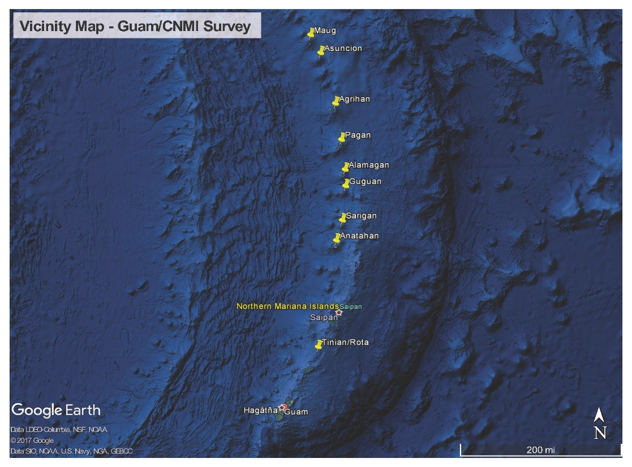
Campaigns
GNSS comparisons helped determine a new plate rotation model for MATRF2022

Slide 7
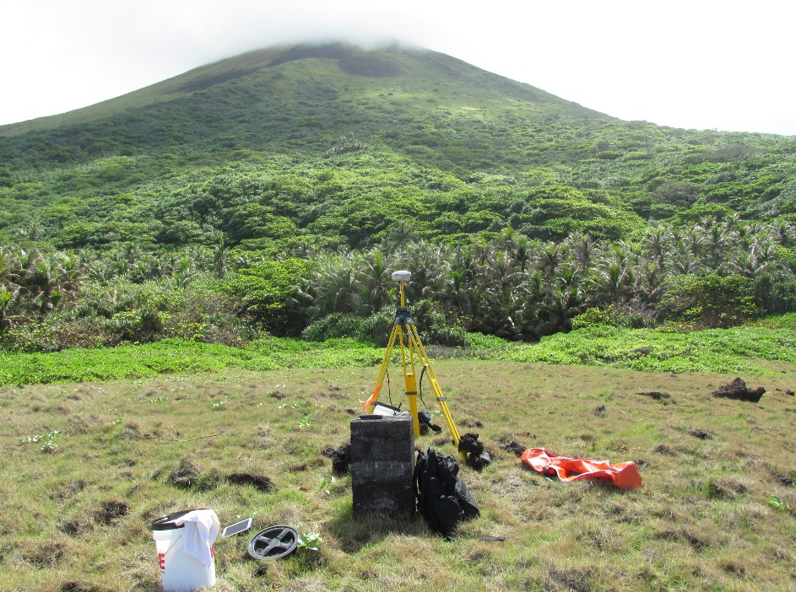
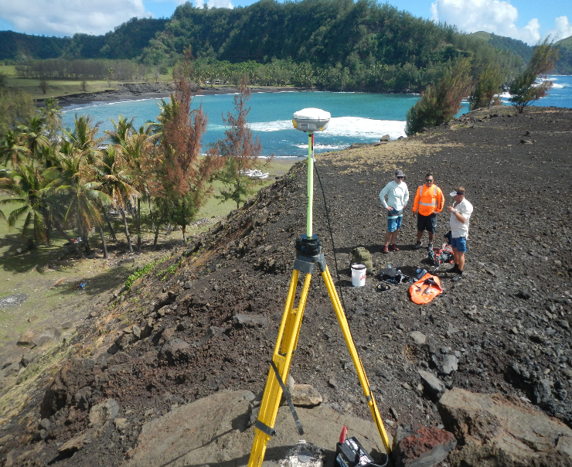
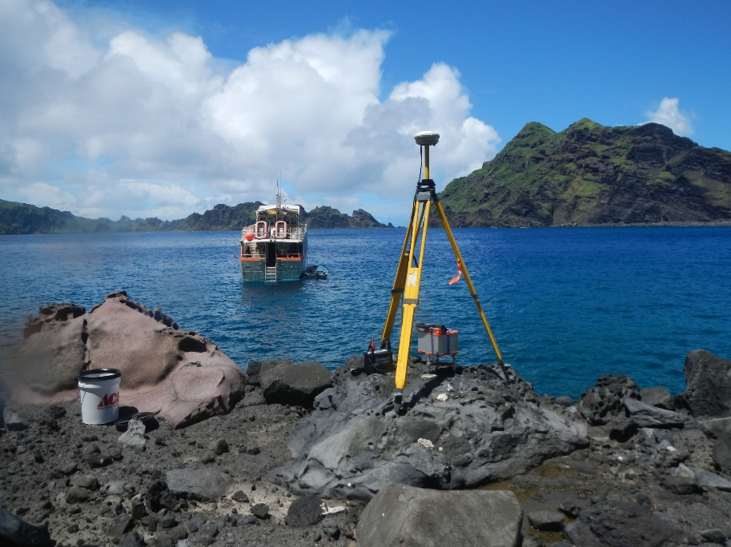
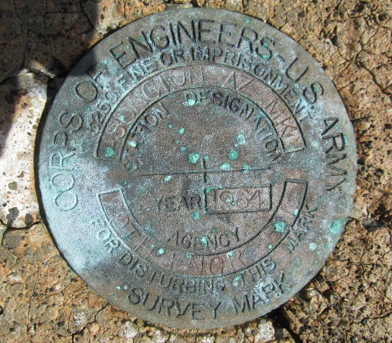
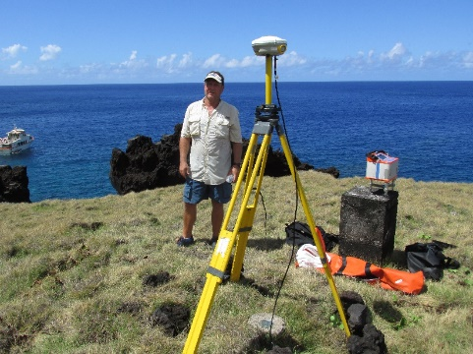
Campaigns
GNSS static survey on mainland and individual islands accessed via two weeks of remote marine charter

Slide 8
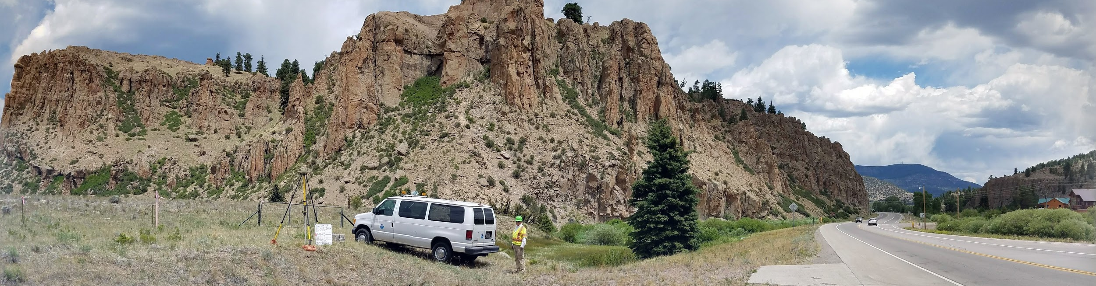
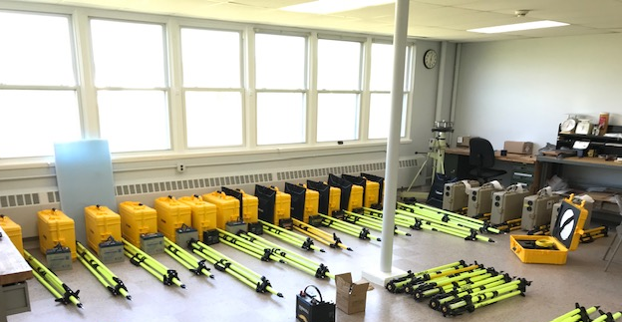
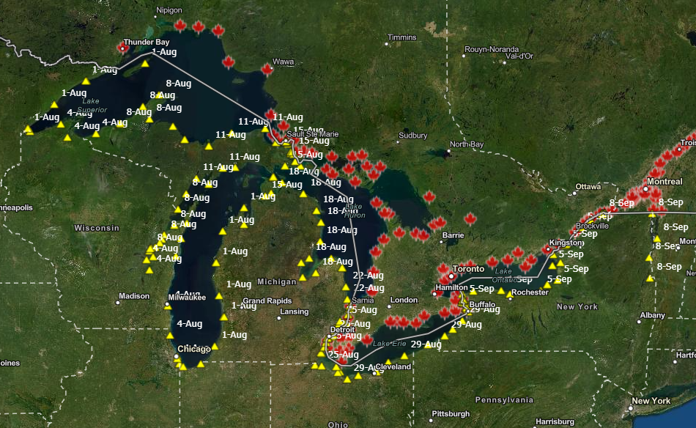
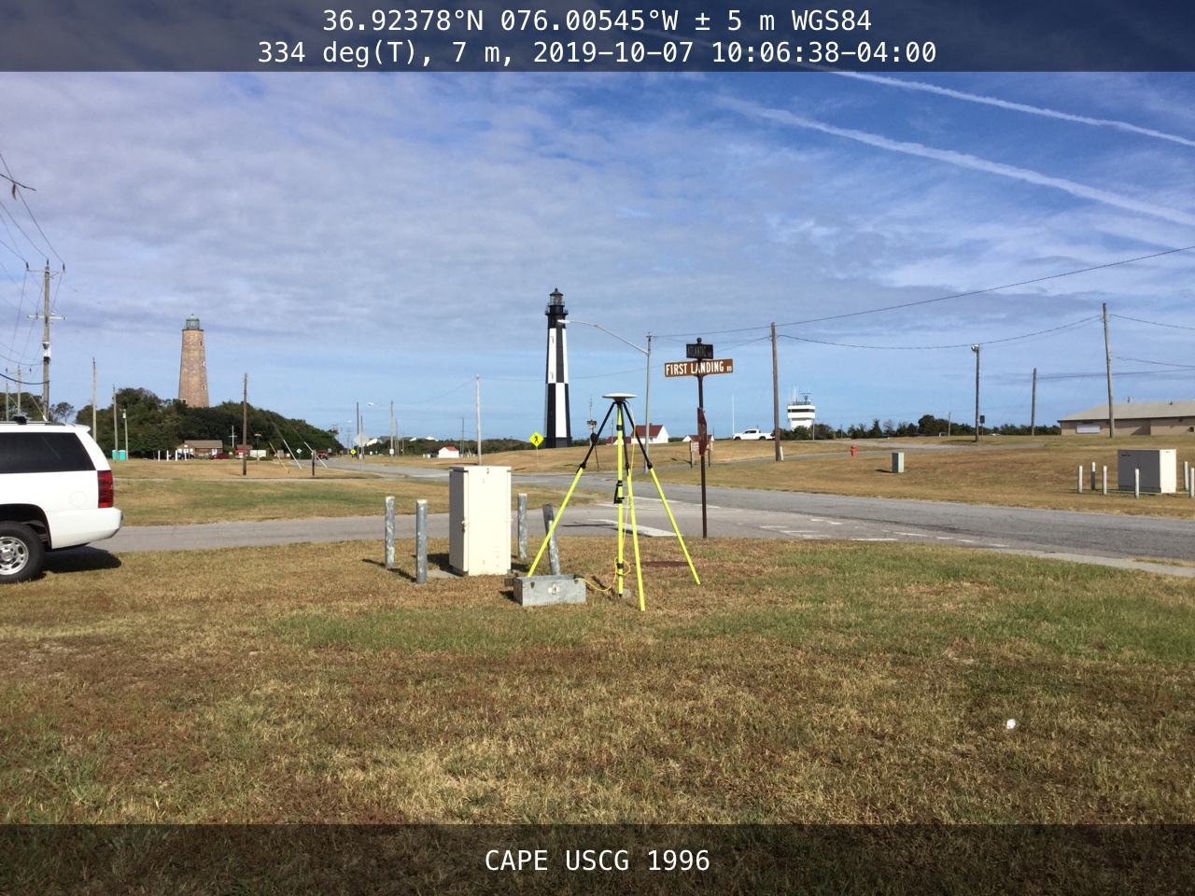
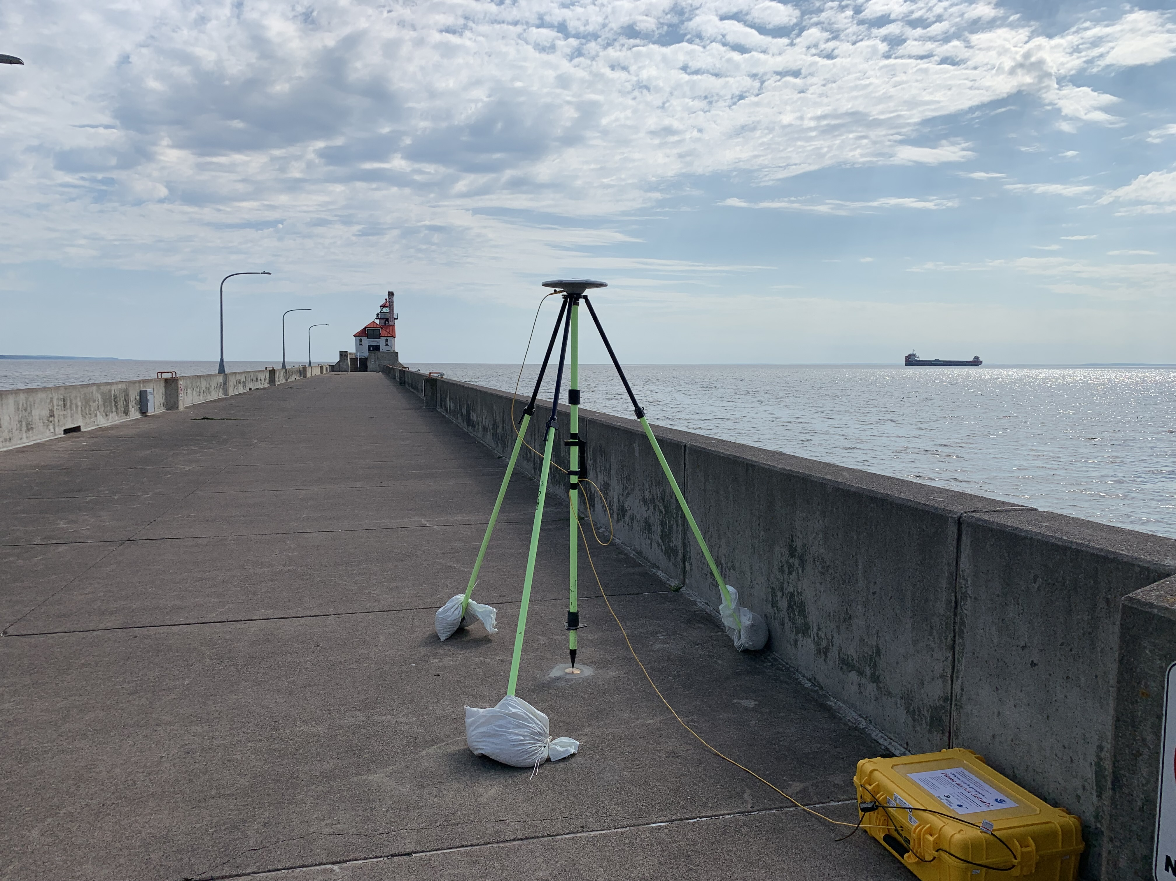
Campaigns
Other Modernization projects include the Geoid Slope Validation Survey (GSVS) and Geoid Monitoring (GeMS)
Projects with specific products include IGLD2022 and Chesapeake Bay VLM
Continual improvement of technology used, logistics, data collection, QA/QC
Upcoming survey in America Samoa for Foundation CORS recon and GNSS collection

Slide 9
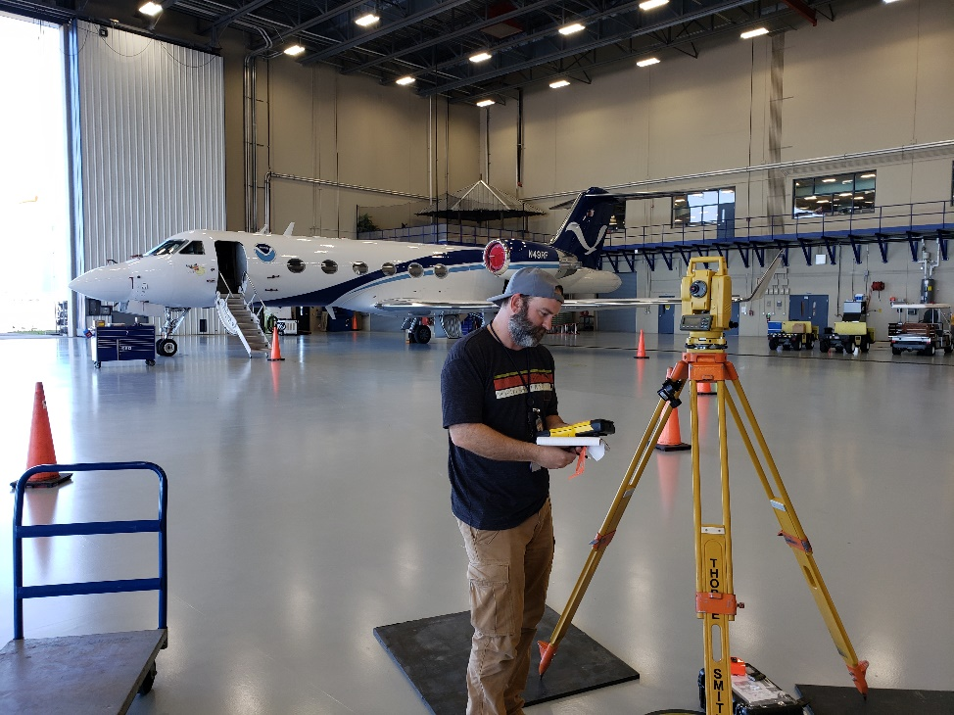
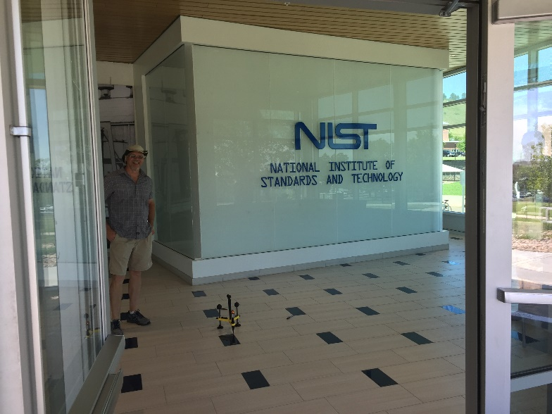
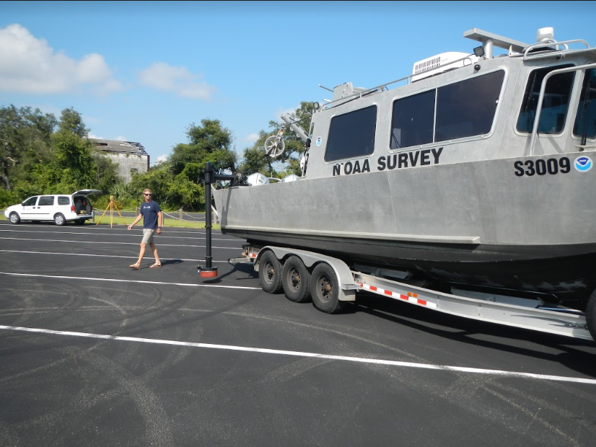
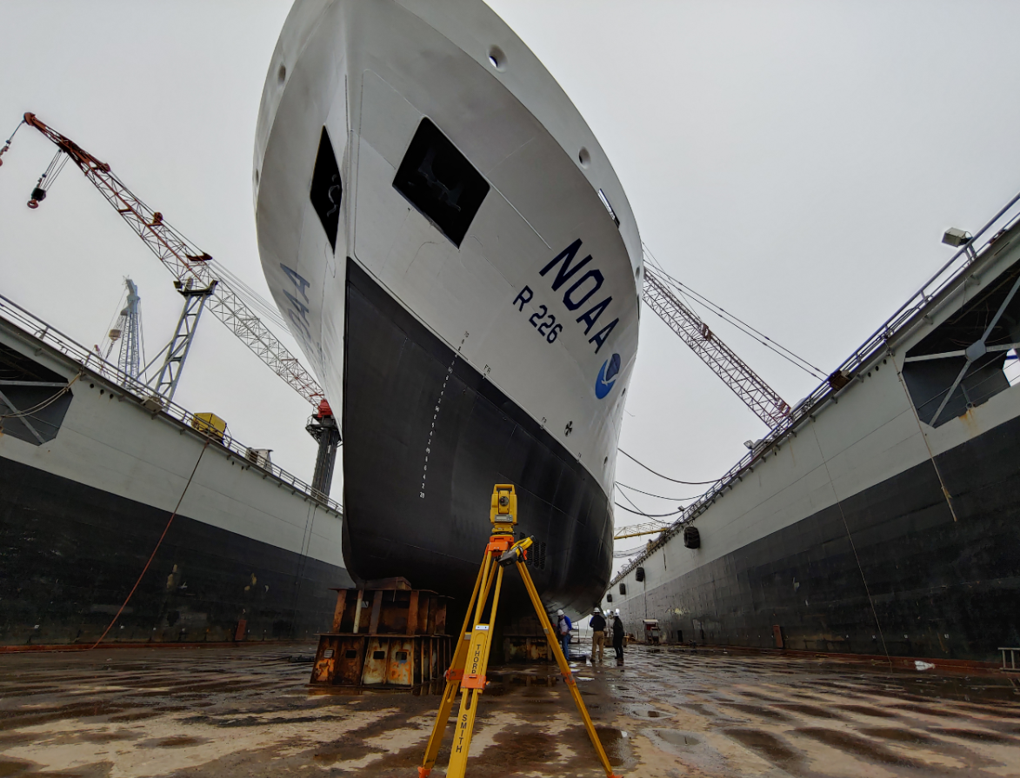
Tech Work
Sensor surveys
Leveling
Real-time
Leveraging GIS
Apps for Ops
These activities support Modernization products, hydrographic mapping, and scientific partners.
In addition they hone skills, equipment use, and protocols for high-precision work

Slide 10
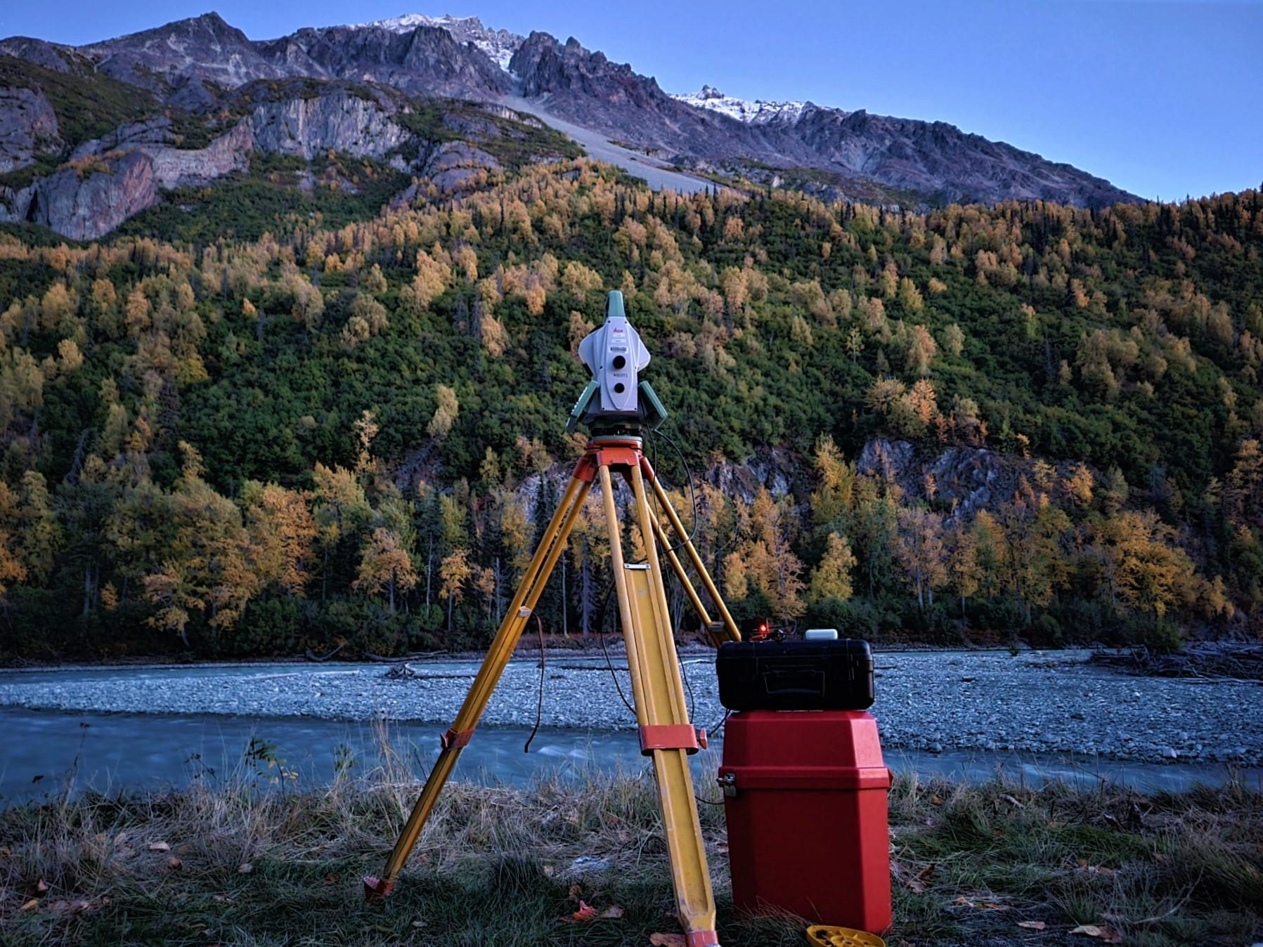
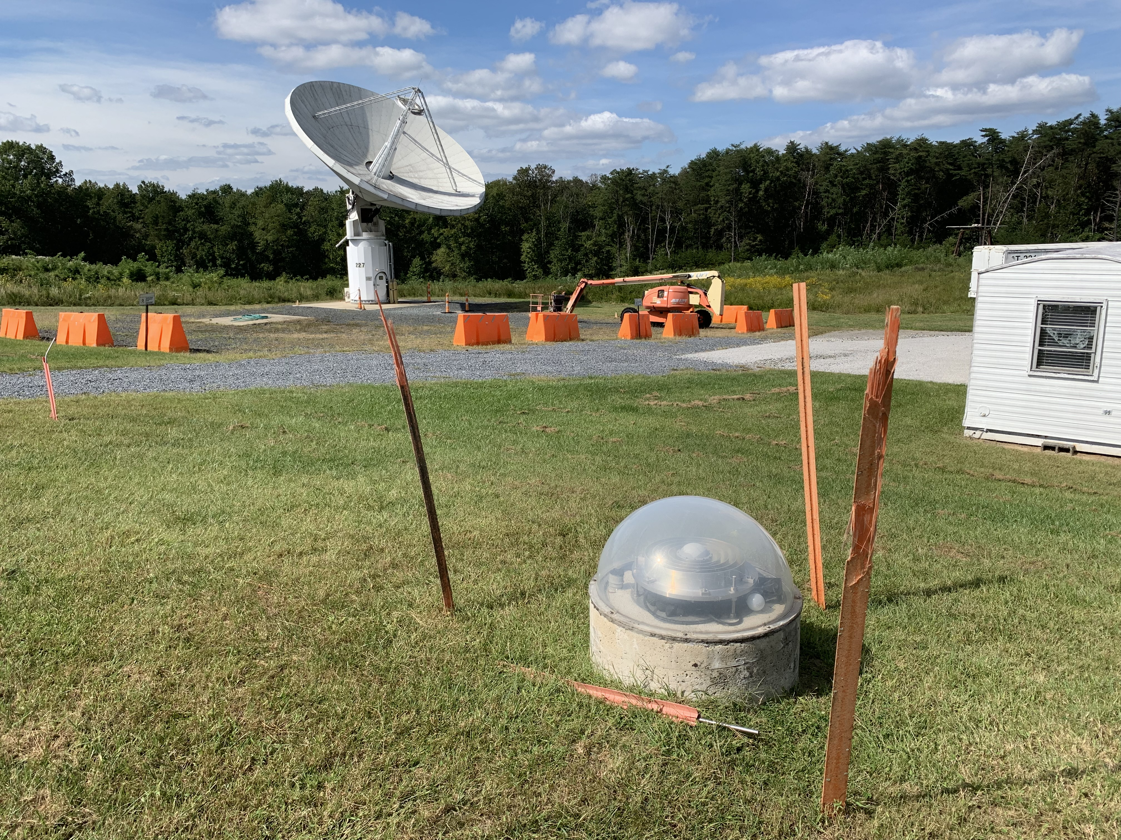
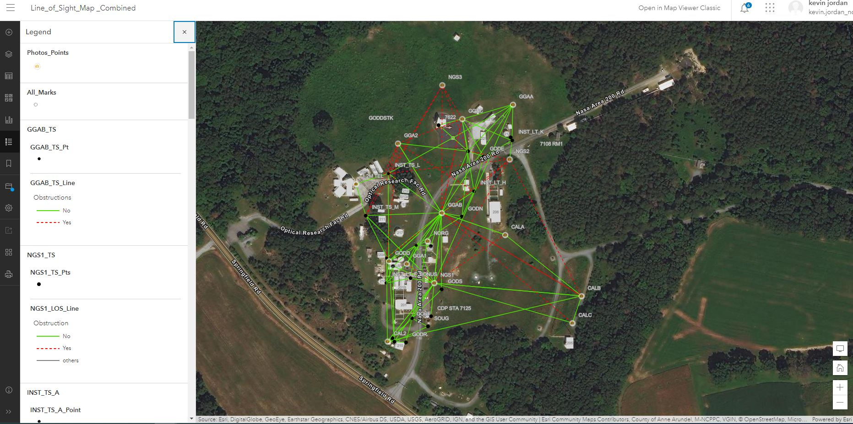
Emerging
RTK/N for control
Deflection of Vertical
Astrogeodetic azimuths
CORS/FCORS
Tie surveys
New data exchange formats will be key to layered data
These projects inform Modernization standards, field test new tools in place, help establish new protocols

Slide 11
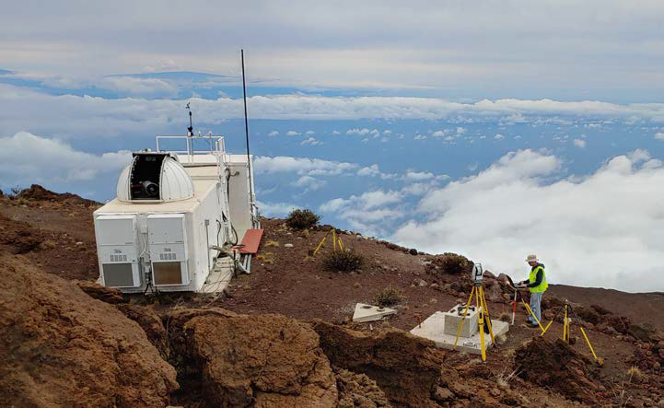
Tie Surveys & Co-location
History of NGS local tie surveys:
  Supporting mobile VLBI and SLR programs, evolving into
  Supporting IERS by completing annual surveys at co-location sites
ITRF realizations are the combination of the four space geodetic techniques
  VLBI, SLR, DORIS, GNSS
  Co-locating these techniques allows for their combination
  Individual techniques are asking for millimeter precision
      No matter how accurate the individual techniques are, a ground survey ties them together.

Slide 12
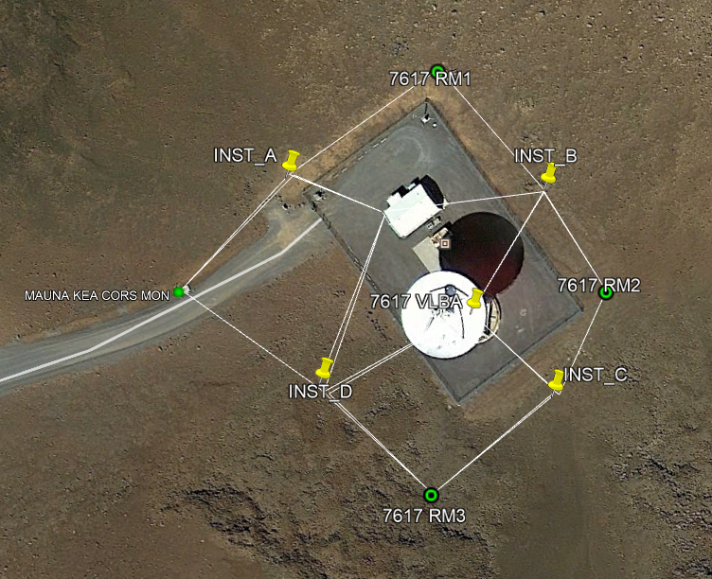
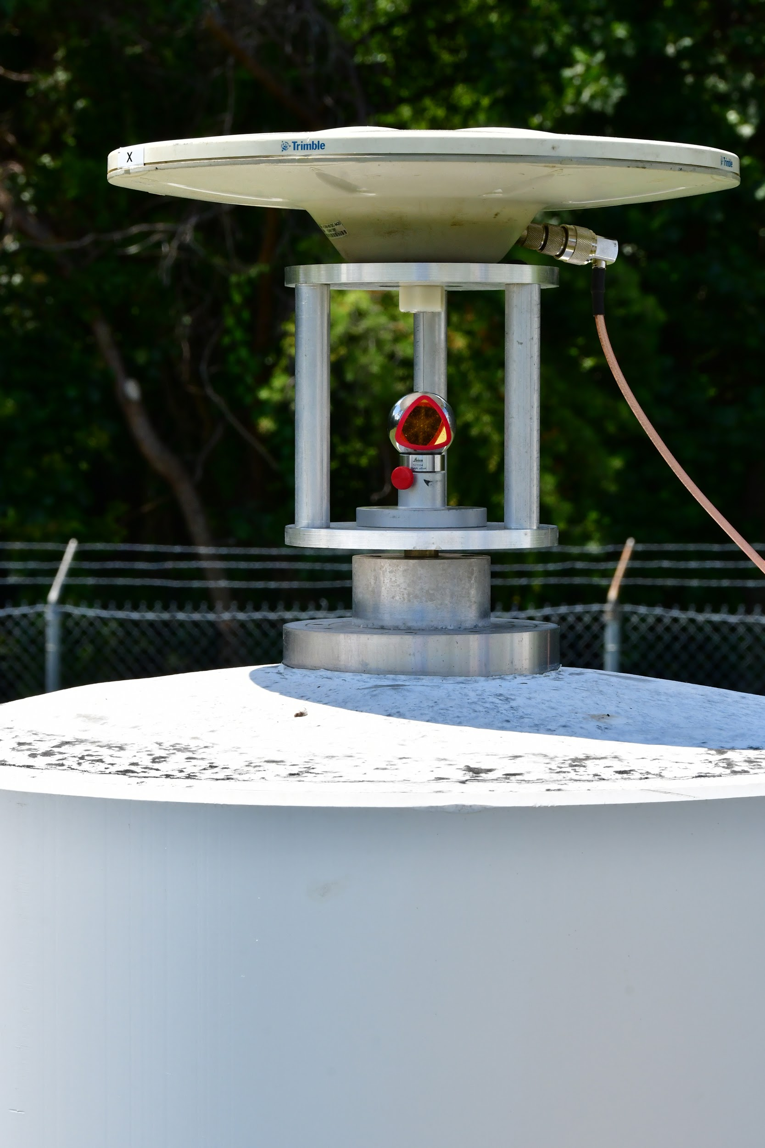
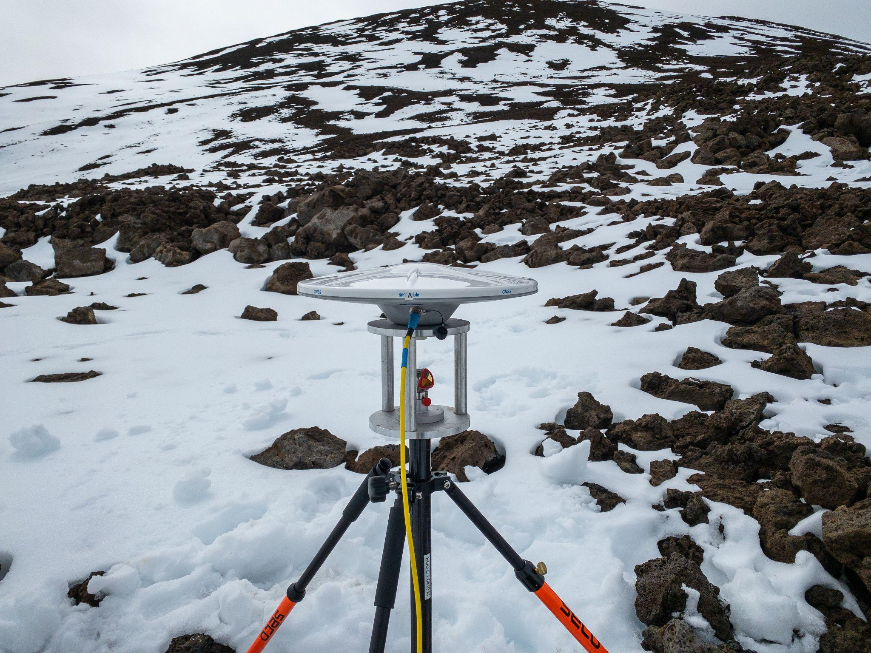
IERS/ITRF Work
Using passive marks as our fabric, we measure ties with terrestrial observations and align with GNSS…..for now
Data goes through rigorous analysis and processing and is submitted to IERS via a SINEX file for incorporation in ITRF development

Slide 13
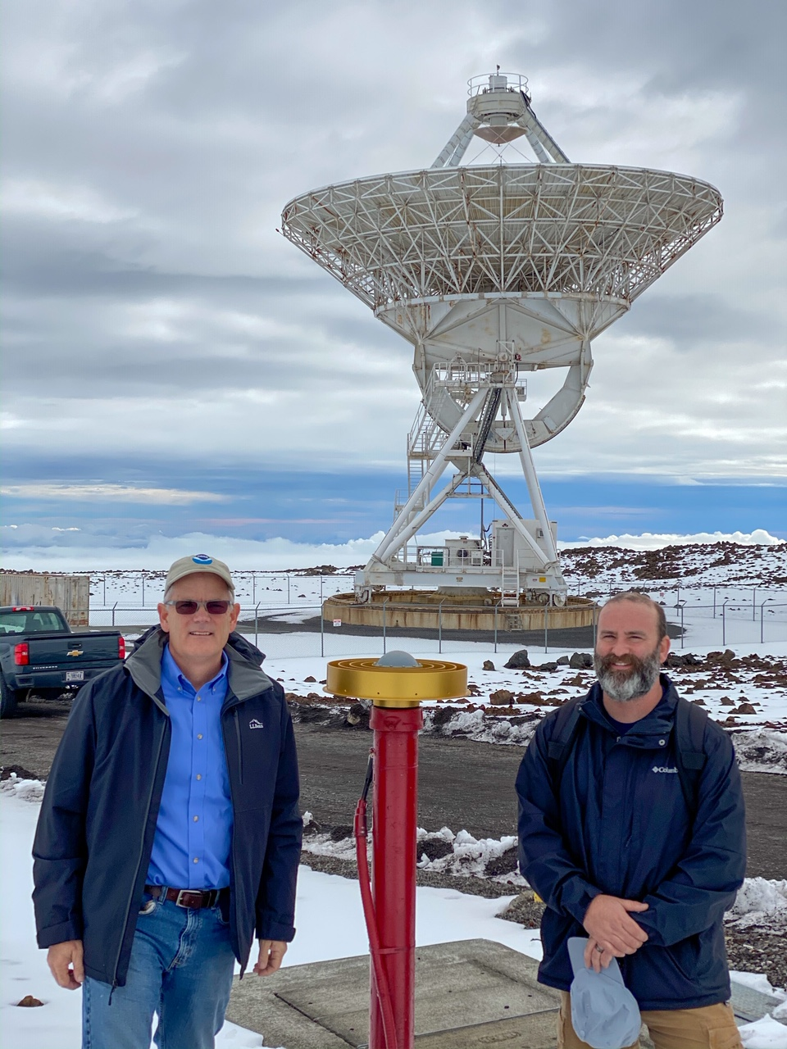
IERS/ITRF Work
Recent Activities
Maui, HI (GNSS/SLR)
Westford, MA (GNSS/VLBI)
Stafford, VA (GNSS/SLR)
Table Mountain, CO (GNSS/Gravity)
Mauna Kea, HI (VLBI/GNSS)
Greenbelt/Goddard (All)
Kokee (VLBI/GNSS)
There was an increase in tie surveys vectors from GNSS to DORIS, SLR, VBLI between 2014 to 2020 (Altamimi 2022)
  Total vectors from 212 to 253
  Vectors with discrepancy <5mm from 64 to 96

Slide 14
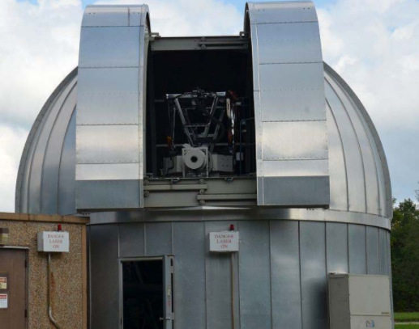
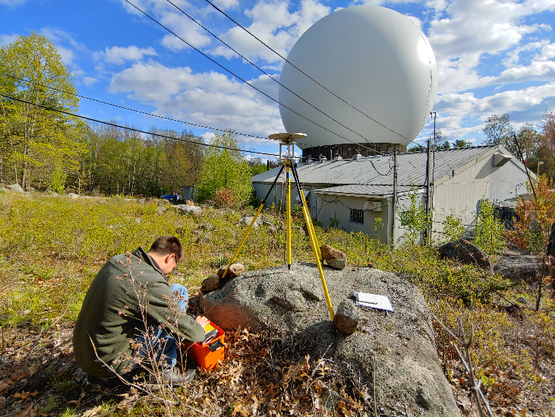
Need for Co-location
Enhanced partnerships due to Foundation CORS development has increased need and number of partners
Growing interest in water levels and coastal resilience has increased the desire and need for tie surveys and layered data
Researchers and scientists are striving for (and reporting in) mm’s, so the continued need for robust field surveying protocols is only growing

Slide 15
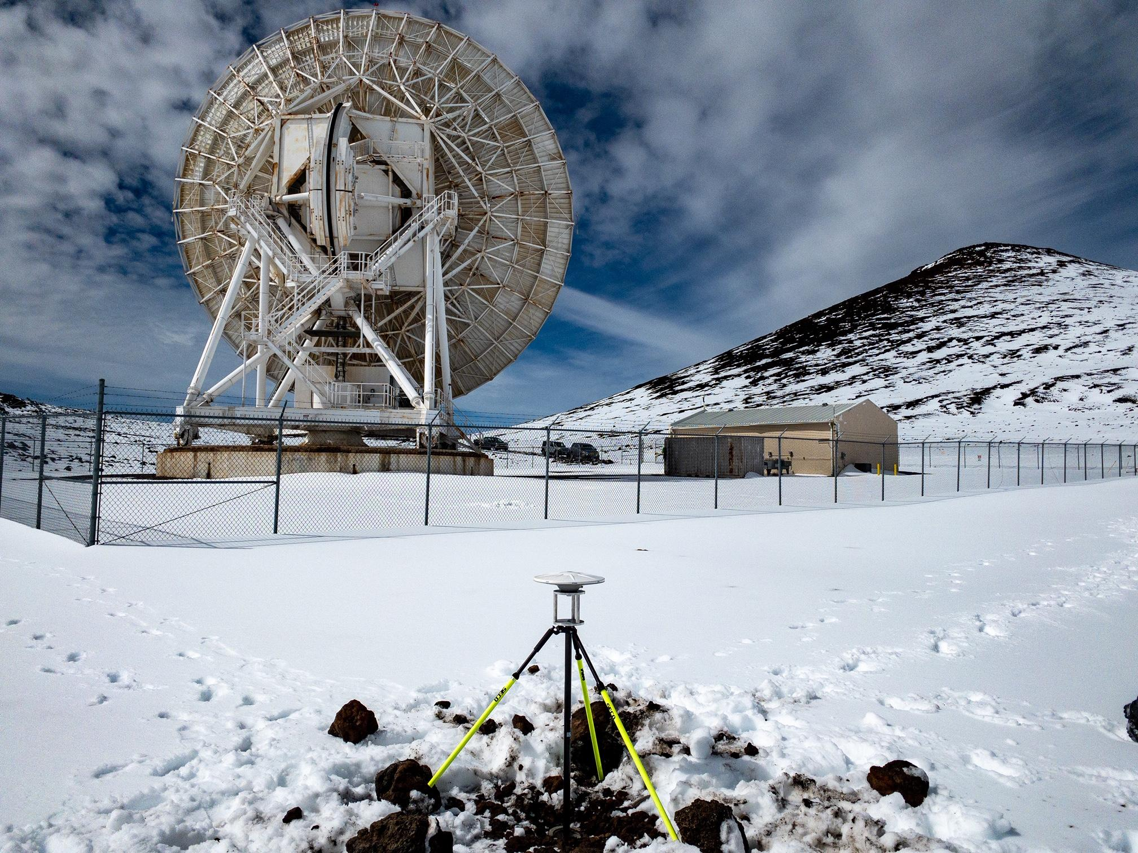
Co-location research
On-going development in field protocols and research topics are development based on field discoveries, operator requests, and site-specific challenges
Current topics are VLBI antenna deformation, automated site monitoring, and the inclusion of additional sensors (InSAR, water levels, etc.)
The value of these surveys to the overall community is immense and co-locating of sensors continues to be a growing area of expertise

Slide 16
NGS Field Support
Surveying
  Conduct or provide input on campaign surveys utilizing long-duration static GNSS
  Measure local ties at co-location sites (observatories, water level stations, VLM)
Training
  Videos or job aids available from various projects that describe tripod calibration, receiver configuration, and best practices
  Established training courses available
  Lessons learned in the field
Geodetic Expertise
  We will answer questions, provide feedback on survey plans, or potentially operationalize for those that have challenges requiring field work
Equipment
  Consistently working with CORSs, GNSS, robotic total stations, leveling procedures, etc. to determine best course forward for geodetic-quality work

Slide 17
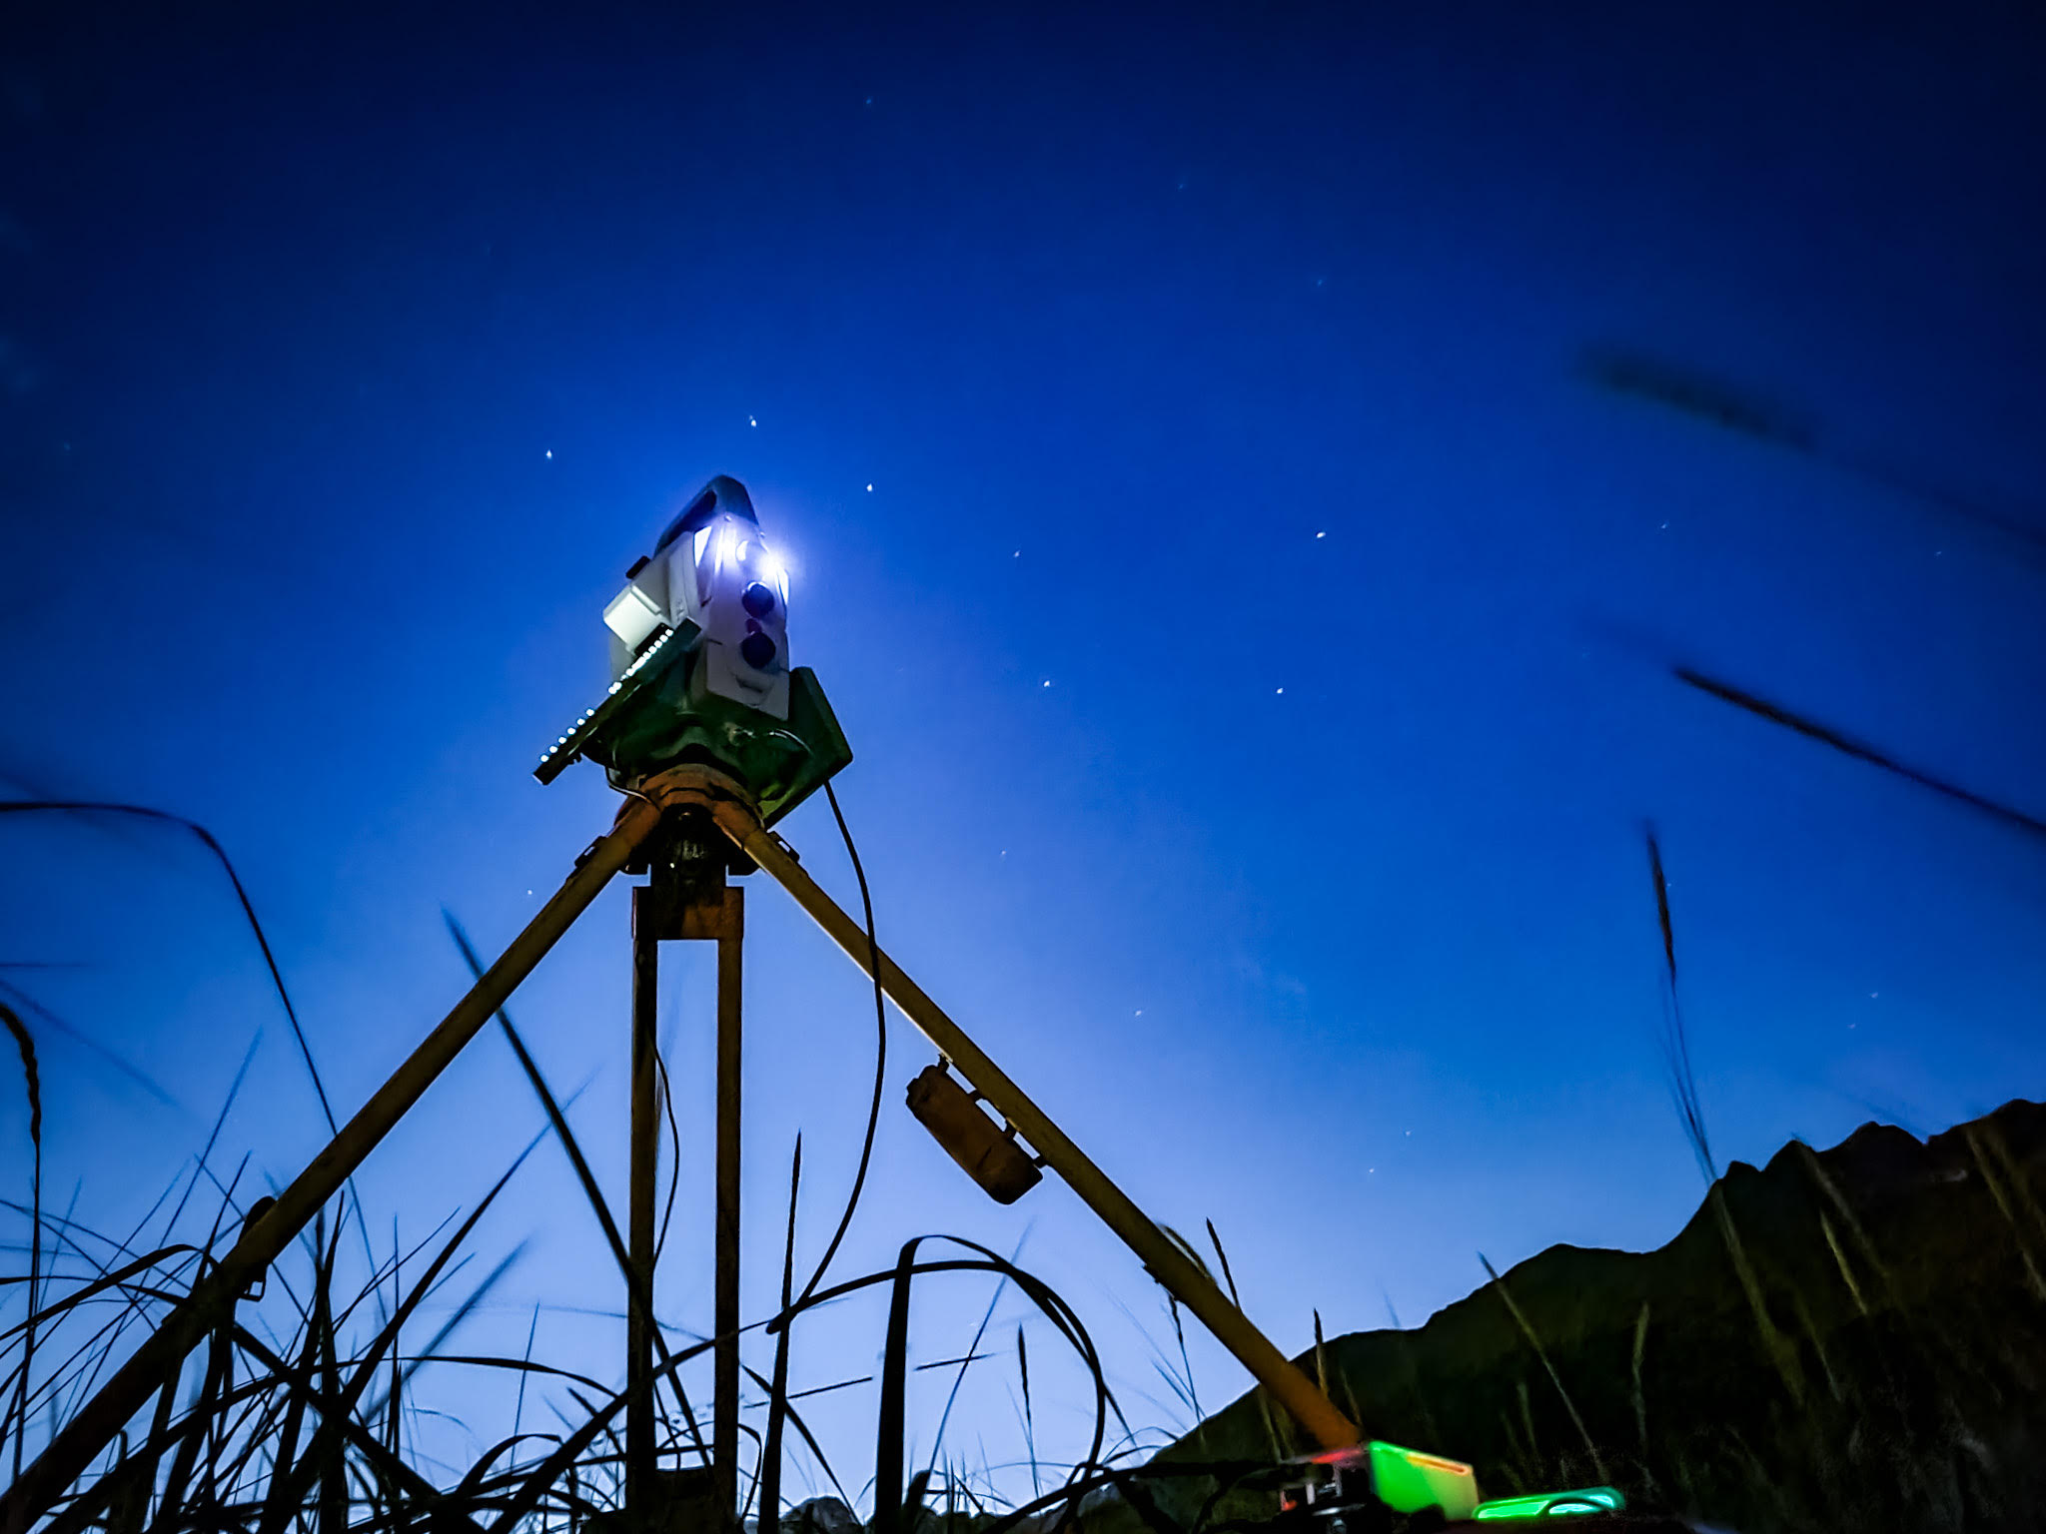
Thank You
Ryan Hippenstiel, PLS
Chief, Field Operations Branch
NOAA's National Geodetic Survey
https://www.ngs.noaa.gov/
ryan.hippenstiel@noaa.gov

