Slide 1

OPUS-Projects to the
NGS Integrated Data Base
Mark Schenewerk
mark.schenewerk@noaa.gov
816-994-3067

Slide 2
Define bluebooking:
bluebook [bloo bo͝ok] noun
The NGS Bluebook is a set of strongly structured data formats. While its origins go back to the late 1970s and early 1980s, it has been updated and adapted to changes in technology over the years.
See also: Input Formats and Specifications of the National Geodetic Survey Data Base. https://www.ngs.noaa.gov/FGCS/BlueBook/
bluebooking [bloo bo͝okiNG] verb
To format surveying results following the NGS Bluebook specifications for submission to the Integrated Database (IDB).
April 25, 2017
OPUS-Projects to NGS Integrated Data-Base

Slide 3
Bluebooking is integral to NGS tasks.
Pros
  It has been the standard for submissions to the IDB for decades.
  Many programs are tailored specifically to these formats.
  Folks are used to it.
  It has served its purposes very well.
Cons
  It uses 1960’s technology.
  Its detail and complexity are intimidating.
  It is time intensive for you.
  Difficult if not impossible to adapt for the future.
April 25, 2017
OPUS-Projects to NGS Integrated Data-Base

Slide 4
What is OP2IDB?
In 2015, NGS began a project called “Deriving a valid path for OPUS-Projects GPS projects to be loaded to the NGS IDB.”
That title is a mouthful, so I call it OP2IDB.
The project plan in two sentences:
  Bluebooking is tedious and time-consuming.
  Demonstrate that, with minimal changes to its web-based Graphical User Interface (GUI), OPUS-Projects can be extended to prepare in toto submissions to the IDB.
April 25, 2017
OPUS-Projects to NGS Integrated Data-Base
Notes:
In short: demonstrate that OPUS-Projects can “feed” the IDB.

Slide 5
So let’s get started.
There is insufficient time to describe all changes, so I’ll focus on a handful that indicate how users will prepare a project for submission.
But first, two quick asides.
  Some folks won’t want to submit their results for publication or their projects won’t be appropriate to submit. For them, we’ve preserved the current OPUS-Projects appearance and functionality with two exceptions. However, we have enhanced a few functions.
  OP2IDB doesn’t change the requirements for submissions - that’s for a future step. It does; however, simplify meeting those requirements.
April 25, 2017
OPUS-Projects to NGS Integrated Data-Base
Notes:
The enhancements are selected from some of the most popular requests made by users.
You’ll see some of the enhancements in these slides.

Slide 6
Accessing the new features.
The first step in preparing a submission to the IDB is the NGS online survey project proposal form. After entering a brief description of the survey project, you’re provided a survey project tracking ID to facilitate communication to NGS about your project.
OP2IDB uses that tracking ID to “tag” projects in preparation for submission to the IDB.
Eventually, the survey project proposal and OPUS-Projects project creation will be integrated, but for this “proof of concept” stage, there are two ways to associate a project tracking ID with your OPUS-Projects project.
April 25, 2017
OPUS-Projects to NGS Integrated Data-Base

Slide 7
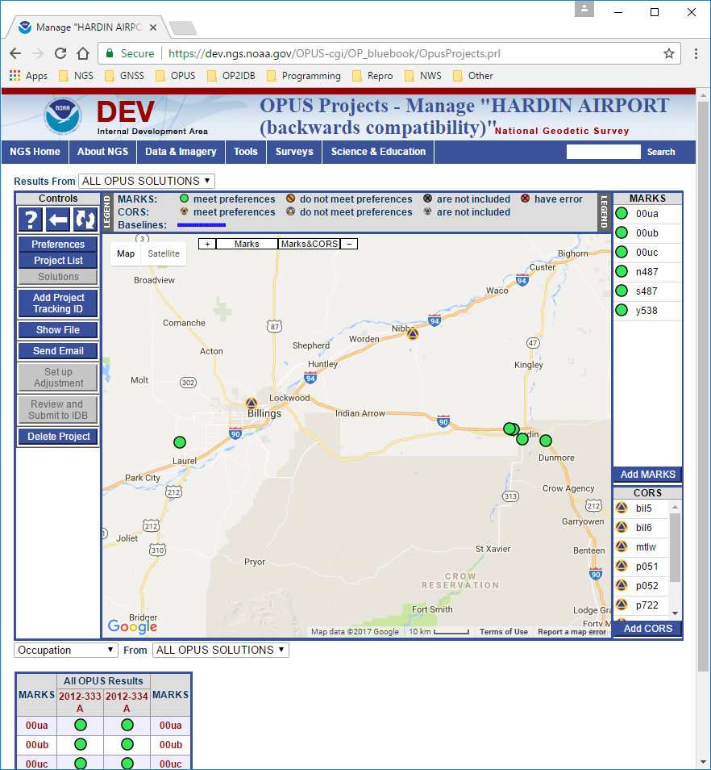
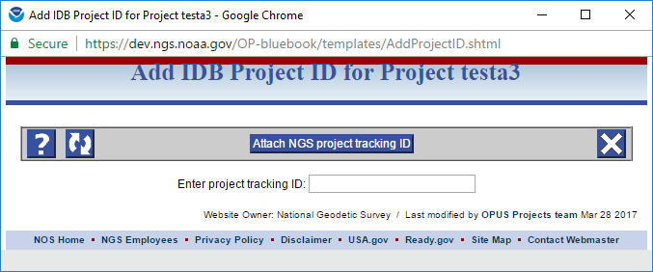
Manager’s page: NGS tracking ID.
April 25, 2017
OPUS-Projects to NGS Integrated Data-Base
Notes:
For projects already in OPUS-Projects, manager’s will be able to enter the project tracking ID after-the-fact making it possible to submit those projects for publication in the IDB if they meet publication requirements.

Slide 8
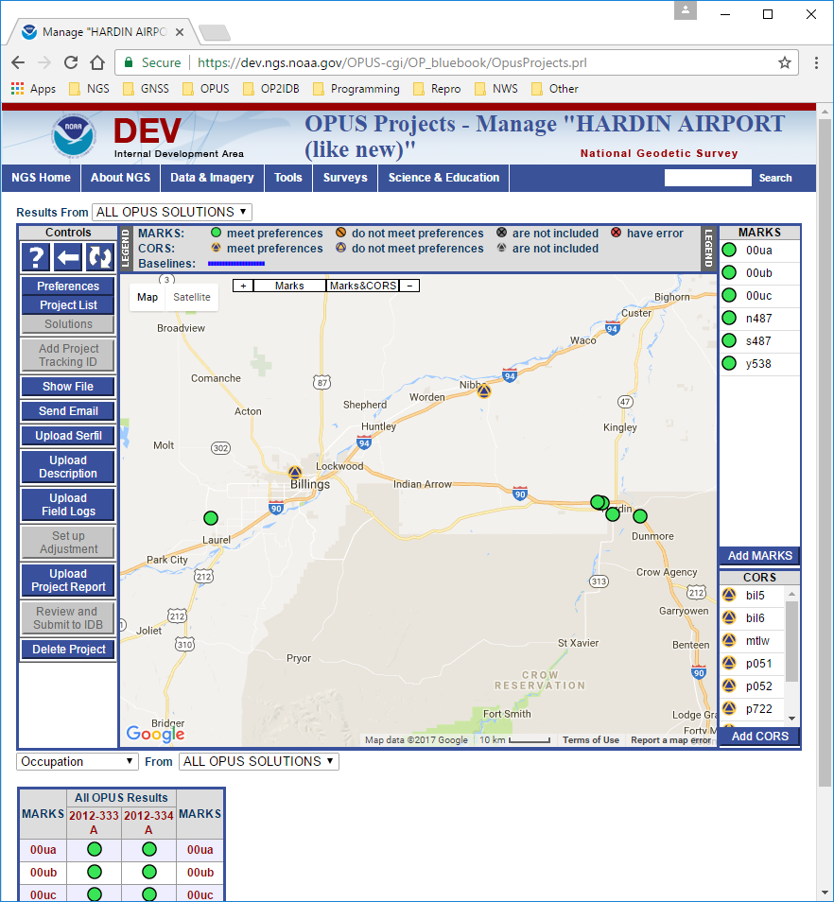
Manager’s page: new controls
April 25, 2017
OPUS-Projects to NGS Integrated Data-Base
Notes:
When a project tracking ID is attached to a project, controls specific to creating a submission become available.

Slide 9
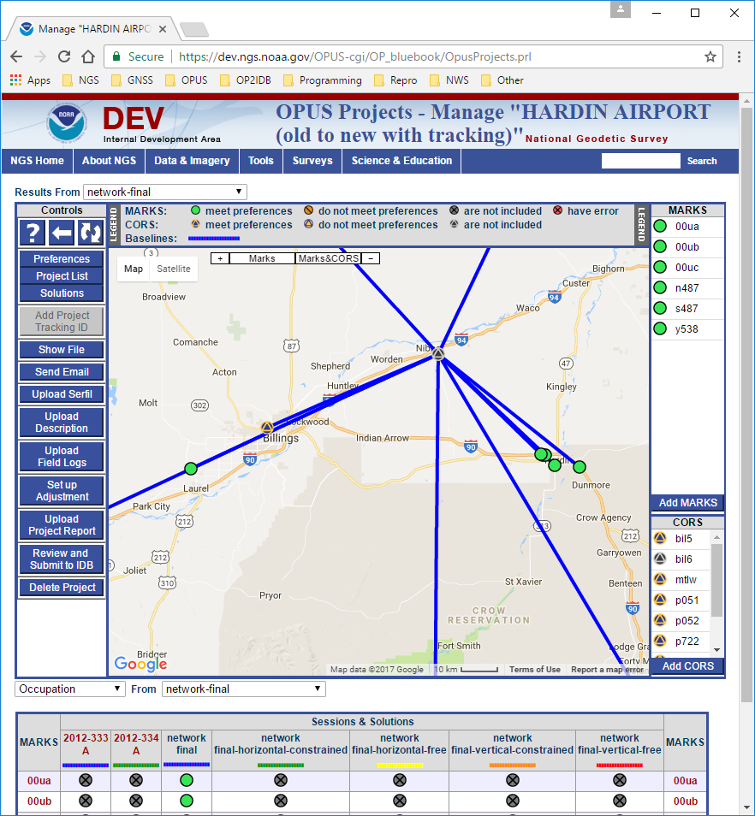
Manager’s page: Upload Description.
April 25, 2017
OPUS-Projects to NGS Integrated Data-Base
Notes:
Mark description files created by WinDesc are required for publication at this time.
WinDesc is a Microsoft Windows program. While it could be made available through a web app, the effort required to do so are beyond the scope of this project.
Therefore, a means to upload the WinDesc description files is provided.
In a future version of OPUS-Projects, online description creation should be possible.

Slide 10
Manager’s page: Upload Field Logs.
April 25, 2017
OPUS-Projects to NGS Integrated Data-Base
Notes:
Submissions requires electronic copies (scanned paper or PDF forms) of the field logs. The manager can upload a ZIP file of those copies, or load them mark-by-mark from their project web pages.

Slide 11
Manager’s page: Setup Adjustment.
April 25, 2017
OPUS-Projects to NGS Integrated Data-Base
Notes:
The most significant changes for OP2IDB occur in the Setup Adjustment form.

Slide 12
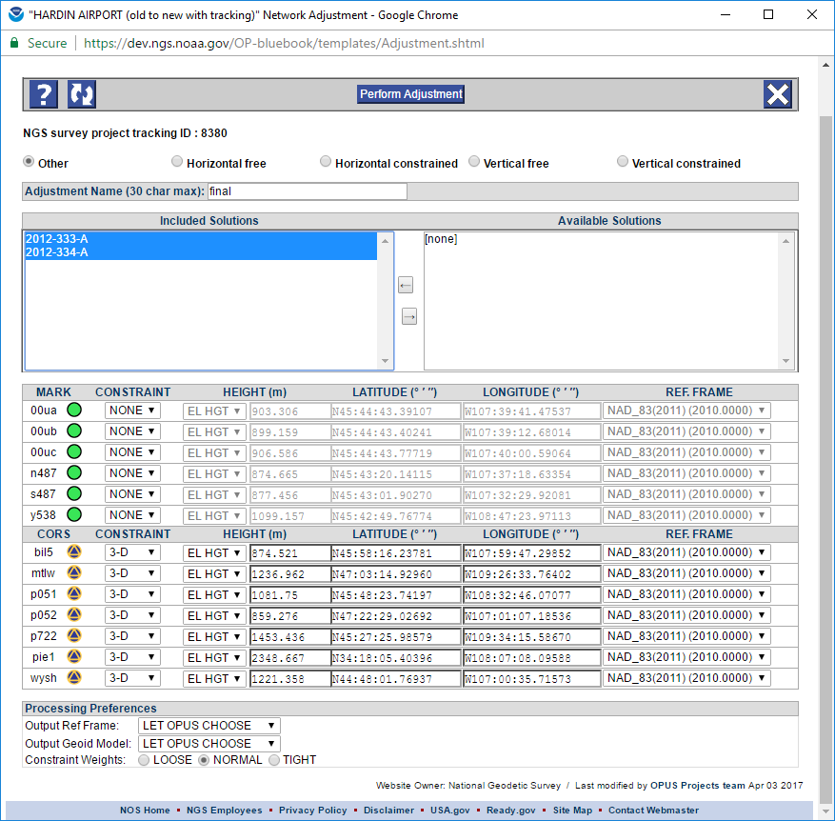
Adjustment setup form.
April 25, 2017
OPUS-Projects to NGS Integrated Data-Base
Notes:
Five adjustment types are listed and required for a submission. Adjustments types must be completed in the left-to-right order shown on the form. Later adjustment types are disabled until the earlier ones are completed.
Other: for backwards compatibility, a standard OPUS-Projects adjustment and creates b-file.
Horizontal-free: constrain a single set of horizontal coordinates and a single ellipsoid height coordinate.
Horizontal-constrained: fix all currently published positions and ellipsoid heights.
Vertical-free: fix one position and one published orthometric height.
Vertical-constrained: constrain all previously adjusted orthometric heights and one NAD 83 adjusted position.
Only the appropriate “source” for an adjustment is offered as a selection. In this case, the session solution results.
The constraint defaults offered are appropriate for the adjustment type based upon project information and previous processing. These defaults can, of course, be changed, but should be quite reasonable.

Slide 13
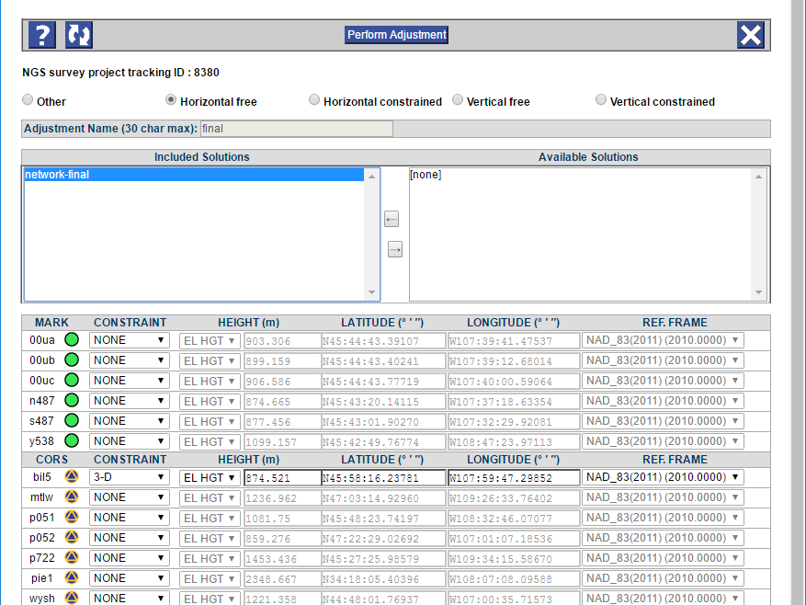
Adjustment setup: horizontal-free
April 25, 2017
OPUS-Projects to NGS Integrated Data-Base
Notes:
The horizontal-free, A.K.A. minimally constrained adjustment constrains only one set of horizontal coordinates and one ellipsoidal height. This is a “final test” to confirm that no outliers exist in the session processing results. It also computes the appropriate scaling for the horizontal and vertical components of the GPS vectors to be applied before beginning the subsequent adjustments.
Again, the constraint defaults are appropriate to the adjustment type. In the case of a horizontal-free adjustment, the CORS hub is offered as the mark to be constrained by default.

Slide 14
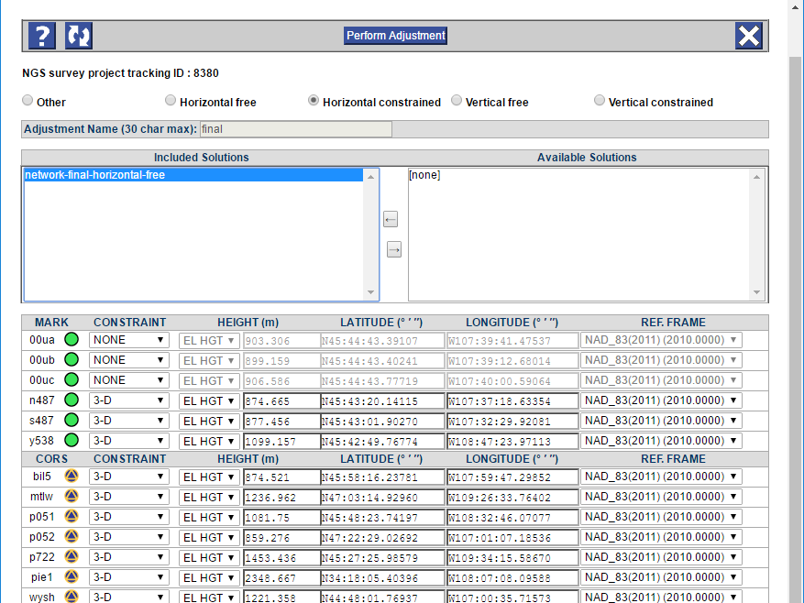
Adjustment setup: horizontal-constrained
April 25, 2017
OPUS-Projects to NGS Integrated Data-Base
Notes:
Horizontal-constrained holds all marks with published coordinates. This adjustment “creates” the NAD 83 coordinates derived from this survey.

Slide 15
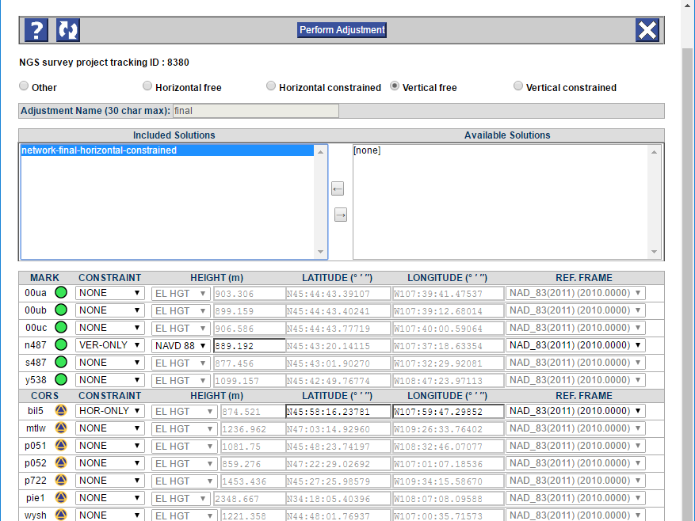
Adjustment setup: vertical-free
April 25, 2017
OPUS-Projects to NGS Integrated Data-Base
Notes:
A vertical-free adjustment performs a similar function for the vertical adjustment as the horizontal-free does for the horizontal adjustment.
One pair of horizontal coordinates and one published orthometric height are held. Note that, once again, reasonable defaults are suggested.

Slide 16
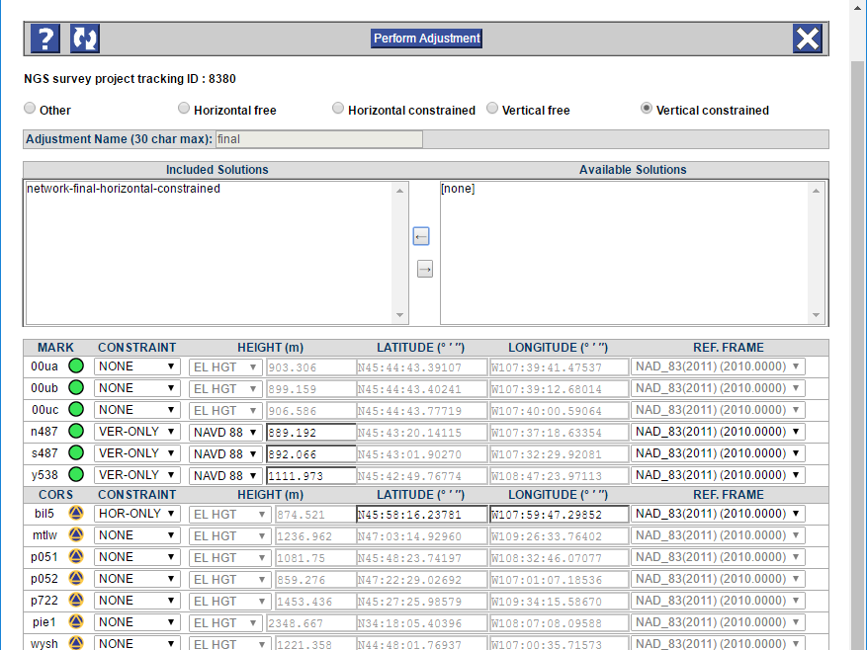
Adjustment setup: vertical-constrained
April 25, 2017
OPUS-Projects to NGS Integrated Data-Base
Notes:
The vertical-constrained is for the vertical what horizontal-constrained is for the horizontal.
In this case, all mark with published orthometric heights are offered as the defaults as needed and expected. One pair of horizontal coordinates must be constrained and a reasonable default is offered.

Slide 17
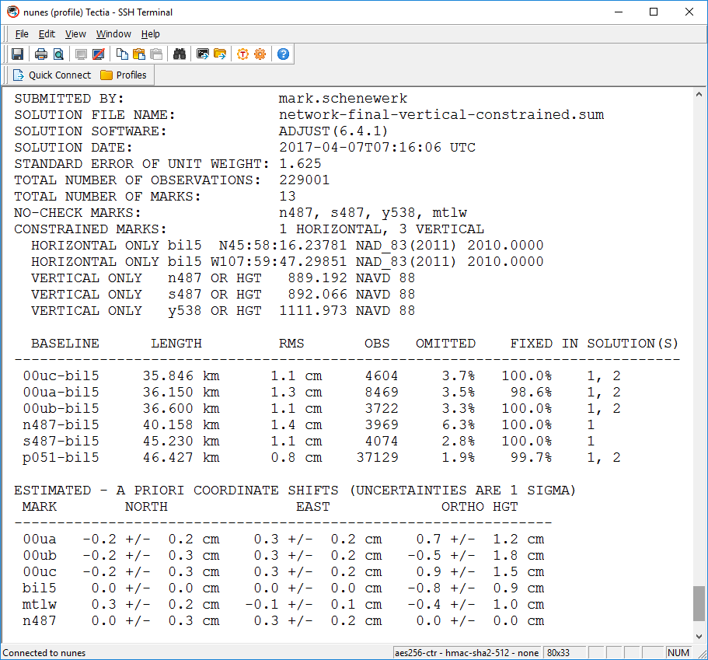
Changes to the OPUS-like adjustment report.
April 25, 2017
OPUS-Projects to NGS Integrated Data-Base
Notes:
We’ll diverge briefly to talk about changes to the adjustment reports. The ADJUST program output file will be included in the processing attachments or available through the “Show File” control. As always, an OPUS-like summary report is also attached to the email. In that summary, additional tables appear to help with quality control.

Slide 18
Manager’s page: Upload Project Report.
April 25, 2017
OPUS-Projects to NGS Integrated Data-Base
Notes:
Of course, a project report is required for publication. An electronic copy of that report will be uploaded and stored with the project.

Slide 19
Manager’s page: Review and Submit to IDB.
April 25, 2017
OPUS-Projects to NGS Integrated Data-Base
Notes:
When all processing is complete and all files are uploaded, the project manager will click the “Review and Submit to IDB” button. A popup window appears with a table confirming that all necessary components of a submission exist in the project and the project results are complete. If so, a button is enable that will create the submission. An action summary report will be sent to the user and the submission package sent on to the IDB team.

Slide 20
So, why “do” OP2IDB?
It makes your life easier now:
Machines work for you rather than you work for machines. Not once did I mention binary formats of description file or editing b-files or transforming g-files. All these are taken care of by WinDesc and OPUS-Projects.
It makes your life easier later:
Re-inventing bluebooking and many of the other changes needed for the new National Spatial Reference System (NSRS) will be “hidden” behind the user interfaces of tools being developed to support the new NSRS.
April 25, 2017
OPUS-Projects to NGS Integrated Data-Base
Notes:
Re-inventing bluebooking means going from users creating and NGS interpreting strongly formatted reports to users entering information in much more human-friendly ways and NGS receiving that information formatted in much more flexible formats like XML.

Slide 21
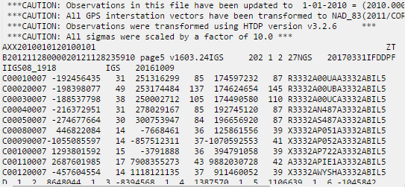
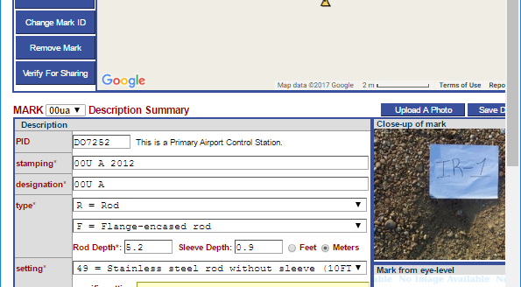
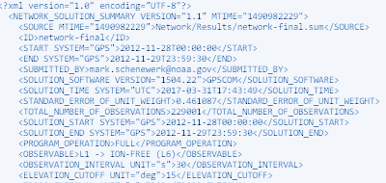
In other words:
We go from you do this …
… to you do this.
NGS still gets this now ....
… but NGS will get this later.
April 25, 2017
OPUS-Projects to NGS Integrated Data-Base
Notes:
User’s go from columns-are-important, numeric codes stand for words text editing to entering those words and making selections from menus on a form. All the “dusty stuff” is hidden.
Once the “dusty stuff” is hidden and users are comfortable with that, then the NGS can change the way results are encoded. Those changes won’t be reflected in the GUI so users won’t care.

Slide 22
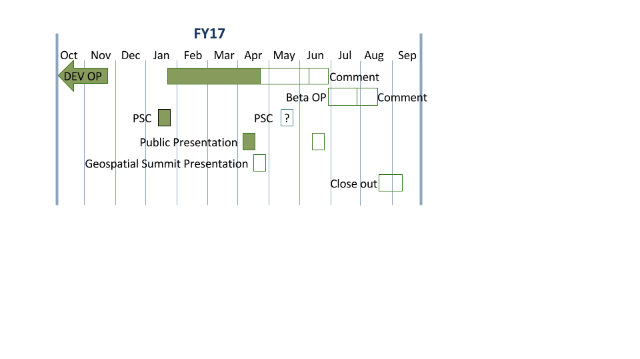
Remaining timeline for the project.
Release for internal tests and comments (DEV) early June.
Release for external comments (BETA) no sooner than July.
Assuming feedback is largely positive, a follow-on project will take OP2IDB from beta to production.
April 25, 2017
OPUS-Projects to NGS Integrated Data-Base

Slide 23
Thank you!
April 25, 2017
OPUS-Projects to NGS Integrated Data-Base

