Slide 1

The history of GPS and coordinates on PID DI4044 (Southern Louisiana)
A cautionary tale about passive control points and the dynamic crust in which they reside
Dru Smith
NSRS Modernization Manager
NOAA’s National Geodetic Survey

Slide 2
The Punch Line
Because the following presentation is extremely complicated and detailed, it’s best to preview the conclusion to which this presentation is driving…
  Earth’s crust is a dynamic place, and passive control set into that crust will move because of it, creating time-dependent coordinates
  True time dependency is not properly captured in the NGS IDB, nor on the datasheets of passive control.
  True time dependency will be properly captured in the NSRS DB and it will be reflected on datasheets of passive control after 2022.
    But it will be modeled and removed in two phases
      1) Plate Rotation (affecting horizontal coordinates only)
      2) Intra-Frame Velocities (affects all three coordinates)

Slide 3
Part 1: Ellipsoid Heights

Slide 4
History of Surveys/Coordinates
The following slides follow the history of one passive control point, DI4044, in Louisiana.
5 GPS surveys took place in 2006, 2006 (again), 2010, 2012 and 2016
  Though the 2012 survey was done in 2 parts, separated by 9 months
Survey-by-Survey processing of ellipsoid heights were performed and loaded in 2007, 2008 and 2011
Epochs given to those adjustments were, respectively, 2004.65, 2002, and 2002 (again)
National Readjustments of already processed GPS vectors were performed in 2007 (didn’t include this point) and 2010
This disparity of dates causes confusion at best, and potentially dangerous conclusions at worst (such as an incorrect subsidence rate)
In the *TRF2022, such disparity between survey dates, adjustment dates and epoch dates will go away.
  Data will be computed and assigned to the actual date when the data were collected.
Notes:
Potential outline and speaker assignments; can be adjusted as needed.

Slide 5
Q: Is there any time-dependent ellipsoid height information on an NGS datasheet?
A: Theoretically there could be.
NAD 83 is plate fixed in horizontal coordinates only. Let’s find out..

Slide 6
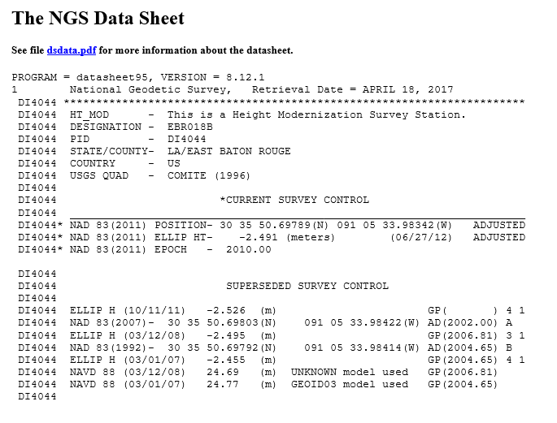
1st “h” load
Load date
Date adjusted? NO
Date observed? NO
Epoch? YES
What datum? Need to look here…

Slide 7
2nd “h” load
Load date
Date adjusted? NO
Date observed? YES!!!!
Epoch? NO!!!!
What datum? Need to look here…
What epoch? Need to look here…

Slide 8
3rd “h” load
Load date
Date….wait, what?
What datum? Need to look here…
What epoch? Need to look here…
Note: This is the same datum and
epoch as the 2nd “h” load

Slide 9
4th “h” load
Load date? YES
Date adjusted? YES
Date observed? NO
Epoch? NO
What datum? Need to look here…
What epoch? Need to look here…

Slide 10
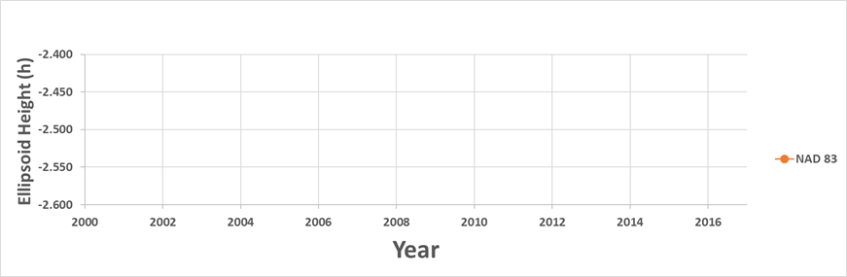
January 2006: Project 2262 (field)
The current realization in Louisiana at this time: NAD 83(1992)
Point DI4044 is occupied 9 separate times with GPS over 11 days
1/9/2006 | 14:04:00 | 19:11:00 | 5+ hour occupation as part of GPS2262
1/10/2006 | 20:19:15 | 1:30:15 | 5+ hour occupation as part of GPS2262
1/11/2006 | 15:48:45 | 21:10:15 | 5+ hour occupation as part of GPS2262
1/18/2006 | 14:21:00 | 19:30:15 | 5+ hour occupation as part of GPS2262
1/18/2006 | 20:46:30 | 2:03:15 | 2nd 5+ hour occupation this day as part of GPS2262
1/19/2006 | 13:21:15 | 18:32:15 | 5+ hour occupation this day as part of GPS2262
1/19/2006 | 19:41:30 | 0:50:30 | 2nd 5+ hour occupation as part of GPS2262
1/20/2006 | 11:12:30 | 16:30:45 | 5+ hour occupation as part of GPS2262
1/20/2006 | 17:21:45 | 22:30:30 | 2nd 5+ hour occupation this day as part of GPS2262
Notes:
Potential outline and speaker assignments; can be adjusted as needed.

Slide 11
October 2006: Project 2329 (field)
The current realization in Louisiana at this time: NAD 83(1992)
Point DI4044 is occupied an 3 separate times with GPS
over 14 days.
10/17/2006 | 22:02:45 | 19:40:45 | 21 hour occupation as part of GPS2329
10/18/2006 | 19:46:45 | 19:17:14 | 24 hour occupation as part of GPS2329
10/31/2006 | 19:20:15 | 18:29:15 | 29 hour occupation as part of GPS2329
Notes:
Potential outline and speaker assignments; can be adjusted as needed.

Slide 12

February 2007: Project 2300 (office)
The current realization in Louisiana at this time: NAD 83(NSRS2007)
Before projects 2262 or 2329 are processed and loaded into the NGS IDB,
the National Readjustment of NAD 83 takes place, creating NAD 83(NSRS2007).
Point DI4044, with no processed vectors in the database, gets no
coordinate in this new realization.
Notes:
Potential outline and speaker assignments; can be adjusted as needed.

Slide 13
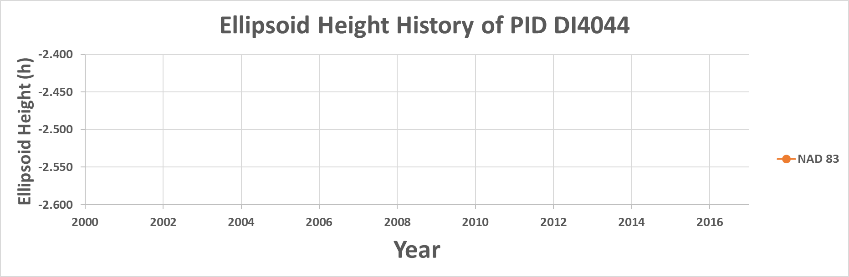
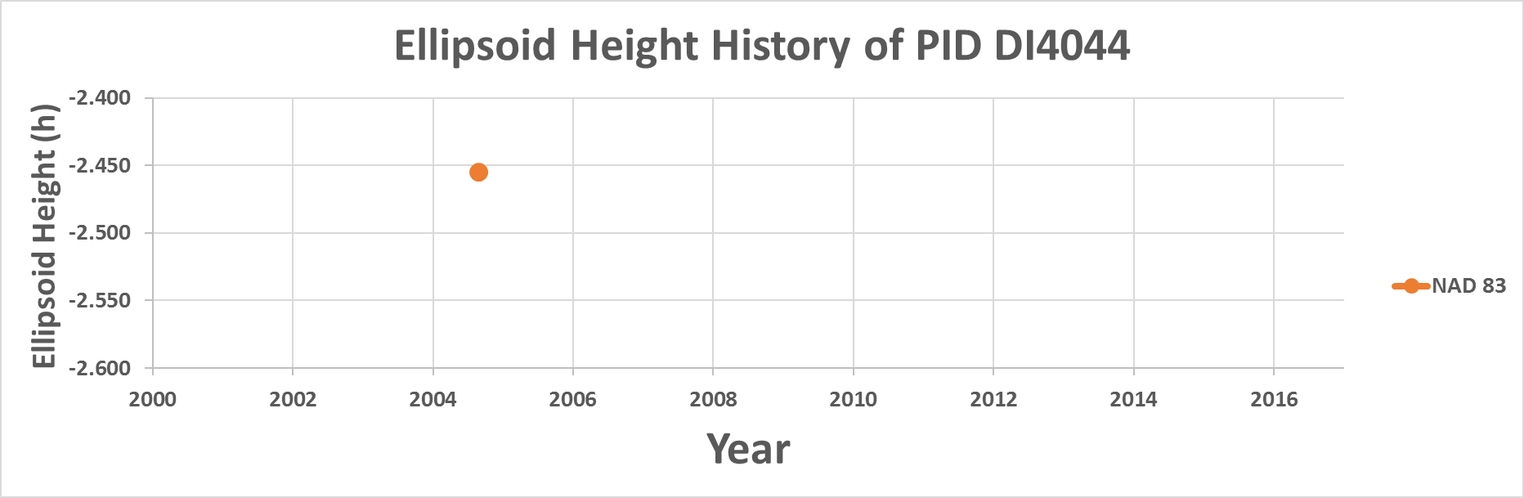
April 2007: Project 2262 (office)
The current realization in Louisiana at this time: NAD 83(NSRS2007)
Project 2262 is processed and loaded. Although NGS is now
on NAD 83(NSRS2007), the values are loaded as “NAD 83(1992)”.
DI4044 gets an ellipsoid height of:
-2.455 m | NAD 83(1992) | Epoch: 2004.65
1
Notes:
Potential outline and speaker assignments; can be adjusted as needed.

Slide 14
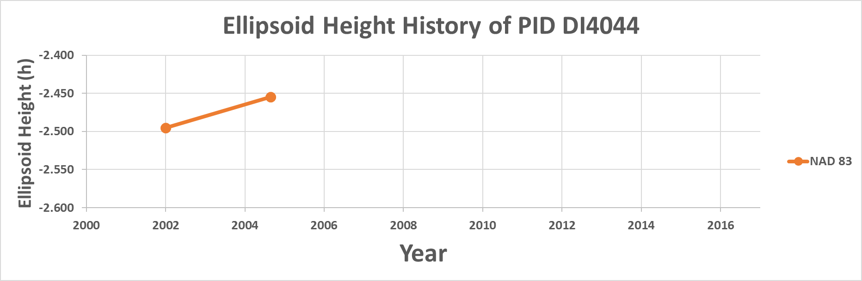
November 2008: Project 2329 (office)
The current realization in Louisiana at this time: NAD 83(NSRS2007)
Project 2329 is processed and loaded. The values are loaded
as “NAD 83(NSRS2007)”.
DI4044 gets an ellipsoid height of:
-2.495 m | NAD 83(NSRS2007) | Epoch: 2002.00
Despite being loaded
19 months after 2262,
it gets an earlier epoch
date, as that was the
date given for NSRS2007
1
2
Current best estimate of dh/dt: +15.5 mm/year
Notes:
Potential outline and speaker assignments; can be adjusted as needed.

Slide 15
September 2010: Project 2772 (field)
The current realization in Louisiana at this time: NAD 83(NSRS2007)
Point DI4044 is occupied 2 separate times with GPS over 2 days
9/20/2010 | 21:11:30 | 19:46:00 | 22 hour occupation as part of GPS2772
9/21/2010 | 20:01:30 | 18:00:00 | 22 hour occupation as part of GPS2772
1
2
Current best estimate of dh/dt: +15.5 mm/year
Notes:
Potential outline and speaker assignments; can be adjusted as needed.

Slide 16
October 2011: Project 2772 (office)
The current realization in Louisiana at this time: NAD 83(NSRS2007)
Project 2772 is processed and loaded. As it is computed in NAD 83(NSRS2007)
its ellipsoid height supersedes the previous one.
1
2
X
X
Current best estimate of dh/dt: +15.5 mm/year
Notes:
Potential outline and speaker assignments; can be adjusted as needed.

Slide 17
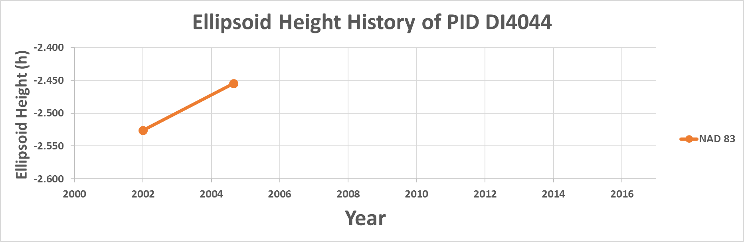

October 2011: Project 2772 (office)
The current realization in Louisiana at this time: NAD 83(NSRS2007)
Project 2772 is processed and loaded. As it is computed in NAD 83(NSRS2007)
its ellipsoid height supersedes the previous one.
DI4044 gets an ellipsoid height of:
-2.526 m | NAD 83(NSRS2007) | Epoch: 2002
1
2
3
Current best estimate of dh/dt: +26.8 mm/year
Notes:
Potential outline and speaker assignments; can be adjusted as needed.

Slide 18
March 2012: Project 2995 (field, part 1)
The current realization in Louisiana at this time: NAD 83(NSRS2007)
Project 2995 begins (but has a 9 month hiatus until December before
being completed). Point DI4044 is occupied 2 separate times with
GPS over 4 days
3/22/2012 | 23:25:30 | 18:00:15 | 19 hour occupation as part of GPS2995
3/26/2012 | 23:30:30 | 18:00:15 | 19 hour occupation as part of GPS2995
1
2
3
Current best estimate of dh/dt: +26.8 mm/year
Notes:
Potential outline and speaker assignments; can be adjusted as needed.

Slide 19
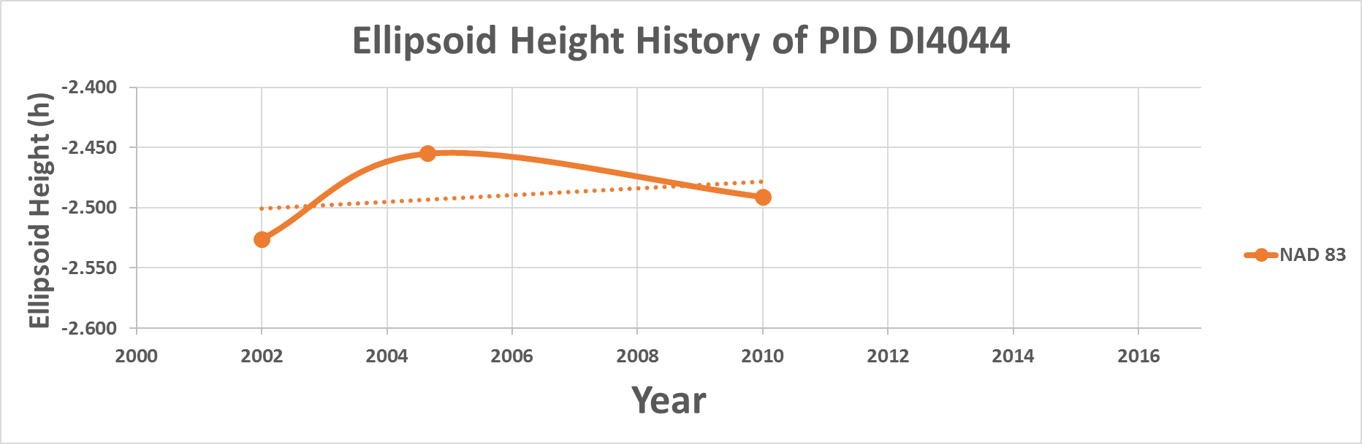
June 2012: Project 2800 (office)
The current realization in Louisiana at this time: NAD 83(2011)
Before project 2995 is completed a National Readjustment of NAD 83 takes
place, creating NAD 83(2011).
DI4044 gets an ellipsoid height of:
-2.491 m | NAD 83(2011) | Epoch: 2010.00
1
2
4
3
(By sheer coincidence, the trendline
through 1, 3 and 4 seems to line up with 2)
Current best estimate of dh/dt: +2.8 mm / year
Notes:
Potential outline and speaker assignments; can be adjusted as needed.

Slide 20
Dec. 2012: Project 2995 (field, part 2)
The current realization in Louisiana at this time: NAD 83(2011)
Project 2995 observations finish. Point DI4044 is occupied 3 separate
times with GPS over 3 days
12/3/2012 | 14:18:50 | 23:18:40 | 9 hour occupation as part of GPS2995 (note 9 month gap in project)
12/4/2012 | 17:27:30 | 22:58:00 | 5 hour occupation as part of GPS2995
12/5/2012 | 14:10:10 | 23:52:00 | 9 hour occupation as part of GPS2995
1
2
4
3
Current best estimate of dh/dt: +2.8 mm / year
Notes:
Potential outline and speaker assignments; can be adjusted as needed.

Slide 21
Sep 2016: Project #TBD (field)
The current realization in Louisiana at this time: NAD 83(2011)
Project #TBD occurs. Point DI4044 is occupied 1
time with GPS over 1 days
9/30/2016 | 0:00:00 | 18:00:00 | 18 hour occupation as part of 2016 S. Louisiana survey (unknown GPS#)
1
2
4
3
Current best estimate of dh/dt: +2.8 mm / year
Notes:
Potential outline and speaker assignments; can be adjusted as needed.

Slide 22
April 2017: How things stand
The current realization in Louisiana at this time: NAD 83(2011)
Point DI4044 has 3 different NAD 83 ellipsoid heights (plus one superseded),
each at an epoch that does not match the epoch of the occupations, yielding
an estimate of the subsidence uplift of the point of +2.8 mm/year.
What happens in NATRF2022, when actual survey epochs will be used?
1
2
4
3
Current best estimate of dh/dt: +2.8 mm / year
Notes:
Potential outline and speaker assignments; can be adjusted as needed.

Slide 23
Summary as of April 2017
GPS2262 | GPS2300 | GPS2329 | GPS2772 | GPS2800 | GPS2995 | TBD | Project # | Activity | Date | Notes
✓ |  |  |  |  |  |  | 2262 | Field Work | Jan 2006
 |  | ✓ |  |  |  |  | 2329 | Field Work | Oct 2006
 | ✓ |  |  |  |  |  | 2300 | National Readjustment | Feb 2007 | No DI4044 data in IDB yet; created NSRS2007
✓ |  |  |  |  |  |  | 2262 | Processing | Apr 2007 | NAD 83(1992) despite NSRS2007 done
 |  | ✓ |  |  |  |  | 2329 | Processing | Nov 2008 | NAD 83(NSRS2007)
 |  |  | ✓ |  |  |  | 2772 | Field Work | Sep 2010
 |  |  | ✓ |  |  |  | 2772 | Processing | Oct 2011 | NAD 83(NSRS2007) - superseding
 |  |  |  |  | ✓ |  | 2995 | Field Work | Mar 2012 | (Part 1…part 2 was 9 months later)
 |  |  |  | ✓ |  |  | 2800 | National Readjustment | Jun 2012 | NAD 83(2011)
 |  |  |  |  | ✓ |  | 2995 | Field Work | Dec 2012 | (Part 2…part 1 was 9 months earlier)
 |  |  |  |  |  | ✓ | TBD | Field Work | Sep 2016
Projects GPS2995 and TBD have not been processed and loaded
into the IDB yet.

Slide 24
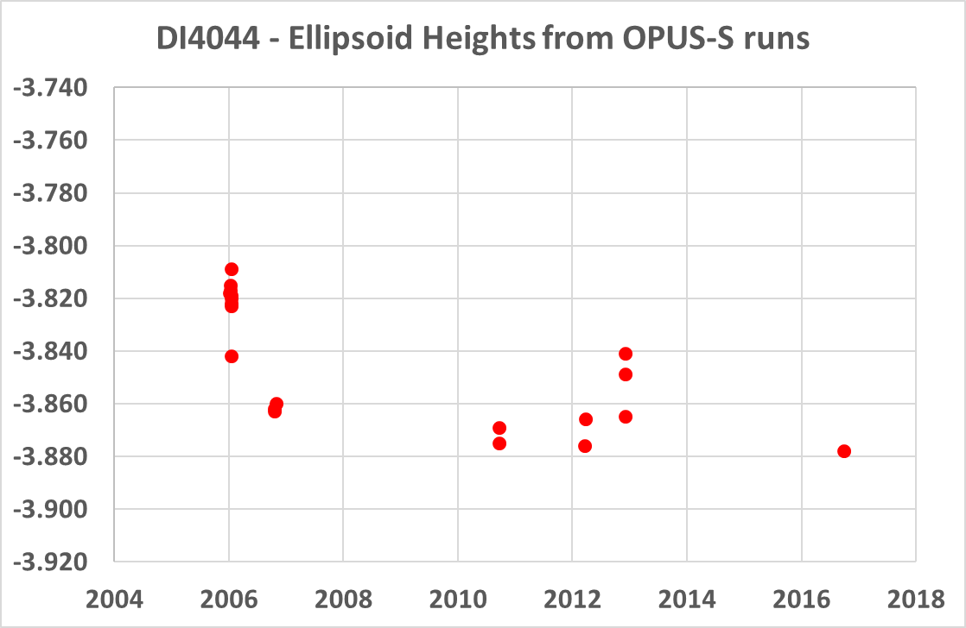
NATRF2022 and actual survey epochs
Point DI4044 was surveyed with GPS in 2006, 2006 (again), 2010, 2012 (in 2 parts which will be treated separately) and 2016. Each of those surveys spanned a few days to weeks, and had multiple occupations. To get to NATRF2022 coordinates, begin with an occupation-by-occupation run through OPUS-S
Notes:
Potential outline and speaker assignments; can be adjusted as needed.

Slide 25
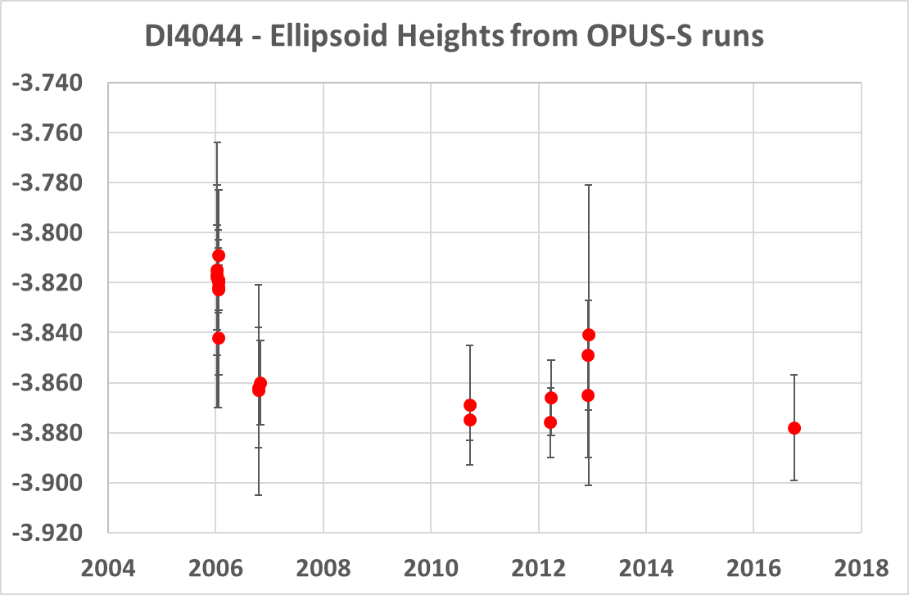
NATRF2022 and actual survey epochs
Put error bars on these runs for context, but it also helps see the 6 survey clusters…
Let’s zoom in on just one…
1
5
2
3
4
6
Notes:
Potential outline and speaker assignments; can be adjusted as needed.

Slide 26
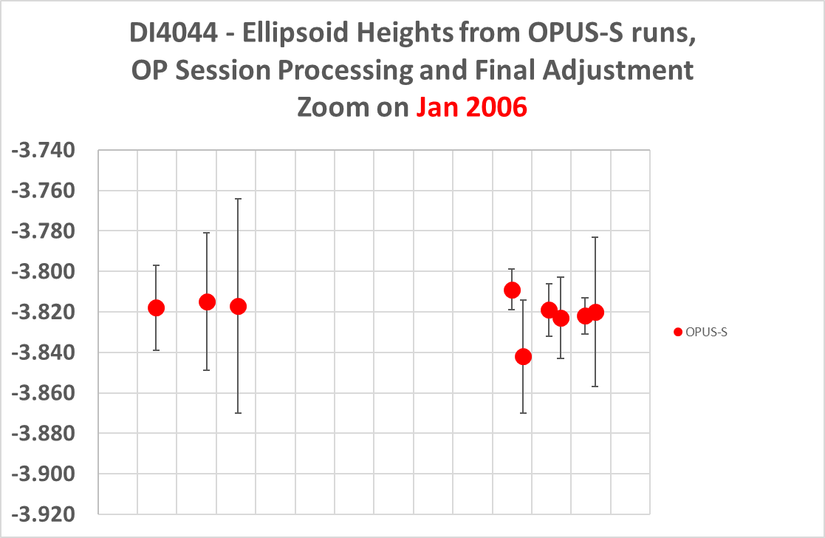
Processing one survey….
Step 1: OPUS-S
1

Slide 27
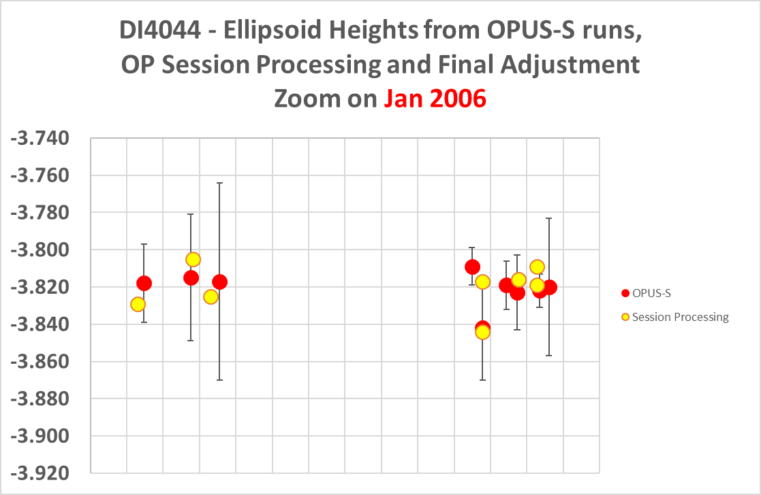
Processing one survey…
Step 2: Session Processing

Slide 28
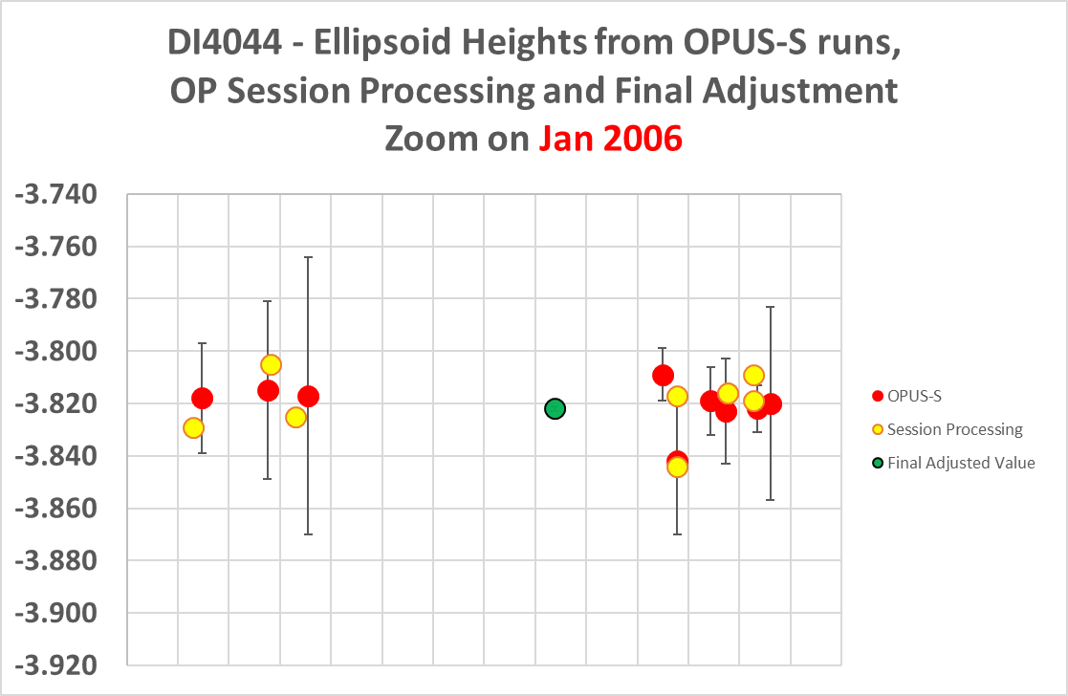
Processing one survey…
Step 3: Final Adjustment

Slide 29
NATRF2022 and actual survey epochs
With the final adjusted value in the IGS frame, the same processing can be applied to the other 5 surveys

Slide 30
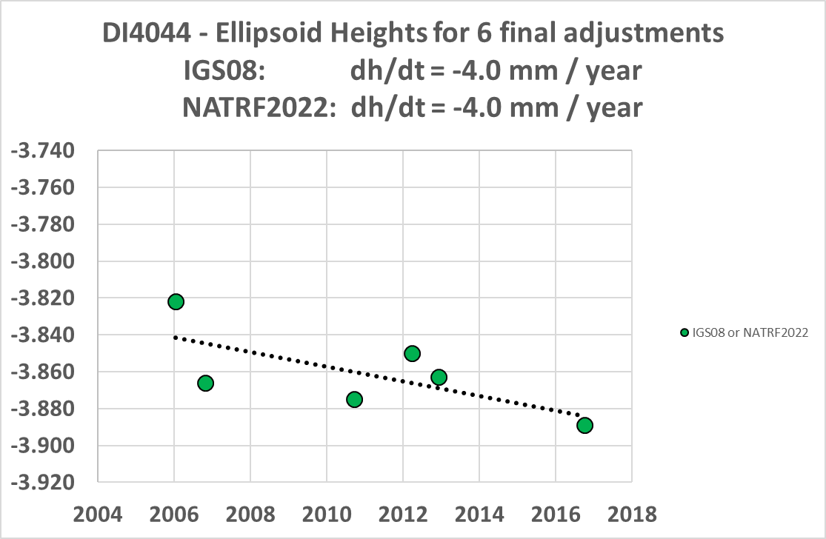
DI4044 – True Ellipsoid Height History

Slide 31
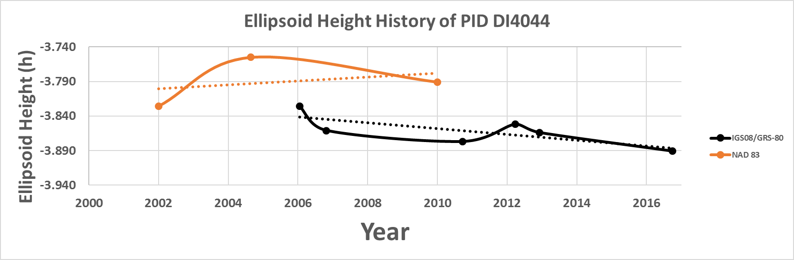
NATRF2022 and actual survey epochs
Point DI4044 was surveyed with GPS in 2006, 2006 (again), 2010, 2012 (in 2 parts which will be treated separately) and 2016. Computing the “h” values at the actual dates of the survey (using OPUS-S, then OPUS-Projects, and letting OPUS choose our CORS values) yields the following graph. IGS 08 serves as a proxy for NATRF2022 heights for now. (Note the NAD 83 values are shown with a bias of 1.38 meters so as to fit near the IGS08 values)
NAD 83 best estimate of dh/dt: +2.8 mm / year
NATRF2022 best estimate of dh/dt: -4.0 mm / year
Notes:
Potential outline and speaker assignments; can be adjusted as needed.

Slide 32
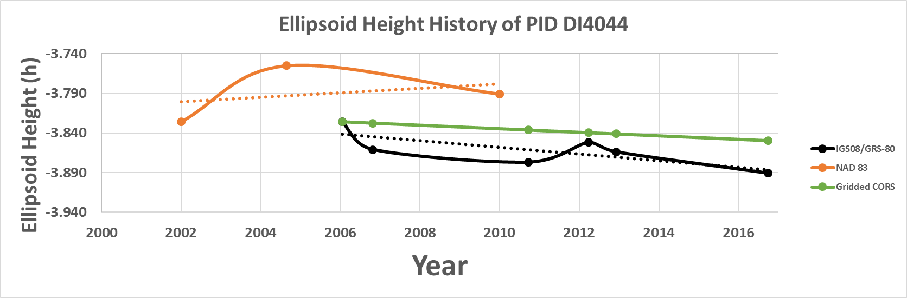
NATRF2022 and actual survey epochs
Further information can be added, such as gridding the surrounding
CORS velocities, for a coarse estimate of what is happening locally.
NAD 83 best estimate of dh/dt: +2.8 mm / year
NATRF2022 best estimate of dh/dt: -4.2 mm / year
CORS best estimate of dh/dt: -2.2 mm / year
Notes:
Potential outline and speaker assignments; can be adjusted as needed.

Slide 33
Summary (Part 1)
The NGS standard operating procedure has been to use survey data from multiple dates and adjust said data to one epoch.
  Using HTDP, which has no vertical modeling at all.
Values are often superseded with new adjustments, but rarely have those adjustments actually been given the epoch of the survey
Using the data, as is, will yield erroneous results, such as an observable subsidence rate that is actually aliased into an uplift rate

Slide 34
Part 2: Latitude and Longitude

Slide 35
Part 2: Latitude and Longitude
NAD 83 is, in theory, a plate-fixed frame
HTDP was used to remove both tectonic rotation and intra-plate motion for latitude and longitude
In theory, NAD 83 coordinates should look fixed over time

Slide 36
Saving some time…
Following the same story as before…
  Only there were only 3 loads of lat/lon
    As opposed to 4 loads of ellipsoid height

Slide 37
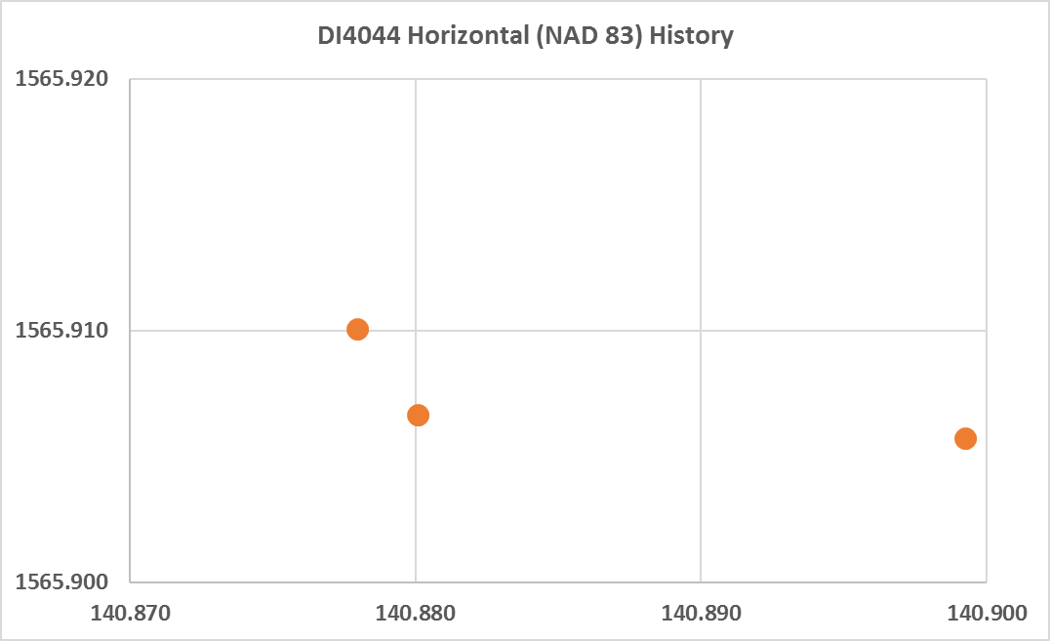
As seen from above
2007: NAD 83(1992)
epoch 2004.65
2008: NAD 83(NSRS2007)
epoch 2002.0
2012: NAD 83(2011)
epoch 2010.0

Slide 38
As seen from above
2.65 years
5.35 years
NGS does not haphazardly assign epochs to horizontal coordinates; they have actual meaning. As such, NGS’s
official NAD 83 coordinates on this point could be interpreted as this point exhibiting horizontal motion on the order
of 2.5 mm / year, mostly eastward. Such motion should be prevented by both a plate fixed system (to remove
the rotation) and especially HTDP (to remove all intra-plate motion). At this level of accuracy, that method fails.

Slide 39
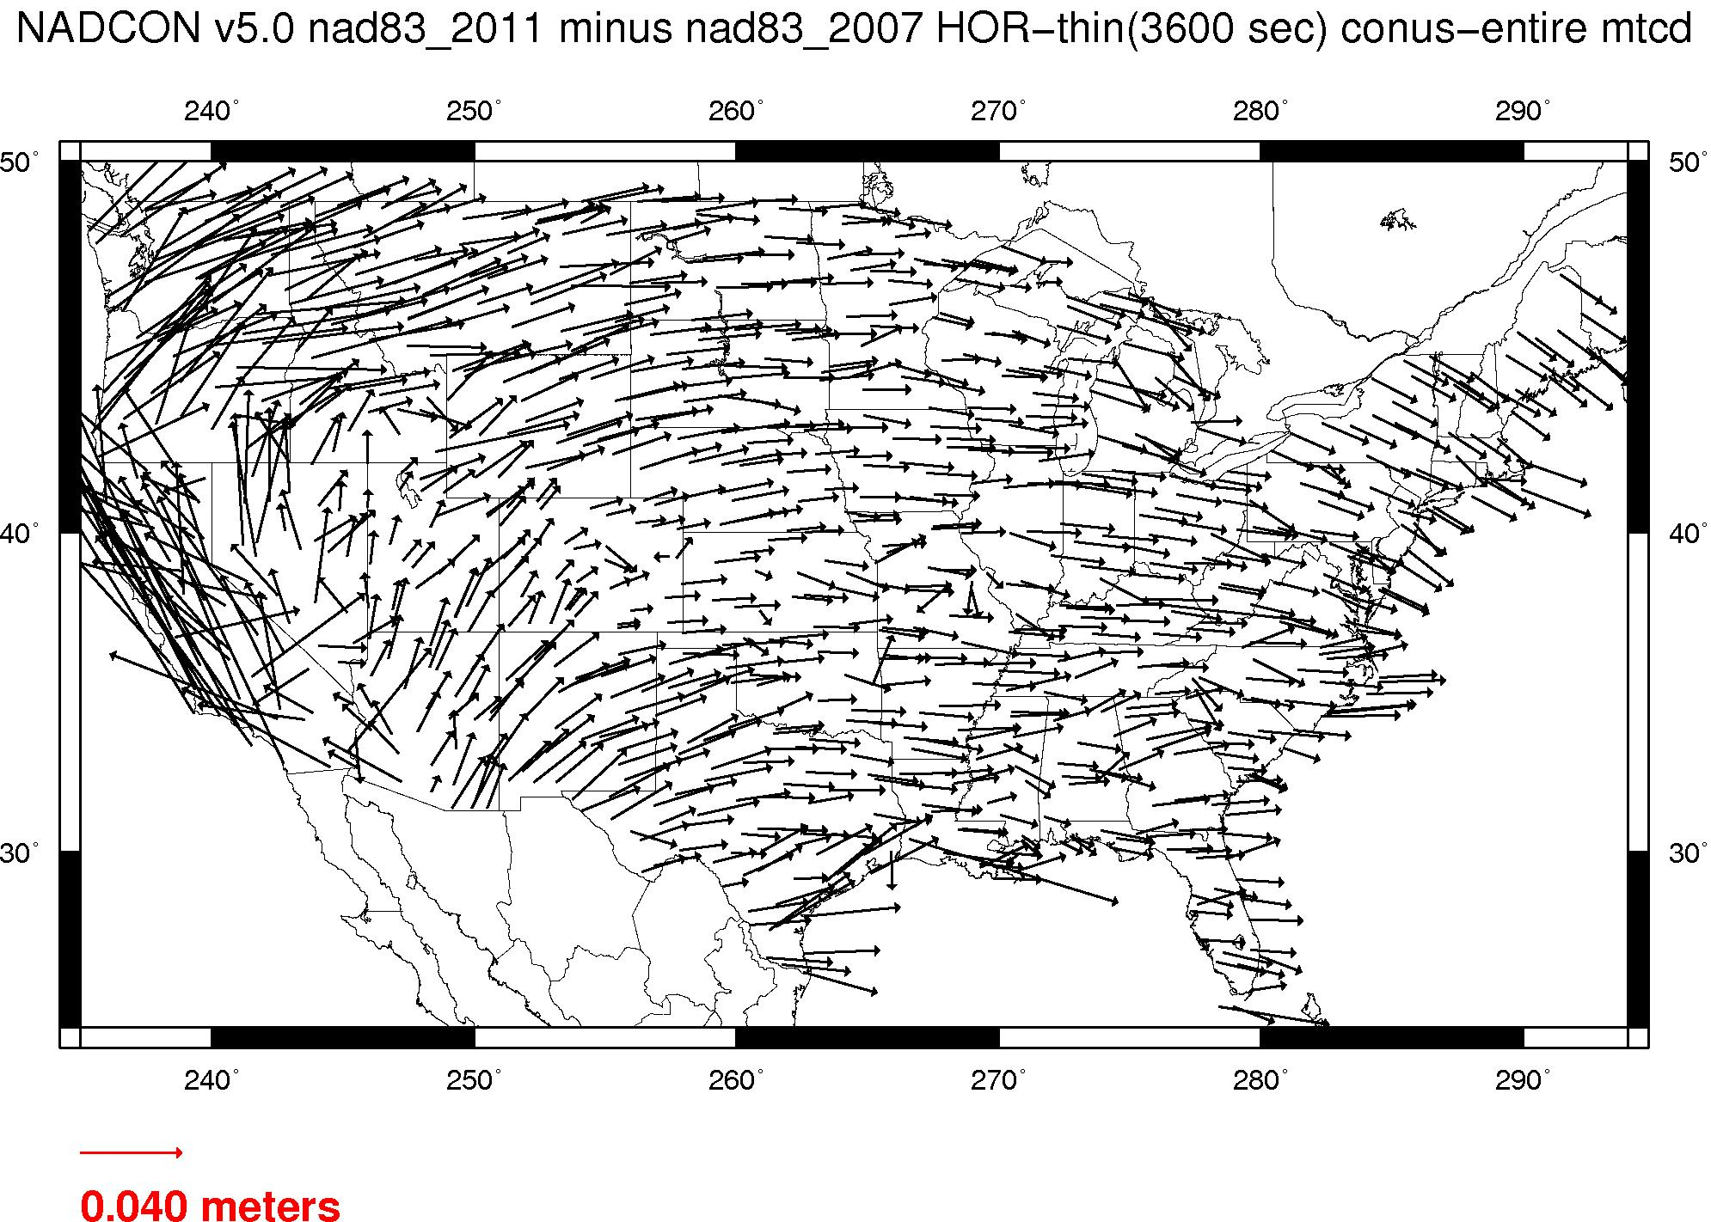
Residual Plate Rotation…
Within the errors expected
in NAD 83, a 2 cm horizontal
coordinate difference over
8 years would not normally
be considered “significant”
But when every point (east of the
Rockies) between
NAD 83(NSRS2007) epoch 2002.0
and
NAD 83(2011) epoch 2010.0
has the exact same
systematic movement (see left)
then it is clear that some “residual
plate rotation” is in NAD 83…
That is, the NAD 83 frame and the
North American Plate have different
rotation rates, and thus the frame
is not “plate fixed”

Slide 40
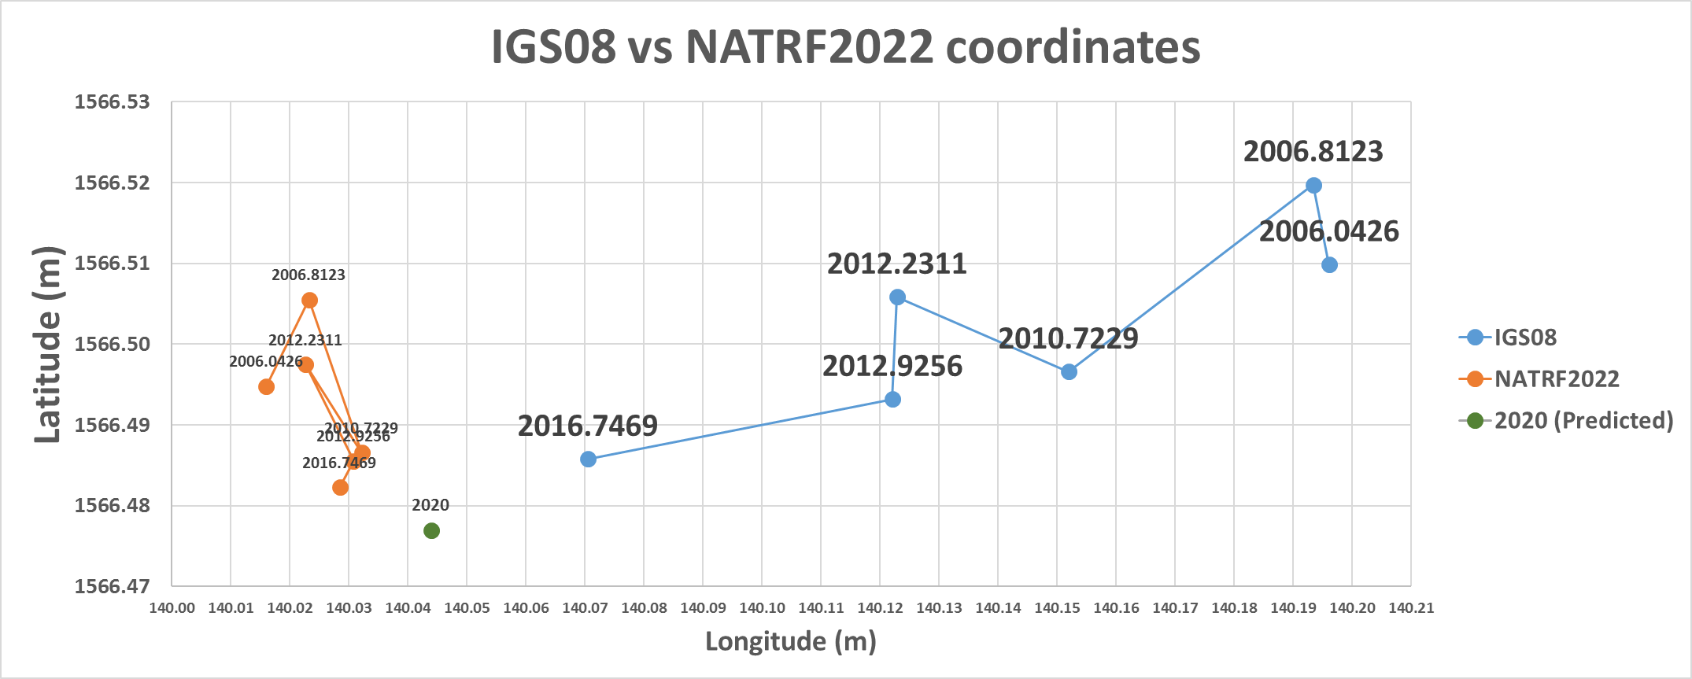
IGS08 vs NATRF2022
NATRF2022 coordinates will have the plate rotation removed, but still
exhibit their time-dependency, until
the Intra-frame velocity model is used to estimate a coordinate at an epoch of convenience.
IGS08 coordinates are dominated by the primary motion associated with the North American Plate rotation, as manifest at this lat/lon:
12.9 mm/y West
1.1 mm/y South

Slide 41
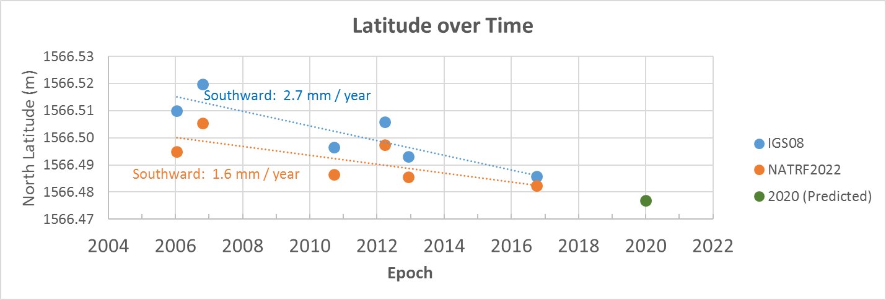
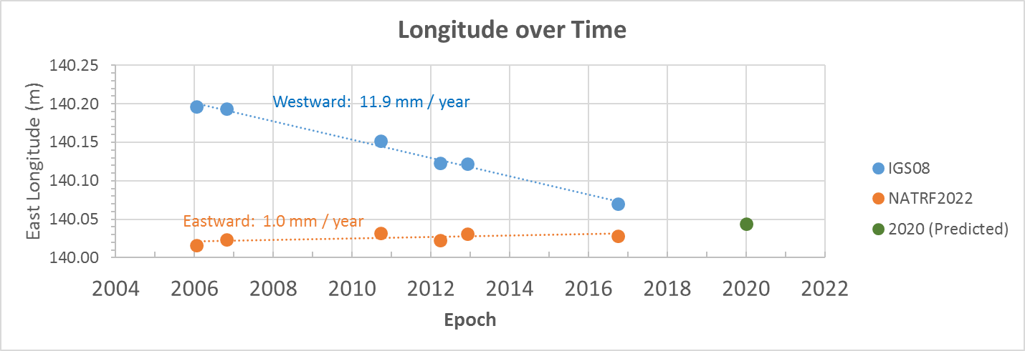
IFV implied by interpolating
from surrounding CORS:
Northward 0.4 mm / year:
Difference: 2.0mm/year
NA plate rotation:
South 1.1 mm/year
“Intra Frame Velocity”
IFV implied by interpolating
from surrounding CORS:
Eastward 0.3 mm / year
Difference: 0.7 mm / year
“Intra Frame Velocity”
NA plate rotation:
West 12.9 mm/year

Slide 42
Summary
Passive control will move with the crust
NGS sees value in acknowledging and presenting that movement through both measurements and models
NGS also sees the value in having semi-static coordinates, for comparisons across years

Slide 43
Summary
Future coordinate products:
  Time dependent IGS coordinates
  Time dependent *TRF2022 coordinates
    Above, minus plate rotation
  Predicted *TRF2022 coordinates at “epochs of convenience”
    Above, using the intra-frame velocity model to predict

Slide 44
EXTRA

Slide 45
Introduction (Part 2)
The following slides follow the history of one passive control point, DI4044, in Louisiana.
5 GPS surveys took place in 2006, 2006 (again), 2010, 2012 and 2016
  Though the 2012 survey was done in 2 parts, separated by 9 months
Survey-by-Survey processing of latitude and longitude were performed and loaded in 2007, 2008
  2011 “fix” to ellipsoid heights loaded a new height only
Epochs given to those adjustments were, respectively, 2004.65 and 2002
National Readjustments of already processed GPS vectors were performed in 2007 (didn’t include this point) and 2010
This disparity of dates causes confusion at best, and potentially dangerous conclusions at worst (such as an incorrect subsidence rate)
In the *TRF2022, such disparity between survey dates, adjustment dates and epoch dates will go away.
  Data will be computed and assigned to the actual date when the data were collected.
Notes:
Potential outline and speaker assignments; can be adjusted as needed.

Slide 46
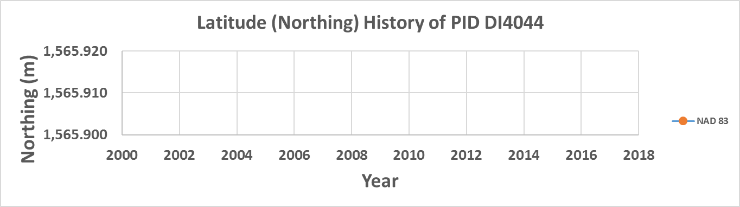
January 2006: Project 2262 (field)
The current realization in Louisiana at this time: NAD 83(1992)
Point DI4044 is occupied 9 separate times with GPS over 11 days
1/9/2006 | 14:04:00 | 19:11:00 | 5+ hour occupation as part of GPS2262
1/10/2006 | 20:19:15 | 1:30:15 | 5+ hour occupation as part of GPS2262
1/11/2006 | 15:48:45 | 21:10:15 | 5+ hour occupation as part of GPS2262
1/18/2006 | 14:21:00 | 19:30:15 | 5+ hour occupation as part of GPS2262
1/18/2006 | 20:46:30 | 2:03:15 | 2nd 5+ hour occupation this day as part of GPS2262
1/19/2006 | 13:21:15 | 18:32:15 | 5+ hour occupation this day as part of GPS2262
1/19/2006 | 19:41:30 | 0:50:30 | 2nd 5+ hour occupation as part of GPS2262
1/20/2006 | 11:12:30 | 16:30:45 | 5+ hour occupation as part of GPS2262
1/20/2006 | 17:21:45 | 22:30:30 | 2nd 5+ hour occupation this day as part of GPS2262
Notes:
Potential outline and speaker assignments; can be adjusted as needed.

Slide 47
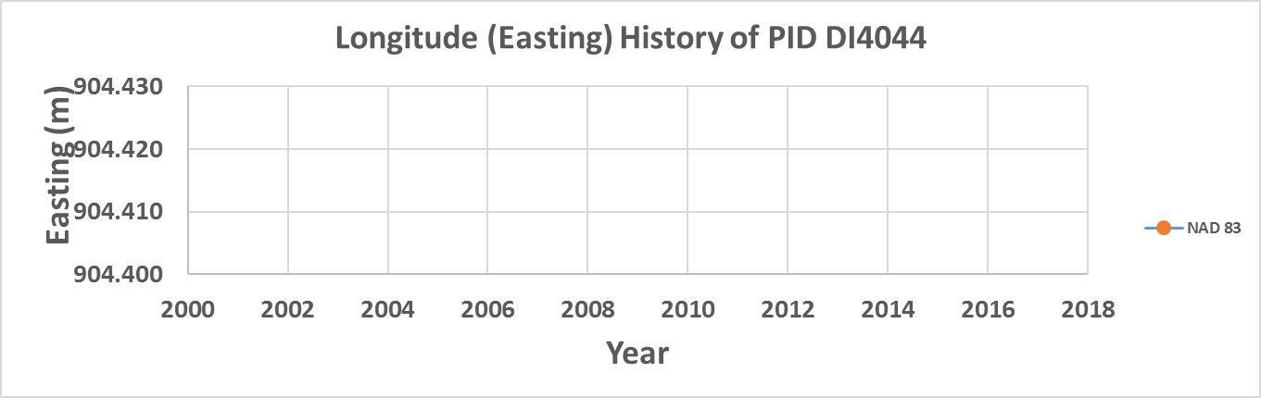
January 2006: Project 2262 (field)
Notes:
Potential outline and speaker assignments; can be adjusted as needed.

Slide 48
October 2006: Project 2329 (field)
The current realization in Louisiana at this time: NAD 83(1992)
Point DI4044 is occupied an 3 separate times with GPS
over 14 days.
10/17/2006 | 22:02:45 | 19:40:45 | 21 hour occupation as part of GPS2329
10/18/2006 | 19:46:45 | 19:17:14 | 24 hour occupation as part of GPS2329
10/31/2006 | 19:20:15 | 18:29:15 | 29 hour occupation as part of GPS2329
Notes:
Potential outline and speaker assignments; can be adjusted as needed.

Slide 49
October 2006: Project 2329 (field)
Notes:
Potential outline and speaker assignments; can be adjusted as needed.

Slide 50
February 2007: Project 2300 (office)
The current realization in Louisiana at this time: NAD 83(NSRS2007)
Before projects 2262 or 2329 are processed and loaded into the NGS IDB,
the National Readjustment of NAD 83 takes place, creating NAD 83(NSRS2007).
Point DI4044, with no processed vectors in the database, gets no
coordinate in this new realization.
Notes:
Potential outline and speaker assignments; can be adjusted as needed.

Slide 51
February 2007: Project 2300 (office)

Slide 52
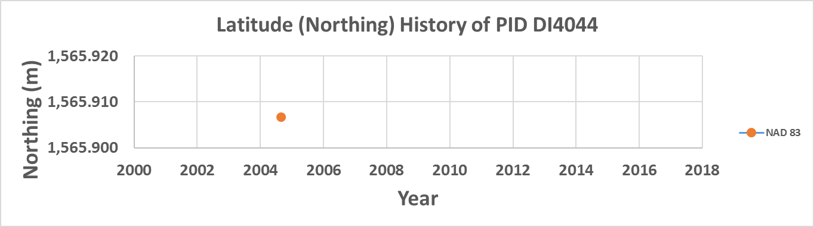
April 2007: Project 2262 (office)
The current realization in Louisiana at this time: NAD 83(NSRS2007)
Project 2262 is processed and loaded. Although NGS is now
on NAD 83(NSRS2007), the values are loaded as “NAD 83(1992)”.
DI4044 gets a lat/lon (arcseconds only) of:
50.69792 / 33.98414 | NAD 83(1992) | Epoch: 2004.65
1
Notes:
Potential outline and speaker assignments; can be adjusted as needed.

Slide 53
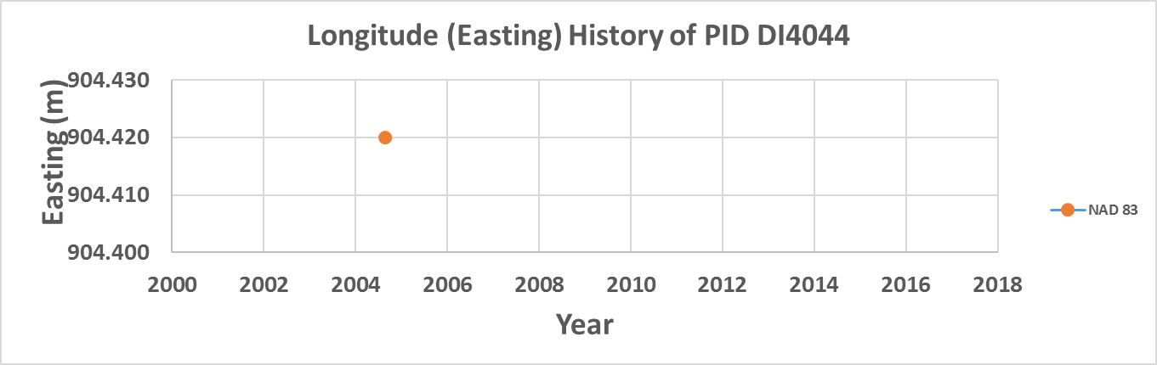
April 2007: Project 2262 (office)
1
1
Notes:
Potential outline and speaker assignments; can be adjusted as needed.

Slide 54
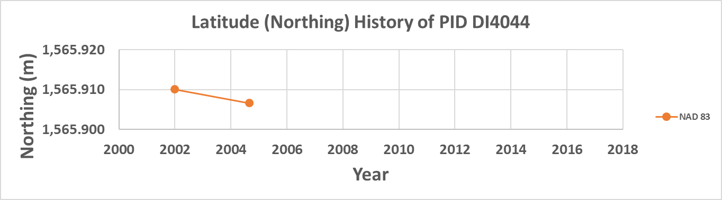
November 2008: Project 2329 (office)
The current realization in Louisiana at this time: NAD 83(NSRS2007)
Project 2329 is processed and loaded. The values are loaded
as “NAD 83(NSRS2007)”.
DI4044 gets an lat/lon of of:
50.69803 / 33.98422 | NAD 83(NSRS2007) | Epoch: 2002.00
Despite being loaded
19 months after 2262,
it gets an earlier epoch
date, as that was the
date given for NSRS2007
2
1
Notes:
Potential outline and speaker assignments; can be adjusted as needed.

Slide 55
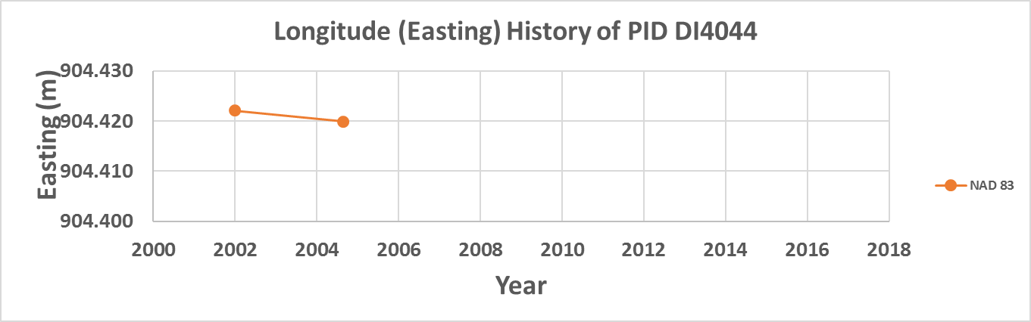
November 2008: Project 2329 (office)
2
1
2
1
Current best estimate of dN/dt & dE/dt: -1.3 mm/y & -0.8 mm/y
Notes:
Potential outline and speaker assignments; can be adjusted as needed.

Slide 56
September 2010: Project 2772 (field)
The current realization in Louisiana at this time: NAD 83(NSRS2007)
Point DI4044 is occupied 2 separate times with GPS over 2 days
9/20/2010 | 21:11:30 | 19:46:00 | 22 hour occupation as part of GPS2772
9/21/2010 | 20:01:30 | 18:00:00 | 22 hour occupation as part of GPS2772
2
1
Current best estimate of dN/dt & dE/dt: -1.3 mm/y & -0.8 mm/y
Notes:
Potential outline and speaker assignments; can be adjusted as needed.

Slide 57
September 2010: Project 2772 (field)
2
Point DI4044 is occupied 2 separate times with GPS over 2 days
1
9/20/2010 | 21:11:30 | 19:46:00 | 22 hour occupation as part of GPS2772
9/21/2010 | 20:01:30 | 18:00:00 | 22 hour occupation as part of GPS2772
2
1
Current best estimate of dN/dt & dE/dt: -1.3 mm/y & -0.8 mm/y
Notes:
Potential outline and speaker assignments; can be adjusted as needed.

Slide 58
Good to here

