Slide 1

NOAA’s 2017 Geospatial Summit
Preparing for New Datums
W. Russell Callender, Ph.D.
Assistant Administrator
NOAA’s National Ocean Service
April 24, 2017
Notes:
2017 Geospatial Summit – Talking points
NGS Messages for Russell to convey:
NGS provides the framework for all positioning activities in the Nation.
The foundational elements of latitude, longitude, elevation, shoreline information and their changes over time contribute to informed decision making and impact a wide range of important activities, including mapping and charting, navigation, flood risk determination, transportation, land use, and ecosystem management.
NGS' authoritative spatial data, models, and tools are vital for the protection and management of our resources, and support the economic prosperity and environmental health of the Nation.
The new reference frames will rely primarily on GPS, as well as an updated and time-tracked geoid model. This paradigm will be easier and more cost-effective to maintain.
Although this change is some years away, the time for stakeholders to prepare is NOW.
NGS has tools to facilitate the transformation to new datums, and we are here to help prepare.

Slide 2
NOAA’s 2017 Geospatial Summit
Preparing for New Datums
W. Russell Callender, Ph.D.
Assistant Administrator
NOAA’s National Ocean Service
April 24, 2017
Notes:
Last month, the Texas Land Commissioner George P. Bush announced that his office had completed the Texas Coastal Resiliency Master Plan.
They need this plan because 65 percent of the flat, gently, sloping Texas Gulf shoreline is eroding at an average rate of approximately six feet per year. So not only is this a large scale problem, but there’s a sense of urgency on the matter. Their solution is equally large in scale (at 367 miles, Texas has the 6th longest coast in US), and cost – the estimated range is from 735 million to 1.6 billion. And that’s not just because everything’s bigger in Texas.
I mention this because I met Commissioner Bush when I visited the Gulf late in March. During the meeting, I hoped to connect the state with resources and partnership opportunities in NOS.
So I made the point that the work NGS does is foundational to any coastal infrastructure Texas wants to build. Simply put, without knowing accurately the rates of subsidence and erosion, you don’t know where your shoreline stabilization project is going to be in 5, 10, or 20 years.
In the end, I succeeded because I could highlight how the foundational data from NGS ensured accurate positioning of sea walls, surge gates, and levees.
The fact is, we’re moving towards a world where everything, not just large-scale infrastructure projects, is going to be georeferenced. And that means the work NGS is doing is going to be invaluable for the foreseeable future.

Slide 3
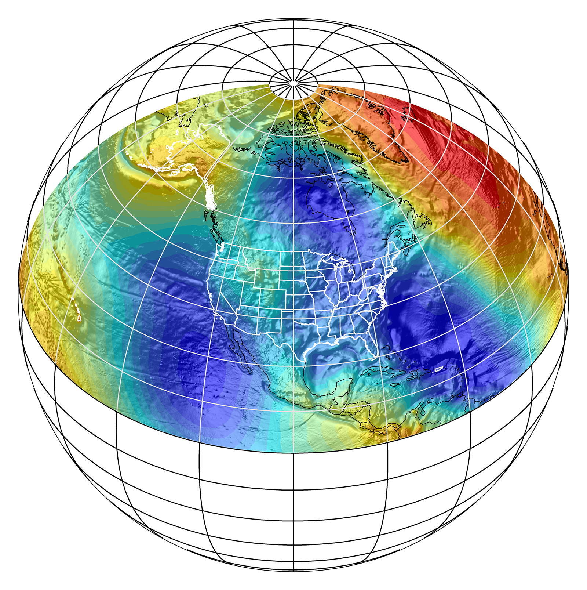
Outline
Alignment with priorities and foundational information
Modernized NSRS and modernized tools
Benefits of new datums
Partnerships and where you fit in
Notes:
I’m glad to be here today to talk with you to continue the dialog with NOAA and NGS as we prepare to transition to New Datums in 2022. My remarks today are intended to open this larger summit during which NGS will share its progress while seeking your feedback and input regarding how to best manage this process.
We appreciate you; receiving your feedback and understanding your requirements are important to us.

Slide 4
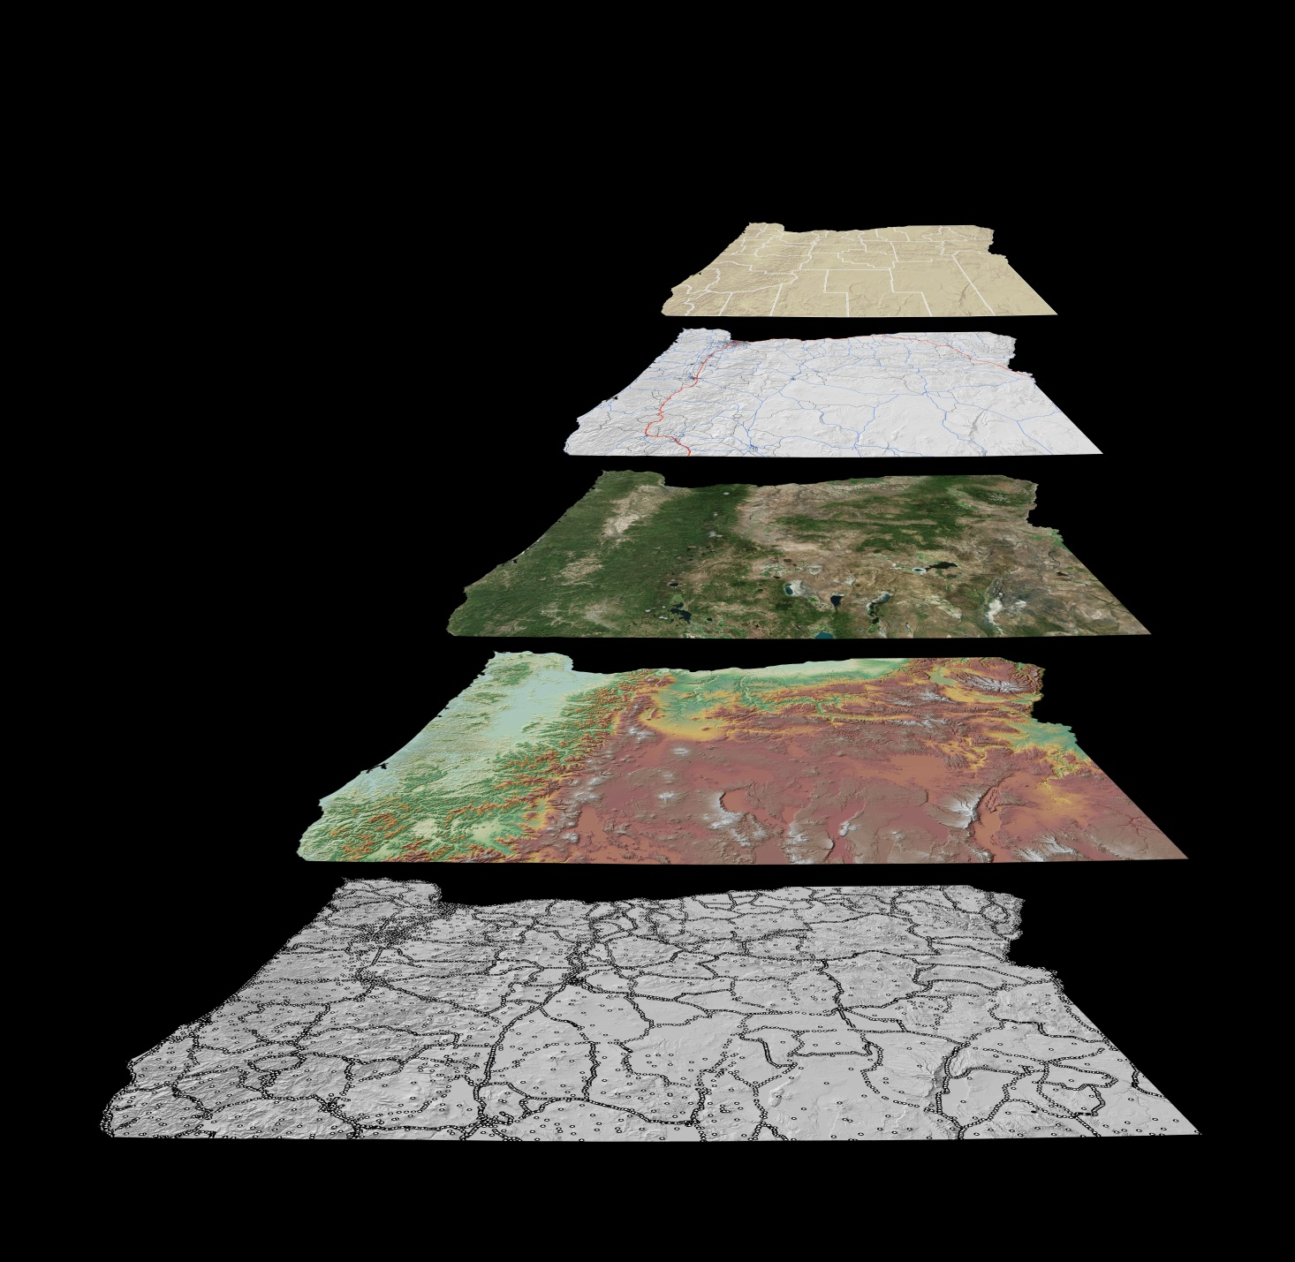
Foundational Information
National Spatial Reference System (NSRS)
Supports users from coast to coast, and everywhere in between
Planned improvements will leverage new technology and increase accuracy of positional information
Notes:
The National Ocean Service has a large portfolio of programs to support, but they are all supported by the National Spatial Reference System (NSRS).
This is because the NSRS is Foundational information
The NSRS provides a reliable, accurate national coordinate system across the entire country, far beyond just the coast.
Coastal areas have many unique challenges, but the NSRS lays an accurate framework for all geospatial and georeferenced data across the entire country.
NGS maintains the NSRS, and has prioritized improving and modernizing the NSRS within its Ten Year Plan.
These plans and priorities will leverage technology like the Global Navigation Satellite System (GNSS), which continues to make accurate positioning available to more and more constituents.
These efforts will also improve the accuracy of the common foundational reference frames used by all fields with geospatial data or applications.

Slide 5
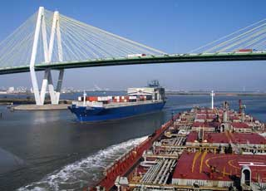
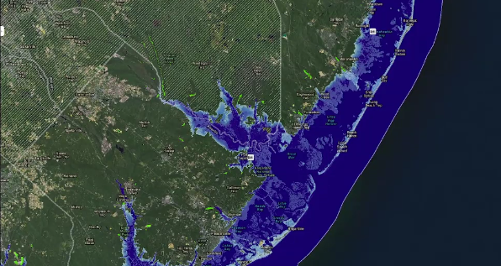
Aligning Priorities
Foundational Information
The modernized NSRS aligns critical data, observations, models, and products.
Safe and efficient transportation and commerce
Preparedness and risk reduction
Stewardship, recreation, and tourism
Notes:
The NSRS is foundational because it supports the mapping, charting, and transportation activities and infrastructure that decision makers and communities rely on daily.
NSRS also aligns critical observations, models and products and thus underlies the three NOS priorities: safe and efficient transportation; preparedness and risk reduction; and stewardship, recreation and tourism.
Supporting safe and efficient transportation begins at the coast when ships enter ports, and have confidence in nautical charts as well as real-time water levels.
From the ports, the goods that need to reach the rest of the country take advantage of an intermodal transportation network that all relies on the NSRS as foundational information.

Slide 6
Aligning Priorities
Foundational Information
The modernized NSRS aligns critical data, observations, models, and products.
Safe and efficient transportation and commerce
Preparedness and risk reduction
Stewardship, recreation, and tourism
Notes:
Highways are filled with cars and trucks increasingly leveraging GPS technology for navigation. Airports obstructions are carefully charted to ensure safe take-offs and landings. All of these infrastructure networks are aligned with the NSRS, which is particularly important for any new projects.
Many NOS Programs support preparedness and risk reduction along the coasts, further taking advantage of the NSRS in applications like inundation modeling. The value of the NSRS is equally applicable inland, as floodplain mapping and the development of 3D elevation models is beneficial to the entire country.
Even with respect to stewardship, recreation and tourism, the National Spatial Reference System is the source of foundational information for all of the datasets that underlie NOS priorities.
For this reason, I believe, the recent preliminary FY18 budget blueprint from the administration noted that core functions that need to be maintained within NOAA include surveys and charting.

Slide 7

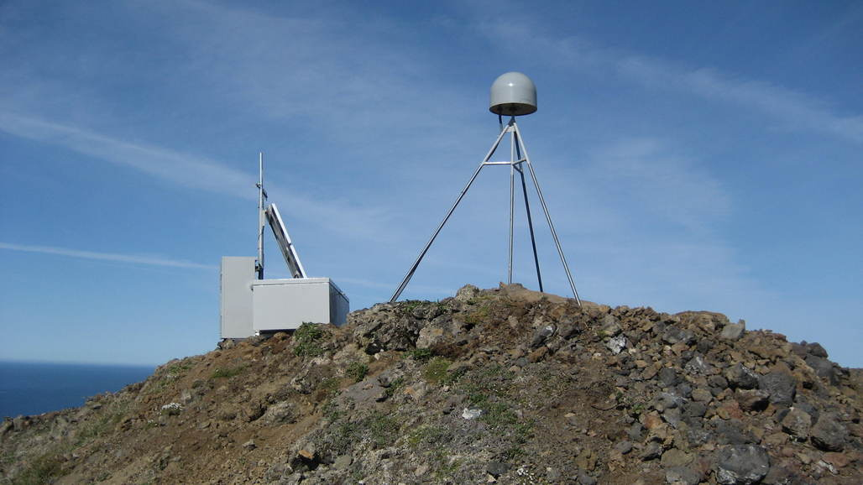
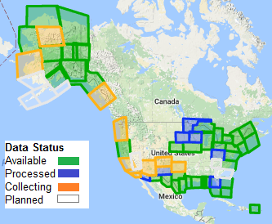
Modernized NSRS
Replace NAD 83
Replace NAVD 88
GRAV-D
Foundation CORS
Notes:
Modernizing the NSRS is a significant undertaking, and will culminate with the replacement of NAD 83 and NAVD 88 with a new geometric (horizontal) and geopotential (vertical) reference frame in 2022.
A related critical project is Gravity for the Redefinition of the American Vertical Datum (GRAV-D).
Upon completion, GRAV-D's airborne gravity data will be used to develop a new American Vertical Datum in 2022. The current vertical datum contains elevation errors ranging from 16 inches to 6 feet relative to sea level.
GRAV-D will allow surveyors, scientists and others to employ GPS to determine more precise and accurate elevations than currently possible, in less time and with less effort.
We have collected over 50% of the planned gravity data collection.
Another critical project is Foundation CORS. These permanent reference stations are needed to better connect the National Spatial Reference System to the global reference frame, the International Terrestrial Reference Frame.

Slide 8
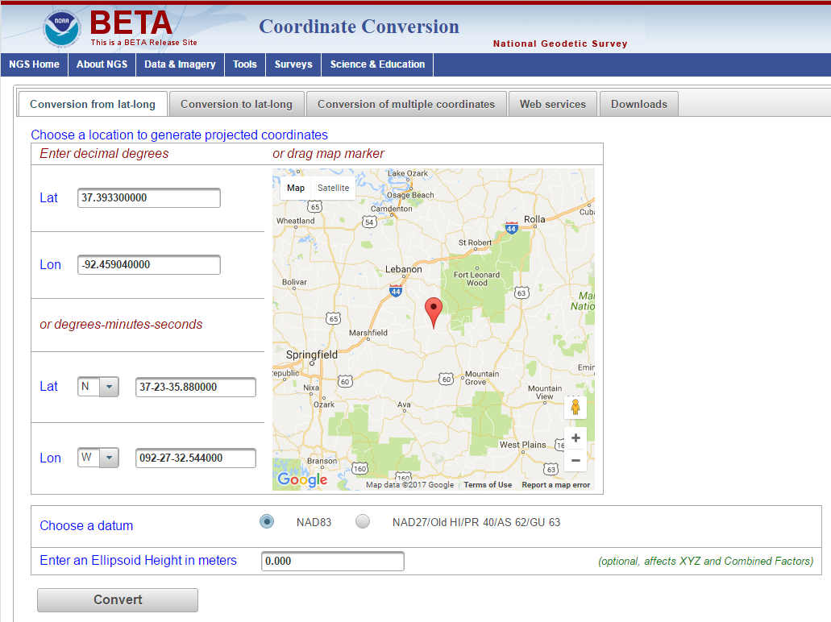
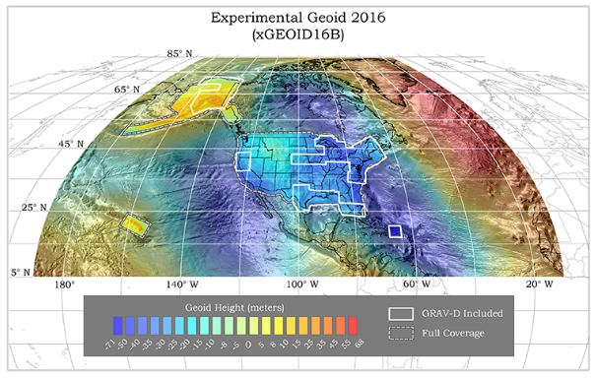
Modernized Tools
Transformation Tools
https://beta.ngs.noaa.gov/gtkweb/
Experimental Geoids
https://beta.ngs.noaa.gov/GEOID/xGEOID/
Notes:
Modernized tools have to be created to ensure you can access the NSRS:
The most frequently requested tool is one to transform data from historical datums to the future datums that will replaced NAD 83 and NAVD 88.
In addition to the function of the tool, we want it to be easy to use, easy to maintain, and accessible to all our partners.
For that reason, we are already modernizing our Geodetic Toolkit, that contains many existing transformation tools.
To provide stakeholders with approximations for the replacement of the current vertical datum, NGS is publishing annual experimental geoids which include gravity data from the GRAV-D project.
You can test this updated toolkit on our beta web-site and give us feedback.

Slide 9
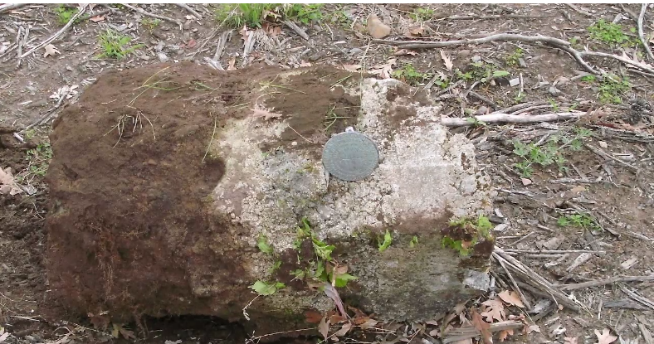
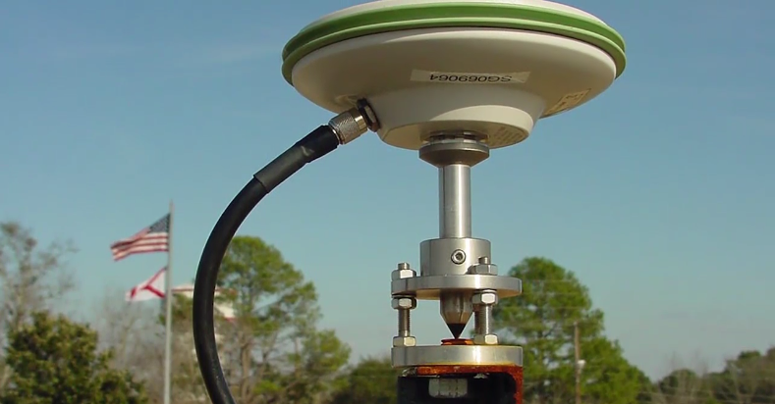
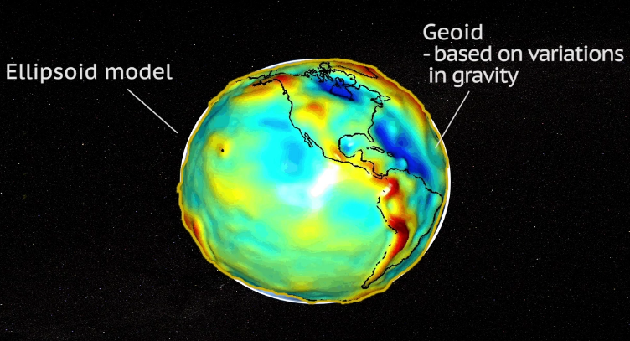
Benefits: New Datums
Easier to maintain
Passive control deteriorates; land moves
Leverages technology
Datums will be realized through GNSS
Better heights
GRAV-D will improve geoid model
Notes:
The new datums will bring new benefits:
The new reference frames will be easier to maintain because they will rely less on passive control (i.e. physical survey marks) that deteriorates over time. Additionally, land moves over time, and we need to have reference frames that monitor this change.
As already mentions, there is a greater role for GNSS and it will continue to leverage advances in technology
The new vertical datum / geopotential reference frame will help improve heights, information that is critical for resilience of our coasts and everywhere in the country with flood risk. GRAV-D has an estimated $522 million in annual economic benefits, with approximately $240 million saved from improved floodplain mapping alone (Leveson 2009, https://geodesy.noaa.gov/PUBS_LIB/Socio-EconomicBenefitsof CORSandGRAV-D.pdf).
Together, of these benefits combine, to bring into reality the core of the NGS vision statement "Everyone accurately knows where they are and where other things are anytime, anyplace."

Slide 10

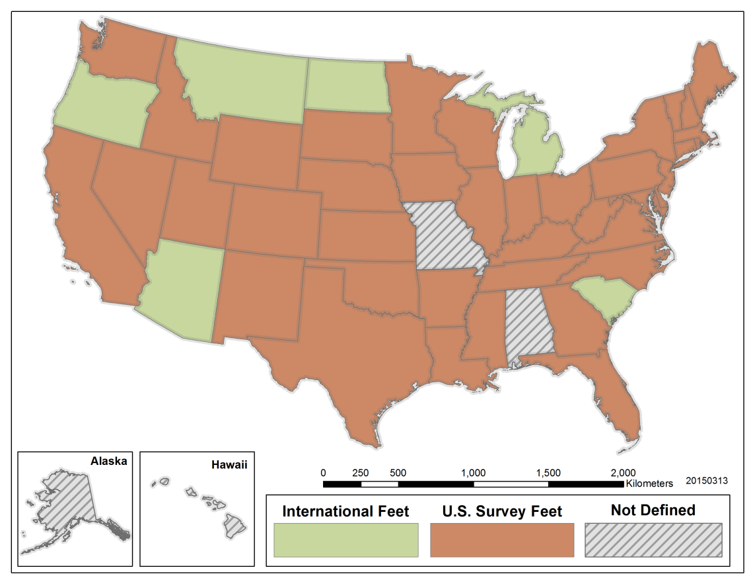
Partners
Federal agencies
FGDC will formally adopt new datums
State and local agencies
Laws, contracts, etc. may need to change
Private sector
Continued engagement is critical
Notes:
Partnerships are critically important:
NGS will continue to work with its federal partners that have mapping responsibilities and otherwise use the NSRS to complete their missions.
The Federal Geodetic Control Subcommittee, which is chaired by the Director of NGS and a part of the Federal Geographic Data Committee (FGDC), is a formal venue for this coordination to occur, but there will be significant work to complete less formally as well.
Some of the related programs are quite large, and adopting the new datums will take careful planning.
For example:
USGS topographic maps and water resource data reference datums defined by the NSRS and FEMA’s Flood Insurance Rate Maps reference geodetic datums.
The USACE needs accurate geospatial information referenced to the correct datums to determine levee heights and positions.
Any new collections of data will need to be coordinated carefully across agencies [e.g. 3D Elevation Program (3DEP) and IOCM] with an understanding that the carefully georeferenced data will have to be transformed to new datums in a few years. NGS will work with it’s federal partners to make sure this happens.

Slide 11
Partners
Federal agencies
FGDC will formally adopt new datums
State and local agencies
Laws, contracts, etc. may need to change
Private sector
Continued engagement is critical
Notes:
NGS will work with state/local governments and agencies as well. The state advisor program has transitioned to a regional model in which every state will have a designated POC to liaison with NGS.
In addition to coordination and planning, some states may want to revisit relevant legislation that specifically references the current horizontal datum: NAD 83. Working in partnership with the National Society of Professional Surveyors, states can adopt legislation or policies to ensure smooth transition to the new datums. Similar updates may need to be made in contracts and statements of work.
NGS will also need to work with the private sector. Since the NSRS is foundational data, it will be accordingly integrated into other products and services. In fact, the value added by the private sector can be of tremendous benefit to the broader surveying and mapping community. However, for a smooth transition, there needs to be coordination and open communication.
Continued dialogue is the key.
NOAA and/or its federal partners participate in various Federal Advisory Committees that include representatives from all these sectors.
The Hydrographic Services Review Panel, National Geospatial Advisory Committee, and Technical Mapping Advisory Council all share visions that are ultimately dependent on accurate geospatial information supported and aligned by the NSRS (don’t read list below – just for FYI).
NGAC Vision of the Desired Future State is: "The Nation and its citizens value and are empowered by geospatial resources."
TMAC Program Vision and Goals: A Nation more resilient to flood hazards through the effective identification and communication of flood hazards and risk.

Slide 12
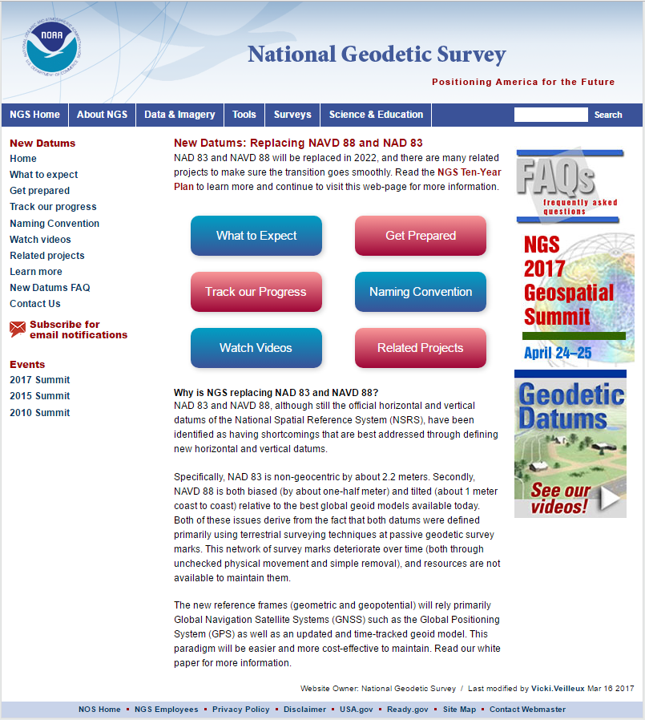
Where you fit in
Engage NOAA and NGS
Geospatial summits
Webinars and trainings
Manage your geospatial data
Metadata
Retain original observations
Notes:
The Charge: Find where you fit in and can contribute to this effort:
As the amount of data that we collect, ingest, store and manage continues to increase rapidly - especially with respect to lidar, imagery, and other georeferenced data/information – we will be presented with an increasing challenge and opportunity.
Engage with NOAA and NGS through Summits like this and other efforts NGS provide, whether they are monthly meetings, guest columns in trade publications, or just regularly visiting the web site.
Engage with professional societies like – NSPS and MAPPS. These societies have a tremendous national and local reach, and NGS will meet with them consistently to best take advantage of their communication networks that translate to the state and local levels.
Take ownership of this project of transitioning to the new datums, tackling how you manage your data today, change processes moving forward, and prepare for a smooth (as possible) transition .
With your support and engagement, I know we’ll succeed.
Thank you again for giving me the chance to talk to you today and I look forward to your questions.

Slide 13
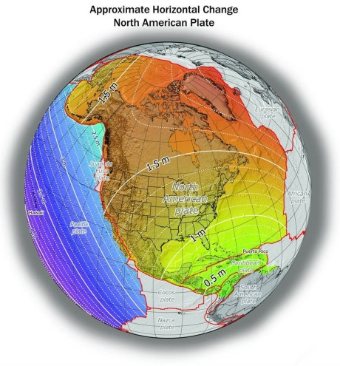
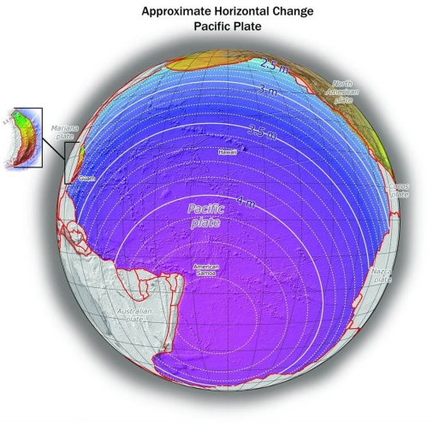
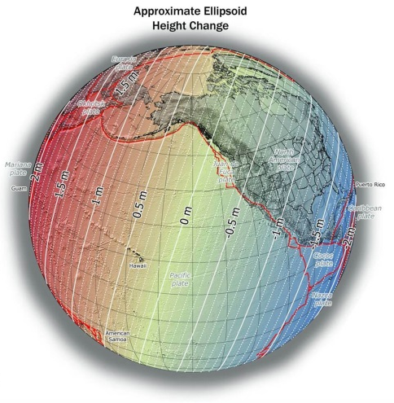
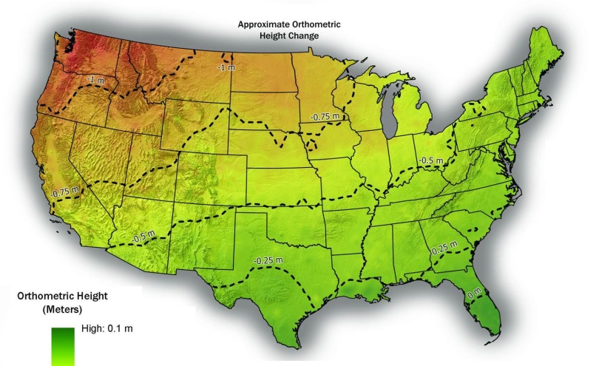
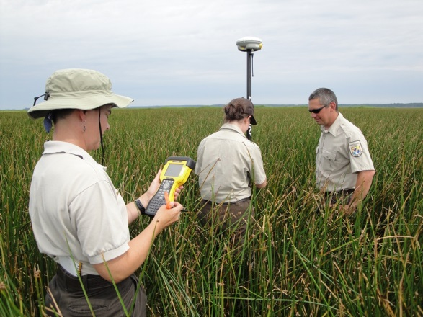
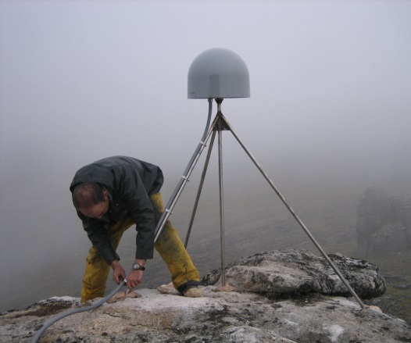
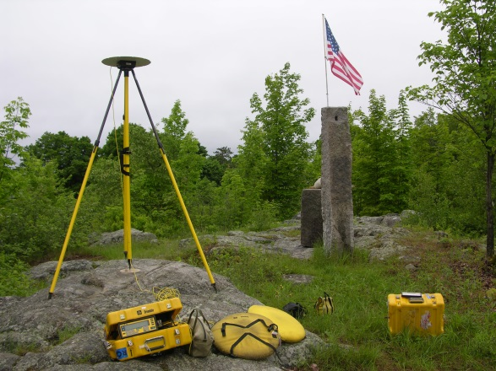
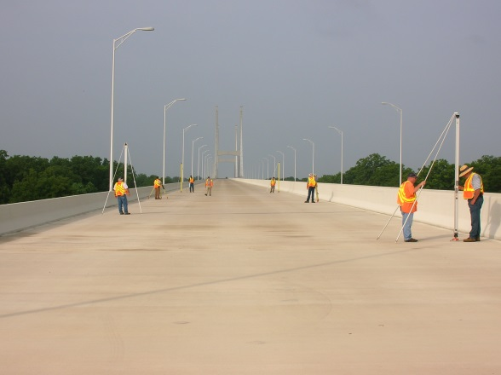
Questions?

