Slide 1


Precise Digital Leveling
DAY 2
Presented by Daniel Determan:
Northwest Regional Geodetic Advisor (WA, OR, ID)
Notes:
Hello everyone and welcome to day two of NGS’s Virtual Precise Digital Leveling Course.
My name is…
I am NGS’s Regional Geodetic Advisor for the Northwest. The Northwest Region includes the states of WA, OR and ID.
‹#›

Slide 2
Overview:
Leveling Unit/Crew
Safety
Equipment, Use and Setup
Collimation Check
Review Terminology
Observation Guides and Field Notes
Important Information
Equipment & Field Technique Videos
Tips
NGS’s 3rd Order Reset Document
Notes:
Today I will be talking about:
-a “leveling unit” or leveling crew
-creating and maintaining safety for the crew (must make your highest priority!)
-equipment, use and setup
-methods to complete the required daily collimation checks
-terms: “setup”, “section”, “line”, “loop”, “spur”, “single run”, and “double run”
-observation guides and field note forms
-important information required to perform precise geodetic leveling.
-videos that demonstrate how to use leveling tools and equipment, and the field procedures required
-several important tips to keep in mind (to minimize your chances for problems and hopefully improve your results!
*Benchmark Reset Procedures document used for 3rd Order Resets, two methods for elevation transfers @ 3rd Order, and where to find the document.

Slide 3
Typical Level Unit
One Observer (Instrument Person)*
Two Rod People*
One or Two Vehicles
  One capable of transporting equipment – rods*
  Drop one vehicle at end of day’s work
Safety People if Necessary
  Warning Person to drive behind crew
One Pacer to Help with Setups
Computer to Download and Process Data*
* Required
Notes:
‹#›
A typical leveling crew includes:
-One Observer (Instrument Person)*
-Two Rod People*
-One or Two Vehicles
one to transport rods and equipment*
one to drop at end of days work
-Safety People if Necessary
for example, someone to drive behind the crew
-One Pacer to help with setups
-Level*, Rods*, Thermosters*
-Turtles*, Turning Pins*, Spacers, Centering Guides
-Computer to Download and Process Data*
* = Required

Slide 4
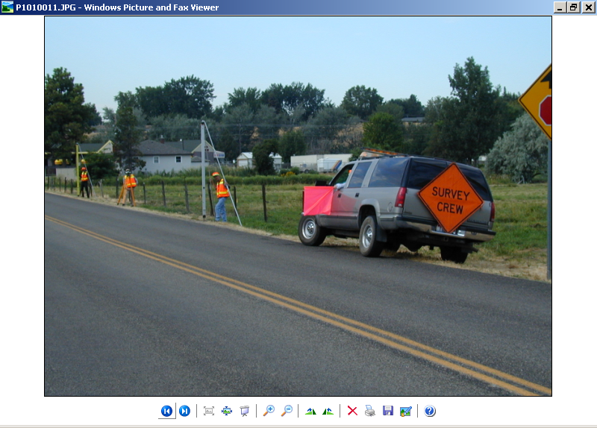
Level Unit
One Observer
Two Rod Persons
+ Support Personnel
Notes:
‹#›
For production geodetic leveling a minimum sized crew would require three people; an instrument operator and two people maintaining the rods and turning points.
Don’t forget support personnel when considering cost estimates for geodetic leveling, especially safety personnel. There are more than just “3” people needed to successfully accomplish higher order geodetic leveling.
The other dramatic change to the electronic digital/bar-code leveling system equipment is the Invar bar-code rod – a whole new concept and design over conventional optical leveling systems – There are no numbers for reading height differences – just a bar-code.
*Where is 0.5 meter on this rod? That is important as you are not allowed to read below 0.5 meter during leveling setups. (We’ve placed electricians black tape on the rod to indicate 0.5 meter at the top of the tape to assist in setups).
This is a Leica, single piece, calibrated, 3 meter, Invar rod with brace struts and leveling vial typical of those for Topcon and Trimble, though with different bar-code scales, required for 1st and 2nd Order leveling.

Slide 5
Safety is Paramount!

Slide 6
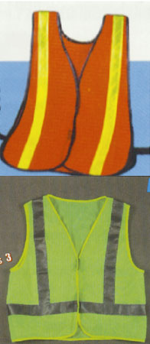
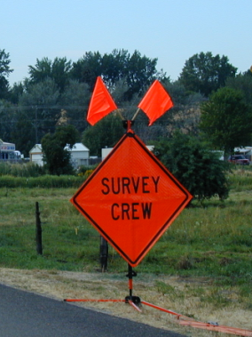
Please be Safe!
Notes:
This section cannot be emphasized enough especially in light of today’s very busy traffic conditions and the fact that leveling requires the field crew to work in close proximity to the flow of traffic.
Safety must be considered when planning level routes and logistics such as required personnel.
Safety vests must provide high visibility and be worn at all times.
Faded, worn out, “but it’s my favorite” safety vests are not an option. Remember, we are protecting the public as well as the surveyor.
Safety signs are effective but very difficult to maintain in the leveling process as the field crew moves quite rapidly and exceeds the effective distance from safety signs quickly.

Slide 7
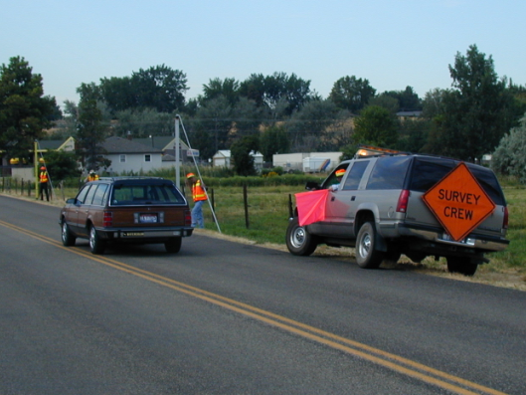
Please be Safe!
Notes:
Level routes are quite frequently right next to the driving surface placing the survey crew in harms way.
In this particular instance, a safety chase vehicle with flashing strobe lights and attached safety sign closely follows the crew. The driver watches approaching traffic and can use the red flag as an additional warning to traffic.

Slide 8
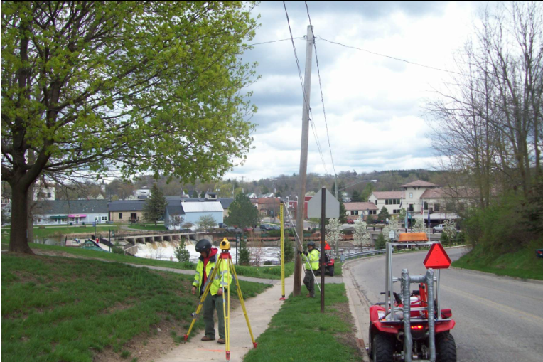
“Motorized” Leveling
Photo courtesy of Coleman Engineering Co.
Notes:
Example of “motorized” level unit using all terrain vehicles (ATV) to transport personnel and equipment. ATV shown in foreground includes instrument/tripod mount.

Slide 9
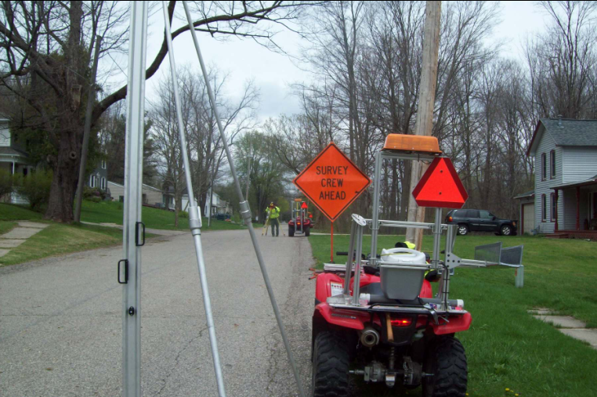
“Motorized” Leveling
Photo courtesy of Coleman Engineering Co.
Notes:
Example of “motorized” level unit using all terrain vehicles (ATV) to transport personnel and equipment. ATV shown in foreground includes level rod mount.

Slide 10
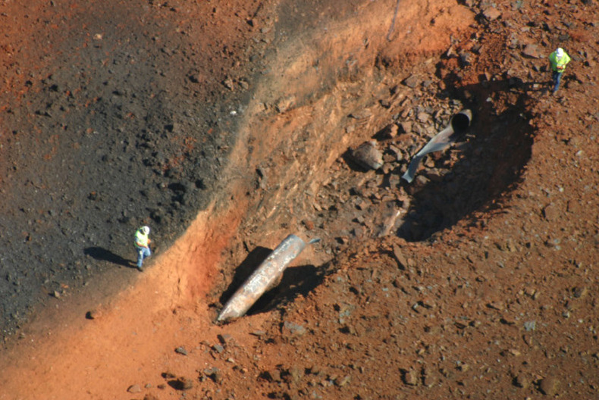
September 14, 2008 near Appomattox, Virginia
Call Before You Dig!
Notes:
Dramatic picture illustrating potential hazards caused by buried utilities. This buried gas pipeline near Appomattox, Virginia failed due to pipe corrosion on September 14, 2008.
This photo really has nothing to do with requesting a utility locate to ensure safe digging but does grab viewer attention.

Slide 11
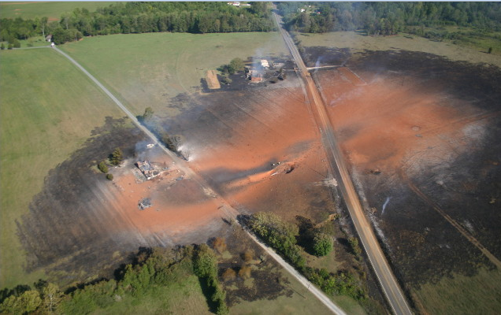
September 14, 2008 near Appomattox, Virginia
Call Before You Dig!
Notes:
Dramatic picture illustrating potential hazards caused by buried utilities. This buried gas pipeline near Appomattox, Virginia failed due to pipe corrosion on September 14, 2008.
This photo really has nothing to do with requesting a utility locate to ensure safe digging but does grab viewer attention.

Slide 12
Precise Digital Leveling
Section 2
Leveling Equipment and Setup

Slide 13
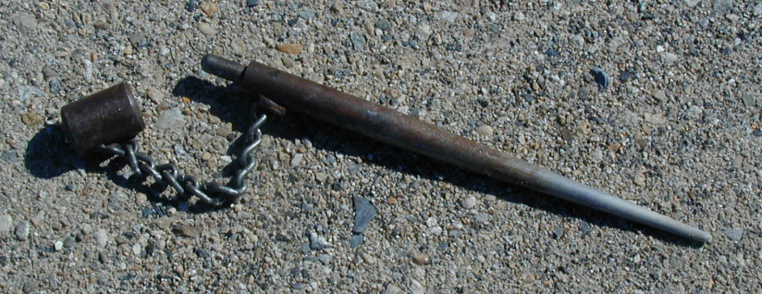
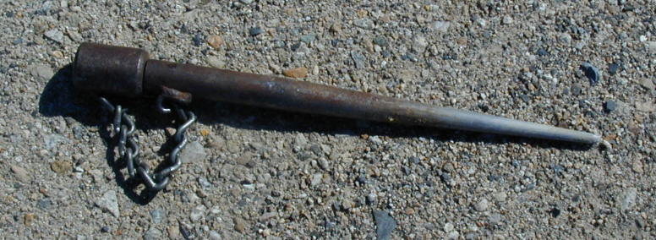
Turning Pin – Cap Off
Turning Pin – Cap On
Notes:
Example of a 15 inch long, tapered stainless-steel turning pin with attached protective cap: Lower turning pin showing the protective cap on for hammering into the ground which protects the smooth turning surface. Upper turning pin showing the protective cap off and exposing the smooth turning surface.
NOAA Manual NOS NGS 3, Geodetic Leveling; 3.5 Turning Points

Slide 14
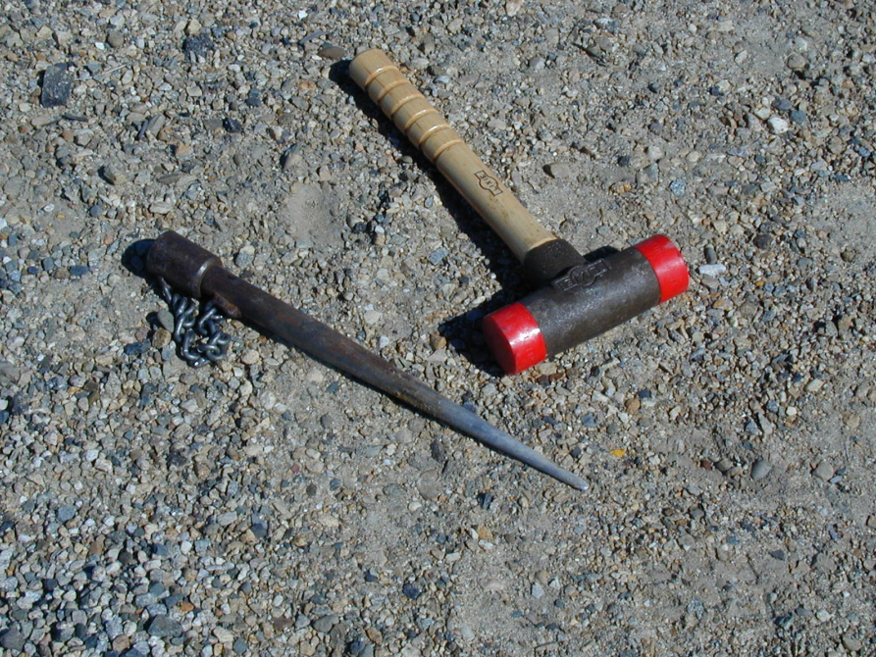
Urethane Faced
Dead-Blow Hammer
Turning Pin – Cap On
Notes:
Example stainless-steel turning pin and Urethane faced dead-blow hammer: Picture showing the turning pin with protective cap on for hammering into the ground which protects the smooth turning surface.
The Urethane faced dead-blow hammer, minimum 3 lbs., easily drives the turning pin in providing for a very stable setup for the leveling rods and does not damage the driving surface of the turning pin.
NOAA Manual NOS NGS 3, Geodetic Leveling; 3.5 Turning Points

Slide 15
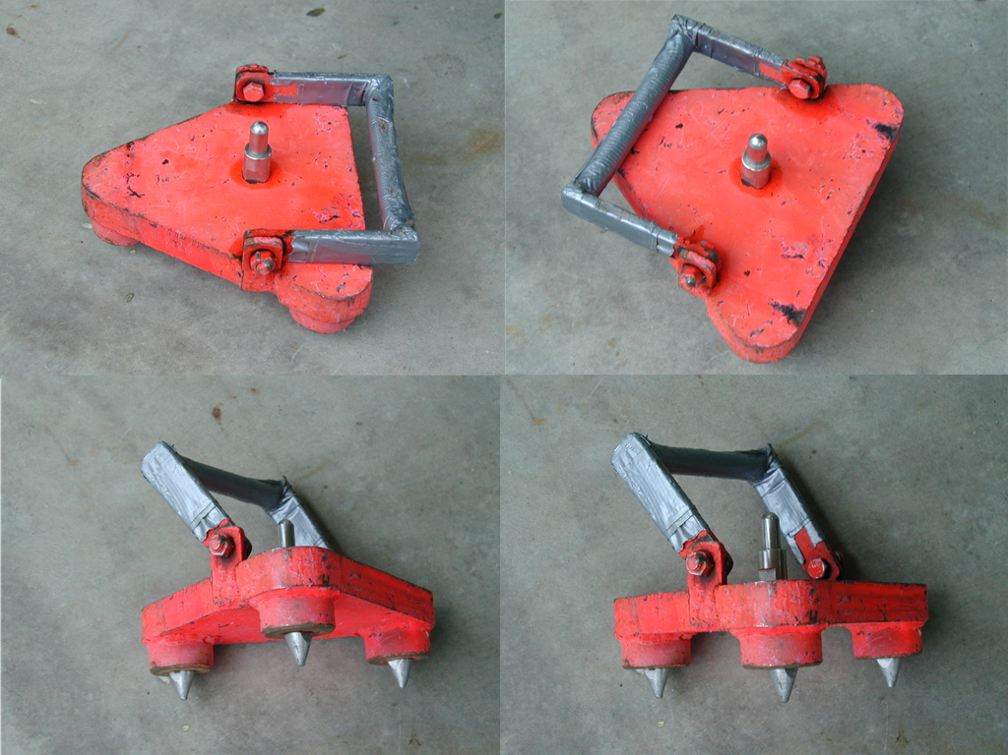
“Turtle” with Removable Pointed Feet
Notes:
Example turning plate: Four views of a minimum 7 kg (15 lbs.) triangular shaped turning plate (also known as a “turtle”) with removable pointed feet and carrying handle.
Turning plate. When a turning pin cannot be driven efficiently, such as in the hard-packed gravel of a road shoulder, in very firm clay, or on a concrete sidewalk, use a turning plate (turtle). A turning plate should have (1) a definite high point, (2) three flat feet with removable points, and (3) weigh at least 7 kg (15 lb).
NOAA Manual NOS NGS 3, Geodetic Leveling; 3.5 Turning Points

Slide 16
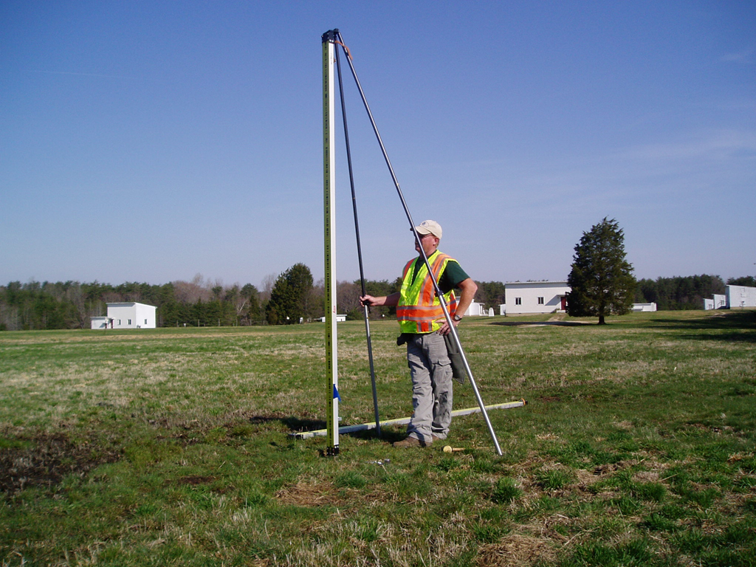
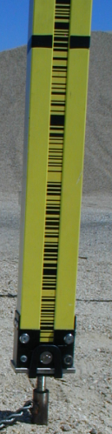
Single-Piece, Bar-Coded Invar, Calibrated Rod with Brace Poles
Notes:
‹#›
Documents available through this link relating to geodetic leveling.

Slide 17
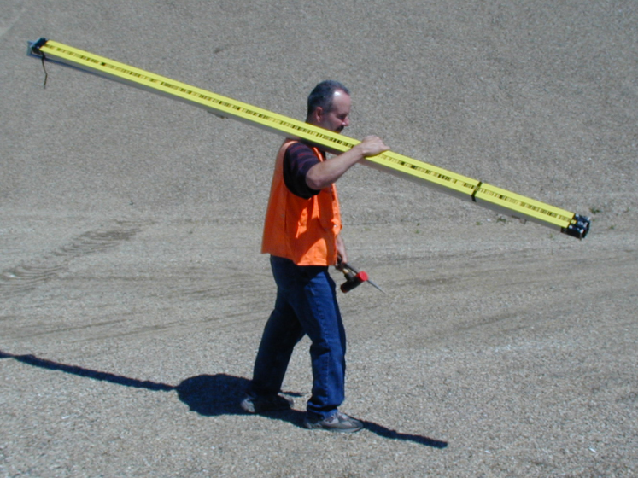
Carrying Level Rod and Hammer and Turning Pin
Do Not Place Hand Directly on Invar
Notes:
Example carrying the 3-meter level rod, turning pin and Urethane faced dead-blow hammer.
Note: DO NOT TOUCH THE BAR-CODED INVAR WITH YOUR HAND. Oils from your skin will stick to the Invar attracting dust and dirt and ultimately wear out the reading surface of the bar-code. In this example, the rod person is cupping his hand over the bar-coded Invar while carrying the rod on his shoulder.
General handling. Because of its length, the leveling rod is so easily struck against objects that great care must be exercised when handling it. Paint does not stick easily to the special materials used for rod scales. As a result, striking the rod against any hard object (such as poles, trees, signs, rocks, vehicles, or the ground) may chip paint off the scale, making it difficult to continue observing precisely and efficiently. Such shocks may also damage the inner spring assembly or the housing, causing unpredictable change in the length of the scale.
Carry the rod by holding it with one hand at the middle and balancing it face up across your shoulder. Do not touch the painted scale. Use your arm as a spring to absorb shocks.
NOAA Manual NOS NGS 3, Geodetic Leveling; 3.4 Leveling Rods; 3.4.3 Use and Maintenance

Slide 18
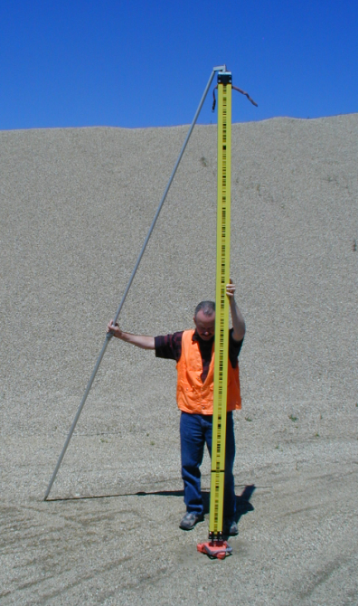
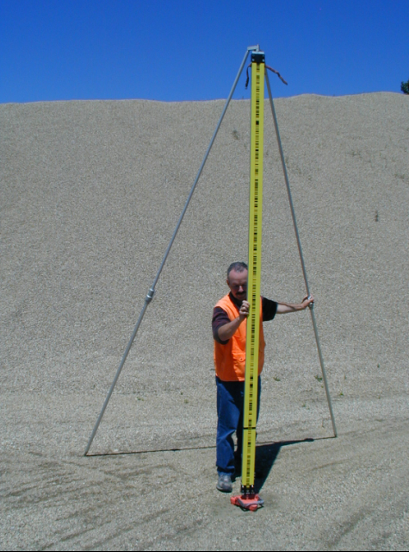
Setting Rod Brace Poles – One and Then the Other
Notes:
Typical setup of the 3 meter level rod with adjustable brace poles.
Left Illustration: Hold the rod with one hand and set one brace pole a fair distance from the rod to provide support with the other hand. Squeezing the adjustable clamp allows the rod to be lengthened or shortened.
Right Illustration: Hold the rod with the other hand and set the second brace pole a fair distance from the rod to provide support similar to the first brace pole.
DO NOT hold and try to set both brace poles simultaneously as this places a lot of unwanted stress on the turning pin and could possibly affect its stability - elevation.
Place the brace poles downwind from the rod, and arrange them so they do not interfere with the observer's line of sight. Face the rod toward the instrument and plumb it by adjusting the lengths of the poles until the bubble in the circular level is centered precisely.
NOAA Manual NOS NGS 3, Geodetic Leveling; 3.4 Leveling Rods; 3.4.3 Use and Maintenance

Slide 19
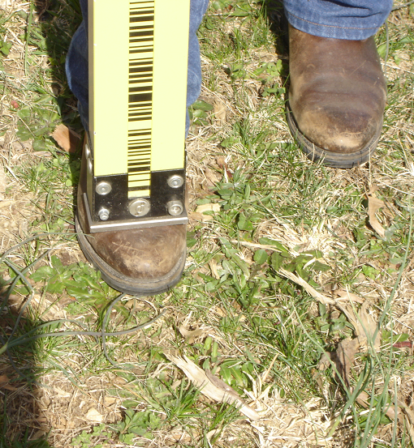
Always Protect Bottom of Rod
Do Not Place Rod on Ground!
Place Rod on Shoe When Idly Holding or
Temporarily Showing Rod
Notes:
NEVER PLACE THE BOTTOM OF THE ROD DIRECTLY ON THE GROUND OR OTHER IRREGULAR SURFACE. This is the measurable surface of the level rod and should be protected from unnecessary wear and abrasion. The relationship of the bottom surface of the rod to the bar-coded Invar is a critical feature of the level rod and is included as part of the rod’s precise calibration. As this relationship changes due to surface wear on the bottom of the rod, a new rod calibration is required.
An easy solution to holding the rod in an upright position, either idly during the leveling process or to temporarily show the rod for a quick check by the observer, is to place the rod on the toe of your boot or shoe.
During a halt in the leveling operation, hold the rod vertically on the toe of your boot. Otherwise, place the rod in a protected location where it can be easily seen. Do not place it near the path of a vehicle Lay it gently on the ground, with the scale facing up and the circular level protected from stress. See that no dirt or rocks are kicked on the rod while it is on the ground.
NOAA Manual NOS NGS 3, Geodetic Leveling; 3.4 Leveling Rods; 3.4.3 Use and Maintenance

Slide 20
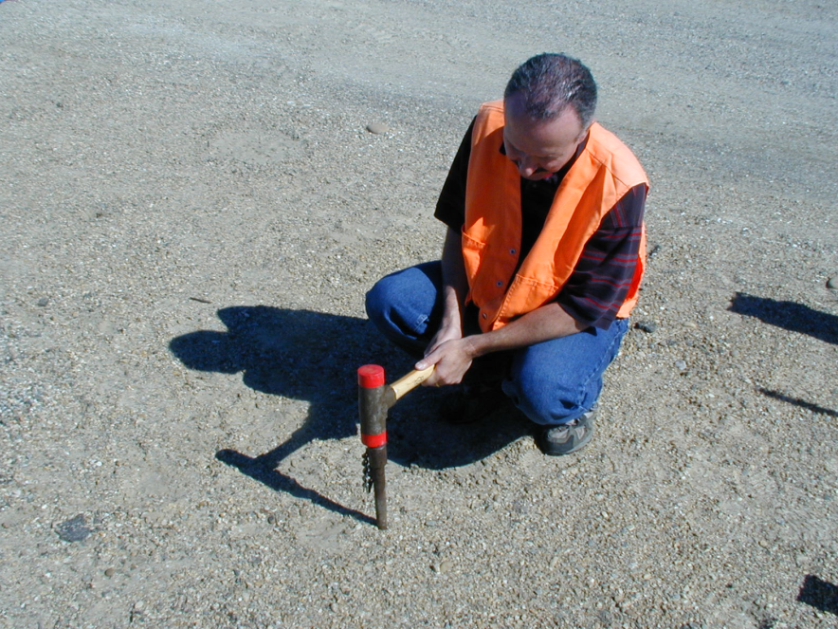
Using Dead Blow Hammer to Drive Turning Pin – Cap On
Notes:
Example of driving a stainless-steel turning pin into the ground with the Urethane faced dead-blow hammer.
This example illustrates using both hands for this process but it is possible to hold the rod on your shoulder with one hand while using the other to set the pin.
When using two hands to set the turning pin, as illustrated, place the rod flat on the ground (not pictured) with the Invar side facing up and not touching the ground.
Turning pin. To set a turning pin, place the driving cap over the high point and use a 2-kg (4 lb) hammer to drive the pin into the ground. The faces of the hammer should be made of replaceable soft plastic, to prevent damage to
the driving cap. Do not hold the hammer with its head crossways when hammering, since this may damage the
metal part of the head and make replacement of the faces difficult. Drive the pin straight, not at an angle, until the driving shoulder is within 5 cm (2 in) of the ground. If the pin is set at an angle, or not driven deeply enough, it is more likely to rebound or settle. After setting the pin, remove the driving cap and carefully place the rod on the high point.
NOAA Manual NOS NGS 3, Geodetic Leveling; 3.5 Turning Points; 3.5.1 Selection and Use

Slide 21
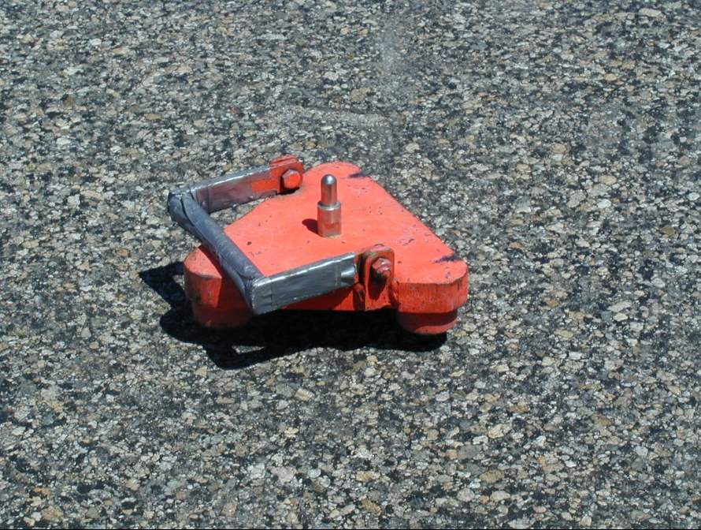
Turtle Setup on Asphalt
Notes:
NEVER EVER SET UP ON ASPHALT!!! Asphalt is an unstable surface and settlement during a single setup on asphalt cannot be controlled. The settlement may be very slight and not dramatically detectable but it is still settlement and causes erroneous elevation differences during the leveling process.

Slide 22
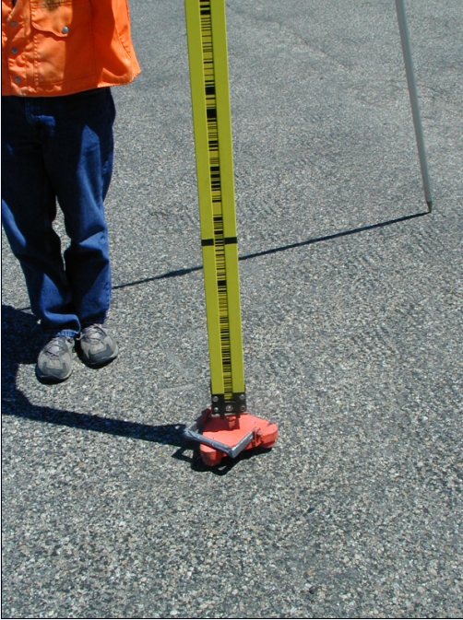
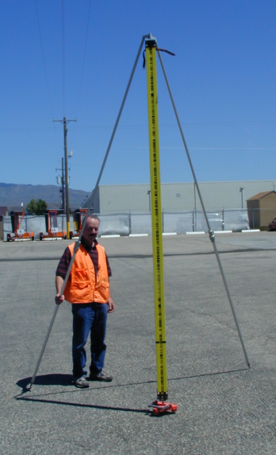
Rod/Turtle Setup on Asphalt
Notes:
Illustration depicting a setup on asphalt to emphasize the fact that this situation is NOT ACCEPTABLE for precision geodetic leveling.

Slide 23
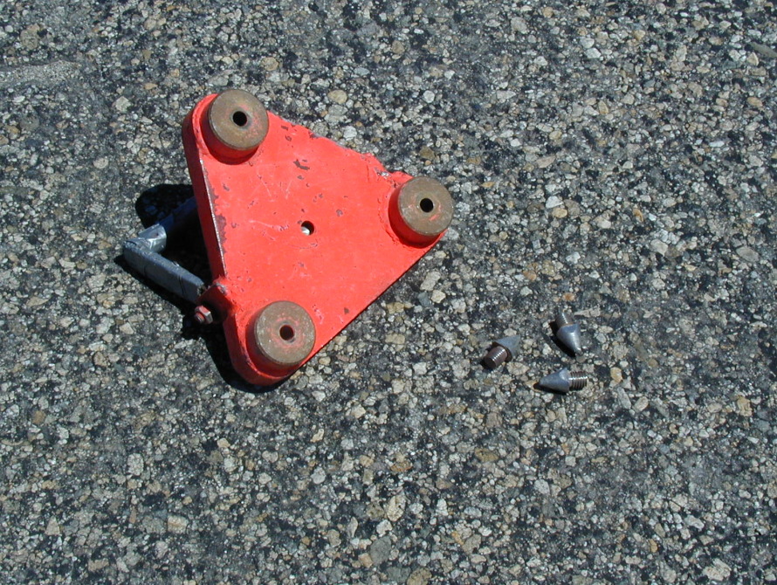
Special Case Only
Turtle Being Prepared for Setup on Asphalt
Points Removed
Notes:
Now, back to reality. In today’s world of construction and development there is no way that setups on asphalt can be completely avoided. So, if you must setup on asphalt, realize the hazards of probable settlement during the setups and take measures to minimize the impact on the elevations.
Realize the hazards of probable settlement during setups on asphalt and take measures to minimize the impact on the elevations.

Slide 24
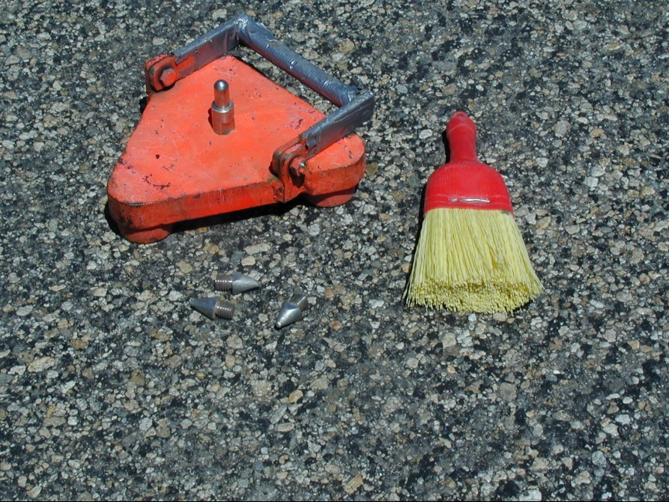
Special Case Only
Turtle on Asphalt
Points Removed
Location Swept
Turtle Stomped
Notes:
Remove the pointed feet from the turning plates and setup on the broad, flat surfaces of the support feet. Use a whisk broom to sweep little rocks, asphalt pieces, and other loose items from the asphalt surface so the support feet won’t settle into the asphalt during the setup.
Stomp the turtle well onto the cleaned asphalt surface to help minimize settlement.

Slide 25
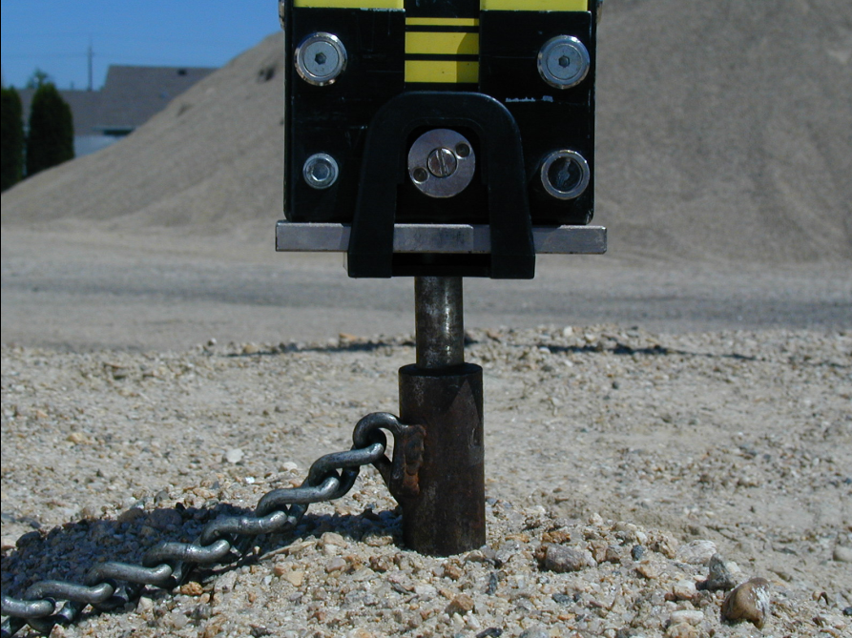
Rod on Turning Pin
Using Centering Guide
Notes:
View of the bottom of the rod held in place on top of the turning pin by the centering guide. The centering guide keeps the rod setups very consistently in the bottom, center, towards the front of the rod, directly below the Invar.

Slide 26
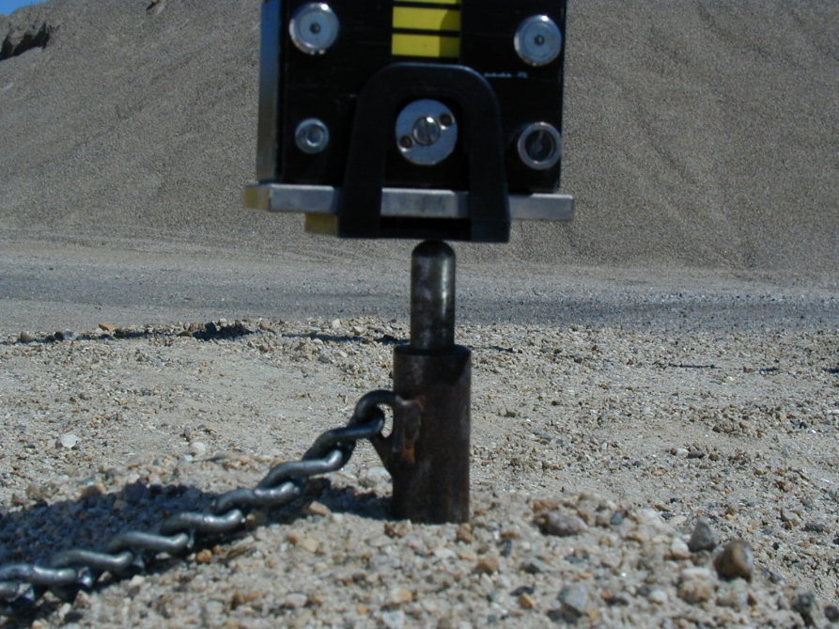
OOPS!!!
Centering Guide on Turning Pin
Not Base of Rod!
Notes:
A critical mistake is to set the rod on the turning pin but failing to notice the bottom of the rod is not on the turning pin but the centering guide is on top of the turning pin. Usually in this situation, when the rod is turned the opposite direction, the bottom of the rod drops onto the turning pin as it is supposed to be. This will produce an error of about a cm as the centering guide is about that thick and the section will not check backward and forward runnings.
This is the rod person’s responsibility and must be constantly checked every setup to ensure this does not happen.

Slide 27
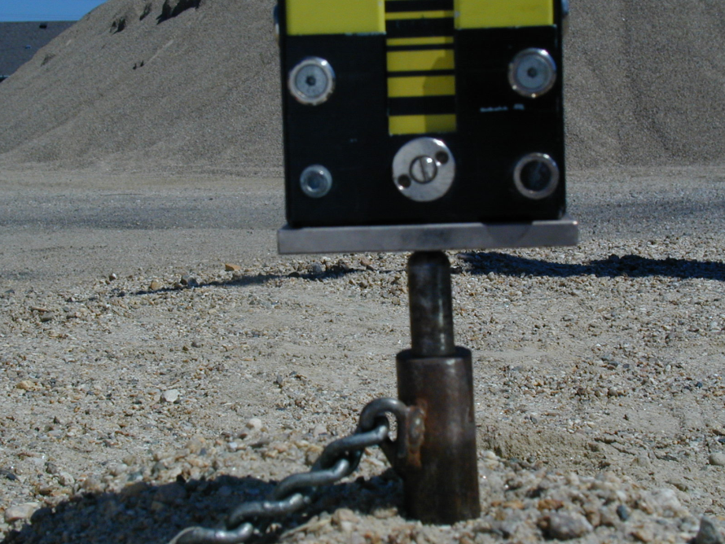
Rod on Turning Pin
Without Centering Guide
Notes:
View of the bottom of the rod on top of the turning pin without the use of the centering guide. The rod person must check and ensure the bottom, center of the rod is on the turning pin every setup. This is an acceptable practice and will produce elevation differences equal to using the centering guide, as long as special care is given to ensure proper setups.
This practice is not recommended to be used by novice rod persons or during windy conditions when the rod is easily blown off the turning pin.

Slide 28
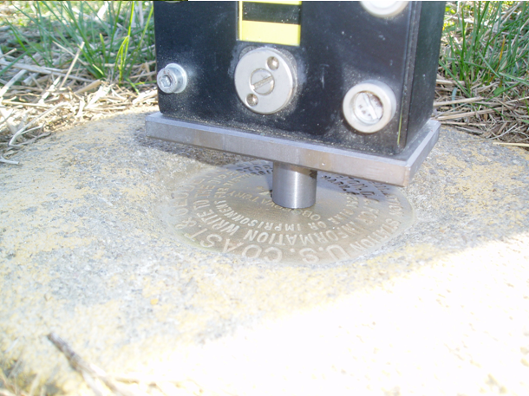
Spacer Set on High Point of Disk
Adding Height of Spacer
Notes:
Use of the 2-cm spacer. The spacer is used to lift the bottom of the rod above an interfering surface such as concrete surrounding a brass survey disk. The base of the level rods are quite wide, wider than the survey disks, which in many cases are set in such a way that the surrounding concrete is higher than the center (datum) of the disk. It is critical that the bottom of the rod be placed on the center of the survey disk and not accidentally on the surrounding concrete. When using the spacer, ensure it is placed directly on the center of the disk.
When a spacer is used, either the same spacer or another one identical in height must be used on the turning point of the same setup. Make a note on the recording form whenever a spacer is used. To use a single spacer, place it under the backsight rod of the setup. After reading the backsight, place the spacer under the foresight rod.
The height of the spacer is included in the observed heights of both the backsight and the foresight; therefore, the extra height is canceled when the elevation difference is computed. A pair of spacers, manufactured and calibrated to agree in height within 0.05 mm (0.0015 ft), can be used simultaneously for a more efficient operation.
NOAA Manual NOS NGS 3, Geodetic Leveling; 3.7 Observing Routine; 3.7.4 Precautions to Take at Control Points

Slide 29
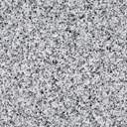


Control on Horizontal Surfaces
Class A and B Rod Mark
Disk in Bedrock
Concrete Post
Rod Mark With Disk
Notes:
Identify the control point: The leveling rod must rest on a clearly defined point. On a horizontal surface, the control point is the highest point of the mark. On a vertical surface, it is at the intersection of a pair of crossed lines (the exact center of a bench mark disk, fig. 3-76). The one exception to these rules occurs if some other point is specifically defined in the description of the control point. If any other point is used, describe it clearly in the leveling records.
Center the base plate of the rod precisely on the control point. If the point is in a location that does not permit this, use the center of the back or front edge before resorting to a comer of the base plate. If a mark is very flat, use a spacer placed exactly at the center. Sometimes the concrete around a disk may prevent centering or rotating the rod. Use a spacer in this situation as well.
NOAA Manual NOS NGS 3, Geodetic Leveling; 3.7 Observing Routine; 3.7.4 Precautions to Take at Control Points

Slide 30
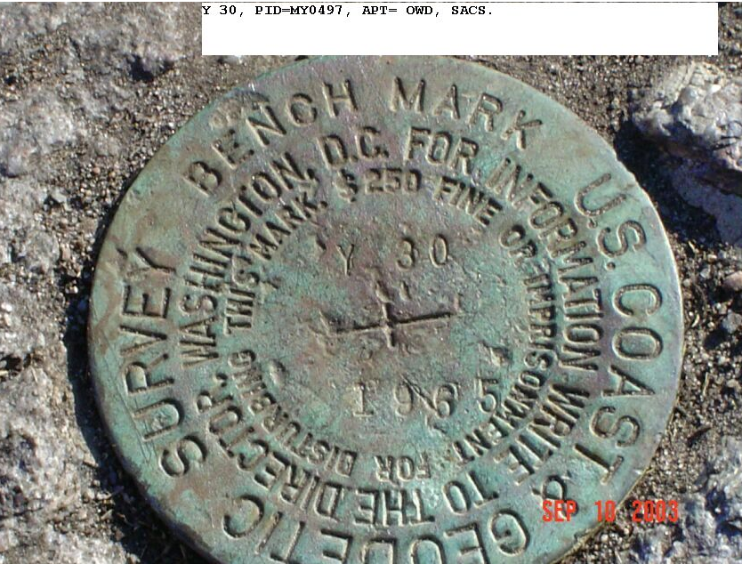
Y 30, MY0497, 1, SACS, 20030918
Note where the mark was leveled to in the Back-Up recording sheets and in written station description.
GPS
Where do you measure HI from?
The bottom of the recessed cross!
Leveling
A “Flat” disk and the way it’s set the High Point is located between the “S” and “U” of Survey
Where do you level to?
Notes:
So, where do you setup your level rod on this flat disk with the “high point” clearly located between the “S” and “U” of the word “SURVEY” on the edge of the disk?
“Tradition” says to level to the “high point” on the disk.
Where will the elevation be published to this mark - to millimeters? Where is the “datum” for this mark?
Where will I measure from up to my GPS receiver to determine elevation for my survey project? From the “BOTTOM” of the center of the “cross” which is a surface never, ever measured by leveling methods.
So, if you level to any point on a mark other than the top of the disk at the “cross” (datum of the disk) it MUST be recorded in the station description, e.g. add the note “the high point leveled to on the disk was between the S and U of SURVEY on the edge of the disk” as the last line in the station description.

Slide 31
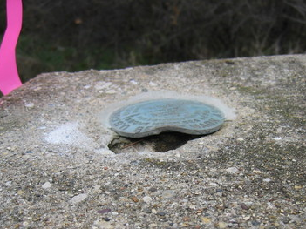
NH0303, Q 102, 3W, 20061016
Notes:
So, where do you setup your level rod on this disk with the “high point” clearly off-center?
Obviously this mark should be “destroyed” and replaced with an improved monument.

Slide 32
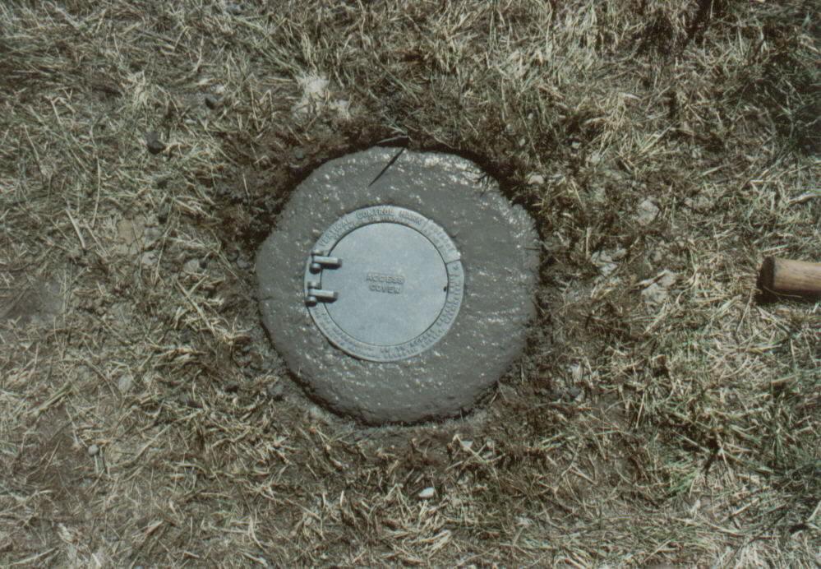
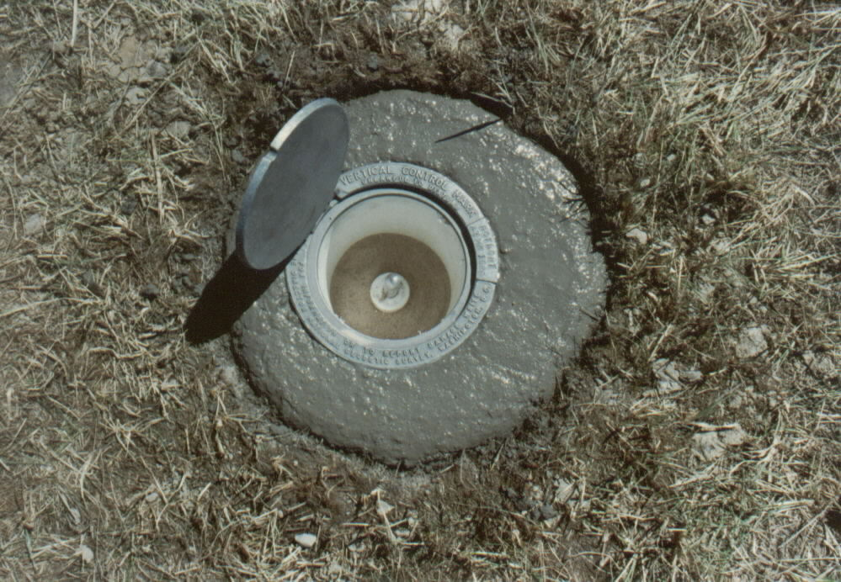
Notes:
So, where do you setup your level rod on this type of deep-driven rod mark? You must open the lid as the “datum” point is the top center of the rod.

Slide 33
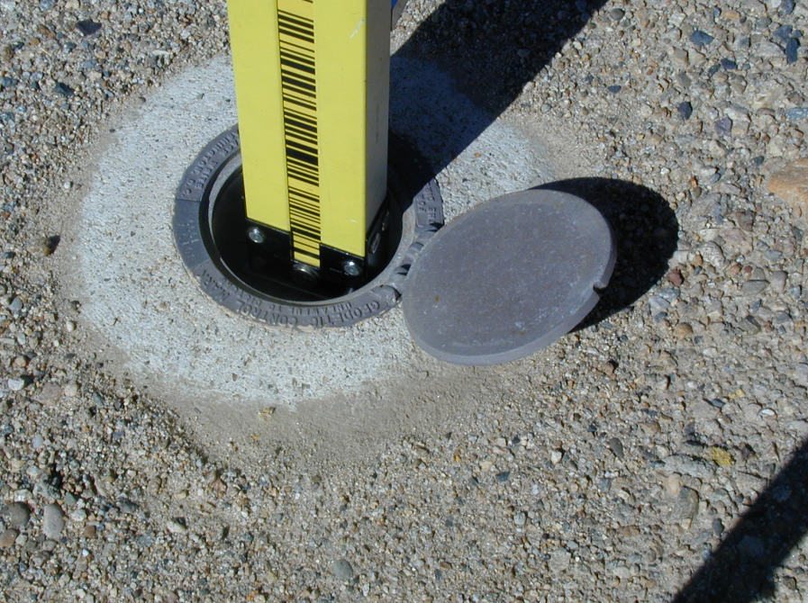
Notes:
Ensure the level rod is “cleanly” resting on top of on this type of deep-driven rod mark. Rotate rod back and forth slightly to ensure base plate of level rod is centered on metal rod and not “hung up” on something which is hard to see in the recessed area.

Slide 34
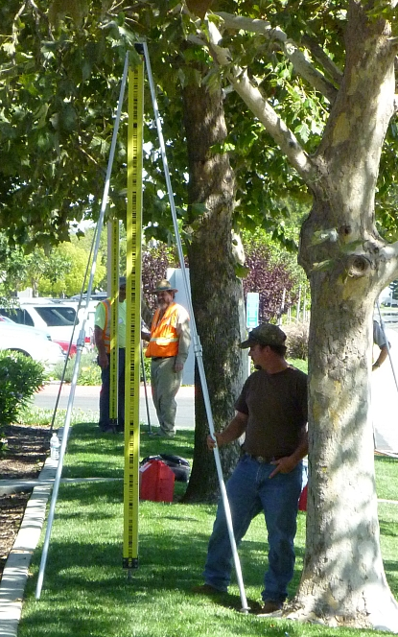
“Dappled Light”
Instrument may not be able to read rod
Notes:
‹#›
“Dappled” light – mix of sun and shadow can “confuse” the digital level and the instrument may not be able to read the rod. Try to rotate the rod to remove or minimize this effect or fully shade the rod and try another reading. Sometimes the instrument location can be changed to get a different lighting effect on the rod. If this is a foresight, the rod may be able to be moved to a better location.
Knowing this situation exists when working around trees or tall brush the rodmen should try and find setups which will provide setups free of this effect, especially when they become the next backsight.

Slide 35
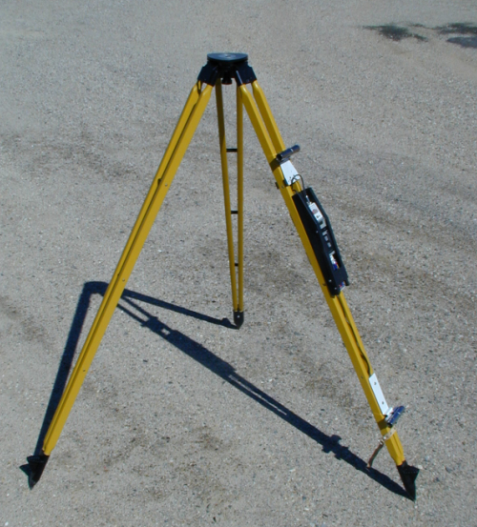
Rigid Leg Tripod
With Thermister
Equipment
Notes:
Example of the NGS manufactured, manually read and recorded, thermistor unit mounted on a rigid leg tripod.
Measuring air-temperature difference: The best mathematical models for computing refraction corrections depend upon measuring at least one air temperature difference during every setup. Temperatures are measured at two different heights above the ground. The difference is computed by subtracting the temperature at the bottom from that at the top. It is usually negative during daylight hours when the Sun heats the ground, warming the lower air layers. It is positive when the air near the ground is cooler than that above it. Use aspirated thermometers, accurate to ± 0. l° C (± 0.2° F), to measure the temperature difference. A typical measuring system includes two thermistors, each shaded by a metal tube and aspirated by a small, battery powered fan. A digital display permits readings to be made from either thermistor. Air movement across the thermistors should be equal at all times. Check for air movement by placing your hand in front of each thermistor.
NOAA Manual NOS NGS 3, Geodetic Leveling; 3.6 Atmospheric Conditions; 3.6.1 Air Temperature, Sun, and Wind

Slide 36
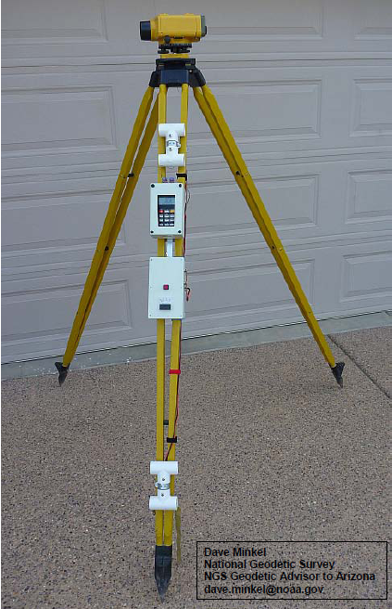
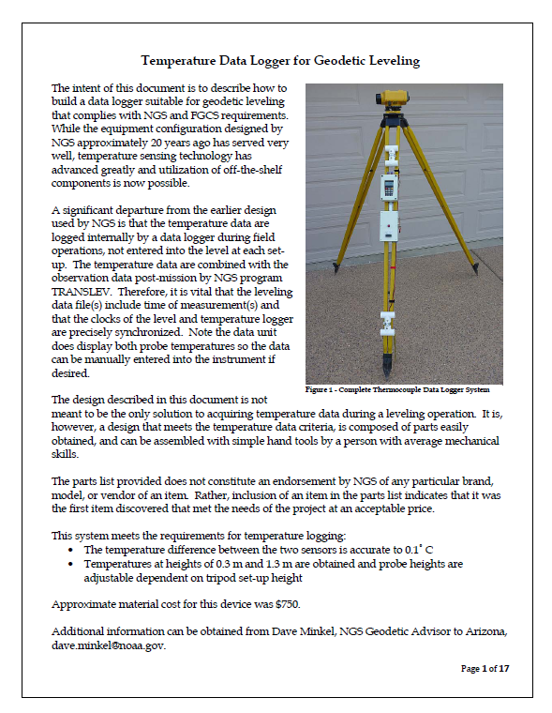
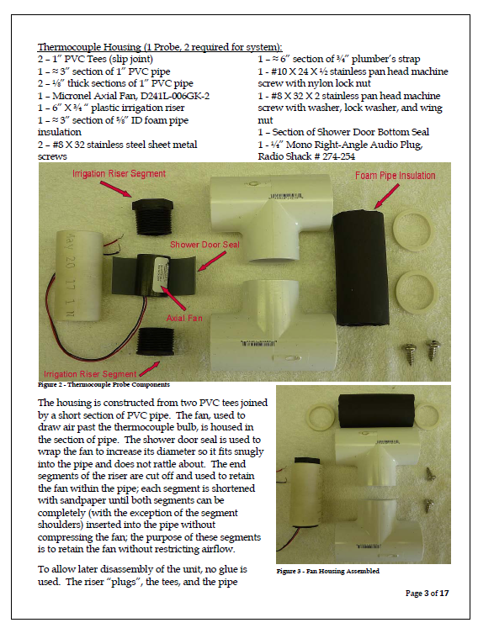
Temperature Data Logger for Geodetic Leveling
Notes:
Example of the NGS manufactured, digitally displayed and recorded, thermistor unit mounted on a rigid leg tripod.
Measuring air-temperature difference: The best mathematical models for computing refraction corrections depend upon measuring at least one air temperature difference during every setup. Temperatures are measured at two different heights above the ground. The difference is computed by subtracting the temperature at the bottom from that at the top. It is usually negative during daylight hours when the Sun heats the ground, warming the lower air layers. It is positive when the air near the ground is cooler than that above it. Use aspirated thermometers, accurate to ± 0. l° C (± 0.2° F), to measure the temperature difference. A typical measuring system includes two thermistors, each shaded by a metal tube and aspirated by a small, battery powered fan. A digital display permits readings to be made from either thermistor. Air movement across the thermistors should be equal at all times. Check for air movement by placing your hand in front of each thermistor.
NOAA Manual NOS NGS 3, Geodetic Leveling; 3.6 Atmospheric Conditions; 3.6.1 Air Temperature, Sun, and Wind

Slide 37
PLAY VIDEOS
Using a Turning Plate (Turtle)
Using a Centering Guide
Using a Spacer
Dappled Light
Thermisters

Slide 38
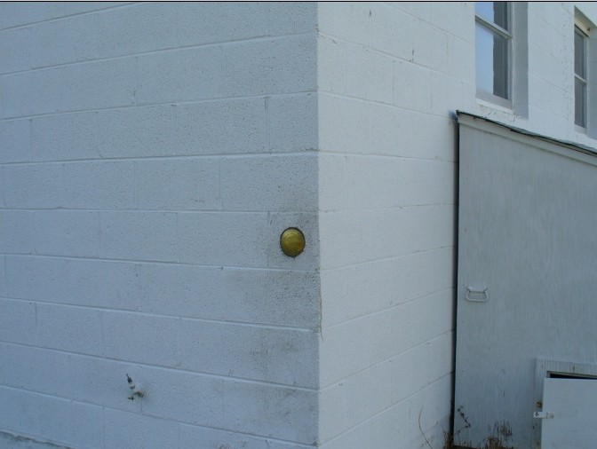
Vertically Set Bench Mark
Notes:
So, where do you setup your level rod on this type of survey disk set vertically in a wall or bridge abutment?
How do you setup your GPS receiver on this type of survey disk set vertically in a wall or bridge abutment?

Slide 39
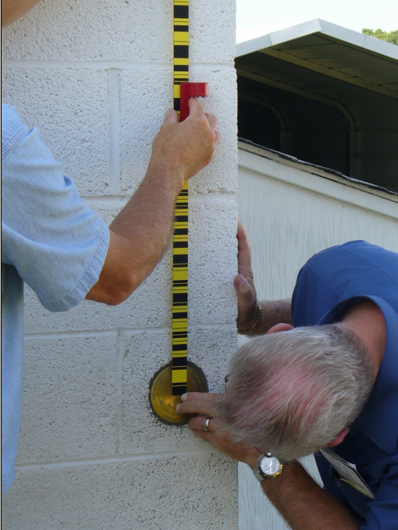
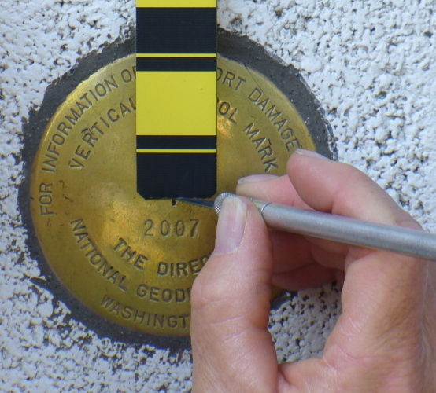
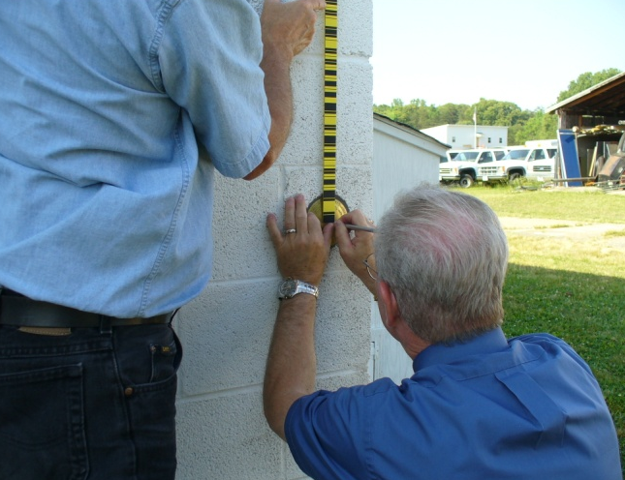
Notes:
Use a short scale known as an Invar strip:
1. During the setup, which includes the control point, adjust the instrument height so that when the instrument
is leveled the line of sight is as close to the control point as possible.
2. Two people should hold the scale, one at the top and the other at the bottom. Center the index line of
the scale on the point.
3. Plumb the scale by observing it through the instrument and aligning the scale with the vertical reticule line. When necessary, support and plumb the scale with a carpenter's level.
4. Observe the scale exactly as though it were rod 1 in a routine setup. Make a note that the short scale was used.
NOAA Manual NOS NGS 3, Geodetic Leveling; 3.7 Observing Routine; 3.7.5 Leveling to Awkward Control Points

Slide 40
VIDEO
Setting Up on a
Vertical Mark
Notes:
Example of driving a stainless-steel turning pin into the ground with the Urethane faced dead-blow hammer.
This example illustrates using both hands for this process but it is possible to hold the rod on your shoulder with one hand while using the other to set the pin.
When using two hands to set the turning pin, as illustrated, place the rod flat on the ground (not pictured) with the Invar side facing up and not touching the ground.
Turning pin. To set a turning pin, place the driving cap over the high point and use a 2-kg (4 lb) hammer to drive the pin into the ground. The faces of the hammer should be made of replaceable soft plastic, to prevent damage to
the driving cap. Do not hold the hammer with its head crossways when hammering, since this may damage the
metal part of the head and make replacement of the faces difficult. Drive the pin straight, not at an angle, until the driving shoulder is within 5 cm (2 in) of the ground. If the pin is set at an angle, or not driven deeply enough, it is more likely to rebound or settle. After setting the pin, remove the driving cap and carefully place the rod on the high point.
NOAA Manual NOS NGS 3, Geodetic Leveling; 3.5 Turning Points; 3.5.1 Selection and Use

Slide 41
Rules – Short List
Never Setup on Asphalt
Double Run Everything
Never Read Below 0.5 Meter on Rod
All Three Crosshairs Must be on Invar
Same Rod on Starting and Ending BM
Use Turtles and Turning Pins for Turning Points
Always Keep a Hand on Rod when Setup
Keep Setup Imbalance at a Minimum
Notes:
This slide is a recap of some of the very important issues to assure good leveling practice. Most of these “rules” are self-explanatory and are a result of many of the conditions set in the section on corrections applied to geodetic leveling.

Slide 42
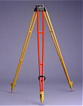
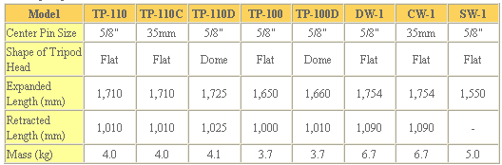
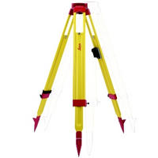
http://www.topcon.co.jp/eng/survey/tripod.html
http://www.leica-geosystems.com/corporate/en/ndef/lgs_6161.htm
GST20 RANGE OF WOODEN TRIPODS
These Tripods are well regarded by the market for being extremely stable and long lasting. The GST20 range consists of the GST20, GST20-9, GST120-9 and GST40 wooden tripods. Being highly rigid and with good vibration characteristics, these tripods are recommended by Leica Geosystems to be used with TPS for surveying and engineering applications.
The GST120-9 model provides a unique, patented self-closing feature for quick set-up and stowing.
The GST40 model is recommended for the DNA digital levels providing extremely high stability and fast set-ups due to the rigid legs.
Notes:
There are many vendors that supply rigid leg tripods. Here are some examples.
Tripod . To ensure a stable platform for the instrument, the tripod on which it is mounted must be strong and rigid. It should be constructed of a material that is affected very little by temperature change. To provide stability in various types of soil, the feet of the tripod should have tapered metal shoes with projections that permit them to be pushed into the ground. The legs should be of sufficient length to allow the observer to stand erect. For a given observer this means that the length necessary depends upon the location of the instrument eyepiece, which can vary considerably from instrument to instrument.
NOAA Manual NOS NGS 3, Geodetic Leveling; 3.3 Leveling Instruments; 3.3.5 Use and Maintenance

Slide 43
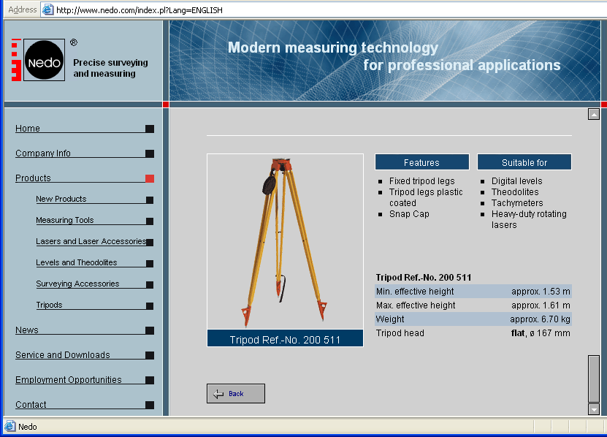
Notes:
There are many vendors that supply rigid leg tripods. Here are some examples.
Tripod . To ensure a stable platform for the instrument, the tripod on which it is mounted must be strong and rigid. It should be constructed of a material that is affected very little by temperature change. To provide stability in various types of soil, the feet of the tripod should have tapered metal shoes with projections that permit them to be pushed into the ground. The legs should be of sufficient length to allow the observer to stand erect. For a given observer this means that the length necessary depends upon the location of the instrument eyepiece, which can vary considerably from instrument to instrument.
NOAA Manual NOS NGS 3, Geodetic Leveling; 3.3 Leveling Instruments; 3.3.5 Use and Maintenance

Slide 44
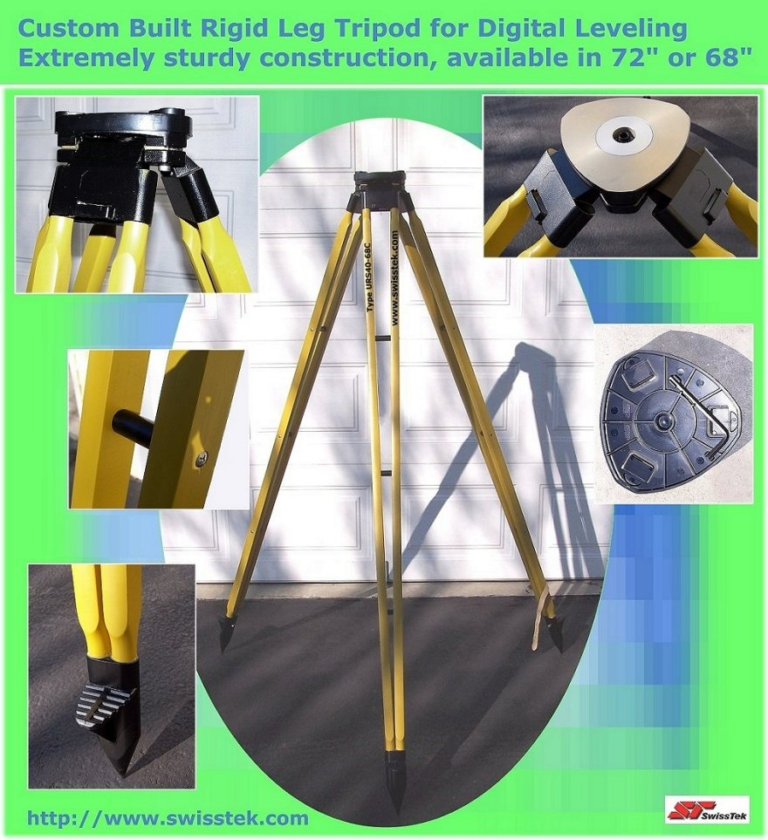
SuperTripod.com
Rigid leg tripod, available in four models: 68" and 72" inches in height, with fixed center head or slide head. Made of hardwood ash, grown and made in Europe.
NOAA commissioned.
Notes:
There are many vendors that supply rigid leg tripods. Here are some examples.
Tripod . To ensure a stable platform for the instrument, the tripod on which it is mounted must be strong and rigid. It should be constructed of a material that is affected very little by temperature change. To provide stability in various types of soil, the feet of the tripod should have tapered metal shoes with projections that permit them to be pushed into the ground. The legs should be of sufficient length to allow the observer to stand erect. For a given observer this means that the length necessary depends upon the location of the instrument eyepiece, which can vary considerably from instrument to instrument.
NOAA Manual NOS NGS 3, Geodetic Leveling; 3.3 Leveling Instruments; 3.3.5 Use and Maintenance

Slide 45
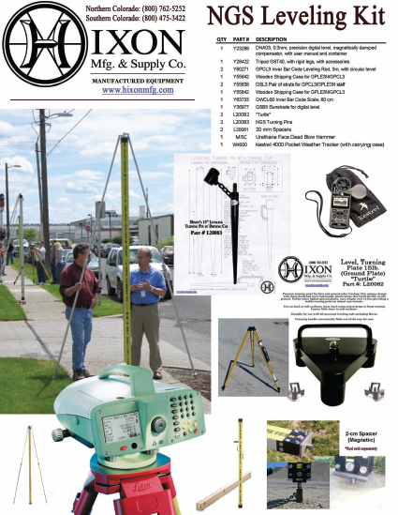
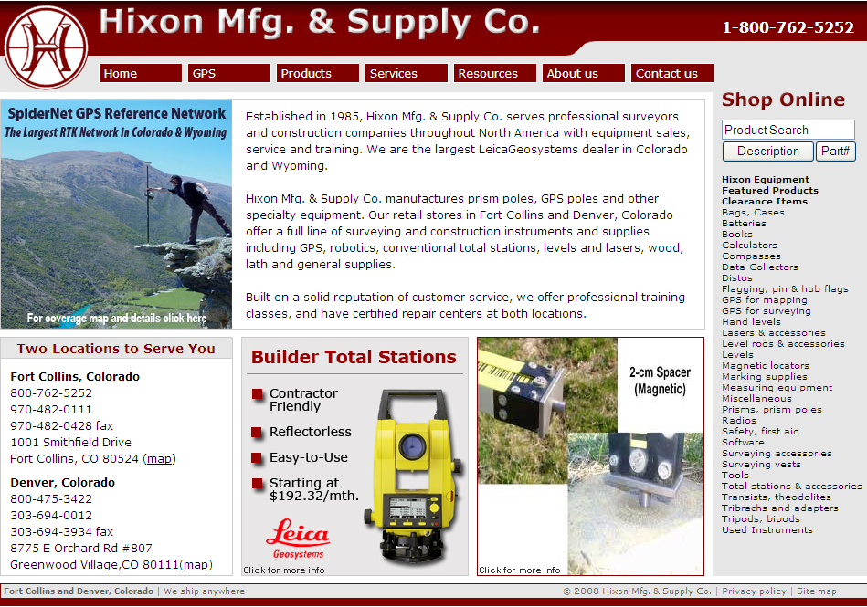
http://www.hixonmfg.com/
Notes:
As an example, Hixon Manufacturing supplies many of the leveling support items such as hammers and turning pins, turning plates, spacer plugs, Invar strip index, and other items as part of their advertised “NGS Leveling Kit.”
http://www.hixonmfg.com/

Slide 46
VIDEOS
Tri Pod Care and, Maintenance
Tri Pod Set Up
Notes:
Example of driving a stainless-steel turning pin into the ground with the Urethane faced dead-blow hammer.
This example illustrates using both hands for this process but it is possible to hold the rod on your shoulder with one hand while using the other to set the pin.
When using two hands to set the turning pin, as illustrated, place the rod flat on the ground (not pictured) with the Invar side facing up and not touching the ground.
Turning pin. To set a turning pin, place the driving cap over the high point and use a 2-kg (4 lb) hammer to drive the pin into the ground. The faces of the hammer should be made of replaceable soft plastic, to prevent damage to
the driving cap. Do not hold the hammer with its head crossways when hammering, since this may damage the
metal part of the head and make replacement of the faces difficult. Drive the pin straight, not at an angle, until the driving shoulder is within 5 cm (2 in) of the ground. If the pin is set at an angle, or not driven deeply enough, it is more likely to rebound or settle. After setting the pin, remove the driving cap and carefully place the rod on the high point.
NOAA Manual NOS NGS 3, Geodetic Leveling; 3.5 Turning Points; 3.5.1 Selection and Use

Slide 47
Precise Digital Leveling
Section 3
Collimation Check and Field Notes
Notes:
‹#›

Slide 48


Collimation Check
C-Check
Peg Test

Slide 49
Collimation Check
Allow instrument and rods to acclimate prior to performing the collimation and/or leveling (allow equipment to adjust to the working environment for 10 minutes or more)
Perform Collimation Check on level ground at the work site in the work environment
Perform a Collimation Check at the beginning of every day that geodetic leveling is performed or when the level is jarred or any time there is a question about the instrument
Notes:
A collimation check is required at the beginning of each work day. Under field conditions the collimation error of a leveling instrument is measured by obtaining a set of observations called a collimation check (“C-shot” or “peg test”). Collimation error is limited by adjustment of the instrument.
Because the adjustment can change easily under field conditions, thus changing the collimation error, make the collimation check at least once a day. In addition, make the check any time the instrument sustains a severe shock or seems to function abnormally.
The collimation check has two purposes: to prove that the instrument is properly adjusted within the standard of accuracy required for the survey, and to provide a collimation factor with which to correct data from unbalanced setups.
Apply the daily collimation determination to all subsequent digital leveling data – a process that is easily set in the instrument. Record the daily collimation error on the back-up recording log.

Slide 50
Collimation Check (continued)
Perform a Collimation Check whenever the ambient temperature changes more than 10 degrees Celsius during the course of leveling during the day
Remove parallax and sharply focus the instrument and ensure all circular levels are in adjustment
Apply collimation to all future measurements (also note in digital data files that this correction has been applied to all measurements)
Record collimation (arc-seconds) on Backup Recording Sheet
Notes:
‹#›
Typically, the equipment will acclimate while the crew is getting ready for the day’s work. Once you arrive at the work site, get the equipment out of the truck, place the rods in a safe location and set up the instrument on the tripod. Pace out the required distances for the collimation check and setup the equipment. Unless there has been a dramatic change in temperatures from where the equipment was stored to where the work will be performed this should be adequate time for acclimation.
Make a collimation check on uniformly flat ground. The slope should be no more than 2 percent.
Make a collimation check at the beginning of each day’s observations. Because the adjustment can change easily under field conditions, thus changing the collimation error, make the collimation check at least once a day. In addition, make the check any time the instrument sustains a severe shock or seems to function abnormally.
Make another collimation check during any day’s observations if the ambient temperature changes more than 10 degrees Celsius (50 degrees Fahrenheit). An example would be where you start work on a cool morning and after the lunch break it’s become quite warm.
Make sure the circular levels on the instrument and rods are properly adjusted.
Apply the daily collimation determination to all subsequent digital leveling data – a process that is easily set in the instrument. Record the daily collimation error on the back-up recording log.

Slide 51
Collimation Check - Kukkamaki Method
A x B x
Rod A
Rod B
Instrument
Position 1
Instrument
Position 2
10 m
10 m
20 m
Notes:
‹#›
The NGS preferred collimation check is the Kukkamaki or “AxBx” method. (The “A” and “B” denote rod positions and the “x” denotes instrument positions)
First, mark out the instrument/rod positions providing the distances indicated in the diagram. Then set turning points at the two rod positions, A and B. Setup and plumb the number 1 rod at position A and the number 2 rod at position B. Setup the instrument at the first position half way between the rod setups.

Slide 52
Collimation Check - Kukkamaki Method
A x B x
Rod A
Rod B
Instrument
Position 1
10 m
Notes:
‹#›
Using the AxBx collimation check program provided in the instrument and the setups previously described, point and focus on rod 1 (position Rod A). Obtain a measurement following the instrument’s on-screen prompts.
When obtaining this first measurement from this middle position you must ensure you do not measure to the Rod B position by mistake.

Slide 53
Collimation Check - Kukkamaki Method
A x B x
Rod A
Rod B
Instrument
Position 1
10 m
Notes:
‹#›
After the first measurement of the Rod A position has been accepted, turn the instrument and point and focus on rod 2 (position Rod B). The focus should still be sharp and distinct since the distances to the rods in the middle setup are the same. Obtain a measurement following the instrument’s on-screen prompts.
When obtaining this second measurement from this middle position you must ensure you do not inadvertently measure to the Rod A position again.

Slide 54
Collimation Check - Kukkamaki Method
A x B x
Rod A
Rod B
Instrument
Position 2
20 m
Notes:
‹#›
After the measurement of the Rod B position has been accepted, move the instrument to the outside instrument position number 2 and setup the instrument. Point and focus on rod 2 (position Rod B), the closer of the two rods. The focus will not be sharp and distinct since the distances to the rods from this outside position are different. Obtain a measurement following the instrument’s on-screen prompts.

Slide 55
Collimation Check - Kukkamaki Method
A x B x
Rod A
Rod B
Instrument
Position 2
40 m
Notes:
‹#›
After the measurement from the outside of the Rod B position has been accepted, point and focus on rod 1 (position Rod A), the further of the two rods. The focus will not be sharp and distinct when first pointing at the new rod position since the distances to the rods from this outside position are different. Obtain a measurement following the instrument’s on-screen prompts.
When obtaining this second measurement from the outside position you must ensure you do not inadvertently measure to the Rod B position again. The instrument will not mis-measure the wrong rod by itself because the instrument must be clearly in focus to obtain a measurement.
This completes the collimation check – a new collimation error should now be displayed. Apply the daily collimation determination to all subsequent digital leveling data – a process that is easily set in the instrument. Record the daily collimation error on the back-up recording log.

Slide 56
Collimation Check – FÖrstner Method
A x x B
Rod A
Rod B
Instrument
Position 1
Instrument
Position 2
1/3
1/3
1/3
15 m
15 m
15 m
Notes:
‹#›
An alternate and completely acceptable collimation check is the Förstner or “AxxB” method. (The “A” and “B” denote rod positions and the “x” denotes instrument positions)
First, mark out the instrument/rod positions providing the distances indicated in the diagram. Then set turning points at the two rod positions, A and B. Setup and plumb the number 1 rod at position A and the number 2 rod at position B. Setup the instrument at the first position closest to the rod A position which is one third of the total distance between the rod setups.

Slide 57
Collimation Check – FÖrstner Method
A x x B
Rod A
Rod B
Instrument
Position 1
15 m
Notes:
‹#›
Using the AxxB collimation check program provided in the instrument and the setups previously described, point and focus on rod 1 (position Rod A). Obtain a measurement following the instrument’s on-screen prompts.
When obtaining this first measurement from this first position you must ensure you do not measure to the Rod B position by mistake.

Slide 58
Collimation Check – FÖrstner Method
A x x B
Rod A
Rod B
Instrument
Position 1
30 m
Notes:
‹#›
After the first measurement of the Rod A position has been accepted, turn the instrument and point and focus on rod 2 (position Rod B). The focus will not be sharp and distinct since the distances to the rods in the setups are different. Obtain a measurement following the instrument’s on-screen prompts.
When obtaining this second measurement from this first position you must ensure you do not inadvertently remeasure to the Rod A position again.

Slide 59
Collimation Check – FÖrstner Method
A x x B
Rod A
Rod B
Instrument
Position 2
15 m
Notes:
‹#›
After the measurement of the Rod B position has been accepted, move the instrument to the instrument position number 2, which is closer to the rod 2 position and two thirds the distance from rod A to Rod B. Setup the instrument. Point and focus on rod 2 (position Rod B), the closer of the two rods. Obtain a measurement following the instrument’s on-screen prompts.
When obtaining this first measurement from the instrument position 2 you must ensure you do not measure to the Rod A position by mistake.

Slide 60
Collimation Check – FÖrstner Method
A x x B
Rod A
Rod B
Instrument
Position 2
30 m
Notes:
‹#›
After the measurement from the instrument position number 2 of the Rod B position has been accepted, point and focus on rod 1 (position Rod A), the longer of the two rod distances. The focus will not be sharp and distinct when first pointing at the new rod position since the distances to the rods from this instrument position are different. Obtain a measurement following the instrument’s on-screen prompts.
When obtaining this second measurement from the instrument position number 2 you must ensure you do not inadvertently measure to the Rod B position again.
This completes the collimation check – a new collimation error should now be displayed. Apply the daily collimation determination to all subsequent digital leveling data – a process that is easily set in the instrument. Record the daily collimation error on the back-up recording log.

Slide 61
VIDEO
Taking a “C”-Shot
(collimation check)
Notes:
Example of driving a stainless-steel turning pin into the ground with the Urethane faced dead-blow hammer.
This example illustrates using both hands for this process but it is possible to hold the rod on your shoulder with one hand while using the other to set the pin.
When using two hands to set the turning pin, as illustrated, place the rod flat on the ground (not pictured) with the Invar side facing up and not touching the ground.
Turning pin. To set a turning pin, place the driving cap over the high point and use a 2-kg (4 lb) hammer to drive the pin into the ground. The faces of the hammer should be made of replaceable soft plastic, to prevent damage to
the driving cap. Do not hold the hammer with its head crossways when hammering, since this may damage the
metal part of the head and make replacement of the faces difficult. Drive the pin straight, not at an angle, until the driving shoulder is within 5 cm (2 in) of the ground. If the pin is set at an angle, or not driven deeply enough, it is more likely to rebound or settle. After setting the pin, remove the driving cap and carefully place the rod on the high point.
NOAA Manual NOS NGS 3, Geodetic Leveling; 3.5 Turning Points; 3.5.1 Selection and Use

Slide 62
Setup of Leveling, Δh = B – F and S = S_{B} + S_{F}
Rod 1
Rod 2
Backsight
Foresight
B
F
Δh
S_{B}
S_{F}
S
Notes:
‹#›
This is a single setup of leveling. A leveling instrument placed halfway between two leveling rods with precise graduations. The elevation at the beginning point, supporting rod 1, is transferred to the instrument through a measurement at the back rod (backsight) along with a distance (stadia distance) from the rod to the instrument. The elevation is then transferred from the instrument through a measurement at the front rod (foresight) along with a distance (stadia distance) from the instrument to the rod. The imbalance between the backsight and foresight distances must be kept to a minimum. The elevation has then been transferred to the point supporting rod 2.

Slide 63
Section of Leveling
ΔH = Δh₁ + Δh₂ + … + Δh_{n} and S = S₁ + S₂ + … + S_{n}
Rod 1
Rod 1
Rod 2
Rod 2
Rod 1
Δh_{n}
Δh₂
Δh₁
ΔH_{n}
S₁
S₂
S_{n}
S
Notes:
‹#›
A section consists of one or more setups.

Slide 64
Section of Leveling
BM A
TP 1
TP 2
TP 3
TP 4
TP 5
BM B
BM = Bench Mark
TP = Turning Point
Notes:
‹#›
A section is comprised of one or more setups transferring elevation differences from one fixed point, in this case bench mark A, to another fixed point such as bench mark B through a series of temporary turning points.

Slide 65
Accumulated Distance Imbalance
Dbal = (Bd₁ + Bd₂ + ... + B_{n}) – (Fd₁ + Fd₂ + ... +F_{n})
Rod 1
Rod 2
Rod 1
55.7 m
54.5 m
54.3 m
55.0 m
Backsight Distance₁
Foresight Distance₁
Backsight Distance₂
Foresight Distance₂
Bd₁
Fd₁
Bd₂
Fd₂
Setup Length₁ (110.2 m)
Setup Length₂ (109.3 m)
Section Length (219.5 m or 0.22 km)
Example:
Bd₁ = 55.7 m; Fd₁ = 54.5 m Setup Imbalance = +1.2 m (short)
Bd₂ = 54.3 m; Fd₂ = 55.0 m Setup Imbalance = -0.7 m (long)
Section Accumulated Imbalance = +0.5 m (short)
Notes:
‹#›
Geodetic Glossary; leveling line - A unit of field work consisting of bench marks and temporary bench marks connected by chains of differential leveling.

Slide 66
Level Line
BM A
BM B
BM C
BM D
BM = Bench Mark
Notes:
‹#›
Geodetic Glossary; leveling line - A unit of field work consisting of bench marks and temporary bench marks connected by chains of differential leveling.

Slide 67
Level Loop(s)
BM A
BM D
BM B
BM C
BM E
BM F
BM R
BM G
BM Q
BM S
BM H
BM P
BM N
BM M
BM L
BM K
BM J
BM = Bench Mark
= Forward Running
Notes:
‹#›
Level loops consist of multiple level lines forming loops and part(s) of a leveling network. There are three level loops illustrated in this diagram; (1) BM A through BMs B, C, D, R, S, L, M, N, P, and Q closing back to BM A; (2) BM D through BMs E, F, G, H, J, K, L, S and R closing back to BM D; and (3) Starting at BM A and going completely around the perimeter closing back at BM A.
Geodetic Glossary; leveling network - A collection of level lines connected together to form a network of loops or circuits extending over a region. Also called a vertical control network, a vertical network, or a level network.

Slide 68
Level Spur
BM D
BM Z
BM A
BM B
BM C
BM E
BM F
BM G
BM R
BM T
BM S
BM = Bench Mark
= Forward Running
= Backward Running
Notes:
‹#›
Geodetic Glossary; level line spur - (1) A level line that is connected to a leveling network but is neither part of the principal leveling network nor is it part of a loop.
(2) A level line run as a branch from the main level line, either to determine the elevations of bench marks not conveniently reached by the main level line or to connect with tidal or other previously established bench marks. The spur is used for obtaining checks on old leveling either at the beginning or end of a line of levels or at intermediate junctions along the new line of levels.
A branching level line that is run from a bench mark on a spur line is called a double-spur line or a double-spur. Similarly, a branching level line that is run from a bench mark on a double-spur line is called a triple-spur line, and so on.

Slide 69
Single Run
BM A
BM B
BM C
BM = Bench Mark
= One Way Leveling
Notes:
‹#›
.
This is a “single run”. Leveling is performed in only one direction (forward).

Slide 70
Double Run
BM A
BM B
BM C
BM = Bench Mark
= Forward Running
= Backward Running
Notes:
‹#›
This is a “double run”. Leveling is performed in both directions (forward and reverse).

Slide 71
VIDEO
Running a Section
Notes:
Example of driving a stainless-steel turning pin into the ground with the Urethane faced dead-blow hammer.
This example illustrates using both hands for this process but it is possible to hold the rod on your shoulder with one hand while using the other to set the pin.
When using two hands to set the turning pin, as illustrated, place the rod flat on the ground (not pictured) with the Invar side facing up and not touching the ground.
Turning pin. To set a turning pin, place the driving cap over the high point and use a 2-kg (4 lb) hammer to drive the pin into the ground. The faces of the hammer should be made of replaceable soft plastic, to prevent damage to
the driving cap. Do not hold the hammer with its head crossways when hammering, since this may damage the
metal part of the head and make replacement of the faces difficult. Drive the pin straight, not at an angle, until the driving shoulder is within 5 cm (2 in) of the ground. If the pin is set at an angle, or not driven deeply enough, it is more likely to rebound or settle. After setting the pin, remove the driving cap and carefully place the rod on the high point.
NOAA Manual NOS NGS 3, Geodetic Leveling; 3.5 Turning Points; 3.5.1 Selection and Use

Slide 72

Observing Guides and Field Notes
Notes:
‹#›
This is an example of a Precise Digital Leveling backup recording form.
Back-up recording forms that capture required information in support of the NGS “Blue Book” process have also been developed for the various digital leveling systems. These forms, which are in digital format, can be easily modified or partially filled-in with common data such as project information and equipment serial numbers to facilitate field data collection. The format is intended to support the field data collection process providing tips such as “code” and “info block” or “remarks” at appropriate places and in order of data collection.
All support data collection recorded on the backup recording sheets in the field are required in the “Blue Book” process and are editable fields in the leveling data processing back in the office.
THIS INFORMATION IS CRITICAL META DATA, REQUIRED FOR YOUR LEVELING PROJECT!!
THIS IS THE ONLY PLACE TO CHECK/VERIFY/CORRECT INFORMATION ENTERED INTO THE INSTRUMENT DURING FIELD WORK (AND WHAT WILL BE USED IN THE WINDESC AND TRANSLEV SOFTWARE)!!

Slide 73

Notes:
Observing guidelines for digital leveling systems have been developed to streamline field data collection in support of the NGS “Blue Book” process and Translev software.
‹#›

Slide 74
Required Leveling Notes
Entered at the beginning of the day
Or for change in observer, or instrumentation
Entered at the beginning of a section
Temperature readings inserted after each set-up
For recording gradient temperatures
Entered at the end of a section
Entered at the end of day
Or for change of observer or equipment
Notes:
The required leveling notes and temperature readings are to be entered as indicated
‹#›

Slide 75
Required LEVEL NOTES
Beginning of Day or Change in Observer/Instrument Type
Date (mmddyy)
Observer’s Number (1, 2, 3, etc – observer specific for project)
Instrument Type (DNA03, DL101C, DINI12, etc)
Temperature Code (0 for Celsius or 1 for Fahrenheit)
Equipment Used
Instrument Serial Number (like 90810)
Collimation Check Error in Arc Seconds
Rod 1 Serial Number (like 25458)
Rod 2 Serial Number (like 25534)
Notes:
These are the required leveling notes to be entered.
‹#›

Slide 76
Required Notes Entered Per Section
Start of Leveling Section
Start Time (hhmm, 24 hour local)
Rod on Mark (1 or 2)
Starting Temperature at Instrument
Wind and Sun Code
Temperature Gradient
(Recorded in instrument only - after each complete BF setup)
Info 1 Lower Probe (decimal or no decimal by instrument type)
Info 2 Upper Probe (decimal or no decimal by instrument type)
Notes:
Certain elements are required to support level observations for the “Blue Book” process. Information is required at the beginning of each section, during the section and at the end of each section. This specific required information is independent of the various manufacturer types of leveling systems.
‹#›

Slide 77
Required Notes at End of Leveling Section
Ending Time (hhmm, 24 hour local)
Rod on Mark (1 or 2 – should be the same as starting)
Ending Temperature at Instrument
Wind & Sun Code (00 = Calm/Cloudy; 02 = Calm/Sunny, etc.)
Wind Code:
0 – Calm Wind speed averaged less than 6 mph during section
1 – Breezy Wind speed averaged 6 to 15 mph during section
2 – Windy Wind speed averaged greater than 15 mph during section
Sun Code:
0 – Cloudy Less than 25% of setups are performed in sunny conditions
1 – Partly Cloudy 25 to 75% of setups are performed in sunny conditions
2 – Sunny More than 75 % of setups are performed in sunny conditions
9999 End of Day or Change of Observer or Change of Equipment
Notes:
Certain elements are required to support level observations for the “Blue Book” process. Information is required at the beginning of each day’s observations or if there is a change in observer or piece of equipment. This specific required information is independent of the various manufacturer types of leveling systems.
‹#›

Slide 78

Sample Backup
Recording Sheet
Notes:
Leica sample backup recording sheet.
‹#›

Slide 79

F = -13.23456 m
B = +13.23750 m
+ 0.00294 m
Allowable
Section Closure
1st Order, Class II
4√1.47782 = 4.86262 mm
2nd Order, Class I
6√1.47782 = 7.29393 mm
Notes:
This slide/form shows calculations for 1st Order, Class II and 2nd Order, Class I allowable closures.
‹#›

Slide 80
Precise Digital Leveling
Section 7
Wrap-up and Bench Mark Resets
Notes:
‹#›

Slide 81
Leveling Tips
Follow safety protocols - Watch for moving vehicles!
Slow or no readings? Reduce sight lengths for:
  Heat shimmer (scintillation)
  Instrument vibration due to wind
  Standard deviation won’t come down
  Dappled light on rod(s)
Carry instrument upright between setups
Check rods’ and instrument’s circular levels weekly or after receiving abnormal bump or shock
Minimize latency between backsight and foresight
Do not leave the instrument setup unattended
Do not let thermistors or level get wet
Notes:
Review of important issues and reminders to perform precise geodetic leveling.
Never observe one rod until the other is set up, or nearly set up.

Slide 82
Leveling Tips (continued)
Cross pavement (roadway) at right angles to minimize uneven sight conditions
Clearly focus level instrument before measurement
Stabilize both turning points and tripod every setup
Never read below 0.5 meters on rod
Ensure upper stadia crosshair is not above Invar when reading near the top of the rod
Maintain tight setup imbalances
Don’t point the instrument into the sun
Orchestrate setups so instrument is not pointing into low sun angle
Notes:
Review of important issues and reminders to perform precise geodetic leveling.

Slide 83
Leveling Tips (continued)
DO NOT DROP RODS!!
Keep one hand on rod at all times
Keep rod faces clean – do not touch Invar
Always protect base of rod – keep off ground
Never setup rod or instrument on asphalt
Turn rod to change shadows if measurement fails
Rod person calls out BM designation for check
Start and end with the same rod on mark
Backsight rod person does not move until foresight has been recorded and observer directs
Notes:
Review of important issues and reminders to perform precise geodetic leveling.
‹#›

Slide 84
Leveling Tips (continued)
Make sure base of rod is directly on the turning point or BM, not on centering guide
Be aware of your surroundings carrying rod
Spacer must have a backsight and a foresight
Do not forget to retrieve spacer after setup
Double run all required sections
Plan reverse leveling during a different time of day from the first level run
Place visible mark on rod to indicate 0.5 m
Notes:
Review of important issues and reminders to perform precise geodetic leveling.
‹#›

Slide 85


Slide 86


Slide 87


Slide 88



3rd Order Reset
Notes:
The purpose of these guidelines is to provide the necessary information to preserve elevation data for a soon-to-be
disturbed or soon-to-be destroyed bench mark.
Each vertical control bench mark represents a large investment of resources. Since it is intended for a bench mark to provide a continuous record of elevation changes, as well as vertical control for many local surveyors, its preservation is vital. Although bench marks are constructed in locations where they are less likely to be disturbed, many are disturbed or destroyed by: highway rebuilding and retrofitting; railroad maintenance; urban development; addition of buried utilities; and building construction and demolition.
http://www.ngs.noaa.gov/heightmod/Leveling/Manuals/Benchmark_9_13_07.pdf
‹#›

Slide 89



Method 1
Direct Old to New Mark
Elevation Transfer
Method 2
Reference Points to “Hold”
Elevation Prior to Transfer
Tolerances
Notes:
‹#›

