Slide 1


Precise Digital Leveling
Day 1
March 16, 2020
Charlie Geoghegan, Trainer
NGS Testing and Training Center
Charles.Geoghegan@noaa.gov
Notes:
Precision Digital Leveling is a 1, 2, or 3 day seminar detailing the intricacies of geodetic leveling procedures developed by the National Geodetic Survey with emphasis on precise digital/barcode levels and support equipment. The seminar provides an overview of the geodetic leveling process including discussion of corrections applied to leveling, the FGCS specifications and procedures for electronic digital/barcode leveling systems, required equipment, project reconnaissance, bench mark requirements and monumentation, field data collection, review, reduction, and “blue book” preparation for inclusion into the NGS National Spatial Reference System.
1

Slide 2
Day 1
Part 1 – Introduction to Geodetic Leveling
Part 2 – Vertical Datums
Part 3 – Leveling Specifications
Part 4 – Geodesy and Corrections for Leveling

Slide 3
Precise Digital Leveling
Part 1
Introduction to Geodetic Leveling
Notes:
Precision Digital Leveling is a 1, 2, or 3 day seminar detailing the intricacies of geodetic leveling procedures developed by the National Geodetic Survey with emphasis on precise digital/bar-code levels and support equipment and how geodetic leveling is an integral part of Height Modernization. The seminar provides an overview of the geodetic leveling process including discussion of corrections applied to leveling, the FGCS specifications and procedures for electronic digital/bar-code leveling systems, required equipment, project reconnaissance, bench mark requirements and monumentation, field data collection, review, reduction, and “blue book” preparation for inclusion into the NGS National Spatial Reference System.

Slide 4
History of Geodetic Leveling in the U.S.
U.S. Coast and Geodetic Survey
U.S. Geological Survey
U.S. Army Corps of Engineers (Lake Surveys)
Railroads, States, other agencies and organizations
Notes:
4
Geodetic leveling seems to have been started by the U.S. Coast Survey in 1856 along the Hudson River. The U.S. Lake Survey (Corps of Engineers) began geodetic leveling in 1875, based on the Coast Survey leveling of 1856. The Coast Survey commenced the Transcontinental Leveling at Hagerstown, Md., in 1877. Geodetic leveling was taken up by the U.S. Geological Survey in 1884, with a loop from Morehead City, N.C., inland to Knoxville and Chattanooga, Tenn., and back to Brunswick, Ga. The first general adjustment of the geodetic leveling network in the United States was made in 1900, containing links by the U.S. Coast and Geodetic Survey, U.S. Army Corps of Engineers, U.S. Geological Survey, and several railroads. Other adjustments were made in 1903, 1907, 1912, 1929, the last of which defined the National Geodetic Vertical Datum of 1929 (NGVD29).
-
By RALPH MOORE BERRY
Assistant to Director, National Geodetic Survey
National Ocean Survey, NOAA
Reprinted from SURVEYING AND MAPPING.* June, 1976

Slide 5
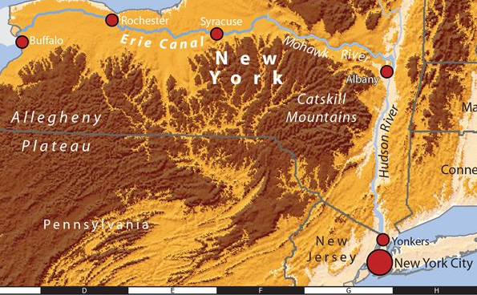
First “precise” leveling
Notes:
The first “precise” levels - U.S. Coast Survey in 1856-1857 instructed G. B. Vose to run a line of levels in connection with a detailed study of the tides and currents in New York Bay and the Hudson River. A series of tide gauges were established along the Hudson River from New York to Albany, and all were interconnected by the line of levels run by Mr. Vose. As a product of this operation, the important bench mark GRISTMILL was established. This bench mark provided the mean sea level datum to which subsequent levelings by the U.S. Lake Survey (replaced now by IGLD) were referred in determining elevations of the water surfaces in the Great Lakes.
5

Slide 6
Evolution and Refinement of Geodetic Leveling
500 km (~300 mi) first-order, at one standard deviation:
<1901 ~ 56 mm
1901 – 1916 ~ 48 mm
1917 – 1955 ~ 34 mm
1956 – 1974 ~ 22 mm
1974> ~ 11 mm (class 1)
Notes:
6
Geodetic leveling now consists of several orders and classes. Each one was developed to serve a particular need or group of needs. The higher the order and, in general, the more recent the leveling, the greater the precision. In 1984, the Federal Geodetic Control Committee (FGCC) published Standards and Specifications and then later. When it became apparent that digital levels were a viable option for precise leveling, the Federal Geodetic Control Subcommittee (FGCS) published the latest version of Specifications and Procedures to Incorporate Electronic Digital/Bar-Code Leveling Systems in 2004. These two publications define leveling orders and classes. They are designed to achieve maximum precision in new leveling at reasonable cost.

Slide 7
What is Geodetic Leveling
And how is it different from other leveling?
Notes:
7
Geodetic leveling has been defined as ". . . leveling of a high order of accuracy,
usually extended over large areas, to furnish accurate vertical control . . . for all surveying and mapping operations." There are two important considerations involved in this definition, "high order of accuracy" and extension "over large areas."
High order of accuracy (to be carefully distinguished from precision) is to be achieved only by use of a combination of a carefully designed and precisely constructed set of instruments (level and rods), used by a knowledgeable and conscientious personnel, in accordance with a proper observing routine, together with a data reduction system that applies appropriate corrections for all the physical and environmental situations that may affect the condition and/or calibration parameters of the instruments and observing conditions.

Slide 8
Geodetic leveling has been defined as
". . . leveling of a high order of accuracy,
usually extended over large areas, to furnish accurate vertical control . . . for all surveying and mapping operations."
Notes:
8
Geodetic leveling has been defined as ". . . leveling of a high order of accuracy,
usually extended over large areas, to furnish accurate vertical control . . . for all surveying and mapping operations.“
There are two important considerations involved in this definition, "high order of accuracy" and extension "over large areas."
High order of accuracy (to be carefully distinguished from precision) is to be achieved only by use of a combination of a carefully designed and precisely constructed set of instruments (level and rods), used by a knowledgeable and conscientious personnel, in accordance with a proper observing routine, together with a data reduction system that applies appropriate corrections for all the physical and environmental situations that may affect the condition and/or calibration parameters of the instruments and observing conditions.

Slide 9
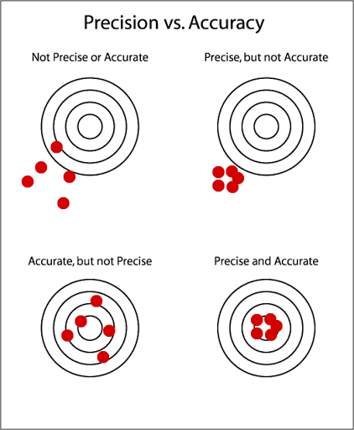
Precision
Vs.
Accuracy
“True” value
Notes:
9
As surveyors we strive for both accuracy and precision. In the surveying profession, these words have different meanings. “Accuracy” refers to how closely a measurement or observation comes to measuring the “truth." since measurements and observations are always subject to error. “Precision” refers to how closely repeated measurements or observations come to duplicating measured or observed values.

Slide 10
How is geodetic leveling different?
Equipment
Procedures
Applied Corrections
Notes:
10

Slide 11
Equipment & Procedures
Rod 1
Rod 2
Backsight
Foresight
B
F
Δh
S_{B}
S_{F}
S
Notes:
11
Equipment:
Precise level instruments (digital)
Calibrated single-piece invar rods
Specially designed turning pins and plates
Procedures:
FGCC/FGCS specifications
NOAA Manual NOS NGS 3 Geodetic Leveling (1981) discusses:
Attention to detail
Double running
Loop closures
Error sources and corrections

Slide 12
Error Sources and Corrections
Blunders
Systematic Errors
Random Errors
Notes:
12
Leveling precision is a function of the nature and magnitude of the errors associated with the individual measurements. We have to consider error sources and their control.
Recognized errors associated with geodetic leveling range from those that are trivial and can be easily controlled, through those that can be virtually eliminated through meticulous adherence to field and laboratory procedures, to those whose nature is so complex that they continue to cause concern. Leveling errors are usually categorized as blunders, systematic errors, and random errors.
Procedures make blunders generally easy to detect
Forward and backward runnings made with a pair of leveling rods used alternately for foresight and backsight.
Systematic errors tend to accumulate in proportion to (1) distance and (2) height or height gradient and may become very large over relatively short distances. It is the recognition or suspicion of these potentially large errors that has dictated many of the procedural requirements stipulated for geodetic leveling

Slide 13
Corrections
Orthometric
Rod Scale
Rod Temperature
Collimation
Refraction
Astronomic
Notes:
13
Orthometric heights (observed ht. diff. combined with surface gravity = geopotential ht. diff., converted to orthometric hts.)

Slide 14
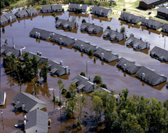
Heights Matter!
Notes:
14
An example of the need for height modernization. Several states, along with North Carolina, have launched major efforts to update vertical positions with height modernization. On September 15, 1999, Hurricane Floyd dropped 21 inches of rain on North Carolina, damaging more than 67,000 homes and destroying nearly 8,000. Many of the homeowners did not have flood insurance, because their residences were built on land that had not been designated as flood prone on the Federal Emergency Management Agency’s (FEMA) Flood Insurance Rate Maps (FIRMs).

Slide 15
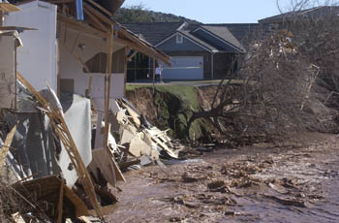
Southern Utah Flooding 1/12/2005
DESCRIPTION: The Santa Clara River flows past destroyed homes and a fallen tree in the Creek side subdivision Wednesday in St. George. Seven homes in the subdivision were completely lost to the river and at least another four were severely damaged by this week's flooding. CREDITS: Jud Burkett COPYRIGHT: The Spectrum
Notes:
15
DESCRIPTION: The Santa Clara River flows past destroyed homes and a fallen tree in the Creek side subdivision Wednesday in St. George, Utah. Seven homes in the subdivision were completely lost to the river and at least another four were severely damaged by this flooding.
Note: Even though the homes were not identified in the flood zone – base elevation at a potential water level – the severe undercutting of the bank caused by the expanded flood waters created this hazardous situation.
CREDITS: Jud Burkett COPYRIGHT: The Spectrum

Slide 16
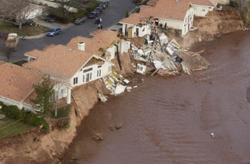
Southern Utah Flooding 1/12/2005
DESCRIPTION: A row of damaged homes in Riverwood subdivision cling to the banks of the Santa Clara River Thursday in St. George. CREDITS: Jud Burkett COPYRIGHT: The Spectrum
Notes:
16
DESCRIPTION: A row of damaged homes in Riverwood subdivision cling to the banks of the Santa Clara River Thursday in St. George, Utah.
CREDITS: Jud Burkett COPYRIGHT: The Spectrum

Slide 17
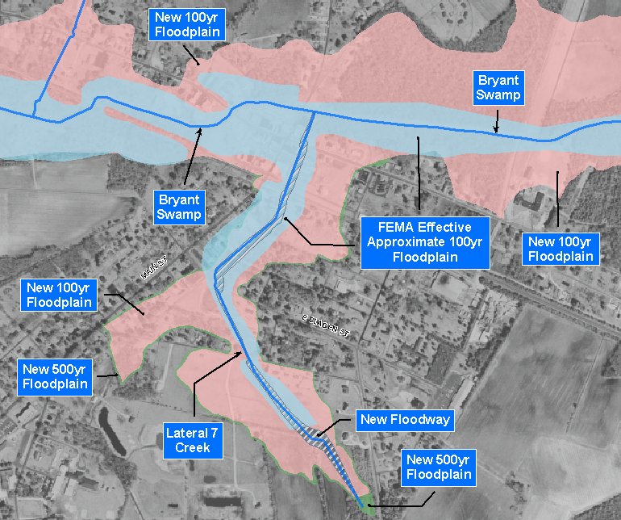
North Carolina Floodplain Mapping
2002 Detail Mapping vs. Effective Approximate Mapping
Notes:
17
Benefits of modernized heights: Sample of “effective approximate 100 year floodplain mapping” (in blue) versus new floodplain map (in red) and new 500 year floodplain map (in green).
Some homes identified in “effective approximate 100 year floodplain mapping” (in blue) are potentially paying expensive flood insurance when in fact they are not in a flood zone as indicated in the new floodplain map (in red). Also quite a few homes are now shown to be in flood prone areas where they were not in the “effective approximate 100 year floodplain mapping” (in blue) so they were not paying flood insurance, but should have been.

Slide 18
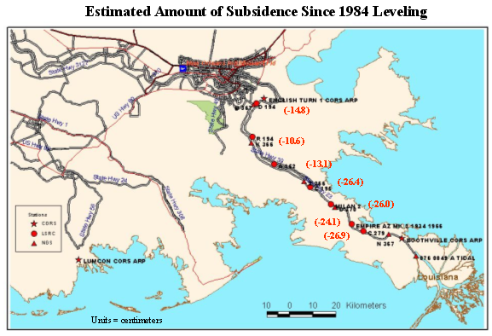
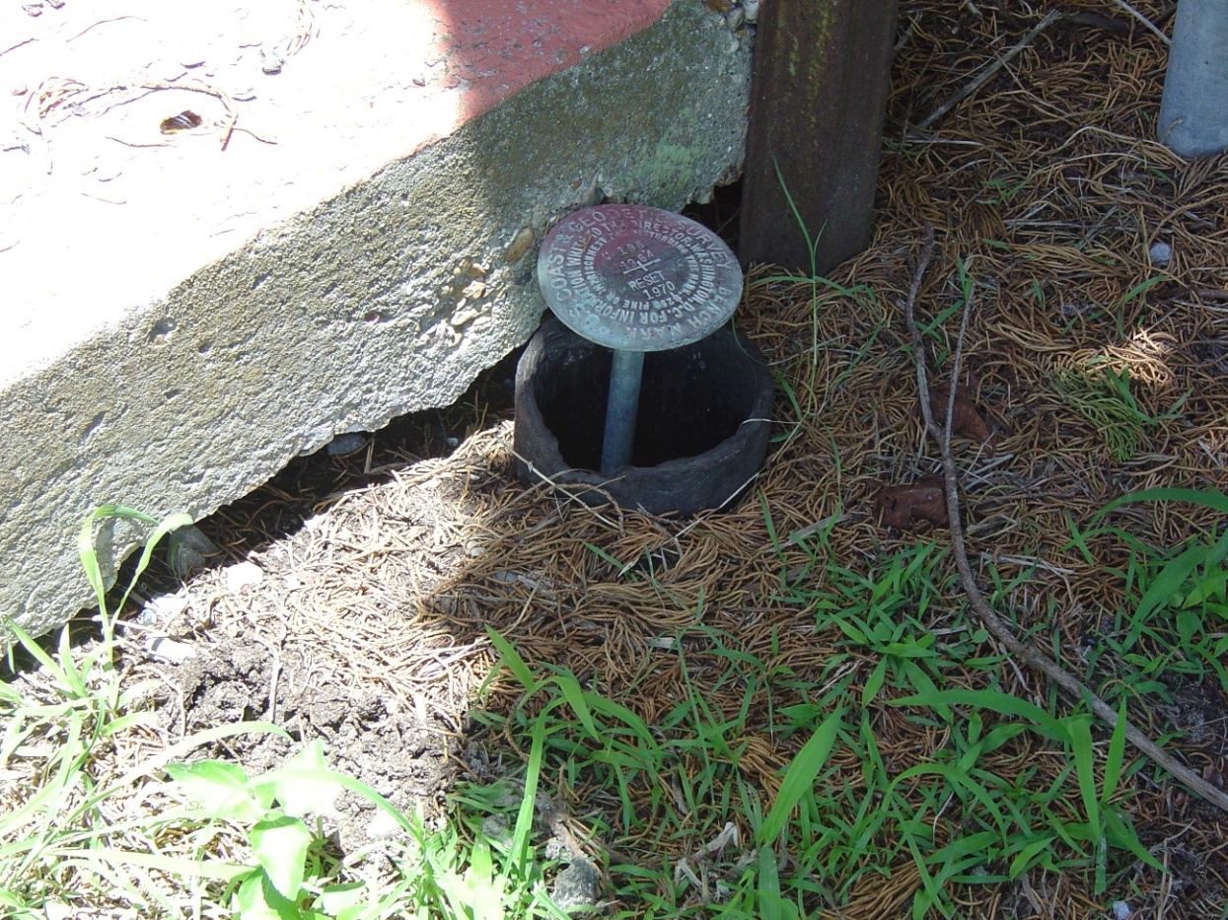
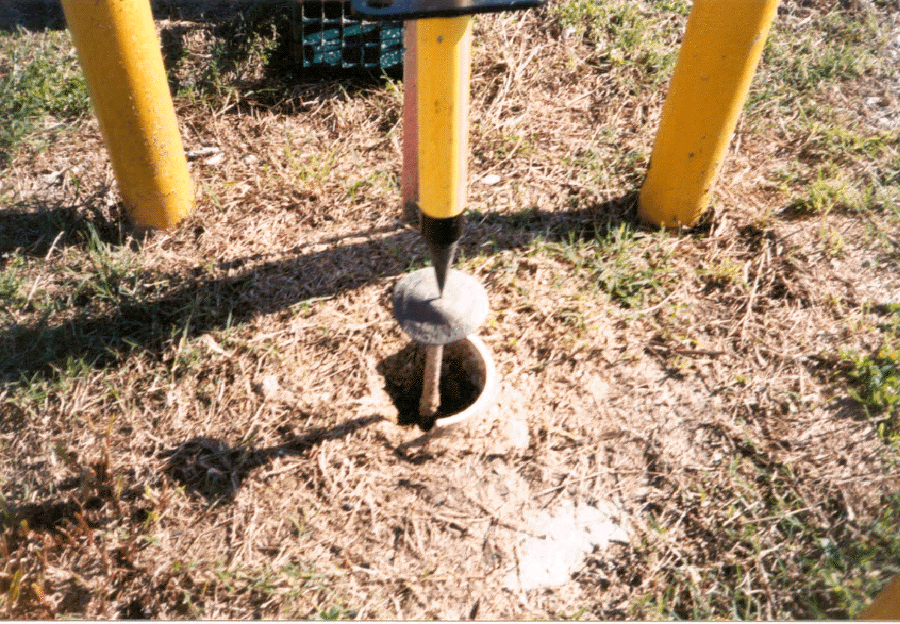
Subsidence
Areas
Questionable
Elevation Data
Notes:
18
Speaking of valid elevations, would you expect monuments looking like these rod marks which were originally set 4 inches below the top of the surrounding pipe to still have a valid elevation even though NGS still publishes it to millimeters?
The answer is NO! The elevations on these marks in a subsidence area are wrong by as much as 2 feet.

Slide 19
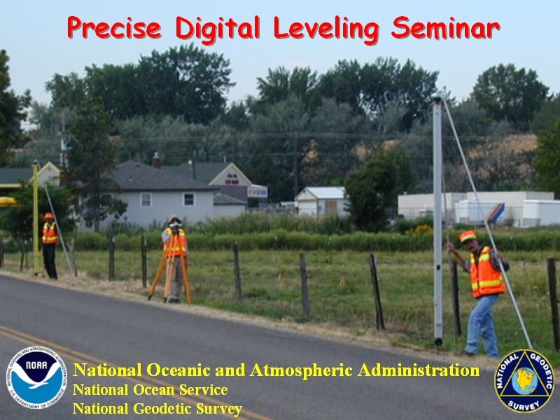
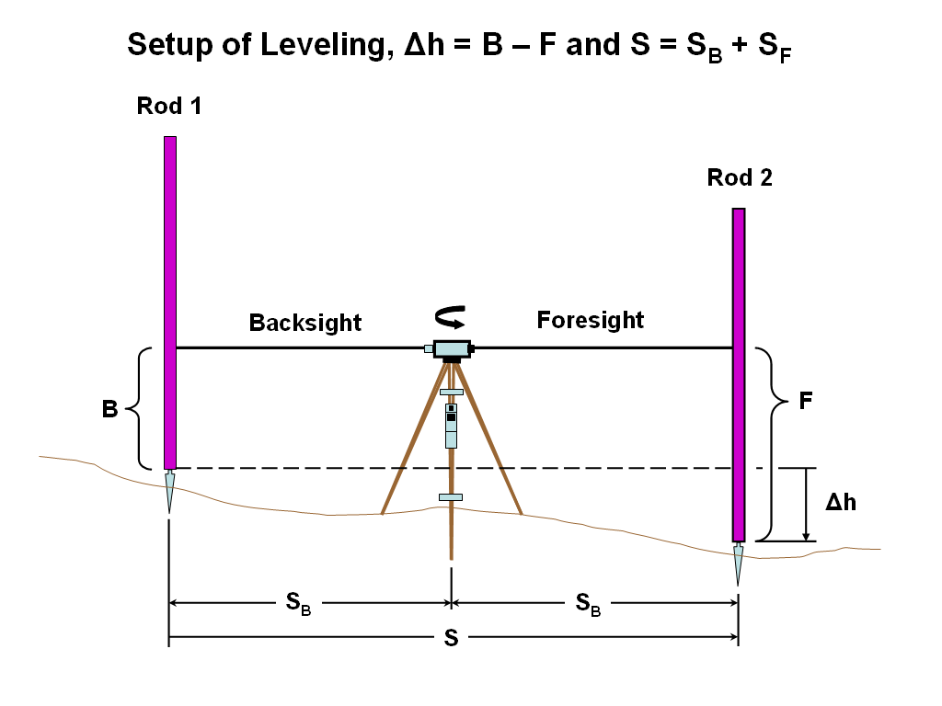
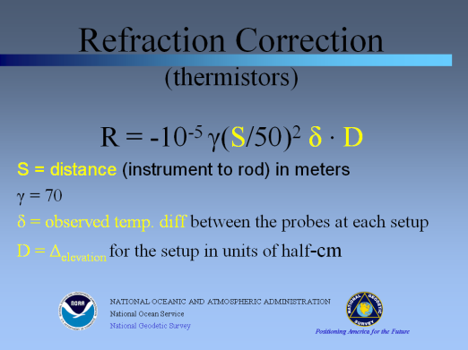
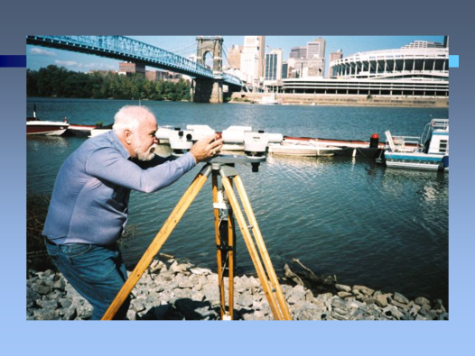
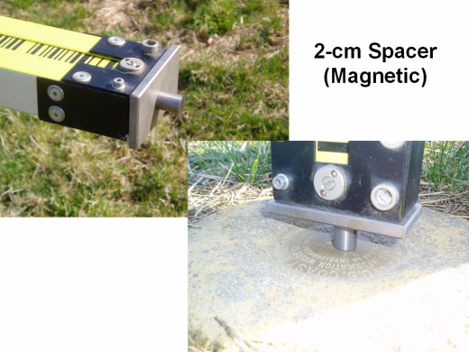
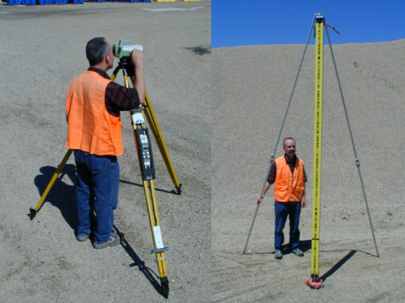
Notes:
19
This presentation is designed to cover the required elements to support contract SOW for geodetic leveling.
Precision Digital Leveling is a 1-day (8 hour) seminar detailing the intricacies of geodetic leveling procedures developed by the National Geodetic Survey with emphasis on precise digital/bar-code levels and support equipment and how geodetic leveling is an integral part of Height Modernization. The seminar provides an overview of the geodetic leveling process including discussion of corrections applied to leveling, the FGCS specifications and procedures for electronic digital/bar-code leveling systems, required equipment, project reconnaissance, bench mark requirements and monumentation, field data collection, review, reduction, and “blue book” preparation for inclusion into the NGS National Spatial Reference System.

Slide 20
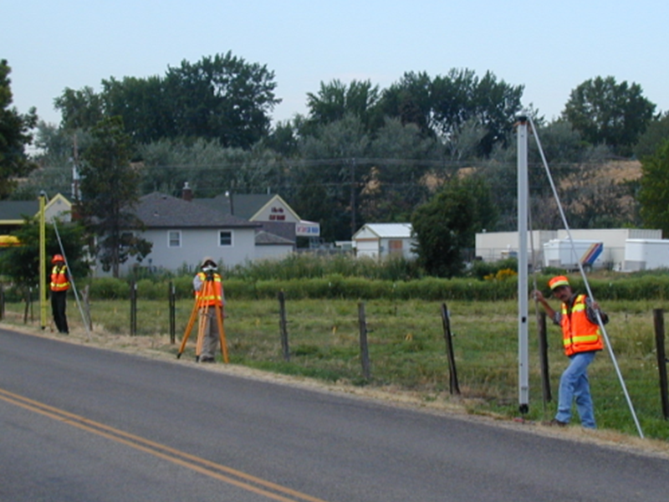
Level Unit
One Observer
Two Rod Persons
Notes:
20
One of the apparent benefits of the electronic digital/bar-code leveling system is the ability of the instrument to record the setup observations internally eliminating the need for an additional recorder.
For production geodetic leveling a minimum sized crew would require three people; an instrument operator and two people maintaining the rods and turning points.

Slide 21
Typical Level Unit
One Observer (Instrument Person)*
Two Rod People*
One or Two Vehicles
  One capable of transporting equipment – rods*
  Drop one vehicle at end of day’s work
Safety People if Necessary
  Warning Person to drive behind crew
One Pacer to Help with Setups
Computer to Download and Process Data*
* Required
Notes:
21
Consider required support staff when proposing and planning geodetic leveling projects.
There are more than just “3” people needed to successfully accomplish higher order geodetic leveling.

Slide 22
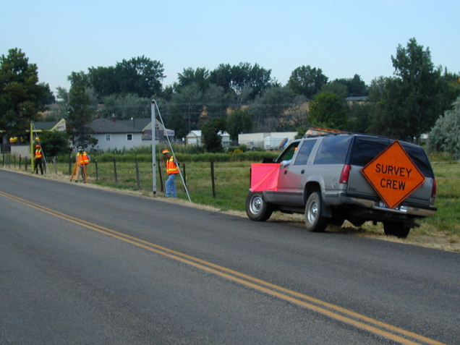
Level Unit
One Observer
Two Rod Persons
+ Support Personnel
Notes:
22
For production geodetic leveling a minimum sized crew would require three people; an instrument operator and two people maintaining the rods and turning points.
Don’t forget support personnel when considering cost estimates for geodetic leveling especially safety personnel.

Slide 23
Setup of Leveling, Δh = B – F and S = S_{B} + S_{F}
Rod 1
Rod 2
Backsight
Foresight
B
F
Δh
S_{B}
S_{F}
S
Notes:
23
Leveling; a “simple” form of surveying - transferring elevation differences through a series of backsight minus foresight measurements.
Geodetic Glossary: Leveling - Leveling between two points relatively close to each other (within 2-3 meters vertically, and less than 100 meters horizontally) is done by holding a graduated leveling rod vertically at each point and reading, with a horizontal telescope placed midway between the two points, the place where each rod intersects the horizontal plane established by the telescope's line of sight. The difference in readings is, approximately, the difference in elevation. If the points are farther apart than the distances mentioned above, measurements are made at shorter distance intervals and the total difference in elevation is taken as the sum of the resulting smaller measured differences. The elevation of a point is determined by proceeding as above, starting at a point that is either on the reference surface or at a previously determined elevation. The desired elevation is called the orthometric elevation; quantities approximating the orthometric elevation and derived from the measurements by applying various kinds of corrections are given special names such as Helmert height, Niethammer elevation, and the like.
This is a single setup of leveling. A leveling instrument placed halfway between two leveling rods with precise graduations. The elevation at the beginning point, supporting rod 1, is transferred to the instrument through a measurement at the back rod (backsight) along with a distance (stadia distance) from the rod to the instrument. The elevation is then transferred from the instrument through a measurement at the front rod (foresight) along with a distance (stadia distance) from the instrument to the rod. The imbalance between the backsight and foresight distances must be kept to a minimum. The elevation has then been transferred to the point supporting rod 2.

Slide 24
Section of Leveling
ΔH = Δh₁ + Δh₂ + … + Δh_{n} and S = S₁ + S₂ + … + S_{n}
Rod 1
Rod 1
Rod 2
Rod 2
Rod 1
Δh_{n}
Δh₂
Δh₁
ΔH_{n}
S₁
S₂
S_{n}
S
Notes:
24
Geodetic Glossary; section - (1) The portion of a level-line that is recorded and abstracted as a unit, and constitutes a self-consistent and self-sufficient set of measurements of differences of elevation. A section always begins and ends on either a temporary or permanent bench mark, whether the mark is part of the main level-line or is on a spur from a level-line. In the case of a spur to a point whose elevation is determined by taking an additional foresight, the section must begin on a temporary or permanent bench mark and end at the point on which the leveling rod was held when the additional foresight was taken. (2) The segment of a leveling line consisting of two neighboring markers connected by a running.
A section consists of one or more setups.

Slide 25
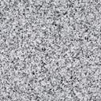
Section of Leveling
BM A
TP 1
TP 2
TP 3
TP 4
TP 5
BM B
BM = Bench Mark
TP = Turning Point
Notes:
25
A section is comprised of one or more setups transferring elevation differences from one fixed point, in this case bench mark A, to another fixed point such as bench mark B through a series of temporary turning points.

Slide 26
Level Line
BM A
BM B
BM C
BM D
BM = Bench Mark
Notes:
26
Geodetic Glossary; leveling line - A unit of field work consisting of bench marks and temporary bench marks connected by chains of differential leveling.

Slide 27
Level Loop(s)
BM A
BM D
BM B
BM C
BM E
BM F
BM R
BM G
BM Q
BM S
BM H
BM P
BM N
BM M
BM L
BM K
BM J
BM = Bench Mark
= Forward Running
Notes:
27
Level loops consist of multiple level lines forming loops and part(s) of a leveling network. There are three level loops illustrated in this diagram; (1) BM A through BMs B, C, D, R, S, L, M, N, P, and Q closing back to BM A; (2) BM D through BMs E, F, G, H, J, K, L, S and R closing back to BM D; and (3) Starting at BM A and going completely around the perimeter closing back at BM A.
Geodetic Glossary; leveling network - A collection of level lines connected together to form a network of loops or circuits extending over a region. Also called a vertical control network, a vertical network, or a level network.

Slide 28
Level Spur
BM D
BM Z
BM A
BM B
BM C
BM E
BM F
BM G
BM R
BM T
BM S
BM = Bench Mark
= Forward Running
= Backward Running
Notes:
28
Geodetic Glossary; level line spur - (1) A level line that is connected to a leveling network but is neither part of the principal leveling network nor is it part of a loop.
(2) A level line run as a branch from the main level line, either to determine the elevations of bench marks not conveniently reached by the main level line or to connect with tidal or other previously established bench marks. The spur is used for obtaining checks on old leveling either at the beginning or end of a line of levels or at intermediate junctions along the new line of levels.
A branching level line that is run from a bench mark on a spur line is called a double-spur line or a double-spur. Similarly, a branching level line that is run from a bench mark on a double-spur line is called a triple-spur line, and so on.

Slide 29
Leveling routes through tidal bench marks to a tide station
Tidal BM
Tidal BM
Bench
Mark
Tidal BM
Tidal BM
Tide
Staff
Tidal BM
BM = Bench Mark
= Forward Running
= Backward Running
Notes:
29
A typical example of a level line spur providing connections to tidal stations and possible vertical control at airports. These situations are quite often remote from path of the level line.
The illustration shows the double-run leveling from the level line to the tide station through a series of tidal bench marks located near and in support of the tide station.

Slide 30
Single Run
BM A
BM B
BM C
BM = Bench Mark
= One Way Leveling
Notes:
30
Geodetic Glossary; leveling, single-run - Leveling done by proceeding from the starting point to the final point of a level line without leveling back to the starting point.
A direction for a level line is indicated in project instructions, such as an example level line L-123456, from Boise, Idaho to Mountain Home, Idaho. All level runnings going east from Boise to Mountain Home would be in the forward direction. All level runnings going west from Mountain Home to Boise would be in the backward direction. This is important in accounting for the numeric signs of the elevation differences.

Slide 31
Double Run
BM A
BM B
BM C
BM = Bench Mark
= Forward Running
= Backward Running
Notes:
31
Geodetic Glossary; leveling, double-run - Leveling done by proceeding from starting point to final point and then returning to the starting point in the opposite direction.
Usually, the same general route is taken on returning as on going out, and points occupied in the morning on the forward part of the journey are occupied in the afternoon on the returning part. This and other precautions are intended either to cancel or to identify systematic errors as well as to reduce random errors.
Important: Double-run everything! Double-run sections are comprised of a forward and a backward direction level run.
FGCS Specifications and Procedures to Incorporate Electronic Digital/Bar-Code Leveling Systems: Double-run leveling may always be used, but single-run leveling procedures can only be used where it can be evaluated using published height values, i.e., the difference in published height values can be substituted for the backward running.
For establishing a height of a new bench mark, double-run procedures must be used. Single-run methods can be used to relevel existing work provided the new work meets the allowable section misclosure.

Slide 32
RM 2
Bench Mark
A
Bench Mark
B
RM 1
Triangulation
Station Mark
Leveling routes through a cluster of control points
at a triangulation station
BM = Bench Mark
= Forward Running
= Backward Running
Notes:
32
Accepted procedure for leveling through closely spaced stations such as those found at triangulation stations with reference marks. The return double-run route would be in the same route, but reversed order.
Note: One must be careful to reverse the exact order of running through these stations or a single-run section could be realized. Example: In the diagram, a reverse running from BM B to RM2 provides a forward and backward double-run. A reverse running from RM 2 to RM 1 only provides a single-run in the backward direction and there may possibly not be a double-run from RM 2 to the triangulation station mark.

Slide 33
Accumulated Distance Imbalance
Dbal = (Bd₁ + Bd₂ + ... + B_{n}) – (Fd₁ + Fd₂ + ... +F_{n})
Rod 1
Rod 2
Rod 1
55.7 m
54.5 m
54.3 m
55.0 m
Backsight Distance₁
Foresight Distance₁
Backsight Distance₂
Foresight Distance₂
Bd₁
Fd₁
Bd₂
Fd₂
Setup Length₁ (110.2 m)
Setup Length₂ (109.3 m)
Section Length (219.5 m or 0.22 km)
Example:
Bd₁ = 55.7 m; Fd₁ = 54.5 m Setup Imbalance = +1.2 m (short)
Bd₂ = 54.3 m; Fd₂ = 55.0 m Setup Imbalance = -0.7 m (long)
Section Accumulated Imbalance = +0.5 m (short)
Notes:
33
As previously noted, many sighting/equipment errors may cancel if a balanced setup is strictly adhered to. A very good practice, and I cannot emphasize this enough, is to maintain a well balanced setup, i.e., same backsight distance from the instrument to the back rod as the foresight distance from the instrument to the fore rod for every setup.
Setup imbalance is determined by subtracting the foresight distance from the backsight distance. Algebraically, if you accrue long foresights the difference will be a negative number and if you accrue short foresights the difference will be a positive number.
It is good practice to work slowly on minimizing/correcting for the overall accumulated imbalance – don’t try to correct for the imbalance in one (the next) setup. If you show you are 2 meters long in the imbalance, try to correct half the difference in the next setup. In the case of being 2 meters long in the accumulated imbalance, setup 1 meter short in the foresight distance on two consecutive setups to apply this correction.

Slide 34
End of Part 1
Questions?
Notes:
34
Orthometric heights (observed ht. diff. combined with surface gravity = geopotential ht. diff., converted to orthometric hts.)

Slide 35
Precise Digital Leveling
Part 2
Vertical Datum
Notes:
Precision Digital Leveling is a 1, 2, or 3 day seminar detailing the intricacies of geodetic leveling procedures developed by the National Geodetic Survey with emphasis on precise digital/bar-code levels and support equipment and how geodetic leveling is an integral part of Height Modernization. The seminar provides an overview of the geodetic leveling process including discussion of corrections applied to leveling, the FGCS specifications and procedures for electronic digital/bar-code leveling systems, required equipment, project reconnaissance, bench mark requirements and monumentation, field data collection, review, reduction, and “blue book” preparation for inclusion into the NGS National Spatial Reference System.

Slide 36
Vertical Datum
Local/Regional
  Assumed
  City, County
  International Great Lakes Datum 1955 (IGLD55)
  International Great Lakes Datum 1985 (IGLD85)
  Tidal Datums
National
  National Geodetic Vertical Datum of 1929 (NGVD29)
  North American Vertical Datum of 1988 (NAVD88)
Notes:
Geodetic Glossary: datum, vertical control - (1) A set of fundamental elevations to which other elevations are referred. (2) The coordinate system specified by the fundamental elevations.
Local/Regional
There are numerous city, county, and area reference datums.
Geodetic Glossary: datum, tidal - A surface with a designated elevation from which heights or depths are reckoned; the tidal datum is defined by a certain phase of the tide.
A tidal datum is local, usually valid only for a restricted area about the tide gauge used in defining the datum. For permanency and convenience, a bench mark is emplaced in stable ground close to the tide gauge. The elevation of the bench mark with respect to the tidal datum is determined from the tide gauge. When used as reference surfaces for hydrographic surveys, tidal datums have been called datum planes; however, they are not planes and so are not treated as planes but as curved level surfaces. The tidal datum in most general use in geodesy is mean sea level. In land surveying, where boundaries and riparian rights are involved, mean high water and mean low water are sometimes used as tidal datums.
Geodetic Glossary: datum, International Great Lakes (1955) - A vertical control datum with zero at mean sea level at Pointe-au-Pere, Quebec, as determined from readings over the period 1941-1956.
It is used primarily for hydraulic studies and for the definition of chart datums in the Great Lakes and connecting waterways. Elevations on this datum are based on leveling from Pointe-au-Pere to Lake Ontario and along all connecting waterways, to Lake Superior. Elevations on the lakes are derived by water level transfer, based on the assumption that the mean water level in each lake, for the months of June, July, August, and September (for the period 1941-1956) defines an equipotential surface. Elevations are stated in units of dynamic number as defined in Bowie and Avers (1914).
The International Great Lakes Datum (IGLD) 1985 is expressed as dynamic height. Informally, this could also be considered as a height equivalent (based on work to raise a unit mass) above mean sea level. IGLD 85 is also based on an adopted elevation at Point Rimouski/Father's Point. And, IGLD 85 is realized as mean water levels at a set of master water level stations on the Great Lakes. Due to various observational, dynamical, and steric effects, there will be slight departures between a dynamic height and an IGLD 85 height. These departures are known as hydraulic correctors, and are part of the NAVD 88/IGLD 85 datum transformation.
Geodetic Glossary: datum, tidal - A surface with a designated elevation from which heights or depths are reckoned; the tidal datum is defined by a certain phase of the tide.
A tidal datum is local, usually valid only for a restricted area about the tide gauge used in defining the datum. For permanency and convenience, a bench mark is emplaced in stable ground close to the tide gauge. The elevation of the bench mark with respect to the tidal datum is determined from the tide gauge. When used as reference surfaces for hydrographic surveys, tidal datums have been called datum planes; however, they are not planes and so are not treated as planes but as curved level surfaces. The tidal datum in most general use in geodesy is mean sea level. In land surveying, where boundaries and riparian rights are involved, mean high water and mean low water are sometimes used as tidal datums.
Geodetic Glossary: Datum, National Geodetic Vertical - (1) The vertical control datum used by the National Geodetic Survey for vertical control.
(2) In the form "National Geodetic Vertical Datum of 1929", a synonym for Sea Level Datum of 1929. This term was officially adopted by the National Geodetic Survey on May 17, 1976. It was a change in name only--the datum remained the same.
The North American Vertical Datum (NAVD) 1988 is based on orthometric height. Informally, this could be considered as a height above mean sea level. NAVD 88 is based on an adopted elevation
at Point Rimouski/Father's Point. And NAVD 88 is realized as Helmert orthometric heights, which are a good approximation to true orthometric heights. The NAVD 88 was affirmed as the official vertical datum for the United States by a notice in the Federal Register (Vol. 58, No. 120, page 34325) on June 24, 1993.

Slide 37
National Geodetic Vertical Datum 1929
(NGVD 29)
Defined by heights of 26 tidal stations in U.S. and Canada
Tide gages were connected to the network by leveling from tide gage staffs to bench marks
Water-level transfers used to connect leveling across Great Lakes
Normal Orthometric Heights:
  H* = C / γ
  C = model (“normal”) geopotential number
  γ = from normal gravity formula
H* = 0 level is NOT a level surface
Notes:
National Geodetic Vertical Datum of 1929 (NGVD29): A fixed reference adopted as a standard geodetic datum for elevations determined by leveling. The datum was derived for surveys from a general adjustment of the first-order leveling nets of both the United States and Canada. In the adjustment, mean sea level was held fixed as observed at 21 tide stations in the United States and 5 in Canada. The year indicates the time of the general adjustment. A synonym for Sea-level Datum of 1929. The geodetic datum is fixed and does not take into account the changing stands of sea level. Because there are many variables affecting sea level, and because the geodetic datum represents a best fit over a broad area, the relationship between the geodetic datum and local mean sea level is not consistent from one location to another in either time or space. For this reason, the National Geodetic Vertical Datum should not be confused with mean sea level. See North American Vertical Datum of 1988 (NAVD 88). NGVD 29 should not be used as Mean Sea Level. NGVD 29 is no longer supported by NGS.
NGVD 29 - 0 height (mean sea level) - not true level surface due to inherent problems; normal heights (averaged gravity). NGVD29 “warped” to fit 26 tide gages; disparity between Pacific and Atlantic Oceans, mean sea level … geoid.
Individual tide gages are not the same; affected by sea surface topography due to currents, salinity, temperature, weather patterns, etc.; USC&GS forced heights to tide gages creating biases; knew bad but presented a fair approximation.
Normal heights + bias … level surface.

Slide 38
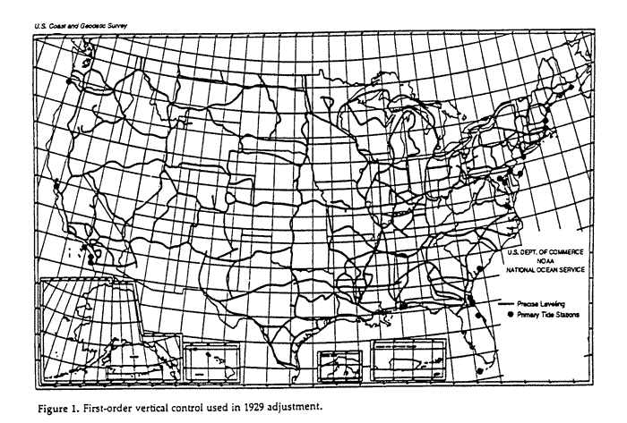
First-Order Leveling Network NGVD 29
Notes:
Sample map of the leveled network and tide station connections included in NGVD29.

Slide 39
North American Vertical Datum 1988 (NAVD 88)
Defined by one height (Father Point/Rimouski)
Water-level transfers connect leveling across Great Lakes
Adjustment performed in Geopotential Numbers
Helmert Orthometric Heights:
  H = C / (g + 0.0424 H₀)
  C = geopotential number
  g = surface gravity measurement (mgals)
  H₀ = approximate orthometric height (km)
H = 0 level is nearly a level surface
H = 0 level is biased relative to global mean sea level
Notes:
North American Vertical Datum of 1988 (NAVD88): A fixed reference for elevations determined by geodetic leveling. The datum was derived from a general adjustment of the first-order terrestrial leveling nets of the United States, Canada, and Mexico. In the adjustment, only the height of the primary tidal bench mark, referenced to the International Great Lakes Datum of 1985 (IGLD 85) local mean sea level height value, at Father Point, Rimouski, Quebec, Canada was held fixed, thus providing minimum constraint. NAVD 88 and IGLD 85 are identical. However, NAVD 88 bench mark values are given in Helmert orthometric height units while IGLD 85 values are in dynamic heights. See International Great Lakes Datum of 1985, National Geodetic Vertical Datum of 1929, and geopotential difference. NAVD 88 should not be used as Mean Sea Level.
NAVD 88 - 0 height - took the opportunity to produce a close approximation to a level surface within ± 3 cm; only one bias introduced; defining the 0 height at Father Point, Rimouski, Quebec, Canada.
Problems - height based on Father Point, Rimouski - minimizes changes to USGS maps but adds about 30 cm error relative to global mean sea level at Father Point, Rimouski.
Utilizes good gravimetric coverage of the U.S.

Slide 40
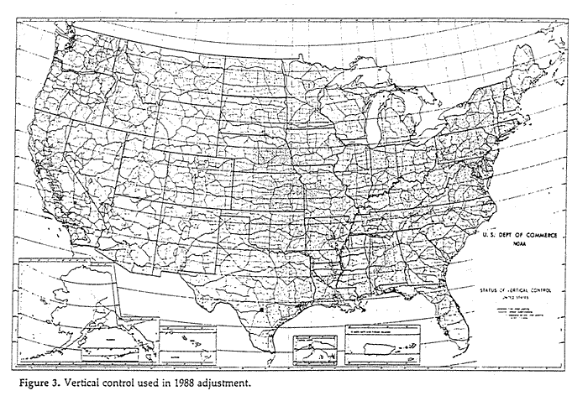
Vertical Control Network NAVD 88
Notes:
Sample of the leveled network and only the one connection to tide gage at fathers Point, Rimouski, Canada included in NAVD88.

Slide 41
NGVD 29 Versus NAVD 88
Datum Considerations: NGVD 29 NAVD 88
Defining Height(s) 26 Local MSL 1 Local MSL
Tidal Epoch Various 1960-78
        (18.6 years)
Treatment of Leveling Data:
Gravity Correction Ortho Correction Geopotential Nos.
(normal gravity) (observed gravity)
Other Corrections Level, Rod, Temp. Level, Rod, Astro,
Temp, Magnetic,
and Refraction
Adjustments Considerations:
Method Least-squares Least-squares
Technique Condition Eq. Observation Eq.
Units of Measure Meters Geopotential Units
Observation Type Links Between Height Differences
        Junction Points Between Adjacent BMs
Notes:
Differences between NGVD29 and NAVD88 - summation of defining characteristics.
Basis for defining heights; biases and tidal epochs used, treatment of data, adjustment considerations, adjustment statistics, and published information.

Slide 42
NGVD 29 Versus NAVD 88 (continued)
Adjustments Statistics : NGVD 29 NAVD 88
No. of Bench Marks 100,000 (est) 450,000 (US only)
Km of Leveling Data 75,159 (US) 1,001,500
31,565 (Canada)
Published Information:
Orthometric Height Type Normal Helmert
Orthometric Height Units Meters Meters
Gravity Value Normal “Actual”
Notes:
Differences between NGVD29 and NAVD88 - summation of defining characteristics.

Slide 43
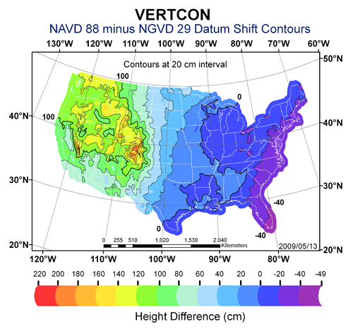
Notes:
Area contour map - note areas of extreme and moderate changes between datums.
VERTCON program: To support users needing to transform data between the National Geodetic Vertical Datum of 1929 (NGVD 29) and the North American Vertical Datum of 1988 (NAVD 88) NGS has developed the VERTCON program. The magnitude of the differences between the two height systems is shown in the depicted image.

Slide 44
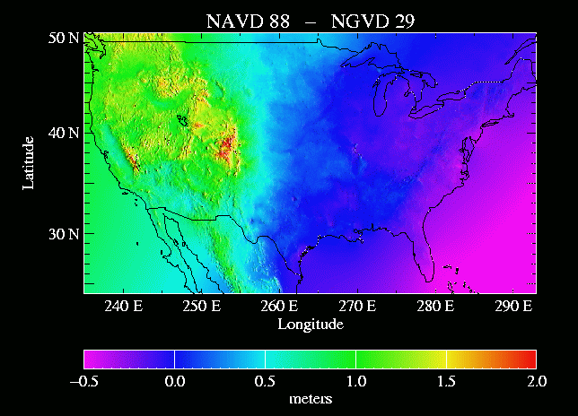
Notes:
National color map - differences between NGVD29 and NAVD88 datums
Portrays general east - west tilt; rugged areas indicate major changes whereas smooth are minor changes. 2 & 3 cm level differences over steep gradients.

Slide 45
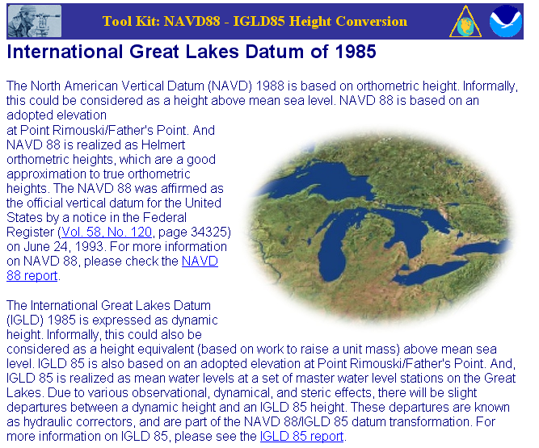
Notes:
The International Great Lakes Datum (IGLD) 1985 is expressed as dynamic height. Informally, this could also be considered as a height equivalent (based on work to raise a unit mass) above mean sea level. IGLD 85 is also based on an adopted elevation at Point Rimouski/Father's Point. And, IGLD 85 is realized as mean water levels at a set of master water level stations on the Great Lakes. Due to various observational, dynamical, and steric effects, there will be slight departures between a dynamic height and an IGLD 85 height. These departures are known as hydraulic correctors, and are part of the NAVD 88/IGLD 85 datum transformation.

Slide 46
Tidal Datum
Heights Measured Above Local Mean Sea Level
National Tidal Datum epoch; 19 year series
Encompasses all significant tidal periods including 18.6 year period for regression of Moon’s nodes
Averages out nearly all meteorological, hydrological, and oceanographic variability
Leveling is used to determine relationship between bench marks and tidal gauges
Notes:
Sea level heights - we want heights relative to mean sea level to equal that of the geoid but we cannot achieve this goal; always differences between levels and local mean sea level..
National Tidal Datum epoch - 19 year period of averaging phases such as lower low water almost eliminates effects within ocean caused by lunar phases, meteorological, hydrological, and oceanographic variability.
Tidal Datum: In general, a datum is a base elevation used as a reference from which to reckon heights or depths. A tidal datum is a standard elevation defined by a certain phase of the tide. Tidal datums are used as references to measure local water levels and should not be extended into areas having differing oceanographic characteristics without substantiating measurements. In order that they may be recovered when needed, such datums are referenced to fixed points known as bench marks. Tidal datums are also the basis for establishing privately owned land, state owned land, territorial sea, exclusive economic zone, and high seas boundaries. http://tidesandcurrents.noaa.gov/

Slide 47
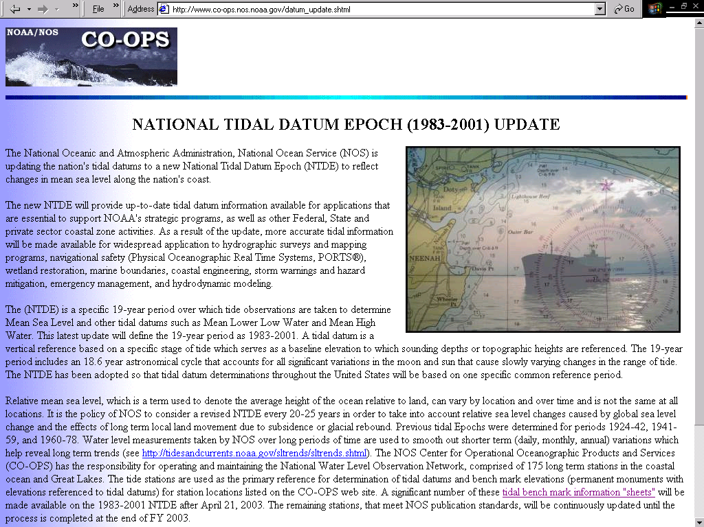
Notes:
The specific 19-year period adopted by the National Ocean Service as the official time segment over which tide observations are taken and reduced to obtain mean values (e.g., mean lower low water, etc.) for tidal datums. It is necessary for standardization because of periodic and apparent secular trends in sea level. The present NTDE is 1983 through 2001 and is actively considered for revision every 20-25 years. Tidal datums in certain regions with anomalous sea level changes (Alaska, Gulf of Mexico) are calculated on a Modified 5-Year Epoch.
http://tidesandcurrents.noaa.gov/

Slide 48
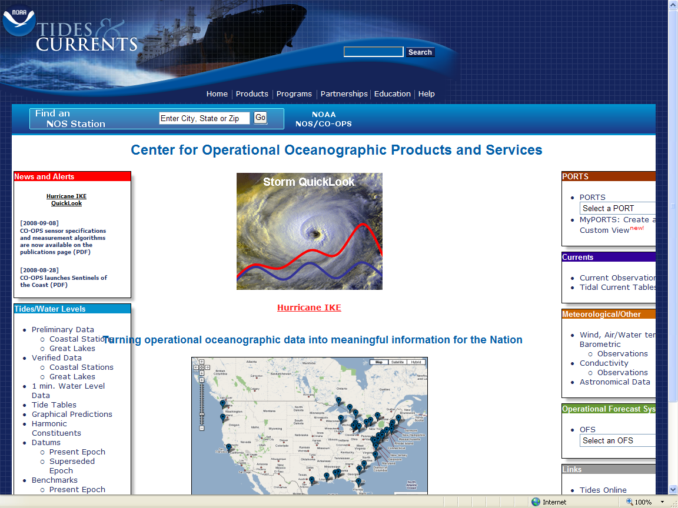
http://tidesandcurrents.noaa.gov/
Notes:
CO-OPS provides the national infrastructure, science, and technical expertise to monitor, assess, and distribute tide, current, water level, and other coastal oceanographic products and services that support NOAA's mission of environmental stewardship and environmental assessment and prediction. CO-OPS provides operationally sound observations and monitoring capabilities coupled with operational Nowcast Forecast modeling.
http://tidesandcurrents.noaa.gov/

Slide 49
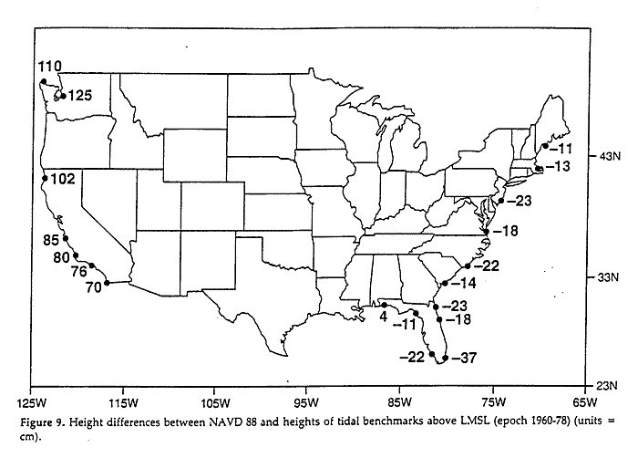
NAVD 88 minus
LMSL (1960-1978)
(units = cm)
Notes:
Note differences along coasts and that there is a slope to LMSL (local mean sea level).
This image was based on the tidal epoch 1960 to 1978.

Slide 50
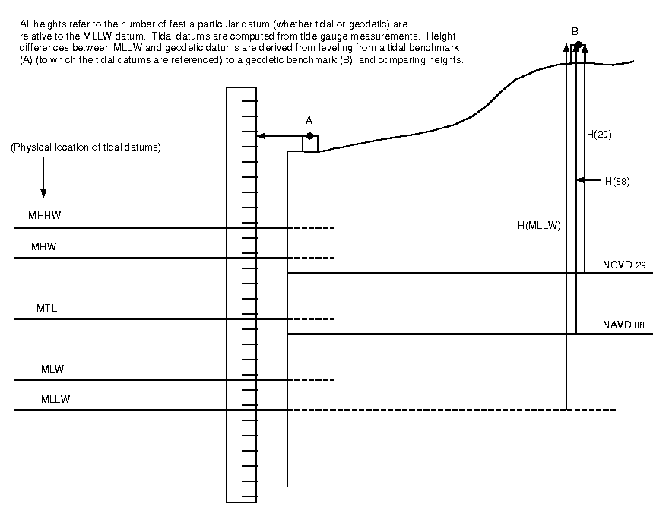
Notes:
Chart illustrating relationship of tidal information, vertical datums, and bench marks.
Geodetic datum relationships to tidal datums are established at tide stations by connecting tidal bench mark networks to the National Spatial Reference System (NSRS) maintained by NGS. There are two survey procedures used to make this connection. The first is to connect the tidal bench marks with traditional differential levels to nearby geodetic bench marks with known geodetic elevations. The second is to occupy the tidal bench marks using a static GPS survey to determine the geodetic elevations of the bench marks directly. In all cases it is advised to make the connections to more than one bench mark, preferably to three marks, in order to confirm the connection and identify unstable bench marks. The elevation relationship between geodetic datums and tidal datums should not be extrapolated away from a particular location without correction or interpolation as the relationships vary with parameters such as variations in range of tide, bathymetry, topography, geoid variations, and vertical land movement. Any interpolation should be done carefully, and where possible guided by the use of the National Ocean Service VDatum tool which can be obtained at: http://vdatum.noaa.gov.

Slide 51
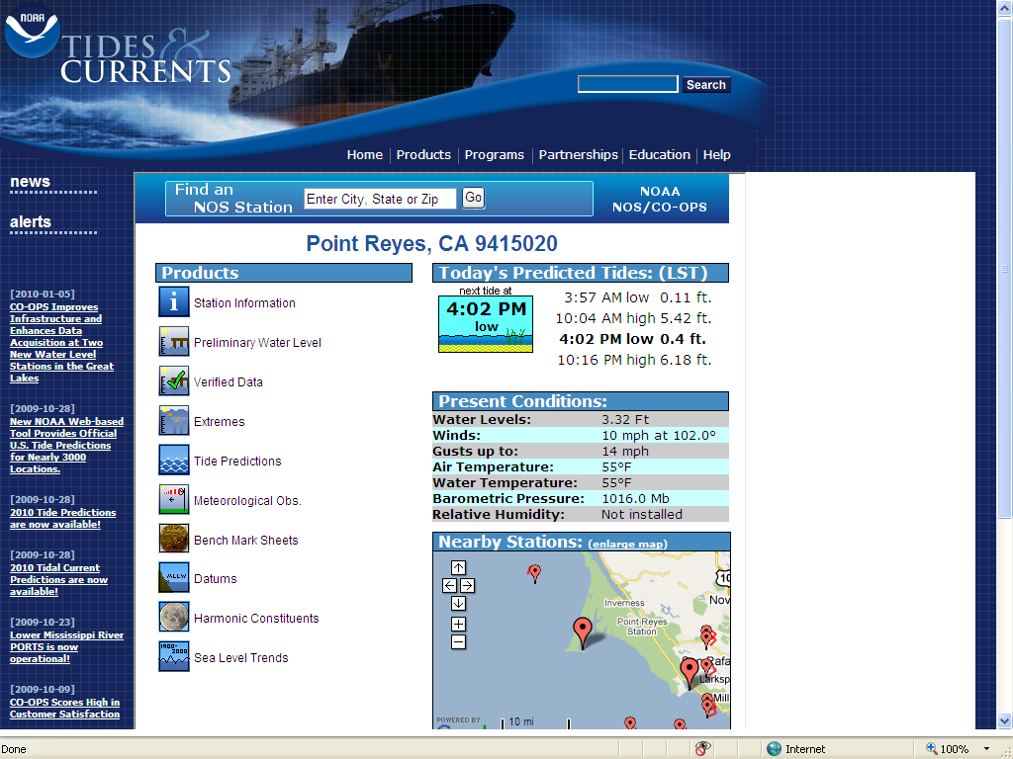
Notes:
An example tidal station at Point Reyes, California. To reach the tidal bench marks from Inverness Post Office, proceed 23.5 km (14.6 mi) NW along Sir Francis Drake Highway (taking the right fork to Point Reyes Beach south), turn left onto Chimney Rock Road (an unmarked road immediately after passing a dairy farm), follow macadam road and turn left at the parking lot Y intersection, and follow the road down to a private pier. The bench marks are located along the road leading to the pier. The tide gauge is located 3 m (11 ft) east of the south corner of the pier.

Slide 52
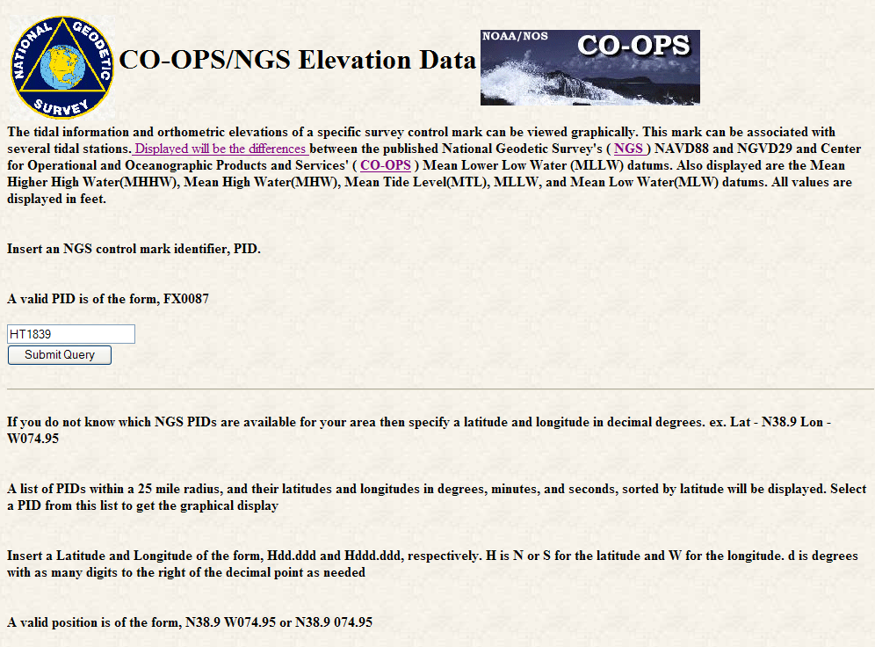
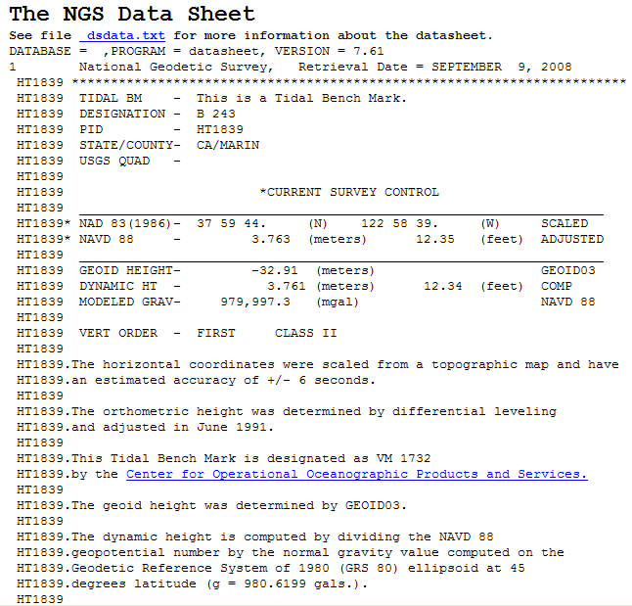
Notes:
The tidal information and orthometric elevations of a specific survey control mark can be viewed graphically. This mark can be associated with several tidal stations. Displayed will be the differences between the published National Geodetic Survey's ( NGS ) NAVD88 and NGVD29 and Center for Operational and Oceanographic Products and Services' ( CO-OPS ) Mean Lower Low Water (MLLW) datums. Also displayed are the Mean Higher High Water (MHHW), Mean High Water (MHW), Mean Tide Level (MTL), MLLW, and Mean Low Water (MLW) datums. All values are displayed in feet.
http://www.ngs.noaa.gov/newsys-cgi-bin/ngs_opsd.prl

Slide 53
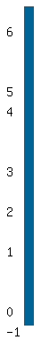
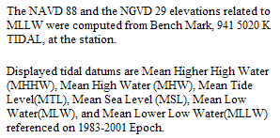
FT
Point Reyes, Drakes Bay, California
Notes:
The NAVD 88 and the NGVD 29 elevations related to MLLW were computed from Bench Mark, 941 5020 K TIDAL, at the station.
Displayed tidal datums are Mean Higher High Water (MHHW), Mean High Water (MHW), Mean Tide Level(MTL), Mean Sea Level (MSL), Mean Low Water (MLW), and Mean Lower Low Water (MLLW) referenced on 1983-2001 Epoch.

Slide 54
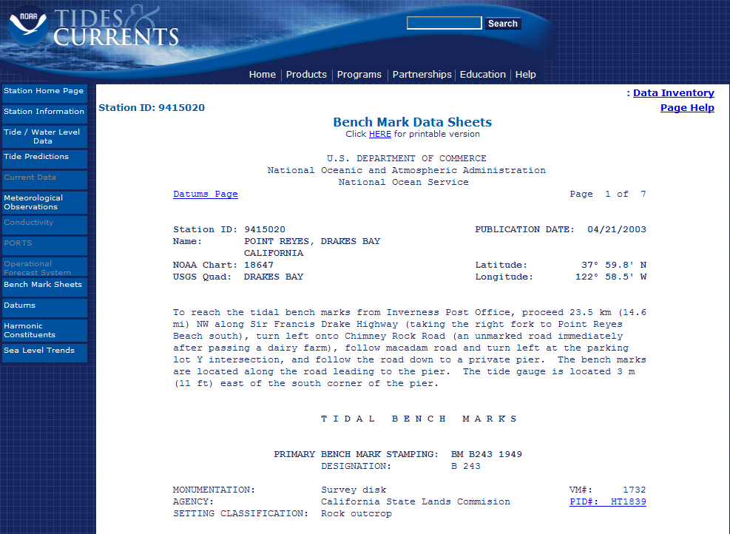
Notes:
The Bench Mark Sheets page provides access to bench mark sheets for the station indicated in the upper left corner of the page.
A tidal bench mark is a physical object, usually a stamped metal disk, that is near a tide station and is used as an elevation reference for the tide gauge and tidal datums. Bench Mark Sheets provide descriptions, locations, and elevations of the bench marks for a station.
http://tidesandcurrents.noaa.gov/

Slide 55
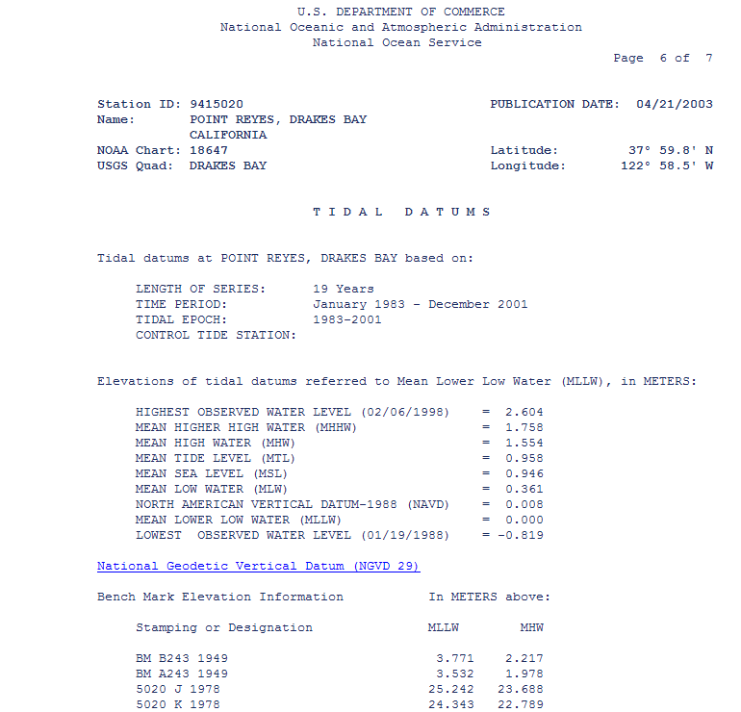
Notes:
Mean Sea Level (MSL) is a tidal datum determined over a 19-year National Tidal Datum Epoch. It pertains to local mean sea level and should not be confused with the fixed datums of North American Vertical Datum of 1988 (NAVD 88).
NGVD 29 and NAVD 88 are fixed geodetic datums whose elevation relationships to local MSL and other tidal datums may not be consistent from one location to another.
The NAVD 88 elevation is shown on the Elevations of Tidal Datums Table Referred to MLLW only when two or more of the bench marks listed have NAVD 88 elevations. The NAVD 88 elevation relationship shown in the table is derived from an average of several bench mark elevations relative to tide station datum. As a result of this averaging, NAVD 88 bench mark elevations computed indirectly from the tidal datums elevation table may differ slightly from NAVD 88 elevations listed for each bench mark in the NGS database.
http://tidesandcurrents.noaa.gov/

Slide 56
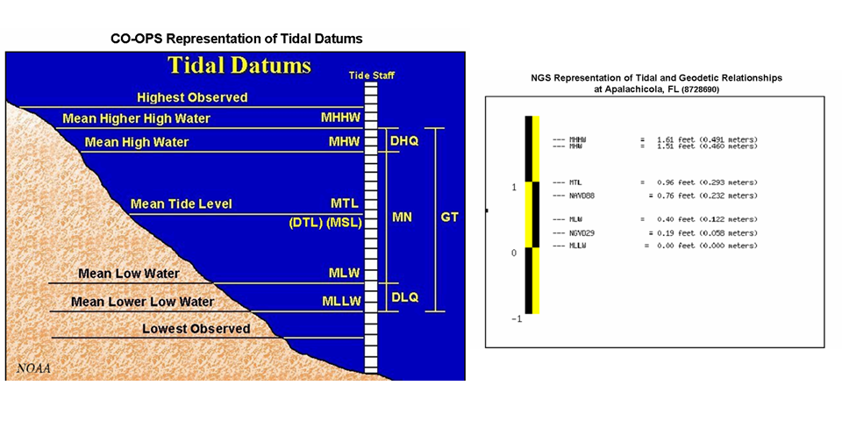
Geodetic and Tidal
Geodetic and Tidal Datum Relationships
Notes:
Geodetic datum relationships to tidal datums are established at tide stations by connecting tidal bench mark networks to the National Spatial Reference System (NSRS) maintained by NGS. There are two survey procedures used to make this connection. The first is to connect the tidal bench marks with traditional differential levels to nearby geodetic bench marks with known geodetic elevations. The second is to occupy the tidal bench marks using a static GPS survey to determine the geodetic elevations of the bench marks directly. In all cases it is advised to make the connections to more than one bench mark, preferably to three marks, in order to confirm the connection and identify unstable bench marks. The elevation relationship between geodetic datums and tidal datums should not be extrapolated away from a particular location without correction or interpolation as the relationships vary with parameters such as variations in range of tide, bathymetry, topography, geoid variations, and vertical land movement. Any interpolation should be done carefully, and where possible guided by the use of the National Ocean Service VDatum tool which can be obtained at: http://vdatum.noaa.gov.
http://tidesandcurrents.noaa.gov/

Slide 57
Importance of Shoreline
AL, AK, CA, CT, FL, GA, LA, MD, MS, NJ, NY, NC, OR, RI, SC, WA
Territorial Seas
Privately Owned
Uplands
State Owned
Tidelands
Contiguous Zone
Exclusive Economic Zone
State Submerged Lands
Federal Submerged Lands
3 n. mi.
High Seas
12 n. mi.
MHHW
MHW
200 n. mi.
MLLW
Chart Datum
Privately
Owned
State
Owned
Privately
Owned
State
Owned
TX
DE, MA, ME, NH, PA, VA
Notes:
Tidal datums are also the basis for establishing privately owned land, state owned land, territorial sea, exclusive economic zone, and high seas boundaries.
Changes in sea level will affect these boundaries.

Slide 58
End of Part 2
Questions?
Notes:
58
Orthometric heights (observed ht. diff. combined with surface gravity = geopotential ht. diff., converted to orthometric hts.)

Slide 59
Precise Digital Leveling
Part 3
Geodesy and Corrections for Leveling
Notes:
Precision Digital Leveling is a 1, 2, or 3 day seminar detailing the intricacies of geodetic leveling procedures developed by the National Geodetic Survey with emphasis on precise digital/bar-code levels and support equipment and how geodetic leveling is an integral part of Height Modernization. The seminar provides an overview of the geodetic leveling process including discussion of corrections applied to leveling, the FGCS specifications and procedures for electronic digital/bar-code leveling systems, required equipment, project reconnaissance, bench mark requirements and monumentation, field data collection, review, reduction, and “blue book” preparation for inclusion into the NGS National Spatial Reference System.

Slide 60
Leveled Height Differences
B
Topography
A
C
Notes:
Leveling is a very “simple” survey practice - determining elevation differences through use of conventional leveling procedures – through backsight minus foresight measurements between points A to B and B to C.
Differential leveling surveys, being a “piecewise” metric measurement technique, accumulate local height differences (dh).
But, being a piecewise metric measurement system, we must also be aware and account for factors affecting our understanding and use of height interpretations.
Traditionally, orthometric heights can be considered as a distance (elevation difference) above a reference surface or datum.

Slide 61
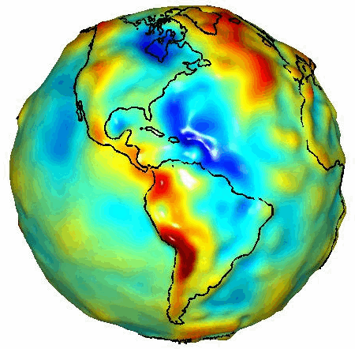
GRACE Gravity Model 01
- Released July 2003
Image credit: University of Texas Center for Space Research and NASA
Notes:
To fully appreciate the reasoning for many of strict requirements for geodetic leveling we must begin with understanding what are orthometric heights.
A realistic “view” of our very irregular shaped Earth as depicted in this gravity model determined from space borne gravity measurements by GRACE, gravity recovery and climate experiment.
Every time we set up and plumb our level equipment we are then determining our horizon through the optics of the instrument perpendicular to the attraction of gravity at that point. Now, envision about 26 setups per mile and hundreds and thousands of setups over distances covering a County, each perpendicular to the attraction at that point on our irregular shaped, curved Earth and you can begin to get the feeling that leveling must be much more than a “simple” routine of backsights minus foresights.

Slide 62
The Geoid
Geopotential
Surfaces
Ellipsoid
Surface
Gravity Vector
The relationships between the ellipsoid surface (solid red), various geopotential surfaces (dashed blue), and the geoid (solid blue). The geoid exists approximately at mean sea level (MSL). Not shown is the actual surface of the earth, which coincides with MSL but is generally above the geoid.
Notes:
Looking at a side view of the irregular shaped Earth and the relationships between surfaces of equal potential (equipotential or geopotential surfaces), perpendicular to the attraction of gravity at that point. Note these geopotential surfaces are not geometrically parallel due to the variations in the earth’s irregular gravity field. Also, the geopotential surfaces converge (become closer together) at the poles due in large part to Earth’s rotation.
As you run levels across theses surfaces the equipment is plumbed per the attraction of gravity at that point. Our assumption is that our horizontal field of view can be corrected for a nice consistent Earth curvature when in fact a correction for conditions affecting us at a particular point must be accounted for.
Running levels north and south require more correction for the convergence of the geopotential surfaces than when running levels east and west.
The red oval illustrates the reference ellipsoid for our space based coordinate system and, though a close approximation of the size and shape of the Earth, is an entire, unrelated reference surface when determining GPS-derived ellipsoid heights.

Slide 63
Level Surfaces and Orthometric Heights
Earth’s
Surface
W_{P}
Level Surfaces
P
Plumb
Line
Mean
Sea
Level
“Geoid”
W_{O}
P_{O}
Ocean
Level Surface = Equipotential Surface (W)
Geopotential Number (C_{P}) = W_{P} -W_{O}
H (Orthometric Height) = Distance along plumb line (P_{O} to P)
Area of High Density Rock
Area of Low Density Rock
Notes:
Level surfaces - imagine earth standing still - ocean standing still; no effects such as currents, tides, winds; except for slight undulations created by gravity effects = level surface.
Geoid is this level surface relating to today’s mean sea level surface - this does not truly coincide with mean sea level because of the non-averaging effects of currents, tides, water temperatures, salinity, weather, solar/lunar cycle, etc. The geoid is a best fit mean sea level surface.
Equipotential surfaces - add or subtract water and level surface changes parallel to previous surface = infinite number of possible level surfaces. Each equipotential surface has one distinct potential quantity along its surface.
Point on earth’s surface is the level surface parallel to the geoid achieved by adding or subtracting potential. Lines don’t appear parallel; they are based on the gravity field and are affected by mass pluses and minuses.
Geopotential number is the numerical difference between two different equipotential surfaces. W = potential along a level surface. C_{P} = geopotential number at a point.
Plumb line (over exaggerated in drawing) - is a curved distance due to effects of direction of gravity- known as deflection of the vertical.
Orthometric height is exactly the distance along this curved plumb line between the geoid and point on the earth’s surface. We can make close approximations but to be exact we would need to measure gravity along this line requiring a bored hole which is impractical.

Slide 64
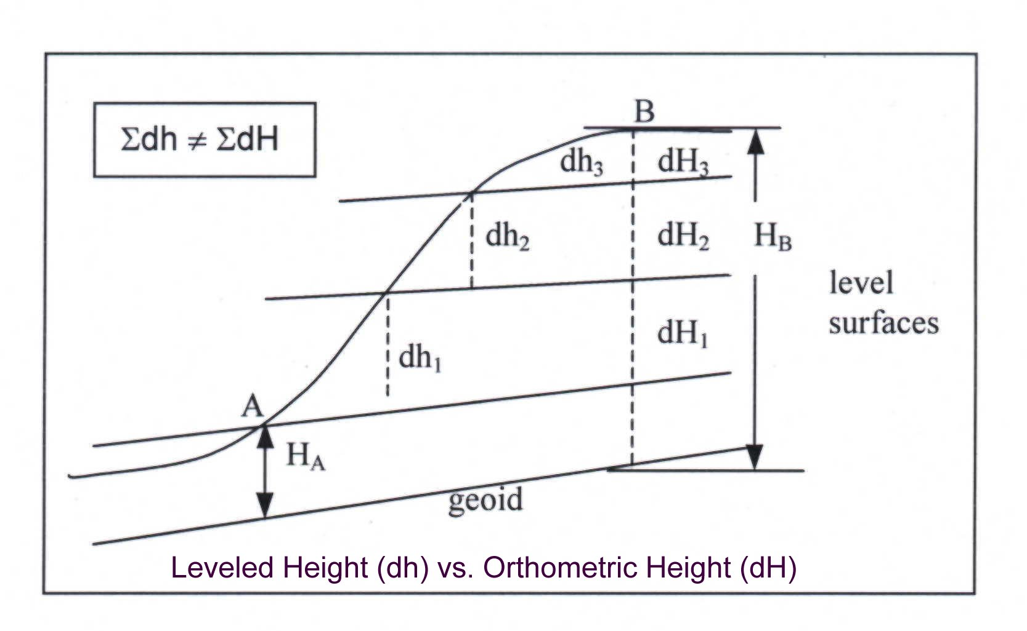
Notes:
Bench marks of NAVD 88 constitute the official national vertical datum for mapping and charting, and provide a vertical reference for the national infrastructure. Thus, surveyors frequently use these bench marks for reference points and to check their measurements. Leveled height differences (dh) do not strictly correspond to orthometric height differences (dH), because the nonparallelism of level surfaces is not reflected in the leveling measurements collected in the field (see figure); e.g., the sum of dh (${dh}_{1}$+${dh}_{2}$+${dh}_{3}$) ≠ ∑dH (${dH}_{1}$+${dH}_{2}$+${dH}_{3}$) between bench marks A and B, where sum of dH = $H_{B}$ – $H_{A}$. In contrast to leveled heights, adjusted NAVD 88 heights published by the National Geodetic Survey (NGS) are defined in the same Helmert orthometric vertical system as the orthometric heights obtained through global navigation satellite systems (GNSS) measurements and the proper geoid height value (apart from occasional small system shifts), such as the values provided by GEOID18.

Slide 65

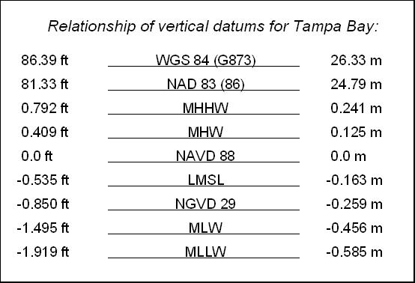
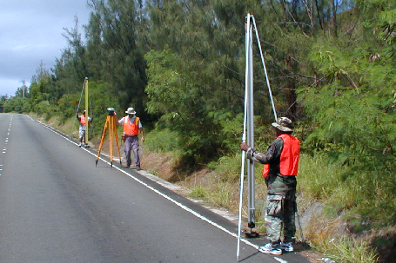
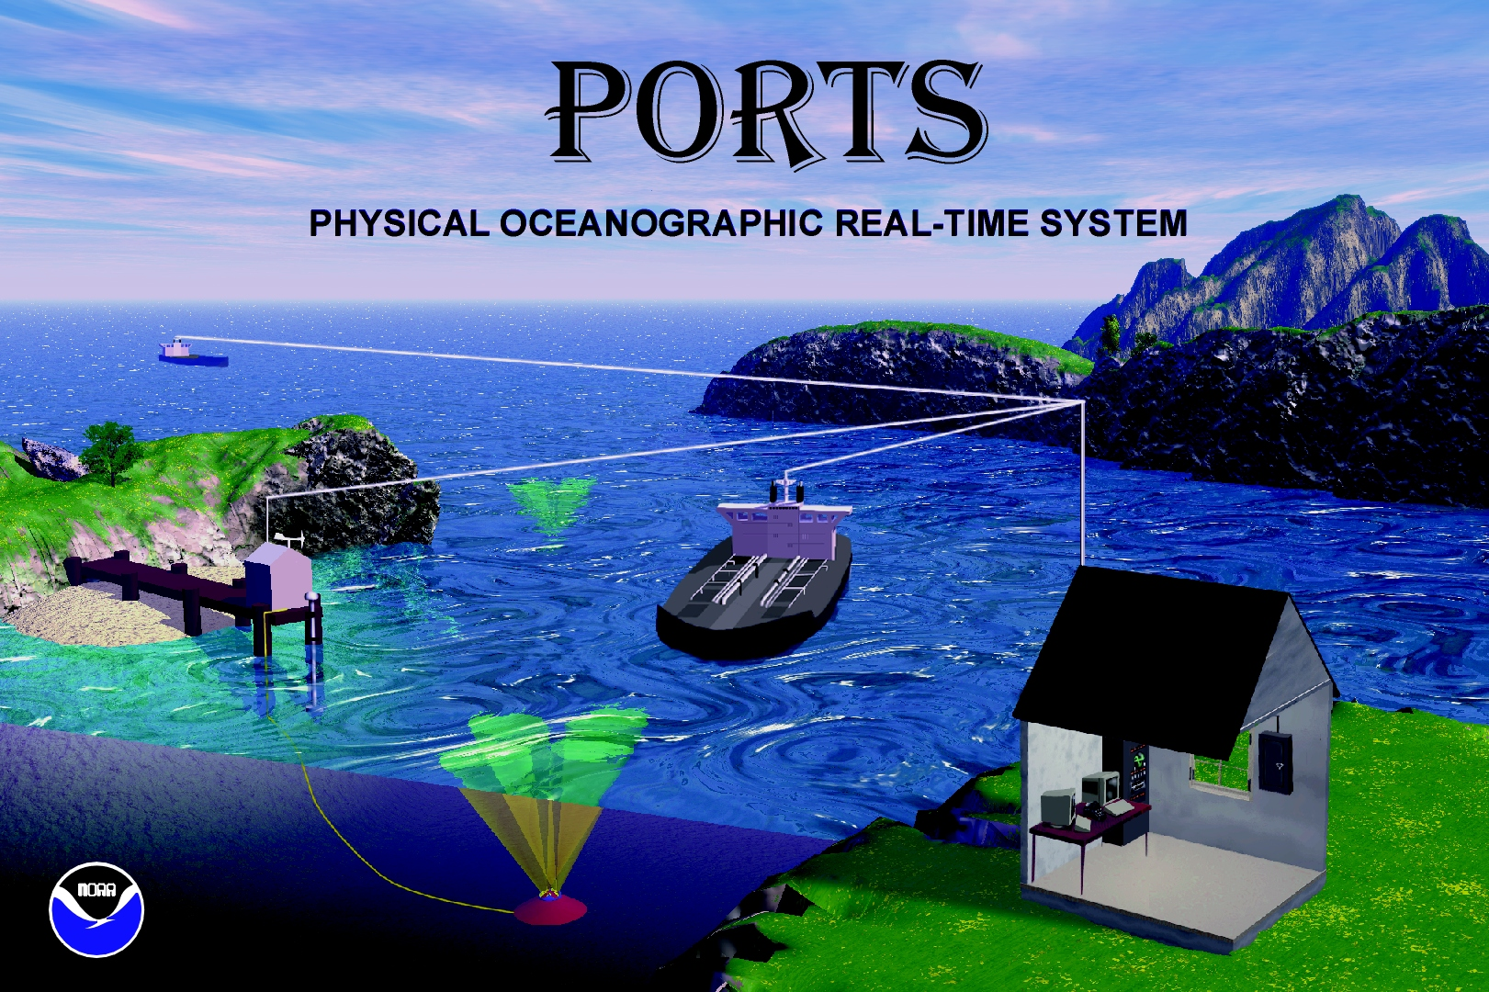
Vertical Datum Relationships
3-D Datums
WGS 84, NAD 83 (86)
NAVD 88, NGVD 29
Orthometric Datums
MHHW,MHW, MTL, DTL, MLW, MLLW
Tidal Datums
Notes:
There are many ways to describe heights. Here are illustrated different “elevations” for the exact same point dependent on the measurement type and reference datum.

Slide 66
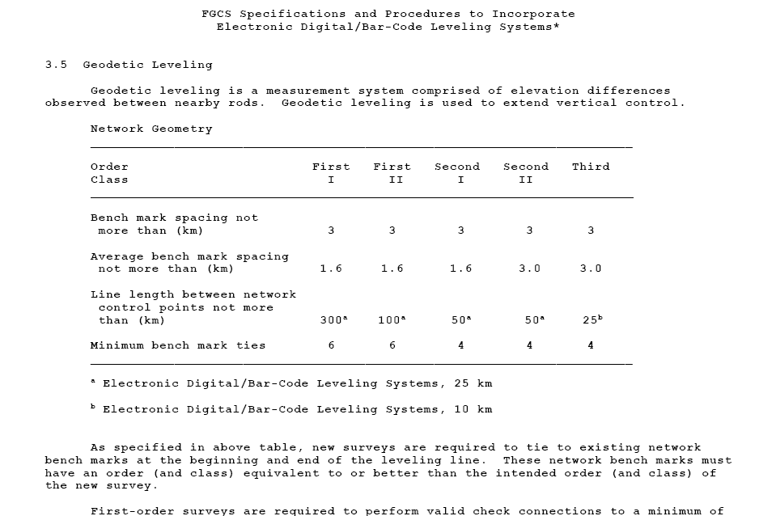
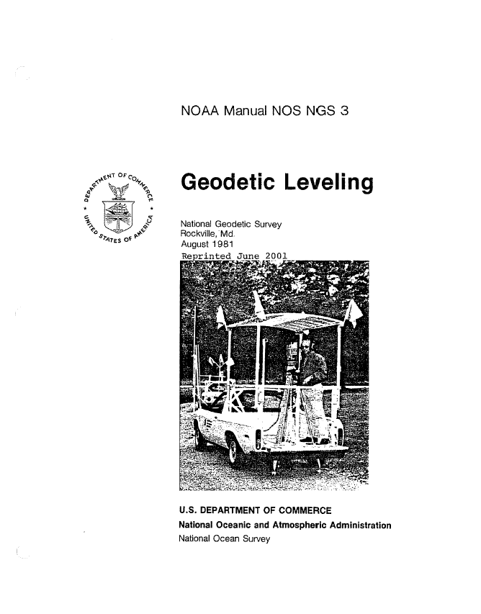
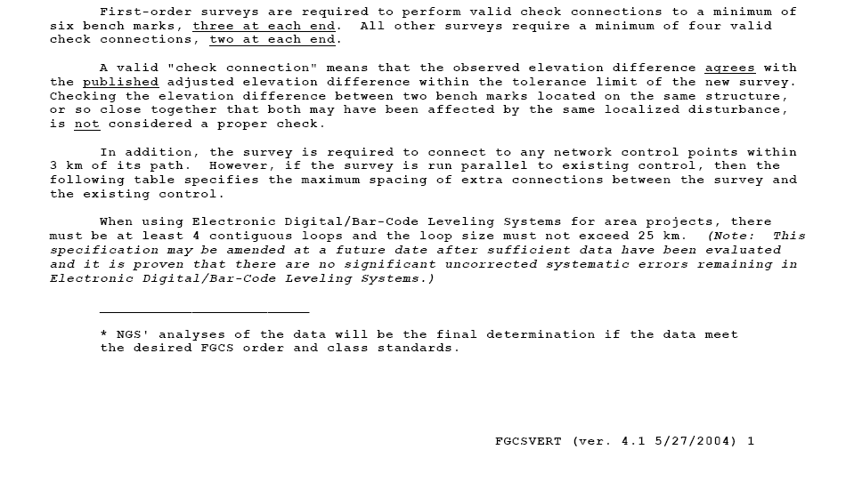
Corrections Applied to NGS’ Leveling Observations
Notes:
Source Documents: Balaz, Emery I., Young, Gary M.; NOAA Technical Memorandum NOS NGS 34; “CORRECTIONS APPLIED BY THE NATIONAL GEODETIC SURVEY TO PRECISE LEVELING OBSERVATIONS”; June 1982: FGCSVERT (ver. 4.1 5/27/2004)
The intent of this presentation is NOT to go into a discussion of how the following equations were derived, but rather, to familiarize the field observer about the variables which must be observed correctly in order to reduce leveling observations in conformance with NAVD88 conventions.
The following corrections, and there are some either/or options, are used to reduce the rod readings to the geopotential numbers input to NGS’ geodetic leveling adjustment program: ASTA, and are the same corrections applied to the observations used to compute the NAVD88.
Typeface coloring conventions: Black was used for the general points, Red was used to distinguish variables that the observers were directly involved in collecting.

Slide 67
Curvature Error, C, Where the Line of Sight
Is not Parallel to an Equipotential Surface
Cancels if S_{B} = S_{F}
S_{B}
S_{F}
Horizontal
Line of Sight
C_{B}
C_{F}
Equipotential
Surface
Direction of Gravity
Notes:
Our assumption is that the line of sight is perfectly horizontal, perpendicular to the attraction of gravity and that we work on a “flat” surface. We in fact live and work on a curved surface that is irregular due to the variable gravity influences in our world.
The effects of curvature cancel if you maintain a close imbalance in your setups.
FGCS Specifications and Procedures to Incorporate Electronic Digital/Bar-Code Leveling Systems: Difference of forward and backward sight lengths never to exceed: 5 m per setup and 10 m per section for 1st and 2nd Order leveling.

Slide 68
Rod A
Heat Shimmer
or
Scintillation
Rod B
Shorten setup distances – instrument to rod
Balance setups – minimize differences
Observe over similar surfaces
Notes:
Refraction is most notable when the line of sight passes through air of fluctuating density, as when “heat waves” are observed. The graduations on the scales appear to move up and down rapidly. This phenomenon, called shimmer, makes it difficult to intercept the scales precisely, thus increasing the magnitude of pointing error. It can be reduced by shortening the sighting distances or, in some cases, raising the height of the line of sight.
Balanced setups tend to cancel some effects of shimmer if conditions are the same in both the backsight and foresight observations.
Important Note: Observe over similar surfaces in backsight and foresight observations. This becomes very apparent when crossing roadways as the backsight may be along the road shoulder but the foresight across an asphalt highway would be over a dissimilar surface. Cross the highway at nearly a right angle which requires a setup with reduced distances backsight and foresight to help minimize the effects observing over dissimilar surfaces.

Slide 69
Crossing a Highway
Avoid if Possible
Minimize Dissimilar Backsight -
Foresight Observing Conditions
Notes:
Important Note and Example: Observe over similar surfaces in backsight and foresight observations. This becomes very apparent when crossing roadways as the backsight may be along the road shoulder but the foresight across an asphalt highway would be over a dissimilar surface. Cross the highway at nearly a right angle which requires a setup with reduced distances backsight and foresight to help minimize the effects observing over dissimilar surfaces.

Slide 70
Rod 1
Rod 2
Rod 1
B₁cos P₁
F₁cos P₂
B₂cos P₂
F₂cos P₁
Systematic effect of plumbing error (and scale errors) is small on flat terrain, since B₁ ≈ F₂ and F₁ ≈ B₂
Notes:
To observe accurate heights above the points on which the leveling rods rest, precise relationships must be maintained between the rods and the equipotential surface, and between the rods and the scales mounted on them.
This is ensured by plumbing, or aligning the rods with the direction of gravity, a task which is analogous to leveling the instrument. If they are not aligned, an error is introduced into each observation. Although the error may be small, it accumulates systematically with change of elevation, especially on steep slopes where observations are made alternately low and high on scale. It can be limited only by plumbing the scales properly.

Slide 71
Rod 1
Rod 2
Rod 1
F₂cos P₁
B₂cos P₂
F₁cos P₂
B₁cos P₁
Systematic effect of plumbing error (and scale errors) accumulates on sloping terrain, since B₁ ≠ F₂ and F₁ ≠ B₂
Notes:
Again, it is important to ensure the rods are plumb at every setup. If they are not aligned, an error is introduced into each observation. Although the error may be small, it accumulates systematically with change of elevation, especially on steep slopes where observations are made alternately low and high on scale. It can be limited only by plumbing the scales properly.

Slide 72
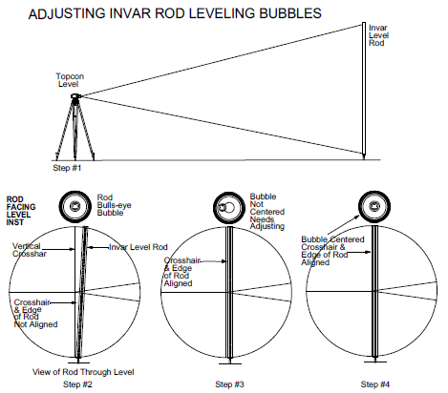
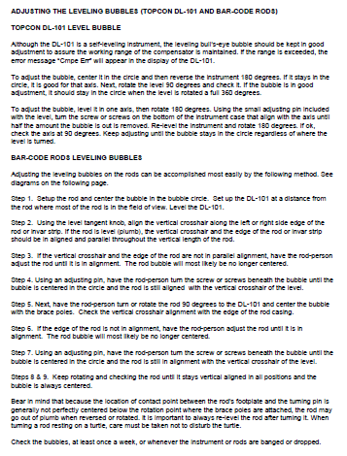
Notes:
Checking rod plumb: During a setup each leveling rod must be plumb, in other words, vertically aligned with the direction of gravity. Achieve this by centering the bubble in the vial of the circular level attached to the rod housing. To center the bubble precisely, observe the level from as nearly overhead as possible, not at an angle.
Each day, while leveling, the observer should check the plumbing of each rod by comparing the alignment of each rod to the vertical line in the reticle of the leveling instrument. Check the rod while it faces the instrument; then, after the rodman turns the rod ${90}^{O}$ (at a right angle to the instrument), check it again. This procedure quickly reveals gross errors in the plumbing of the rod.

Slide 73
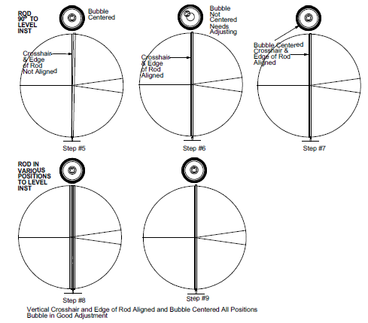
Notes:
If the circular level is not properly adjusted, centering the bubble does not ensure that the rod is plumb. Check the level at least once a week and immediately after any shock to the rod. Include a note in each weekly report, stating the time and date that the check was performed, and explaining the adjustments required.
If the level cannot be adjusted within tolerance, the rod housing may be warped or the level may be defective. In this case, check the housing by stretching a string from one end of the rod to the other and looking for bends or twists, If the rod has such defects, replace it immediately. If not, replace the circular level.
NOAA Manual NOS NGS 3, Geodetic Leveling; 3.4 Leveling Rods; 3.4.3 Use and Maintenance

Slide 74
Rod Scale Correction
C_{r} = De
D = observed Δ_{elevation} for the section in meters
e = average length excess of the rod pair in mm/m
Length excess is determined in rod calibration process
Notes:
The length of the Invar strip of a leveling rod used in precise leveling should be traceable to the National length standard. While they should be calibrated before and after each project or at least once a year, this has never been deemed practical except when the client has “deep pockets” and has told NGS they wanted the “best” inferring 1st Order, Class I leveling. In practice, the rods are calibrated before one uses them for a precise leveling project, and then, possibly if they’ve been in storage for a long while, so when “dusted off” still look new and/or the ownership of the rods has changed and the new owner is uncertain about the quality of the original certification.
While the rods should be recalibrated after they are damaged, most users would rather buy and calibrate new rods than repair and recalibrate a damaged rod set. Also, handling quickly wears painted surfaces off the rods, thus they often get retired before the true end of their useful life.
You get two useful values out of a rod calibration; one is related to the thermal index of expansion of the Invar strip, and the other is related to the distance between the bottom of the rod (the part that contacts the monument) and the “zero point” on each strip. Now, most geodetic rods really don’t display “0.00000”. More likely they display a different range of numbers that were chosen by the manufacturer to catch blunders because certain combinations of differences as measured by the backsight followed by the foresight would be impossible if both rods started with “zero.” This thinking then leads to the procedural technique that says you always quit the section on a Bench Mark with the same rod as you used when you started the section on another Bench Mark.
This correction deals with the differences between the bottom of the rod and the “zero point.” Now, since 1980, NGS would like the calibration to include more than one “zero point” so we can do a least squares determination of all the check points which are related to the foot of the rod. When the National Bureau of Standards was doing them we got them every 10cm along the rod. More recently, non NIST labs doing calibrations have only been producing one index value per meter along the rod. NGS accepts these calibrations but wishes the labs would produce more fiducial point comparisons.
Source Documents: Balaz, Emery I., Young, Gary M.; NOAA Technical Memorandum NOS NGS 34; “CORRECTIONS APPLIED BY THE NATIONAL GEODETIC SURVEY TO PRECISE LEVELING OBSERVATIONS”; June 1982: FGCSVERT (ver. 4.1 5/27/2004)

Slide 75
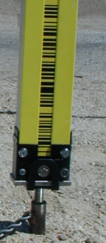
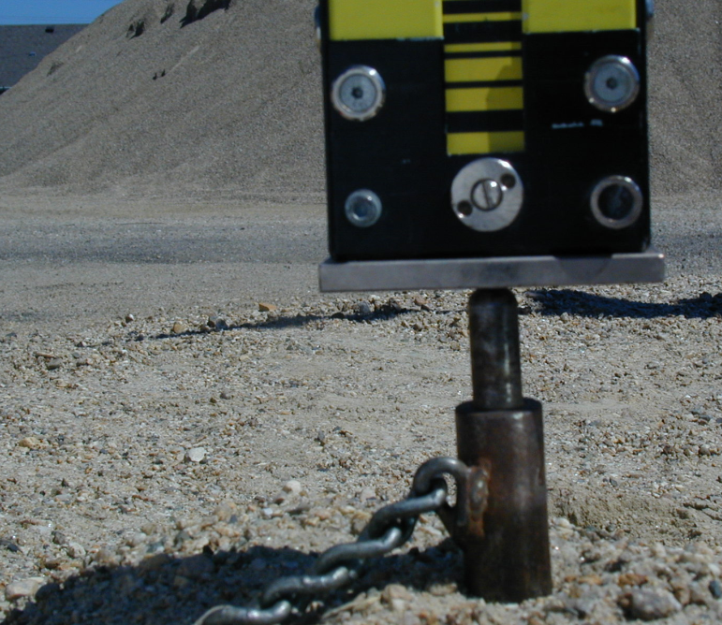
Rod Calibration – Invar to
Bottom Reference Plate
Notes:
Rod scale is the distance between the bottom of the rod (the part that contacts the monument) and the “zero point” on each Invar strip.

Slide 76
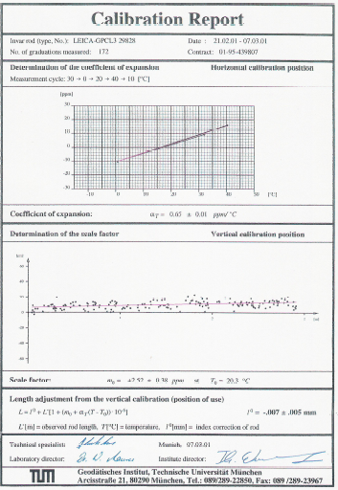
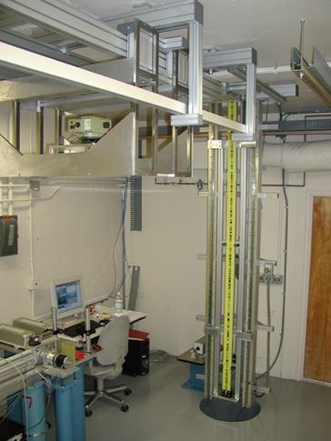
Calibration Report
SLAC Metrology Laboratory
Notes:
An example “paper” rod calibration report and a picture of the Stanford Linear Accelerator Center (SLAC) rod calibration setup in a climate controlled laboratory. http://www-group.slac.stanford.edu/met/
The rods used for geodetic leveling must be calibrated routinely by a reputable laboratory against a standard that has been compared to the National Standard of Length. A complete set of calibration data should be obtained for each rod before the rod is first used, every 5 years during its use, and just before the rod or scale is retired. The data should include the index error, length excess, and coefficient of thermal expansion. In addition, during each year of use, at least one calibration should be made to determine the index error and length excess. If a rod is dropped, or otherwise handled in a way that may have damaged it, it should not be used again until it has been recalibrated. Each calibration consists of the precise measurement of at least four overlapping intervals on the scale (usually between the base plate and the bisected graduations at 0.2, 1.0, 2.0, and 3.0 m). The measurements, with respect to the National Standard of Length, should be accurate to ± 0.05 mm. From one calibration, a value for the index error and a factor for the length excess can be computed. The differences between the calibrated and assigned lengths of the graduations are plotted versus the assigned lengths. The intercept of the plotted line with the axis of the differences is the index correction which is equal and opposite in sign to the index error. The slope of the line is the length excess. To obtain a complete set of calibration data, at least four calibrations must be made, each at a different temperature between 15° and 35°C. The variations in graduation values, due to changes in temperature, are described by the coefficient of thermal expansion, computed from these data.
NOAA Manual NOS NGS 3, Geodetic Leveling; 3.4 Leveling Rods; 3.4.2 Calibration

Slide 77



Laval University
(ULAVAL)
Notes:
An example “paper” rod calibration report from the Laval University in Quebec, Canada.

Slide 78



Technical University
in Munich
(TUM)
Notes:
An example “paper” rod calibration report from the Technical University in Munich, Germany (TUM).

Slide 79



Stanford Linear
Accelerator Center
(SLAC)
Notes:
An example “paper” rod calibration report from the Stanford Linear Accelerator Center (SLAC).
Stanford Linear Accelerator Center
Metrology Department
2575 Sand Hill Road, Menlo Park, CA 94025
Tel.: (650) 926 3689, Fax: (650) 926 4055

Slide 80


Stanford Linear
Accelerator Center
(SLAC)
Additional Notes
Notes:
3 Notes and Recommendations; 3.1 Visual inspection of the rods:
Figure 1: Footplate of both rods. Both rods show wear at the center of the footplate, indicating that they have been set up in the center. The correct spot to set up the rods is not the center of the footplate. The rods should be set up in line with the scale itself, indicated with a green dot in the picture above. This mitigates errors if the rod is not set up perfectly straight.
Figure 2: Strap in front of code. The DNA03 uses a ~1 deg section of the code visible at its CCD array. No section of the code should be covered. In the image above, the modification of the strap covers a small portion of it.
System Calibration Report; GPCL3 Rod (SN: 26923)– GPCL3 Rod (SN: 26924); Leica DNA03 (SN: 330698)

Slide 81

Critical Distances: It is already well known in the metrology community that digital levels give inaccurate results at certain distances. Therefore the expansion of these distances have to be evaluated to avoid them during the field measurements. As an example, measurements at and around a critical distance of the DNA03 are shown below.
Notes:
Stanford Linear Accelerator Center (SLAC) rod calibration report including information on critical distances. Precision in height measurements is reduced at these critical distances.
It is already well known in the metrology community that digital levels give inaccurate results at certain distances. Therefore the expansion of these distances have to be evaluated to avoid them during the field measurements. As an example, measurements at and around a critical distance of the DNA03 are shown.
Some of the manufacturers have built these “critical” distances into their digital level firmware and a warning is indicated prohibiting readings when these critical distances are encountered in the field.
http://www-group.slac.stanford.edu/met/Align/Down2004/Descriptions/Leveling.pdf

Slide 82

Hence Rule – Keep all three crosshairs on Invar!
Notes:
Stanford Linear Accelerator Center (SLAC) rod calibration report including information on readings near the ends of staff. Precision in height measurements is reduced when observing near the ends of the rods.
For determination of the height reading, a certain area of the code on the leveling rod is used by the level. If only parts of this area are visible, as is the case at the end sections of the staff, inaccurate measurements are the consequence.
Some of the manufacturers of digital levels have built user input limitations for high or low staff readings into their leveling routine and a warning is indicated prohibiting readings when exceeding these limitations are encountered in the field.
http://www-group.slac.stanford.edu/met/Align/Down2004/Descriptions/Leveling.pdf

Slide 83

Keep all three crosshairs on Invar!
Notes:
As a procedural routine, keep all three crosshairs on the Invar of the rod to force reading below the top (or bottom) 10 cm where the precision in height measurements is reduced when observing near the ends of the rods.
For determination of the height reading, a certain area of the code on the leveling rod is used by the level. If only parts of this area are visible, as is the case at the end sections of the staff, inaccurate measurements are the consequence.
Some of the manufacturers of digital levels have built user input limitations for high or low staff readings into their leveling routine and a warning is indicated prohibiting readings when exceeding these limitations are encountered in the field.

Slide 84

Maintain Line-of-Sight 0.5 m Above Ground
Rod
Must be ≥ 0.5 m
0.5 m
Notes:
Leveling; a “simple” form of surveying - transferring elevation differences through a series of backsight minus foresight measurements.
Geodetic Glossary: Leveling - Leveling between two points relatively close to each other (within 2-3 meters vertically, and less than 100 meters horizontally) is done by holding a graduated leveling rod vertically at each point and reading, with a horizontal telescope placed midway between the two points, the place where each rod intersects the horizontal plane established by the telescope's line of sight. The difference in readings is, approximately, the difference in elevation. If the points are farther apart than the distances mentioned above, measurements are made at shorter distance intervals and the total difference in elevation is taken as the sum of the resulting smaller measured differences. The elevation of a point is determined by proceeding as above, starting at a point that is either on the reference surface or at a previously determined elevation. The desired elevation is called the orthometric elevation; quantities approximating the orthometric elevation and derived from the measurements by applying various kinds of corrections are given special names such as Helmert height, Niethammer elevation, and the like.
This is a single setup of leveling. A leveling instrument placed halfway between two leveling rods with precise graduations. The elevation at the beginning point, supporting rod 1, is transferred to the instrument through a measurement at the back rod (backsight) along with a distance (stadia distance) from the rod to the instrument. The elevation is then transferred from the instrument through a measurement at the front rod (foresight) along with a distance (stadia distance) from the instrument to the rod. The imbalance between the backsight and foresight distances must be kept to a minimum. The elevation has then been transferred to the point supporting rod 2.

Slide 85


RI-LOAD Documentation
Notes:
Detailed level instrument and rod calibration data are stored in the National Geodetic Survey’s (NGS) integrated data base (NGSIDB) to apply corrections by the processing programs to the leveling data contained in the leveling observations file (*.hgz) in an attempt to remove systematic errors from the observations. This generates a “phase 1” file (*.ph1) which theoretically has only random errors remaining. The phase 1 file (*.ph1) can be used as input for the least-squares adjustment process which is applicable only if errors are random in nature.
The information about the level instrument and rod is added into the NGSIDB through coded load-files which are created on the basis of an internal NGS document, RILOAD.wpd. Additional descriptive information can be found in the Input Formats and Specifications of the National Geodetic Survey Data Base, known as the “Blue Book” and available from the NGS Web site at: http://www.ngs.noaa.gov/FGCS/BlueBook/.
The fields in the data input record are comma separated. The specified widths for each field are the maximum spaces allowable. Tabs and other special characters are not allowed nor should fields be enclosed in quotes. A field may have any number of leading and trailing blanks as the RILOAD program will remove leading or trailing blanks from each field before processing. Embedded blanks in strings are considered to be part of the string. All data input records are case insensitive. Wildcards are NOT allowed in any data input commands.

Slide 86

Notes:
Leveling instruments are passive measurement systems that use ambient light to read the rods. In tunnels, we use flashlights to illuminate the rods and allow measurements. Therefore tests with our instruments have to be carried out to find out if the inhomogeneous illumination of flashlights has an effect or not.
By taking more then 100 measurements at a sighting distance of 3 m, illuminating the staff with a flashlight (Black & Decker Snake Light) in front of the rod and up to an angle of about 45°, either no measurements were taken or the measurements were correct.
But taking measurements with the illumination at a very steep angle (see Figure 5) deviations of up to 0.1 mm could be invoked. This can be explained by a shadowing effect of the code elements. During the manufacturing process the whole scale is first covered with a black layer and then with a yellow layer. The top yellow layer is removed with a high energy laser to make the black color visible. Due to this process the code elements have a certain thickness of a few micrometers, Fischer and Fischer (1999).
http://www-group.slac.stanford.edu/met/Align/Down2004/Descriptions/Leveling.pdf

Slide 87
Rod Temperature Correction
C_{t} = ( t_{m} – t_{s} ) D · CE
t_{m} = mean observed temperature of Invar strip
t_{s} = standardization temperature of Invar strip
D = observed Δ_{elevation} between the bench marks
CE = mean coefficient of thermal expansion
Notes:
This is the second correction that comes out of information determined during the rod calibration procedure.
The ambient air temperature should be measured and recorded to the nearest degree F or 0.5 degree C at the beginning of the section and the end of the section; the appropriate units (C or F) noted and/or recorded.
Source Documents: Balaz, Emery I., Young, Gary M.; NOAA Technical Memorandum NOS NGS 34; “CORRECTIONS APPLIED BY THE NATIONAL GEODETIC SURVEY TO PRECISE LEVELING OBSERVATIONS”; June 1982: FGCSVERT (ver. 4.1 5/27/2004)

Slide 88
Refraction Correction (thermistors)
R = -10⁻⁵ γ(S/50)² δ · D
S = distance (instrument to rod) in meters
γ = 70
δ = observed temperature difference
between probes at each setup
D = Δ_{elevation} for the setup in units of half-cm
Notes:
This is required for all leveling of O/C equal to and greater than 2/1. 2/2 leveling may be done without observing the temperature gradient but it is preferred if probes and this method is used.
The probes need to be compared at the start and end of every day and when one is “suspicious” of the observations. This is done by bringing the two probes to the same height and comparing the readings. The two probe temperature readings thus compared should not disagree by more than 0.2° C. If they do, then they should be adjusted so that they do.
This is “pretty automatic” when the digital level is set up properly. Distance “S” is the stadia distance and the instrument reads and normally records it. The elevation difference, of course comes from the rod readings and the digital level Bluebooking program should take care of converting the elevation difference into units of half-cm. The observer just has to be careful about remembering to read the probes and enter the read values correctly into the appropriate variables via the keypad on the instrument. Some manufacturer’s may even allow a programmer to “filter” the readings to observer punches in to trap “fat fingering” blunders.
Source Documents: Balaz, Emery I., Young, Gary M.; NOAA Technical Memorandum NOS NGS 34; “CORRECTIONS APPLIED BY THE NATIONAL GEODETIC SURVEY TO PRECISE LEVELING OBSERVATIONS”; June 1982: FGCSVERT (ver. 4.1 5/27/2004).

Slide 89
Refraction Error, r, Does Not Cancel on
Sloping Terrain Since r_{B} ≠ r_{F}, even if S_{B} = S_{F}
Cool
r_{B}
r_{F}
Warm
S_{B}
S_{F}
Notes:
Refraction. Variations in atmospheric density cause the line of sight to refract or bend in the direction of increasing air density. These variations seem to be primarily a function of air temperature. Refraction is most noticeable when the line of sight passes through air of fluctuating density. As long as atmospheric conditions are similar along both the foresight and backsight, the error may be nearly eliminated by balancing setups. However, conditions are often not the same along both lines of sight. Air close to the ground changes in density more rapidly than air situated 1 m or more above ground. This can be visualized by imagining air layers, of equal density, conforming to the topography. On a slope, even if setups are exactly balanced, the conditions along the foresight differ from those along the backsight. Because the sight uphill passes through a greater change in air density, it is refracted more. Refraction error, then, accumulates with change in elevation.
NOAA Manual NOS NGS 3, Geodetic Leveling; 3.1 Introduction; 3.1.2 Sources of Error

Slide 90

NGS Aspirated Temperature Probes
Notes:
Example of the NGS manufactured, manually read and recorded, thermistor unit mounted on a rigid leg tripod.
Leveling results may be corrected at least partially for refraction if atmospheric conditions are determined and recorded with the observations. Of the many mathematical models that attempt to predict refraction error, the most successful require that air-temperature differences be precisely measured during every setup.
NOAA Manual NOS NGS 3, Geodetic Leveling; 3.1 Introduction; 3.1.2 Sources of Error
Measuring air-temperature difference: The best mathematical models for computing refraction corrections depend upon measuring at least one air temperature difference during every setup. Temperatures are measured at two different heights above the ground. The difference is computed by subtracting the temperature at the bottom from that at the top. It is usually negative during daylight hours when the Sun heats the ground, warming the lower air layers. It is positive when the air near the ground is cooler than that above it. Use aspirated thermometers, accurate to ± 0. l° C (± 0.2° F), to measure the temperature difference. A typical measuring system includes two thermistors, each shaded by a metal tube and aspirated by a small, battery powered fan. A digital display permits readings to be made from either thermistor. Air movement across the thermistors should be equal at all times. Check for air movement by placing your hand in front of each thermistor.
NOAA Manual NOS NGS 3, Geodetic Leveling; 3.6 Atmospheric Conditions; 3.6.1 Air Temperature, Sun, and Wind

Slide 91

Rigid Leg Tripod
With Thermister
Equipment
Notes:
Example of the NGS manufactured, manually read and recorded, thermistor unit mounted on a rigid leg tripod.
Leveling results may be corrected at least partially for refraction if atmospheric conditions are determined and recorded with the observations. Of the many mathematical models that attempt to predict refraction error, the most successful require that air-temperature differences be precisely measured during every setup.
NOAA Manual NOS NGS 3, Geodetic Leveling; 3.1 Introduction; 3.1.2 Sources of Error
Measuring air-temperature difference: The best mathematical models for computing refraction corrections depend upon measuring at least one air temperature difference during every setup. Temperatures are measured at two different heights above the ground. The difference is computed by subtracting the temperature at the bottom from that at the top. It is usually negative during daylight hours when the Sun heats the ground, warming the lower air layers. It is positive when the air near the ground is cooler than that above it. Use aspirated thermometers, accurate to ± 0. l° C (± 0.2° F), to measure the temperature difference. A typical measuring system includes two thermistors, each shaded by a metal tube and aspirated by a small, battery powered fan. A digital display permits readings to be made from either thermistor. Air movement across the thermistors should be equal at all times. Check for air movement by placing your hand in front of each thermistor.
NOAA Manual NOS NGS 3, Geodetic Leveling; 3.6 Atmospheric Conditions; 3.6.1 Air Temperature, Sun, and Wind

Slide 92
Refraction Correction (predicted)
R = -10⁻⁵ γ{S/[(2n)(50)}² δ · d · W
S = distance (instrument to rod) in meters
γ = 70
n = number of setups
δ = “predicted” temp. diff.
d = Δ_{elevation} for the setup in units of half-cm
W = weather factor based upon “sun code” where it equals 0.5 for totally overcast, 1.0 for 50% cloudy, 1.5 for 100% sunny
Correction not used when thermistors are used!
Notes:
This reduction is used for Second-order Class II and lower leveling when information for computing the temperature gradient is not provided by the observer, and when, occasionally, reductions using the temperature values provided do “not work” for Second-Order Class I and higher-order leveling. Now in the case of Second-order Class I and higher, don’t expect this fallback procedure to be used for more than a couple of sections in the entire project! What is being said here is just because temperature gradients are being observed does NOT mean the observer can neglect observing “sun codes”.
Now, the model that uses these sun codes is dependent upon the time of observation and the position of the section’s starting and ending Bench Marks. So be sure to record times of observation – and their time zones, and get the position correct in the associated description!
Source Documents: Balaz, Emery I., Young, Gary M.; NOAA Technical Memorandum NOS NGS 34; “CORRECTIONS APPLIED BY THE NATIONAL GEODETIC SURVEY TO PRECISE LEVELING OBSERVATIONS”; June 1982: FGCSVERT (ver. 4.1 5/27/2004).

Slide 93
Time Zones
U.S. NAVY TIME ZONE DESIGNATIONS
STANDARD DAYLIGHT TIME TIME ZONE U.S.NAVY
TIME TIME MERIDIAN DESCRIP’N DESIGNATION
Atlantic AST Eastern EDT 60W +4 Q (Quebec)
Eastern EST Central CDT 75W +5 R (Romeo)
Central CST Mountain MDT 90W +6 S (Sierra)
Mountain MST Pacific PDT 105W +7 T (Tango)
Pacific PST Yukon YDT 120W +8 U (Uniform)
Yukon YST AK/HI HDT 135W +9 V (Victor)
AK/HI HST Bering BDT 150W +10 W (Whiskey)
Notes:
Note the zone letter changes when you change from STANDARD time to DAYLIGHT time.
Previous slides mentioned the importance recording the time zone correctly.
The recorded date, time zone, and time must be accurate because observations are stored and sorted chronologically. Corrections for collimation error, refraction, tidal accelerations, and scale error are applied
accordingly. Time zones should be coded according to the alphabetical system of the U.S. Navy.
NOAA Manual NOS NGS 3, Geodetic Leveling; 3.8 Field Records; 3.8.1 Recording Observations

Slide 94
Astronomic Correction
C_{a} = 0.7 · Ks
s = section length
K = tan ε_{m} cos(A_{m} – α) + tan ε_{s} cos(A_{s} – α)
where A_{s} = azimuth of the sun;
A_{m} = azimuth of the moon;
α = azimuth of section (Δ_{λ}/Δ_{θ} of adjacent BMs)
0.7 because the earth is elastic
Notes:
The astronomic correction model uses the time of day as well as the position of the Bench Marks to compute the azimuths of the Sun and Moon, so once again, those positions in the description and those recorded times and zones are very important.
Source Documents: Balaz, Emery I., Young, Gary M.; NOAA Technical Memorandum NOS NGS 34; “CORRECTIONS APPLIED BY THE NATIONAL GEODETIC SURVEY TO PRECISE LEVELING OBSERVATIONS”; June 1982: FGCSVERT (ver. 4.1 5/27/2004).

Slide 95
One of Several Corrections Applied to Precise Leveling
Leveling Route
є
α
S
Reference Surface
Maximum Tide
N
Equilibrium
S
Effect, α, of tidal deflection, є, on a section
of length and direction S
Notes:
Tidal accelerations. Because leveling instruments and rods are oriented to the direction of gravity, after curvature
has been taken into account, the elevation difference of each section is computed along a route that approximately parallels an equipotential surface. However, the Sun and Moon create tidal accelerations that periodically distort this surface, generally more toward the equator than the poles. The distortion is termed a deflection and is described by two component vectors. The vertical component affects only the magnitude of gravity along the route, resulting in a negligible effect on the elevation difference. The horizontal component, however, acts at 90° to the equipotential surface, resulting in a small error, especially if the section is oriented in a line with the Sun, Moon, and the north or south pole. The error accumulates significantly in leveling lines oriented north-south, particularly in the middle latitudes. To remove it, a correction must be applied.
NOAA Manual NOS NGS 3, Geodetic Leveling; 3.1 Introduction; 3.1.2 Sources of Error

Slide 96
Level Collimation Correction
C_{c} = - (e·SDS)
e = collimation error in radians x 1000
or mm/m
SDS = accumulated difference in sight
lengths for the section in meters
Notes:
The collimation correction is applied to leveling, but it can sometimes be “zero.” That happens when the instrument is in perfect adjustment. And the observation procedure (peg test) used to determine the correction can also be used to physically adjust the instrument to make it “aero.” But it is so tedious to adjust the instrument as opposed to applying it as a correction almost everyone opts for applying the correction.
There are several methods used to determine the correction. The collimation error for digital levels must be determined at least daily. Some digital levels compensators have been shown to change linearly with temperature change. Until this is determined or known to be corrected by firmware, it is recommended the instrument be collimated throughout the day as the temperature since the last collimation changes by 10° C.
The level collimation error must NOT be determined when the temperature gradient at the observing site is positive. This occurs when the air near the ground is colder than the air directly over the same point. If equipment is not available to determine the temperature gradient, the collimation error should be determined during the time of day between 2 hours after sunrise and 2 hours before sunset. If possible the surveying team should avoid frozen or snow-covered ground when determining collimation error.
Source Documents: FGCSVERT (ver. 4.1 5/27/2004): Jordan, Eggert, and Kneissl; Hanbuch der VermesSungskunde, Vol 3, Tenth Edition, 1976; J.B. Metzlersche Verlagsbuchlandlugn, Stuttgart, FRG, 749 pp: Rappleye, H. S.; Special Publication 240, “Manual of leveling computation and adjustment”; Coast and Geodetic Survey, National Geodetic Survey Information Center, NOS/NOAA, Silver Spring, MD 20910.

Slide 97
Effect of Collimation Error, α
Line of Sight
S(tan α)
α
Horizontal
S
Direction of Gravity
Notes:
When the results from the daily collimation check are set in the digital leveling systems, observations are corrected for collimation error at every setup.
To be horizontal, the line of sight should be perpendicular to the direction of gravity, at the vertical axis of the instrument. If the line of sight is not horizontal, the angle by which it deviates from being horizontal causes an error in every observation. This angle is referred to as collimation error.
Collimation error can be limited by using a well designed, properly maintained instrument. The angle should be measured and adjusted to specifications. The effect of collimation error on each observation can be reduced by limiting the sighting distance. Furthermore, if the sighting distances in each setup are balanced, the errors resulting from collimation error become equal. They cancel when the foresight is subtracted from the backsight to compute the elevation difference.
Although it is impractical to balance every setup exactly, the total contribution of collimation error can be limited very effectively while leveling by keeping the imbalance small and random in sign. Any systematic contribution that accumulates with distance may be eliminated by later applying corrections computed from the imbalance and a precisely determined value for the collimation error.
NOAA Manual NOS NGS 3, Geodetic Leveling; 3.1 Introduction; 3.1.2 Sources of Error

Slide 98
Consistent Collimation Error Cancels
In Balanced Setup Since S_{B} = S_{F}
α
α
S_{B}
S_{F}
Direction of Gravity
Notes:
To be horizontal, the line of sight should be perpendicular to the direction of gravity, at the vertical axis of the instrument. If the line of sight is not horizontal, the angle by which it deviates from being horizontal causes an error in every observation. This angle is referred to as collimation error.
Collimation error can be limited by using a well designed, properly maintained instrument. The angle should be measured and adjusted to specifications. The effect of collimation error on each observation can be reduced by limiting the sighting distance. Furthermore, if the sighting distances in each setup are balanced, the errors resulting from collimation error become equal. They cancel when the foresight is subtracted from the backsight to compute the elevation difference.
Although it is impractical to balance every setup exactly, the total contribution of collimation error can be limited very effectively while leveling by keeping the imbalance small and random in sign. Any systematic contribution that accumulates with distance may be eliminated by later applying corrections computed from the imbalance and a precisely determined value for the collimation error.
NOAA Manual NOS NGS 3, Geodetic Leveling; 3.1 Introduction; 3.1.2 Sources of Error

Slide 99
Orthometric Correction
C_{o}=-2hα·sin2ρ[1+(α–2β/α)cos2ρ]dρ
h = average height of section
α = 0.002644; β = 0.000007
ρ = average latitude of the section
dρ = latitude difference between the beginning and end points of the section
Correction not needed when geopotential numbers are used!
Notes:
This orthometric correction was used for the NGVD29. The NAVD88 leveling adjustment model uses geopotential numbers so this correction is not applied to the observations if one is to get an NAVD88 value.
But, if one insists on running levels in order to get an NGVD29 elevation and is using a program that adjusts elevation differences, then this correction is applied. Note that the latitude of the Bench Marks is critical to this computation, so the latitude values in the description are used.
Source Documents: Balaz, Emery I., Young, Gary M.; NOAA Technical Memorandum NOS NGS 34; “CORRECTIONS APPLIED BY THE NATIONAL GEODETIC SURVEY TO PRECISE LEVELING OBSERVATIONS”; June 1982: FGCSVERT (ver. 4.1 5/27/2004).

Slide 100
All Heights Based on Geopotential Number (C_{P})
The geopotential number is the potential energy difference between two points
g = local gravity; W_{O} = potential at datum (geoid); W_{P} = potential at point
  Why use Geopotential Number? - because if the GPN for two points are equal they are at the same potential and water will not flow between them
Notes:
The leveling observations used in NAVD 88 were corrected for rod scale and temperature, level collimation, and astronomic, refraction, and magnetic effects (Balazs and Young 1982; Holdahl et al. 1986).
All geopotential differences were generated and validated, using interpolated gravity values based on actual gravity data. Geopotential differences were used as observations in the least-squares adjustment, geopotential numbers were solved for as unknowns, and orthometric heights were computed using the well-known Helmert height reduction (Helmert 1890): H = C/(g + 0.0424H), where C is the estimated geopotential number in gpu, g is the gravity value at the benchmark in gals, and H is the orthometric height in kilometers.
The weight of an observation was calculated as the inverse of the variance of the observation, where the variance of the observation is the square of the a priori standard error multiplied by the kilometers of leveling divided by the number of runnings.
Documentation: David B. Zilkoski, John H. Richards, and Gary M. Young; Special Report, Results of the General Adjustment of the North American Vertical Datum of 1988; American Congress on Surveying and Mapping
Surveying and Land Information Systems, Vol. 52, No. 3, 1992, pp.133-149

Slide 101
Geopotential Number
O = one point on the geoid
A = another point on the geoid connected to “O”
by precise leveling
dn = Δ_{elevation} between the Bench Marks
g = average value of actual gravity between
successive Bench Marks, but to look up g we
need θ and λ, and we need to know the
number of setups since we are integrating
Notes:
The gravity computation that is done to get “g” is dependent upon the NAD27 position of point “O” and point “A”. In the 1980’s and early 1990’s the position in the description was a NAD27 position, yet the NGS was publishing surveyed positions in NAD83. This led to, and may still lead to a lot of confusion.
Just a little history: prior to 1985 or so NGS did not write down the position of a Bench Mark anywhere unless it coincidently was also positioned horizontally by geodetic means. They determined the latitude for the orthometric correction at the time of computation, applied it and never touched the reduction again. But about 1985, since geopotential numbers were determined the proper way to adjust a continental sized level net, NGS had to come up with a systematic means to get positions for Bench marks. For about 3 years the Cartographic Section (now reorganized and transferred) with the help of Mark Maintenance personnel, plotted Bench Marks from the descriptive information onto USGS quad maps. Then they scaled the positions. Perhaps you can see potential for plotting and scaling mistakes – as well as for assumptions and misunderstandings when reading and interpreting the Bench Mark description.
Now, as mentioned, the gravity tables were referenced to NAD27, but converting an NAD83 to an NAD27 position for the sake of looking up a value in the gravity tables was easy to do, so in the later ’90’s NGS changed the position displayed on the data sheet to a NAD83 value, but continued to maintain the NAD27 value in the database because it really was an “observation” and not just something descriptive. With the accuracy and availability of handheld GPS units which would only output NAD83 positions, but positions that could be determined more accurately than scaling from a map, people writing descriptions wanted to give NGS NAD83 positions coming from an autonomous GPS position.
But again, to properly compute “g” we need the correct time (as reflected by the correct time zone) and a position that we can convert, if need be, to NAD27 for entry to the gravity table. So it is very important to note if the position furnished on the description is NAD83 or NAD27 if you have the ability to do so on the form. And if you don’t, be sure to mention it when submitting the project. It would be good to note it in the comments section of the G-file.

Slide 102
Geopotential to Orthometric
H = C/(g + 0.0424 H₀)
C = the estimated geopotential number in gpu
g = the gravity value at the benchmark in gals
H = the orthometric height in kilometers
Notes:
So, if the NAVD88 adjustment comes out in geopotential numbers, how come NGS publishes Orthometric heights?
This is the equation in a very generalized format. The formula is based upon a surface gravity measurement which provides an assumption of the density of underlying rock. The average 0.0424 interpretation of rock density is good across most of the U.S. and provides value in equation used in iterative determination of H NAVD88.
The equation is right, it’s determination of “g” that’s the tricky part. Mr. Rudy Fury, a retired employee of NGS, was responsible for this determination. To the best of my knowledge, his procedure was not documented. DBH from conversation with Ed Herbrechtsmeier 2005.
Source Documents: Balaz, Emery I., Young, Gary M.; NOAA Technical Memorandum NOS NGS 34; “CORRECTIONS APPLIED BY THE NATIONAL GEODETIC SURVEY TO PRECISE LEVELING OBSERVATIONS”; June 1982: Heiskanen, W. A. and Moritz, H.; Physical Geodesy; 1987; W.H. Freeman and Company; San Francisco, 416 pp.

Slide 103
Heights Based on Geopotential Number (C)
Normal Height (NGVD 29) H* = C / γ
  γ = Average normal gravity along plumb line
Dynamic Height (IGLD 55, 85) H^{dyn} = C / γ₄₅
  γ₄₅ = Normal gravity at 45° latitude
Orthometric Height H = C / g
  g = Average gravity along the plumb line
Helmert Height (NAVD 88) H = C / (g + 0.0424 H₀)
  g = Surface gravity measurement (mgals)
Notes:
Heights based on Geopotential Number - all heights relate to geopotential number but with different components.
Normal Height - ( (gamma) = average normal gravity; value determined equal around equator then equal around lines of latitude.
NGVD29 did not have very much gravity information known in the U.S. or world; made simple model by latitude. Need accurate gravity data to fill equation for proper determination. H* is not true orthometric height.
Dynamic Height - (₄₅ is value of normal gravity determined at 45E latitude. Designed for use by IGLD55, 85 International Great Lakes Datum. Orthometric Height - g average gravity along plumb line; definition is true but impractical to obtain - measurements obtained through bored hole with gravity meter due to layer changes.
Helmert Height - g is surface gravity measurement; provides very close approximation of height above geoid and a model with 3 cm differences (better than previous 2 m model) - achievable - practical.
Helmert - Geodesist 1860's - designed formula based upon a surface gravity measurement which provides an assumption of the density of underlying rock. The average 0.0424 interpretation of rock density is good across most of the U.S. and provides value in equation used in iterative determination of H NAVD88.

Slide 104
Idiosyncrasies & Caveats
θ and λ observables are stored in description file
  What happens to observations when you create a TBM?
The gravity file is in the NAD27 datum
Temperatures are taken at many places and times
  Thermistor probes at each instrument setup
  Thermometers at each bench mark
  Thermometers on each rod
Wind and sun codes are a very important fallback
Notes:
Now, what does happen with a TBM since at least one of the positions for the section of leveling into the TBM is recorded in the description and the Blue Book says you don’t furnish a description for a TBM? Well … the position for the other end of the section should be described since we don’t set two TBMs in a row. The kludge is to use the same position at both ends of the line, but then, are we really integrating over the line? The best solution I can suggest is to not set TBMs, but if you do keep the section short to minimize change in the gravity between the BM and the TBM and to write and/or send in a description for the TBM so NGS can “break the rule” to do the “right thing.”
While thermometers are placed on the rods by the manufacturers most observers rely on another source. But old observing procedures called for the observer on the BM to call out the reading on his rod’s thermometer, which the observer recorded. If that is done, the rod person should visually verify that the bulb of the thermometer is touching the invar strip. In practice, an air temperature from yet another thermometer is used, but if you think about to what the correction is being applied, you may want to use the rod temperature. The argument against it is that the sun may be shining on the black portion of the painting on the invar strip, causing it’s temperature to be biased too high, while during the running of the section the invar strips may have been shaded by trees or just the direction of the line.
The Wind and Sun codes might be used in the alternate reduction if the temperature gradient looks “fishy” and one can get the section to “come in” by using the alternate reduction.

Slide 105
Idiosyncrasies & Caveats (Continued)
Tables of constants are tabulated in time and position so time, time zone, and datum are very important
When data are loaded to the data base they are supposed to be statistically free of biases and blunders.
Field specifications and procedures are designed to trap biases and blunders in the field
Notes:
As mentioned over and over, some of these reductions use modeled values which are time and position dependent. Times, when asked for should be recorded in a 24-hour format with the proper time zone noted.
Just a little error theory here once again. These corrections are used to reduce sources of biases in observations that geodesists have detected and isolated over the years. When we adjust data we make an assumption. That assumption is that the data are free of biases and blunders. We write and teach field procedures and specifications to detect blunders with the intent that if a blunder is detected by a field test, the observations will be repeated. We use these ancillary observations to reduce the primary observation’s biases.

Slide 106

“Phase 1” Data
Office Abstract
Notes:
An example of the possible magnitude of the described corrections to leveling data. This data was created by NGS from its adjustment process by applying part or all associated corrections to the field level differences.
The 3 example bench marks are shown with their distances indicated from the start of the level line. This then shows that K 785 is 1.5 km from W 4 and that PUB is 0.88 km from K 785.
The first (top) group lists unadjusted heights with just the 1 correction applied for “level” (collimation) which is a direct comparison with the digital leveling systems that apply the collimation correction at each observation. These then would yield field elevation differences between bench marks.
The second (middle) group lists unadjusted heights with 2 corrections for “level” and “refraction.” The right hand column then shows the difference between the 1 and 2 corrections.
The third (bottom) group lists the unadjusted heights with 7 corrections. The right hand column then shows the difference between the 1 and 7 corrections. Notice these corrections are opposite in sign between the 2 and 7 correction comparisons and that they are “fairly” large over such short sections.

Slide 107
Setup of Leveling, Δh = B – F and S = S_{B} + S_{F}
Rod 1
Rod 2
Backsight
Foresight
B
F
Δh
S_{B}
S_{F}
S
Notes:
Leveling; a very simple form of surveying. Transferring elevation through the use of an observing instrument and calibrated rods with a backsight and a foresight measurement.

Slide 108
End of Part 3
Questions?
Notes:
108
Orthometric heights (observed ht. diff. combined with surface gravity = geopotential ht. diff., converted to orthometric hts.)

Slide 109
Precise Digital Leveling
Part 4
Leveling Specifications
Notes:
Precision Digital Leveling is a 1, 2, or 3 day seminar detailing the intricacies of geodetic leveling procedures developed by the National Geodetic Survey with emphasis on precise digital/bar-code levels and support equipment and how geodetic leveling is an integral part of Height Modernization. The seminar provides an overview of the geodetic leveling process including discussion of corrections applied to leveling, the FGCS specifications and procedures for electronic digital/bar-code leveling systems, required equipment, project reconnaissance, bench mark requirements and monumentation, field data collection, review, reduction, and “blue book” preparation for inclusion into the NGS National Spatial Reference System.

Slide 110
“Traditional” Document
Standards
And
Specifications
Expected Accuracies
Electronic Digital Bar –Code
Leveling Equipment
Not Addressed
Notes:
Geodetic leveling consists of several orders and classes. Each one was developed to serve a particular need or group of needs. The higher the order and, in general, the more recent the leveling, the greater the precision. In 1984, the Federal Geodetic Control Committee (FGCC) published Standards and Specifications and then later. When it became apparent that digital levels were a viable option for precise leveling, the Federal Geodetic Control Subcommittee (FGCS) published the latest version of Specifications and Procedures to Incorporate Electronic Digital/Bar-Code Leveling Systems in 2004. These two publications define leveling orders and classes. They are designed to achieve maximum precision in new leveling at reasonable cost.
This is the older “traditional” Standards and Specifications for Geodetic Control Networks which is available via the NGS Web at www.ngs.noaa.gov. This older document has been updated/superseded, for leveling at least, by the FGCS Specifications to Incorporate Electronic Digital Bar-Code Leveling Systems.
These documents detail the specifications required to achieve high order accuracy leveling data.

Slide 111
Vertical Control Network Standards
Relative Accuracy
Between Directly
Connected Points
or Benchmarks
Classification (Standard Error)
First - Order, Class I 0.5 mm √K
First - Order, Class II 0.7 mm √ K
Second - Order, Class I 1.0 mm √ K
Second - Order, Class II 1.3 mm √ K
Third – Order 2.0 mm √ K
(K is the distance in Kilometers between points traced
along existing leveling routes)
Notes:
When a vertical control point is classified with a particular order and class, NGS certifies that the orthometric elevation at that point bears a relation of specific accuracy to the elevations of all other points in the vertical control network. That relation is expressed as an elevation difference accuracy.
An elevation difference accuracy is the relative elevation error between a pair of control points that is scaled by the square root of their horizontal separation traced along existing level routes.

Slide 112
What Does First-Order, Class II Accuracy Mean?
H 236
F 236
G 236
D 236
E 236
D 236 to G 236 = 3 miles = 4.8 km
Therefore, the accuracy of the vertical relationship
between D 236 and G 236 is:
0.7 √ 4.8 = 1.5 mm
Each section = 1 mile = 1.6 km
Notes:
An elevation difference accuracy is the relative elevation error between a pair of control points that is scaled by the square root of their horizontal separation traced along existing level routes.
As an example, the distance between illustrated bench marks D 236 to G 236 is 4.8 km. Therefore, the accuracy of the vertical relationship between these two pints is 1.5 mm for 1st Oder, Class II bench marks.

Slide 113
What Does Second-Order, Class I Accuracy Mean?
H 236
F 236
G 236
D 236
E 236
V 78
U 78
T 78
S 78
R 78
D 236 to R 78 = 7 miles = 11.2 km
Therefore, the accuracy of the vertical relationship between
D 236 and R 78 is:
1.0 √ 11.2 = 3.3 mm
NOT: 1.0 √ 1.6 = 1.3 mm
Each section = 1 mile = 1.6 km
Notes:
An elevation difference accuracy is the relative elevation error between a pair of control points that is scaled by the square root of their horizontal separation traced along existing level routes.
Another example; the horizontal distance along the level lines between illustrated bench marks D 236, through E 236, F 236, G 236, to U 78, then T 78, S 78 and finally to R 78 is a total of 11.2 km even though the spatial straight-line distance is only 1.6 km. Therefore, the accuracy of the vertical relationship between these two pints D 236 and R 78 is 3.3 mm 2nd Oder, Class I bench marks.

Slide 114

Astoria –
Megler
Bridge
Notes:
Here is a real world illustration. An elevation difference accuracy is the relative elevation error between a pair of control points that is scaled by the square root of their horizontal separation traced along existing level routes.
The Astoria, Oregon to Megler, Washington bridge spans the Columbia River at a point where the river is 4.1 miles wide. The type of bridge does not allow geodetic leveling. In fact the bridge moves slightly with winds and vehicles and precise leveling is not an option.

Slide 115

Astoria – Megler Bridge
Cannot cross with conventional leveling technique
Notes:
Another view of the Astoria – Megler bridge spanning the 4 mile wide Columbia River. The type of bridge does not allow geodetic leveling. In fact the bridge moves slightly with winds and vehicles and precise leveling is not an option. This is an extreme distance for a river crossing as well.

Slide 116

GPS-derived orthometric heights do not compare to
leveled orthometric heights better than 0.1 meter
from Astoria, OR to Megler, WA
Megler
Level route from Astoria, Oregon east along U.S. Highway 30 to bridge over Columbia River at Longview, Washington then west along State Highway 4 to Megler, Washington.
Notes:
A view from space of the situation. First Order, Class II leveling was performed in both Washington and Oregon. The level lines ran along highway 101 but could not cross at Astoria to Megler. The level lines ran east from Astoria, along highway 30 in Oregon all the way to the next substantial bridge crossing the Columbia River at Longview which could be leveled across – about 53 miles. Then, the line ran west along highway 4 in Washington back to Megler – about 62 miles - and then continued north along highway 101 in Washington.
Remember, an elevation difference accuracy is the relative elevation error between a pair of control points that is scaled by the square root of their horizontal separation traced along existing level routes.
Now, the rest of the story. Astoria and Megler are only 4.1 miles (6.6 km) apart but the existing level routes are more like 115 miles (185 km). So, the relative accuracy between bench marks at these two locations is 9.5 mm and not 1.8 mm for 1st Order, Class II bench marks.
The unsettling issue between these points in Astoria and Megler is that when GPS elevations were derived between these two points and compared with published orthometric heights, a 10 cm difference in elevation was determined.

Slide 117
FGCS Specifications and Procedures to Incorporate Electronic Digital/Bar-Code Leveling Systems
www.ngs.noaa.gov
Products and Services
Publications Available On Line
Notes:
Electronic digital/bar-code leveling system equipment – a whole new equipment design and measurement concept over conventional optical leveling systems – required changes in the older Standards and Specifications for Geodetic Control Networks from 1984.
You must be able to interpret what is presented in the manufacturer’s specifications with those required in Standards and Specifications for Geodetic Control Networks when considering whether the equipment is suitable for a particular level of surveying, i.e., 1st Order, Class II.
This document was written in 1994 when the electronic digital/bar-code leveling system was fairly new so some of its elements can and should be superseded with new developments and improved understanding of the electronic digital/bar-code leveling systems. Many of the elements in this document still address optical leveling systems with annotations for the electronic digital/bar-code leveling system so you have to keep that in mind when trying to read through the document.
This document is available electronically on the NGS Web site.
http://www.ngs.noaa.gov/FGCS/tech_pub/Fgcsvert.v41.specs.pdf

Slide 118

FGCS Specifications and Procedures to Incorporate Electronic Digital/Bar-Code Leveling Systems
Notes:
These slides were made from portions of the FGCS Specifications and Procedures to Incorporate Electronic Digital/Bar-Code Leveling Systems – cropped and enlarged to aid display and to highlight specific information.
Important Note: Superscript caveats generally describe conditions for the digital leveling systems.
Control points: The spacing between control points in the national network should average 1.6 km (1.0 mi). In dense networks, designed to measure such phenomena as movement near faults or local subsidence, spacing should average 1.0 km (0.6 mi) or less. The distance between any pair of control points may normally range between 1.0 and 3.0 km (0.6 and 1.9 mi). In municipalities, housing or commercial zones, and other areas of intensive development, shorten the spacing to 1.0 km. In rural areas, with gentle terrain and only infrequent periods of windy or stormy weather, spacing may be increased.
If a portion of the line must follow a steep grade, space the control points to limit the number of leveling setups required to 40 or less. If the steep grade extends over several kilometers or the entire line, adopt an average spacing which corresponds to the slope.
Junctions/Connections: Lines in a network begin and end at clusters of control points called junctions. In a large network, considerable time (sometimes several years) may elapse between the completion of one line and the start
of another; therefore, the monuments at junctions must be permanent and stable. The most desirable locations for
junctions are areas without significant subsidence or uplift relative to a majority of the area covered by the network. Though cities often serve as the logical intersections for lines routed along highways, cities may not be the best locations for junctions. Locate a junction in the most stable zone possible, even if it is necessary to detour as much as 10 km (6 mi) from the logical intersection of the lines. To establish the junction, recover a minimum of three control points of the best possible quality. They should be located at intervals of at least 0.5 km (0.3 mi). This limits the possibility that they might all be affected by the same local disturbance. At an international boundary, locate the points along the border, if possible, so they are accessible to surveyors from either country. All three points must be leveled in every line beginning or ending at the Junction.
NOAA Manual NOS NGS 3, Geodetic Leveling; 2.3 Routing a Line for leveling; 2.3.3 Routing Specifications
Make single-run ties at each connection with a previous or concurrent line of leveling. To tie to a first-order line, level to three points in the line (two sections). To tie to a second-order line, level to two points in the line (one Section). To tie to an area survey, with several lines crossing the new work, level to three points from the survey that span its area. At each connection, check the new leveling for closure with the previous, unadjusted leveling, using tolerances for whichever survey has the lower order and class. Elevation differences for the previous survey may be obtained from an unadjusted abstract for the survey. If the sections do not close after one running, re-level them until they close to verify the new work and contact the project office immediately to find out if additional points must be leveled to complete the tie.
NOAA Manual NOS NGS 3, Geodetic Leveling; 3.7 Observing Routine; 3.7.1 General Instructions

Slide 119

Notes:
Important Note: Superscript caveats generally describe conditions for the digital leveling systems.
To quantify the digital leveling systems and interpreting caveat “c” for 1st Order, Class I and II and 2nd Order, Class I the digital instrument must read to 5 decimal places (m). Caveat “d” indicates that digital level instruments that read to 4 decimal places (m) are acceptable for 2nd Order, Class II work and below.
Caveat “g” notes that the leveling rod construction for the digital leveling systems must be Invar, single-scale.
FGCS Specifications and Procedures to Incorporate Electronic Digital/Bar-Code Leveling Systems

Slide 120




Leveling rods must be one piece.
A turning point consisting of a steel turning
pin with a driving cap should be utilized. If a
steel pin cannot be driven, then a turning plate ("turtle") weighing at least 7 kg should be substituted.
In situations allowing neither turning pins nor turning
Plates (sandy or marshy soils), a long wooden stake with
a double-headed nail should be driven to a firm depth.
According to at least one manufacturer's specifications, the electronic digital leveling instrument should not be exposed to direct sunlight. The manufacturer recommends using an umbrella in bright sunlight.
Notes:
A turning point is the temporary support on which a leveling rod is placed during a setup. The foresight point for one setup becomes the backsight point for the next, "holding" the elevation while the leveling instrument is moved between setups. Therefore, turning points must be stable, well defined, and properly spaced to measure accurately elevation differences from one setup to the next. The degree of care taken by the pacer and rod men in setting and using turning points greatly affects the quality of the leveling.
A turning point should not settle or rebound. It should have a definite high point on which to hold the rod and should be easy to set and remove. Do not use objects such as stones, fire hydrants, railroad spikes and ties, or marks on the pavement. Instead, use a pair of standardized points, suitable for the terrain likely to be encountered Any of the three types described in this section is acceptable. The most satisfactory of these for routine use, under a variety of conditions, is the turning pin. On concrete sidewalks and gravel, the turning plate is suitable. If the route crosses sandy or marshy ground (and the line cannot be relocated to avoid this), a wooden stake with a double-headed nail provides the most reliable turning point.
NOAA Manual NOS NGS 3, Geodetic Leveling; 3.5 Turning Points; 3.5.1 Selection and Use
Shading the digital level instrument can improve precision, especially if the instrument remains stationary pointing in the same general direction over time, such as at a construction site. However, the recommended shading of the instrument is not a requirement and in line leveling the instrument is consistently turned and moved in relation to the position of the sun minimizing the effect of differential heating on the instrument.
FGCS Specifications and Procedures to Incorporate Electronic Digital/Bar-Code Leveling Systems

Slide 121


Notes:
Caveat “h” For Electronic Digital/Bar-Code Systems, collimation error determinations are required at the beginning of each day (0.05 mm/m = 10 arc seconds).
Collimation data must be recorded with the leveling data and the daily updated value must be used during the daily data capture.
FGCS Specifications and Procedures to Incorporate Electronic Digital/Bar-Code Leveling Systems

Slide 122
Notes:
Caveat “i” For Electronic Digital/Bar-Code Rods, until the U.S. National Standard Testing Procedure is implemented, manufacturer's scale calibration standard is acceptable, provided the data used during the calibration are furnished in digital format.
Important Note: The U.S. National Standard Testing Procedure has been implemented and detailed rod calibrations are required for 1st Order, Class I and II and 2nd Order, Class I leveling projects.
Compensator-type instruments should be checked for proper operation at least every 2 weeks of use. Rod calibration should be repeated whenever the rod is dropped or damaged in any way. Rod levels should be checked for proper alignment once a week. The manufacturer's calibration standard should, as a minimum, describe scale behavior with respect to temperature.
Rod Calibrations: The rods used for geodetic leveling must be calibrated routinely by a reputable laboratory against a standard that has been compared to the National Standard of Length. A complete set of calibration data should be obtained for each rod before the rod is first used, every 5 years during its use, and just before the rod or scale is Retired. The data should include the index error, length excess, and coefficient of thermal expansion. In addition, during each year of use, at least one calibration should be made to determine the index error and length excess. If a rod is dropped, or otherwise handled in a way that may have damaged it, it should not be used again until it has been recalibrated.
NOAA Manual NOS NGS 3, Geodetic Leveling; 3.4 Leveling Rods; 3.4.2 Calibration
Important Note: Leveling rod bubble verticality maintained to within 10’ is specified, however, the single-piece bar-code Invar leveling rods manufactured today are delivered with 12’ rod bubbles – this is acceptable but should be documented in the project report as deviation from specifications.
FGCS Specifications and Procedures to Incorporate Electronic Digital/Bar-Code Leveling Systems

Slide 123



Notes:
Caveat “k” for establishing a height of a new bench mark, double-run procedures must be used. Single-run methods can be used to re-level existing work provided the new work meets the allowable section misclosure.
Double-run leveling may always be used, but single-run leveling procedures can only be used where it can be evaluated using published height values, i.e., the difference in published height values can be substituted for the backward running.
When a line is to be double run, level each section once forward and once backward, under different environmental conditions if possible. A good practice is to level in one direction in the morning and return in the afternoon, leveling in the other direction. Alternate the starting direction each day. The two runnings of each section must close as specified for the order and class of survey to be achieved. This procedure minimizes blunders and the accumulation of most types of systematic error.
Caveat “l” maximum sight length permitted unless the manufacturer recommends a maximum sight length which is less.
Keep sighting distances within the prescribed tolerance for the order and class of the survey. If shimmer presents a challenge, shorten the sighting distance until acceptable readings can be made. In addition, do not allow the line of sight to pass closer than 0.5 m (1.6 ft) to the ground or to any intervening object. These precautions should reduce the error caused by refraction.
Balance the sighting distances as closely as possible on every setup, at least within the prescribed tolerance. This reduces the effects of collimation error, refraction, and curvature. Keep the total of the setup imbalances as small as possible, at least within the prescribed tolerance. If the accumulated imbalance becomes large during the leveling of the section, adjust the remaining setups to diminish it gradually. Do not try to correct for it with a few extremely unbalanced setups.
NOAA Manual NOS NGS 3, Geodetic Leveling; 3.7 Observing Routine; 3.7.1 General Instructions
Always start and end a section with the same rod on the bench mark – even number of setups. The only exception to a section with an even number of setups is the 1 setup section – short distance between marks. Again, start and stop the section with the same rod on both bench marks.
As the unit approaches the end of the section, if required, adjust the sighting distances to make an even number of setups for the section The final setup should have rod 1 on the control point and rod 2 on the last turning point.
NOAA Manual NOS NGS 3, Geodetic Leveling; 3.7 Observing Routine; 3.7.2 Micrometer Leveling

Slide 124



Notes:
Often in single-run leveling, and always in double-run leveling, two or more runnings of a section are required. Just as two elevation differences observed on a single setup must be checked for agreement, the elevation differences obtained from multiple runnings of a section must be checked for agreement. The check is analogous to closing a loop by summing the differences of a series of setups beginning and ending on the same point and comparing the result to a tolerance. Thus, the check for agreement is called "closing the section.
If all leveling errors were eliminated, section runnings would agree exactly. However, since small amounts of random error are always present, tolerances have been set to ensure that runnings retained in the uncorrected leveling data disagree by no more than an amount consistent with the precision of the prescribed leveling procedure. When multiple runnings of a section disagree by more than the tolerance, one or more blunders may have occurred. Blunders occur when prescribed procedures are not followed. The section must be re-leveled to obtain a sample of data, excluding blunders, that more accurately provides the elevation difference.
NOAA Manual NOS NGS 3, Geodetic Leveling; 3.7 Observing Routine; 3.7.7 Re-leveling and Closing Sections
MDS (modified double simultaneous or BFFB routine) procedures are recommended for all single-run leveling, but single-difference procedures are permitted. When using the MDS procedures, the instrument must be off-leveled/re-leveled between observing the 1st and 2nd foresights when using the digital leveling systems. The 2nd foresight/backsight scale difference tolerance is used only for the control of blunders.
The digital leveling systems are required to use multiple readings to obtain each observation which consists of a minimum of 3 readings.
Caveat “m” if the standard deviation of the mean exceeds 0.1 mm, continue making readings until it is less than 0.1 mm or repeat observation.
FGCS Specifications and Procedures to Incorporate Electronic Digital/Bar-Code Leveling Systems

Slide 125

Notes:
Excerpt from Table 3-1. – Tolerances for Geodetic Leveling form NOAA Manual NOS NGS 3, Geodetic Leveling, which was not addressed in FGCS Specifications and Procedures to Incorporate Electronic Digital/Bar-Code Leveling Systems for one setup and other short sections less than 0.1 km in length.
To produce reliable elevations, the results of geodetic leveling must satisfy the appropriate standard of accuracy for the order and class of a survey. This standard is attained in three ways while leveling: first, by operating a well-organized and well-trained leveling unit; second, by selecting sufficiently precise equipment and calibrating it properly; and third, by adopting observing and recording routines that limit accumulation of error. Tolerances, suitable for attaining each standard of accuracy, are presented in table 3-1.
NOAA Manual NOS NGS 3, Geodetic Leveling; 3.1 Introduction; 3.1.3 Tolerances for Geodetic Leveling

Slide 126

Double-run leveling may always be used, but single-run leveling procedures can only be used where it can be evaluated using published height values, i.e., the difference in published height values can be substituted for the backward running. DS and MDS procedures are recommended for all single-run leveling, but single-difference procedures are permitted.
Rods must be leap-frogged between setups (alternate setup method).
The date, beginning and ending times, cloud coverage, air temperature (to the nearest degree), temperature scale, and average wind speed should be recorded for each section, plus any changes in the date, instrumentation, observer, or time zone.
Notes:
Double-run leveling may always be used, but single-run leveling procedures can only be used where it can be evaluated using published height values, i.e., the difference in published height values can be substituted for the backward running. DS and MDS procedures are recommended for all single-run leveling, but single-difference procedures are permitted.
Rods must be leap-frogged between setups (alternate setup method).
The date, beginning and ending times, cloud coverage, air temperature (to the nearest degree), temperature scale, and average wind speed should be recorded for each section, plus any changes in the date, instrumentation, observer, or time zone.
The MDS procedures for digital levels with bar-code scale rods is described in detail.
FGCS Specifications and Procedures to Incorporate Electronic Digital/Bar-Code Leveling Systems

Slide 127

Notes:
Attachment A. Guidelines and Procedures to Replace a Destroyed Bench Mark along an Existing Level Line, and Maintain Original Order of Accuracy. The guidelines and procedures were written to provide guidance on establishing, to the same order/class, one or two bench marks along a previously leveled line of bench marks, from the remaining bench marks along that line. If a large number of bench marks in a row, along a line, are destroyed, it is required that a minimum of two or three existing bench marks, depending on the intended order and class, on each side of the destroyed bench marks be tied.
This illustration depicts both preferred and option scenarios for replacing 1st Order bench marks.
Bench Mark Reset Procedures: http://www.ngs.noaa.gov/heightmod/Leveling/Manuals/Benchmark_9_13_07.pdf

Slide 128
1ST Order, Class II
Ties to Existing Vertical Control
A
B
C
3 Mark Tie
1
2
3
4
5
Legend
Existing BM
New BM
Single Run Leveling
Double Run Leveling
6
R
S
T
3 Mark Tie
Notes:
This illustration depicts the scenario for the required 6 bench mark tie to existing 1st Order, Class II bench marks, 3 at each end of the new level line, to produce 1st Order, Class II levels.
Make single-run ties at each connection with a previous or concurrent line of leveling. To tie to a first-order line,
level to three points in the line (two sections). To tie to a second-order line, level to two points in the line (one
Section). To tie to an area survey, with several lines crossing the new work, level to three points from the survey that span its area. At each connection, check the new leveling for closure with the previous, unadjusted leveling, using tolerances for whichever survey has the lower order and class. Elevation differences for the previous survey may be obtained from an unadjusted abstract for the survey. If the sections do not close after one running, relevel them until they close to verify the new work and contact the project office immediately to find out if additional points must be leveled to complete the tie.
NOAA Manual NOS NGS 3, Geodetic Leveling; 3.7 Observing Routine; 3.7.1 General Instructions
Junctions/Connections: Lines in a network begin and end at clusters of control points called junctions. In a large network, considerable time (sometimes several years) may elapse between the completion of one line and the start of another; therefore, the monuments at junctions must be permanent and stable. The most desirable locations for junctions are areas without significant subsidence or uplift relative to a majority of the area covered by the network. Though cities often serve as the logical intersections for lines routed along highways, cities may not be the best locations for junctions. Locate a junction in the most stable zone possible, even if it is necessary to detour as much as 10 km (6 mi) from the logical intersection of the lines. To establish the junction, recover a minimum of three control points of the best possible quality. They should be located at intervals of at least 0.5 km (0.3 mi). This limits the possibility that they might all be affected by the same local disturbance. At an international boundary, locate the points along the border, if possible, so they are accessible to surveyors from either country. All three points must be leveled in every line beginning or ending at the Junction.
NOAA Manual NOS NGS 3, Geodetic Leveling; 2.3 Routing a Line for leveling; 2.3.3 Routing Specifications

Slide 129

Notes:
Attachment A. Guidelines and Procedures to Replace a Destroyed Bench Mark along an Existing Level Line, and Maintain Original Order of Accuracy. The guidelines and procedures were written to provide guidance on establishing, to the same order/class, one or two bench marks along a previously leveled line of bench marks, from the remaining bench marks along that line. If a large number of bench marks in a row, along a line, are destroyed, it is required that a minimum of two or three existing bench marks, depending on the intended order and class, on each side of the destroyed bench marks be tied.
This illustration depicts both preferred and option scenarios for replacing 2nd Order bench marks.
Bench Mark Reset Procedures: http://www.ngs.noaa.gov/heightmod/Leveling/Manuals/Benchmark_9_13_07.pdf

Slide 130
2nd Order, Class I
Ties to Existing Vertical Control
A
B
2 Mark Tie
1
2
3
4
5
Legend
Existing BM
New BM
Single Run Leveling
Double Run Leveling
6
R
S
2 Mark Tie
Notes:
This illustration depicts the scenario for the required 4 bench mark tie to existing 2nd Order, Class I or II bench marks, 2 at each end of the new level line, to produce 2nd Order, Class I or II levels.
Make single-run ties at each connection with a previous or concurrent line of leveling. To tie to a first-order line, level to three points in the line (two sections). To tie to a second-order line, level to two points in the line (one Section). To tie to an area survey, with several lines crossing the new work, level to three points from the survey that span its area. At each connection, check the new leveling for closure with the previous, unadjusted leveling, using tolerances for whichever survey has the lower order and class. Elevation differences for the previous survey may be obtained from an unadjusted abstract for the survey. If the sections do not close after one running, re-level them until they close to verify the new work and contact the project office immediately to find out if additional points must be leveled to complete the tie.
NOAA Manual NOS NGS 3, Geodetic Leveling; 3.7 Observing Routine; 3.7.1 General Instructions
Junctions/Connections: Lines in a network begin and end at clusters of control points called junctions. In a large network, considerable time (sometimes several years) may elapse between the completion of one line and the start
of another; therefore, the monuments at junctions must be permanent and stable. The most desirable locations for junctions are areas without significant subsidence or uplift relative to a majority of the area covered by the network. Though cities often serve as the logical intersections for lines routed along highways, cities may not be the best locations for junctions. Locate a junction in the most stable zone possible, even if it is necessary to detour as much as 10 km (6 mi) from the logical intersection of the lines. To establish the junction, recover a minimum of three control points of the best possible quality. They should be located at intervals of at least 0.5 km (0.3 mi). This limits the possibility that they might all be affected by the same local disturbance. At an international boundary, locate the points along the border, if possible, so they are accessible to surveyors from either country. All three points must be leveled in every line beginning or ending at the Junction.
NOAA Manual NOS NGS 3, Geodetic Leveling; 2.3 Routing a Line for leveling; 2.3.3 Routing Specifications

Slide 131

FGCS Specifications and Procedures to Incorporate Electronic Digital/Bar-Code Leveling Systems*
*NGS analysis of the data will be the final determination if the data meet the desired FGCS order and class standards
http://www.ngs.noaa.gov/FGCS/tech_pub/Fgcsvert.v41.specs.pdf
Notes:
Electronic digital/bar-code leveling system equipment – a whole new concept and design over conventional optical leveling systems – required changes in the older Standards and Specifications for Geodetic Control Networks from 1984.
You must be able to interpret what is presented in the manufacturer’s specifications with those required in Standards and Specifications for Geodetic Control Networks when considering whether the equipment is suitable for a particular level of surveying, i.e., 1st Order, Class II.
This document was written in 1994 when the electronic digital/bar-code leveling system was fairly new so some of its elements can and should be superseded with new developments and improved understanding of the electronic digital/bar-code leveling systems. Many of the elements in this document still address optical leveling systems with annotations for the electronic digital/bar-code leveling system so you have to keep that in mind when trying to read through the document.
This document is available electronically on the NGS Web site.

Slide 132


“1st-order surveys are required to perform valid check connections to a minimum of six bench marks, three at each end. All other surveys require a minimum of four valid check connections, two at each end.”
FGCS Specifications and Procedures to Incorporate Electronic Digital/Bar-Code Leveling Systems
Notes:
Point of order: “First-order surveys are required to perform valid check connections to a minimum of six bench marks, three at each end. All other surveys require a minimum of four valid check connections, two at each end.”
As specified in FGCS Specifications and Procedures to Incorporate Electronic Digital/Bar-Code Leveling Systems
Two examples illustrating 1st Order and 2nd Order ties.

Slide 133



Notes:
Example project map in Judith gap, Montana with existing stations V 535 (PID# RV0624) and W 535 (PID# RV0625) separated by 0.92 mi (1.48 km) with their published datasheets and elevations.
These stations were to be used as tie stations for additional leveling in the area.

Slide 134




1413.773 m
-12.676 m leveled difference
-12.667 m published difference
0.009 m difference from published
1401.106 m
-12.67637 m
Notes:
The back-up recording sheet for the field leveling indicates a leveled difference of -12.67637 m between existing bench marks V 535 (PID# RV0624) and W 535 (PID# RV0625) with their datasheets and published elevation difference of -12.667 m. The difference between the leveled difference and the published difference is 0.009 m.
These stations were to be used as tie stations for additional leveling in the area.

Slide 135



“A valid "check connection" means that the observed elevation difference agrees with the published adjusted elevation difference within the tolerance limit of the new survey.”
4√1.480 = 4.86621 mm (Tolerance)
FGCS Specifications and Procedures to Incorporate Electronic Digital/Bar-Code Leveling Systems
Notes:
Point of order: A valid "check connection" means that the observed elevation difference agrees with the published adjusted elevation difference within the tolerance limit of the new survey.
As specified in FGCS Specifications and Procedures to Incorporate Electronic Digital/Bar-Code Leveling Systems.
The “maximum section misclosure” tolerance for the section between bench marks V 535 (PID# RV0624) and W 535 (PID# RV0625) separated by 1.480 km, per the back-up recording sheet, is 4.86621 mm per specification for 1st Order, Class II.
The difference between the leveled difference and the published difference is 0.009 m. This then does not indicate a valid “check connection” between these two marks.
Unfortunately, comparing “leveled differences” to “published adjusted elevation differences” is like comparing “apples” and “grapefruit” as they are no where near the same thing. The document is wrong.

Slide 136

www.ngs.noaa.gov
Geodetic Tool Kit
Notes:
So, what can one do to use as a comparison of their leveled elevation differences against the “published” stations?
One field method, which yields pretty fair comparisons, is to use the NGS program LVL_DH found at the “geodetic Tool Kit” site at: http://www.ngs.noaa.gov/TOOLS/

Slide 137

Notes:
The LVL_DH program computes the expected leveled difference in height between two North American Vertical Datum of 1988 (NAVD 88) bench marks.
Program LVL_DH converts the published orthometric height difference between two NAVD 88 bench marks into a leveled height difference by removing the orthometric correction from the published relative height.

Slide 138
Notes:
Bench marks of NAVD 88 constitute the official national vertical datum for mapping and charting, and provide a vertical reference for the national infrastructure. Thus, surveyors frequently use these bench marks for reference points and to check their measurements. Leveled height differences (dh) do not strictly correspond to orthometric height differences (dH), because the nonparallelism of level surfaces is not reflected in the leveling measurements collected in the field (see figure); e.g., ∑dh (dh1+dh2+dh3) ≠ ∑dH (dH1+dH2+dH3) between bench marks A and B, where ∑dH = HB – HA. In contrast to leveled heights, adjusted NAVD 88 heights published by the National Geodetic Survey (NGS) are defined in the same Helmert orthometric vertical system as the orthometric heights obtained through the Global Positioning System (GPS) measurements and the proper geoid height value (apart from occasional small system shifts), such as the values provided by GEOID18.

Slide 139




Published Elevation Differences (m)
1413.773 V 535 (RV0624)
1401.106 W 535 (RV0625)
12.667 1.480 km apart
Notes:
As an example, PIDs were submitted to LVL_DH for bench marks V 535 (PID# RV0624) and W 535 (PID# RV0625) with a result of -12.674 m. The “published” differences between these two bench marks was 12.667 m which differs from the LVL_DH difference by 0.007 m.
Note: Orthometric heights and their associated gravity values can be submitted in place of PIDs. Also note that associated datasheets with the PIDs can be included as part of the output report.
Common practice is to perform LVL-DH computations between all existing bench marks before going to the field so one has a reasonable check while they’re in the field that the leveled differences fit the control.

Slide 140
Does it Check?
1413.773 m V 535 (published)
1401.106 m W 535 (published)
12.667 m (published difference)
12.67637 m (leveled difference)
12.667 m (published difference)
0.00937 m (difference)
12.67637 m (leveled difference)
12.674 m (LVL_DH difference)
0.00237 m (difference)
4√1.480 = 0.00486621 m (Tolerance)
Notes:
The “leveled difference” compares well with that computed from LVL-DH and will probably fit the previous “unadjusted” leveled difference about the same. Leveled difference minus LVL_DH difference is 2.37 mm and the tolerance is 4.86 mm.
If the “leveled difference” barely compares with that computed from LVL-DH, i.e., less than 1 mm within the tolerance, it is advisable to obtain the previous unadjusted leveled differences from the NGS for the “final” field comparison.
“Published adjusted elevation differences” are exactly that, adjusted, and should not be directly compared with leveled elevation differences which are not adjusted.
This is especially true in the western United States where gravity differences are much greater in short distances than in eastern states.
At each connection, check the new leveling for closure with the previous, unadjusted leveling, using tolerances for whichever survey has the lower order and class. Elevation differences for the previous survey may be obtained from an unadjusted abstract for the survey. If the sections do not close after one running, relevel them until they close to verify the new work and contact the project office immediately to find out if additional points must be leveled to complete the tie.
NOAA Manual NOS NGS 3, Geodetic Leveling; 3.7 Observing Routine; 3.7.1 General Instructions

Slide 141

“P-File”
12.67461 (P-File difference)
12.674 (LVL_DH difference)
0.00061 (difference)
12.67637 (leveled difference)
12.67461 (P-File difference)
0.00176 (difference)
Notes:
The Unadjusted Data, known as the P-file, available from NGS, lists unadjusted heights with just the 1 correction applied for “level” (collimation) which is a direct comparison with the digital leveling systems that apply the collimation correction at each observation. These then would yield “unadajusted” elevation differences between bench marks for comparison with digital leveling system field elevation differences.
Note: The “P-file” difference between bench marks V 535 (PID# RV0624) and W 535 (PID# RV0625) compares very close to that computed in the LVL_DH program.

Slide 142



Notes:
Another example in Mohave County, Arizona with existing stations C 486 (PID# FS0919) and B 486 (PID# FS0918) separated by 1.0 mi (1.6 km) with their published datasheets and elevations.
These stations were to be used as tie stations for additional leveling in the area.

Slide 143


Published Elevation Differences
1128.010 m B 486 (FS0918)
1040.755 m C 486 (FS0919)
87.255 m 1.6 km apart
87.255 m Δ Published
87.242 m Δ LVL_DH
0.013 m Difference
Notes:
PIDs were submitted to LVL_DH for bench marks C 486 (PID# FS0919) and B 486 (PID# FS0918) with a result of -87.242 m. The “published” differences between these two bench marks was 87.255 m which differs from the LVL_DH difference by 0.013 m.

Slide 144

Notes:
Office procedures also include similar checks to those from checks performed in the field.
Note: Office procedures include checks on the algebraic sums of all sections and loops misclosure.
Rejecting section runnings. A section running must be rejected if it contains a blunder; that is, if it includes observations that do not satisfy either the tolerances or the procedural requirements specified in the project instructions. Most blunders are detected and flagged as rejected during leveling, such as observations that fail to satisfy the reading check, movement of a turning point that is reported to the unit chief, or a running that is incomplete. Setups that do not satisfy tolerances should be flagged as rejected when observations are recomputed. If a section running includes one or more rejected setups, or setups that are missing or out of order, reject the entire running. Sometimes the project office discovers a procedural error or equipment deficiency after the leveling has been completed. In such a case, flag the affected runnings as rejected, explaining the circumstances on the recording forms of handwritten data or on a comment record in the observation file of computer-recorded data. Rejected sections must be releveled until project requirements are satisfied.
NOAA Manual NOS NGS 3, Geodetic Leveling; 5.4 Processing Leveling Data; 5.4.1 Checking Observation Records
Finally, working clockwise, sum the elevation differences, If a link was leveled counterclockwise in the loop, change the 'sign of the elevation difference before adding it to the total. Write the closure error in the center of the loop, Compute the total distance around the loop and write it under the closure error, To compute the loop tolerance, total the leveling distances separately for each order and class of survey, If the entire loop consists of leveling of the same order and class, the tolerance is computed, as described in fig, 3-9 (sec, 3.1.3).
NOAA Manual NOS NGS 3, Geodetic Leveling; 5.4 Processing Leveling Data; 5.4.3 Preliminary Analysis

Slide 145

Notes:
Example office check of field abstract for a project that is 119 km in length and has 133 sections.
Pay close attention to the –(F+B) Total column. If “errors” were truly “random” one would expect in a project this size the accumulated –(F+B) to be about “0.0 mm.”
The next 3 pages are parts of this abstract – (not every page is shown).

Slide 146

Notes:
Continuation of the example office check of field abstract for a project that is 119 km in length and has 133 sections.
Pay close attention to the –(F+B) Total column. If “errors” were truly “random” one would expect in a project this size the accumulated –(F+B) to be about “0.0 mm.”
The previous and next 2 pages are parts of this abstract – (not every page is shown).

Slide 147

Notes:
Continuation of the example office check of field abstract for a project that is 119 km in length and has 133 sections.
Pay close attention to the –(F+B) Total column. If “errors” were truly “random” one would expect in a project this size the accumulated –(F+B) to be about “0.0 mm.”
The previous 2 and next page are parts of this abstract – (not every page is shown).

Slide 148


4*√119.36 = 43.70 mm
133 Sections
31 Sections or 23.3% with positive -(F+B)
Approximately 0.8 mm per kilometer
Notes:
Continuation and last page of the example office check of field abstract for a project that is 119 km in length and has 133 sections.
Pay close attention to the –(F+B) Total column. If “errors” were truly “random” one would expect in a project this size the accumulated –(F+B) to be about “0.0 mm.”
The previous 3 pages are parts of this abstract – (not every page is shown).
Even though every section “closed” within single section tolerances the accumulated differences, -(F+B), at the end of the line are not close to 0.0 mm and quite to the contrary indicate some sort of systematic trend in the leveling.
Though the “trend” was only 0.8 mm per kilometer it was accumulative and added up to 96.6 mm by the end of the line which does not meet 1st Order, Class II closure tolerance of 43.7 mm for this length of level line.

Slide 149
Notes:
An “obvious trend” is plotted, even though every section “closed” within single section tolerances (the dark blue diamonds plotted at the top) the accumulated differences (pink squares), -(F+B), at the end of the line are not close to 0.0 mm and quite to the contrary indicate some sort of systematic trend in the leveling.
Though the “trend” was only 0.8 mm per kilometer it was accumulative and added up to 96.6 mm by the end of the line which does not meet 1st Order, Class II closure tolerance of 43.7 mm for this length of level line.
The 3 tie bench marks at each end of the line checked themselves within tolerance but did not check from end to end, much of which can be attributed to this trend in the leveling.

Slide 150

Notes:
There is no “obvious trend” plotted from this leveling project, every section “closed” within single section tolerances (the dark blue diamonds plotted at the top) and the accumulated differences (pink squares), -(F+B), at the end of the line are close to 0.0 mm. The negative “trend” at the beginning of this work might be attributable to that this was a “new” level crew and the first days were building confidence in their work.

Slide 151
The least squares adjustment will use models that account for:
Gravity Effect or Orthometric Correction
Rod Scale Errors
Rod (Invar) Temperature
Refraction - Need Latitude and Longitude Accurate to at Least 6“ or (Preferably) Vertical Temperature Difference Observations Between 0.3 and 1.3 M Above the Ground
Earth Tides and Magnetic Field
Collimation Error ^{n}
Crustal Motion
^{n} For Electronic Digital/Bar-Code Leveling Systems, collimation data must be
recorded with leveling data and updated value must be used during data capture
Notes:
In a survey network, numerous lines are leveled with various instrumental systems and under varying environmental conditions. Before the lines are adjusted, the data must be “normalized” or “reduced” to provide elevation differences that refer to a standard set of conditions, under which the probable magnitude of random error may be estimated. All known instrumental and environmental effects, causing systematic error to accumulate in one section relative to another, must be removed from the measured elevation differences.
Geodetic leveling limits systematic error with symmetrical procedures. However, to obtain the most accurate results, particularly for surveys covering large areas or areas of dramatic elevation change, certain types of systematic error may be removed sufficiently only by applying corrections. These include the effects of instrument collimation error, scale imperfections, atmospheric refraction, curvature of the reference surface, tidal accelerations on the gravity field, and variations inherent in the gravity field.
A detailed explanation of the corrections applied by NGS to precise leveling observations appears in NOAA Technical Memorandum NOS NGS 34, Corrections applied by the National Geodetic Survey to precise leveling observations (Balazs and Young 1982).
Typically, the equation describing an error effect is derived mathematically and tested by experiment. To make the correction worthwhile, the effect must be computed with sufficient accuracy relative to its magnitude. The parameters necessary to compute the error are measured routinely during leveling. To remove it from the leveling results, the error is subtracted. Thus, the correction that is added to the elevation difference of a setup or section is always equal in magnitude and opposite in sign to the effect itself.
NOAA Manual NOS NGS 3, Geodetic Leveling; 5.5 Verification and Adjustment; 5.5.2 Computing Corrections

Slide 152
End of Part 4
Questions?
Notes:
152
Orthometric heights (observed ht. diff. combined with surface gravity = geopotential ht. diff., converted to orthometric hts.)

