Slide 1
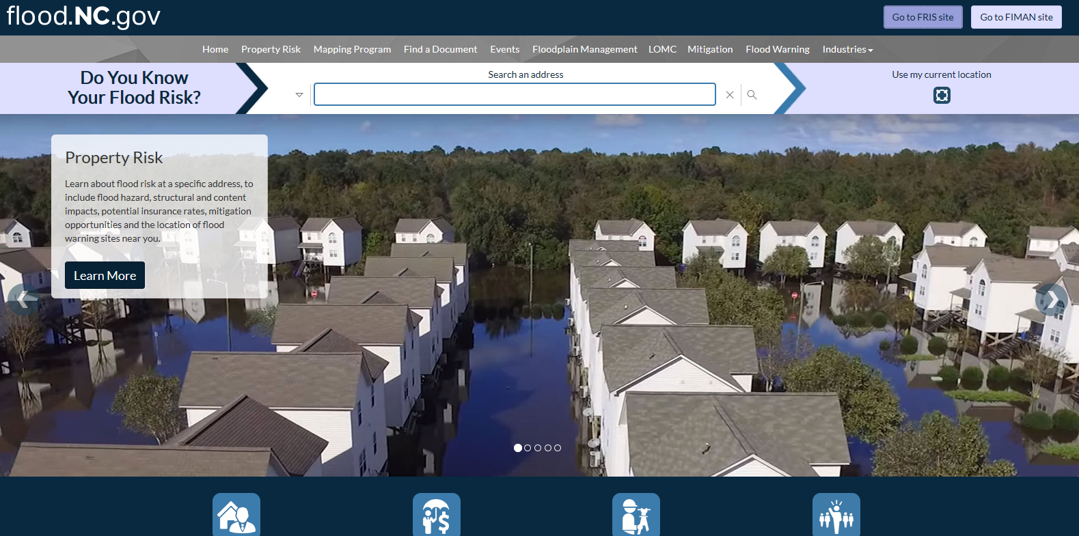
North Carolina Floodplain Mapping Program

Slide 2
Why Did NC Undertake this Project?

Slide 3
State Strategies
Creation of a statewide program to acquire, process, and disseminate current, accurate, and detailed elevation data, flood hazard studies, and Digital Flood Insurance Rate Maps
Establishment of North Carolina as a Cooperating Technical State (CTS) by FEMA

Slide 4
Cooperating Technical State (CTS) Agreement
Signed September 15, 2000
Establishes formal overall partnership between State, Federal, and Local partners
State, FEMA, and other Federal partners will collaborate on flood hazard identification and post-flood hazard verification activities
Establishes CTS Committee
Signed by State and all partners

Slide 5
Program Objectives
Define boundary and base flood elevation for 1% annual chance flood
Minimize long-term losses through better floodplain management
Time and cost-efficient FIRM updates
Provide 24-hour online access to GIS data and maps
Use accurate, detailed, digital data to make more precise flood risk determinations

Slide 6
Notes:
NCFMP is currently in the process of updating 50 counties with back populated information.
The 50 western counties will still have to use FMIS for their information. As we fill in the data these counties will move to the new site.

Slide 7
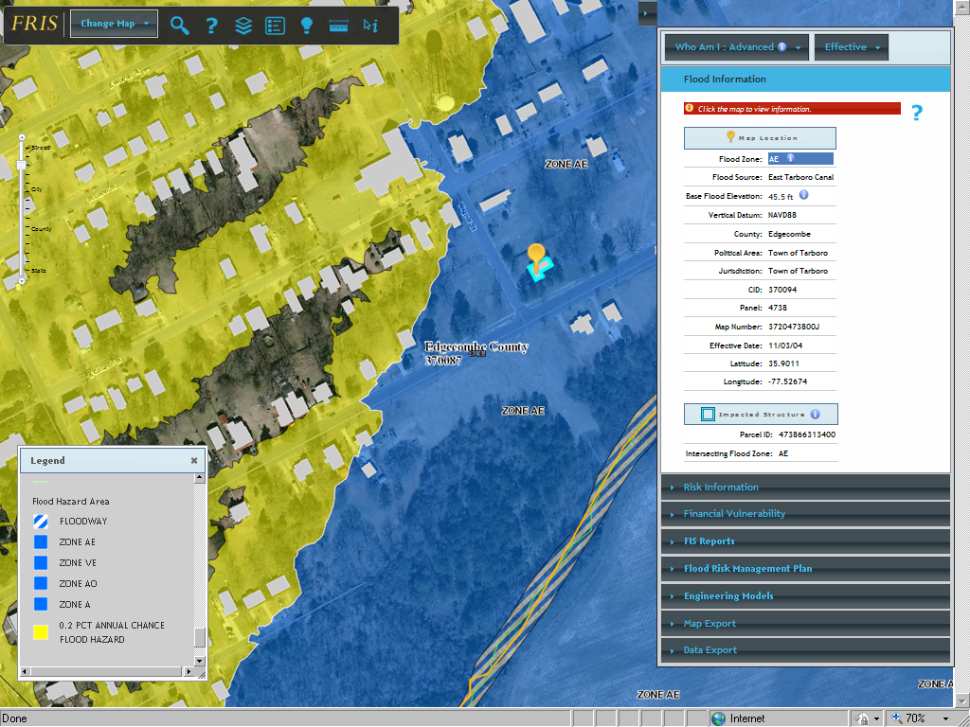
FRIS DFIRM Map Symbology

Slide 8
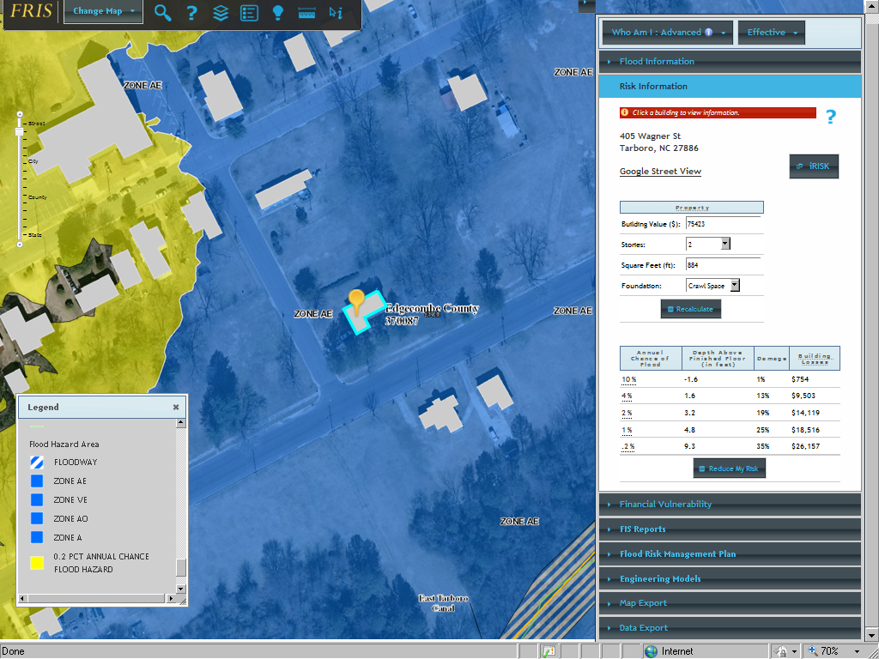
FRIS DFIRM Map Symbology

Slide 9
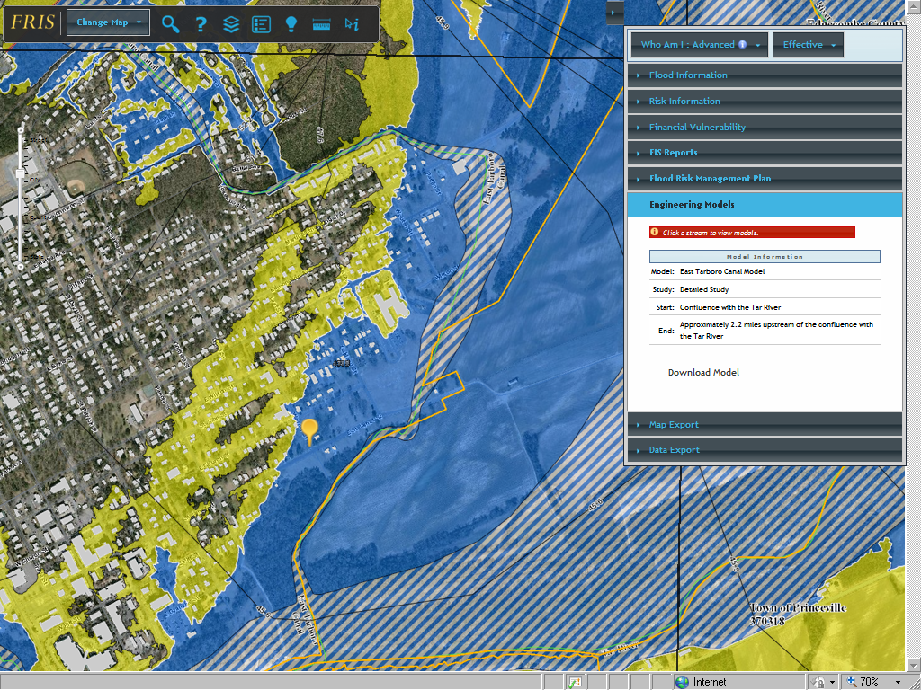
FRIS DFIRM Map Symbology

Slide 10
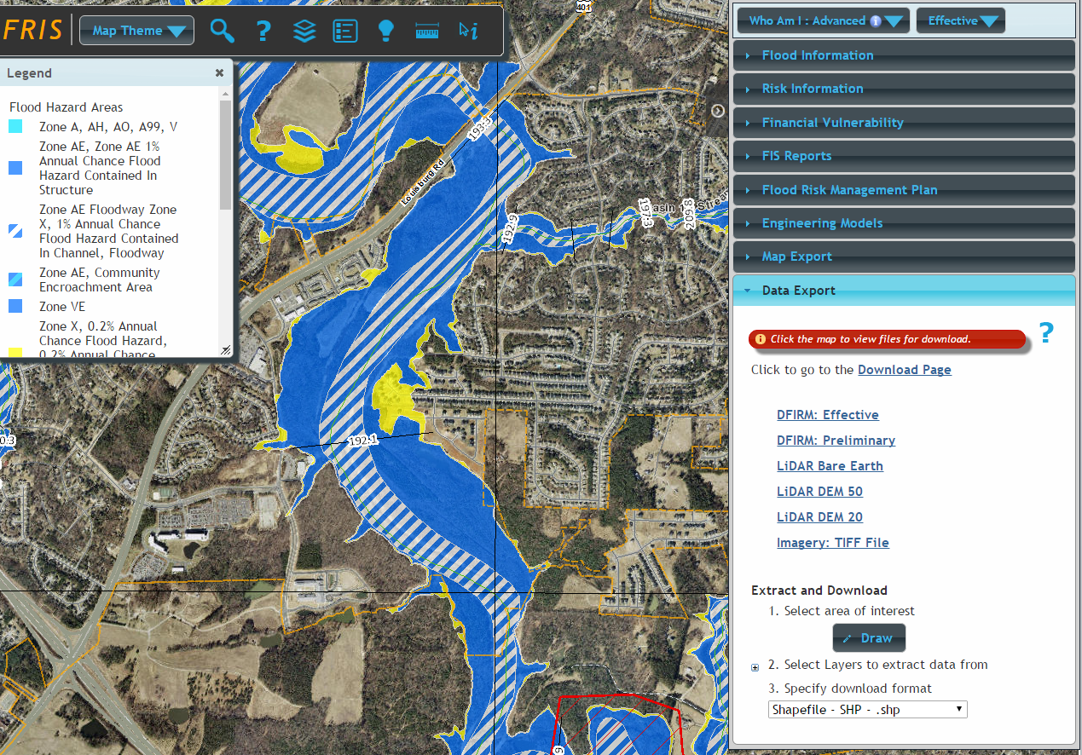

Slide 11
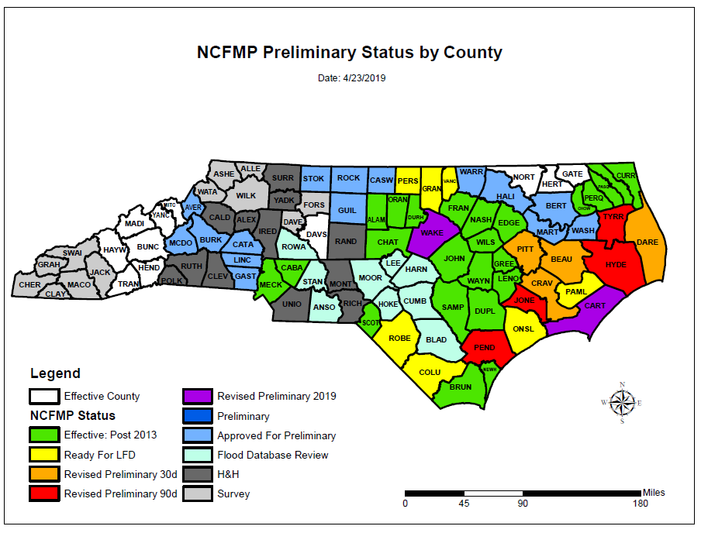
North Carolina Floodplain Mapping Program Current Status
Effective Post 2013 - 24
Ready for LFD - 7
90 Preliminary (Appeals) - 4
30 Preliminary (Comments) - 4
Ready to Issue Revised Prelim - 2
Preliminary- 0
Ready to Issue Prelim - 2
Flood Database Review - 9
H&H Review - 12
Field Survey - 12

Slide 13
Flood Inundation Mapping Alert Network (FIMAN)
https://fiman.nc.gov/fiman/

Slide 14
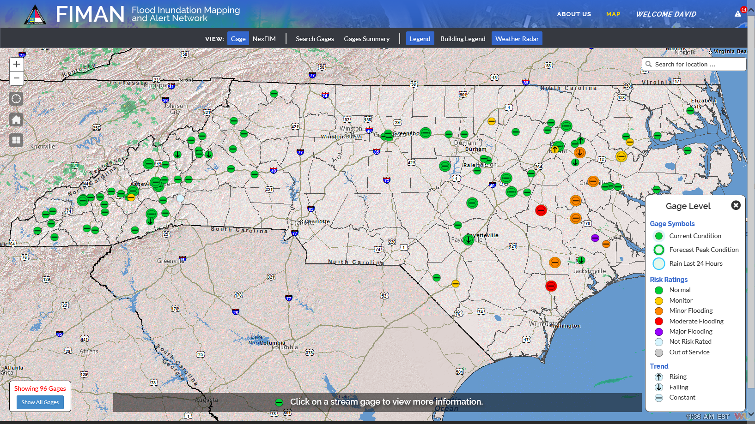
Home Screen / Current Severity

Slide 15
Gage View - Dashboard Concept
Three Tabs
Current: Provides most recent inundation extent
Scenario: Planning tool for visualization and impact
Forecast: Shows timeline using NWS forecast data
Info Widgets
Interactive for rainfall, stage, flow, forecast, impacts

Slide 16
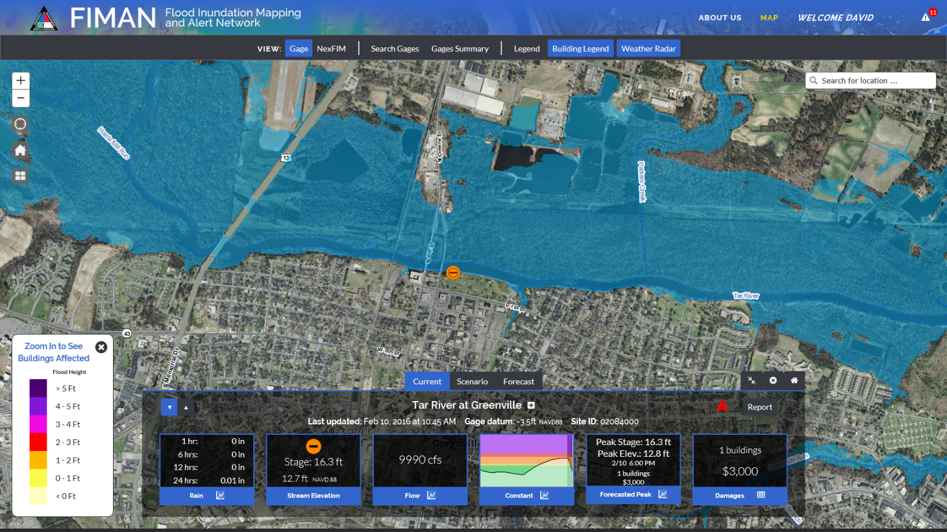
Current Inundation Level and Map

Slide 17
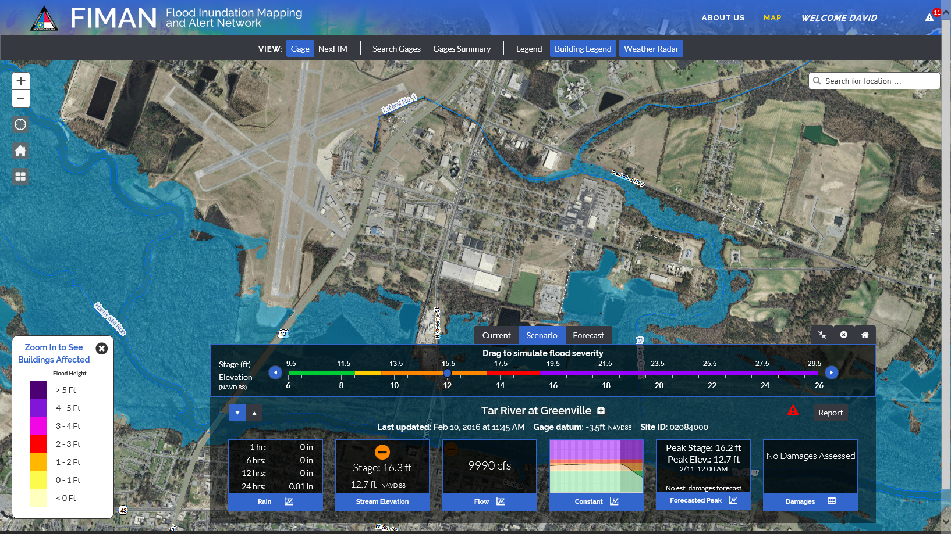
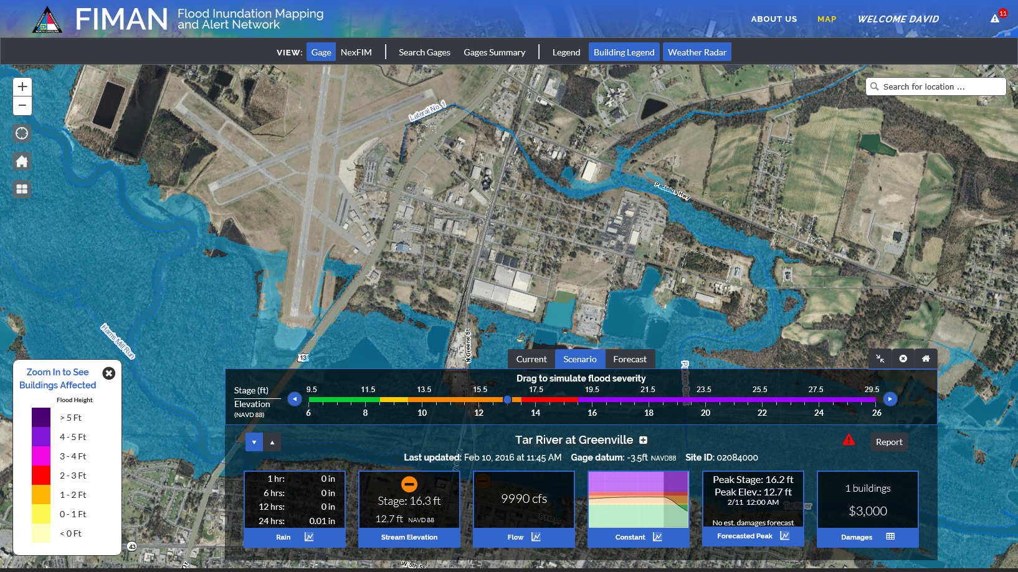
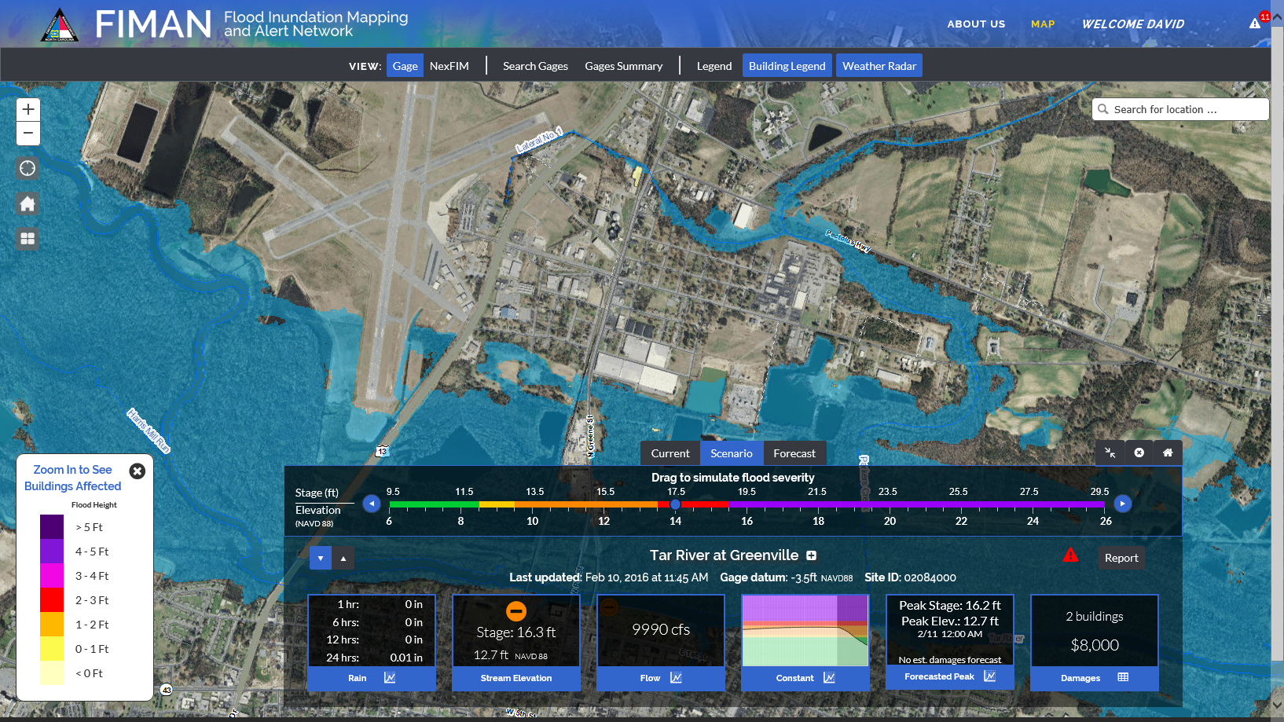
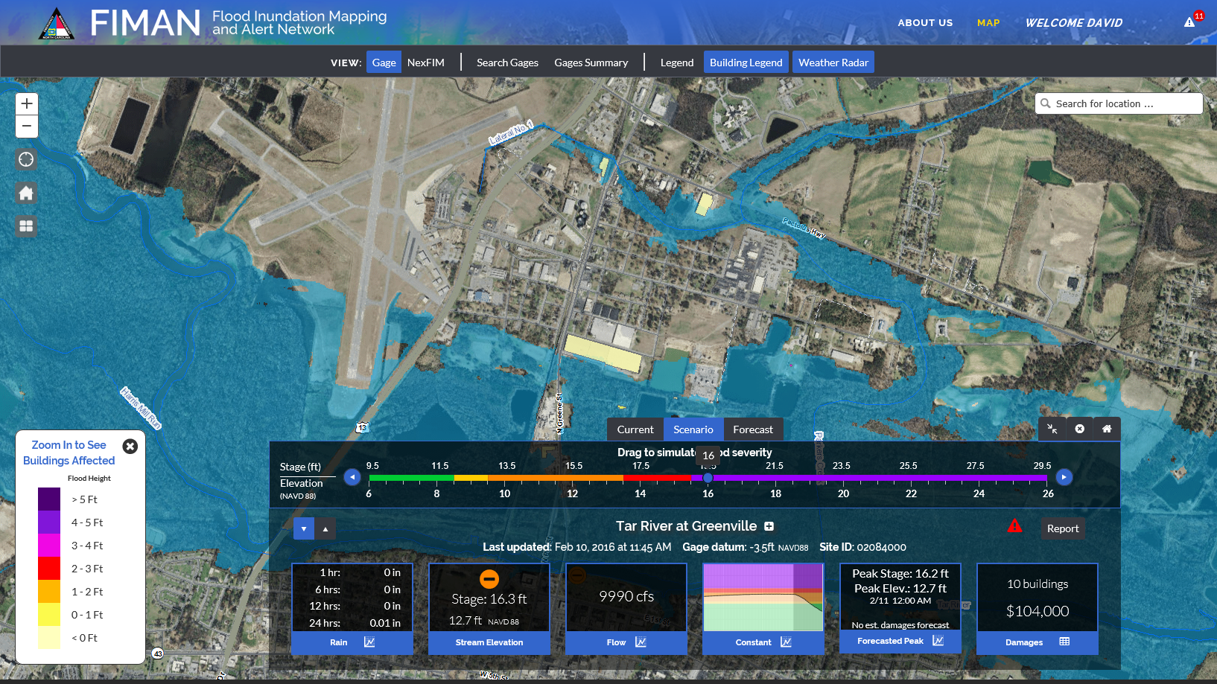
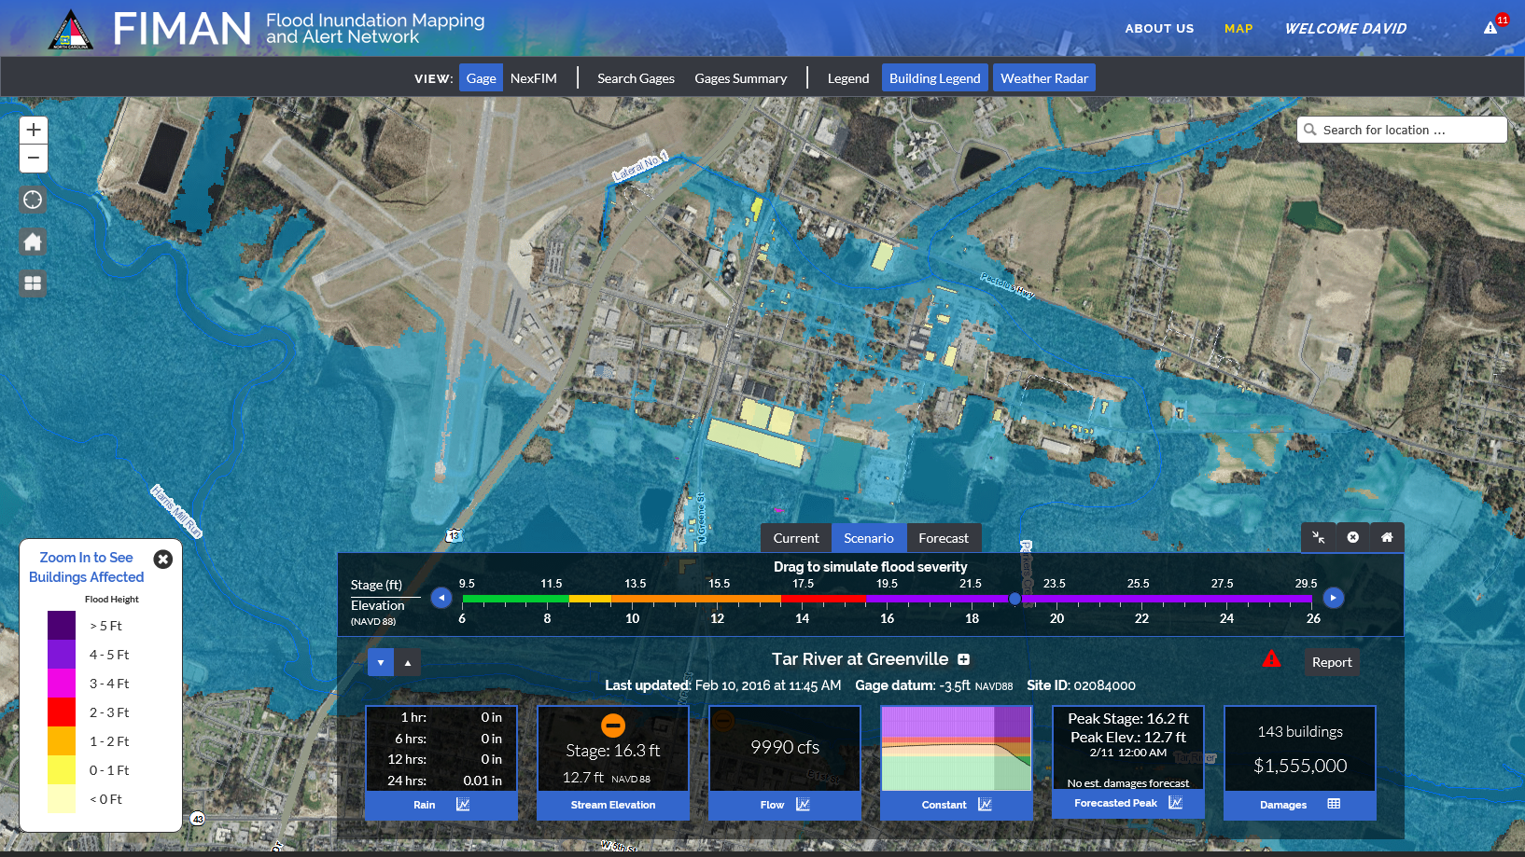
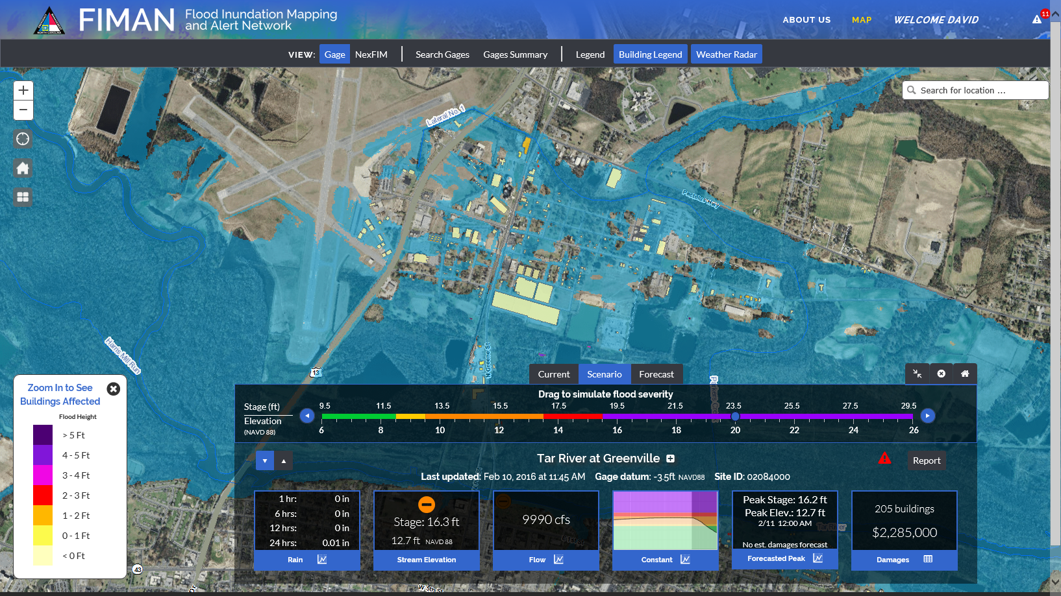
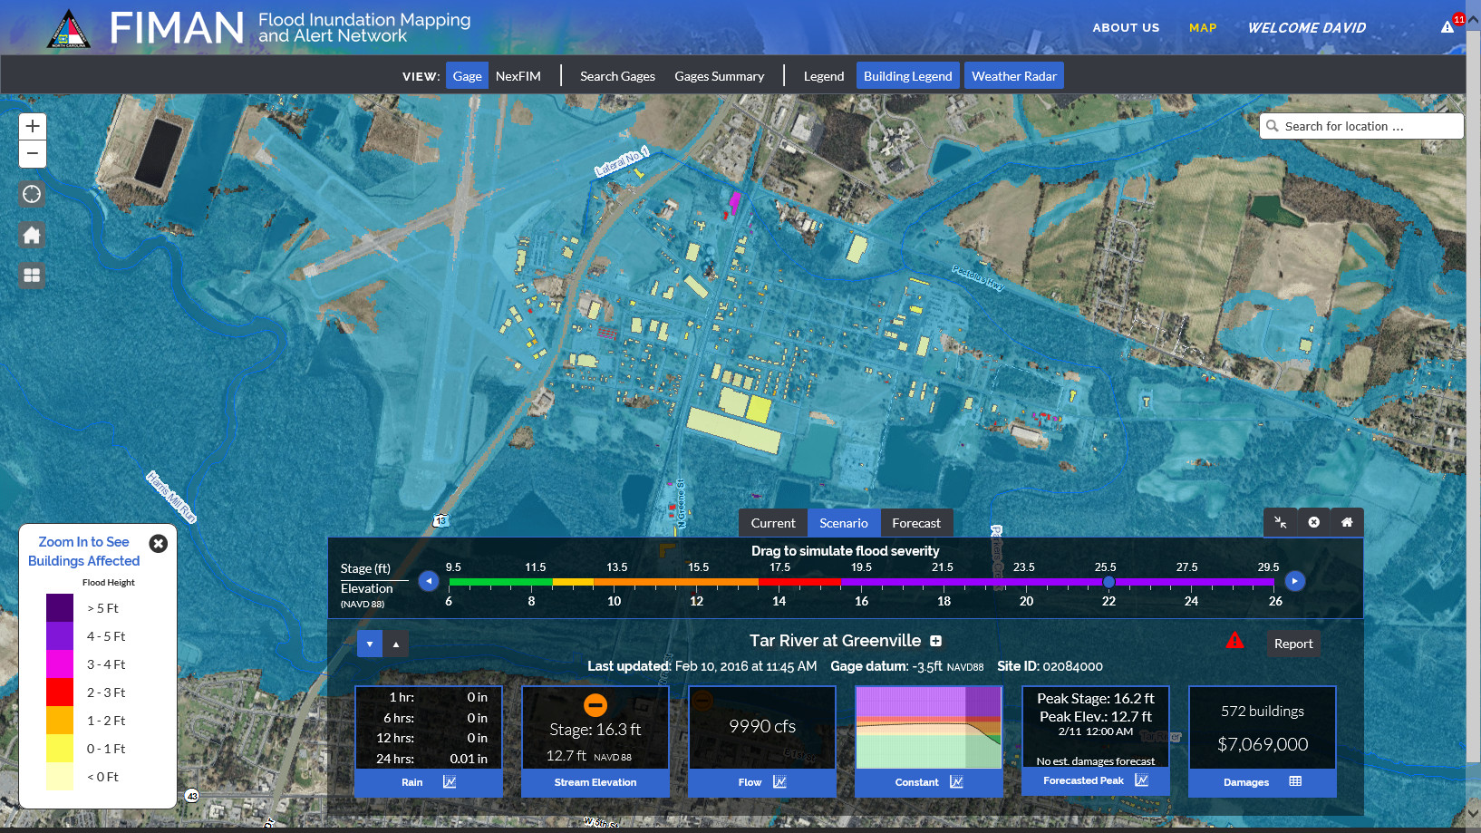
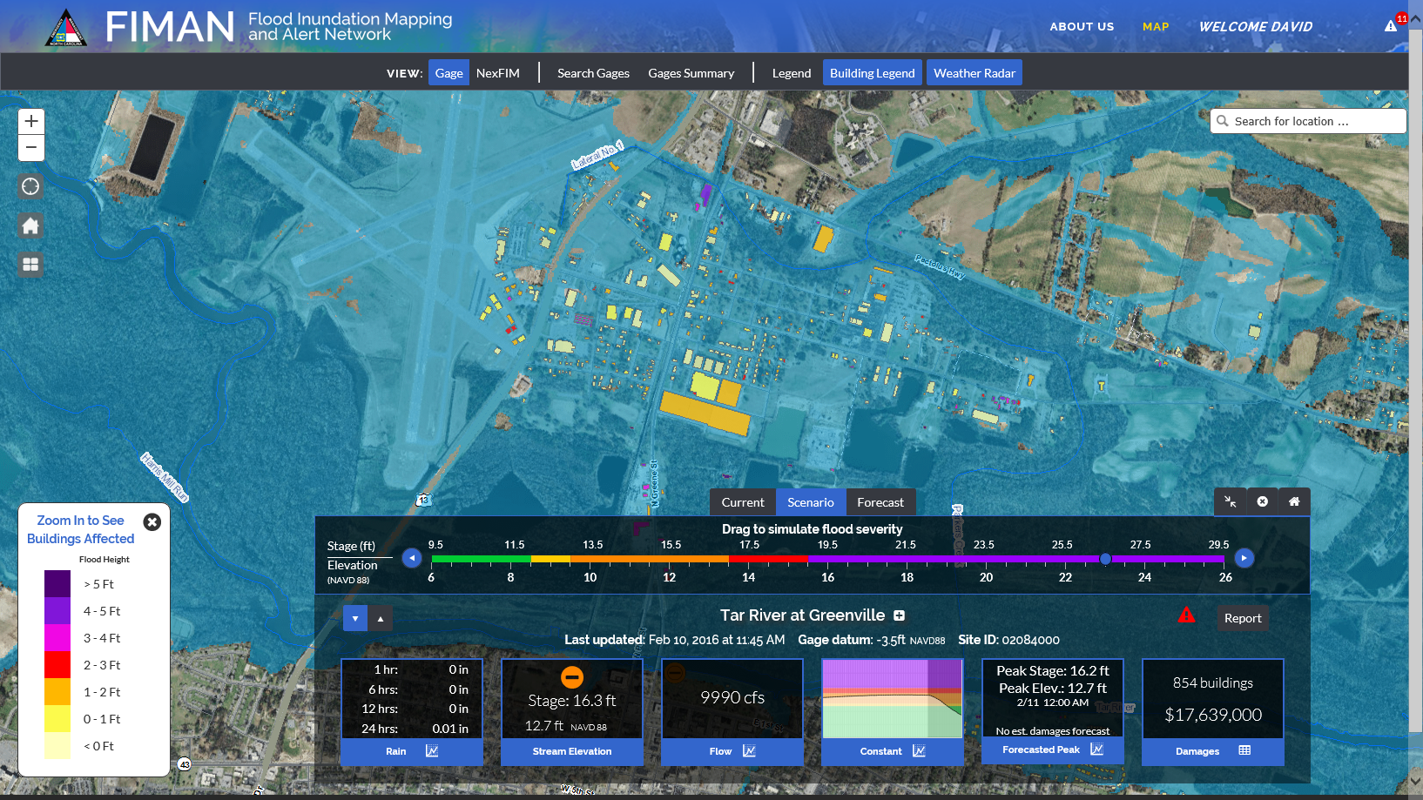
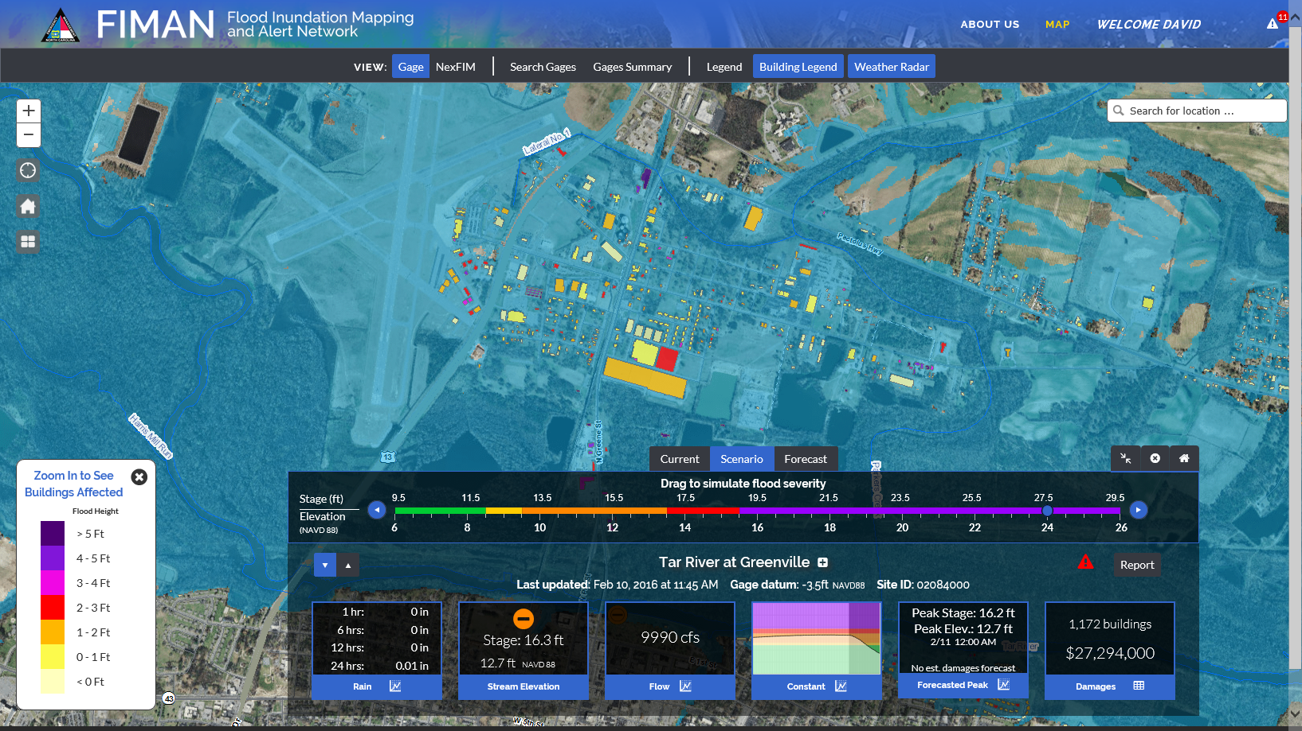
Flood Scenario Mode

Slide 18
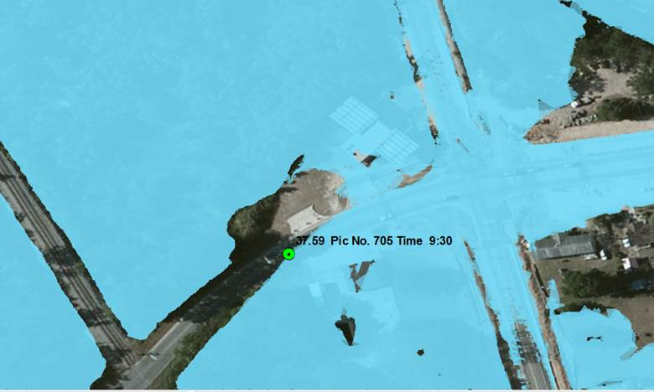
Comparing LiDAR based flood mapping to surveyed edge of water

Slide 19
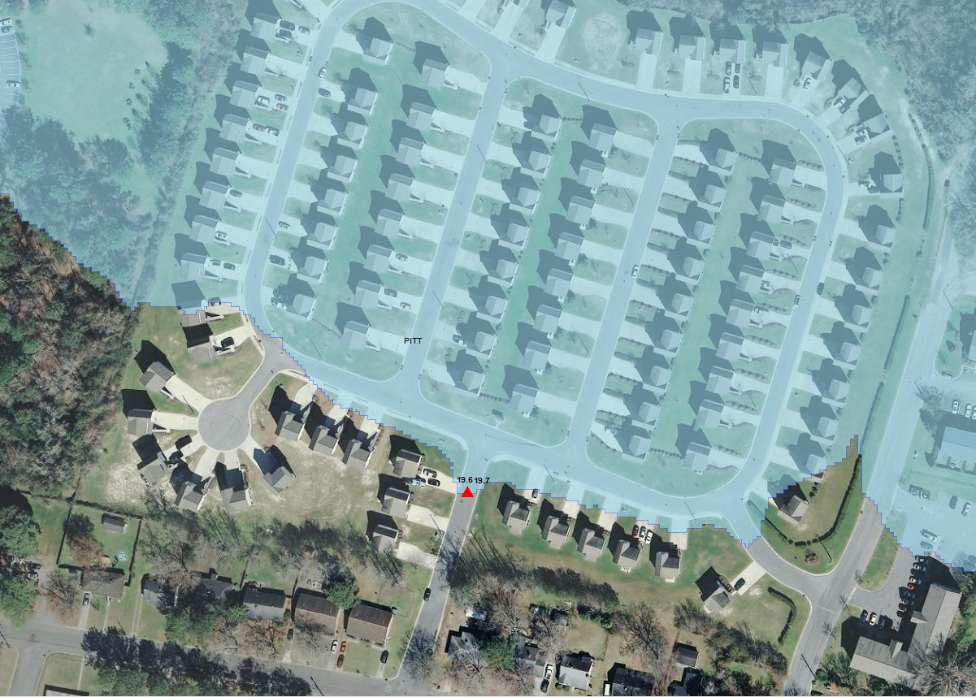

Slide 20
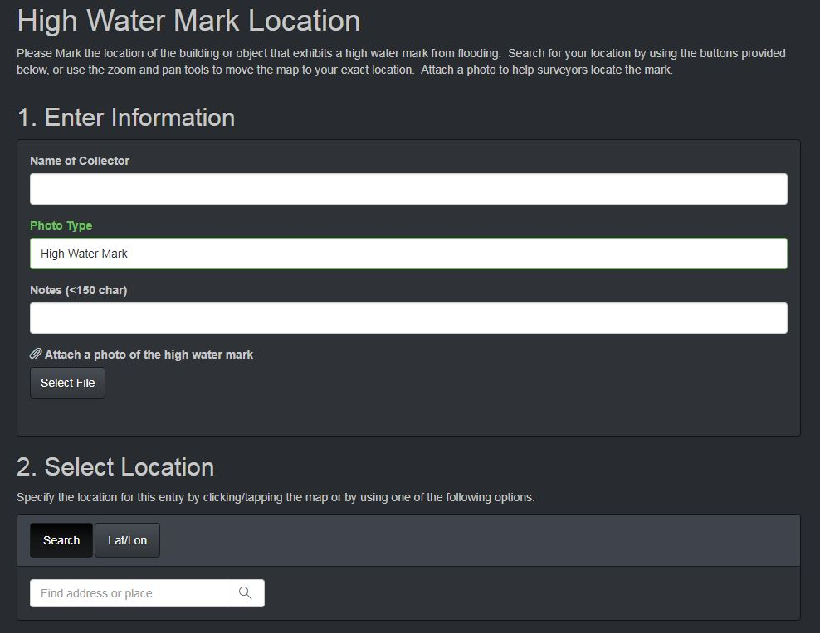
High Water Mark (HWM) Photo Application
High Water Mark Location Collection Tool
The high water mark collection tool can be accessed using the link below:
https://bit.ly/EM_HWM

Slide 21
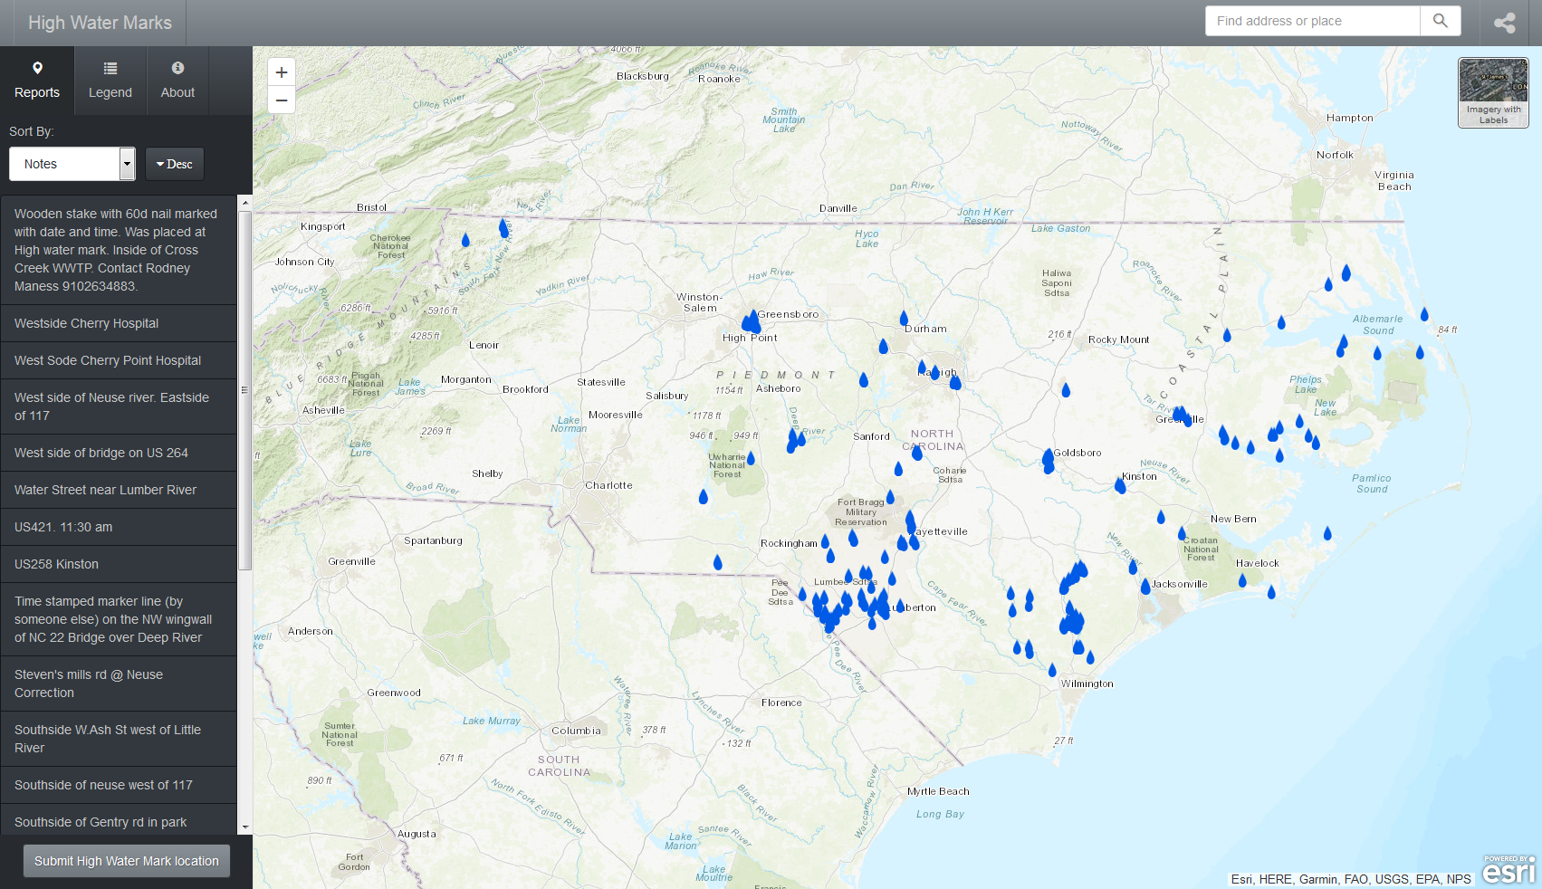
High Water Marks Submitted

Slide 22
Lidar Phases
Phase 1- Collected by USGS and NCFMP with Hurricane Sandy funds 2014
Phase 2- collected by NCFMP and NCDOT in conjunction with USGS - 2014
Phase 3- collected by NCFMP and NCDOT with assistance from the General Assembly-2015
Phase 4- collected by NCFMP and NCDOT-2016-17
Phase 5- collected by NCFMP and NCDOT -2017
Phase 1, 2, and 3
2 points per square meter/linear sensor
Phase 4 and 5
8 points per square meter/Geiger sensor
Phase 4
Phase 3
Phase 2
Phase 1
Phase 5
All available Data will be provided on rmp.nc.gov/sdd
Notes:
Explain the current phases of the lidar
Phase one was done by USGS with Hurricane sandy Money. NC agreed to do

Slide 23
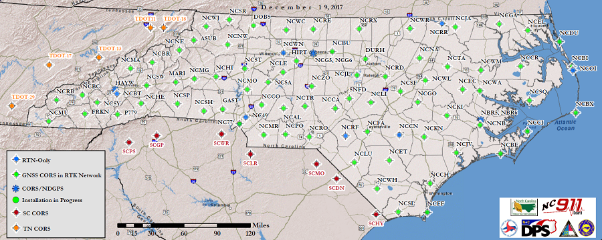
North Carolina (NC) Continuously Operating Reference Station (CORS) Network
2019
Future CORS location =

Slide 24
Tiling Scheme based on the North Carolina State Plane Coordinate System

Slide 26
Questions?
Gary Thompson, PLS
NC Emergency Management
Risk Management/Geodetic Survey
4105 Reedy Creek Road
Raleigh, NC 27607
Main office: 919-733-3836
Direct line: 919-948-7844
gary.thompson@ncdps.gov

