Slide 1
New National Spatial Reference System Impacts to the 3D Elevation Program
Barry Miller, GISP
United States Geological Survey
National Geospatial Technical Operations Center
May 7, 2019

Slide 2
Presentation Overview
        What is the 3D Elevation Program (3DEP)?
        What Will the New National Spatial Reference System (NSRS) Change for USGS?
        3DEP Products and Transition Planning
        Impacts to 3DEP Tiling Scheme
        Questions

Slide 3
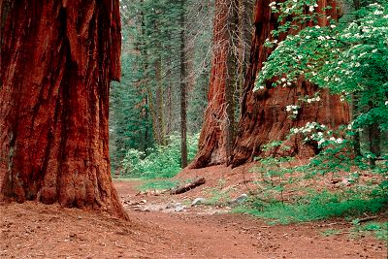
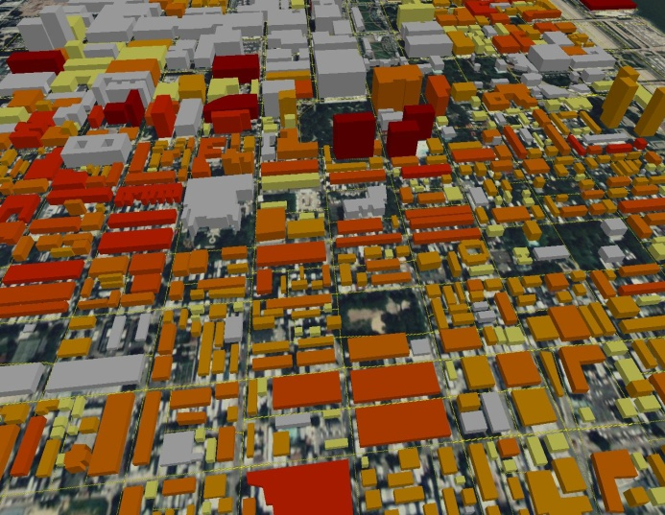
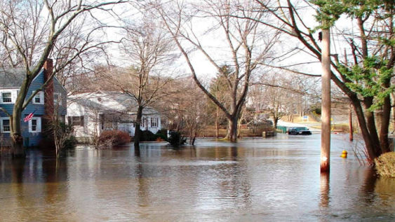
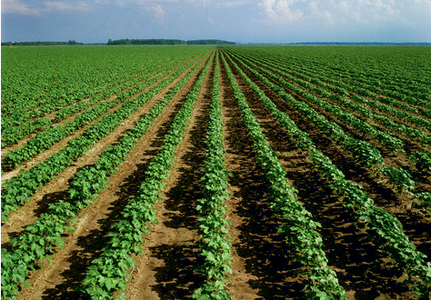
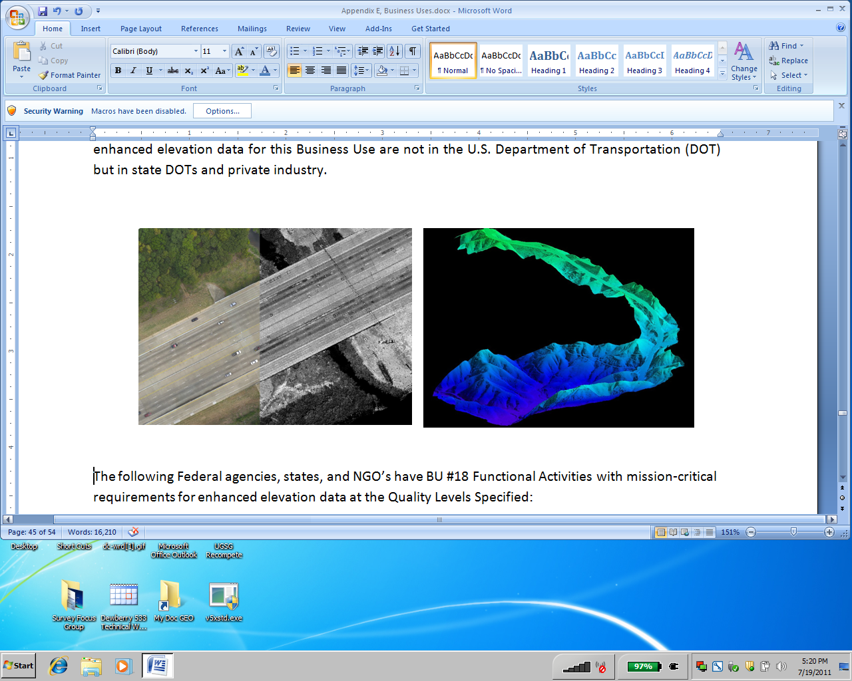
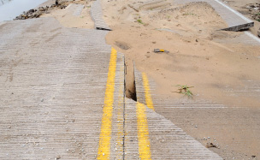
What is the 3D Elevation Program?
3DEP is a call for community action to…
Address the mission-critical requirements of 34 Federal agencies,
50 states, and a sampling of local governments, tribes, private and not‐for profit organizations documented in the National Enhanced Elevation Assessment
Increase the overall investment in 3D data from about $45 M to $146 M annually to return more than $690 million annually in new benefits
Leverage collaboration among Federal, state, local and tribal partners to systematically complete national 3D data coverage in 8 years
Completely refresh national elevation data holdings with new lidar and IFSAR elevation data products and services
Natural Resource Conservation
Infrastructure Management
Flood Risk Mitigation
Precision Farming
Land Navigation
and Safety
Geologic Resources and Hazards Mitigation
Notes:
The USGS National Geospatial Program is developing the 3D Elevation Program (3DEP) to respond to growing needs for high-quality topographic data of the Nation's natural and constructed features.
The primary goal of 3DEP is to systematically collect 3D elevation data in the form of light detection and ranging (lidar) data over the conterminous United States, Hawaii, and the U.S. territories, Interferometric synthetic aperture radar (IFSAR) data will be acquired for Alaska, where cloud cover and remote locations preclude the use of lidar in much of the State.
with data acquired over an 8-year period.
The 3DEP initiative is based on the results of the National Enhanced Elevation Assessment that documented more than 600 business uses across 34 Federal agencies, all 50 States, selected local government and Tribal offices, and private and nonprofit organizations.
A fully funded and implemented 3DEP would provide more than $690 million annually in new benefits to government entities, the private sector, and citizens.
http://nationalmap.gov/3DEP/3dep_whatis.html

Slide 4
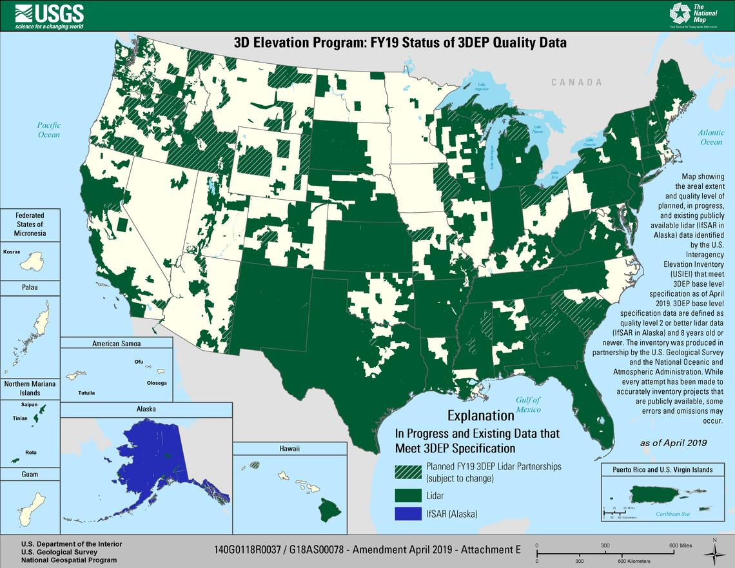
FY19 Status of 3DEP Quality Data
Notes:
In July 2015, the USGS issued a Broad Agency Announcement (BAA) for 3DEP.
The BAA provides detailed information on how to partner with the USGS and other Federal agencies to acquire high-quality 3D Elevation data.
This map represents 3DEP data acquisition as of April, 2019
https://www.usgs.gov/core-science-systems/ngp/3dep/fy19baa

Slide 5
What Will the New NSRS Change for the USGS 3DEP?
        Horizontal datum will need to be updated from North America Datum (NAD) 1983 (various epochs) to four new horizontal reference frames: North American Terrestrial Reference Frame (NATRF) 2022, Mariana Terrestrial Reference Frame 2022, Pacific Terrestrial Reference Frame 2022, and Caribbean Terrestrial Reference Frame 2022
        Vertical datum will need to be updated from North America Vertical Datum (NAVD) 1988 to the North American-Pacific Geopotential Datum (NAPGD) 2022
        Tile Indexing for the USGS 1/3, 1, and 2 arc-second seamless Digital Elevation Model (DEM) and the 1 meter DEMs will have to be updated to reflect coordinate shifts
        Coordinate systems and EPSG Codes used by software packages we use (Esri, QGIS/GDAL, PDAL, LASTools, Global Mapper) will have to be updated to include not only the new NSRS but also the projections (UTM or Albers Equal Area)

Slide 6
3DEP Products and Transition Planning

Slide 7
3DEP Products
Layer
Seamless DEM
2 Arc Second (~ 60 meter resolution)
1 Arc Second (~ 30 meter resolution)
1/3 Arc Second (~ 10 meter resolution)
Project Based DEM
1 meter
5 meter*
Source Data
Source DEM – Original Product Resolution (OPR)
Lidar Point Cloud
Digital Surface Model (DSM)*
Orthorectified Radar Intensity Imagery (ORI)*
        * Alaska Only
Notes:
An integral part of the 3D Elevation Program (3DEP) Plan is to expand the elevation products and services offered through The National Map. The USGS continues to produce the nationally seamless elevation layers of The National Map - 1/3, 1, and 2 arc-second digital elevation models (DEMs) traditionally referred to as the National Elevation Dataset (NED). However, beginning in 2015 these seamless layers are offered under the 3DEP brand along with other new elevation products. The new product offerings to date include the classified lidar point cloud; DEMs in their original (source) resolution; IFSAR digital surface model and ortho-rectified radar intensity imagery; and a new standard USGS 1-meter DEM for the conterminous US.

Slide 8
Nationwide Seamless DEM Layers
2 Arc-second, 1 Arc-second, 1/3 Arc-second
        Seamless
        Bare earth
        Hydro-flattened
        1x1 degree of lat and lon blocks
        ArcGrid, IMG and Grid Float formats
        Horizontal Datum: GCS North American 1983 (1986)
        Vertical Datum: North American Vertical Datum 1988 (Various Geoid Models)
Notes:
Seamless – all adjacent projects mosaicked and blended together to create a nationwide seamless dataset
Bare earth – vegetation, buildings removed
Hydro-flattened – water bodies single elevation, Rivers and streams level bank to bank, and water level consistently lower as the river runs down stream
- bridges have been removed but not culverts
1 deg x 1 degree with a 6 pixel overlap between tiles.
Available in 3 file formats, which are selectable at the time of download.

Slide 9
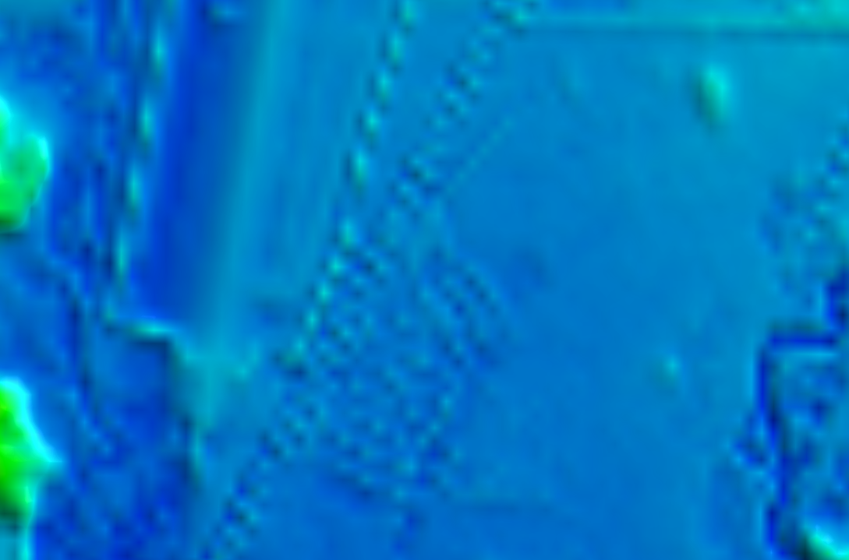
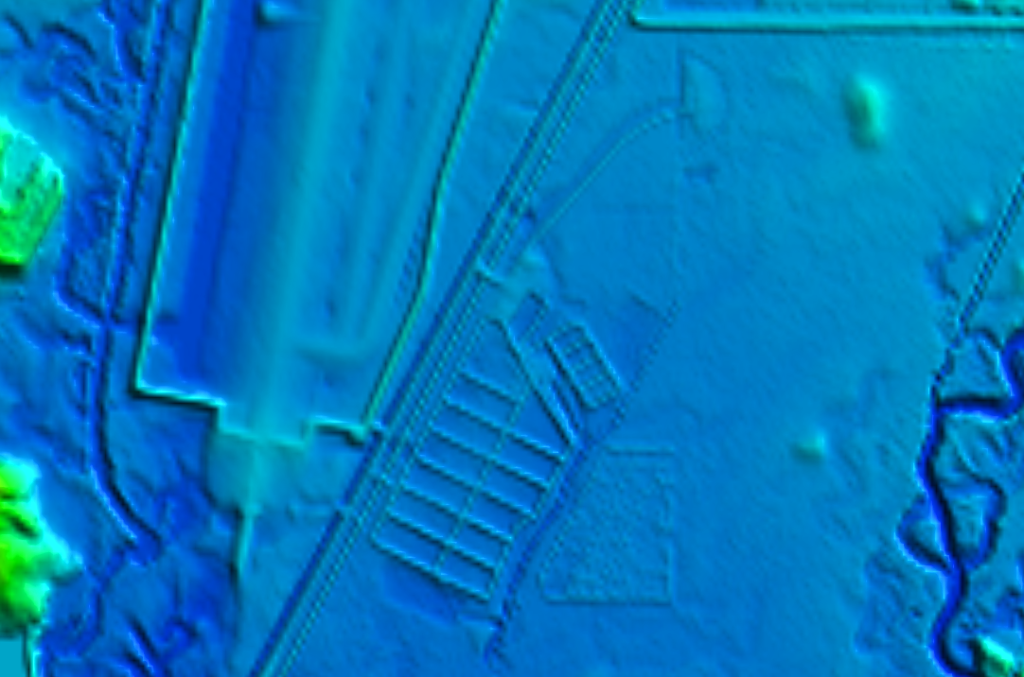
1 Arc-second
1/3 Arc-second
Notes:
1 arc-sec
1/3 arc-sec

Slide 10
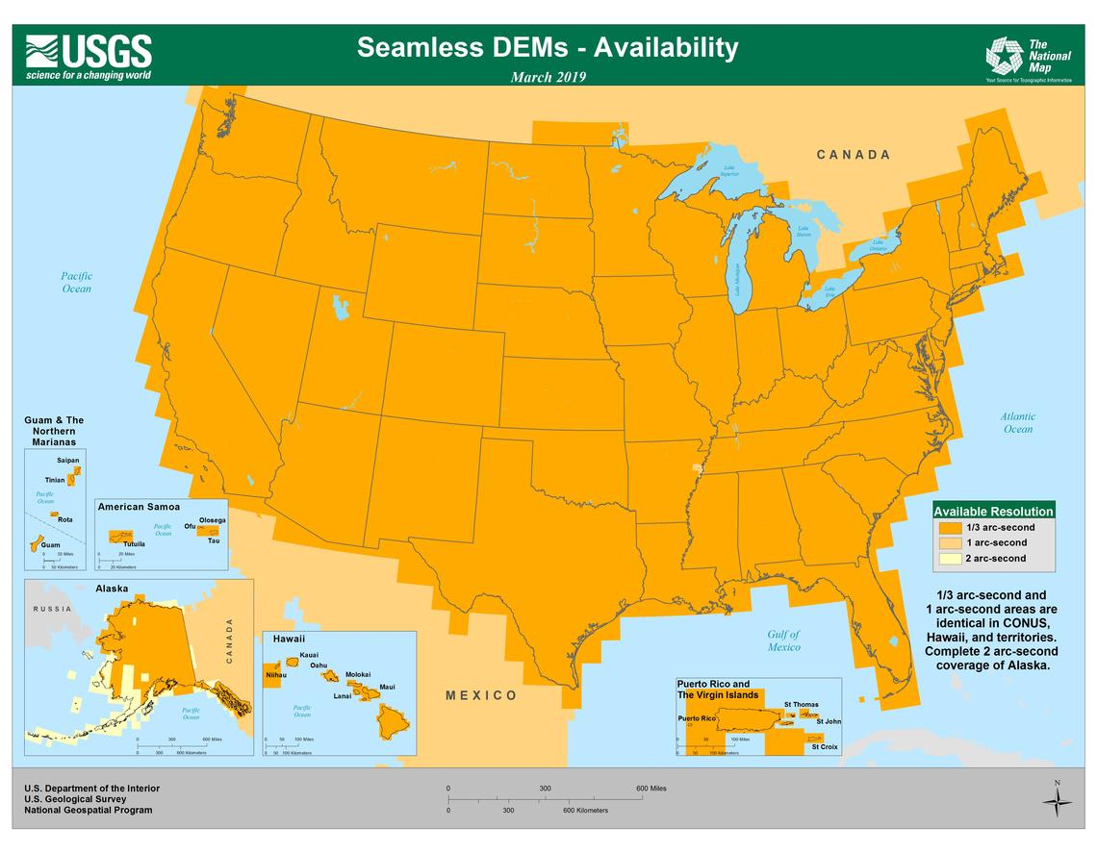
Seamless DEM Layer Availability
Notes:
Orange – 1/3 arc-second, also 1 arc second
Tan – 1 arc second
Off white – 2 arc second
https://www.usgs.gov/core-science-systems/ngp/3dep/3dep-product-availability-maps

Slide 11
Nationwide Seamless DEM Layers
Transition Planning
        Six pixel overlap between raster tiles (minimum 60 meters)
        Small horizontal shifts will be fine
        Will have to transform NAD 1983 (1986) to NAD 1983 (2011) first unless NGS builds a transformation that will allow direct conversion from the older version of NAD 1983
        The Geoid Model used for the NAVD 1988 vertical datum is not defined for older lidar projects or contour-derived portions of the DEM
        The accuracy of the contour-derived DEMs is not as good as lidar so any transformation errors will be overwhelmed by the source accuracy
        All new 3DEP lidar projects include information on the vertical datum and Geoid model
        Will need to re-tile the 1x1 degree blocks due to small coordinate shifts

Slide 12
1 Meter DEM
  Only where original DEM resolution is 1 meter or better
  Project-based, hydro-flattened
  10,000 x 10,000 meter tiles
  IMG format
        Horizontal Datum: North American 1983 UTM Zone XX
        Vertical Datum: North American Vertical Datum 1988 (Various Geoid Models)
Notes:
1m – new product in 2015
- only for new projects moving forward, no plans to populate with older projects at this time.
- single file for the entire project

Slide 13
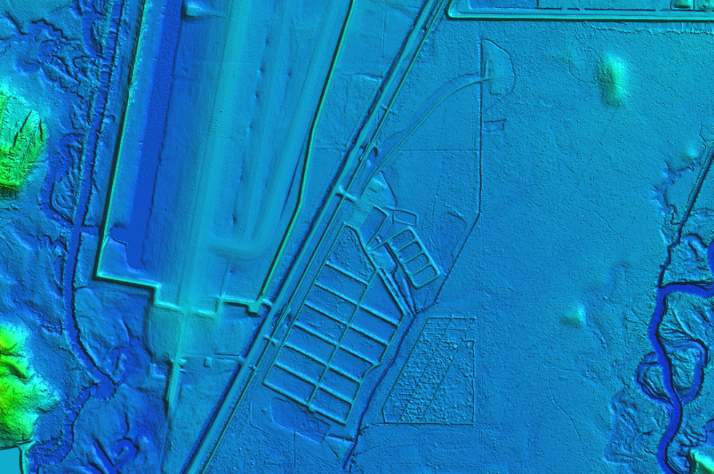
1-meter
Notes:
1 meter
Note striking difference in the 1m resolution vs. what was available prior to the 3DEP program.

Slide 14
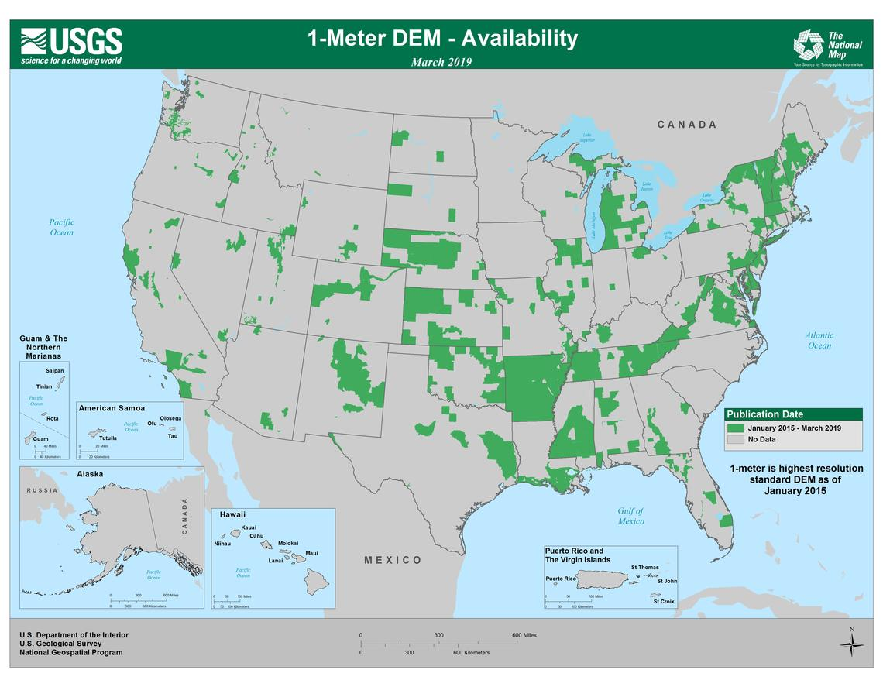
1 Meter DEM Availability
Notes:
Green – 1 meter elevation projects as of March.
https://www.usgs.gov/core-science-systems/ngp/3dep/3dep-product-availability-maps

Slide 15
1 Meter DEM
  Transition Planning
        Will have to transform NAD 1983 (1986) to NAD 1983 (2011) first unless NGS builds a transformation that will allow direct conversion from the older version of NAD 1983
        All 3DEP lidar projects include information on the vertical datum and Geoid model, although this is not defined in the 1 meter raster header
        New National Indexing Scheme is being used for all new lidar projects, will be impacted
        Will need to test if re-projecting and re-tiling the source DEMs introduces significantly less transformation errors than just re-projecting the 1 meter derived product

Slide 16
Source (OPR) DEMs
  Includes projects that do not meet the criteria for inclusion
  in the 1 Meter DEM layer
  Project-based
  Bare earth
  Original projection and resolution
  Vertical units converted to meters
  ArcGrid file format
Notes:
Note on bare earth - we’re considering providing DEMs with other surface treatments (i.e., hydro-enforced, hydro-conditioned, no hydro editing (leaving bridges for transportation applications, etc.)
Tiling scheme and sizes as they were delivered to us by contractors and partners.

Slide 17
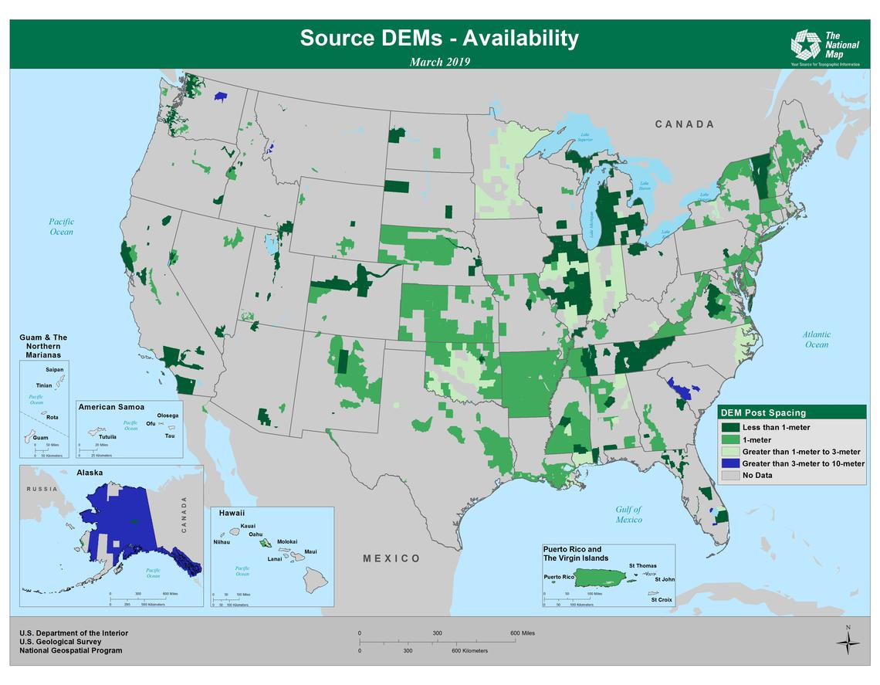
Source (OPR) DEM Availability
Notes:
Blue - All this data in AK – should excite some people!
AK data is considered source resolution, but I will discuss the Alaska data later in this presentation.
New projects starting in 2015
Dark Green – higher resolution than 1 m (usually 0.7 meter)
Medium Green – 1 m Shown on previous map
Light Green – 1-3 meter
https://www.usgs.gov/core-science-systems/ngp/3dep/3dep-product-availability-maps

Slide 18
Lidar Point Cloud
  Point classifications
  All points provided to us
  Tile-based
  Original tile size
  Horizontal Datum: Original projection, typically UTM or State Plane
  Vertical Datum: NAVD 1988 (Various Geoid Models)
  .las/.laz file format
Notes:
Describe that the tiles can vary in size/volume

Slide 19
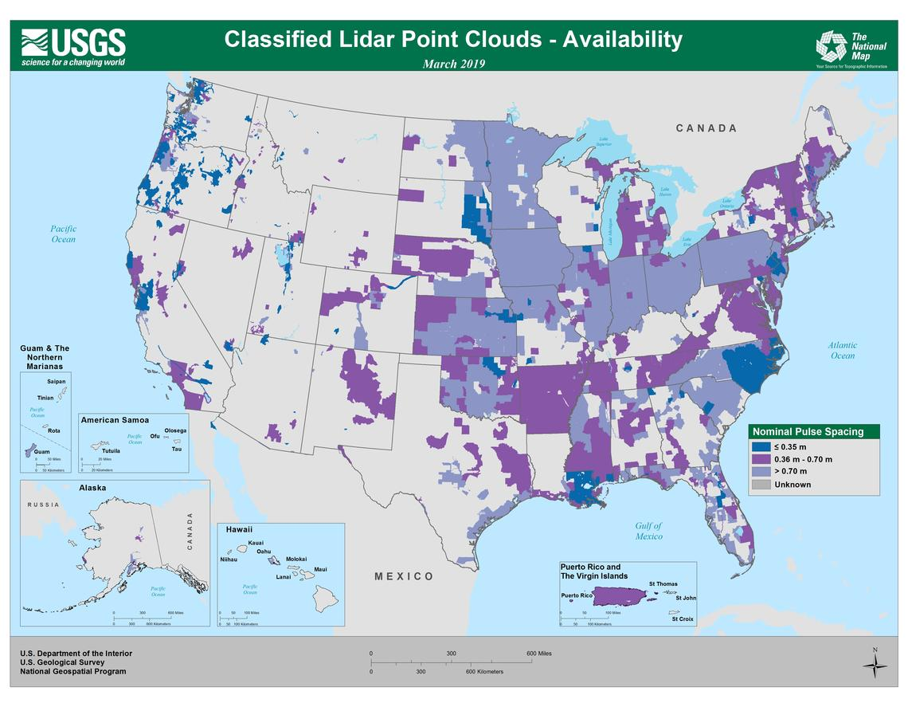
Lidar Point Cloud Availability
Notes:
Nominal Point Spacing
Blue – 1 ft
Dark purple – 2 ppm
Light purple - 1 m or higher
Gray – unknown (inherited projects with poor metadata)
https://www.usgs.gov/core-science-systems/ngp/3dep/3dep-product-availability-maps

Slide 20
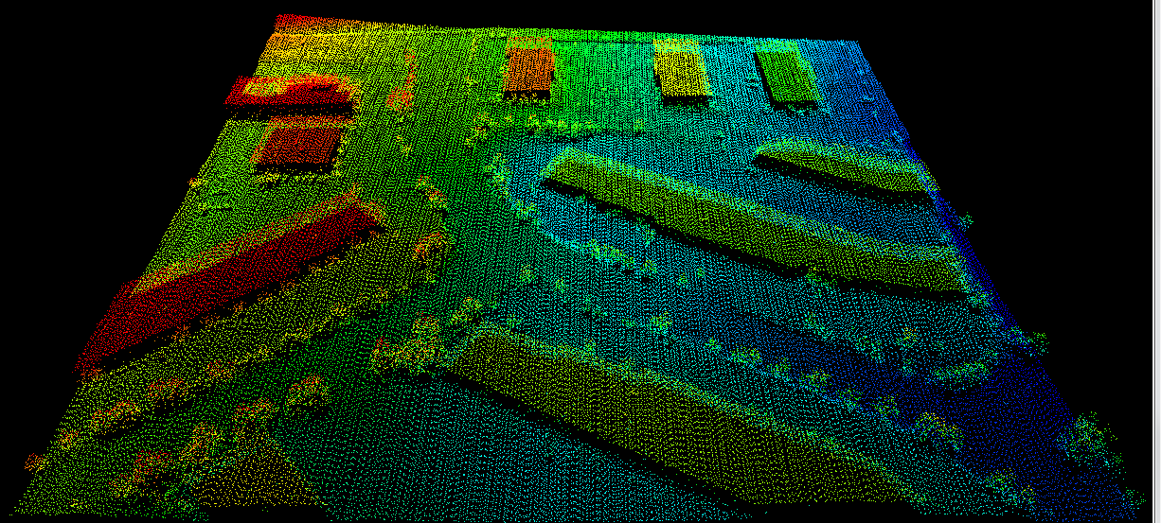
Lidar Point Cloud
Notes:
Lidar point cloud. Colored according to elevation

Slide 21
OPR DEM and Lidar Point Cloud
  Transition Planning
        All projects stored in their original horizontal and vertical projection
        Will probably not update these to the new NSRS unless there is a need
        Contracts for new data acquisition will be modified to match the new NSRS
        May have to re-use the source OPR DEMs to reproduce the 1 meter DEM if the accuracy trade-off is worth the processing time
Notes:
1/9 arc sec – approximately 3 meter discontinued with the addition of the new 1m layer for 3DEP
- also project based, 15x15 minute of latitude and longitude
- still the highest resolution available for approximately 1/3 of the country.
1m – new product in 2015
- only for new projects moving forward, no plans to populate with older projects at this time.
- single file for the entire project

Slide 22
IFSAR and Related Products
  5 Meter DEM
  Digital Surface Model (DSM)
  Orthorectified Radar Intensity Image (ORI)
Notes:
Currently in AK only

Slide 23
5 meter DEM
Alaska IFSAR source
Project-based
Bare earth
Hydro-flattened
15’ x 15’ tile
GeoTIFF format
Horizontal Datum: NAD 1983 (CORS 1996) Alaska Albers Equal Area projection
Vertical Datum: NAVD 1988 (Various Geoid Models)

Slide 24
Other IFSAR Products
DSM
  Digital Surface Model (DSM)
  Project-based
  Alaska Albers Equal Area projection
  GeoTIFF format
ORI
  Orthorectified Radar Intensity Image (ORI)
  Project-based
  Alaska Albers Equal Area projection
  GeoTIFF format

Slide 25
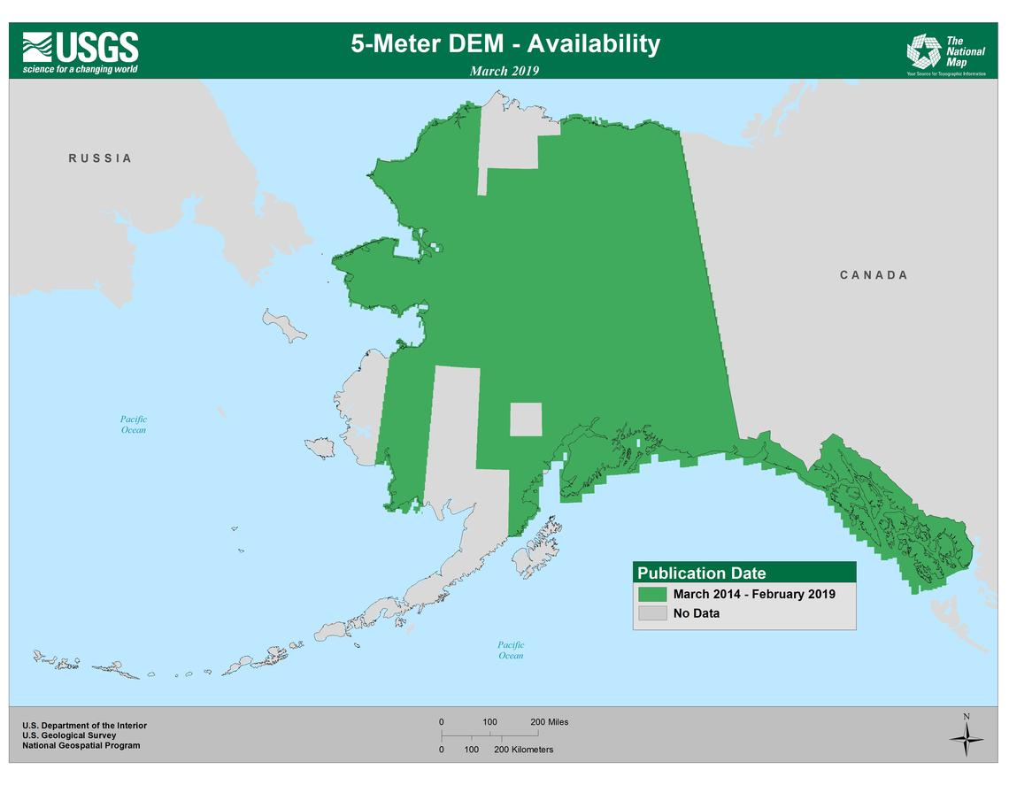
5-Meter DEM, DSM, and ORI
Notes:
All the 5-meter DEM is created from IFSAR
https://www.usgs.gov/core-science-systems/ngp/3dep/3dep-product-availability-maps

Slide 26
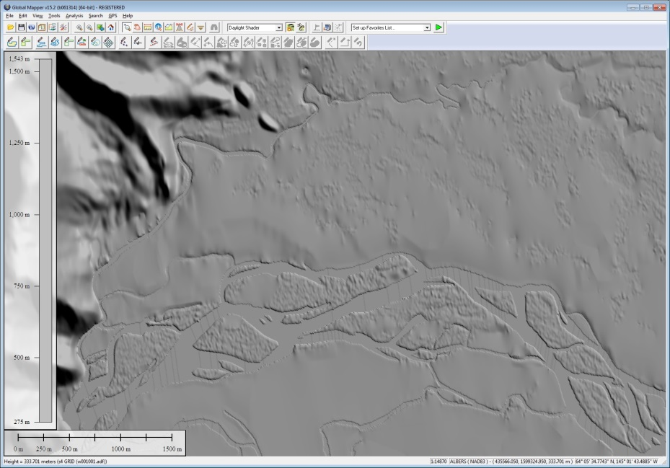
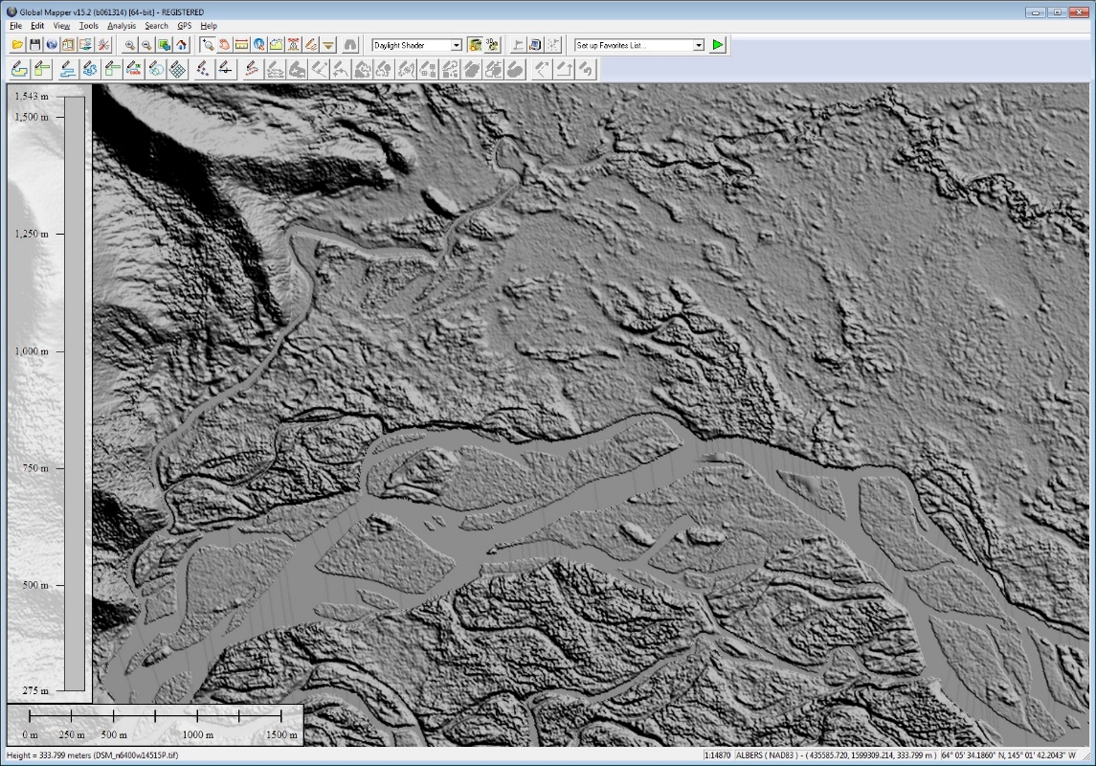
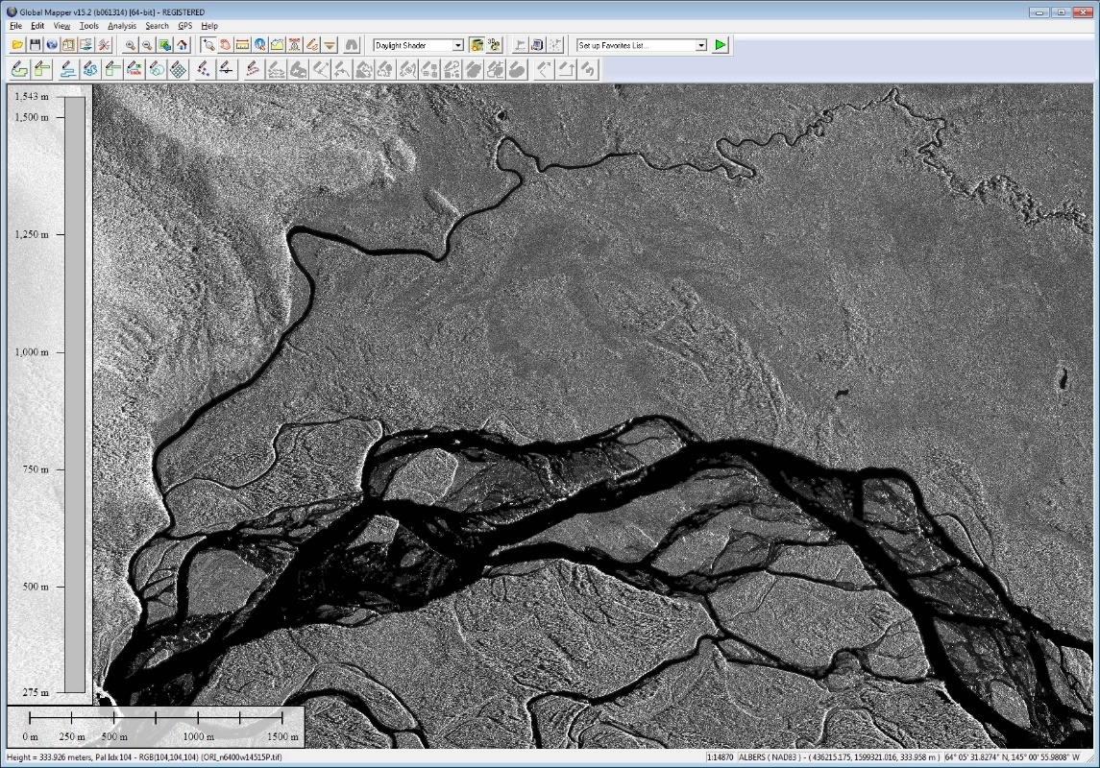
5 Meter
DSM
ORI
Notes:
2 arc-sec
1 arc-sec
1/3 arc-sec
5 meter

Slide 27
5 Meter, DSM, ORI
  Transition Planning
        Collection efforts should be complete by 2022
        5 Meter, DSM and ORI will probably stay in the source projection and tiling scheme
        Minimum 350 meter overlap between tiles
        If there is a customer demand, we can create a VRT or Mosaic Dataset of the entire Alaska project and re-tile/re-project the data as long as there is a new EPSG code for the Alaska Albers Equal Area Projection

Slide 28
3DEP Lidar National Indexing Scheme Case Study

Slide 29
3DEP National Indexing Scheme
Created to make acquisition of high resolution elevation data more consistent and standardized
Prevent gaps or unnecessary overlaps with adjacent projects
Coordinate reference system is NAD 1983 (2011) Albers Equal Area (EPSG code 6350), with XYZ units in meters.
Each tile is 1 square kilometer (km2) in area

Slide 30
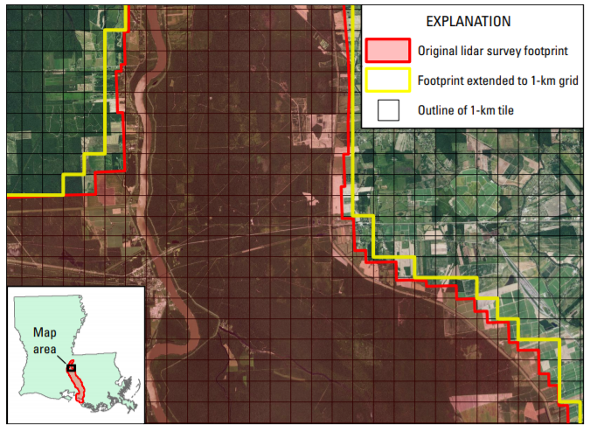
3DEP National Indexing Scheme
The standard naming convention is based on the easting and northing locations of the lower left corner for each tile
Example of a tile name for a 1-km tile is w0002n0612
Notes:
https://pubs.usgs.gov/fs/2017/3073/fs20173073.pdf

Slide 31
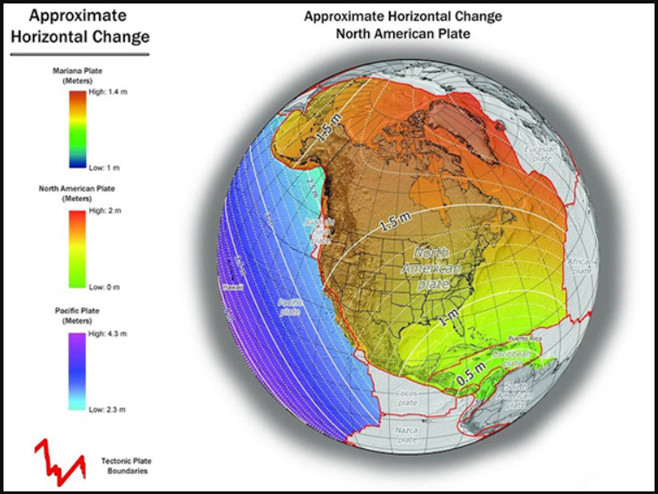
3DEP National Indexing Scheme
The tile name is coordinate based
With NATRF 2022, we expect shifts of between 0.5 and 1.5 meters with the biggest shifts in the Pacific Northwest
This will change the tile names where the coordinate shifts to the east and/or south
Notes:
https://www.ngs.noaa.gov/datums/newdatums/images/HorizontalNorthAmericanPlate.jpg

Slide 32
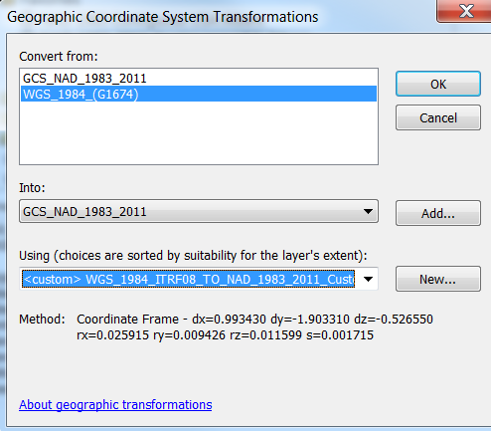
3DEP National Indexing Scheme
ITRF can be used as a proxy for testing NATRF 2022 coordinates
A 7-Parameter Coordinate Frame transformation was applied to the 3DEP Tiling Scheme to determine the new lower-left coordinate of each tile

Slide 33
3DEP National Indexing Scheme
A sampling of several states shows that the shift, although less than a meter in the easting or northing, will change the names of the 3DEP Tiles in areas such as Florida, Kansas, Minnesota, and Maine

Slide 34
3DEP National Indexing Scheme Options
Keep the tiling scheme the same and accept the coordinate shift as a rounding error
Re-name the tiles by the center coordinate, which will ensure that the NATRF 2022 coordinate will always be inside of the tile
Rebuild the tiling scheme using an ITRF 2014 Albers Equal Area Conic projection so it is closer to NATRF 2022
Change the tile name to a row/column construct
Decision still pending…

Slide 35
Summary
        The new NSRS will require updates to the USGS Elevation Products
        New horizontal and vertical datums will require USGS to transform its seamless, 1 meter, and potentially its OPR raster products
        Changes to the tiling scheme coordinates will also impact our products
        Coordinate systems and EPSG Codes used by software packages we use (Esri, QGIS/GDAL, PDAL, LASTools, Global Mapper) will have to be updated to include not only the new NSRS but also the projections (UTM or Albers Equal Area)

Slide 36
Questions?
Notes:
Now open up for questions…
Show slide with websites….

