Slide 1
2019 NGS Geospatial Summit
Keeping Coordinates Moving
Working in Dynamic California
Scott P. Martin, PLS
Caltrans HQ - Office of Land Surveys
25 years with State (DWR and Caltrans)
Licensed Surveyor for 32 years
NGS recognized California Geodetic Coordinator
Member of California Spatial Reference Center’s
Coordinating Council since 2001
Chair California Geodetic Control Work Group
2019 NOAA NGS Partner Award Recipient

Slide 2
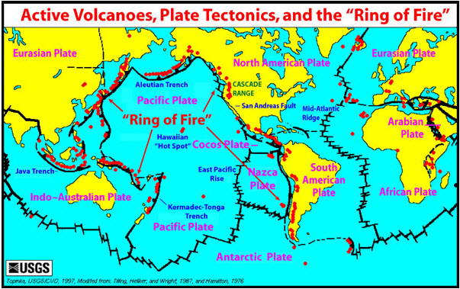
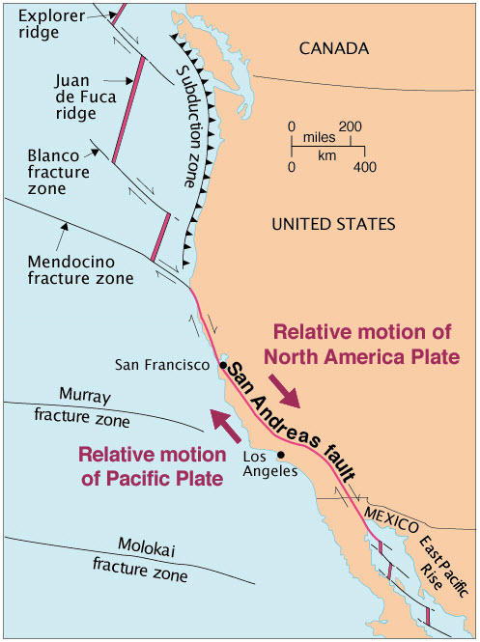
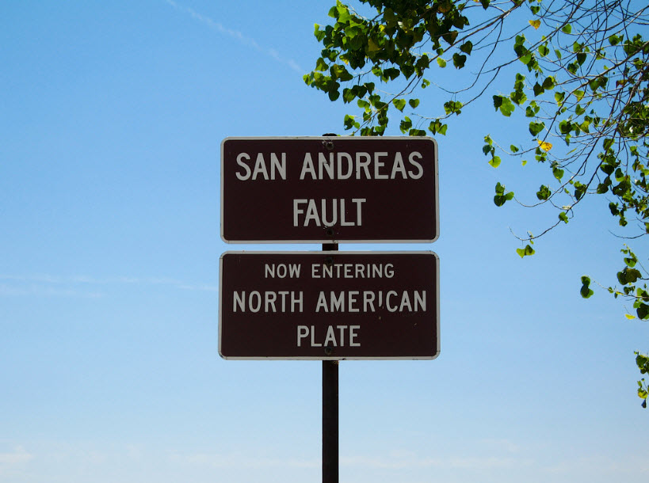
California: A Movin and a Shakin

Slide 3
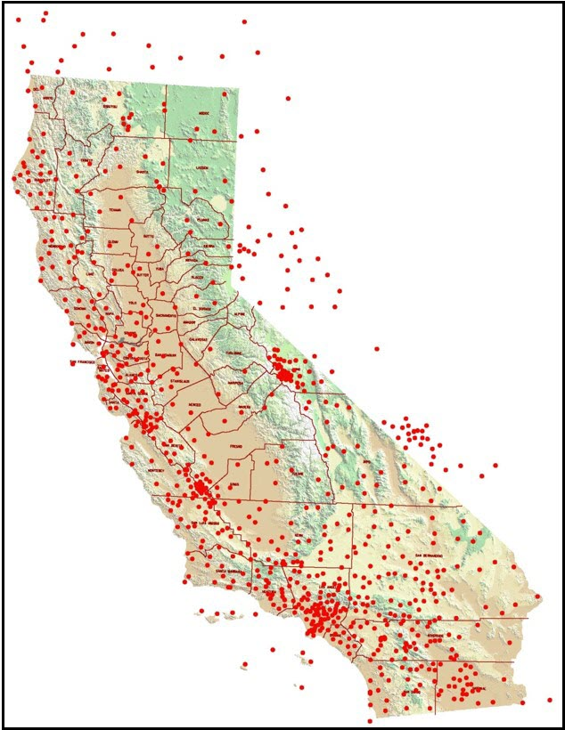
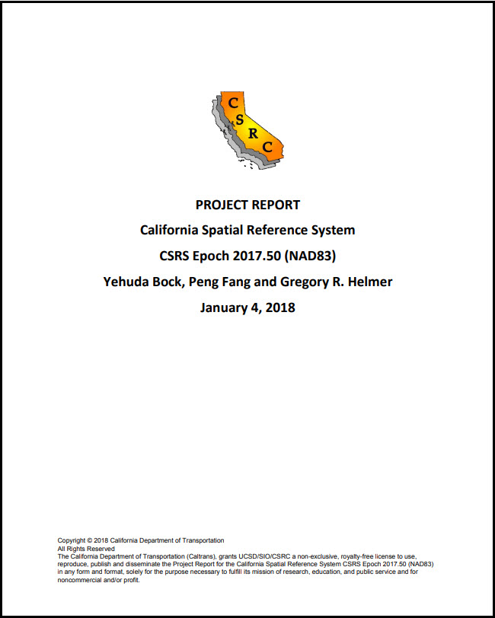
NAD83(2011) Epoch 2017.50 California Spatial Reference System (CSRS)
~ 950 CGPS sites, including several in bordering states
Coordinates, heights, velocities, & positional uncertainties, plus report
CSRS Epoch 2017.50 now published and broadcast through the California Real Time Network (CRTN)
Is aligned to the NSRS through approx. 250 CORS stations
Average horizontal shift from CSRS epoch 2011.00 to epoch 2017.50 = 15 cm northwesterly (max of approx. 35cm)
Data available here: http://sopac-csrc.ucsd.edu/index.php/epoch2017/

Slide 4
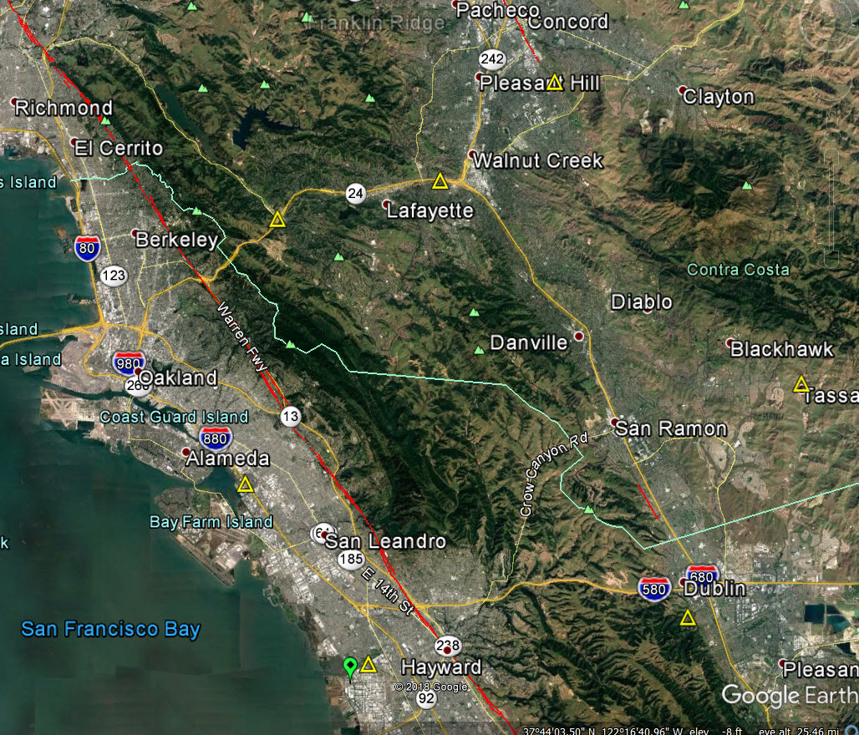
East San Francisco Bay Area Velocities
DE8506
13.48mm/yr N
11.57mm/yr W
AA3807
17.26mm/yr N
12.85mm/yr W
DE8484
19.61mm/yr N
12.97mm/yr W
Hayward Fault
23 miles (37.0 km)
DE8490
12.05mm/yr N
10.61mm/yr W
19 miles (30.6 km)
AA3814
25.56mm/yr N
17.25mm/yr W
WINT CORS
25.54mm/yr N
17.33mm/yr W
HS5109
16.73mm/yr N
12.62mm/yr W
HT3687
25.24mm/yr N
17.16mm/yr W
Notes:
Disparate velocities demonstrate why the relative (local) accuracies of epoch date coordinates deteriorate quickly over a relatively small area.

Slide 5
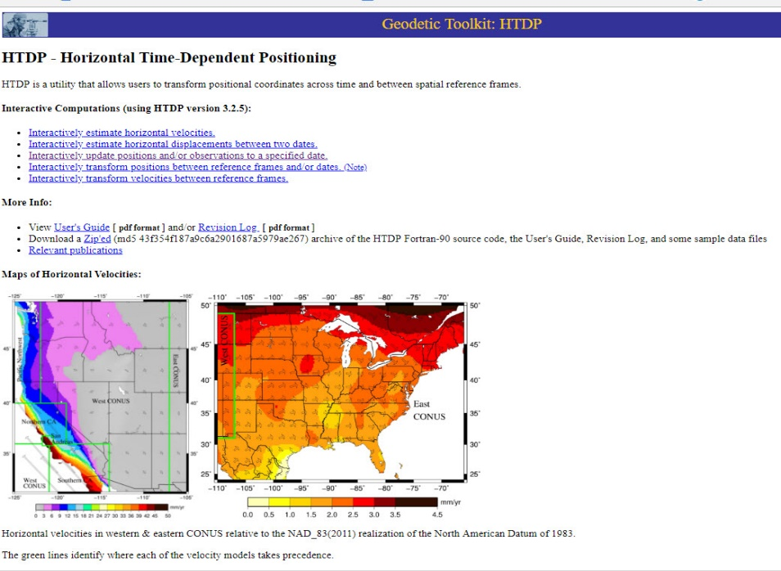
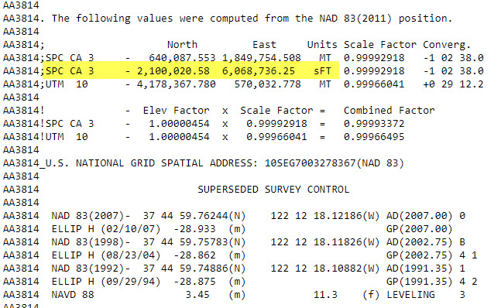
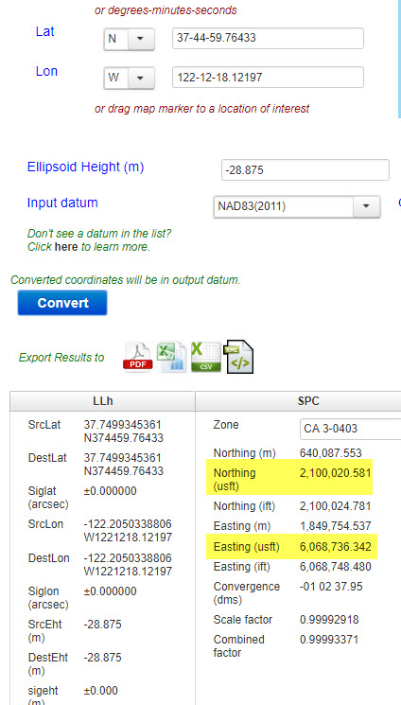
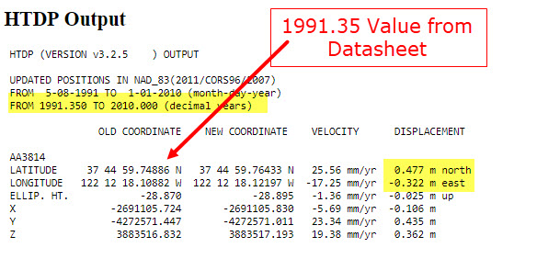
HTDP Test – AA3814
HTDP computed value for 2010.00
From Datasheet
2,100,020.58
6,068,736.25
1.56’ x 1.06’ in 18.65 years
0.00’ x 0.09’ between HTDP and datasheet. HTDP WORKS!

Slide 6
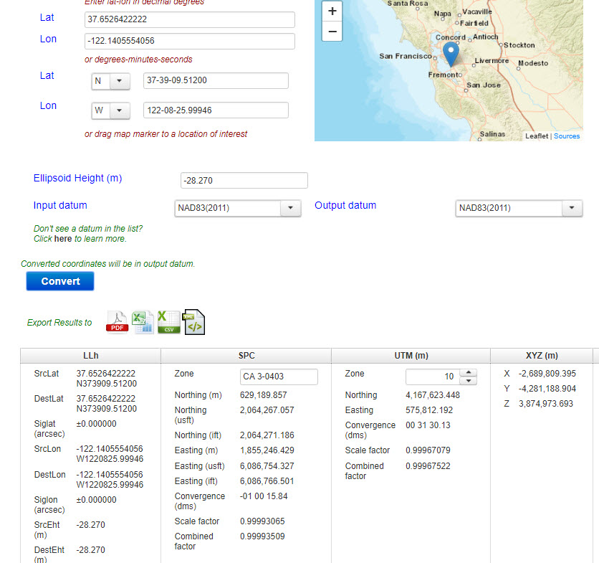
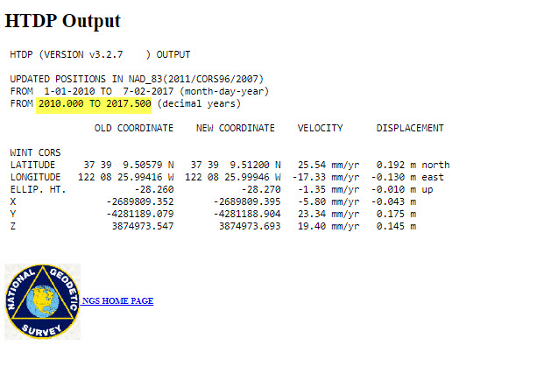
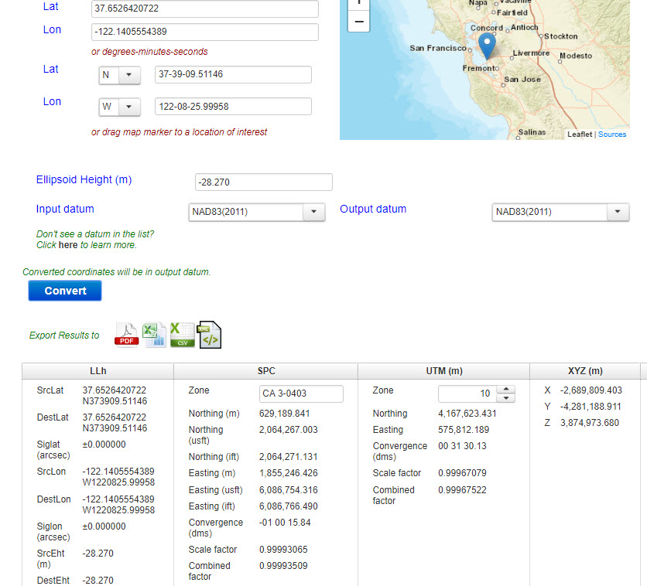
HTDP Test vs. 2017.50 Epoch – WINT CORS
HTDP computed value for 2017.50
2010.00 from Datasheet
CSRC published value for 2017.50
0.63’ x 0.43’ in 7.50 years
From HTDP
2,064,267.057
6,086,754.327
0.054’ x 0.011’ between HTDP and CSRC. HTDP works again
BUT IT CAN BE BETTER!

Slide 7
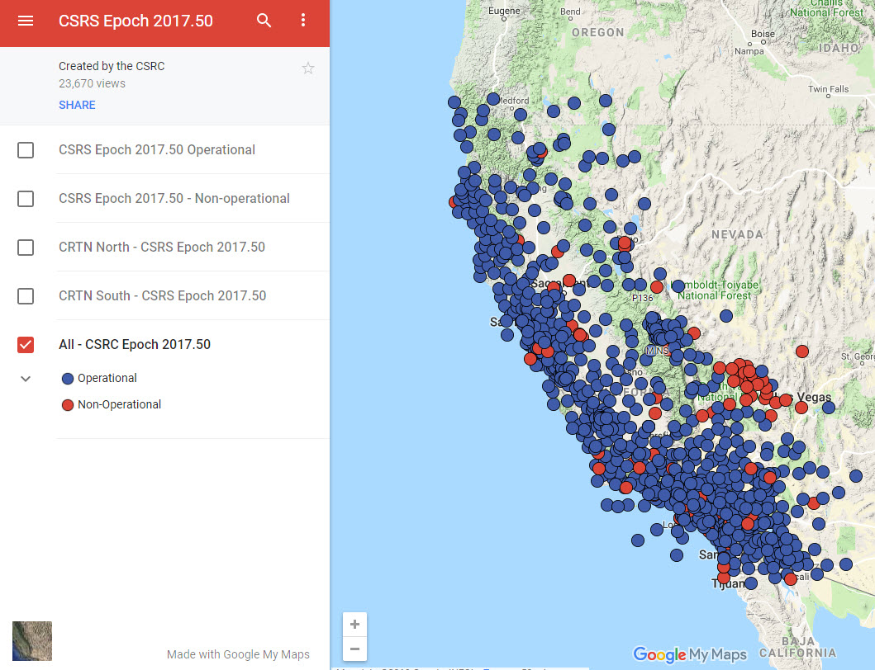
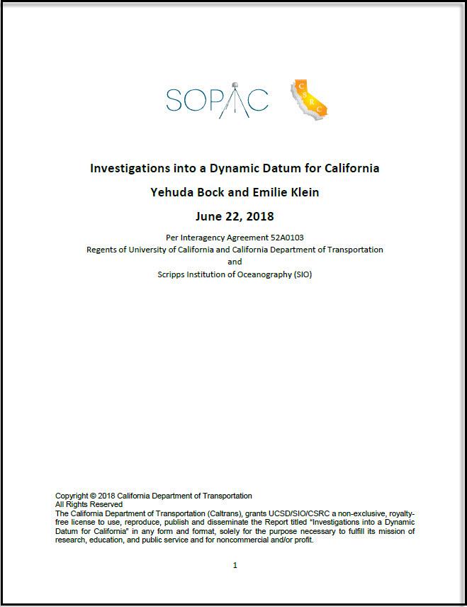
Building a Better Dynamic Datum Modeling Tool
CSRS Epoch 2017.50 Stations

Slide 8
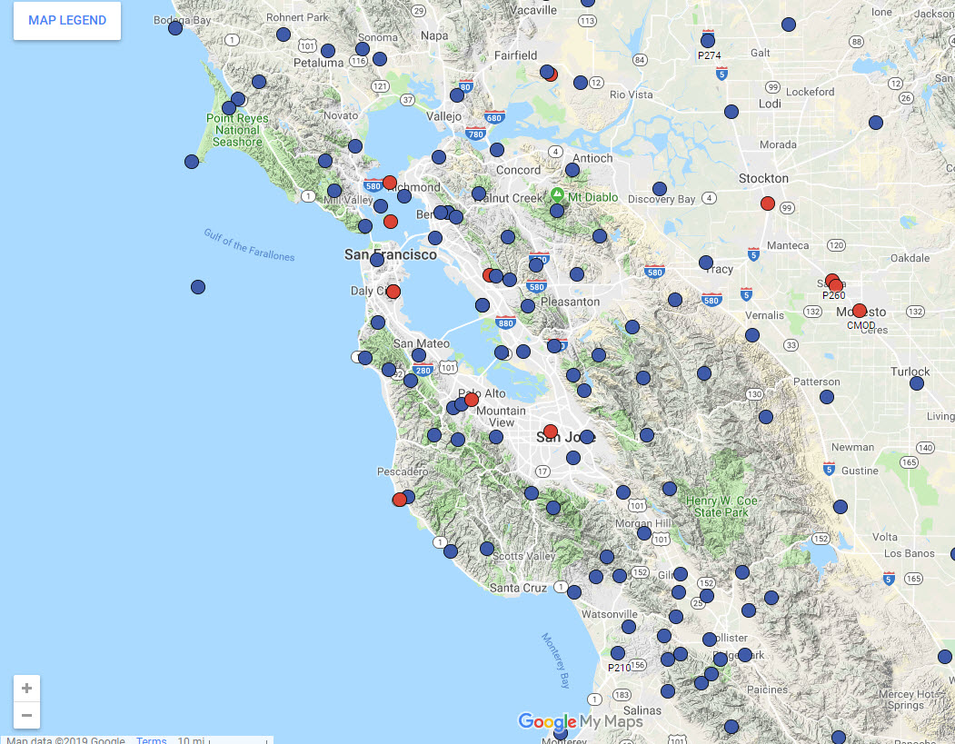
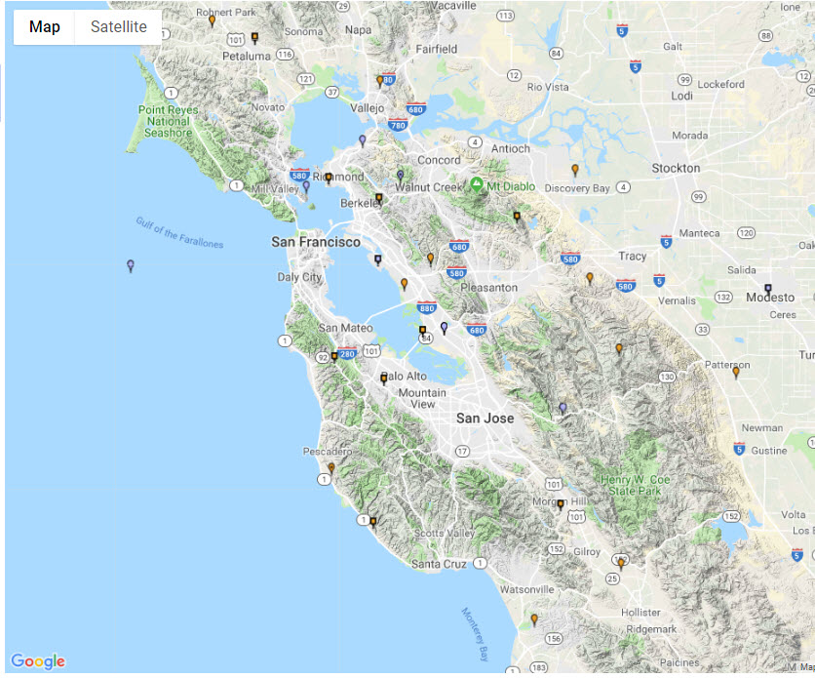
More Velocity Nodes
Make a Better Model
CORS Map
CSRS 2017.50 Station Map

Slide 9
Enhancements/Advantages Over HTDP
Approximately 900 CGPS velocity nodes coupled with a geophysical model versus ~250 CORS nodes – More refined
Can be updated regularly in 3-D based on weekly time series for each station – Truly Dynamic
Co-Seismic and Post-Seismic Displacements (cm level) can be added to the model – not just secular plate velocities and major episodic events (6.0 or greater)
Could be used in the vertical component, not just horizontal

Slide 10
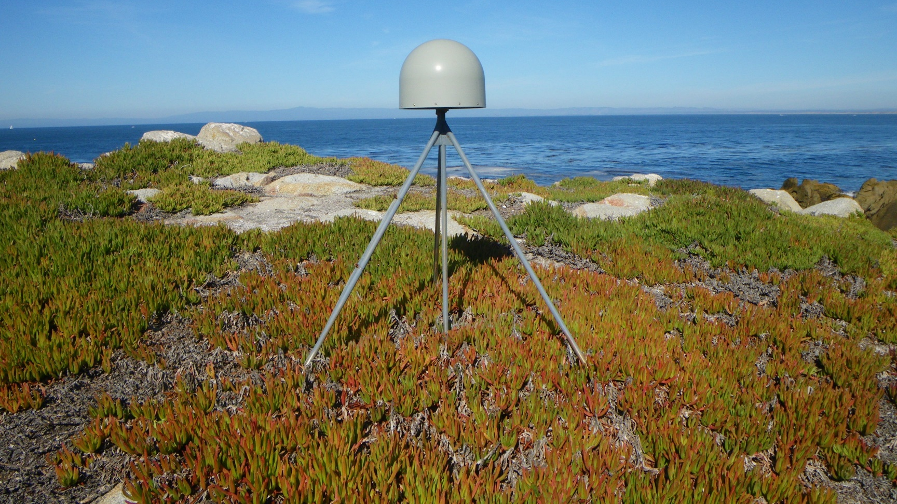
Questions?

