Slide 1
OPUS Projects Manager’s Training: Transitioning from Mandatory, Instructor-Led to Online, Self-Paced Instruction
FIG 2023
NGS Day
Erika Little, NGS Training Coordinator

Slide 2
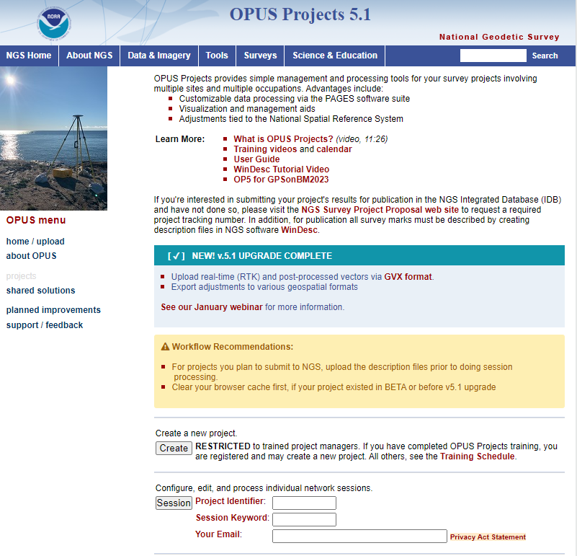
OPUS Projects
NGS has operated the Online Positioning User Service (OPUS) since March 2001, to provide end-users easy access to the National Spatial Reference System (NSRS) using GPS data.
In 2011, OPUS Projects became available to the public.
OPUS Projects is a highly integrated tool for managing GPS campaigns, including initial observation metadata and positions, session solution statistics, and network adjustments.
Provides data visualization and project management aids.

Slide 3
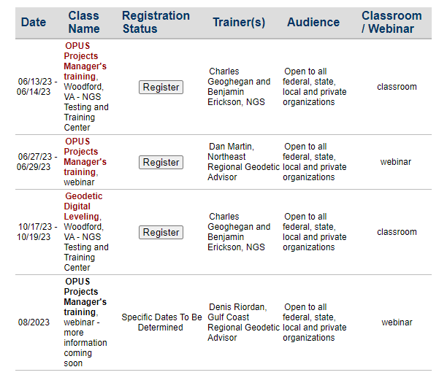
Training Requirement
NGS has required training of approximately 12 hours to access OPUS Projects
This was due to its complexity, flexibility, and ability of users to select options that would likely produce unintended outcomes.
Since 2014 when training began to be tracked, NGS has conducted training for over 4,000 participants.
Conducted by a staff of less than 20 instructors, with an average class size of approximately 20 students. These instructors are balancing OPUS Projects classes with many other responsibilities.

Slide 4
Is Mandatory Training Still Necessary?
As OPUS Projects has matured, NGS began discussions about possibly removing the mandatory training requirement. Why?
OPUS Projects has become much more intuitive and the process has been significantly streamlined. OPUS Projects now builds all of the important files for supporting data submittal, and it runs a number of quality control tests automatically, without requiring input or decisions from the user.
NGS has developed a User Guide including both a “quick start” portion and significant details on how to use the software. The User Guide explains much of the content that has previously been covered by an instructor.

Slide 5
Is Mandatory Training Still Necessary?
Some organizations cannot afford the time/money for their employees to attend a 2-day course to learn how to run software, or sometimes they are not interested in all of the facets of OPUS Projects and just want basic information.
The popularity of the instructor-led training has grown. Classes frequently fill up, sometimes months in advance. It is anticipated that demand will continue to grow as OPUS Projects adds the capability to ingest RTK data. To adequately meet the demand of our constituents would require significantly more NGS staff time.
Requiring training makes NGS a gatekeeper and a barrier to the use of its own software.

Slide 6
NGS Will Stop Requiring Mandatory Training when…..
On-demand training videos are available on the NGS website. Users can view the videos at times convenient to them.
Tutorial lessons and an example data set are posted to the NGS website. Users can download the data set to work through an example within OPUS Projects, following the tutorials to ensure they understand key concepts.

Slide 7
NGS Will Stop Requiring Mandatory Training when…..
Update to the User Guide to include content on OPUS Projects 5 and how to work with GNSS vectors processed outside OPUS Projects is made available.
Done!
Users have an easy-to-understand way to self-register and access training materials - users do not have to be registered by NGS to ‘Create a Project’.

Slide 8
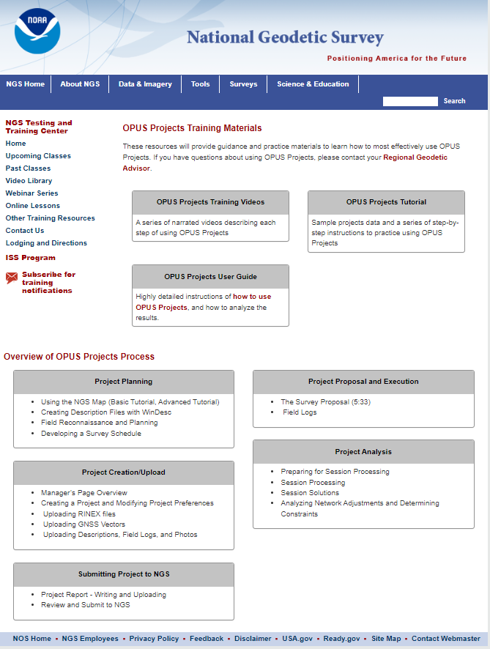
Draft Training Materials Landing Page

Slide 9
For more information, please see FIG paper number 12005: OPUS-Projects for Managers Training: Transitioning from Mandatory Instructor-Led to Online, Self-Paced
Lead author: Daniel Martin, USA, NGS Northeast Regional Geodetic Advisor
Co-authors: Erika Little, USA, NGS Training Coordinator, and Jeff Jalbrzikowski, USA, NGS Appalachian Regional Geodetic Advisor

Slide 10
What’s Next?
Instructor-led training, both online and in-person, will still be offered regularly. It just will not be mandatory.
These materials should be online and available by the end of September 2023.
Refresh cycle established as OPUS Projects undergoes updates.

Slide 11
Educational resources currently available in Spanish or French
Videos
Online Lesson
Program and Project Descriptions

Slide 12
Educational Videos
Partnership with the University Corporation for Atmospheric
Research’s (UCAR) COMET Program
geodesy.noaa.gov

Slide 13
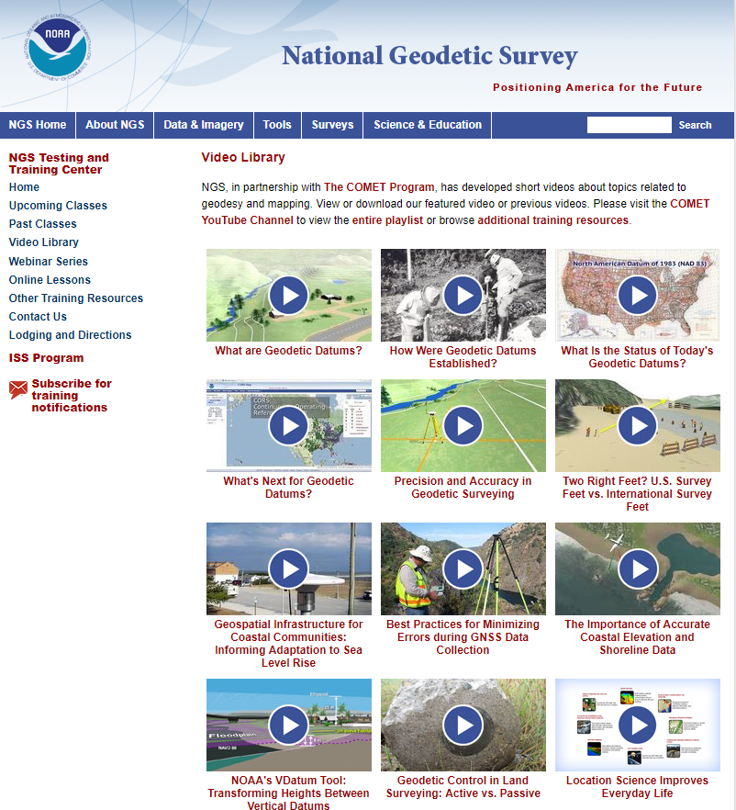
Educational Videos
Partnership with the University Corporation for Atmospheric
Research’s (UCAR) COMET Program
Most Viewed on COMET YouTube channel (through 5/9/2023)
What are Geodetic Datums? | 190,031
Best Practices for Minimizing Errors During GNSS Data Collection | 92,927
Precision and Accuracy in Geodetic Surveying | 72,944
These two videos now available in Spanish!

Slide 14
Online Lessons
Partnership with the University
Corporation for Atmospheric
Research’s (UCAR) COMET Program

Slide 15
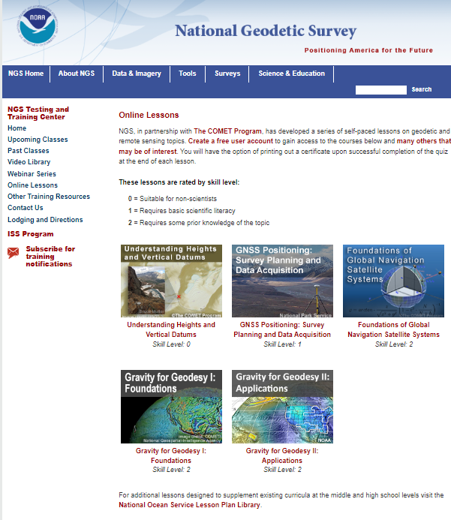
Online Lessons
Take anywhere from 45 minutes to 2 hours to complete
All lessons allow the user to receive a certificate *if* a quiz is passed
Currently 5 lessons available

Slide 16
Understanding Heights and Vertical Datums lesson
Available in French and Spanish

Slide 17
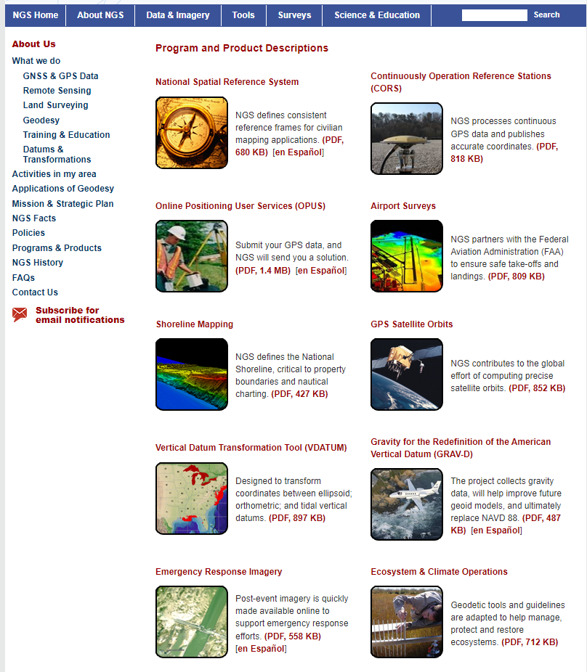
Program and Product Descriptions Available in Spanish
National Spatial Reference System
Online Positioning User Service
Gravity for the Redefinition of the American Vertical Datum (GRAV-D)
Emergency Response Imagery

Slide 18
Your Input is always welcome on:
Topics
Content
Delivery methods
Send to ngs.training@noaa.gov
Thank you!

Slide 19
End of presentation - Back up slides if extra time

Slide 20
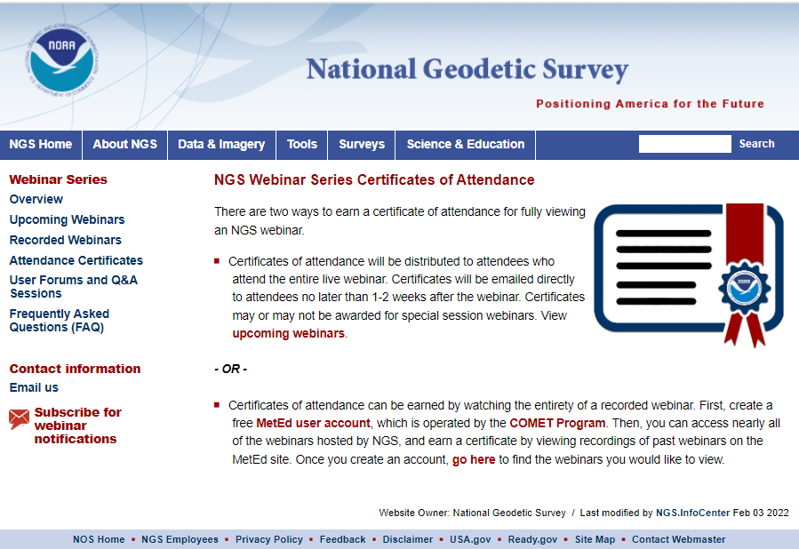
New Tool to Earn Webinar Certificates on
Your Schedule
Can’t make a webinar during the scheduled time? A recorded version is always available on the NGS website.
But NOW you can earn a certificate for viewing a recorded webinar.

Slide 21
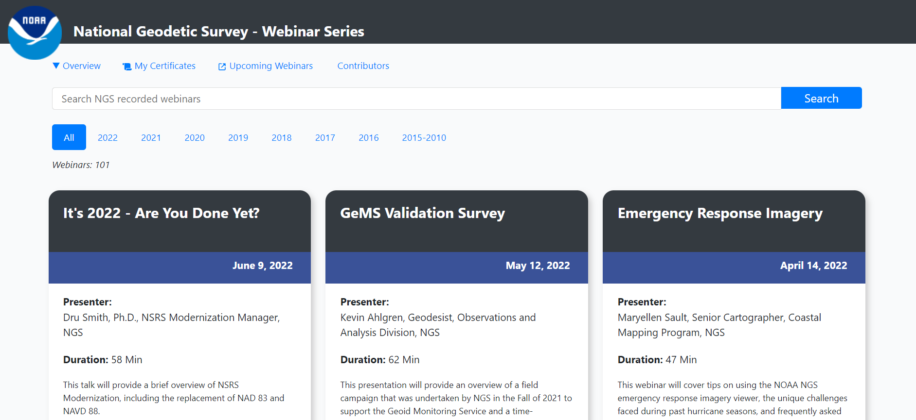
New Tool to Earn Webinar Certificates on
Your Schedule
NGS again worked with the COMET MetEd program to develop a tool through which you can earn a certificate by viewing recordings of past webinars.
Over 100 recorded webinars available.

Slide 22
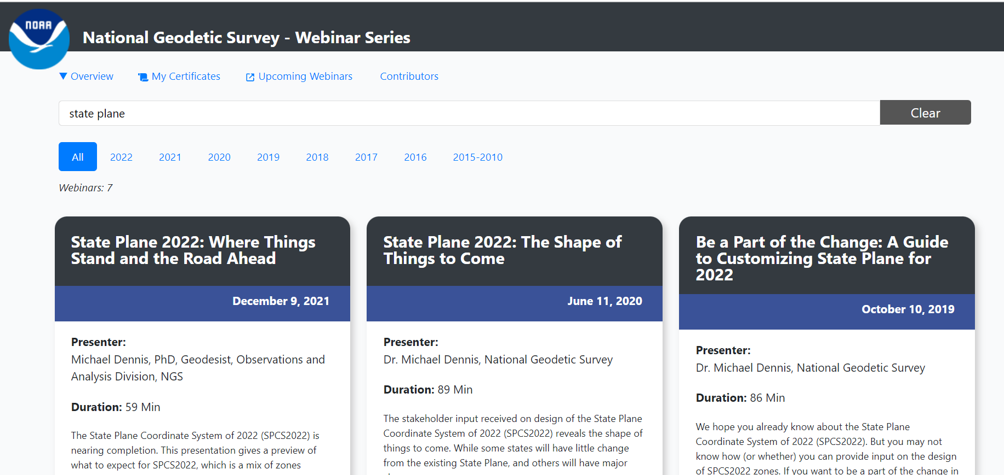
New Tool to Earn Webinar Certificates on
Your Schedule
Great search function to find webinars on a certain topic.
If you are in the education field, you could assign these as pre-requisites, class work, extra credit, etc.

Slide 23
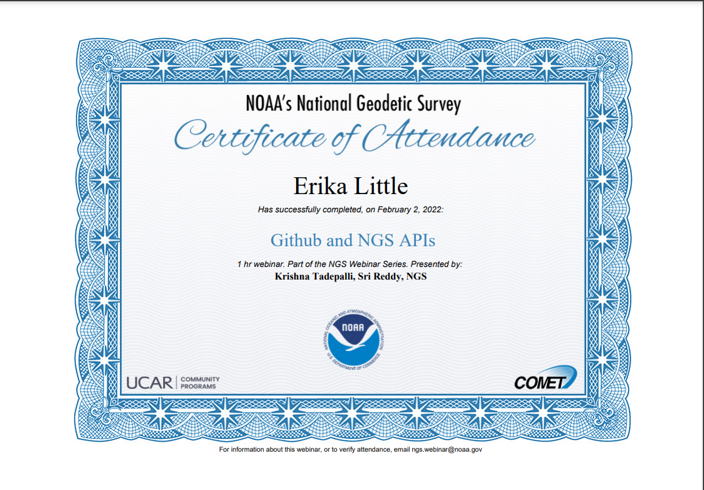
New Tool to Earn Webinar Certificates on
Your Schedule
Once you watch the entirety of a webinar, you can download a Certificate of Attendance.

Slide 24
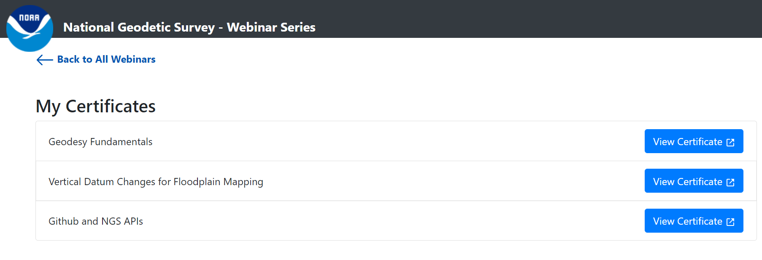
New Tool to Earn Webinar Certificates on
Your Schedule
COMET MetEd will store all earned certificates.

