Slide 1
Updating OPUS-S to Support Multi-GNSS
Online
Positioning
User
Service
-Static
Nick Forfinski-Sarkozi (Presentor)
Geodesist, NGS Observations and Analysis Division
Dan Gillins, PLS
Chief, NGS Spatial Reference System Division
Andria Bilich
Geodesist, NGS Geodetic Research Division
Notes:
Title: Updating OPUS-S to Support Multi-GNSS
Authors: Nick Forfinski-Sarkozi, Dan Gillins, Andria Bilich
Presentor: Nick Forfinski-Sarkozi
Body: NOAA’s National Geodetic Survey (NGS) is updating OPUS-S to support multi-GNSS static baseline processing. Previously designed around PAGES (NGS’s GPS-only processing engine), OPUS-S has been redesigned to use M-PAGES, which is NGS’s new software to process static GNSS data for observation periods greater than two hours. In addition to fundamental changes in the underlying processing engine, multi-GNSS OPUS-S will process RINEX3 files directly and include enhancements to the logic used to select CORS. Whereas OPUS-S with PAGES considers only baseline length and direction when selecting CORS, OPUS-S with M-PAGES also considers constellation availability and recently developed station stability scores (for NCN stations only) using a heuristic weighting scheme. This presentation will show an accuracy comparison of OPUS-S with M-PAGES and multi-GNSS signals versus the current version of OPUS-S with GPS alone. Future OPUS development plans include replacing OPUS-RS with expanded M-PAGES support for shorter occupations and integrating M-PAGES into OPUS-Projects session processing.

Slide 2
Overview
Brief review of existing OPUS-S (4.0)
Why update OPUS-S?
New features in OPUS-S 5.0
Alpha-Testing Plan
Preliminary Results
Online
Positioning
User
Service
-Static

Slide 3
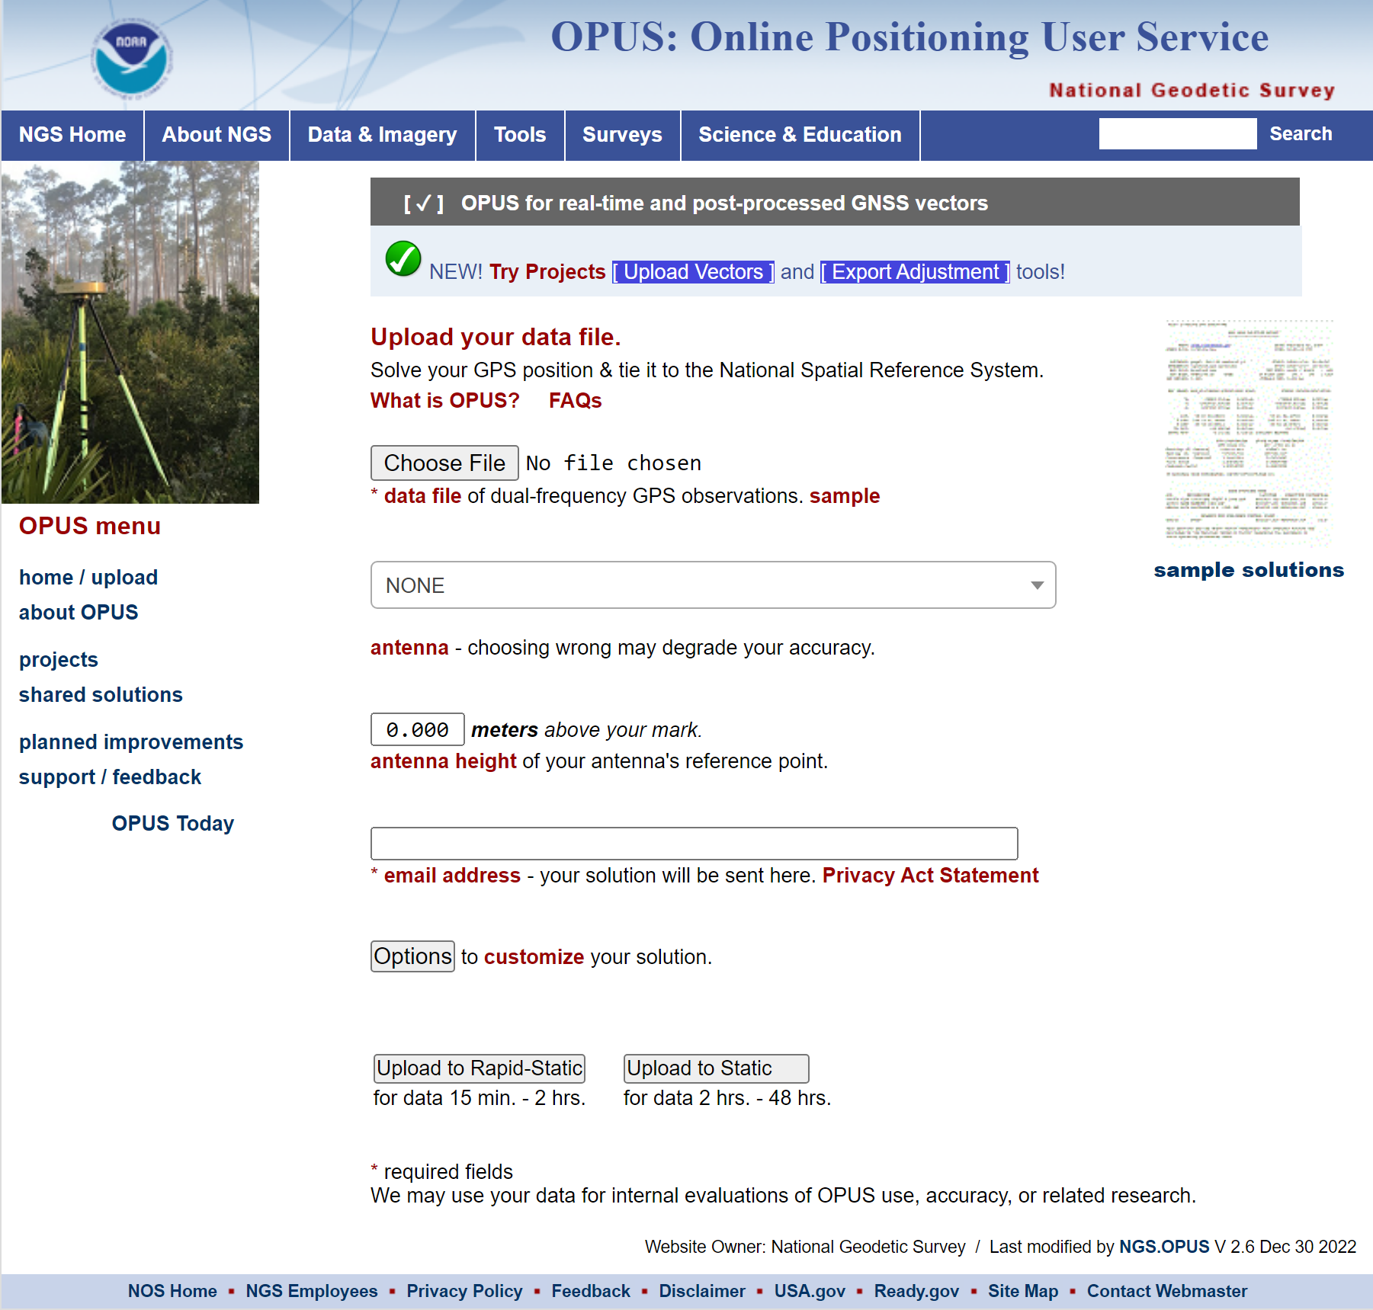
Brief review of existing OPUS-S v4.0
https://geodesy.noaa.gov/OPUS/
Uses PAGES* for sequential static baseline processing
GPS L1/L2 only
Averages best 3 of 5 baselines
*Program for the Adjustment of GPS Ephemerides

Slide 4
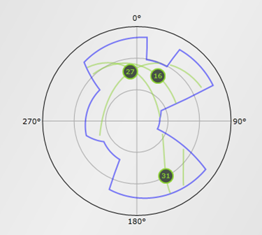
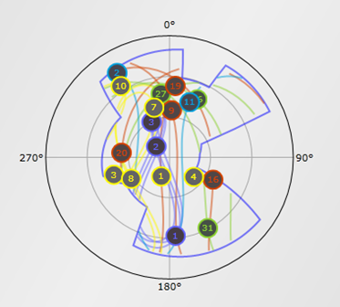
Why Update OPUS-S?
More satellites = better positioning!
Improved geometry
Better coverage when signals are obstructed (bottom right)
Various studies have already demonstrated the improvements in positioning with added systems (e.g., Jamieson & Gillins 2018)
versus
http://www.gnssplanningonline.com
(slide adapted from Multi-GNSS Positioning with the New M-PAGES Software by Bryan Stressler)
Notes:
Note that higher sampling rates do not translate to better positioning; change in satellite geometry is needed to see the impacts

Slide 5
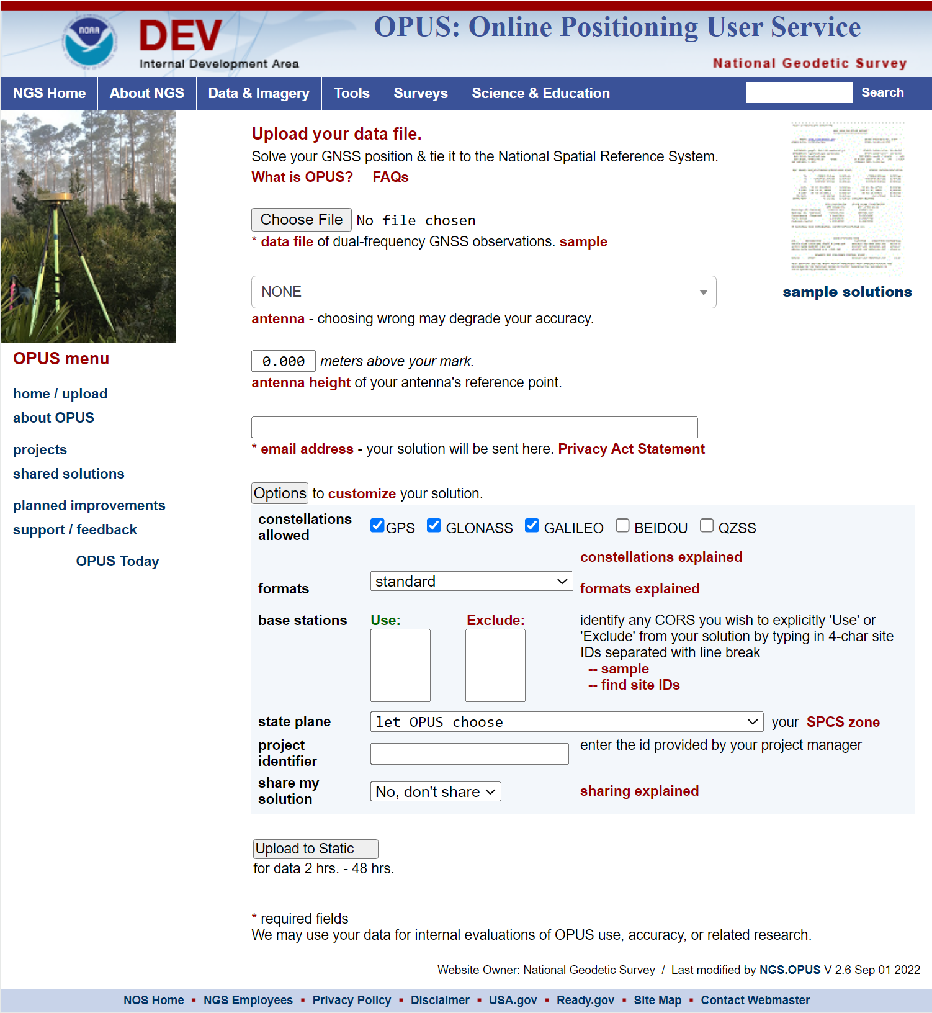
New features in OPUS-S 5.0
Replaces PAGES with M-PAGES
Includes RINEX “sniffer” to scan available constellations
Enhanced CORS-selection logic
Slightly modified best 3-of-5 baselines selection
Supports RINEX v3

Slide 6
Overview of PAGES v. M-PAGES
PAGES GPS L1/L2 only Double differencing Outputs custom-format file FORTRAN Used in OPUS, OPUS-Projects, and Orbit Production | M-PAGES* All dual-frequency systems Single differencing Outputs JSON file C++ (with Python utilities) Currently only used in OPUS-S v5-alpha
*NGS M-PAGES Webinar:
https://geodesy.noaa.gov/web/science_edu/webinar_series/multi-ngss-world-at-ngs.shtml

Slide 7
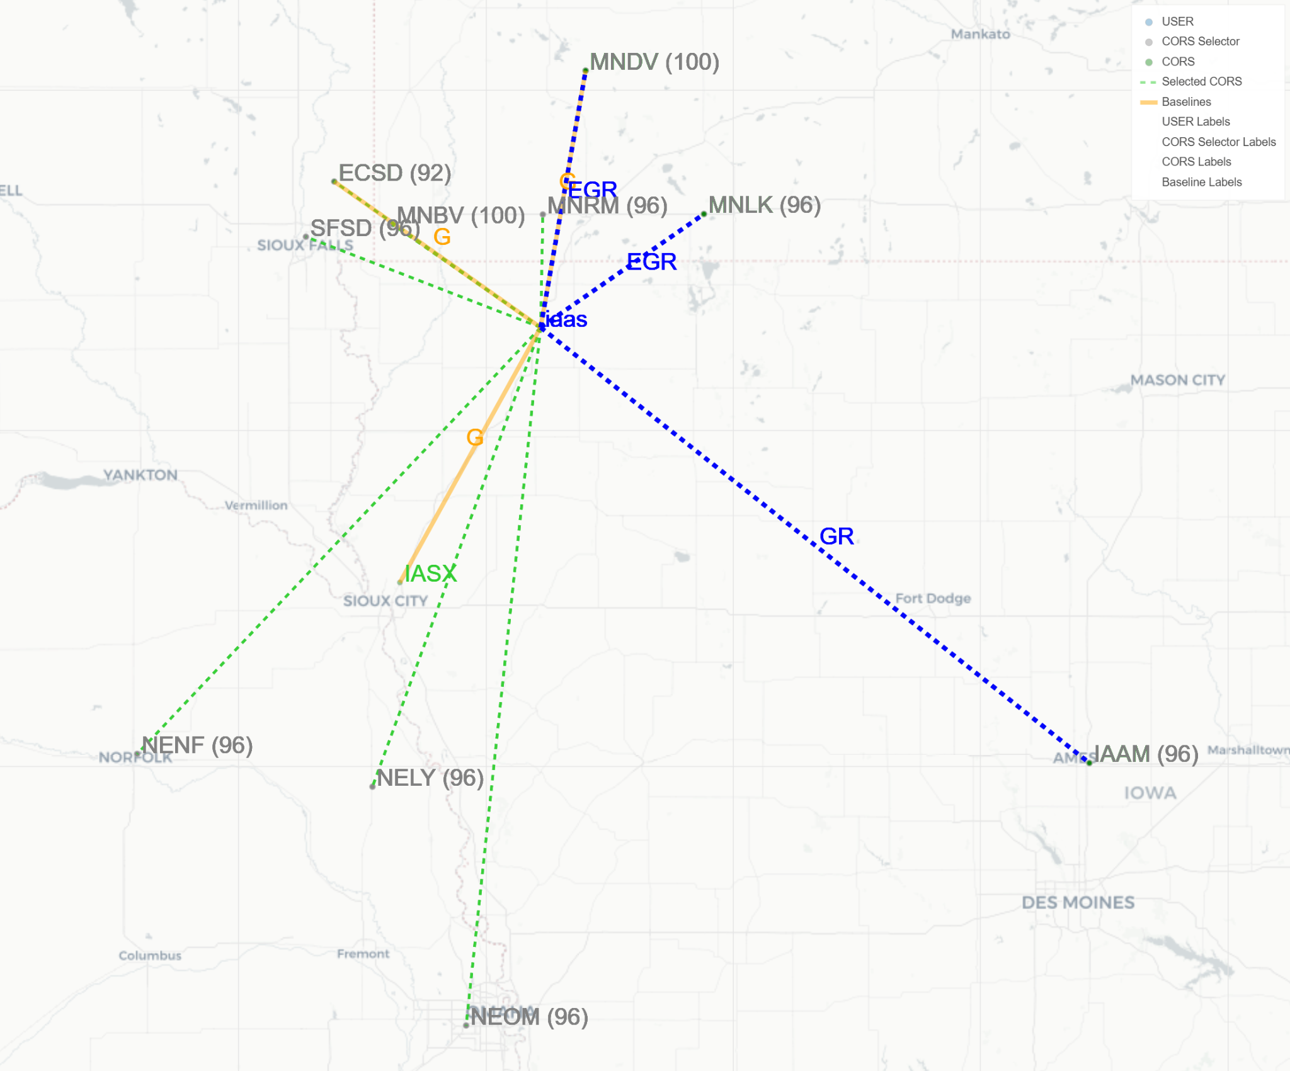
Legend
Enhanced CORS-selection logic
CORS Selector
Baseline Selection for station IAAS
OPUS-S v5
Each CORS within pool of candidates is graded, based on weighted components:
Data availability
Constellations availability
CORS quality metrics
Spatial distribution over 4 quadrants is also considered
OPUS-S v4
IAAS

Slide 8
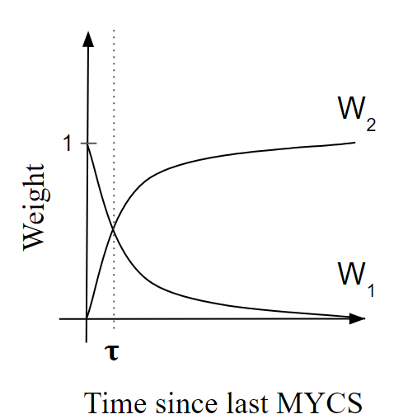
CORS Quality Metric
Helps choose better base stations
Reference: AGU Fall Meeting Abstracts 2022, G25D-0249
RMS₁: time period spanned by the most recent MYCS
RMS₂: from the end of the most recent MYCS to present
RMS₃: over the last 4 weeks from user date

Slide 9
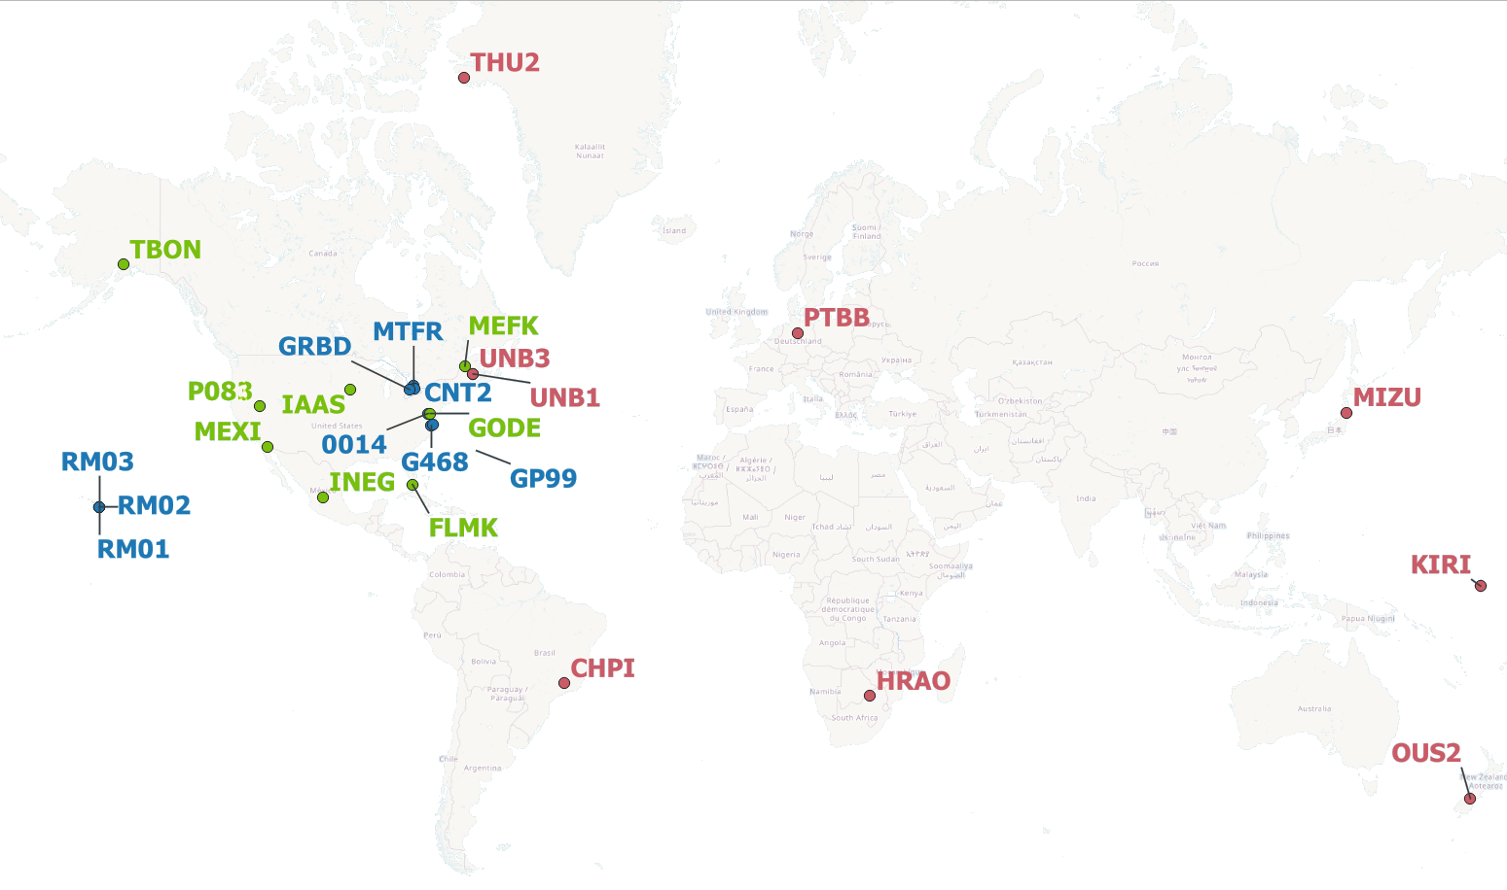
Alpha-Testing Plan
Upload numerous RINEX files
NCN, IGS, and user data
Spatiotemporally distributed
Represent good and bad data
Assess results
Component testing
System (end-to-end) testing, including accuracy assessment
NCN Sites:
IGS Sites:
User Sites:
50 RINEX files
56 RINEX files
20 RINEX files

Slide 10
Accuracy Assessment
NGS OPUS SOLUTION REPORT
========================
All computed coordinate accuracies are listed as peak-to-peak values.
For additional information: https://www.ngs.noaa.gov/OPUS/about.jsp#accuracy
USER: nick.forfinski-sarkozi@noaa.gov DATE: April 25, 2023
RINEX FILE: rm010190.20o TIME: 20:54:25 UTC
SOFTWARE: page5 2008.25 master273.pl 160321 START: 2020/01/19 00:00:00
EPHEMERIS: igs20890.eph [precise] STOP: 2020/01/19 23:59:00
NAV FILE: brdc0190.20n OBS USED: 58319 / 63634 : 92%
ANT NAME: TRM115000.00 NONE # FIXED AMB: 204 / 227 : 90%
ARP HEIGHT: 1.1922 OVERALL RMS: 0.014(m)
REF FRAME: NAD_83(PA11)(EPOCH:2010.0000) ITRF2014 (EPOCH:2020.0506)
X: -5464049.608(m) 0.007(m) -5464050.691(m) 0.007(m)
Y: -2495220.635(m) 0.003(m) -2495217.551(m) 0.003(m)
Z: 2148357.621(m) 0.005(m) 2148358.961(m) 0.005(m)
LAT: 19 48 7.21375 0.005(m) 19 48 7.25800 0.005(m)
E LON: 204 32 39.66295 0.002(m) 204 32 39.55117 0.002(m)
W LON: 155 27 20.33705 0.002(m) 155 27 20.44883 0.002(m)
EL HGT: 3750.804(m) 0.008(m) 3750.980(m) 0.008(m)
ORTHO HGT: 3724.366(m) 0.056(m) [ H = h-N (N = GEOID12B HGT)]
UTM COORDINATES STATE PLANE COORDINATES
UTM (Zone 05) SPC (5101 HI 1)
Northing (Y) [meters] 2191439.691 107224.901
Easting (X) [meters] 242745.514 504646.805
Convergence [degrees] -0.83236111 0.01502500
Point Scale 1.00041807 0.99996693
Combined Factor 0.99982857 0.99937770
Compare ITRF coordinates with…
IGS weekly solution
NRCAN PPP
OPUS-S v4 (PAGES)
Published coordinates
Transform delta vector from XYZ to NEU
Compare at survey epoch

Slide 11
Preliminary Accuracy Results: residual NEU components
(only partial results shown)
N=
62
92
121
86

Slide 12
Empirical Cumulative Distribution Functions of Residuals

Slide 13
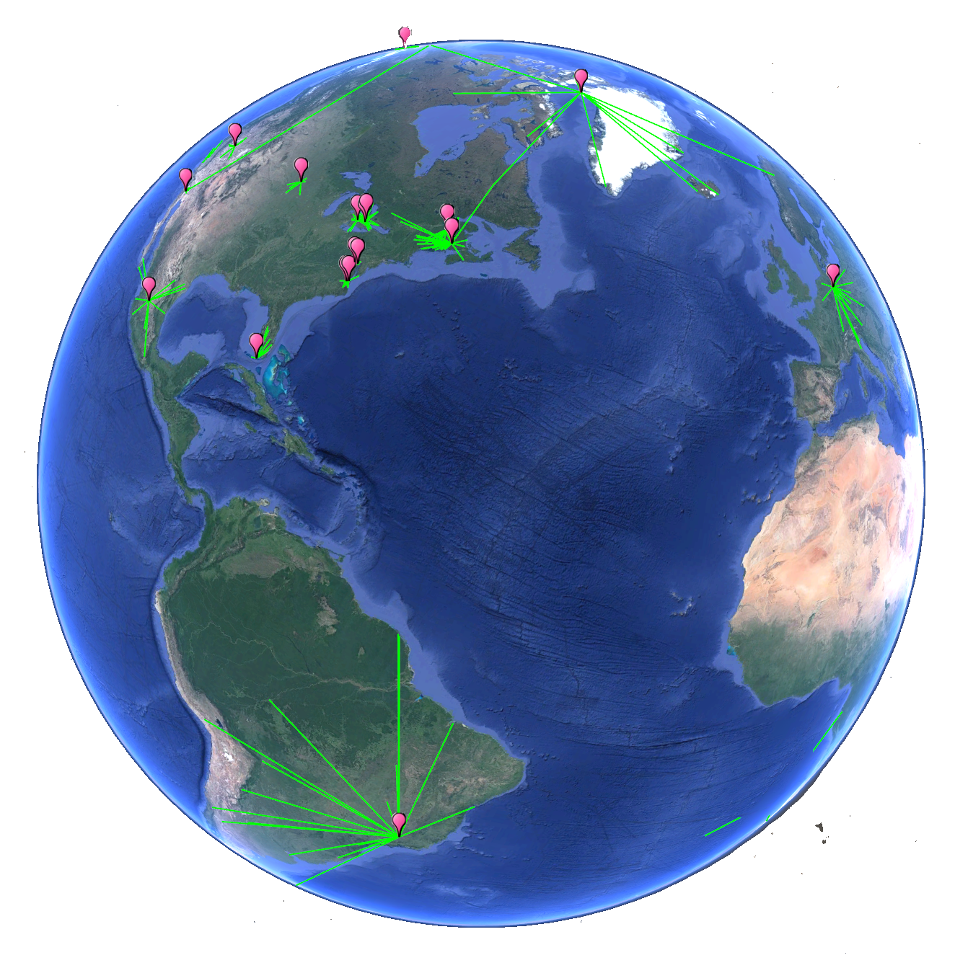
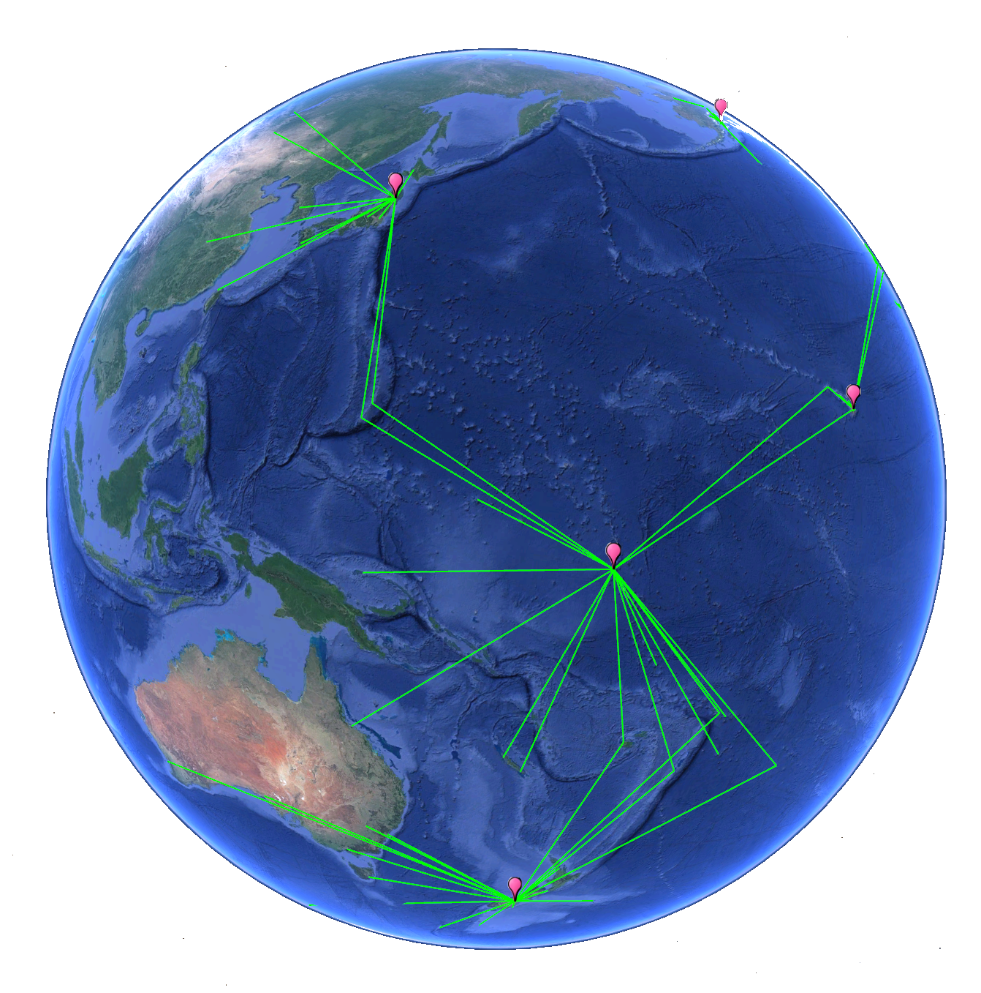
Summary
OPUS-S v5.0-alpha supports Multi-GNSS
M-PAGES replaces PAGES
Enhanced logic when selecting CORS
Preliminary results show good agreement with comparison solutions
Alpha-testing results will feed further M-PAGES development

Slide 14
BETA VERSION COMING SOON!
Future BETA Testers:
anticipate OPUS-S v5.0-beta release around August 2023
BETA OPUS-S URL
https://beta.ngs.noaa.gov/OPUS/
Please feel free to contact me with any questions.
nick.forfinski-sarkozi@noaa.gov

