Slide 1
NGS Updates MARTI IKEHARA, Geodetic Advisor
CLSA Monterey Chapter
June 2011

Slide 2
Topics for discussion
CBL Process
CBL Site Characteristics
Adoption of new reference frame for CORS
Subsequent adjustment for passive stations
HTDP
CGAR
Developments of various NGS products

Slide 3
CBL Process
Location, Location, Location (access)
Selection, permission, layout, install 4 mons
Find donor or pay for materials, labor
Personnel: Gun, recorder, prisms, ‘runner’
Training: ‘on-the-job’
Measurement: Two LONG days. Equipment handoffs before and after, usually

Slide 4
CBL Site characteristics
Length 1 km; difficult to see farther
Relief: flat to slight dip in center
Slope: <1% 0-150 m; <3% 150-430-1000 m
LOS over a single type of ground—
Dirt, grass, pavement, water
No interference (reflective) sources (signage)
Install 4 monuments, let cure 4-6 months

Slide 5
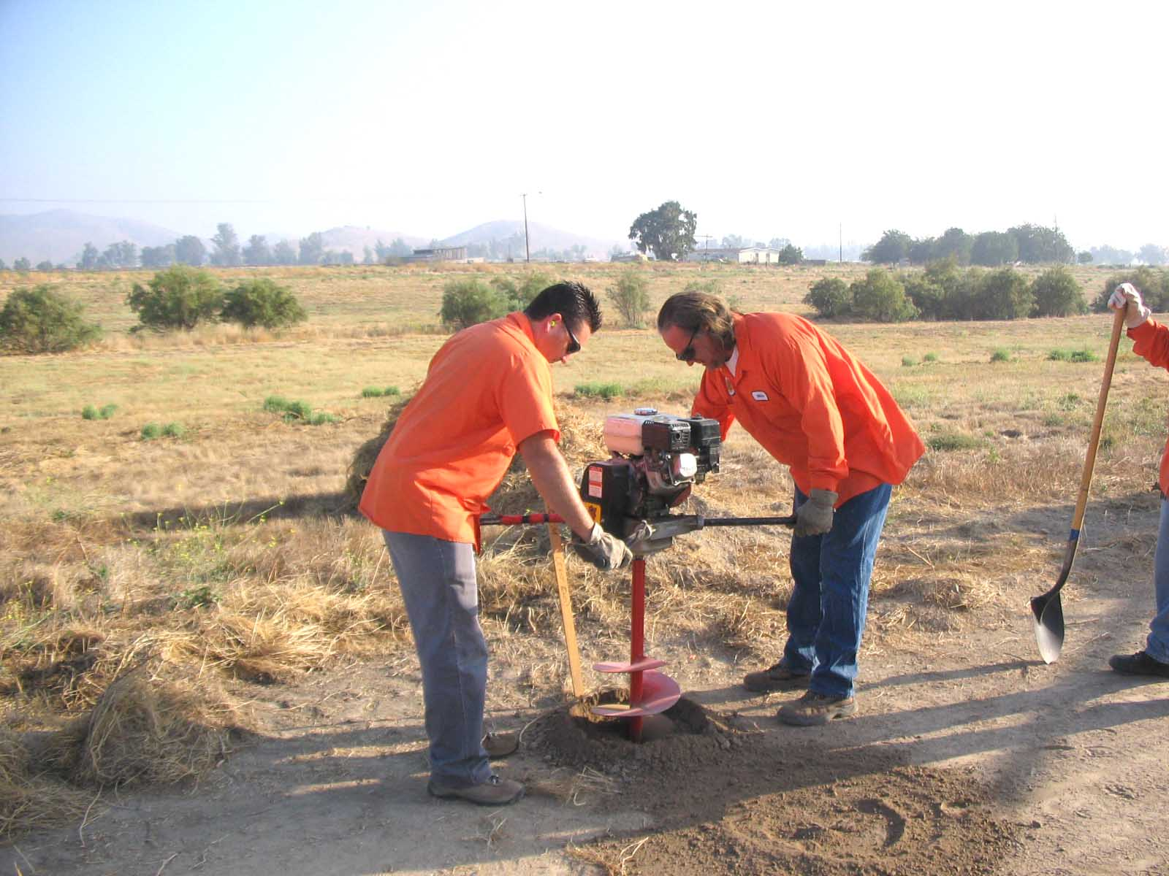

Slide 6
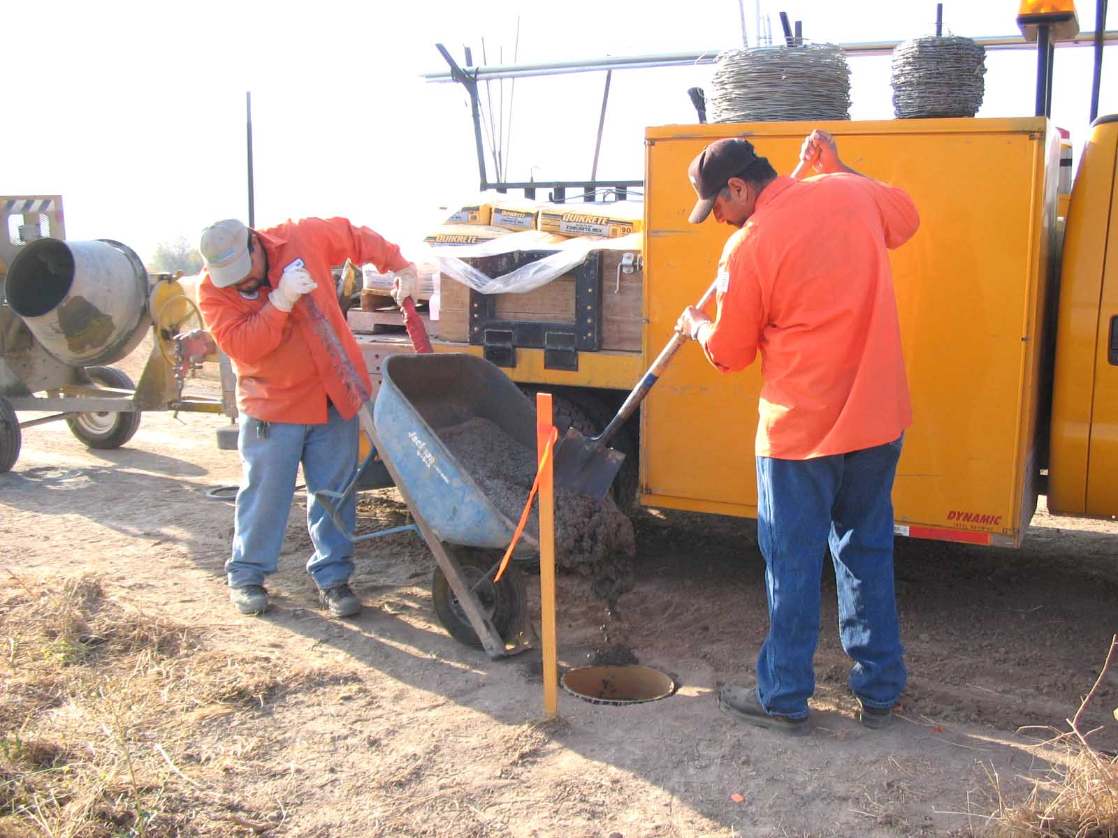

Slide 7
Notes:
Centering in concrete is not as important as adhering to the alignment

Slide 8
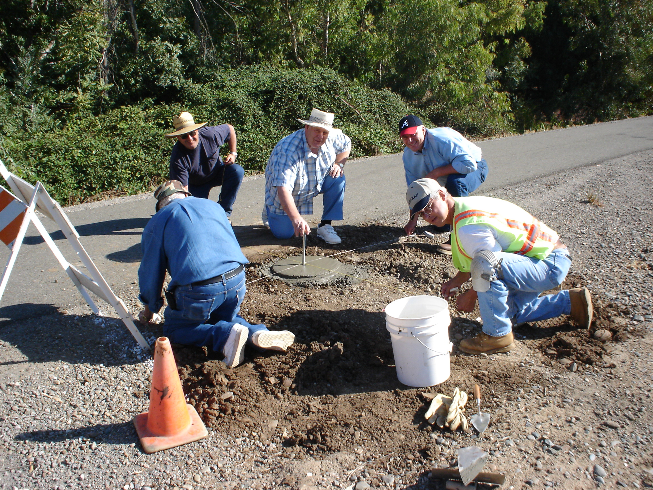

Slide 9
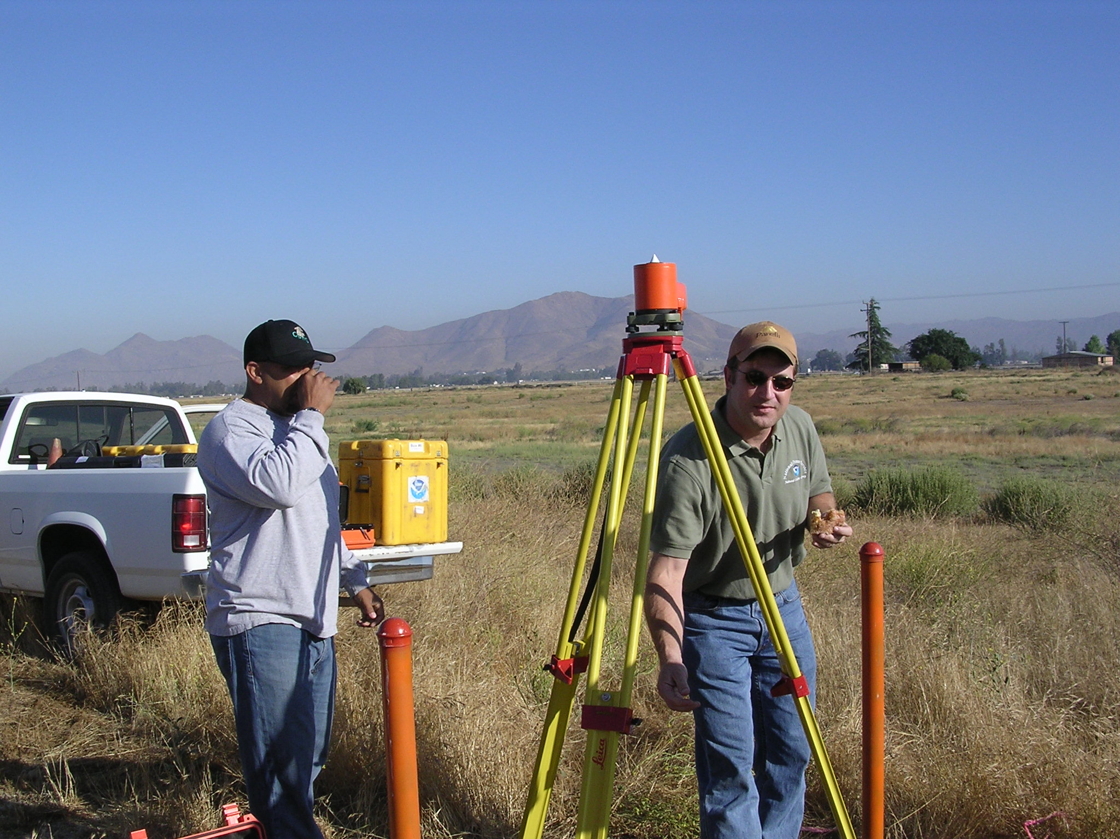

Slide 10
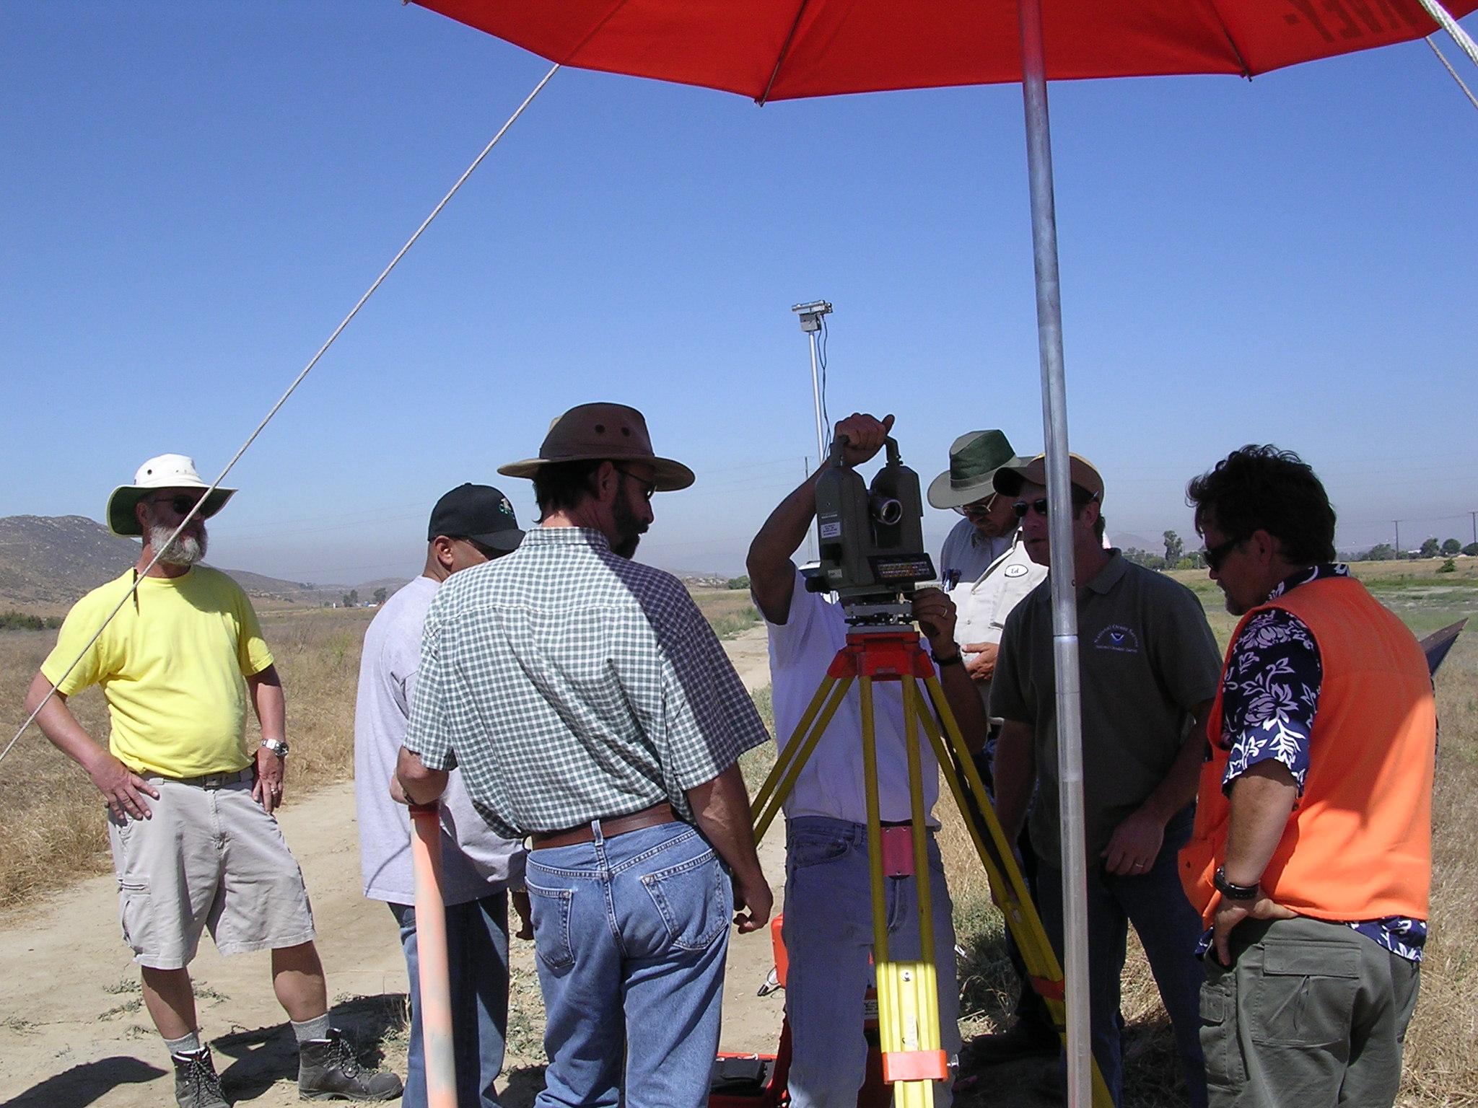
Notes:
Wild 2000, with DI 2002’s

Slide 11
CORS Reference Frame Changing
Current
Upcoming
ITRF2000 1997.00
NAD83(CORS96) 2002.00
Relative antenna calibration
ITRF2000, defined by only 8 global stations
IGS08 (2011) 2005.00
NAD83(2011) 2010.00
Absolute
ITRF2008 uses ~230 stations
What does this all mean?
Average differences of NAD 83(2011) epoch 2002.00 minus NAD 83(CORS96) epoch 2002.00:
East -0.18±1.86 cm; North 0.14±1.07 cm;
Vertical 0.17±2.11 cm
< 2 mm +/- 1-2 cm
(nationally)

Slide 12
Same epoch date—2002.0; NAD83 (2011) vs (CORS96)

Slide 13
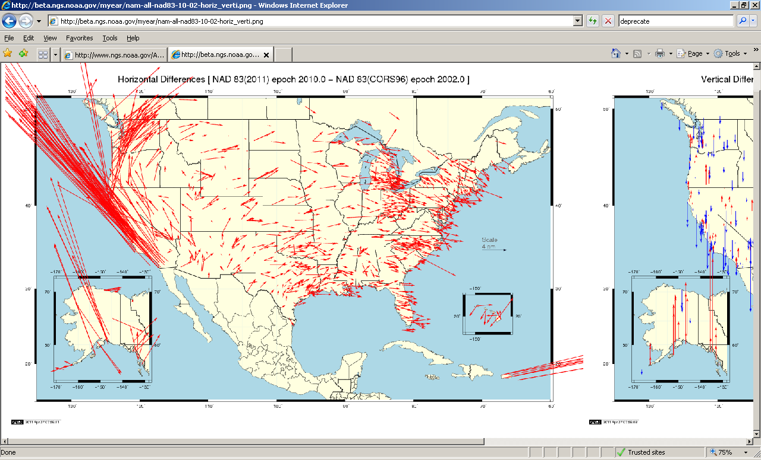

Slide 14
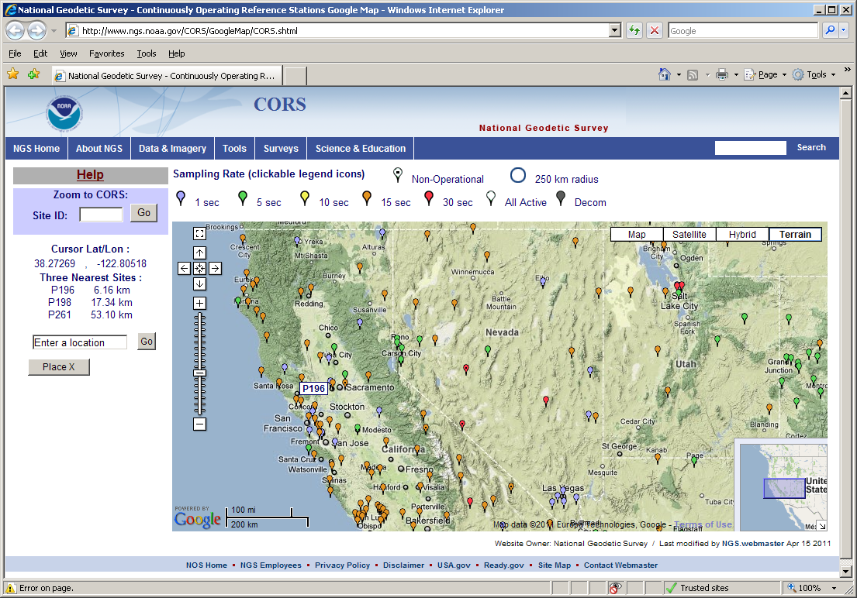
Notes:
When you hover the mouse over a location, the 4-char ID of the site pops up and the 3 nearest sites for that location show up in the left column of the page

Slide 15
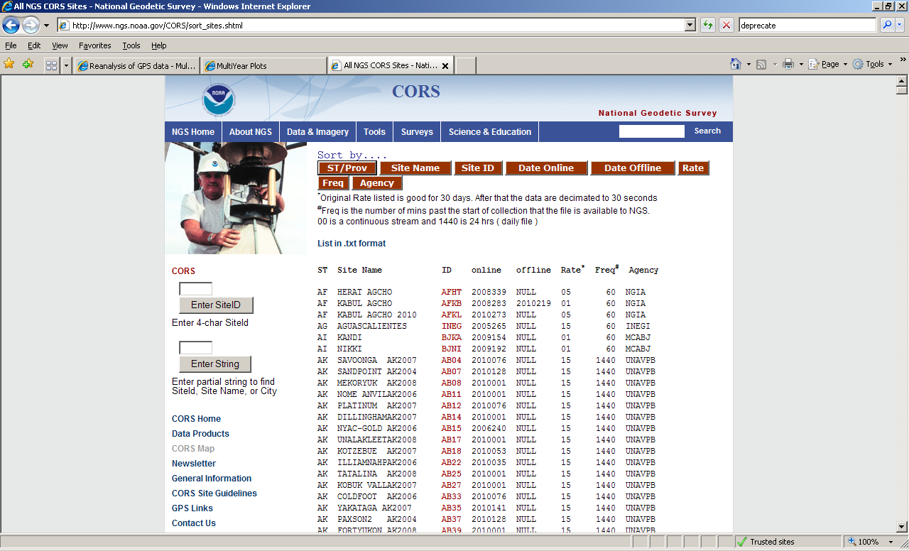

Slide 16
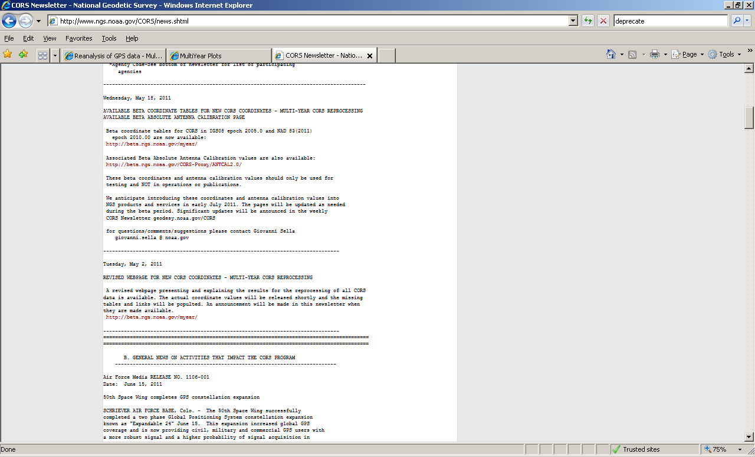
New CORS Coordinates
News that IMPACTS the CORS program, June 15, 2011 (today)

Slide 17
Updates emailed directly to you
requests@willamette.nos.noaa.gov with subject "Subscribe NGS_CORS_news“
04/20/2011 - NGS Launches Public News Subscription Service NOAA's National Geodetic Survey (NGS) now has a subscription news service to keep the public informed of NGS activities. Subscribing (and unsubscribing) is easy!...more
subject “Subscribe NGS.news”
This story found on ‘main’ NGS page (chron order)

Slide 18
Passive network update
In order for the coordinates of passive stations to maintain consistency with the CORS’ representation of the NSRS, NGS will be doing another national adjustment this year
The datum tag that will be adopted for both CORS (active) and passive is NAD83(2011)
CORS (only) will be the control for the LSA

Slide 19
What will be included?
4127 projects --3411 projects for 2007 adjustment, 21% increase
77,694 stations --67,693 stations , 15% increase
398,588 vectors --313,477 vectors , 27% increase
FAQ document link available in news story 5/27/2011 at www.ngs.noaa.gov

Slide 20
HTDP v 3.1
Interactively estimate displacements between two dates.
Individual points entered interactively or
Points on a specified grid
Select NAD83(CORS96) or NAD83(NSRS2007)
Select the dot for Deci-year format

Slide 21
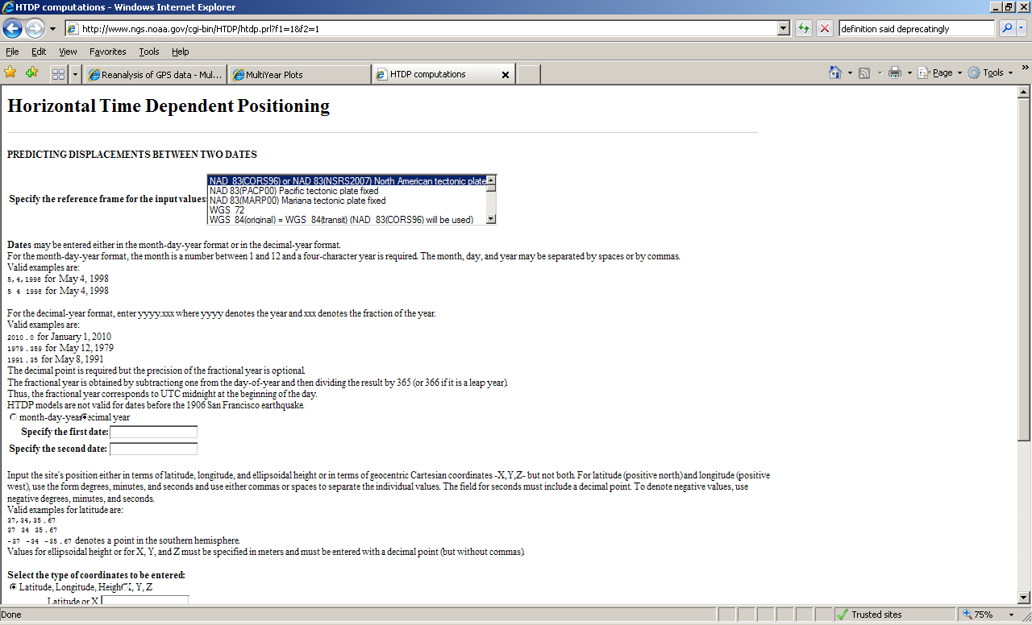

Slide 22
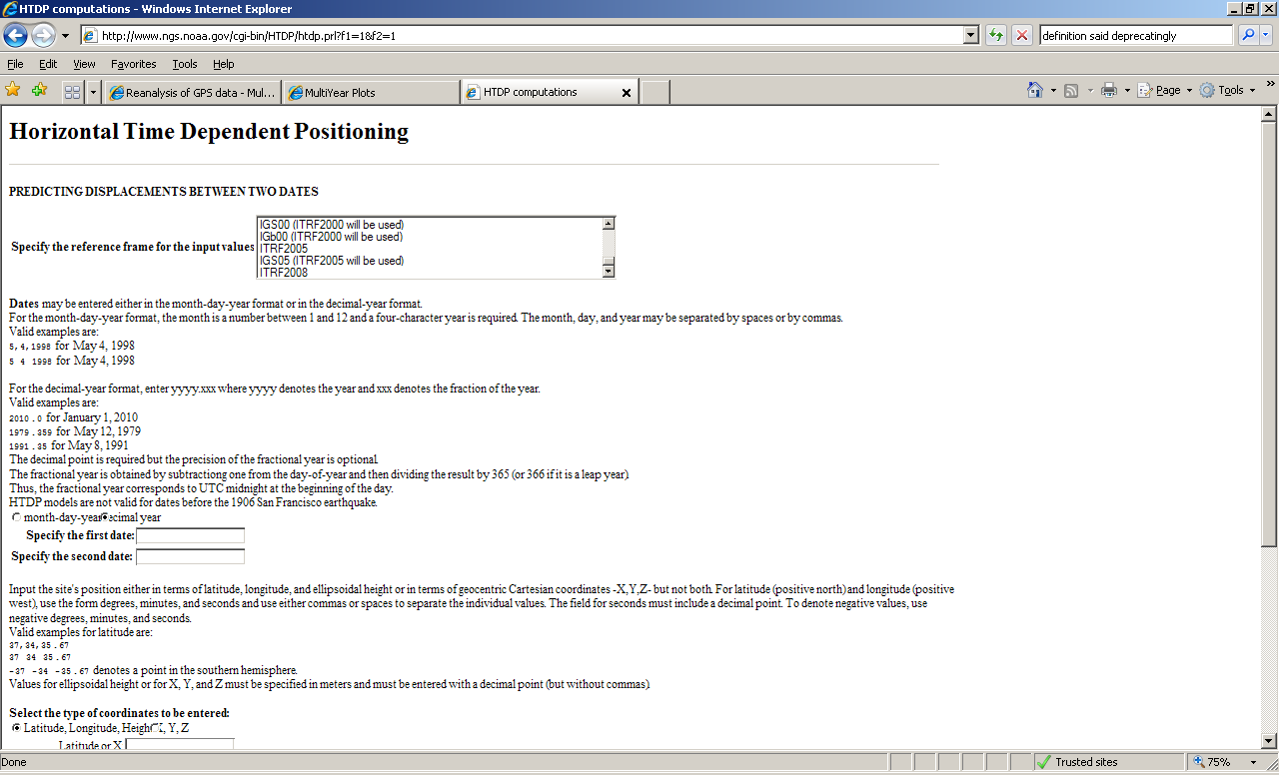

Slide 23
http://www.dot.ca.gov/hq/row/landsurveys/geodetic/geodetic_control.html
CGAR (CA Geodetic Advisor Resources) website
Google Earth display, or Google Maps
Geodetic Control Stations for California: NAD83(NSRS2007) and NAVD88 only
Link to real-time Datasheet

Slide 24
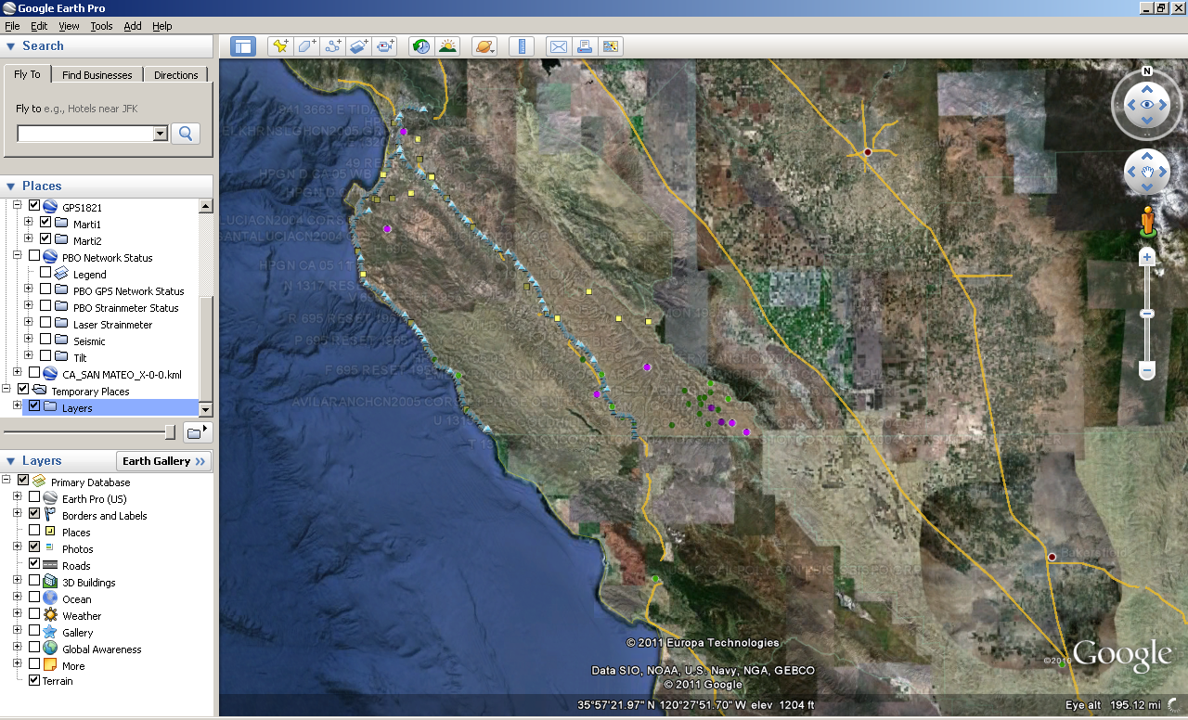

Slide 25
Guidelines for Real Time GNSS Networks - Draft Release
found via Science and Education tab, then
online Publications page under the subject GPS: Technology, Orbits, CORS. The direct link: http://www.ngs.noaa.gov/PUBS_LIB/NGS.RTN.Public.v2.0.pdf
Comments desired now(soon); write to: william.henning@noaa.gov

Slide 26
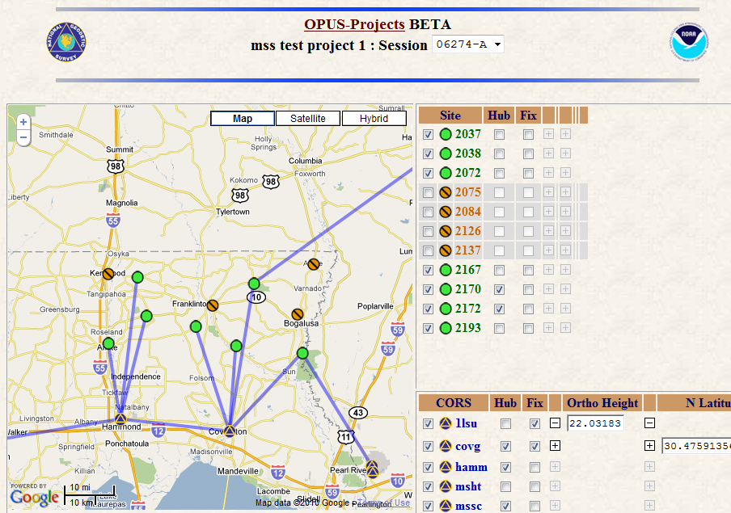
OPUS-Projects
project planning / monitoring
automated file management
review repeat measurements
reports sent to project managers
network adjustment
publish in NGS OPUS database
Under
Construction
Notes:
These are some of the properties of OPUS Projects

Slide 27
GRAV-D Survey in California, Jan/Feb 2011

Slide 28
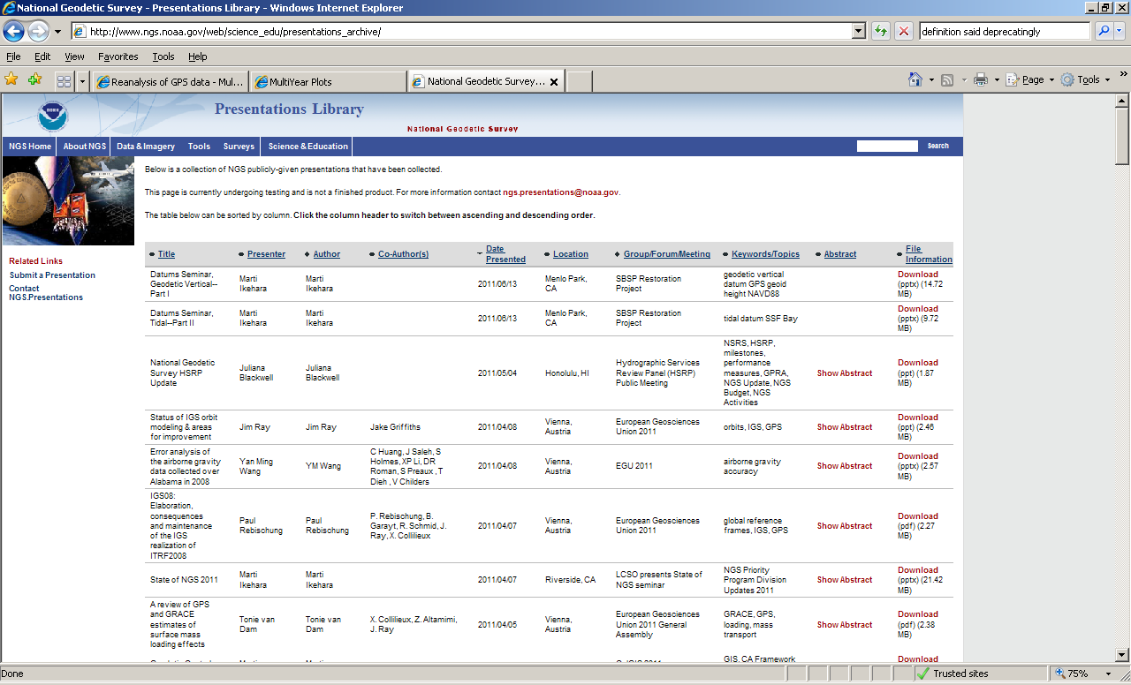
http://www.ngs.noaa.gov/web/science_edu/presentations_archive/

