Slide 1


geodesy.noaa.gov
National Geodetic Survey
Programs & Geodetic Tools
William Stone
Southwest Region Geodetic Advisor
NOAA’s National Geodetic Survey
william.stone@noaa.gov
CLSA - NALS Conference
March 7, 2011
Las Vegas

Slide 2
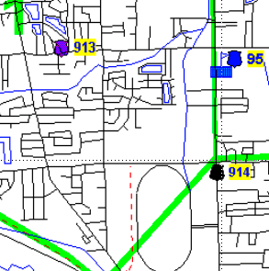

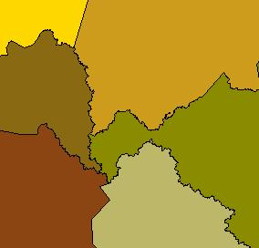
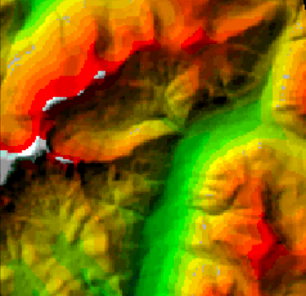
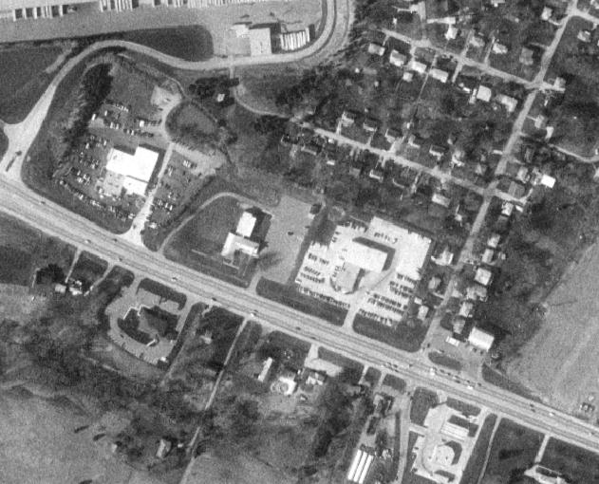
U.S. Department of Commerce
National Oceanic & Atmospheric Administration
National Geodetic Survey
Mission: To define, maintain & provide access to the
National Spatial Reference System (NSRS)
to meet our Nation’s economic, social & environmental needs
      Latitude
      Longitude
      Height
  Scale
  Gravity
  Orientation
NSRS =
& time variations
Horizontal / Vertical Control
(NSRS)

Slide 3
Today’s Topics
Continuously Operating Reference Stations (CORS)
International Terrestrial Reference Frame (ITRF)
  vs. North American Datum of 1983 (NAD83)
Multi-Year CORS Solution (New CORS Coords)
Online Positioning User Service (OPUS)
NGS Ten-Year Plan (New Datums)

Slide 4
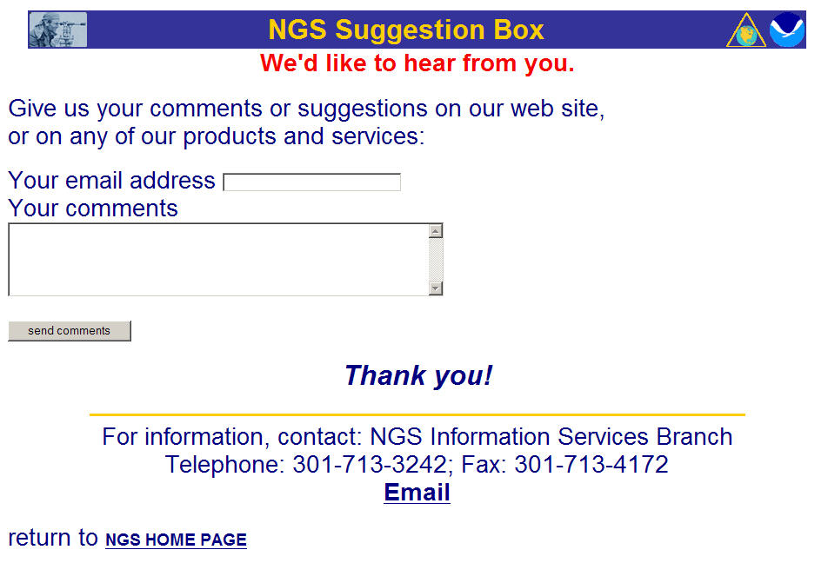

Slide 5
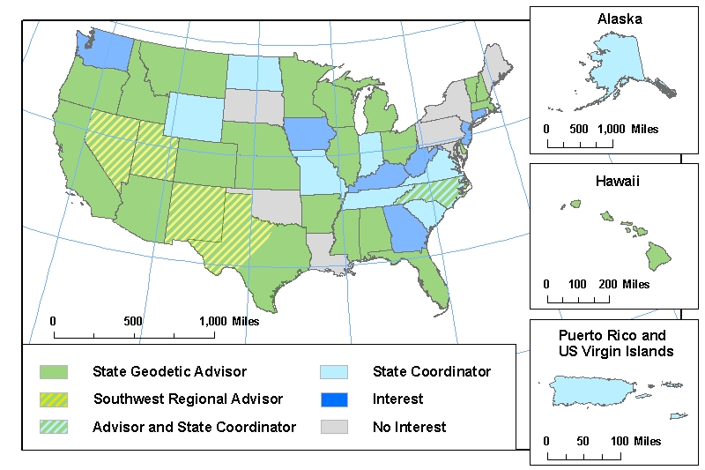
NGS Geodetic Advisors

Slide 6
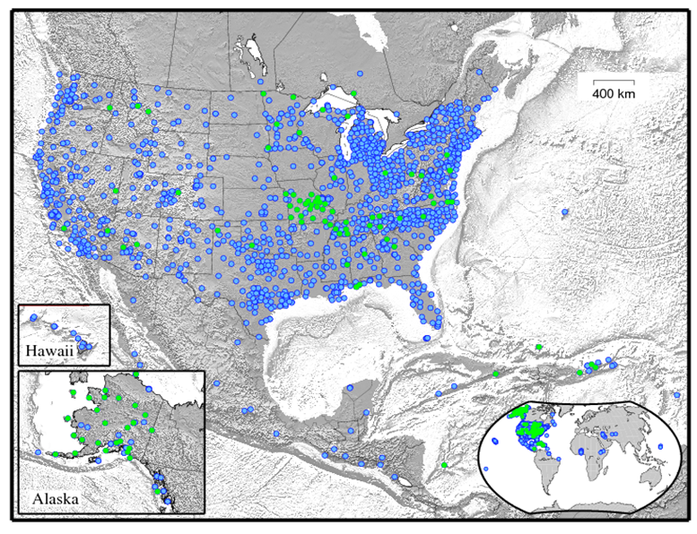
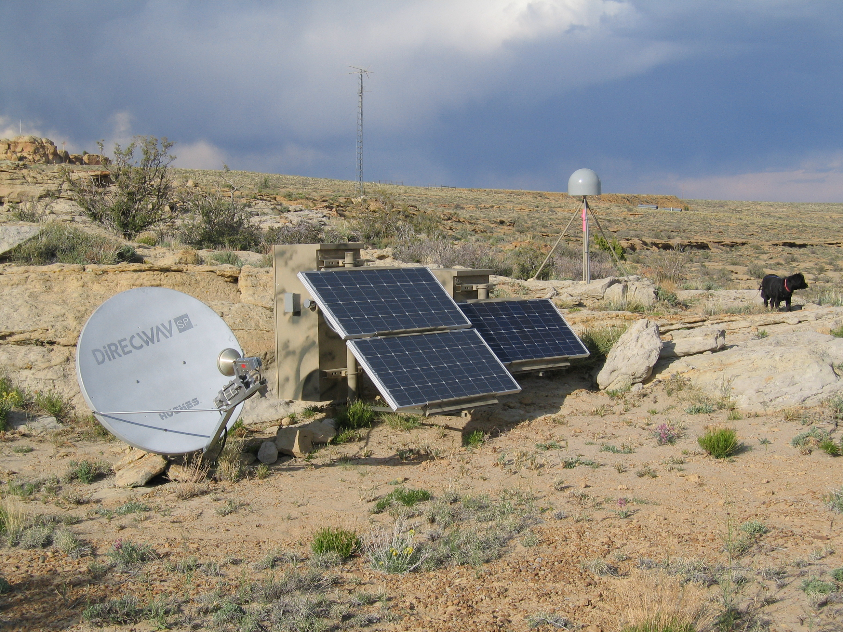
Continuously Operating
Reference Stations (CORS)
CORS Network - (March, 2011)
~1,650 GPS / GNSS Stations
200 organizations
Added 210 Stations – FY2010
Data, coordinates, time series plots, photos, metadata, logs, etc. available for FREE from NGS @ geodesy.noaa.gov/CORS/
1,000,000 files/month downloaded
In FY2011 NGS will:
  Install 1 “Foundation” CORS to support ITRF connection & improvement
  Install 3 CORS co-located with tide/water level stations

Slide 7
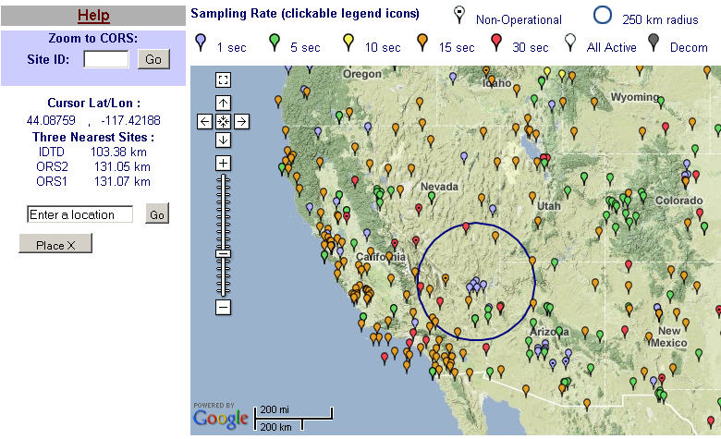
CORS Network – CA / NV and Beyond

Slide 8
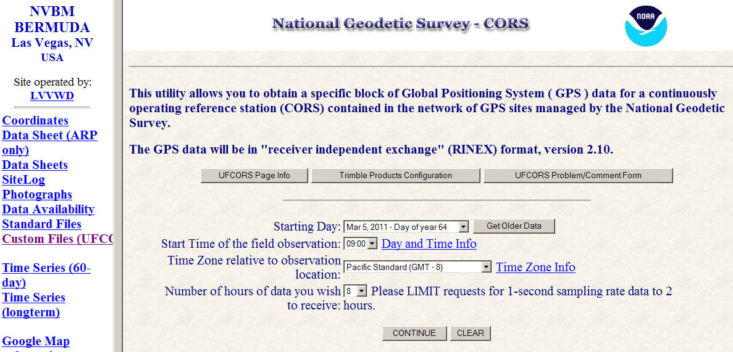
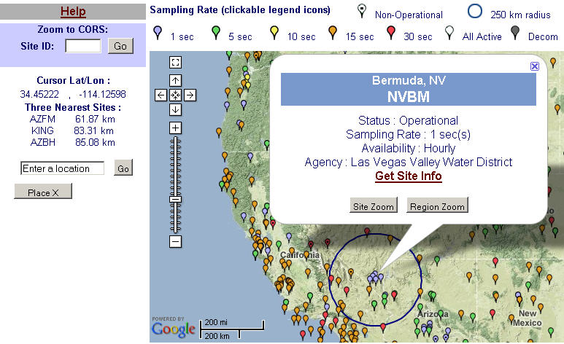
CORS Data Access

Slide 9

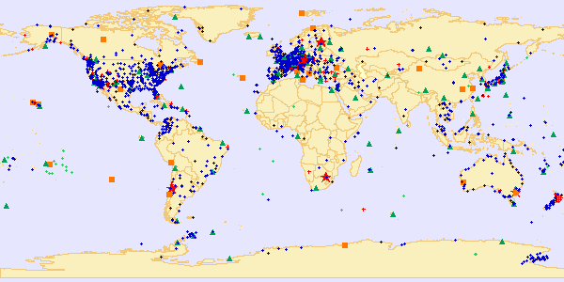
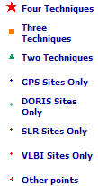
International Terrestrial Reference Frame (ITRF) –
space-based techniques: VLBI, DORIS, SLR, GNSS
Current version: ITRF2008 (epoch 2005.0)
International Earth Rotation and Reference System Service(IERS)
(http://www.iers.org)

Slide 10
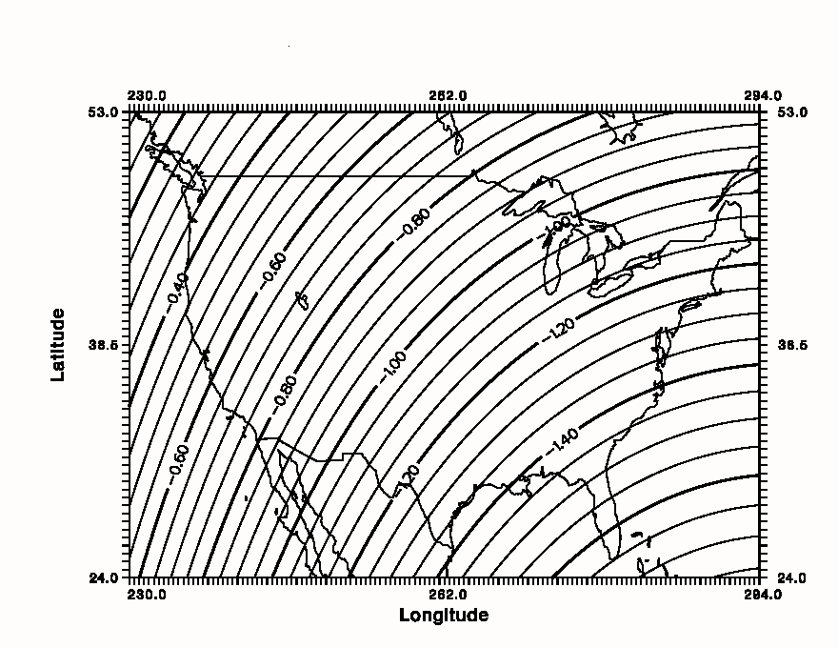
Simplified Concept of NAD 83 vs. ITRF
NAD83 and ITRF
differ by
ABOUT 1 meter H & V
h_{NAD83}
h_{ITRF}
Earth’s
Surface
ITRF 00
Origin
2.2 meters
Ellipsoid for both NAD83 and ITRF:
Geodetic Reference System 1980 (GRS80)
a = 6,378,137.000 meters (semi-major axis)
1/f = 298.25722210088 (flattening)
NAD 83
Origin
( WGS84 (G1150) ~ ITRF2000 )
Notes:
ITRF (International Terrestrial Reference Frame) just has an origin; take NAD83 shaped ellipsoid centered at the ITRF origin to derive ITRF97 ellipsoid heights.
Ellipsoid heights NAD83 vs. ITRF97 - Defined origins are best estimate of the center of mass; NAD83 is not geocentric. Move origin; move ellipsoid surface as illustrated.
Ellipsoid height differences reflect the non-geocentricity of NAD83.

Slide 11
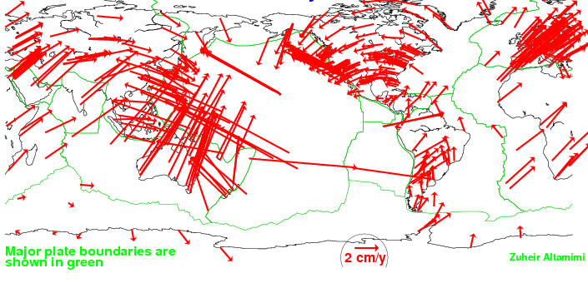
NAD83 vs. ITRF Station Velocities
<<< NAD83
(FIXED to
North American Plate)
ITRF>>>
(NO NET-ROTATION)

Slide 12
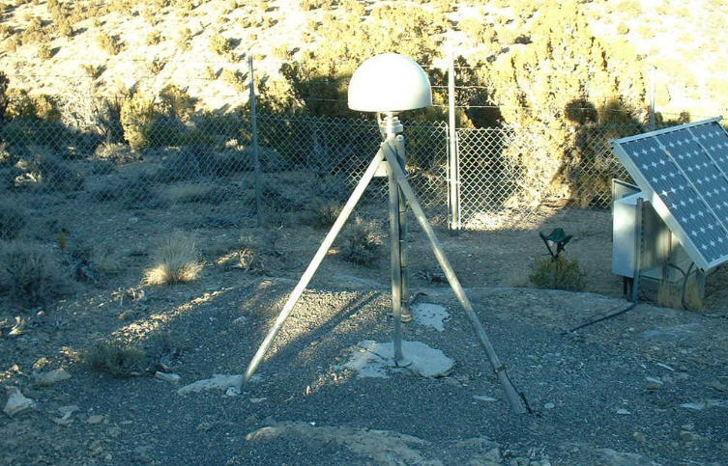
CORS - EGAN, NV
ITRF00(1997.0):39-20-42.88052N/ 114-56-19.86979W/ 1998.362m
Velocities (m/yr): N: -0.0118 / E: -0.0166 / Up: 0.0010
ITRF00
2cm/yr
1.219 m
NAD83
3mm/yr
NAD83(CORS96/2002.0):39-20-42.86001N/ 114-56-19.82629/ 1999.012m
Velocities (m/yr): N: -0.0028 / E: -0.0001 / Up: 0.0100

Slide 13
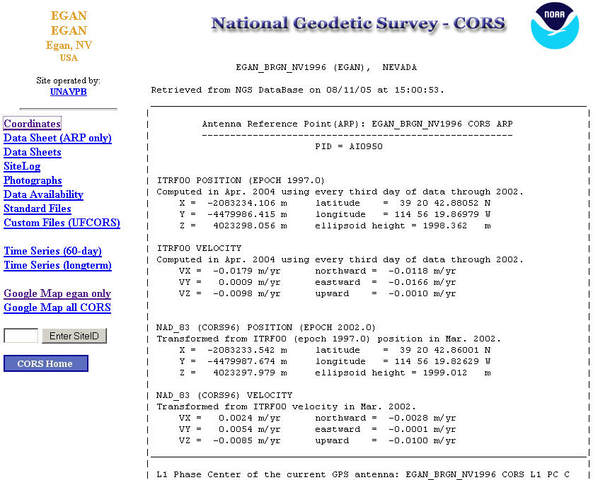
ITRF00
Position
Velocity
NAD83
Position
Velocity

Slide 14
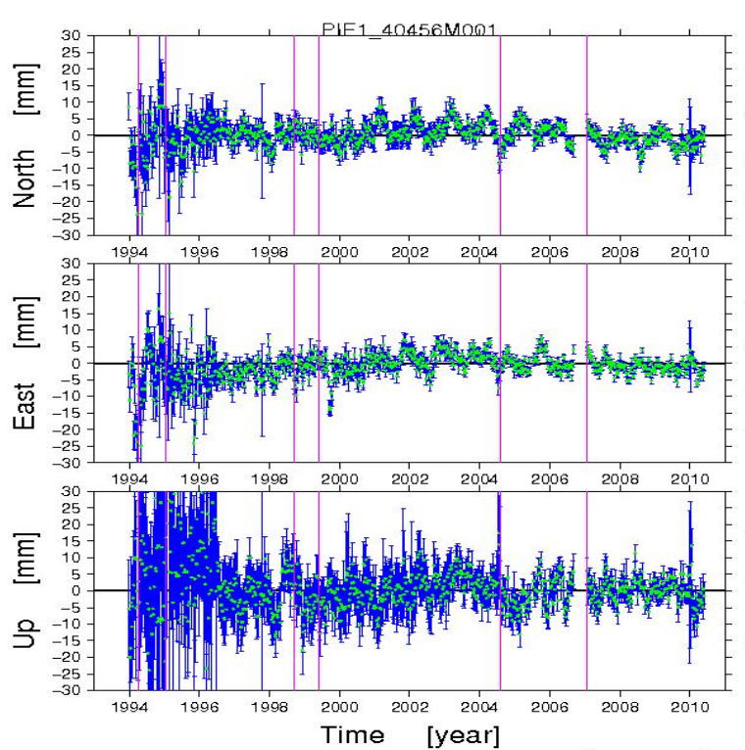
Pie Town, NM CORS (PIE1): 1994 - 2010

Slide 15
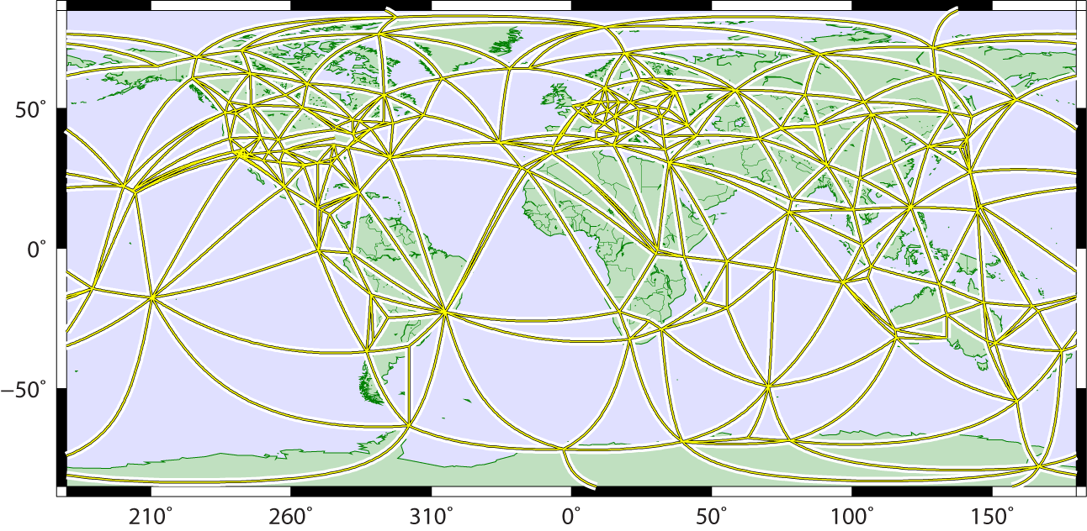
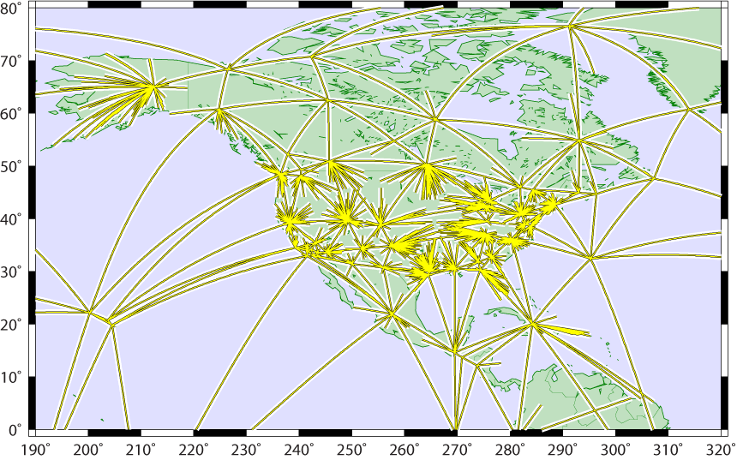
Maintaining Coordinate Accuracy: the Multi-Year CORS Solution
global tracking network used for estimating:
  satellite orbits (15-min intervals)
  terrestrial framework
    Earth Orientation (EOPs)
    global station positions (weekly averages)
Global
U.S. CORS tied to global framework via single baselines radiating from global stations
  minimizes frame distortions from local effects in dense regional networks
Global+CORS

Slide 16
Multi-Year CORS Solution – Work Completed
CORS RINEX observations from 1994 thru 2010.5 processed in fully consistent global framework
  evaluated approx. 90 billion double-difference observation eqs.
  using latest IERS models and processing methods
    switch to absolute (vs. relative) antenna calibrations
    reduced positioning errors and distortions of global frame
860 weekly (full history) CORS+global SINEX (Solution Independent Exchange format) files containing X,Y,Z positions and full variance-covariance info
CATREF software from Institut Géographique National (IGN) to stack weekly CORS+global SINEX files
resulted in new positions and velocities for CORS
    4,906 position / velocity estimates for 2,264 CORS+global stations
    solution aligned to ITRF2008 with negligible distortions of frame
    calibrated for use with pending igs08.atx antenna phase center variation (PCV) models

Slide 17
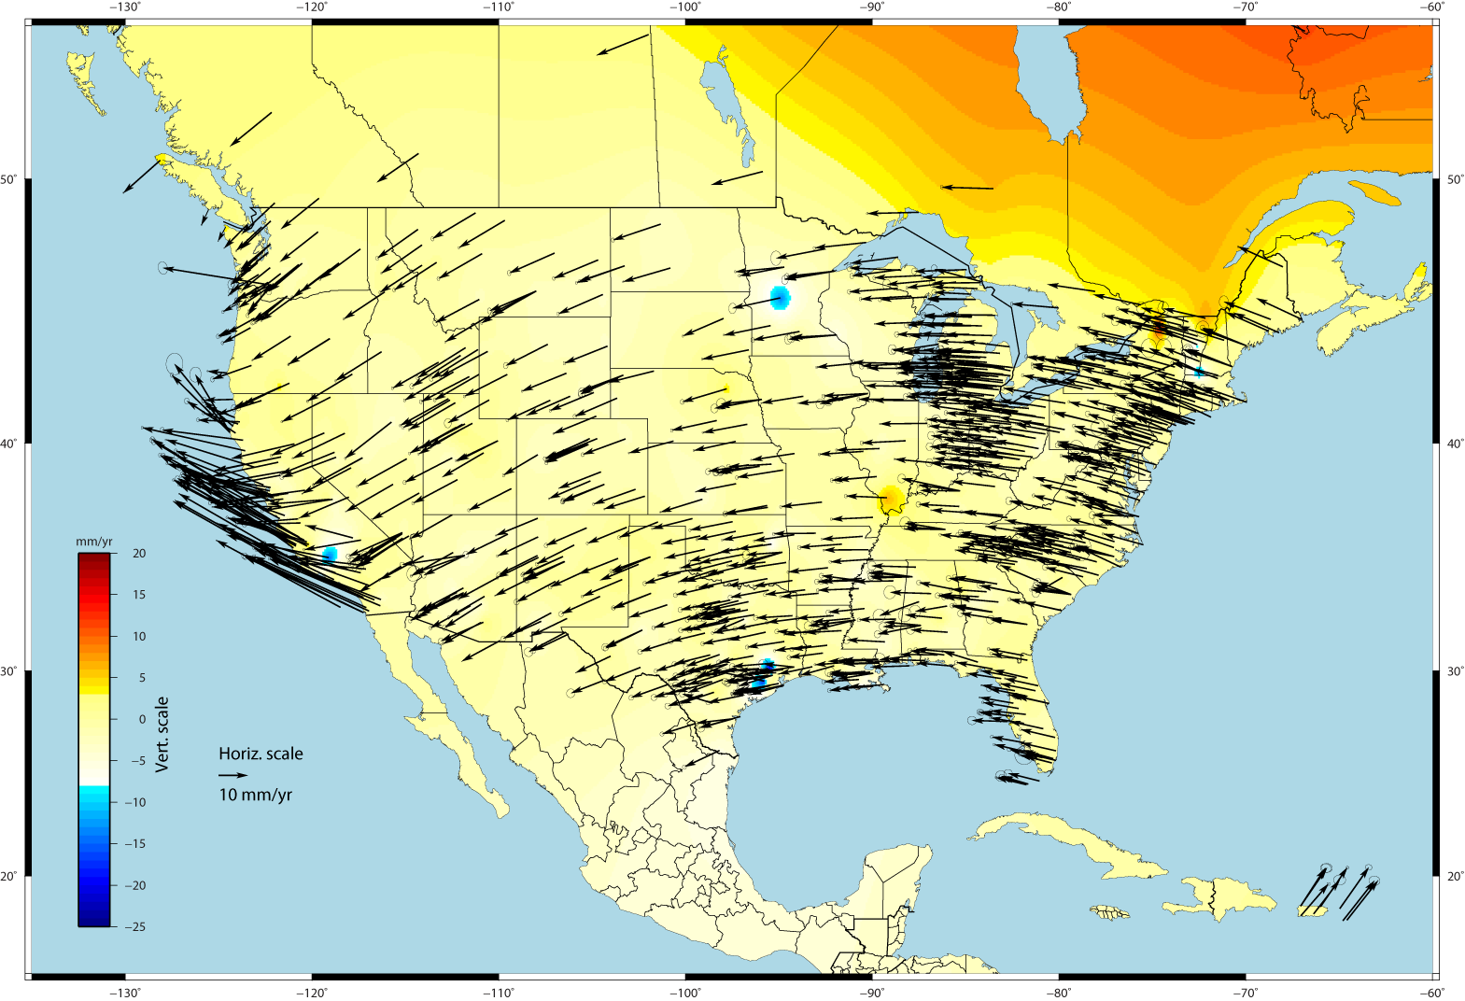
U.S. CORS Velocity Field (ITRF2008)
~1000 CORS w/ sufficient data &
linear velocities

Slide 18
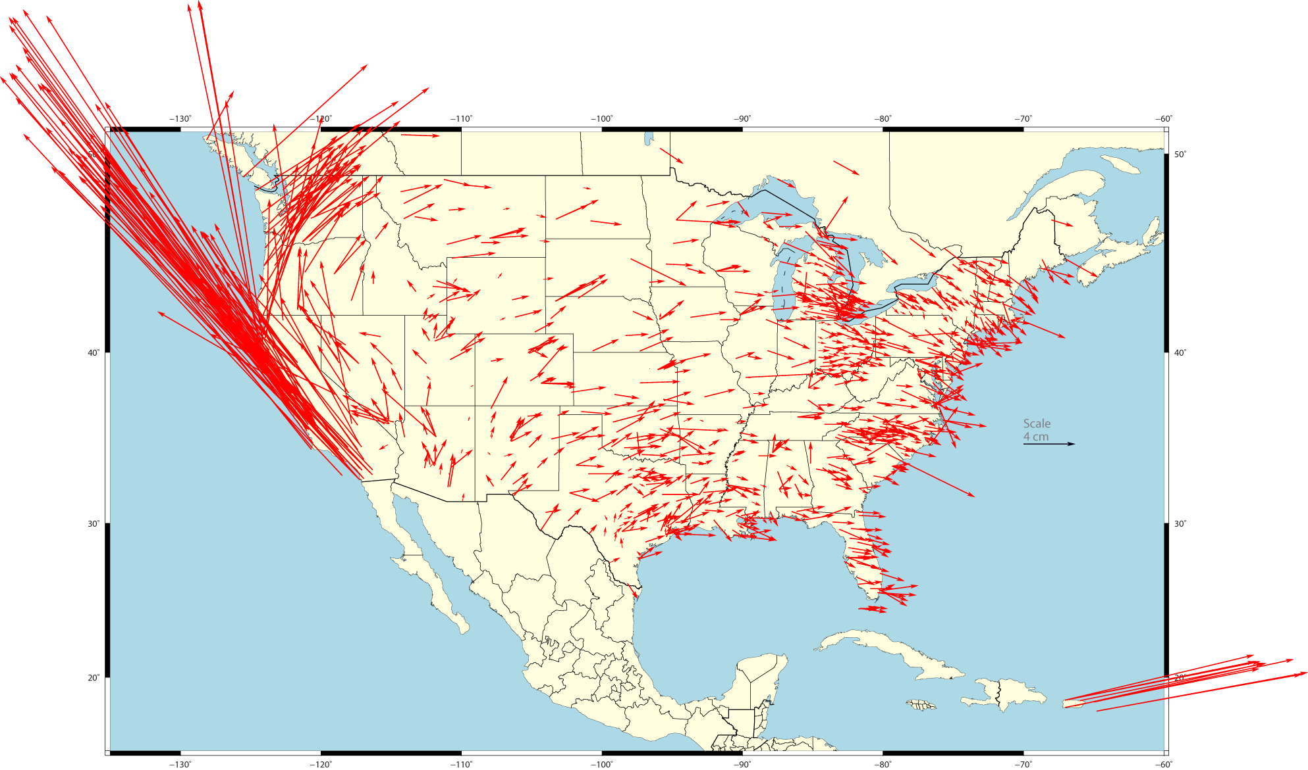
Change in NAD83 Horizontal Positions
NAD 83 (2011) epoch 2010.0 – NAD 83(CORS96) epoch 2002.0
avg. horizontal shift: ΔE = 0.20 (± 5.85) cm ΔN = 1.95 (± 6.12) cm
  combination of position and velocity differences
  due mostly to updated velocities (up to 8 more years of data)
~1000 CORS w/ sufficient data &
linear velocities

Slide 19
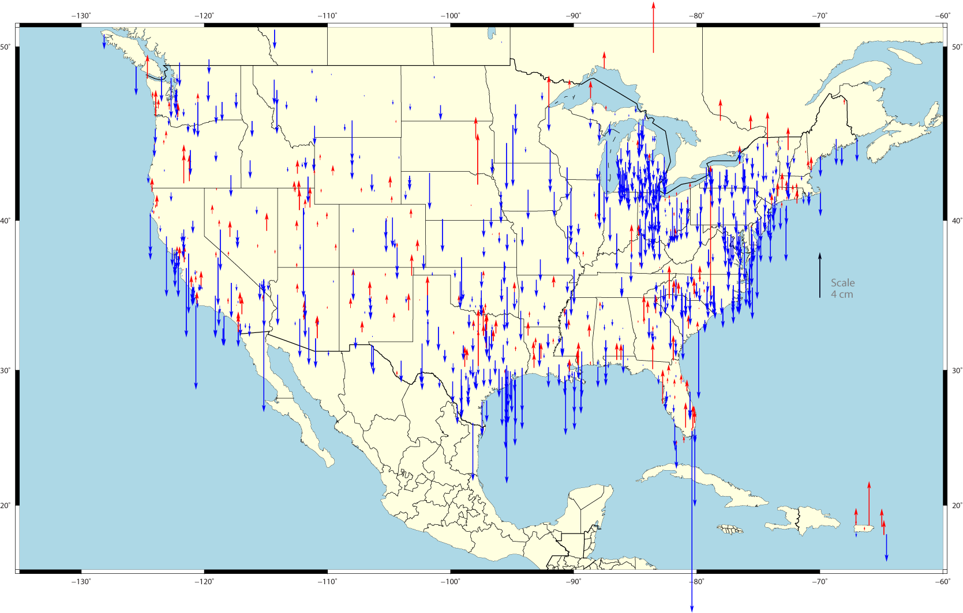
Change in NAD 83 Ellipsoid Heights
NAD 83 (2011) epoch 2010.0 – NAD 83(CORS96) epoch 2002.0
avg. vertical shift: ΔU = -0.9 (± 1.82) cm
  combination of position and velocity differences
  assuming vertical velocity ≈ 0.00 in NAD 83(CORS96)
~1000 CORS w/ sufficient data &
linear velocities

Slide 20
CORS Reference Frame Changes Due to MYCS (to be released
JULY, 2011)
> IGS08 epoch 2005.0
IGS08 = International GNSS Service 2008
(GPS-only realization of ITRF2008)
> NAD83 (2011) epoch 2010.0
NAD83 (2011) = North American Datum 1983
(2011 Realization)

Slide 21
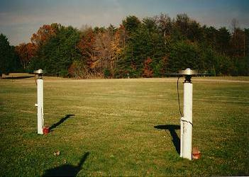
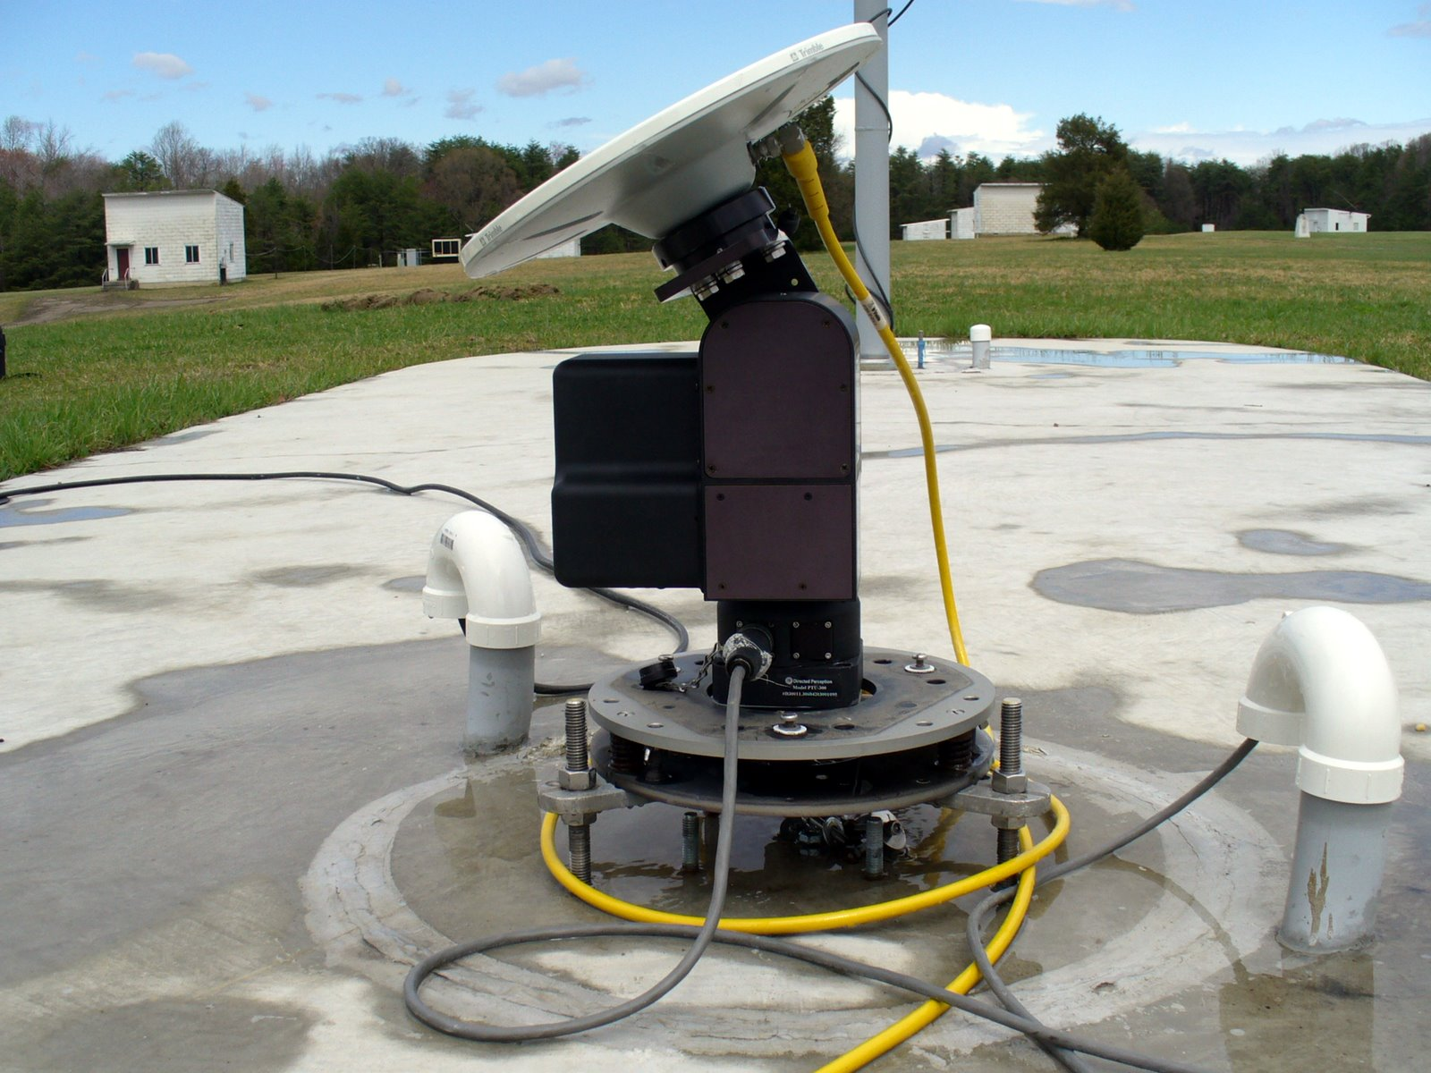
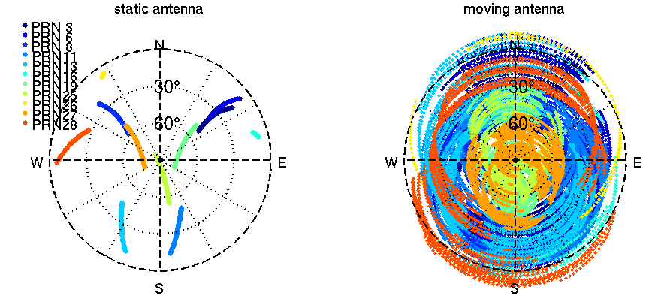
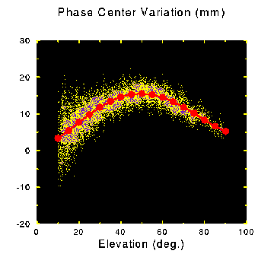
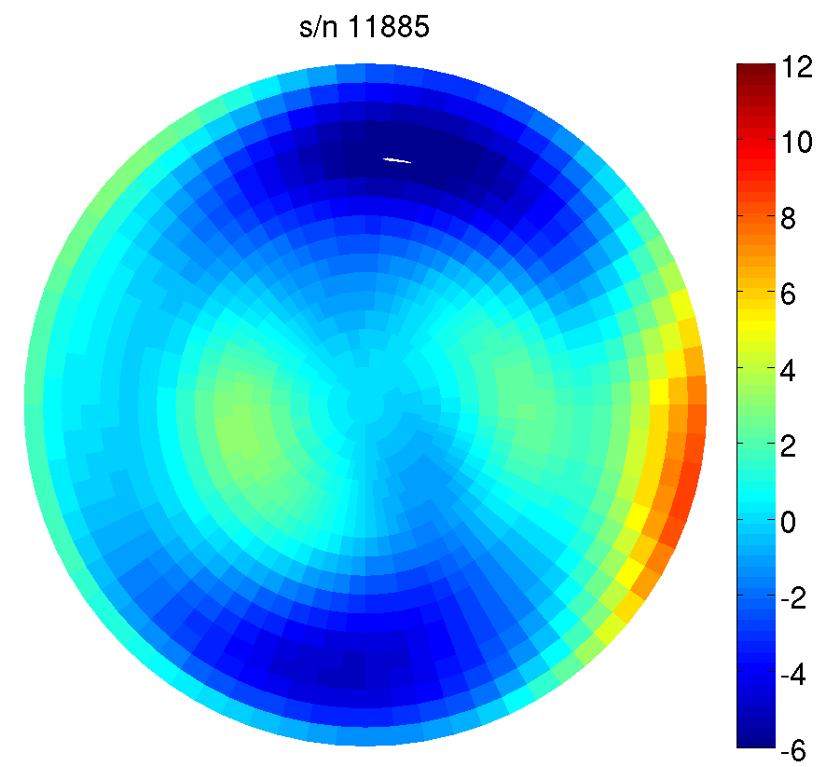
NGS Antenna Calibration –
Relative vs. Absolute GNSS Antenna Calibration
relative
absolute
2 hours
GPS tracking

Slide 22
Key Changes With New CORS Solution
1 ppm scale change due to relative >> absolute antenna PCV
Distinction between computed (tracked) & modeled (HTDP) velocities must be maintained & emphasized (OPUS might use only CORS with computed velocities – min 2.5 years history)
NAD83 CORS (& OPUS) epoch changed from 2002.0 to 2010.0
New CORS coords to be released JULY, 2011; 2-month overlap
Likely readjustment of passive control & new hybrid geoid model
NO transformation model from old to new CORS coordinates
WEBINAR – Tomorrow (March 8) at 10:00 am PST (details in CORS Newsletter; available for post-viewing)

Slide 23
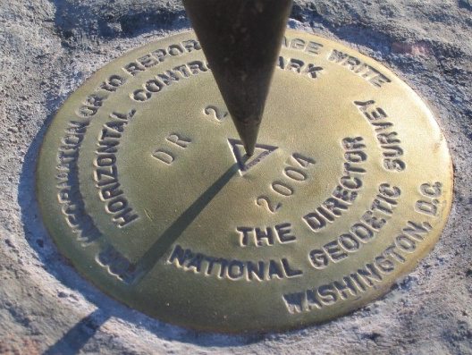
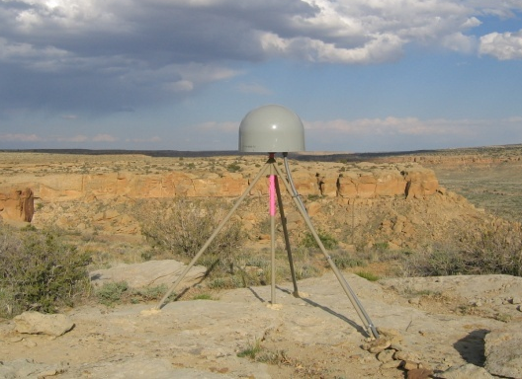
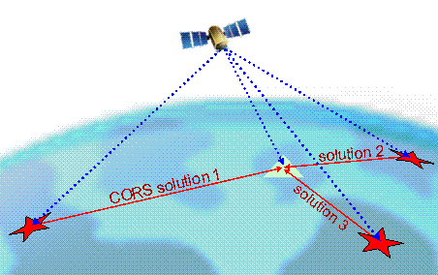
Online Positioning User Service (OPUS)
>15 min of L1/L2 GPS data >>> geodesy.noaa.gov/OPUS/
Processed automatically on NGS computers, tied to CORS
Solution via email - in minutes
Fast, easy, consistent access to NSRS

Slide 24
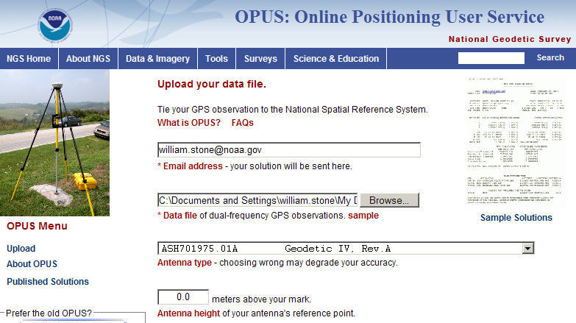
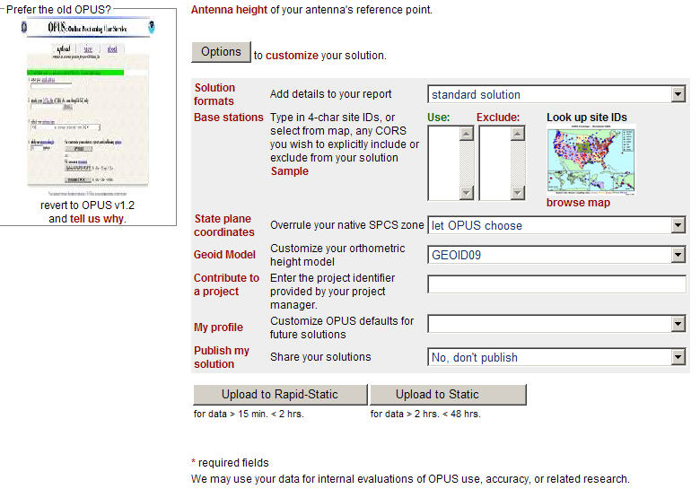
OPTIONS
extended solution
e-mail
in/exclude CORS
GPS file
SPC zone
antenna
geoid model – ‘03/‘09
antenna height
project
profile
publish
OPUS-RS or OPUS-Static
(15 min-2 hr) (2-48 hr)

Slide 25
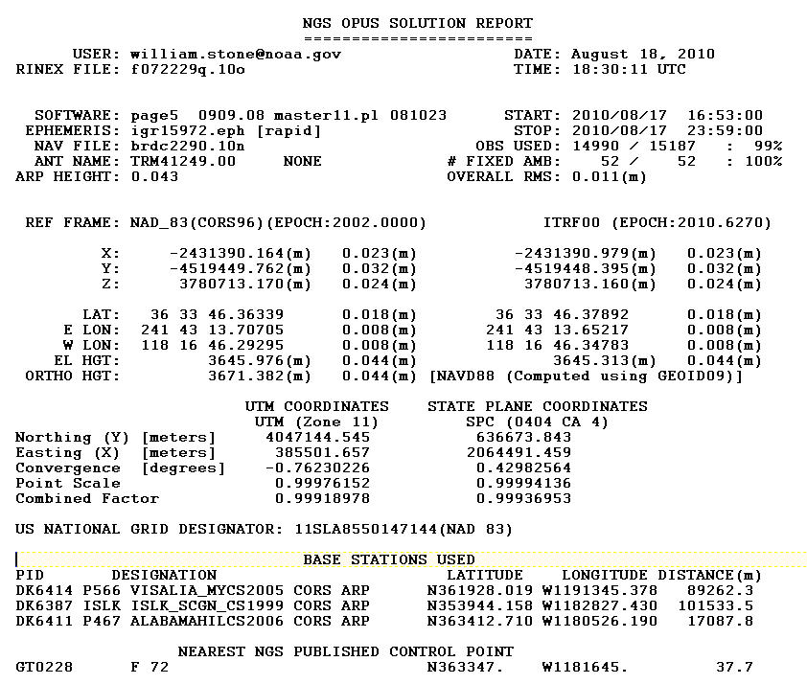
OPUS Solution Report
check your OPUS reports (March – August, 2010)
for incorrect accuracy estimate for Orthometric Height

Slide 26
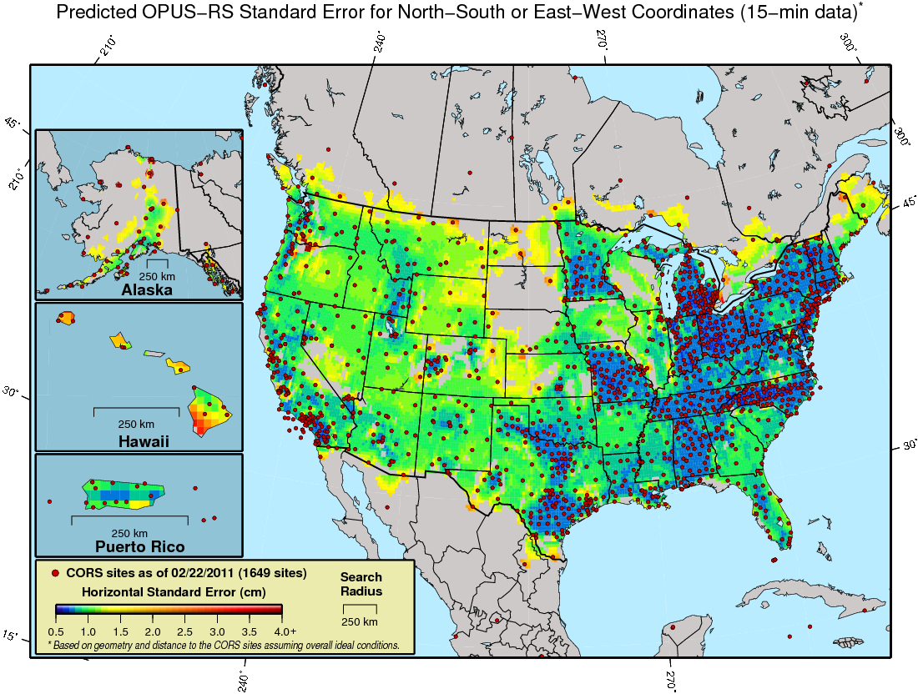
Predicted 15-minute OPUS-RS N/S or E/W Standard Error

Slide 27
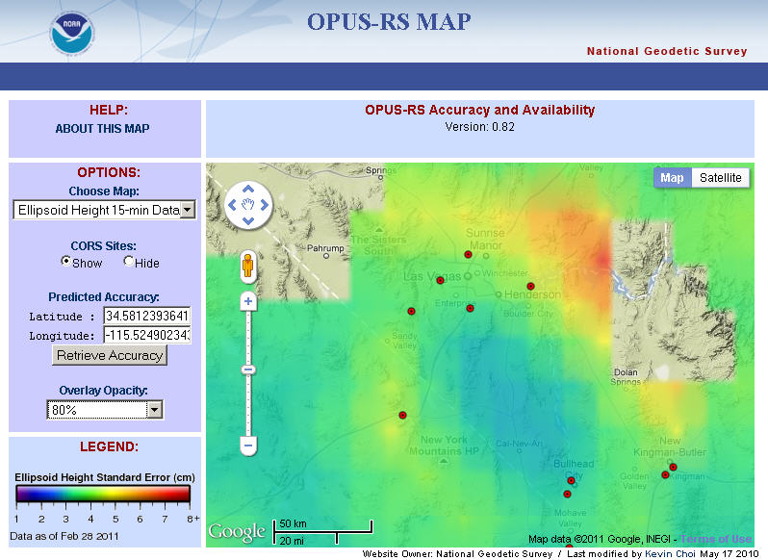

Slide 28
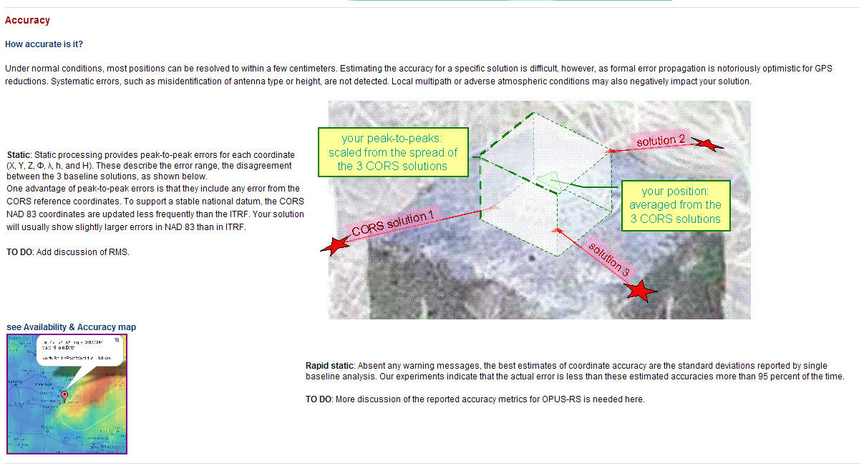
OPUS-RS Accuracy Map Tool –
Links on “About OPUS” Page & in CORS Newsletter

Slide 29
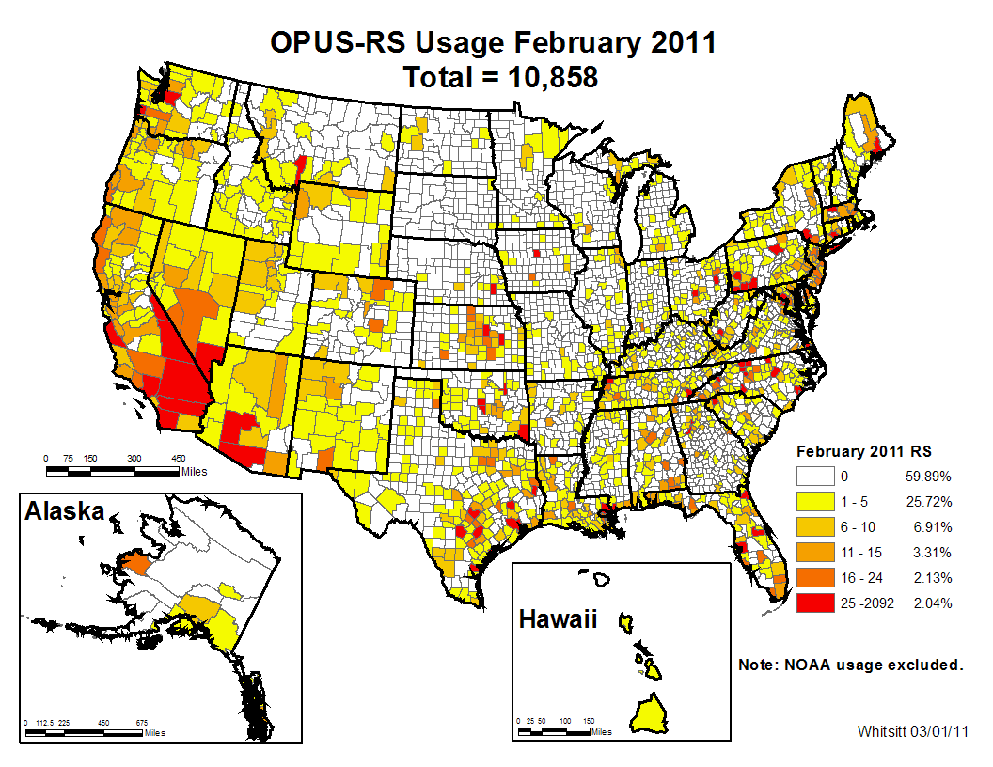

Slide 30
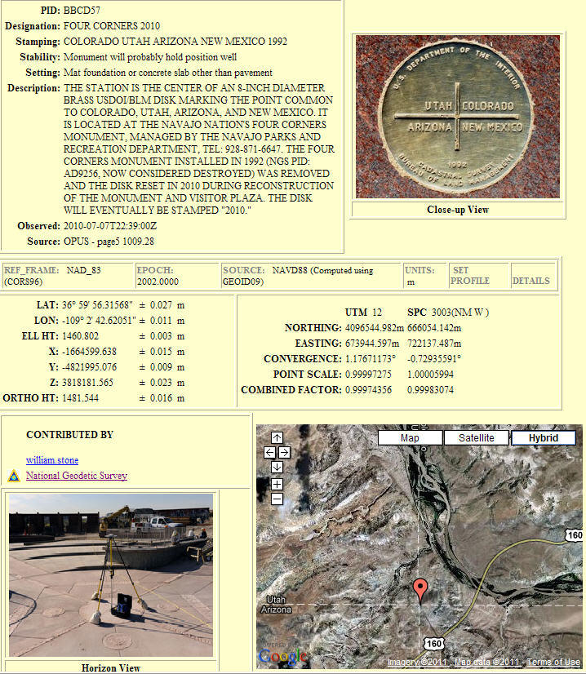
OPUS –
Datasheet Publishing
Publishing Criteria:
NGS-calibrated GPS antenna
> 4 hour data span
> 70% observations used
> 70% fixed ambiguities
< 0.04m H peak-to-peak
< 0.08m V peak-to-peak
Uses:
  GPS on BMs
  PLSS / GCDB
  Data archive
  Data sharing

Slide 31
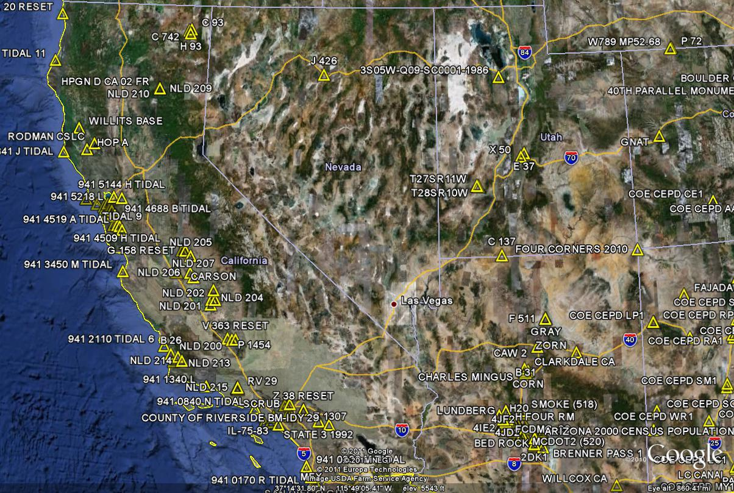
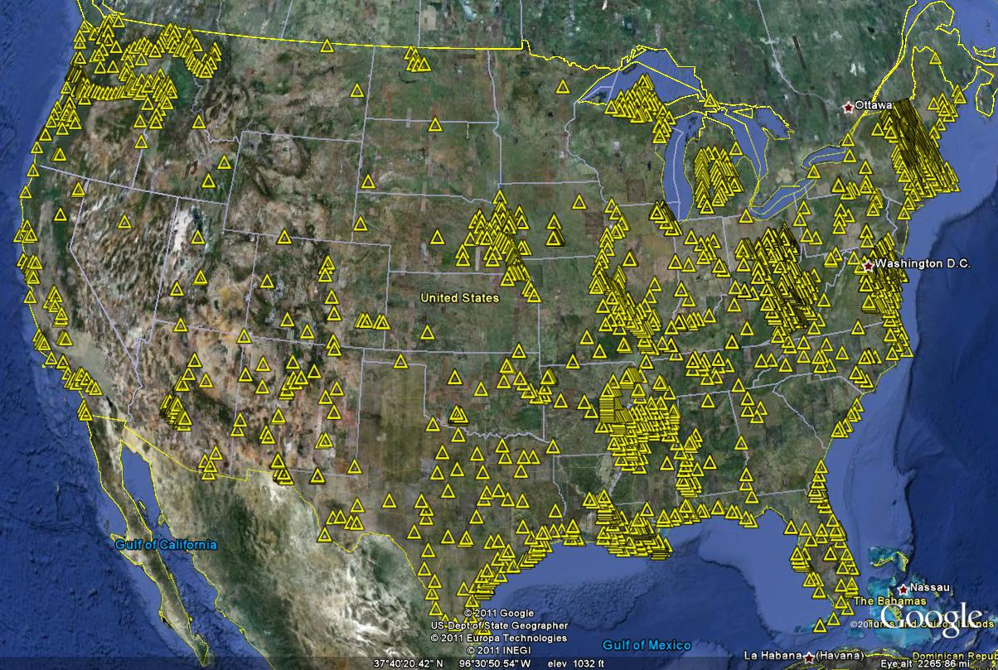
OPUS-Published Stations (3,000 stations - Feb., 2011)

Slide 32
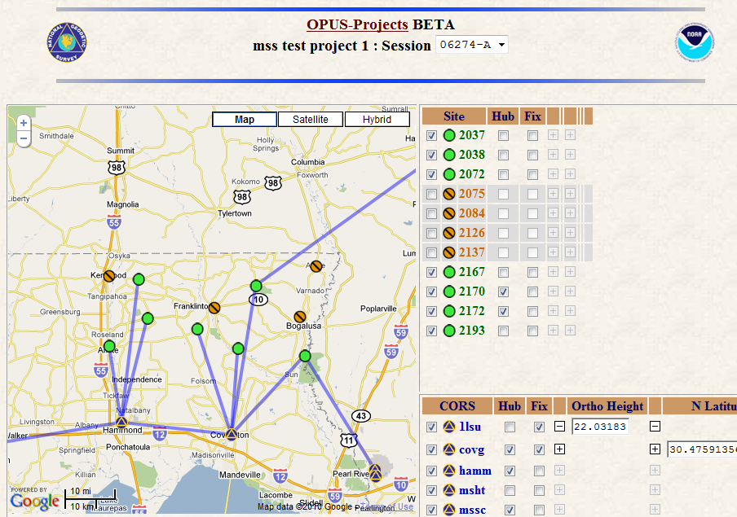
OPUS-Projects
project planning / monitoring
automated file management
review repeat measurements
reports sent to project managers
network adjustment
publish in NGS OPUS database
Under
Construction
Notes:
These are some of the properties of OPUS Projects

Slide 33

NGS Ten-Year Plan
Approved January, 2008
Refines mission, vision, & strategy for the future of NGS actions
Emphasis on outside capacity
  Modernize the Geometric (“Horizontal”) Datum
  Modernize the Geopotential (“Vertical”) Datum
  Migrate the Coastal Mapping Program >>> Integrated Ocean & Coastal Mapping
  Evolve Core Capabilities
  Increase Agency Visibility
Available at: geodesy.noaa.gov

Slide 34
Future Geometric (3-D) Datum
replace NAD83 with new geometric datum – by 2022
coordinates & velocities in ITRF and official US datum
  (NAD83 replacement: plate-fixed or “ITRF-like”?) and relationship
passive control tied to new datum; not a component of new datum
address user needs of datum coordinate constancy vs. accuracy
CORS-based, via GNSS
lat / long / ellipsoid height of defining points accurate to 1 mm, anytime
CORS coordinates computed / published daily; track changes
support development of real-time networks

Slide 35
Future Geopotential (Vertical) Datum
replace NAVD88 with new geopotential datum – by 2022
gravimetric geoid-based, in combination with GNSS
monitor time-varying nature of gravity field
develop transformation tools to relate to NAVD88
produce most accurate continental gravimetric geoid model ever
determine gravity with accuracy of 10 microGals, anytime
support both orthometric and dynamic heights
Height Modernization is fully supported

Slide 36

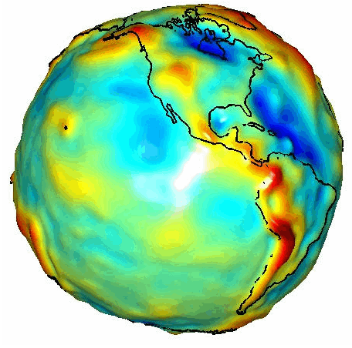
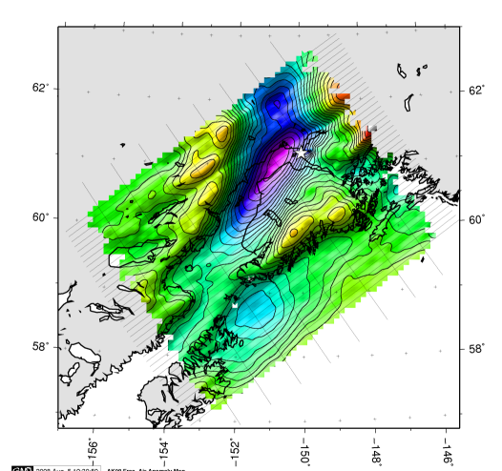
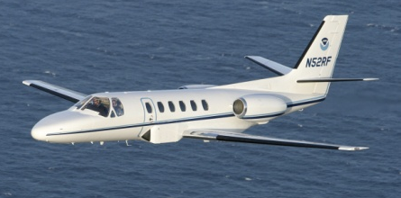
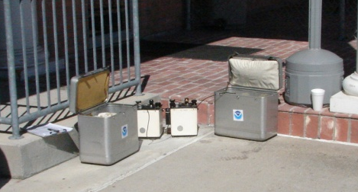
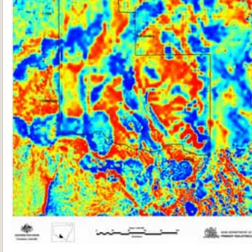
Building a Better Gravity Field (and geoid model)
Long Wavelengths
(≥ 350 km)
GRACE Satellite
GRAV-D >
Intermediate Wavelengths
(500 km to 20 km)
Airborne Measurement
Short Wavelengths
(< 200 km)
Surface Measurement

Slide 37
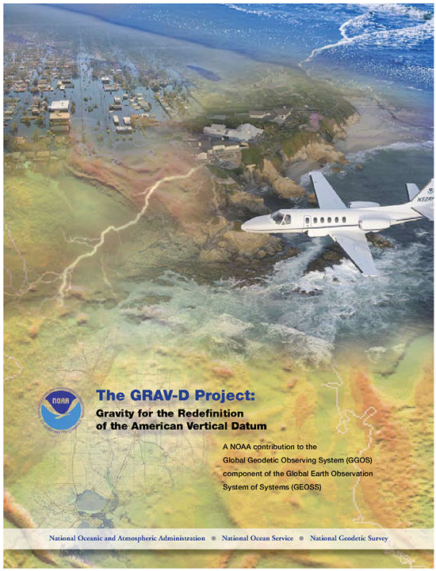
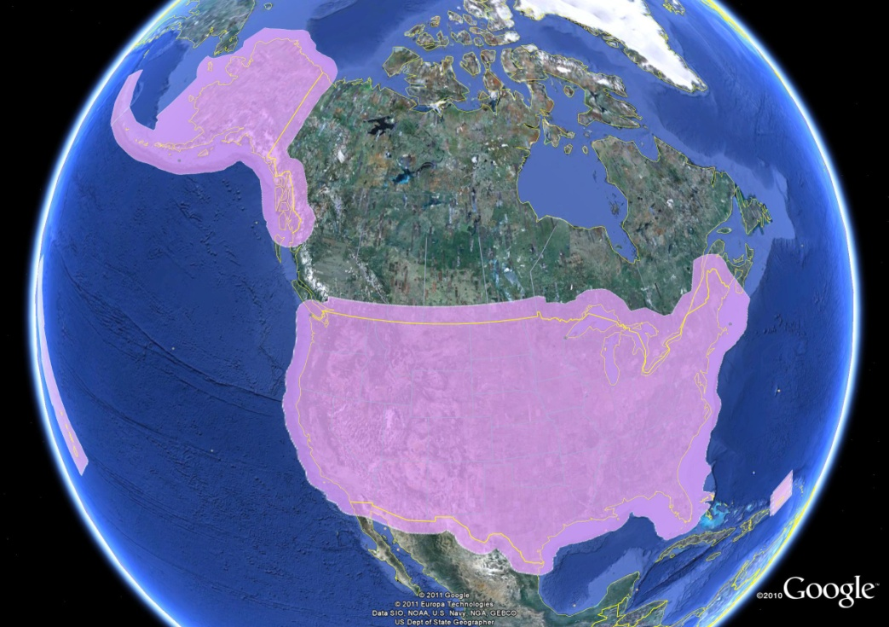
GRAV-D Project:
Gravity for the Redefinition of the
American Vertical Datum
Gravity and Heights are
inseparably connected
$38.5M
Airborne Gravity Snapshot
Absolute Gravity Tracking
Redefine the US
Vertical Datum by 2022

Slide 38
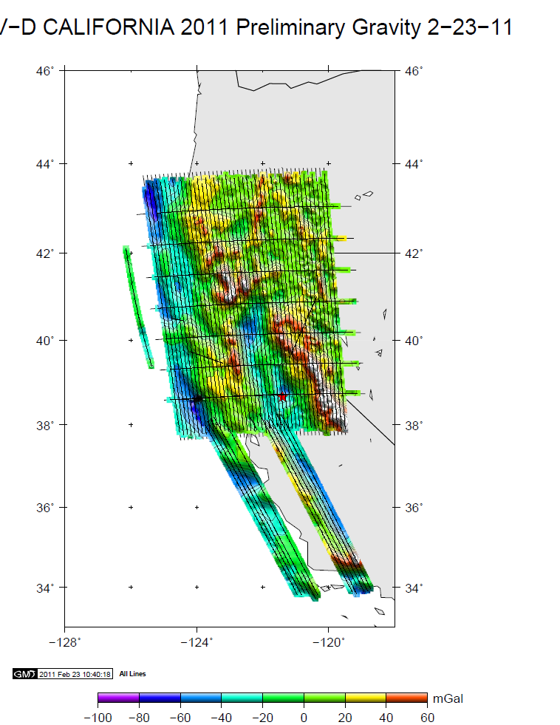
Recent GRAV-D Survey in California

Slide 39

GRAV-D Goals
2 cm accuracy orthometric heights -
  from GNSS (1 cm) + geoid model (1 cm)
fast, accurate, consistent orthometric heights -
everywhere in the USA

Slide 40

Estimated Positional Changes ~ 2022
Mount Whitney, CA
(NAD83 / NAVD88 – NEW DATUMS)
HORIZONTAL: 1.78 m ( 5.8 ft)
ELLIPSOID HEIGHT: - 0.67 m (- 2.2 ft)
(Predicted with HTDP)
ORTHOMETRIC HEIGHT: - 0.81 m (- 2.7 ft)
(Predicted with USGG2009)
HTDP = Horizontal Time-Dependent Positioning Software/Model
USGG2009 = US Gravimetric Geoid 2009

