Slide 1
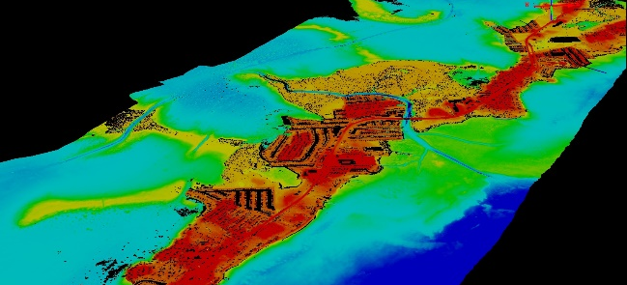
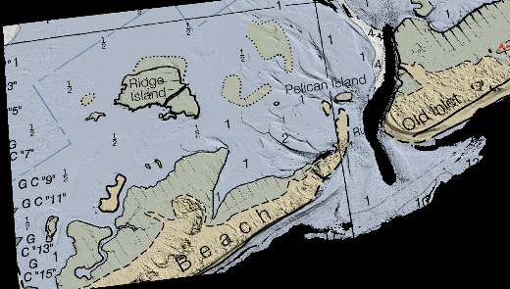
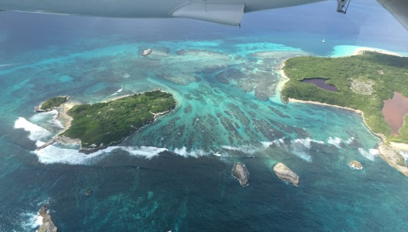
Shoreline Mapping Data and Products
Tim Blackford
Systems & Quality Assurance Branch
Remote Sensing Division
National Geodetic Survey
Notes:
Hello everyone! My name is Tim Blackford. I have been a cartographer with the Remote Sensing Division of NGS for about 28 years. And I am currently the lead for Quality Assurance of our Coastal Mapping Program. Today I’d like to talk about how we produce our shoreline products and distribute them to the public.

Slide 2
Outline
National Shoreline and the Remote Sensing Division
Updating nautical charts
Mapping the shoreline
Shoreline data format and feature attribution
Final products
Project types
Data access and delivery
Other shoreline data layers
Imagery and Lidar data access
Notes:
We are going to cover several topics today, starting off with who we are and what we do. I am going to talk about (read slide).

Slide 3
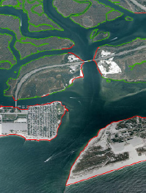
National Shoreline
NGS’s Remote Sensing Division works to produce an accurate, consistent, and up-to-date national shoreline.
Primary application:
NOAA nautical chart updates
Other important applications:
Defining U.S. territorial limits
Coastal resource management
Modeling storm surge and coastal flooding
GIS analysis, etc.
Notes:
The NGS Remote Sensing Division produces shoreline and other data for our primary customer, the NOAA Office of Coast Survey, for application to the nautical charts.
But there are many other important applications for our shoreline data (read list)

Slide 4
Remote Sensing Division
National Ocean Service
Office of Coast Survey
National Geodetic Survey
Requirements Branch
Plans projects
Acquires remote sensing data
Initial processing
Geodetic Svcs
Div.
Spatial Reference System Div.
Remote Sensing
Div.
Observations & Analysis Div.
Systems Dev
Div.
Geosciences Research Div.
Requirements Branch
Applications Branch
Further processing
Compiles shoreline
Final product preparation
Applications Branch
Systems & QA Branch
Quality Assurance Review
Loads products to database
Project release and delivery
Systems & QA Branch
Notes:
The Remote Sensing Division is one of six divisions within NGS, and is made up of three branches, divided along functional lines.
The Requirements Branch plans our mapping projects, acquires the remote sensing data, and performs initial processing
The Applications Branch performs further processing on the data, compiles the shoreline and other features, and produces our final mapping products
The Systems and Quality Assurance Branch performs a final QA review, and makes the products available to our customers through the NGS web site.

Slide 5
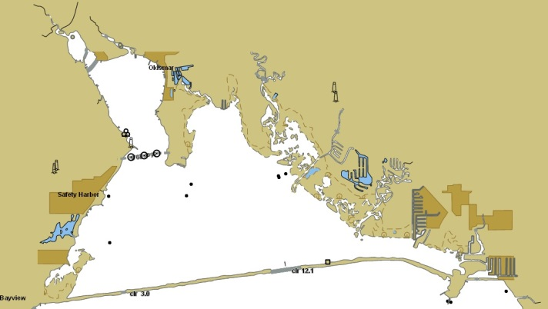
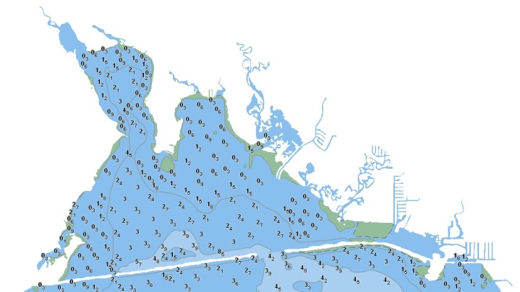
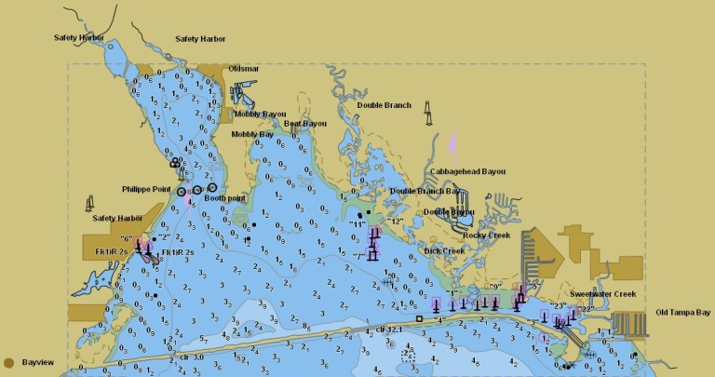
Updating Nautical Charts
The primary base mapping data for nautical charts consist of two parts:
TOPOGRAPHY + HYDROGRAPHY (+Additional Info) = NAUTICAL CHART
Notes:
To create a nautical chart you need two primary base mapping data sets: Topography and Hydrography
You put these together, with a lot of additional cartographic and navigational information, to get the nautical chart

Slide 6
Updating Nautical Charts
NGS Remote Sensing Division produces the topography
Notes:
The NGS remote sensing division produces the topography layer

Slide 7
Updating Nautical Charts
OCS Hydro Survey Division produces the hydrography
Notes:
The OCS Hydrographic Survey Division produces the hydrography layer

Slide 8
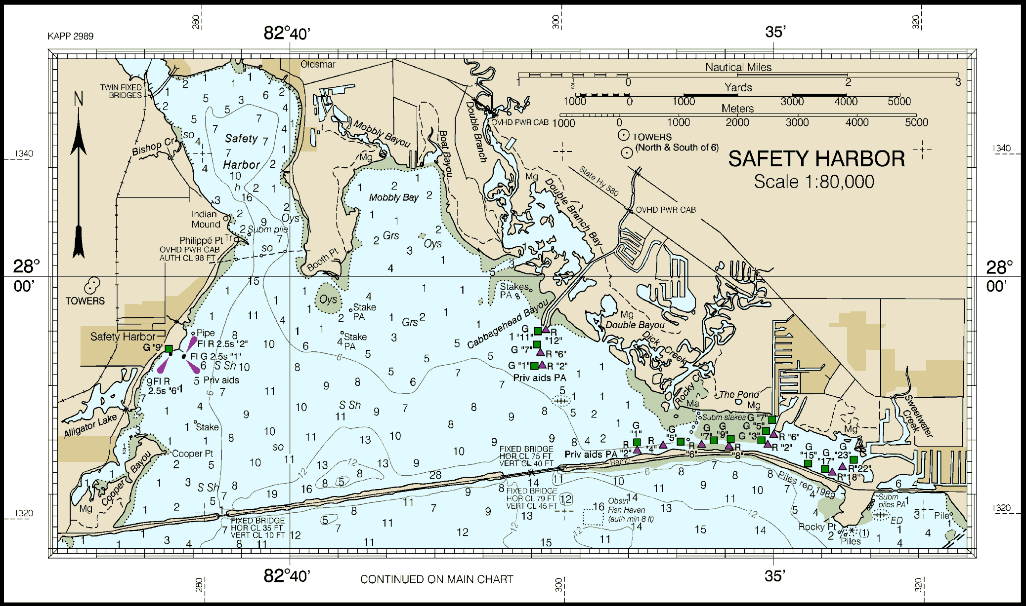
Updating Nautical Charts
OCS Marine Charting Division produces the chart (NIS)
Notes:
And the Marine Charting Division puts it all together in their Nautical Information System, which is used to produce the final nautical charting products

Slide 9
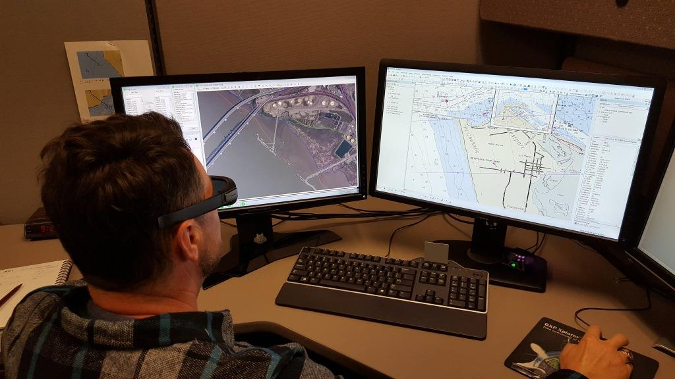
Softcopy Photogrammetry
Notes:
The NGS Remote Sensing Division uses softcopy photogrammetry with airborne or satellite imagery, typically on a stereo-capable workstation, to map the shoreline and other nearshore features that make up the topography layers of the nautical charts.

Slide 10
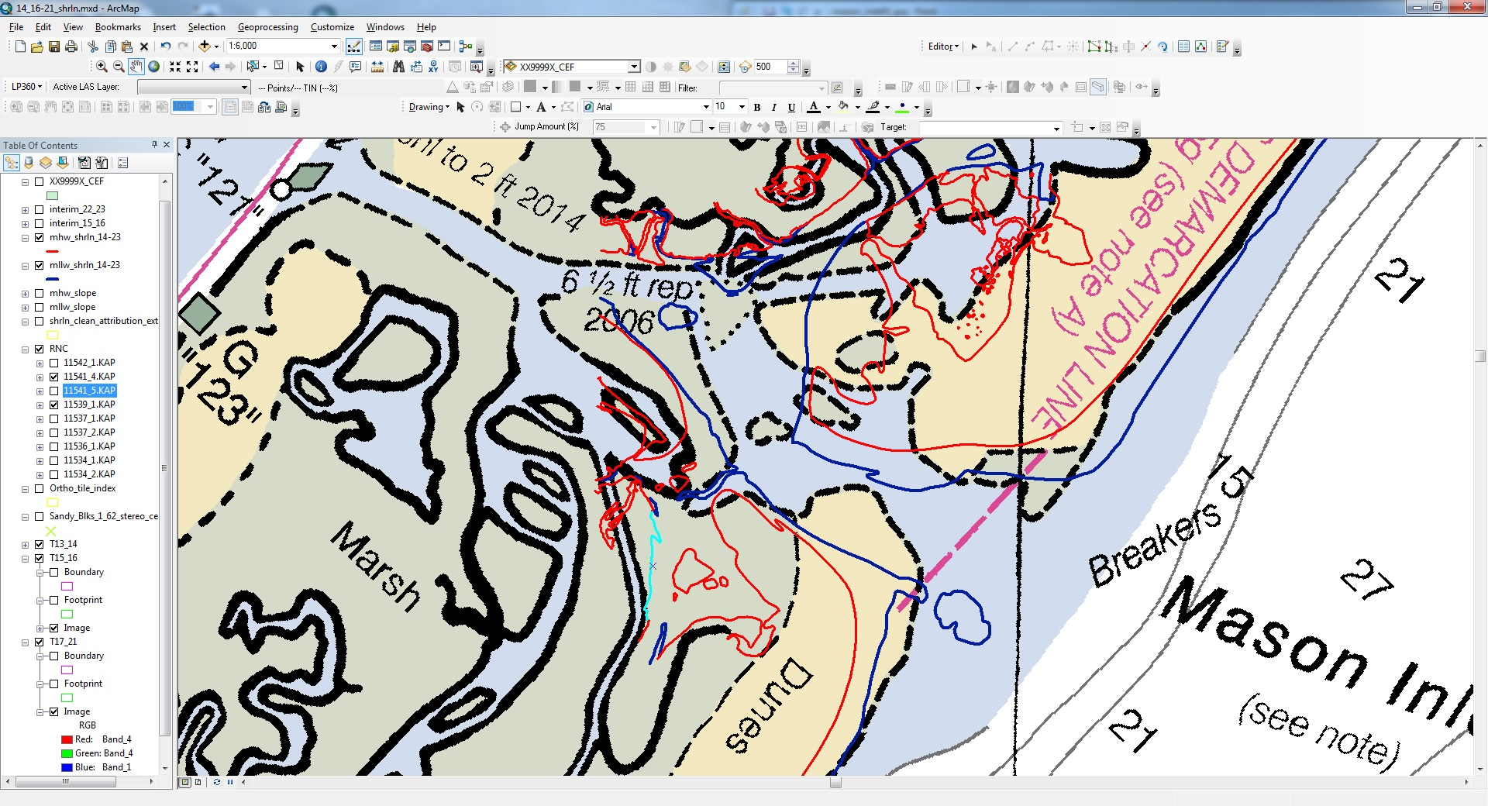
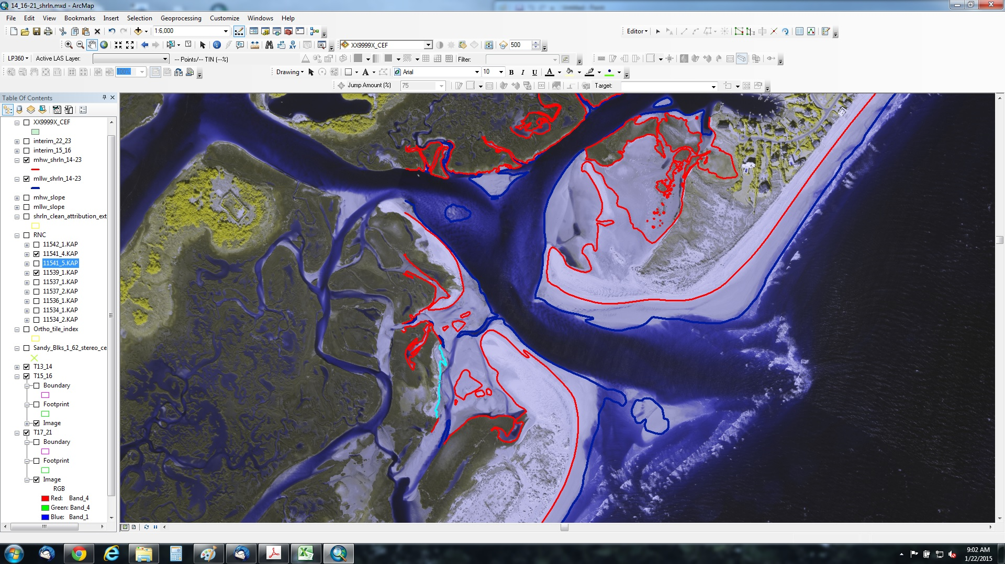
Topographic-Bathymetric Lidar for Shoreline
Notes:
RSD also uses airborne topographic and bathymetric (topo-bathy) lidar to derive the Mean High Water shoreline vector and Mean Lower Low Water depth contour line for application to the nautical charts.

Slide 11
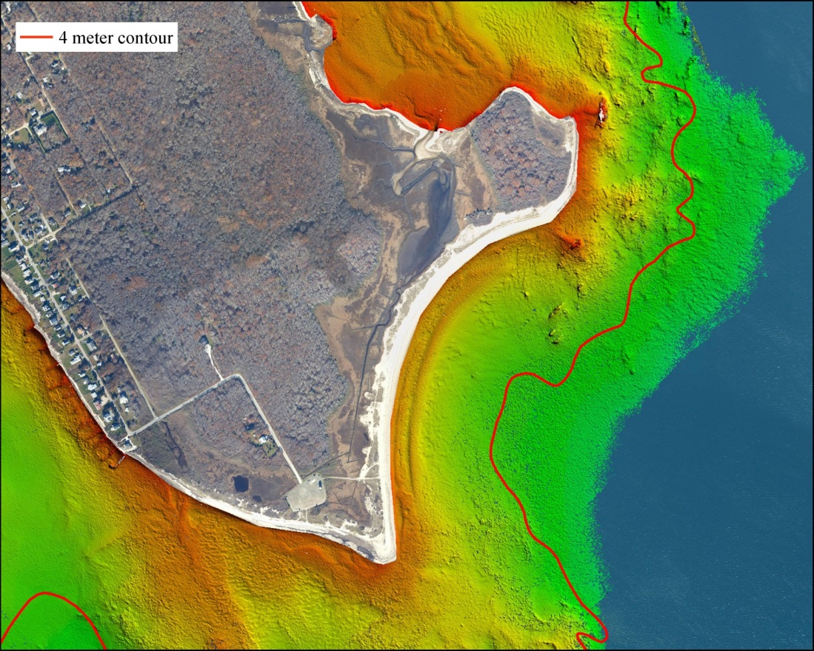
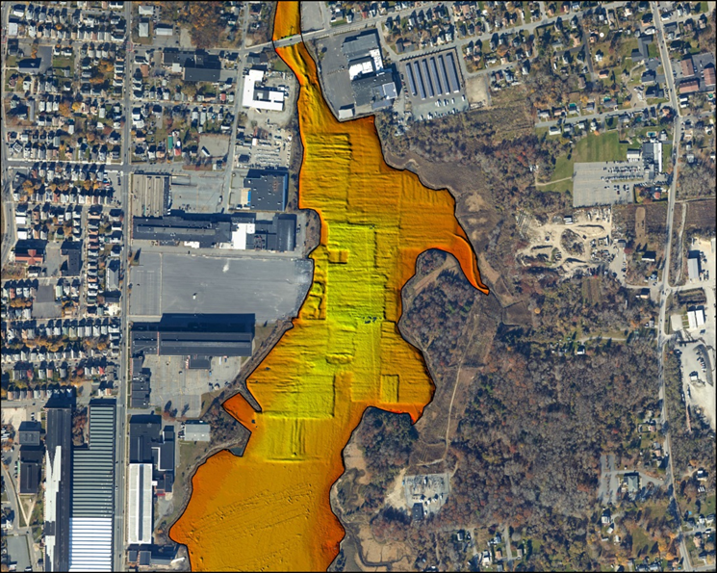
Topo-Bathy Lidar for Near-Shore Bathymetry
Notes:
In addition to the shoreline and depth contours, the topo-bathy lidar is also used to produce shallow-water bathymetry, in the form of shoal-biased Digital Elevation Models. These DEMs are delivered to the Office of Coast Survey, who use them to create nearshore hydrography for the charts.

Slide 12
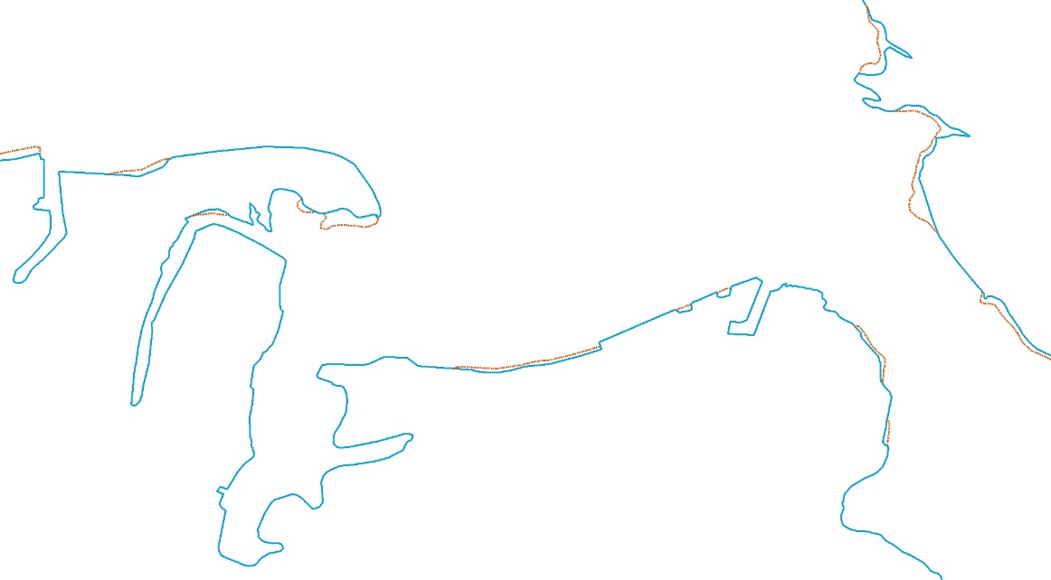
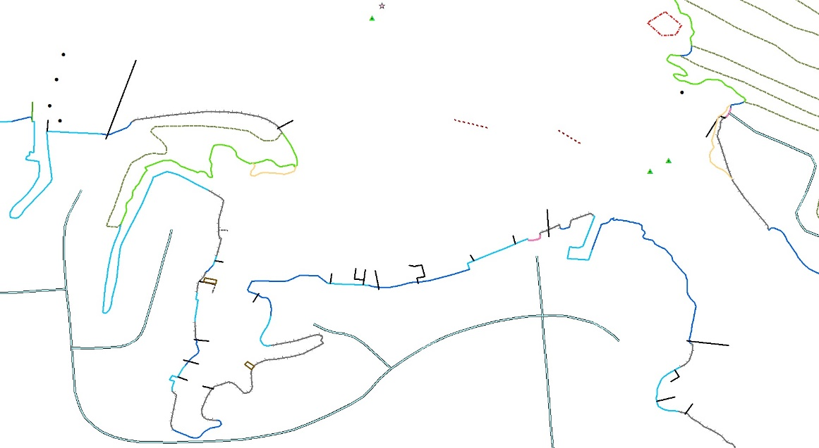
Photogrammetry - Lidar Hybrid
The MHW and MLLW contour lines are derived from the Lidar data
Segmented and attributed with the appropriate type of shoreline
Edited to compilation scale
Additional features compiled from imagery
Notes:
Typically both of these technologies, photogrammetry and topo-bathy lidar, are used together in a hybrid approach to produce our shoreline mapping products.
First the mean high water and mean lower low water lines are extracted as contours from the shoal-biased DEMs. These lines are then overlaid on an imagery backdrop so they can be segmented and attributed by feature type. The lines are generalized to the desired compilation scale and edited according to our coast project specifications. And finally, additional features are compiled from the aerial imagery to fulfill charting requirements.

Slide 13
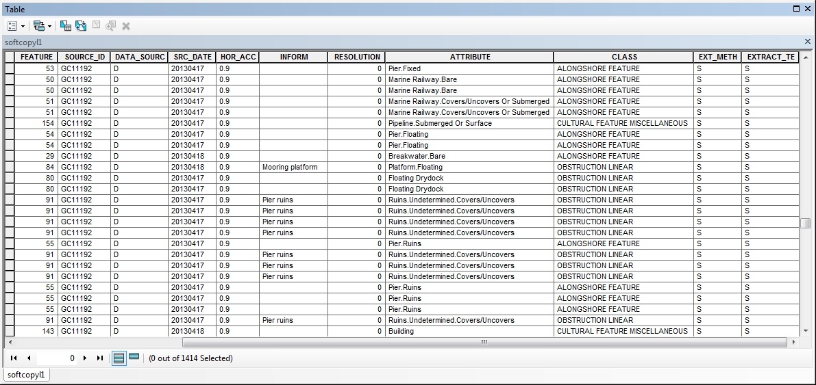
Shoreline Data Format
The Coastal Cartographic Object Attribute Source Table (C-COAST) was developed to be compatible with our earlier digital mapping format, while allowing our data to be easily translated into IHO S-57 standard attribution used for NOAA ENCs, and to support FGDC standard metadata.
Notes:
The final shoreline data is cleaned and edited in ESRI shapefile format (one shapefile for lines and one for points), using the C-COAST attribution scheme developed by NGS. The shapefiles and associated metadata for a project Geographic Cell (GC) are uploaded to our shoreline database and distributed through the NOAA Shoreline Data Explorer web application.

Slide 14
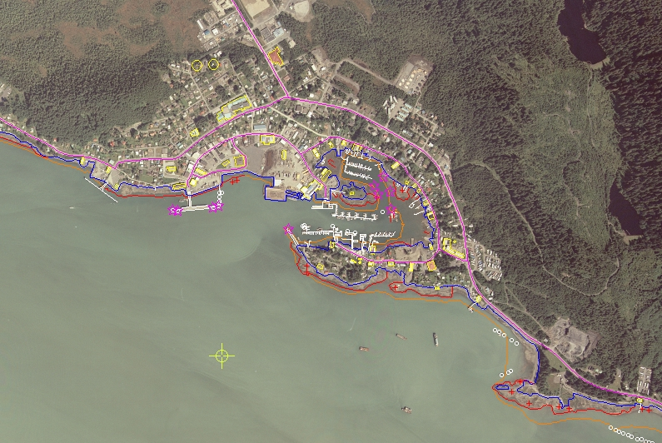
Landmark
Transportation
Obstruction Point
Cultural Feature Miscellaneous
Obstruction Linear
Aid To Navigation
Alongshore Feature
Freestanding Marine Feature
Shoreline
Danger Area
Contour
Notes:
The C-COAST attribution scheme includes many different classes of feature types important for nautical charting. # Shoreline, of course, is the most important. # In tidal areas we will also map the MLLW line as a zero-depth contour from tide-coordinated IR imagery. # We generally compile the first major road within 2000 feet of the shoreline, and the smaller roads leading toward the shoreline. # Alongshore Features consist of Piers, Breakwaters, Jetties, Bridges, Fenders, and so on. # Some prominent buildings, tanks, and the like are compiled. # Danger Areas are features like Shoals, Ledges, and Reefs. # Fixed lights and daybeacons are compiled, but floating aids are not. # Point obstructions are usually rocks. # Linear obstructions are Wrecks, Ruins, Platforms, etc. # Freestanding Marine Features are Piles, Dolphins, and Stakes. # Charted landmarks are compiled to confirm their existence and position, and occasionally we recommend new landmarks for charting. # Additional classes include various natural features and aquatic vegetation.

Slide 15
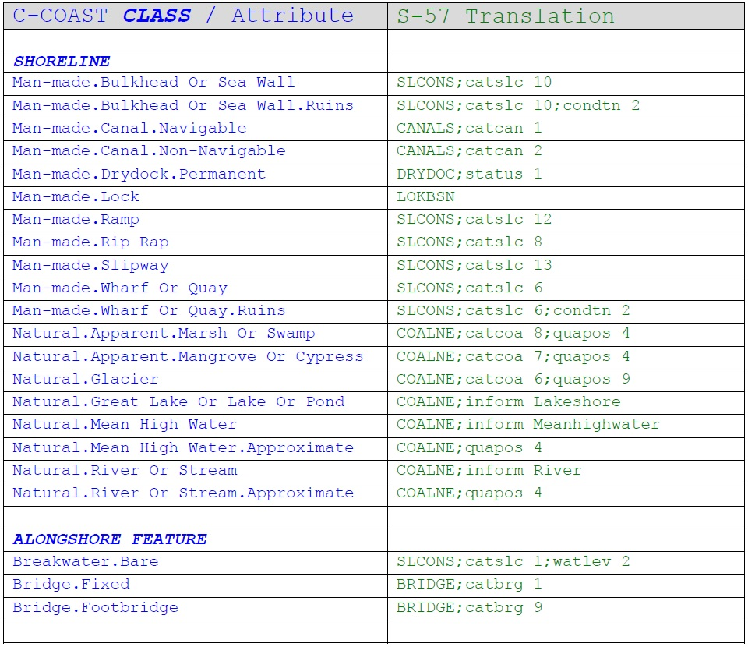
C-COAST to S-57 Translation
Notes:
The C-COAST attribution schema was designed to support RSD’s legacy data while still enabling easy translation to S-57 encoding used by OCS.

Slide 16
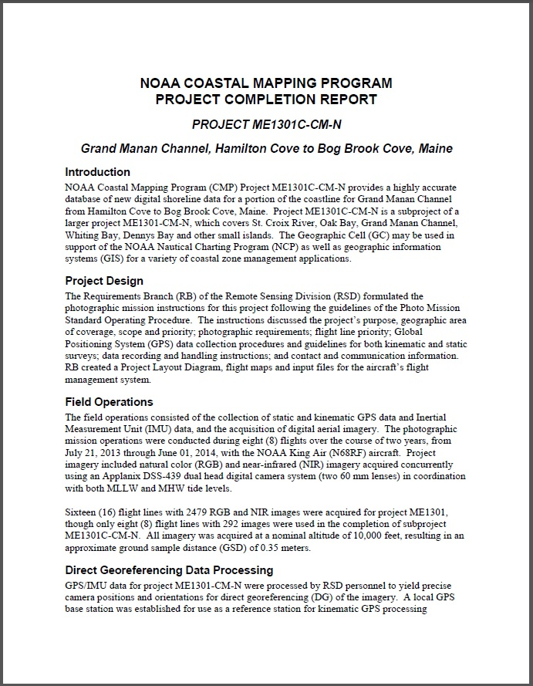
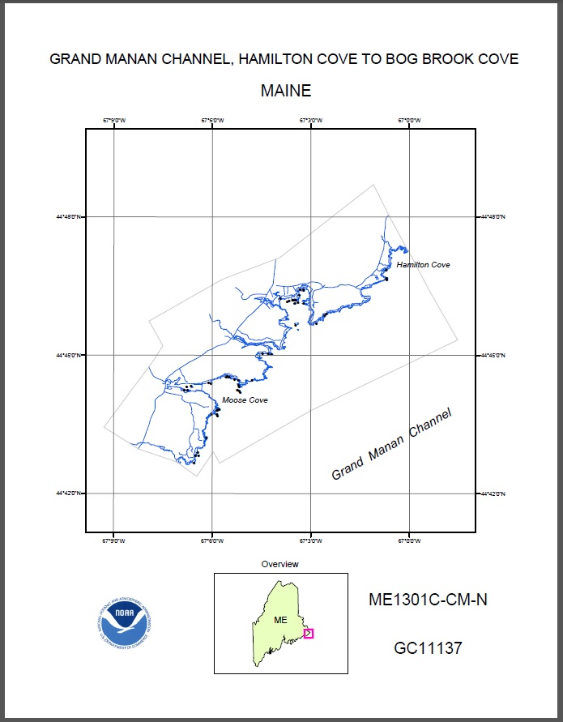
Project Completion Report
Notes:
The metadata includes a link to the Project Completion Report (PCR) in Adobe PDF format. The PCR provides an overview of all the steps of the project from planning and image acquisition, to feature compilation and final review. The back page of the PCR includes a plot of the data, and an overview map showing the project location.

Slide 17
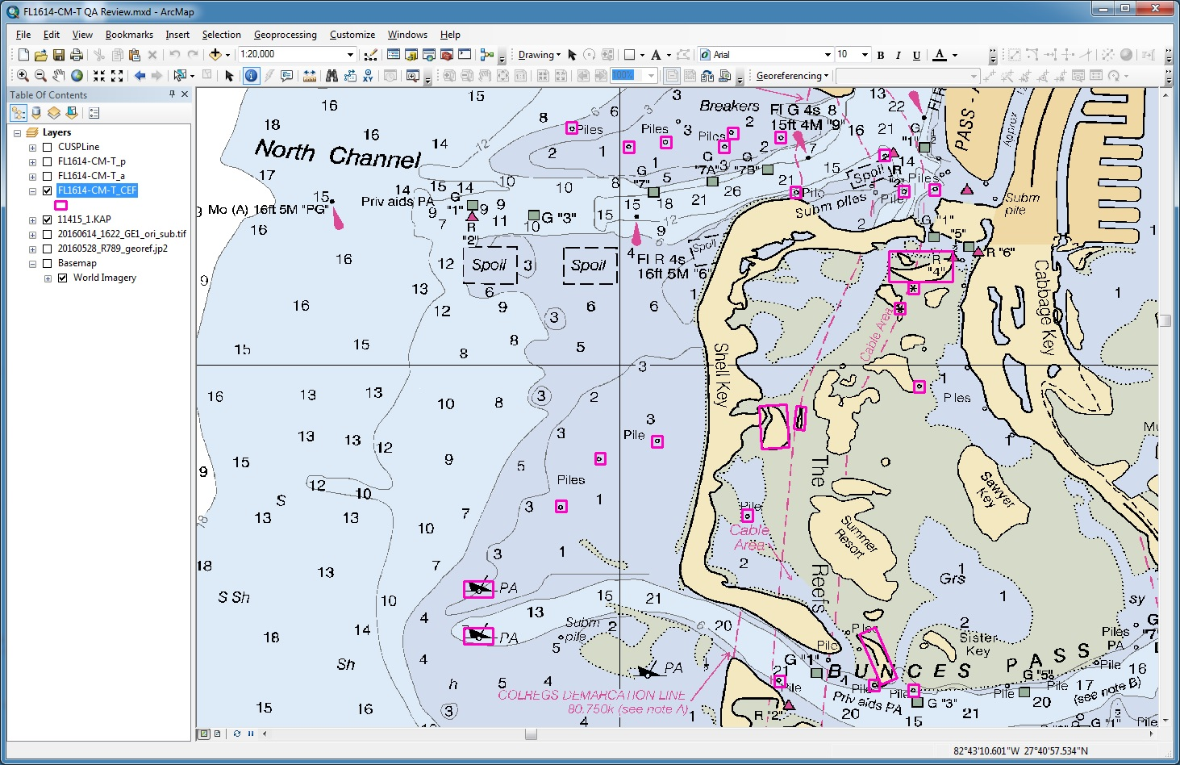
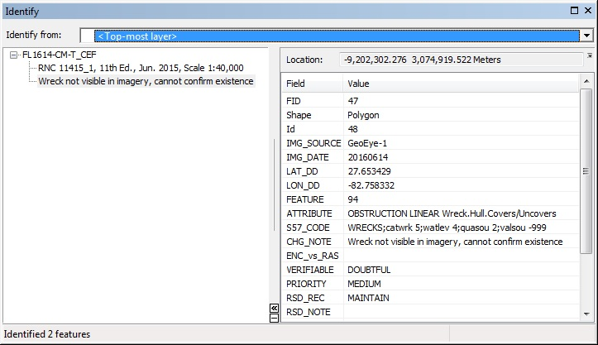
Chart Evaluation File
Notes:
The project cartographer also creates the Chart Evaluation File (CEF), which is a polygon shapefile intended to be overlaid on the largest scale nautical charts, for the purpose of documenting certain charted features that either have changed from their charted depiction, no longer exist, or could not be confirmed in the imagery. The CEF is not provided to the public, but is sent directly to the OCS Marine Charting Division to help them properly apply the GC shoreline data to the charts.

Slide 18
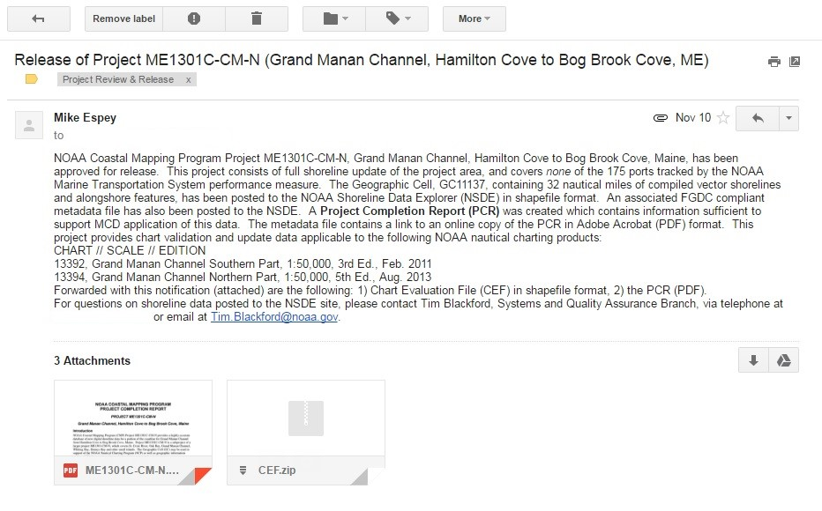
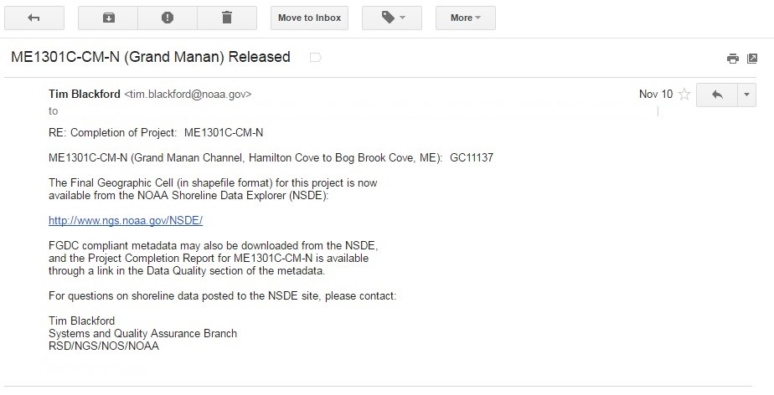
Project Release
OCS is informed via email that shoreline data is available on the NOAA Shoreline Data Explorer, with the PCR and CEF sent as attachments.
Notes:
After the mapping project has been completed the project metadata and shapefiles are loaded into the NGS shoreline database. Then the Office of Coast Survey and other primary stakeholders are informed via email that the project has been released, and the data is available for download from the NOAA Shoreline Data Explorer. An email is also sent to the OCS Nautical Data Branch with copies of the PCR and the CEF attached.

Slide 19
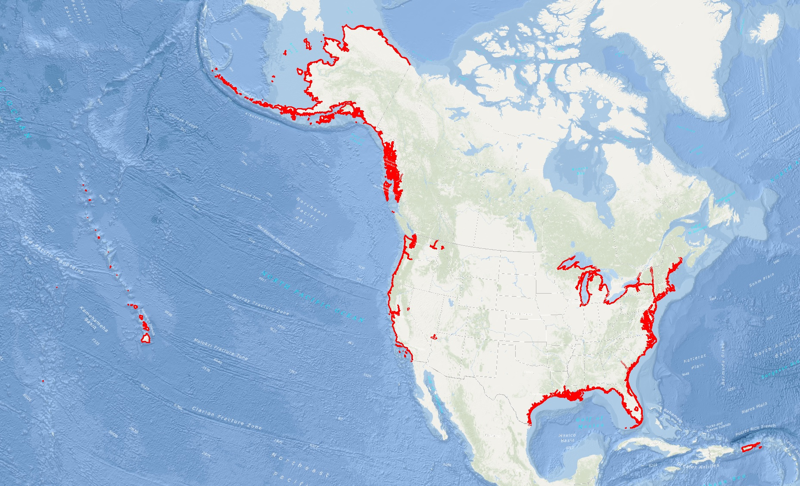
Shoreline Survey Question
How long is the (charted) U.S. Shoreline?
18,236 miles
95,025 miles
166,802 miles
All of the above
Notes:
Now I’d like to side-track for a moment to mention an important issue: The length of the U.S. shoreline.
How many of you know the total length of shoreline in statute miles for all of the United States and its territories, including the Great Lakes and other inland water bodies, that are covered by NOAA Nautical Charts? 18,236 miles? 95,025 miles? 166,802 miles? Or all of the above. I’ll give you a minute to pick your answer.
The answer is all of the above!

Slide 20
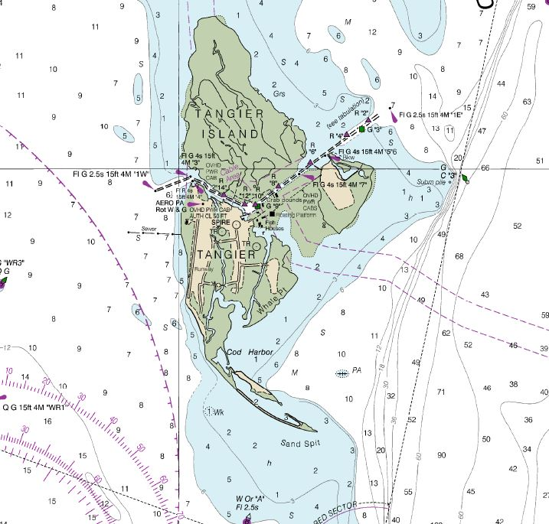
Shoreline Length Measurement Based on Scale
Chart No 12228 @ 1:40,000
Chart No 12280 @ 1:200,000
Notes:
It all depends on the level of detail you choose to include in your measurement. The more detailed little nooks and crannies along the shore you choose to measure, the greater your total length will be. All three of the previous mileage numbers were based on actual measurements of the coastline from maps, but they used different map scales and different measurement methodologies and assumptions. So there is no wrong answer to this little quiz. You all get top marks!
At the scale NGS maps the shoreline, the total length is greater than the highest of those numbers. So, there is a lot of shoreline to map in the U.S., and it could take a long time to map any particular area. Some coastal mapping projects might take a few years to collect all the tide-coordinated imagery, process the data, compile and edit the features, and review all the products, before the project is finally completed and delivered. Consequently, after we map a particular area of the coast, it could be many years, decades, before we get around to remapping that area.

Slide 21
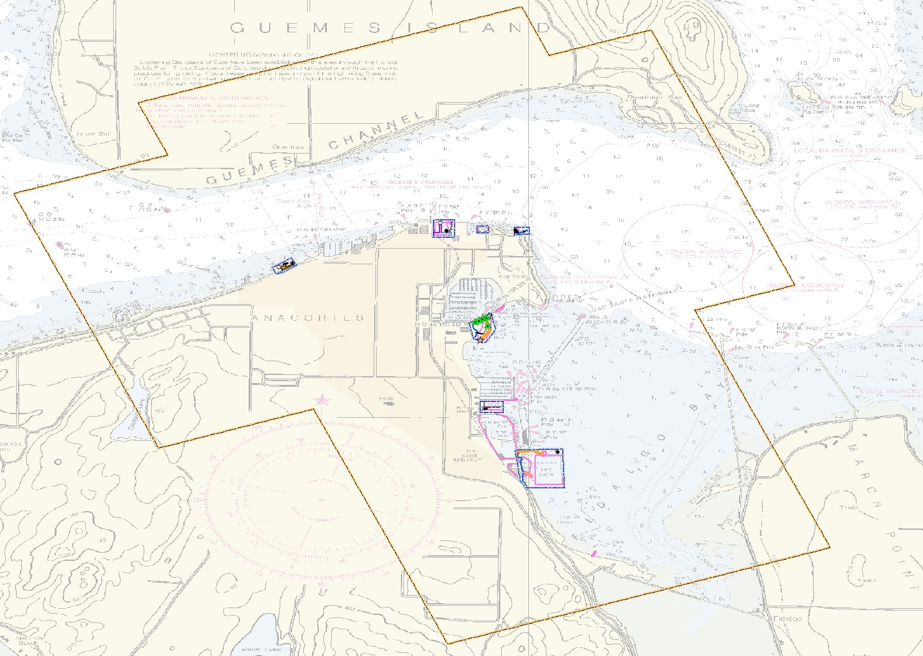
CSCAP: Coast and Shoreline Change Analysis Program
Compare charts in priority ports to recent imagery
Identify discrepancies
Compile targeted updates
Outcome: Much more frequent updates to critical port infrastructure
Notes:
This brings me to our Coast and Shoreline Change Analysis Program, or CSCAP. The Remote Sensing Division developed the CSCAP program to improve the frequency of shoreline updates in the highest priority areas from every few decades to every few years. The program focuses on the priority port areas. We will acquire recent imagery over a port, by either using our own aircraft or using commercial satellite imagery, and an analyst will compare the imagery to the latest charts, looking for changes to critical port infrastructure. The CSCAP analyst will create a Chart Evaluation shapefile to identify the discrepancies, and pass the project on to our Applications Branch, where a cartographer will compile just those targeted changes.

Slide 22
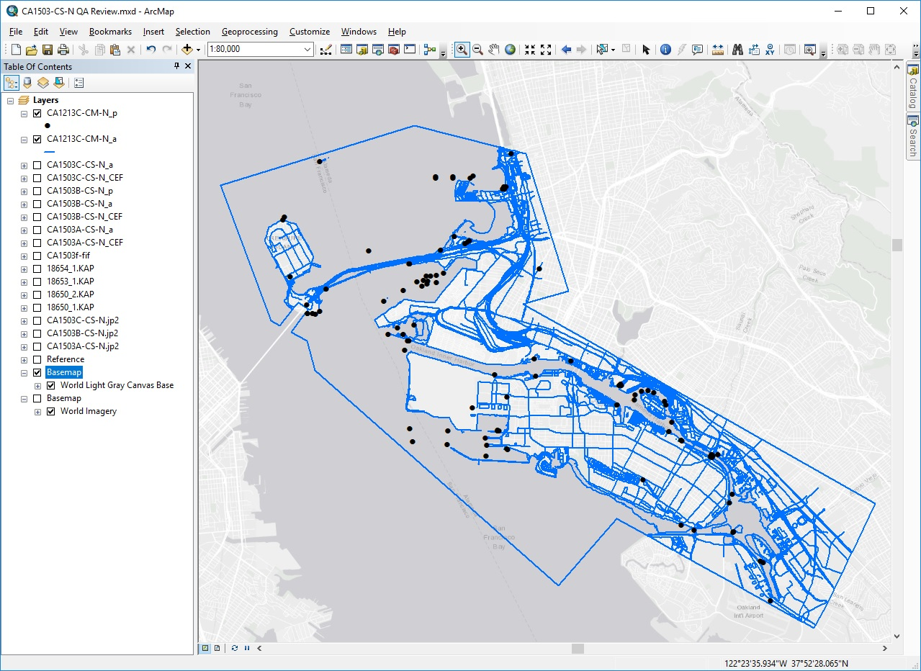
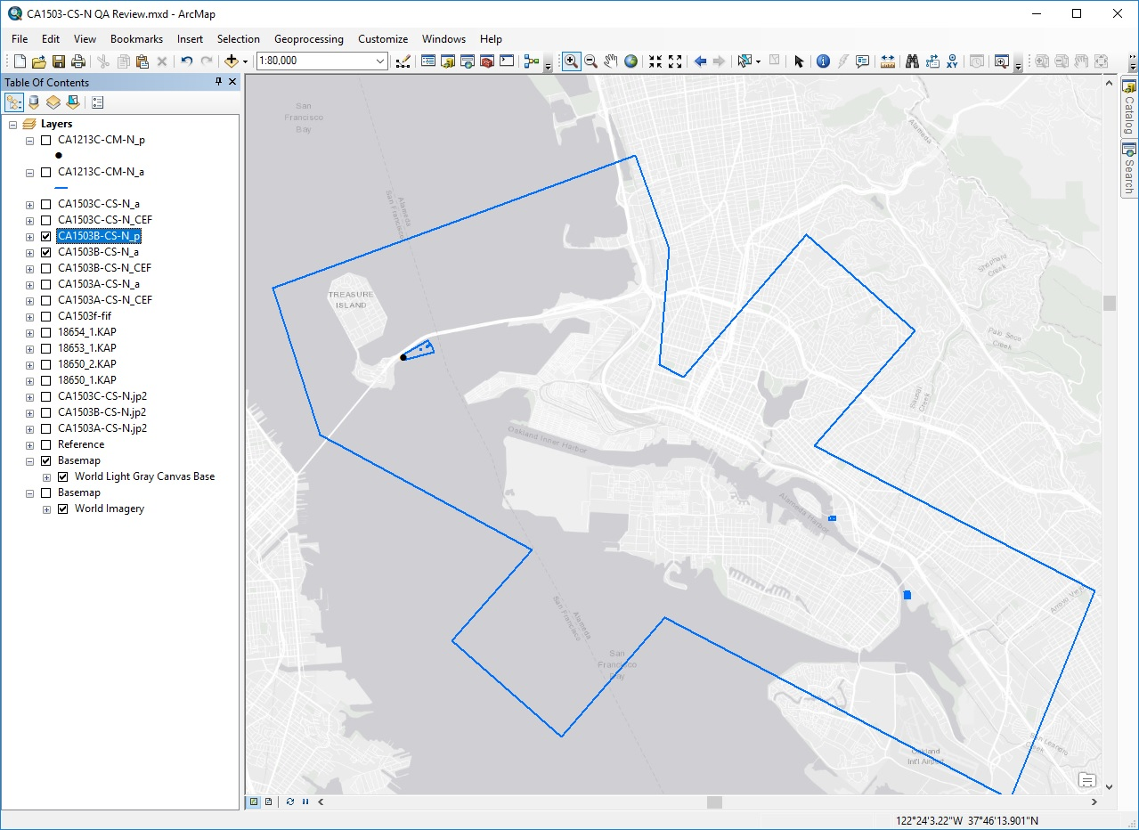
Example: Full Compilation vs. Targeted Updates
Notes:
This is an example of “full compilation” vs. “targeted updates”. By only including these targeted port infrastructure updates the amount of time it takes to compile, review, and complete a CSCAP project is greatly reduced compared to a traditional “full compilation” coastal mapping project. A CSCAP project is also much quicker and easier for the Coast Survey Marine Charting cartographers to apply to the nautical charts.
Other than the limited feature compilation, CSCAP projects are generally processed and delivered in the same way as our standard Coastal Mapping projects.

Slide 23
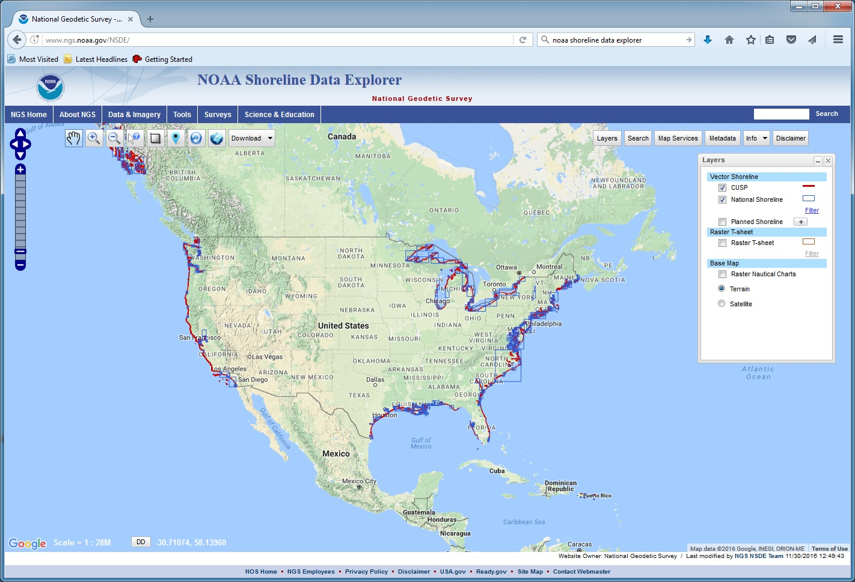
Access shoreline data from the NOAA Shoreline Data Explorer
http://www.ngs.noaa.gov/NSDE/
Notes:
The NOAA Shoreline Data Explorer application on the NGS web site provides access to the vector shoreline data from National Shoreline projects (both modern and historic), as well as our Continually Updated Shoreline Product (CUSP)

Slide 24
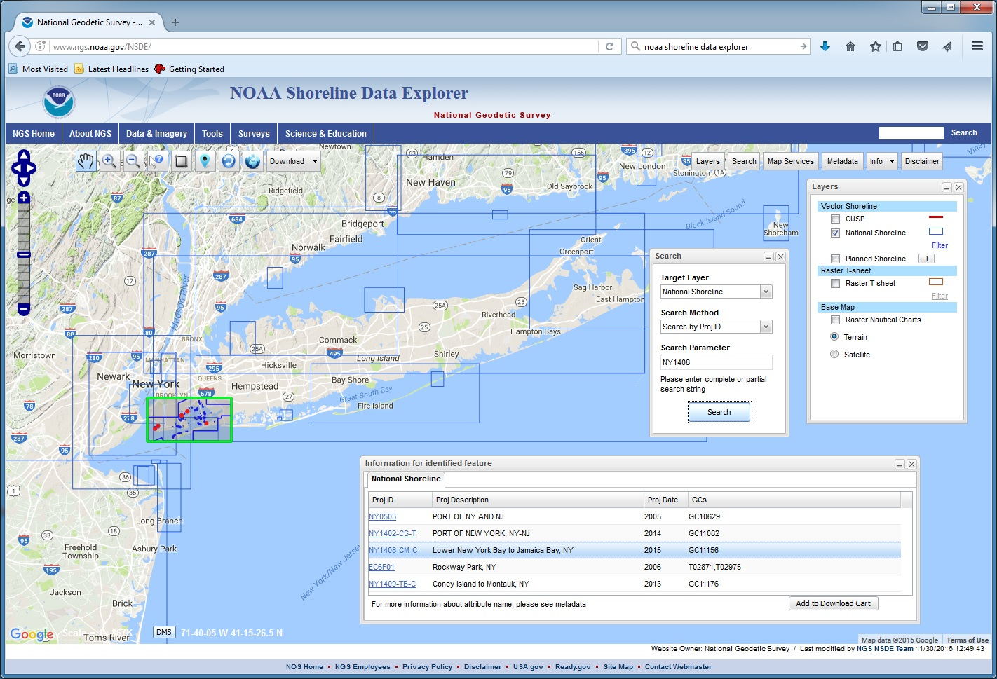
NOAA Shoreline Data Explorer
Search for, select, and display National Shoreline data geographically, or by entering the Project ID or GC Number into the Search tool.
Notes:
There are various ways to search for and select the vector shoreline data (read slide).

Slide 25
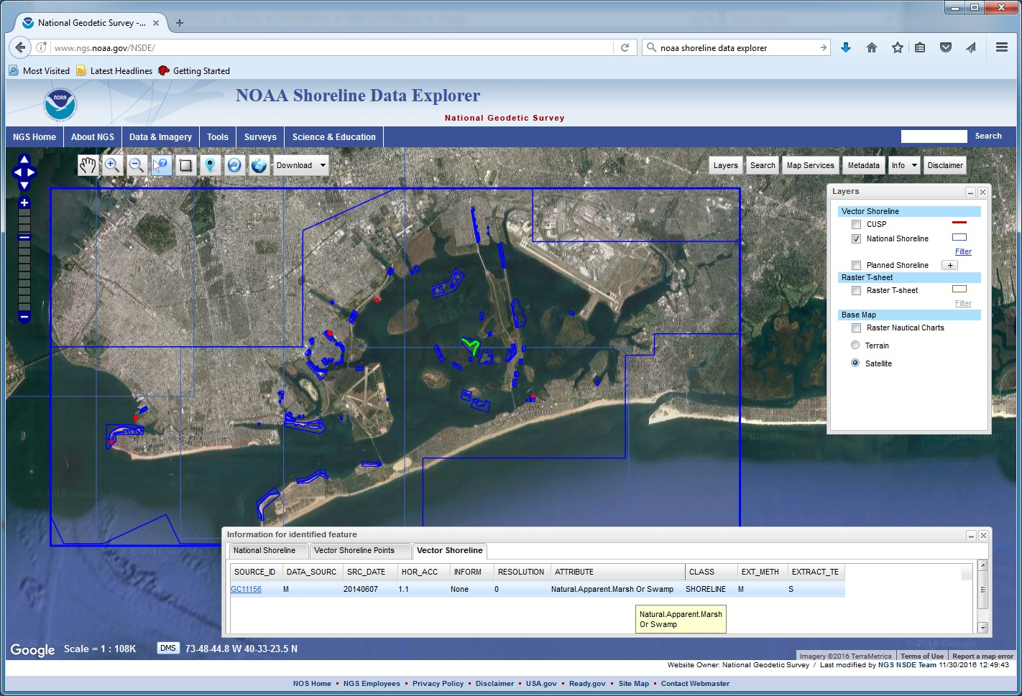
NOAA Shoreline Data Explorer
Once the vectors are displayed, individual features can be identified and the feature attributes are shown in the information box.
Notes:
(read slide)

Slide 26
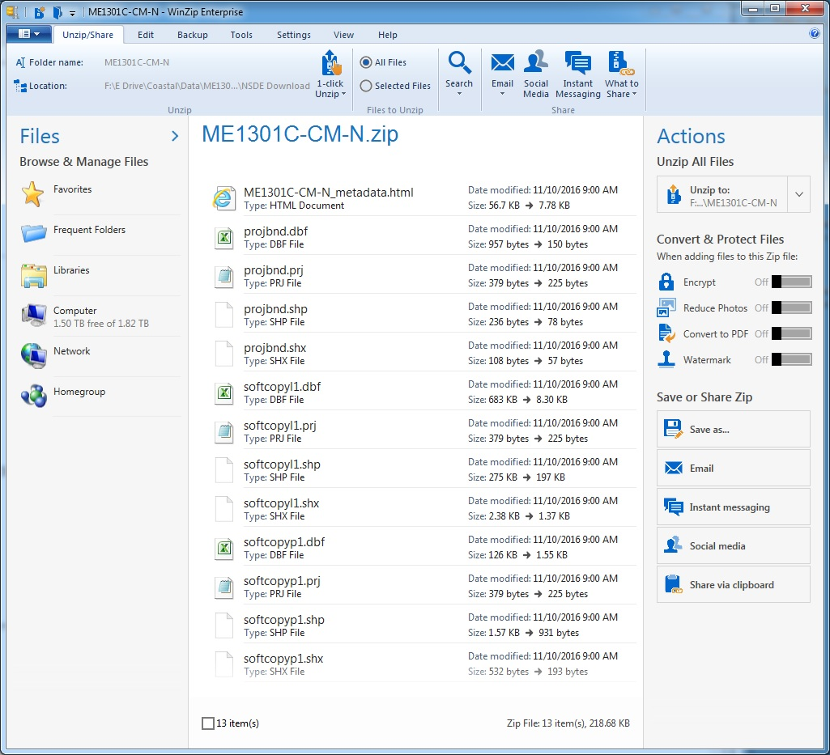
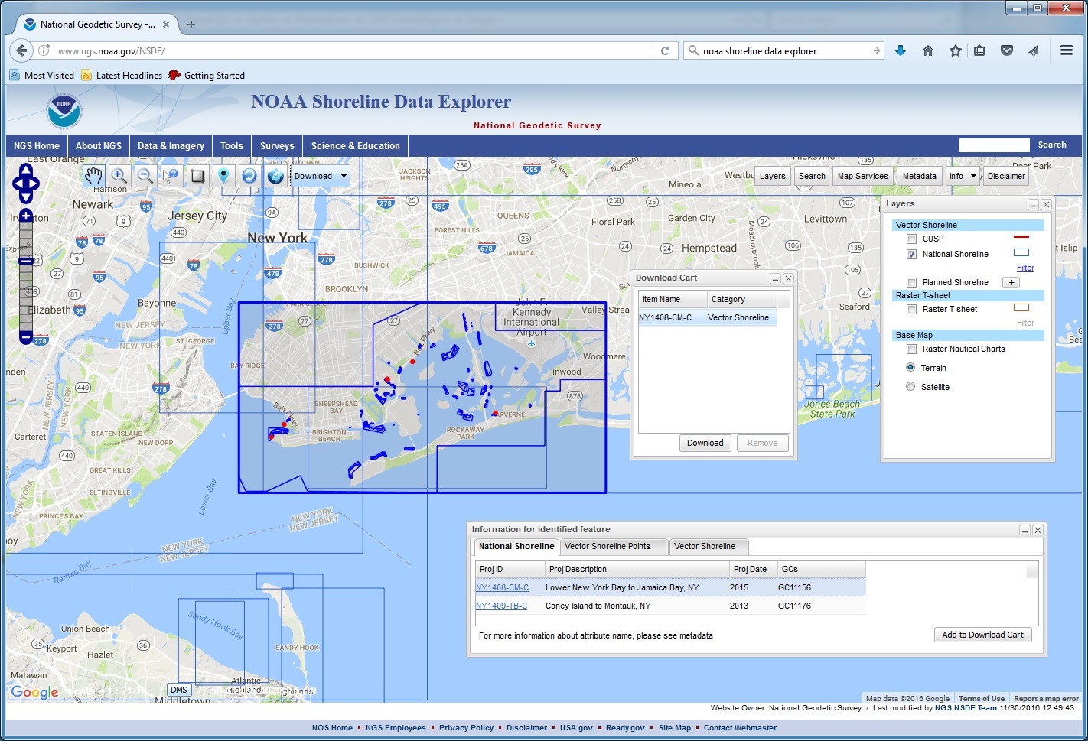
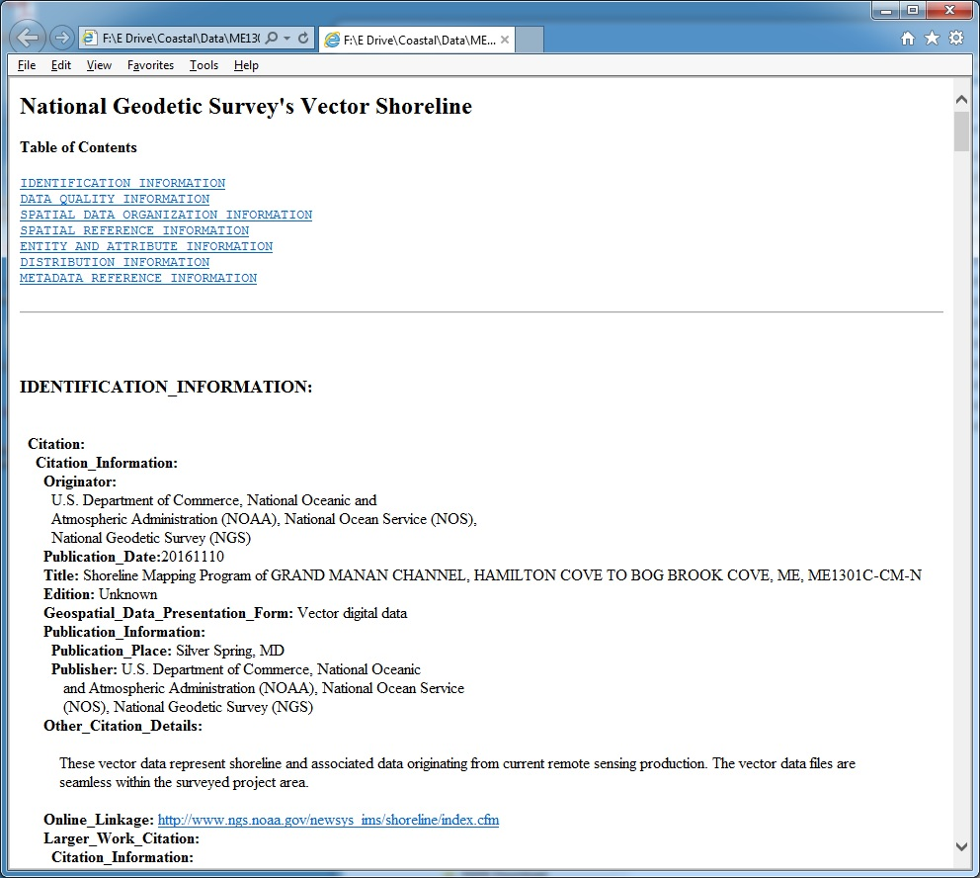
NOAA Shoreline Data Explorer
Up to five projects can be added to the Download Cart.
Notes:
Vector Shoreline data is downloaded as a zip file containing up to three shapefiles: A project boundary rectangle, and line and point shapefiles with C-COAST attribution. Also included is an FGDC compliant metadata file in HTML format.

Slide 27
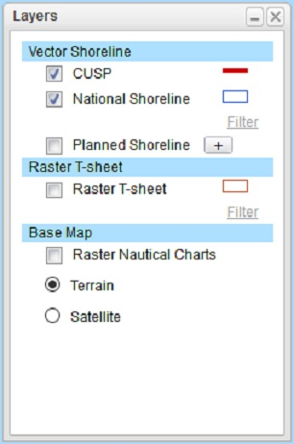
NOAA Shoreline Data Explorer Vector Shoreline Layers
http://www.ngs.noaa.gov/NSDE/
Notes:
Now, going back to the Shoreline Data Explorer: You may have noticed that there are a few different layers that can be displayed on the base map. What I have been talking about so far is the National Shoreline layer, but you can also access our Continually Updated Shoreline Product (CUSP) from this web site. The CUSP layer is shown as a red line on the map, and is displayed as the default layer when you first access the web site.

Slide 28
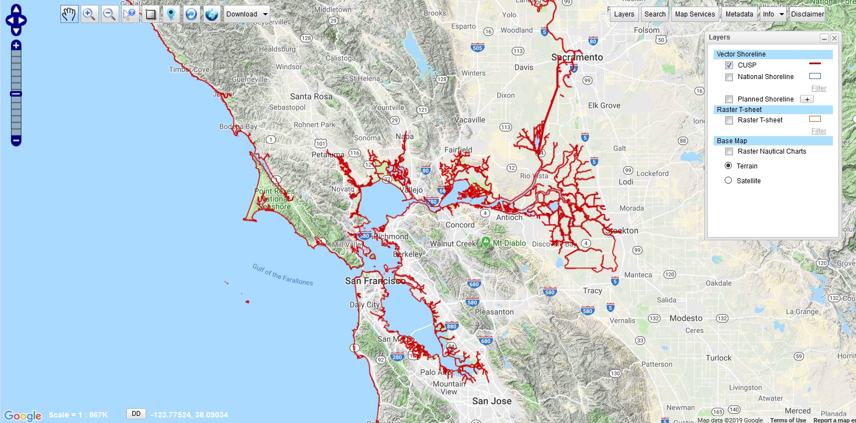
Continually Updated Shoreline Product (CUSP)
Contemporary
Continuous… (still working on this…)
Attributed (shoreline type, date, source, accuracy, etc.)
Referenced to MHW tidal datum (where applicable)
Maintained and up-to-date
Notes:
The Continually Updated Shoreline Product, or CUSP, was designed to meet the need for a contemporary, continuous and attributed shoreline of the United States that is referenced to the Mean High Water tidal datum (where applicable) and is regularly maintained and kept up-to-date.
Before CUSP there were several continuous shorelines available, but these were generally one-time products that were not maintained, and none of them met all of these needs.
The CUSP product is not yet continuous for the entire United States. We decided to make what has been completed available, so that folks could start using it.

Slide 29
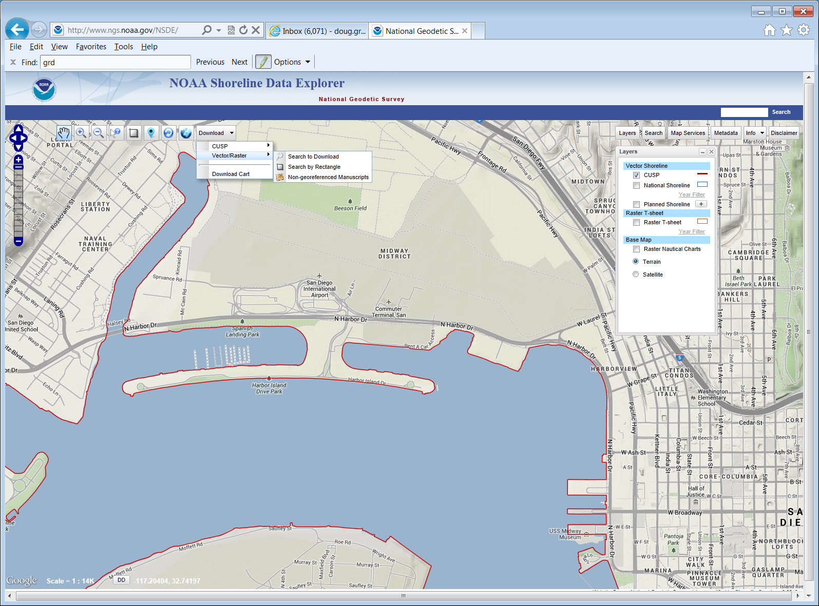
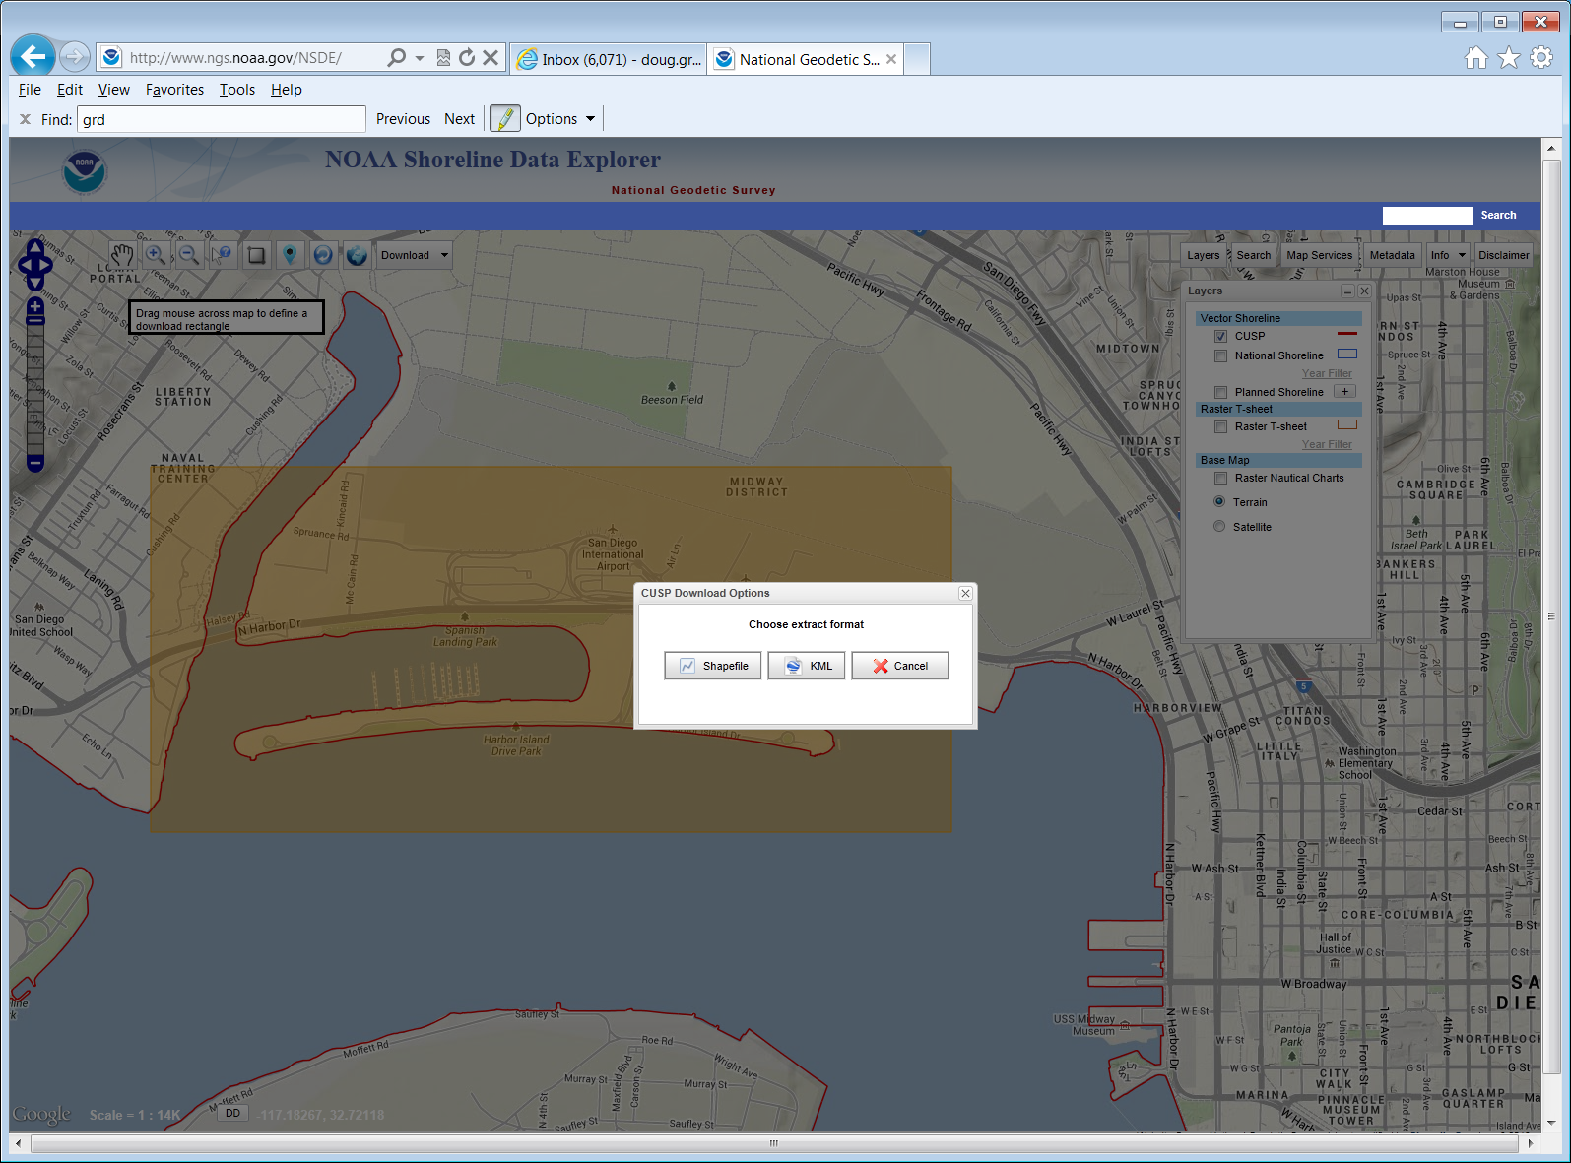
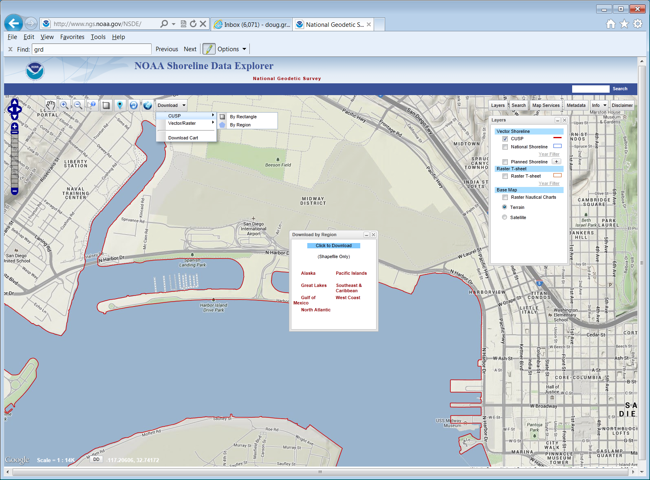
Continually Updated Shoreline Product (CUSP)
CUSP downloaded by selected area or by region
Notes:
CUSP shoreline can be downloaded from the Shoreline Data Explorer by selecting a rectangular area on the map and choosing your preferred format (shapefile or KML), or by picking pre-zipped shoreline for a whole region (in shapefile format only).

Slide 30
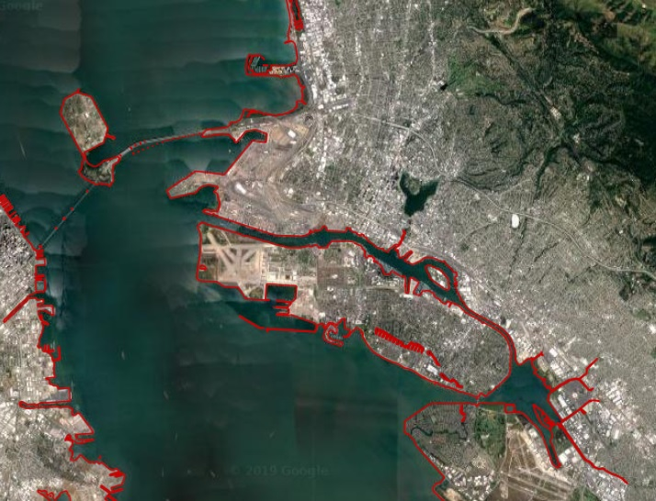
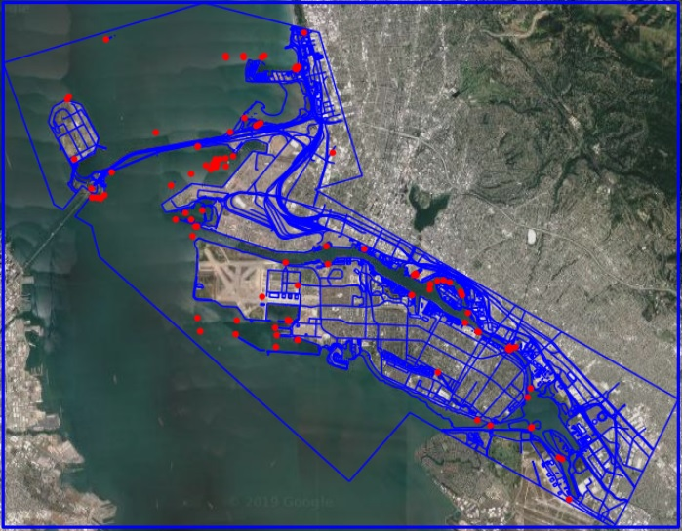
Continually Updated Shoreline Product (CUSP)
CUSP
National Shoreline
Only shoreline features
Whatever recent high-resolution imagery is available
Variable accuracy (20 m. standard)
One level of quality review
Limited process documentation
All chart topography features
Usually tide-coordinated color and infrared aerial imagery
High accuracy (1 – 5 m. standard)
2-3 levels of quality review
Substantial documentation
Notes:
CUSP only includes the shoreline features, as opposed to the National Shoreline, which includes all the other features needed for the nautical chart topography, such as piers, bridges, piles, obstructions, marsh areas, danger areas, buildings, roads, landmarks, aids to navigation, etc.
CUSP also has looser requirements for image sources, accuracy, quality review, and process documentation.
Therefore CUSP shoreline can be compiled and delivered much more quickly than a typical National Shoreline project, but generally it is not suitable for nautical charting application.

Slide 31
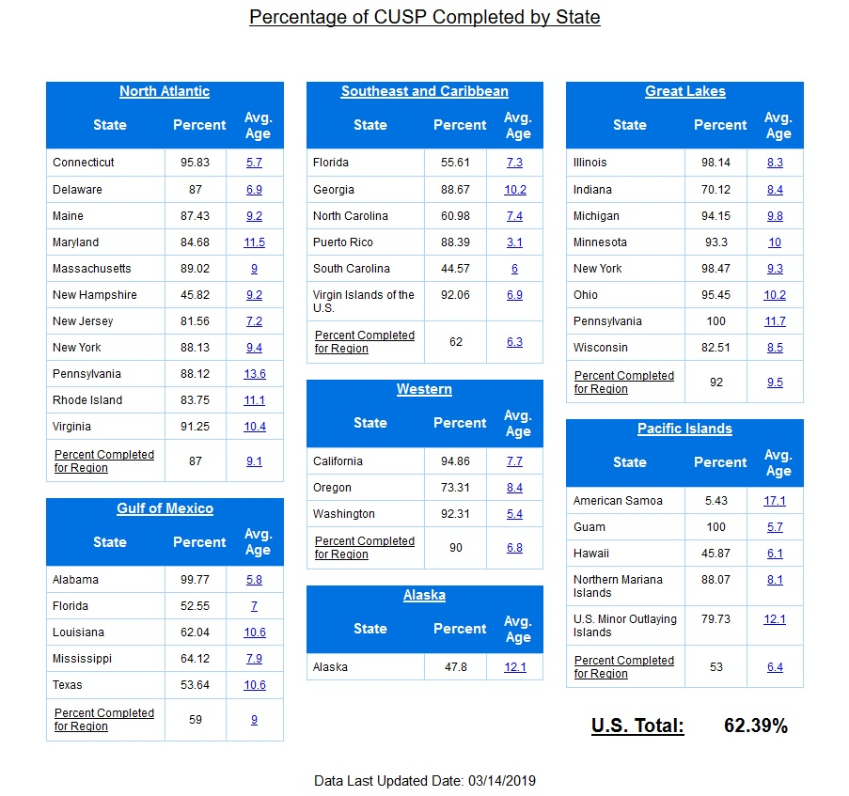
Continually Updated Shoreline Product (CUSP)
North Atlantic – 87%
Gulf of Mex. – 59%
SE & Carib. – 62%
Western – 90%
Alaska – 48%
Great Lakes – 92%
Pacific Isles – 53%
U.S. Total – 62.4%
(as of March 2019)
Notes:
As of March 2019 the Continually Updated Shoreline Product is available for about 62% of the United States shoreline. In some regions we have completed about 90%. Though CUSP will never be “final”, since we intend to continually update it, we expect that in a few years the CUSP product will be available for 100% of the U.S. shoreline.

Slide 32
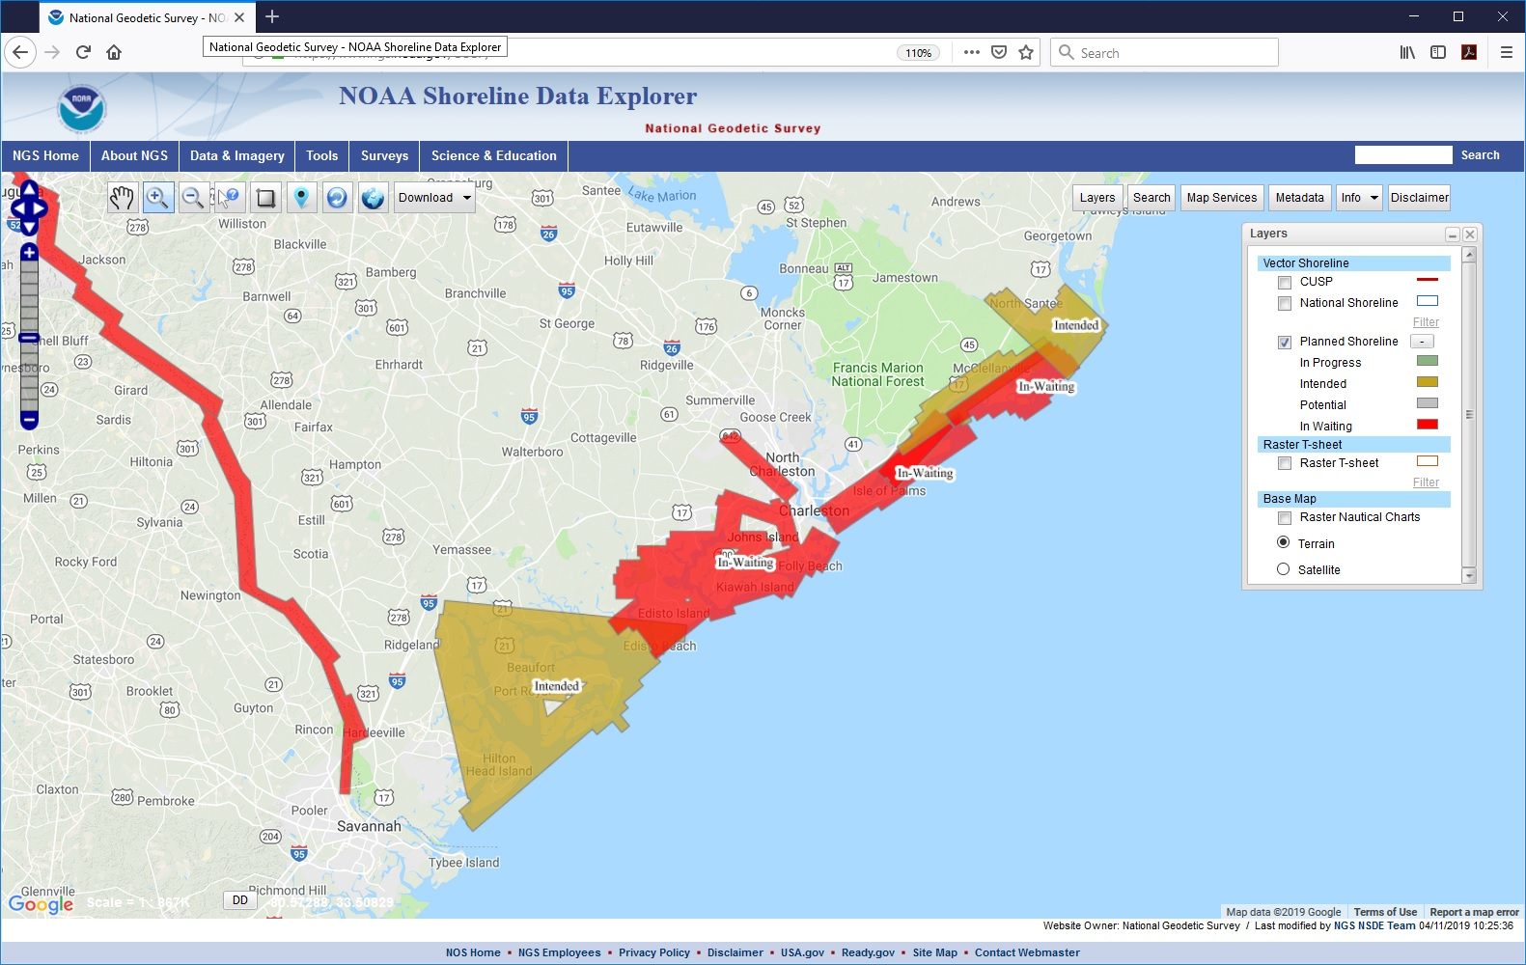
NOAA Shoreline Data Explorer
Planned Shoreline Layer
Notes:
The other vector layer on the Shoreline Data Explorer is the Planned Shoreline. This shows where NGS is planning to deliver shoreline products in the near future.

Slide 33
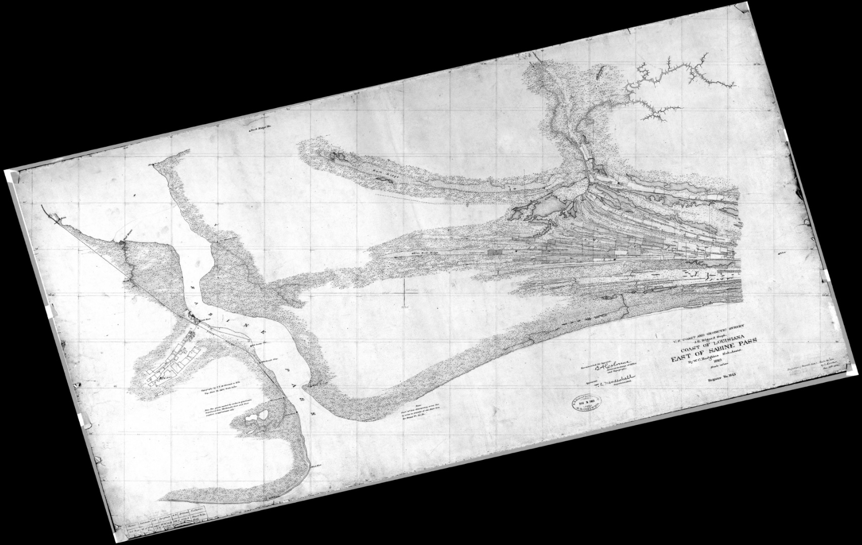
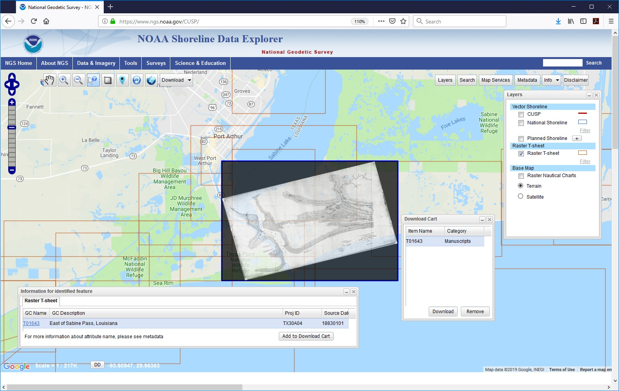
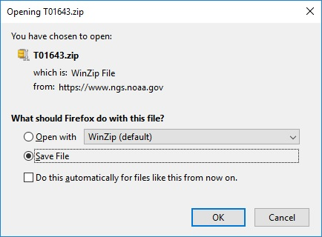
NOAA Shoreline Data Explorer
Historic Raster T-Sheet Layer
Notes:
And finally we have the Raster T-Sheet layer. From this layer you can select georeferenced scans of our historic shoreline manuscripts, popularly known as “T-Sheets”, add them to your cart, and download the raster file.

Slide 34
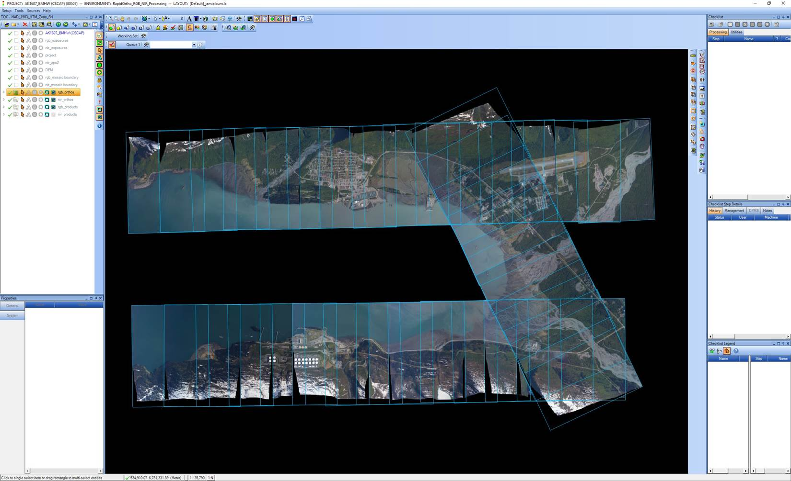
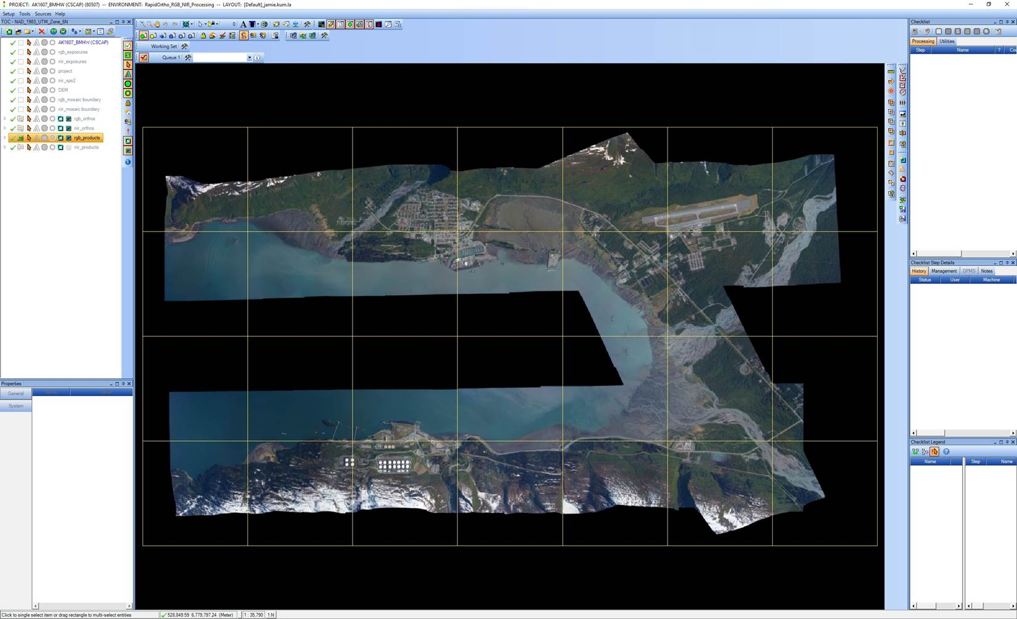
Orthoimagery
The aerial photos are ortho-rectified and merged into an orthomosaic image, which is cut into 2.5 km square tiles, and sent to Digital Coast.
Notes:
As part of our standard production process, the aerial images we collect are orthorectified and merged into an orthomosaic image. The mosaic is then cut into 2.5 km square tiles, in GeoTiff format. These are then packaged up, along with the metadata, and sent to NOAA’s Digital Coast web site for public distribution.

Slide 35
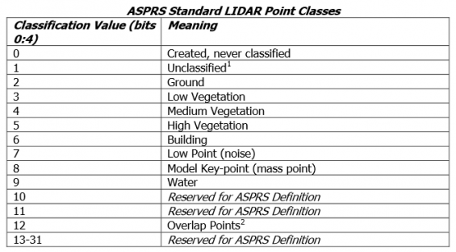
Lidar Data Formats
Topobathy lidar classified point-cloud data in ASPRS standard LAS 1.2 format, and topobathy DEMs (1-meter) in IMG format are provided to NOAA’s Digital Coast website for distribution to the public.
Notes:
Our topo-bathy lidar data is another standard product we deliver. The lidar point cloud data is classified and processed to standard ASPRS LAS 1.2 format, and 1-meter resolution DEMs are created in IMG format. These are sent to the Digital Coast web site for public distribution. In addition the DEMs are further processed to 5-meter grid spacing with shoal-biased depths, and delivered directly to the Office of Coast Survey (OCS) in GeoTIFF format, so they can generate soundings and depth contours for application to the nautical charts.

Slide 36
Access lidar data using NOAA Digital Coast
Notes:
The NGS lidar elevation data can be accessed from the NOAA Digital Coast web site. From the Data Access Viewer select the Elevation data type to explore. You will see a map interface with a list of available lidar datasets on the right side. You can use the pencil tool to draw a search box, or type in a place name, address, or latitude / longitude coordinates. Data sets within the search area will be listed on the right. Click on the data set name for more information and to view the data. Click on the shopping cart button to download the selected area. If the amount of data in the search area is too large, the cart button will be grayed out. You will need to redraw a smaller area until the shopping cart button is available. Or you can click “bulk download” for direct download of the entire dataset from an FTP site.

Slide 37
Orthomosaic Imagery on Digital Coast
Notes:
The orthoimagery can be accessed from the same interface. Click the “Imagery” data type in the top ribbon, search for your area, select your data set from the list, and either add the custom area to the shopping cart, or “bulk download” the whole data set.

Slide 38
Provision Data in the Cart
Notes:
The data in your Cart can be provisioned to a variety of datums, projections, and output formats.

Slide 39
Review and Submit Data in the Cart
Notes:
After provisioning your data you enter your contact information, then you have an opportunity to review your selections and go back to make changes if necessary. After you submit your order you will receive a confirmation email with a link to check the status and progress of your data request. When the data is ready you will receive email(s) with links to download the zip files containing your data. Finally, once the order processing is complete and all of the data is available for download, you will receive a summary email with links to the data and notification that the data will be deleted after 10 days.

Slide 40
Questions?
Tim Blackford
Systems & Quality Assurance Branch
Remote Sensing Division
National Geodetic Survey
Tim.Blackford@noaa.gov

