Slide 1
Online Positioning User Service (OPUS)
PLSC Northern Chapter
Brian Shaw
brian.shaw@noaa.gov
February 9, 2022

Slide 2
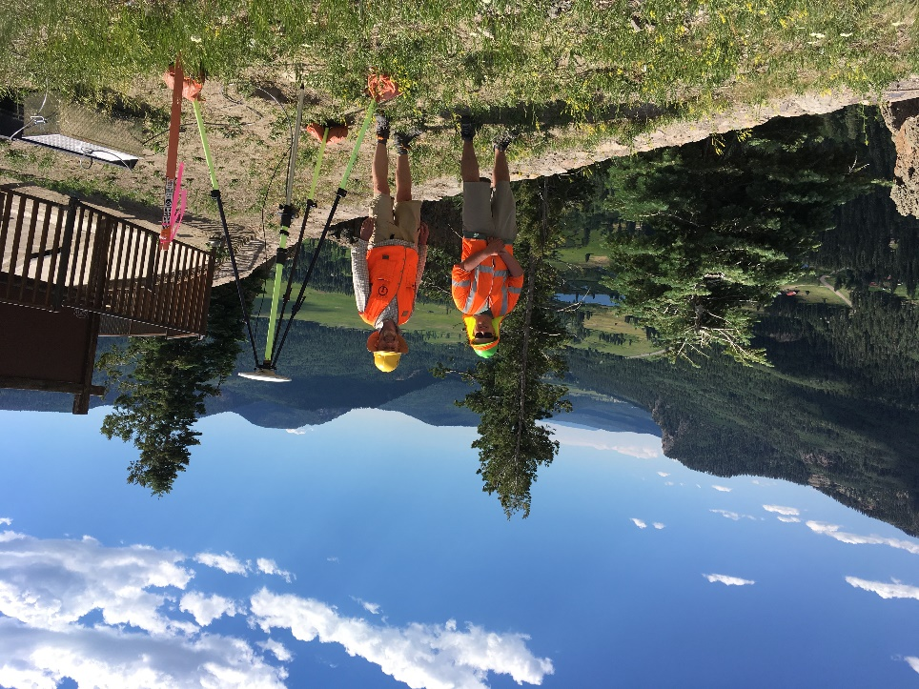
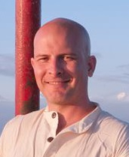
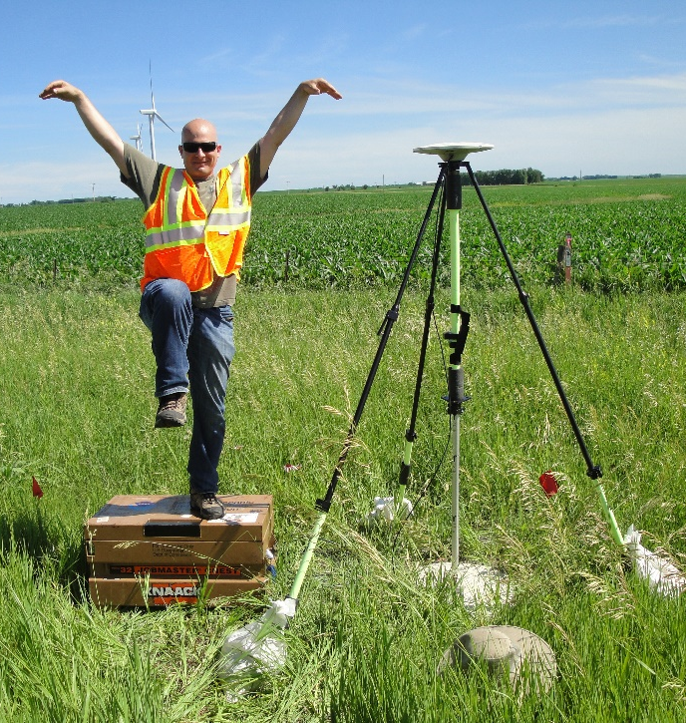
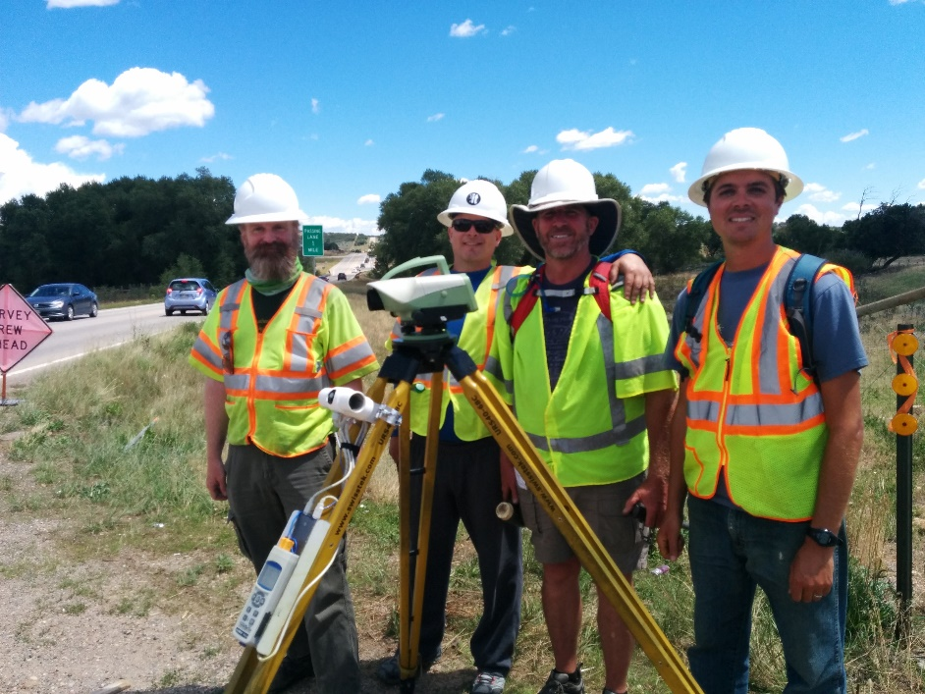
Brian Shaw
Rocky Mountain Advisor
brian.shaw@noaa.gov

Slide 3
What is OPUS?
A tool for processing GPS data collections (GNSS soon)
2 hr minimum
(network adjustment)
OPUS Projects
2 hrs to 48 hrs
OPUS Static
PAGES
OPUS Share
4 hr minimum
(single solution)
15 min to 2 hrs
OPUS Rapid Static
RSPGS

Slide 4
How to use OPUS?
5 Easy Steps
Upload your data file
Select the antenna used
Enter your Antenna Reference Point (ARP) height
Enter your email
Select additional options

Slide 5
Upload Your Data
Data files must meet the following requirements
From dual frequency GPS receiver
Include static data only (antenna must not be moved during observations)
Include minimum of 15 minutes and maximum of 48 hours of data not crossing UTC midnight more than once
Files under 2 hours must include both P2 observables and either P1 or C1 observables
Record data at intervals of 1,2,3,5,10,15 or 30 seconds

Slide 6
Upload Your Data
Accepted data formats include
RINEX 2
RINEX 3
Compressed UNIX, gzip, pkzip and Hatanaka formats
For compressed files, all files must share the
same antenna type and height
Many other raw data formats

Slide 7
Upload Your Data
A few notes on data types:
OPUS currently only uses GPS observables (even if file contains other GNSS observables)
OPUS decimates all data to 30 seconds
OPUS accepts all mask angles but only satellites more than 10 degrees above the horizon are used

Slide 8
Select Antenna type and enter ARP height and email
Select the Antenna type used
This is very important to use the correct antenna as OPUS uses
the antenna calibrations so choosing an incorrect antenna may
result in a height error as large as 80 cm and a horizontal error
up to 1 cm.
Enter your Antenna Reference Point (ARP) height
This is also very important as any errors in the entered height
will be reflected in the solution heights
Enter your email address

Slide 9
Select additional options
Customize your solution format
Choose your base stations
Choose your State Plane Coordinate System (SPCS) zone
Include a project identifier (for OPUS Projects)
Choose to share your solution publicly (for OPUS Share)
Set a profile:
If you choose to set a profile, OPUS will save your email, antenna type
and height, and options used.
Subsequent uploads will require only your email and a data file to apply
your customized defaults.
Caution! If you choose to set a profile, your selections will override the
optimized defaults for all subsequent uploads.

Slide 10
OPUS Accuracy
Various factors impact the accuracy including user error, multipath or adverse atmospheric conditions
Static: For each coordinate (X, Y, Z, Φ, λ, h, and H), static processing provides the range of the three individual single baselines, called peak-to-peak errors. One advantage of peak-to-peak errors is that they include any error from the CORS (base station) coordinates.
Rapid-Static: The best estimates of coordinate errors are the standard deviations reported by single baseline analysis. Our experiments indicate that the actual error is less than these estimated accuracies more than 95 percent of the time.

Slide 11
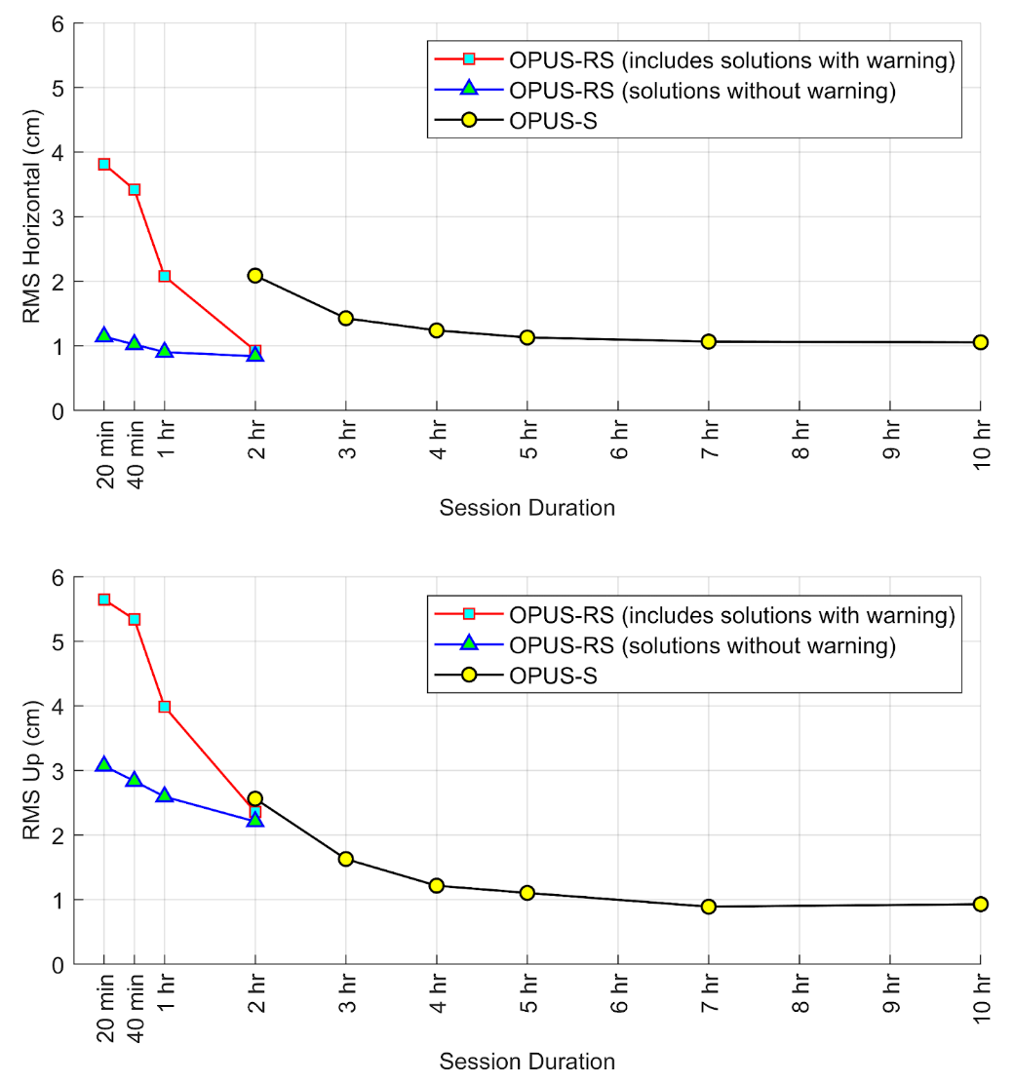
Improving your OPUS results
Observe longer: A longer session provides OPUS a better opportunity to accurately fix ambiguities and mitigate multipath error.
At 5 Hours you get to about 1 cm RMS horizontally and vertically

Slide 12
Accurate OPUS solution characteristics
Orbits used are precise or rapid
Over 90% of observations are used
Over 50% of ambiguities are fixed
The correct antenna type and ARP height are entered
For OPUS-S:
Overall RMS is less than 3 cm
Peak-to-peak errors are less than 5 cm (Lat/Lon), 8 cm (Ellip Ht)
For OPUS-RS: the solution contains no warning messages

Slide 13
OPUS Share
To share your OPUS solution publicly:
1 - Upload your data file to OPUS
2 - After entering and verifying your antenna type and ARP height,
click the Options button
3 - For the option share my solution, choose Options > yes, share

Slide 14
OPUS Share
OPUS shared solutions must meet the following requirements:
Your GPS data file must be 4 hours or longer.
Your mark must be a permanent mark of public interest.
The mark must be durable, have a stable setting, and good satellite visibility.
Include a description and photos to help others find your mark.
Your shared solution must be a high-quality solution:
≥ 70% observations used and ambiguities fixed
≤ 3 cm RMS
≤ 4 cm peak-to-peak error ranges for latitude and longitude
≤ 8 cm peak-to-peak error range for ellipsoid height

Slide 15
OPUS Projects
Free, web-based software
• Online training available
• Designed for managing campaign-style GPS surveys
• Multiple repeat occupations of several marks
• Ability to add GPS data from NOAA CORS Network
• Session baseline processing using PAGES
• Customize tropospheric delay models, elevation cutoff masks,
constraint weighting
• Network least squares adjustments of multiple sessions
• Choice of reference frames and geoid models
• Currently requires ≥ 2-hour static GPS observation for post-processing

Slide 16
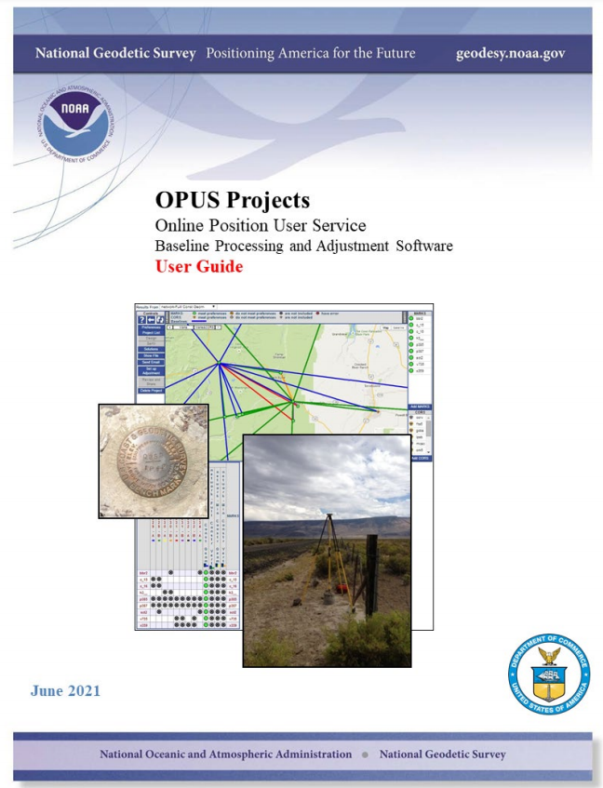
Great News!
There is a new User Guide with detailed instructions
https://geodesy.noaa.gov/OPUS-Projects/docs/Documentation.pdf

Slide 17
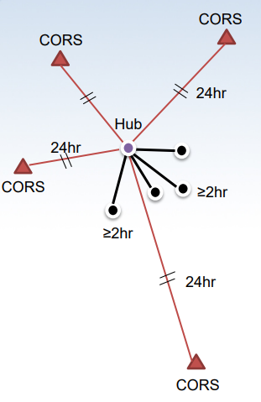
How to use OPUS Projects?
"Hub design" recommended by NGS
• Hub to project marks recommended to be ~100 km
• Use multiple CORSs
• Use one very long baseline from hub to CORS (improves tropospheric modeling)
• OPUS-Projects does session baseline processing

Slide 18
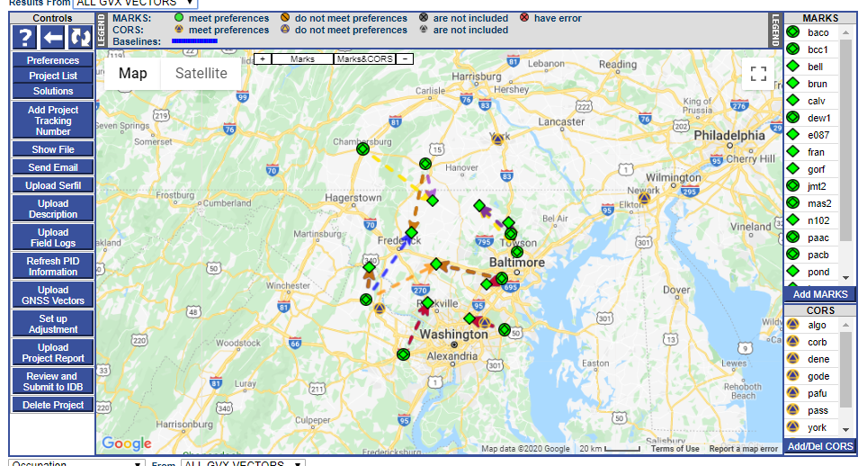
Beta OPUS-Projects 5.0 for RTK/RTN Vectors
NGS is developing a new Standardized GNSS Vector EXchange Format (GVX) that will be used to ingest vectors into OPUS Projects

Slide 19
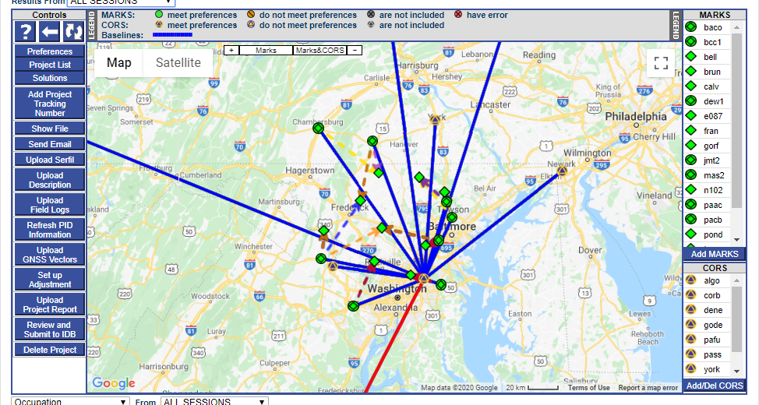
Beta OPUS-Projects 5.0 for RTK/RTN Vectors : Please Test

Slide 20
Requirements for Vertical Control
Now that we’ve discussed distance (X-axis), let’s talk Occupation Length (Y-axis)
To meet NGS requirements, you need to do a minimum of two 2-h observations on every mark in the network.
But how accurate will it all be?
Two important considerations:
Redundancy (how many reps)
Duration (how long an observation)
Recommended/Permitted
Not Permitted*
*Future developments of OP will permit real-time vectors from shorter occupations

Slide 21
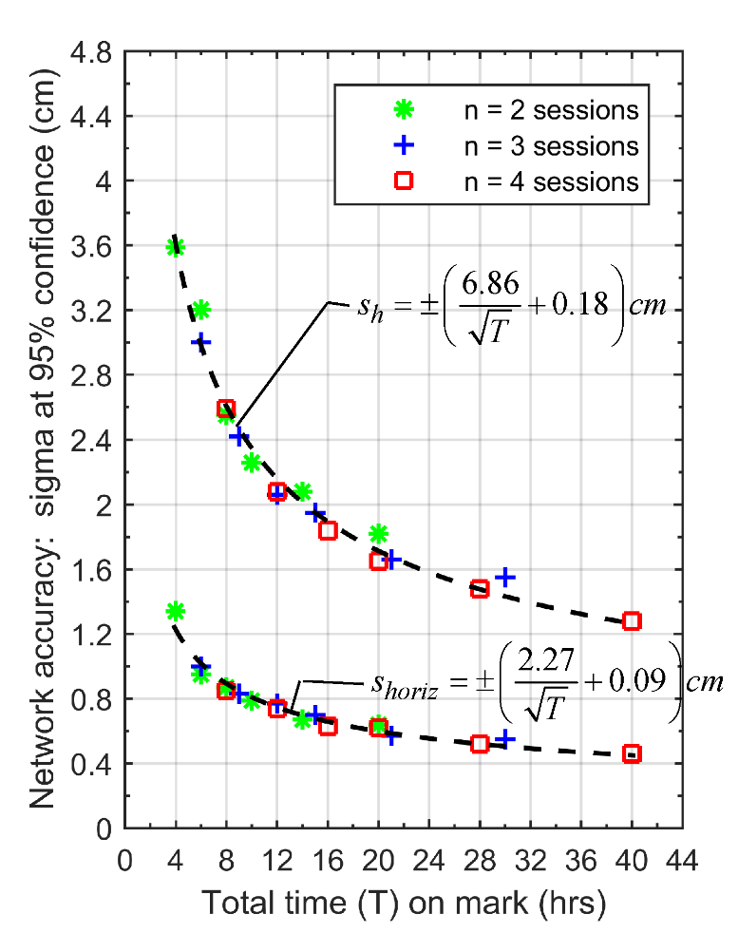
Accuracy of OPUS-Projects
OPUS Projects Network Accuracies
Most important variable for reducing error is Total Time
Note! Cumulative time, not individual occupations

Slide 22
Recommendations
Summary on Expected Accuracy of OPUS-Projects
Expected Ellipsoid Height Accuracy | Expected Horizontal Accuracy | Total Time on Mark (h) | Recommended Sessions and duration
3.0 cm | 1.5 cm | 4 | (2) 2-h
2.5 cm | 1.3 cm | 8 | (2) 4-h or (3) 3-h
2.0 cm | 1.0 cm | 20 | (2) 10-h or (3) 7-h

Slide 23
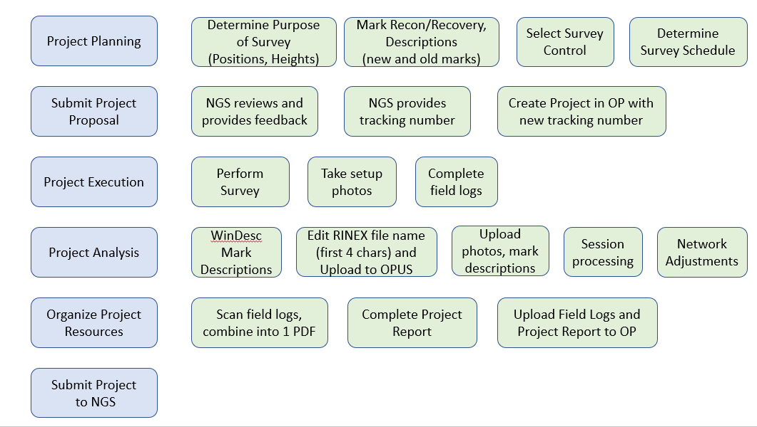
OPUS Projects Bluebooking Summary

Slide 24
Demonstrations

Slide 25
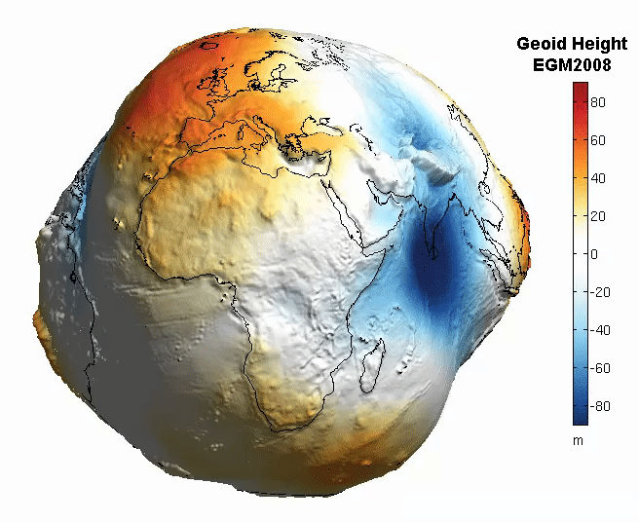
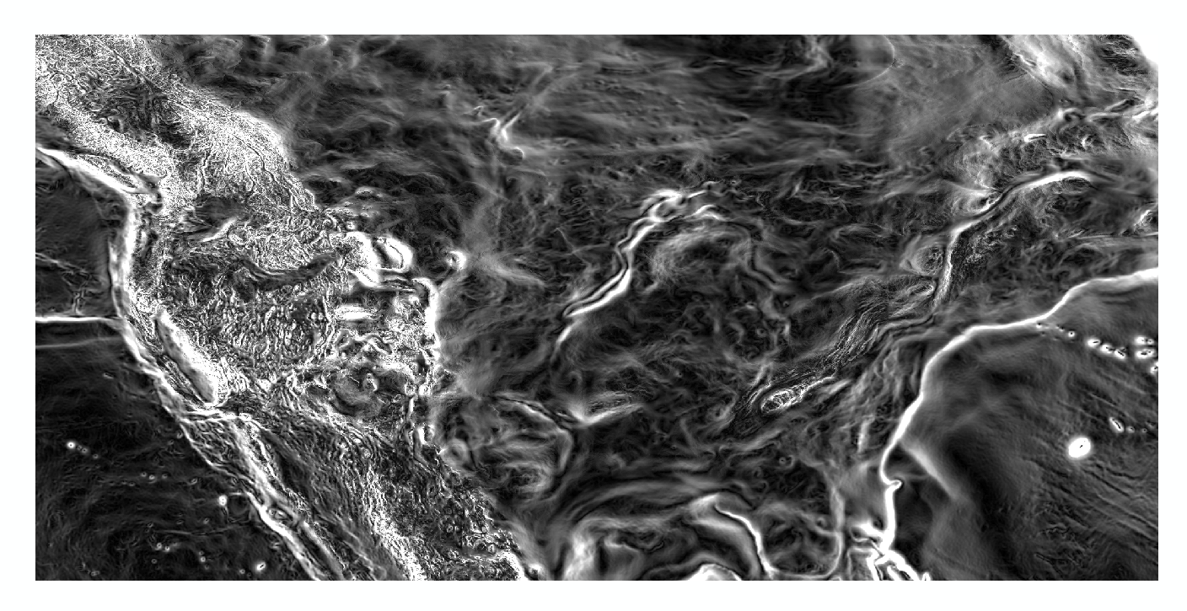
Magnitude of the Deflection of the Vertical
Questions?
Brian Shaw
brian.shaw@noaa.gov

