Slide 1

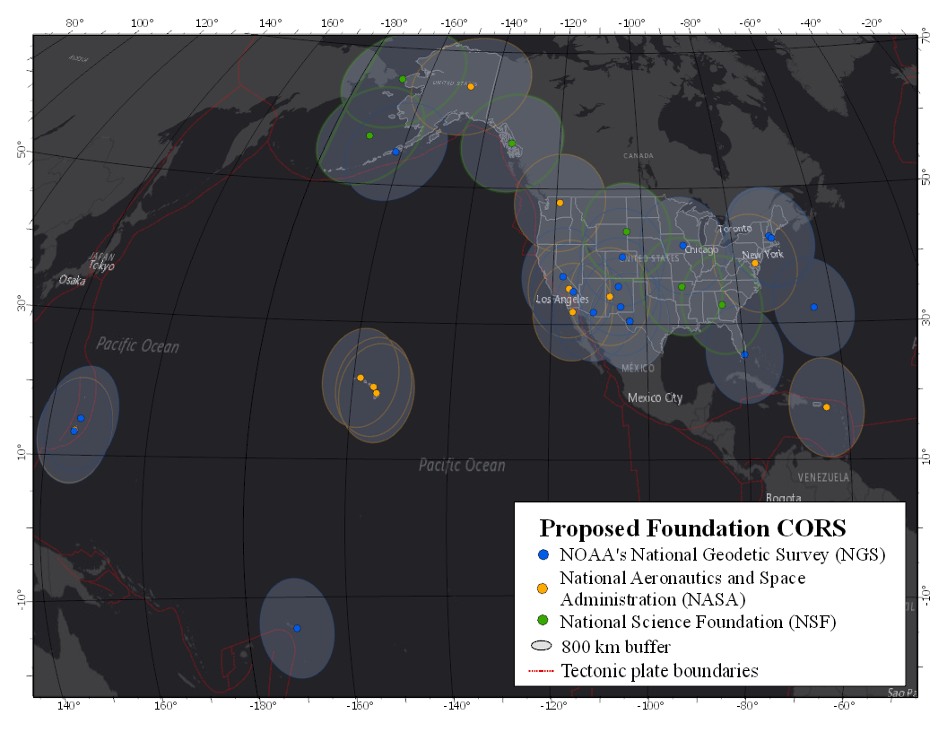
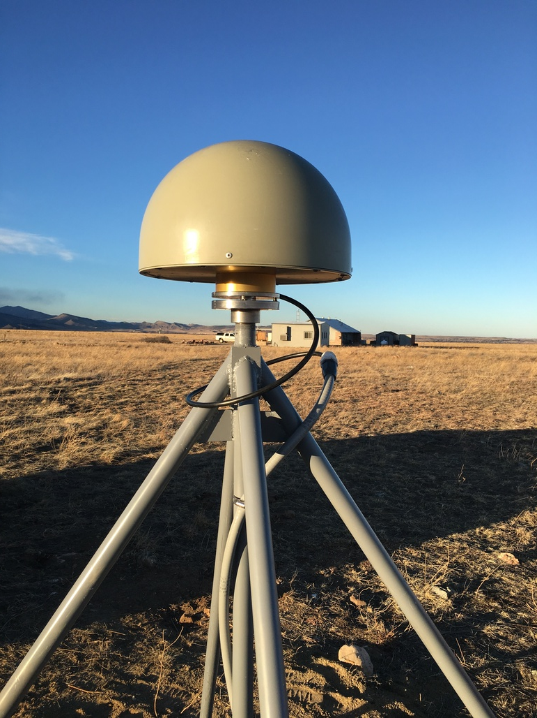
The NOAA Foundation CORS Network
U.S. Federal Partners | GNSS Site ID | Location | Existing IGS or ITRF Site
National Science Foundation (NSF) Existing Sites Program: Network of the Americas (NOTA) | AB09 | Wales, AK
 | AB51 | Petersburg, AK
 | ATQK | Atqasuk, AK
 | P043 | New Castle, WY
 | P777 | Dennard, AR
 | P804 | The Rock, GA
NSF Existing Sites Program: COCONet | CN11 | Pedro Cay, Jamaica
 | SAN0 | San Andres Island, Colombia
National Aeronautics and Space Administration (NASA) Existing Sites Program: Global GNSS Network (GGN) | BREW | Brewster, WA | ITRF
 | CRO1 | St. Croix, VI | ITRF
 | FAIR | Fairbanks, AK | IGS
 | TBD | Greenbelt, MD | IGS/ITRF
 | GUAM | Dededo, Guam | IGS
 | HAL1 | Haleakala, HI | IGS/ITRF
 | KOKB | Kauai, HI | IGS/ITRF
 | MDO1 | McDonald Observatory, TX | ITRF
 | MKEA | Mauna Kea, HI | IGS/ITRF
 | MONP | Mount Laguna, CA | IGS/ITRF
 | PIE1 | Pie Town, NM | IGS/ITRF
NOAA- National Geodetic Survey (NGS) Existing and New Sites Program: NOAA CORS Network | ASPA | Pago Pago, American Samoa | IGS
 | BRSG | St. George, Bermuda
 | CNMR | Saipan, Northern Mariana Islands | IGS
 | CORB | Woodford, VA
 | FLF1 | Richmond, FL | Proposed IGS/ITRF
 | GUUG | Mangilao, Guam | IGS/ITRF
 | TMG2 | Boulder, CO | Proposed IGS
 | WES2 | Westford, MA | IGS/ITRF
 | NEW | Apache Point, NM | ITRF
 | NEW | Fort Davis, TX | ITRF
 | NEW | Fort Irwin, CA | ITRF
 | NEW | Hancock, NH | ITRF
 | NEW | Los Alamos, NM | ITRF
 | NEW | Kitt Peak, AZ | ITRF
 | NEW | Owens Valley, CA | ITRF
 | NEW | Cold Bay, AK | ITRF
 | NEW | North Liberty, IA | ITRF
26 in North America, 4 in the Pacific,
3 in the Caribbean, and
3 in the Marianas.
A set of federally-operated, high quality, highly reliable stations with the longevity to guarantee citizens’ access to official National Spatial Reference System positions and support international positioning consistency efforts.

Slide 2
Goals of Foundation CORS Project
Federally-owned and operated “backbone”
Chosen for location, longevity, and high quality
Operational Goals:
  Non-operational time minimized for each station
  90% of NOAA Foundation CORS Network available
  at any time (no more than 4 stations non-operational)
All stations are critical to some function of the new NSRS, including:
A geographic distribution no greater than 800 km to provide minimum 1.5 cm accuracy ellipsoidal height results through NGS’ OPUS tools anywhere in the U.S.
22 out of 36 stations are (currently or will be) co-located with other space geodetic stations supporting the IGS/ITRF, which the NSRS depends on
Deep-drilled, braced monument design for some new installations

Slide 3
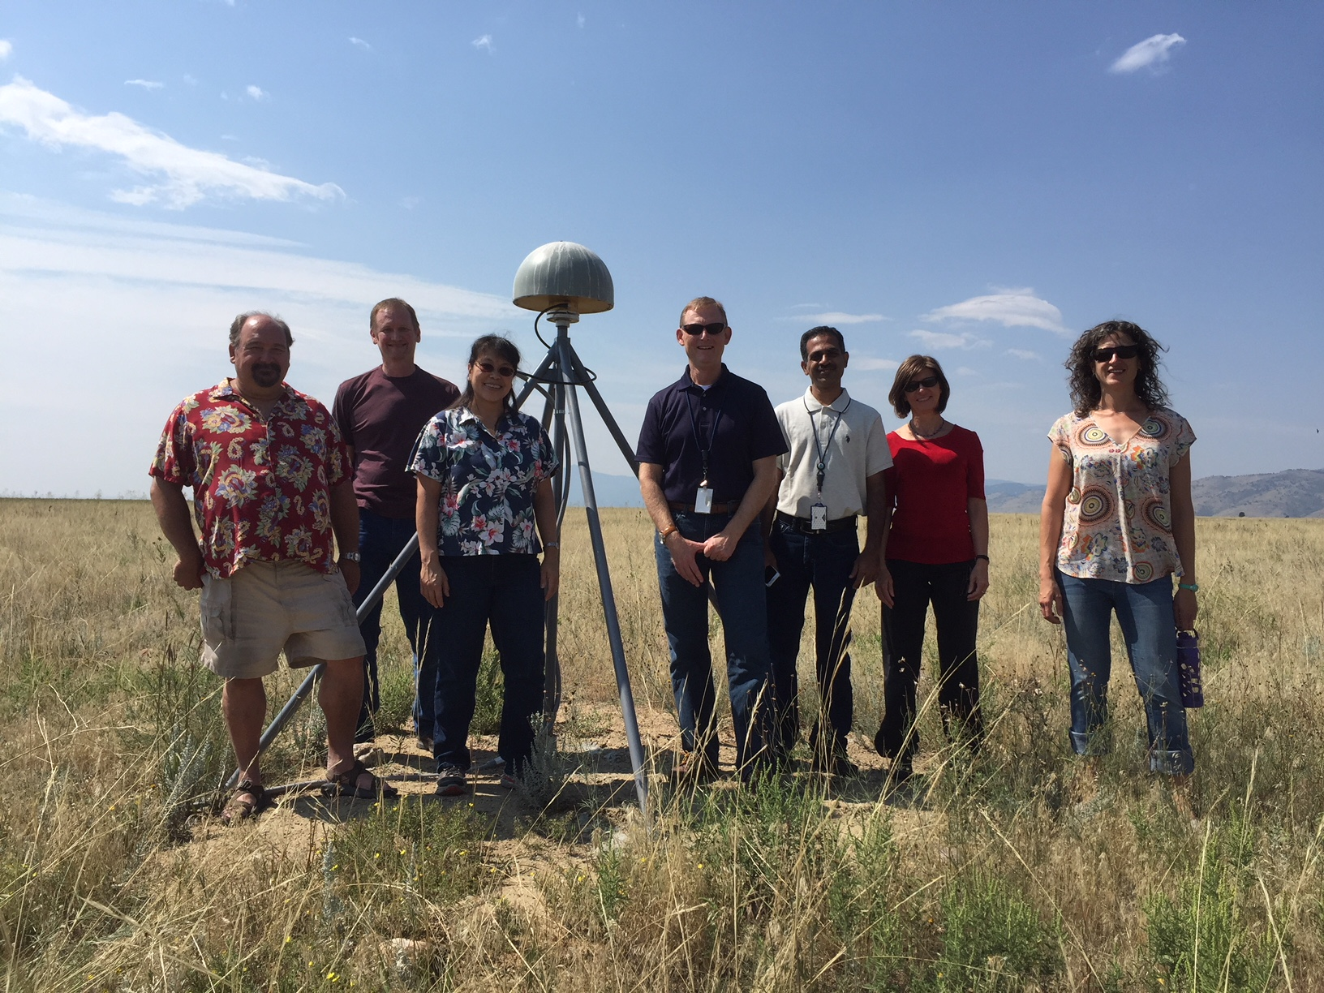
Three Ongoing Phases of Foundation CORS
Phase 1: Incorporate partner stations
Existing NASA, NSF, and Caribbean partner stations brought into the Foundation CORS network.
[NASA MOU expected approval by November 2019. Started discussions with NSF.]
Phase 2: Upgrade existing NGS CORS
Upgrades include fully-GNSS equipment and submission to IGS to meet Foundation CORS requirements
[RINEX3 development underway. 5 of 7 existing NGS Foundation CORS are fully-GNSS enabled]
Phase 3: Construct ~8 new stations
These NGS-owned stations will be co-located at sites with existing space geodetic techniques
[Planning for Fort Davis, TX and Apache Point, NM station installations in 2020]
Foundation CORS at NGS’ Table Mountain Geophysical Observatory in Boulder, CO, installed 2018 (ID: TMG2)
Notes:
CORS is a method-agnostic term, but common useage applies it to GPS/GNSS stations.

Slide 4
Multi-Year CORS Solution 2 (MYCS2) Released
As of Last Week (Sept 13th): You now have access to more accurate NOAA CORS Network station coordinates and velocities in both the national (NAD83) and international (ITRF) reference frames
What:
New robust coordinates and velocities in ITRF2014 and NAD83(2011) epoch 2010.00 (a within-realization update) for all NCN stations installed before 2014.
Modeled coordinates and velocities available for stations installed between 2014 and present.
New GPS orbits to match with ITRF2014.
Updated OPUS online positioning software uses the new coordinates and velocities, and new GEOID18.
How:
Two years of detailed quality control on all data collected by the NCN over 22 years (1995-2017).
A full network adjustment of 3050 stations, 1100 weeks of data for all NCN stations installed before 2014 (active and decomm.), IGS, and NGA stations.
~240 new CORS (<3 yrs old) have approximate coordinates and velocities “modeled” with OPUS-Net and HTDP
(lower accuracy than the network solution).
Notes:
CORS is a method-agnostic term, but common useage applies it to GPS/GNSS stations.

Slide 5
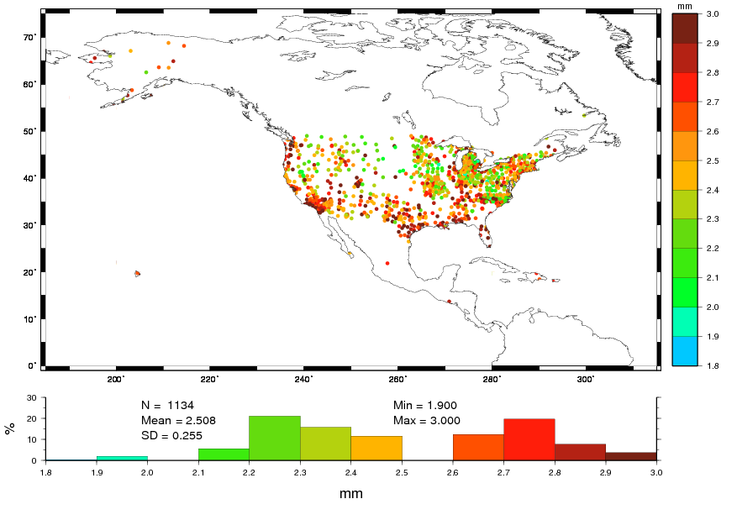
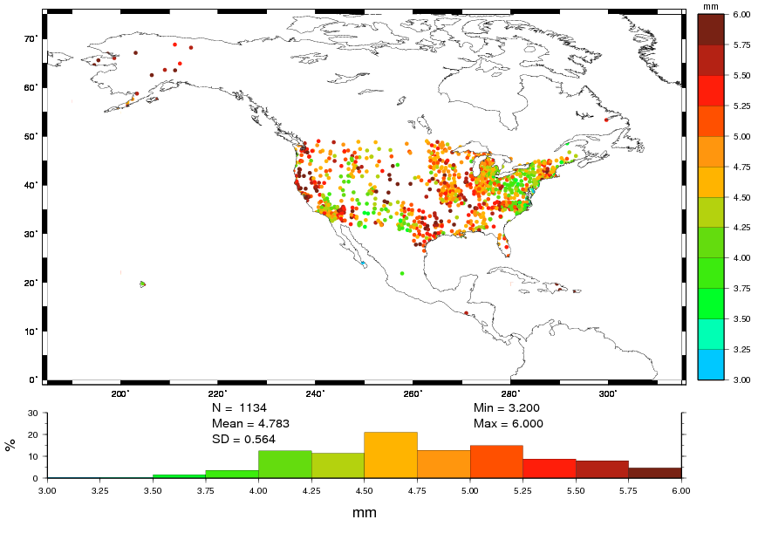
NOAA CORS Network Quality
% of Stations | # of Stations | Horizontal Motion | Vertical Motion
64% | 1139 | <= 3 mm | <= 6 mm
35% | 623 | <= 5 mm | <= 10 mm
1% | 16 | > 5 mm | > 10 mm
AND
AND
OR
Notes:
After calculating the new NAD83 velocities, these are the % and # of stations that have residual (remaining) unexplained motion in these ranges-- as of Repro2 end date in 2017. Note that there have been 2.5 years of motion since then and at least one major earthquake (Ridgecrest), so ~130 stations’ positions are now out of spec according to our old metrics (> 2cm horiz or >4 cm vert).

Slide 6
Continued Modernization Efforts
Better access to the National Spatial Reference System (NSRS)
  Goal: achieve sustained quality of 5 mm horizontal, 10 mm vertical – See Blueprint Part 3
  That’s nearly 75% BETTER than before
  All but 16 CORS met the standard as of MYCS2 end date in 2017
  Today (2.5 yrs later), motion (e.g. Ridgecrest Earthquake, July 2019) means more stations are out of spec and need to have coords/velocities repaired.
NOAA CORS Network Comprehensive Plan (Expected Fall 2020). Present new ways to:
  Redesign the CORS website with dynamic plots, new metrics, faster refresh
  Improve OPUS’ selection of CORS by providing it with better CORS data quality statistics
  Repair out-of-spec stations and provide new station coordinates more quickly
  Provide an OPUS tool to track NSRS coords/velocities for any continuous GNSS station
  Increase CORS data provider and data user communications
  Better models of motion, for both plate rotation and regional motion (IFVM)
  Automate more of the network management at NGS
Notes:
Plan will look at ways to

