Slide 1
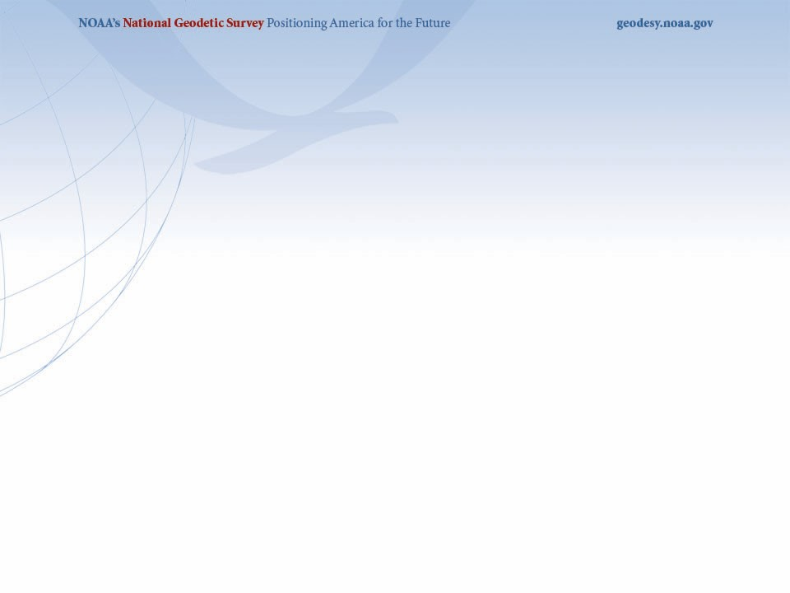


NGS Update: 2022 Datums and Related Products
NSRS 2022 Overview Workshop
University of Florida – Plant City Campus
Plant City, FL
September 20, 2019
Denis Riordan, PSM
NOAA, National Geodetic Survey
denis.riordan@noaa.gov

Slide 2
U.S. Department of Commerce
National Oceanic & Atmospheric Administration
National Geodetic Survey
Mission: To define, maintain & provide access to the
National Spatial Reference System (NSRS)
to meet our Nation’s economic, social & environmental needs
National Spatial Reference System
* Latitude * Scale
* Longitude * Gravity
* Height * Orientation
& their variations in time
Notes:
- NSRS benefit to the nation = $2.5B/year
est. 300K precision GPS users worldwide (2008); ¼ in US
- Very exciting to us at NGS to see how it has evolved over the years – now cm-accuracy capability / tracking with time

Slide 3
New U.S. Geometric Datums in 2022

Slide 4
National Spatial Reference System(NSRS)
Improvements in the Horizontal Datums
TIME NETWORK METHOD
NETWORK SPAN ACCURACY OF REFERENCE
NAD 27 1927-1986 10 meter
NAD83(86) 1986-1990 1 meter
NAD83(199x)* 1990-2007 0.1 meter
HARN
NAD83(2007) 2007 - 2011 0.01 meter
(CORS)
NAD83(2011) 2011 - 2022 0.01 meter
(CORS)
TRAVERSE & TRIANGULATION -
GROUND MARKS USED FOR REFERENCING THE NSRS.
TERRESTRIAL BASED
REFERENCE SYSTEM
FOR NSRS
GPS BECOMES MEANS OF POSITIONING – STILL GRND MARKS.
TERRESTRIAL BASED REFERENCED
SYSTEM FOR NSRS
GPS – CORS STATIONS ARE MEANS OF REFERENCE FOR THE NSRS.
SPACE BASED
REFERENCE SYSTEM
FOR NSRS

Slide 5
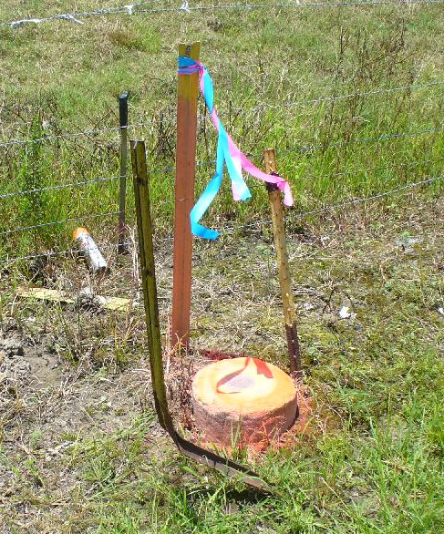
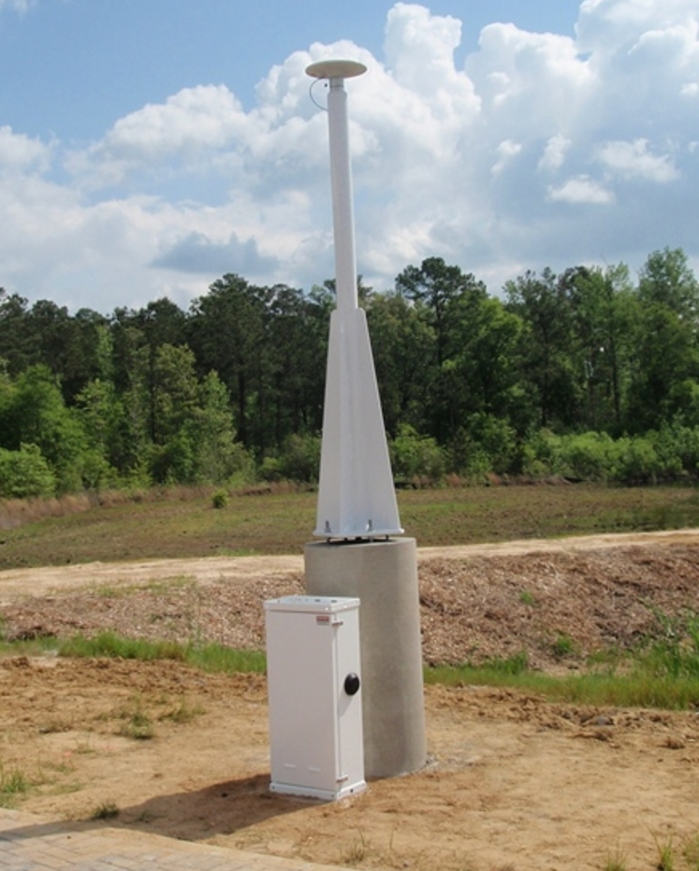
NSRS Reference Basis
Old Method - Ground
Marks (Terrestrial)
New Method - GNSS Stations
(CORS)

Slide 6
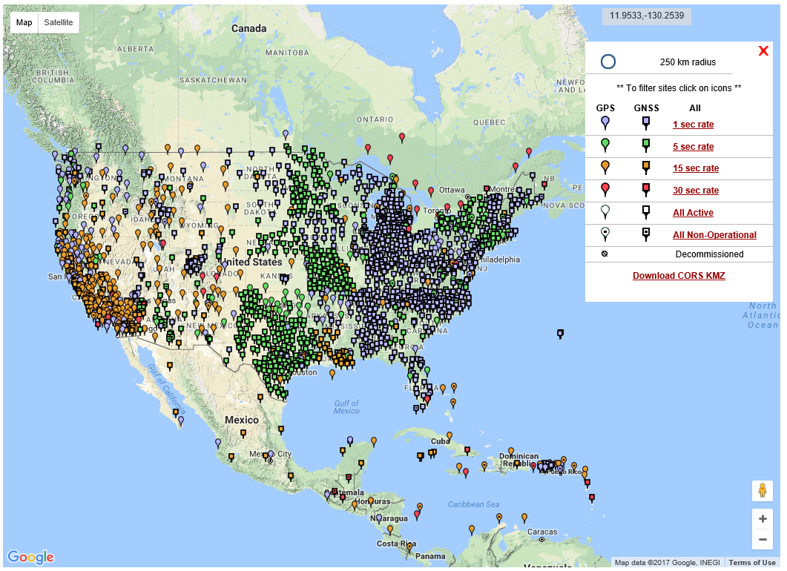
NGS Published CORS

Slide 7
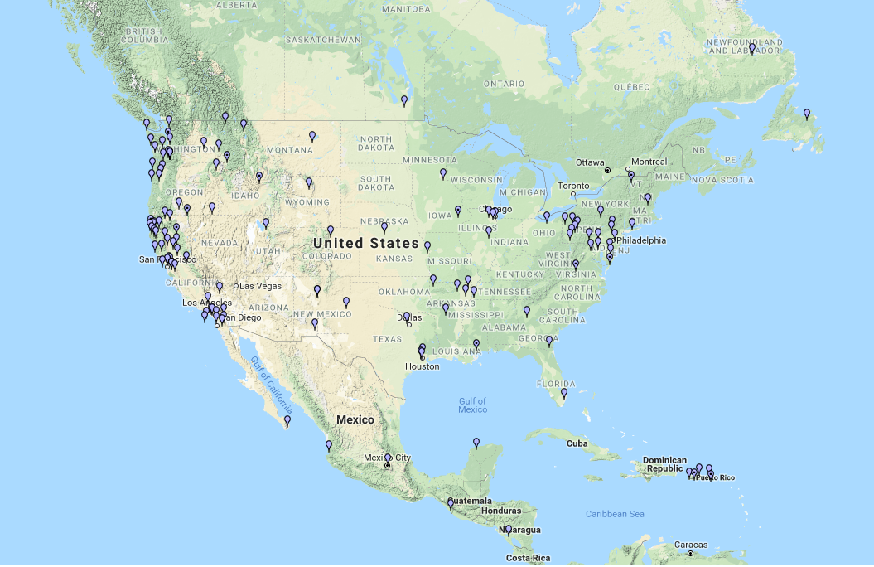
NSRS “Constrained” CORS
* Stations shown for
concept purposes only.

Slide 8
Why Replace NAD83?
Datum based on best known information about the earth’s size and shape from the early 1980’s (≈35 years old), and the terrestrial survey data of the time.
NAD83 is NON-geocentric & hence inconsistent w/GNSS .
Necessary for agreement with future ubiquitous positioning of GNSS capability.

Slide 9
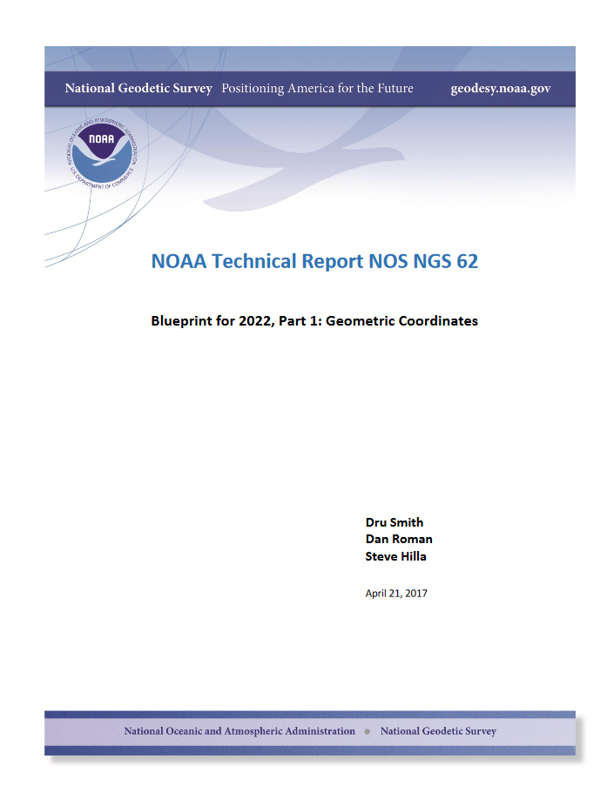

Slide 10
Future Geometric (3-D) Reference Frame
Blueprint for 2022: Part 1 – Geometric Datum
Replace NAD83 with new geometric reference frame – by 2022.
CORS-based, accessed via GNSS observations.
Coordinates & velocities in ITRF (IGS) & new US reference frame.
Passive control tied to new reference frame (not a component).
Transformation tools will relate NAD83 to new US reference
frame (NCAT with 2022 transformation).

Slide 11
Datum Names
The Old:
NAD 83(2011)
NAD 83(PA11)
NAD 83(MA11)
The New:
The North American Terrestrial Reference Frame of 2022
(NATRF2022)
The Caribbean Terrestrial Reference Frame of 2022
(CATRF2022)
The Pacific Terrestrial Reference Frame of 2022
(PATRF2022)
The Mariana Terrestrial Reference Frame of 2022
(MATRF2022)

Slide 12
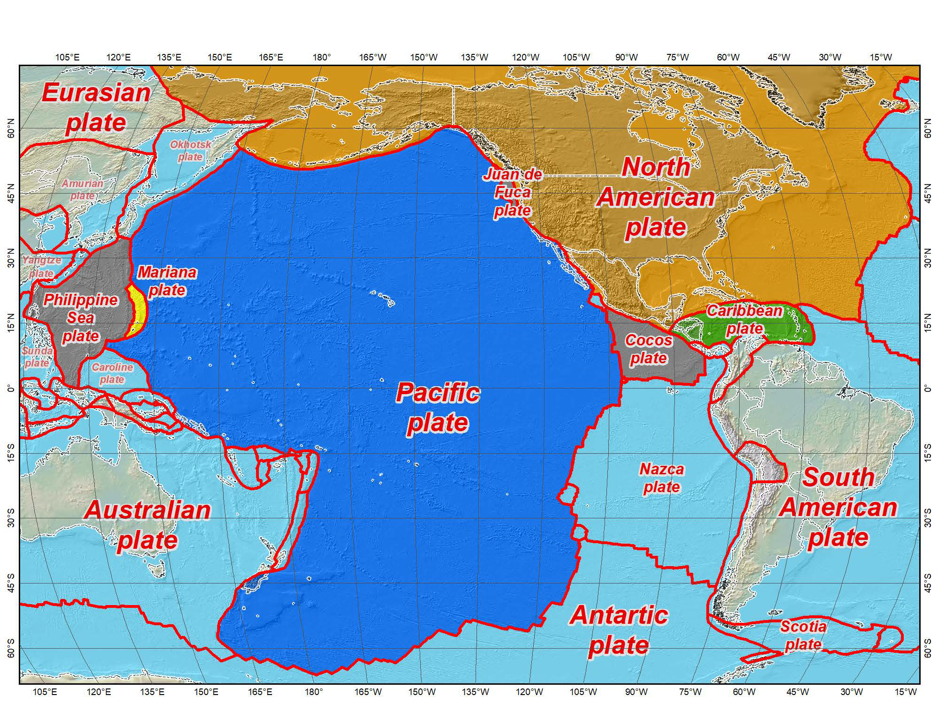

Four Frames/Plates in 2022
Tectonic plates modeled by NGS
July 12, 2017
2017 Esri User Conference
13

Slide 13
NSRS Plate Rotation Modeling
Each frame will get 3 parameters
Euler Pole Latitude
Euler Pole Longitude
Rotation rate (radians / year)
This will be used to compute
time-dependent TRF2022
coordinates from time-dependent
IGS coordinates.
EULER Pole
13

Slide 14
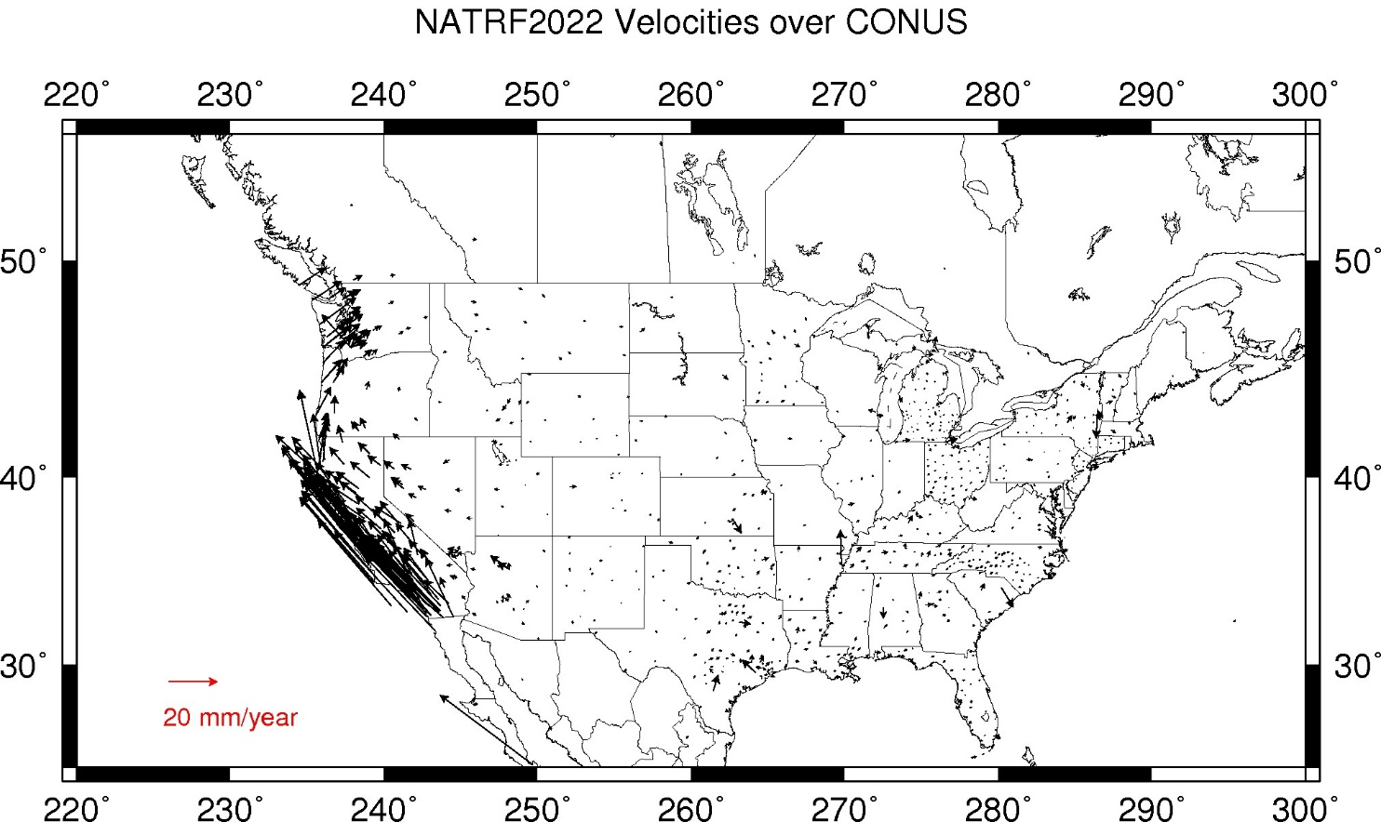
CORS Velocities – IGS08
Crustal motion to be removed by Intra Frame Velocity Models for each TRF.
Notes:
These velocities were arrived at by taking IGS08 velocities and removing the 3 parameter Euler Pole rotation of the North American plate as currently known (ITRF08 plate motion model).
These residual velocities will then be modeled into the IFVM for NATRF2022

Slide 15
Intra-frame velocities
This is the velocity of the
point in NATRF2022.
Rotation of plate removed.
It is not constant because
the point still suffers small
“intra-frame” velocities.
Such IFVs will be captured
in a model by NGS.
This is the velocity of the
point in ITRF. Includes all
movements, but the
dominant one is the
rotation of the N.A. Plate.

Slide 16
IFVM – How to Build?
Intra-Frame Velocity Models must:
  Estimate non-Eulerian motions at any location
Three primary methods being investigated
  Interpolation from CORS
    Pro: Easy
    Con: Gets worse as CORS gets coarse
  Satellite IfSAR
    Pro: Covers vast areas
    Con: No IfSAR experts in NGS; data availability issues
  Geodynamic
    Pro: Like HTDP, so NGS has experience
    Con: Requires knowing why things move, rather than just measuring that they move (and requires “keeping up” with every event.)

Slide 17
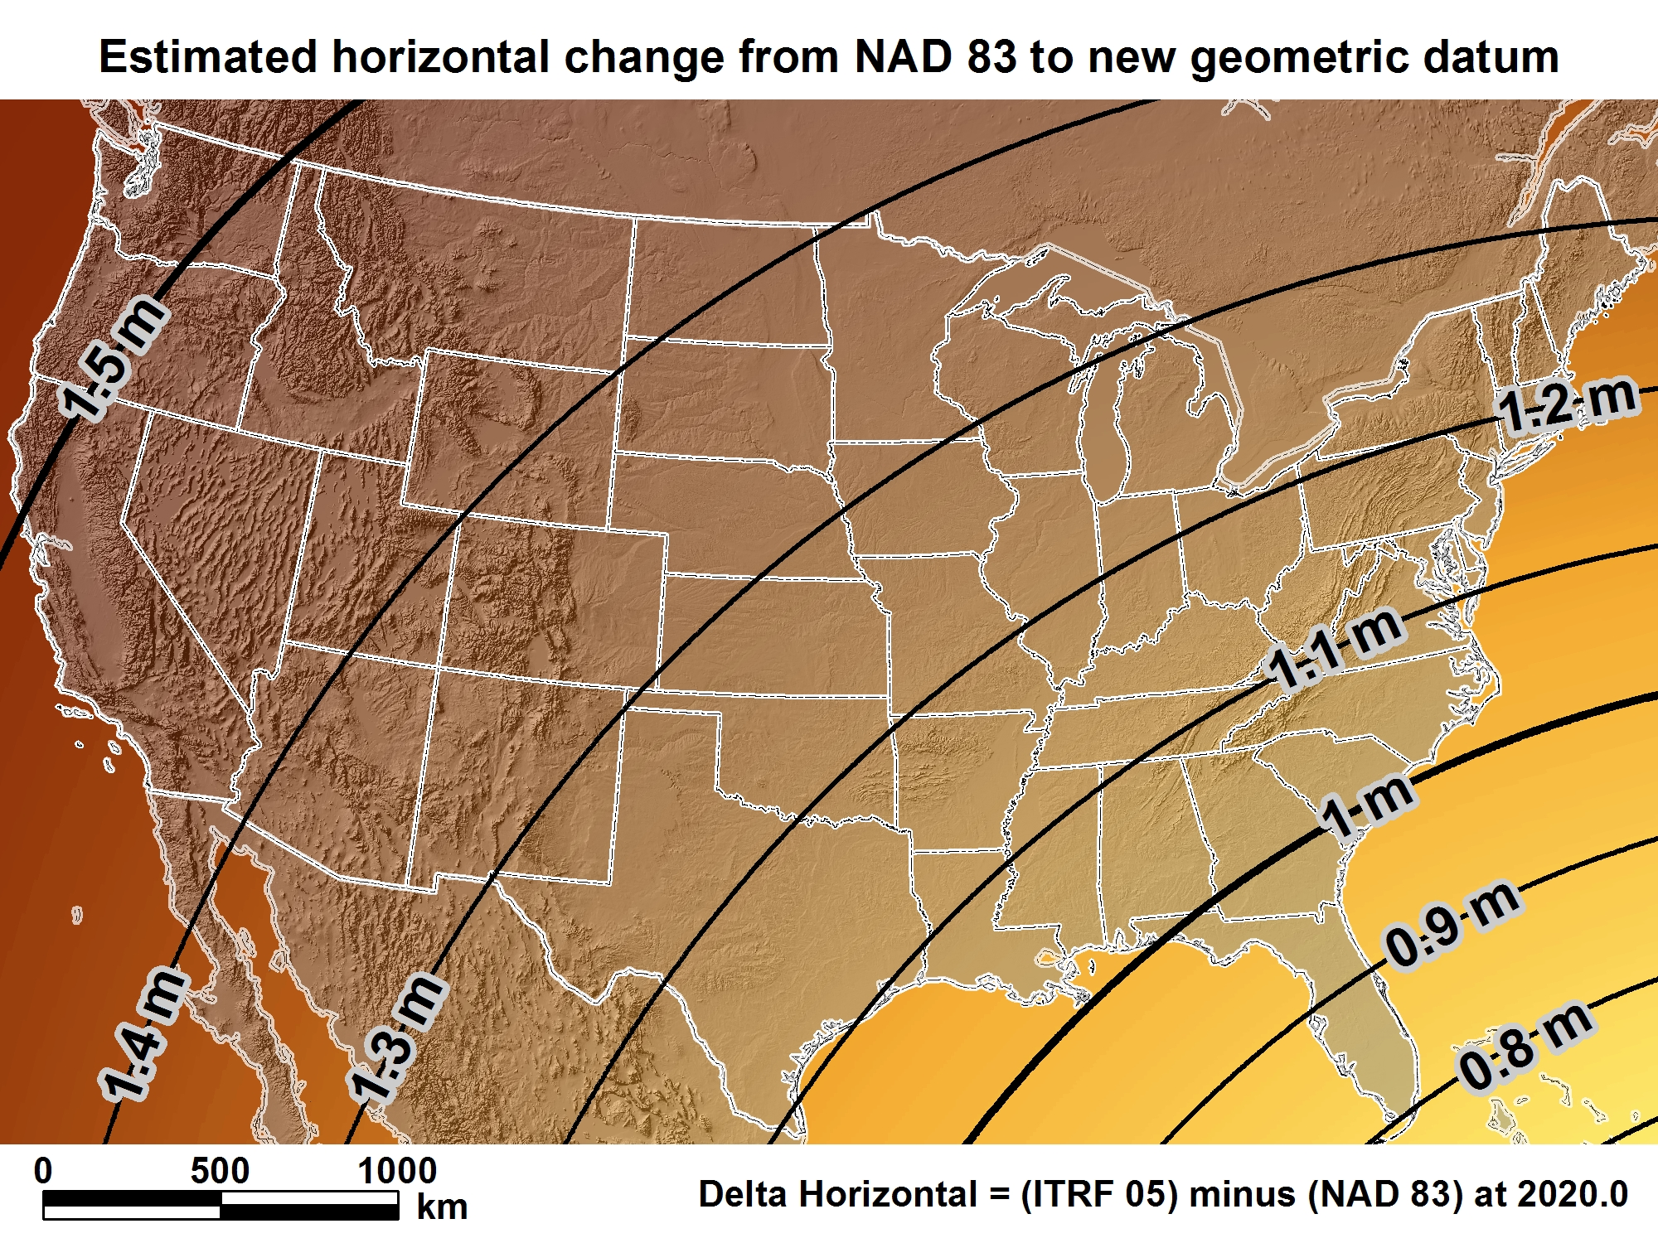
NATRF2022
New geometric datum minus NAD 83 (horizontal)
For Florida = 0.8 > 1.02 m (2.6 > 3.3 ft.)

Slide 18
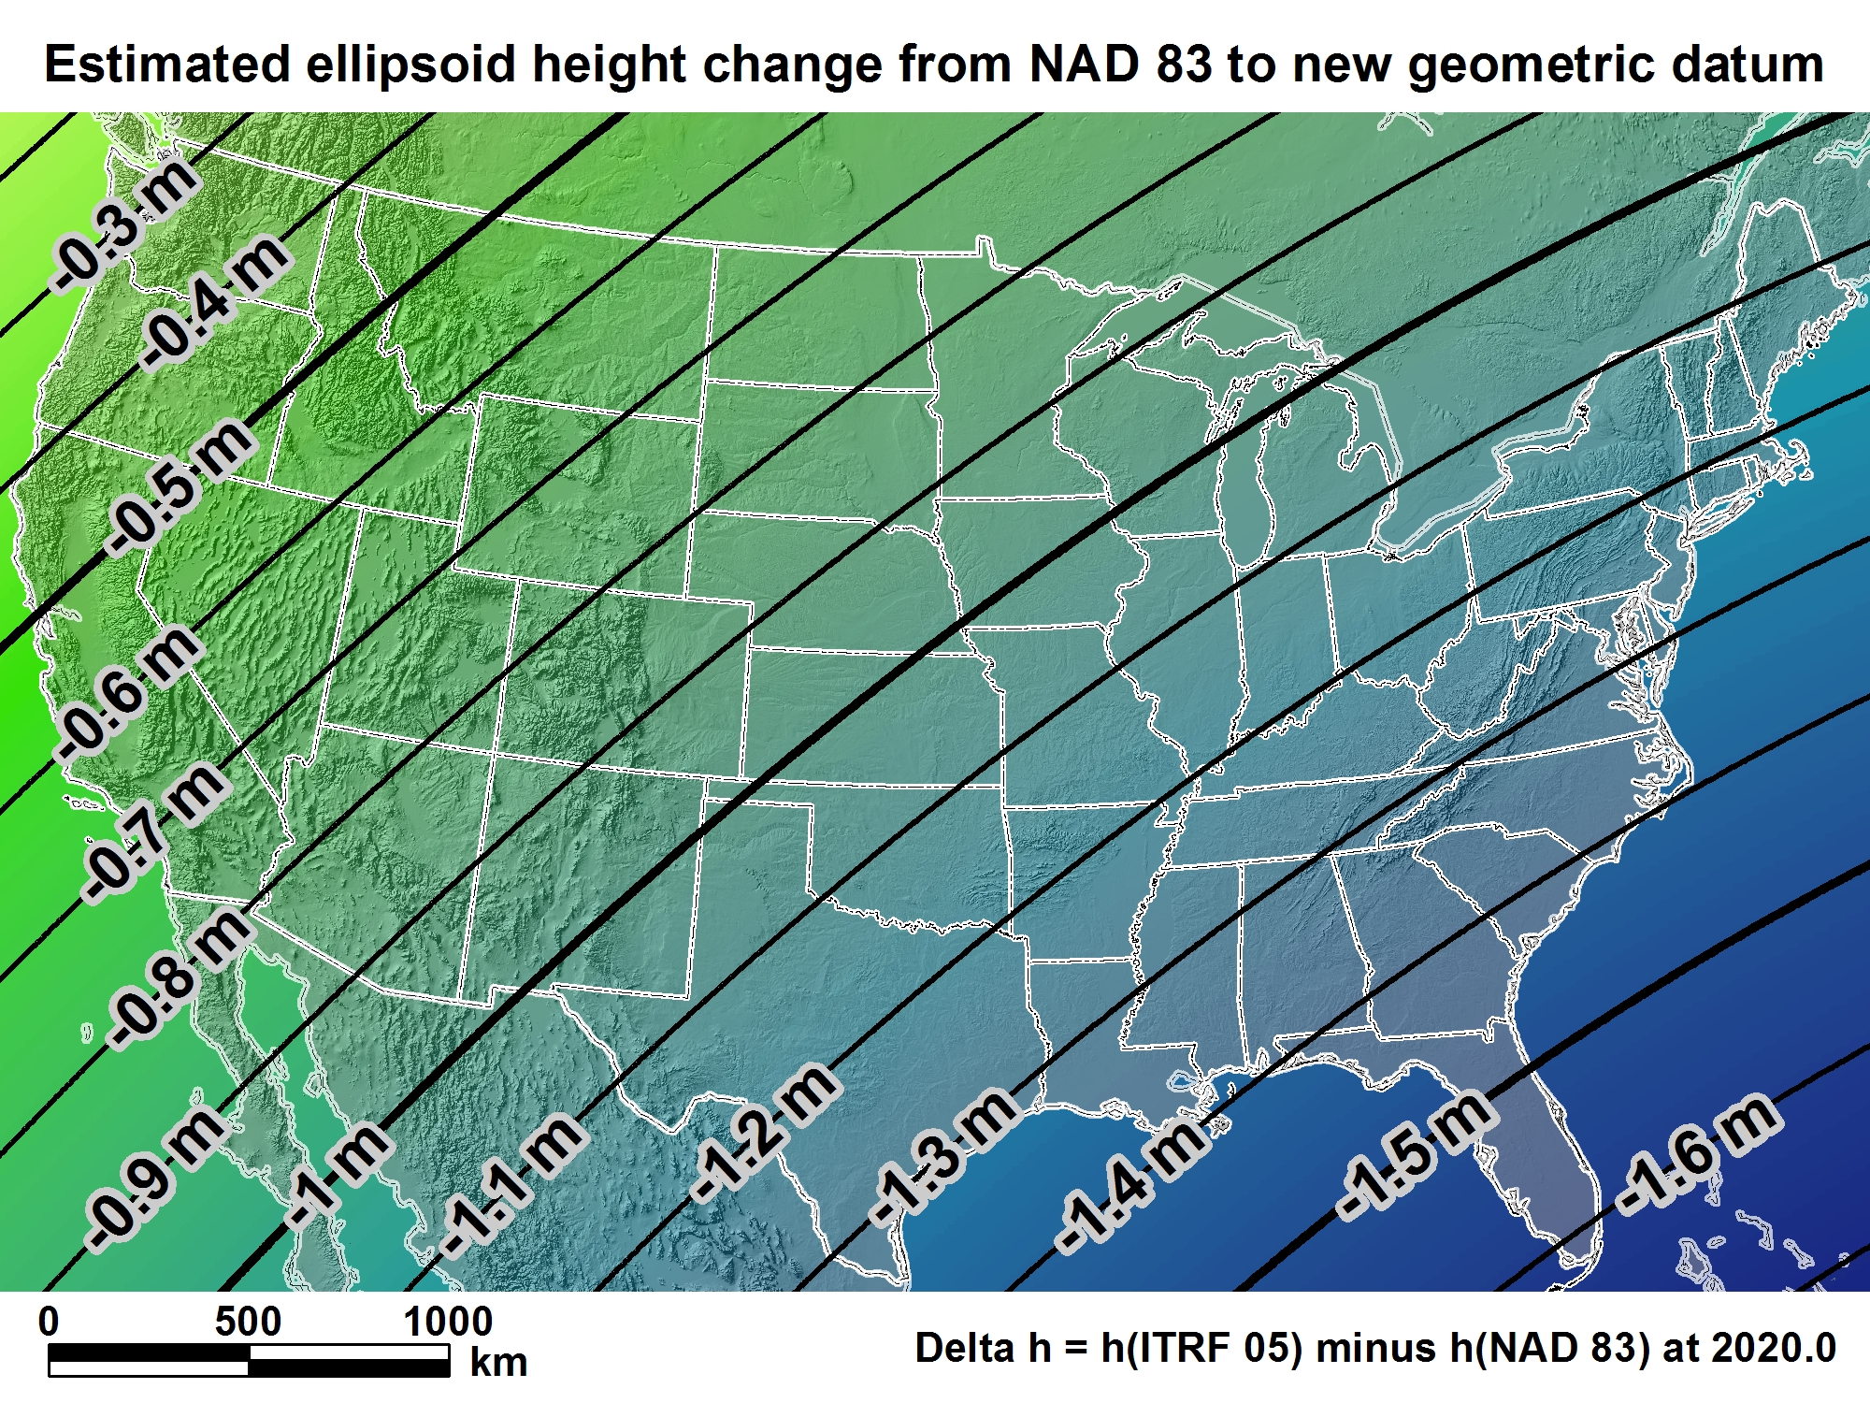
NATRF2022
For Florida = -1.39 > -1.62 m (-4.5 > -5.3 ft.)

Slide 19

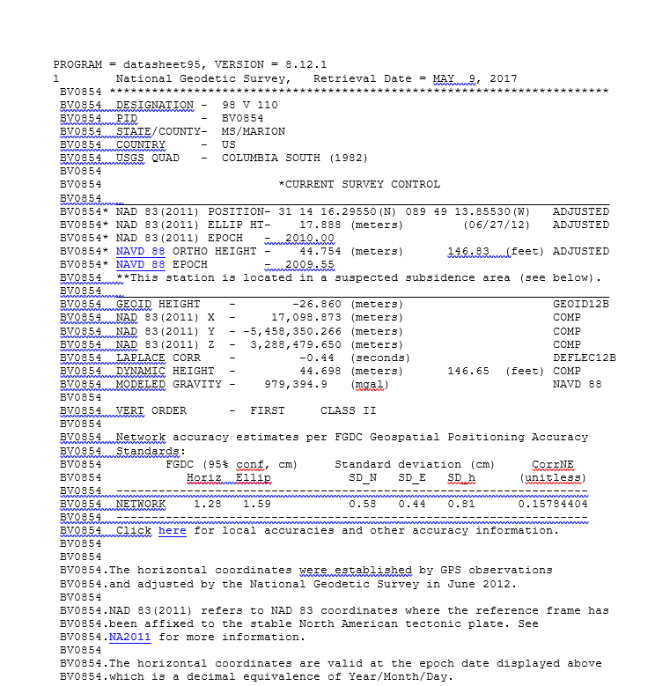
Geometric Position Epochs

Slide 20
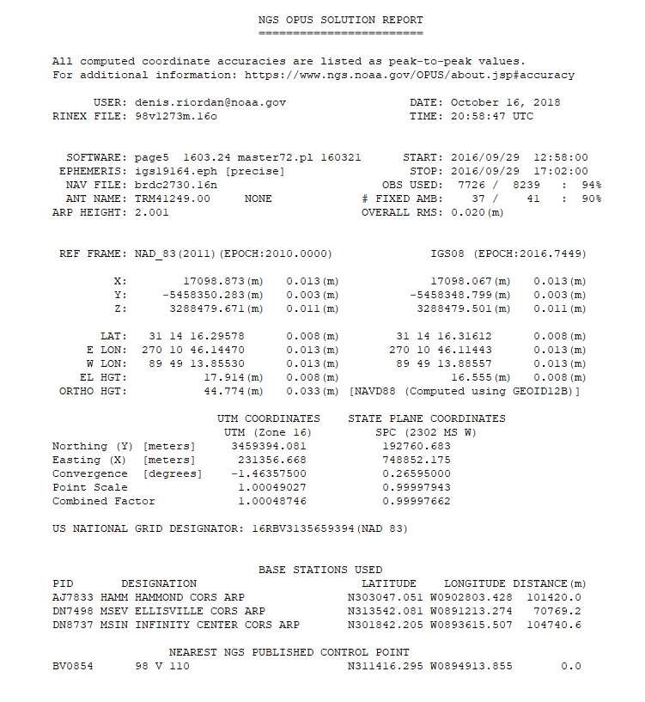
Geometric Position Epochs
NGS OPUS SOLUTION REPORT

Slide 21
New U.S. Vertical Datum in 2022

Slide 22
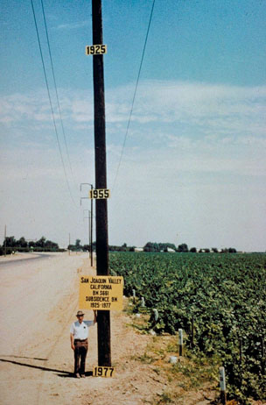
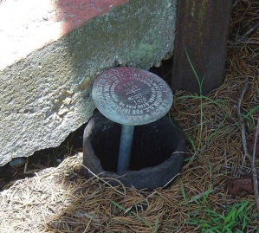
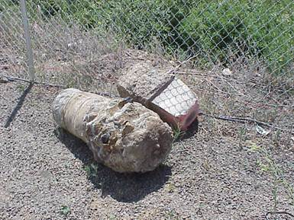
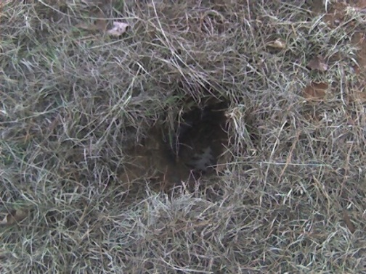
Why isn’t NAVD 88 good enough anymore?
* NAVD 88 is a terrestrial based vertical datum that changes as the land changes.
NAVD 88 suffers from use of bench marks that:
  Are almost never re-checked for movement
  Disappear by the thousands every year
  Are not funded for replacement
  Are not necessarily in convenient places
  Don’t exist in most of Alaska
  Were determined by leveling from a single point, allowing cross-country error build up

Slide 23
Can NAVD 88 be fixed?
Long term fix: Re-level some/all of NAVD 88
  81,500 km of 1st order leveling at least
  625,000 km of mixed 1st and 2nd order leveling
Re-leveling NAVD 88 estimated to cost between
  $200 Million and $2 Billion
Time factor in that amount of leveling
Still would have problems related to passive control
Notes:
Re-leveling NAVD 88 won’t fix:
Sparseness of the bench marks
Continued subsidence or uplift of bench marks
Destruction of bench marks
Canada’s decision not to adopt NAVD 88
Whatever errors caused a continent-wide 1 meter build up in the leveling the first time around

Slide 24
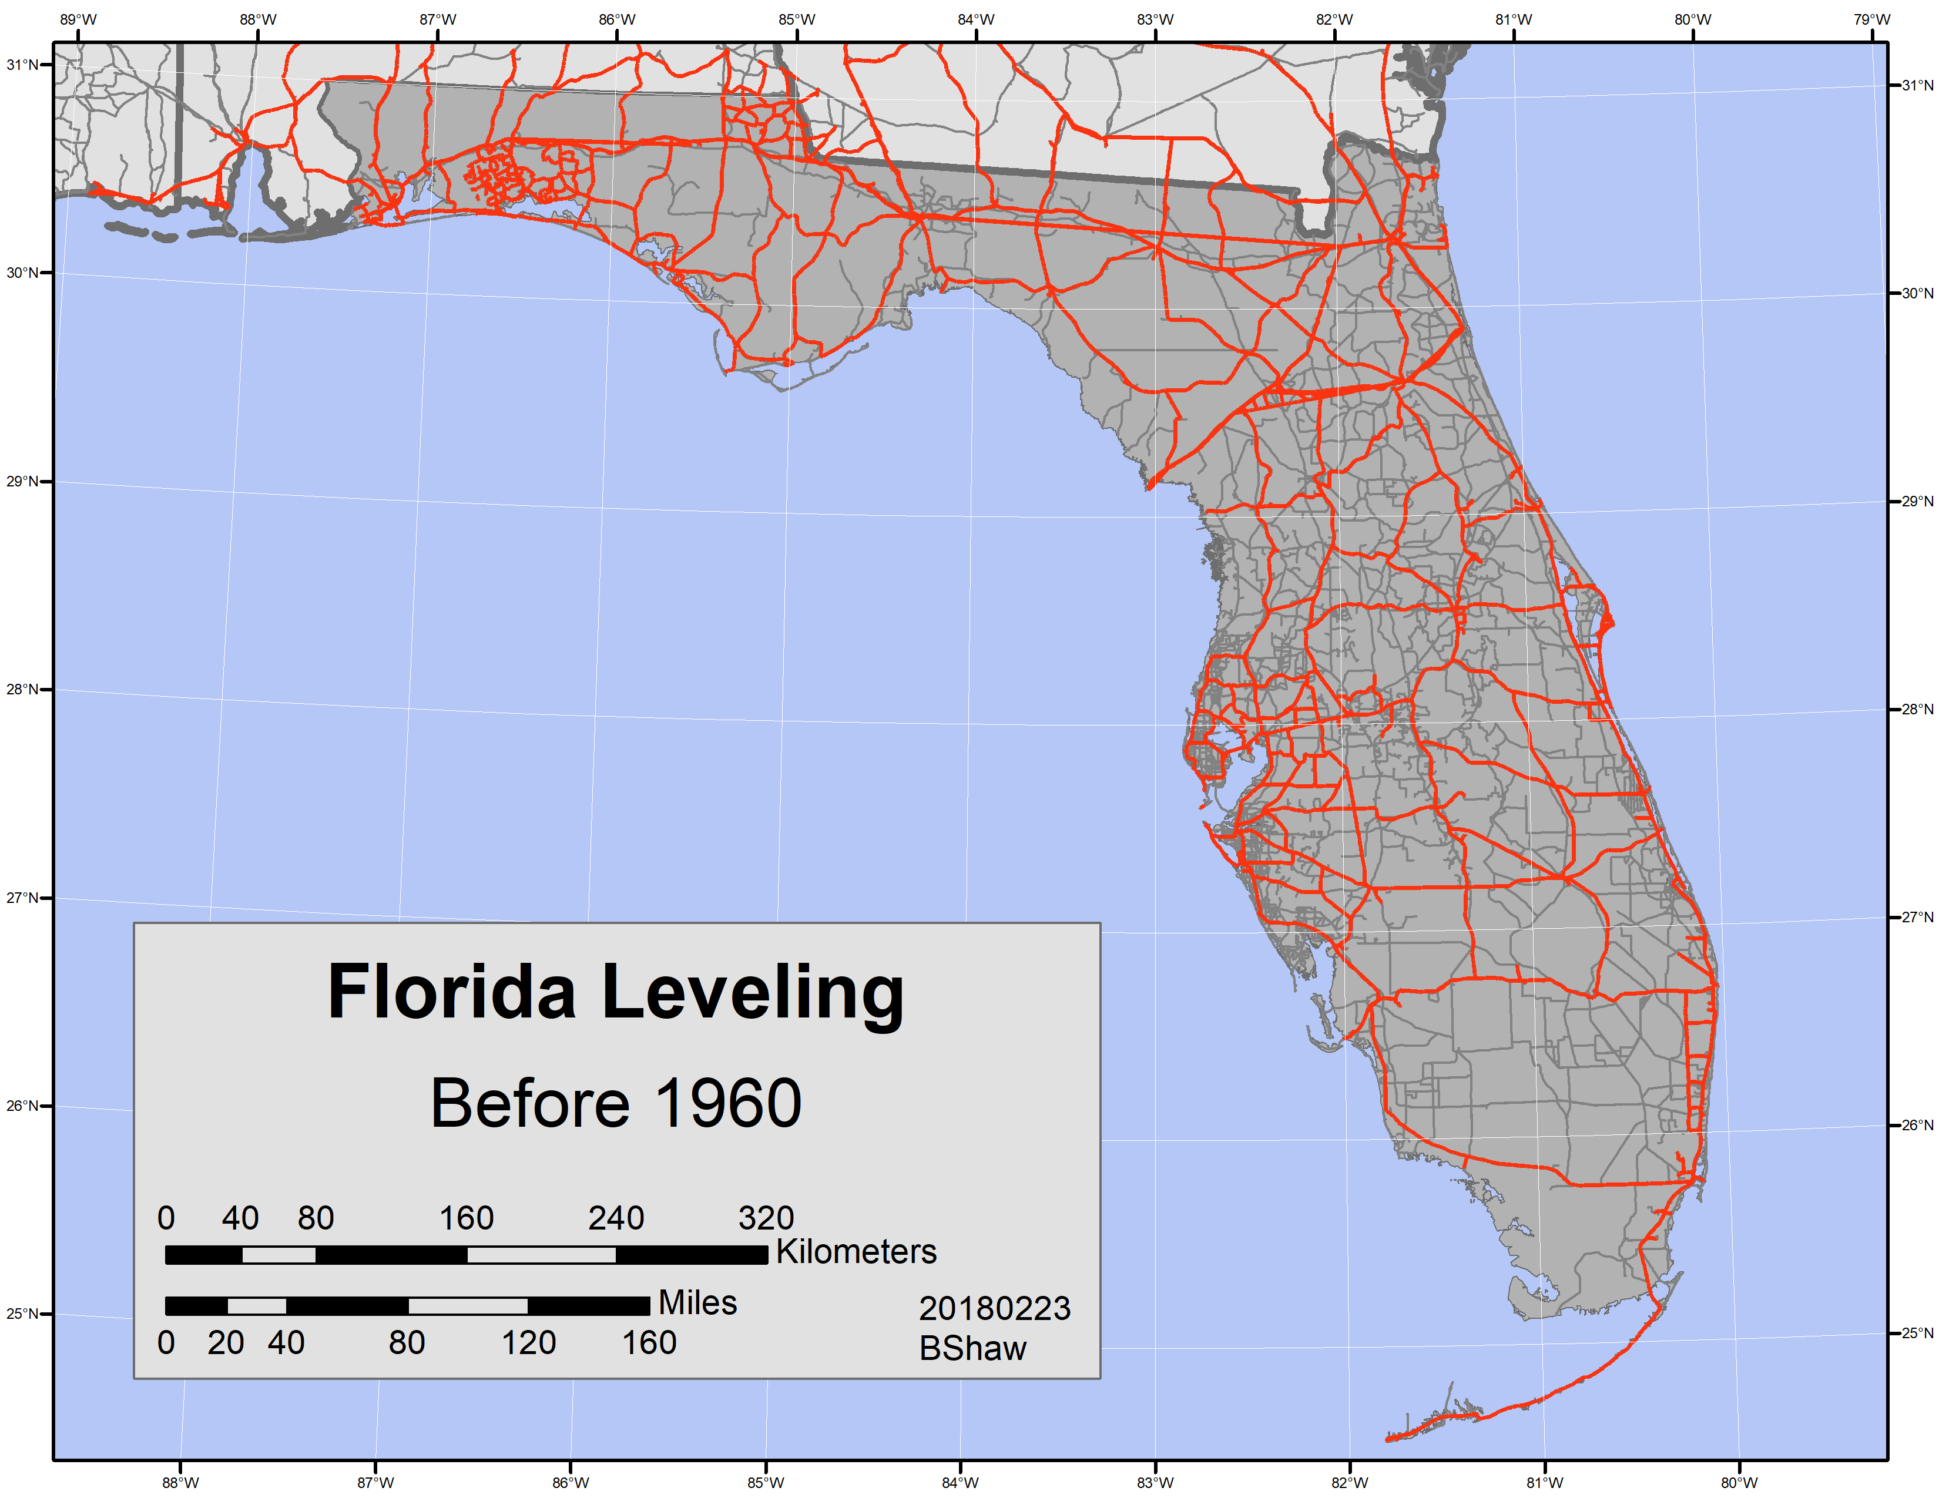




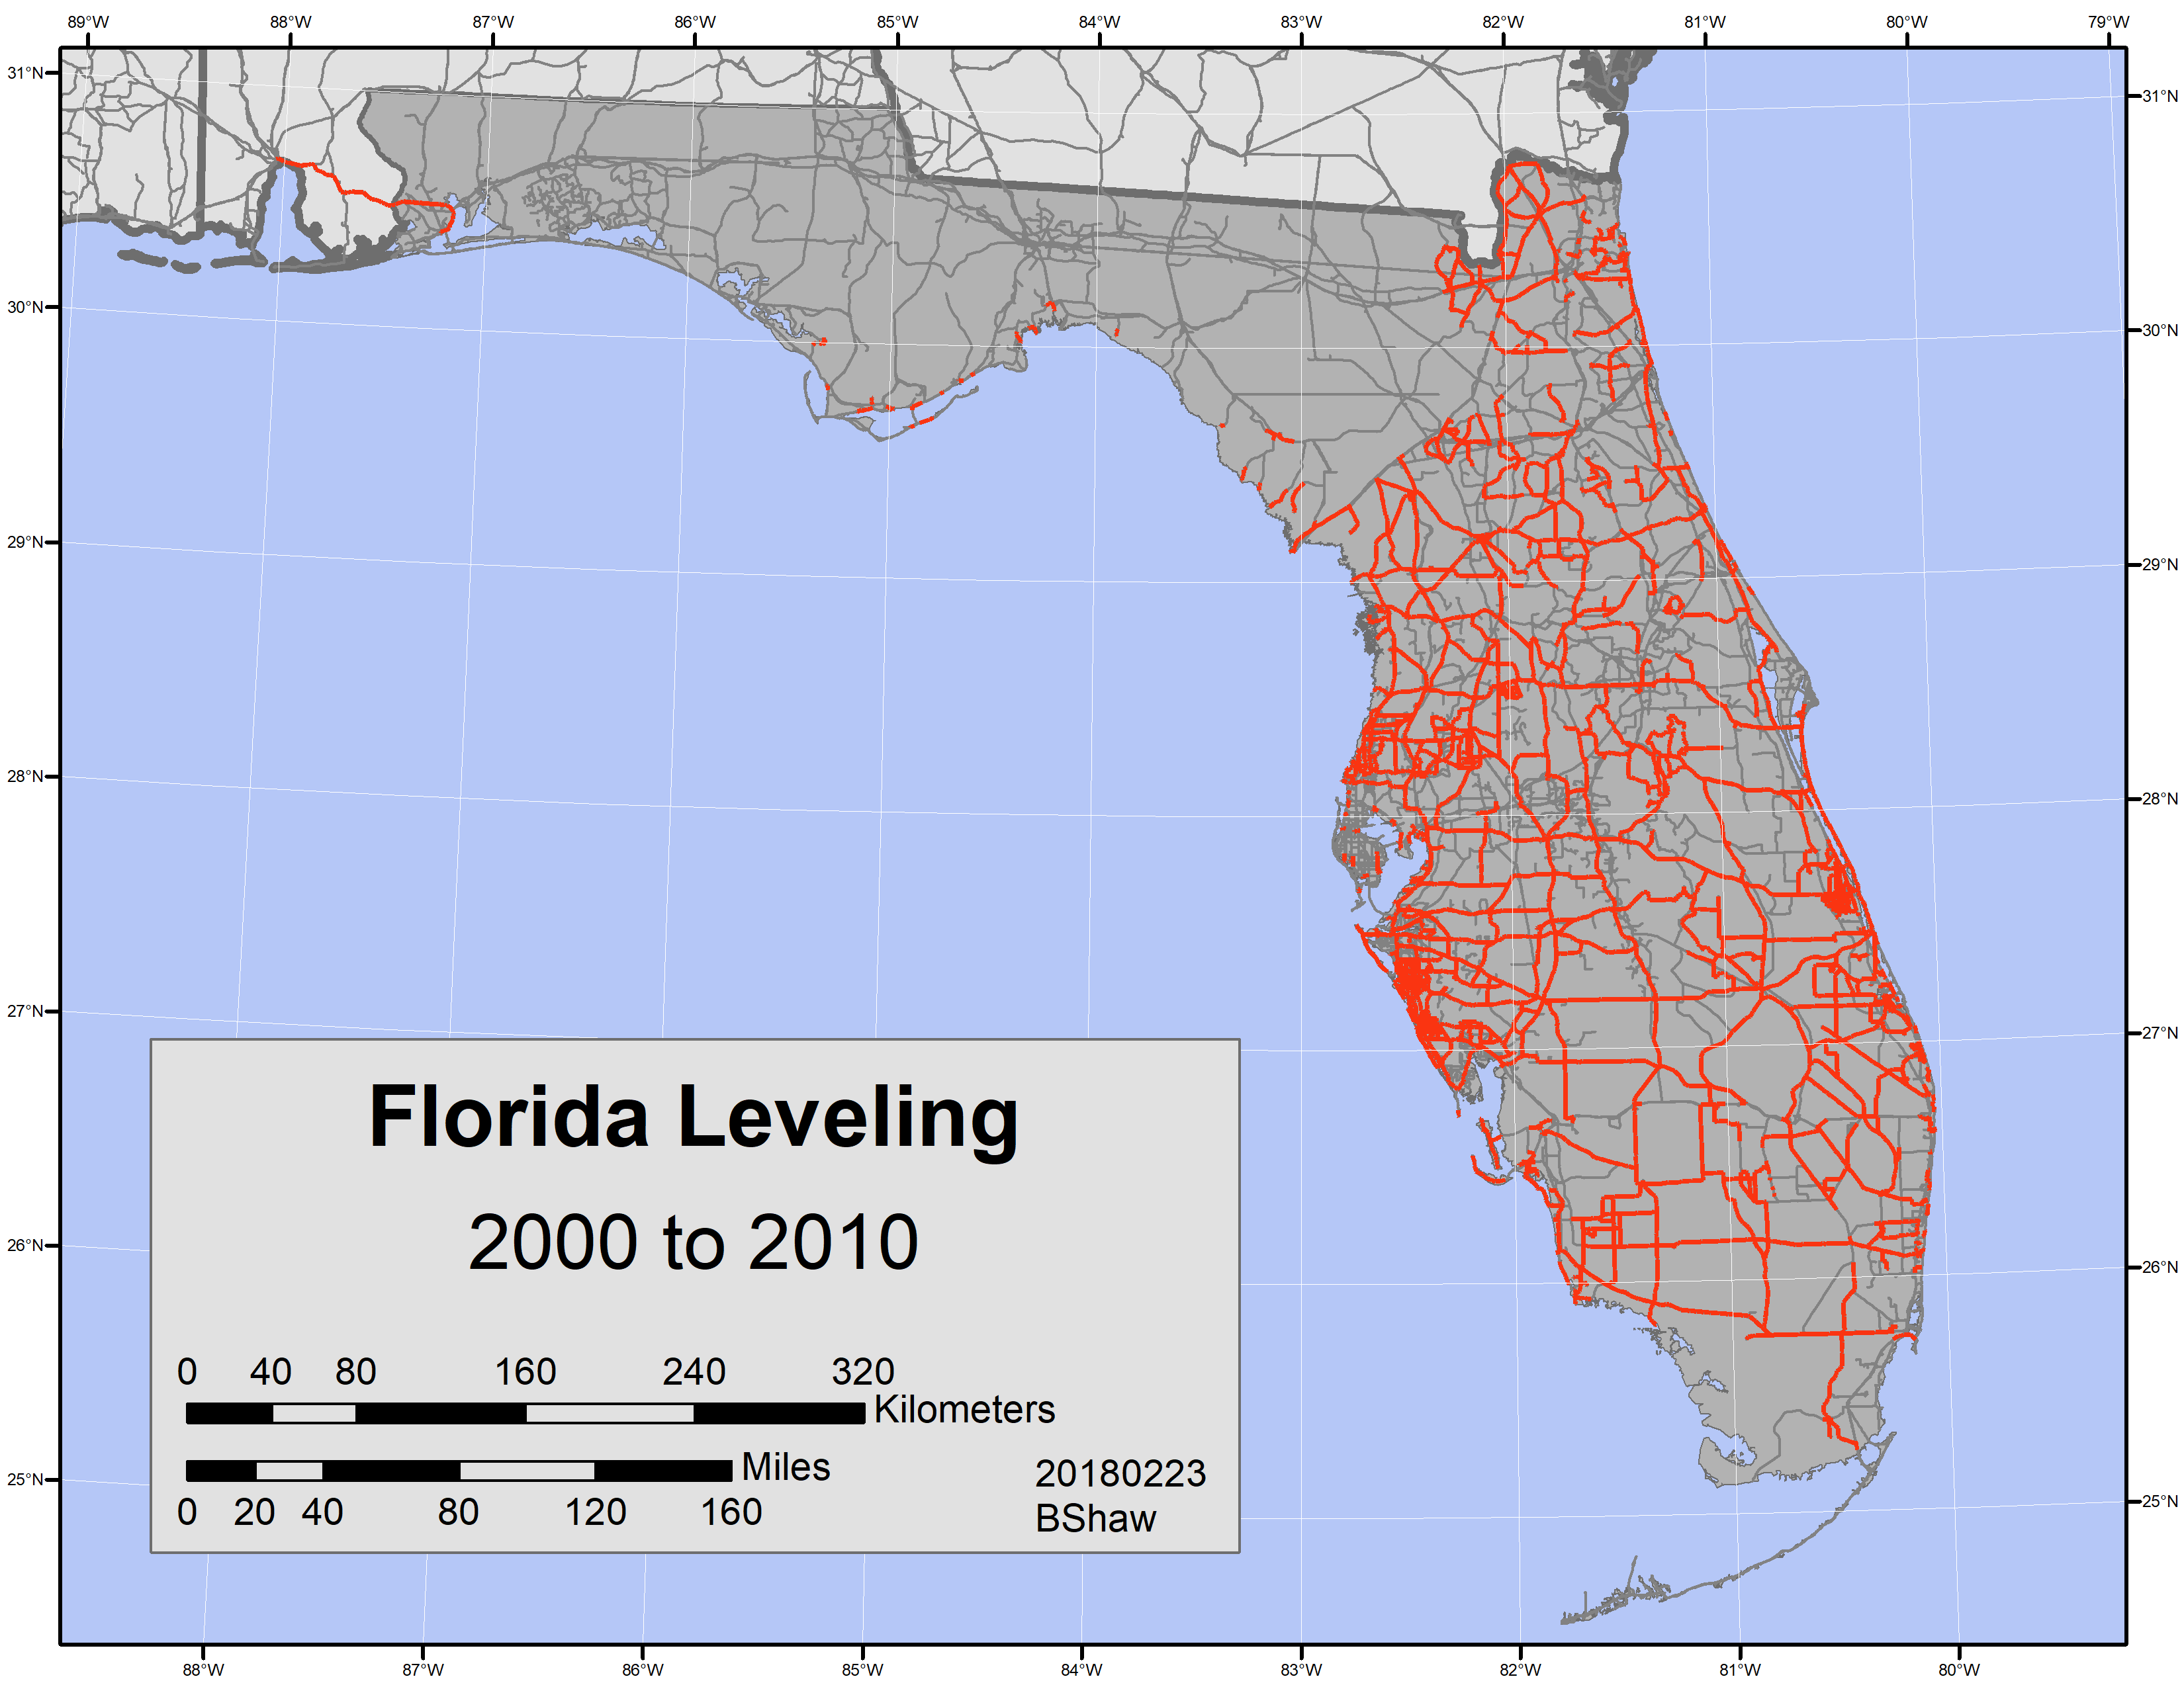


Slide 25
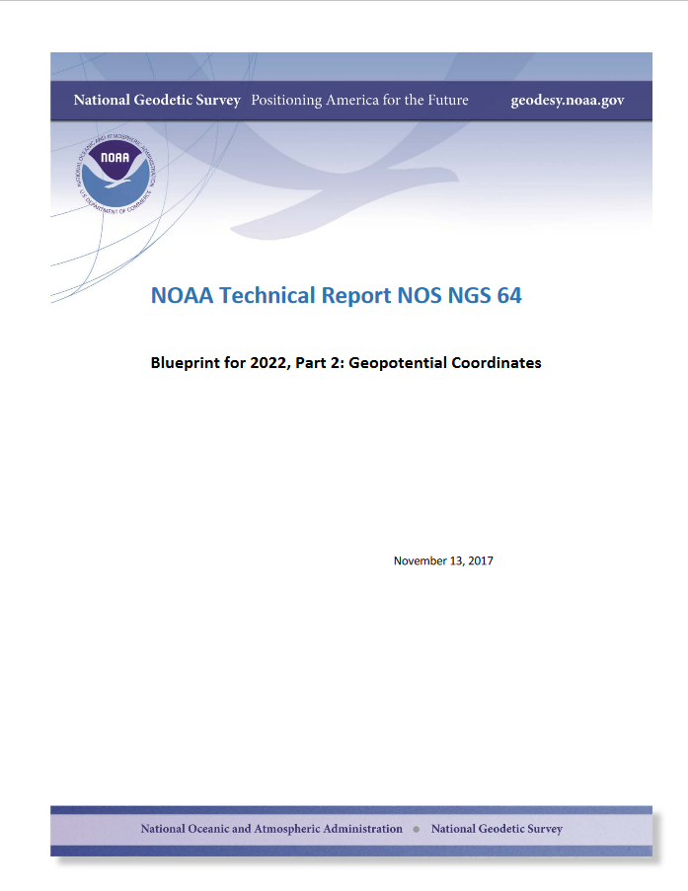

Slide 26
NEW VERTICAL DATUM (Rationale)
  A move away from differentially leveled passive control as the defining mechanism of the reference surface
  To be consistent with the shift in the geometric reference frame/ellipsoid (2022)
  Improvement in our technical abilities in reference surface realization (geopotential gravimetric reference surface - 1cm accuracy of the geoid (GNSS/GRAV-D))
  Goal - ability to establish 2cm orthometric height anywhere in U.S. using a minimum of 15 min. of GNSS data.
  The new geopotential reference surface will be aligned with the geometric reference frame/ellipsoid (i.e., no hybrid geoid)

Slide 27
Names
  The Old:
  NAVD 88
  PRVD 02
  VIVD09
  ASVD02
  NMVD03
  GUVD04
  IGLD 85
  IGSN71
  GEOID12B
  DEFLEC12B
Orthometric
Heights
  The New:
  The North American-Pacific
  Geopotential Datum of 2022
  (NAPGD2022)
  - Will include:
  GEOID2022
  DEFLEC2022
  GRAV2022
  DEM2022
Normal
Orthometric
Heights
Dynamic
Heights
Gravity
Geoid
Undulations
Deflections of
the Vertical

Slide 28

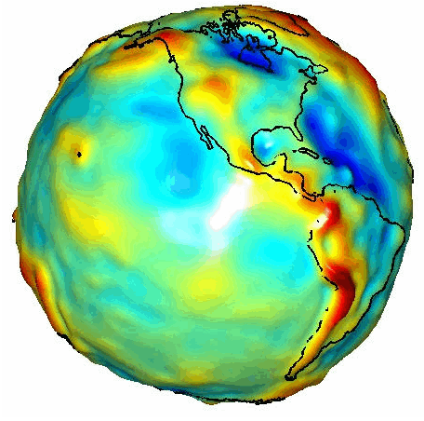
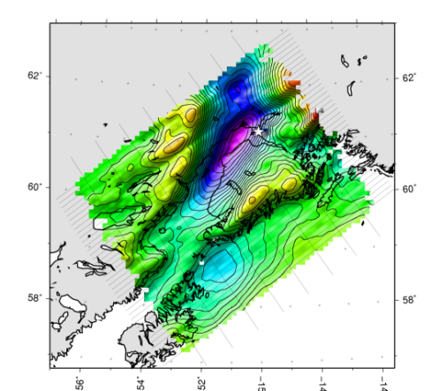
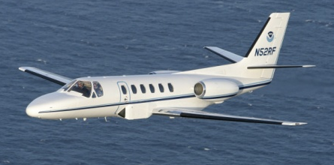
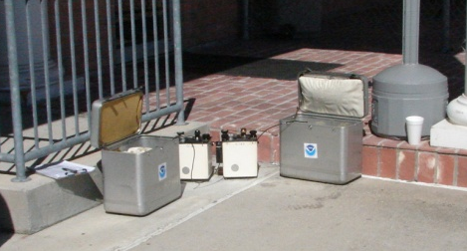
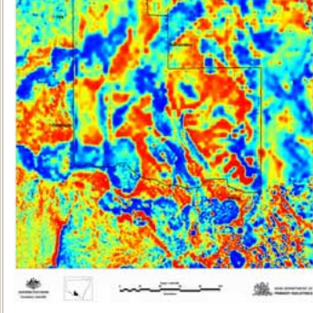
Building a Gravity Field
Long Wavelengths
(≥ 250 km)
GRACE/GOCE/Satellite Altimetry
+
Intermediate Wavelengths
(500 km to 20 km)
Airborne Measurement
+
Short Wavelengths
(< 100 km)
Surface Measurement and
Predicted Gravity from Topography
Notes:
Give example of how short wavelength information is like low altitude aerial photos (1/2” pixel accuracy) in that it provides very accurate and detailed information. The long wavelength gravity can be likened to the old LANDSAT imagery (3 meter pixel accuracy) in that it was good over large areas, but didn’t give much detail for local areas. The intermediate wavelength gravity data gives us a connection between the two (the short and long), allowing the NGS gravity team to use all available gravity information in working toward the production of a 1 cm accurate gravitational surface.

Slide 29
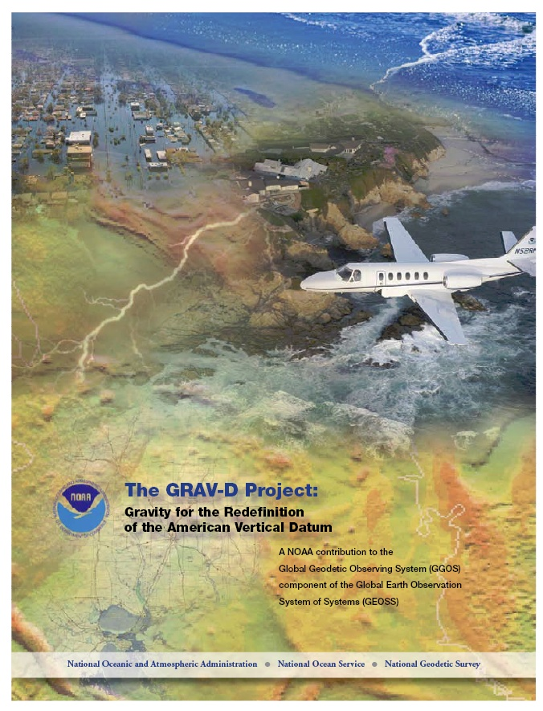
Gravity for the Redefinition of the American Vertical Datum (GRAV-D)
Replace the Vertical Datum of the USA by 2022 (at today’s funding)
GRAV-D is:
  An airborne gravity survey of the entire country and its holdings
  A 2022 gravimetric geoid accurate to 1 cm
  Long-term monitoring of geoid change over time
  Partnership surveys
Working to launch a collaborative effort with the USGS for simultaneous magnetic measurement
Acting Manager: Jeffery Johnson
Gravity and Heights are
inseparably connected
Notes:
GRAV-D is the NGS project designed to replace NAVD88 with a vertical datum based upon a gravimetric geoid accurate to 1 cm. Heights above this datum will be accessed via GNSS measurements. Three thrusts of project. Launch USGS collaboration for simultaneous mag measurement.

Slide 30
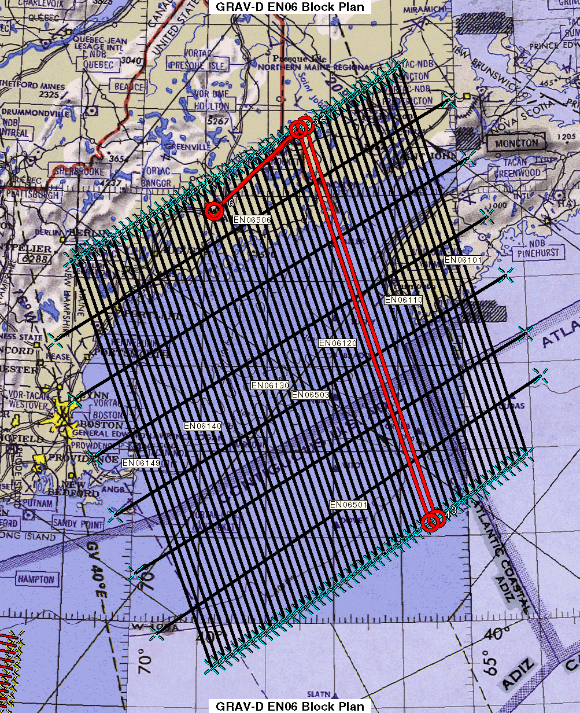
Survey and Block Plans
Data lines spaced 10 km apart.
Cross lines spaced 60-80 km apart.
Flight lines run 100-150 km offshore.
Flight altitude 20,000 ft.
Nominal speed 220-250 knots.
Notes:
Block layout based on aircraft, adjust size of block if needed

Slide 31
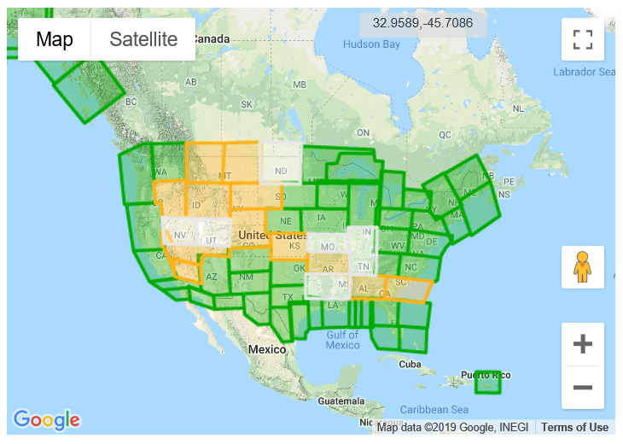
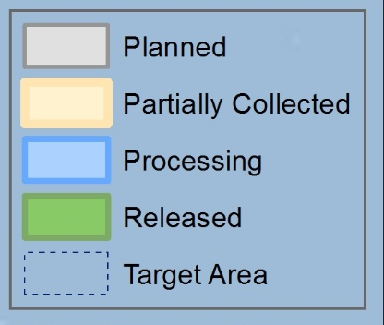
GRAV-D Status - Over 78% Complete

Slide 32
Geoid Monitoring Service (GeMS)
Goal: Track all changes to the geoid which would prevent 1 cm accuracy
Aspects included:
  Shape, Secular: e.g. Hudson Bay
  Shape, Episodic: e.g. Massive Earthquakes
  W0, Secular: Global Sea Level Change (see next slides)
Examples of things excluded:
  Size, Secular: Mass quantity of Earth is effectively static
  Shape, Periodic: Seasonal glacier cycle

Slide 33
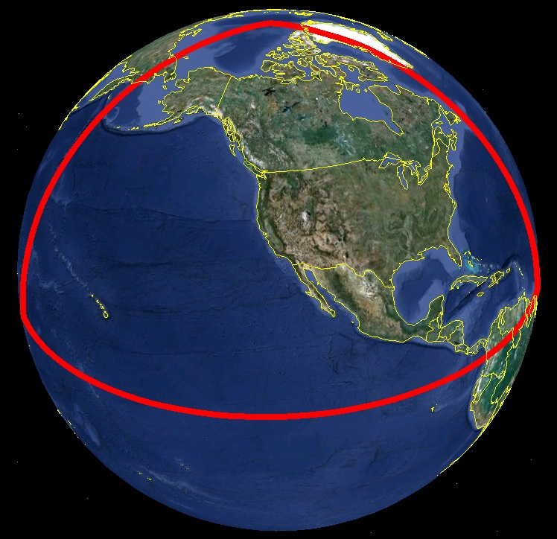
Extent of 2022 gravimetric geoid model used for NAPGD2022

Slide 34
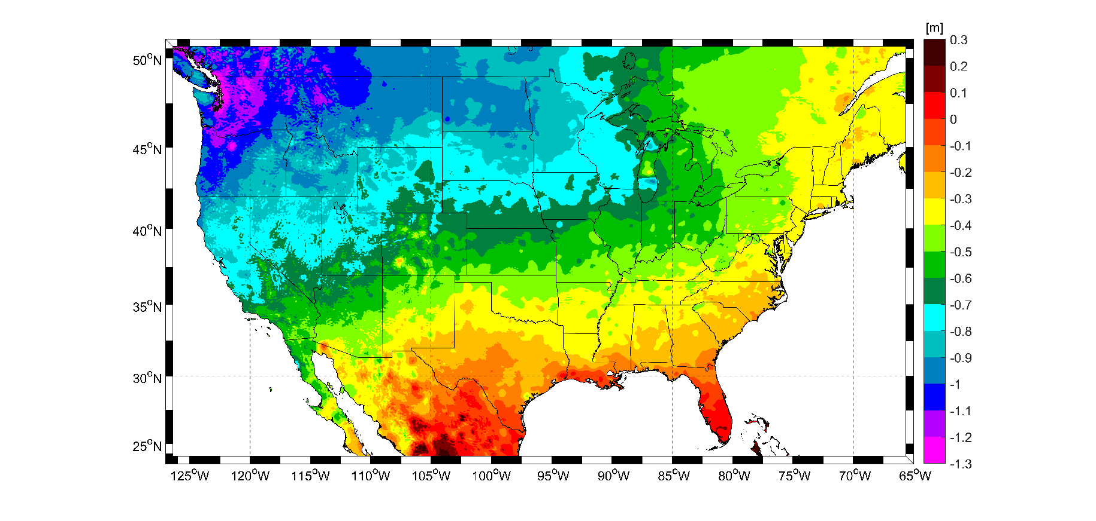
Expected changes to orthometric heights – NAVD88 to NAPGD2022
For Florida = 0.1 > -0.3 m (4 > -11 in.)

Slide 35
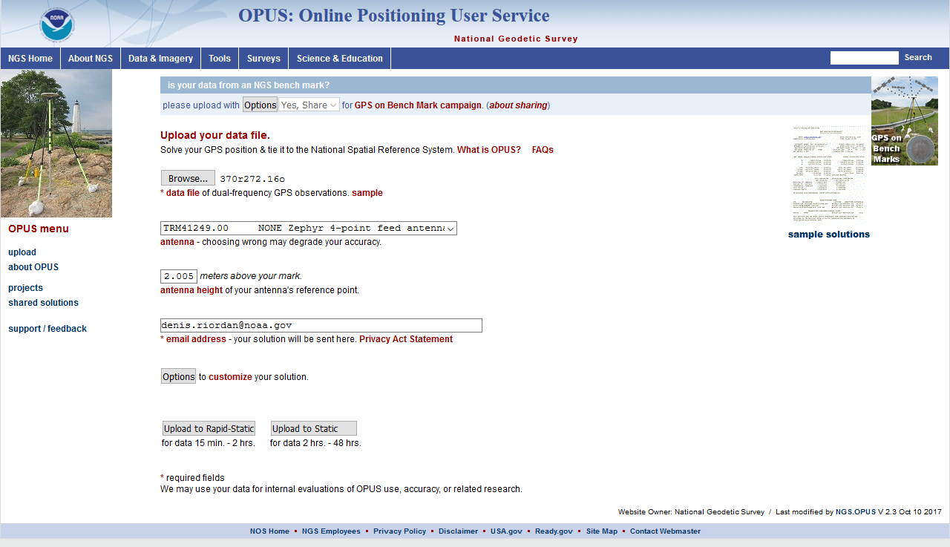
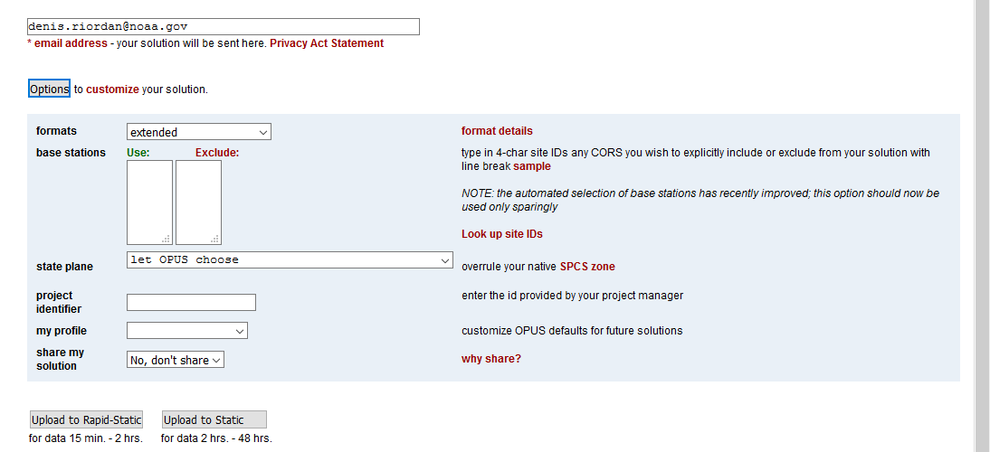

Slide 36
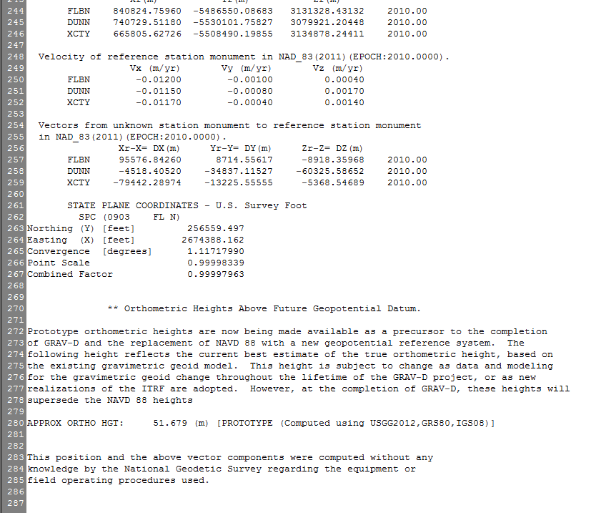

Slide 37
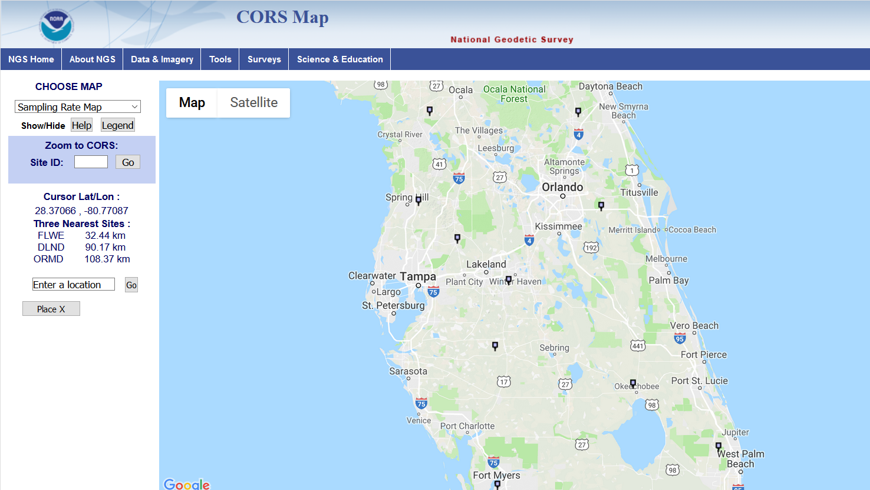
Vertical Shifts (BETA)
ZEFR
-1.02 IN.
WACH
0.35 IN.
OKCB
0.83 IN.

Slide 38
How to Plan for 2022
Move to newest realizations
  NAD 83(2011) epoch 2010.00
  GEOID12B (hybrid geoid)
Move to NAVD 88
  understand the accuracy of VERTCON in your area
Utilize passive marks that are up to date
  Stay aware of what marks are included in datum updates
  Use OPUS & Hgt. Mod procedures to update mark positions
Metadata
  Document positions in current datums to know what you have in the future.
NGS Outreach Efforts
  Participate in NGS webinars, Geospatial summits, contact NGS Regional Advisor, etc.
GEOID 18 (hybrid geoid)

Slide 39
NGS Products Update
Coordinate Conversion and Transformation Tool – NCAT using NADCON v5.0

Slide 40
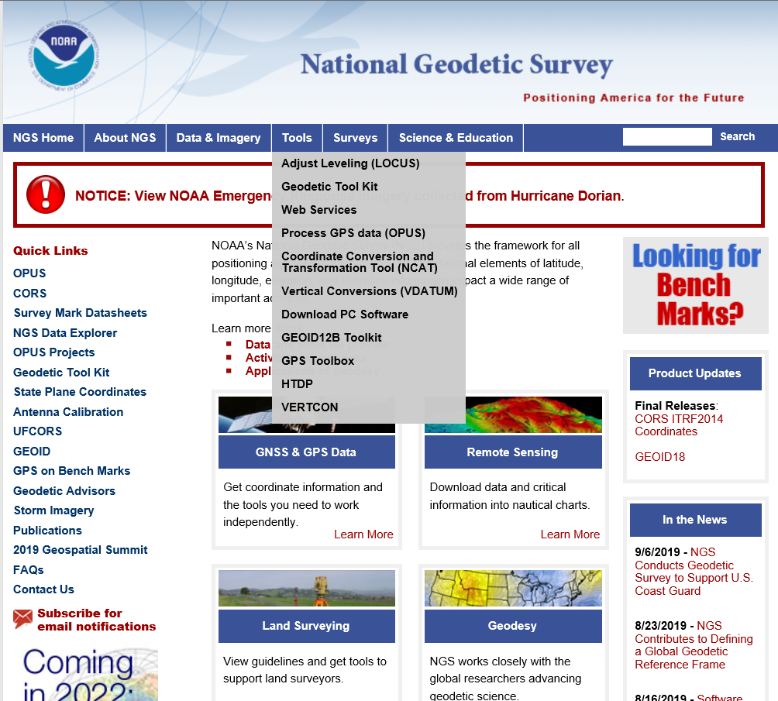
NGS Products Update - NCAT

Slide 41
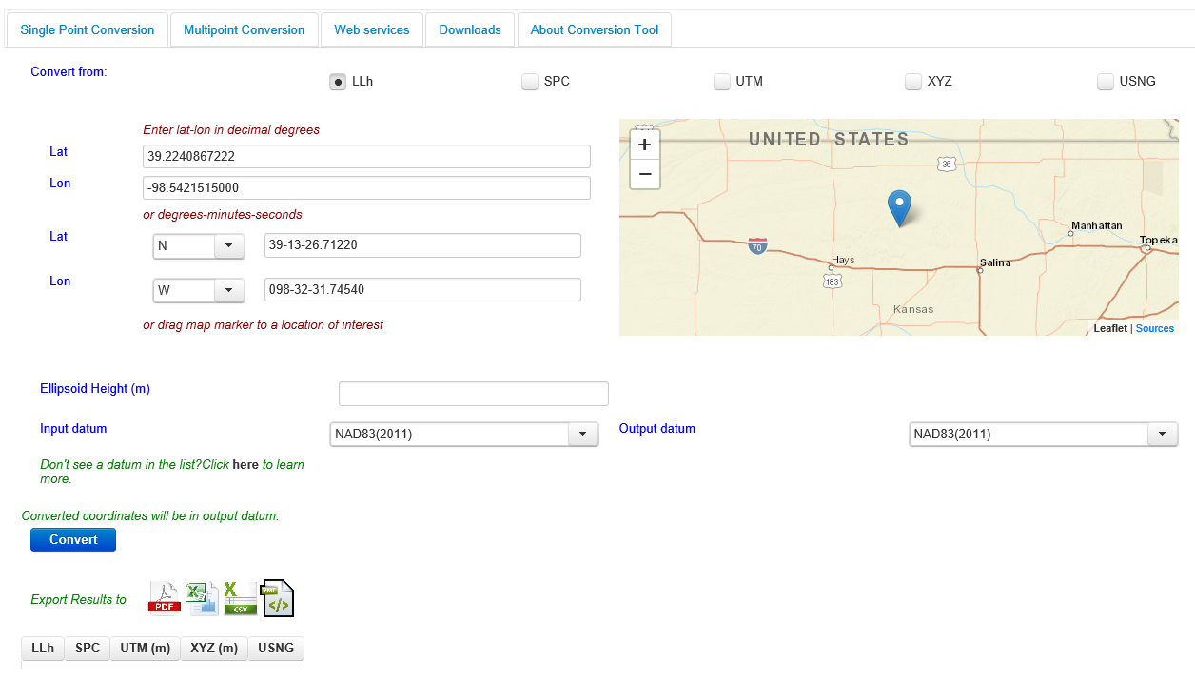
NGS Products Update - NCAT

Slide 42
X, Y, Z
φ, λ, h
φ, λ, h
Region: CONUS
2022
X, Y, Z
SPC
UTM
USSD
USNG
UTM
φ, λ, h
GEOCON 11
φ, λ, h
NAD 27
NAD 83 (2011)
X, Y, Z
SPC
X, Y, Z
SPC
USNG
UTM
NADCON
GEOCON
USNG
UTM
NAD 83 (NSRS2007)
φ, λ, h
NAD 83 (1986)
φ, λ, h
NAD 83 (FBN)
NAD 83 (HARN)
φ, λ, h
X, Y, Z
SPC
X, Y, Z
SPC
φ, λ, h
USNG
UTM
USNG
UTM
X, Y, Z
SPC
X, Y, Z
SPC
USNG
UTM
USNG
UTM

Slide 43
X, Y, Z
φ, λ, h
φ, λ, h
Region: CONUS
2022
X, Y, Z
SPC
UTM
USSD
NCAT (NADCON 5)
USNG
UTM
φ, λ, h
φ, λ, h
NAD 27
NAD 83 (2011)
X, Y, Z
SPC
X, Y, Z
SPC
USNG
UTM
USNG
UTM
NAD 83 (NSRS2007)
φ, λ, h
NAD 83 (1986)
φ, λ, h
NAD 83 (FBN)
NAD 83 (HARN)
φ, λ, h
X, Y, Z
SPC
X, Y, Z
SPC
φ, λ, h
USNG
UTM
USNG
UTM
X, Y, Z
SPC
X, Y, Z
SPC
USNG
UTM
USNG
UTM

Slide 44

? ? QUESTIONS ? ?
Denis.Riordan@noaa.gov

