Slide 1
Current State of Surveying in Civil Engineering Programs in the United States
-Daniel Gillins, Michael Olsen

Slide 2
For more details, a paper is available…
Gillins, D.T., Olsen, M.J., and Schultz, R.J. (2017). “The Current State of Surveying Education within Civil Engineering Programs in the United States,” Surveying and Land Information Science, Vol. 76, No. 1, pp 5-15.

Slide 3
Introduction
Surveying engineering has traditionally been closely tied with civil engineering
In 1937, average number of semester credits for surveying in a civil engineering degree was 14.3 (McNair 1964)
By 1960s, civil engineering students were only required to take 5.5 semester credits, on average (Brown 1966)
Decline blamed on engineering accreditation boards that started in 1932 which required more courses in science, math, humanities rather than surveying

Slide 4
Objectives
Determine how many credits each ABET-accredited, 4-year civil engineering program in U.S. requires in surveying
Document how many surveying courses are offered as an elective
Find civil engineering programs that offer surveying as an emphasis area
Identify graduate civil engineering programs where graduate-level surveying courses are offered

Slide 5
Methodology
From May to June 2015, researched the course offerings of all 239 ABET-EAC-accredited, 4-yr civil engineering programs
Program web sites
Curriculum flow charts
General catalogs
Class schedules
Developed a database that documented for each surveying course:
Catalog number and title of course
Name of department offering course
Required vs. elective
Number of credits (broken into lecture vs. lab)
Instructor’s name and e-mail address (if available)

Slide 6
Methodology Continued
Counted Surveying Courses:
Course with “surveying” in title
Photogrammetry
GPS
Boundary Law
Land Subdivision
Courses where CAD and GIS were integrated with surveying
Standalone CAD or GIS courses were not counted
Credits normalized to semester units
221 of 239 (92.5%) of programs on semester college system

Slide 8
Limitations and Assumptions
Some program’s websites appeared out-of-date
Some websites were difficult to understand or had sparse information
May have missed courses that are offered irregularly
No information on enrollment or class size

Slide 9
Required Surveying Courses in Civil Engrg.

Slide 10
Year Required Surveying Courses are Taught
70.0% are taught at the sophomore level
“Plane Surveying”
16.4% taught at junior and senior level combined

Slide 11
Required Surveying Courses – Lecture vs. Lab

Slide 12
Optional Surveying Courses (Electives)
85 (35.5%) programs do not require surveying
66 (27.6%) programs do not require nor offer surveying as an elective
Most programs do not offer surveying electives
Limited options to further surveying education
But, some programs (25) have many electives

Slide 13
Total Number of Available Semester Credits

Slide 14
Civil Engineering with Geomatics/Surveying Emphasis
25 programs list surveying/geomatics as a track or emphasis area
Some offer a minor or certificate in surveying
California State Polytechnic University, Pomona | South Dakota State University
California State University, Fresno | Southern Illinois University Carbondale
Florida Atlantic University | The Ohio State University
Kennesaw State University | The University of Akron
Louisiana State University and A&M College | University of Colorado Denver
Louisiana Tech University | University of Connecticut
Michigan Technological University | University of Kentucky
Montana State University – Bozeman | University of Maine
Ohio University | University of New Orleans
Oregon Institute of Technology | University of Puerto Rico, Mayaguez Campus
Oregon State University | University of Wyoming
Pennsylvania State University | Western Kentucky University
Purdue University
Notes:
Some of these programs offer significantly more than 9 credits in surveying
Asterisks (redt text) represent programs where the surveying courses are taught primarily outside of the Civil Engineering department (Fresno State is within its dept. but courses are taught by the geomatics engineering professors) Blue text are for civil engineering departments with surveying degrees as a major

Slide 15
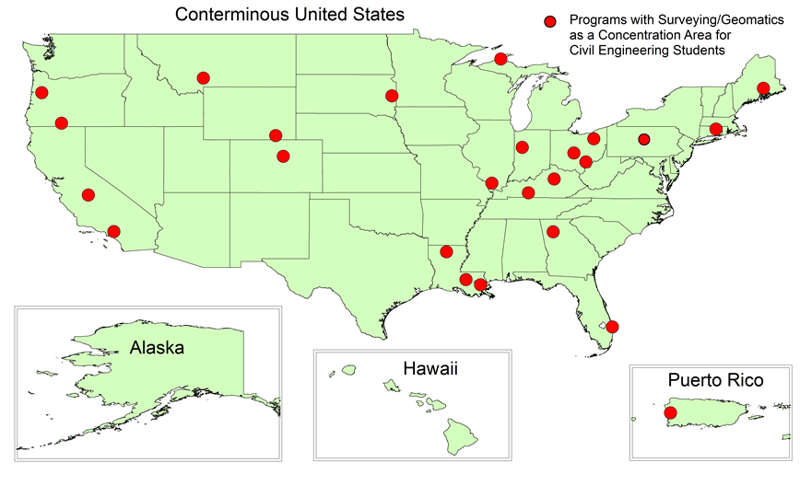
Programs with Surveying Option in Civil Engrg

Slide 16
Programs with Accredited 4-year Degree Related To Surveying

Slide 17
Graduate Civil Engineering Programs with Geomatics/Surveying Emphasis
University | M.Eng. | M.S. | Ph.D.
1. California State University – Fresno |  | X
2. Oregon State University | X | X | X
3. Purdue University |  | X | X
4. The Ohio State University |  | X | X
5. University of Colorado – Denver | X |  | X
6. University of Houston (geosensing) |  | X | X

Slide 18
Graduate Programs Outside of Civil Engineering
CE students could take graduate-level surveying/geomatics courses at these universities
University | PSM* | M.S. | Ph.D.
1. Michigan Tech. (Integrated Geospatial Technology; School of Technology) |  | X
2. University of Connecticut (Natural Resources; College of Agriculture) |  | X | X
3. University of Florida (College of Agriculture) |  | X | X
4. University of Maine (Surveying Engineering in the College of Engineering)* | X
* Professional Science Masters (PSM)

Slide 19
Additional Findings
Geographic Information Systems (GIS)
16 Civil Engineering Programs require a course in GIS
52 total programs have GIS as a requirement or as an elective course in their curriculum
Building Information Modeling (BIM)
2 Civil Engineering Programs require a course in BIM
7 total programs have BIM as a requirement or as an elective course in their curriculum

Slide 20
Summary
64.4% of ABET-EAC Civil Engineering programs require at least 1 course in surveying
Median of 3 semester hours (in 1966 it was 8.2 hours)
Median of 2 hours of lecture and 3 hours of lab work per week
Generally sophomore-year
Few additional courses offered in most programs
72.4% of programs require or offer as an elective at least 1 course in surveying
10.5% (25) of programs offer surveying as an emphasis or concentration area

Slide 21
Future Work
What is taught in these required surveying courses?
What should be taught?
Who is teaching the surveying courses?
Adjuncts?
Lecturers?
Tenured or tenured-track professors?
Licensed surveyors?

Slide 22
Acknowledgements
Professor Robert Schultz, Oregon State University
Dr. Tracy Arras, Dr. Chris Parrish, Oregon State University
Graduate students in the civil engineering (geomatics) program at Oregon State University

