Slide 1
The U.S. National Spatial Reference System in 2022
Daniel R. Roman, (Chief Geodesist)
NOAA’s National Geodetic Survey

Slide 2
Outline
Why change?
Naming conventions of NSRS 2022
Geometric component
Regional Terrestrial Reference Frames
Intra Frame Velocity Models
Geopotential component
Static
Time-varying
Future Plans and Summary

Slide 3
NGS Vision
Everyone accurately knows where they are and where other things are anytime, anyplace.
NGS 10 Year and Strategic Plans provide a more detailed description of NGS and the vision for the future looking ten years out.

Slide 4
Replace NAD 83
Simplified concept of NAD 83 vs. “2022”
Earth’s Surface
h_{”2022”}
h_{NAD83}
φ_{NAD83} – φ_{”2022”}
λ_{NAD83} – λ_{”2022”}
h_{NAD83} – h_{”2022”}
all vary smoothly by latitude and longitude
“2022” origin
~2.24 m
NAD 83 origin

Slide 5
Vertical Shifts
Ellipsoidal
Orthometric

Slide 6
Outline
Why change?
Naming conventions of NSRS 2022
Geometric component
Regional Terrestrial Reference Frames
Intra Frame Velocity Models
Geopotential component
Static
Time-varying
Future Plans and Summary

Slide 7
NSRS Modernization
The Old:
NAD 83(2011)
NAD 83(PA11)
NAD 83(MA11)
The New:
The North American Terrestrial Reference Frame of 2022
(NATRF2022)
The Caribbean Terrestrial Reference Frame of 2022
(CTRF2022)
The Pacific Terrestrial Reference Frame of 2022
(PTRF2022)
The Mariana Terrestrial Reference Frame of 2022
(MTRF2022)

Slide 8
NSRS Modernization
The Old:
NAVD 88
PRVD 02
VIVD09
ASVD02
NMVD03
GUVD04
IGLD 85
IGSN71
GEOID12B
DEFLEC12B
Orthometric
Heights
The New:
The North American-Pacific Geopotential Datum of 2022 (NAPGD2022)
- Will include GEOID2022
Normal
Orthometric
Heights
Dynamic
Heights
Gravity
Geoid
Undulations
Deflections of
the Vertical

Slide 9
NSRS Modernization
The Old:
Bluebooking
(PAGES, ADJUST, B files, G files, FORTRAN)
The New:
OPUS-Projects for Everything
GPS
Leveling
Traverse
Gravity
RTK/RTN
More?

Slide 10
Outline
Why change?
Naming conventions of NSRS 2022
Geometric component
Regional Terrestrial Reference Frames
Intra Frame Velocity Models
Geopotential component
Static
Time-varying
Future Plans and Summary

Slide 11
Replacing the NAD 83’s
Three plate-(pseudo)fixed frames will be replaced with four plate-fixed reference frames
N. Amer., Pacific, Mariana, Caribbean(new!)
Remove long-standing non-geocentricity of NAD 83 frames
All four : identical to IGSxx at a TBD epoch
2020.00?
All four : differ from IGSxx by plate rotation only
Updated Euler Pole determination for rigid plate only

Slide 12
Plate-(pseudo)fixed frames
NAD 83(2011) minus NAD 83(NSRS2007)
NAD 83(NSRS2007)
Epoch 2002.0
NAD 83(2011)
Epoch 2010.0
If NAD 83 were truly “plate
fixed” then an 8 year
epoch change would not
yield the systematic
plate rotation seen here.
(*)TRF2022 will determine
a new Euler Pole rotation
for each of 4 plates.
(*)=NA, C, T or P

Slide 13
Four Frames/Plates in 2022
Previous NGS frames (Snay 2003)
North America
Pacific
Mariana
Caribbean will be treated as 4th frame

Slide 14
Each frame will get 3 parameters
Euler Pole Latitude
Euler Pole Longitude
Rotation rate (radians / year)
This will be used to compute
time-dependent TRF2022
coordinates from time-dependent
IGS coordinates.

Slide 15
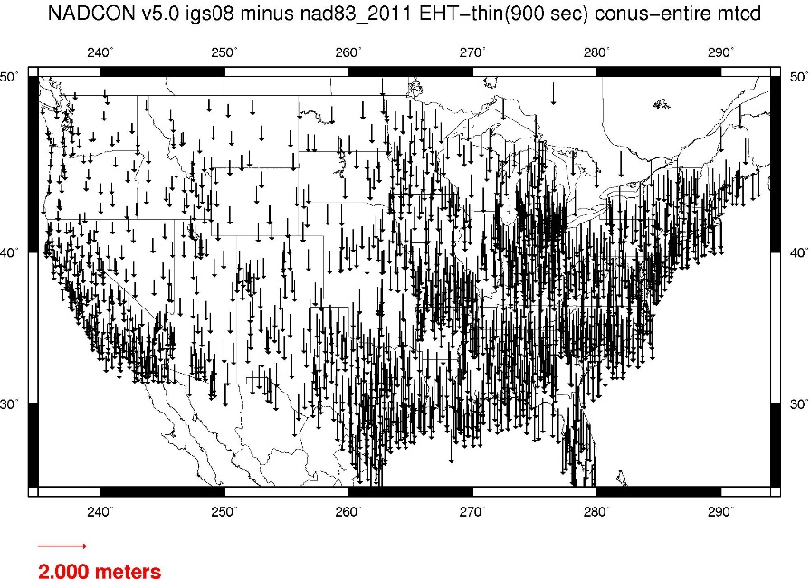
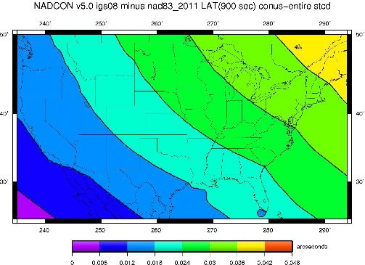
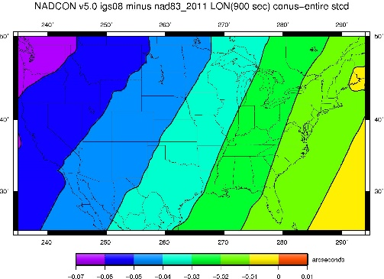
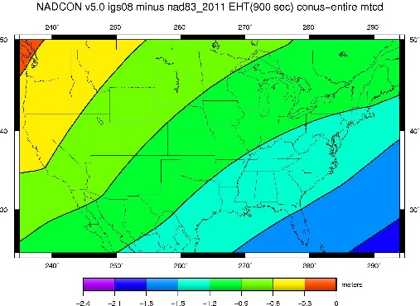
Fixed-Epoch Transformation NAD 83 to “2022”

Slide 16
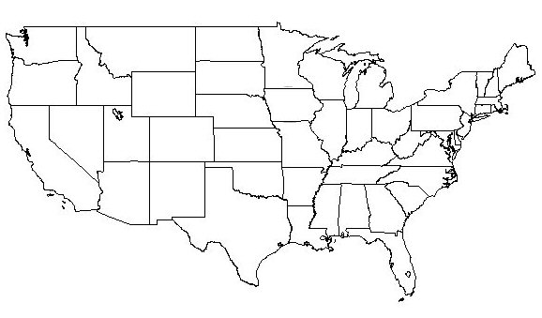
NATRF2022 frame is rigid and fixed to rigid part of the N.A. plate
Non-rigid part of the N.A. plate
(deformation)
area

Slide 17
Outline
Why change?
Naming conventions of NSRS 2022
Geometric component
Regional Terrestrial Reference Frames
Intra Frame Velocity Models
Geopotential component
Static
Time-varying
Future Plans and Summary

Slide 18
So if not HTDP, then what?
NATRF2022 would account for most horizontal velocity over time
Remaining signal typically modeled by HTDP (now)
In future, a TBD velocity model would be applied to account for that and vertical
The simplest solution is gridded CORS velocities

Slide 19
Horizontal velocities after Repro1
Note scale difference between West (10 mm/yr) and east (2 mm/yr)

Slide 20
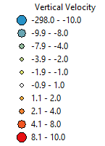
CORS Implied Vertical Velocities - Control
Courtesy Galen Scott

Slide 21
CORS Implied Vertical Velocities – Heat Map
Courtesy Galen Scott

Slide 22
How to use this information?
Assuming CORS spacing is sufficient – grid
Yields horizontal (NEV & GIA) plus vertical signal
Vertical important for orthometric heights:
H^{t} = (h^{t0} + (t-t₀)*dh/dt) - (N^{t0} + (t-t₀)*dN/dt)
Where H^{t} is orthometric height at desired time
h^{t0} is ellipsoidal height at epoch (maybe 2020.0)
N^{t0} is geoid height at epoch
dh/dt is change in ellipsoid height over time
dN/dt is change in geoid height over time

Slide 23
What if this isn’t enough?
Will investigate sufficiency of gridded CORS
Concern is dynamic areas: horizontal & vertical
Will look at other models to evaluate
Cost versus benefit
What we can easily do in-house and support
increased complexity from outside models
Alternatively, users can model their own …

Slide 24
Outline
Why change?
Naming conventions of NSRS 2022
Geometric component
Regional Terrestrial Reference Frames
Intra Frame Velocity Models
Geopotential component
Static
Time-varying
Future Plans and Summary

Slide 25
NAPGD2022
Begins with a 3-D global geopotential model
Then, derivative products are built
GEOID2022
DEFLEC2022*
NGRAV2022*
* Names not yet finalized

Slide 26
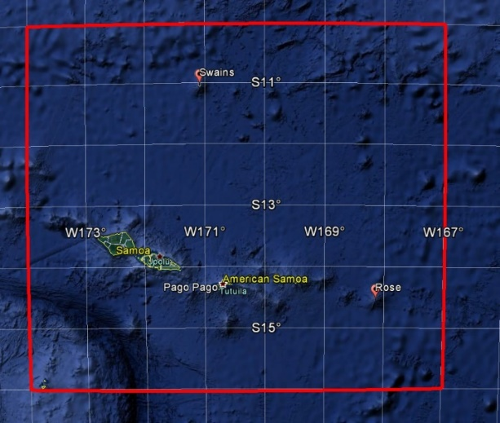
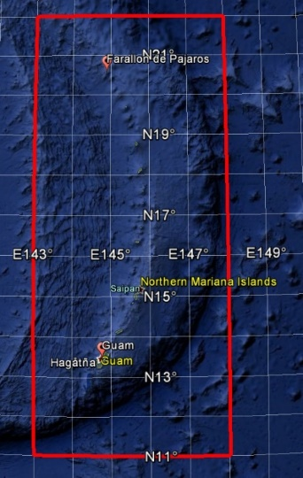
NAPGD2022
GEOID2022 (et al) over American Samoa:
-16 to -10, 186-193
GEOID2022 (et al) over Guam/CNMI:
11-22, 143-148
GEOID2022 (et al.) over the North America/Pacific/Caribbean/Central America/Greenland region will range from
0 to 90 latitude and from 170 to 350 longitude.

Slide 27
Outline
Why change?
Naming conventions of NSRS 2022
Geometric component
Regional Terrestrial Reference Frames
Intra Frame Velocity Models
Geopotential component
Static
Time-varying
Future Plans and Summary

Slide 28
NAPGD2022: Pre-decisional items
Three types of geoid change will be tracked
Size, Shape, Change to W0
Time/Space span evaluated for cost/benefit ratio
Examples:
Issue | Type of Change | Temporal Period | Temporal Duration of Geoid Change | Spatial Impact | Magnitude of geoid change | Decision
Accretion of Space Dust | Size | Secular | Permanent | Global | 4x10⁻⁷ mm / y | Ignore
Earthquakes | Shape | Episodic | Permanent-ish | Local | Can be as large as a few cm | Study further
GMSL rise | W0 value | Secular | Permanent | Global | 1.7 mm / y | Provide as optional correction

Slide 29
Time-Varying Geoid
GRACE/GFO
GeMS
Geoid Monitoring Service
Part of GRAV-D
Theresa Damiani, Ph.D. lead
SG and other meters to monitor select gravity BM’s
Supplements and validates satellite-derived models
GIA signals over Hudson Bay, Greenland, and Alaska
Figure 3 from
Tregoning et al.
(2009)
Non-Stationary
GRACE Signals

Slide 30
Outline
Why change?
Naming conventions of NSRS 2022
Geometric component
Regional Terrestrial Reference Frames
Intra Frame Velocity Models
Geopotential component
Static
Time-varying
Future Plans and Summary

Slide 31
Future Plans and Summary
IGS Stations => Foundation CORS (FCORS)
Sites collocated with other techniques (IERS)
Adopt some/build others/cover all plates
Foundation CORS => Regional CORS/Repro’s
Constrain Euler solutions/CORS positions to FCORS
Standing up IAG NA WG on Euler Pole
Forms four separate Frames

Slide 32
Future Plans and Summary
Models of Intraplate velocities (hor. & ver.)
Could be simply modeled from existing CORS
Density and quality of CORS impacts
GIA signal must be taken into account (hor. & ver. vel.)
Could be as complicated as Trans4D or equivalent
How to maintain?
Earthquakes? Re-surveys?
Orthometric heights in 2022: H(t) = h(t) – N(t) h(t) = survey epoch N(t) = N(t₀) +N (t – t₀)

Slide 33
To Learn More
Visit the New Datums web page
geodesy.noaa.gov/datums/newdatums/index.shtml

Slide 34
To Learn More
Attend the Geospatial Summit
Silver Spring, MD
April 24-25, 2017
FREE
geodesy.noaa.gov/geospatial-summit/index.shtml

Slide 35
Questions?

