Slide 1

State of NGS 2011
Marti Ikehara
California Geodetic Advisor
Marti.ikehara@noaa.gov
Sacramento, CA
http://www.ngs.noaa.gov/web/science_edu/presentations_archive
State of NGS Seminar, Riverside, CA, 2011

Slide 2
Table of Contents
NGS Priorities: CORS, OPUS, GRAV-D, Ht Mod
Update of activities within each Division
  Geodetic Services
  Spatial Reference System
  Remote Sensing
  Observations and Analysis
  Systems Development
  Geosciences Research
NGS as part of NOAA

Slide 3
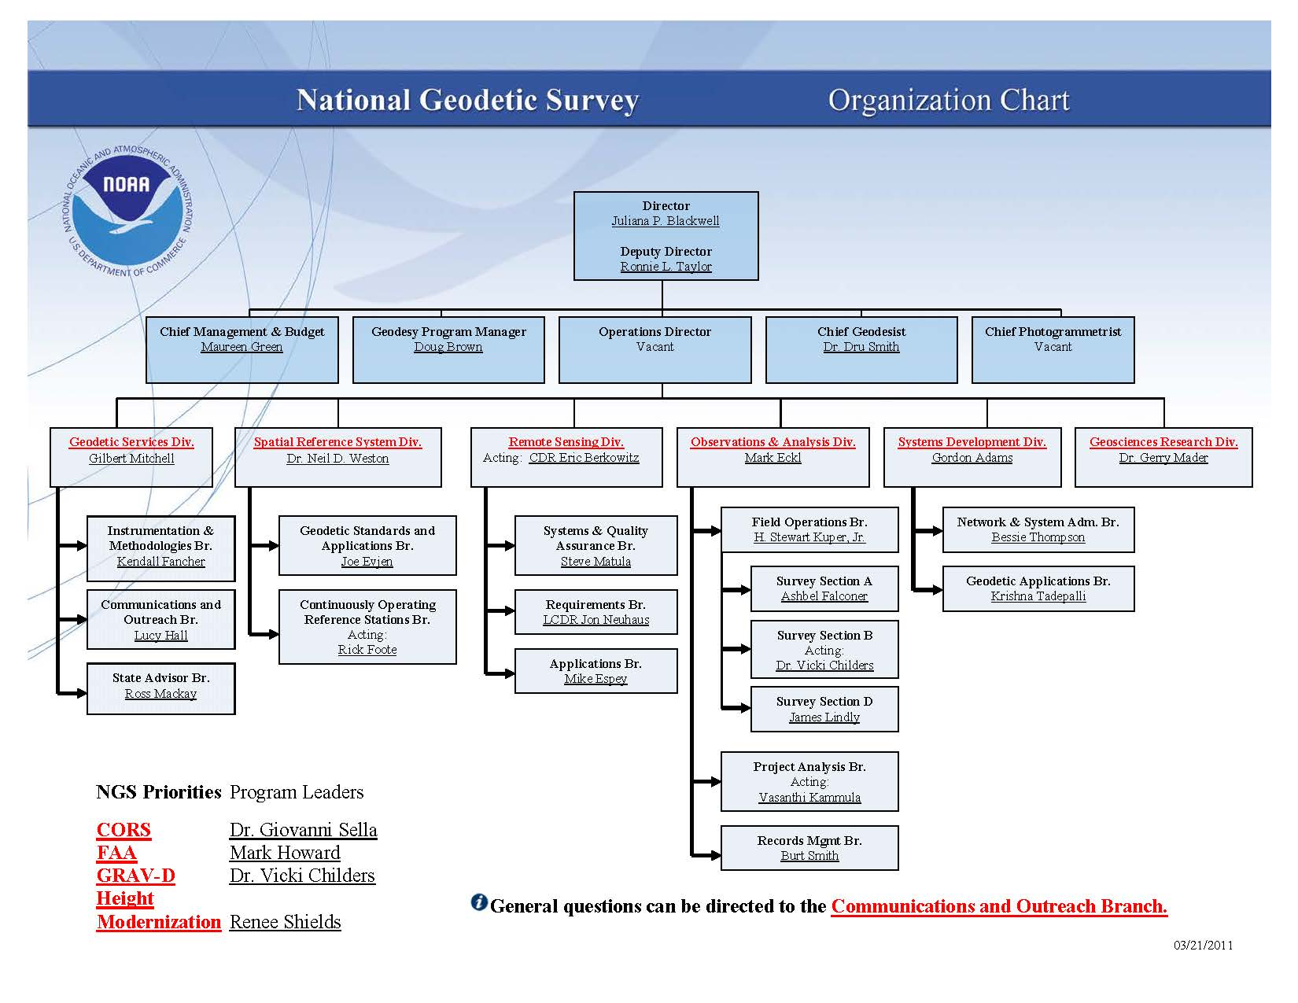

Slide 4
Profile of National Geodetic Survey
FTE Federal employees: 198
  26 State Geodetic Advisors + 1 Regional GA
  26 positions; 1 GA retired a month ago
  Majority of staff are in Silver Spring, MD; about 30 based at Field Office in Norfolk, VA; handful in Corbin, VA and handful in Boulder, CO; scattered GA’s and some others
FTE’s + Contractors = 247 staff
Budget: No formal FY11 budget right now
  Most recent base budget: $29 million

Slide 5
CORS: Continuously Operating Reference Stations (Giovanni Sella)
8 CGPS have recently (March) become CORS
P188 Annapolis, P300 Coalinga, P544 Lost Hills,
P558 Tehachapi, P565 Delano, P572 Badger,
P598 Big Bear, SIO3 La Jolla
P188 is in Mendo County, in the Coast Range
The 500-series PBO sites are all in So CA (462-654) ; a table of all PBO sites is at the link ‘GPS Coordinates’ on http://pbo.unavco.org/
SIO3 has a co-located met sensor

Slide 6
CORS Coordinate Update: Some History
‘Multi-year’ effort began 5 years ago
IGS proposed re-processing all data to re-compute station coordinates, orbits and EOPs from 1994-present
  MYCS positions were derived from the reprocessing of the full 16 year time series (1994-2010) and a rigorous stacking of weekly estimates in a fully consistent, global framework.
NAD 83 (2011) Epoch2010 .0 is a new realization of NAD 83 based on this NGS Multi-Year CORS Solution (MYCS)
Notes:
Intl GNSS Service, Earth Orientation Parameters

Slide 7
Why Reprocess?
Generate fully consistent orbits, EOPs and CORS+global station coordinates using latest models and methods—existing history is inadequate for modern realizations of TRFs
  much longer (double) data spans available
  consistency with use of absolute antenna calibrations in ITRF2008
  new network design—added redundancy
    Delaunay triangulation over global sites and CORS backbone
    tie remaining CORS to backbone CORS
  IERS 2003 conventions generally implemented
  updated model for station displacements due to ocean tidal loading
  updated models for troposphere propagation delays
  first attempt to obtain a full history of products in a fully consistent framework rather than piecemeal additions
Contribute NGS reprocessed orbits, EOPs and global SINEX files to International GNSS Service (IGS) repro1 campaign
Slide by J. Griffiths and the MYCS Team
Notes:
Earth orbit parameters; Intl Earth Rotation Service

Slide 8
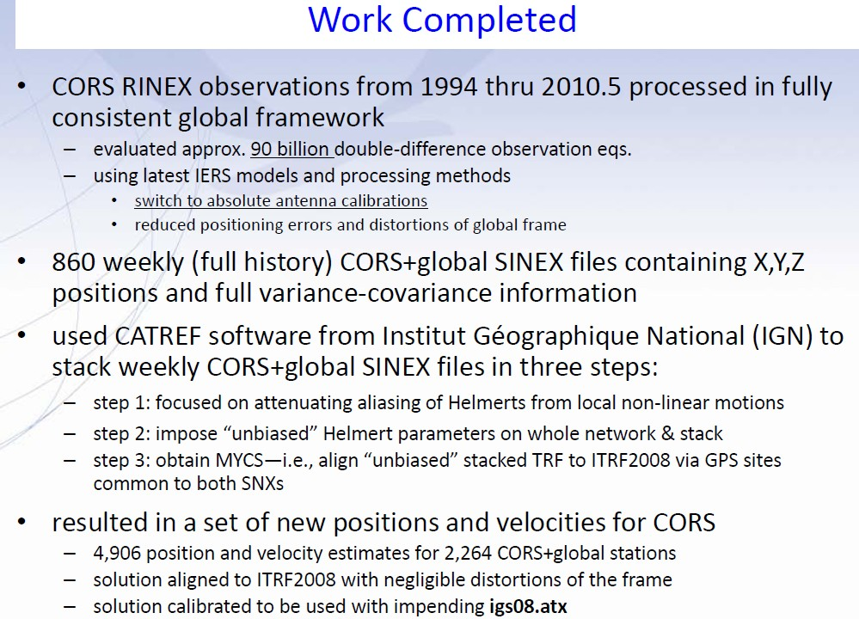

Slide 9
Frame Nomenclature and Characteristics
ITRF frame (global) multi-technique—vlbi, slr, doris, gnss
IGS frame (global) GNSS only
NAD frame (plate fixed) related to IGS
Frame Name Epoch Antenna PCV* Data Duration
ITRF2000 1997.0 Rel ANTEX 1994.0-2002.0
ITRF00 1997.0 RelNGS ANTEX 1994.0-present
NAD 83(CORS96) 2002.0 RelNGS ANTEX 1994.0-present
ITRF2008 2005.0 Abs IGS05 ANTEX 1997.0-2009.5
IGS08 2005.0 Abs IGS08 ANTEX 1997.0-2009.5
IGS08 2005.0 Abs IGS08 ANTEX 1994.0-2010.5 NGS
NAD 83 (2011) 2010.0 Abs IGS08 ANTEX 1994.0-2010.5 Products

Slide 10
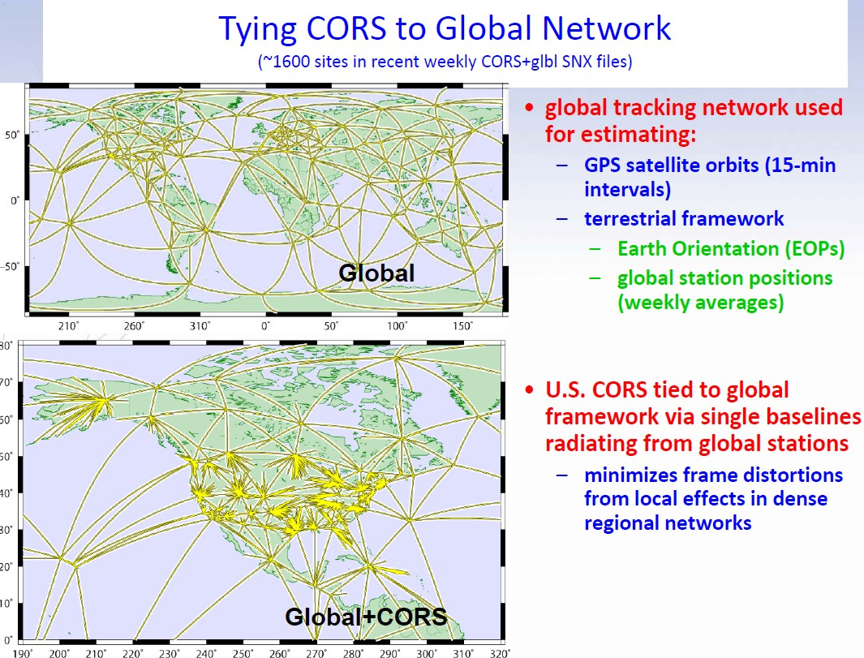
Slide by J. Griffiths and the MYCS Team

Slide 11
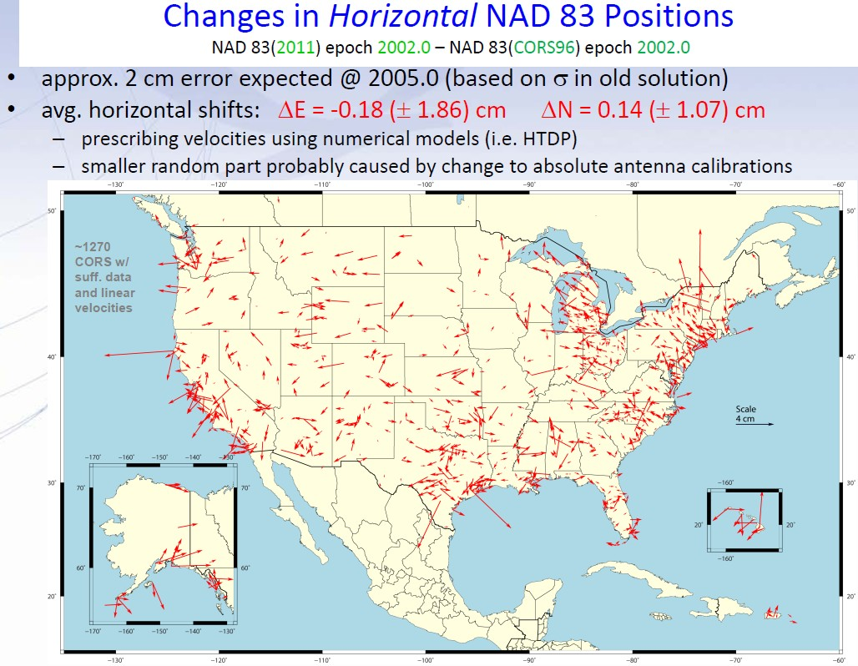

Slide 12
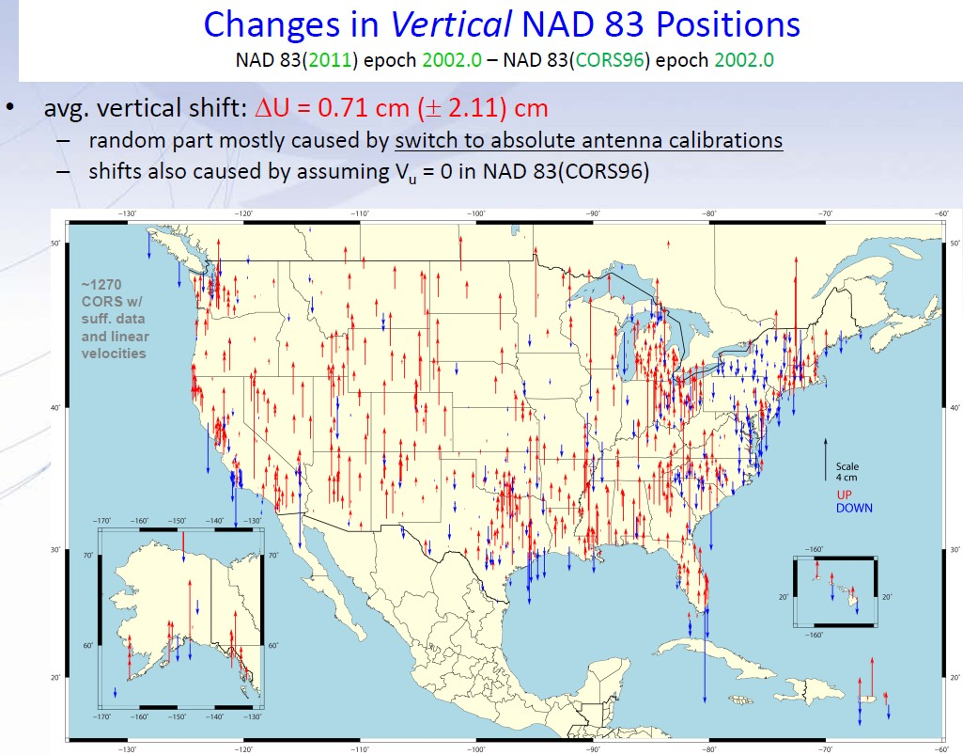

Slide 13
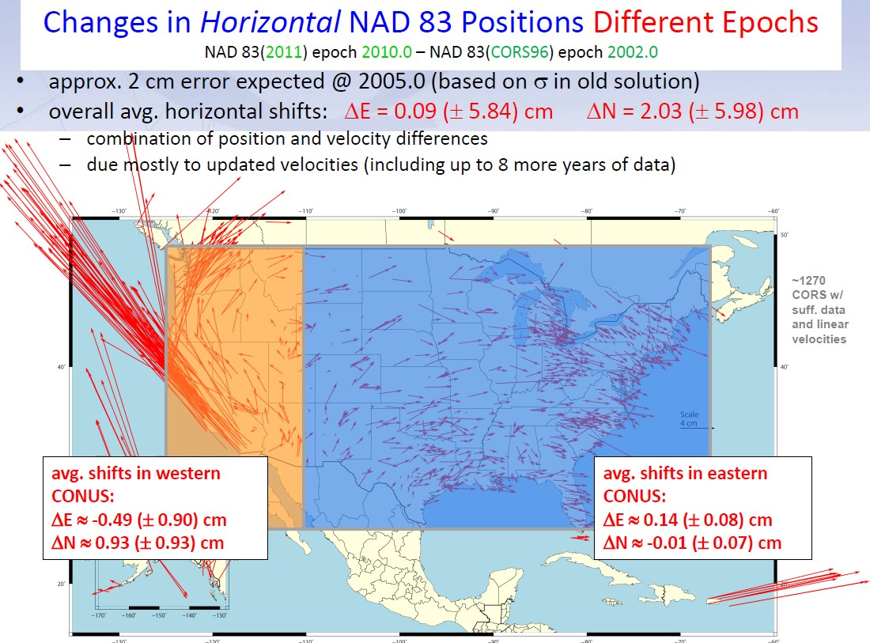

Slide 14
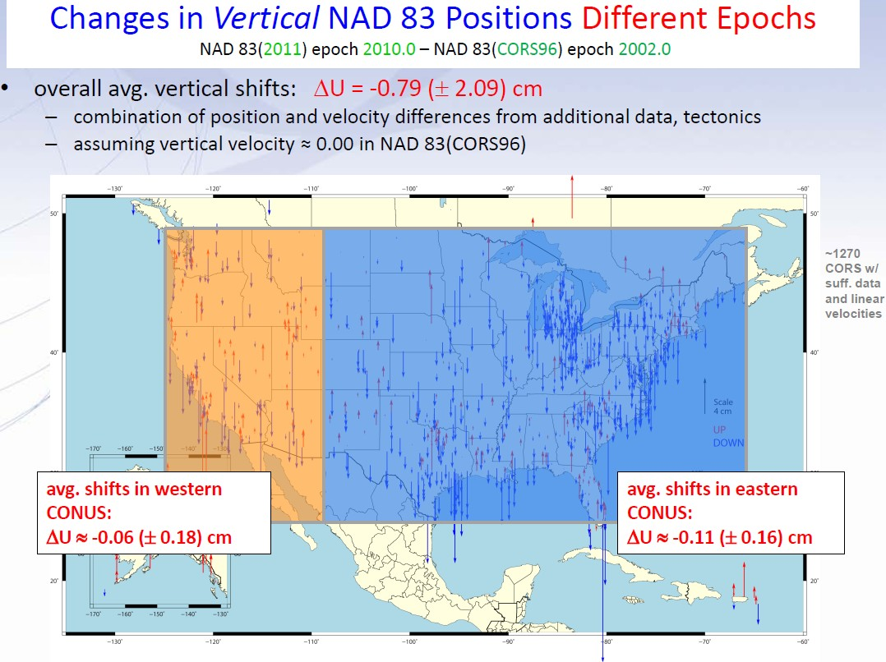

Slide 15
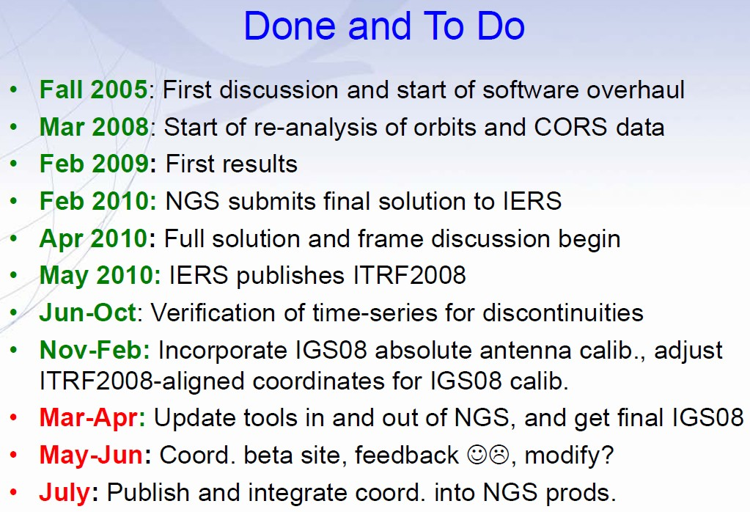

Slide 16
Key Changes With New CORS Solution
1 ppm scale change due to relative >> absolute antenna PCV
Distinction between computed (tracked) & modeled (HTDP) velocities must be maintained & emphasized ; OPUS might use only CORS with computed velocities- minimum 2.5 years history
NAD83 CORS (& OPUS) epoch changed from 2002.0 to 2010.0
New CORS coords to be released JULY, 2011; 2-month overlap
Likely readjustment of passive control & new hybrid geoid model
NO transformation model from old to new CORS coordinates
WEBINAR held March 8 available for download
Notes:
Phase Center Values

Slide 17
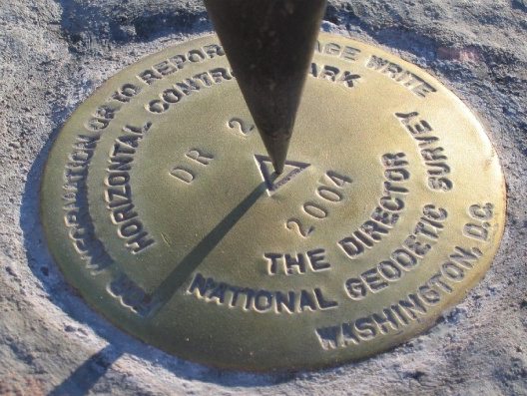
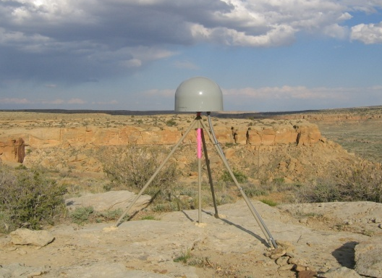
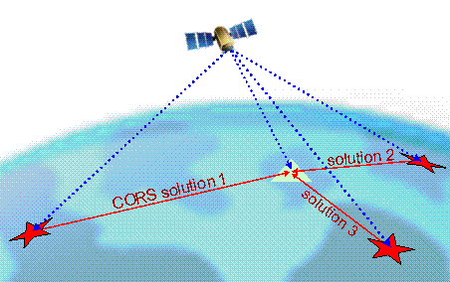
Online Positioning User Service (OPUS)
>15 min of L1/L2 GPS data >>> geodesy.noaa.gov/OPUS/
Processed automatically on NGS computers, tied to CORS
Solution via email - in minutes
Fast, easy, consistent access to NSRS

Slide 18
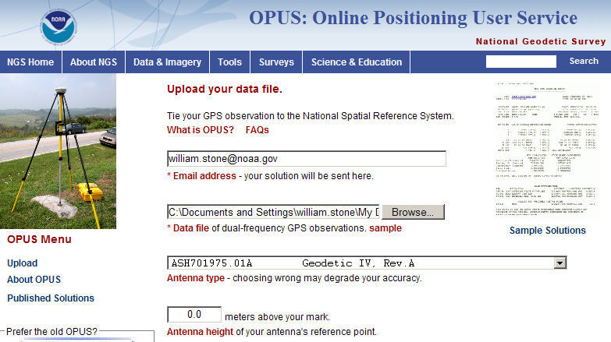
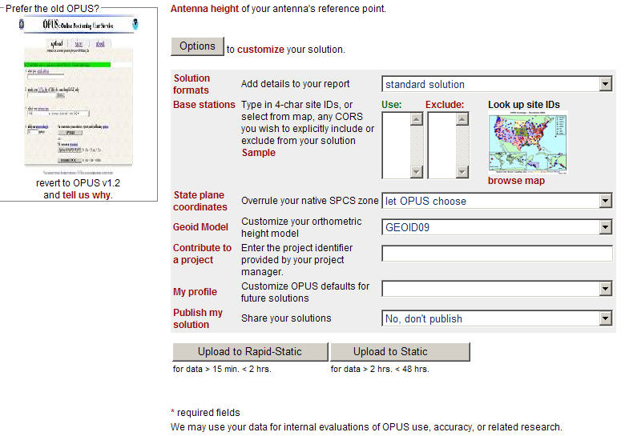
OPTIONS
extended solution
e-mail
in/exclude CORS
GPS file
SPC zone
antenna
geoid model – ‘03/‘09
antenna height
project
profile
publish
OPUS-RS or OPUS-Static
(15 min-2 hr) (2-48 hr)

Slide 19
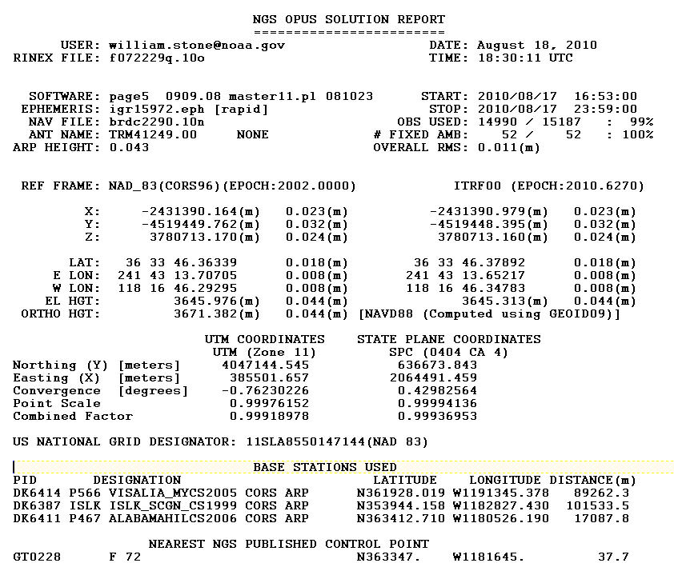
OPUS Solution Report
check your OPUS reports (March – August, 2010)
for incorrect accuracy estimate for Orthometric Height

Slide 20
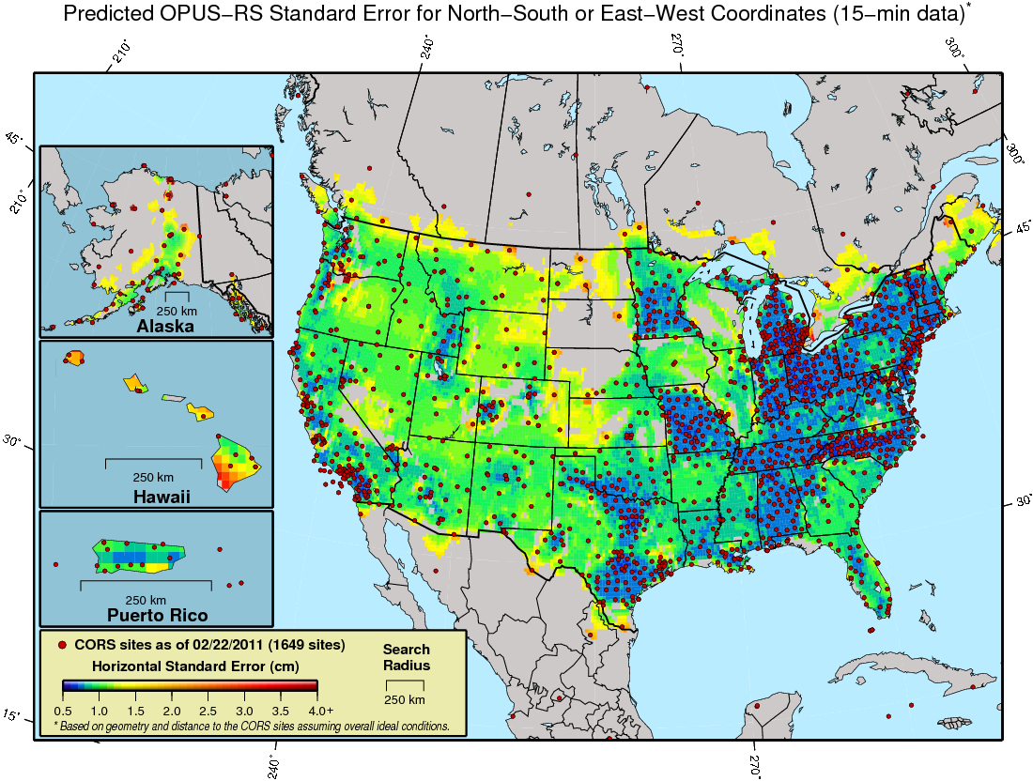
Predicted 15-minute OPUS-RS N/S or E/W Standard Error

Slide 21
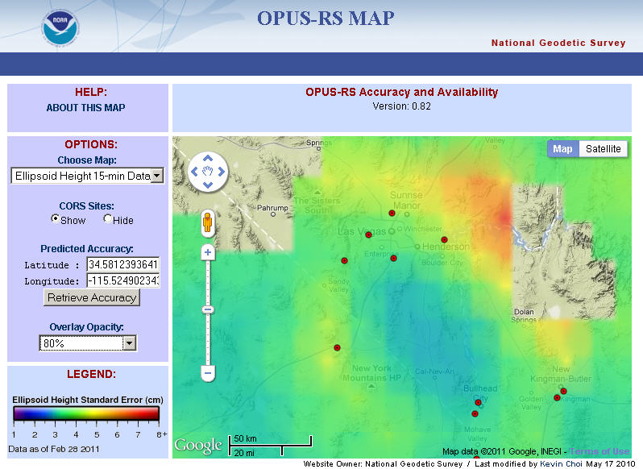

Slide 22
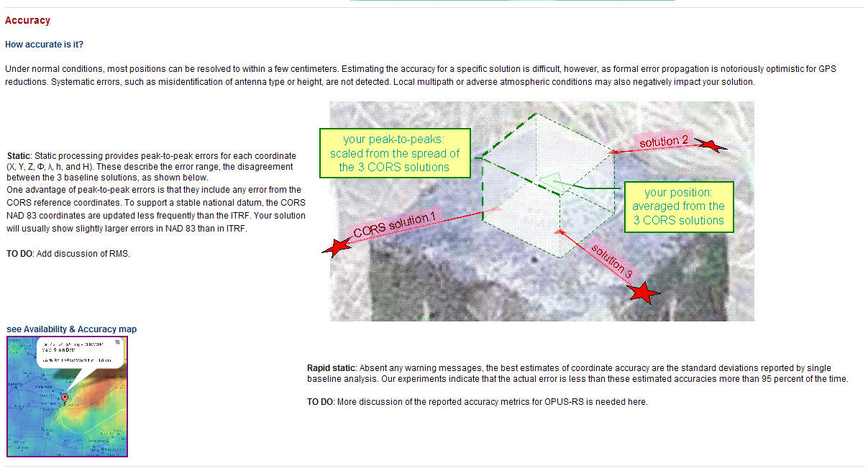
OPUS-RS Accuracy Map Tool –
Links on “About OPUS” Page & in CORS Newsletter

Slide 23
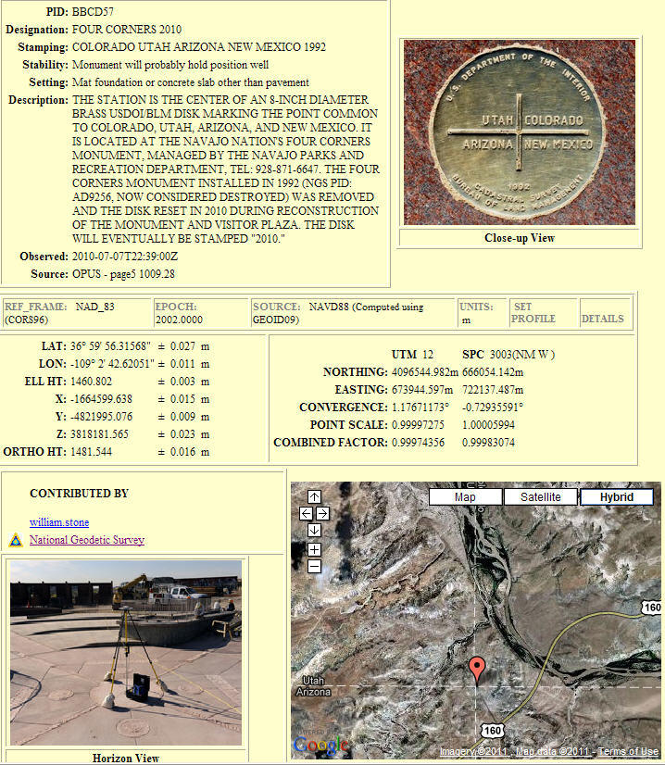
OPUS –
Datasheet Publishing
Publishing Criteria:
NGS-calibrated GPS antenna
> 4 hour data span
> 70% observations used
> 70% fixed ambiguities
< 0.04m H peak-to-peak
< 0.08m V peak-to-peak
Uses:
  GPS on BMs
  PLSS / GCDB
  Data archive
  Data sharing

Slide 24
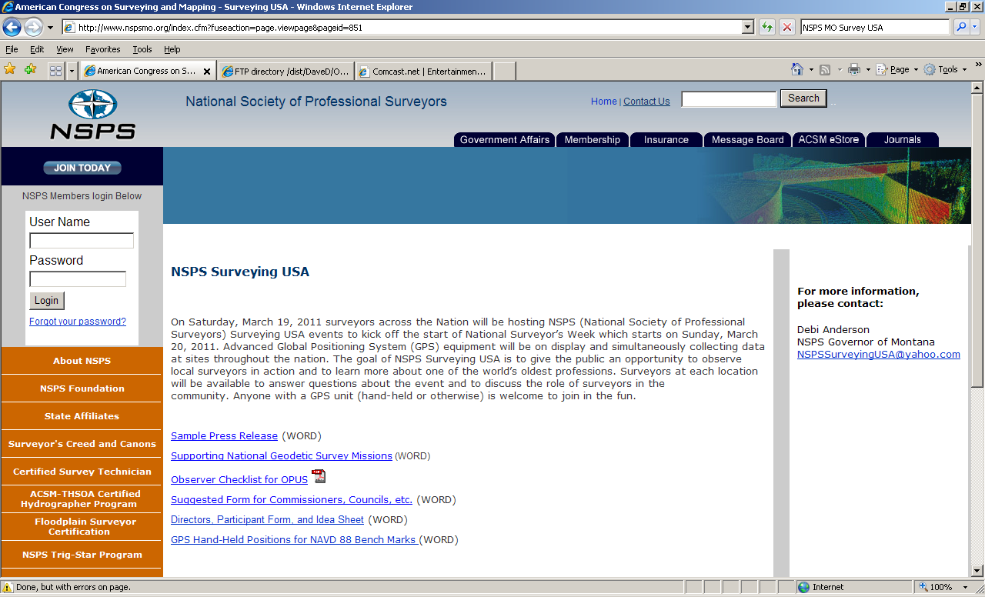
NSPSMO.org: Surveying USA, 3/19 could support NGS geoid modeling
Notes:
Give public an opportunity to observe surveyors in action and to learn about one of the world’s oldest professions.

Slide 25
NSPS Surveying USA or ANYTIME
NGS can use 4 hours DF at an ‘88 BM
Dual-frequency GPS for 4.25 hours
Where? Not at same nor rejected locations, unless ‘h’ is shown as reason (Col V)
  Review map(CA) and xls files on my web site (CGAR)
Looking for GPS ellipsoid height data at a BM that has a leveled NAVD88 height AND is not likely to have subsided since 1988 or level date
Data submitted to OPUS-DB can contribute to next iteration of NGS geoid model

Slide 26
GEOID09 published in Sept 09
In California, GEOID03 considered 567 bench marks with GPS data (ellipsoid heights), and kept 549
In GEOID09, there were 833 considered; 738 were included, a 36% increase from Geoid03

Slide 27
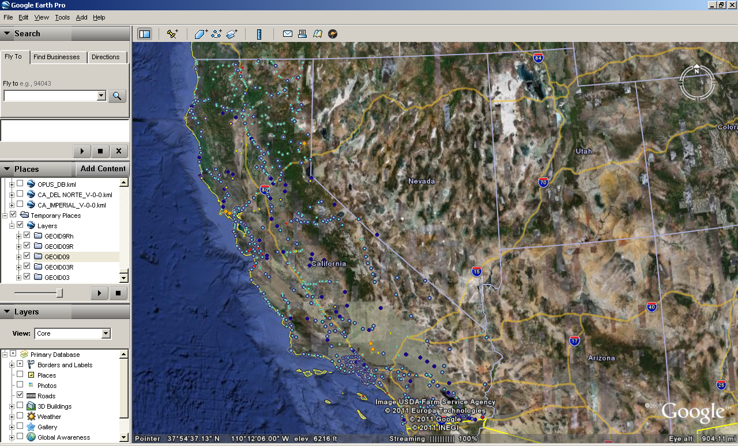

Slide 28
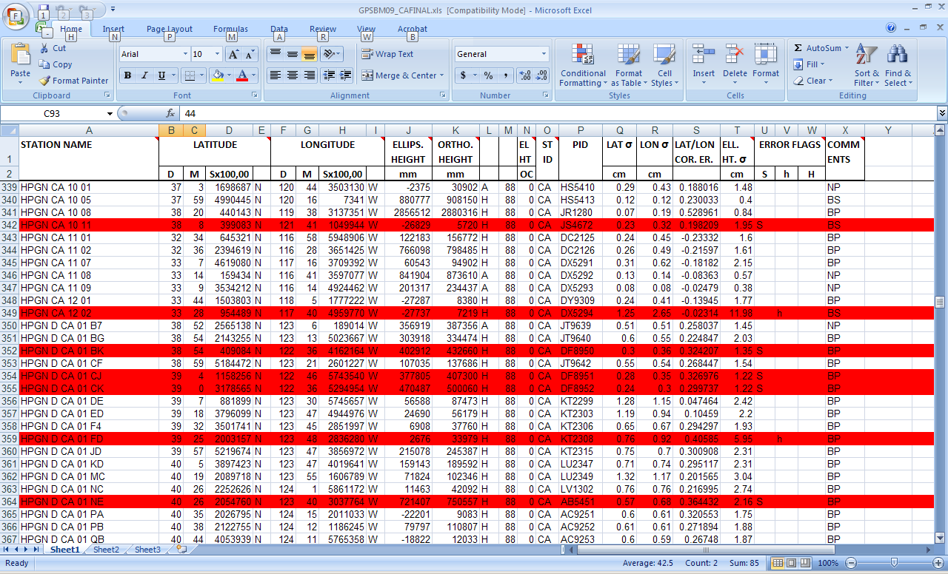
Notes:
Red are rejected; in this case, these were NOT NAVD88 level ties.

Slide 29
Surveying USA results shared on OPUS-DB
471 solutions processed for observations 3/19. Compared to the usual 1 out of every 100 submittals, 1 out of 8 submittals was published to OPUS. Some people are waiting (2 wks) for precise ephemerides to be available.
Suspect that weather—stormy day-- here in CA played a factor in lower quality solutions

Slide 30
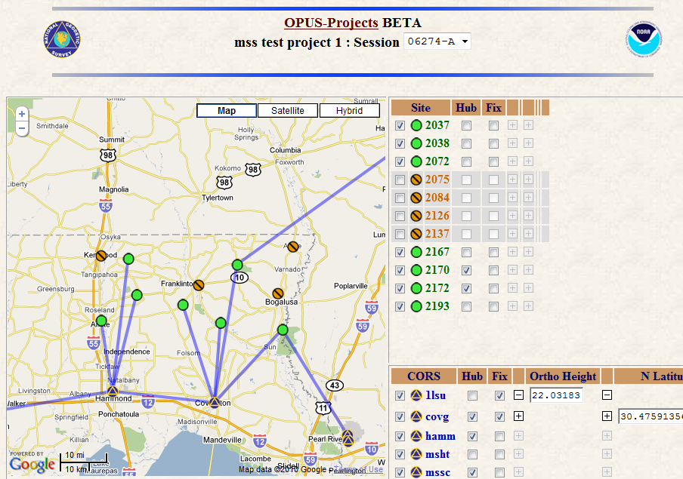
OPUS-Projects
project planning / monitoring
automated file management
review repeat measurements
reports sent to project managers
network adjustment
publish in NGS OPUS database without bluebooking for NGSIDB!
BREAKING NEWS!
Workshop in San Diego
@Courtyard, July 11-12—
post ESRI/ACSM dates
Under
Construction
Notes:
These are some of the properties of OPUS Projects

Slide 31
OPUS-Static vs. OPUS-Net
OPUS-Static
  U.S. CORS Network
  Fixed IGS ephemerides
    Computes independent double differenced baseline solutions between the unknown and 3 CORS
  Relative antenna models
  Phase ambiguity integer fixing
  Relative troposphere modeling
  ITRF2000 reference frame
  Average position solution
  Peak – Peak error reported
OPUS-Net
  U.S. CORS Network & IGS Global Network
  Network approach
    Consists of 3 nearby CORS + up to 12 CGPS from global IGS network
  Absolute antenna models
    SV & ground
  Ocean tidal loading model
  Satellite weighting
  Relative troposphere modeling
  ITRF2008 reference frame
  Weighted least squares adjustment
  Weighted mean and standard deviations reported at 95%
OPUS-net info courtesy of Dr. Neil Weston

Slide 32
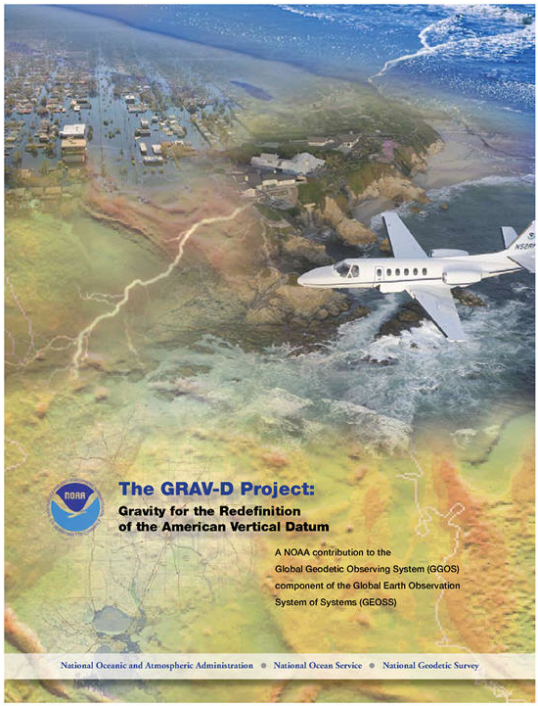
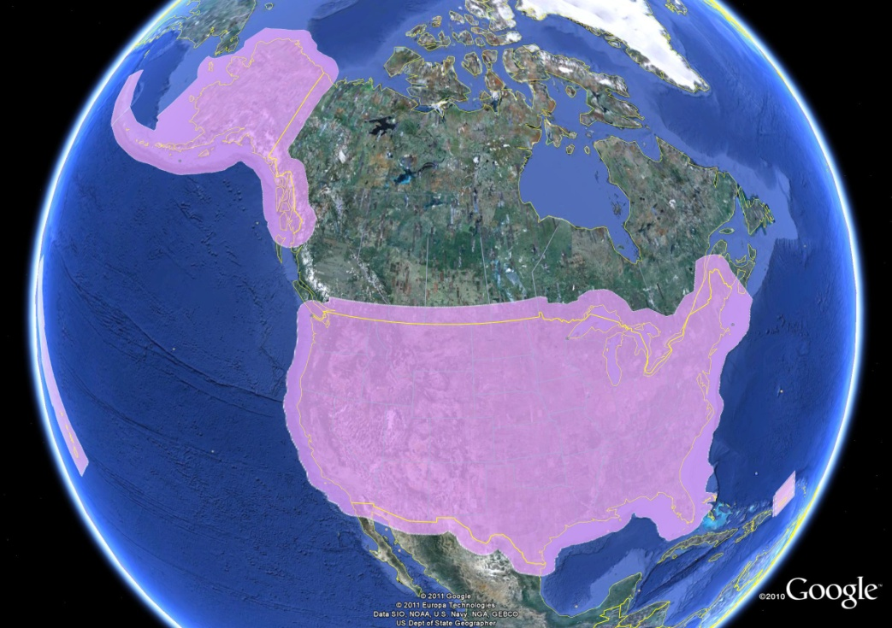
GRAV-D Project:
Gravity for the Redefinition of the
American Vertical Datum
(Vicki Childers)
Gravity and Heights are
inseparably connected
$38.5M
Airborne Gravity Snapshot
Absolute Gravity Tracking
Redefine the US
Vertical Datum by 2022

Slide 33
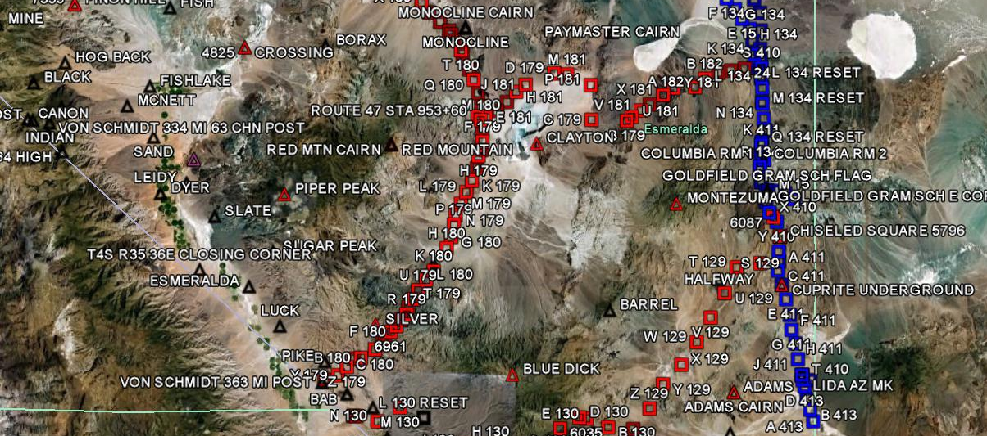
GRAV-D Goals (10-year plan)
2 cm accuracy orthometric heights -
  from GNSS (1 cm) + geoid model (1 cm)
fast, accurate, consistent orthometric heights -
everywhere—and anywhere-- in the USA

Slide 34

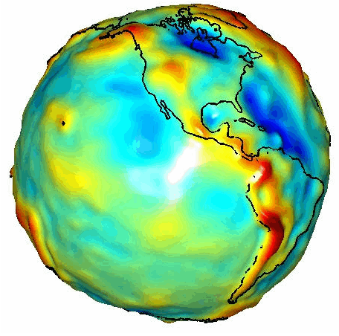
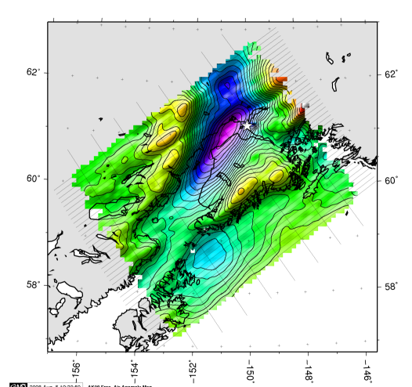
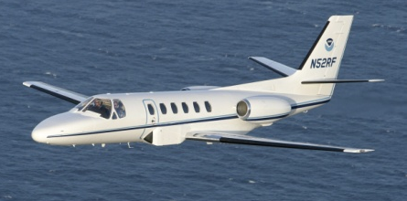
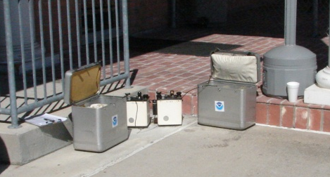
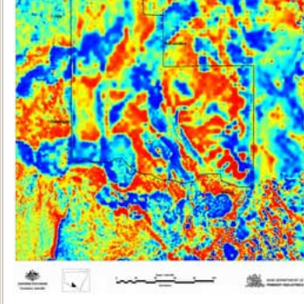
Building a Better Gravity Field (and geoid model)
Long Wavelengths
(≥ 350 km)
GRACE Satellite
GRAV-D >
Intermediate Wavelengths
(500 km to 20 km)
Airborne Measurement
Short Wavelengths
(< 200 km)
Surface Measurement

Slide 35
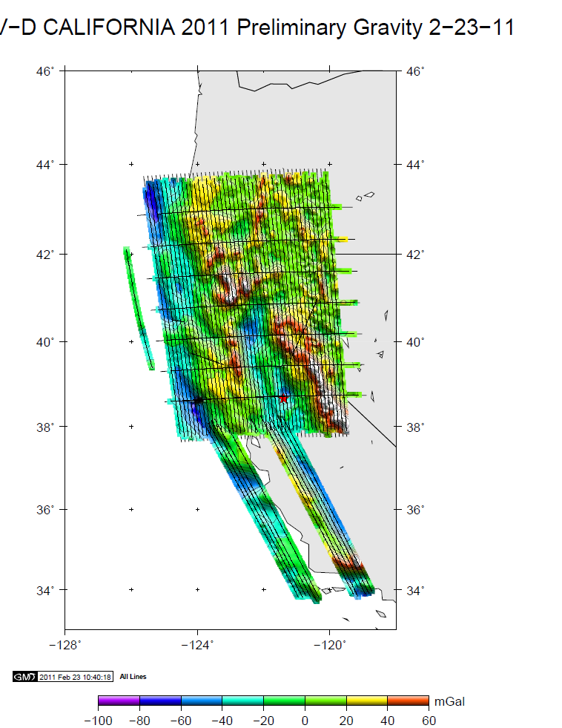
GRAV-D Survey in California, Jan-Feb 2011
Look for article written by Ikehara in next CA Surveyor issue
Notes:
The “tails” in central CA are data collected after the original data acquisition plan was completed ahead of schedule.

Slide 36

(Renee Shields)

Slide 37
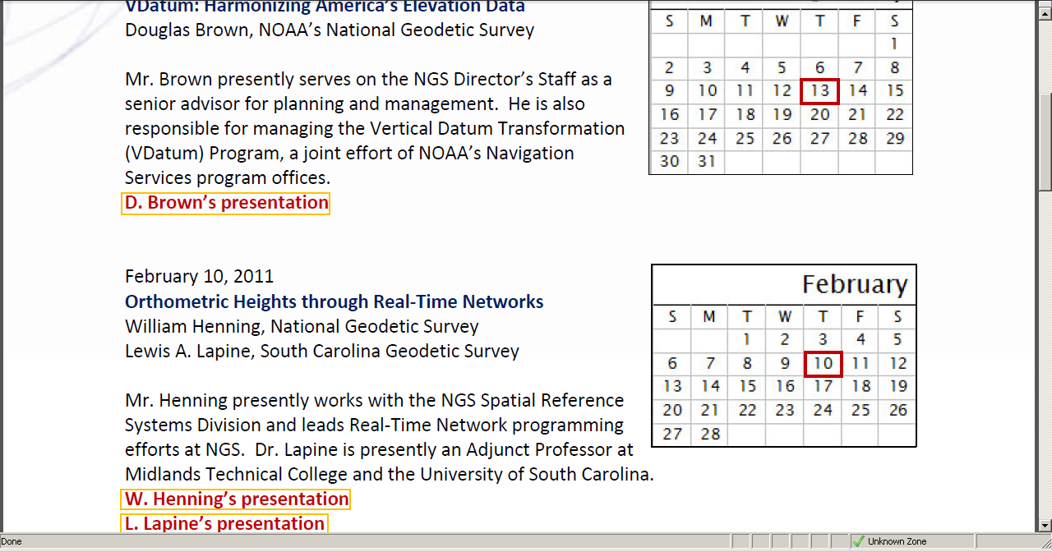

Slide 38
Table of Contents
NGS Priorities: CORS, OPUS, GRAV-D, Ht Mod
Update of activities within each Division
  Geodetic Services
  Spatial Reference System
  Remote Sensing
  Observations and Analysis
  Systems Development
  Geosciences Research
NGS as part of NOAA

Slide 39
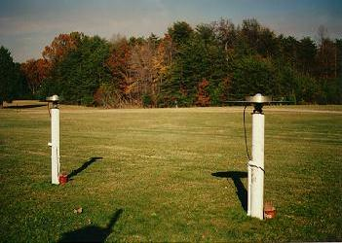
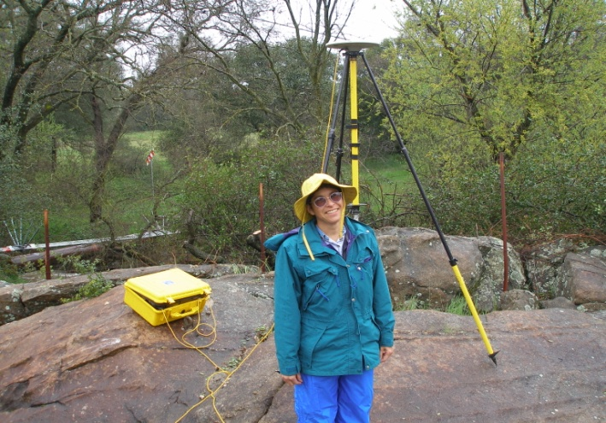
GEODETIC SERVICES DIVISION
Instrumentation and Methodologies
Branch
Communication and Outreach Branch
State Advisor Branch

Slide 40
Instrumentation and Methodologies Branch
Potential interference to GPS Spectrum
BACKGROUND
  On Jan. 26, LightSquared received FCC approval –a conditional waiver--to install a terrestrial communications service in the radio spectrum adjacent to GPS's L1 signal, on either side of it
  The company plans to build 40,000 ground stations to provide broadband 4G wireless service to cover 92% of the population—260 million people-- even in rural areas, by 2015 to support the National FCC Broadband Plan
  4G-LTE technology provides speeds up to 100 MB/second
FEDERAL ACTIONS
  The DOC representative to the IRAC signed a multi-agency letter to NTIA urging delay of the LS waiver
  NOAA DAA Charles Baker also sent a note to NTIA saying the same thing at the senior executive level
  Finally, NTIA (which is part of DOC) sent a letter to the FCC on 1/12/11 conveying the concerns of all of the federal agencies:
  http://www.ntia.doc.gov/filings/2011/NTIA_FCCletter_01122011.pdf
Notes:
Federal Communications Commission, Interdepartment Radio Advisory Committee, Natl Telecommunications and Information Administration

Slide 41
Instrumentation and Methodologies Branch
Potential interference to GPS Spectrum (cont)
NGS/NOAA/DOC INVOLVEMENT
  Knute Berstis is NGS rep on the Positioning, Navigation, and Timing (PNT) National Coordination Office (NCO)
  Acting Deputy Secretary Rebecca Blank is the DOC rep to the PNT Executive Committee
  We are participating in the PNT NCO-initiated study being conducted by the NPEF (Natl PNT Engineering Forum)
  LightSquared is also doing a study, ordered by the FCC, and involving the U.S. GPS Industry Council
  NGS has submitted a Trimble NetR9 to be used in chamber testing, and will suggest 8 other receivers for field testing; contact Mr Berstis if you wish to be involved

Slide 42
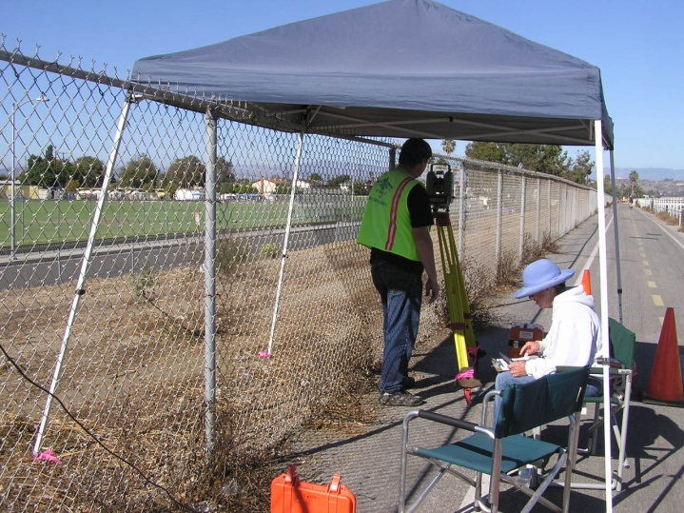
Instrumentation and Methodologies Branch
Calibration Base Lines (CBLs)
5 measured in Aug/Sept 2010
  PORT OAKLAND; brand new
  CONCORD, remeasured; distances to/from 2nd mon in 2007 suspect; 2010 correlate with 1990
  MODESTO; measured by ACSM previously
  LOS ANGELES BALLONA; existing City of LA CBL
    Near Marina del Rey, north of Hwy 90, along Ballona Creek recreation trail, west of Centinella Ave
  SACRAMENTO, brand new. Data not converging; still trying options, may need to re-observe

Slide 43
Communications and Outreach Branch
State Advisor Branch
Customer feedback is VERY important
Advisors’ monthly reports first item is to be FEEDBACK, so please contact your advisor if you have ideas/concerns/requests/criticism
Or praise!
New SAB Chief: Ross.Mackay@noaa.gov
Website undergoing revisions: providing more news and learning/training materials
Webinars and seminars, on-site training at Corbin, VA

Slide 44
Table of Contents
NGS Priorities: CORS, OPUS, GRAV-D, Ht Mod
Update of activities within each Division
  Geodetic Services
  Spatial Reference System
  Remote Sensing
  Observations and Analysis
  Systems Development
  Geosciences Research
NGS as part of NOAA

Slide 45

  SPATIAL REFERENCE SYSTEM DIVISION
Continuously Operating Reference Stations Branch
Geodetic Standards and Applications Branch
  NGS User Guidelines for Single Base Real Time GNSS Positioning v1.1, May 2010 (Publications)
  Future: guidelines for RTN Operators; evaluate ways to validate RTNs
  Reactivating FGCS work groups: Fixed Reference Stns, Instruments, Methodology, Spectrum Issues, Vertical Reference System
  Proposing a 4-hr FGCS mtg at
  ACSM/ESRI in July
Notes:
Link to FGCS website in right column of NGS homepage

Slide 46
Spatial Reference System Division
Geodetic Standards and Applications Branch
Modernizing the NSRS by defining new datums
Proceedings from May ‘10 Geospatial Summit available by reading webpage top story
Horizontal becomes Geometric; Vertical becomes Geopotential. Priority Leads recently named: Joe Evjen and Mark Eckl, respectively
Implementation timeframe dependent on successful completion of GRAV-D program and valid geoid model referenced to ECEF RF

Slide 47

NGS Ten-Year Plan
Approved January, 2008
Refines mission, vision, & strategy for the future of NGS actions
Emphasis on outside capacity
  Modernize the Geometric (“Horizontal”) Datum
  Modernize the Geopotential (“Vertical”) Datum
  Migrate the Coastal Mapping Program >>> Integrated Ocean & Coastal Mapping
  Evolve Core Capabilities
  Increase Agency Visibility
Available at: geodesy.noaa.gov

Slide 48
Future Geometric (3-D) Datum
replace NAD83 with new geometric datum –by 2022 is current projection
coordinates & velocities in ITRF/IGS and official US datum
  (NAD83 replacement: plate-fixed or “ITRF-like”?) and relationship
passive control tied to new datum; NOT a component of new datum
address user needs of coordinate/height constancy vs. accuracy
CORS-based, via GNSS
lat / long / ellipsoid height of defining points accurate to 1 mm, anytime
CORS coordinates computed / published daily; track changes
support development of real-time networks

Slide 49
Future Geopotential (Vertical) Datum
replace NAVD88 with new geopotential datum – by 2022
gravimetric geoid-based, in combination with GNSS
monitor time-varying nature of gravity field
develop transformation tools to relate to NAVD88
produce most accurate continental gravimetric geoid model ever
determine gravity with accuracy of 10 microGals, anytime
support both orthometric and dynamic heights
Height Modernization is fully supported

Slide 50
Table of Contents
NGS Priorities: CORS, OPUS, GRAV-D, Ht Mod
Update of activities within each Division
  Geodetic Services
  Spatial Reference System
  Remote Sensing
  Observations and Analysis
  Systems Development
  Geosciences Research
NGS as part of NOAA

Slide 51
REMOTE SENSING DIVISION
Mapping the National Shoreline: MHW
Assessing Coastal Change for more accurate Navigation Charts
Imagery acquired for Disaster Response
  NGS team earned NOAA Bronze Medal for their efforts in supporting post-EQ recovery in Haiti

Slide 52
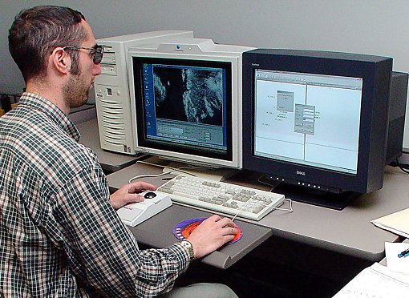
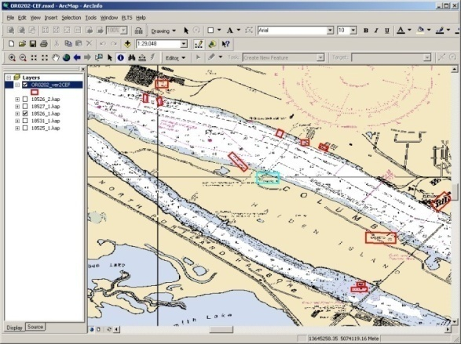
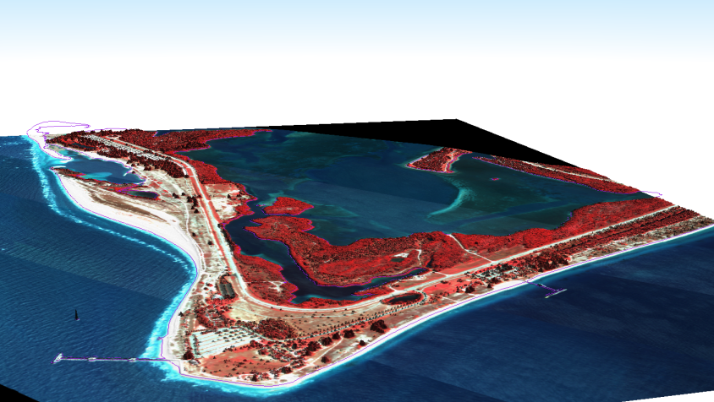
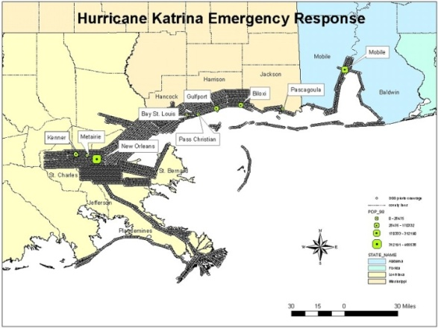
Current Components of the Coastal Mapping Program
Includes:
  Shoreline Mapping
  Coast and Shoreline Change Analysis Program (CSCAP)
  Emergency Response
  Research

Slide 53
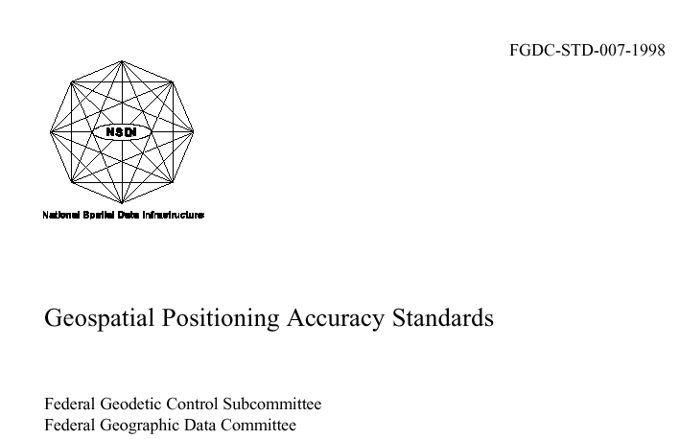
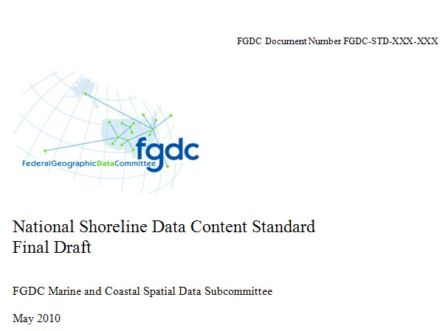
NGS Helps Develop FGDC/FGCS
Standards and Specifications
http://www.fgdc.gov/standards/projects/FGDC-standards-projects/shoreline-data-content/index_html

Slide 54
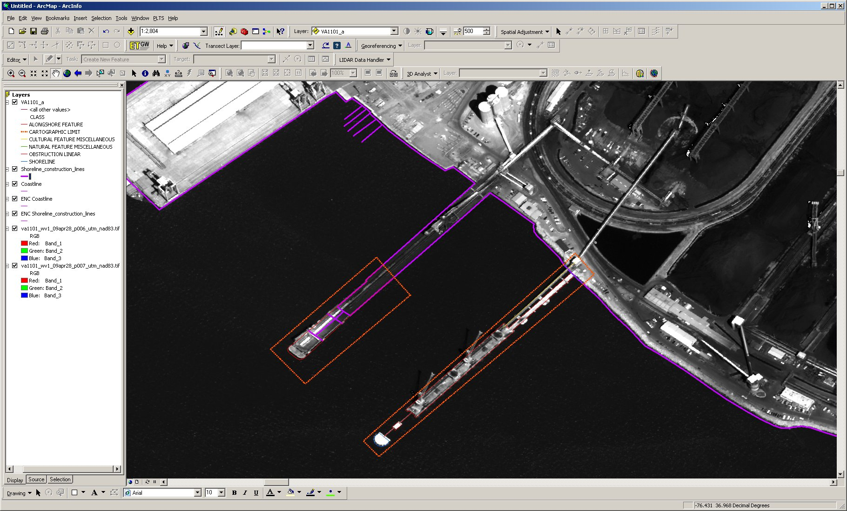
CSCAP Compilation
Pier Extension
New Pier
VA1101
Notes:
Coastal and Shoreline Change Analysis Program

Slide 55
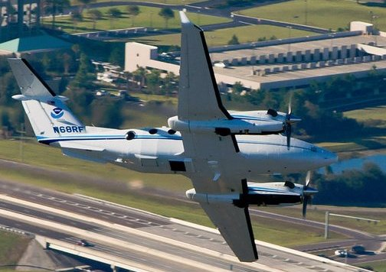
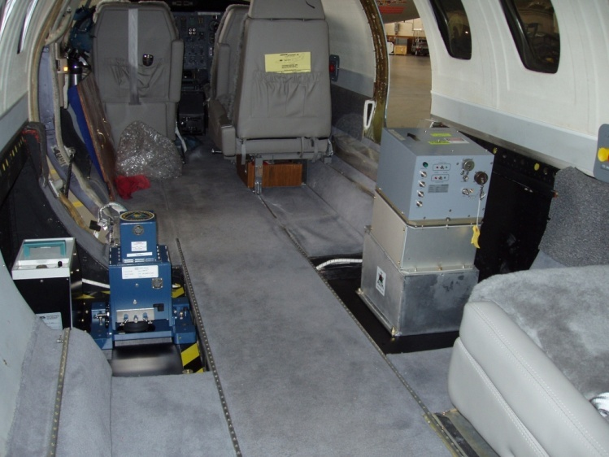
Emergency Response
Sensors utilized:
  Digital Camera (DSS)
  LiDAR
  Hyperspectral
  Thermal
CASI-2
DSS
ALTM
Beachcraft King Air 350
Cessna Citation II

Slide 56
Table of Contents
NGS Priorities: CORS, OPUS, GRAV-D, Ht Mod
Update of activities within each Division
  Geodetic Services
  Spatial Reference System
  Remote Sensing
  Observations and Analysis
  Systems Development
  Geosciences Research
NGS as part of NOAA

Slide 57
OBSERVATIONS AND ANALYSIS DIVISION
Datasheet format will be undergoing extensive revision; example and explanation/rationale of changes soon posted on website
  Logical grouping of primary data: lat/long/ellip ht, ortho ht and ideally geoid ht and model used,
  Network accuracies and median Local accuracies with a link to the full list of local accuracies and station ties
  Clarification of geoid model shown
Re-adjustment of passive stations in NGSIDB after new realization of CORS reference frame; Michael Dennis named as lead

Slide 58
Table of Contents
NGS Priorities: CORS, OPUS, GRAV-D, Ht Mod
Update of activities within each Division
  Geodetic Services
  Spatial Reference System
  Remote Sensing
  Observations and Analysis
  Systems Development
  Geosciences Research
NGS as part of NOAA

Slide 59
SYSTEMS DEVELOPMENT (IT)
HTDP 3.1, new version released early March
DSWorld, visualization software using Google Earth platform
BONUS: CGAR website for viewing/downloading California Geodetic Control: kml’s, shp’s, online Google Maps

Slide 60
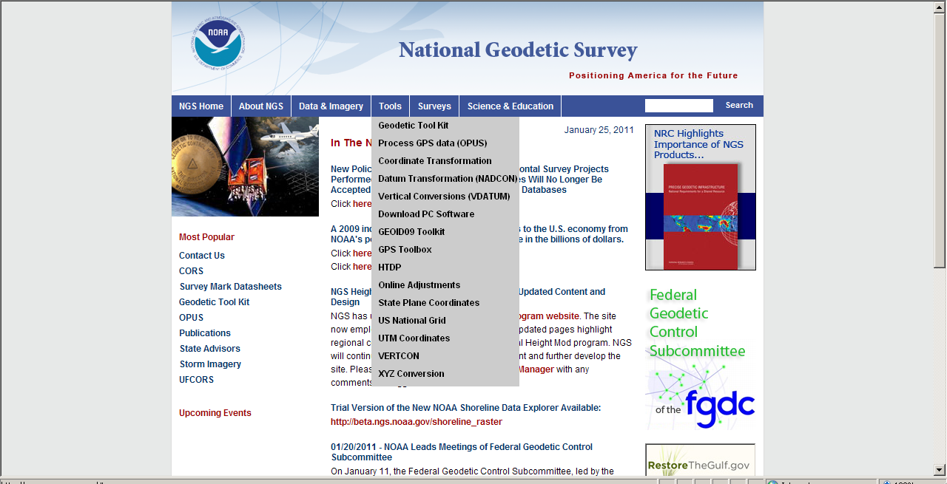
HTDP
Horizontal Time Dependent Positioning

Slide 61
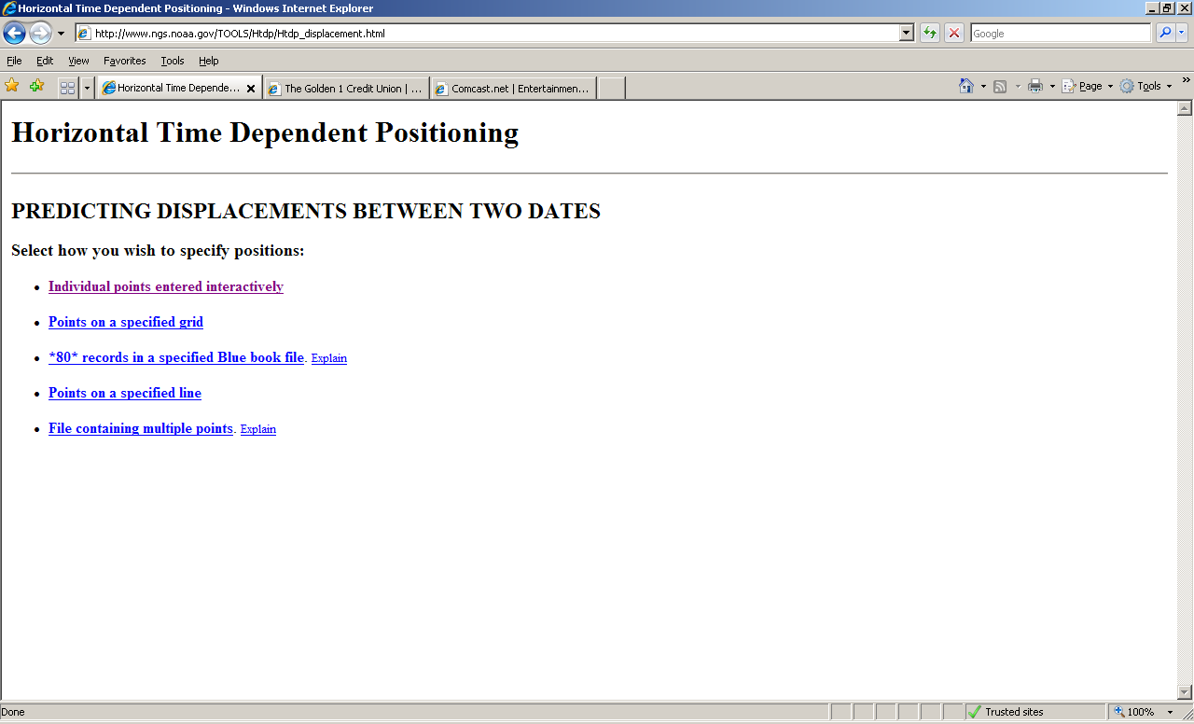

Slide 62
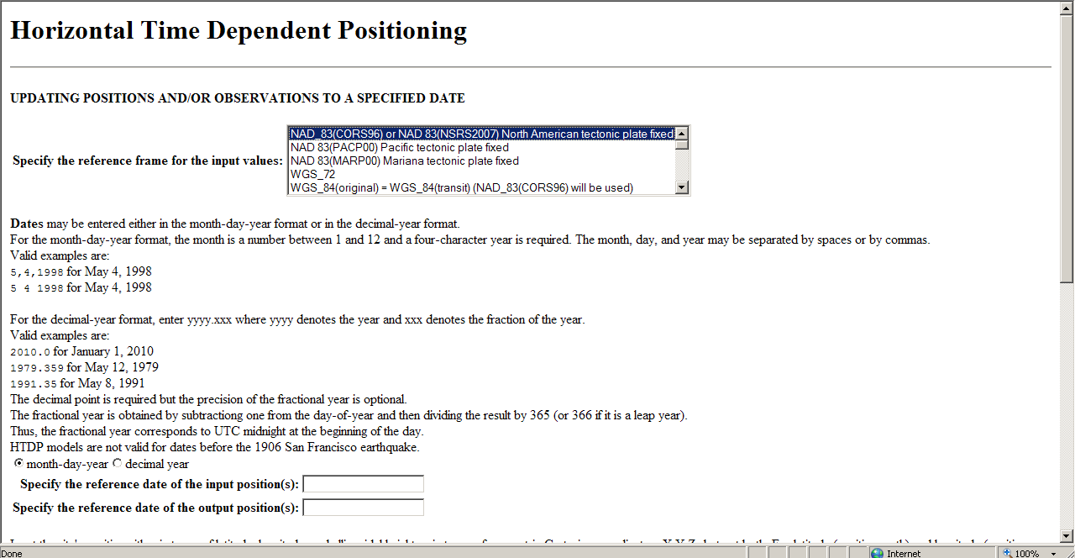
HTDP 3.1 version

Slide 63
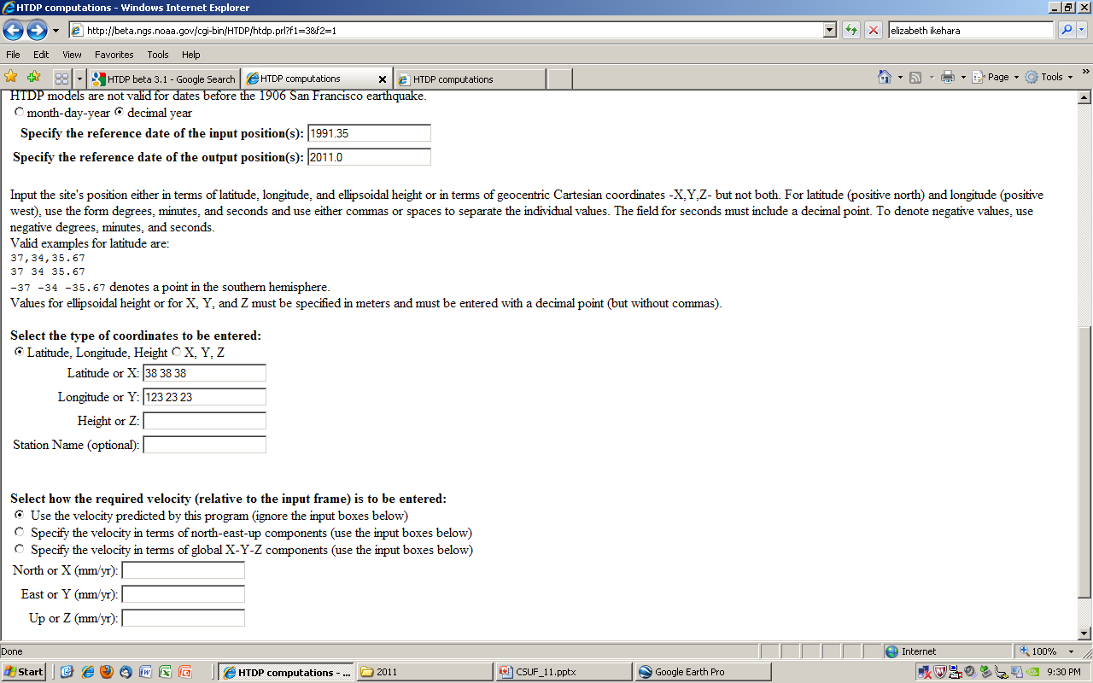
In Mendocino County, on the coast near Stewart’s Point; San Andreas Fault Zone is offshore

Slide 64
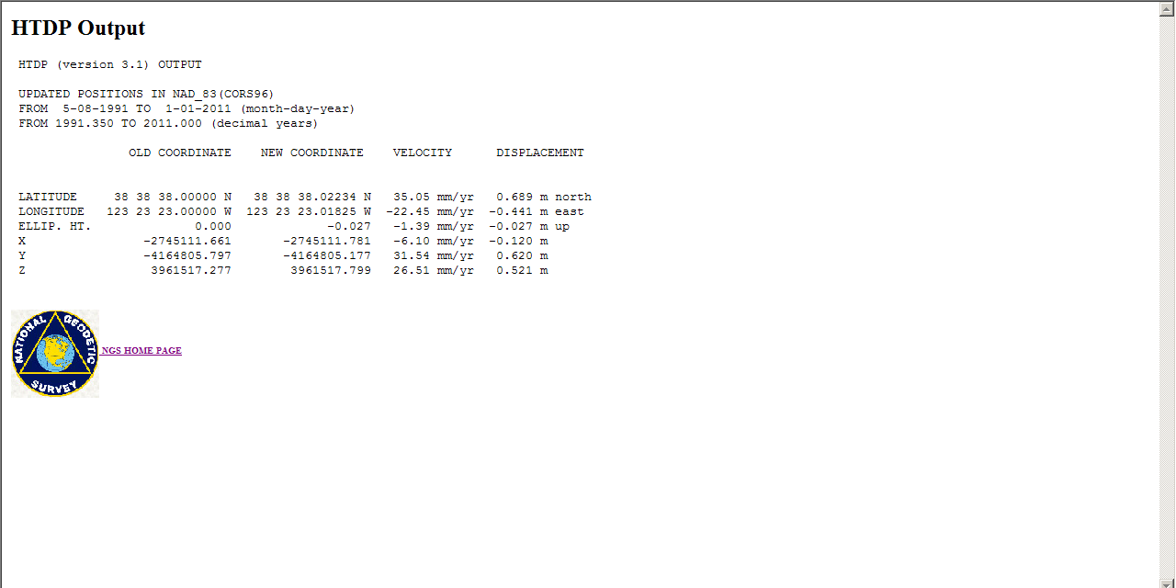
Almost 0.7m N and -0.5m E in 20 years
You MUST incorporate/apply horizontal velocities to ‘published’ coordinates to do geodetic surveying

Slide 65
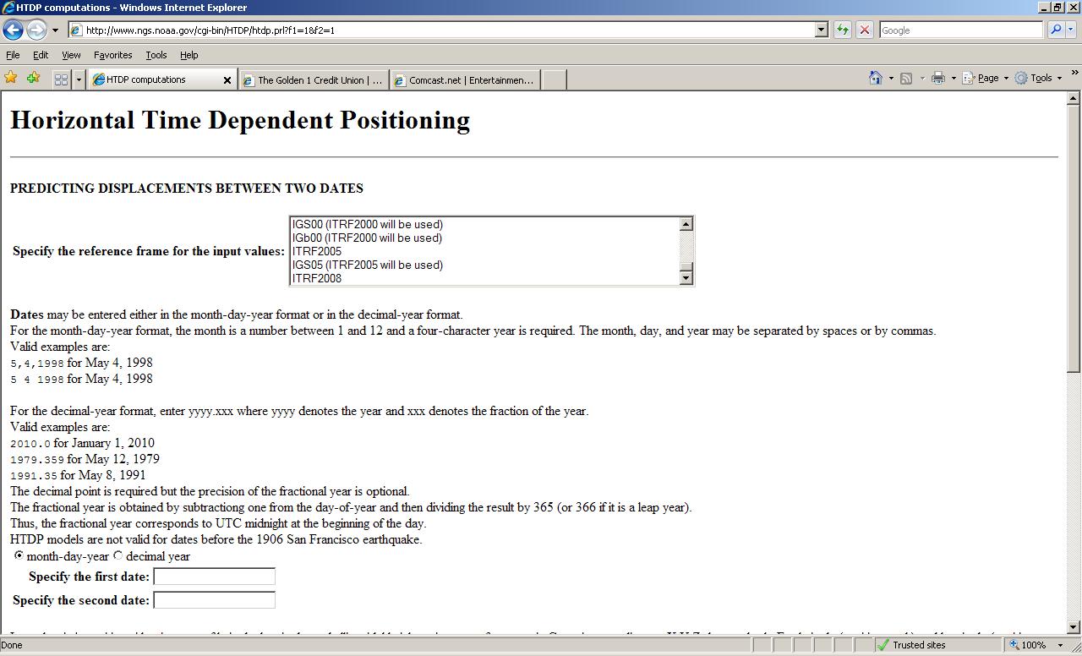
New reference frame, ITRF2008

Slide 66
DSWorld Legend
Blue: First order leveled
Red: Second order leveled
Black: Other, eg, third, posted, readjusted
Lt Green: Horizontal control
Yellow: Not Found
Gold: OPUS-DB

Slide 67


Slide 68



Slide 69


Slide 70
Visualization of CA Geodetic Control using CGAR website
CA Geodetic Advisor Resources (CGAR) website, hosted by CT Office of Land Surveys webpage
http://www.dot.ca.gov/hq/row/landsurveys/geodetic
  Google Earth kmls
  Shapefiles
  Online Google Maps

Slide 71

http://www.dot.ca.gov/hq/row/landsurveys/geodetic/geodetic_control.html
Notes:
Shown on the state are the 12 Caltrans districts; the counties are arranged by which CT District they are in.

Slide 72


Slide 73


Slide 74


Slide 75
http://www.dot.ca.gov/hq/row/landsurveys/geodetic/geodetic_control.html

Slide 76

Notes:
To better spread out and make easier accesss to vertical control, NGS started an initiative in the mid-1990’s called Height Modernization, whereby GPS data was observed in networks often at the scale of a county. This shows Sac County before the Sac Valley HM project was loaded in mid- 2010. Because conversion fr GE to GM is not working (can someone help?), these are not the most current.

Slide 77
Table of Contents
NGS Priorities: CORS, OPUS, GRAV-D, Ht Mod
Update of activities within each Division
  Geodetic Services
  Spatial Reference System
  Remote Sensing
  Observations and Analysis
  Systems Development
  Geosciences Research
NGS as part of NOAA

Slide 78
GEOSCIENCES RESEARCH
Absolute antenna calibration
Relative antenna calibrations were relative to AOAD/M_T antenna; thus 2 set up
AOAD/M_T Dorne Margolin T, chokerings (TurboRogue)NGS ( 0) 97/10/27
0.0 0.0 110.0 (L1 Offset)
0.0 0.0 0.0 0.0 0.0 0.0 0.0 0.0 0.0 0.0 0.0 0.0 0.0 0.0 0.0 0.0 0.0 0.0 0.0
0.0 0.0 128.0 (L2 Offset)
0.0 0.0 0.0 0.0 0.0 0.0 0.0 0.0 0.0 0.0 0.0 0.0 0.0 0.0 0.0 0.0 0.0 0.0 0.0
Notes:
Allen Osborne Associates Dorne-Margolin Turborogue

Slide 79




NGS Antenna Calibration –
Relative vs. Absolute GNSS Antenna Calibration
relative
absolute
2 hours
GPS tracking

Slide 80
Table of Contents
NGS Priorities: CORS, OPUS, GRAV-D, Ht Mod
Update of activities within each Division
  Geodetic Services
  Spatial Reference System
  Remote Sensing
  Observations and Analysis
  Systems Development
  Geosciences Research
NGS as part of NOAA

Slide 81
NGS as part of NOAA
Contributions to VDATUM integration model
CORS co-located at tide gages
Contributions to Digital Coast library
Participation as team doing presentations at conferences and training

Slide 82




All Elevation Data is Referenced to a Vertical Datum
Ellipsoid Datums
WGS 84,
NAD 83 (NSRS)
Orthometric Datums
(NSRS)
(MSL)
NAVD 88, NGVD 29
Tidal Datums
MHHW, MHW, MTL, DTL, LMSL, MLW, MLLW

Slide 83
Datum Relationships
H = Orthometric Height (NAVD 88)
H = h - N
h = Ellipsoidal Height (WGS 84)
N = Geoid Height (Geoid09)
Physical Earth
H
h
MLLW
N
GEOID 09
Geoid
Ellipsoid
GRS80

Slide 84


VDATUM
  VDatum – A NOAA Java developed tool to convert elevation data (heights and soundings) among various vertical datums
  Operates in either batch mode or interactive mode
  Requires accurate Geoid and Hydrodynamic models for shoreline applications

Slide 85









VDATUM Tidal Datum Grid Process
Finite Element grid is created and populated with bathymetry
Tidal Datum fields are derived from ADCIRC (Advanced Circulation) Model, simulations are made on cluster computers at NOAA’s Earth System Research Laboratory
VDatum Marine Grid is populated with results
Correct results by spatially interpolating errors with TCARI (Tidal Constituent and Residual Interpolation)

Slide 86


Slide 87


Slide 88

Errors from (in) source data and from transformations
Notes:
Error in source data (eg, NAD83=2 cm) AND in transformations (eg going fr 83 to 88 = 5cm

Slide 89

www.tidesandcurrents.noaa.gov

Slide 90
NGS and CO-OPS establish CORS at NWLON stations
210 NWLON or Primary Tide Gage sites
Funding from NOAA’s Climate Program Office
Key climate observation locations, namely 10 ocean island and/or remote stations in the Pacific, Alaska, and the Caribbean
3 GLOSS stations (Global Sea Level Observation System) on West Coast: South Beach, OR; SF, CA; and La Jolla, CA
Recon being done for SF this year

Slide 91

www.csc.noaa.gov/digitalcoast

Slide 92
NGS/CO-OPS Outreach Efforts
Conferences:
Coastal GeoTools 2011 (Myrtle Beach, SC)
Coastal Zone ‘11 (Chicago)
On-site Training:
US Army Corps of Engineers at District offices nationwide
Webinars:
March 2010

Slide 93



Educational/Presentations materials
Science & Education tab
Training center Online Learning Resources
  Webinars: visuals PLUS recorded audio
Archived Presentations (in development)

Slide 94


ftp://ftp.ngs.noaa.gov/pub/marti/Presentations
OR
http://www.ngs.noaa.gov/web/science_edu/presentations_archive/ (in development)
Marti.ikehara@noaa.gov

