Slide 1
So Let It Be Written, so Let It Be Done
Adopting the New Datums and State Plane in Legislation
Michael Dennis, PhD, PE, PLS, M.ASCE

Slide 3
Why have State Plane in statute?
Proposed to state legislatures in 1945 by Council of State Governments to:
Establish legal status
Insure uniformity and definiteness in use
Impose reasonable standards when coordinates become part of public record
Additional reasons:
To make corners “indestructible”
Save time and money by providing specifications on using State Plane
Other things:
Use of system is permissive, not mandatory
Uniformity of legislation is desirable

Slide 4
History of State Plane in legislation
First nine states with State Plane laws:
1935 (NJ), 1937 (PA), 1938 (NY), 1939 (MD, NC, GA), 1941 (MA), 1943 (TX), 1944 (LA)
Model act provided to state legislatures in 1945
Model act has 11 sections (below are some pertinent ones):
Sec 1. Description of zone coverage (all by counties)
Sec 5. Definitions of zone projection parameters
Sec 6. For public recording, must have control with 2nd order accuracy within ½ mile
Sec 8. Coordinates supplemental and subordinate to existing PLSS location description
Sec 9. Use of State Plane not required for purchase or mortgage of real property

Slide 5
Changes in model act for SPCS 83 (created 1977)
Some changes in model act from SPCS 27 to SPCS 83 (10 sections):
Sec 3. Specified how coordinates are defined in SPCS 27 and 83
y and x used for SPCS 27; northing and easting used for SPCS 83
Specified U.S. survey foot for SPCS 27; meter for SPCS 83 (but not U.S. survey foot)
Sec 4. Coordinates sufficient to describe property (removed statement that coordinates are supplemental and subordinate to PLSS descriptions)
Sec 6. Gives both SPCS 27 and 83 zone parameters
Sec 7. Distance to 2nd order control changed from ½ mile to 1 km
Sec 10. Date after which SPCS 27 will no longer be used
Interesting note at end of SPCS 83 model act (ca. 1989):
“In light of GPS technology, the 1 km limitation of Section 7 should be reevaluated.”

Slide 6
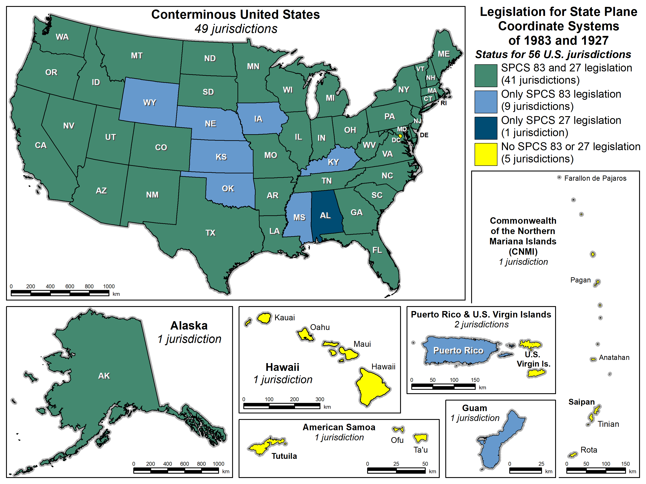
State Plane legislation SPCS 27 and SPCS 83
56 U.S. jurisdictions
41 with SPCS 83 and 27
9 with only SPCS 83
1 with only SPCS 27
5 with no legislation

Slide 7
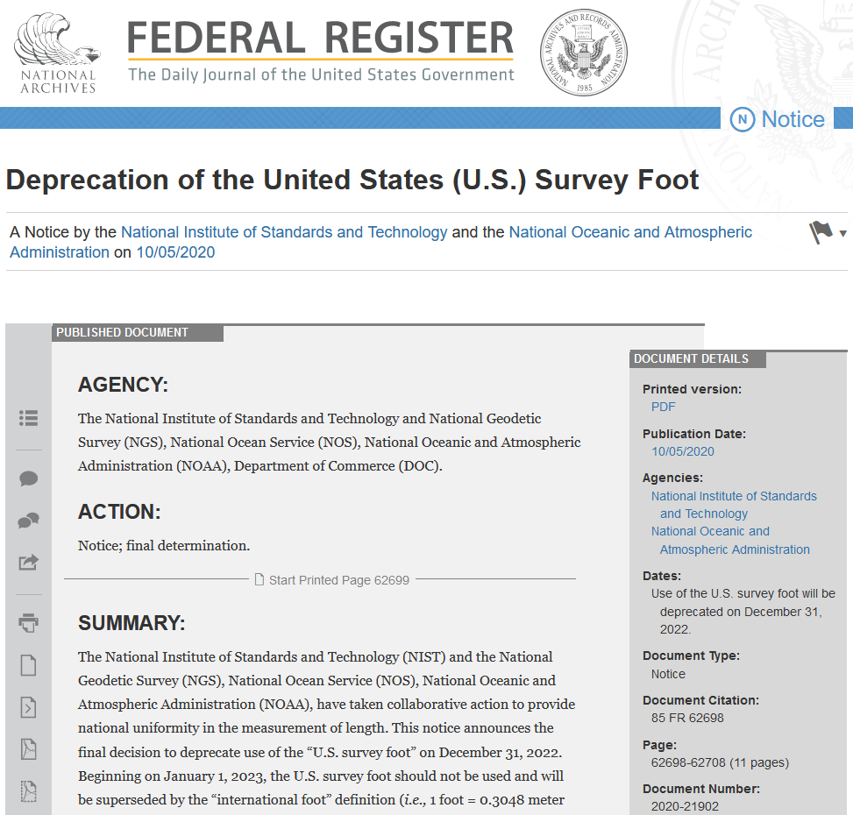
What about the U.S. survey foot?
Will be deprecated on Dec 31, 2022
Per final determination Federal Register Notice issued on Oct 5, 2020
Describes public comments received, along with the plan, resources, training, and other information for an orderly transition
(this image is hyperlinked to the Federal Register page)

Slide 8
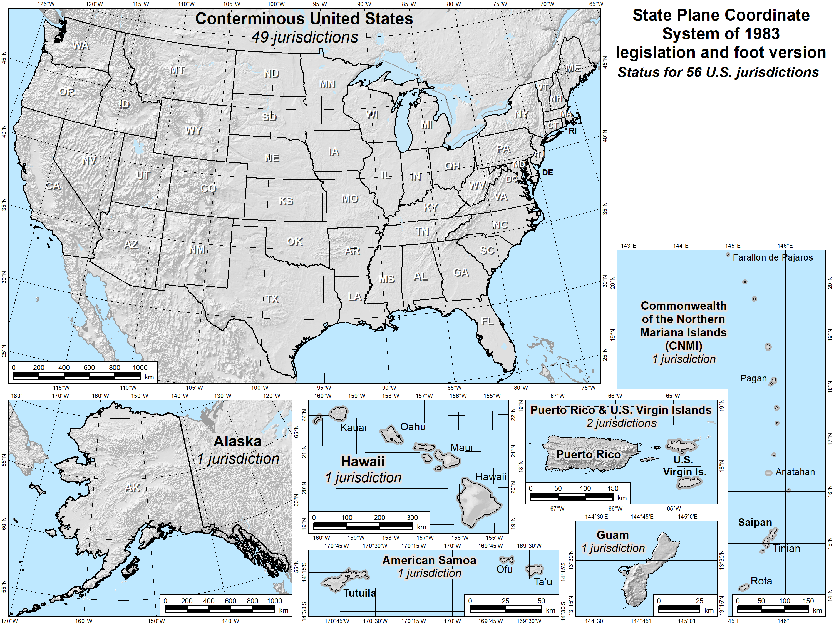
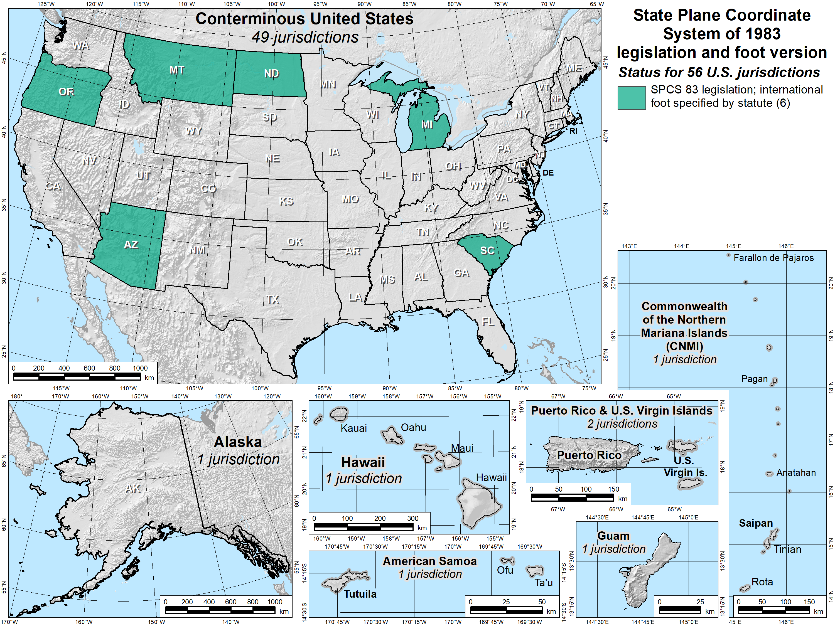
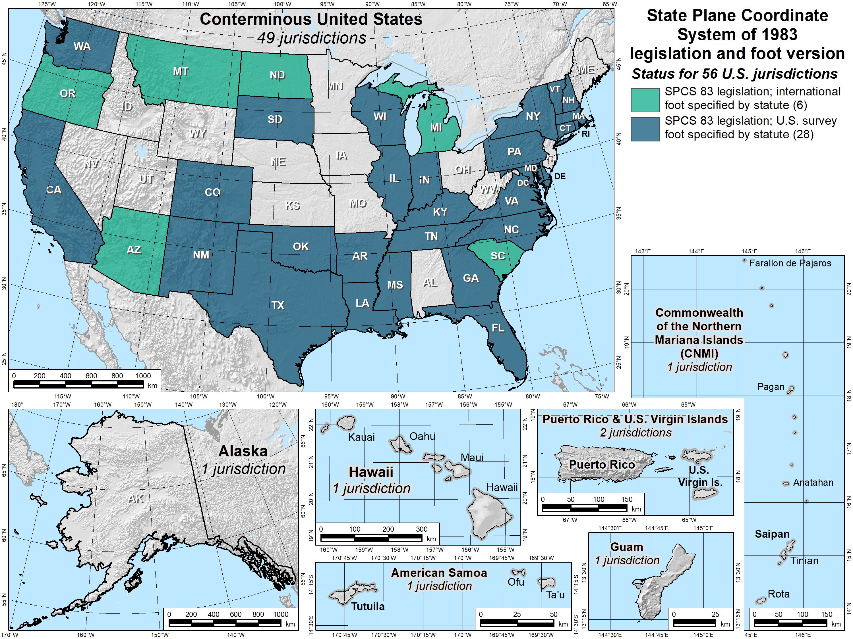
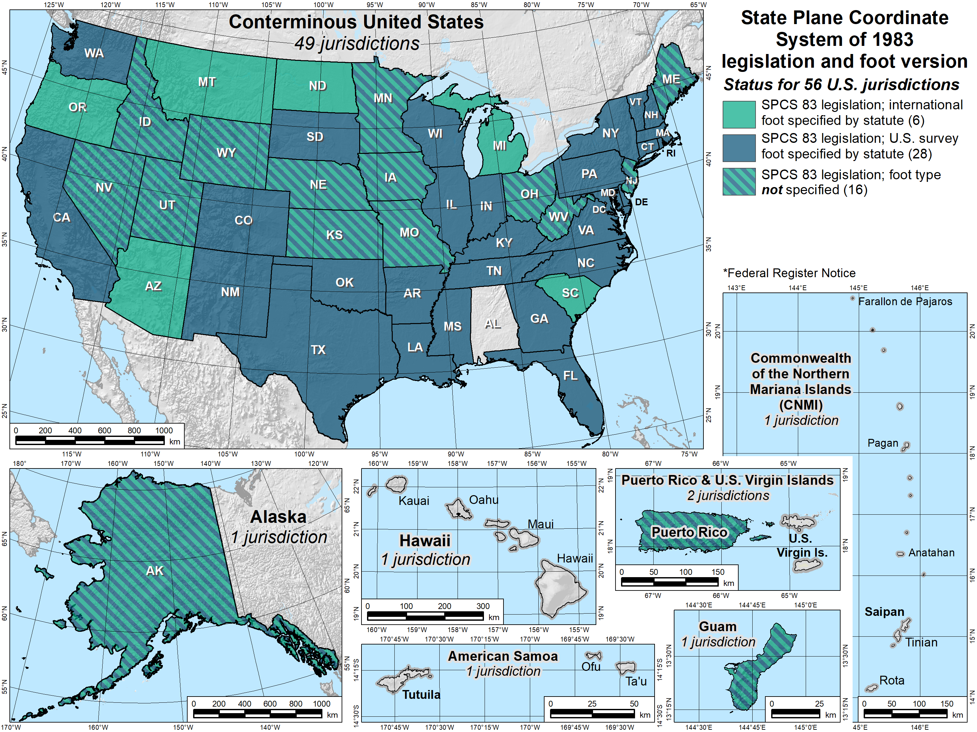
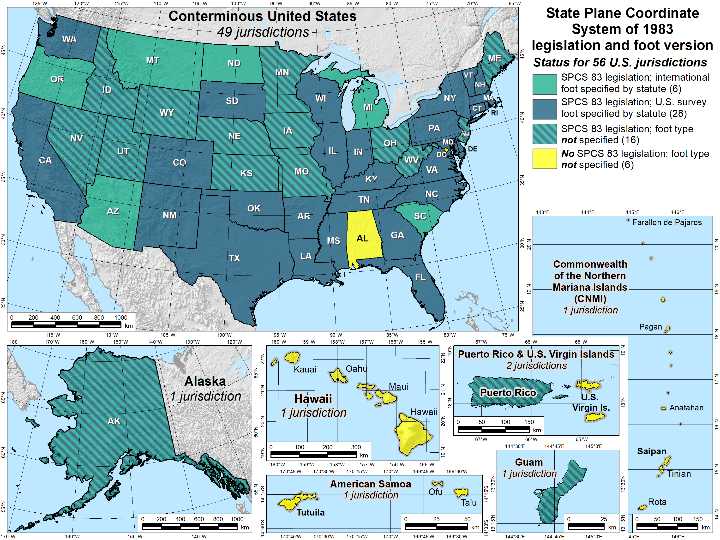
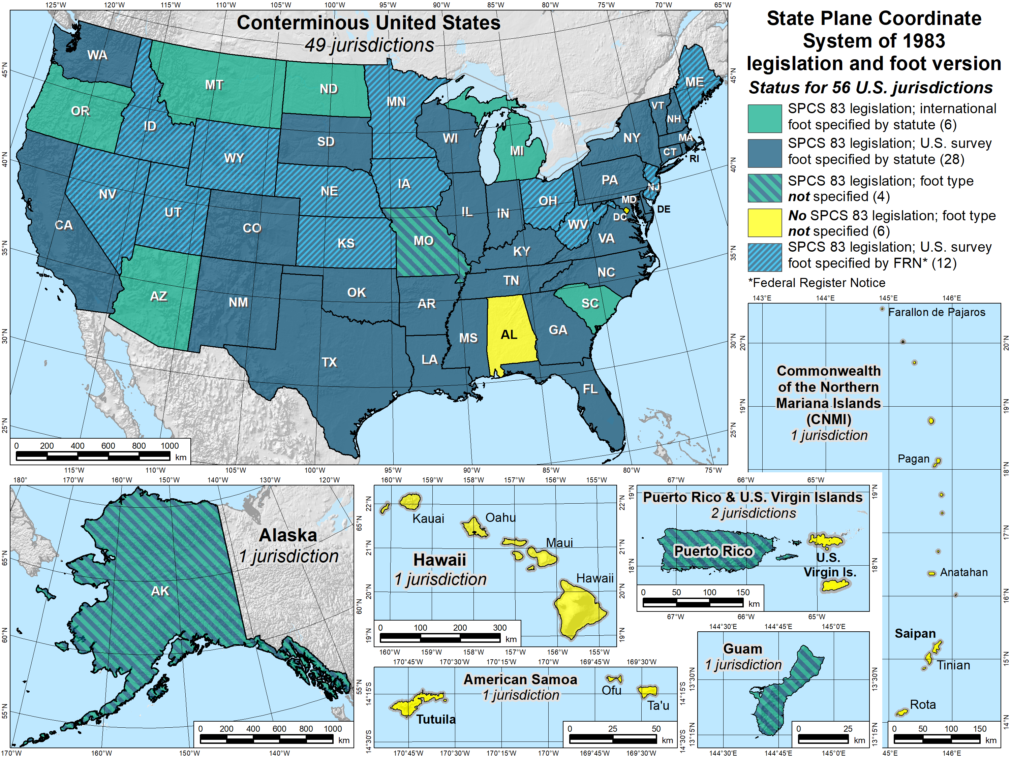
SPCS 83 legislation and foot version
56 U.S. jurisdictions
Legislation
International foot: 6
U.S. survey foot: 28
Neither: 16
No legislation at all: 6
Fed Register Notice
U.S. survey foot: 12
In lieu of legislation
Done in 2006-2009
8

Slide 9
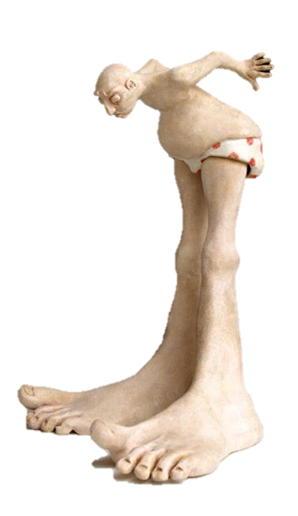
Putting the “best” foot forward
U.S. survey foot will be retired
Not supported for State Plane Coordinate System of 2022 (or any part of modernized NSRS)
Should not be specified in new legislation
Only international foot will be supported by NGS
In some states, law specifies U.S. survey foot for boundary surveys
A separate issue since not part of NSRS (not dealt with here)
Effective December 31, 2022
Independent of NSRS modernization
U.S. survey foot will still be supported for legacy products (e.g., existing State Plane)…

Slide 10
Repeat until slapped
U.S. survey will be foot deprecated on 12/31/2022
But use can continue for SPCS 83 (and SPCS 27)
The 40 states that “officially” use U.S. foot for SPCS 83
All SPCS 27 zones
NGS will support such “legacy” use forever
But NOT supported for ANY zones in SPCS2022
Please repeat:
NGS will always support U.S. survey foot for SPCS 83 and 27
Thank you.

Slide 11
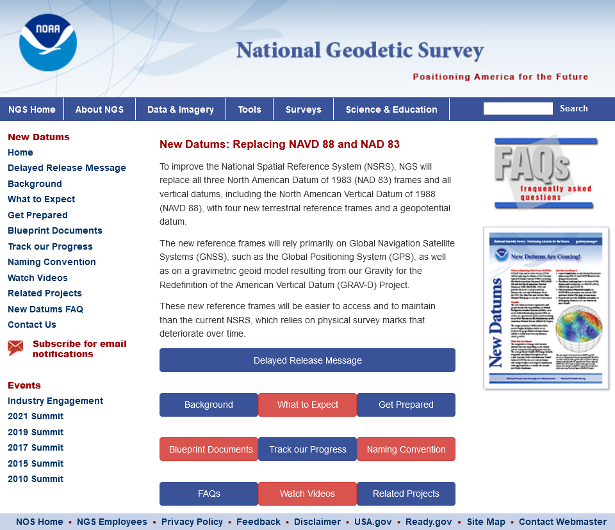
Modernized NSRS in legislation
geodesy.noaa.gov
National Spatial Reference System will change in 2025
NGS recommends updating legislation for modernized NSRS
Template and example legislation available on NGS website

Slide 12
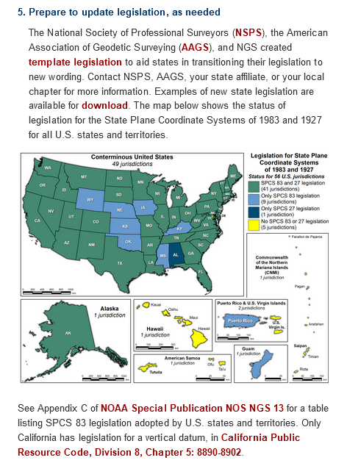
Template state legislation https://geodesy.noaa.gov/datums/newdatums/GetPrepared.shtml
Created by NSPS, AAGS, and NGS
Intended to augment existing legislation
Defined by NGS OR by state (not both)
If NGS, must adhere to NGS policy for SPCS2022
Sections
Abbreviations
The <state> Plane Coordinate System
Geodetic Coordinates
Reduce need for later legislation updates
Do not include specific names of datums, etc.
Do not include zone projection parameters
Foot version must be 1 ft = 0.3048 m

Slide 13
Example state legislation https://geodesy.noaa.gov/datums/newdatums/GetPrepared.shtml
Washington
Most closely follows template
Definitions maintained by NGS
Uses foot definition 1 ft = 0.3048 m
Kentucky
Uses name “international foot”
Refers to administrative regs for definitions
Added SPCS 27 (not previously legislated)
Alaska
“Alaska Coordinate System of 2022”
Uses name “international foot”

Slide 14
Recommendations on NSRS legislation
Do not include specific technical information
No state plane zone parameters
No survey accuracy or performance specifications
Goal is to “future-proof” legislation
Create statute that will not require later updates
Technical information should be elsewhere
…and to just make life easier
Much harder to change information in statute
No need to explain to legislators
Some states will have a LOT of zones (e.g., 8 in Kentucky, 58 in Indiana, 89 in Ohio, etc.)
Do you really want to put all of these zones into statute?

Slide 15
You don’t want stuff like this in statute…
Arizona Revised Statute, Title 33, Chapter 1, Article 3, Section 133:
B. For the purpose of more precisely defining the Arizona coordinate system, the following definitions of the national geodetic survey are adopted:
1. The Arizona coordinate system, 1983, west zone, is a transverse mercator projection of the North American datum, 1983, having a central meridian 113° 45' 00" west of Greenwich, on which meridian the scale is set one part in fifteen thousand too small. The origin of the coordinates is at the intersection of the meridian 113° 45' 00" west of Greenwich and the parallel of 31° 00' 00" north latitude. This origin is given the coordinates of "X" equals seven hundred thousand feet and "Y" equals zero feet.
Do you really want to explain this to legislators?
Do you want to repeat this 58 times (IN) or 89 times (OH) or…?
What if you want or need to change something?
What if anything becomes obsolete?

Slide 16
Or like this…
Arizona Revised Statute, Title 33, Chapter 1, Article 3, Section 132:
A. The position of the Arizona coordinate system shall be marked on the ground by horizontal control stations which have been established in conformity with standards adopted by the federal geodetic control committee for first order, second order class I or second order class II surveys or equivalent standards adopted by successors, at the time the surveys were made and computed on the North American datum, 1983.
B. A horizontal control station normally consists of, if practicable, a group of bronze or brass discs imbedded in concrete posts nearly flush with the ground surface or cemented into holes drilled into rock outcrops or ledges in such a configuration that the station is referenced by a subsurface mark in a precise vertical register with the surface mark, two reference marks, similar to the surface mark accurately located by azimuth and horizontal distance in respect to the horizontal control station and not more than one hundred fifty feet distant and an azimuth mark which may be similar to the horizontal control station not less than one thousand feet distant, or optionally, an object not less than three thousand feet distant such as a church spire, water tank, radio or television transmitting antenna, by which azimuth mark subsequent surveys may be accurately oriented.
Obsolete
Remember prescient words about model act in 1989:
“In light of GPS technology, the 1 km limitation… should be reevaluated.”

Slide 17
Summary
Long history of State Plane in legislation (since 1935!)
Make it “future proof”
Do not include specific names, dates, etc.
Do not include technical info (e.g., projection parameters, surveying specifications)
Handle technical info by reference to admin rules/regulations/code or other sources
Legislation template and examples exist
U.S. survey foot will not be supported in modernized NSRS
Language on this is in template and all examples
Many states have U.S. survey foot specified for boundary surveys in statute
Legislation entirely up to states; NGS can only provide guidance

Slide 18
So let there be questions, or let there be none.

