Slide 1
National Spatial Reference System (NSRS)
Modernization Industry Workshop
Preparing for a New State Plane Coordinate System in 2022
Michael L. Dennis
SPCS2022 Project Manager
NOAA Science Center
1301 East West Highway
Silver Spring, MD 20910
May 7-8, 2018

Slide 2
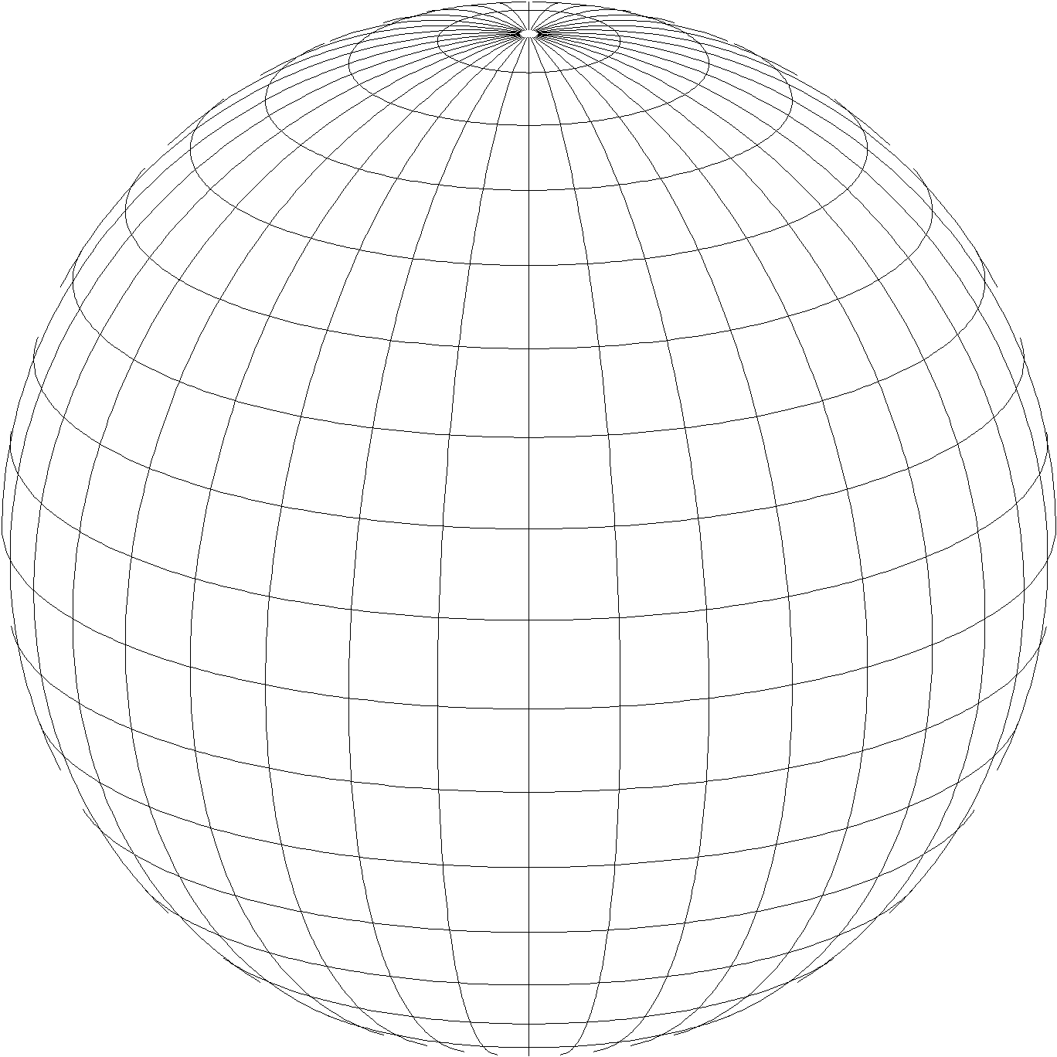
A New State Plane Coordinate System
State Plane Coordinate System of 2022 (SPCS2022)
Referenced to 2022 Terrestrial Reference Frames (TRFs)
Based on same reference ellipsoid as SPCS 83 (GRS 80)
Same 3 conformal projection types as SPCS 83 and 27:
Lambert Conformal Conic (LCC)
Transverse Mercator (TM)
Oblique Mercator (OM)

Slide 3
Recent activity at NGS on State Plane
New report on State Plane history, policy, and future
NOAA Special Publication NOS NGS 13
Draft SPCS2022 policy and procedures
Define characteristics and requirements for SPCS2022
Instructions for state requests and proposals
Federal Register Notice (FRN) published April 18, 2018
Requests public comment on policy and procedures
Includes “special purpose” zones
State Plane NGS Webinar Series (March 8 and April 12)
Recordings, slides, and Q&A documents available

Slide 4
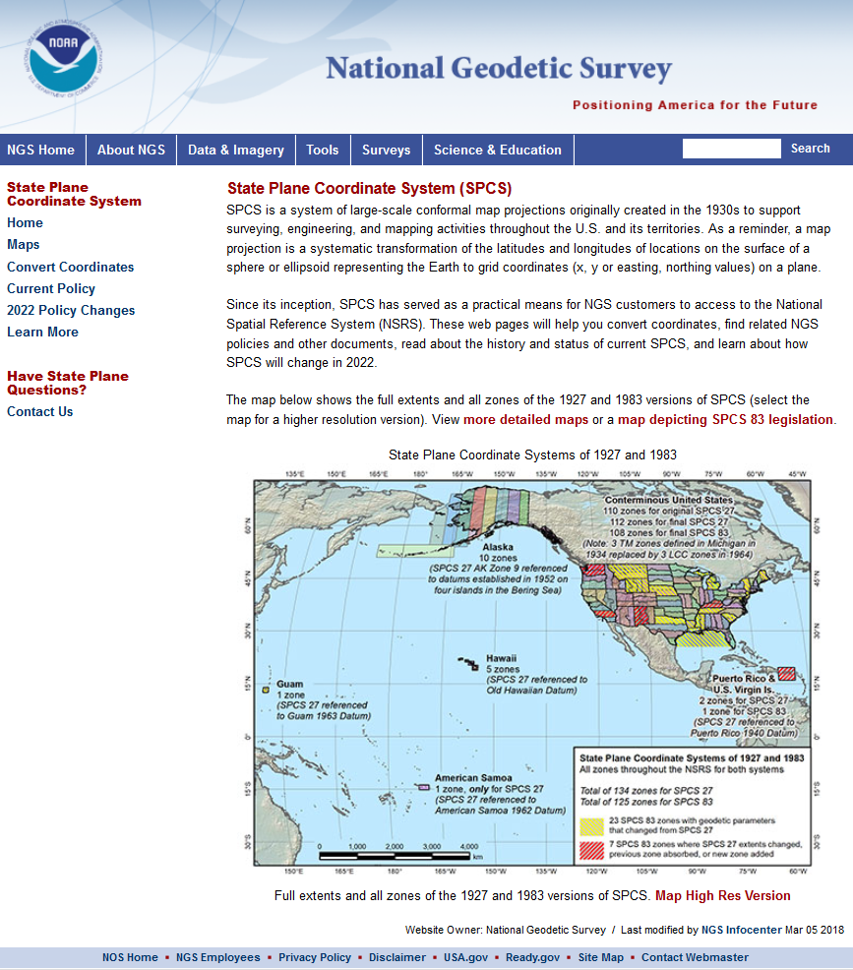
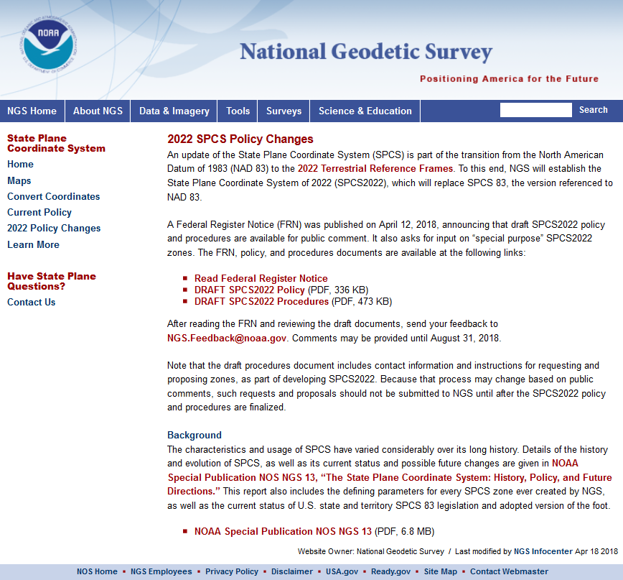
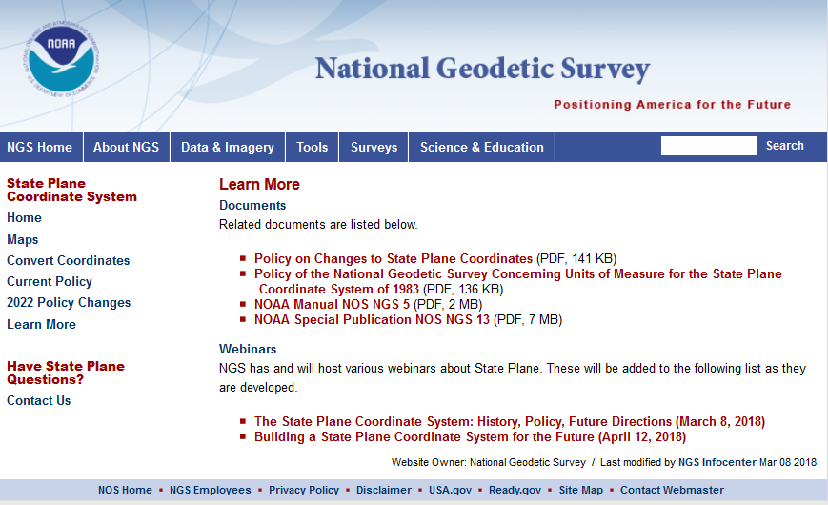
geodesy.noaa.gov/SPCS/

Slide 5
Overview: Policy, Procedures, and FRN
Linear distortion at topographic surface
Default SPCS2022 zone designs
Statewide and “layered” zones
Linear distortion design criteria
Maximum and minimum distortion and zone size
Allow “low distortion projections” (LDPs)
“Special purpose” zones (in FRN only)
SPCS2022 parameters and computations

Slide 6
Linear distortion with respect to ellipsoid
Projection axis
Ellipsoid surface
Ellipsoid distance
Projection surface (secant)
Grid distance > ellipsoid distance
This design approach used for SPCS 27 and 83 (minimizes distortion with respect to ellipsoid)
Ellipsoid distance
Grid distance < ellipsoid distance

Slide 7
Linear distortion with respect to topographic surface
Horizontal ground distance
> ellipsoid distance and > grid distance
Topographic surface
Projection axis
Ellipsoid surface
Ellipsoid distance
Projection surface (secant)
Grid distance > ellipsoid distance < ground distance
This design approach used for SPCS 27 and 83 (minimizes distortion with respect to ellipsoid)
Ellipsoid distance
Grid distance < ellipsoid distance < ground distance

Slide 8
Linear distortion with respect to topographic surface
Horizontal ground distance
> ellipsoid distance and > grid distance
Topographic surface
Projection axis
Ellipsoid surface
Ellipsoid distance
Grid distance > ellipsoid distance ≈ ground distance
Projection surface (non-intersecting)
This design approach will be used for SPCS2022 (minimizes distortion with respect to topography)

Slide 9
Overview: Policy, Procedures, and FRN
Linear distortion at topographic surface
Default SPCS2022 zone designs
Statewide and “layered” zones
Linear distortion design criteria
Maximum and minimum distortion and zone size
Allow “low distortion projections” (LDPs)
“Special purpose” zones (in FRN only)
SPCS2022 parameters and computations

Slide 10
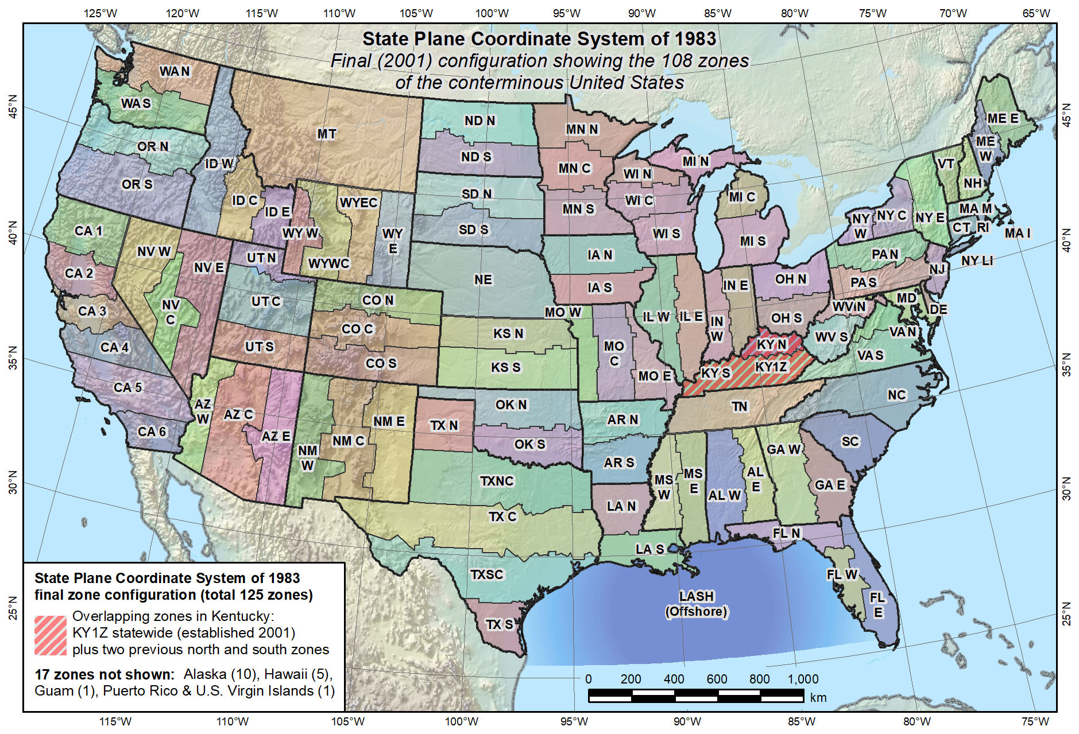
Default SPCS2022 would look a lot like SPCS 83…

Slide 11
Overview: Policy, Procedures, and FRN
Linear distortion at topographic surface
Default SPCS2022 zone designs
Statewide and “layered” zones
Linear distortion design criteria
Maximum and minimum distortion and zone size
Allow “low distortion projections” (LDPs)
“Special purpose” zones (in FRN only)
SPCS2022 parameters and computations

Slide 12
Statewide and “layered” zones
States often want statewide and small zones
Statewide: Single geometry required for state GIS
Subzones: Lower distortion for surveying/engineering
Limitations
Max of TWO layers: Statewide and subzones
If two layers, one MUST be statewide
Minimum subzone dimension > 50 km
One already exists in SPCS 83…

Slide 13
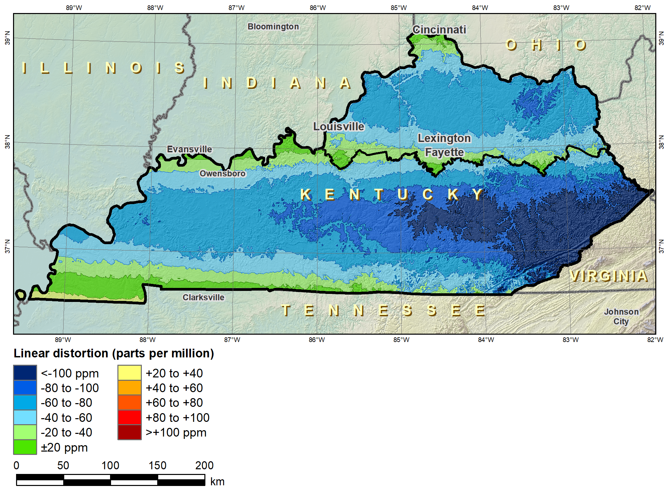
Kentucky layered zones
“Layered” zones
SPCS 83 Kentucky N and S zones (Lambert Conformal Conic)
 |  | North | South
N parallel |  | 38°58’N | 37°56’N
S parallel |  | 37°58’N | 36°44’N
 |  | Distortion (ppm)
Min |  | -93 | -211
Max |  | +17 | +42
Mean |  | -56 | -67

Slide 14
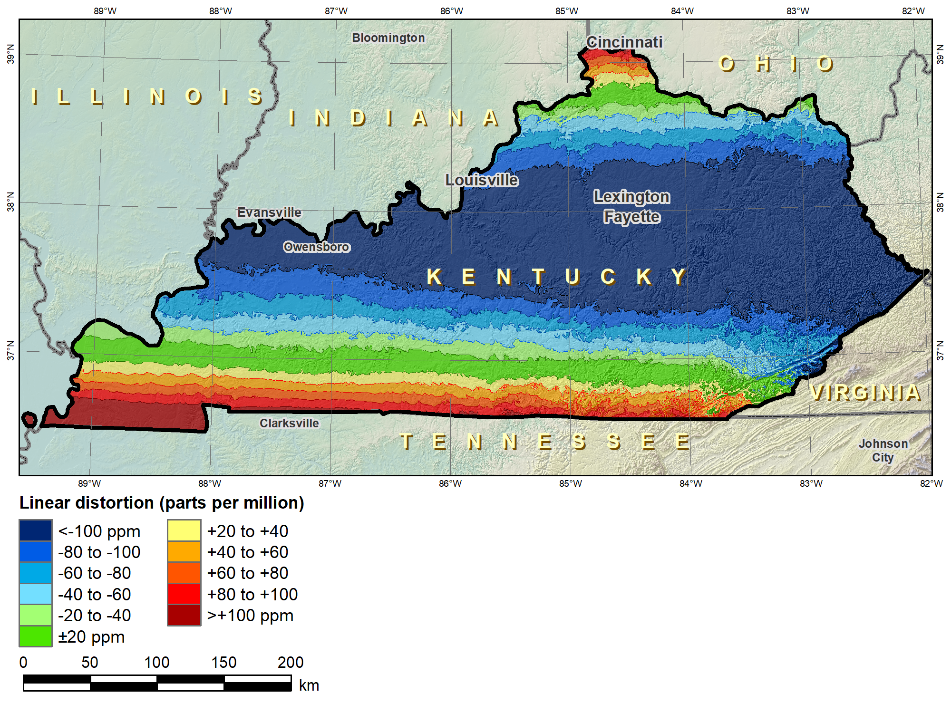
Kentucky layered zones
“Layered” zones
SPCS 83 Kentucky statewide zone (Lambert Conformal Conic)
 |  | North | South | Statewide
N parallel |  | 38°58’N | 37°56’N | 38°40’N
S parallel |  | 37°58’N | 36°44’N | 37°05’N
 |  | Distortion (ppm)
Min |  | -93 | -211 | -166
Max |  | +17 | +42 | +181
Mean |  | -56 | -67 | -58

Slide 15
Overview: Policy, Procedures, and FRN
Linear distortion at topographic surface
Default SPCS2022 zone designs
Statewide and “layered” zones
Linear distortion design criteria
Maximum and minimum distortion and zone size
Allow “low distortion projections” (LDPs)
“Special purpose” zones (in FRN only)
SPCS2022 parameters and computations

Slide 16
Linear distortion design criteria
NGS design of zones requested by stakeholders
Minimum: 50 ppm = 5 cm/km = 0.3 ft/mi = 1:20,000
Maximum: 400 ppm = 40 cm/km = 2.1 ft/mi = 1:2,500
Design criterion < 50 ppm (“low distortion”)
Minimum distortion criterion 20 ppm (0.1 ft/mi)
Minimum zone width 50 km (31 miles)
Must be designed by others (not by NGS)
Proposed and final design reviewed by NGS

Slide 17
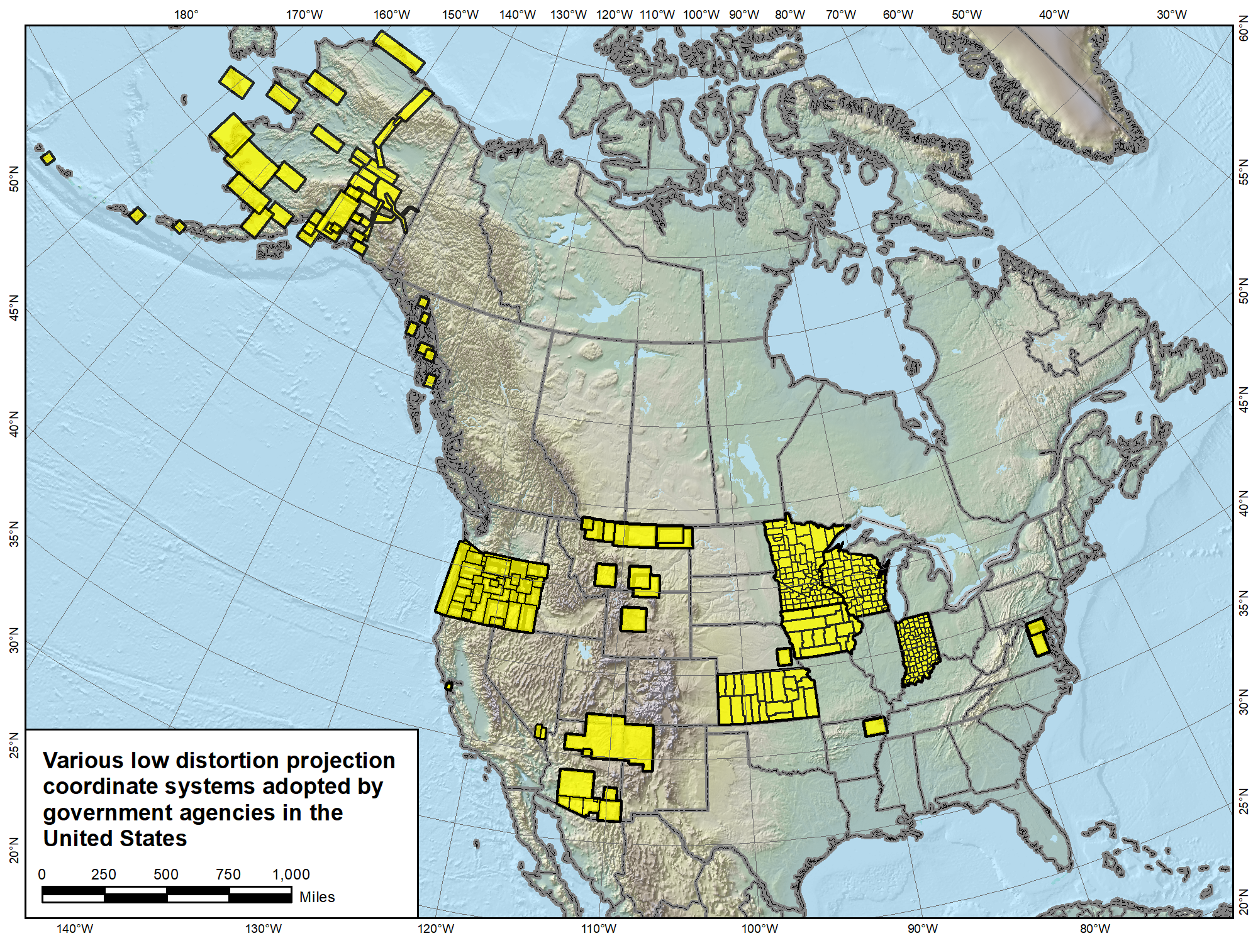

Slide 18
Overview: Policy, Procedures, and FRN
Linear distortion at topographic surface
Default SPCS2022 zone designs
Statewide and “layered” zones
Linear distortion design criteria
Maximum and minimum distortion and zone size
Allow “low distortion projections” (LDPs)
“Special purpose” zones (in FRN only)
SPCS2022 parameters and computations

Slide 19
“Special purpose” zones
For areas with inadequate SPCS zone coverage
Usually areas in more than one zone
Categories:
Major urban areas (e.g., New York, Chicago, St. Louis)
Large Indian reservations (e.g., Navajo Nation)
Federal applications covering large areas (e.g., coastal mapping of Atlantic Coast; Grand Canyon National Park)
Only in FRN, not in draft policy & procedures
Intent is to get input on concept first
If used in SPCS2022, will NOT count as a subzone layer

Slide 20
Overview: Policy, Procedures, and FRN
Linear distortion at topographic surface
Default SPCS2022 zone designs
Statewide and “layered” zones
Linear distortion design criteria
Maximum and minimum distortion and zone size
Allow “low distortion projections” (LDPs)
“Special purpose” zones (in FRN only)
SPCS2022 parameters and computations

Slide 21
Providing SPCS2022 Parameters
Standardized projection definitions (metric)
Parameters: 5 for LCC and TM, and 6 for OM
LCC: One-parallel with latitude of origin on central parallel
OM: Rectified Hotine using local (centered) definition
Ellipsoid inverse flattening to 9 decimal places
Ways to provide definitions
Well-Known Text (WKT) format…?
Geography Markup Language (GML) format…?
Use standardized database or registry?
E.g., EPSG Geodetic Parameter Registry

Slide 22
SPCS2022 Computations
Computational accuracy goals (within zone)
Coordinates to ±0.01 mm
Convergence angles to ±0.001 arc-second
Grid point scale factor to 10 decimal places
Related calculations
Height (“elevation”) factor based on ellipsoid height
Compute using geometric mean radius of curvature
Existing NGS algorithms will be evaluated
May require changes to meet accuracy goals
Will endeavor to use existing accepted methods

Slide 23
Deadlines for SPCS2022 input
NGS.Feedback@noaa.gov by August 31, 2018
Anyone can comment!
Federal Register Notice (FRN)
Announcement and public comments
On draft SPCS2022 policy & procedures
On “special purpose” zones
SPCS2022 Procedures (draft)
Consensus input per SPCS2022 procedures
Requests for designs done by NGS
Proposals for designs by contributing partners
Submittal of approved designs
Proposal must first be approved by NGS
Designs must be complete for NGS to review
Later requests will be for changes to SPCS2022
NGS.SPCS@noaa.gov
by December 31, 2019 for requests and proposals
by December 31, 2020 for submittal of approved designs
State stakeholders only!

Slide 24
Summary
Draft SPCS2022 policy and procedures
Designed with respect to “ground”
Default designs similar to existing SPCS 83
Can include a statewide zone plus one subzone layer
LDPs can be used but must be designed by others
Federal Register Notice (FRN)
Public comment on policy & procedures
Input on “special purpose” zones
Standardized definitions and computations
Consensus state stakeholder input required for SPCS2022 zone requests, proposals, and designs

