Slide 1
Improved Geoid Height Models from Supplemental Data on
Bench Marks
Gerald L. Mader and Daniel R. Roman
Surveying Calculations
Sunday, July 10 1:00-3:00 PM
The ACSM Annual Conference
San Diego Convention Center, San Diego CA
July 7-12, 2011

Slide 2
OUTLINE
Where we are (45 minutes)
  USGG2009  GEOID09
  Gravity Database Analysis
Break (15 minutes)
Where we are going (45 minutes)
  USGG2012  GEOID12
  GRAV-D  OPUS-DB
Questions (15 minutes)

Slide 3
General Review of Modeling
Developing a Gravimetric Geoid
  Reference model covers global aspects
    In some ITRF version (i.e., USGG2009 is in ITRF00)
  Point gravity data enhance to fill in finer detail
  Elevation models account for shortest wavelengths
Developing a Hybrid Geoid
  Start from gravimetric geoid
  Well distributed & accurate control data (GPSBM’s)
  Everything on the same datum (NAD 83)
Notes:
Reference models: EGM96, EGM2008, various GRACE- and GRACE/GOCE-based models from around the world
Point gravity data: over two million individual points also including satellite altimeter-implied gravity and shipborne observations
Elevation models: many available including National Elevation Models and Shuttle Radar Topography Mission
For hybrid modeling, GPSBMs are MUCH sparser and not equitably distributed: up to 100-200 km between points
This means that changes in the gravimetric geoid impact hybrid geoid much more greatly in the sparser regions
Also, a new hybrid model is required every time a major change is made in the passive geometric coordinates (NA2011 upcoming)

Slide 4
Notes:
EGM2008 uses the GRACE gravity field, which is believed to be cm-level accurate at scales greater than about 400 km.
Significant features (meter-level) are present in these differences. These represent great changes between the older and newer reference models.
Note the 50 cm sinusoidal signal (red to green) through Texas, Arkansas, and Kentucky.
Smith and Milbert previously documented this a problem in EGM96.
This directly impacted comparisons between gravimetric geoids based on the different reference models (e.g. USGG2003 and USGG2009)
Expectations are for much smaller scale and reduced magnitude changes from subsequent satellite gravity missions (GOCE) - though some changes are still expected!

Slide 5
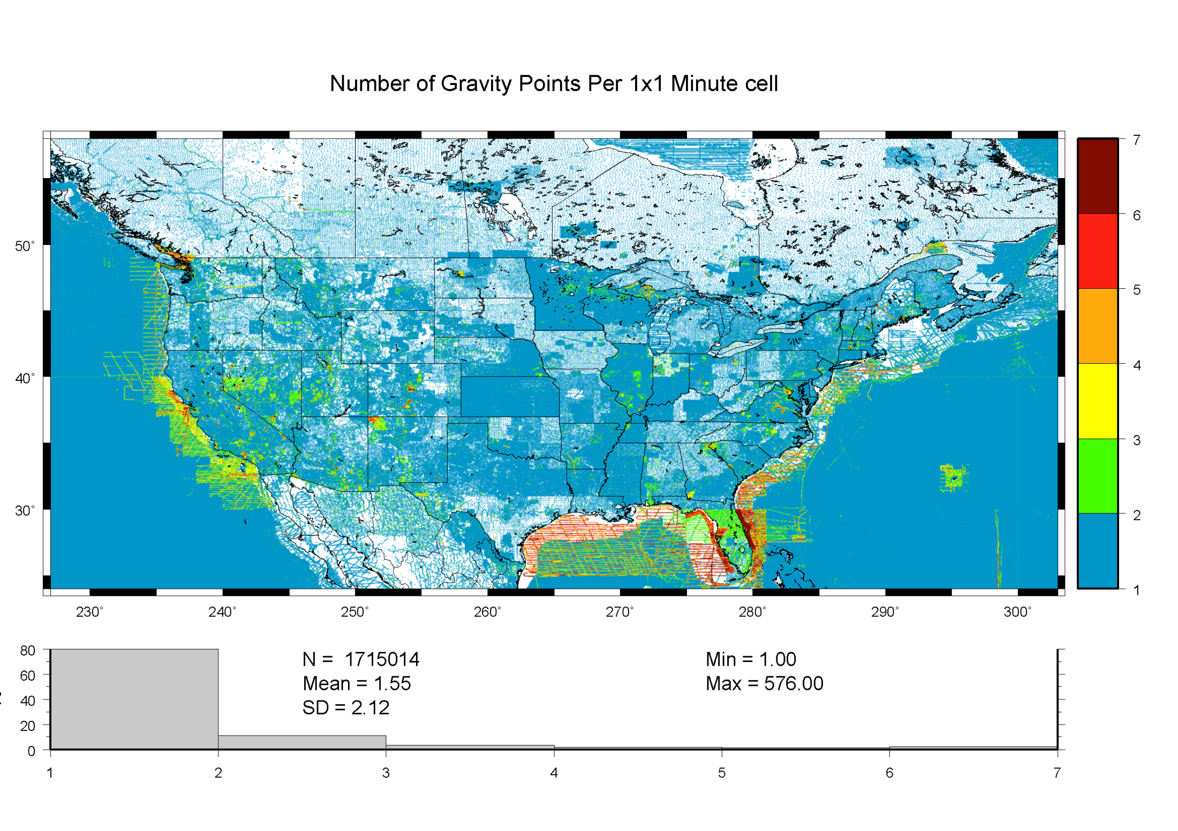
Notes:
5
This shows the extent of the gravity data that went info the USGG2009
Terrestrial data onshore; shipborne and altimetric data offshore.
Note the disparity in coverage. This is further reason for GRAV-D.

Slide 6
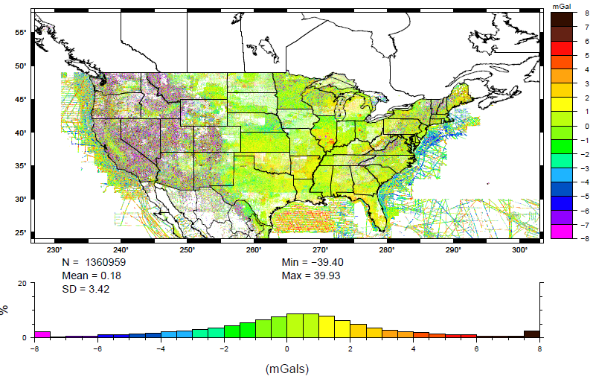
Residual gravity data for CONUS
Notes:
Residual gravity data in and around CONUS. About 2700 residuals with absolute value > 40 mGal were excluded, most of which belong to an old airborne gravity survey in north-east North Carolina, mistakenly classified in the NGS database as a surface survey.
Note systematic effects:
in Rockies – mix of Dark Brown and Deep Purple pretty much evenly
In middle Plain states: slightly yellowish trend

Slide 7
Long wavelength (deg 2-120) gravity errors
Notes:
Residuals formed using EGM2008 (121-2160) and RTM model from 3”-1’. Remaining signal is mainly indicative of long wavelength (degree 2-120) errors present in NGS data.
Doesn’t look like much – only a quarter milligal, right?

Slide 8
Long wavelength (deg 2-120) geoid errors
Notes:
Associated geoid signal with previous long wavelength gravity errors
However, this is very much a systematic effect and leads to a huge signal

Slide 9
Internal Crossovers Between 1489 Surveys
Notes:
About 1000 ICOE greater than 40 mgal were excluded here – old aerogravity data
Tends to be blotchy because these can ONLY be over the region of each survey
So we looked to see how well the data behave WITHIN any given survey

Slide 10
External Crossovers Between 1489 Surveys
Notes:
Keep in mind the impact that apparently minor systematic gravity signal had on the geoid (slides 4-5)
Note errors in Illinois, Minnesota – these are big enough GRACE/GOCE should help – first click
What about smaller features though – second click –features of this scale and magnitude have caused multi-dm errors in the Gulf Coast
Keep in mind, these aren’t all the errors – just the ones I expect to find based on data analysis

Slide 11
244 Surveys with Significant Biases
Notes:
The bias from the residuals formed WRT EGM2008 was greater than the SD
Again, there are many obvious surveys that GRACE/GOCE would catch – first click
… but many smaller ones that would otherwise have been missed leaving significant errors – second click
Again, these ar just the ones I expect to find – not necessarily all of those that exist.

Slide 12
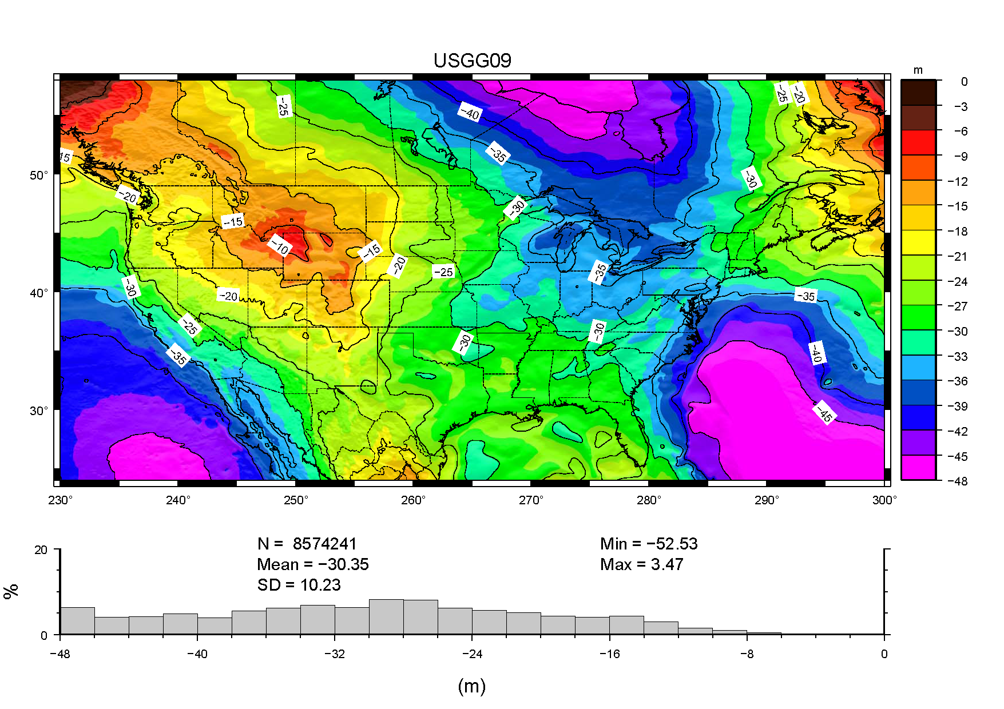
Notes:
Visually, this is identical to USGG2003 or even GEOID09.

Slide 13
Notes:
One difference in USGG2009, was that more points were dropped.
Most of these rejected points were in the northern Rockies – hence, the big shift there.
Offshore of the East coast and in Hudson Bay, you see the differences caused by shifting altimetric anomaly models (GSFC00.1 to DNSC08).
13

Slide 14
USGG2009 Summary
Based in ITRF 00
  Converts from ITRF 00 to selected geoid surface
  Does not convert between NAD 83 and NAVD 88
Best for scientific applications
  It’s geocentric and has data offshore
  Tied to universally accepted global model (GRACE)
Significant changes from USGG2003
  Multi-dm to meter level
Notes:
Transition to GEOID09 development.
Rehash hybrid geoid development
- start from the USGG2009 model
- then look at any changes in the GPS-derived ellipsoid heights on leveled bench marks (GPSBM’s).

Slide 15
Hybrid Geoids
Earth’s Surface
h
h
h
h
h
H
H
Ellipsoid
H
H
N
H
N
N
N
N
Hybrid Geoid =~ NAVD 88
NGS Gravimetric Geoid
Gravimetric Geoid systematic misfit with benchmarks
Hybrid Geoid biased to fit local benchmarks
e = h – H - N
Notes:
to transform from the NGS gravimetric geoid to NAVD 88 is more complicated
Gravimetric geoid is from derived from gravity measurements
NAVD 88 bench marks are adjusted using a sea level height at Point au Pere (Father Point) in Rimouski, Canada
There is going to be a slight difference between the two. If we want to use geoid to compute NAVD 88 heights, it must be consistent with the NAVD 88
Therefore we “bias” the geoid to be consistent with the NAVD 88 using high accuracy GPS on NAVD 88 bench marks.
Use Least Squares Collocation to determine the systematic components while allowing for random GPS observation errors (2-5 cm standard).
-Use the control points (GPSBM’s) to define a surface that can be interpolated to make internally consistent predictions (precision versus accuracy).
As you can easily see, the quality and distribution of the control, data will directly impact the quality of the predictions.
also note that the error vector residual (e) is a function of all the errors sources: from the GPS observations (usually random, but each HARN could have systematic errors), the gravimetric geoid height model (errors in gravity & terrain data as well as theoretical/processing errors can contribute here) as well as any errors in the NAVD 88 network.

Slide 16

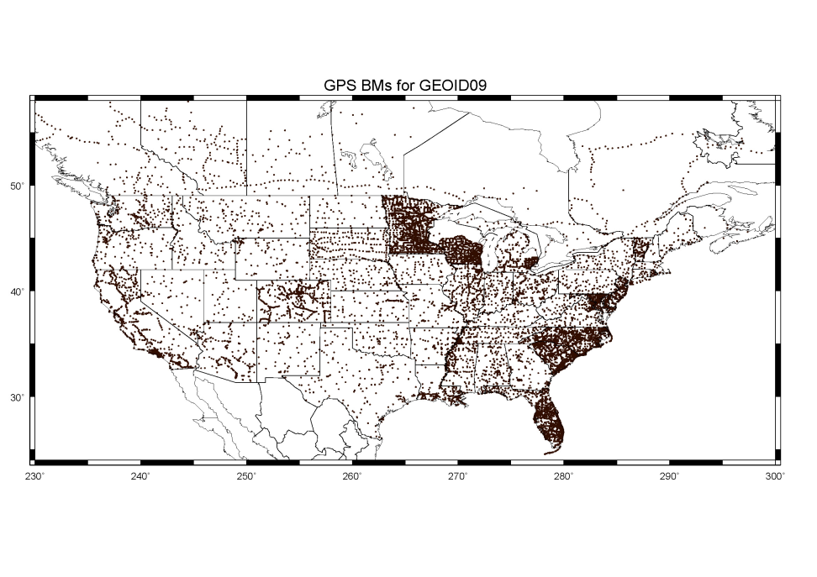
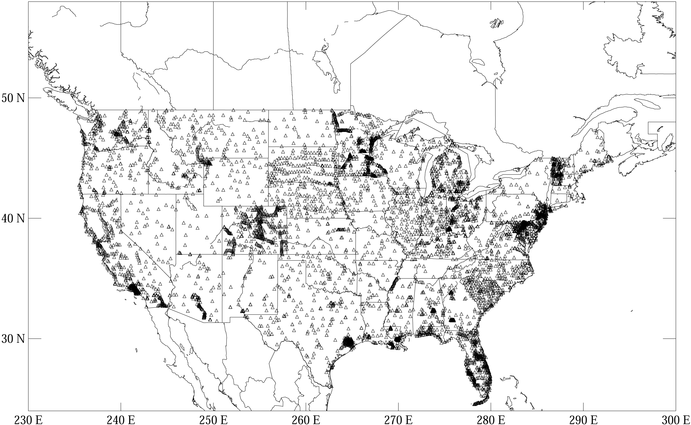
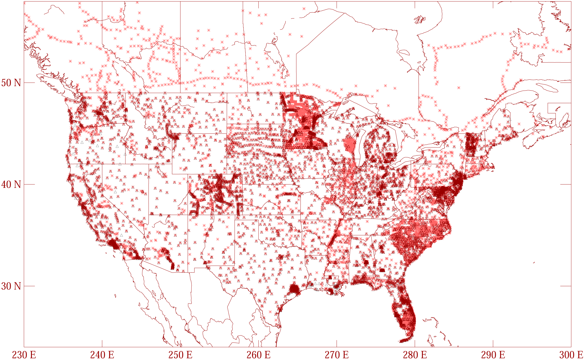
1003 rejections based on:
S: State adviser
h: ell ht err (NRA)
H: ortho ht err
N: geoid err (misfit)
D: duplicate
GPSBM1999: 6,169 total 0 Canada STDEV 9.2 cm (2σ)
GPSBM2003: 14,185 total 579 Canada STDEV 4.8 cm (2 σ)
GPSBM2009: 18,867 total 576 Canada STDEV 3.0 cm (2 σ)
Notes:
These are the control data used to make xGEOID06a, GEOID03 and GEOID99 (GPS on bench marks: GPSBM’s).
Improvements in Distribution are primarily due to obtaining data in Canada.
The bulk of the increase comes in one state: Minnesota (603 => 4161).
Note the inequitable distribution.
You could practically grid the GPSBM’s in South Carolina or Minnesota and get a good result.
Other places are not so fortunate…
Also note that this shows distribution but not quality of the points.
Some regions (e.g., Texas) have systematic quality problems (due to subsidence) that impact the GPSBM’s and the derived hybrid geoids.
Current techniques rely on creating models of the systematic effects at multiple wavelengths. If the spatial density doesn’t support the shorter wavelength models, then the quality of predictions will commensurately be reduced.
Note that a hyper-dense survey isn’t necessary to achieve optimal results. Later discussion on Minnesota will emphasize this.

Slide 17
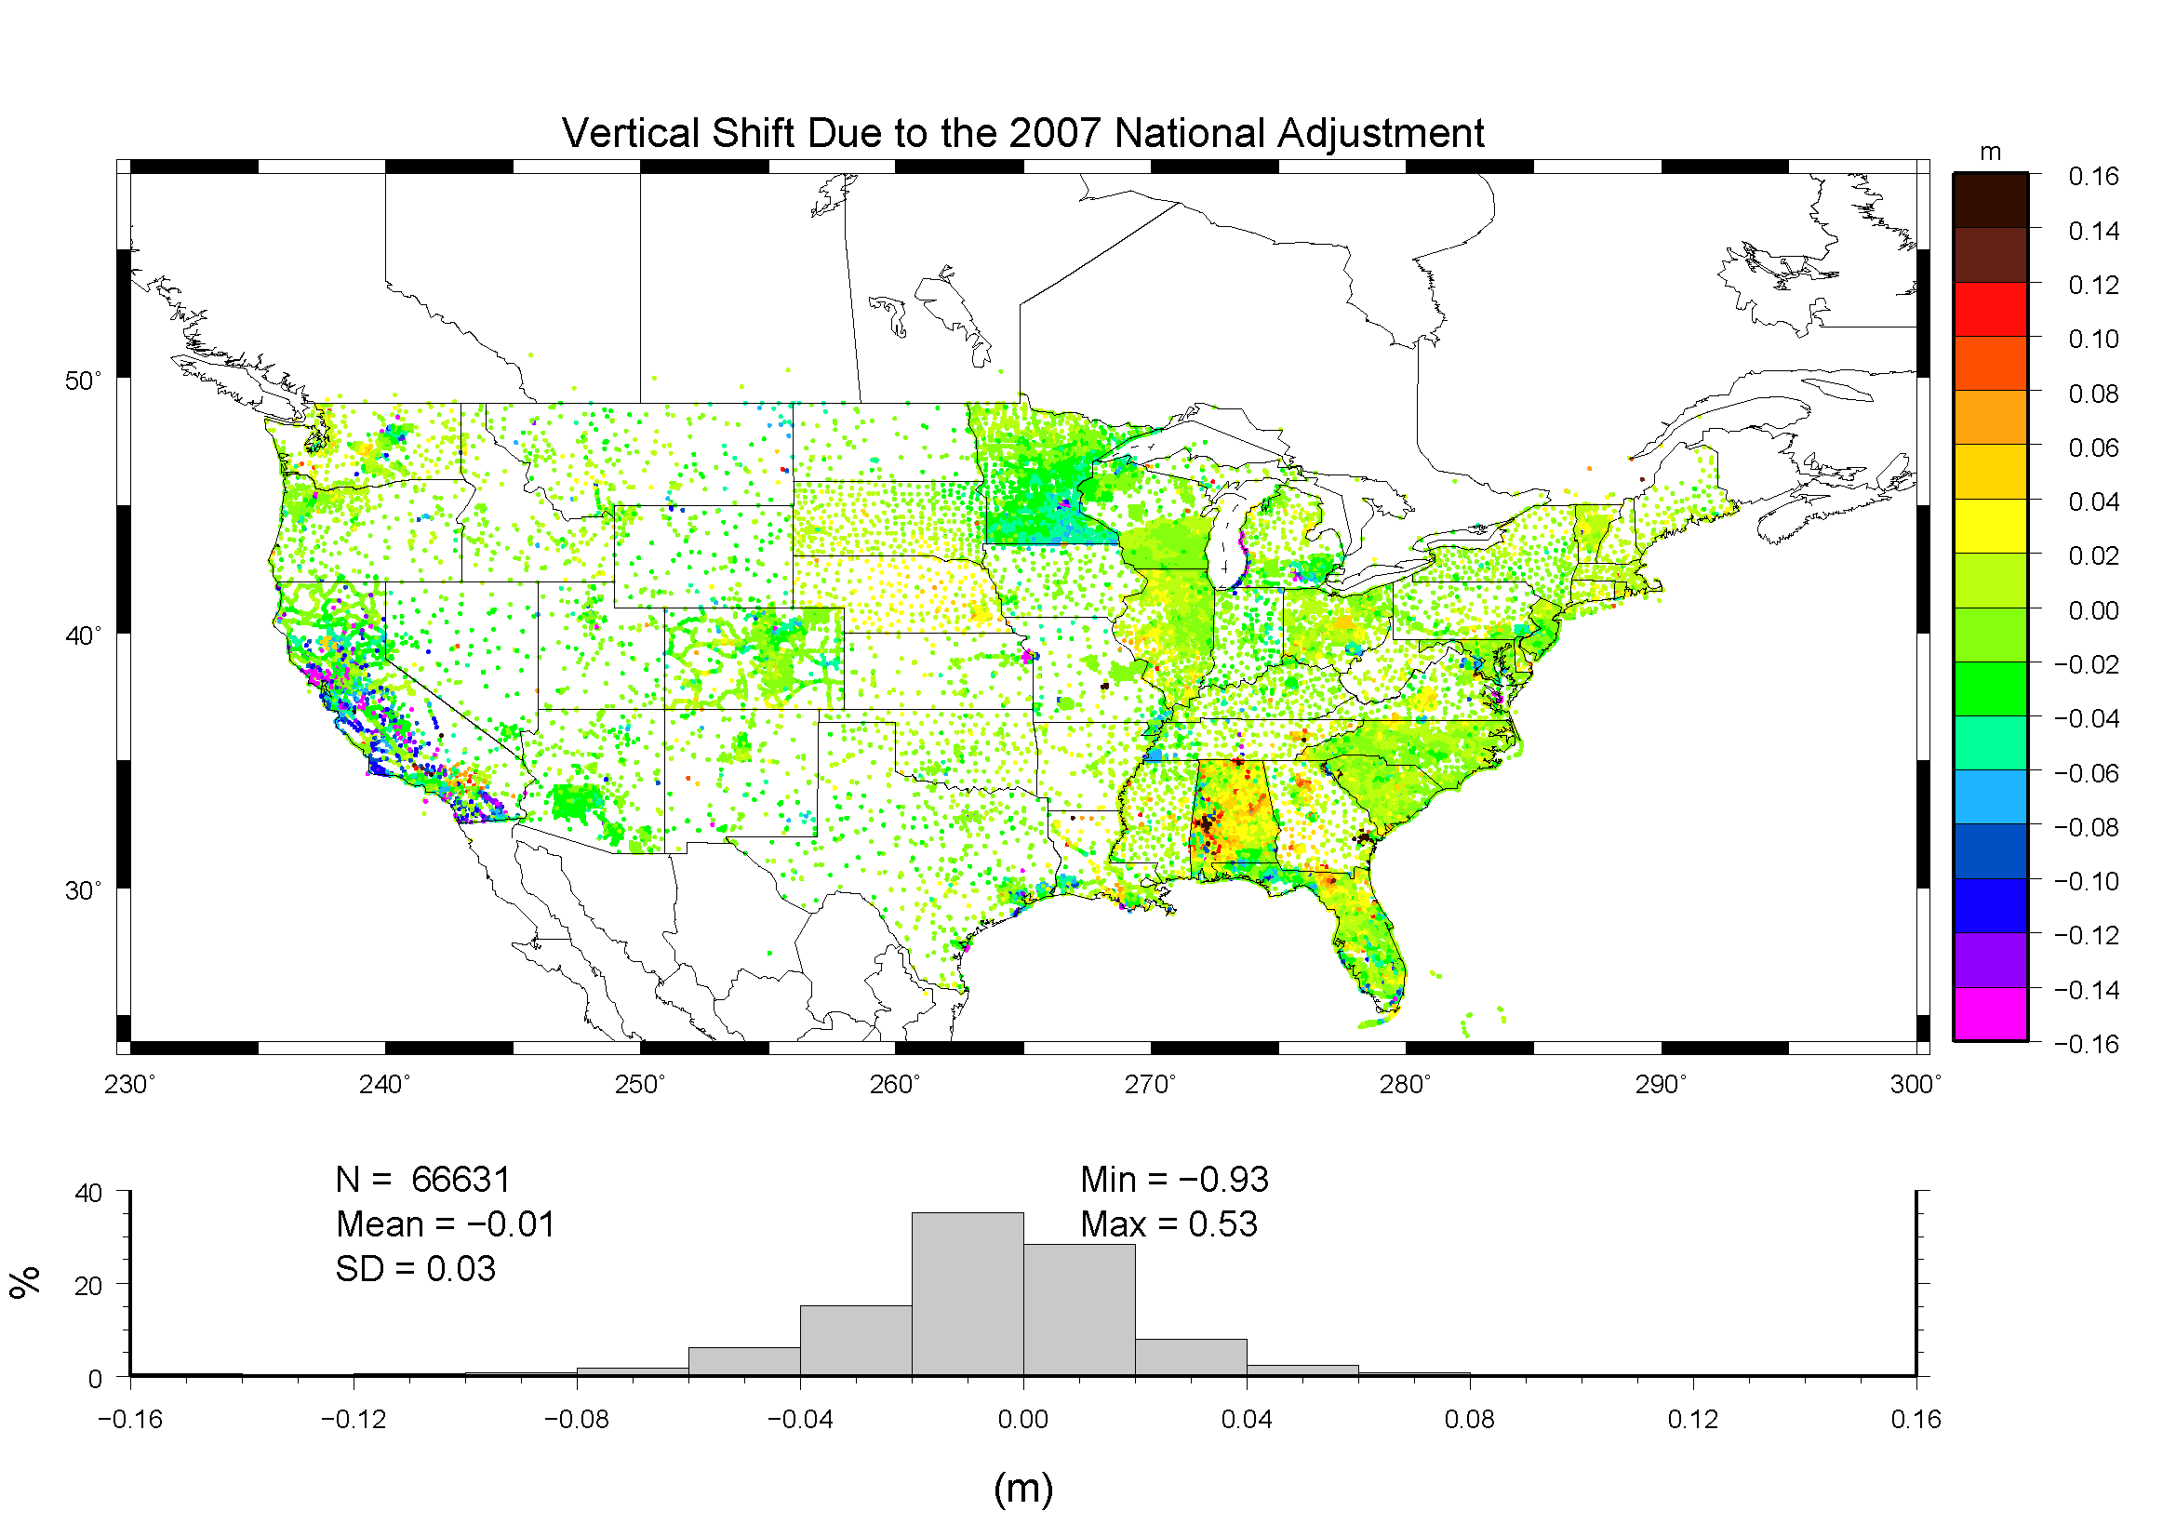
Notes:
… and, low and behold, there were big changes here – mainly due to NA 2007
Note significant problems in CA, NE, MN,and AL.

Slide 18
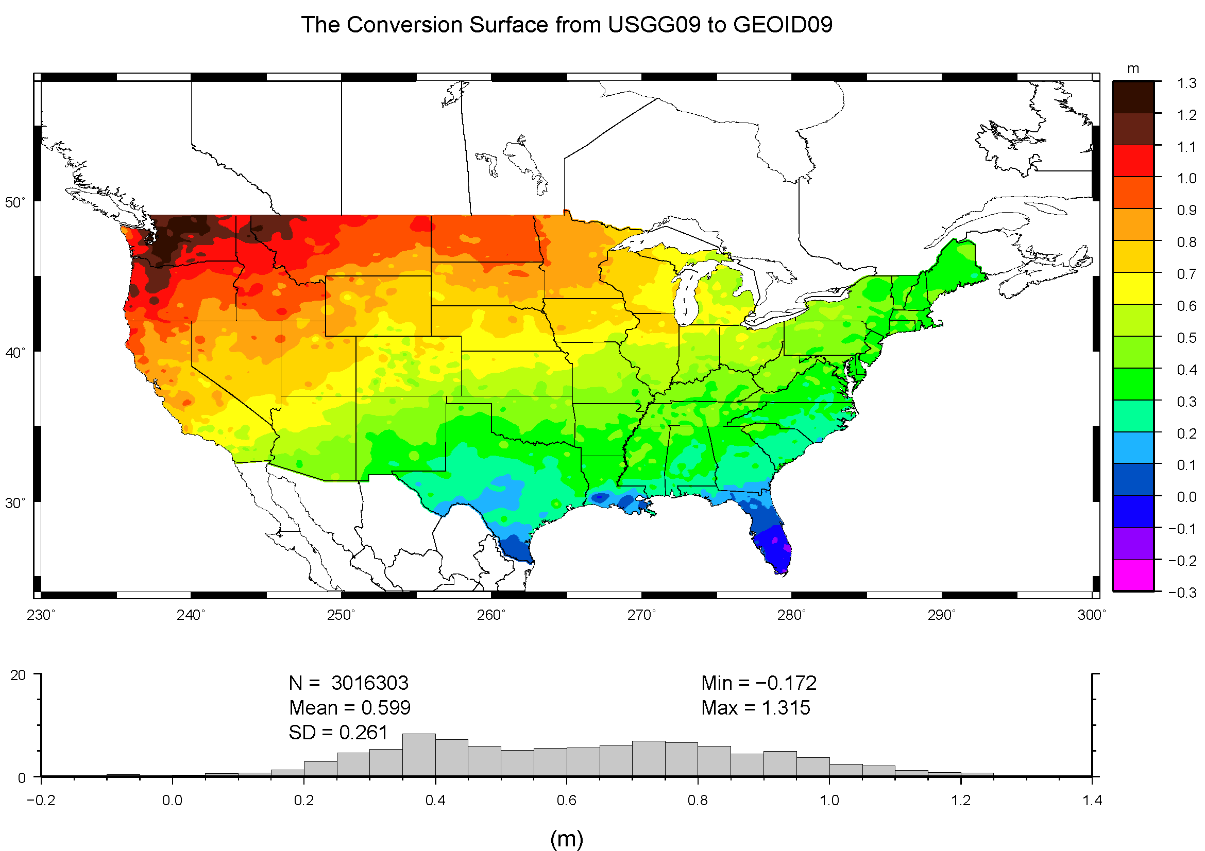
Notes:
This primarily accounts for NAVD 88 trend.
The shift from ITRF 00 to NAD 83 is not accounted for here – that adds another meter or so trend surface.

Slide 19
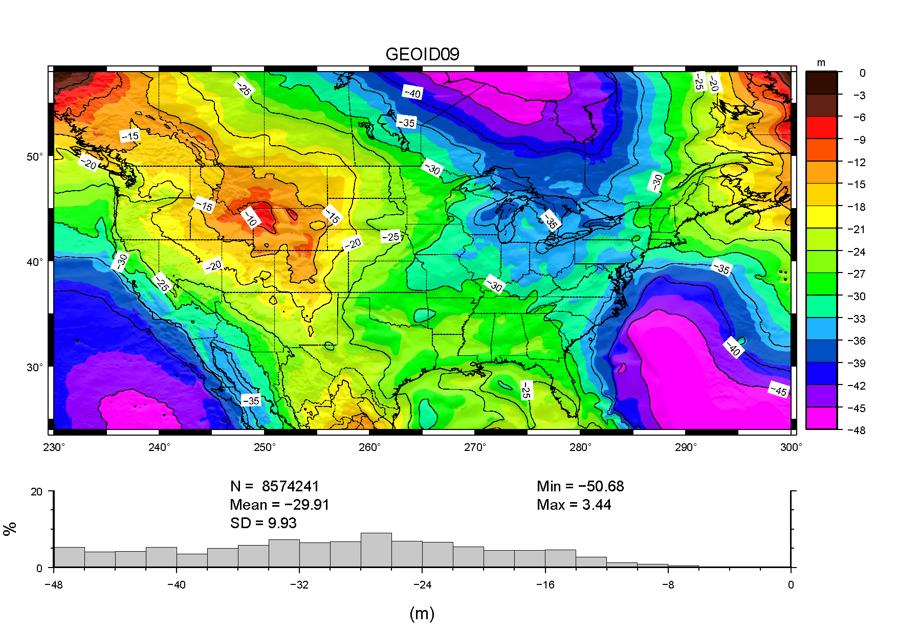

Slide 20
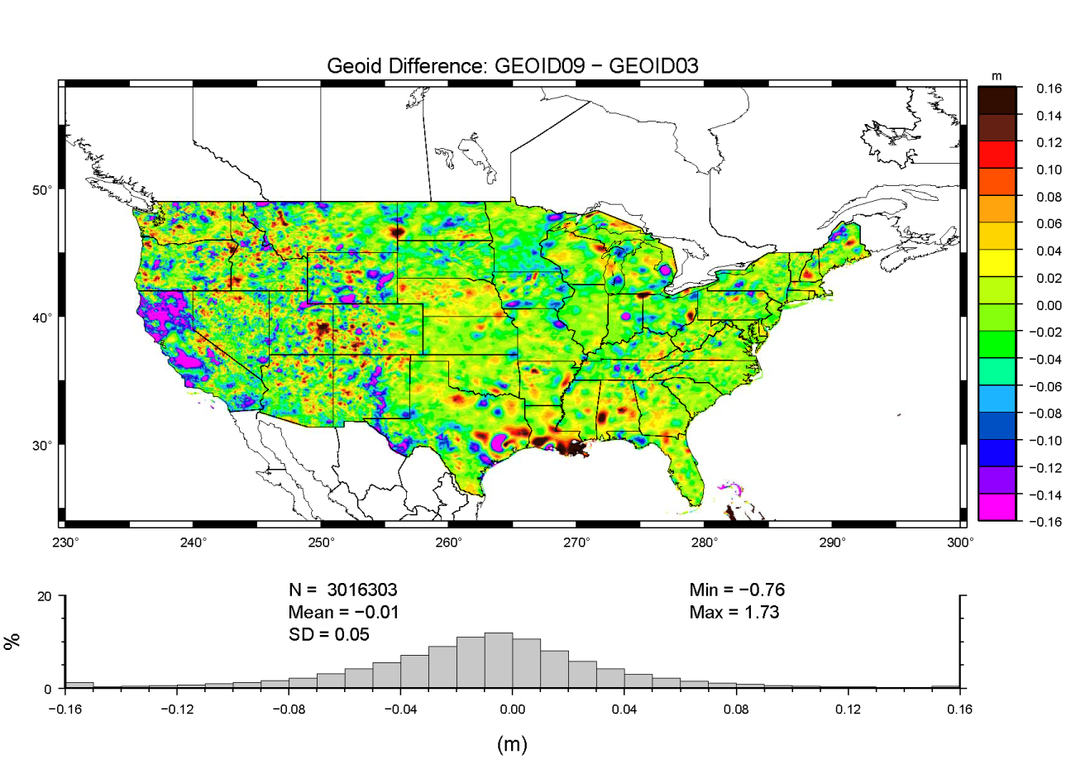
Houston –Galvest.
Region
LA Subsid.
Region
Notes:
Note significant differences between the models.
Most are attributable to changes in the ellipsoidal coordinates (NSRS 2007). See similarities with that slide.
A lot of the signal differences in the western state are due to changes in the underlying gravimetric geoid (USGG2009).
Louisiana is mainly a function of redefining the ellipsoidally determined orthometric heights.

Slide 21
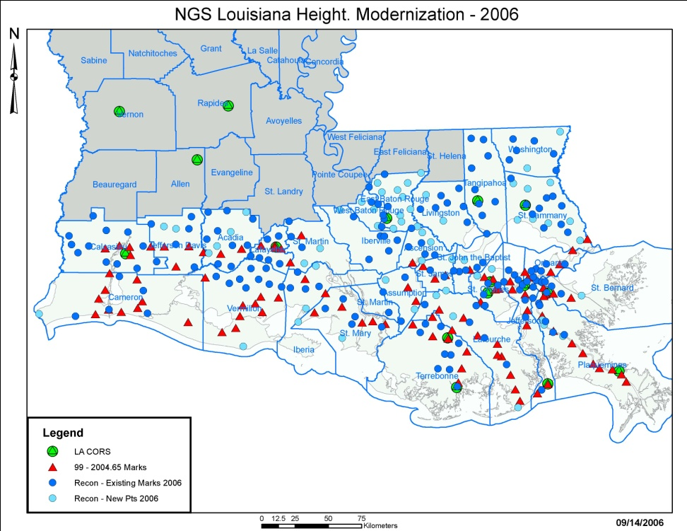
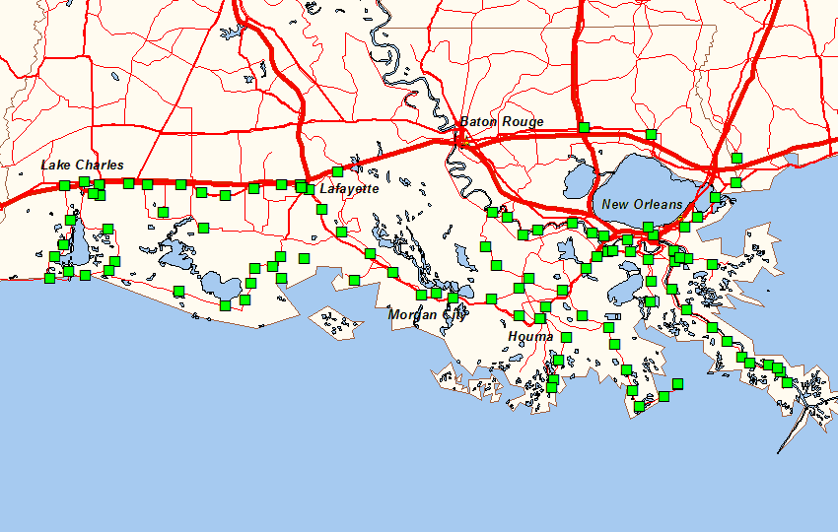
LA differences result from use of GPS-derived orthometric heights
HT MOD 2004 => GEOID03 *
HT MOD 2006 => GEOID09
Notes:
Since the “orthometric” heights changed, the NA 2007 changes weren’t the cause of the differences here.
Significant changes have occurred between models, but is it real?
The changes (and the models) are only as good as the HT MOD surveys used in these regions.
A concurrent survey of GPS on *new* leveling would help tremendously and hold value even after subsidence.

Slide 22
GEOID09 Summary
Converts between NAD 83 and NAVD 88
  Most useful for the surveying community
Built from the GPS solutions on leveled BM’s
  Starts from USGG2009 but warps to fit NAVD 88
  Systematic errors in NAVD 88 are passed to model
GEOID09 is precise to 3 cm at 95% conf. level
It is just as inaccurate as NAVD 88 (m-level bias/trend)

Slide 23
15 Minute Break

Slide 24
OUTLINE
Where we are (45 minutes)
  USGG2009  GEOID09
  Gravity Database Analysis
Break (15 minutes)
Where we are going (45 minutes)
  USGG2012  GEOID12
  GRAV-D  OPUS-DB
Questions (15 minutes)

Slide 25
USGG2012
Similar techniques as for USGG2009
  Use a modified kernel to force fit to reference
GOCE to supplement GRACE for reference
3”-5’ RTM will be used
Probably no aerogravity yet
  Need to assess behavior at survey edges
  Intend to use cleaned terrestrial data

Slide 26
GRAV-D Processing Update
Alabama (‘08) and 2008 Alaska survey already delivered to Geoid team (Newton v1.1)
Next major version of aerogravity processing software is complete by week’s end (Newton 1.2)
Newton 1.2 data for Alabama and Louisiana will be delivered to geoid team by month’s end; other surveys will quickly follow
LA/AL airborne gravity data will release publicly in next month via a web page designed to share data
Still partnering for flights; seeking a dedicated plane

Slide 27
GRAV-D Survey Plans
FY 2011:
  Alaska
  California/Oregon coastline
  Eastern Great Lakes Region
  As of June 1, 13.45% of total area has been surveyed
FY2012:
  Great Lakes region
  Washington State
  California
FY2013:
  Finish Great Lakes
  TBD
Notes:
GRAV-D will provide a means of normalizing all the biases and other problems and bridge the gap between the satellite data and the surface data.

Slide 28
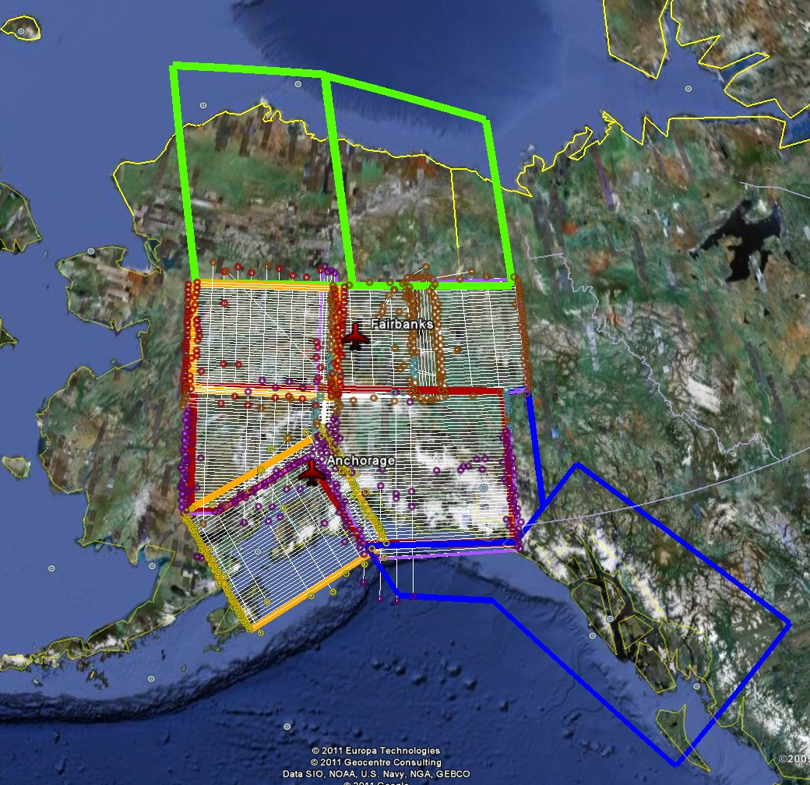
Alaska FY11
FY10 = Green
FY11 = Blue
FY12 = Orange
Lines show areas already flown, the open polygons are planned

Slide 29
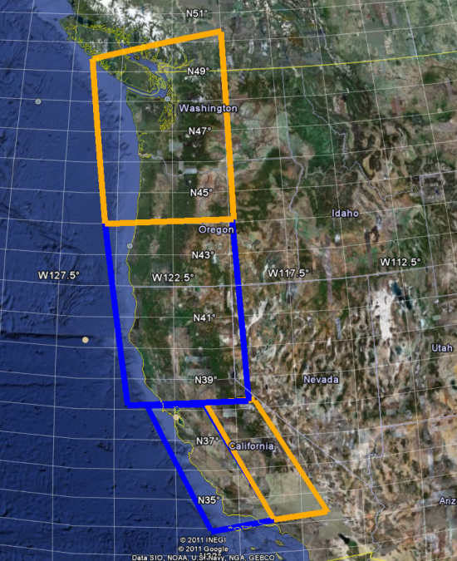
California FY11-FY12
FY11 = Blue
FY12 = Orange
(FY11 Already Flown)
Blue polygon complete, white polygon ~50%

Slide 30
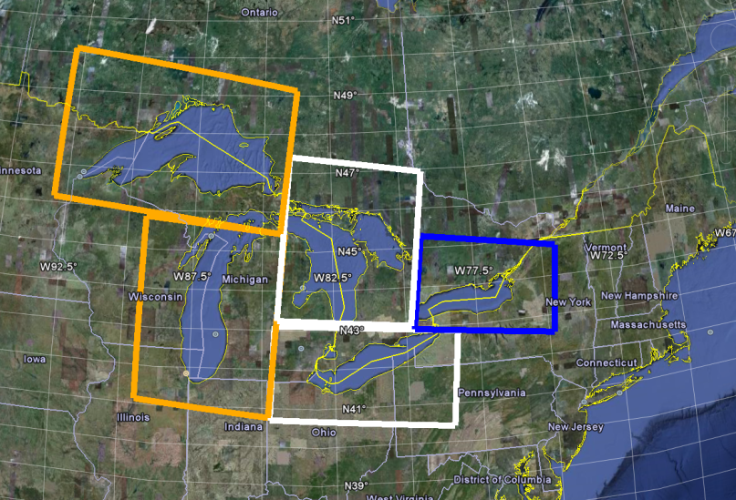
FY10-13 Great Lakes Plan
FY11 = Blue
FY12 = Orange
FY13 = White
FY12 = White, FY13 = Orange

Slide 31
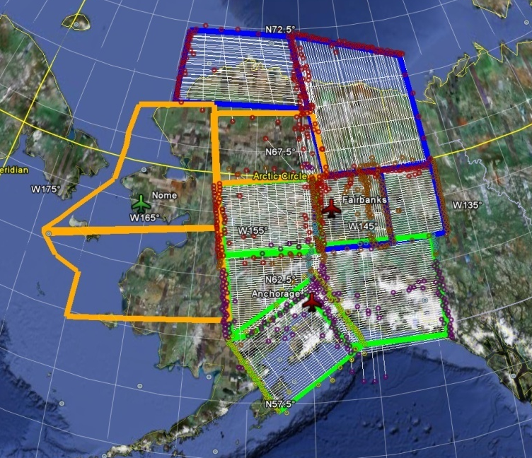
Alaska FY11
West Coast FY11-12
(FY11 Already
Flown)
FY11-13 Great Lakes Plan
FY10 = Green
FY11 = Blue
FY12 = Orange
FY13 = White

Slide 32
USGG2012 Summary
USGG2012 regions will be same as USGG2009
  CONUS, AK, HI, PR/VI, Am. Samoa, Guam, & CNMI
  Likely based in ITRF 08
Incorporating GRAV-D aerogravity still pending
W₀ value currently being decided upon
  Common datum for U.S.A., Canada, & IGLD 15
  Based on best fit to MSL in around North America

Slide 33
GEOID12
Driven in part by USGG2012
Mainly driven by NA 2011
  Ellipsoidal heights will change again
  Form part of the residual in hybrid geoid modeling
  Significant, systematic changes in ellipsoid require a new hybrid geoid to be generated
The aim is to deliver NA 2011 by the end of CY
Look for GEOID12 shortly after NA 2011 release

Slide 34
Discussion about NA 2011
This adjustment use same vectors as NA 2007
However, they’ll be tied to CORS coordinates developed after the recent multi-year solution
NA 2011 results will provide more consistency between CORS/OPUS solutions & passive control
Michael Dennis is lead and Jarir Saleh is technical lead

Slide 35
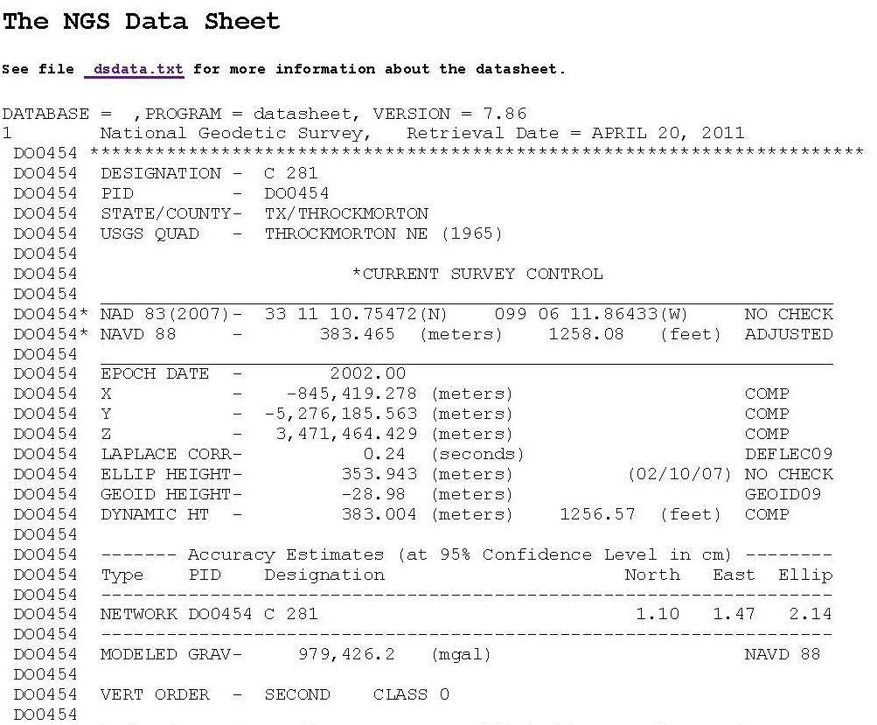
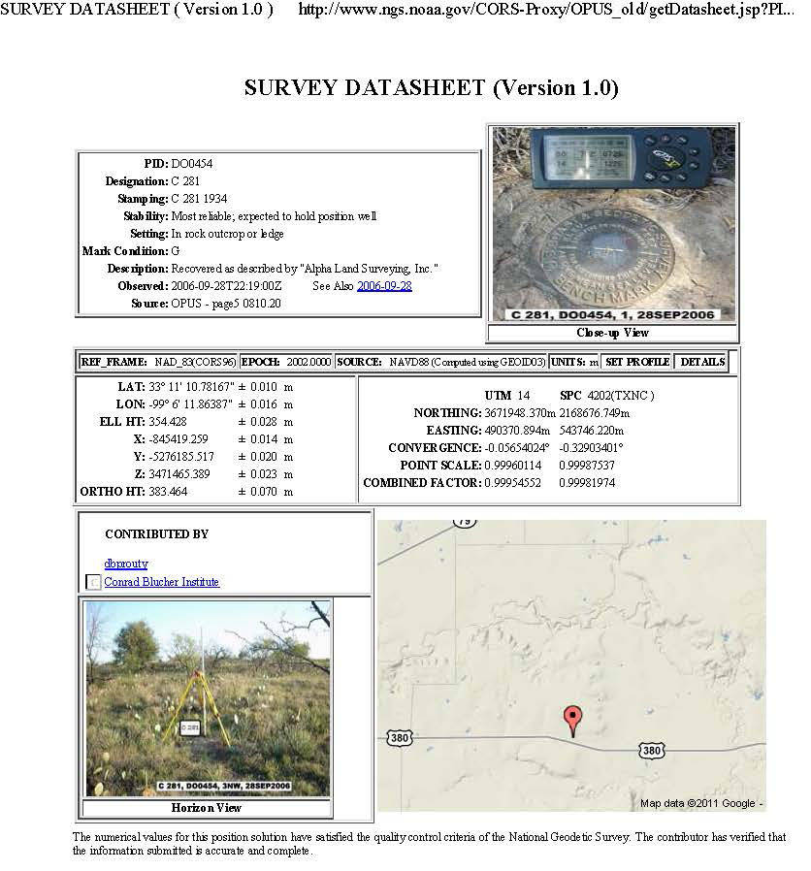
NGSIDB Versus OPUS-DB
NGSIDB
  Passive control
  Episodically refined (NRA2011)
  Traditional surveying
  A lot of (important!) numbers and text
OPUS-DB
  Actively determined from CORS
  Constantly refined
  GPS Surveying
  A lot of numbers/text and some useful graphics/images

Slide 36
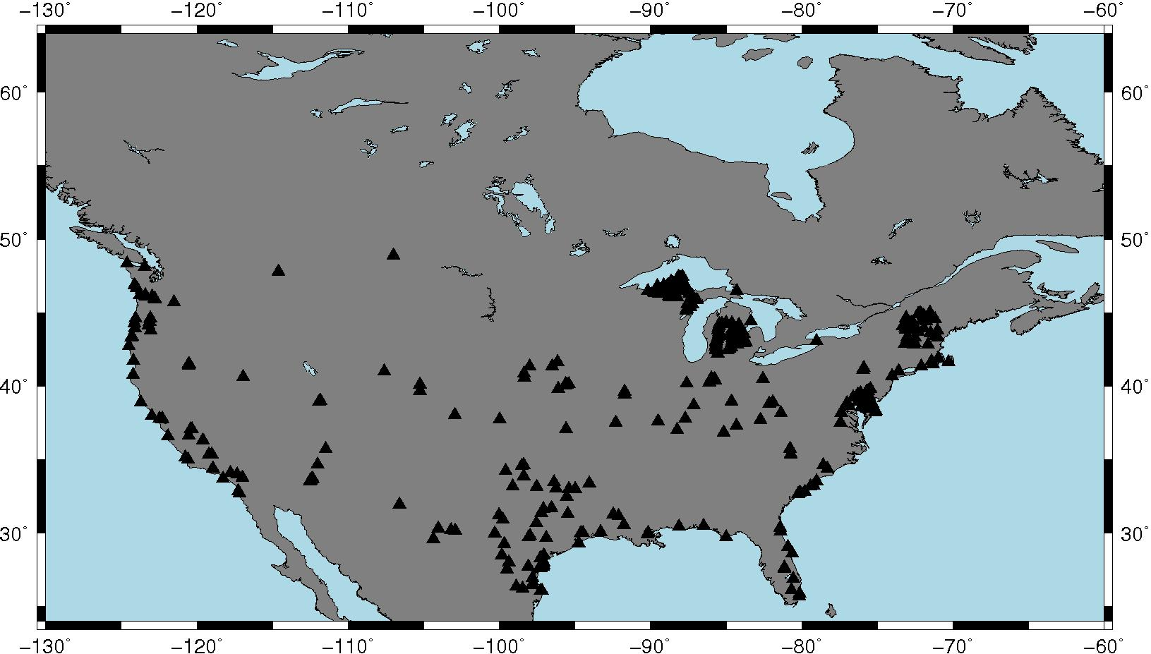
Leveled Bench Marks Occupied by GPS and stored in OPUS-DB
Notes:
80 are in common with NGSIDB and were used in making GEOID09
57 are in common with NGSIDB and were *NOT* used in making GEOID09
285 are new points never before occupied with GPS
Distribution is fair, but you can see that some states are more active than others

Slide 37
Statistics of the 422 OPUS-DB Points
 |  | A |  | B |  | C
Groups of the 422 points pulled from OPUS-DB | No. Pts | NGSIDB Res. |  | OPUS-DB Res. |  | OPUS-DB–NGSIDB
 |  | Ave | SD | Ave. | SD | Ave | SD
(1.a) All Common Points that were used in GEOID09 | 80 | -0.009 | 0.065 | 0.004 | 0.036 | 0.013 | 0.060
(1.b) Common Points less the 9 rejects | 71 | -0.004 | 0.015 | 0.003 | 0.031 | 0.006 | 0.028
(2) Common Points but not used to make GEOID09 | 57 | 0.001 | 0.043 | 0.007 | 0.037 | 0.006 | 0.044
(3.a) Points Not Previously Observed with GPS | 285 | n/a | n/a | -0.011 | 0.112 | n/a | n/a
(3.b) Points Not Previously Observed less the 11 rejects | 274 | n/a | n/a | -0.008 | 0.047 | n/a | n/a
New Control Data
Notes:
First line is all the data used in making GEOID09. Well, of course the NGSIDB data do better – they were used to make GEOID09
Second line is a refinement of the first and highlights that removing problem data always helps the numbers.
Third line is first real head-to-head comparison. These are points in b oth NGSIDB and OPUS-DB (i.e., ellipsoid heights on both). OPUS-DB does better.
It is worth noting that these points were rejected from use in making GEOID09 because they were poorer in quality – but still OPUS-DB did better on the BM’s.
The fourth and fifth lines are for the new points where no previous GPS observations had been made. These represent real no data.

Slide 38
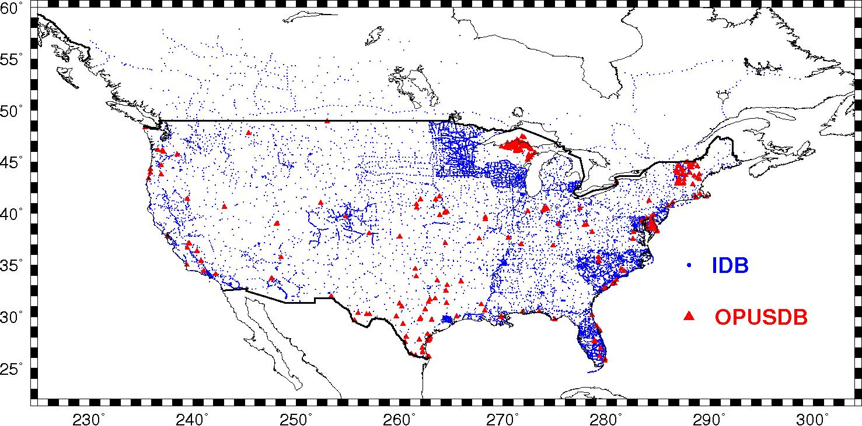
Plot of GPSBM’s with 274 new OPUS-DB pts overlaid
Notes:
Note that many of the new points are in distinct clusters and that the rest are scattered across the country.
Those collected in clustered in VT and DE overlap significant local GPSBM groups.
The cluster in northern WI represents a densification not see in the underlying region.

Slide 39
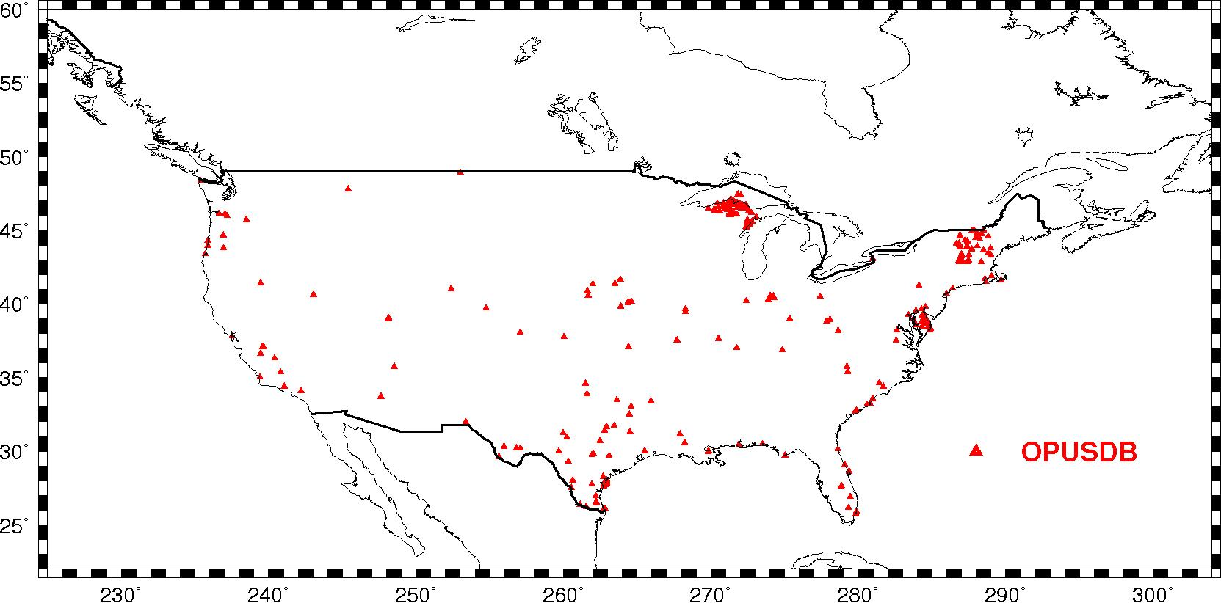
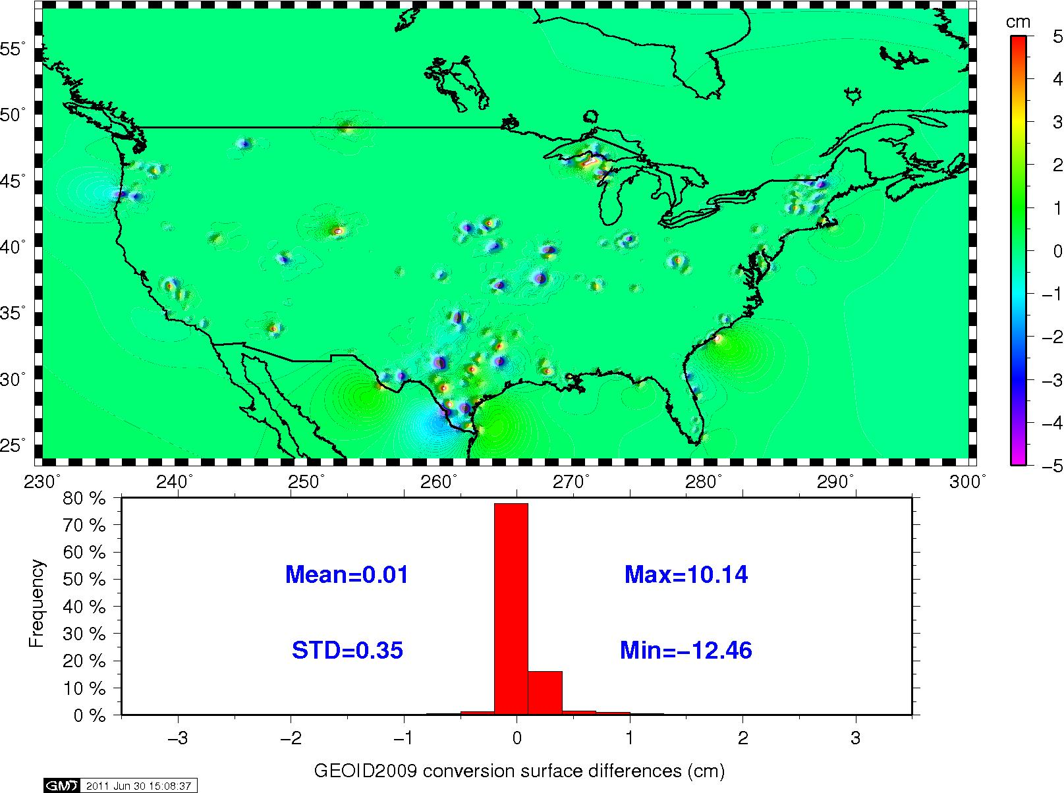
Change in Conversion Surface due to use of OPUS-DB
Overlay of
OPUS-DB Points
Notes:
The first thing to note is that the effect of including OPS-DB is primarily local around the points. This is because of the use of Least Squares Collocation with stacked matrices and the shortest correlation length being 30 km. This means that any changes seen will likely be limited to a 30-60 km scale, which is still significant for local surveying.
The cluster in DE and VT had relatively little impact, most probably because the OPUS-DB results are agreeable with the underlying GPSBM’s from NGSIDB.
The cluster in WI had more effect.
The most wide spread effect came in TX where the GPSBM’s were more widely scattered and interspersing OPUS-DB points greatly increased resolution.

Slide 40
Conclusions
Big changes from USGG2003 to USGG2009
  Changes in reference model & rejection criteria
Rejections will significantly drop in USGG2012 by incorporating 3”-5’ RTM
More changes from GEOID03 to GEOID09
  Mostly from NA 2007 (changes in ellipsoid height)
  Changes in Louisiana are from HT MOD survey changes to GPS-derived orthometric heights
NA 2011 will necessitate making GEOID12

Slide 41
Conclusions (cont.)
OPUS-DB shows great promise for filling gaps
BM’s can be targeted by State Advisers based on GPSBM coverage maps to provide supplement
Effects generally limited to 60 km but at dm-level
Best results came from interspersing between existing relatively sparse coverage (e.g., Texas)
Cannot help in south LA or Houston-Galveston
  OPUS-DB puts GPS on previously unoccupied leveling
  It cannot help make GPS-derived leveling better

Slide 42
QUESTIONS?

