Slide 1
Organizational Alphabet Soup: IGOs, NGOs & OGAs
Dr. Daniel R. Roman
Chief Geodesist

Slide 2
OGC
ASPRS
NGO’s
ISPRS
ISO
National Oceanic and
Atmospheric Administration
ASCE/UESI
NSPS
AAGS
FIG
OGA’s
IGO’s
FGDC
BIA
FAA
UN-GGIM
NOAA
FGCS
BOEM
UN-SCoG
USFS
OSMRE
NASA
UN-GGIM-Americas
FSA
USBR
UN-GGIM-AP
Alphabet Soup
EPA
IGS
IDS
National Ocean Service
Census
USGS
NOS
UN-GGIM-Europe
NIST
NPS
APREF
ILRS
OAS
TVA
USCG
BLM
EUREF
IVS
PAIGH
FCC
FEMA
FWS
SIRGAS
GGOS
GEO
National Geodetic Survey
OCS
NGS
CO-OPS
NGA
IBC
UN GGRF
ITRF
USACE
IBWC
IERS
IHRF
IHRS
ITRS
USNO
DOT
IAG
IUGG
AGU
EGU

Slide 3
Intent
Not just to spam you with acronyms
Explain why NGS engages with these groups
Expectations about what NGS will gain
Expectations about what it means for the U.S.

Slide 4
Other Government Agencies (OGA’s)
Many different agencies work with Geospatial Data
Geospatial Data Act (GDA) recently enacted
Codifies all geospatial activities by the United States Government (USG)
Seeks to ensure that all government data is collected in a consistent and accurate manner
Data maintained at appropriate website (data.gov)
Federal Geospatial Data Committee (FGDC) coordinates

Slide 5
Federal Geospatial Data Committee (FGDC)

Slide 6
Active Subcommittees of the FGDC
3D Nation Elevation
Address
Cadastral
Cultural Resources
Federal Geodetic Control
Geologic Data
Homeland Infrastructure Foundation Level Data (HIFLD)
Marine and Coastal Spatial Data
National Digital Orthoimagery Program
Spatial Water Data
Transportation
Vegetation
Wetlands
Note that many aspects of these subcommittees are
in limbo until the final OMB Circular A-16 is released.

Slide 7
Federal Geodetic Control Subcommittee (FGCS)
Having a single reference system is necessary
NGS’s mission is to define, maintain and provide access to the National Spatial Reference System (NSRS)
Role of NGS has been to lead the Federal Geodetic Control Subcommittee (FGCS) inside the FGDC

Slide 8
FGCS Membership
DEPARTMENT OF AGRICULTURE
USFS –US Forestry Service
FSA – Farm Service Agency
DEPARTMENT OF COMMERCE
Census
NIST – National Institute of Standards & Technology
NOAA – National Oceanic and Atmospheric Administration
DEPARTMENT OF HOMELAND SECURITY
USCG – US Coast Guard
FEMA – Federal Emergency Management Agency
DEPARTMENT OF DEFENSE
NGA – National Geospatial-Intelligence Agency
USACE – US Army Corps of Engineers
USNO – US Naval Observatory
DEPARTMENT OF THE INTERIOR
BIA – Bureau of Indian Affairs
BOEM – Bureau of Ocean Energy Management
OSMRE – Office of Surface Mining and Reclamation Enforcement
USBR – US Bureau of Reclamation
USGS – US Geological Survey
NPS – National Park Service
BLM – Bureau of Land Management
FWS – Fish and Wildlife Service
DEPARTMENT OF STATE
IBC – International Boundary Commission
IBWC – International Boundary and Water Commission
DEPARTMENT OF TRANSPORTATION
DOT – Department of Transportation
FAA – Federal Aviation Administration
INDEPENDENT AGENCIES
NASA – National Aeronautics and Space Administration
EPA – Environmental Protection Agency
TVA – Tennessee Valley Authority
FCC – Federal Communications Commission

Slide 9
InterGovernmental Organizations (IGO’s)
Includes:
Pan-American Institute on Geography and History (PAIGH)
Organization of American States (OAS)
Group on Earth Observations (GEO)
However, this primarily means the United Nations (UN) and subsidiary units of that
Participation means you represent the U.S.
Usually requires accreditation by State Dept.
IGO’s are involved in international governance
Notes:
GEOSS – Global Earth Observation System of Systems

Slide 10
Definitions
What is Governance?
Government. (Merriam-Webster)
Comprises all of the processes of governing – whether undertaken by the government of a state, by a market or by a network – over a social system (family, tribe, formal or informal organization, a territory or across territories) and whether through the laws, norms, power or language of an organized society. (Wikipedia)
What is an InterGovernmental Organization (IGO)?
An intergovernmental organization (IGO) is an organization composed primarily of sovereign states (referred to as member states), or of other intergovernmental organizations. IGOs are an important aspect of public international law. IGOs are established by a treaty that acts as a charter creating the group. Treaties are formed when lawful representatives (governments) of several states go through a ratification process, providing the IGO with an international legal personality. (Wikipedia)
Notes:
The Merriam-Webster definition for Governance was a bit too brief. Hence, I checked in with Wikipedia for a clearer definition.
Governance is about running things. In the case of countries, the definition then narrows to the government of the State.
An IGO is then composed of Member States that agree to work together through treaties and international laws.
UN-GGIM is then an IGO dedicated to the Governance of Geospatial Information matters and is comprised of sovereign States.

Slide 11
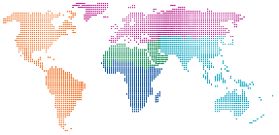
What does UN-GGIM do as an IGO?
Frameworks, guides,
norms, standards and
methodological
development
Normative strengthening,
capacity building and
implementation of GGIM
in support of the 2030 Agenda
Legal and policy frameworks and issues related to authoritative data
Adoption of standards and technical specifications
Strengthening global geospatial information management
Contribution of regional committees, thematic groups and networks
Trends in national institutional arrangements
Strengthening collaboration with UNGEGN
United Nations activities in geospatial information management
Secretariat programme management
UN-GGIM:
Strengthening
the Global Data
Ecosystem
Global geodetic reference frame
Global fundamental geospatial data themes
Integration of geospatial, statistical and other information
Land administration and management
Geospatial information for sustainable development
National geospatial data and information systems
Geospatial information and services for disasters
Marine geospatial information
The activities and efforts
that contribute to the
unique local-to-global
value of UN-GGIM
for Member States
Notes:
This is one of the stock slides provided to explain the work of UN-GGIM.
What you start to see in looking at their tasks is that the UN-GGIM mirrors the FGDC just at global scales.

Slide 12
United Nations Committee of Experts on Global Geospatial Information Management (UN-GGIM) Structure
Environmental Statistics and Geospatial Information Management Branch
United Nations Statistical Commission
UN-GGIM Committee of Experts
Co Chairs:
Mr. Li Pengde (China)
Ms. Dorine Burmanje (Netherlands)
Rapporteur:
Mr Fernand Isseri (Cameroon)
President:
Ms. Paloma Gomez (Mexico)
Vice President:
Ms. Macarena Perez
(Chile)
Secretariat:
Ms. Gabriela Seco
(Mexico)
Data Development and Outreach Branch
United Nations
Committee of Experts on Global Geospatial Information Management
Partners
Demographic and Social Statistics Branch
Working Group on the Integration of Statistical and Geospatial
Information
PAIGH
United Nations Group of Experts on Geographical Names (UN-GEGN)
UN-GGIM Asia Pacific
UN-GGIM Arab States
UN-GGIM Africa
UN-GGIM Europe
UN-GGIM Americas
Data Innovation
Branch
SIRGAS
Economic Statistics
Branch
Working Group on Access and Use of Geospatial
Information in Disaster Risk Reduction and Climate Change
GeoSUR
Subcommittee on Geodesy
Development of Shared Principles for the Management of Geospatial Information
Geospatial Societies
Association of
Caribbean States
Trends in National Institutional Arrangements in Geospatial Information Management
Working Group on promotion and assessment of Spatial Data Infrastructure
Academic Network
University of Guyana
Reports to Statistical Commission and
UN-GGIM
Expert Group on the Integration of Statistical and Geospatial Information
Geospatial Information and Services for Disasters
Private Sector Network
AMEXCID
Denotes the participation of the United States of America
Global Fundamental Geospatial
Data Themes
UN System Network
(under formation)
CDEMA
Expert Group on Land Administration and Management
Legal and Policy Frameworks for
Geospatial Information
Management
URISA Caribbean
Reports to Statistical Commission via the Inter-Agency and
Inter-Agency and Expert Group on Sustainable Goals Indicators (IAEG- SDGs) – Working Group on
Geospatial Information
Expert Group on SDG
Indicators and
UN-GGIM
Marine Geospatial Information
Joint Group on Standards
(IHO, ISO, OGC)
Notes:
This is the official organization and reporting structure.
In English, I would say this is an “eye chart.”
I’ll break it down a bit more in the next couple of slides

Slide 13
UN-GGIM Structure
Argentina: Diego Pinon
Canada: Calvin Klatt
Costa Rica: Álvaro Álvarez
Jamaica: Nolan Aikens
Mexico: Francisco Parra United States: Daniel Roman Uruguay: Gustavo Fabián Caubarrere Diab
SubCommittee on Geodesy (UN SCoG)
EG on Land Administration and Management
EG on the Integration of Statistical and Geospatial Information
WG on Development of a Statement of Shared Principles for the Management of Geospatial Information
WG on Trends in National Institutional Arrangements in Geospatial Information Management
WG on Geospatial Information and Services for Disasters
WG on Global Fundamental Geospatial Data Themes
WG on Legal and Policy Frameworks for Geospatial Information Management
WG on Marine Geospatial Information
United Nations
Department of Economic and Social Affairs (ECOSOC)
Statistics Division
United Nations Global Geospatial Information Management (UN-GGIM)
UN-GGIM Asia-Pacific | UN-GGIM Americas | UN-GGIM Arab States | UN-GGIM Europe | UN-GGIM Africa
UN-GGIM adopted the GGRF – that is, all Nations have agreed to use a common reference frame based on the ITRS.
The UN-SCoG is tasked with implementing the GGRF globally.
That agreement and the obligation to adopt the GGRF was
also passed through to the Regional Committees (RCs).
Notes:
This a little easier to read and understand. The hierarchical organization is clearer.
The UN-GGIM adopted the Global Geodetic Reference Frame (GGRF), which I’ll go into detail on later.
UN-GGIM tasked the UN-SCoG with implementing the GGRF at the global level.
The RC Member States collectively form the broader UN-GGIM organization, and they inherited the responsibility for implementing the GGRF in their regions.
Additionally, the RC contribute members to the UN SCoG as well as the EG’s, and WG’s. (click)
There are seven people from the Americas RC who serve on the UN SCoG. (click)
They are shown here. (click)

Slide 14
What is the UN Global Geodetic Reference Frame?
Conceptually, the GGRF encompasses all aspects of the a modernized reference frame including the geodetic infrastructure (GI), Education Training and Capacity Building (ETCB), Governance (GOV), Outreach and Communication (OC) as well as Policies Standards and Conventions (PSC).
Includes both International Terrestrial Reference System (ITRS) and the International Height Reference System (IHRS)
The ITRS focuses on a framework for GNSS applications in an ellipsoidal framework
The IHRS focuses on a framework for physical heights (i.e., leveling, heights above “MSL”)
Both the ITRS and the IHRS are determined and maintained by the International Association of Geodesy (IAG)
The ITRS is very robust and mature, while the IHRS is nascent but growing
Standards are developed and maintained by ISO and OGC
The UN SCoG was tasked with developing a Roadmap and implementation plan to put the GGRF in place.
Notes:
A system is how you do things, whereas a frame is a specific realization within the system.
Except in this case the GGRF is actually more of political construct.
While the ITRS is very mature, the infrastructure behind is very mature – to the point of degradation and potential loss of functionality.
ISO – International Standards Organization
OGC – Open Geospatial Consortium
This has been one of the primary motivations for elevating the concerns of the GGRF to the UN. Scientific groups cannot continue sustain this on their own.
The IHRS is still evolving and growing.

Slide 15
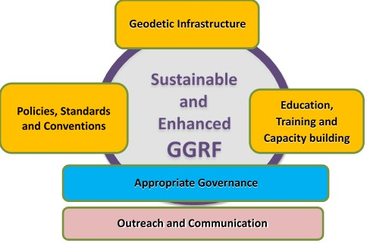
GGRF road map key issue categories
Global Geodetic Center of Excellence
(GGCE)
Notes:
The road map has five key issue categories, reflecting five of the six the operational paragraphs in the resolution.
Develop a global geodetic roadmap for the GGRF
Global cooperation in providing technical assistance in geodesy for those countries in need to ensure the development, sustainability and advancement of a GGRF
Implement open geodetic data sharing
Improve and maintain national geodetic infrastructure
Enhanced multilateral cooperation that addresses infrastructure gaps and duplications globally
Improved Outreach to make the GGRF more visible and understandable to society
While all categories are critical to the success of the GGRF, I will focus on Governance here. The other areas usually involve some overlap with other scientific, technical and administrative organizations. Governance, as we have defined at the outset of this talk, is the one category under the purview of governments.

Slide 16
Non-Governmental Organizations (NGO’s)
Do not have the authority to impose on governments
Professional versus Academic/Scientific
Geodetic professions such as surveying and remote sensing
Scientific groups and their subcomponents
National versus International
National NGO’s are part of international NGO’s
ASPRS is a part of ISPRS; AGU is a part of IAG
Notes:
ASPRS – American Society for Photogrammetry and Remote Sensing
ISPRS – International Society for Photogrammetry and Remote Sensing
AGU – American Geophysical Union
IAG – International Association of Geodesy

Slide 17
Structure of the International Association of Geodesy
International Council for Science (ICSU): 142 Countries, 31 Unions
IAU
IGU
ISPRS
IUGG
IUGS
ICA
other Unions
International Union of Geodesy and Geophysics (IUGG)
IACS
IAG
IAHS
IAGA
IAMAS
IAPSO
IASPEI
IAVCEI
International Association of Geodesy (IAG)
Commissions
1 Reference Frames
2 Gravity Field
3 Earth Rotation
and Geodynamics
4 Positioning and
Applications
Inter-Commission Committee on Theory
Scientific Services
ITRF models
IHRF models (eventually)
Geometry:
IERS
IDS
Gravity:
IGFS
BGI
Combining:
BIPM
IGS
ILRS
IVS
ICGEM
IDEMS
ISG
IGETS
PSMSL
Global Geodetic Observing System (GGOS)
Notes:
IGS: International GNSS Service
IERS: International Earth Rotatoion and reference System Service
ILRS: International Laser ranging Service
IDS: International DORIS Service
DORIS: Doppler Orbitography and Radiopositioning Intergated by Satellite
IVS: International VLBI Service
VLBI: Very Long Baseline Interferometry
ITRS: International Terrestrial Reference System
ITRF: International Terrestrial Reference Frame
IHRS: International Height Reference System
IHRF: International Height Reference Frame
SIstema de Referencia Geocéntrico para las AméricaS (SIRGAS)
Geocentric Reference System for the Americas

Slide 18
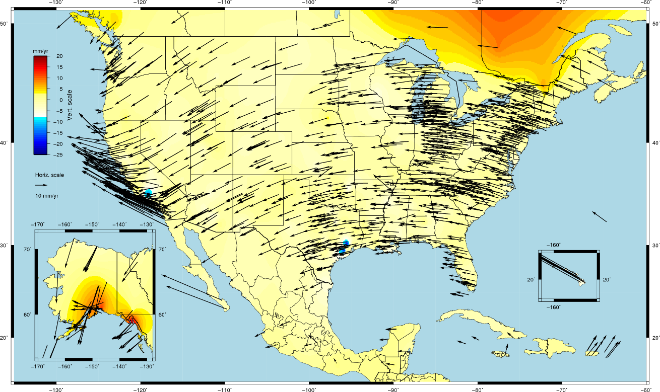
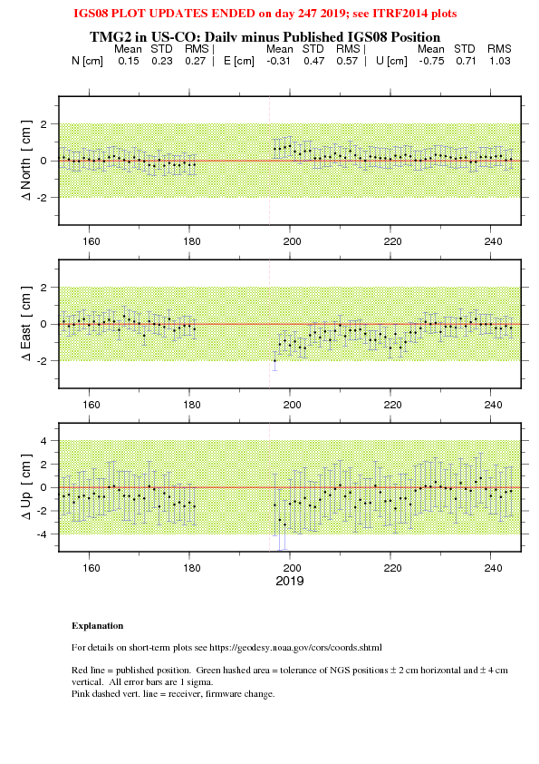
Structure and Activities of the IAG Commission 1
Reference Frames (President: Geoffrey Blewitt, USA)
Sub-commissions:
SC 1.1: Coordination of space techniques;
SC 1.2: Global reference frames;
SC 1.3: Regional reference frames;
SC 1.4: Interaction of celestial and terrestrial reference frames.
Regional reference frames
Example of results: SC 1.3c (NAREF)

Slide 19
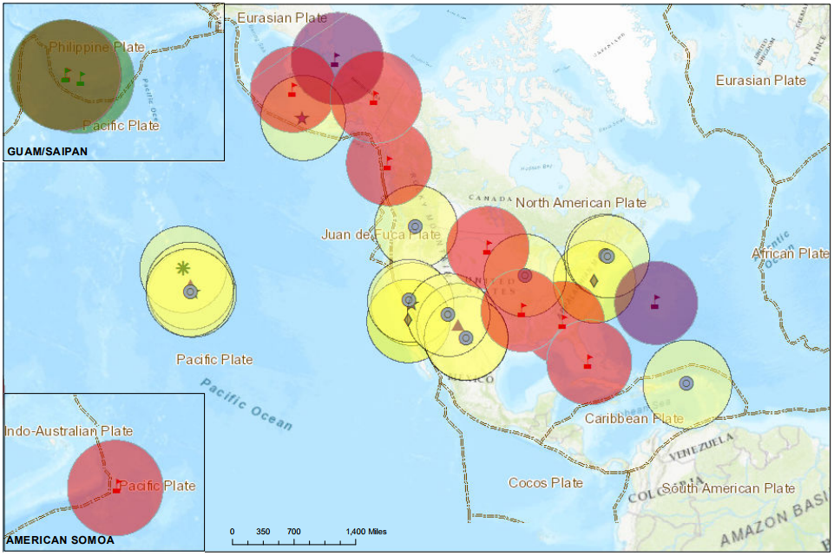
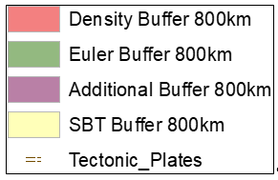
Proposed NOAA Foundation CORS Network => IGS Stations Collocated + Density + Plate Rotation + Additional

Slide 20
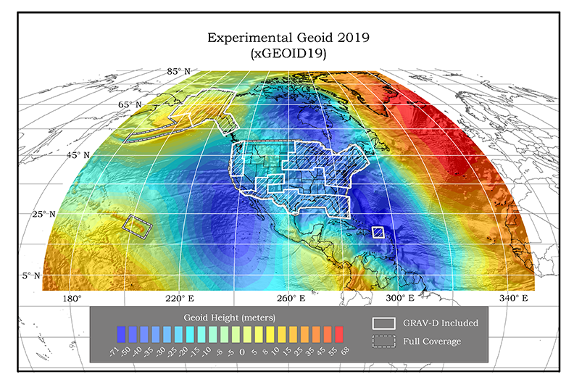
Structure and Activities of the IAG Commission 2
Gravity Field
Sub-commissions:
SC 2.1: Gravimetry and gravity networks;
SC 2.2: Methodology for geoid and height determination;
SC 2.3: Satellite gravity missions;
SC 2.4: Regional geoid determination;
SC 2.5: Satellite altimetry;
SC 2.6: Gravity and mass transport in the Earth System.
GRAV-D: Gravity for the Redefinition
of the American Vertical Datum
Regional geoid determination;
SC 2.4c: Regional geoid for Central America, North America and the Caribbean. Model represents joint work between NGS, the Canadian Geodetic Survey (CGS), and the Instituto Nacional de Estadística y Geografía (INEGI). GRAV-D Aerogravity shown in white boxes

Slide 21
International Federation of Surveyors (FIG)
FIG is a confederation of Member associations, affiliates, academic members
and companies, as well as two levels of honorary members. Through different
membership categories 115 countries are represented in FIG.
Provides professional training and standards globally to the surveying community.

Slide 22
Standards NGO’s
International Standards Organization (ISO)
Robust set of standards on almost every topic
Includes standards for defining reference frames
Must pay to access the standards though
Open Geospatial Consortium (OGC)
More limited standards a re available
But they’re free
Standards are reviewed periodically (~ 5 years)

Slide 23
Summary of NGS Activities
Works with OGA’s to ensure the NSRS is defined, maintained and accessed in a manner consistent with the GDA to meet our mission
Involved with IGO’s to implement the UN GGRF in the U.S. and consistent with other Nations
Works with professional/standards NGO’s to ensure consistent global education and training
Works with scientific NGO’s to ensure the best global data and models are created

Slide 24
Final Thoughts
As with most professions, a technical jargon exists within the National Geodetic Survey
This is further complicated by the need to develop acronyms to convey complex ideas
To the outsider, it might appear to be as though you’re falling through the looking glass
However, it does tie neatly together to enable NGS to meet its commitments to the country
As NGS moves to updating the NSRS in 2022, these collaborations will better ensure success.

Slide 25
Thanks for your attention
Daniel R. Roman, Ph.D.
Chief Geodesist, NGS
dan.roman@noaa.gov

