Slide 1
NGS Products and Services Update
July 14, 2022
Krishna Tadepalli
Bruce Tran
Janet Henderson
Jaya Neti

Slide 2
NGS Products and Services Update
NCAT and API Updates
Rinex3
JSON Datasheets
Mapshaper

Slide 3
NCAT
V2.1 released in March, 2022
Selection of units for heights
Custom Export Formats
FAQs

Slide 4
NCAT Roadmap
3/2022 - V2.1 released
2023-24 - SPCS2022
2023-24 - Geoid/Deflection Models
2024-26 - IFDM/NADCON/VERTCON
2026-27 - Dynamic Heights
2022-24 – Alpha products (xxTRF transformations)

Slide 5
API
API discovery link
https://geodesy.noaa.gov/web_services/
or
Navigate to Tools->Web Services
The link provides:
Available APIs
Sample URL patterns
Description of request parameters

Slide 6
API
NOAA CORS Network(NCN) API
API for station coordinate and metadata
API for nearest NCN stations
APIs for alpha products (in dev)
SEC/REC/xxTRF Transformations
Vector Tile Service (in dev)

Slide 7
RINEX 3 Provide higher precision of CORS positions
Bruce Tran

Slide 8
What is RINEX? (Receiver INdependent Exchange)
Since 1993 the RINEX 2 is available
No updates since 2005
QC with teqc, which is no longer supported
RINEX version 3.05 available December 2020
Supports all Global Navigation Satellite System (GNSS): signals, tracking modes and satellites
The most recent version is RINEX 4.00 from December 2021
Test only

Slide 9
What is RINEX …
The acceptance by the IGS in 2012 of the RINEX 3 as the only GNSS data exchange format moving forward.
RINEX 3 was developed to better handle the many modernized codes from today’s multitude of available satellite systems.
Currently, NGS ingests, stores, archives, and processes raw GNSS data in the older RINEX version 2 (RINEX 2) format. PAGES processes data in RINEX 2 format, and NGS provides CORS’ data in RINEX 2 format.
Several IGS stations currently only output RINEX 3 files. NGS must convert these data files to RINEX 2 prior to using them for baseline processing or orbit determination.
Adopt RINEX 3 at NGS in order to keep up with the GNSS community and make use of the modernized GNSS signals.

Slide 10
GNSS Systems
RINEX 3
GPS - US
GLONASS - Russia
Galileo - EU
BeiDou - China
QZSS - Japan
IRNSS - India
RINEX 2
GPS
GLONASS
Galileo
BeiDou

Slide 11
Naming Convention
For daily RINEX 3 files: - al303600.21d.Z which becomes, with the RINEX 3 long names; - AL3000USA_R_20213600000_01D_30S_MO.crx.gz
For hourly RINEX 3 files: - al30360b.21d.Z which becomes, with the RINEX 3 long names; - AL3000USA_R_20213600100_01H_30S_MO.crx.gz

Slide 12
RINEX 3 File Format

Slide 13
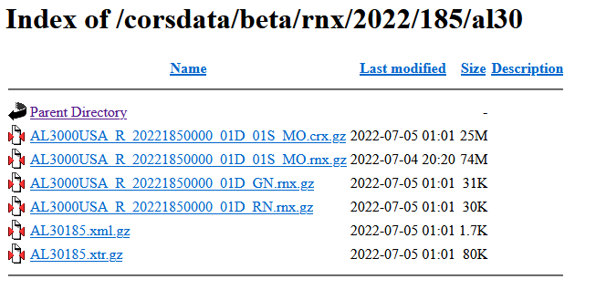
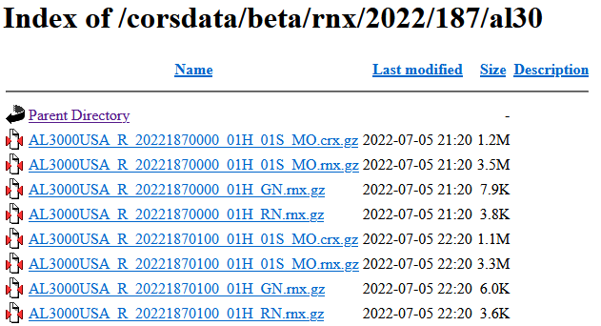
Beta
https://geodesy.noaa.gov/corsdata/beta/rnx/

Slide 14
Who uses RINEX 3?
M-PAGES (Multi-GNSS PAGES)
Replaces PAGES: Program for the Adjustment of GPS Ephemerides
In-house NGS software is still currently in development and testing
Processing engine for all GNSS services at NGS:
OPUS Static
OPUS Projects
NOAA CORS Network (NCN) coordinate maintenance
Orbit production
Capable of ingesting all GNSS observables, frequencies, and constellations
Capable of ingesting RINEX 2 or 3
M-PAGES can support NGS strategic objectives, and will replace PAGES in all applications with no loss of capability or accuracy.

Slide 15
Future Plans
RINEX 2 and RINEX 3 duality will continue to exist for foreseeable future until the infrastructure is ready to support Rinex 3.
RINEX 3 -­‐> RINEX 2 down-­‐converter
Supports backward compatibility
UFCORS – will be enhanced for RINEX 3 download

Slide 16
JSON Datasheets
Janet Henderson

Slide 17
What Is JSON?
Is a lightweight textual data interchange format
Is an internet standard (RFC-7159 as of March 2014)
JSON files are small in size and human readable
Supports data structures and arrays
Supported by modern programming languages, such as Java
JSON is an alternative to XML, and more efficient to parse

Slide 18
JSON Format, A Simple Example
Uses Name-Value Pairs
{
“ID”:1,
“WelcomeMsg1”: Hello”,
“WelcomeMsg2”: “World”,
“Continents”:
[
“North America”, “South America”, “Europe”,
“Asia”, “Africa”, “Australia/Oceania”, “Antarctica”
]
}

Slide 19
XML vs JSON
<?xml version=‘1.0’ encoding=‘UTF-8” standalone=“yes”?> vs {
<CountryInformation> “ListName”:”Country Information”,
<country> “countries”: [“United States of America”, “India”],
<name>United States of America</name> “capitals”: [“Washington DC”, “New Delhi”],
<capital>Washington DC</capital> “codes”: [
<code type=“numeric”>1</code> {“numeric”:91, “alpha”:”US”},
<code type=“alpha”>US</code> {“numeric”:1, “alpha”:”IN”}
</country> ]
<country> }
<name>India</name>
<capital>New Delhi</capital>
<code type=“numeric”>91</code>
<code type=“alpha”>IN</code>
</country>
</CountryInformation>

Slide 20
Why Use JSON Datasheets?
JSON datasheets will be stored in our new NSRS (2022) database.
Will have all of the calculations done already such as (best height, best position, latest GEOID model, reference monuments (a.k.a. boxscore), superseded survey control, and more).
Since they would be pre-processed already, we can server them up immediately to the user.
The JSON datasheets will also be GeoJSONned so the user can just pick it up and render it in any GIS software such as ArcGIS, QGIS, GoogleMaps, etc.
We can store JSON datasheets in binary format in a Postgres database as a JSONB (binary) data type or in an Oracle 21c database as a JSON data type. If we do that, the data is already parsed and stored.

Slide 21
Why Use JSON Datasheets?
Users, such as Trimble, who parse our ASCII datasheets for data to put into their own databases, can simply read the JSON datasheets, and grab only the JSON fields they are interested in.
In the past, if we updated a sensitive area of the datasheets like the ORTHO HEIGHT line or the POSITION line in the CURRENT SURVEY CONTROL section and the spacing of some characters got moved around on these lines, then we would have to notify Trimble that our format changed. They would then change their code so it was in sync with the updated datasheets. With JSON datasheets, because they are already parsed into fields, Trimble would only have to grab the updated fields so parsing is a lot more efficient with JSON and not prone to errors like ASCII text is.
JSON is extensible, so we can easily add new fields to JSON datasheets as needed.
GEOJSONning the JSON datasheets enables us to run all sorts of spatial queries more efficiently and serve up the data in a variety of geospatial formats.

Slide 22
ASCII Datasheets & JSON Datasheets
Accessible via https://www.ngs.noaa.gov/datasheets/
Datasheet95 Program
Regular (ASCII) Datasheets JSON Datasheets
(coming soon!)

Slide 23
ASCII Datasheet for PID=AC6803
Starting Datasheet Retrieval...
1 National Geodetic Survey, Retrieval Date = JULY 1, 2022
AC6803 ***********************************************************************
AC6803 HT_MOD - This is a Height Modernization Survey Station.
AC6803 PACS - This is a Primary Airport Control Station.
AC6803 DESIGNATION - AZC A
AC6803 PID - AC6803
AC6803 STATE/COUNTY- AZ/MOHAVE
AC6803 COUNTRY - US
AC6803 USGS QUAD - LOST SPRING MOUNTAIN EAST (2018)
AC6803
…

Slide 24
JSON Datasheet for PID=AC6803
{"datasheet":
{
"datasheetHeading":"National Geodetic Survey",
"datasheetRetrievalDate":"JULY 1, 2022",
"htMod":"This is a Height Modernization Survey Station.",
"pacs":"This is a Primary Airport Control Station.",
"determinedProjects":[
{"project":"GPS1154"},{"project":"GPS2300"},{"project":"GPS2507"},{"project":"GPS280"},
{"project":"GPS2846"}
],
"observedProjects":[{"project":"GPS1154"},{"project":"GPS1195/11"},{"project":"GPS2507"}],
"occupiedProjects":[{"project":"GPS1154"},{"project":"GPS1195/11"}],
"designation":"AZC A",
"pid":"AC6803",
"state":"AZ",
"county":"MOHAVE",
"country":"US",
"quad":"LOST SPRING MOUNTAIN EAST (2018)",
…
}
}

Slide 25
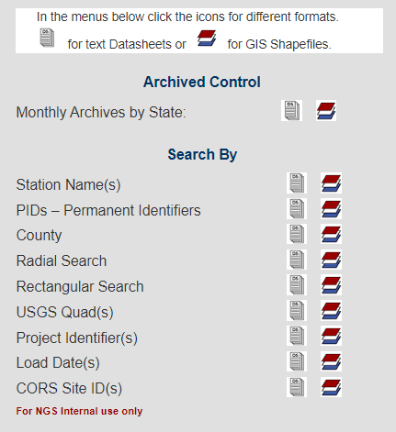
ASCII Datasheets
Accessible via https://www.ngs.noaa.gov/datasheets/

Slide 26
ASCII Datasheet Retrieval Web Pages
You’ve already been able to get ASCII publicly publishable datasheets out via the datasheet web pages retrieval links:
https://www.ngs.noaa.gov/cgi-bin/airports.prl
https://www.ngs.noaa.gov/cgi-bin/ds_cors.prl
https://www.ngs.noaa.gov/cgi-bin/ds_county.prl
https://www.ngs.noaa.gov/cgi-bin/ds_dates.prl
https://www.ngs.noaa.gov/cgi-bin/ds_desig.prl
https://www.ngs.noaa.gov/cgi-bin/ds_mm.prl
https://www.ngs.noaa.gov/cgi-bin/ds_pid.prl
https://www.ngs.noaa.gov/cgi-bin/ds_pids.prl
https://www.ngs.noaa.gov/cgi-bin/ds_proj.prl
https://www.ngs.noaa.gov/cgi-bin/ds_quads.prl
https://www.ngs.noaa.gov/cgi-bin/ds_radius.prl

Slide 27
JSON Datasheets
Accessible via https://www.ngs.noaa.gov/datasheets/
Coming soon!

Slide 28
JSON Datasheet Retrieval Web Pages
Soon you will be able to get publicly publishable datasheet(s) in JSON format out via the JSON datasheet web pages retrieval links:
https://www.ngs.noaa.gov/cgi-bin/airports_json.prl
https://www.ngs.noaa.gov/cgi-bin/ds_cors_json.prl
https://www.ngs.noaa.gov/cgi-bin/ds_county_json.prl
https://www.ngs.noaa.gov/cgi-bin/ds_dates_json.prl
https://www.ngs.noaa.gov/cgi-bin/ds_desig_json.prl
https://www.ngs.noaa.gov/cgi-bin/ds_mm_json.prl Coming soon!
https://www.ngs.noaa.gov/cgi-bin/ds_pid_json.prl
https://www.ngs.noaa.gov/cgi-bin/ds_pids_json.prl
https://www.ngs.noaa.gov/cgi-bin/ds_proj_json.prl
https://www.ngs.noaa.gov/cgi-bin/ds_quads_json.prl
https://www.ngs.noaa.gov/cgi-bin/ds_radius_json.prl

Slide 29
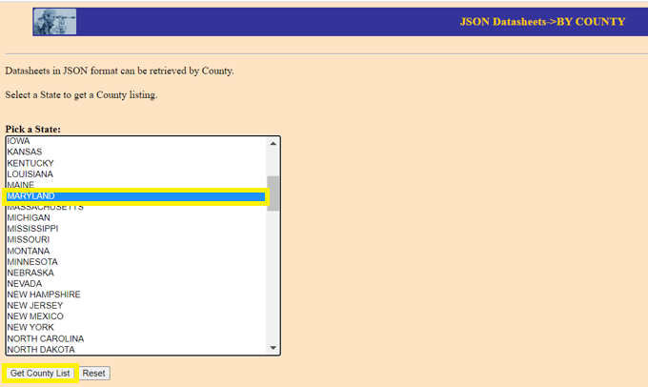
Example JSON Retrieval (by_county)
https://www.ngs.noaa.gov/cgi-bin/ds_county_json.prl (coming soon!)

Slide 30
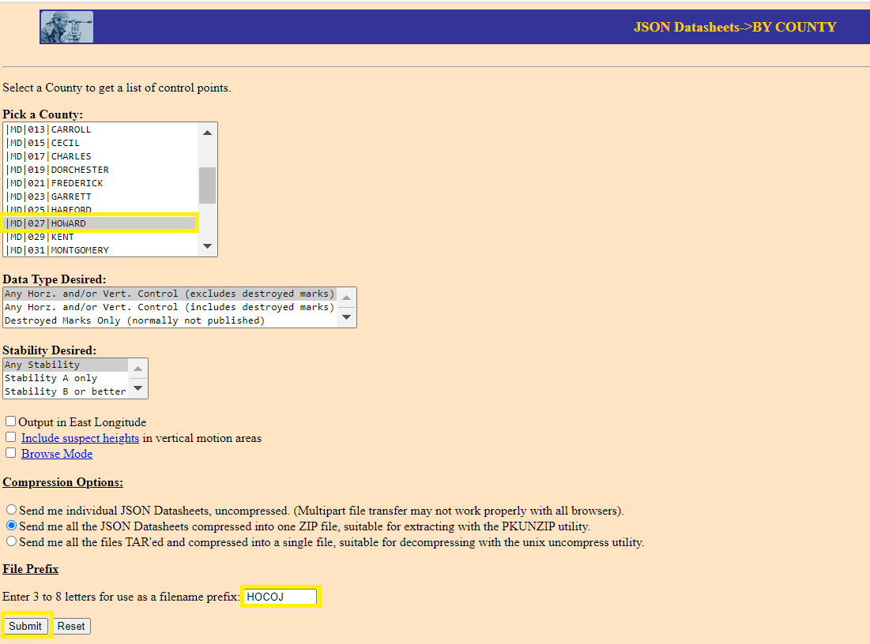
Example JSON Retrieval (by_county)
https://www.ngs.noaa.gov/cgi-bin/ds_county_json.prl (coming soon!)

Slide 31
Example JSON Retrieval (by_county)

Slide 32
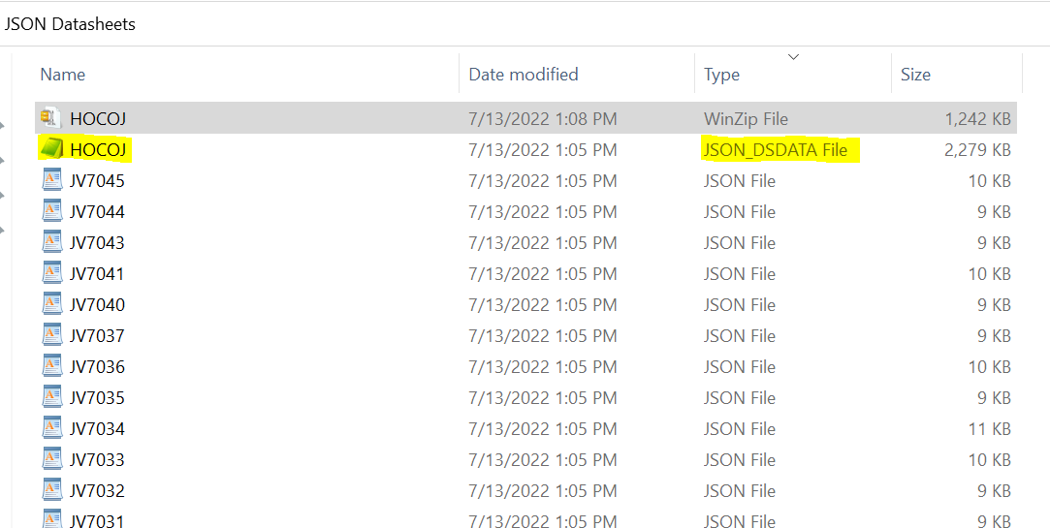
Example JSON Retrieval (by_county)

Slide 33
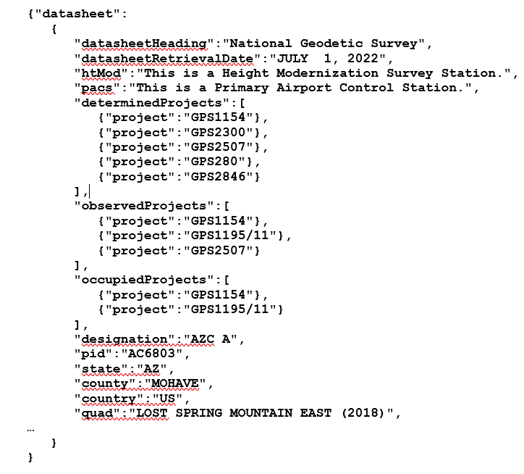
The json2ds Program
Converts JSON Datasheets back into ASCII Datasheets
json2ds

Slide 34
Mapshaper Jaya Neti 07/14/2022

Slide 35
Mapshaper
Purpose
Usage
Features
Use Cases/Scenarios
Demo

Slide 36
Purpose
Mapshaper, a browser based visualization and analysis GIS tool, is being considered to augment LASER.
LASER (Least-Squares Adjustments: Statistics, Estimates and Residuals) - NGS built a new Adjustment tool for the modernized NSRS
LASER will be used to adjust variety of survey projects data (GNSS, Levelling, Classical…)

Slide 37
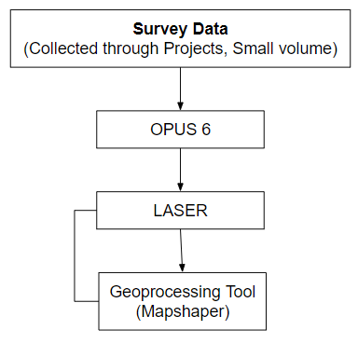
Usage
Mapshaper is going to be incorporated in OPUS 6 and other use cases
Many geoprocessing features available out of the box such as editing attribute data, clipping, deleting, dissolving, filtering
Supports multiple data formats such as Shapefile, GeoJson, CSV

Slide 38
Features
public website at www.mapshaper.org or use the web UI locally via the mapshaper-gui script.
Attribute data
Export data
Split data
Enable/Disable layers
Delete/Remove Data
Clip Data
Merge Data

Slide 39
Use Cases/Scenarios

Slide 40
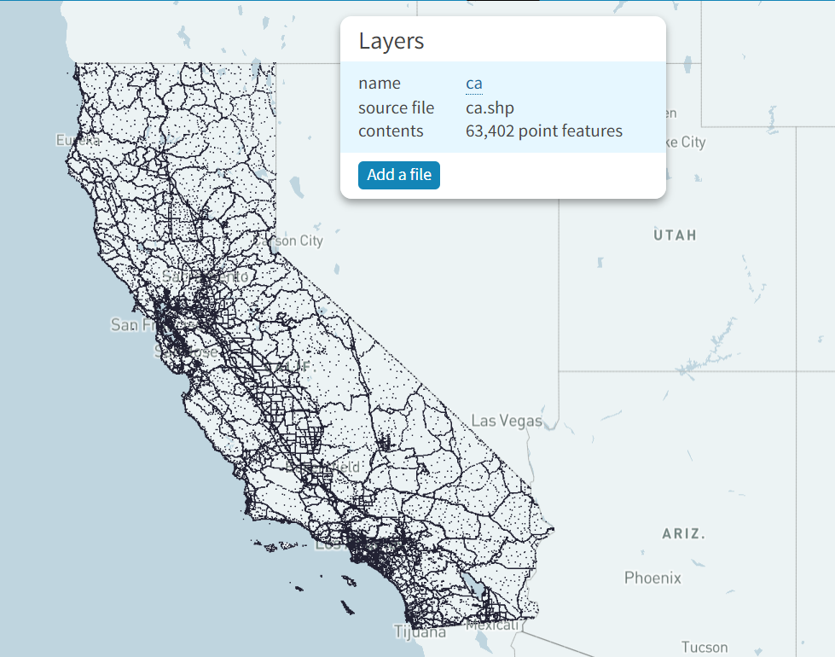
California Datasheets
Use case
CA datasheets
Imported datafile is a ‘shapefile’
Future datasheets download may have an option to view the data before downloading

Slide 41
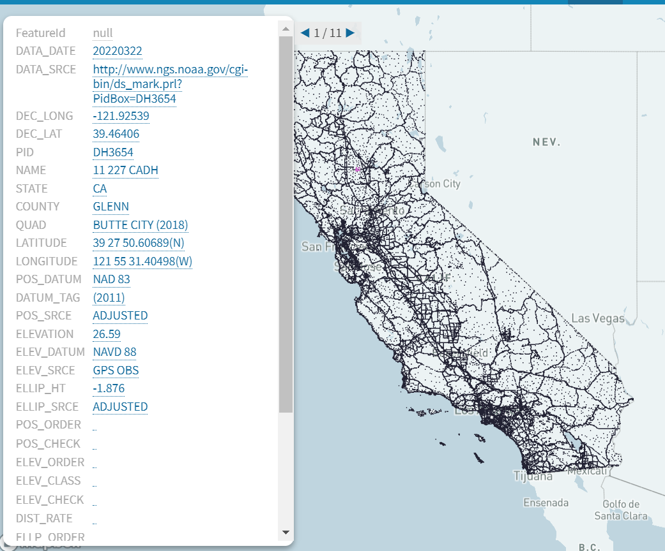
Attribute Data
Use case
Tool allows accessing attributes
If you are re-observing a Mark and want to check name or description or any other attribute before submitting new data to NGS

Slide 42
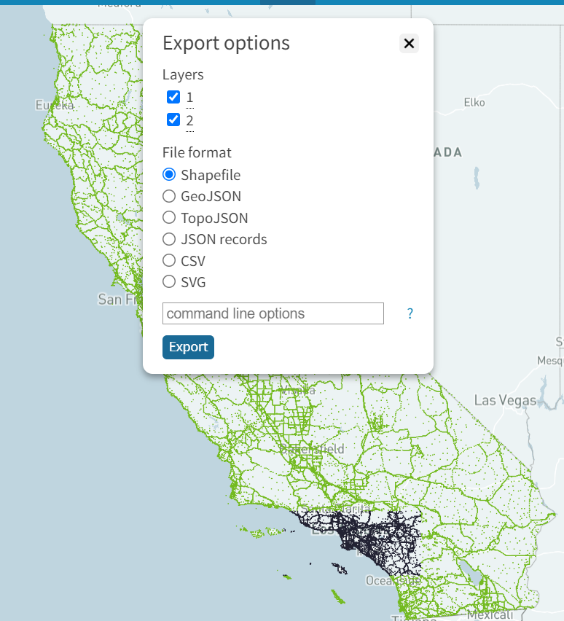
Export Data
Use case
Though imported data file is a ‘shapefile’, tool allows to export to different formats
Export a layer or multiple layers or portion of a layer or a county to your choice of format

Slide 43
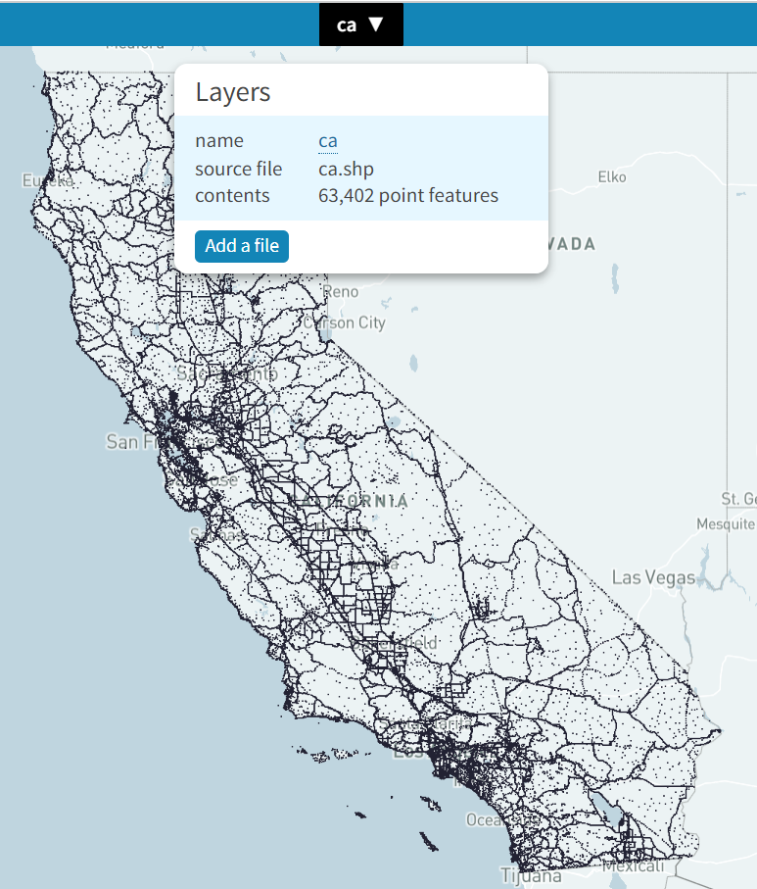
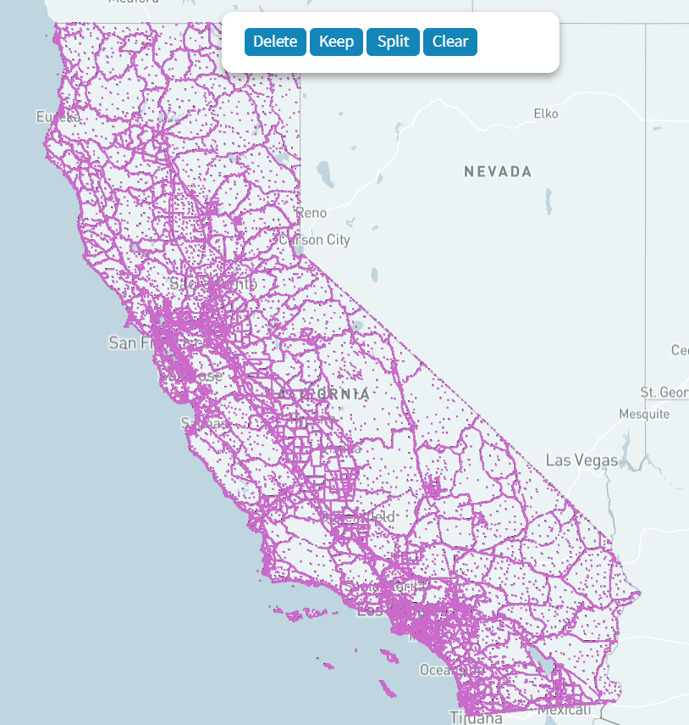
Split Data (by County or any other attribute)
Use case
Spatial query out of the box
Split by an attribute to use a portion of the data
Before split, there is only one layer

Slide 44
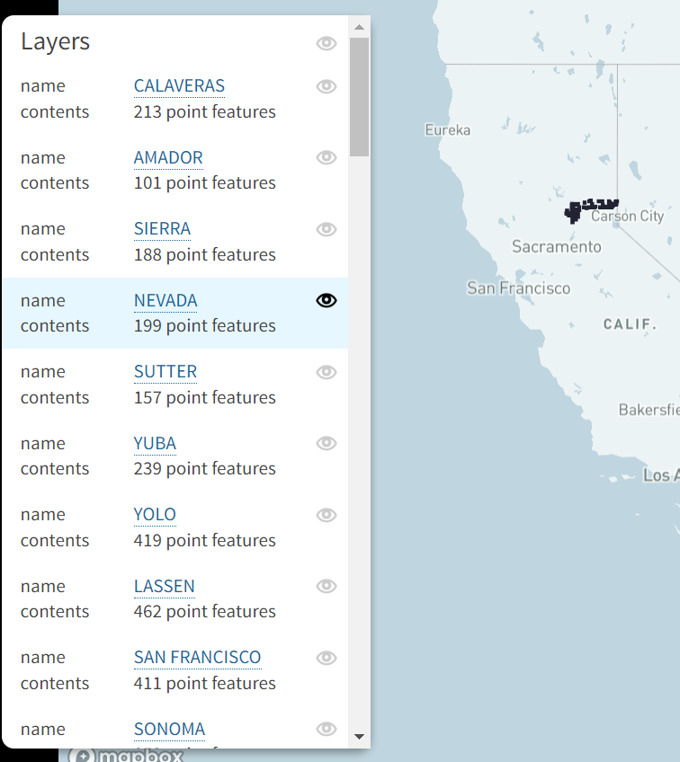
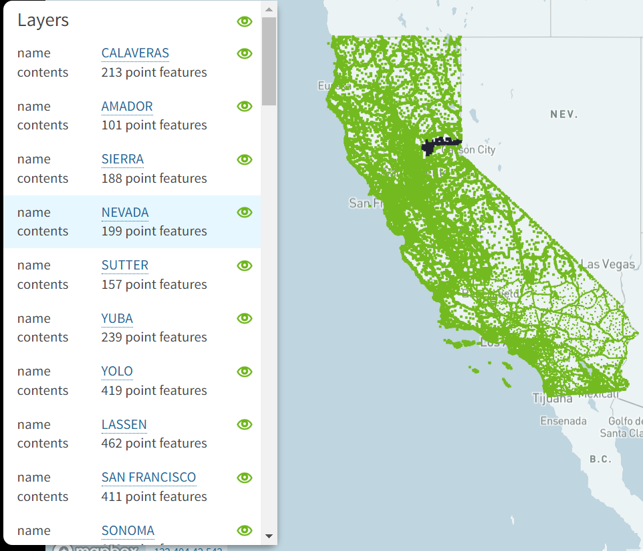
Split Data (by County or any other attribute) (cont…)
Use case
After split, there is a layer per county

Slide 45
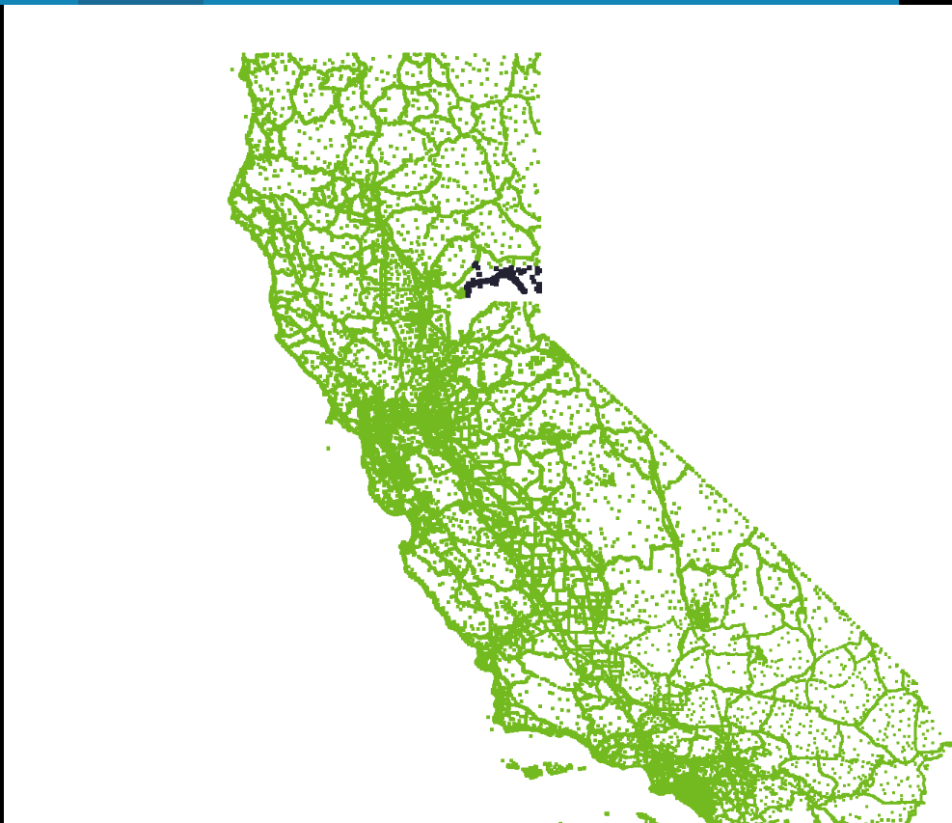
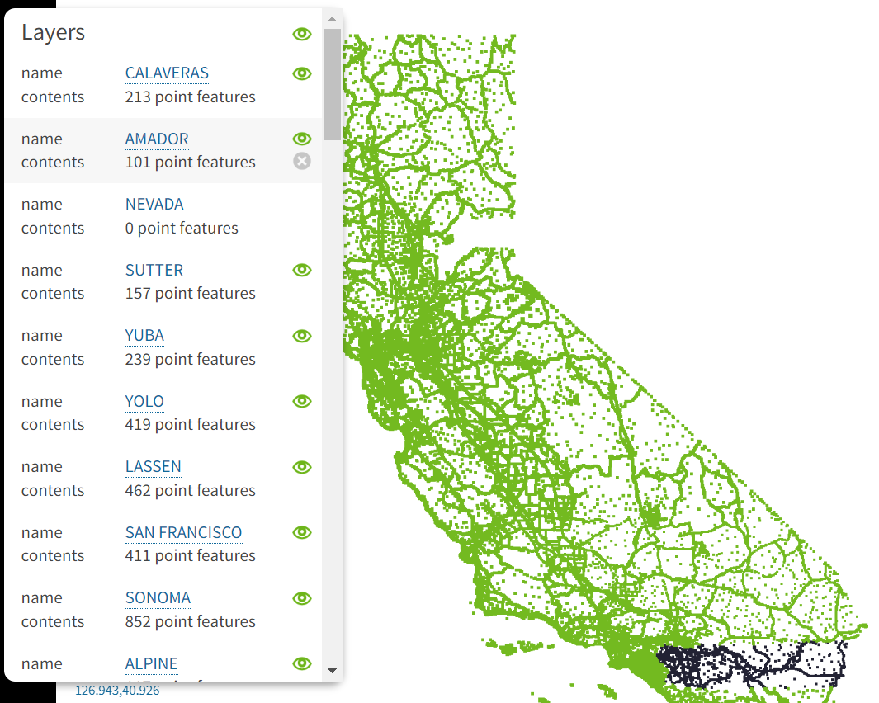
Delete/Remove Data
Use case
Removed a county (or by any attribute) using this tool

Slide 46
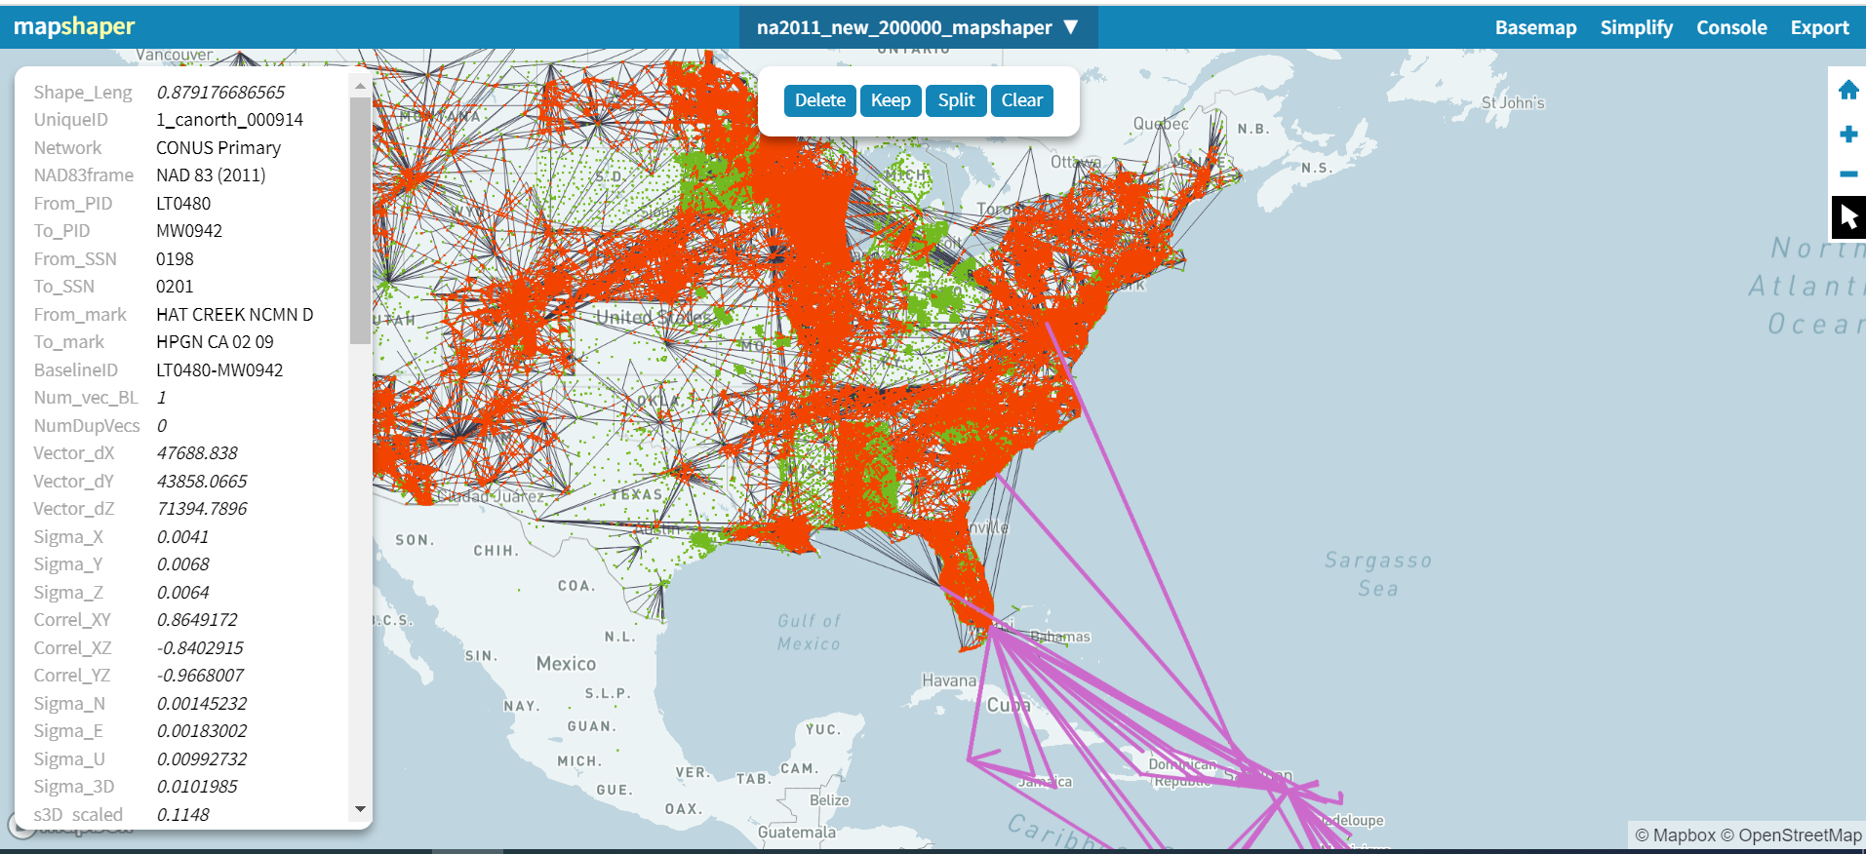
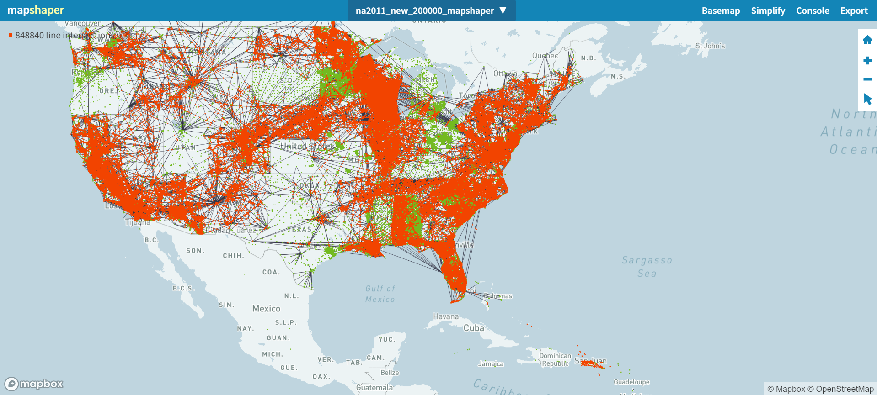
Delete/Remove Data
Use case
Removed purple color outlier data before adjustment

Slide 47
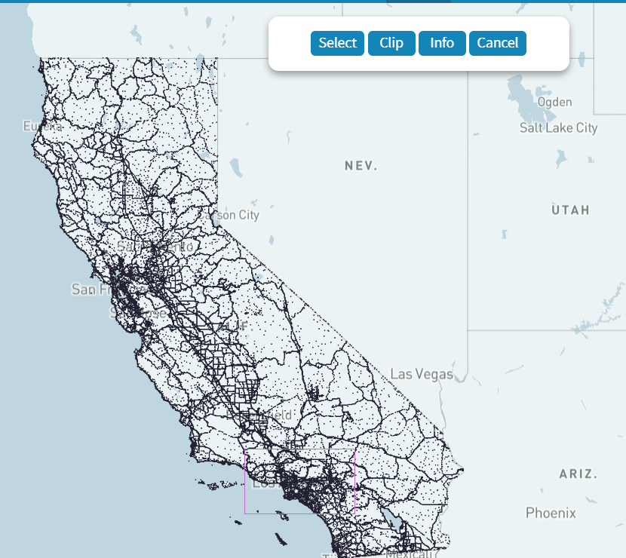
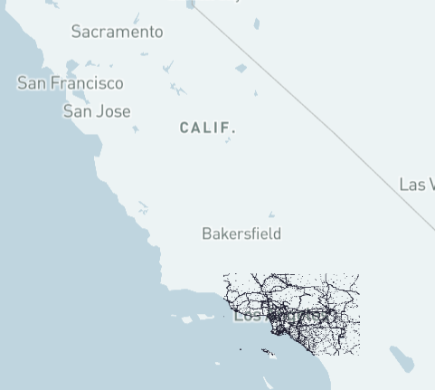
Clip

Slide 48
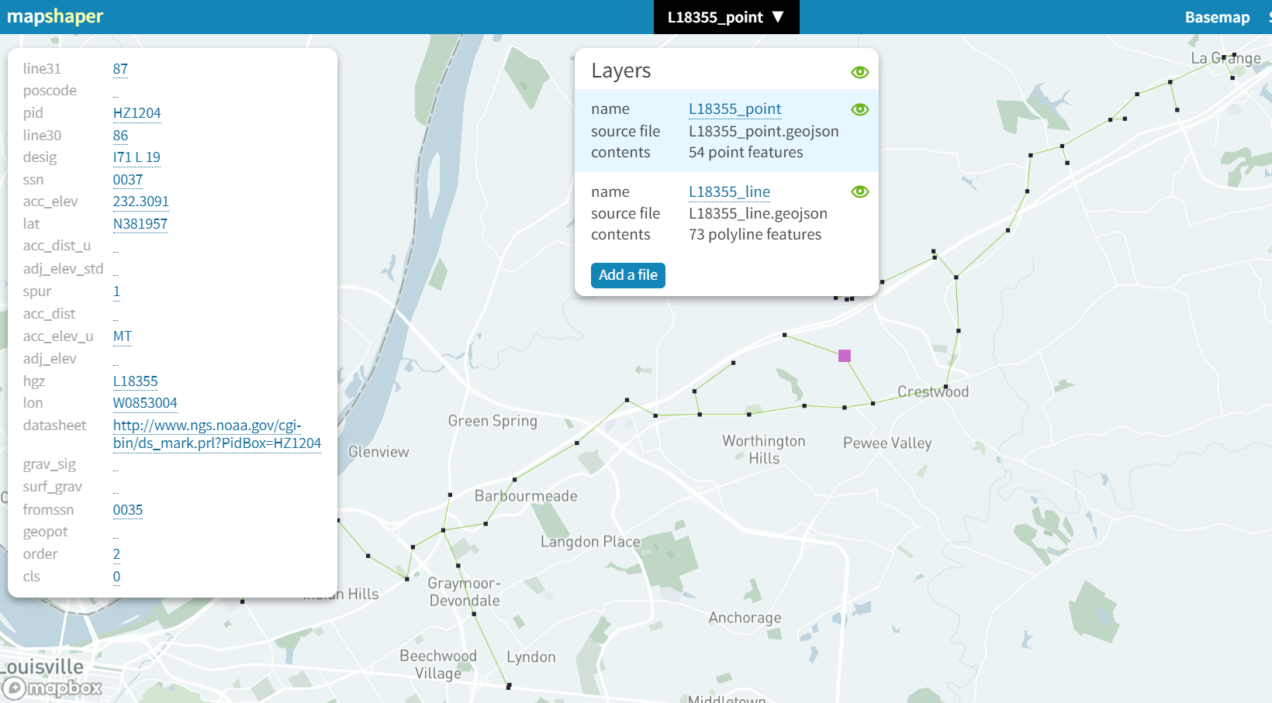
Leveling project example
Use case
Use the tool while surveying a leveling project
If any point is not aligned, then re-observe and add it to the project
Could serve as a pre-submission QA tool

Slide 49
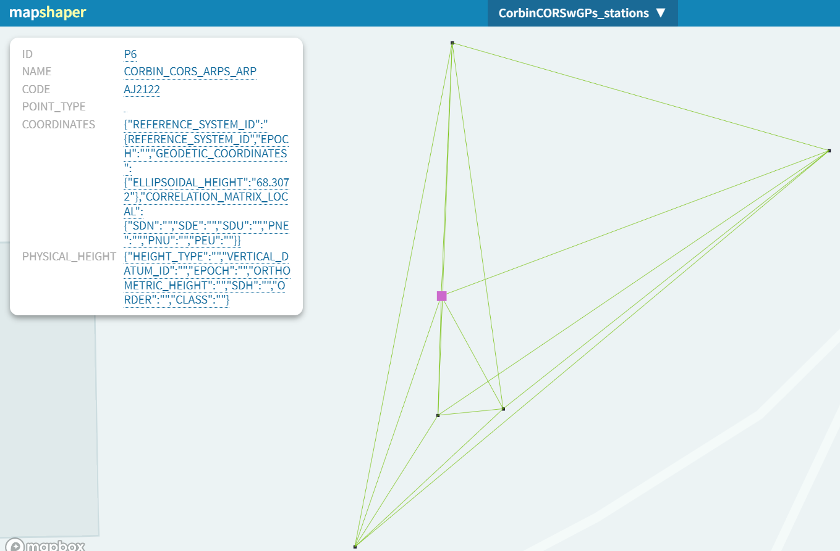
Classical project example
Use case
Use the tool when surveying a classical project
If any point is not aligned, then re-observe and add it to the project
Used as a pre-submission QA tool

Slide 50
Demo

