Slide 1
GPS on Bench Marks
for Better Tools and Models
National Geodetic Survey Webinar Series
February 15th, 2018 2:00 – 3:00 pm
Galen Scott – NGS Project Lead
Kevin Ahlgren – NGS Geoid Team

Slide 2
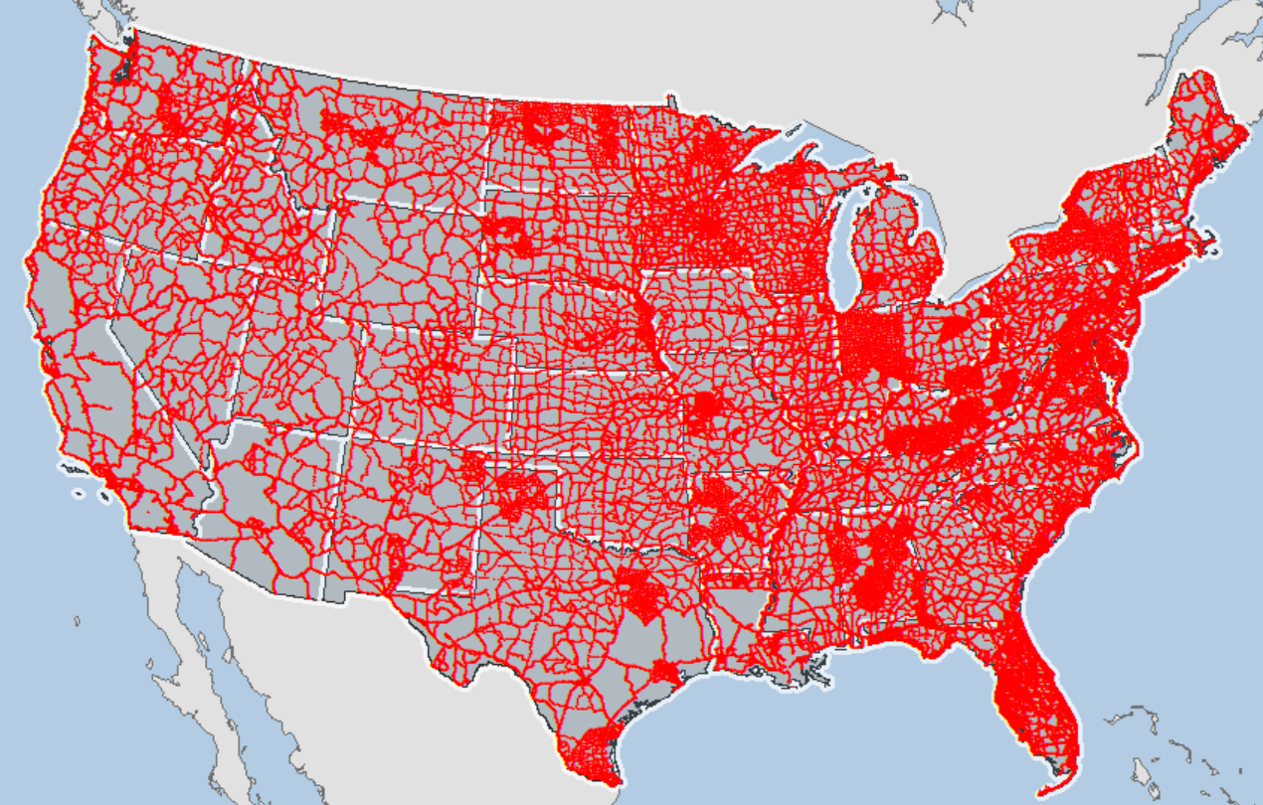
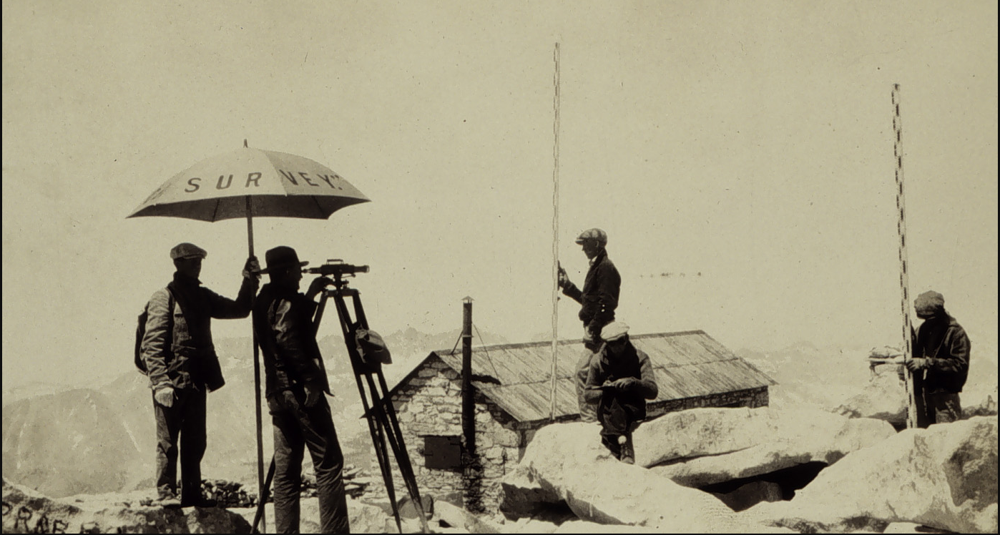
GPS Data on NAVD 88 leveled marks will support development of GEOID18 and the transformation tools to NAPGD2022
Notes:
NAVD 88 consists of about 800,000 benchmarks and ~2.2M km of leveling. Data was collecting over many decades by roving bands of surveyors who walked across the country multiple times over the years, east to west, north to south and back again. It is currently the official vertical datum of the US and is required for federal mapping projects.
GPS data on those leveled marks will be used to create GEOID18 – the model used to derive NAVD88 heights from GPS ellipsoid heights, as well as the transformation tools that will be released with NAPGD2022.

Slide 3
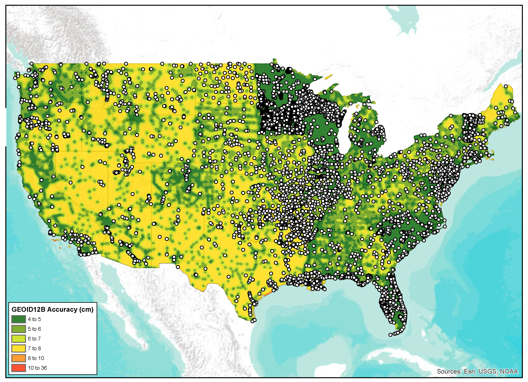
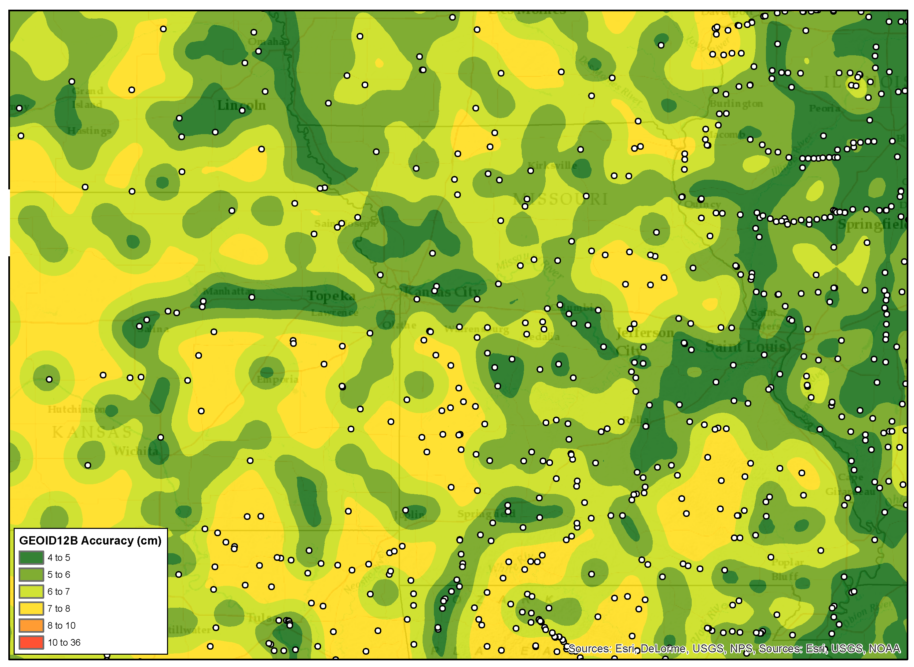
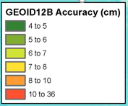
GEOID12B Accuracy and New Data
GPS on BM efforts are paying off.
As of September 2017, 9507 new GPS on BM’s have been submitted to NGS.
New GPS on BM Totals:
GPS on BM | Available | Flagged as bad fit | Used in Model
NGS IDB: | 6,239 | 1,174(18.9%) | 5,065
OPUS-Share: | 3,268 | 402(12.3%) | 2,866
Total: | 9,507 | 1,576 | 7,931

Slide 4
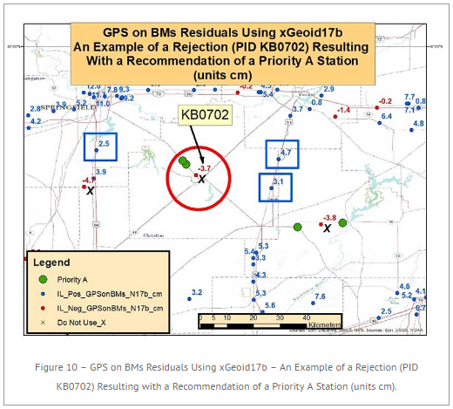
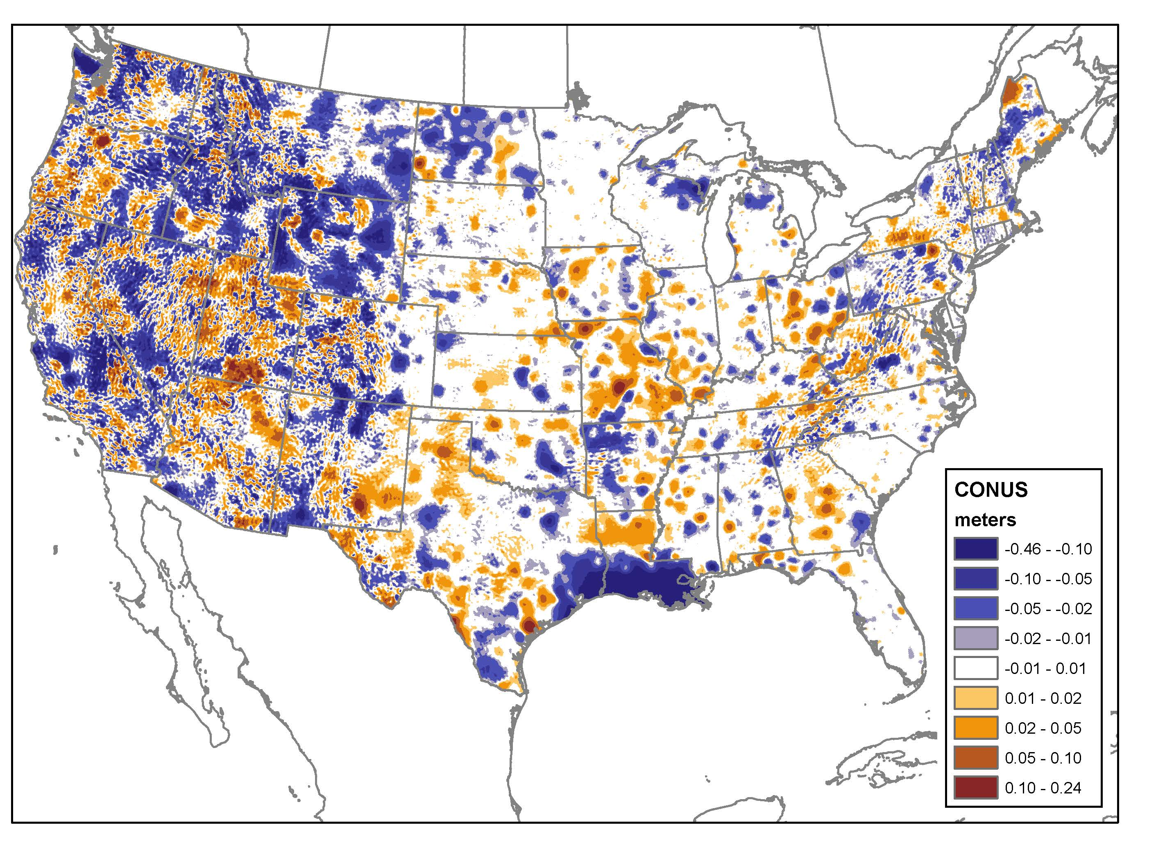
Going from New Data to Better Models and Tools
Significant new analysis of existing GPS on BM data identified problem areas – Described by Dave Zilkoski in GPS World: NGS 2018 GPS on BMs program in support of NAPGD2022 — Part 5
Creation of prototype hybrid geoid model using new data: GPS on BM’s, leveling, & gravity.
Release of prioritized list of ~6,000 bench marks for data collection to update ellipsoid / orthometric / geoid undulation relationship and to fill gaps
https://geodesy.noaa.gov/GPSonBM/prioritize.shtml
Notes:
http://gpsworld.com/ngs-2018-gps-on-bms-program-in-support-of-napgd2022-part-5/

Slide 5
Residual = h - H - N
-
-
h is ellipsoid height measured using GPS
H is an NAVD 88 Orthometric Height from Leveling
N is from a geoid model
Theoretically, the difference between these three values should be zero. In practice, using actual observations gives a residual, or measure of the misfit between the three. We use the residual to evaluate the observations.

Slide 6
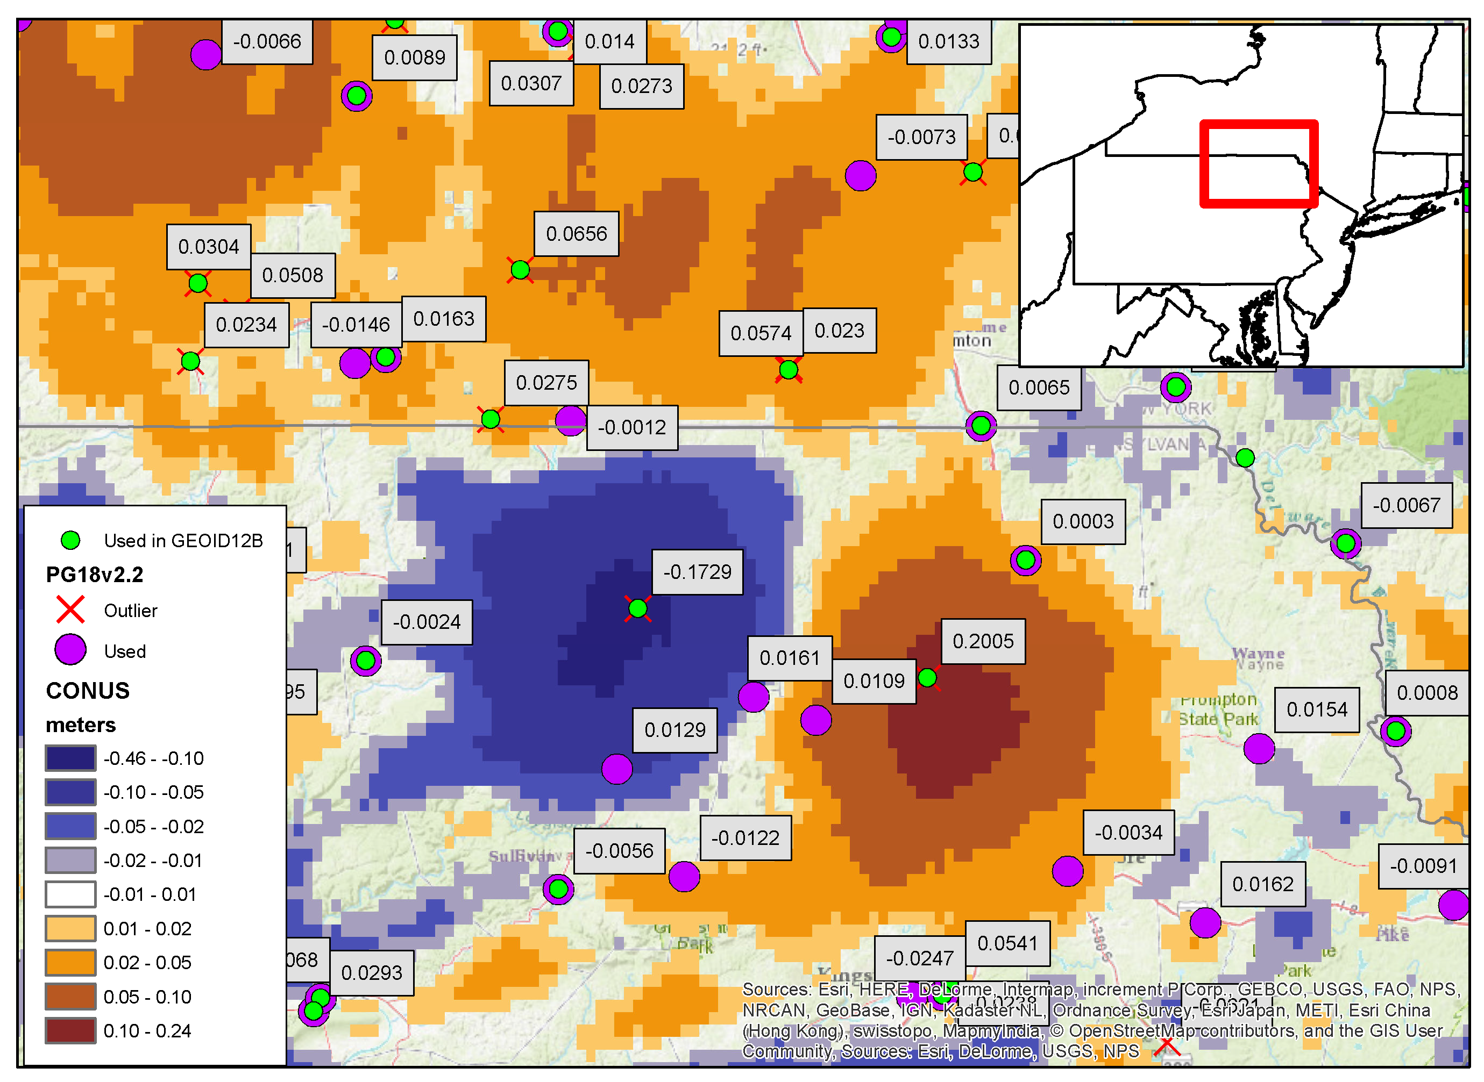
Residuals
(r = h – H - N)
Tremendous amount of work done by Dave Zilkoski & Nagendra Paudel on state-by-state basis
Much cleaner dataset
Impacts will be felt by surveyors
Have a high level of confidence in this (See NE Pennsylvania)
Change from GEOID12B [m]

Slide 7
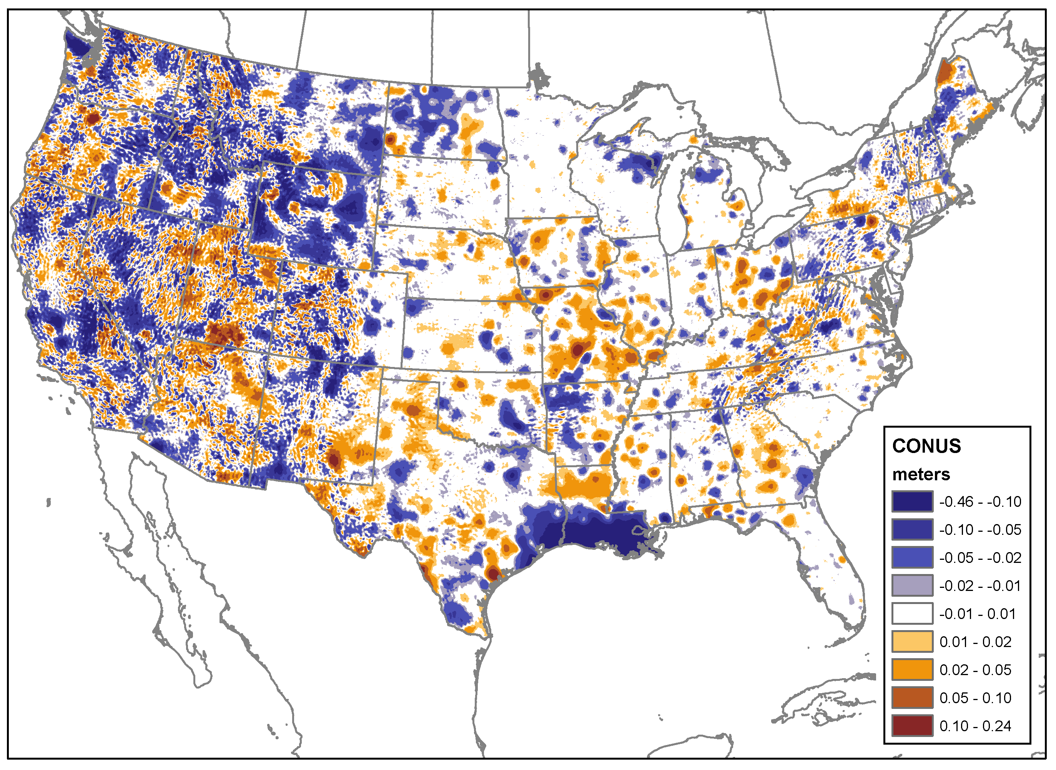
PG18v2.2
(prototype for GEOID18)
Similar construction as GEOID12B.
Gravimetric Geoid Model: xGEOID17B (Interpolate)
GPS on Bench Marks (Constrain)
Change from GEOID12B [m]
GPS on BM | Available | Flagged as bad fit | Used in Model
NGS IDB: | 30,297 | 2,432 (8.0%) | 27,865
OPUS-Share: | 3,749 | 485 (12.9%) | 3,264
Total: | 34,046 | 2,917 | 31,129

Slide 8
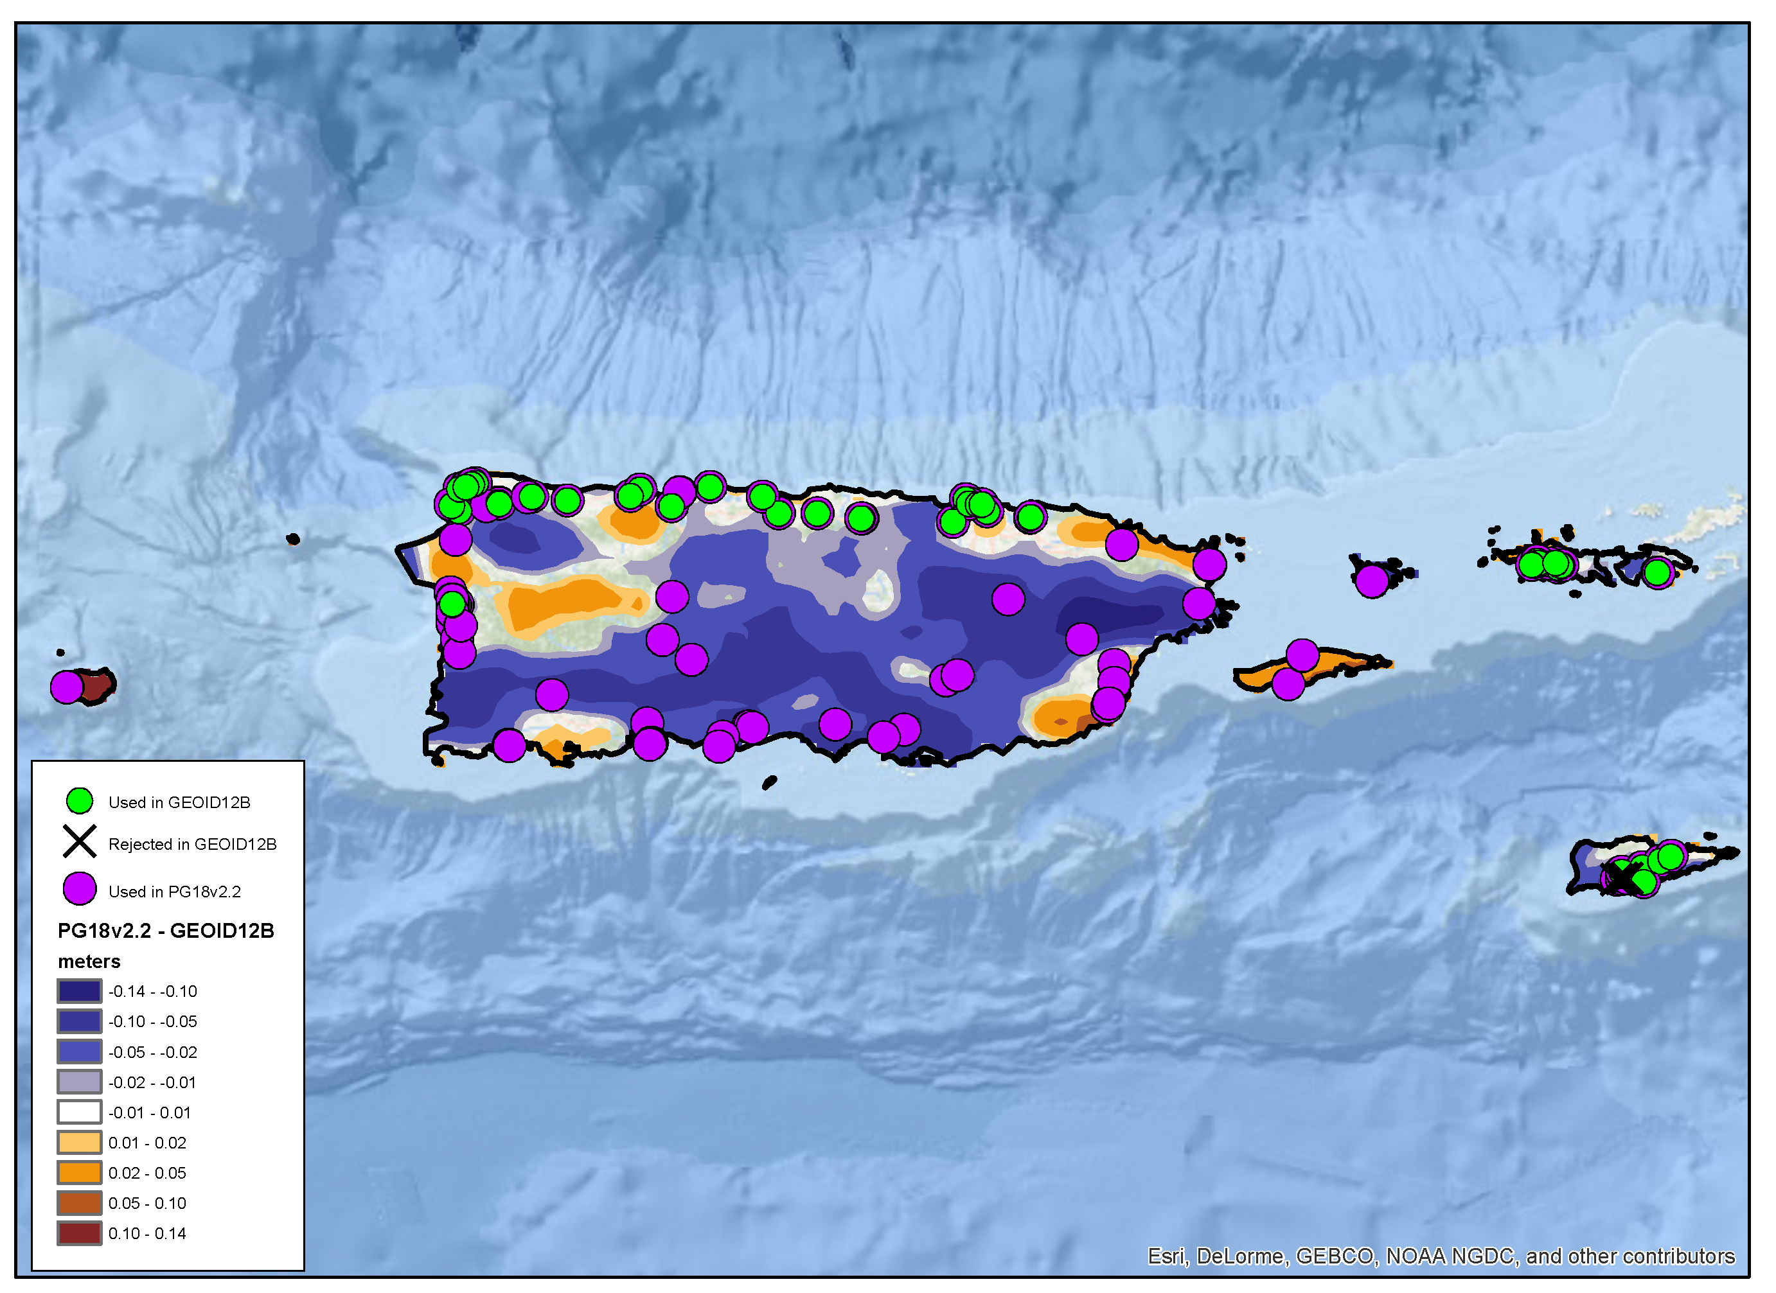
PG18v2.2
(prototype for GEOID18)
Puerto Rico / U.S. Virgin Islands
What’s new?
126 GPS on Bench Marks (Constrain)
79 New Marks:
IDB: 12
OPUS Share: 67
Gravimetric Geoid Model: xGEOID17B (Interpolate)

Slide 9
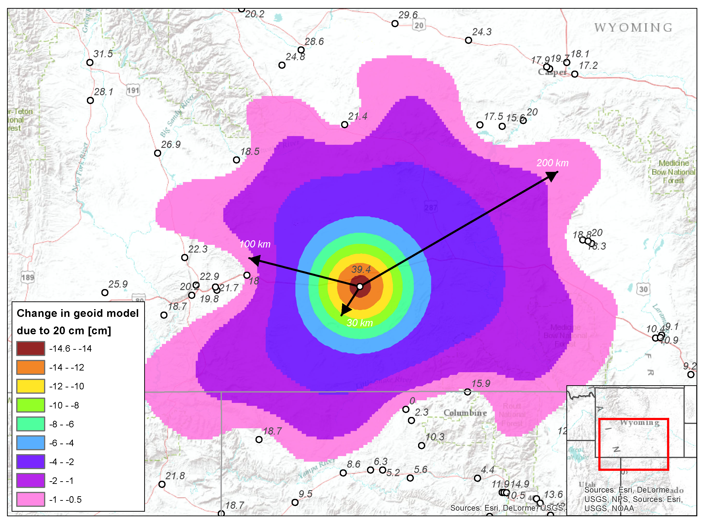
Potential Impacts
of 20 cm:
Hypothetical Situation in Wyoming:
Maximum Change in hybrid geoid = -14.6 cm
1 cm changes are felt at ~200 km distances
Surrounding GPS BM’s constrain the effect

Slide 10
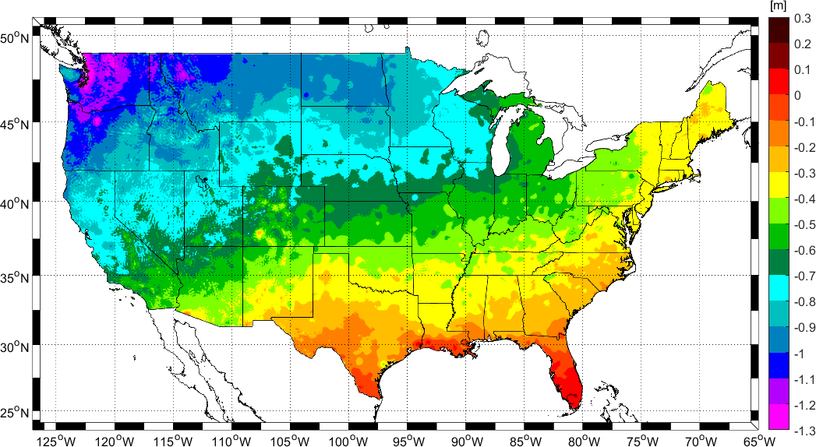
Change in Height from NAVD 88 to NAPGD2022

Slide 11
How you can help?
Download the prioritized list in your favorite format.
Check the Tracking Map to see what data we still need.
Find Bench Marks and submit mark recoveries using DSWorld.
Collect 4 or more hours of GPS data and submit to OPUS Share

Slide 12
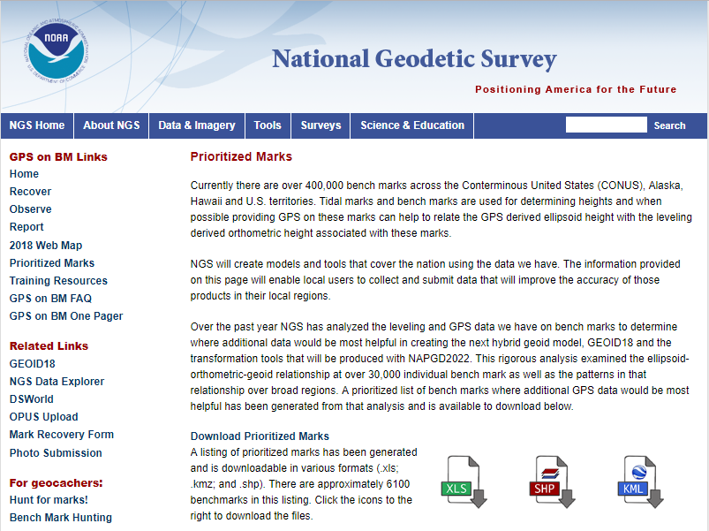
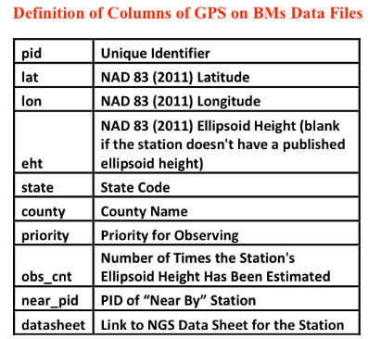
Prioritized List is available as excel file, ESRI shapefile, and Google Earth kmz file.
https://geodesy.noaa.gov/GPSonBM/prioritize.shtml
From Zilkoski GPS World 2/7/2018

Slide 13
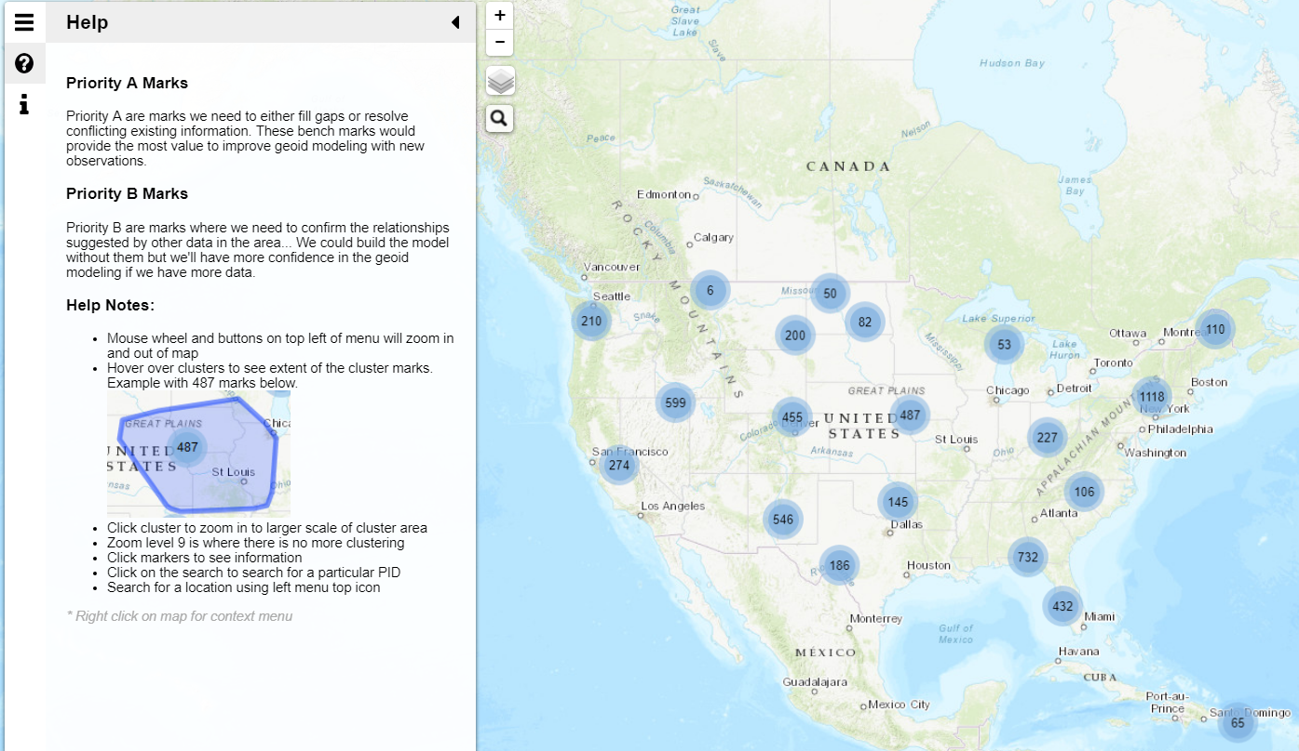
GPS on BM Tracking Map
Click on Clusters to Zoom In

Slide 14
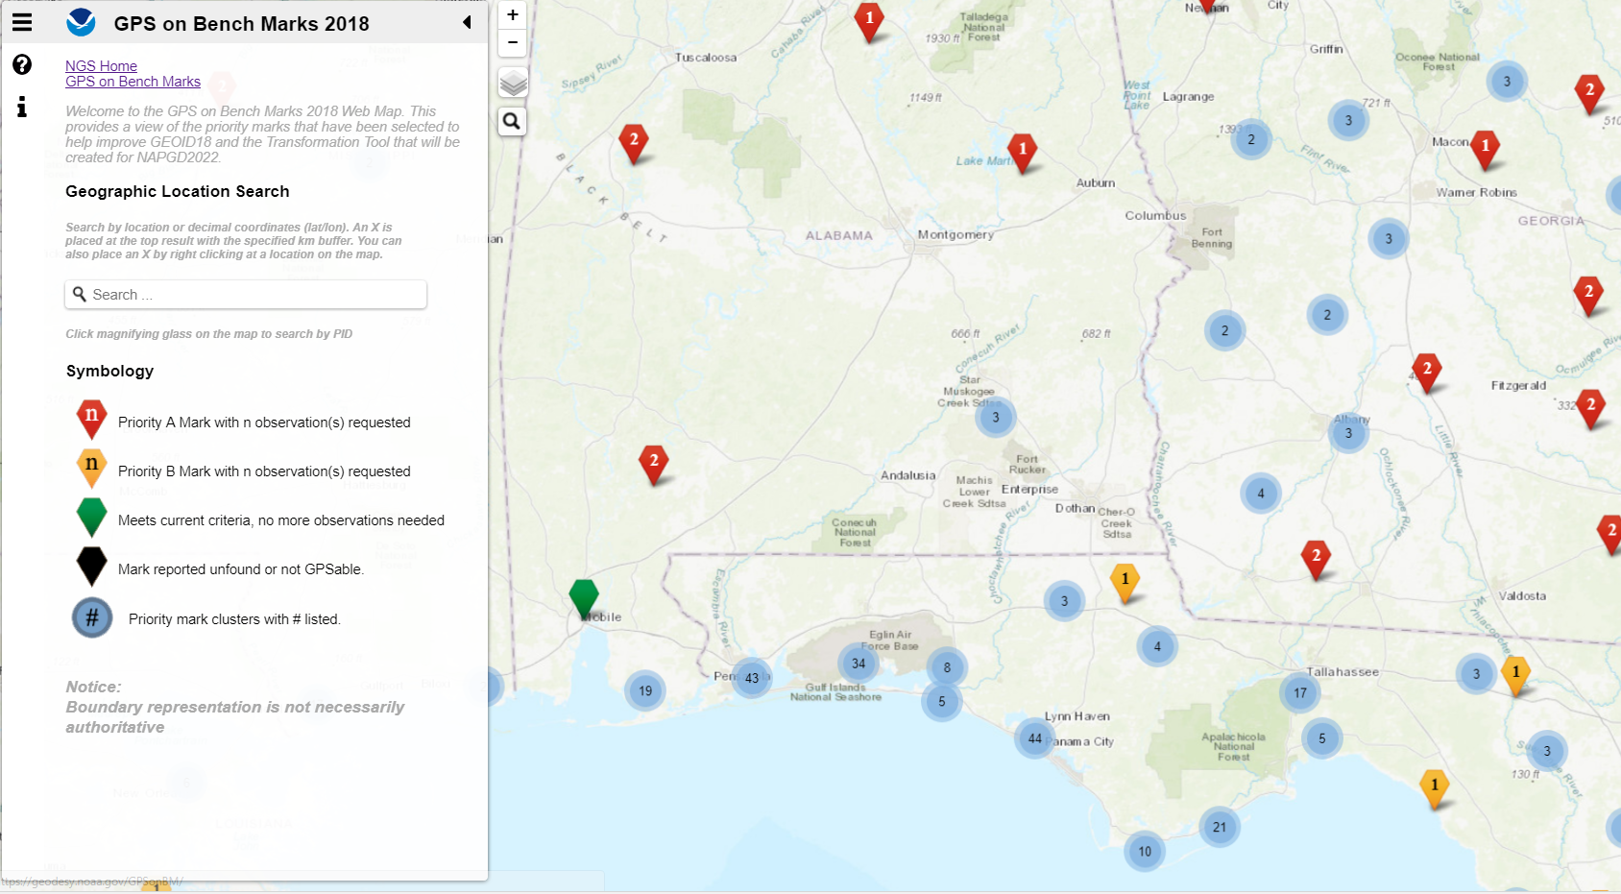

Slide 15
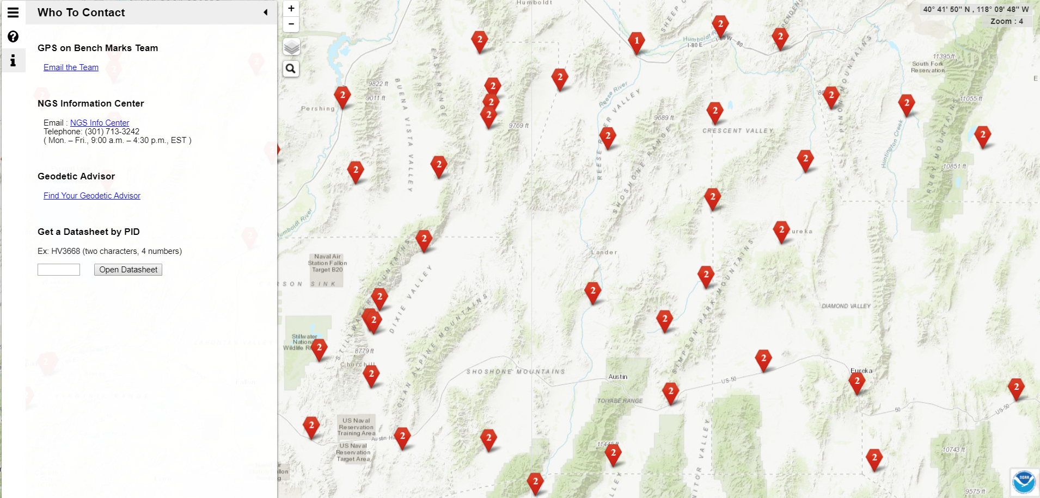
If you can not locate a mark, you can find and observe another nearby NAVD 88 adjusted bench mark
Please be safe and responsible. Avoid dangerous areas and be sure to obtain proper permissions before going to marks on private property

Slide 16
Submitting Mark Recoveries through DSWorld
DSWorld is a multifunction application that enables you to plot bench marks in Google Earth and submit bench mark recoveries to NGS.
Recovery information will let NGS and others know if the mark is still usable and pictures will make it easier to find.
https://geodesy.noaa.gov/PC_PROD/PARTNERS/

Slide 17
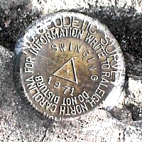
OPUS Requirements for Sharing
GPS Observation: Collect 4+ hours of data on a bench mark
Description: Provide details of how to locate mark (To Reach)
Example: Located in the SW corner of a 2 ft square concrete pad projecting 0.3 ft above ground, 3.3 ft S from S edge of sidewalk...
Accurate antenna height and type values
2 photos:
close-up photo (avoid dark/blurry/dirt-covered)
horizon photo (show equipment in use)
Notes:
- We keep the minimum session time at 4 hours for OPUS share
- Longer sessions = better probability of fixing ambiguities and cancelling some errors in GNSS
Incorrect antenna height is often the cause of an inaccurate orthometric height
Example description at the top
OPUS share requirements
https://geodesy.noaa.gov/OPUS/about.jsp#sharing
OPUS webinar from Dec 2016
https://geodesy.noaa.gov/web/science_edu/webinar_series/understanding-opus.shtml

Slide 18
Why do we need 4 hours of data?
NGS is working on OPUS for RTK that will accept 3 minute observations, however the accuracy will NOT be as good as 4 hour observations.
1 sigma
Graph Courtesy of Dr. Daniel Gillins
Notes:
Better solutions with lower RMS are important for creating the hybrid geoid model. The Transformation Tools will need a higher density of data, so we are willing to trade a decrease in accuracy for the ability to get data on many more marks.

Slide 19
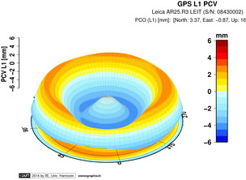
Antenna Type & Antenna Height are crucial for accurate results
rotate NRP to face true north
ARP
Each Antenna Type has unique biases
antenna height
For antenna calibrations, photos, ARP and NRP diagrams, see geodesy.noaa.gov/ANTCAL/
mark
JGE, 2015

Slide 20
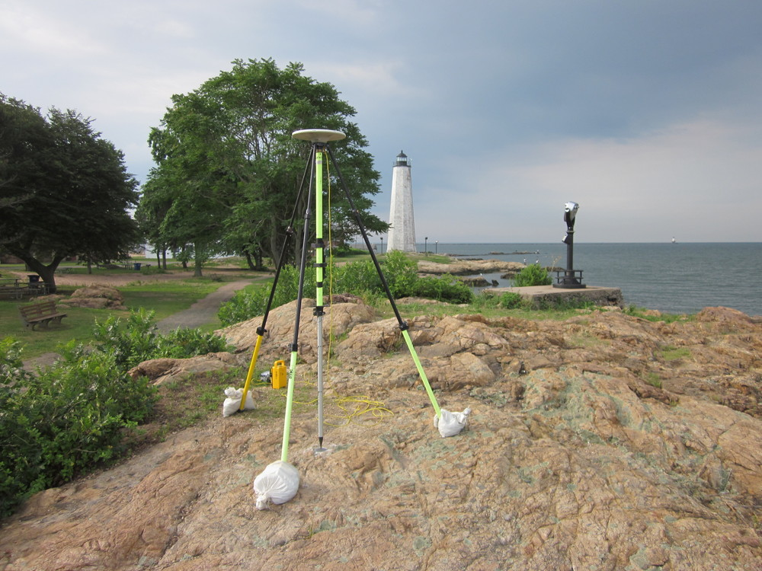
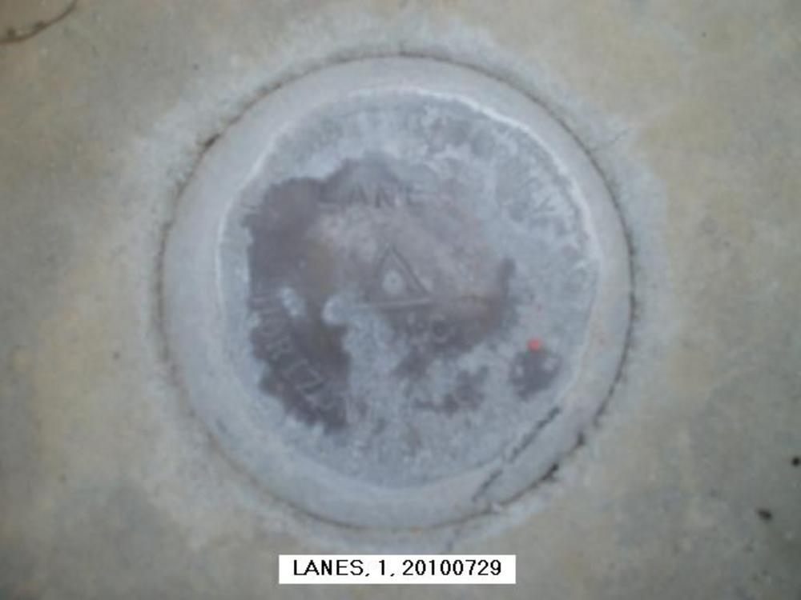
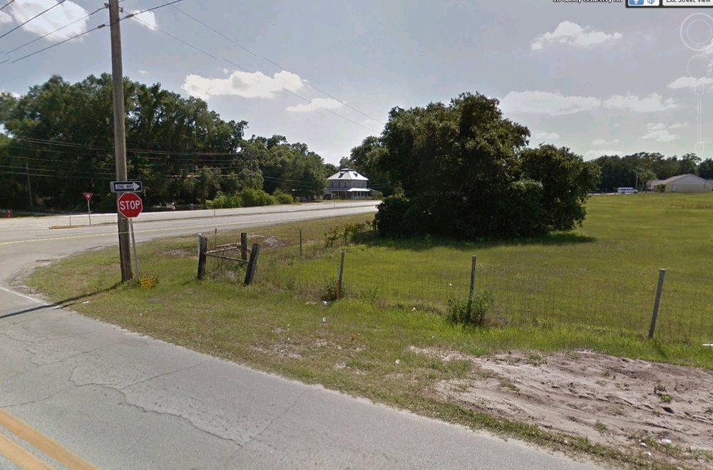
Best Practices for OPUS Share Photos
Best:
Clear, distinct close up and horizon photos
Stamping clearly visible
Equipment shown, location clear, mark distinct
Worst:
Equipment blocking stamping
Photo is blurry, stamping is difficult to read
Location of mark not clear in horizon photo

Slide 21
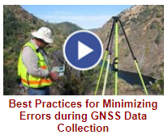
NGS Training Material
GPS on Bench Marks Webpages
NGS Video Library
NGS Online Lessons

Slide 22
Additional Resources
Podcast on why this is important-
Geodesy: The Invisible Backbone of Navigation
https://oceanservice.noaa.gov/podcast/jan18/nop12-geodesy.html
GPS World Article by Dave Zilkoski –
NGS 2018 GPS on BMs program in support of NAPGD2022 — Part 5
http://gpsworld.com/ngs-2018-gps-on-bms-program-in-support-of-napgd2022-part-5/
Coming in April 2018 – Caccamise & Ahlgren article in xyHt print edition
GEOID18: Make Your Mark and Improve Your Heights

Slide 23
Questions?
Contact the team:
ngs.gpsonbm@noaa.gov

Slide 24
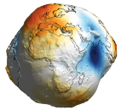
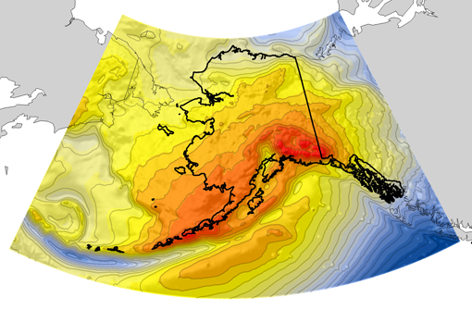
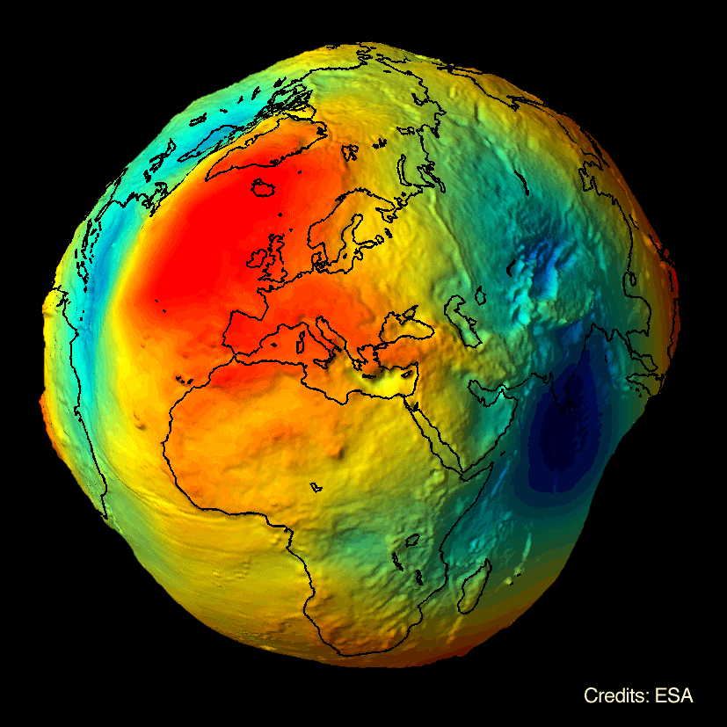
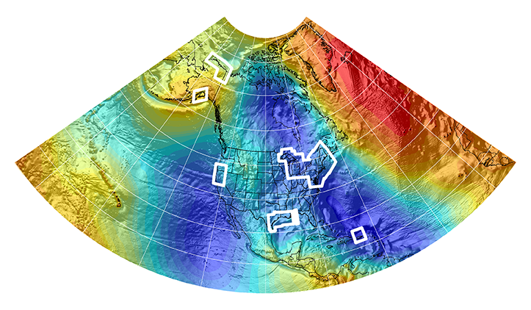
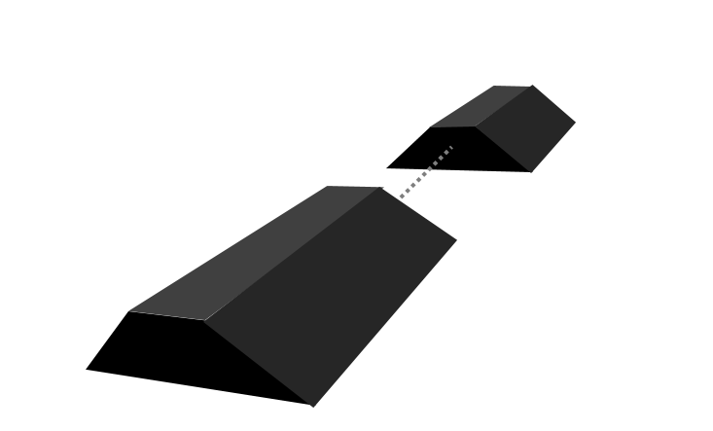
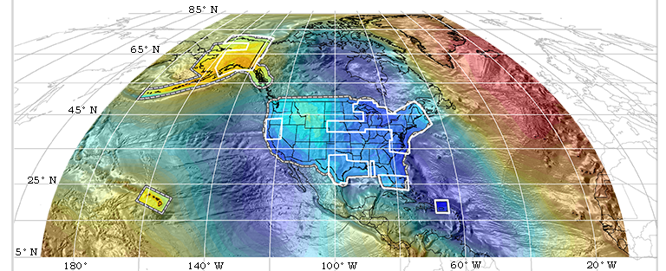
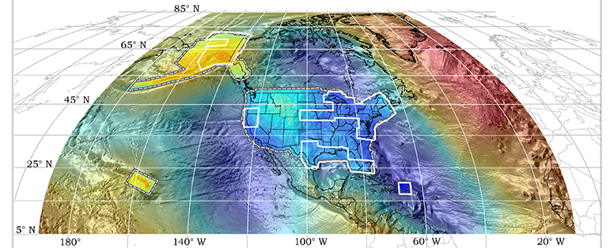
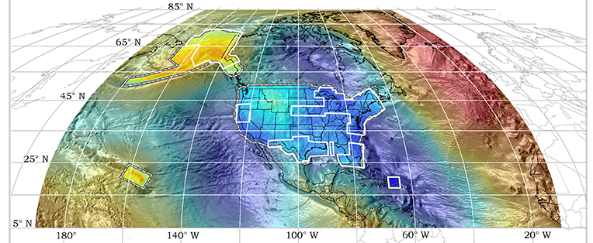
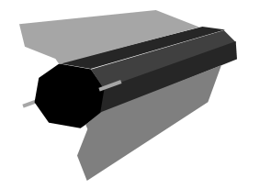
Evolution of Recent NGS Geoid Models
EGM2008
USGG2012
GEOID12A/B
GRAV-D
2008
2012
REF17A
2014
GOCO03s
GOCO05S
2015
2016
xGEOID14B
xGEOID15B
2017
GRACE
xGEOID16B
xGEOID17B
+
GOCE

Slide 25
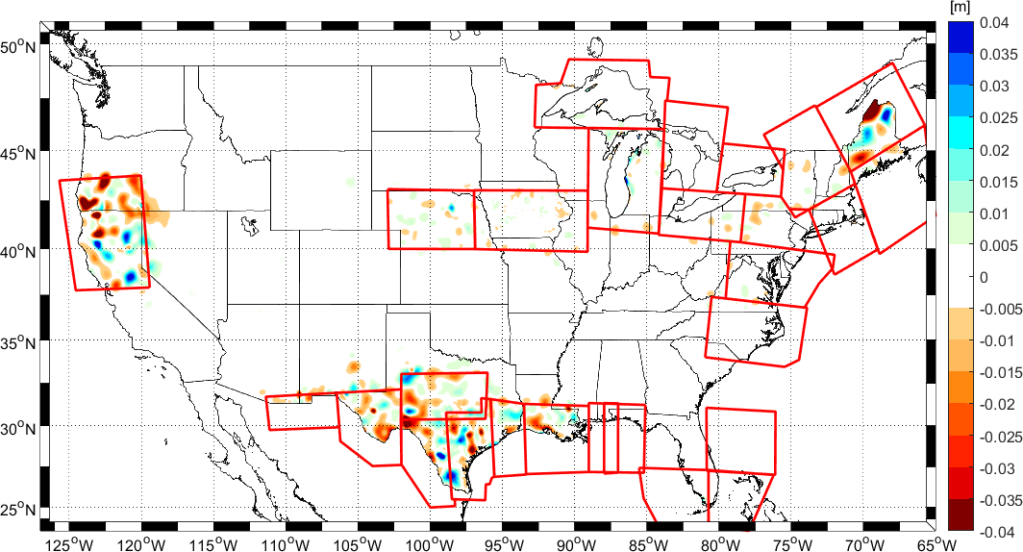
Impact of GRAV-D

