Slide 1
New Developments for OPUS
Dr. Mark Schenewerk
Mark.Schenewerk@noaa.gov
913-481-9998

Slide 2
Gerry Mader sends his apologizes for being unable to attend this workshop. I know he was looking forward to being here and is disappointed he could not attend.
He and Mike Cline asked me to step up and try to fill Gerry’s shoes. I’m honored to participate.
2010-Apr-15
2

Slide 3
Who is this guy?
I am Mark Schenewerk with National Geodetic Survey (NGS).
B.S. from the University of Missouri at Rolla. Ph.D. from the University of Illinois at Champaign-Urbana.
The NGS calls me a geodesist, but I’m actually an astronomer who happens to do things that look like geodesy.
I am the “father” of the PAGES processing software.
I’ve been (very) indirectly involved in OPUS since its inception and directly involved in some of the new development for the last two years.
2010-Apr-15
3

Slide 4
Workshop Outline
What is OPUS? (≈1 hr) An overview of OPUS in which I’ll “pull back the curtain” a bit and let you see what’s going on behind the web pages.
BREAK
New Developments for OPUS (≈1 hr) A summary of pending enhancements and new capabilities.
BREAK
OPUS-Projects (≈1 hr) On-line access to project organization and processing tools.
2010-Apr-15
4

Slide 5
Workshop Outline
I’m an informal speaker, so feel free to ask questions.
I will show examples of the web pages for completeness, but I am assuming a basic familiarity with the existing OPUS web sites. If you find any discussion about a web page too terse, ask for clarification.
2010-Apr-15
5

Slide 6
What is OPUS?
To better understand where OPUS is going, let’s begin by reviewing the who, what, when, where and why of OPUS as it is today.
2010-Apr-15
6

Slide 7
What is OPUS?
OPUS, the On-line Positioning User Service, is a growing set of applications offering web-based access to the tools and resources provided by the NGS.
Currently, OPUS is composed of:
OPUS-S . . . . . . . static processing
OPUS-RS. . . . . . rapid-static processing
OPUS-DB. . . . . . data base and publishing
Reviewing each of these individually…
2010-Apr-15
7

Slide 8
OPUS-S . . . . . . . static processing
A Little OPUS-S History.
The OPUS-S Interface.
How Good Can I Do With OPUS-S?
A Quick Example.
How Does OPUS-S Work?
OPUS-S Uploads By Month.
2010-Apr-15
8

Slide 9
A Little OPUS-S History.
In the late 1990’s, a growing number of organizations were making their Continuously Operating Reference Station (CORS) data publically available with a short latency.
Supporting products such as precise ephemerides were improving and also becoming available with a short latency.
Many organizations recognized that the time seemed ripe for some sort of on-line, processing service.
2010-Apr-15
9

Slide 10
A Little OPUS-S History.
In the NGS, Gerry Mader started promoting the idea of a processing service.
Specifically he envisioned a web-based service that was as simple as possible without significantly sacrificing accuracy thereby creating a tool useful to the largest possible group of potential users.
The NGS recognized that such a service could also be an effective tool to disseminate the National Spatial Reference System (NSRS).
2010-Apr-15
10

Slide 11
A Little OPUS-S History.
Mader and Weston (NGS) cloistered themselves and, with the help others too numerous to be mentioned here, created OPUS, now called OPUS-S, essentially as it exists today.
After an extended trial period, OPUS was formally made available to the public in 2002.
2010-Apr-15
11

Slide 12
The OPUS-S Interface.
Beautiful in its simplicity, the user need only provide:
Their email address.
The antenna type.
The offset to the antenna reference point (ARP).
2- to 48-hours of GPS L1 + L2 data.
In turn, the user receives:
Coordinates accurate to a few centimeters.
2010-Apr-15
12

Slide 13
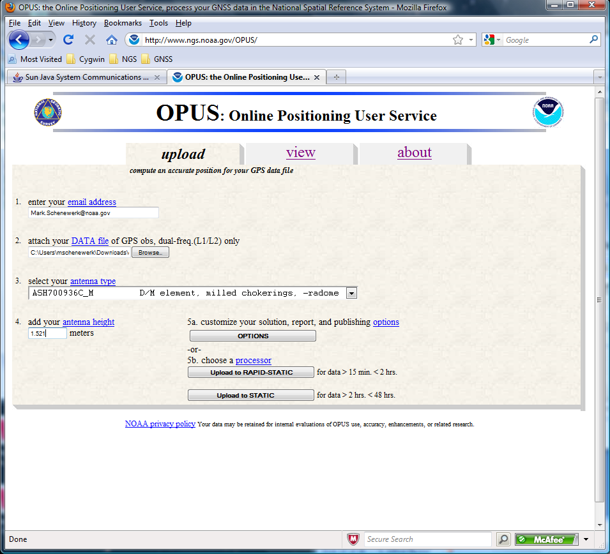
The OPUS-S Interface.
http://www.ngs.noaa.gov/OPUS/
This is the OPUS home page used to submit data to
the OPUS processing queues. To use OPUS-S, complete the four fields, then click the “Upload to STATIC” button. In a few minutes, an email arrives with the results.
2010-Apr-15
13

Slide 14
How Good Can I Do With OPUS-S?
OPUS-S reliably addresses the more historically conventional requirements for GPS data processing. It typically yields accuracies of:
1 – 2 cm horizontally
2 – 4 cm vertically.
However, there is no guarantee that this stated accuracy will result from any given data set. Confirming the quality of the OPUS solution remains the user’s responsibility. That’s the “price” for automated processing.
2010-Apr-15
14

Slide 15
How Good Can I Do With OPUS-S?
As a quality test, 2-hour data sets from more than 200 CORS were submitted to OPUS-S and the results compared to the accepted coordinates.
Mean: <0.1 cm
N-S RMS: 0.8 cm
E-W RMS: 1.4 cm
Weston, N. “OPUS: Online Positioning User Service”, CGSIC USSLS MEETING, 2008-07-08, NEW ORLEANS, LA.
2010-Apr-15
15

Slide 16
How Good Can I Do With OPUS-S?
Same data sets.
Same analysis but for the vertical.
The vertical is always a little more interesting.
Mean: <0.1 cm
U-D RMS: 1.9 cm
Weston, “OPUS: Online Positioning User Service”, CGSIC USSLS MEETING, 2008-07-08, NEW ORLEANS, LA
2010-Apr-15
16

Slide 17
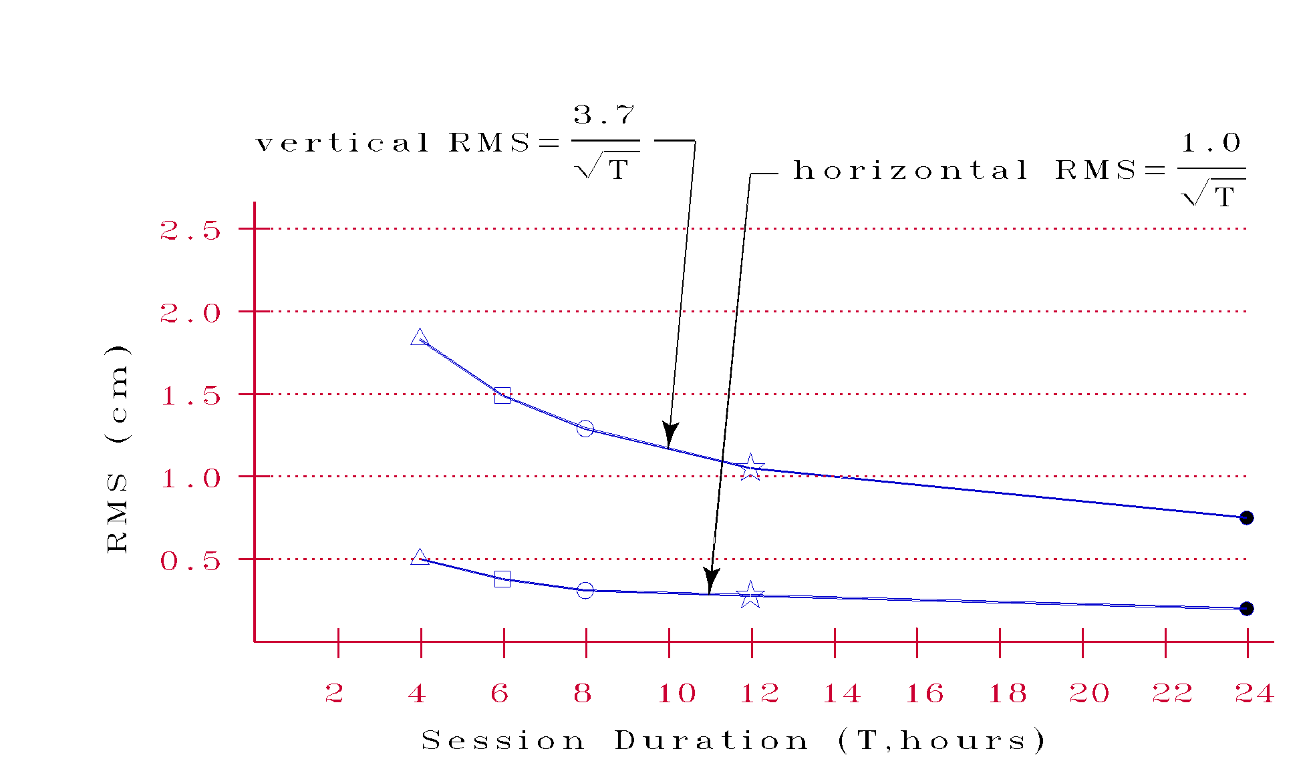
How Good Can I Do With OPUS-S?
More generally, Eckl et al. (NGS) preformed a similar but more extensive test using the same software but outside OPUS.
Eckl et al., 2001, “Accuracy of GPS-derived relative positions as a function of interstation distance and observing-session duration”, J. of Geod. 75, 633-640).
Their results provide a good “rule of thumb” for accuracy versus session duration when using OPUS-S and in many other applications.
2010-Apr-15
17

Slide 18
A Quick Example.
As an example,
2-hours of 2009-059 data from CORV, a PBO CORS in Oregon were submitted to OPUS-S.
2010-Apr-15
18

Slide 19
A Quick Example.
Here is part of the report for this submission.
FYI, these results differ 2.1 cm horizontally and 1.6 cm vertically from the accepted position projected to the epoch of the data.
USER: mark.schenewerk@noaa.gov DATE: March 31, 2010 RINEX FILE: corv059f.09o TIME: 19:43:42 UTC SOFTWARE: page5 0909.08 master40.pl 081023 START: 2009/02/28 05:00:00 EPHEMERIS: igs15206.eph [precise] STOP: 2009/02/28 06:59:00 NAV FILE: brdc0590.09n OBS USED: 5984 / 6181 : 97% ANT NAME: ASH700936C_M NONE # FIXED AMB: 31 / 31 : 100% ARP HEIGHT: 1.521 OVERALL RMS: 0.009(m) REF FRAME: NAD_83(CORS96)(EPOCH:2002.0000) ITRF00 (EPOCH:2009.1596) X: -2498422.603(m) 0.011(m) -2498423.344(m) 0.011(m) Y: -3802821.159(m) 0.007(m) -3802819.941(m) 0.007(m) Z: 4454736.661(m) 0.021(m) 4454736.734(m) 0.021(m) LAT: 44 35 7.91060 0.016(m) 44 35 7.92618 0.016(m) E LON: 236 41 43.48046 0.013(m) 236 41 43.42207 0.013(m) W LON: 123 18 16.51954 0.013(m) 123 18 16.57793 0.013(m) EL HGT: 106.011(m) 0.014(m) 105.627(m) 0.014(m) ORTHO HGT: 128.542(m) 0.020(m) [NAVD88 (Computed using GEOID09)] UTM COORDINATES STATE PLANE COORDINATES UTM (Zone 10) SPC (3601 OR N) Northing (Y) [meters] 4936954.909 105971.559 Easting (X) [meters] 475821.304 2277335.367 Convergence [degrees] -0.21381419 -1.98897513 Point Scale 0.99960719 0.99994603 Combined Factor 0.99959057 0.99992941 US NATIONAL GRID DESIGNATOR: 10TDQ7582136954(NAD 83) BASE STATIONS USED PID DESIGNATION LATITUDE LONGITUDE DISTANCE(m) DH4503 P376 EOLARESVR_OR2004 CORS ARP N445628.313 W1230608.100 42648.2 DE6258 MCSO MARION CNTY COOP CORS ARP N445825.701 W1225720.639 51226.8 DG5352 STAY STAYTON COOP CORS ARP N444950.530 W1224915.036 47030.9
2010-Apr-15
19

Slide 20
A Quick Example.
Again, I’m assuming familiarity with the report, but …
… at the risk of stating the obvious, there are a few items I want to draw attention to.
USER: mark.schenewerk@noaa.gov DATE: March 31, 2010 RINEX FILE: corv059f.09o TIME: 19:43:42 UTC SOFTWARE: page5 0909.08 master40.pl 081023 START: 2009/02/28 05:00:00 EPHEMERIS: igs15206.eph [precise] STOP: 2009/02/28 06:59:00 NAV FILE: brdc0590.09n OBS USED: 5984 / 6181 : 97% ANT NAME: ASH700936C_M NONE # FIXED AMB: 31 / 31 : 100% ARP HEIGHT: 1.521 OVERALL RMS: 0.009(m) REF FRAME: NAD_83(CORS96)(EPOCH:2002.0000) ITRF00 (EPOCH:2009.1596) X: -2498422.603(m) 0.011(m) -2498423.344(m) 0.011(m) Y: -3802821.159(m) 0.007(m) -3802819.941(m) 0.007(m) Z: 4454736.661(m) 0.021(m) 4454736.734(m) 0.021(m) LAT: 44 35 7.91060 0.016(m) 44 35 7.92618 0.016(m) E LON: 236 41 43.48046 0.013(m) 236 41 43.42207 0.013(m) W LON: 123 18 16.51954 0.013(m) 123 18 16.57793 0.013(m) EL HGT: 106.011(m) 0.014(m) 105.627(m) 0.014(m) ORTHO HGT: 128.542(m) 0.020(m) [NAVD88 (Computed using GEOID09)] UTM COORDINATES STATE PLANE COORDINATES UTM (Zone 10) SPC (3601 OR N) Northing (Y) [meters] 4936954.909 105971.559 Easting (X) [meters] 475821.304 2277335.367 Convergence [degrees] -0.21381419 -1.98897513 Point Scale 0.99960719 0.99994603 Combined Factor 0.99959057 0.99992941 US NATIONAL GRID DESIGNATOR: 10TDQ7582136954(NAD 83) BASE STATIONS USED PID DESIGNATION LATITUDE LONGITUDE DISTANCE(m) DH4503 P376 EOLARESVR_OR2004 CORS ARP N445628.313 W1230608.100 42648.2 DE6258 MCSO MARION CNTY COOP CORS ARP N445825.701 W1225720.639 51226.8 DG5352 STAY STAYTON COOP CORS ARP N444950.530 W1224915.036 47030.9
2010-Apr-15
20

Slide 21
A Quick Example.
I apologize for stating the obvious, but …
When reviewing your OPUS solution, double check that the information you provided is correct.
USER: mark.schenewerk@noaa.gov DATE: March 31, 2010 RINEX FILE: corv059f.09o TIME: 19:43:42 UTC SOFTWARE: page5 0909.08 master40.pl 081023 START: 2009/02/28 05:00:00 EPHEMERIS: igs15206.eph [precise] STOP: 2009/02/28 06:59:00 NAV FILE: brdc0590.09n OBS USED: 5984 / 6181 : 97% ANT NAME: ASH700936C_M NONE # FIXED AMB: 31 / 31 : 100% ARP HEIGHT: 1.521 OVERALL RMS: 0.009(m) REF FRAME: NAD_83(CORS96)(EPOCH:2002.0000) ITRF00 (EPOCH:2009.1596) X: -2498422.603(m) 0.011(m) -2498423.344(m) 0.011(m) Y: -3802821.159(m) 0.007(m) -3802819.941(m) 0.007(m) Z: 4454736.661(m) 0.021(m) 4454736.734(m) 0.021(m) LAT: 44 35 7.91060 0.016(m) 44 35 7.92618 0.016(m) E LON: 236 41 43.48046 0.013(m) 236 41 43.42207 0.013(m) W LON: 123 18 16.51954 0.013(m) 123 18 16.57793 0.013(m) EL HGT: 106.011(m) 0.014(m) 105.627(m) 0.014(m) ORTHO HGT: 128.542(m) 0.020(m) [NAVD88 (Computed using GEOID09)] UTM COORDINATES STATE PLANE COORDINATES UTM (Zone 10) SPC (3601 OR N) Northing (Y) [meters] 4936954.909 105971.559 Easting (X) [meters] 475821.304 2277335.367 Convergence [degrees] -0.21381419 -1.98897513 Point Scale 0.99960719 0.99994603 Combined Factor 0.99959057 0.99992941 US NATIONAL GRID DESIGNATOR: 10TDQ7582136954(NAD 83) BASE STATIONS USED PID DESIGNATION LATITUDE LONGITUDE DISTANCE(m) DH4503 P376 EOLARESVR_OR2004 CORS ARP N445628.313 W1230608.100 42648.2 DE6258 MCSO MARION CNTY COOP CORS ARP N445825.701 W1225720.639 51226.8 DG5352 STAY STAYTON COOP CORS ARP N444950.530 W1224915.036 47030.9
RINEX FILE: corv059f.09o
START: 2009/02/28 05:00:00 STOP: 2009/02/28 06:59:00
ANT NAME: ASH700936C_M NONE
ARP HEIGHT: 1.521
2010-Apr-15
21

Slide 22
A Quick Example.
I apologize for stating the obvious, but …
Check the quality control measures provided:
OBS USED > 90%
# FIXED AMB > 50%
OVERALL RMS < 3 cm
peak-to-peak < 5 cm
In this example, we have a .
USER: mark.schenewerk@noaa.gov DATE: March 31, 2010 RINEX FILE: corv059f.09o TIME: 19:43:42 UTC SOFTWARE: page5 0909.08 master40.pl 081023 START: 2009/02/28 05:00:00 EPHEMERIS: igs15206.eph [precise] STOP: 2009/02/28 06:59:00 NAV FILE: brdc0590.09n OBS USED: 5984 / 6181 : 97% ANT NAME: ASH700936C_M NONE # FIXED AMB: 31 / 31 : 100% ARP HEIGHT: 1.521 OVERALL RMS: 0.009(m) REF FRAME: NAD_83(CORS96)(EPOCH:2002.0000) ITRF00 (EPOCH:2009.1596) X: -2498422.603(m) 0.011(m) -2498423.344(m) 0.011(m) Y: -3802821.159(m) 0.007(m) -3802819.941(m) 0.007(m) Z: 4454736.661(m) 0.021(m) 4454736.734(m) 0.021(m) LAT: 44 35 7.91060 0.016(m) 44 35 7.92618 0.016(m) E LON: 236 41 43.48046 0.013(m) 236 41 43.42207 0.013(m) W LON: 123 18 16.51954 0.013(m) 123 18 16.57793 0.013(m) EL HGT: 106.011(m) 0.014(m) 105.627(m) 0.014(m) ORTHO HGT: 128.542(m) 0.020(m) [NAVD88 (Computed using GEOID09)] UTM COORDINATES STATE PLANE COORDINATES UTM (Zone 10) SPC (3601 OR N) Northing (Y) [meters] 4936954.909 105971.559 Easting (X) [meters] 475821.304 2277335.367 Convergence [degrees] -0.21381419 -1.98897513 Point Scale 0.99960719 0.99994603 Combined Factor 0.99959057 0.99992941 US NATIONAL GRID DESIGNATOR: 10TDQ7582136954(NAD 83) BASE STATIONS USED PID DESIGNATION LATITUDE LONGITUDE DISTANCE(m) DH4503 P376 EOLARESVR_OR2004 CORS ARP N445628.313 W1230608.100 42648.2 DE6258 MCSO MARION CNTY COOP CORS ARP N445825.701 W1225720.639 51226.8 DG5352 STAY STAYTON COOP CORS ARP N444950.530 W1224915.036 47030.9
OBS USED: 5984 / 6181 : 97% # FIXED AMB: 31 / 31 : 100% OVERALL RMS: 0.009(m)
0.011(m)
0.007(m)
0.021(m)
2010-Apr-15
22

Slide 23
A Quick Example.
I apologize for stating the obvious, but …
If you’re uncomfortable with your results (we’re not, but speaking hypothetically), check your data first.
Your hardware manufacturer may provide software.
Use third-party software such as TEQC. Estes and Meertens, “TEQC: The Multi-Purpose Toolkit for GPS/GLONASS Data”, 1999, GPS Solutions, 3, 1, 42-49.
Resubmit requesting the extended report.
If you’re still uncomfortable, consider checking the CORS used in the OPUS processing. The performance of the CORS is reflected in your results.
2010-Apr-15
23

Slide 24
A Quick Example.
I apologize for stating the obvious, but …
The CORS selected as reference sites are listed towards the bottom of the standard report.
OPUS examined the available sites and selected P376, MCSO and STAY.
USER: mark.schenewerk@noaa.gov DATE: March 31, 2010 RINEX FILE: corv059f.09o TIME: 19:43:42 UTC SOFTWARE: page5 0909.08 master40.pl 081023 START: 2009/02/28 05:00:00 EPHEMERIS: igs15206.eph [precise] STOP: 2009/02/28 06:59:00 NAV FILE: brdc0590.09n OBS USED: 5984 / 6181 : 97% ANT NAME: ASH700936C_M NONE # FIXED AMB: 31 / 31 : 100% ARP HEIGHT: 1.521 OVERALL RMS: 0.009(m) REF FRAME: NAD_83(CORS96)(EPOCH:2002.0000) ITRF00 (EPOCH:2009.1596) X: -2498422.603(m) 0.011(m) -2498423.344(m) 0.011(m) Y: -3802821.159(m) 0.007(m) -3802819.941(m) 0.007(m) Z: 4454736.661(m) 0.021(m) 4454736.734(m) 0.021(m) LAT: 44 35 7.91060 0.016(m) 44 35 7.92618 0.016(m) E LON: 236 41 43.48046 0.013(m) 236 41 43.42207 0.013(m) W LON: 123 18 16.51954 0.013(m) 123 18 16.57793 0.013(m) EL HGT: 106.011(m) 0.014(m) 105.627(m) 0.014(m) ORTHO HGT: 128.542(m) 0.020(m) [NAVD88 (Computed using GEOID09)] UTM COORDINATES STATE PLANE COORDINATES UTM (Zone 10) SPC (3601 OR N) Northing (Y) [meters] 4936954.909 105971.559 Easting (X) [meters] 475821.304 2277335.367 Convergence [degrees] -0.21381419 -1.98897513 Point Scale 0.99960719 0.99994603 Combined Factor 0.99959057 0.99992941 US NATIONAL GRID DESIGNATOR: 10TDQ7582136954(NAD 83) BASE STATIONS USED PID DESIGNATION LATITUDE LONGITUDE DISTANCE(m) DH4503 P376 EOLARESVR_OR2004 CORS ARP N445628.313 W1230608.100 42648.2 DE6258 MCSO MARION CNTY COOP CORS ARP N445825.701 W1225720.639 51226.8 DG5352 STAY STAYTON COOP CORS ARP N444950.530 W1224915.036 47030.9
BASE STATIONS USED PID DESIGNATION LATITUDE LONGITUDE DISTANCE(m) DH4503 P376 EOLARESVR_OR2004 CORS ARP N445628.313 W1230608.100 42648.2 DE6258 MCSO MARION CNTY COOP CORS ARP N445825.701 W1225720.639 51226.8 DG5352 STAY STAYTON COOP CORS ARP N444950.530 W1224915.036 47030.9
2010-Apr-15
24

Slide 25
A Quick Example.
I apologize for stating the obvious, but …
Shown are the positions of P376, MCSO and STAY relative to our “test” site, CORV.
A similar, interactive map (without the baselines) can be found under the CORS link at the NGS web site. http://www.ngs.noaa.gov/CORS/
2010-Apr-15
25

Slide 26
A Quick Example.
I apologize for stating the obvious, but …
The NGS monitors the CORS data daily and provides summaries of those results.
Site logs and coordinate time series for the CORS can be accessed through the Logfiles option under the CORS Site Metadata.
http://www.ngs.noaa.gov/CORS/logfiles/
2010-Apr-15
26

Slide 27
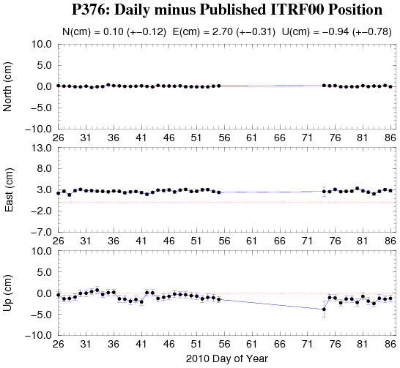
A Quick Example.
I apologize for stating the obvious, but …
Looking at the 60-day time-series around 2009-056 for P376, we discover that the P376 data for the this day happens to be the last before an extended gap.
2010-Apr-15
27

Slide 28
A Quick Example.
I apologize for stating the obvious, but …
Although this site and the results appears fine otherwise, we may want to consider digging a little deeper.
Possible next steps in evaluating this CORS are:
Resubmit requesting the extended report.
Review the P376 site log.
Resubmit excluding P376.
2010-Apr-15
28

Slide 29
How Does OPUS-S Work?
The primary steps of OPUS-S processing are:
Prepare and quality control the submitted data.
Estimate a crude point-position using TEQC.
Compute distances to every available CORS.
Select the three “best” CORS based upon:
Being closest to the user’s site.
Having common satellite visibility with the user data.
Having more than 80% of the possible data available.
Having low multipath measures.
Complete the single-baseline processing using PAGES.
Check the solution quality and replace a CORS if needed.
Generate and email the report to the user.
2010-Apr-15
29

Slide 30
How Does OPUS-S Work?
OPUS-S uses PAGES for data processing.
PAGES is a state-of-the-art processing engine developed by the NGS.
Besides OPUS-S, PAGES is used for orbit production, reference frame definition, network monitoring and many other GPS data processing tasks.
http://www.ngs.noaa.gov/GRD/GPS/DOC/toc.html
http://igscb.jpl.nasa.gov/igscb/center/analysis/noaa.acn
2010-Apr-15
30

Slide 31
How Does OPUS-S Work?
OPUS-S modeling highlights:
Satellite coordinates from the International GNSS Service (IGS) precise ephemerides. http://igscb.jpl.nasa.gov/components/usage.html.
CORS coordinates and hardware histories from the NGS site information data base.
Receiver antenna phase center offsets and variations from the NGS relative antenna model data base. http://www.ngs.noaa.gov/ANTCAL/.
International Earth Rotation Service (IERS) 2003 solid Earth tide model.
http://www.iers.org/nn_11216/IERS/EN/Publications/TechnicalNotes/tn32.html.
Surface met from a climatological model. Boehm et al., “Short Note: A global model of pressure and temperature for geodetic applications”, J. Geod., 2007.
2010-Apr-15
31

Slide 32
How Does OPUS-S Work?
OPUS-S processing highlights:
Everything is “done” in the International Terrestrial Reference Frame (ITRF).
SV coordinates are held rigidly fixed.
CORS coordinates are heavily constrained.
Neutral atmosphere (tropo) dry component modeled.
Neutral atmosphere (tropo) wet component estimated.
Double-differenced, ion-free carrier phase observable.
Carrier phase ambiguities are fixed to their integer values where possible; float ambiguities are estimated otherwise.
Individual baselines are processed and the results combined generating mean coordinates and peak-to-peak uncertainties.
2010-Apr-15
32

Slide 33
How Does OPUS-S Work?
Some thoughts on phase ambiguity integer fixing.
The ambiguities, (charged and neutral) atmosphere delays and station heights strongly alias into each other.
There are really only two ways to “break” this aliasing:
Introduce more data.
Introduce additional information.
2010-Apr-15
33

Slide 34
How Does OPUS-S Work?
OPUS-S uses the former strategy.
Depending upon the circumstances, 1- to 2-hours of observations are sufficient to decorrelate the ambiguities, atmosphere and heights allowing reliable estimation of all. Thus the requirement for a minimum of 2-hours in OPUS-S.
As an aside, be aware that while simply having more data helps, it is actually the change in orientation of the satellites over the data span that forces the decorrelation.
2010-Apr-15
34

Slide 35
OPUS-S Uploads By Month.
Shown here are the monthly upload counts to OPUS-S.
Submissions to OPUS-S comprise a non-trivial percentage of all “hits” on the NGS web sites.
Valid as of 2010-03-30. Values before January, 2005 are approximate.
2010-Apr-15
35

Slide 36
OPUS-RS. . . . . . . rapid-static processing
A Little OPUS-RS History.
The OPUS-RS Interface.
How Good Can I Do With OPUS-RS?
A Quick Example (cont.).
How Does OPUS-RS Work?
OPUS-S and OPUS-RS Uploads By Month.
2010-Apr-15
36

Slide 37
A Little OPUS-RS History
Although successful, OPUS obviously does not satisfy the needs of all users. For this reason, discussions with the user community about future development began almost immediately after OPUS was made public.
These early discussions clearly indicated that the most desired enhancement would be a tool capable of producing a similar quality result from a shorter data span.
2010-Apr-15
37

Slide 38
A Little OPUS-RS History
Work by several groups demonstrated that reliably producing results of similar quality to OPUS from shorter data spans was possible.
Collaboration between the NGS and the Satellite Positioning and Inertial Navigation (SPIN) group at The Ohio State University enabled Schwarz (DST) to implement a new processing engine capable of generating those results.
In early 2007, OPUS-RS was made publically available after its own trial period. To better delineate uses, the original OPUS processing stream was renamed OPUS-S.
2010-Apr-15
38

Slide 39
The OPUS-RS Interface.
With OPUS-RS, the beautiful simplicity remained. In fact the entry form is the same as for OPUS-S. The user provides:
Their email address.
An antenna type.
The vertical offset to the ARP.
15-minutes to 2-hours of GPS L1 + L2 data.
The user receives:
Coordinates accurate to a few centimeters.
2010-Apr-15
39

Slide 40
The OPUS-RS Interface.
http://www.ngs.noaa.gov/OPUS/
http://www.ngs.noaa.gov/OPUS/
The same interface is used except one clicks the “Upload to RAPID-STATIC” button instead.
2010-Apr-15
40

Slide 41
A Quick Example. (cont.)
Shown here is part of the OPUS-RS report for the same CORV data discussed earlier.
The results differ by 2.4 cm horizontally and 0.2 cm vertically from the accepted position projected to the epoch of the data.
USER: mark.schenewerk@noaa.gov DATE: April 01, 2010 RINEX FILE: corv059f.09o TIME: 16:17:51 UTC SOFTWARE: rsgps 1.35 RS11.prl 1.57 START: 2009/02/28 05:00:00 EPHEMERIS: igs15206.eph [precise] STOP: 2009/02/28 06:59:30 NAV FILE: brdc0590.09n OBS USED: 5652 / 11169 : 51% ANT NAME: ASH700936C_M QUALITY IND. 48.23/108.85 ARP HEIGHT: 1.521 NORMALIZED RMS: 0.280 REF FRAME: NAD_83(CORS96)(EPOCH:2002.0000) ITRF00 (EPOCH:2009.15959) X: -2498422.589(m) 0.015(m) -2498423.330(m) 0.015(m) Y: -3802821.147(m) 0.012(m) -3802819.929(m) 0.012(m) Z: 4454736.644(m) 0.021(m) 4454736.717(m) 0.021(m) LAT: 44 35 7.91061 0.004(m) 44 35 7.92619 0.004(m) E LON: 236 41 43.48069 0.011(m) 236 41 43.42230 0.011(m) W LON: 123 18 16.51931 0.011(m) 123 18 16.57770 0.011(m) EL HGT: 105.986(m) 0.026(m) 105.602(m) 0.026(m) ORTHO HGT: 128.517(m) 0.030(m) [NAVD88 (Computed using GEOID09)] UTM COORDINATES STATE PLANE COORDINATES UTM (Zone 10) SPC (3601 OR N) Northing (Y) [meters] 4936954.909 105971.559 Easting (X) [meters] 475821.309 2277335.372 Convergence [degrees] -0.21381414 -1.98897509 Point Scale 0.99960719 0.99994603 Combined Factor 0.99959058 0.99992942 US NATIONAL GRID DESIGNATOR: 10TDQ7582136954(NAD 83) BASE STATIONS USED PID DESIGNATION LATITUDE LONGITUDE DISTANCE(m) DH4503 P376 EOLARESVR_OR2004 CORS ARP N445628.313 W1230608.100 42648.2 DG5352 STAY STAYTON COOP CORS ARP N444950.530 W1224915.036 47030.9 DE6258 MCSO MARION CNTY COOP CORS ARP N445825.701 W1225720.639 51226.8 DI7529 P367 NEWPRTAIR_OR2007 CORS ARP N443506.870 W1240341.598 60113.5
⁞
2010-Apr-15
41

Slide 42
A Quick Example. (cont.)
Note that the solution quality measures are slightly different.
OBS USED > 50%
QUALITY IND. > 3
NORM. RMS ≈ 1
uncertainties < 5 cm
The uncertainties are standard deviations from the solution, not the peak-to-peak values reported by OPUS-S.
USER: mark.schenewerk@noaa.gov DATE: April 01, 2010 RINEX FILE: corv059f.09o TIME: 16:17:51 UTC SOFTWARE: rsgps 1.35 RS11.prl 1.57 START: 2009/02/28 05:00:00 EPHEMERIS: igs15206.eph [precise] STOP: 2009/02/28 06:59:30 NAV FILE: brdc0590.09n OBS USED: 5652 / 11169 : 51% ANT NAME: ASH700936C_M QUALITY IND. 48.23/108.85 ARP HEIGHT: 1.521 NORMALIZED RMS: 0.280 REF FRAME: NAD_83(CORS96)(EPOCH:2002.0000) ITRF00 (EPOCH:2009.15959) X: -2498422.589(m) 0.015(m) -2498423.330(m) 0.015(m) Y: -3802821.147(m) 0.012(m) -3802819.929(m) 0.012(m) Z: 4454736.644(m) 0.021(m) 4454736.717(m) 0.021(m) LAT: 44 35 7.91061 0.004(m) 44 35 7.92619 0.004(m) E LON: 236 41 43.48069 0.011(m) 236 41 43.42230 0.011(m) W LON: 123 18 16.51931 0.011(m) 123 18 16.57770 0.011(m) EL HGT: 105.986(m) 0.026(m) 105.602(m) 0.026(m) ORTHO HGT: 128.517(m) 0.030(m) [NAVD88 (Computed using GEOID09)] UTM COORDINATES STATE PLANE COORDINATES UTM (Zone 10) SPC (3601 OR N) Northing (Y) [meters] 4936954.909 105971.559 Easting (X) [meters] 475821.309 2277335.372 Convergence [degrees] -0.21381414 -1.98897509 Point Scale 0.99960719 0.99994603 Combined Factor 0.99959058 0.99992942 US NATIONAL GRID DESIGNATOR: 10TDQ7582136954(NAD 83) BASE STATIONS USED PID DESIGNATION LATITUDE LONGITUDE DISTANCE(m) DH4503 P376 EOLARESVR_OR2004 CORS ARP N445628.313 W1230608.100 42648.2 DG5352 STAY STAYTON COOP CORS ARP N444950.530 W1224915.036 47030.9 DE6258 MCSO MARION CNTY COOP CORS ARP N445825.701 W1225720.639 51226.8 DI7529 P367 NEWPRTAIR_OR2007 CORS ARP N443506.870 W1240341.598 60113.5
⁞
OBS USED: 5652 / 11169 : 51% QUALITY IND. 48.23/108.85 NORMALIZED RMS: 0.280
2010-Apr-15
42

Slide 43
A Quick Example. (cont.)
Although the quality indices, normalized RMS and uncertainties are OK, the percentage of observations used gives this solution a .
If you are uncomfortable with your solution, the same diagnostic steps discussed for OPUS-S can be applied here too.
USER: mark.schenewerk@noaa.gov DATE: April 01, 2010 RINEX FILE: corv059f.09o TIME: 16:17:51 UTC SOFTWARE: rsgps 1.35 RS11.prl 1.57 START: 2009/02/28 05:00:00 EPHEMERIS: igs15206.eph [precise] STOP: 2009/02/28 06:59:30 NAV FILE: brdc0590.09n OBS USED: 5652 / 11169 : 51% ANT NAME: ASH700936C_M QUALITY IND. 48.23/108.85 ARP HEIGHT: 1.521 NORMALIZED RMS: 0.280 REF FRAME: NAD_83(CORS96)(EPOCH:2002.0000) ITRF00 (EPOCH:2009.15959) X: -2498422.589(m) 0.015(m) -2498423.330(m) 0.015(m) Y: -3802821.147(m) 0.012(m) -3802819.929(m) 0.012(m) Z: 4454736.644(m) 0.021(m) 4454736.717(m) 0.021(m) LAT: 44 35 7.91061 0.004(m) 44 35 7.92619 0.004(m) E LON: 236 41 43.48069 0.011(m) 236 41 43.42230 0.011(m) W LON: 123 18 16.51931 0.011(m) 123 18 16.57770 0.011(m) EL HGT: 105.986(m) 0.026(m) 105.602(m) 0.026(m) ORTHO HGT: 128.517(m) 0.030(m) [NAVD88 (Computed using GEOID09)] UTM COORDINATES STATE PLANE COORDINATES UTM (Zone 10) SPC (3601 OR N) Northing (Y) [meters] 4936954.909 105971.559 Easting (X) [meters] 475821.309 2277335.372 Convergence [degrees] -0.21381414 -1.98897509 Point Scale 0.99960719 0.99994603 Combined Factor 0.99959058 0.99992942 US NATIONAL GRID DESIGNATOR: 10TDQ7582136954(NAD 83) BASE STATIONS USED PID DESIGNATION LATITUDE LONGITUDE DISTANCE(m) DH4503 P376 EOLARESVR_OR2004 CORS ARP N445628.313 W1230608.100 42648.2 DG5352 STAY STAYTON COOP CORS ARP N444950.530 W1224915.036 47030.9 DE6258 MCSO MARION CNTY COOP CORS ARP N445825.701 W1225720.639 51226.8 DI7529 P367 NEWPRTAIR_OR2007 CORS ARP N443506.870 W1240341.598 60113.5
⁞
2010-Apr-15
43

Slide 44
How Good Can I Do With OPUS-RS?
OPUS-RS can produce quality results from more challenging “short” data sets, but it is slightly more restrictive in the data sets allowed. Because of the restrictions, which will be discussed later, the NGS recently made available the “OPUS-RS Accuracy and Availability” tool (Choi, NGS).
Typical estimated and empirical accuracies within the continental U.S. are comparable to OPUS-S.
Remember that the estimated accuracies suggested by this tool are just that - estimates. Confirming the quality of the OPUS solution remains the user’s responsibility.
2010-Apr-15
44

Slide 45
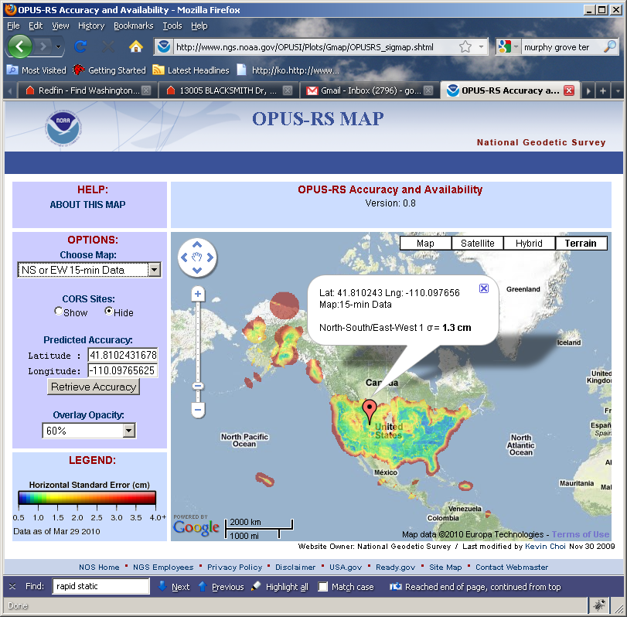
How Good Can I Do With OPUS-RS?
The OPUS-RS Accuracy and Availability Tool.
http://www.ngs.noaa.gov/OPUSI/Plots/Gmap/OPUSRS_sigmap.shtml
2010-Apr-15
45

Slide 46
How Good Can I Do With OPUS-RS?
1 σ for each 0.2 degree grid.
Horizontal and vertical standard errors for 15 minutes and 1-hour length data.
Inverse Distance Weighting method to interpolate the sigmas.
Areas outside the color overlay are where there are less than three active CORS sites within 250 km range. OPUS-RS will usually fail at these locations.
Automated Weekly update
Use updated CORS list and observation data availability
Global coverage including non-US territories.
2010-Apr-15
46

Slide 47
How Does OPUS-RS Work?
OPUS-RS uses the RSGPS program which was developed specifically for this purpose.
Like OPUS-S, OPUS-RS uses state-of-the-art models, but the strategy to fix phase ambiguities to their integer values differs.
To fix integers, OPUS-RS introduces more information:
Pseudorange and carrier phase.
More reference stations if possible.
2010-Apr-15
47

Slide 48
How Does OPUS-RS Work?
OPUS-RS selects three to nine “best” CORS based upon:
Having common satellite visibility with the user data.
Having distances from the user’s site <250 km.
This is shown here graphically. The star represents the user’s site. The triangles are CORS.
No CORS farther than 250 km from the user’s site will be included.
The three CORS minimum is shown. No more than nine are used.
s
>250km
250km
Choi, 2010, personal communication.
2010-Apr-15
48

Slide 49
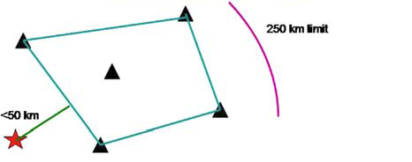
How Does OPUS-RS Work?
In addition, user’s site must be no more than 50 km from the (convex) polygon created by the selected CORS.
Again in this figure, the star represents the user’s site; the
triangles are CORS. Five CORS and their resulting polygon are shown in this example.
If the user’s site, the star, is more than 50 km outside this polygon, alternate CORS will be considered.
If none can be found, the processing will abort.
Schwarz et al., “Accuracy assessment of the National Geodetic Survey's OPUS-RS utility”, 2009, GPS Solutions, 13(2), 119-132.
2010-Apr-15
49

Slide 50
How Does OPUS-RS Work?
OPUS-RS uses no less than 1-hour of CORS data and no more than the submitted data’s span plus 15-minutes before and after.
The CORS data are used to estimate the atmospheric delays at each CORS and predict them at the user’s site.
OPUS-RS then processes each baseline to the user’s site individually to produce a improved a priori position.
Switching modes, the previously determined values and all data are used in an “integer-fixed” solution for the user’s site.
Schwarz et al., “Accuracy assessment of the National Geodetic Survey's OPUS-RS utility”, 2009, GPS Solutions, 13(2), 119-132.
2010-Apr-15
50

Slide 51
OPUS-S And OPUS-RS Uploads By Month.
Upload rates to OPUS-S and OPUS-RS appear to have leveled off at approximately 15,000 per month for each.
Valid as of 2010-03-30.
2010-Apr-15
51

Slide 52
OPUS-DB. . . . . . data base and publishing
A Little OPUS-DB History.
The OPUS-DB Interface.
How Does OPUS-DB Work?
OPUS-DB Uploads By Month.
2010-Apr-15
52

Slide 53
A Little OPUS-DB History.
With the release of OPUS-RS, the comments about OPUS began to focus on a new issue. Users wanted an equally simple way to share their OPUS results with the community.
2010-Apr-15
53

Slide 54
A Little OPUS-DB History.
Historically, when in collaboration with or publishing through the NGS, one submitted results to the Integrated Data Base (IDB) and, in this manner, contributed to the NSRS.
Before submitted results could be entered into the IDB, the submissions had to meet a well-defined set of requirements and quality controls.
Reconciling the “open” input philosophy represented by OPUS with the “controlled” input philosophy represented by IDB is a tremendous challenge.
2010-Apr-15
54

Slide 55
A Little OPUS-DB History.
A significant step in reconciliation came in 2009 with the release of OPUS-DB.
OPUS-DB allows users to publish their OPUS result in an on-line data base if minimum requirements for quality are met and the associated meta-data, such as photos and descriptions, are provided.
2010-Apr-15
55

Slide 56
A Little OPUS-DB History.
For now, OPUS-DB and the IDB exist as two separate tools.
As the NGS begins to more fully understand the characteristics of the OPUS-DB, the OPUS-DB and the IDB will be more fully reconciled.
In the meantime, a submission to the OPUS-DB may be eligible for, but not guaranteed to be included in the IDB.
2010-Apr-15
56

Slide 57
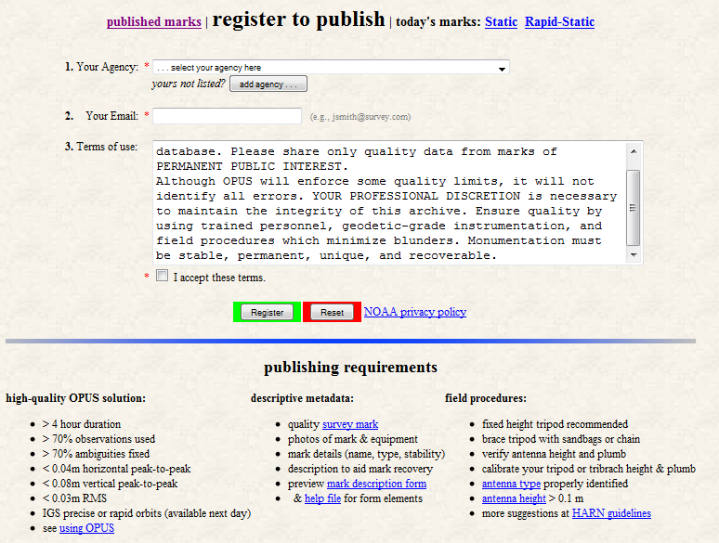
OPUS-DB Interface.
Before publishing to OPUS-DB, one must first register.
That form is found at the bottom of the “view” tab on the OPUS home page.
http://www.ngs.noaa.gov/OPUS/view.jsp
2010-Apr-15
57

Slide 58
OPUS-DB Interface.
The first step in publishing to OPUS-DB is to submit data to OPUS.
The user completes the OPUS form normally, but must explicitly designate that the results should be published. This is done through the Options.
The “Submit to Data Base”, i.e. publish, option is near the bottom of the Options list.
2010-Apr-15
58

Slide 59
OPUS-DB Interface.
The user is taken to a new page where they designate the mark associated with their data as “new” or “recovered”.
2010-Apr-15
59

Slide 60
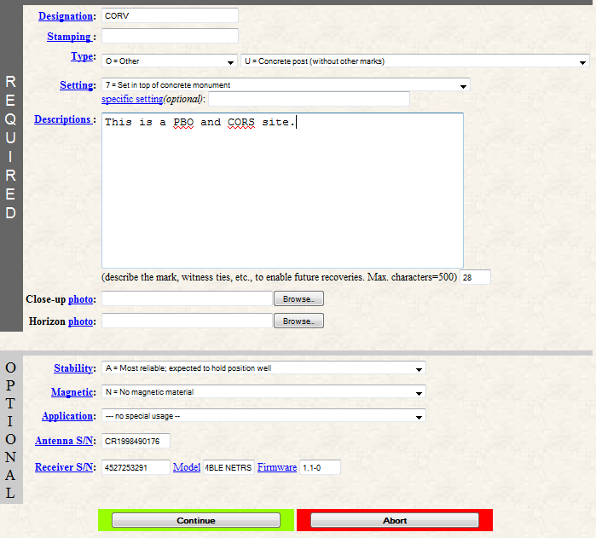
OPUS-DB Interface.
After making that selection, the user is offered the appropriate form for entering the meta-data.
In this example, we’re following the “new” mark designation.
2010-Apr-15
60

Slide 61
OPUS-DB Interface.
Many of you will recognize these fields as a subset of the information required to “blue book” a mark.
2010-Apr-15
61

Slide 62
OPUS-DB Interface.
This is not blue booking per se.
The process is streamlined. This is possible, in part, because some information is provided by the data processing itself.
2010-Apr-15
62

Slide 63
OPUS-DB Interface.
As a last step, the user given a chance to review the submission in the form of a mock-up of the datasheet for their submission.
If the meta-data is complete, the quality control restrictions are met and the user gives the “OK”, the submission is entered into the data base.
2010-Apr-15
63

Slide 64
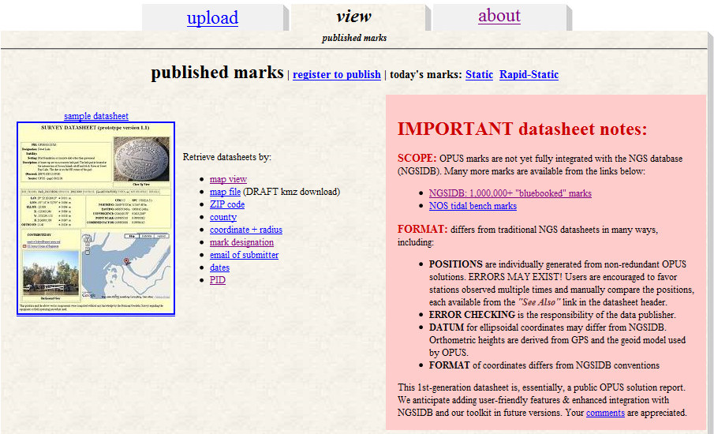
OPUS-DB Interface.
The “view” tab on the OPUS home page provides access to the results stored in the data base.
http://www.ngs.noaa.gov/OPUS/view.jsp
64
2010-Apr-15

Slide 65
OPUS-DB Interface.
The notes in the red box on the right side summarize the characteristics of the OPUS data base and its differences to the IDB.
http://www.ngs.noaa.gov/OPUS/view.jsp
65
2010-Apr-15

Slide 66
OPUS-DB Interface.
This is part of an OPUS-DB
data sheet.
Note the “See Also” highlight.
Note the “See Also” highlight. This provides access to other data base and IDB entries for this mark.
2010-Apr-15
66

Slide 67
How Does OPUS-DB Work?
OPUS-DB is a data base in the sense that we think of electronic, software-driven data bases today.
This implies that entries in the data base can be sorted and sampled by any of the individual data elements provided with each submission.
For example, users normally search the data base by PID, descriptor or location, but, of course, one could search for all the marks in by county or zip code.
2010-Apr-15
67

Slide 68
How Does OPUS-DB Work?
The OPUS-DB interface has started as a small, logical extension of the IDB interface, but, in a sense, OPUS-DB is a “blank sheet”.
Given a fully functional data base with graphical user interface, it’s not clear how OPUS-DB will evolve in the future.
2010-Apr-15
68

Slide 69
How Does OPUS-DB Work?
For this reason, note the “comments” link on the “view” page. This and similar links on other pages are sincere requests for your help in guiding future development.
http://www.ngs.noaa.gov/OPUS/view.jsp
69
2010-Apr-15

Slide 70
OPUS-DB Marks Published.
OPUS-DB
is showing steady growth in registered users and published marks.
2010-Apr-15
Evjen, “OPUS at 1000 published marks”, “Brown bag” presentation 2009-08-06.
70

Slide 71
New Developments for OPUS.
Lots of things are in the works for OPUS. Here is a sample.
New Look And Feel.
OPUS-Net.
OPUS-Mapper.
Other GNSS.
BREAK
OPUS-Projects.
2010-Apr-15
71

Slide 72
New Look And Feel.
The National Oceanic and Atmospheric Administration, the parent of the NGS, has asked all offices to implement a common “look and feel” to their web pages. This will soon be reflected in the OPUS pages too.
2010-Apr-15
72

Slide 73
New Look And Feel.
The exact content isn’t set so I won’t show the page clearly; however, the web page will have several ease-of-use enhancements.
2010-Apr-15
73

Slide 74
New Look And Feel.
The enhancements include:
Simplified antenna selection.
More direct access to the options.
Consistent navigation.
2010-Apr-15
74

Slide 75
OPUS-Net.
Weston and Ray (NGS) have found that by more fully implementing the available processing models in conjunction with changing the CORS selection criteria, at a minimum, the scatter in the north and east components can be significantly reduced with no degradation in the scatter in the height produced by OPUS-S.
Moreover, the resulting coordinates agree better with other sources such as the IGS weekly combinations.
Weston and Ray, “Test of the Use of Regional Networks for OPUS Processing”, 2010, EGU General Assembly 2010,
Geophysical Research Abstracts.
2010-Apr-15
75

Slide 76
OPUS-Net.
Implemented in an OPUS-like application, called OPUS-Net during its testing phase, it includes
An ocean-tide loading (OTL) model.
Absolute antenna phase correction models.
A combination of near-by and more-distant CORS.
Let’s look at these individually.
2010-Apr-15
76

Slide 77
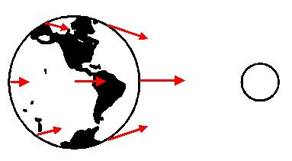
OPUS-Net.
What is OTL?
Subtle differences in the gravitational force of the Moon and Sun cause the Earth to deform. Most commonly seen as ocean tides, it also affects the solid Earth and atmosphere.
Schenewerk, “Physical Models Used (and Not Used) in the PAGES Software Suite”, 2008, private communication.
2010-Apr-15
77

Slide 78
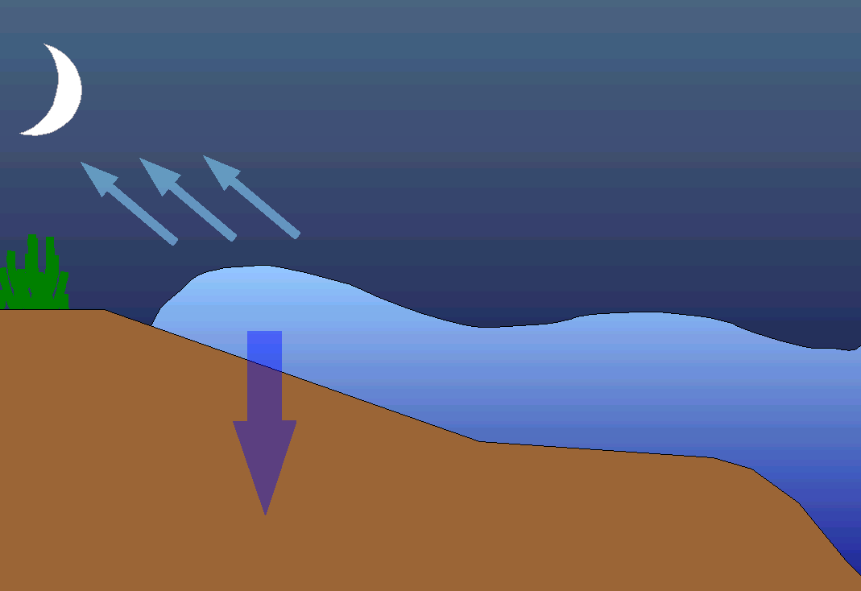
OPUS-Net.
Focusing on ocean tides, as the tide swells and ebbs, the changing weight of water presses on the Earth’s crust causing it to deform with the same period as the tide.
2010-Apr-15
78

Slide 79
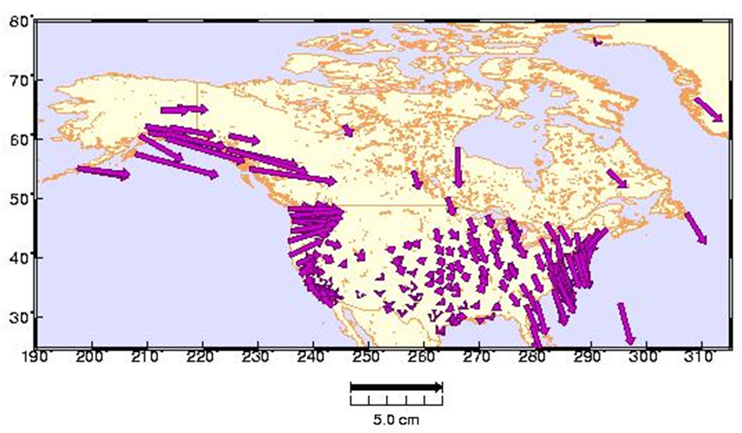
OPUS-Net.
The magnitude of the deformation depends upon the shape of the coastline and topography of the ocean floor. 1 – 3 cm vertical deformation is common along the continental U.S. coasts; larger on the Gulf of Alaska.
Schenewerk et al., "Vertical Ocean Loading Deformations Derived from a Global GPS Network", 2001, J. of the Geod. Soc. Of Japan, 47, 1, 237-242.
2010-Apr-15
79

Slide 80
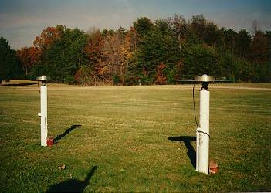
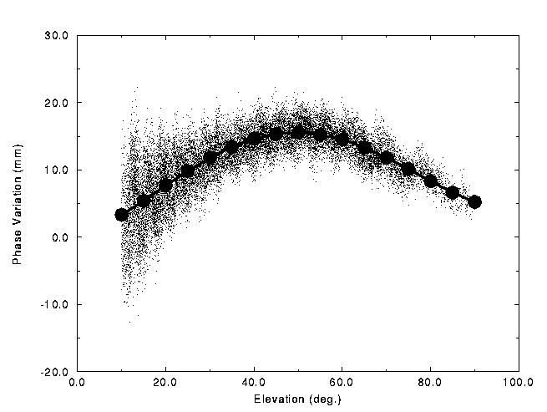
OPUS-Net.
What are absolute antenna phase correction models? No antenna is physically or electro- magnetically perfect.
For about two decades, some sort of antenna correction has been applied as part of processing.
Historically, these corrections have been relative to a specific antenna type.
The NGS antenna test range and a sample relative correction pattern are shown. http://www.ngs.noaa.gov/ANTCAL/
2010-Apr-15
80

Slide 81
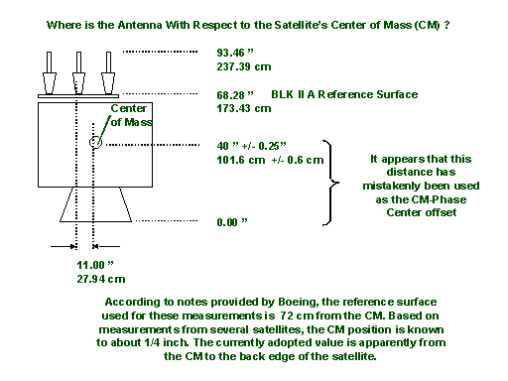
OPUS-Net.
The “relative” antenna corrections work well, particularly if the antennas are close together.
But, as data processing has improved, the limitations of relative antenna corrections have become increas- ingly evident. One example: satellite antenna corrections can not be fully applied when using a relative model.
http://www.ngs.noaa.gov/ANTCAL/
2010-Apr-15
81

Slide 82
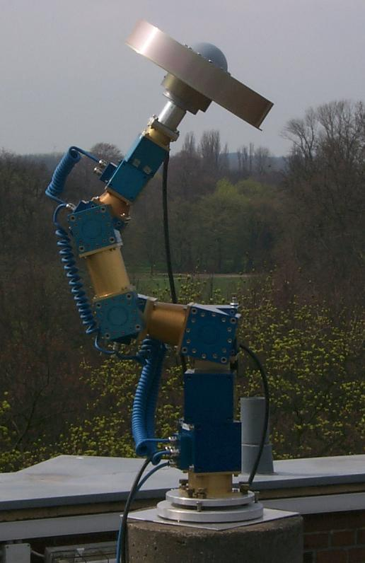
OPUS-Net.
By using data from a spatially large network with diverse equipment, and by including data from new tools such as robotic arms which shift the orientation of the antenna being tested on demand, “absolute” antenna phase patterns can be produced.
Absolute antenna corrections:
More fully implement the corrections.
Help minimize the effects of baseline lengths.
Help minimize hardware changes.
http://www.geopp.de/
2010-Apr-15
82

Slide 83
OPUS-Net.
Why use near-by and more-distant CORS?
Although it may seem counter-intuitive, using a combination of near and distant CORS has a number of advantages.
Site “quality” can be emphasized as well as data quantity.
Longer baselines enable better atmosphere corrections.
More CORS minimizes the effects of missing data and changes.
2010-Apr-15
83

Slide 84
OPUS-Mapper.
Traditionally, NGS products have supported higher-accuracy uses. While the NGS and its products have supported uses such as GIS, kinematic and hand-held tracking, to list a few, OPUS seems an appropriate gateway to supporting at least some activities more directly.
But, do we need another flavor of OPUS?
The answer is probably yes. A limited accuracy application fits into the NGS’s plans and the needs large user community.
2010-Apr-15
84

Slide 85
OPUS-Mapper.
# of People Who Care
NGS Works Here
GIS Works Here
mm
cm
dm
m
dam
hm
km
Position Accuracy
Mader and Weston, “An On-Line Positioning User Service For Geographic Information Systems”, 2007, 2007 ESRI Survey & Engineering GIS Summit.
2010-Apr-15
85

Slide 86
OPUS-Mapper.
What does OPUS-Mapper offer?
Accepts single- and dual-frequency data.
Accepts kinematic data.
Differential pseudorange solution to CORS.
Kinematic trajectory report.
Static occupation report.
Shape files are coming.
2010-Apr-15
86

Slide 87
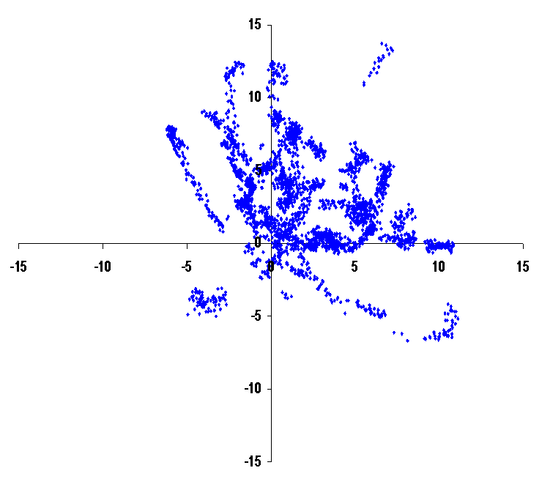
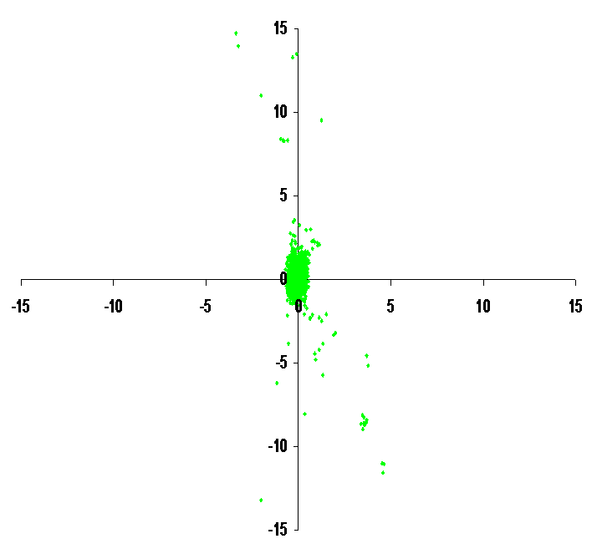
OPUS-Mapper.
Why opt for differential over point positioning?
N
N
W
E
W
E
S
S
Point Positioning
Differential Positioning
2010-Apr-15
87

Slide 88
OPUS-Mapper.
Although some trials were completed, there is no active web interface for OPUS-Mapper at this time. This is because:
Often, results like these are only part of a more comprehensive data set. It was realized that a means for “connecting” user-supplied data and meta-data needed to be developed.
Sometimes the developer needs a “kick in the pants.”
2010-Apr-15
88

Slide 89
OPUS-Mapper.
OPUS–Mapper Kinematic Trajectory Report
2005/12/ 3 17: 1:31.0 2.9 1.160 954480.027 -5680360.821 2729931.909 1.056 2.848 1.418 25.5077314 -80.4616043 -27.099 0.913 1.239 2.977
2005/12/ 3 17: 1:32.0 3.2 1.236 954481.086 -5680362.067 2729932.279 1.441 3.341 1.528 25.5077290 -80.4615959 -25.672 1.070 1.474 3.500
2005/12/ 3 17: 1:33.0 3.2 1.222 954481.036 -5680362.056 2729932.286 1.426 3.303 1.511 25.5077291 -80.4615964 -25.687 1.059 1.458 3.461
2005/12/ 3 17: 1:34.0 3.2 1.083 954481.059 -5680362.424 2729932.291 1.263 2.926 1.338 25.5077277 -80.4615968 -25.353 0.938 1.292 3.066
2005/12/ 3 17: 1:35.0 3.2 1.067 954480.952 -5680362.523 2729932.256 1.245 2.881 1.318 25.5077271 -80.4615980 -25.297 0.924 1.272 3.018
2005/12/ 3 17: 1:36.0 2.9 1.072 954480.179 -5680361.378 2729932.061 0.975 2.626 1.307 25.5077304 -80.4616037 -26.515 0.844 1.143 2.746
2005/12/ 3 17: 1:37.0 2.9 1.007 954480.317 -5680361.418 2729932.122 0.916 2.467 1.228 25.5077307 -80.4616024 -26.432 0.793 1.074 2.579
2005/12/ 3 17: 1:38.0 2.9 0.926 954480.509 -5680361.612 2729932.255 0.843 2.268 1.129 25.5077309 -80.4616009 -26.174 0.729 0.987 2.370
2005/12/ 3 17: 1:39.0 2.9 0.852 954480.740 -5680361.761 2729932.392 0.776 2.088 1.040 25.5077313 -80.4615988 -25.947 0.671 0.909 2.183
2005/12/ 3 17: 1:40.0 2.9 0.772 954480.960 -5680361.889 2729932.507 0.703 1.891 0.941 25.5077316 -80.4615969 -25.752 0.608 0.824 1.977
2005/12/ 3 17: 1:41.0 2.9 0.751 954481.064 -5680362.026 2729932.598 0.683 1.838 0.915 25.5077317 -80.4615961 -25.575 0.591 0.801 1.921
2005/12/ 3 17: 1:42.0 2.9 0.732 954481.140 -5680362.105 2729932.554 0.666 1.790 0.891 25.5077310 -80.4615955 -25.512 0.576 0.780 1.871
2005/12/ 3 17: 1:43.0 3.2 0.970 954481.362 -5680362.468 2729932.576 1.132 2.613 1.196 25.5077297 -80.4615939 -25.146 0.841 1.157 2.738
2005/12/ 3 17: 1:44.0 2.9 0.671 954481.325 -5680362.341 2729932.577 0.611 1.641 0.818 25.5077302 -80.4615941 -25.264 0.528 0.716 1.716
2005/12/ 3 17: 1:45.0 2.9 0.639 954481.429 -5680362.449 2729932.646 0.582 1.563 0.779 25.5077303 -80.4615932 -25.123 0.504 0.682 1.634
2005/12/ 3 17: 1:46.0 2.9 0.625 954481.526 -5680362.463 2729932.677 0.569 1.528 0.761 25.5077304 -80.4615923 -25.083 0.493 0.666 1.598
2005/12/ 3 17: 1:47.0 2.9 0.621 954481.582 -5680362.499 2729932.724 0.566 1.518 0.756 25.5077306 -80.4615918 -25.022 0.490 0.662 1.587
GPST Date & Time
XYZ
XYZ RMS
LAT, LON, EL HGT
NEU RMS
RDOP
RMS
2010-Apr-15
89

Slide 90
OPUS-Mapper.
OPUS–Mapper Static Occupation Report
Station #: 1 File: zzyy337r.05o
2005/12/ 3 17: 1:31 954482.055 0.566 25 1 27.8497 0.603
2005/12/ 3 17: 3:14 -5680362.733 0.590 -80 27 41.7152 0.487
#sec: 103 #pts: 104 2729933.535 0.812 -24.3934 0.855
Station #: 2 File: zzyy337r.05o
2005/12/ 3 17: 4:41 955062.476 0.248 25 4 23.5041 0.268
2005/12/ 3 17: 7:23 -5680325.193 0.257 -80 27 20.9951 0.250
#sec: 162 #pts: 163 2729813.609 0.339 -22.6164 0.330
Station #: 3 File: zzyy337r.05o
2005/12/ 3 17: 9:56 955528.756 0.327 25 9 57.3369 0.179
2005/12/ 3 17:12:31 -5680598.380 0.312 -80 27 6.1520 0.280
#sec: 155 #pts: 156 2729086.863 0.359 -22.5733 0.472
Station #: 4 File: zzyy337r.05o
2005/12/ 3 17:14:13 956928.191 2.125 25 14 57.7295 0.045
2005/12/ 3 17:14:23 -5680357.338 0.525 -80 26 15.3043 2.181
#sec: 10 #pts: 11 2729097.676 0.128 -22.7844 0.206
2010-Apr-15
90

Slide 91
Other GNSS.
Other Global Navigation Satellite System, GNSS, are or will be operational in the future.
GLONASS is operational now.
Galileo is in testing and preparing for deployment.
COMPASS is in planning.
Like you, the NGS wants to make use of these systems.
2010-Apr-15
91

Slide 92
Other GNSS.
Unfortunately, the infrastructure must also be in place before new GNSS can be incorporated into OPUS.
Precise ephemerides must be available in a timely manner.
A robust and comprehensive CORS network is needed.
Antenna models and other information must be available.
Software must be ready and proven robust.
The community must feel a sufficient level of comfort which is gained by reliably producing quality products.
2010-Apr-15
92

Slide 93
Other GNSS.
Looking at these point for GLONASS specifically:
Precise ephemerides are available no sooner than two-weeks and there is limited global support for this product.
The number of GLONASS enable CORS is limited but growing (approximately 12% in the U.S. as of 2010-Apr).
Antenna models and other information are being produced.
Software development is underway at the NGS.
The NGS has begun activities which will help develop a solid foundation for using GLONASS.
2010-Apr-15
93

Slide 94
Other GNSS.
What’s happening now?
Schenewerk is extending the PAGES suite to handle GLONASS and other GNSS.
GLONASS PAGES will be able to process integer-fixed or float GPS and float GLONASS separately or together.
The software is literally an extension of PAGES which has been proven in a variety of operational tasks.
2010-Apr-15
94

Slide 95
Other GNSS.
The GLONASS PAGES programming is largely complete.
Orbit production trials should be underway by June, 2010.
Contribution to the IGS GLONASS precise ephemeris combinations is planned by the end of the year.
Recall that the precise ephemerides have a two-week latency, so the viability of a GLONASS rapid product (one day latency or less) will be investigated.
2010-Apr-15
95

Slide 96
Other GNSS.
But GLONASS PAGES is just a transitional tool:
It provides useful products in the short-term.
Its products will be regularly compared with similar products from the international community.
It can provide experience with other GNSS.
It can provide a way to experiment with other GNSS.
It is a “benchmark” for the next-generation software.
2010-Apr-15
96

Slide 97
Other GNSS.
At the same time, Choi et al. are building the next generation software.
Software requirements:
Ability to process single- or multi-frequency data.
Ability to process single- or multi-constellation data.
Ability to process other many observables.
Ability to fix integers.
2010-Apr-15
97

Slide 98
Other GNSS.
At the same time, Choi et al. are building the next generation software.
Technical aspects:
Object oriented programming.
C++ or Java.
Unified formats and a robust interface which supports backward- and forward-compatibility.
2010-Apr-15
98

Slide 99
Other GNSS.
Challenges in building the next-generation software.
Understanding the biases within and between GNSS.
Receiver clock biases.
Inter-channel biases: hardware dependent for each frequency.
Other system biases.
The classic double-difference approach won’t work.
Different receiver clock estimates for each GNSS.
Mixing different frequencies.
Inter-channel biases.
Integer ambiguity fixing.
2010-Apr-15
99

Slide 100
OPUS-Projects
A Little OPUS-Projects History.
What Is OPUS-Projects?
The OPUS-Projects Interface.
How Good Can I Do With OPUS-S?
2010-Apr-15
100

Slide 101
A Little OPUS-Projects History.
The success of OPUS clearly demonstrated the value of web-based tools for some activities. This begged the question, could a web-based utility be made for a more complex task such as an airport or height modernization survey?
In these cases, one or more survey crews would be occupying one or more marks over several hours or days in a manner consistent with predefined project specifications.
2010-Apr-15
101

Slide 102
A Little OPUS-Projects History.
The “wish list” for such a web-based utility included:
Visualize and organize multiple, related data submissions.
Process all or subsets of the data according to user-required specifications.
Offer the results in useful forms and formats.
Do all this as simply as possible.
2010-Apr-15
102

Slide 103
A Little OPUS-Projects History.
But do we really need another OPUS flavor?
The practical answer is probably yes. The NGS and other groups have a history of project’s whose specifications can’t be entirely supported by OPUS.
The academic answer is probably yes. As good as OPUS does, and that is very good, sacrificing simplicity for flexibility can improve results, at least in some cases.
2010-Apr-15
103

Slide 104
A Little OPUS-Projects History.
In 2005, Weston and Gwinn began initial development on OPUS-Projects.
In 2006, several “proof of concept” tests were completed including one that involved hundreds of occupations spanning several weeks. Many “pros and cons” resulted, but the overall impression was positive.
2010-Apr-15
104

Slide 105
A Little OPUS-Projects History.
After a hiatus, Schenewerk began development again in 2007, in part, thanks to some financial support from the FAA.
Prusky and Schenewerk oversaw a second, more focus test in 2009. Again, many “pros and cons” in the original design were revealed, but a better defined set of desirable capabilities resulted.
2010-Apr-15
105

Slide 106
A Little OPUS-Projects History.
Today, OPUS-Projects BETA is being built incorporating the desired capabilities identified in the earlier tests.
Later in 2010, a third test is planned.
2010-Apr-15
106

Slide 107
What Is OPUS-Projects?
OPUS-Projects gives users web-based access to simple visualization, management and processing tools for multiple sites and multiple occupations.
These tools include:
The advantages of data submission through OPUS.
Data visualization and management aids.
Enhanced data processing using the PAGES suite.
Solution visualization aids.
Seamless connectivity with other OPUS tools.
2010-Apr-15
107

Slide 108
What Is OPUS-Projects?
OPUS-Projects exists in a hierarchical structure
Create . . . . . . . . . . . . . . . . creates a project.
Submit . . . . . . . . . . . . . . . . data submission.
Process . . . . . . . . . . . . . . . session solutions.
Manage . . . . . . . . . . . . . . . network solutions.
OPUS-Projects czar for general support.
2010-Apr-15
108

Slide 109
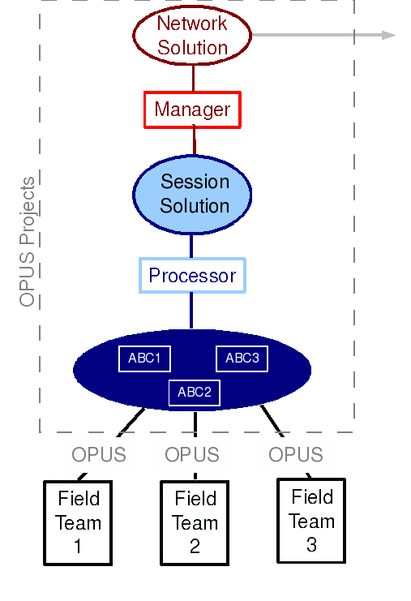
What Is OPUS-Projects?
Graphically, this looks like:
2010-Apr-15
109

Slide 110
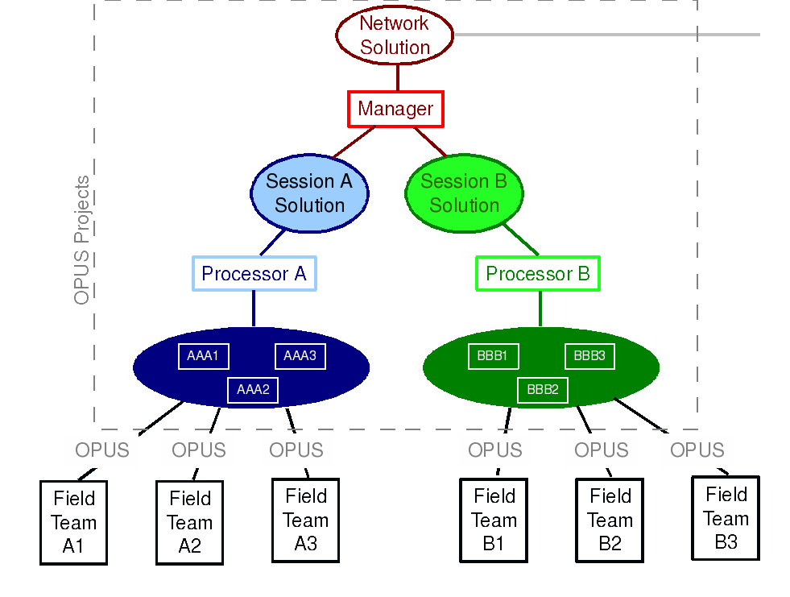
What Is OPUS-Projects?
2010-Apr-15
110

Slide 111
The OPUS-Projects Interface.
It’s probably easier to show the interface than describe it, so let’s walk through some of the basic steps in creating and reviewing a project.
Please be aware …
OPUS-Projects is actively being developed. The information shown here reflects many, but not all of the recent and pending changes.
2010-Apr-15
111

Slide 112
The first step is to “Create” a project. This allocates on-line storage for the project’s data and generates project keywords.
Although it’s not always necessary, we’ll begin the description of this and each major step at the OPUS-Projects home page.
2010-Apr-15
112

Slide 113
Enter a project title and the project manager’s (your) email address, then click the “Create” button.
Don’t worry, these can be changed later.
2010-Apr-15
113

Slide 114
Within moments, project keywords are generated and storage space assigned. An email is sent to the project manager and a confirmation page displayed.
2010-Apr-15
114

Slide 115
The second step is to “Submit” data files to your project.
At this time, this is done through OPUS-S implying the same restrictions:
Your data must be dual frequency pseudorange and phase P1 (or C1), P2, L1 and L2.
A minimum 2-hours data span for each submission.
A collection rate of 1, 2, 3, 5, 10, 15 or 30 seconds.
2010-Apr-15
115

Slide 116
The Opus-Projects web page provides a convenient link to the OPUS page, but it’s OK to skip this and start at the OPUS page.
2010-Apr-15
116

Slide 117
Once at the OPUS “upload page, complete the entry fields normally …
2010-Apr-15
117

Slide 118
… but be sure to follow the “OPTIONS” link to specify that your data be stored with its project.
2010-Apr-15
118

Slide 119
Complete the other option fields as needed, but be certain to insert your project’s keyword.
If you have many data files, consider taking advantage of the “Set User Profile” option, at the bottom of this page.
2010-Apr-15
119

Slide 120
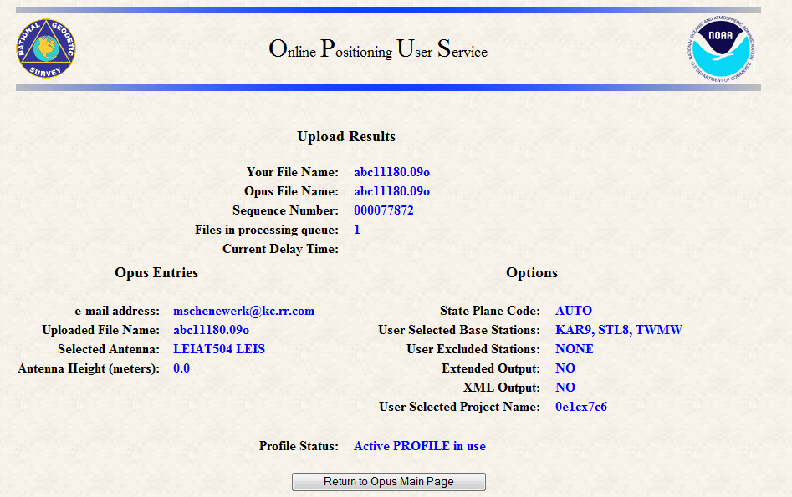
Once uploaded, OPUS-S will remind you that this data will be associated with your project.
2010-Apr-15
120

Slide 121
When data are submitted to a project, the OPUS-S results are “quality controlled” using thresholds specified by the project manager.
If the results from a data file exceed any of the thresholds, a warning message is sent to the email address entered when the data were submitted.
Receiving a warning message does not mean the data will be excluded from your project. That is the project’s decision. However, the data are flagged for easy identification by the project.
2010-Apr-15
121

Slide 122
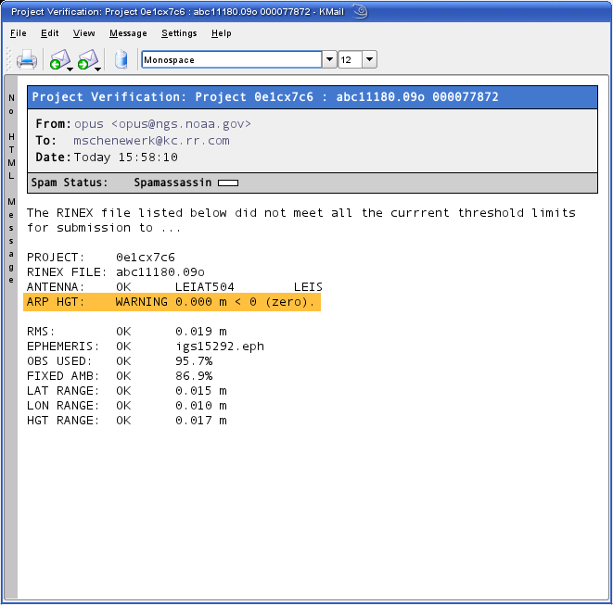
The highlight is mine.
2010-Apr-15
122

Slide 123
OPUS-Projects groups the data into sessions.
Sessions are groups of site occupations that overlap significantly in time. Note that
a site may appear in more than one session.
as new data are submitted, the definitions of the sessions may change.
Now that some data has been submitted to the project, processing can begin.
2010-Apr-15
123

Slide 124
To review or process a session, enter the project and process keywords, and your email address, then click the “Process” button on the OPUS-Projects home page.
OPUS-Projects will display your page after a brief pause.
2010-Apr-15
124

Slide 125
Let’s switch to a project already loaded with data. The project title is: “mss test project 1” The project keywords are:
PROJECT : 6vlap35e
MANAGER : hrpyi51d
PROCESS : vdblq8ye
Please note that this is a project used for testing and, so, may not always be in this exact state. Nevertheless, feel free to visit and look around.
http://www.ngs.noaa.gov/OPUSI/OPUS-Projects.html
2010-Apr-15
125

Slide 126
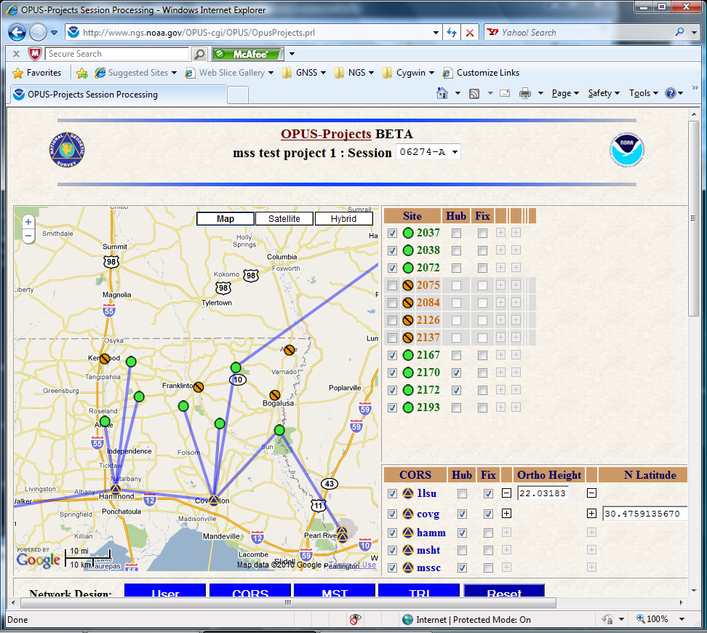
2010-Apr-15
126

Slide 127
This is the page for session 06274-A of “mss test project 1”. The components of this page are:
The banner shows the project’s title and session. The session ID can be used to select another session to review/work with.
2010-Apr-15
127

Slide 128
The map shows the relative positions of the sites in this session. The positions of the included CORS sites are indicated too.
2010-Apr-15
128

Slide 129
The map sidebar’s upper table lists the user’s sites and controls.
2010-Apr-15
129

Slide 130
These are sites whose data met the project’s quality control thresholds.
2010-Apr-15
130

Slide 131
These are sites whose data did not meet the project’s quality control thresholds.
2010-Apr-15
131

Slide 132
The CORS are segregated from the user’s sites in the lower table and identified by a special symbol.
2010-Apr-15
132

Slide 133
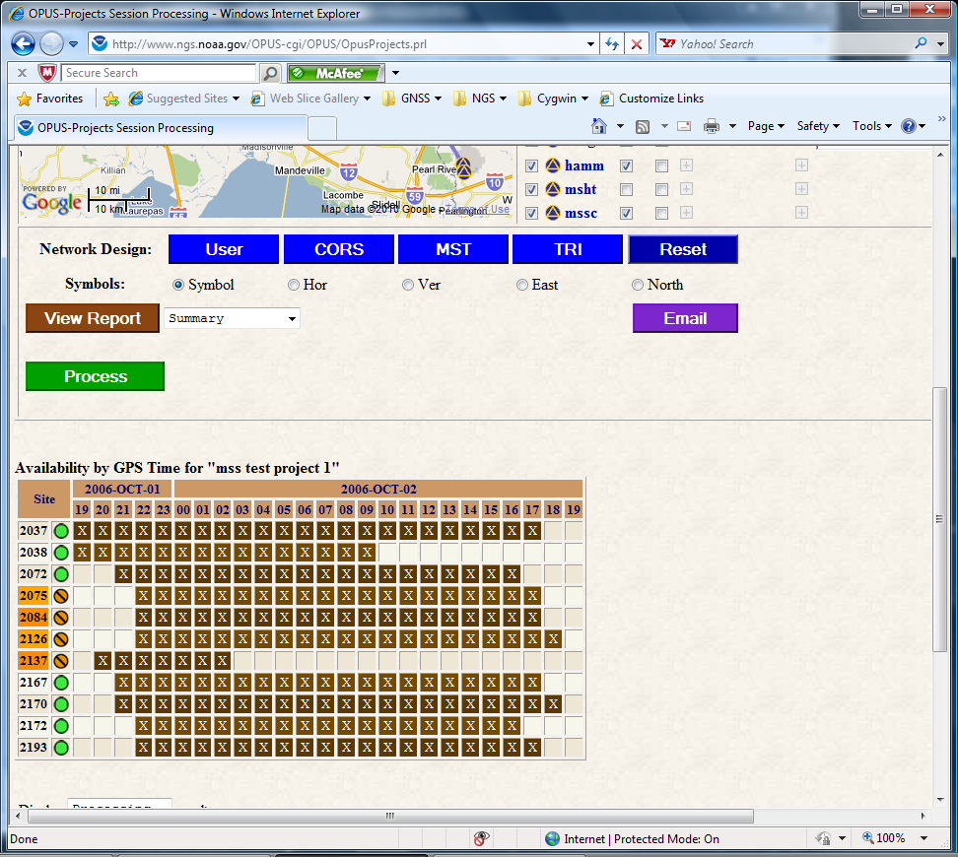
Scrolling down the web page …
Next, you’ll find the display, access and processing controls.
2010-Apr-15
133

Slide 134
Below the processing controls is a table representing the Data Availability for each site in this session.
2010-Apr-15
134

Slide 135
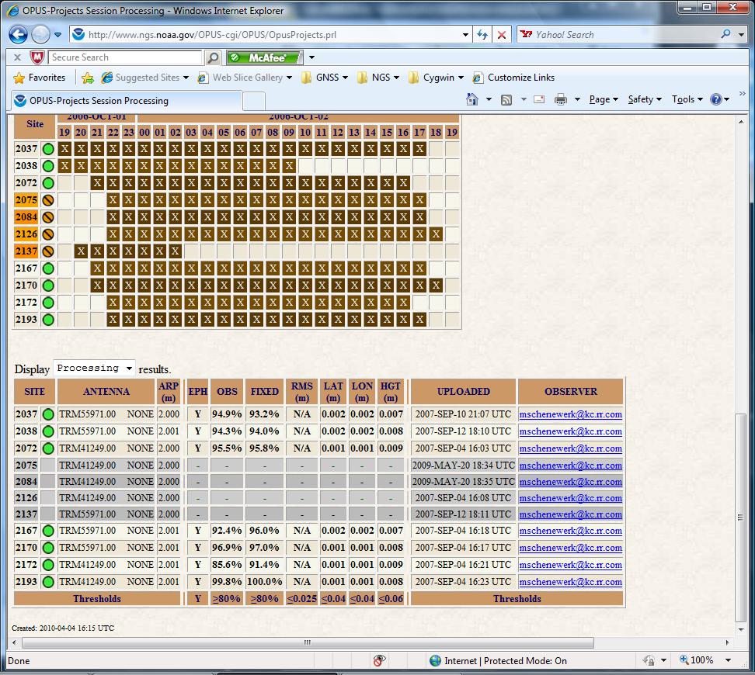
Scrolling one last time …
At the bottom of the page, a table summarizes the most pertinent information about each site including results from OPUS-S or OPUS-Projects.
2010-Apr-15
135

Slide 136
Let’s scroll back to the top of the page and look at some of the controls in a little more detail. First, on the map …
2010-Apr-15
136

Slide 137
If processing has occurred, as is the case here, the baselines selected in that processing are indicated.
2010-Apr-15
137

Slide 138
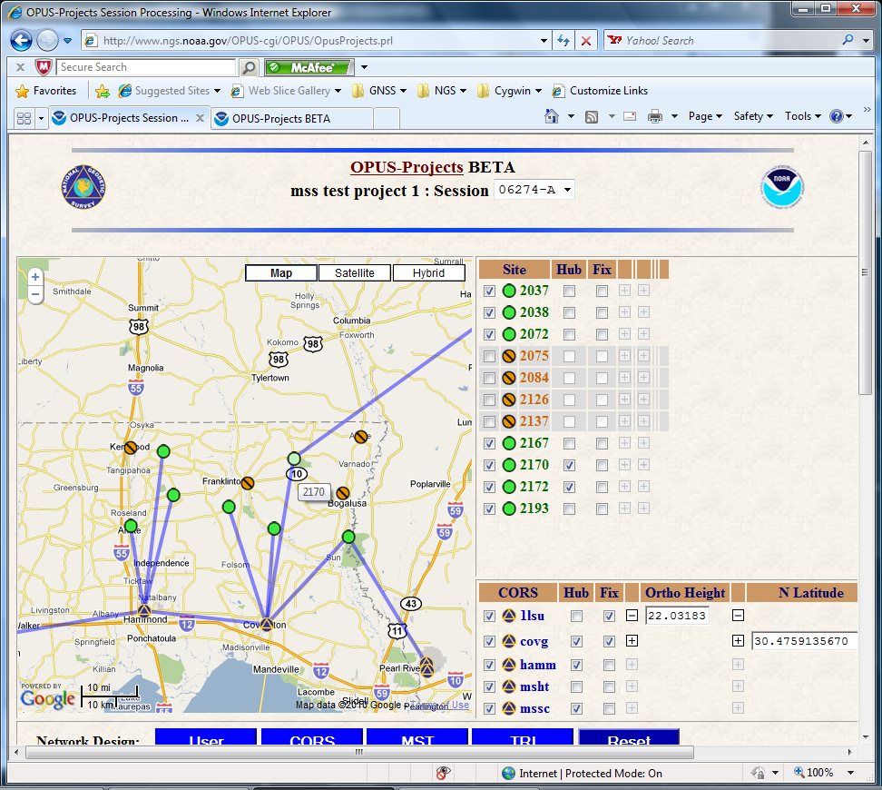
Before leaving the map, notice that if you let the reticule (cursor) hover over a map symbol, the site’s four character identifier appears.

Slide 139
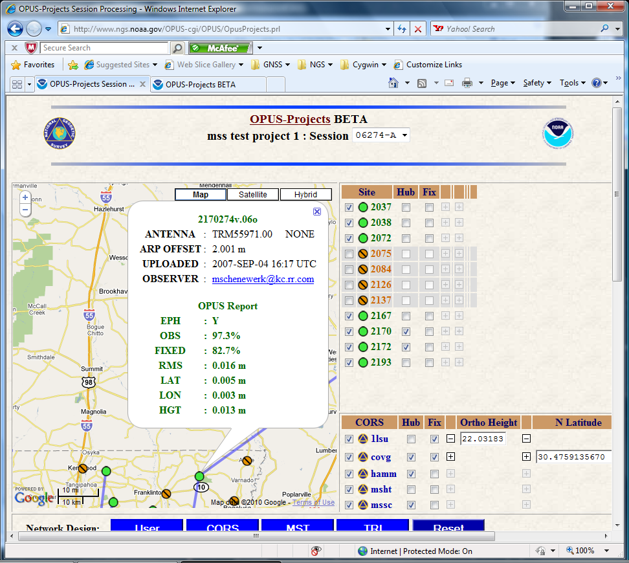
Clicking on a map symbol “pops” a window holding the site summary table’s information for that site.

Slide 140
Turning to the controls, placing the reticule over a sidebar table entry causes the corresponding symbol to “highlight”. Unfortunately, this can not be displayed meaningfully here.
2010-Apr-15
140

Slide 141
The first checkbox on each line signals that the site will or will not be included in the processing.
2010-Apr-15
141

Slide 142
The second checkbox designates sites to be used as “hub” sites.
By hub sites we mean sites that are preferentially selected when baselines are automatically chosen.
2010-Apr-15
142

Slide 143
The third checkbox designates sites that will be fixed, i.e. constrained, in the processing.
2010-Apr-15
143

Slide 144
Moreover, once a site has been designated as a fixed site, clicking the expansion button, the small with a “+” or “-” symbol, reveals fields where the user can enter the values to be used in the constraint.
Here, I’ve specified an orthometric height for 1lsu and horizontal coordinates for covg.
2010-Apr-15
144

Slide 145
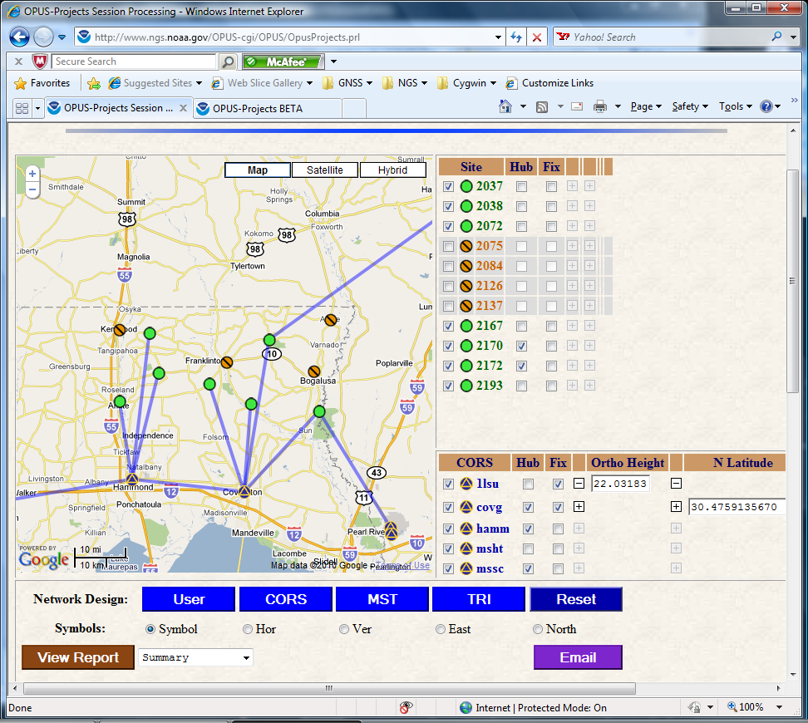
Moving our attention to the controls below the map and sidebar, the first row, labeled “Network Design”, controls the baseline selection.
Note that these controls may change the hub designations but not which sites are included or fixed.
2010-Apr-15
145

Slide 146
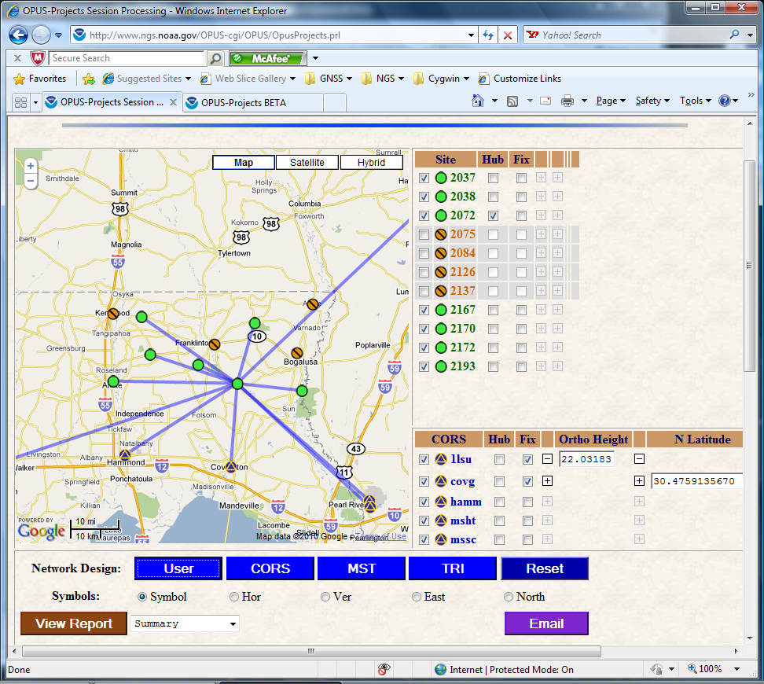
The first button causes baselines to be selected solely based upon user included and hub site selections. Here, I selected only one site to be a hub creating a “radial” design.
Note that the sites selected for omission or constraint are retained. The constraint values are also preserved.
2010-Apr-15
146

Slide 147
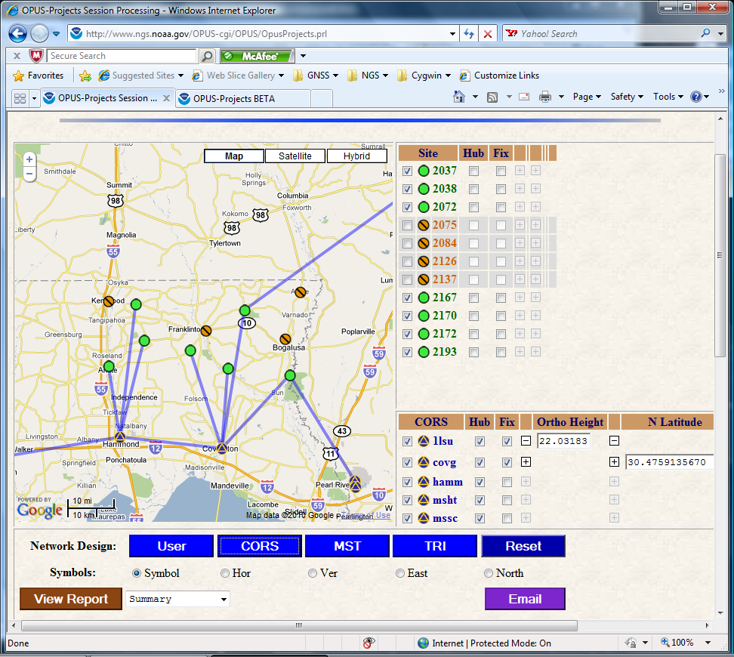
The CORS button forces all included CORS to be hub sites.
2010-Apr-15
147

Slide 148
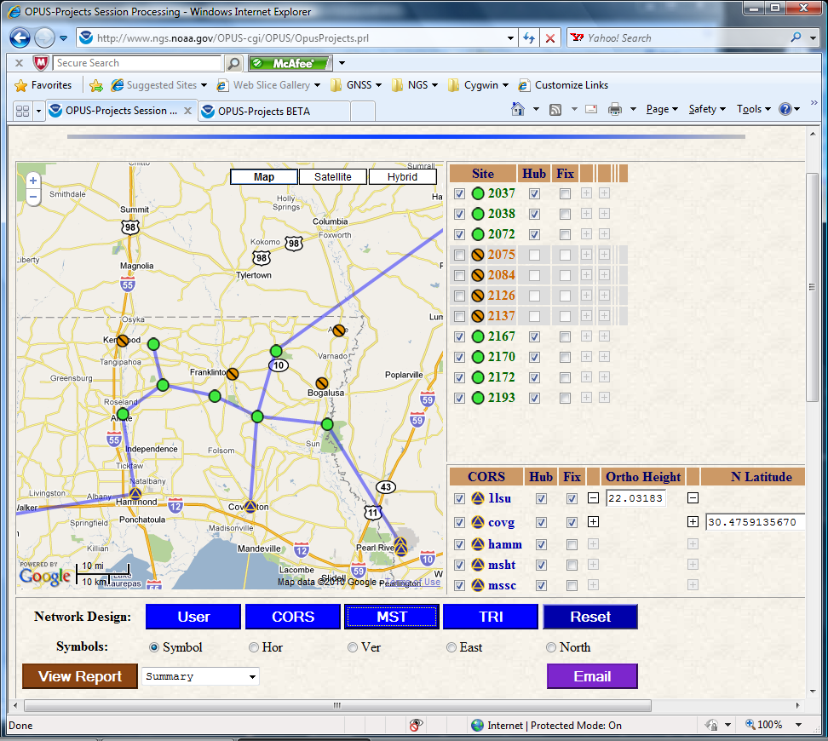
MST causes all included sites to be selected as hub sites resulting in a minimal-spanning tree.
2010-Apr-15
148

Slide 149
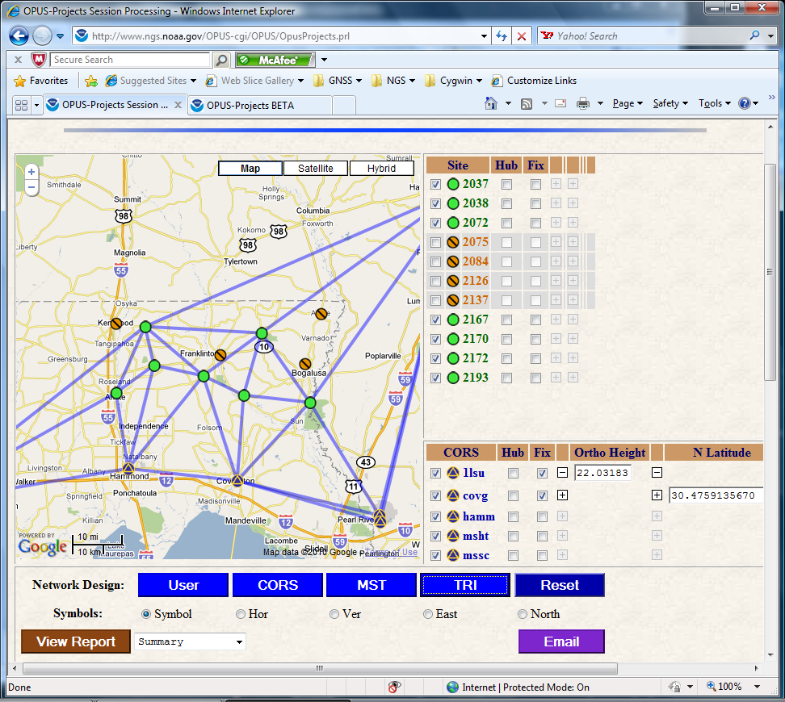
The TRI button creates “closed loop” as specified by a variant of the Delaunay triangulation method.
2010-Apr-15
149

Slide 150
Reset returns all selections to those used when the page is first displayed.
2010-Apr-15
150

Slide 151
Once the included, hub and fixed sites are selected and the network designed, the user only needs to click the “Process” button to submit their request to the processing queue.
OPUS-Projects reviews the selections before the request is inserted in the queue. If any inconsistencies or errors are found, these are reported immediately and the request is not submitted.
2010-Apr-15
151

Slide 152
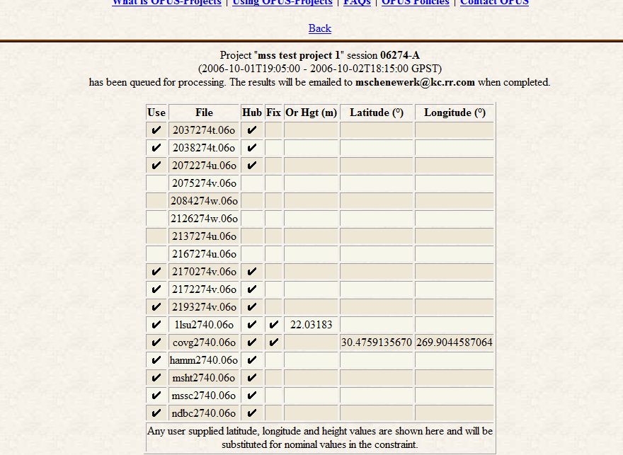
If the request is appears feasible, it is submitted to the queue and the selections summarized for the user’s records.
2010-Apr-15
152

Slide 153
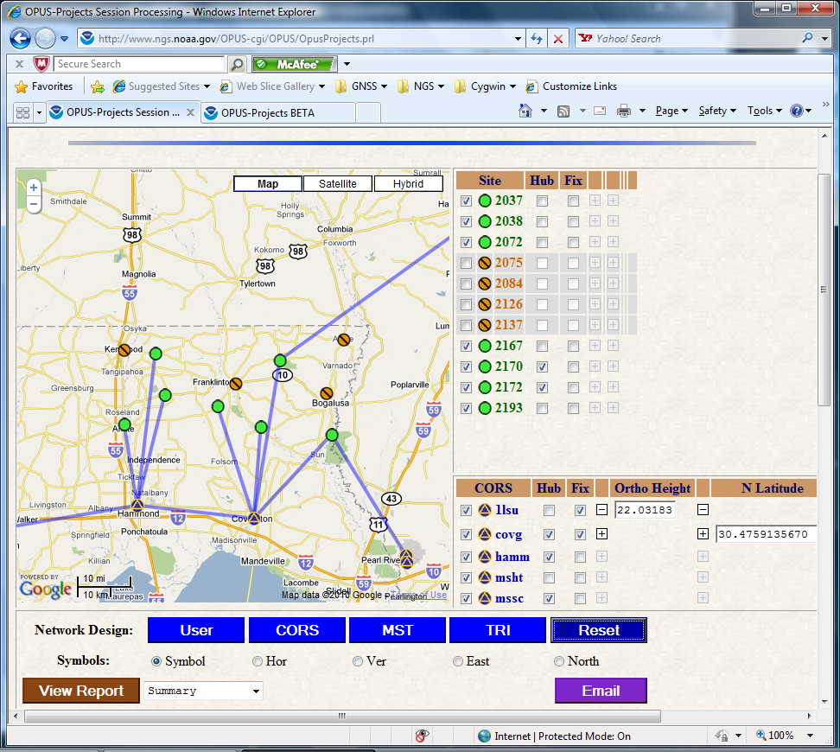
The next row of controls select the site symbols displayed on the map. The default is simple “dots.” A green/open circle indicates that a site has met all the projects thresholds; an orange/barred circle indicates it did not.
2010-Apr-15
153

Slide 154
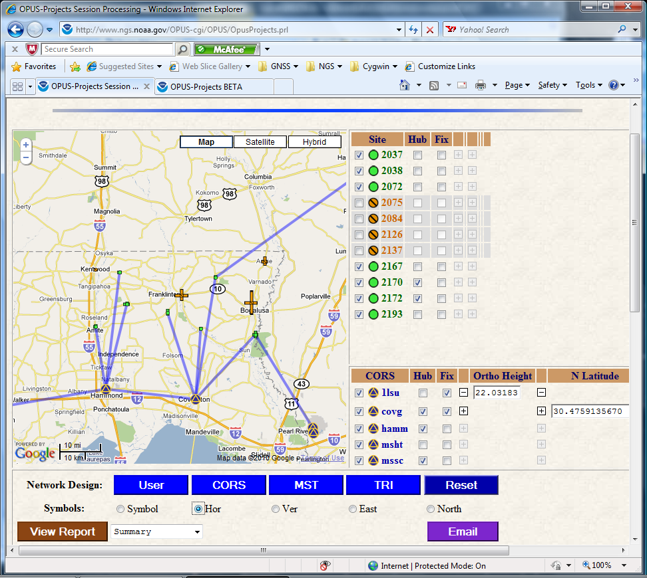
Checking “Hor” displays the north and east horizontal uncertainties for each site.
The threshold color coding is retained.
The East and North uncertainties can be shown separately using the checkboxes at far right.
2010-Apr-15
154

Slide 155
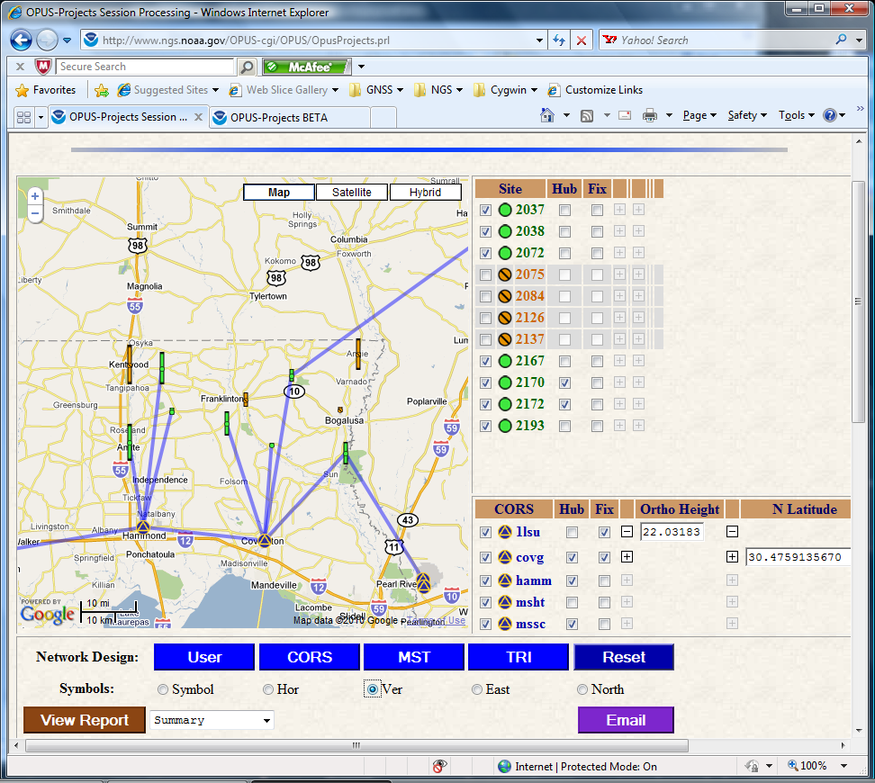
Similarly, the vertical uncertainties are represented when “Ver” is checked.
2010-Apr-15
155

Slide 156
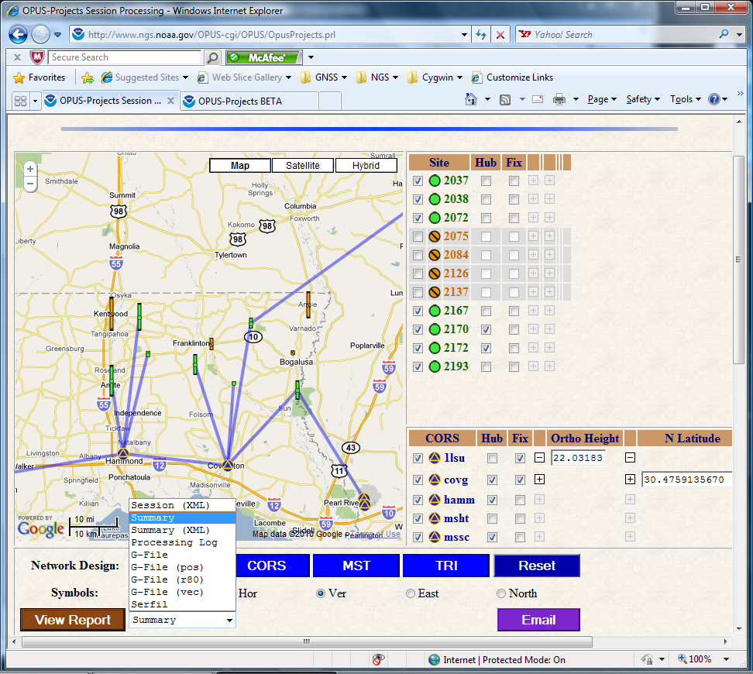
OPUS-Projects automatically generates a variety of reports. “View Report” displays the selected report on the screen. These reports include:
A session summary in XML format.
The processing summary in text and XML formats.
The log from the processing engine.
A variety of G-file components.
As an example, sections of the processing summary are shown in the next slides.
2010-Apr-15
156

Slide 157
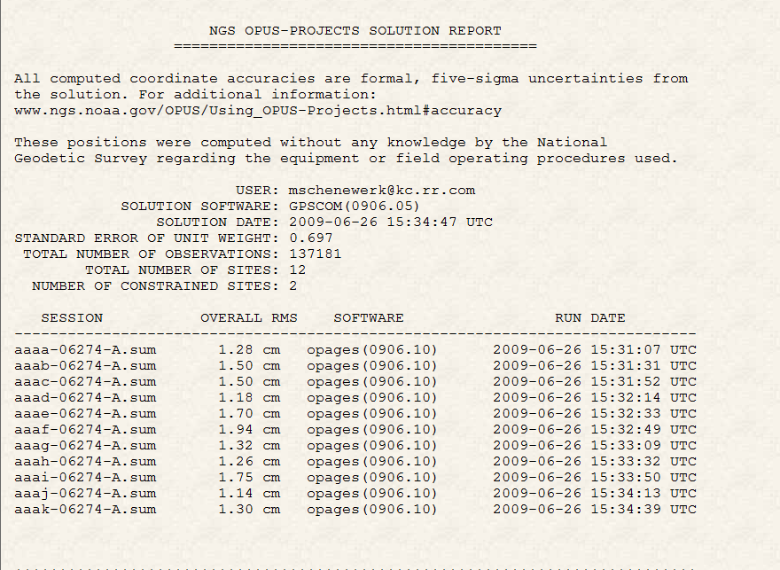
The processing summary reports the most pertinent information and overall statistics at the top.
2010-Apr-15
157

Slide 158
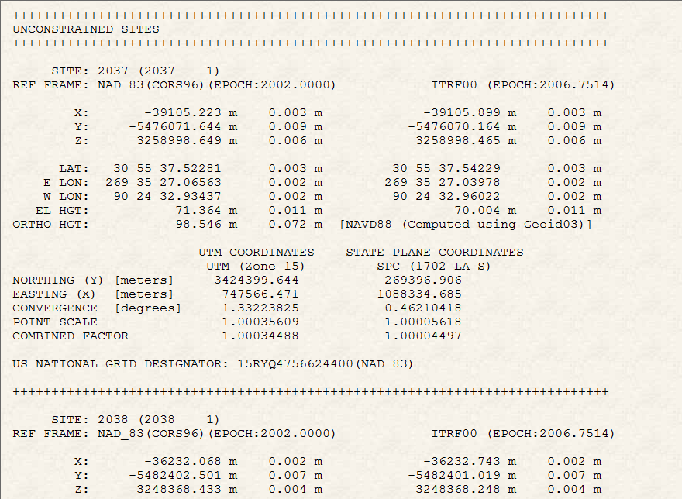
Site-by-site solution information follows in an OPUS-like format.
2010-Apr-15
158

Slide 159
These reports are emailed to the user after processing is complete; however, they can be re-sent or sent to others using the Email tool.
2010-Apr-15
159

Slide 160
At any time during its lifetime, the manager can review the project’s status and modify details. Once again we’ll use the more interesting project, “mss test project 1” whose keywords are:
PROJECT : 6vlap35e
MANAGER : hrpyi51d
PROCESS : vdblq8ye
Recall that this is an active test project and, so, may not always be in this exact state
2010-Apr-15
160

Slide 161
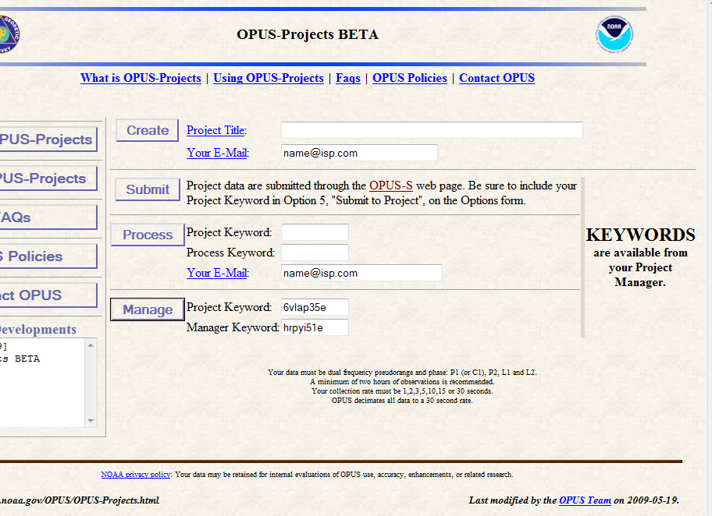
The manager’s tasks are sufficiently numerous and varied to warrant a separate login.
To begin, enter the project and manager keyword, then click the “Manage” button.
2010-Apr-15
161

Slide 162
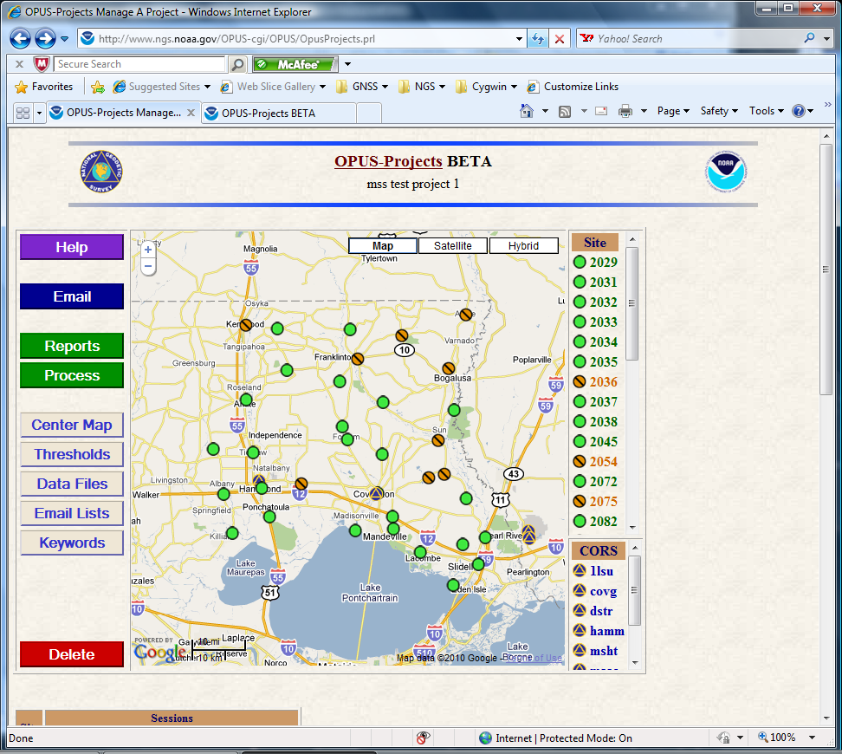
The layout of the “Manage” page is typical of OPUS-Projects: a map showing the relative positions of all sites with sidebar tables on the right side listing the sites.
2010-Apr-15
162

Slide 163
Controls on the left are for managing the project and processing.
2010-Apr-15
163

Slide 164
The manager will be able to access on-line help and tutorials.
2010-Apr-15
164

Slide 165
Send email to the other participants in the project or the OPUS-Project czar.
2010-Apr-15
165

Slide 166
Review processing reports, process sessions or the entire network.
2010-Apr-15
166

Slide 167
Review and modify the thresholds used in quality controlling the data.
2010-Apr-15
167

Slide 168
Change site names, antenna types and ARP offsets.
2010-Apr-15
168

Slide 169
Manage the bureaucratic details of the project.
2010-Apr-15
169

Slide 170
Request the project be deleted.
2010-Apr-15
170

Slide 171
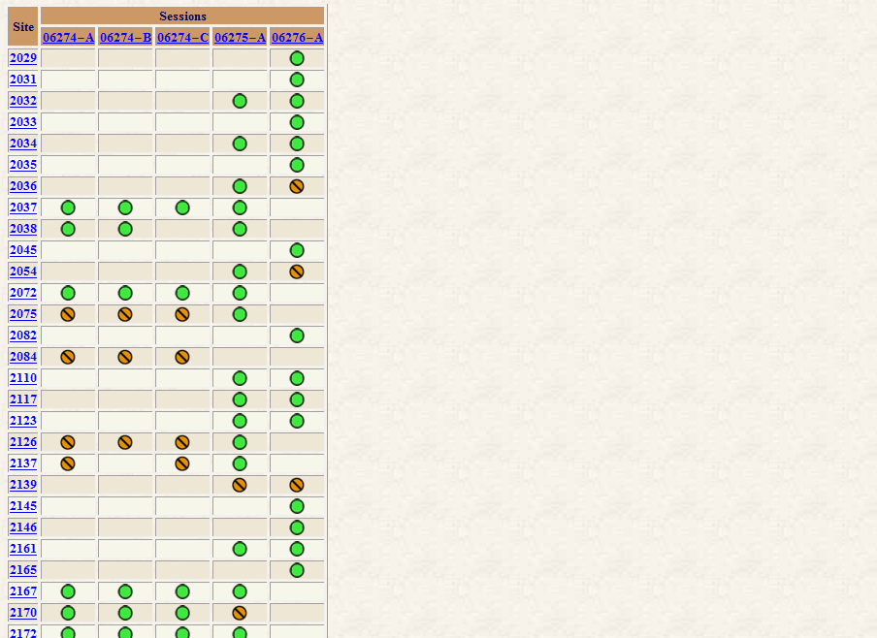
At the bottom of the page is a summary table showing the sites and their quality control status.
The table is organized by site (left) and the sessions in which they’re included (top).
The site and session identifiers are convenient links which take the manager to the indicated site or session (Process) summary page.
2010-Apr-15
171

Slide 172
Work has begun on the individual site summary pages. Hopefully, these pages will address at least some of the concerns voiced about quality controlling the solutions.
Each page will contain pertinent information about each site:
Data file names.
Associated antenna types and offsets.
Plots summarizing the OPUS, session and network solutions
Tables summarizing those solutions.
Other information from OPUS-DB or the IDB.
2010-Apr-15
172

Slide 173
These are examples of two plots-types that can already be displayed for the sites.
The project thresholds are indicated in orange, the OPUS solutions as gray circles, session solutions as blue diamonds, a network solution (not available here) as a green square.
The user will be able to turn on/off each symbol type.
2010-Apr-15
173

Slide 174
Eventually, OPUS-Projects will be integrated with the other aspects of OPUS; most notably OPUS-DB.
With that, in addition to a working tool, the site summaries will seem to be a preview of the publication to the data base.
The manager will be able to review and modify the sites’ meta-data, then publish entire projects (or as much as he/she chooses) with the click of a button.
2010-Apr-15
174

Slide 175
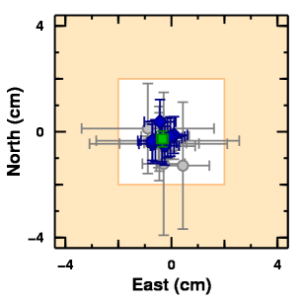
How Good Can I Do With OPUS-Projects?
Schenewerk submitted several 3-hour CORS data sets to OPUS and OPUS-Projects. A representative east versus north plot for anp5 is shown.
The white box represents ±2 cm, centered on the ITRF2000 coordinates projected to the mean epoch of these data.
OPUS results are gray circles with their peak-to-peak uncertainties.
OPUS-Projects solutions for individual occupations are blue diamonds with formal 5σ uncertainties.
The OPUS-Projects solution for all occupations is the green square also with 5σ uncertainties.
2010-Apr-15
175

Slide 176
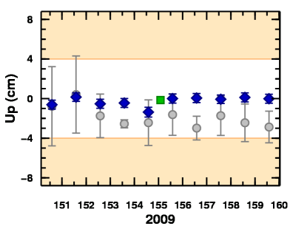
How Good Can I Do With OPUS-Projects?
Here is the related plot showing the ellipsoid height estimates relative to the accepted value projected to the mean epoch of these data.
The white box now represents ±4 cm. The meaning of all other symbols remains the same.
In all cases examined, OPUS performed very well, but OPUS-Projects performed slightly better with minimal additional effort.
2010-Apr-15
176

Slide 177
New Developments for OPUS
Dr. Mark Schenewerk
Mark.Schenewerk@noaa.gov
913-481-9998

Slide 178
Questions
not necessary
my responsibility
It is not necessary my responsibility to verify my OPUS results.
OPUS-S and OPUS-RS use different the same strategies to fix integers.
Publishing in the OPUS-DB guarantee that my results will be included in the IDB.
OPUS-Net uses absolute relative antenna models.
OPUS-Mapper provides accuracy uses like GIS and handhelds.
different
the same
does
does not
absolute
relative
limited
highest
2010-Apr-15
178

Slide 179
Questions
one
more than one
OPUS-Projects is designed to handle occupation of a site.
OPUS-Projects gives me control of my data processing.
OPUS-Projects allow results to be published to OPUS-DB.
less
more
will
won’t
2010-Apr-15
179

Slide 180
Questions
not necessary
my responsibility
It is not necessary my responsibility to verify my OPUS results.
OPUS-S and OPUS-RS use different the same strategies to fix integers.
Publishing in the OPUS-DB guarantee that my results will be included in the IDB.
OPUS-Net uses absolute relative antenna models.
OPUS-Mapper provides accuracy results for uses like GIS and handhelds.
different
the same
does
does not
absolute
relative
limited
highest
2010-Apr-15
180

Slide 181
Questions
one
more than one
OPUS-Projects is designed to handle occupation of a site.
OPUS-Projects gives me control of my data processing.
OPUS-Projects allow results to be published to OPUS-DB.
less
more
will
won’t
2010-Apr-15
181

