Slide 1
Multi-Constellation
Global Navigation Satellite System (GNSS)
Software
May 4, 2021
Andria Bilich (presenting),
Bryan Stressler (online),
and lots of other NGS colleagues

Slide 2
In this talk...
Background on multi-GNSS
Past and future GNSS software at NGS
New multi-GNSS software initial results
New software adoption at NGS

Slide 3
GNSS Overview

Slide 4
GNSS
GPS : Global Positioning System
GLONASS: Globalnaya Navigatsionnaya Sputnikovaya Sistema
Galileo :
BeiDou : BeiDou Navigation Satellite System BDS, BeiDou-2, COMPASS
IRNSS : Indian Regional Navigation Satellite System NavIC
QZSS : Quasi-Zenith Satellite System Michibiki
https://en.wikipedia.org/

Slide 5
Commonly Used Frequencies
System Nation Frequency SV Identification
GPS : USA : L1, L2, L5 : CDMA
GLONASS: Russia : G1, G2, G3 : CDMA+FDMA
Galileo : EU : E1, E5, E6 + others : CDMA
BeiDou : PRC : B1C, B3I, B2a + others : CDMA
IRNSS : India : L5 + 1 other : CDMA
QZSS : Japan : L1, L2, L5, L6 : CDMA
https://www.igs.org/wg/rinex/

Slide 6
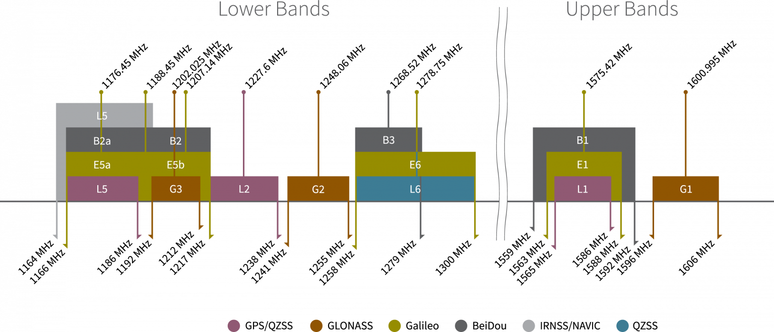
Commonly Used Frequencies
image from https://www.tallysman.com/gnss-mouse-pad/

Slide 7
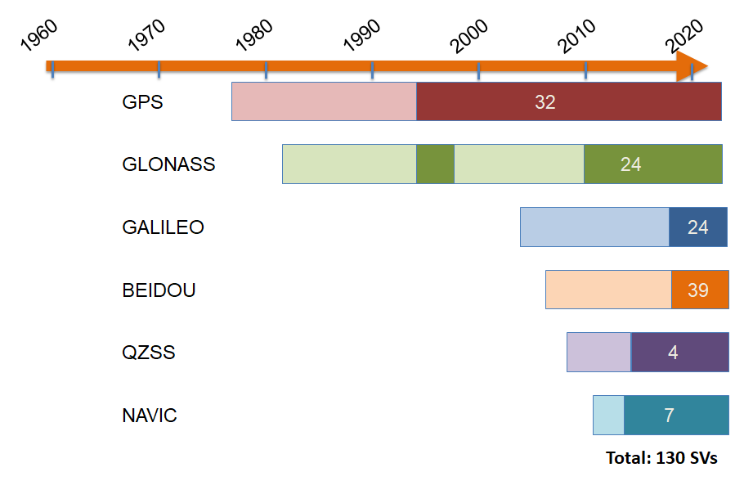
Graphical Representation of Operational Dates
NGS Software
v1
NGS Software
v2
Notes:
Stressler, et. al, Updates on the New GNSS Processing Software, 2019, https://docs.google.com/drawings/d/1pHf97jmekDcvfeNT9-HcJ0OVKx9_yOvmhco7AMQCWKU/edit

Slide 8
Many GNSS = Better Positions
The distribution of and changes in the relative positions of the satellites with respect to the receiving antenna are the most important data characteristics for high accuracy positioning.
GPS (left) is good. Multi-GNSS (right) is better.
images from https://www.gnssplanning.com/
Notes:
Geographic center of CONUS, 2021-1-12 12:00 PM - 6:00 PM CST

Slide 9
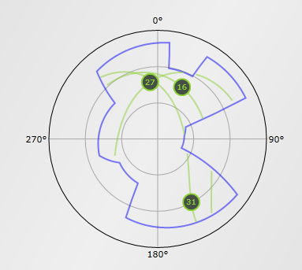
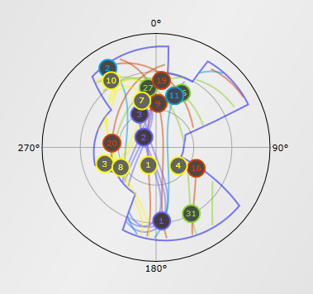
Obstructed View
Simulated sky coverage in urban or natural canyon.
GPS-only (left) isn’t viable. Multi-GNSS (right) is.
images from https://www.gnssplanning.com/

Slide 10
GNSS Software at NGS

Slide 11
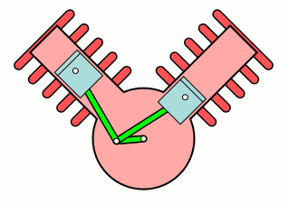
OPUS
GPS/GNSS
SOFTWARE

Slide 12
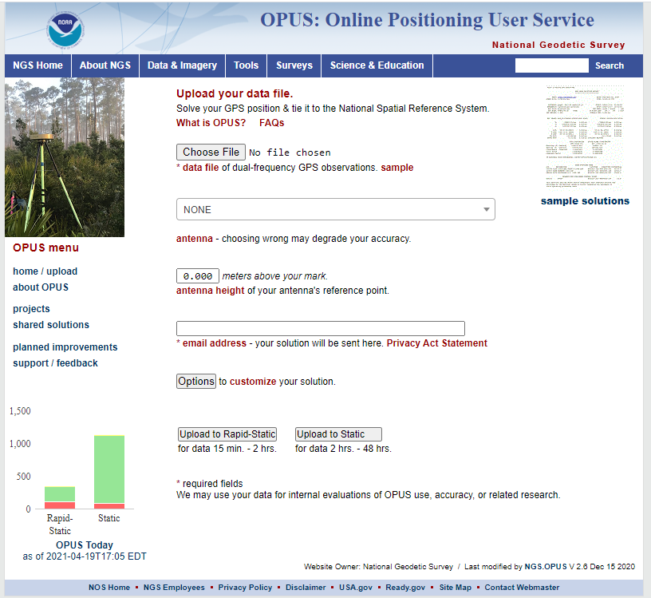
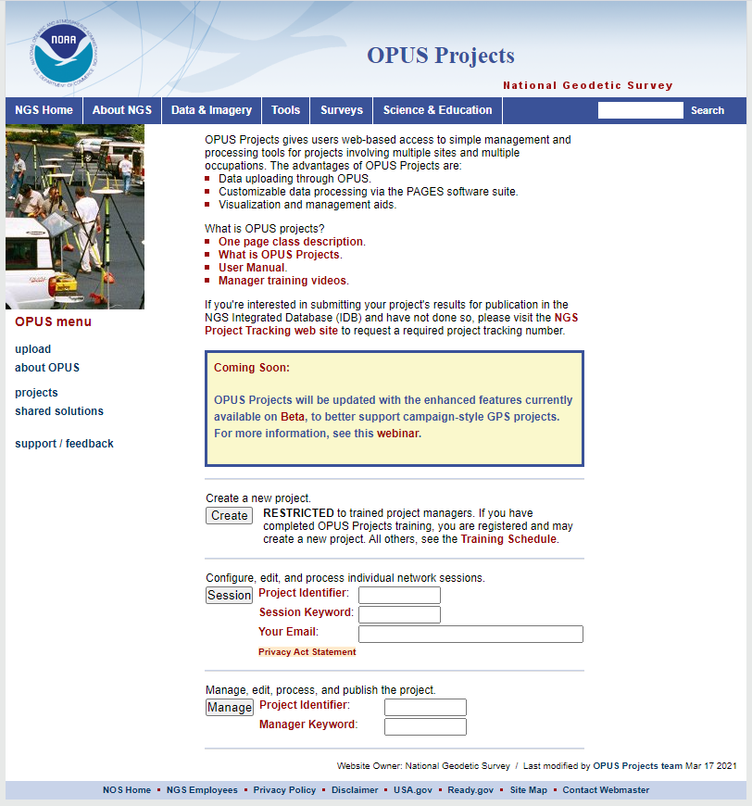
PAGES Suite
PAGES: Program for the Adjustment of GPS Ephemerides
In-house NGS software
“Under the hood” for most GPS services at NGS:
OPUS Static
OPUS Projects
NOAA CORS Network (NCN) coordinate maintenance
GPS orbit production

Slide 13
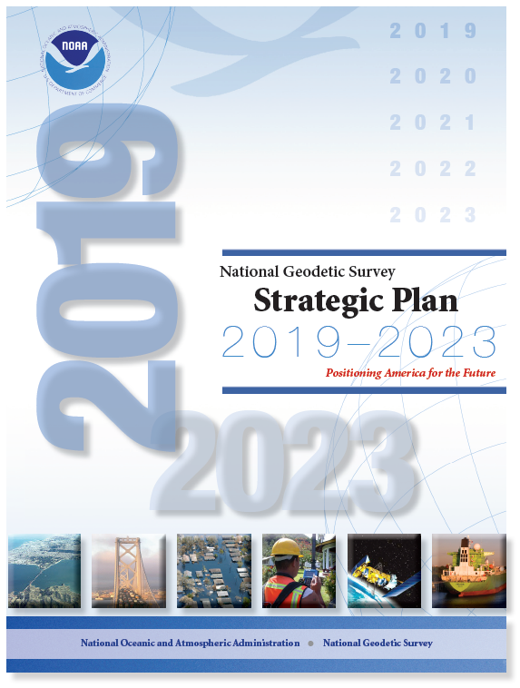
PAGES
The NGS Strategic Plan states that collection and use of multi-GNSS data must be made possible
PAGES is:
30 years old
Primarily written Fortran 77 = not easily supported by current staff
Impossible to extend to other GNSS besides GPS
Difficult to extend to more than two observable frequencies
Difficult to extend to RINEX 3
PAGES cannot support NGS strategic objectives.

Slide 14
M-PAGES = Multi-GNSS PAGES
Capable of ingesting all GNSS observables, frequencies, and constellations
Capable of ingesting RINEX 2 or 3
Capable of using pseudorange and phase
Capable of multi-GNSS processing
Uses a single-difference processing strategy (PAGES = double- difference strategy)
M-PAGES can support NGS strategic objectives, and will replace PAGES in all applications with no loss of capability or accuracy.

Slide 15
M-PAGES Initial Results

Slide 16
M-PAGES Development and Testing
Software is still under active development and testing
GNSS adoption into M-PAGES
GPS+Galileo capability in place now
GLONASS* next
Other GNSS after that
* FDMA

Slide 17
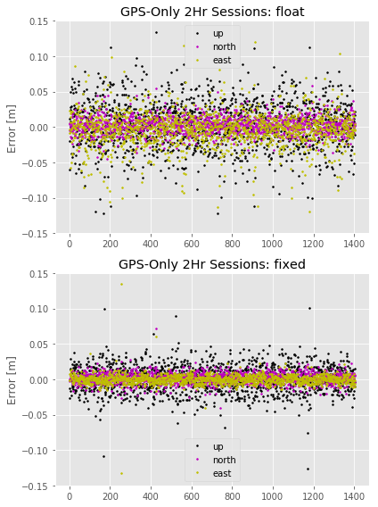
M-PAGES Performance
Results shown here:
2-hour sessions
Evaluate M-PAGES position solution vs. CORS coordinate functions
Systems | Solution Type | East RMS [cm] | North RMS [cm] | Up RMS [cm]
GPS | Float | 2.52 | 1.22 | 3.43
 | Fixed | 1.07 | 0.88 | 2.53
Notes:
taken from
https://docs.google.com/presentation/d/1uq6fm5-Sso7cVfM4bTBA-sQ6ADpDDda6qOSZtaESliQ/edit
~30 baselines (< 200 km) selected from the NOAA CORS Network
45 x 2-Hr sessions (2021-001 - 2021-045)
Single-baseline solutions evaluated against MYCS2 coordinates
M-LAMBDA approach implemented for ambiguity resolution

Slide 18
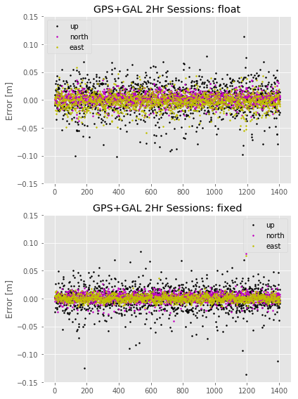
M-PAGES Performance
Results shown here:
2-hour sessions
Evaluate M-PAGES position solution vs. CORS coordinate functions
Adding Galileo improves results
Systems | Solution Type | East RMS [cm] | North RMS [cm] | Up RMS [cm]
GPS | Float | 2.52 | 1.22 | 3.43
 | Fixed | 1.07 | 0.88 | 2.53
GPS+GAL | Float | 1.32 | 0.97 | 2.60
 | Fixed | 0.57 | 0.76 | 2.24
Notes:
taken from
https://docs.google.com/presentation/d/1uq6fm5-Sso7cVfM4bTBA-sQ6ADpDDda6qOSZtaESliQ/edit
~30 baselines (< 200 km) selected from the NOAA CORS Network
45 x 2-Hr sessions (2021-001 - 2021-045)
Single-baseline solutions evaluated against MYCS2 coordinates
M-LAMBDA approach implemented for ambiguity resolution

Slide 19
M-PAGES Adoption at NGS

Slide 20
M-PAGES Adoption at NGS
Current: compare PAGES vs M-PAGES (GPS only)
Single baselines
OPUS solutions
Future: phased integration into OPUS
BETA before production release
Community calls for testing
Future: integration into Orbits
Practice orbits possibly in IGS14
Multi-GNSS orbit products in IGS20
Notes:
1) M-PAGES running GPS only solutions will be proven to be identical to PAGES running GPS only solutions. (Mid 2021). ***NGS has not yet debated or decided whether it is worthwhile at this point to pull PAGES out of OPUS and orbits and to insert M-PAGES. There are pros (plugging in M-PAGES while it is equal to PAGES and stable makes the next steps of ramping up M-PAGES capabilities a little easier; and cons (to pull PAGES out and put M-PAGES in requires a TON of paperwork, version number changes, etc). Personally I'd not bother putting M-PAGES into anything besides a BETA version of OPUS-S at this point, and even that is debatable.
2) M-PAGES GNSS positioning (at least GPS+GAL) will be tested, then integrated into these products in EARLY 2022:
A) OPUS-S: On BETA, we put up a version of OPUS-S where M-PAGES has replaced PAGES (I've no clue what version numbers for -S look like, so won't bother guessing)
B) OPUS-Projects 5.0: M-PAGES replaces PAGES, so this product becomes OPUS-Projects 5.1, and is put on BETA. Meanwhile OPUS-Projects 5.0 moves from BETA to LIVE and OPUS-Projects 4.0 moves off of LIVE to RETIRED.
C) NGS begins making "practice" GNSS orbits in IGS14, but not necessarily turning them in to the IGS formally yet.
D) NGS will make both A and B possible through the use of IGS GNSS orbits. (Our own "practice" orbits, see "C" may not yet be part of the IGS GNSS orbit stream yet)
3) M-PAGES GNSS orbits are created at NGS in either IGS14 or (quite possibly) in IGS20 sometime in late 2022. We begin submitting them to the IGS for their formal orbit process. The IGS14/IGS20 question is highly dependent upon three things: (a) when is ITRF2020 released, (b)how soon thereafter is IGS20 released and (c) how soon thereafter does NGS update the NCN to IGS20 (though this last point may be moot....if we don't need NCN stations on IGS20 to make IGS20 orbits, then ignore this

Slide 21
M-PAGES Needs Multi-GNSS Infrastructure
Input products/models: orbits, antenna calibrations, etc.
Networks: stations known in reference frame
Multi-GNSS processing of rover (e.g. OPUS) requires CORS that track the same GNSS.
rover
GPS-only CORS
multi-GNSS CORS

Slide 22
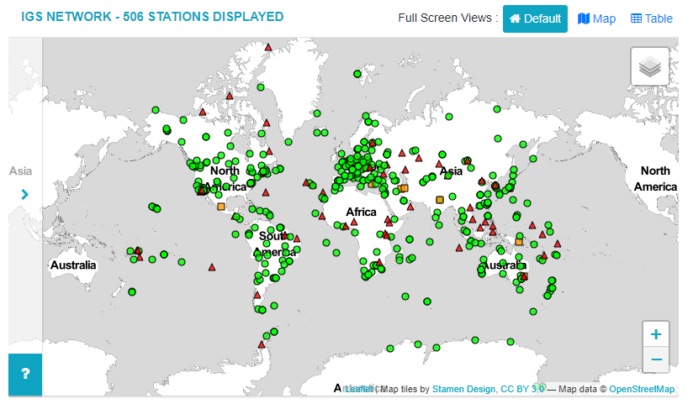
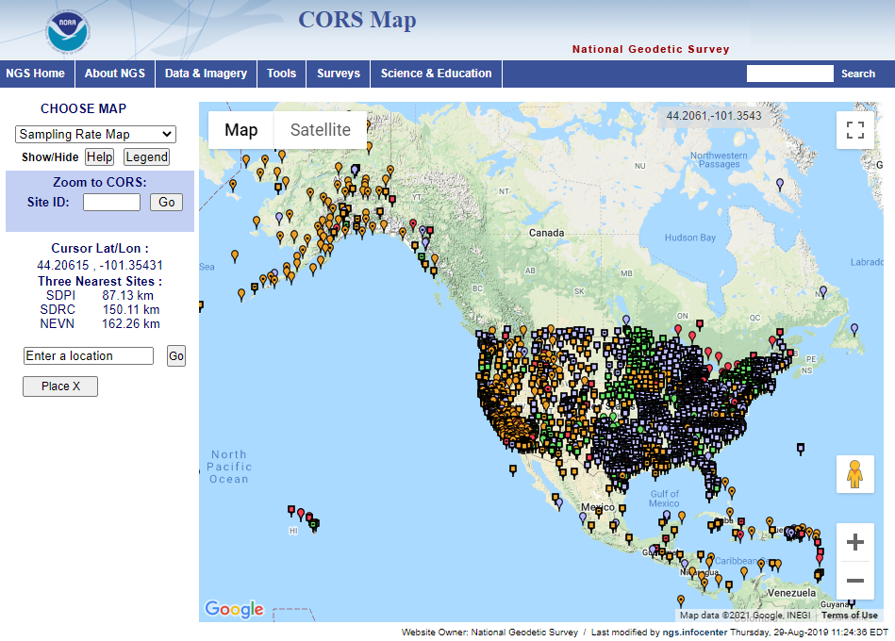
Infrastructure: Networks
IGS Network (as of 2021-01):
100% are tracking GPS.
84% are tracking GLONASS.
69% are tracking Galileo.
55% are tracking BeiDou.
33% are tracking QZSS.
14% are tracking IRNSS.
RINEX 3.x now required
NCN (as of 2021-01):
100% GPS
85% GLONASS
34% other.
RINEX 2.x data holdings
IGS = International GNSS Service, www.igs.org
NCN = NOAA CORS Network
https://geodesy.noaa.gov/CORS/

Slide 23
RINEX 3
the present and future of multi-GNSS
RINEX 2.x
Limited GPS+GLO+GAL
Does not support new Glonass signals
Hard to apply advanced multi-GNSS corrections
No updates since 2005
QC with teqc, which is no longer supported
RINEX 3.x
Supports all GNSS: signals, tracking modes and satellites
Format is actively maintained and updated; available 15+ years
QC through actively-maintained tools
Best M-PAGES solutions with RINEX 3
Notes:
https://kb.igs.org/hc/en-us/article_attachments/115007664947/RINEX-211.pdf
https://files.igs.org/pub/data/format/rinex305.pdf

Slide 24
Conclusions

Slide 25
NGS is entering the multi-GNSS world.
M-PAGES is expected to outperform PAGES.
M-PAGES will become the processing engine for NSRS uses.
Existing NSRS: Phase in over time
Modernized NSRS: Will be in all products and services
The importance of the NCN being able to fully support multi-GNSS activities at NGS cannot be overstated.
Operators:
Turn on all GNSS tracking
Make your data available as RINEX 3, whenever possible
Users: talk to your DOTs, network operators, etc.
Watch NCN updates for RINEX 3 archiving information
Notes:
M-PAGES will become the processing engine for both the existing NSRS and the Modernized NSRS:
- Existing NSRS: M-PAGES will be put into NGS products and services over the next two years, and will continue to serve the current NSRS until the current NSRS is retired
- Modernized NSRS: M-PAGES will be in all products and services of the Modernized NSRS

Slide 26
Join in on OPUS testing when the call comes.

