Slide 1
NGS Educational Offerings
Erika Little
NGS Training Coordinator
5/7/19

Slide 2
Current material
What we have and how we are getting the word out
Ideas for future content
Request for input

Slide 3
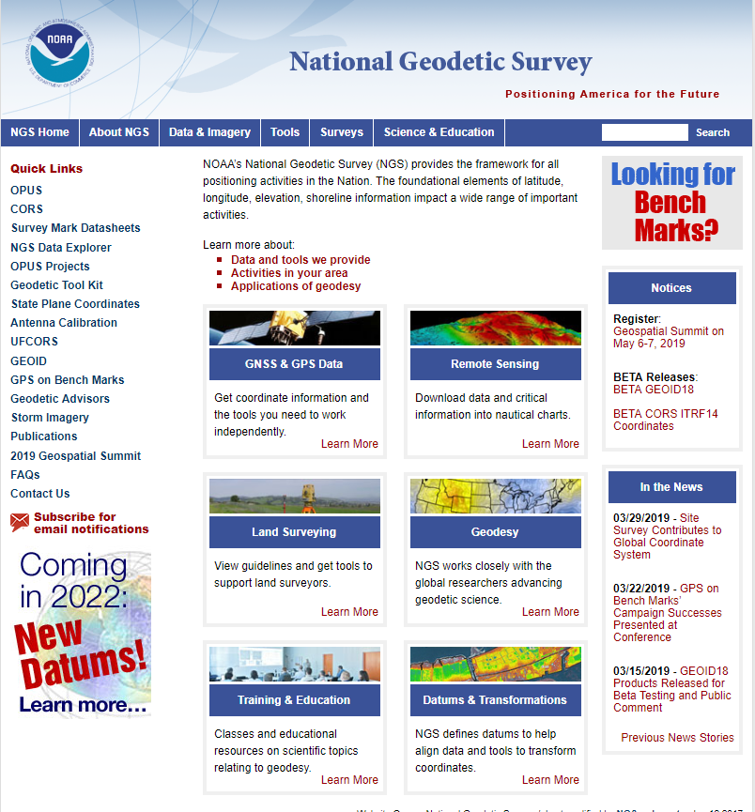

Slide 4
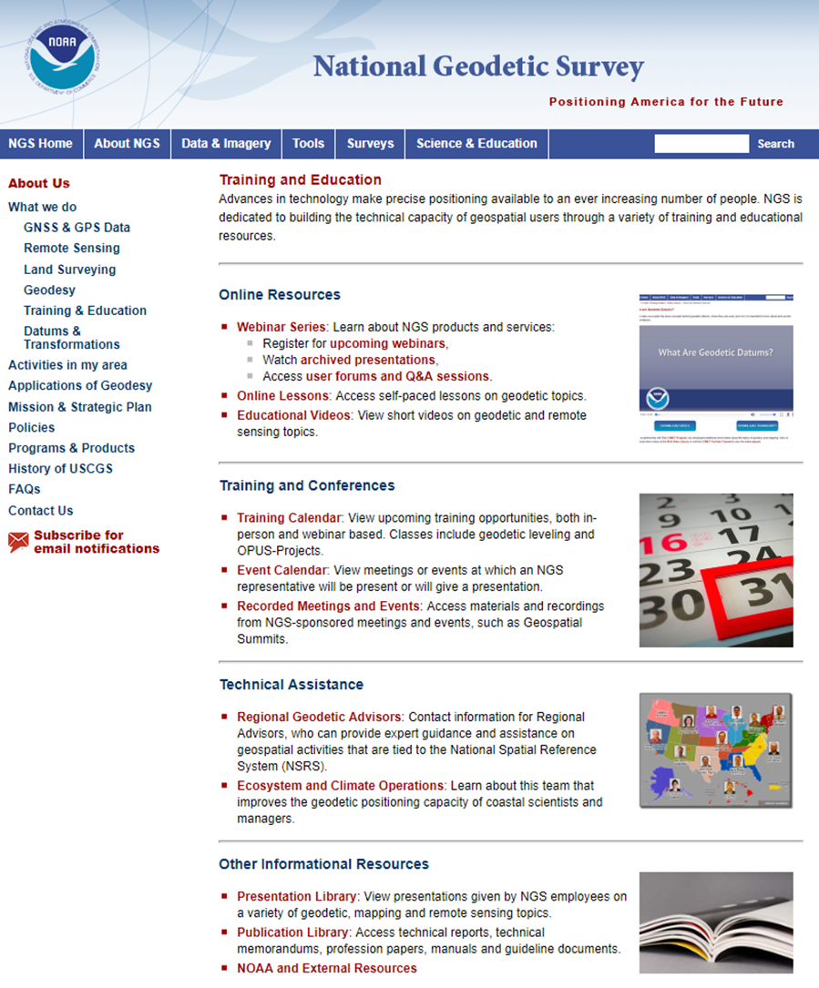

Slide 5
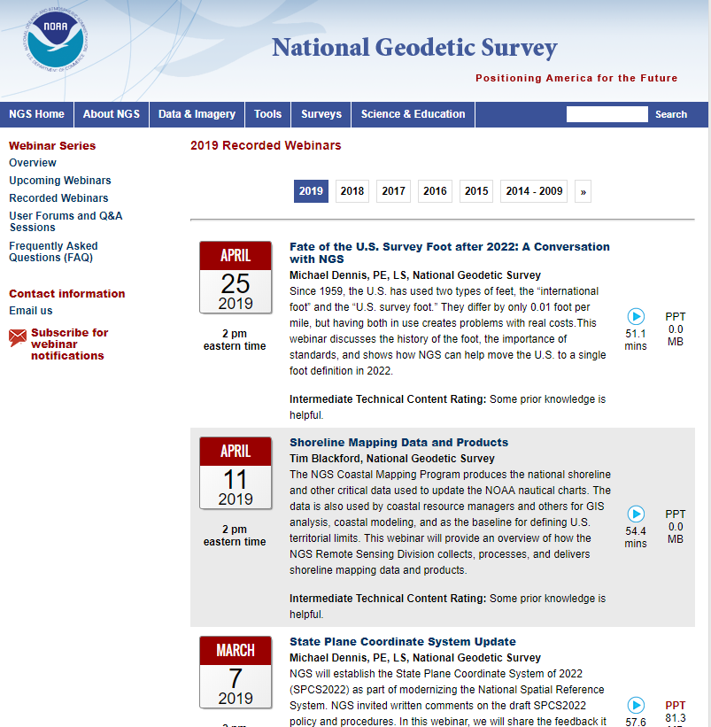
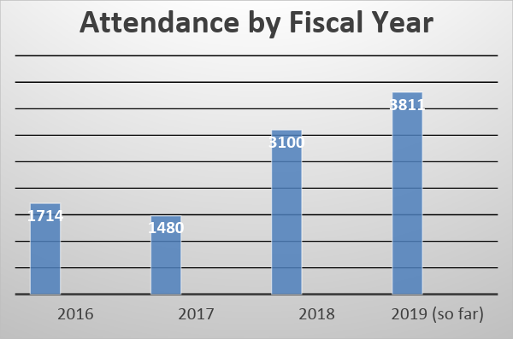
NGS Webinar Series
67 recordings available to date

Slide 6
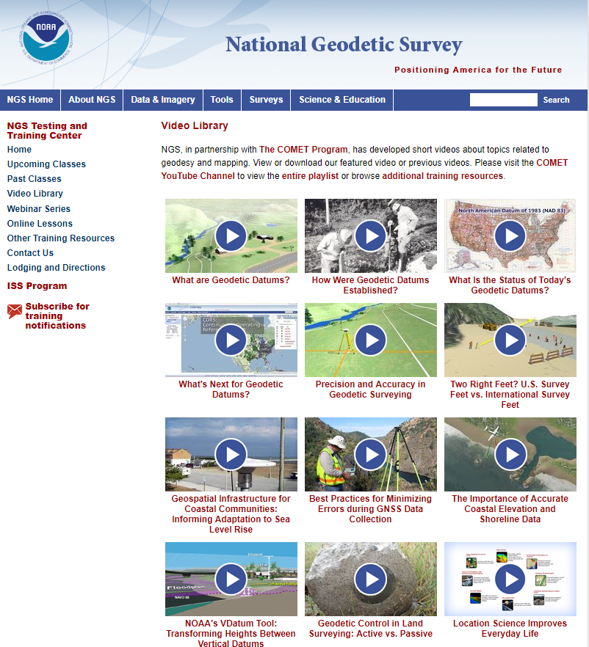
Educational Videos
Partnership with the University Corporation for Atmospheric
Research’s (UCAR) COMET Program
Most Viewed on COMET YouTube channel (through 4/30/19)
What are Geodetic Datums? | 101,009
Best Practices for Minimizing Errors During GNSS Data Collection | 37,438
Precision and Accuracy in Geodetic Surveying | 35,124

Slide 7
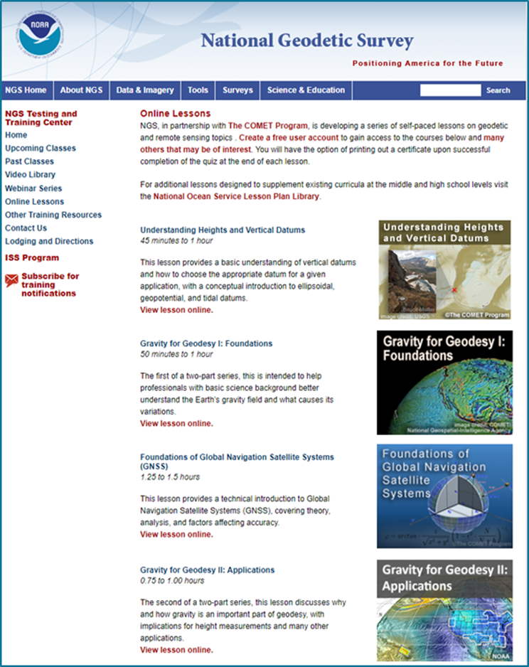
Online Lessons
Partnership with the University Corporation for Atmospheric Research’s (UCAR) COMET Program
Module completions to date by sector (through 2/2019)
Education | 763
Other | 282
Private Sector | 161
State or Local | 149
Weather Enthusiast | 81
NOAA | 80
DOD | 60
Other Federal US | 98
International | 38
Coming Soon! GNSS II: Precise Surveys

Slide 8
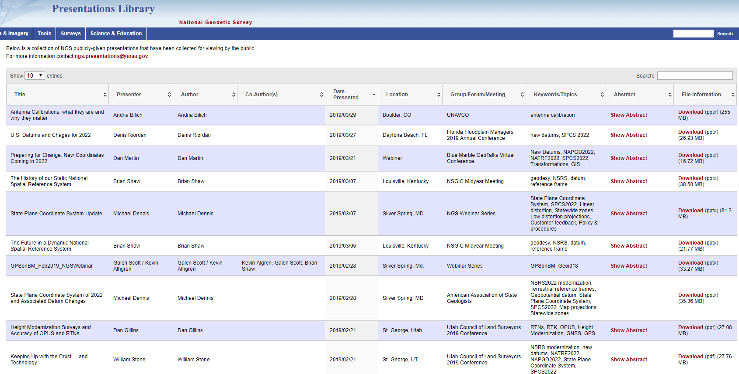
Presentation Library
Over 600 presentations given by NGS employees, available for your viewing and use

Slide 9
Subscription Lists
Subscribers Aug 2018 May 2019
News | 1,432 | 2,175
Training | 1,844 | 2,441
Webinar Series | 1,606 | 2,414
GPS on Bench Marks | 1,033 | 1,479

Slide 10
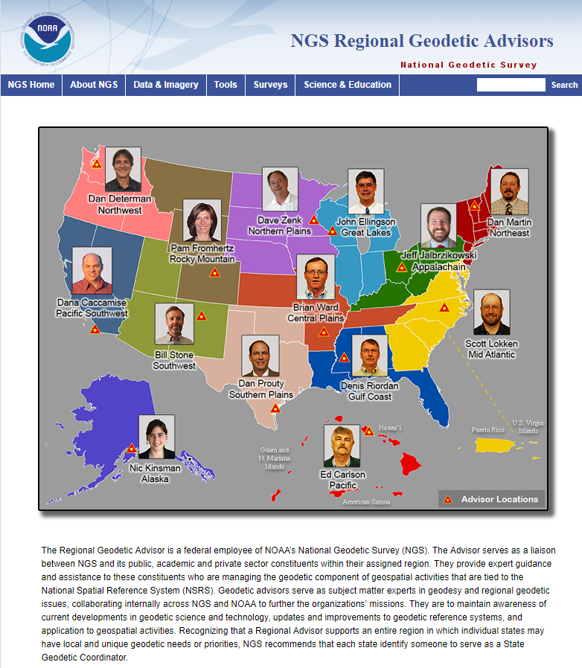
14 Regional Geodetic Advisors
Expert sources for training and education

Slide 11
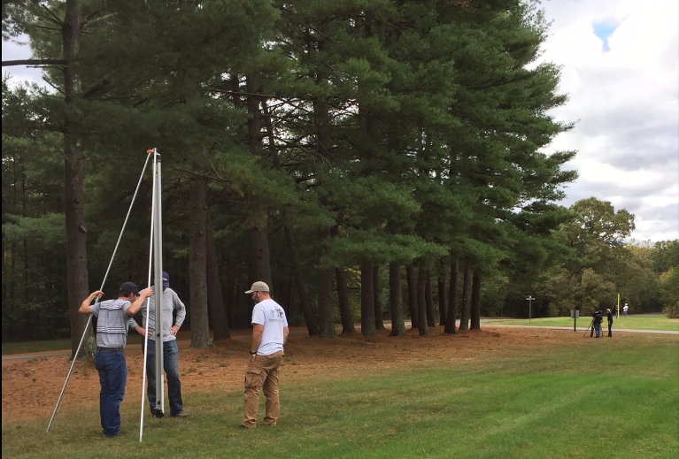
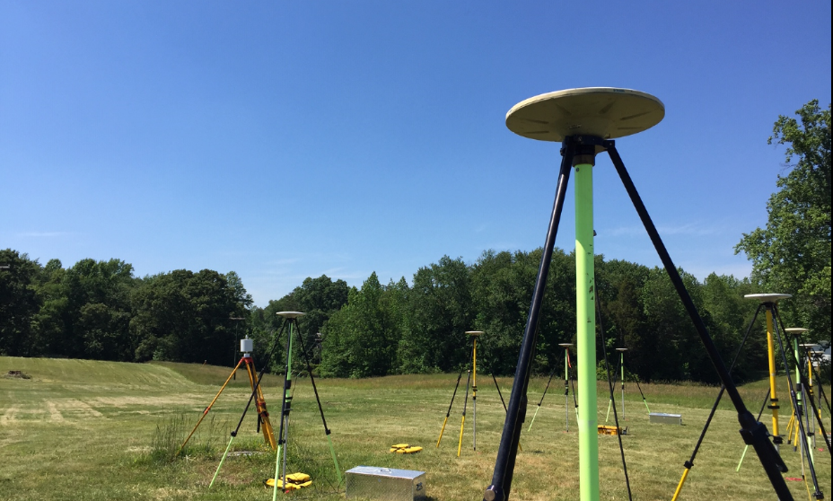
NGS Testing and Training Center
Located near Fredericksburg, VA
In-person training classes such as OPUS Projects Manager’s Training and Geodetic Digital Leveling
Many acres of land for hands-on training and equipment testing

Slide 12
Future Content
Additional Online Lessons
Continued webinars
Series on basic/fundamental geodetic and remote sensing topics
Focus on NSRS Modernization

Slide 13
Your Input is needed and welcome on:
Topics
Content
Delivery methods
Send to ngs.feedback@noaa.gov

