Slide 1
Gravity for the Redefinition
of the American Vertical Datum (GRAV-D) Update
Jeff Johnson
Acting GRAV-D Project Manager
NGS Geospatial Summit
Silver Spring, MD
May 7, 2019

Slide 2
Agenda
Basic Science: Turning gravity data into a Geoid Model
GRAV-D Project Overview
Data Collection Status
2019 Hawaiian Data Collection
2019 American Samoan Data Collection

Slide 3
Airborne Gravity Data Collection
Notes:
The GRAV-D program is collecting airborne gravity data over the entire US and its territories.
The largest factor effecting gravity variation is changes in the density of the earth’s crust.
The Airborne Relative Gravimeter shows changes in the magnitude of the gravity field as the plane flies along.
If ground density increases, gravity increases
If ground density decreases, gravity decreases.

Slide 4
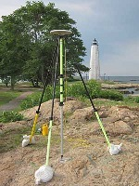
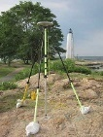
Gravity Data Geoid In Brief
H ≈ -
Notes:
GNSS Users get an ellipsoid height calculated from GNSS satellite data.
Ultimately we need an orthometric height (height in relationship to the geoid) to know where water will flow
Problem: we need to know the difference between the ellipsoid height and geoid (aka geoid height or undulation)
In the past this geoid height was calculated by NGS using large scale leveling and GNSS campaigns. Then provided to users through a realization of NAVD-88
The new NGS vertical datum North American-Pacific Geopotential Datum of 2022 will be based on gravimetric calculations rather than traditional leveling surveys

Slide 5
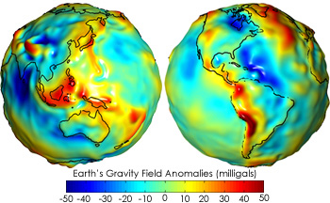
Gravity Data Geoid In Brief
Getting N_{G} (Geoid Height) isn’t trivial…
First you need a gravity field (Satellite, terrestrial, airborne, ship track data)
Then calculate gravity anomaly, ∆g.
Then solve Stokes’ integral:
Need to know ∆g over the entire surface of the earth (or, at least a continental-sized chunk of it…)
(R is the mean radius of the earth, ɣ₀ is mean surface gravity on an equivalent ellipsoidal earth, S is an analytic (geometrical) function of position.)
Notes:
To get Geoid Heights we need a well defined gravity field with gravity observed at multiple distances away from the earths surface.
Then we can calculate the gravity anomaly (difference between observed gravity and normal gravity). Requires complete coverage of the area you want to model.
Fancy Math happens (Stokes Formula)
Geoid Model provides height correctors at given latitude, longitude and ellipsoid heights.

Slide 6
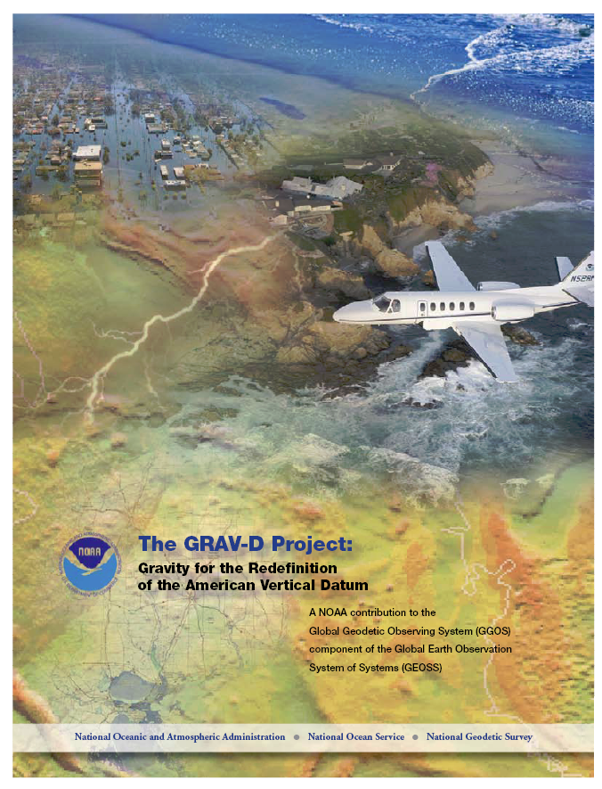
GRAV-D Project Overview
Overall Target: 2 cm accurate orthometric heights from GNSS and a geoid model
GRAV-D Goal: Create gravimetric geoid accurate to 1 cm where possible using airborne gravity data
GRAV-D: Two main goals of the project
Airborne gravity survey of entire country and its holdings
Long-term monitoring of geoid change
Leveraging partnerships to improve and validate gravity data
Notes:
Target is to be able to achieve 2 cm accuracy orthometric heights (where possible) using a GNSS receiver and a geoid model
Roughly 1 cm uncertainty from GNSS and 1 cm from the geoid model
GRAV-D
Phase 1: snapshot of the entire country to provide a consistent data set
Phase 2: long term monitoring of geoid change – Geoid Monitoring Service (Kevin Ahlgren) will present during this session
Work with partners to incorporate additional gravity data, particularly surface gravity data, validate existing data, and monitor change

Slide 7
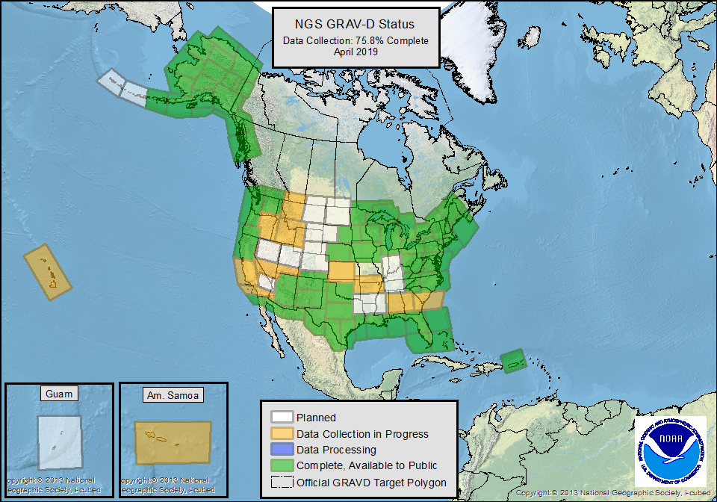
Notes:
GRAV-D Coverage
Entire Unites States and Territories
Covering ~150-200 km into neighboring countries and bodies of water
Take into account bathymetric features such as shelf breaks
Status Map
Explain Colors
White: Planned
Orange: Collection Started
Blue: Collection Complete, Processing Started
Green: Collection and Processing Complete, Released to the Public on web-page.
Milestones
GRAV-D data collection is now 75.8% complete.
Finished mainland Alaska
Started collection in the Pacific Islands (Hawaii and American Samoa)

Slide 8
Year | Goal
FY10 | 7.5%
FY11 | 13%
FY12 | 20%
FY13 | 28%
FY14 | 36%
FY15 | 45%
FY16 | 53%
FY17 | 62%
FY18 | 70%
FY19 | 79%
FY20 | 87%
FY21 | 96%
FY22 | 100%
In Progress
Notes:
GRAV-D Performance Metric
Total area calculated using GIS: ~15.5M sq. km.
We have collected ~11.8M sq. km.
That is 75.8% of the target area.
Explain Slide
A set of yearly goals was created to keep us on track to have 100% collection done in time for the release of the new geopotential datum in 2022 (NAPGD2022).
Historically, GRAV-D has stayed on track each year.
We are on track to reach our FY19 goal of 79%
The FY22 goal is only a 4% increase to give time for processing and inclusion into NAPGD2022.
As we come to the end, we will lose flexibility of choosing locations based on best conditions and may experience some low productivity that will delay our completion.
We have several high risk locations to survey including Guam, American Samoa, Hawaii, and the Aleutian Island Chain. Inability to complete these regions could delay completion before 2022.

Slide 9
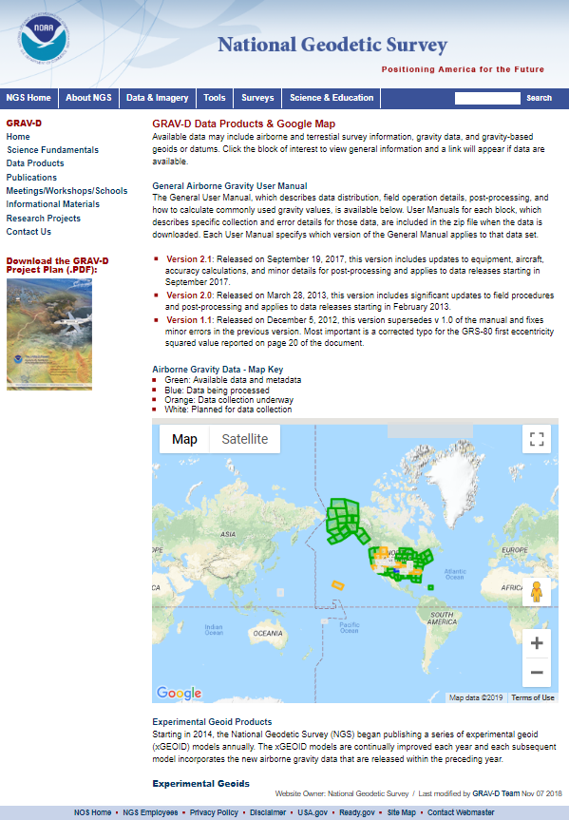
GRAV-D Website
Access GRAV-D Information and Data Products.
www.ngs.noaa.gov/GRAV-D
Notes:
All our processed block data products can be found on our website.

Slide 10
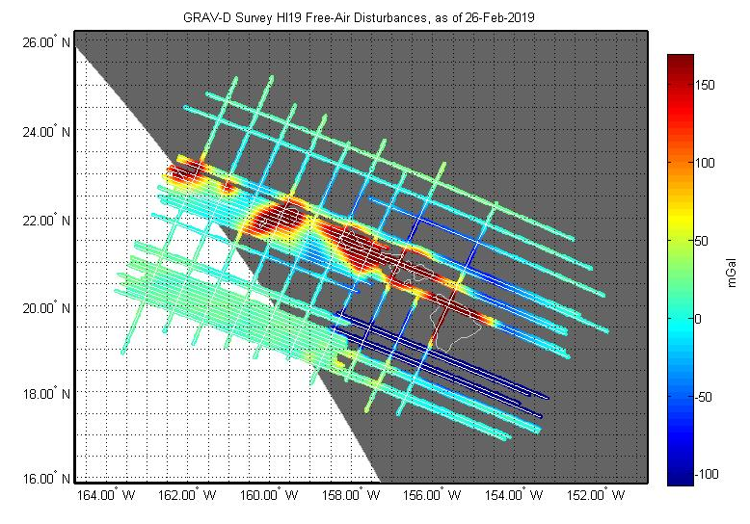
Hawaii 2019
Hawaiian collection is ~58% Complete
GRAV-D returns to Hawaii May-June 2019 to hopefully complete data collection.
Notes:
Explain GRAV-D Hawaiian Block Status
Surveyed a portion of Hawaii in February 2019
~58% complete with Hawaiian Block
Explain Gravity Disturbance Map
Shows the difference between Observed gravity and theoretical (normal) gravity if the earth was actually shaped like a homogeneously dense ellipsoid.
We return to Hawaii to hopefully complete the block in May-June 2019

Slide 11
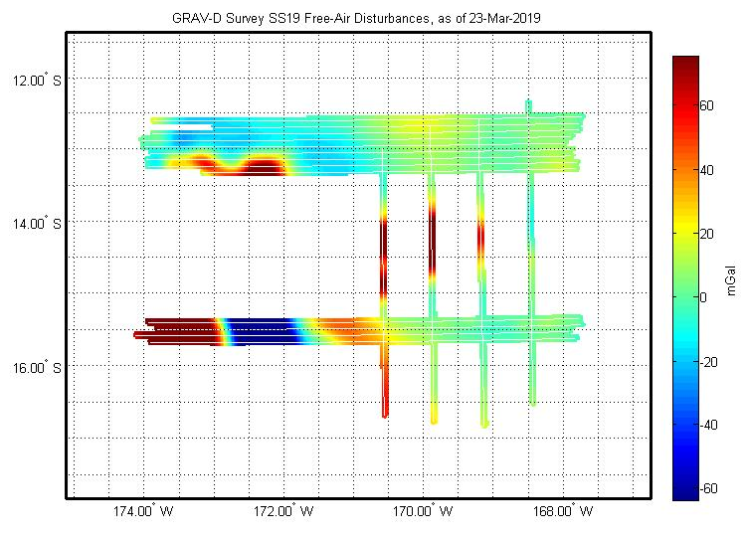
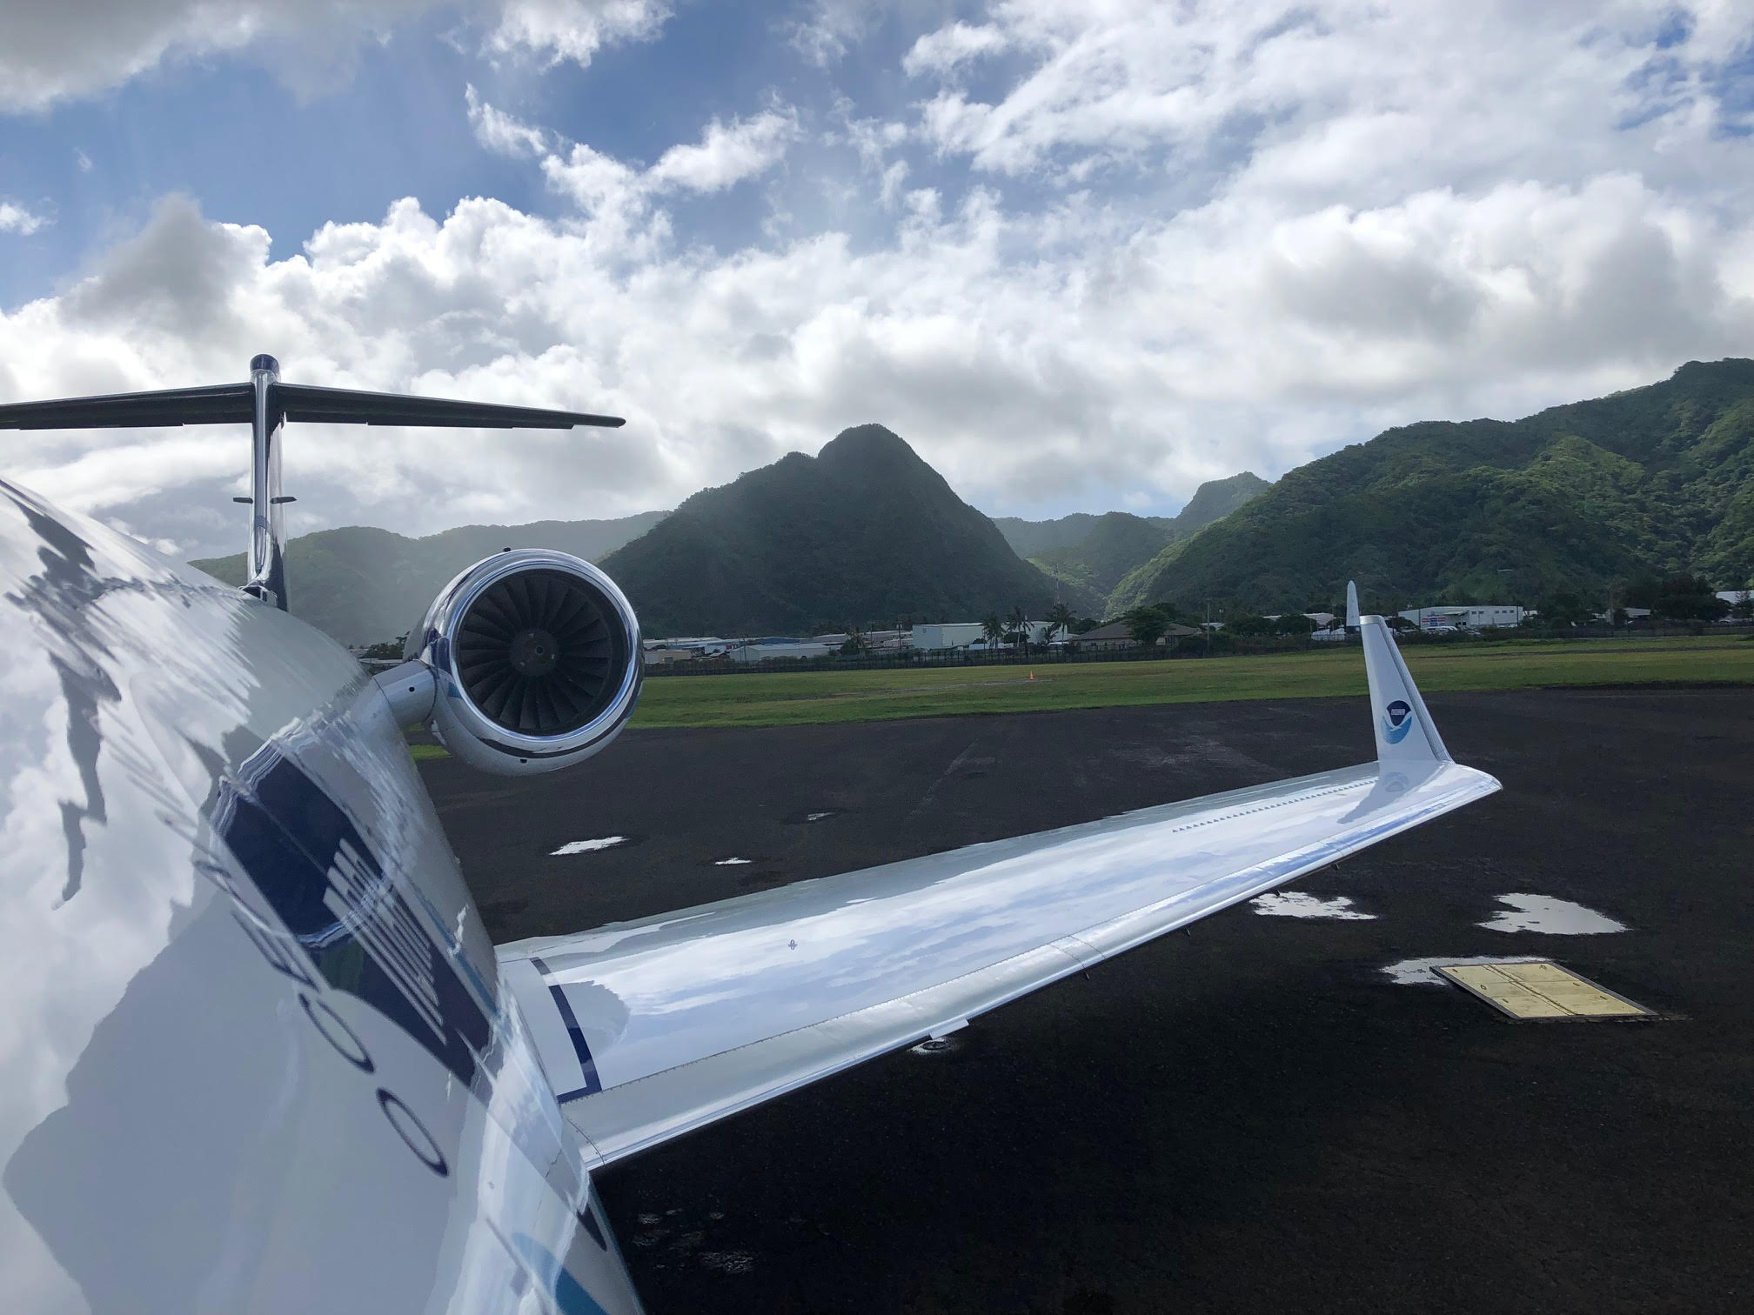
American Samoa 2019
American Samoan collection is ~40% Complete
GRAV-D may return to American Samoa as early as 2021.
Notes:
American Samoa Update
GRAV-D data collection is ~40% complete in American Samoa

Slide 12
Summary
GRAV-D has currently collected 75.8% of the target area. We hope to continue at a pace to be finished in 2022, but are aware of complications that could slow data collection.
Thank you!
Jeffery.Johnson@noaa.gov
NGS.GRAVD@noaa.gov

