Slide 1
Industry Engagement to Modernize the National Spatial Reference System (NSRS)
June 7, 2018

Slide 2
Agenda
2018 NSRS Modernization Industry Workshop (Christine)
Overview
Presentation Recap
Panel Discussion Topics
Break-out Group Questions
Feedback
NSRS Modernization Manager Update (Dru)
Setting the Context
Key Takeaways from Workshop
Prioritizing Current Projects / Products
Expected Timeline of Projects / Products

Slide 3
Part 1:
2018 NSRS Modernization Industry Workshop

Slide 4
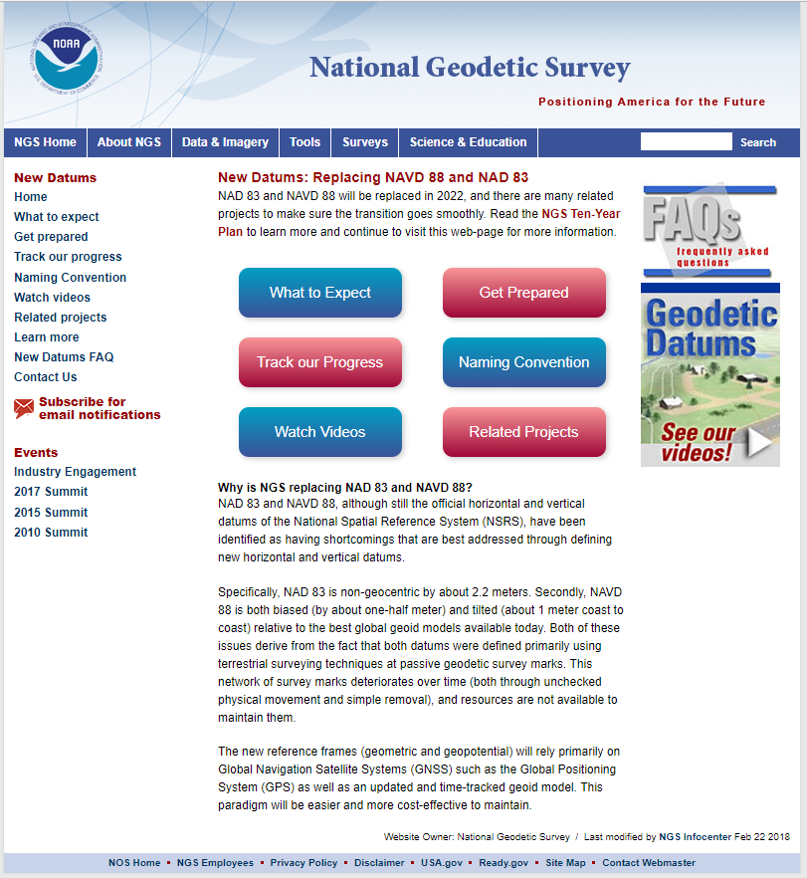
What is NSRS Modernization?
NAD 83 and NAVD 88 will be replaced in 2022
The new reference frames (geometric and geopotential) will rely primarily on Global Navigation Satellite Systems (GNSS) such as the Global Positioning System (GPS) as well as an updated and time-tracked geoid model. This paradigm will be easier and more cost-effective to maintain.
Geospatial Summits engaged user community
2010 - Federal Partner Focus
2015 - Partnered with National Society of Professional Surveyors (NSPS) and MAPPS
2017 - Engaged all partners
Learn more online
Publications:
Blueprint for 2022, Part 1: Geometric Coordinates: NOAA TR NOS-NGS-62
Blueprint for 2022, Part 2: Geopotential Coordinates: NOAA TR NOS-NGS-64
Webinars
Blueprint for 2022, Part 1: Geometric Coordinates, 2017
Blueprint for 2022, Part 2: Geopotential Coordinates, 2018
https://geodesy.noaa.gov/datums/newdatums/index.shtml

Slide 5
What We Heard from Geospatial
Summit Attendees
The products and services most needed from NGS:
Education, education, education
Outreach and more outreach
Geodetic tools and algorithms in modern programming languages
Standards, guidelines, and best practices
Greater focus on “geospatial” partners
Collaboration with industry partners

Slide 6
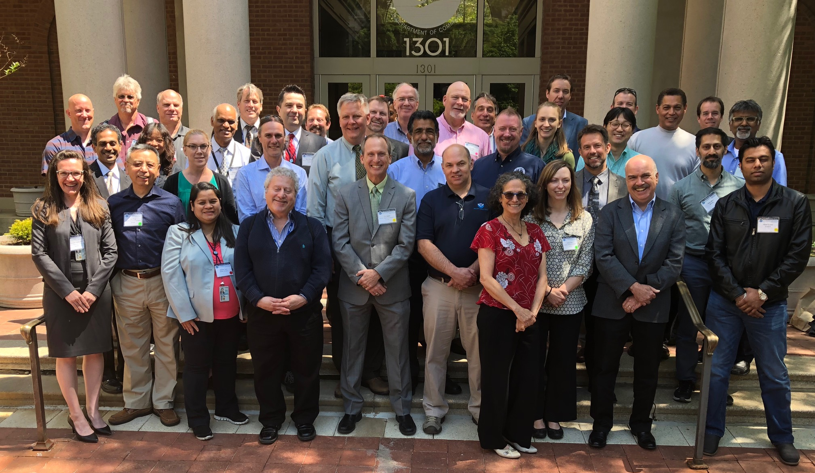
2018 NSRS Modernization Industry
Workshop Overview
Goal: discuss industry needs and concerns regarding the NSRS modernization scheduled for 2022.
External Attendees
Software developers (surveying and GIS vendors)
Internal Attendees
NGS subject matter experts
Notes:
Goal: host a small industry workshop with commercial equipment and software representatives to discuss their needs and concerns regarding the NSRS modernization scheduled for 2022.
External Attendees
Software developers (surveying and GIS vendors)
End-user guest speakers
Trade publications
Internal Attendees
National Ocean Service (NOS) and NGS Leadership
NGS subject matter experts
NGS staff (meeting organizers; break-out group facilitators, etc)

Slide 7
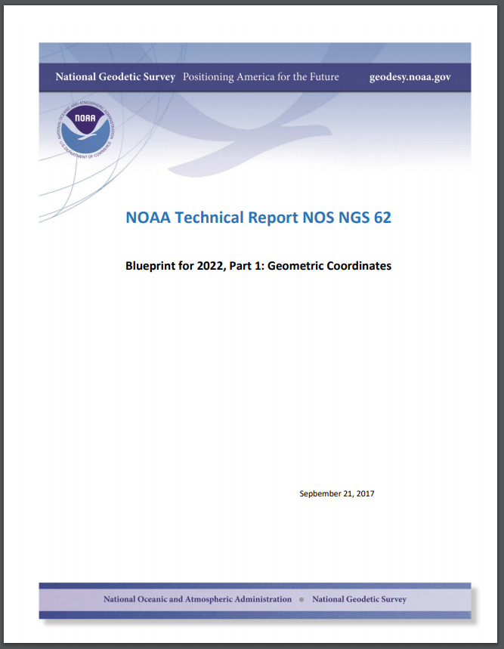
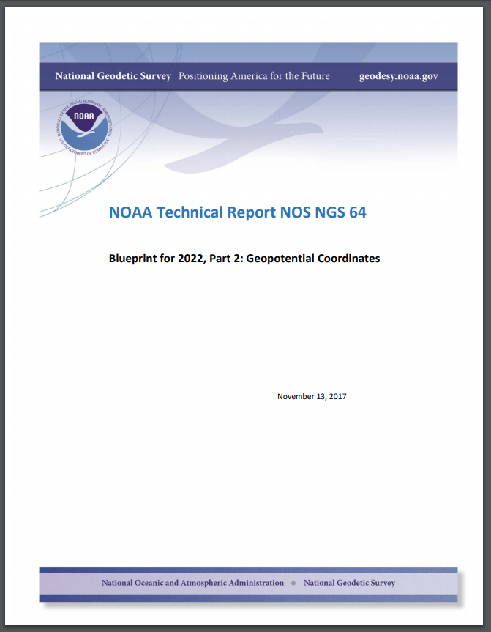
Presentation Recap (1)
NOAA Technical Report NOS NGS 62
Setting the Context
Federal mapping agencies must use the NSRS
Others often use the NSRS, although sometimes mix NSRS and non - NSRS coordinates
NSRS Modernization “Science Decisions”
Existing NAD 83 reference frames will be replaced with four plate-fixed terrestrial reference frames, identical to the latest international reference frame.
NAVD 88 will be replaced with a geopotential datum called, and a time dependent model of the geoid called GEOID2022.
NOAA Technical Report NOS NGS 64
PLUS: corresponding recorded webinars!
Notes:
Existing NAD 83 reference frames will be four plate-fixed terrestrial reference frames:
North American Terrestrial Reference Frame of 2022 (NATRF2022)
Pacific Terrestrial Reference Frame of 2022 (PATRF2022)
Mariana Terrestrial Reference Frame of 2022 (MATRF2022)
Caribbean Terrestrial Reference Frame of 2022 (CATRF2022)
NAVD 88 will be replaced with a geopotential datum called:
North American-Pacific Geopotential Datum of 2022 (NAPGD2022)
Within NAPGD2022, a prominent products will be a time dependent model of the geoid called GEOID2022.

Slide 8
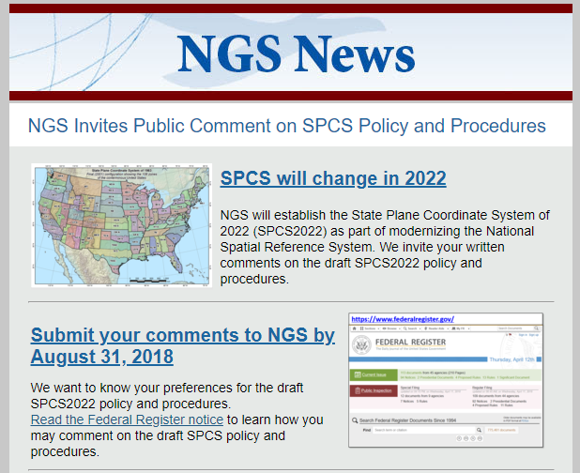
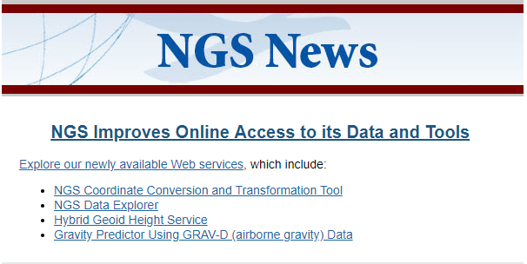
Presentation Recap (2)
Putting Science into Production
Accepting Real-time Kinematic GNSS Data
Preparing for a New State Plane Coordinate System in 2022
Guest speaker presentations gave further insights / examples
Software, Transformation Tools, and Web Services
NGS Coordinate Conversion and Transformation Tool (NCAT)
Web Services - newly released in May
Planning/Testing Prototypes - New NSRS Database
Notes:
Putting Science into Production
Accepting Real-time Kinematic GNSS Data
Also view November 2017 webinar on “Deriving High-accuracy Ellipsoid Heights with OPUS-Projects”
Preparing for a New State Plane Coordinate System in 2022
Also view March 2018 and April 2018 webinars
Comments on Draft Policy and Procedures due Aug 31, 2018
https://geodesy.noaa.gov/SPCS/index.shtml
Guest speaker presentations gave further insights / examples
Software, Transformation Tools, and Web Services
NGS Coordinate Conversion and Transformation Tool (NCAT)
https://geodesy.noaa.gov/NCAT/
Web Services - newly released in May
https://geodesy.noaa.gov/web_services/

Slide 9
Panel Discussion Topics
Continuously Operating Reference Stations (CORS) - “Foundation CORS”
Intraframe velocity model - to support new reference frames
Real time networks - guidelines, connection to NSRS, and more...
Standards and overall standardization - real time networks, accuracy, and more...
File Formats - ISO geodetic registers, projections, gridded products, and more...
Software tools and applications - programming languages, APIs, and more...
NSRS Modernization Schedule - final roll out vs alpha and beta products
Education - increasing understanding of end-users, train the trainer opportunities, and more...

Slide 10
Break-out 1: End Users and Applying Science
Discussion Questions
What end-user problems do you anticipate with NSRS Modernization?
What information can NGS provide to make this transition as smooth as possible for end users?
What training (e.g., documents, guidance, webinar, workshops) would help industry partners and end users prepare for NSRS Modernization?
Do you have your own answers to these questions?
Send to: NGS.Feedback@noaa.gov

Slide 11
Break-out 2: Tools and Data
Discussion Questions
Share feedback about current NGS transformation tools (e.g., transformation parameters; data software standards; and overall architecture)?
What information can NGS provide to ensure industry software and tools can accommodate this new paradigm (i.e. time-dependent coordinates)?
What recommendations would you make to NGS in the development of future tools, database structure, etc.?
Do you have your own answers to these questions?
Send to: NGS.Feedback@noaa.gov

Slide 12
Summary of Feedback
Consistency
e.g. data formats, programming languages, guidelines
More information and faster
e.g. alpha products and test datasets
Continue and expand outreach
e.g. hardware, end-users, and trade publications

Slide 13
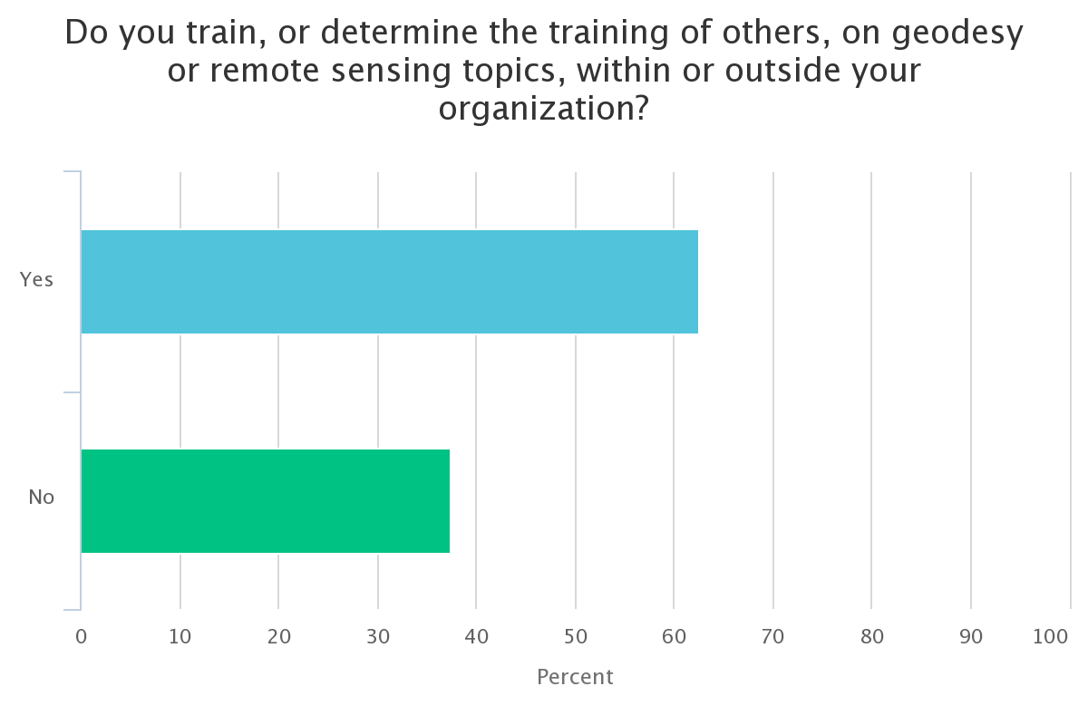
Live Audience Poll

Slide 14
Part 2:
NSRS Modernization Manager Update

Slide 15
Recap “Setting the Context”
An overview of NGS’s mission requirements, as set by OMB A-16:
All civilian federal agencies must use geodetic control
Geodetic control is determined by DOC/NOAA (read “NGS”)
NGS has defined geodetic control as the NSRS
The NSRS is currently:
3 different reference frames, all with the name NAD 83: 2011, PA11 and MA11
6 different vertical datums (NAVD 88, ASVD02, PRVD02, NMVD03, GUVD04, VIVD09)
1 dynamic height datum (IGLD 85)
State Plane Coordinate System of 1983
NADCON and VERTCON
What is and is not the NSRS:
Is: (see above)
Is not: WGS 84, ITRF, IGS, Local/State systems not in SPCS, CORPSCON, etc

Slide 16
Key Takeaways from Workshop
In general, our Industry Partners were positive. NGS received significant and diverse praise for our historic work.
They were also positive about 2022 and said “we’re ready, but we need more information”
“Do more, do it faster, do it better, do it sooner”
NGS response: “We will try, but people and budgets are the limiting factors”
There was a general call for “alpha” versions of our products and services
The intent is that industry would begin to incorporate such P/S into their own software, preparing users for the change and allowing for feedback and creation of Beta products

Slide 17
Prioritizing Current Projects / Products
The call for “alpha” projects meant that certain things need to be given high priority.
New database and datasheets
Euler Pole Parameters (EPPs) for each of the four Terrestrial Reference Frames (NATRF2022, PATRF2022, CATRF2022, MATRF2022)
Intra-Frame Velocity Model (aka “Deformation Model”)
Static and Dynamic Geoid model
OPUS-Projects for everything
GPS
Leveling
NADCON and VERTCON connected to prototype 2022 data
And “how to use them” for all of the above.

Slide 18
Expected Timeline of Projects / Products
Although these products are all in a state of non-readiness, their general nature (file formats, expected interaction with other products and services) is getting well established. As such, prototypes (“alpha” versions) of the following could be put into the public domain before the summer of 2019:
IFVM - Could be a series of grids of dphi/dt, dlam/dt, dh/dt, plus discontinuity grids.
EPPs - Use current ITRF2014 estimates plus recent Mariana work
SGEOID2022 - use xGEOID18
DGEOID2022 - could be a grid of dN/dt, based on dC/dt and dS/dt derived from GRACE
Similarly for DEFLEC2022
NADCON - Built from CORS data (use IGS08 or IGS14 and the EPPs above)
VERTCON - Built from what GPS on BM data we have to date

Slide 19
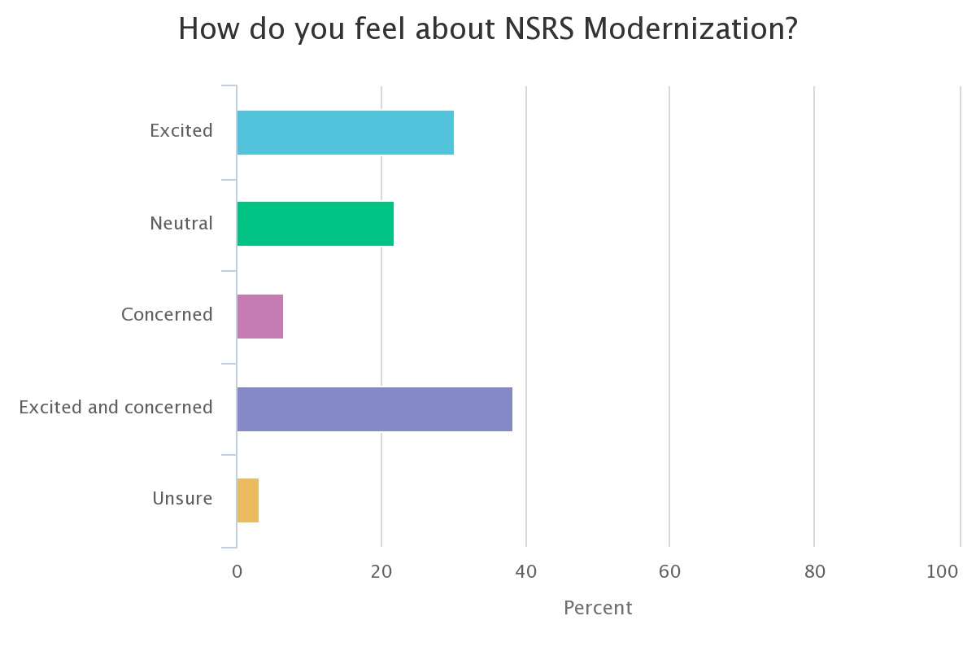
Live Audience Poll

Slide 20
Questions?

