Slide 1
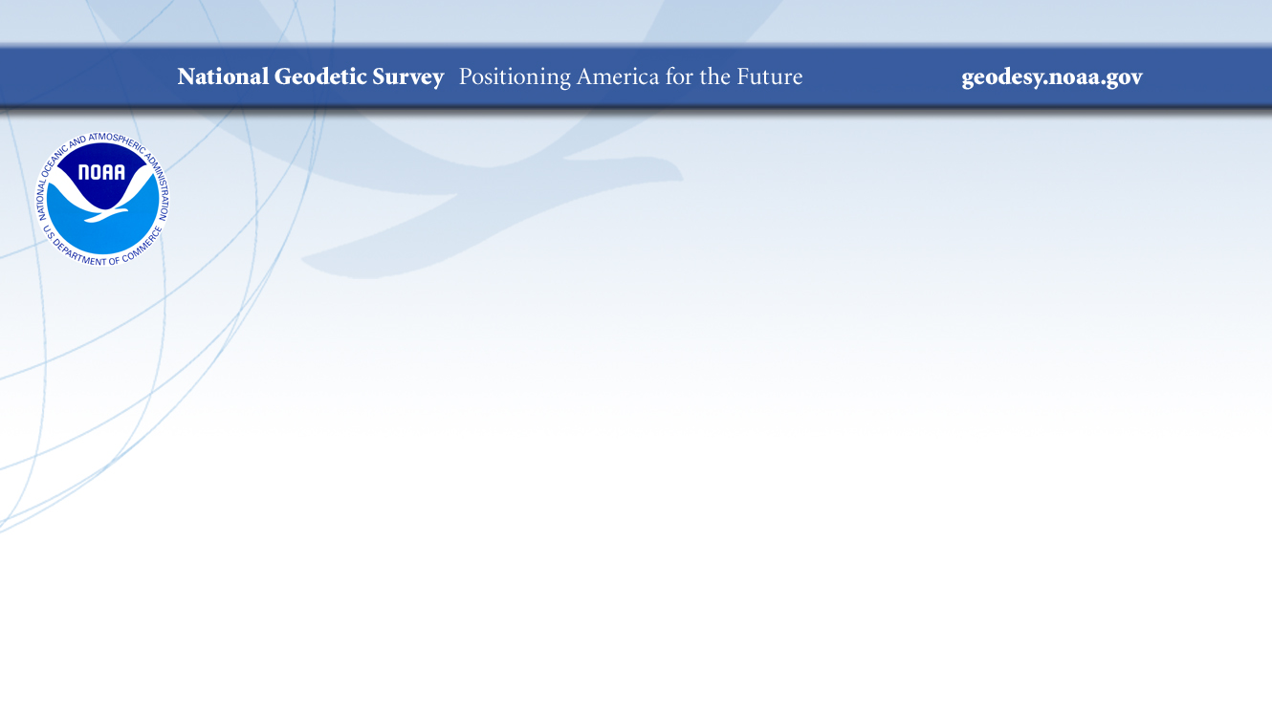
US Department of Commerce
National Oceanic and Atmospheric Administration
National Ocean Service
National Geodetic Survey (NGS)
William (Brad) Kearse
Deputy Director, NGS
Dr. Theresa Damiani
Chief, Spatial Reference System Division, NGS
November 23, 2019

Slide 2
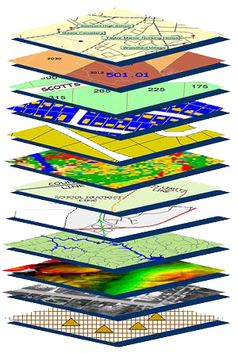
Mission Statement
To define, maintain and provide access
to the National Spatial Reference System (NSRS) to meet our Nation’s economic, social, and environmental needs.
The NSRS is a consistent coordinate system that defines latitude, longitude, height, scale, gravity, orientation, and shoreline throughout the United States.
Notes:
NGS develops and maintains the National Spatial Reference System, a national coordinate system that provides the foundation for transportation, navigation, land record systems, mapping and charting efforts, and a multitude of scientific and engineering applications.
This system defines position (latitude, longitude, and elevation), distances and directions between points, strength and direction of gravity (no, it is not simply “straight down”), shoreline, and how these change over time.

Slide 3
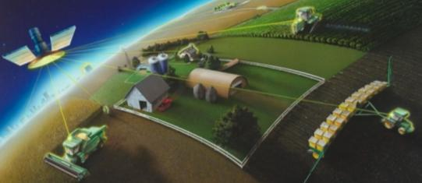
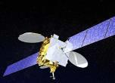
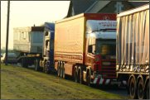
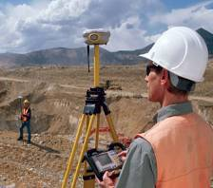
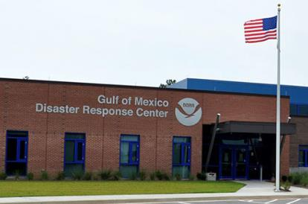
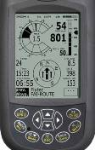

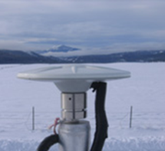

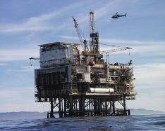

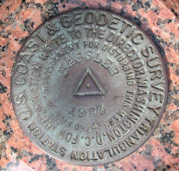
NGS Provides the Geospatial Infrastructure
Critical to Our Economy through the NSRS
Aviation
Satellite
Operations
Precision Agriculture
Trucking and Shipping
Surveying
and Mapping
Disaster Response
Personal
Navigation
CORS
Navigation
Oil Exploration
Fishing and Boating
Survey Marks

Slide 4

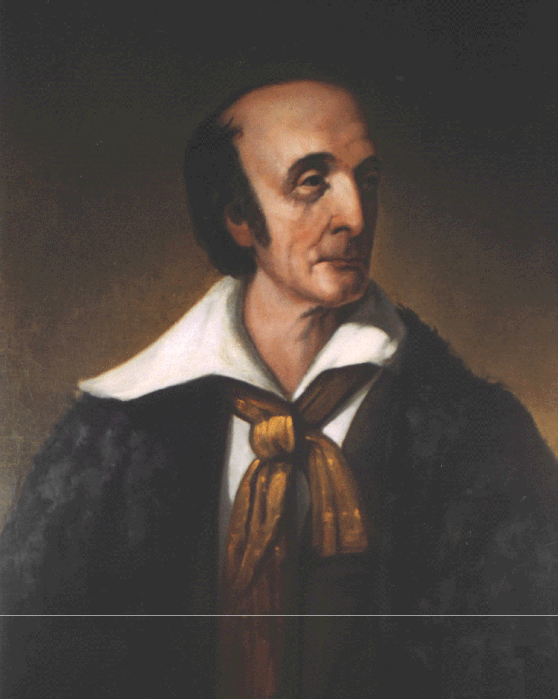
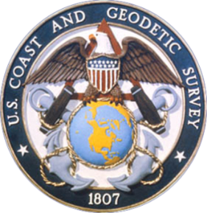

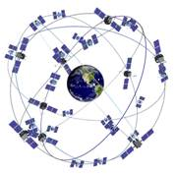
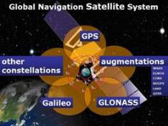
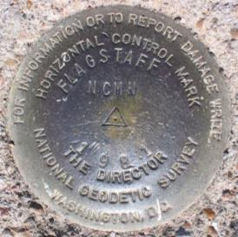
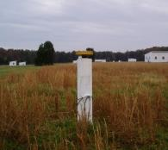
NGS was created (as part of the Survey of the Coast) to define the NSRS: a consistent set of mapping values and location information like latitude, longitude, height, scale, gravity, and orientation throughout the United States.
Our Nation’s first civilian science agency.
  1807
  Thomas Jefferson
  Survey of the Coast
  1878
  Ferdinand Hassler
  U.S. Coast and Geodetic Survey
  1970
  NOAA’s National Geodetic Survey
NGS and the NSRS have evolved over our long history
  GPS
Passive
Control
(Monuments)
Active
Control
(CORS)
  GNSS
Notes:
NGS has been around a long time. For over 200 years, NGS and its predecessor agencies have collaborated with public and private organizations to establish reference stations at precisely determined locations. We began on a mission to conduct a “Survey of the Coast” (as the United States Coast Survey), established by Thomas Jefferson, in 1807 (pictured are Thomas Jefferson and Ferdinand Hassler, the first Superintendent of the Coast Survey). We were renamed US Coast & Geodetic Survey in 1878. And we became National Geodetic Survey in 1970 (when NOAA was created).
Traditionally, precise positionig locations have been identified by setting a survey mark—usually a brass, bronze, or aluminum disk. Locations might also be identified by a deeply driven rod or a prominent object, such as a water tower or church spire. More recently, NGS has fostered a network of continuously operating reference stations (CORS) where each CORS includes a highly accurate receiver that continuously collects radio signals broadcast by Global Navigation Satellite System (GNSS) satellites.
GPS (USA)
Compass (China)
GLONASS (Russia)
Galileo (EU)

Slide 5
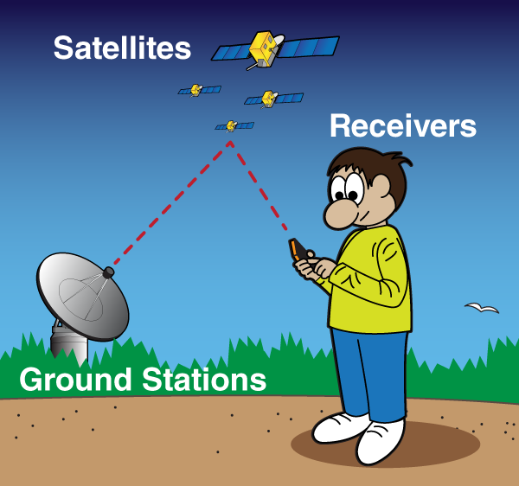
How it Works: Global Positioning System (GPS)
Ground stations tell the satellites where they are expected to be orbiting daily.
GPS satellites broadcast their position, time stamp, and other info.
Devices “listen” to GPS signals and calculate your position based on how long it took the signals to arrive and the satellite positions it “heard”.
ME. HERE. NOW.
Notes:
There are 24-30 GPS satellites in orbit to provide 4 or more visible from every location on the surface (optimally). Why? Need to see 4 in order to figure out your position.
How it works: Air Force launches satellites and tracks their positions in orbit from the ground.
They transmit information to the satellites about their positions and names. T
he satellite sends that back down to Earth, with a time-stamp on it.
The antenna on the ground hears the signal, sends it to a receiver to be time-stamped, then the receiver does some basic math to figure out how long it took the signal to get to the ground and can calculate position based on the satellite’s expected position.
The receiver can be moving (like the tractor) or not moving (static, like the station on left).
This is called real-time (or instantaneous) positioning. It has the lowest accuracy– several feet.
That’s not good enough for surveying and mapping applications that need accuracy of one to a couple inches.
What can we do to get better positions?

Slide 6
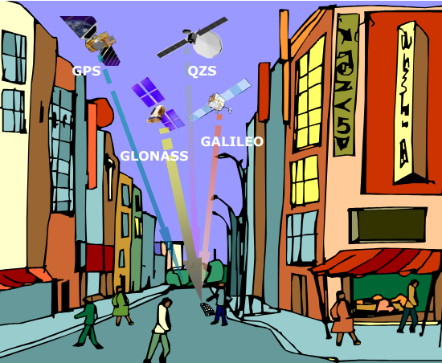
Other countries have satellite systems too. Collectively, all systems are referred to as Global Navigation Satellite Systems (GNSS). Using more satellites improves positioning.
Fact: There are 24 active GPS satellites in orbit, but there are over 100 GNSS satellites in orbit. And the number keeps growing.
Image credit: John Betz, Mitre Corporation
Notes:
Other GNSS in orbit increase the number of possible visible satellites. More satellites gives more information about your position and increased the accuracy.
Completed:
GPS- US
GLONASS- Russia
Galileo- EU
QZSS- Japan
Beidou- China (not shown, not completed)

Slide 7
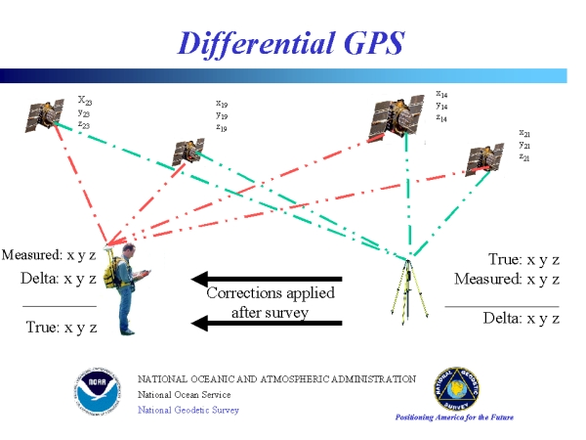
Using Continuously Operating Reference Stations (CORSs) or Real-Time Networks
Many signals interfere with GPS (like any radio/TV/cell signal: static, fading, dropouts, squelch). These degrade position accuracy. Having ground stations improves results.
Notes:
Have you ever had a cell phone drop a call? Or heard crackling, static, or weird noises on the line? Or the person sounded far away?
This happens when something blocks or interferes with the cell signal. The same thing happens to GPS.

Slide 8
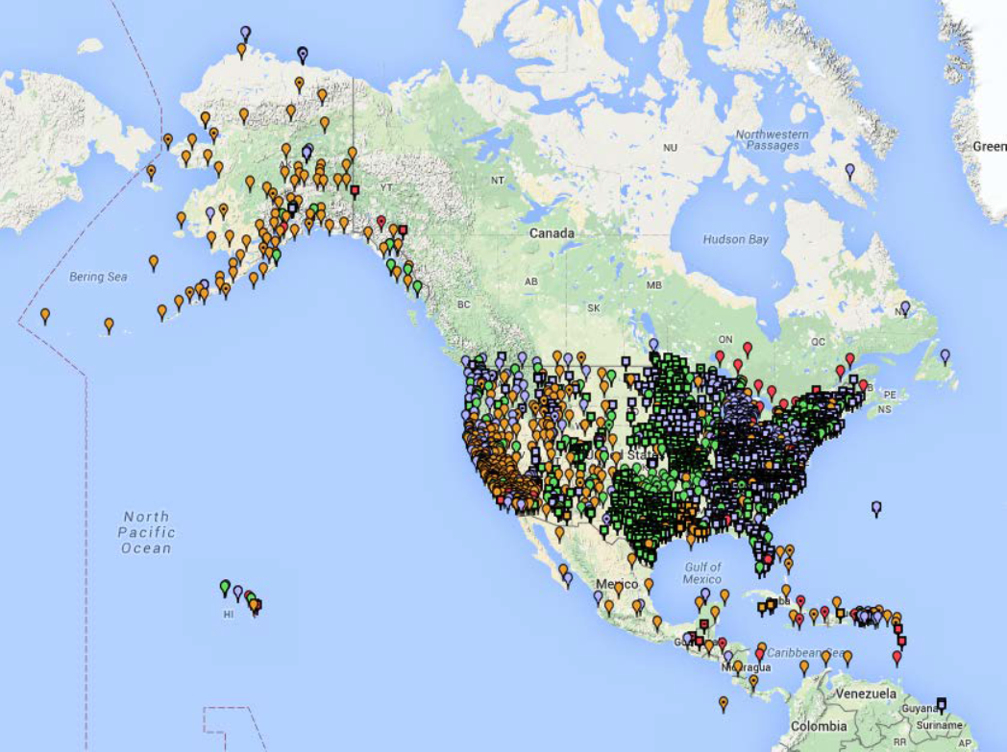
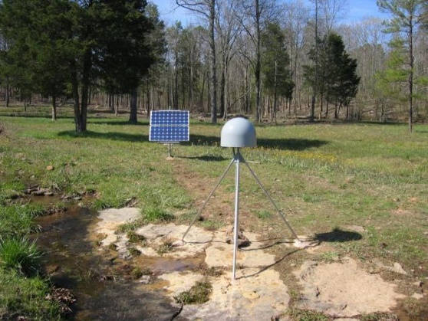
NGS’ CORS Network
~2000 existing partner-operated CORS
(volunteer participation)
Notes:
2000 existing CORS run by more than 200 organizations (various federal government, state government (DOT and mapping agencies), academic, and private organizations). It is a volunteer/crowd-sourced network where we collect, store, and make publicly-available their data in a central location.
Partner controlled means varying quality, with no mandate for availability of data. E.g. equipment breaks, lightning strike, hurricane, bear attack, signal doesn’t make it to NGS (IT issues), etc.
Picture: Station P777 in Dennard, Arkansas, run by the National Science Foundation.

Slide 9
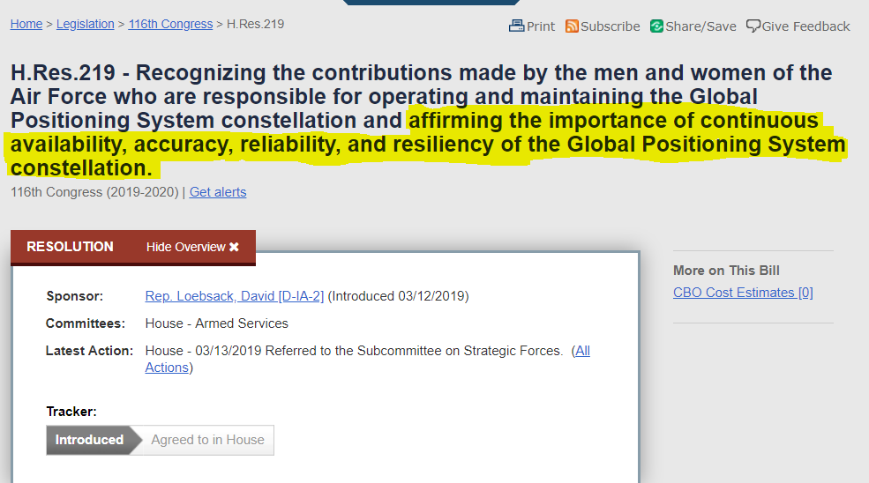
Today: GPS is critical to the world
GPS provides economic benefits valued at $68,700,000,000 [$68 billion] or 0.4 percent of the gross domestic product of the United States
The Department of Homeland Security identifies GPS as essential to 14 of the 16 industries that are classified as part of the Nation’s critical infrastructure;
Globally, 3,600,000,000 [3.6 billion] Global Navigation Satellite System devices were in use in 2014, 450,000,000 [450 million] of which were in North America;
Notes:
https://www.congress.gov/bill/116th-congress/house-resolution/219/text

Slide 10

The Future: Smart Cities, Autonomous Vehicles, Smart Positioning
And so much more, we couldn’t even imagine yet!

