Slide 1
GeMS Validation Survey
NGS Webinar Series – 5/12/2022
NOAA’s National Geodetic Survey
Kevin Ahlgren, PhD - Geodesist & Geoid Modeler

Slide 2
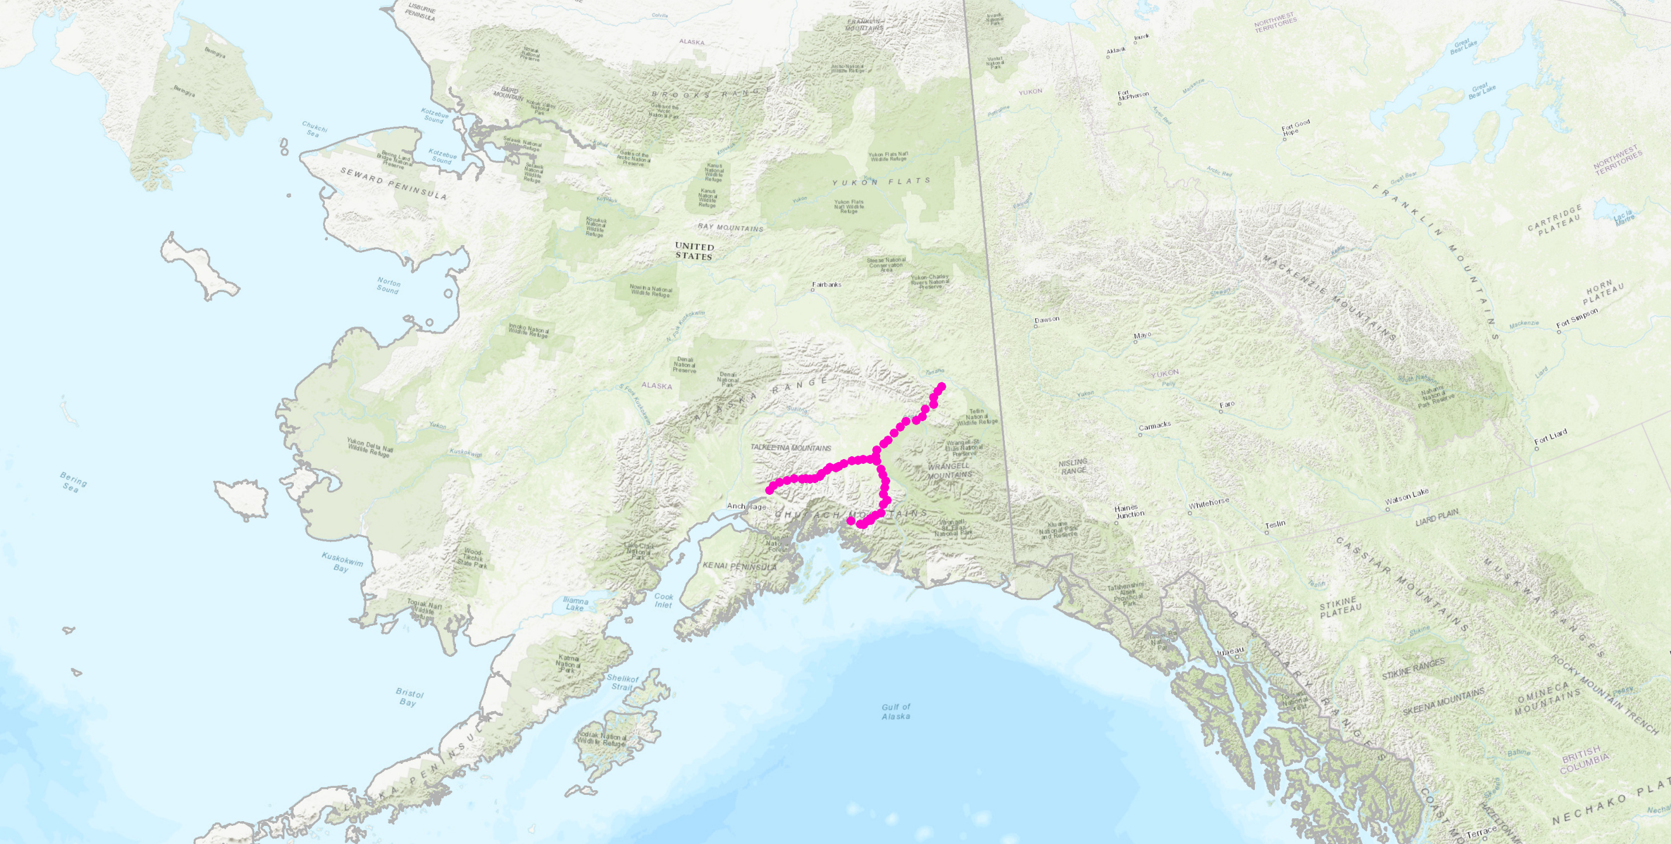
GeMS Validation Survey (GeMS-VS)
Outline:
GeMS Overview
Why Alaska for this type of work (GeMS-VS)?
Geodetic observational techniques
Challenges
Preliminary results
Tok
Palmer
Glennallen
Anchorage
Valdez
Notes:
Geoid monitoring service = GeMS

Slide 3
Acknowledgements:
Field staff and support
NGS Leadership
NGS OAD Field Operations Branch
NGS Geosciences Research Branch
Alaska Regional Geodetic Advisor
NOS: CO-OPs
NOAA: National Weather Service (Anchorage, AK) and Tsunami Warning Center (Palmer, AK).
Federal Partners
National Park Service
Bureau of Land Management
NSF/UNAVCO
State Partners:
Univ. Alaska-Fairbanks
DNR – Division of Geological & Geophysical Surveys
DOT
Local Surveyors

Slide 4
NGS’s Geoid Monitoring Service:

Slide 5
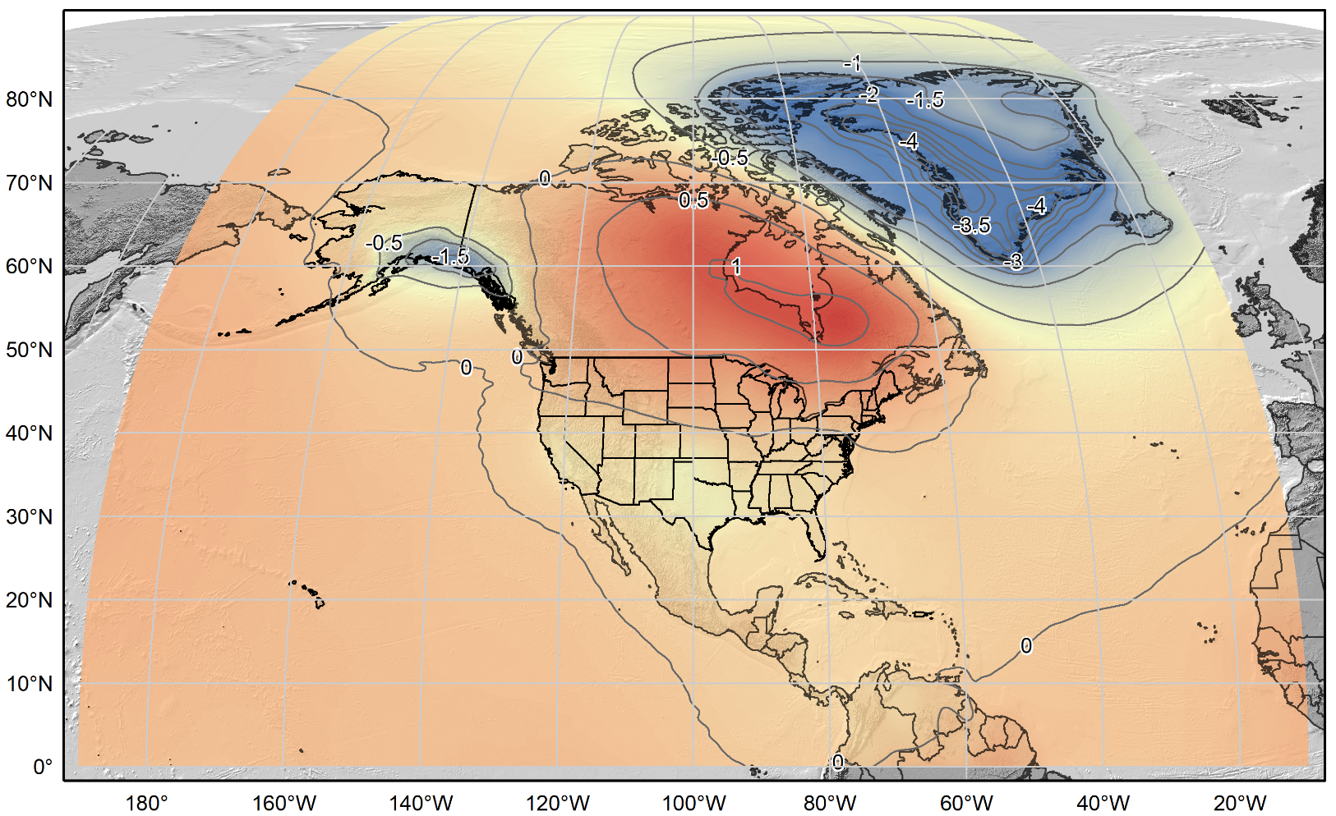
xDGEOID20
Alpha model based on secular trend from GRACE (NASA GSFC mascon v02.4, Luthcke, et al. 2013)).
Units: mm/yr.
Contour Interval: 0.5 mm/yr

Slide 6
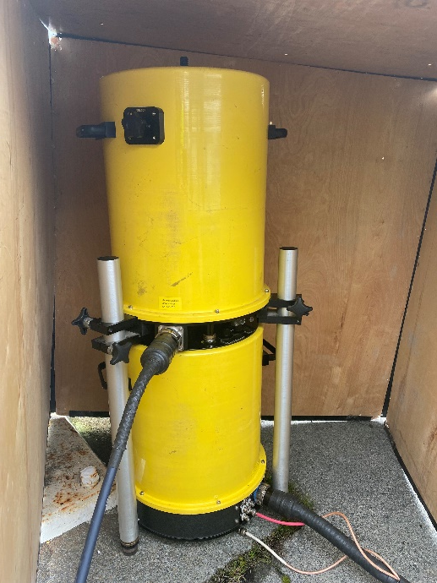
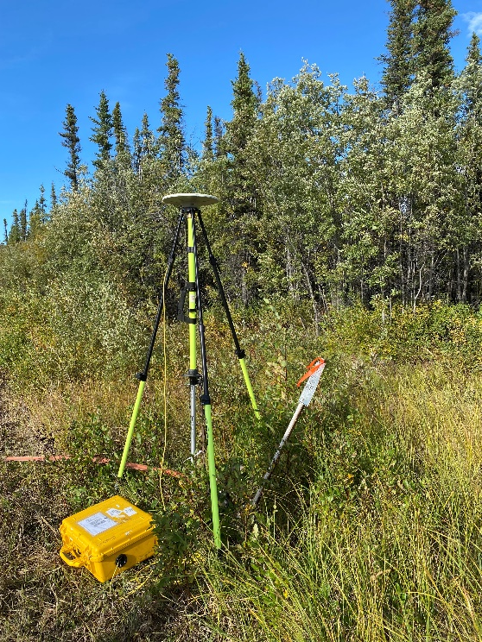
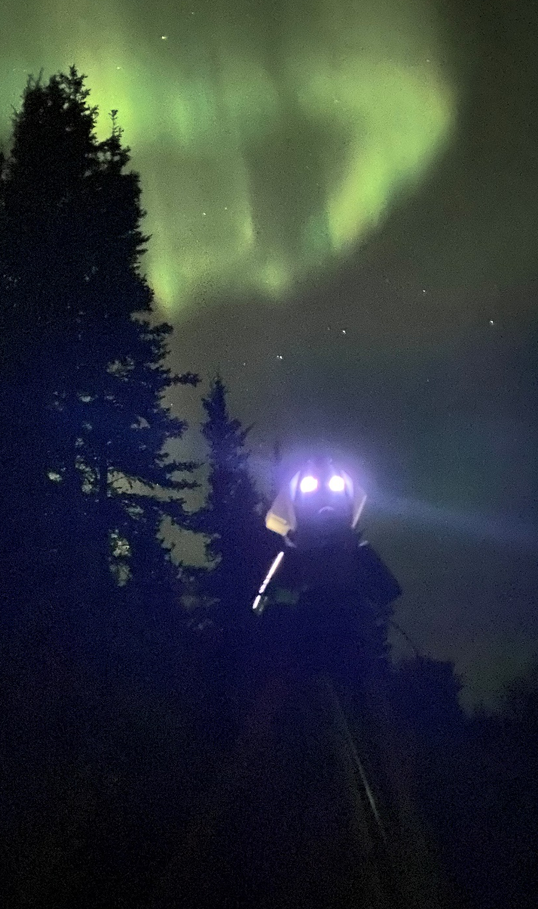
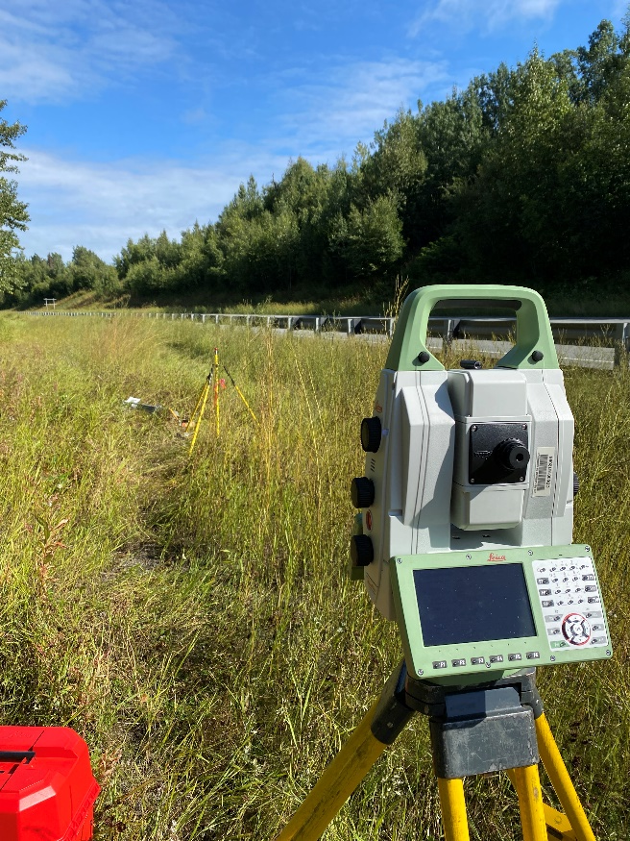
GeMS Validation Survey (GeMS-VS)
Tok
Palmer
Glennallen
Anchorage
Valdez

Slide 7
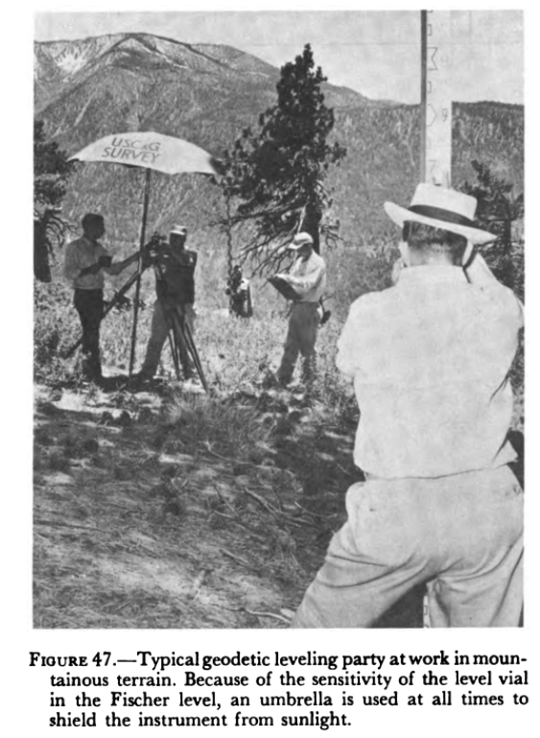
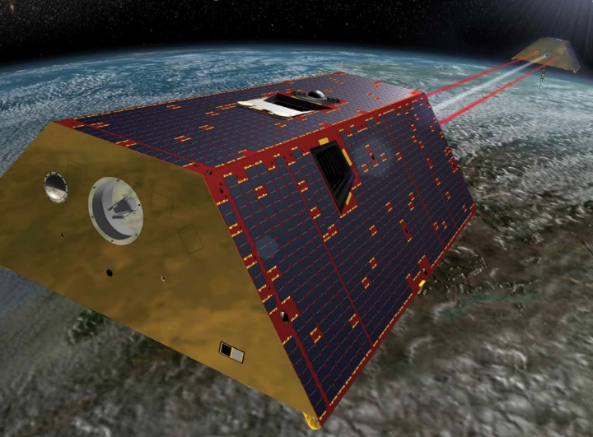
Rationale for GeMS-VS in Alaska
Satellite observations show significant geoid/gravity change (GRACE / GRACE-FO)
Compare high resolution changes on the ground. (omission)
Wealth of geodetic observations done by Coast and Geodetic Survey after 1964 Earthquake
GRACE/GRACE-FO – Twin satellites that measure distance between one another at few μm (a tenth of the thickness of a human hair). (Image courtesy of NASA)
Notes:
GOAL for this 2021 survey is the same --- lay a foundation for future work and geoid / gravity change AND investigate how much change has occurred since 1964

Slide 8
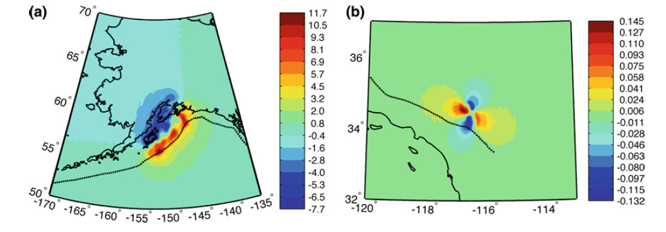
Geoid Change: Episodic Events
Earthquakes, Volcanoes, Landslides…
Can all change the shape of the geoid
In the future, possibly warrant a geodetic response
Very rarely occur at levels of significance
1992 Landers M7.3 Earthquake produced ~0.1 mm
1964 Alaska M9.2 had ~10 mm (20 mm slope)
Mount St. Helens Eruption:
Flank collapse: 10+ cm geoid change
Material redistribution: 2 cm geoid change
Modeled geoid change in mm for (a) the 1964 Alaska earthquake and (b) the 1992 Landers earthquake. (from Jacob, et al., 2012)

Slide 9
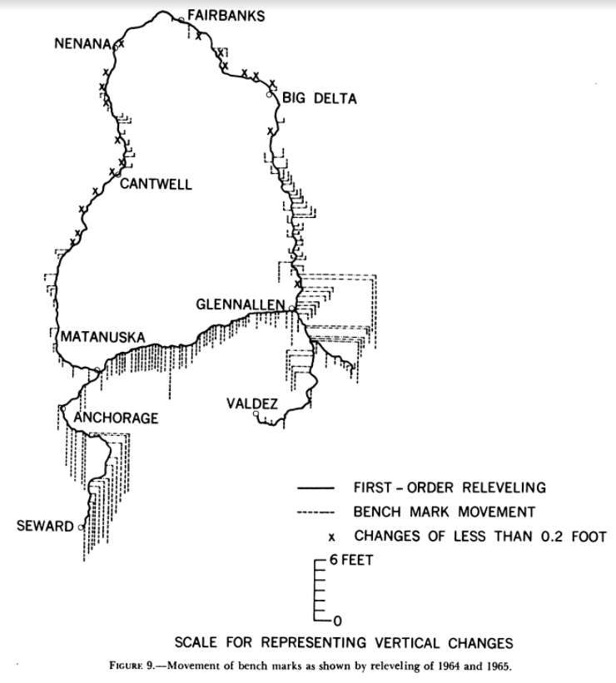
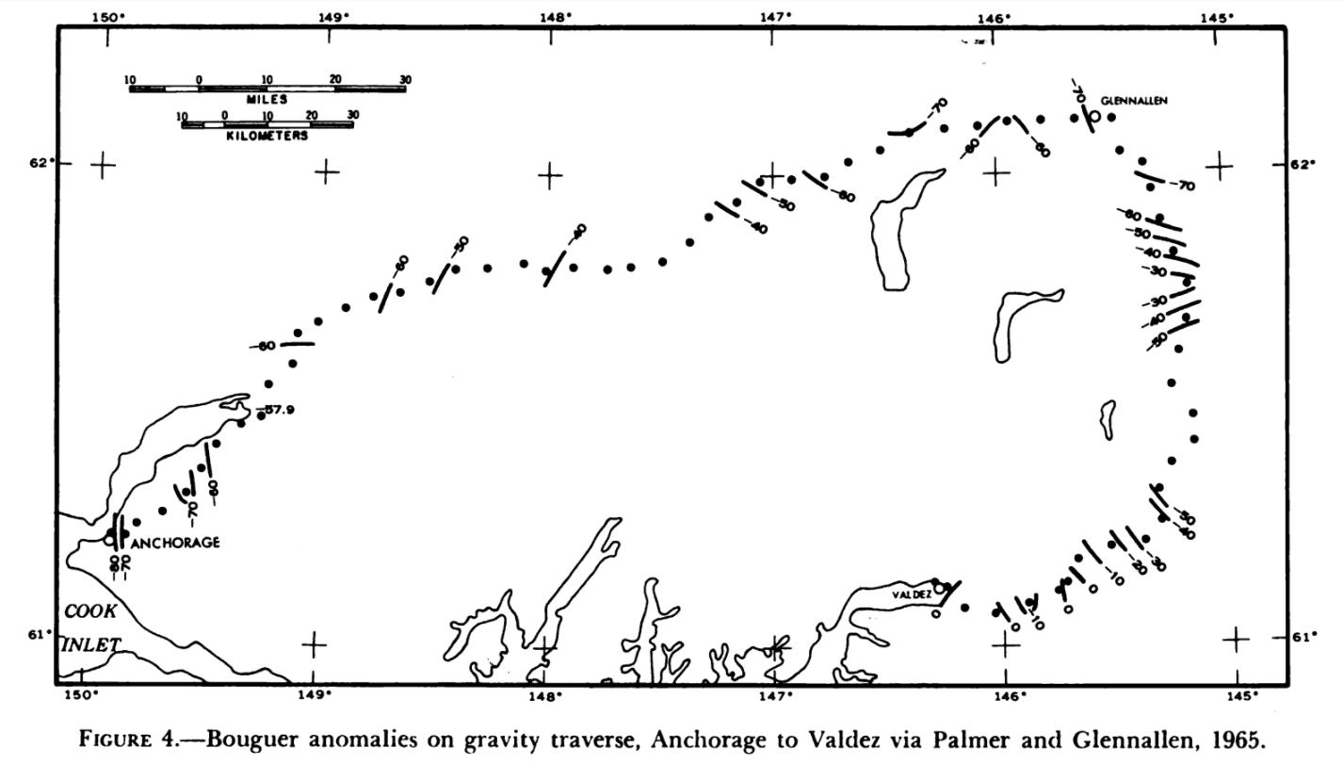
Geodetic Surveys from 1964
“The major objective of the 1964 and 1965 observations was to lay a foundation for future studies of abrupt and secular gravity changes. A better understanding of these changes may ultimately contribute to the prediction of earthquake activity.”
Donald A. Rice (1969)
Notes:
The Prince William Sound, Alaska, Earthquake of 1964 and Aftershocks, Vol. III
Leipold, L. E. & Wood, F. J. (Eds.). (1966). The Prince William Sound, Alaska, Earthquake of 1964 and Aftershocks: Research studies and interpretive Results Geodesy and Photogrammetry. Volume III. Publication 10-3. US Government Printing Office.

Slide 10
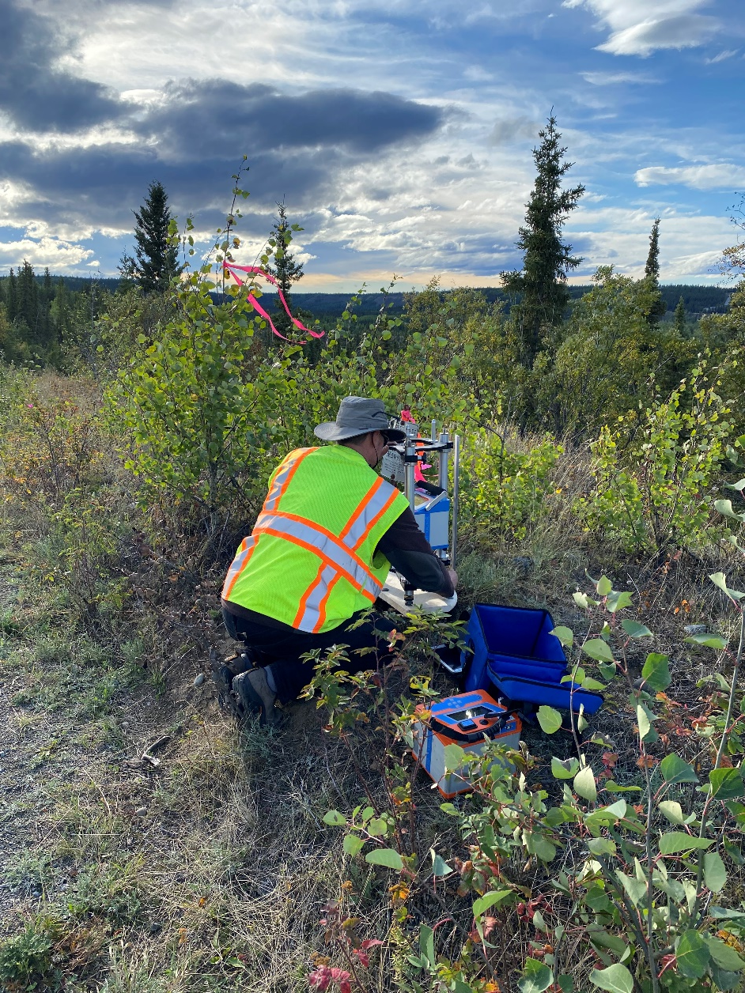
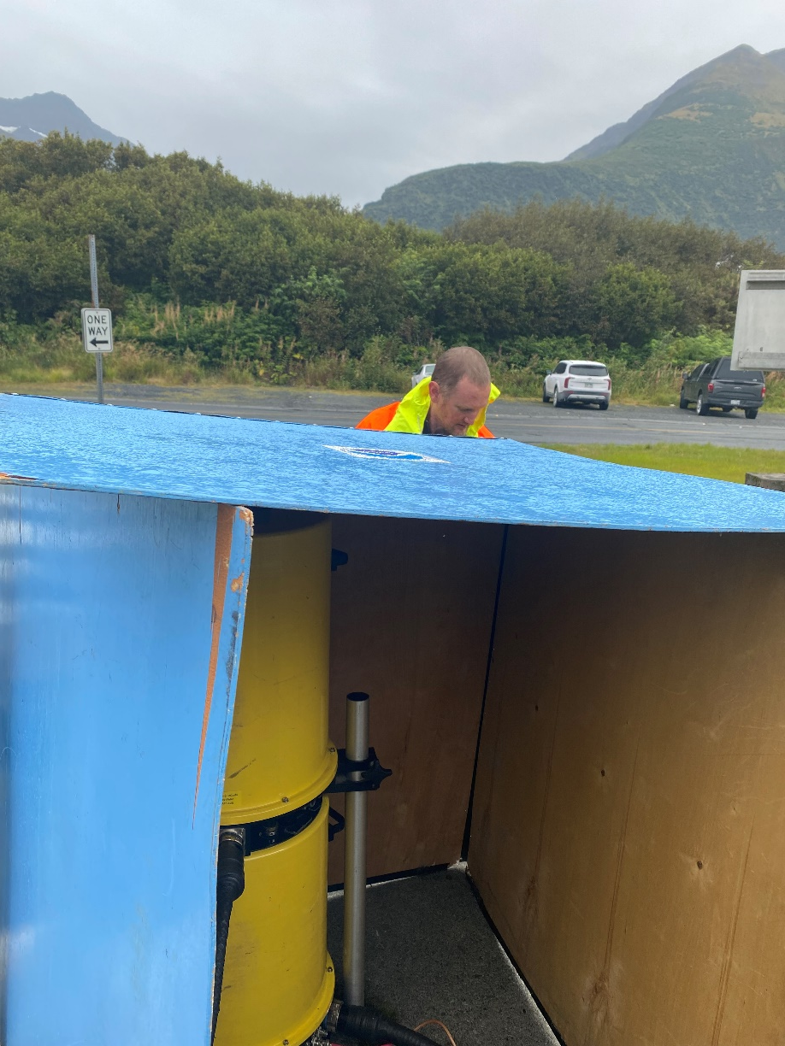
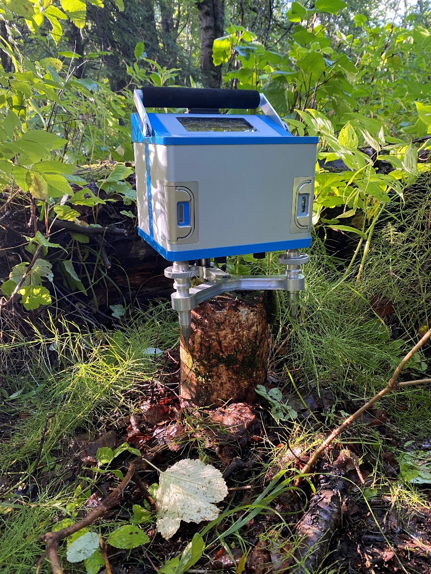
Gravity:

Slide 11
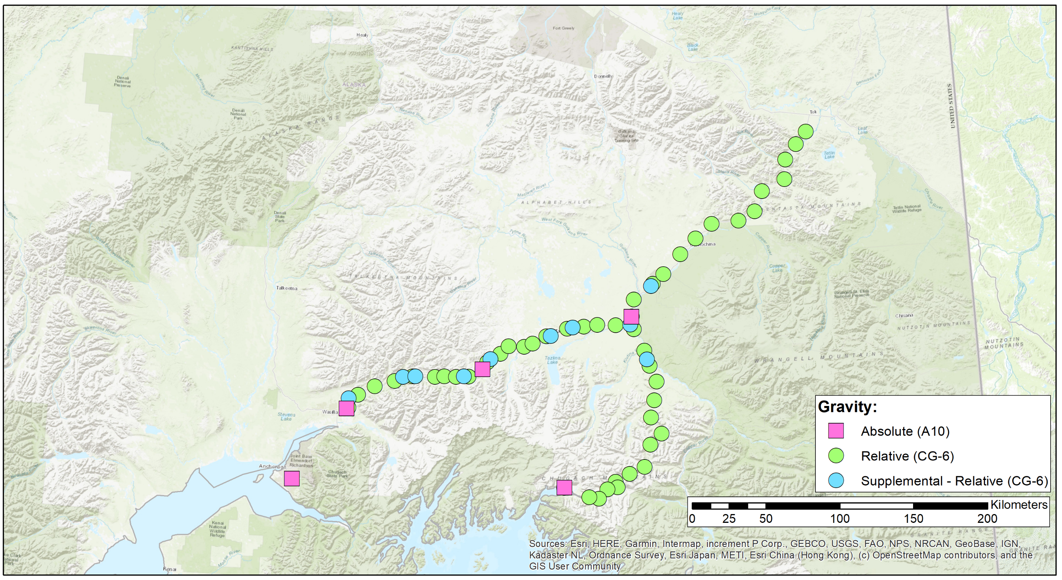
GeMS-VS: Gravity
Tok
Glennallen
Palmer
Anchorage
Valdez

Slide 12
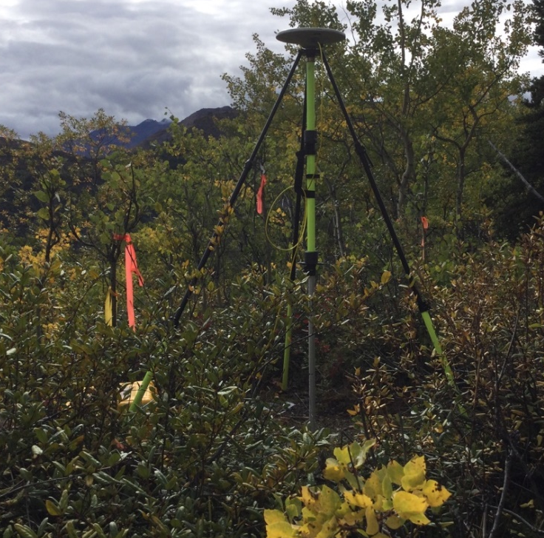
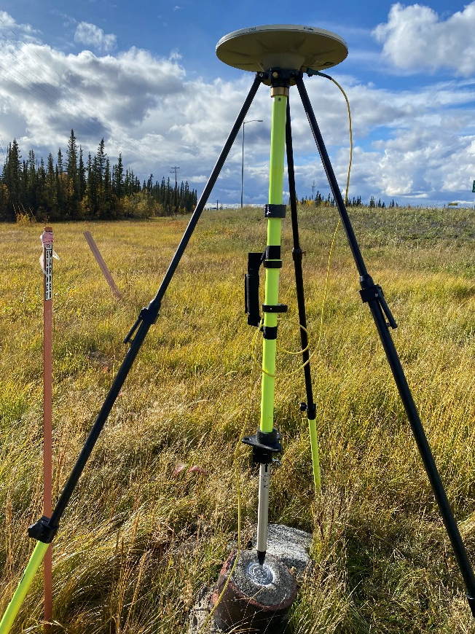
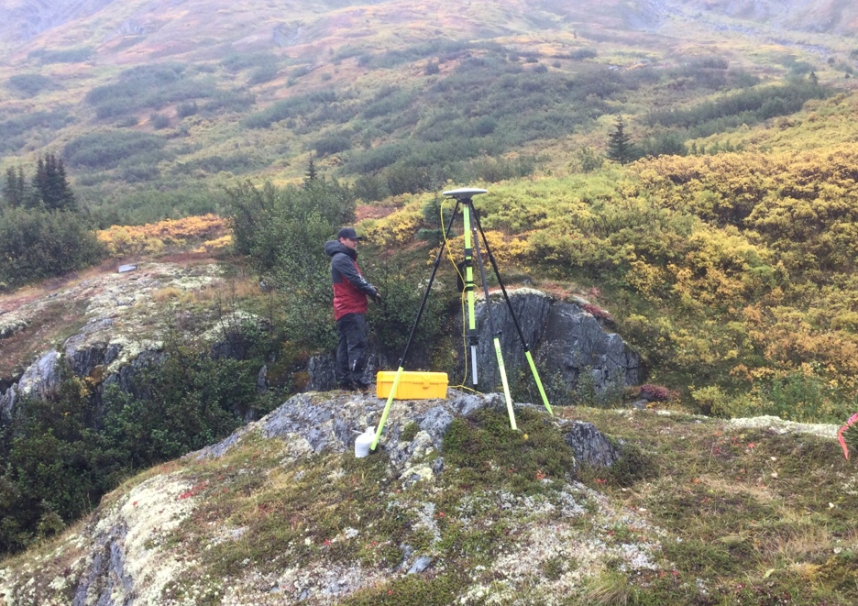
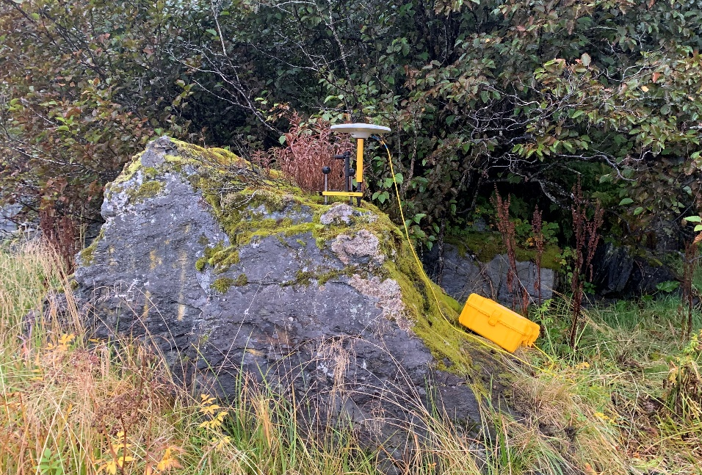
GNSS:

Slide 13
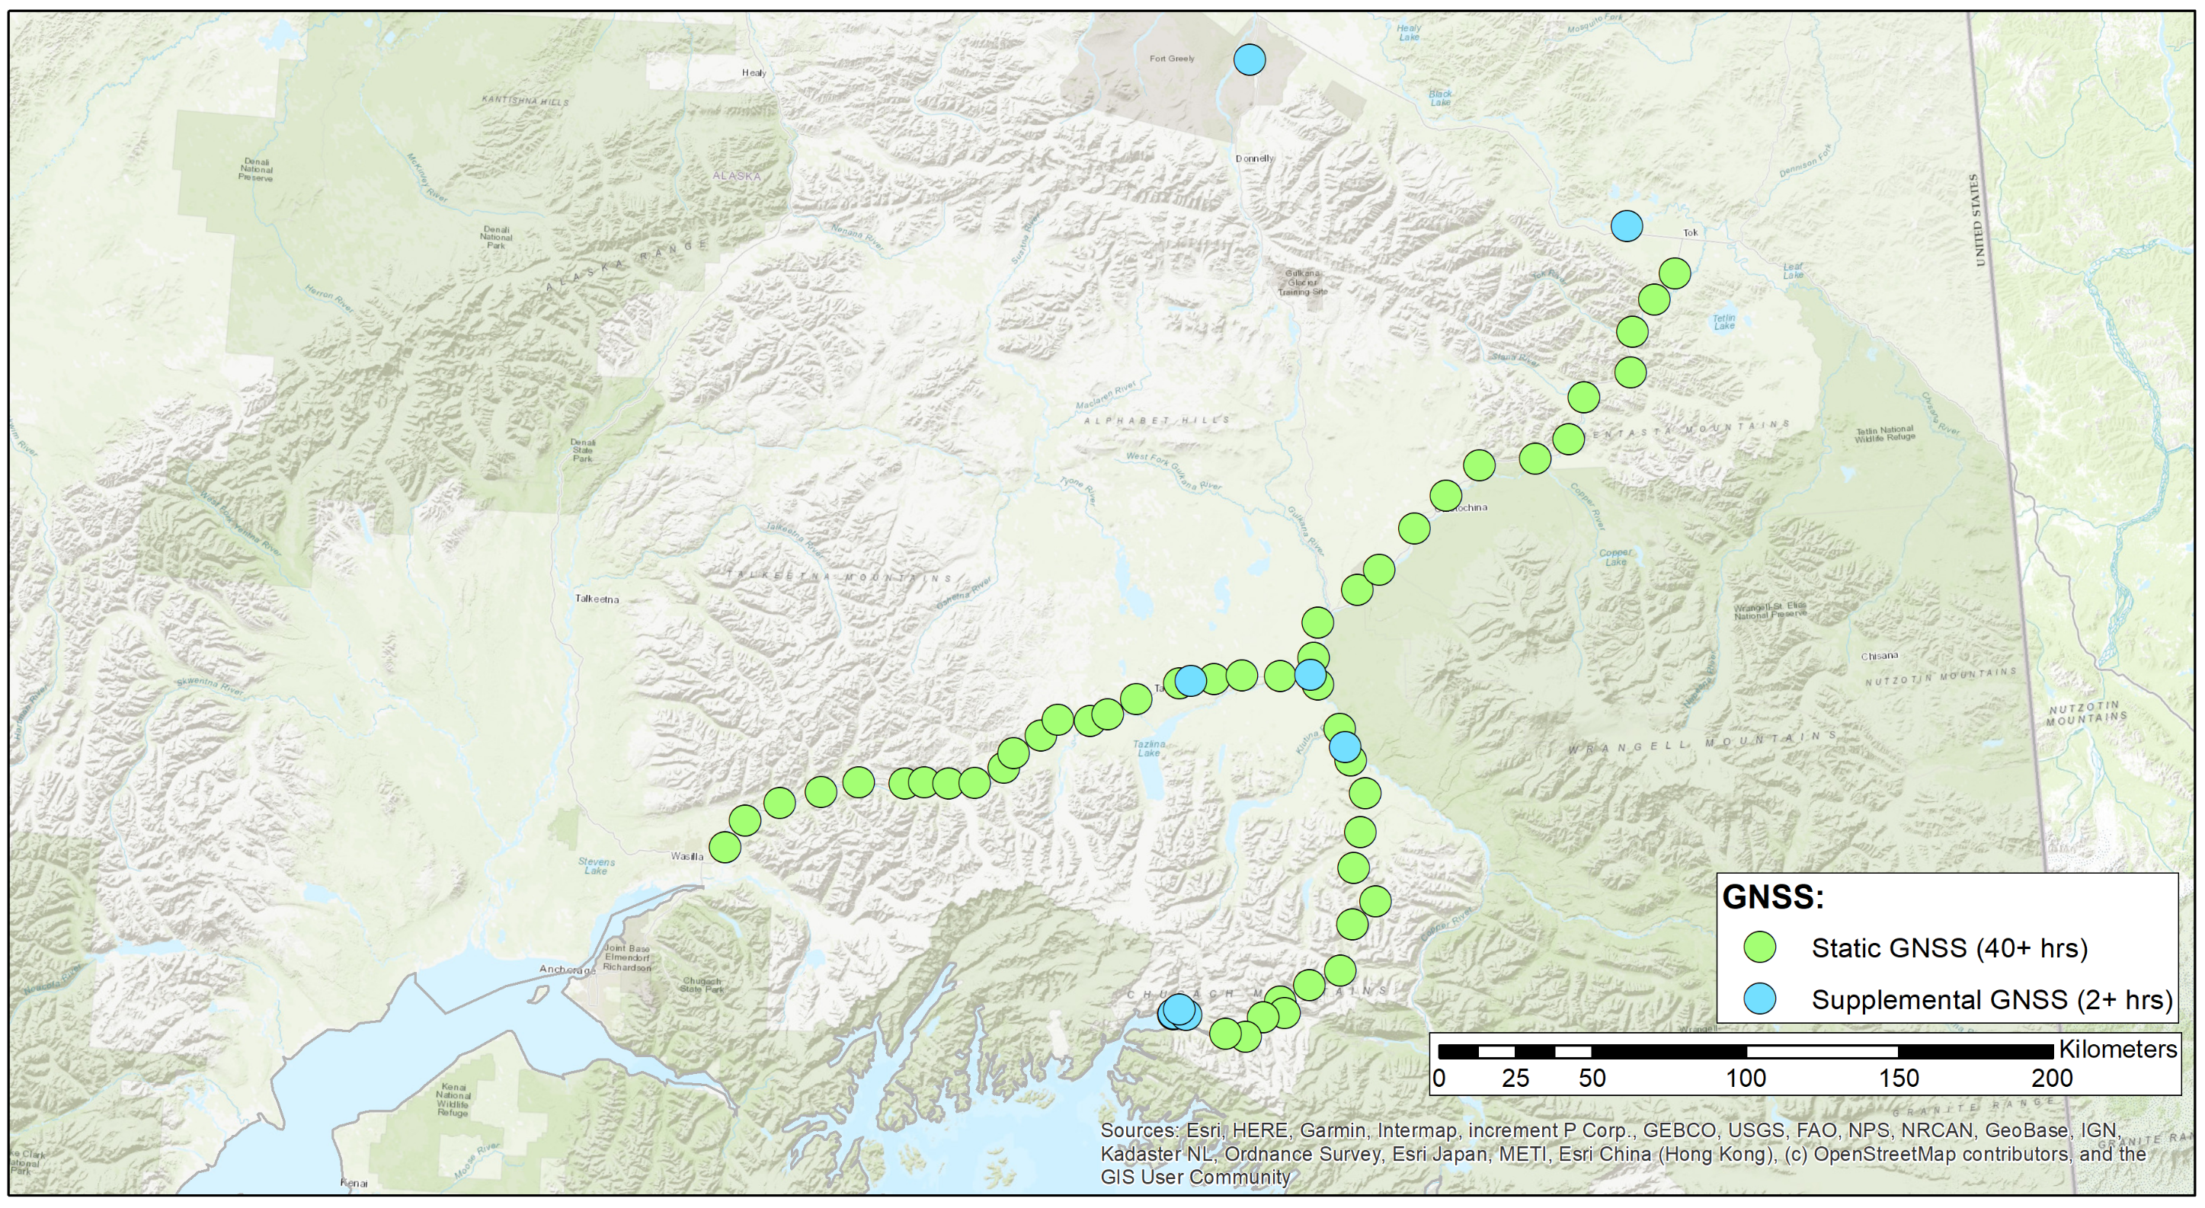
GeMS-VS: GNSS
Tok
Glennallen
Palmer
Anchorage
Valdez

Slide 14
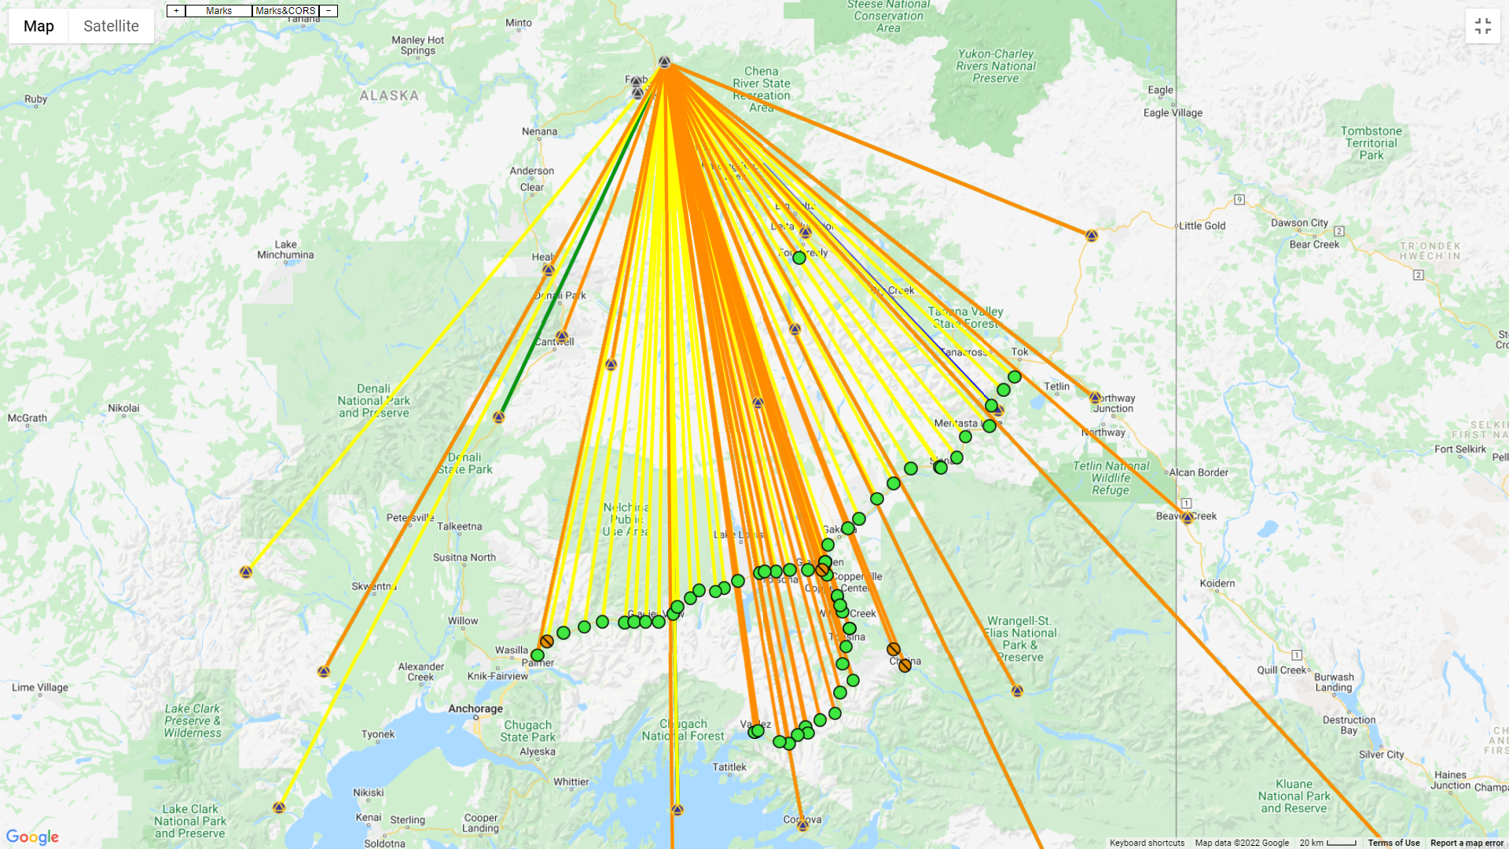
OPUS Projects Overview:
Tok
Glennallen
Palmer
Anchorage
Valdez
Notes:
All of the GPS is processed using OPUS Projects / PAGES software. CORS highlighted with the triangle. Project marks shown as either green or orange circle.

Slide 15
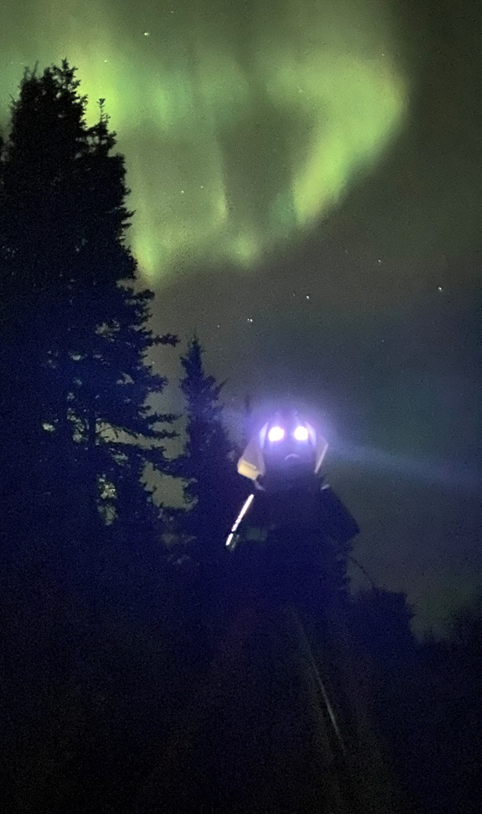
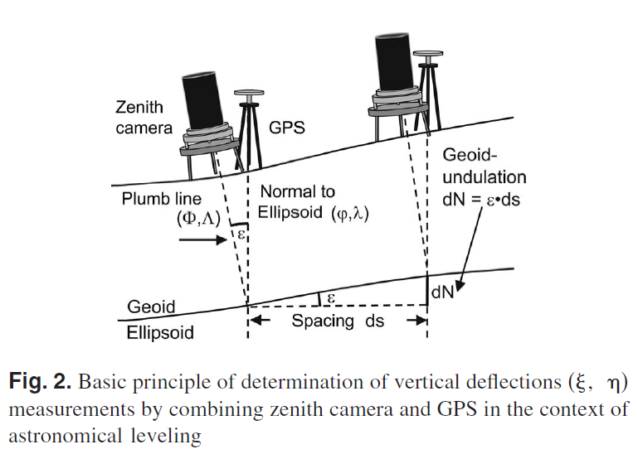
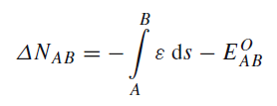
Deflection of the vertical
$$\left(Φ,Λ\right)$$
$$\left(φ,λ\right)$$
Hirt, et al. 2010
Ghilani & Wolf, 2015
N-S component
E-W component
Magnitude in $α$ direction
Notes:
Hirt, C., Bürki, B., Somieski, A., & Seeber, G. (2010). Modern determination of vertical deflections using digital zenith cameras. Journal of Surveying Engineering, 136(1), 1-12.

Slide 16
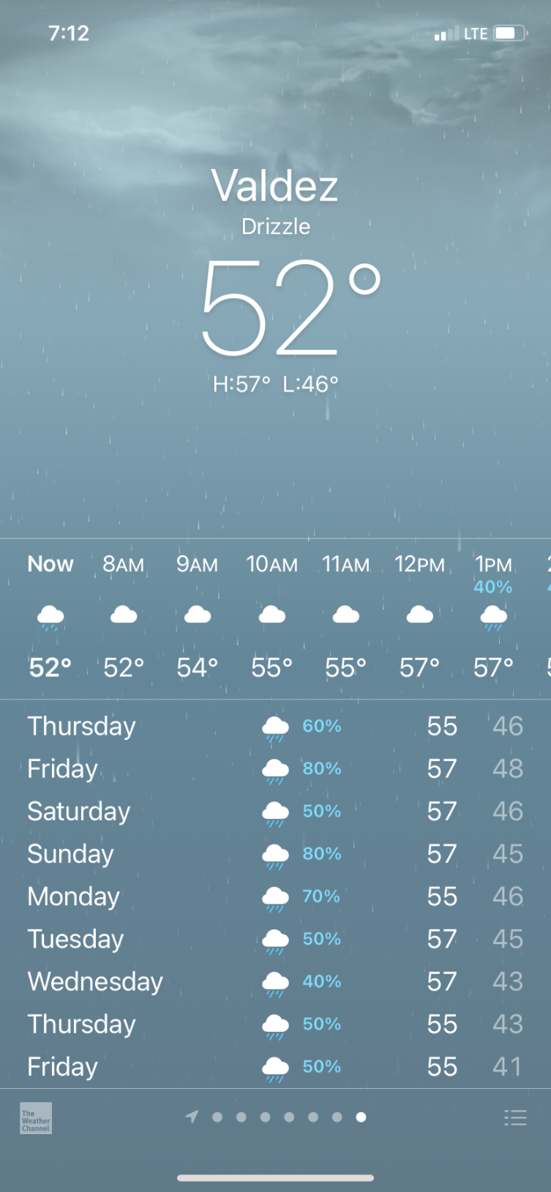
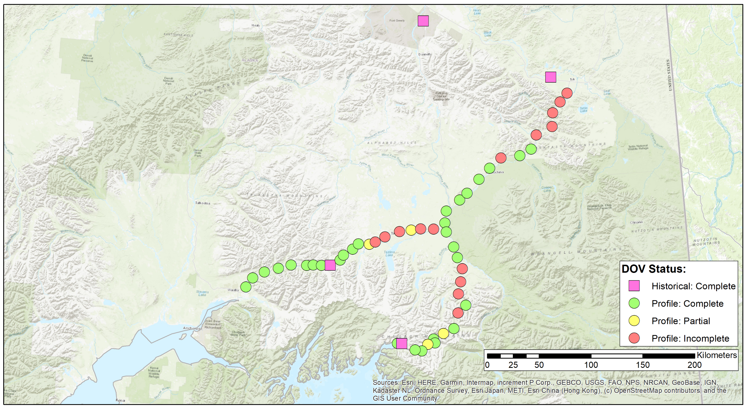
GeMS-VS: DOV
Tok
Glennallen
Palmer
Anchorage
Valdez

Slide 17
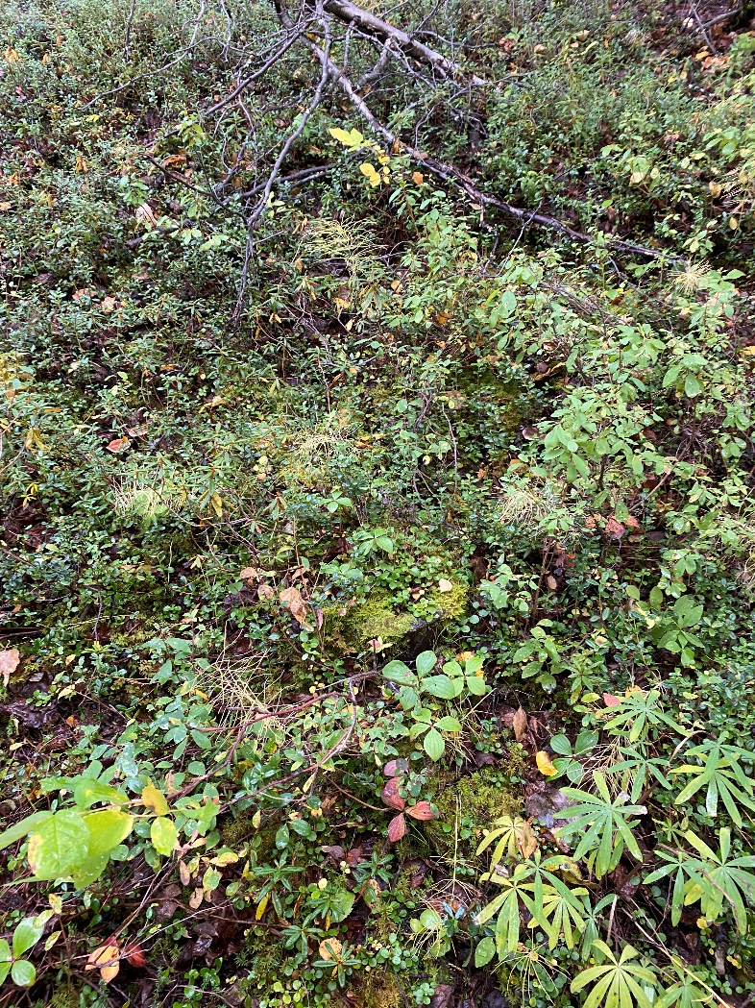
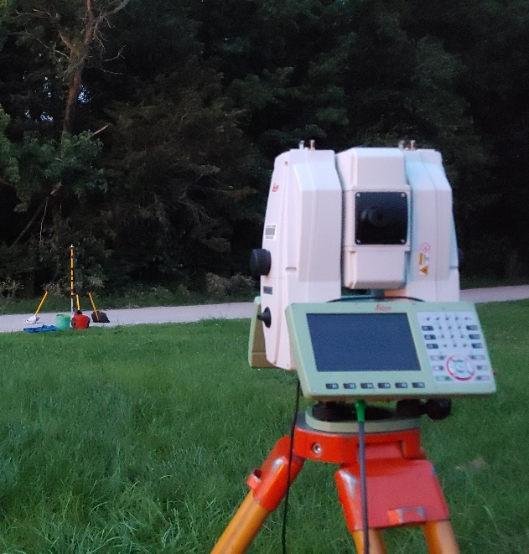
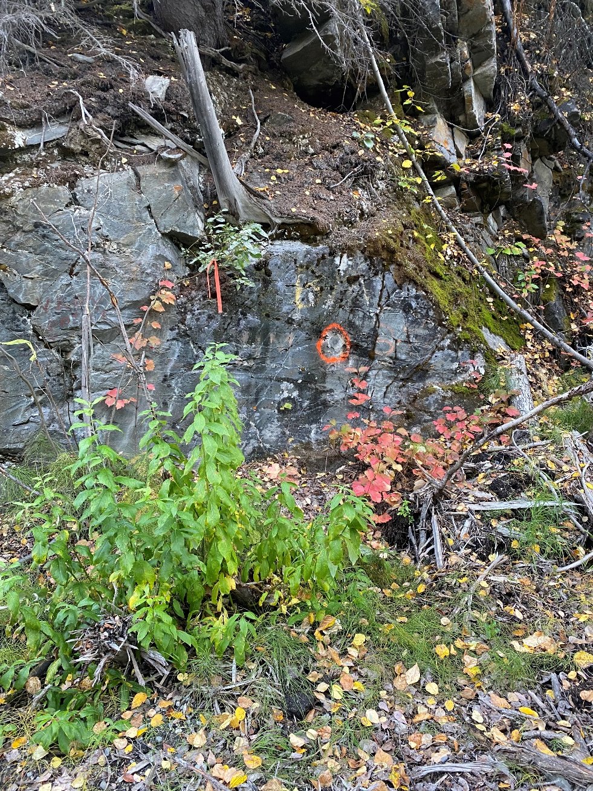
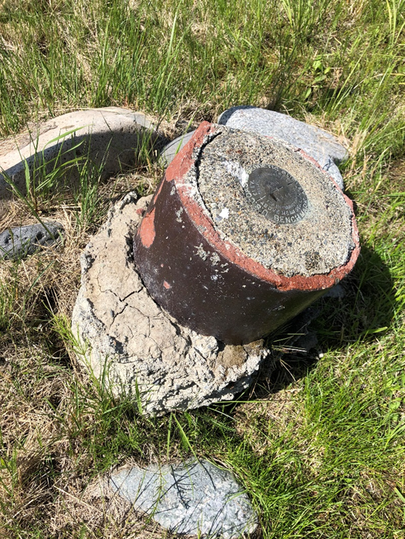
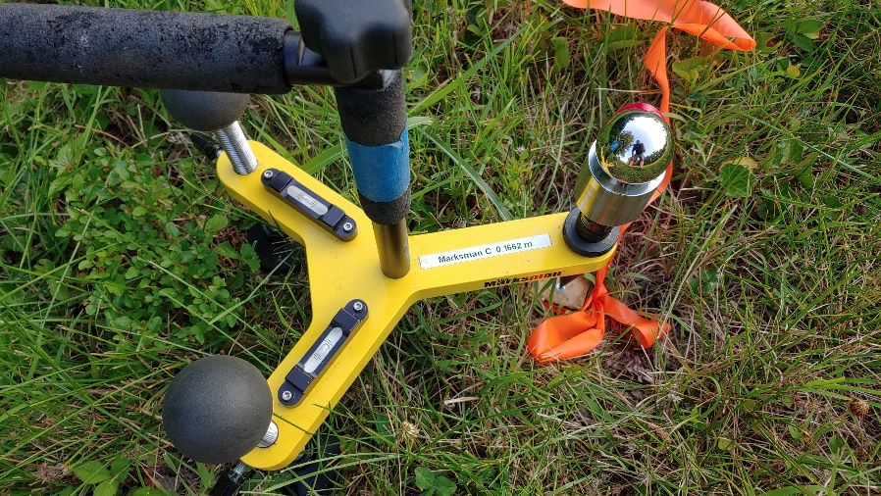
Challenges:
Regional Support:
Advisor
NWS
Federal partners – NPS
State partners
Local surveyors
Logistics:
Shipping
Vehicles
Lodging
Scope of Work / Scheduling:
GNSS
Gravity
DOV
DOV Hardware

Slide 18
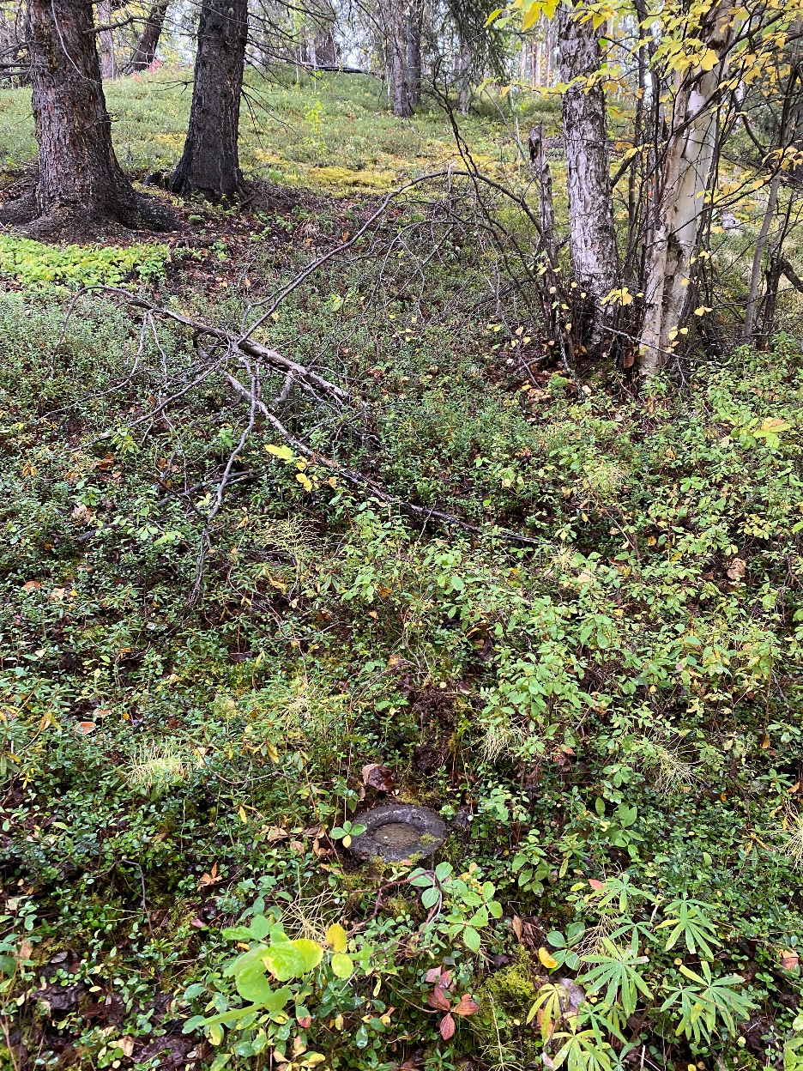
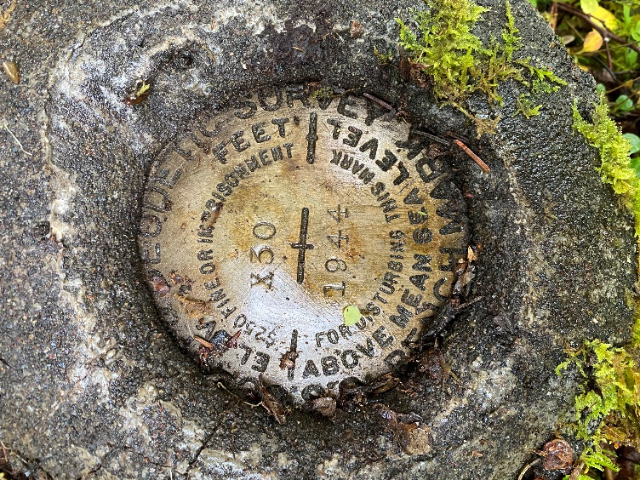
Finding Marks:

Slide 19
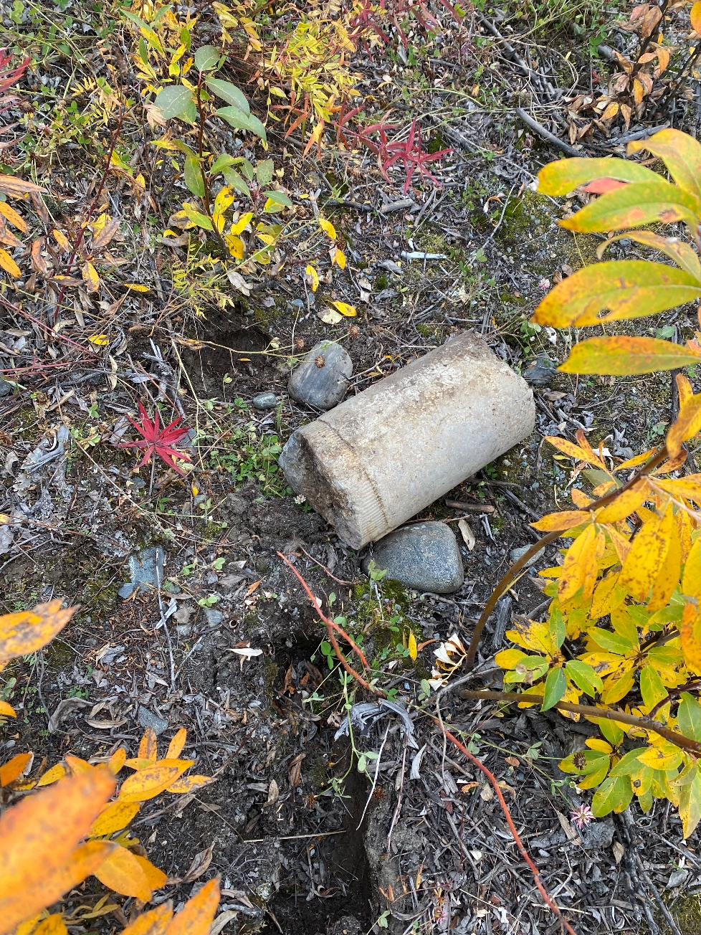
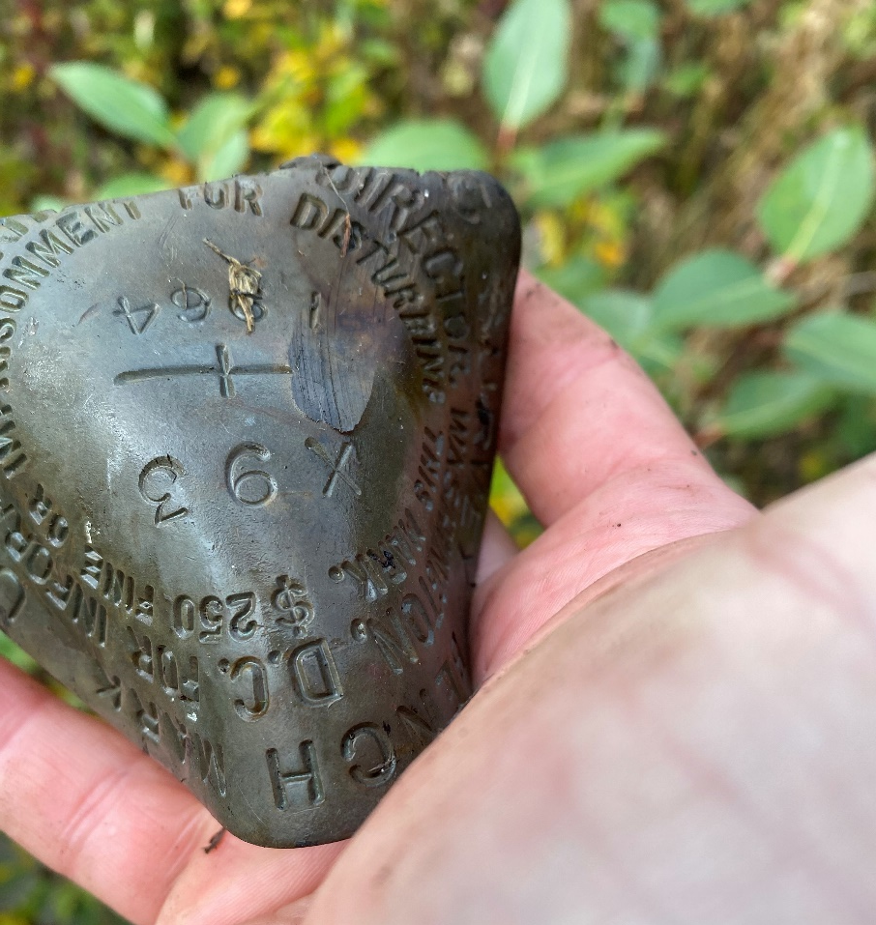
Unstable marks…
Notes:
While challenging to survey with standard NGS tools ----- they do have a number of nice features. Including: easier to find (find a big rock wall) and not concerned about mark stability. Observed with both faces – 2 separate times → difference in the faces is 1 mm while the difference between set-ups in this case was 0.4 mm.

Slide 20
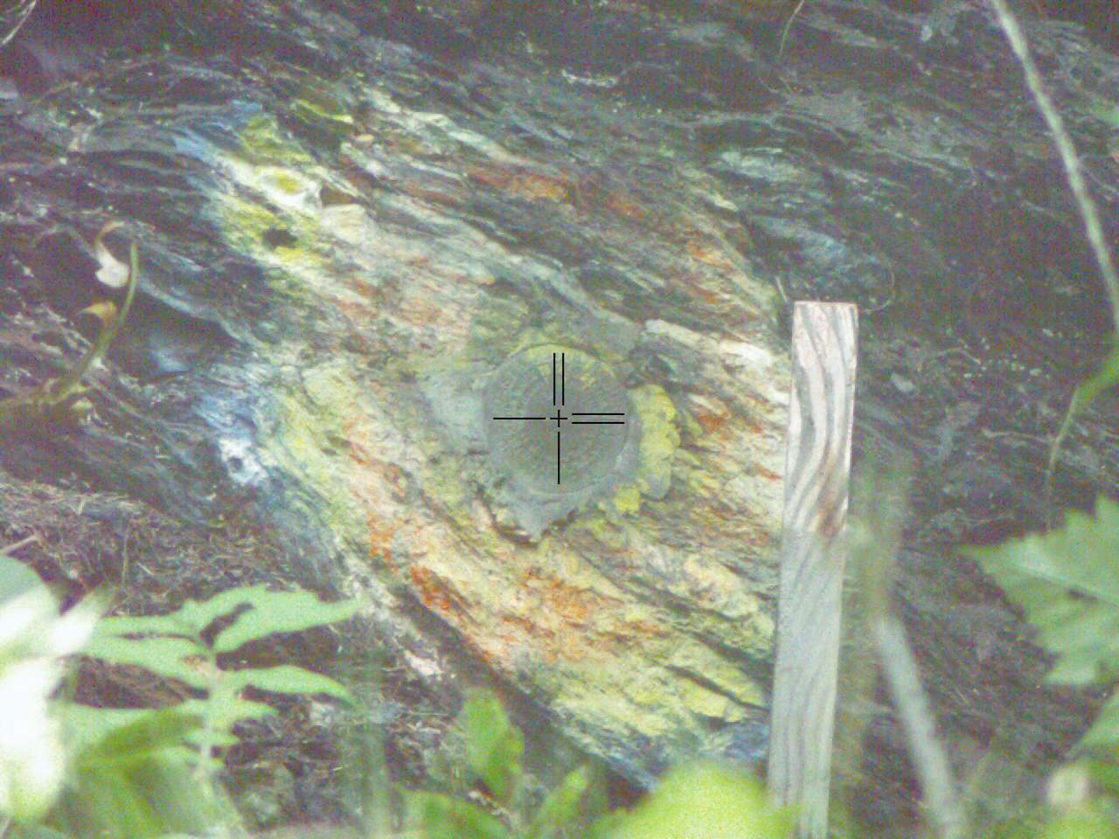
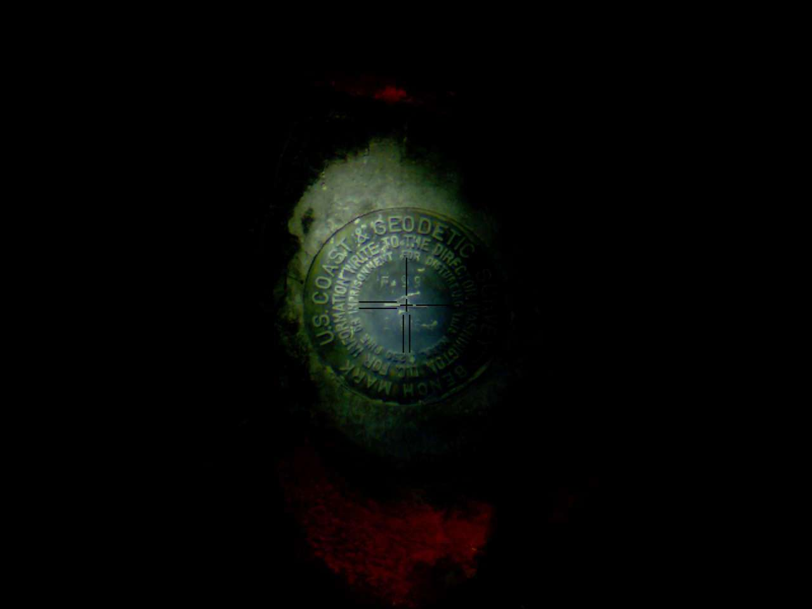
Vertically Set Marks:
Notes:
While challenging to survey with standard NGS tools ----- they do have a number of nice features. Including: easier to find (find a big rock wall) and not concerned about mark stability. Observed with both faces – 2 separate times → difference in the faces is 1 mm while the difference between set-ups in this case was 0.4 mm.

Slide 21
On to some results…

Slide 22
Gravity:
Stats: | [mGal]
Min | -5.45
Max | 5.70
Avg | -0.50
StdDev | 2.08
RMS | 2.13
Notes:
xGRAV21 (not published) to observed gravity.

Slide 23
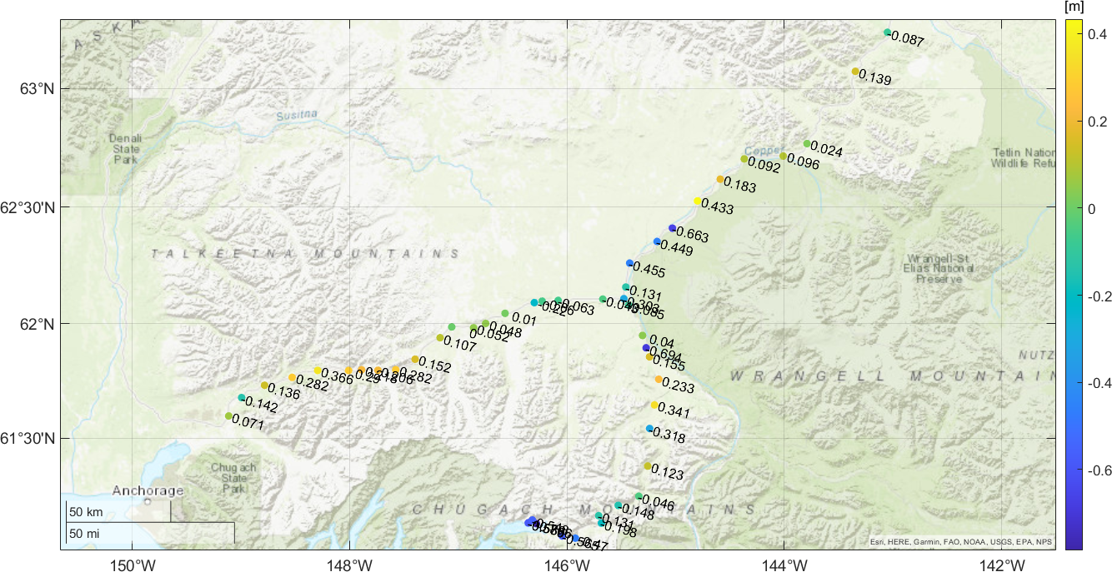
GNSS/Leveling/xGEOID20B Residual:
Stats: | [m]
Min | -0.786
Max | 0.433
Avg | ***
StdDev | 0.309
RMS | ***
Notes:
Removed -1.1 meter bias / NAVD 88 vs NAPGD2022.

Slide 24
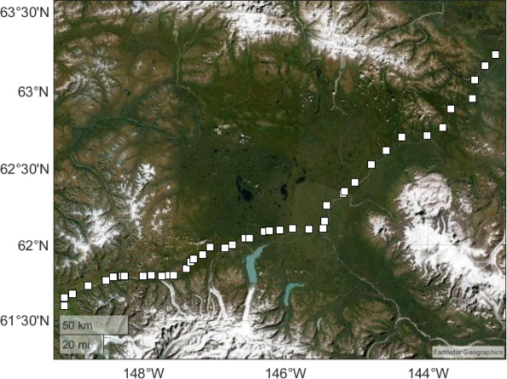
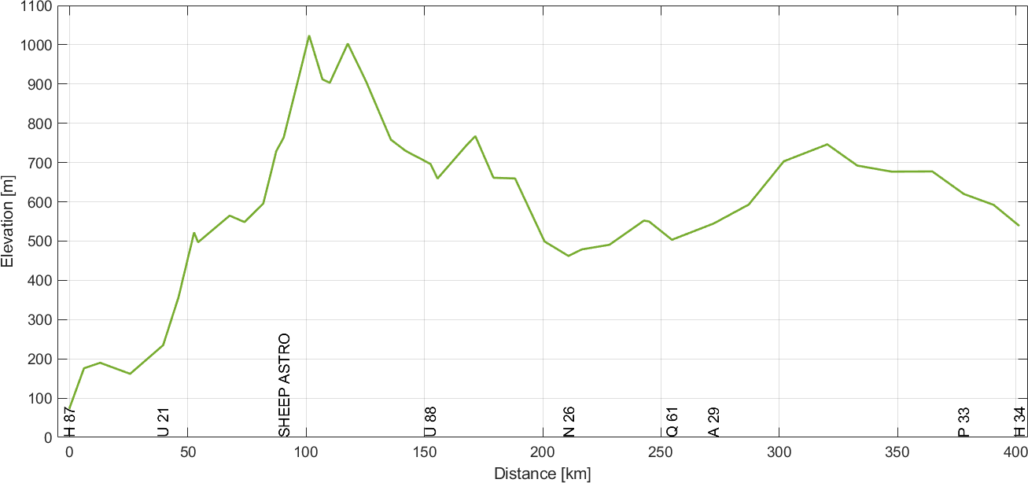
Elevation profile – Palmer - Tok
Notes:
Palmer –Tok Line: Observed gravity vs. xGRAV21 (not published) vs NAVD 88 model.

Slide 25
Gravity – Palmer - Tok
Stats: | NAVD88 | xGRAV
Min | -25.3 | -5.7
Max | 13.2 | 4.6
Avg | -3.7 | 0.7
StdDev | 7.6 | 2.0
RMS | 8.4 | 2.1
Notes:
Palmer –Tok Line: Observed gravity vs. xGRAV21 (not published) vs NAVD 88 model.

Slide 26
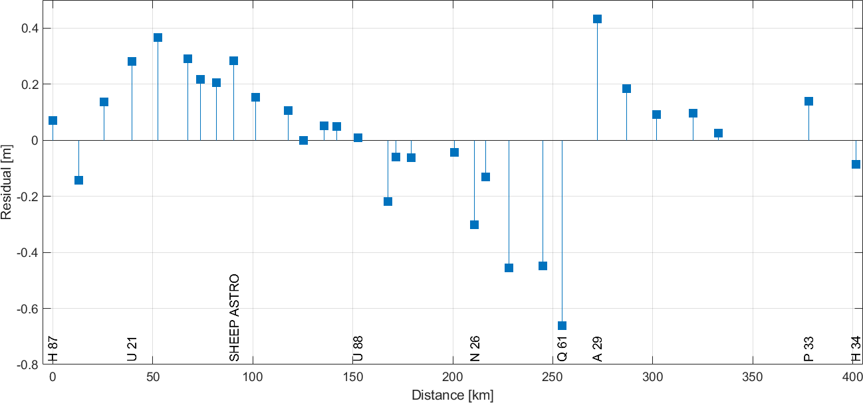
GNSS/Leveling/xGEOID20B
Stats: | [m]
Min | -0.663
Max | 0.433
Avg | ***
StdDev | 0.246
RMS | ***
Notes:
Not showing the average nor RMS since I have a bias/shift that must is pulled out of this – account for the separation between NAPGD2022 and NAVD 88. roughly 1.1 m in this region.

Slide 27
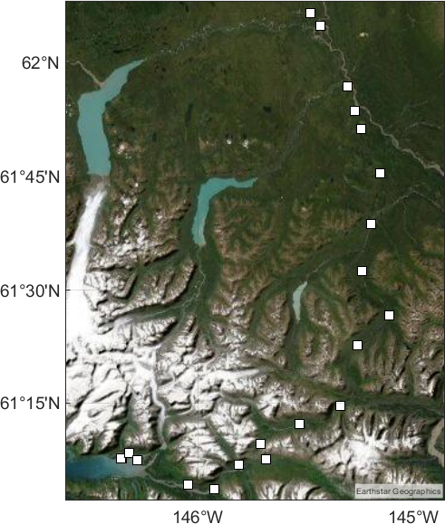
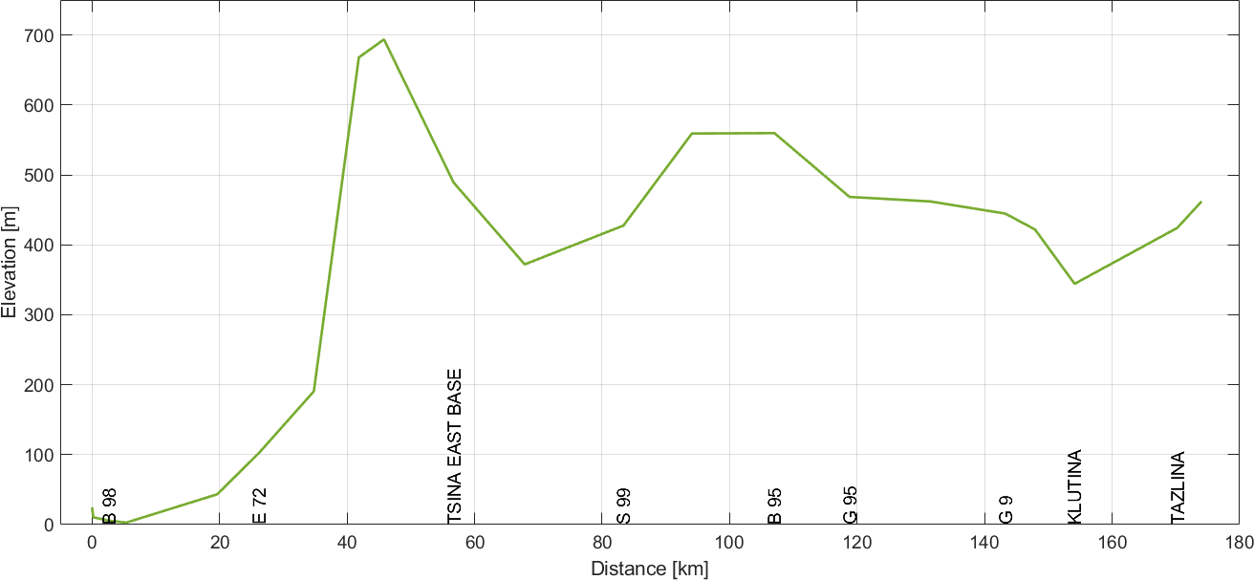
Elevation profile – Valdez - Glennallen
Notes:
Palmer –Tok Line: Observed gravity vs. xGRAV21 (not published) vs NAVD 88 model.

Slide 28
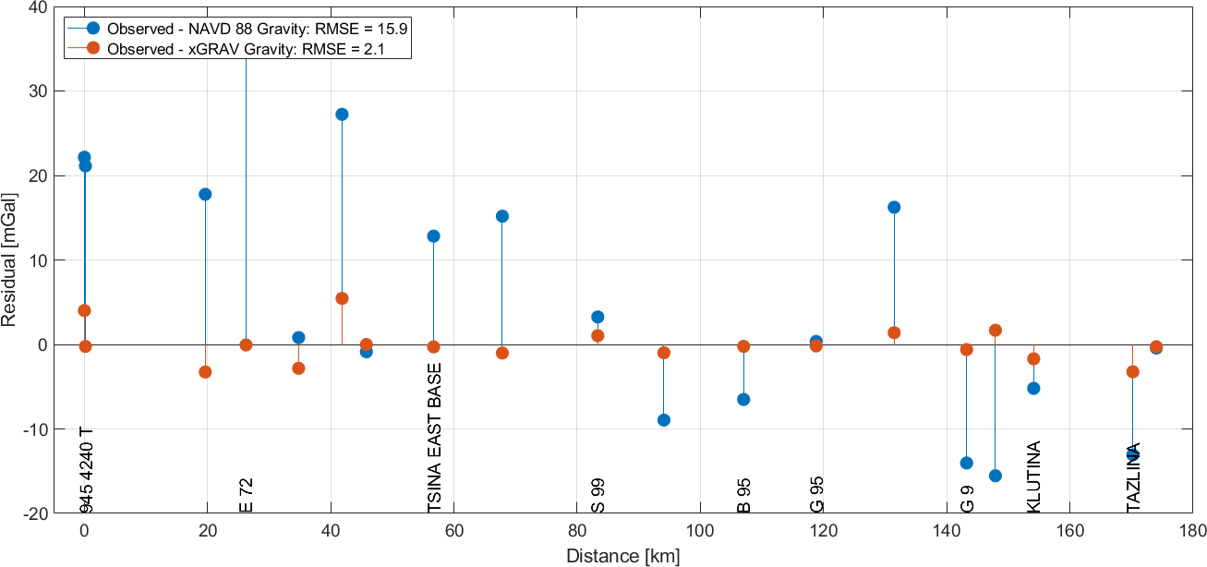
Gravity – Valdez - Glennallen
Stats: | NAVD88 | xGRAV
Min | -15.5 | -3.3
Max | 37.0 | 5.5
Avg | 5.8 | 0.1
StdDev | 15.2 | 2.2
RMS | 15.9 | 2.1
Notes:
Palmer –Tok Line: Observed gravity vs. xGRAV21 (not published) vs NAVD 88 model.

Slide 29
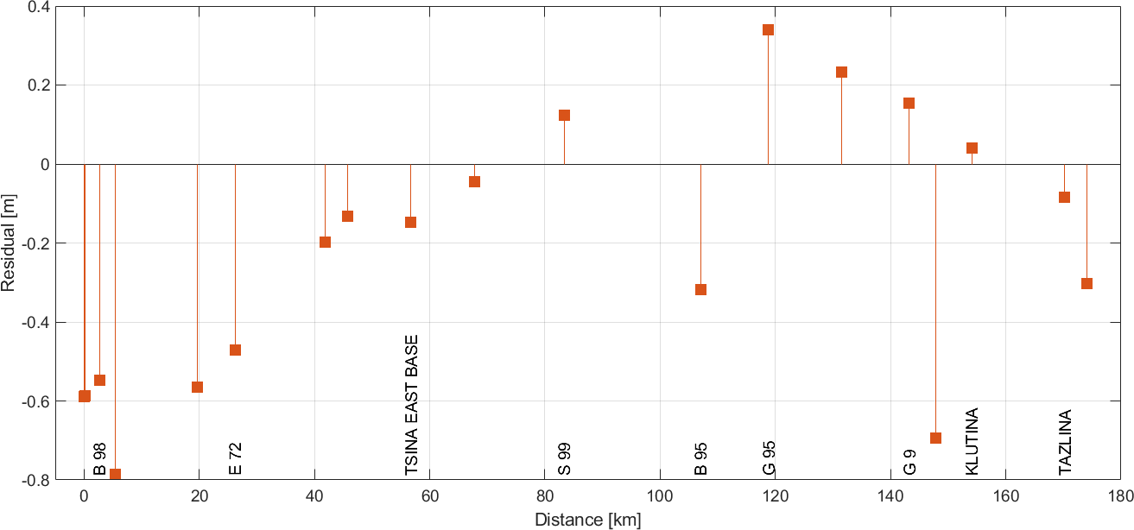
GNSS/Leveling/xGEOID20B
Stats: | [m]
Min | -0.786
Max | 0.341
Avg | ***
StdDev | 0.335
RMS | ***
Notes:
Not showing the average nor RMS since I have a bias/shift that must be pulled out of this – account for the separation between NAPGD2022 and NAVD 88. roughly 1.1 m in this region.

Slide 30
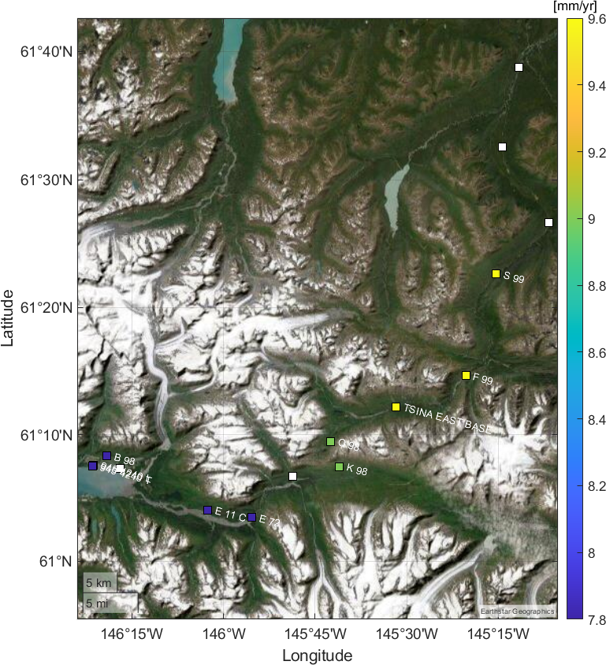
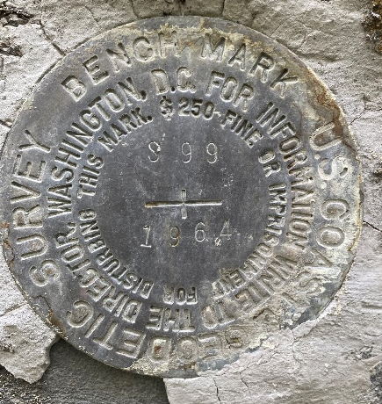
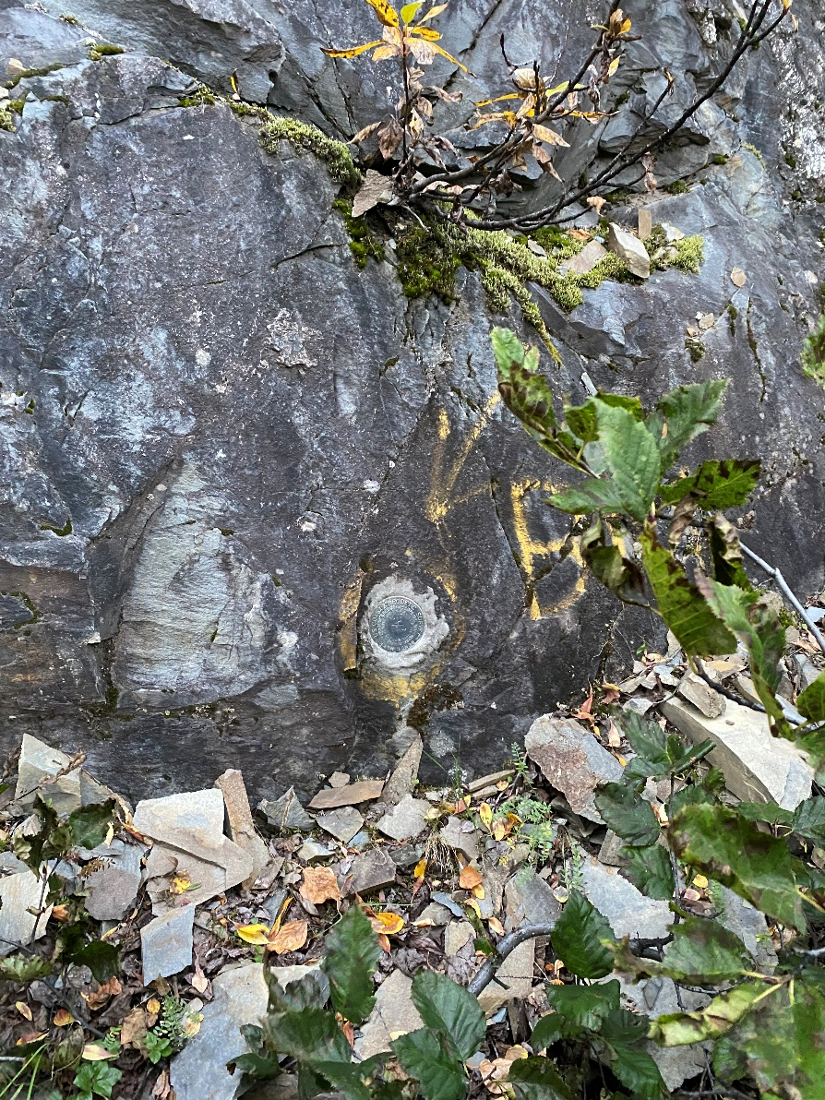
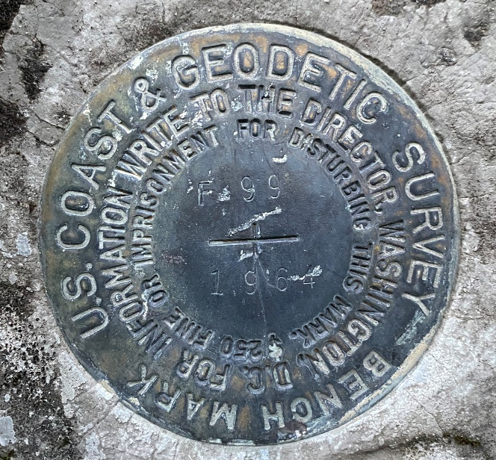
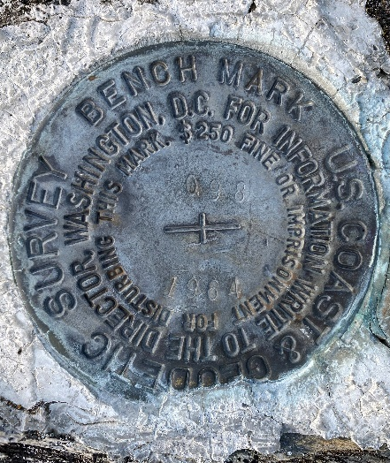
Example
Notes:
While challenging to survey with standard NGS tools ----- they do have a number of nice features. Including: easier to find (find a big rock wall) and not concerned about mark stability. Observed with both faces – 2 separate times → difference in the faces is 1 mm while the difference between set-ups in this case was 0.4 mm.

Slide 31
Approximately 10 cm improvement w/ the velocity applied from 1964 to 2021 but still have significant tilt…
Notes:
Only rock monuments – so have removed any worries about mark instability. We apply an estimated velocity to account for any differential height change from 1964 to 2021, we get ‘better’ fit but still not great. This could be coming from the leveling though this type of tilt is almost unheard of (1 cm per 1 km almost). We should only see about 1 cm / 100 km. This is 100x worse. The most likely suspect is the geoid model though.

Slide 32
Deflection of the Vertical:
GNSS/Leveling/xGEOID20B
Stats: | [m]
Min | -0.786
Max | 0.433
Avg | ***
StdDev | 0.309
RMS | ***
Notes:
Right shows the geoid profiles deteremind by the observed DOV in comparison with xGEOID20B and xGEOID20A. Notice a very small difference in the red profiles

Slide 33
Conclusions:
Kevin M. Ahlgren, PhD
kevin.ahlgren@noaa.gov
Building on 1964 “foundation for future studies of abrupt and secular gravity changes”
Updated, modern observations on ~50 passive marks (GNSS, gravity, DOV)
40+ hour static GNSS
Gravity: 20 uGal precisions
DOV profile of 2021 geoid
Model validation and progress:
Significant improvement with xGRAV model (2.1 mGal RMS)
Identified survey in error and fixed
xGEOID –
Very possible that dm effects are present
Need to investigate in more detail (see Valdez line)
GeMS –
In progress – need to sort out issues with xGEOID in order to isolate

Slide 34
References
Ghilani C., & Wolf, P. (2015). Elementary Surveying An Introduction to Geomatics, 14th Ed. Pearson. Boston MA.
Hirt, C., Bürki, B., Somieski, A., & Seeber, G. (2010). Modern determination of vertical deflections using digital zenith cameras. Journal of Surveying Engineering, 136(1), 1-12.
Jacob, T., Wahr, J., Gross, R., & Swenson, S. (2012). Estimating geoid height change in North America: past, present and future. Journal of Geodesy, 86(5), 337-358.
Leipold, L. E. & Wood, F. J. (Eds.). (1966). The Prince William Sound, Alaska, Earthquake of 1964 and Aftershocks: Research studies and interpretive Results Geodesy and Photogrammetry. Volume III. Publication 10-3. US Government Printing Office.
Luthcke, S. B., Sabaka, T. J., Loomis, B. D., Arendt, A. A., McCarthy, J. J., & Camp, J. (2013). Antarctica, Greenland and Gulf of Alaska land-ice evolution from an iterated GRACE global mascon solution. Journal of Glaciology, 59(216), 613-631.

