Slide 1
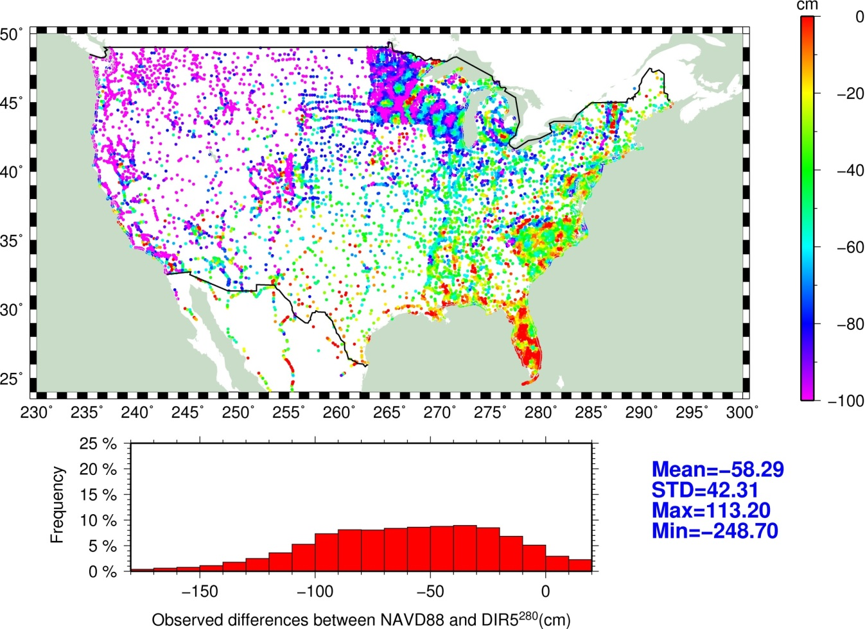
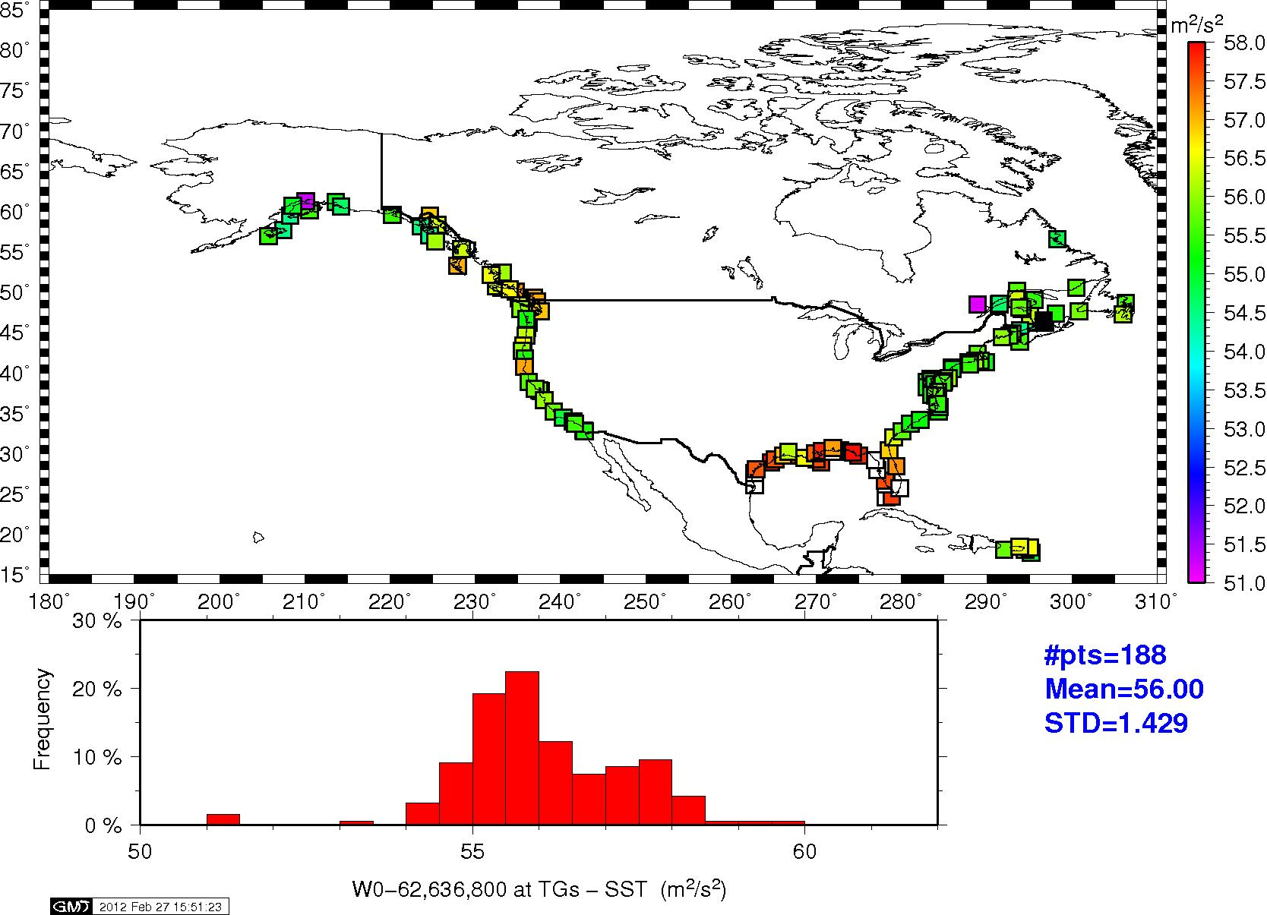
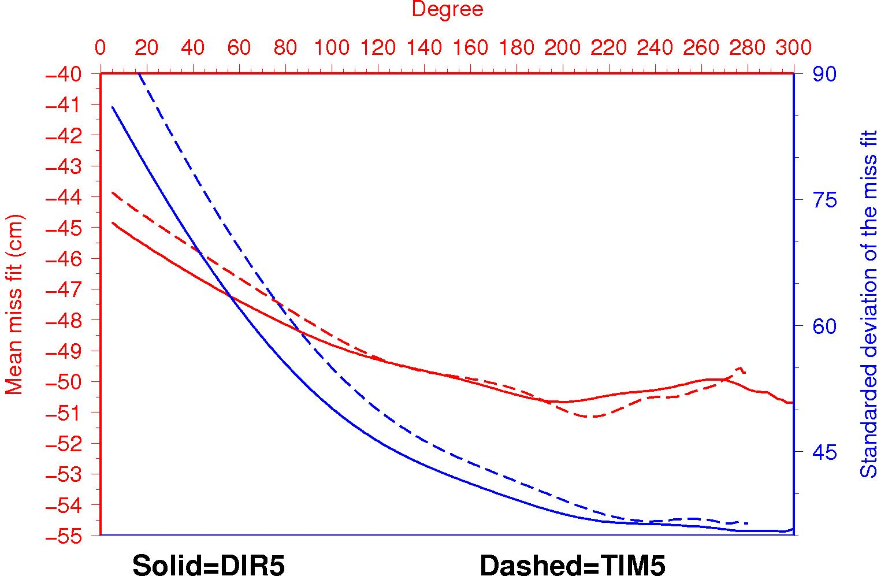
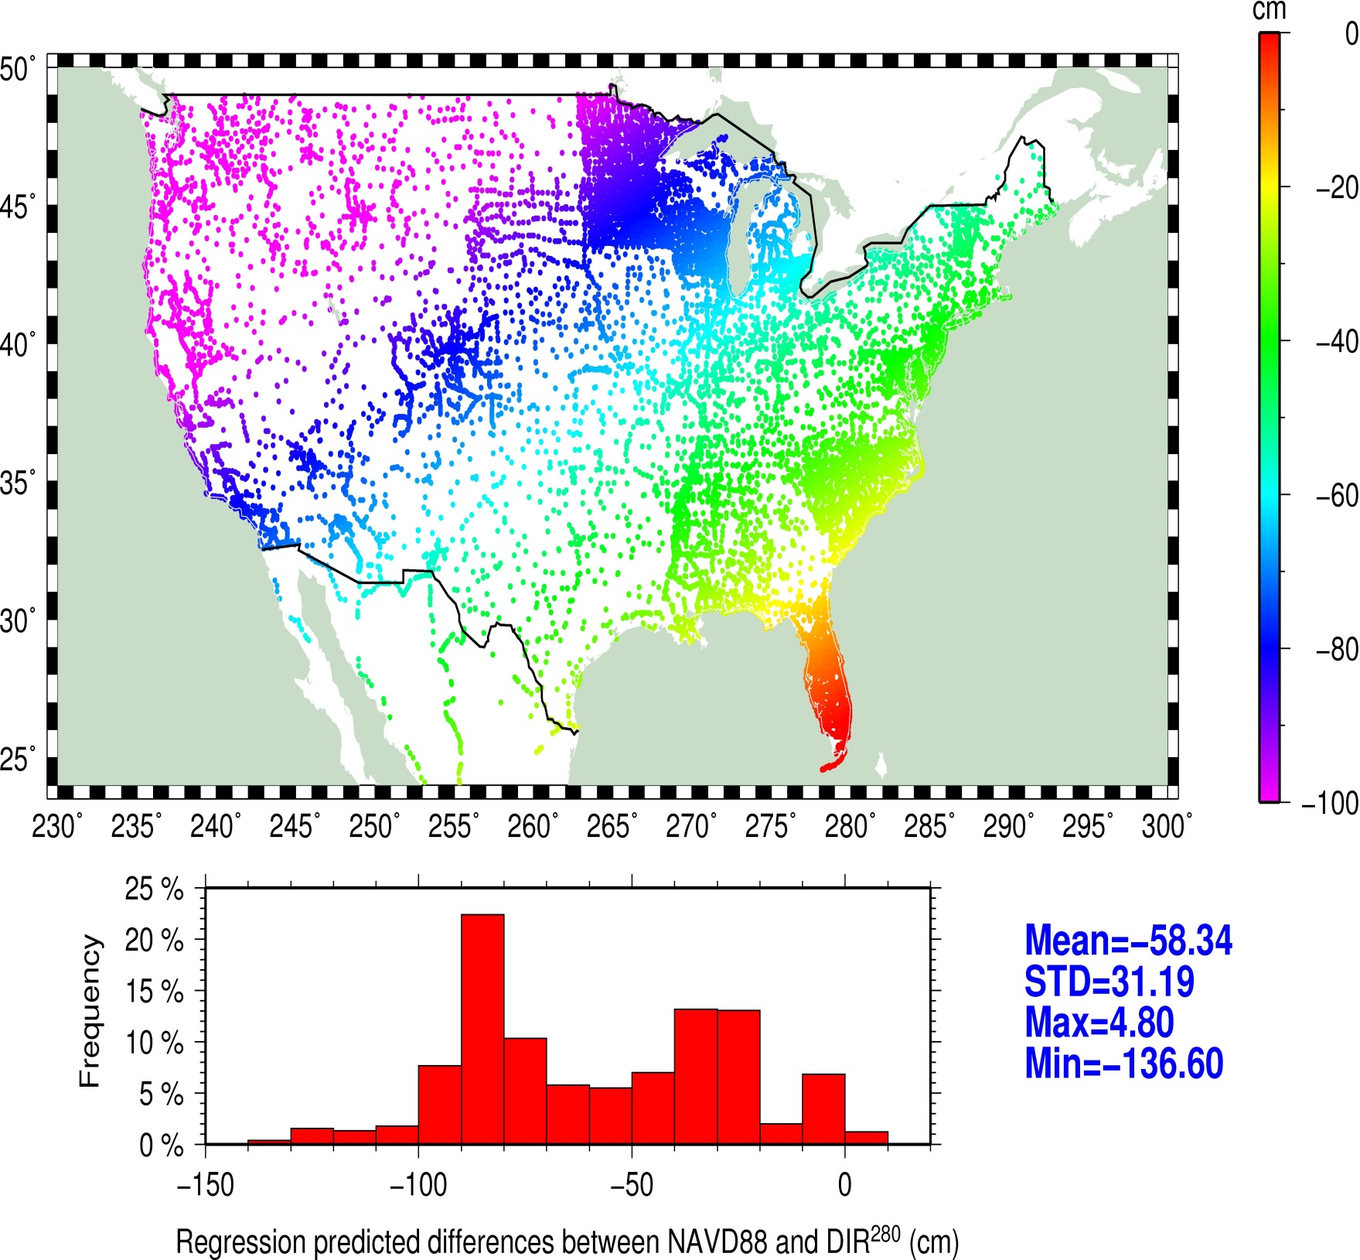
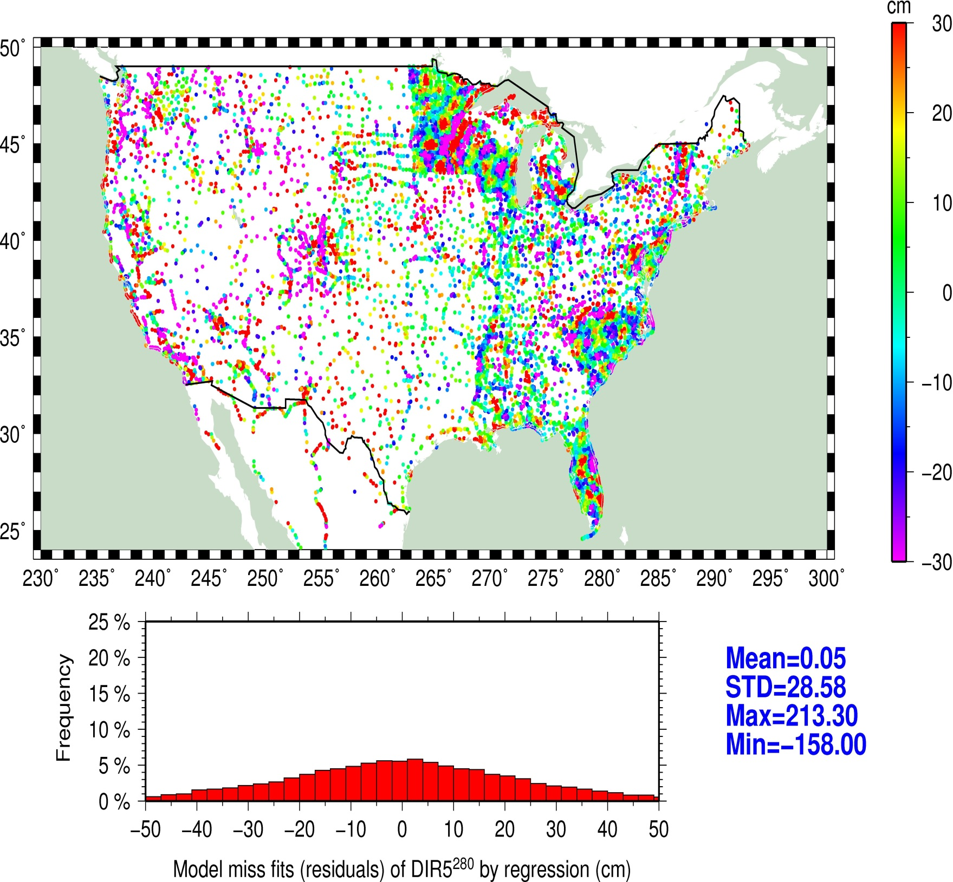
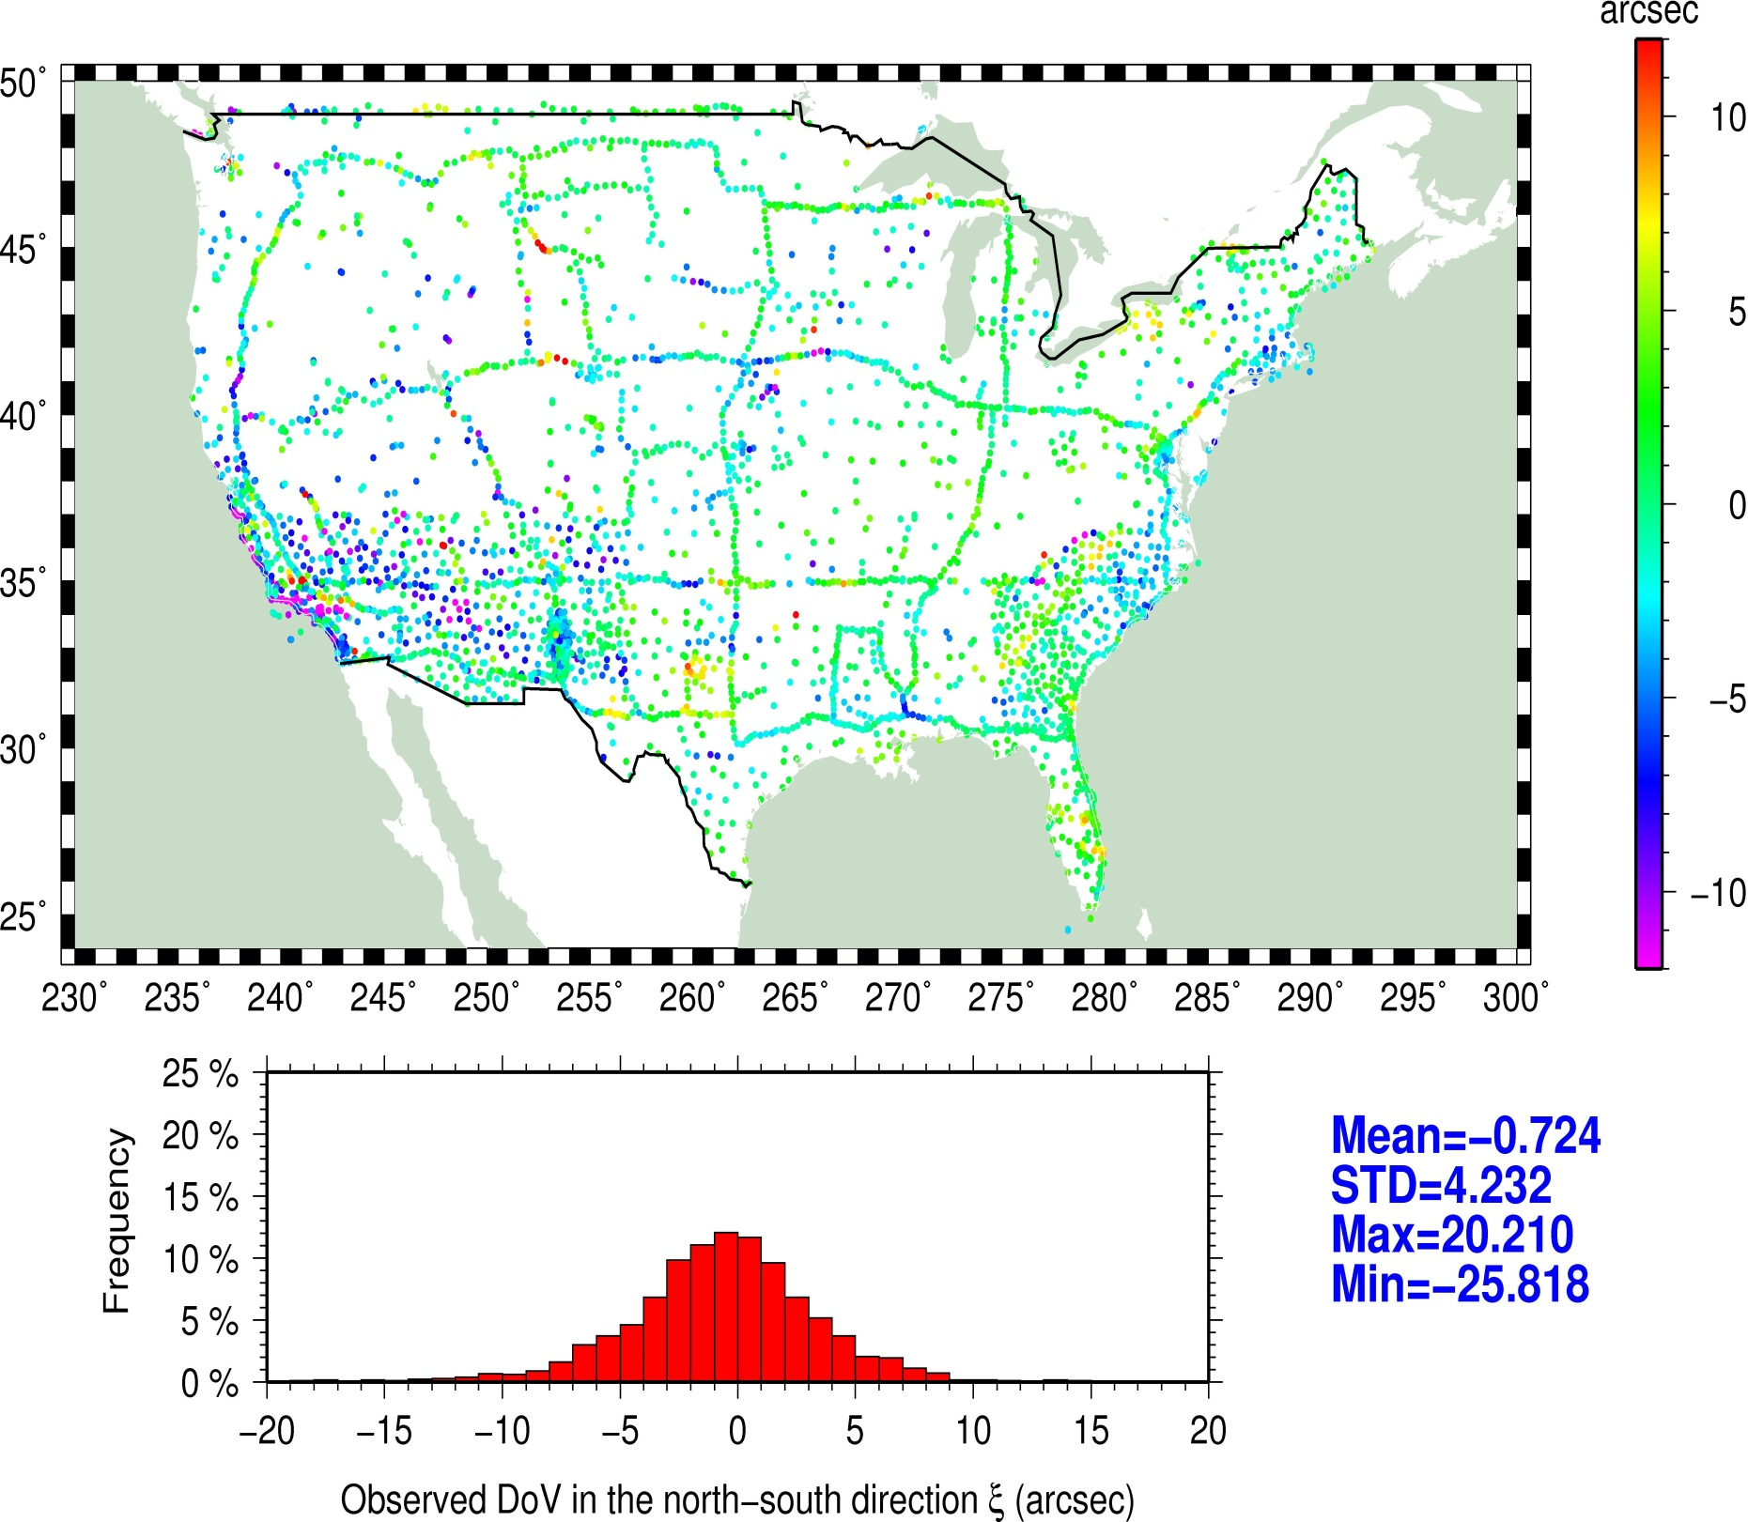
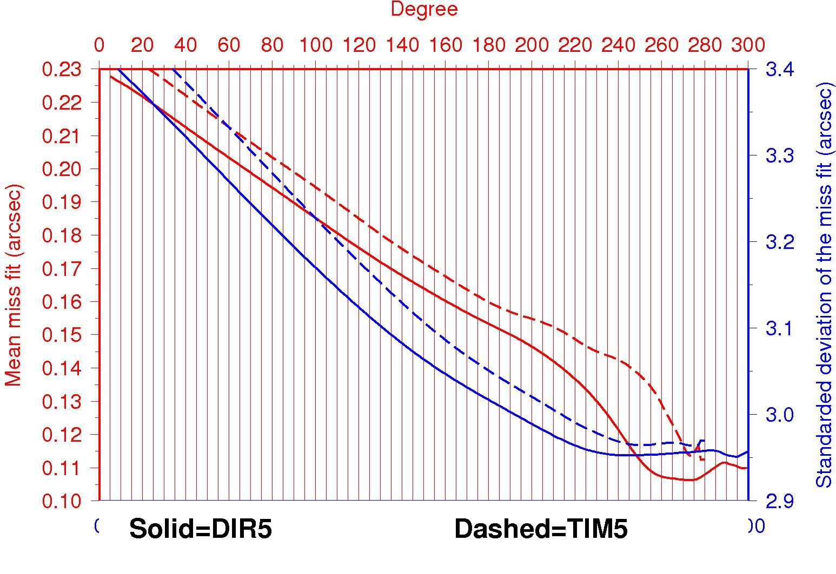
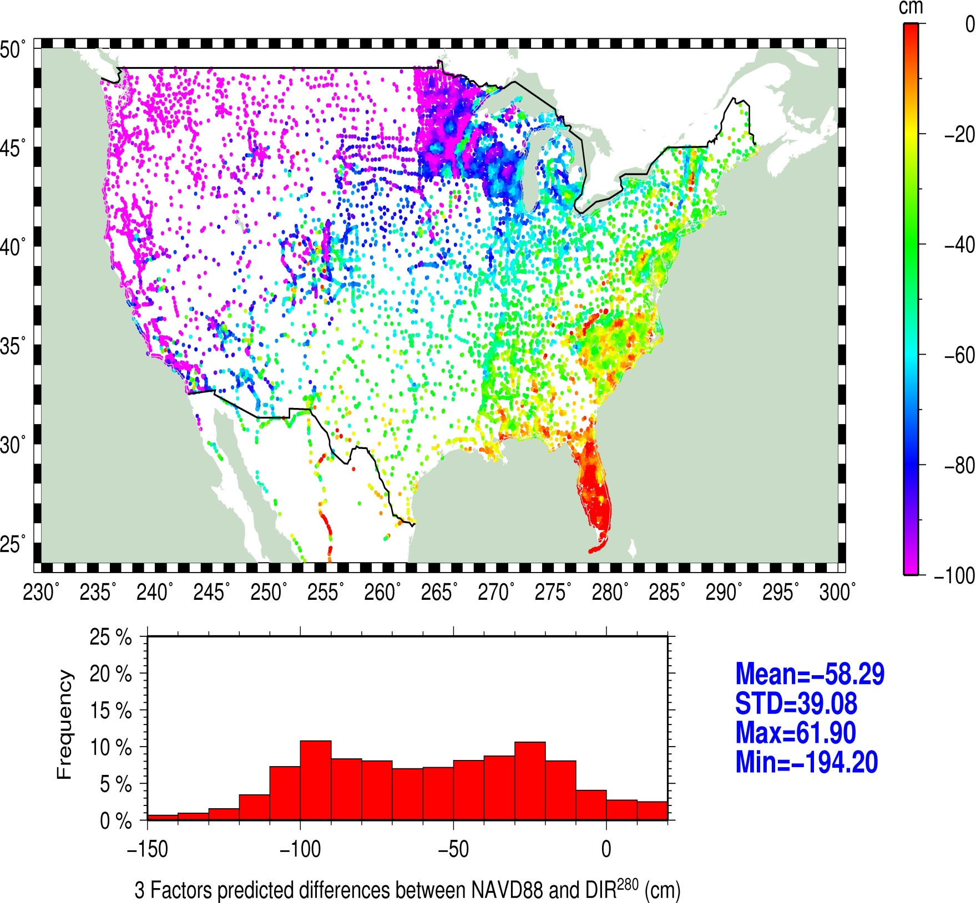
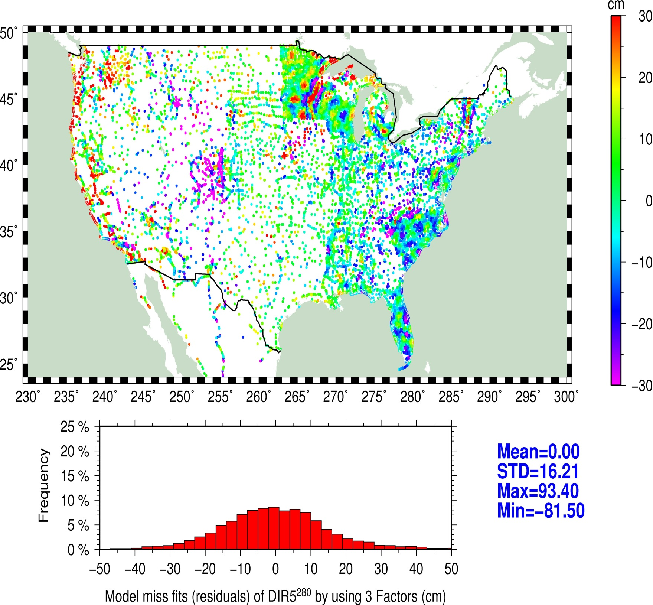
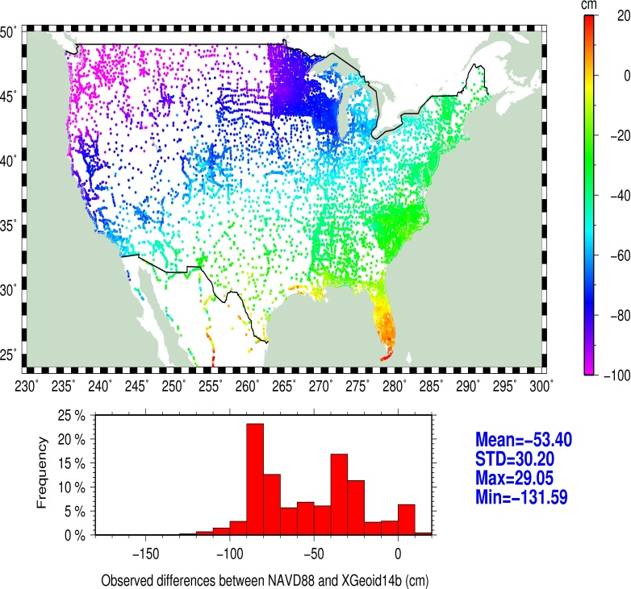
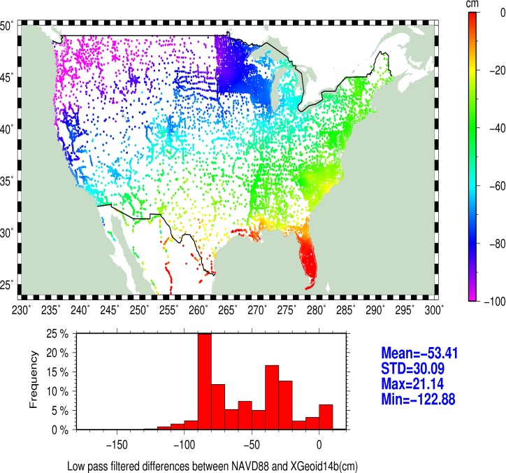
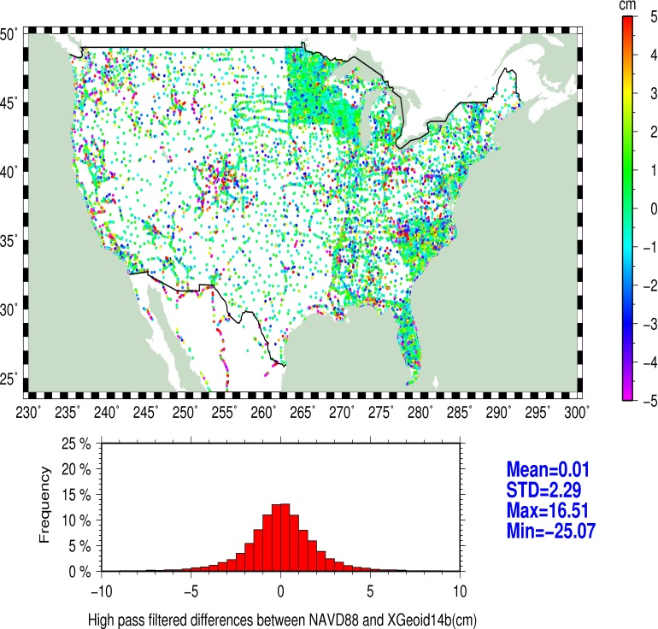
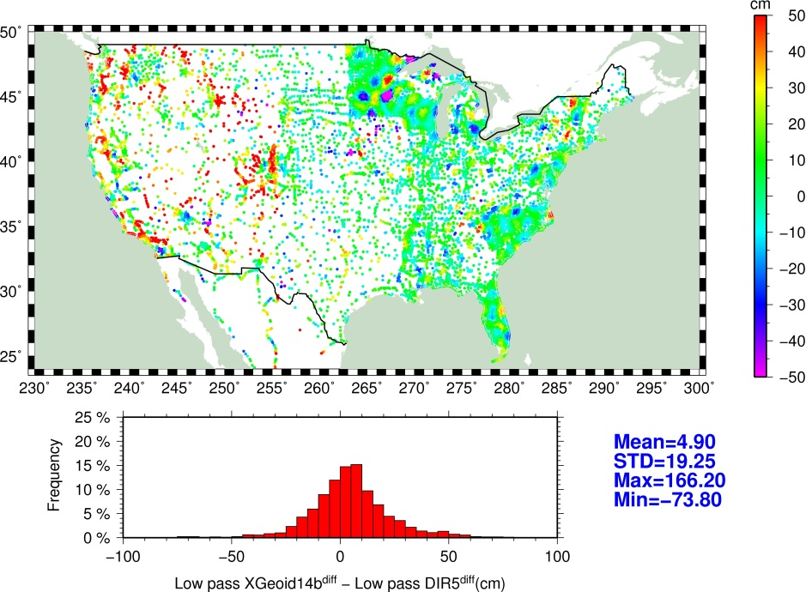
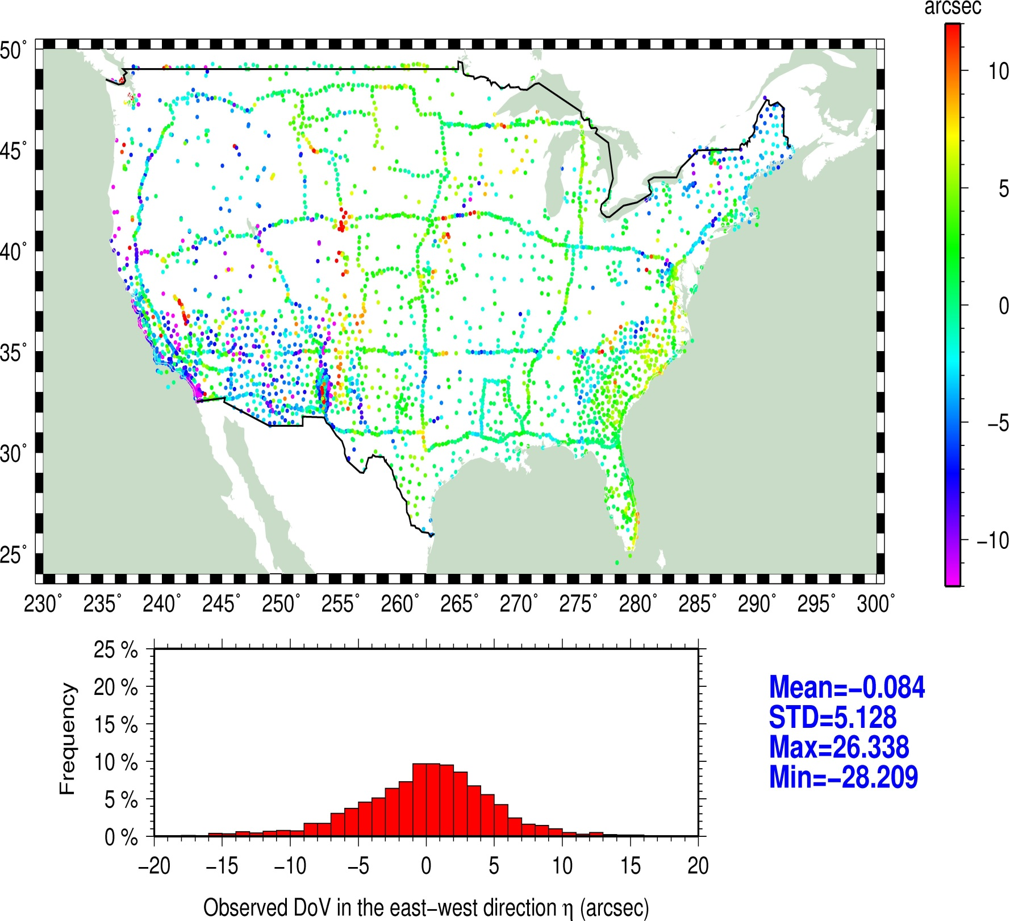
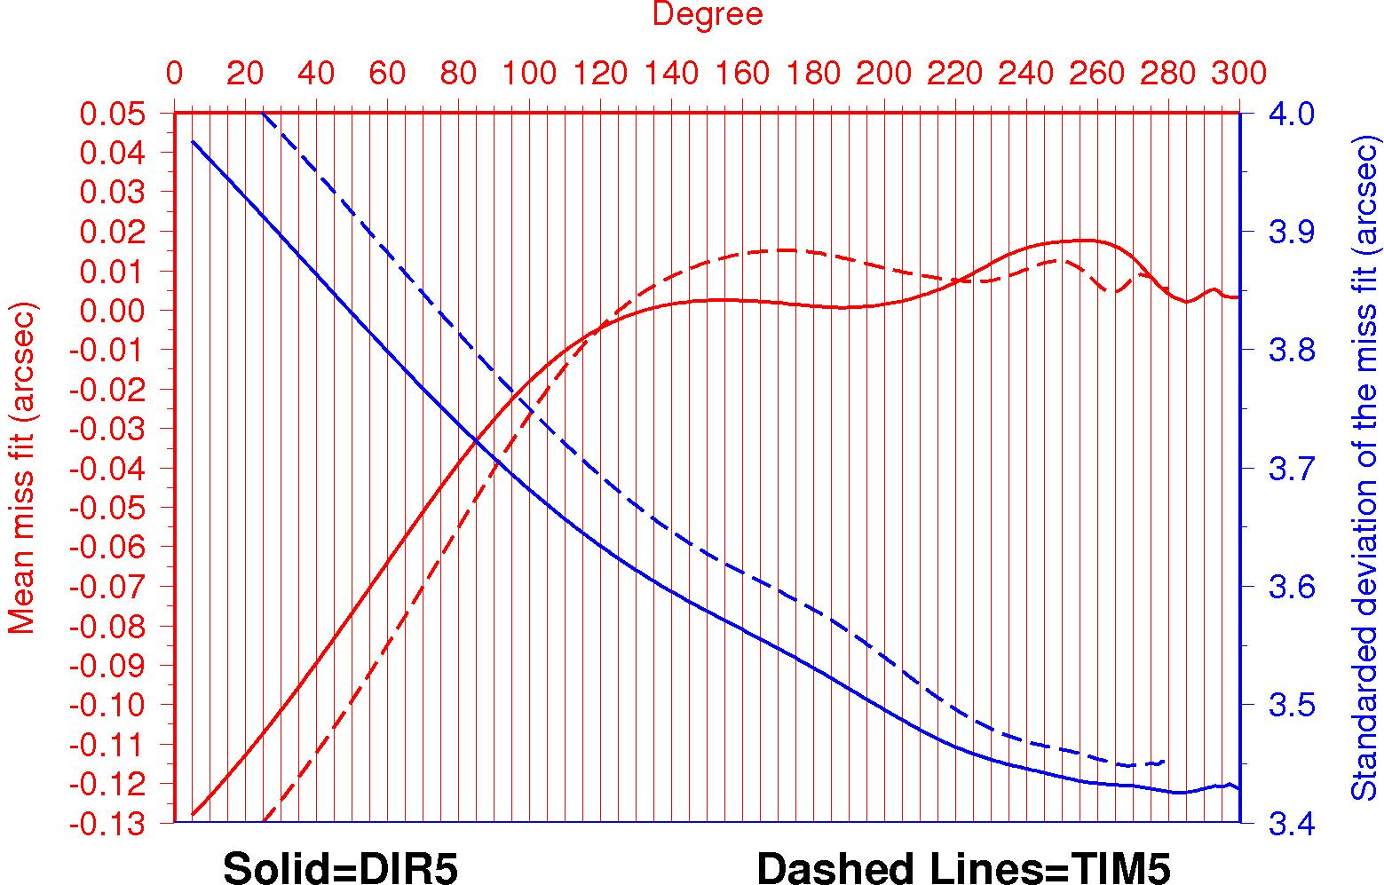
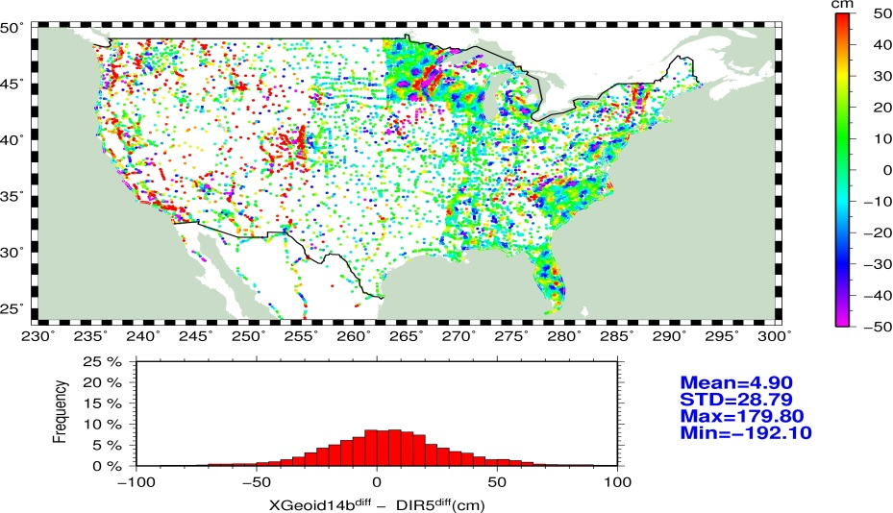
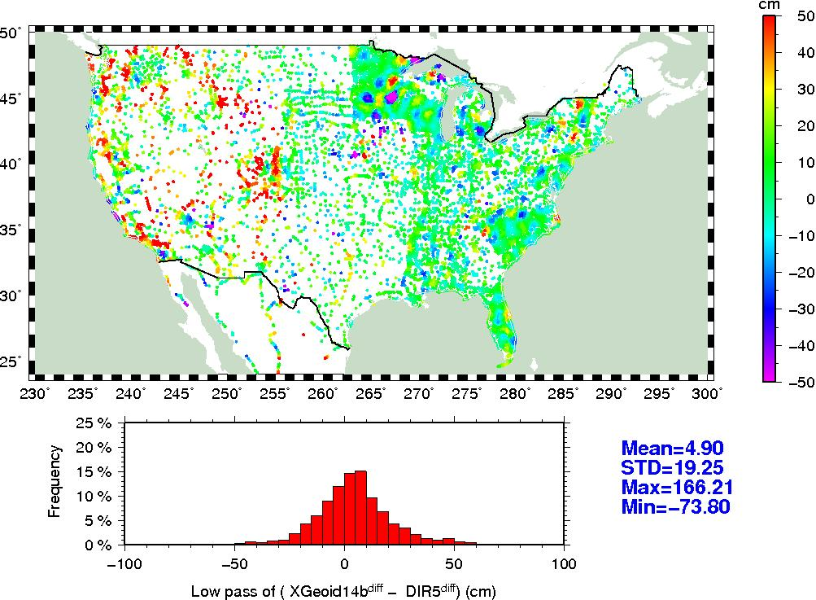
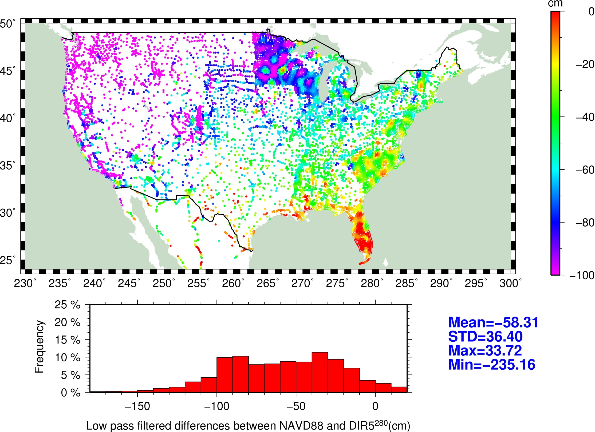
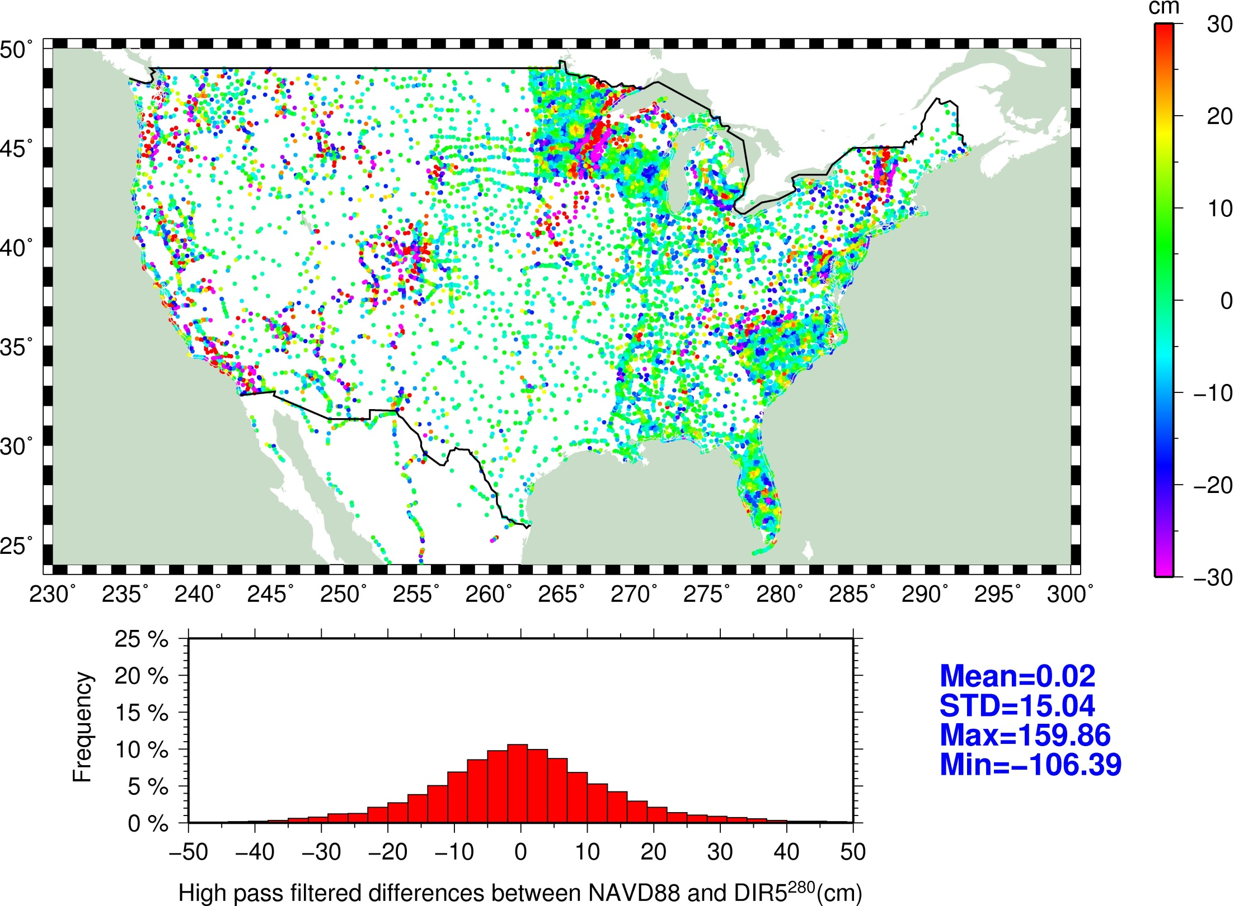
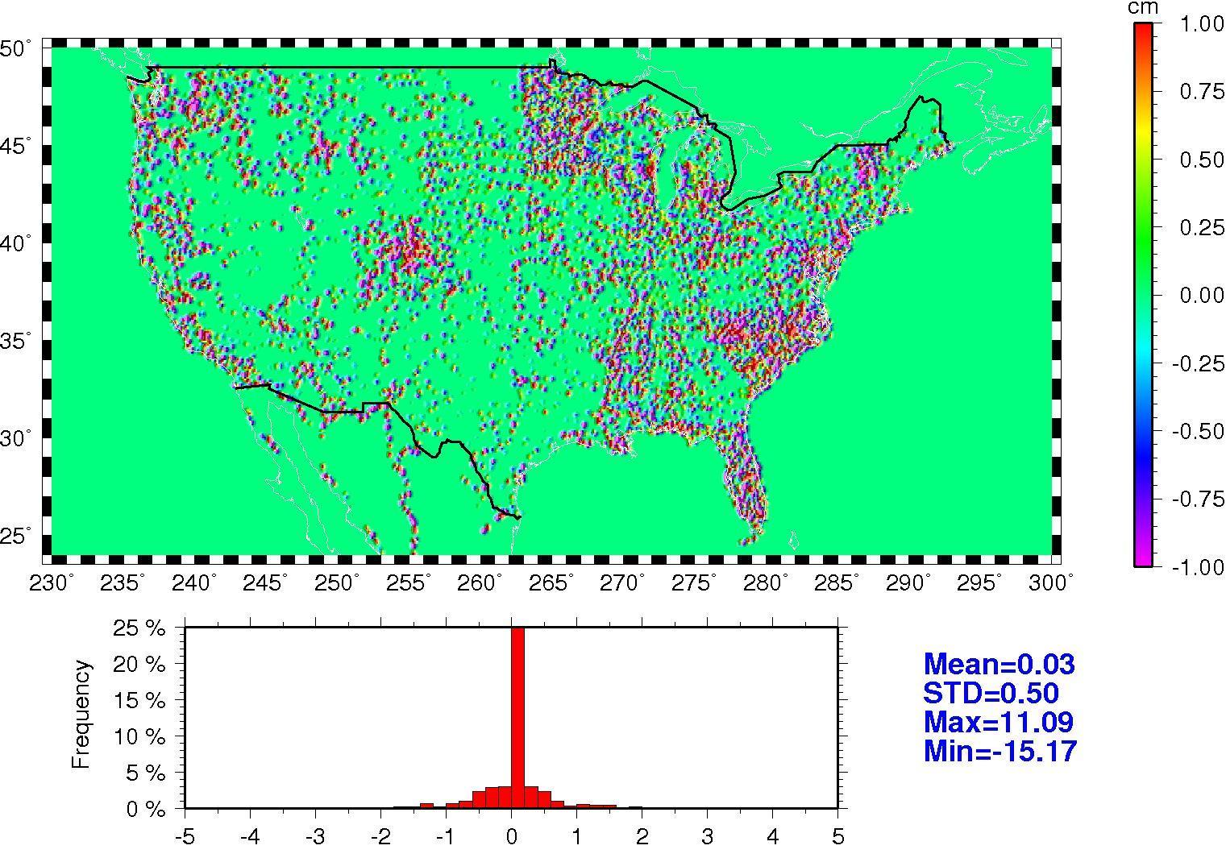
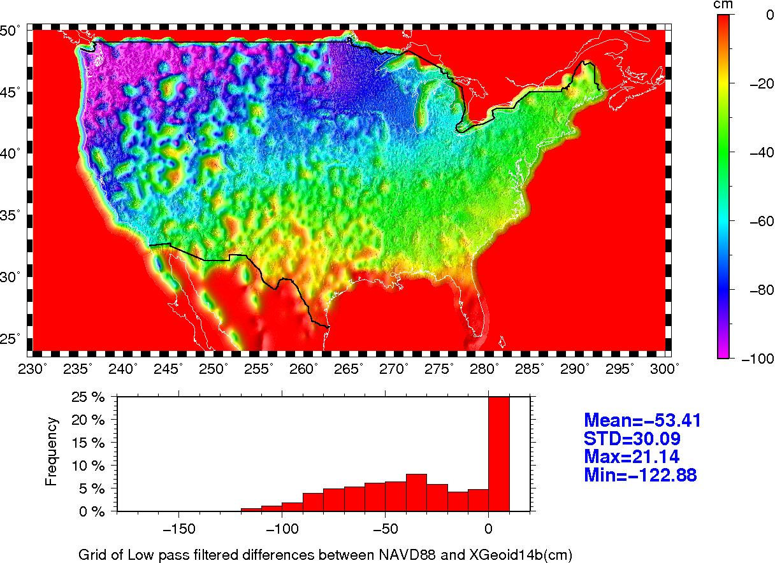
2104 Fall AGU Meeting Session: G51B Paper: G51B-0353 Friday, 19 DEC 2014, 0800-1220 Evaluation of Systematic Differences between the North American
Vertical Datum of 1988 and Release 5 GOCE Products
Daniel R. Roman² and Xiaopeng Li²
¹National Geodetic Survey, NOAA/NOS, 1315 East-West Highway, Silver Spring MD 20910 USA Email: Dan.Roman@noaa.gov
²DST, at NGS, 1315 East-West Highway, Silver Spring MD 20910 USA
3 methods (Regression Analysis top, Factor Analysis middle, Low pass (<72km) filter bottom)
Abstract
The North American Vertical Datum of 1988 (NAVD 88) serves as the primary vertical reference control for the conterminous United States and Alaska. Implemented in 1991, this datum has been shown to disagree at over a meter with global gravity models (GGM’s) based on GRACE products. However, the resolution of such models was limited to about 600 km and larger scales for comparisons with GPS-derived ellipsoid heights on leveled benchmarks. In this study, GGM’s based on GOCE Release 5 are assessed. Given the increased resolution of these models, scales down to 150 km, an improved estimate of the systematic differences with NAVD 88 is possible. Such a model would serve as an a priori estimate of errors and greatly aid in development of hybrid geoid height models used to transform GPS observations into estimates of orthometric heights above NAVD 88. The National Geodetic Survey develops hybrid models using least squares collocation, which presupposes that the data are centered and stochastic and not systematic. In 2022, NGS will develop a replacement for NAVD 88 and future error models, such as the one presented here, will serve as a mechanism for datum transformation for backward compatibility to NAVD 88.
Parameters to be estimated & parameters found to be significant | Model
2/2 |  | 0.41
 |  | 0.31
 |  | 0.10
 |  | 0.10
3/3 |  | 0.54
4/4 |  | 0.54
5/5 |  | 0.54
6/4 |  | 0.55
7/4 |  | 0.55
8/4 |  | 0.55
9/3 |  | 0.55
10/7 |  | 0.56
Data used
Discussion and Outlook
The Release 5 of GOCE Direct (DIR5) and Timewise (TIM5) solutions are compared against Tidal bench marks and astrogeodetic data in the figures to the left. Plots on the left give the relevant comparison data and those on the right give the results of the comparisons of the mean and standard deviations of both DIR5 and TIM5. DIR5, was superior to the TIM producing lower RMS values through a higher degree harmonic. As such, the DIR5 through degree 280 was selected for the further analysis.
In the figures to the right the DIR5 model is removed from the nearly 25,000 GPS derived ellipsoid heights on leveled bench marks used to make the recent GEOID12A/GEOID12B models. The ellipsoid heights are above the NAD 83 datum, while the orthometric heights are above NAVD 88. Subtracting the two gives a point estimate of the separation between the datums. These values are seen in the top left of the righthand panel. Current techniques to model this entail the use of stacking of five to six different Gaussian models to capture signals at various scales. What is desired is a better means of modeling this signal into a regular grid. As such, 3 methods {Regression Analysis top, Factor Analysis middle, Low pass (<72km) filter bottom} are examined. Regression tried to fit the data at the points using an increasing number of parameters to fit the surface (parameters are given in upper right image of the panel). Factor Analysis sought to fit a surface to the features in the residuals. The last approach applied a filter commensurate with the degree harmonic used (degree 280 => 72 km half wavelength). The plots of the resulting models are on the left and the residuals to the starting reference values are on the right. Applying a low pass filter gave the best method with the lowest residual values.
The images below then highlight the use of the above approach. DIR5 is too coarse for further work here to check against the existing approach but a model is available that uses much of this data. NGS released an experimental geoid height model, xGEOID14B that includes the GOCE satellite data, available airborne data, and an enhanced method of combining them all. The xGEOID14B model is removed from the GPSBM values to produce raw residuals, low pass filtered residuals, high pass filtered residuals, and a difference plot of the final result against the starting values all in the top row of the bottom panel. The low pass filtered model is fairly straight forward to develop into a regular grid because it is smoother. The high pass filtered results (circled in red) required only a single function Gaussian filter to model the signal. A much easier approach than is currently in use. The next two images merely highlight the additional content in the xGEOID14B model over the DIR5 solution. The bottom figures then show the plot of the gridded low pass filtered values and the high pass filtered residuals. When combined, these two produce a new reference geoid height grid for transforming between NAD 83 and NAVD 88. There is no mean value and the Standard deviation is only 1.3 cm – on par with the existing approach.

