Slide 1
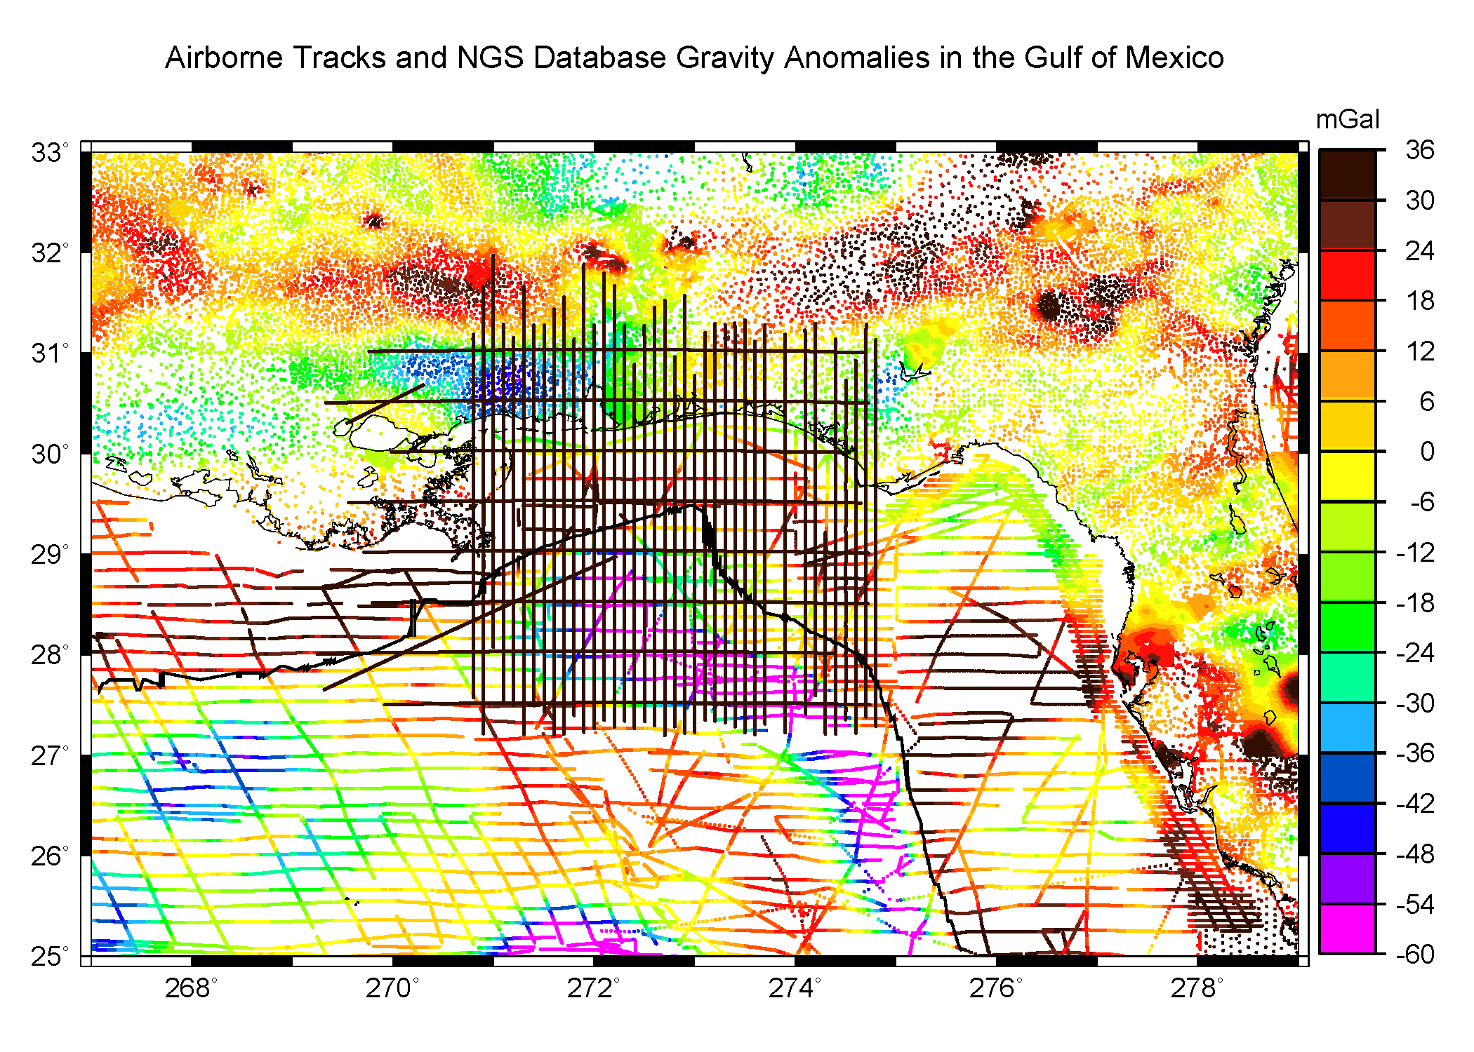
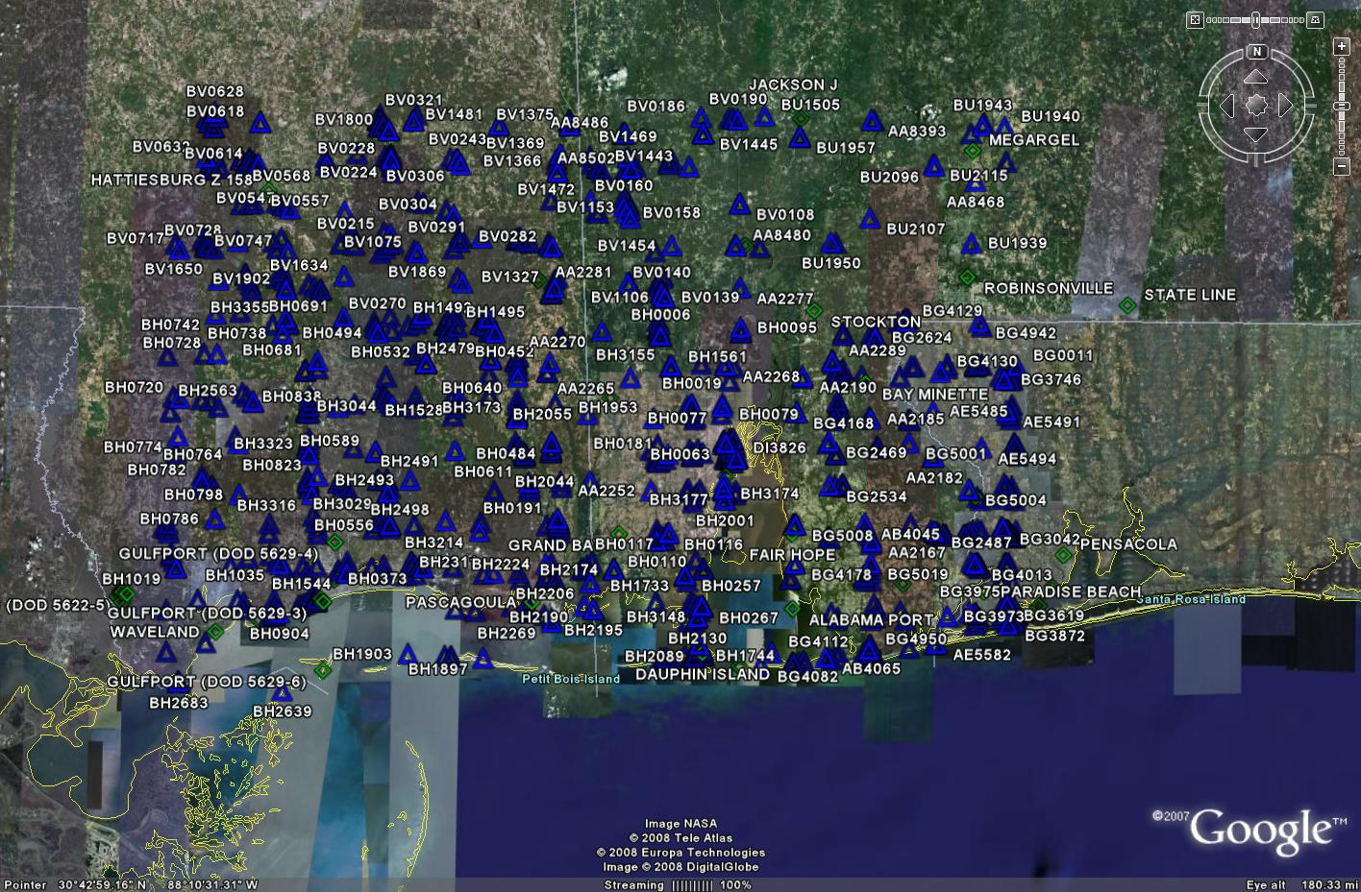
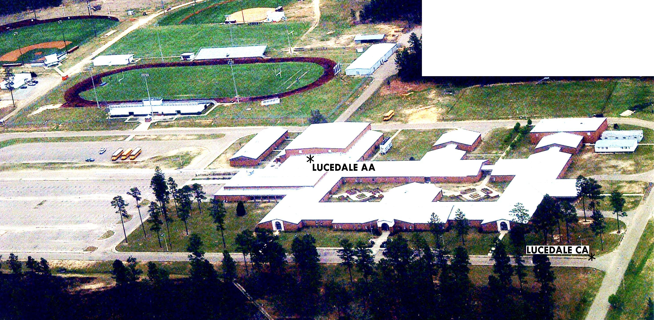
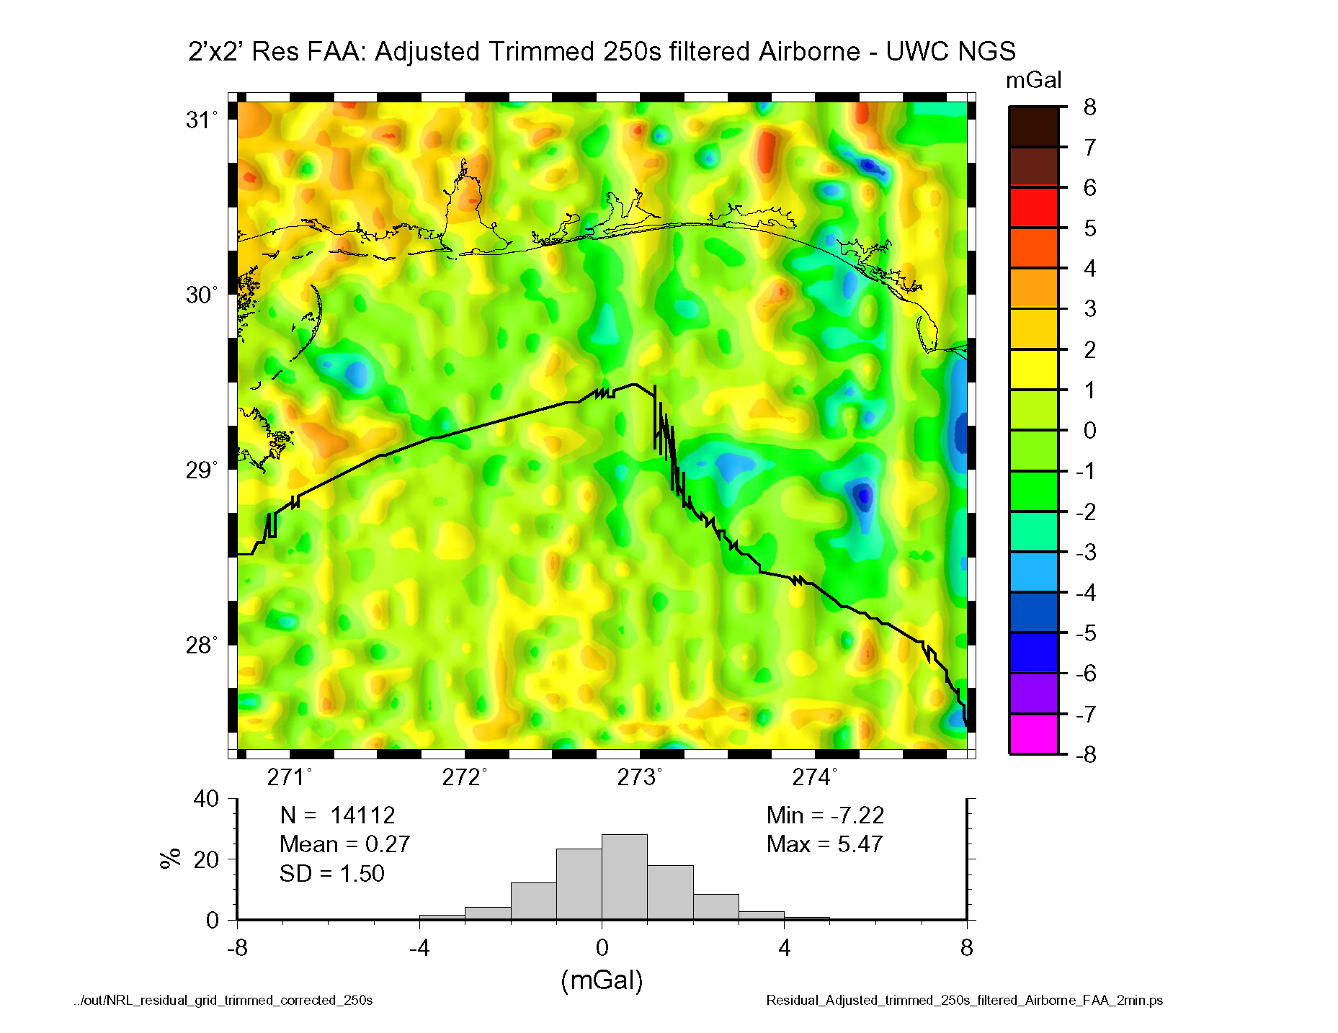
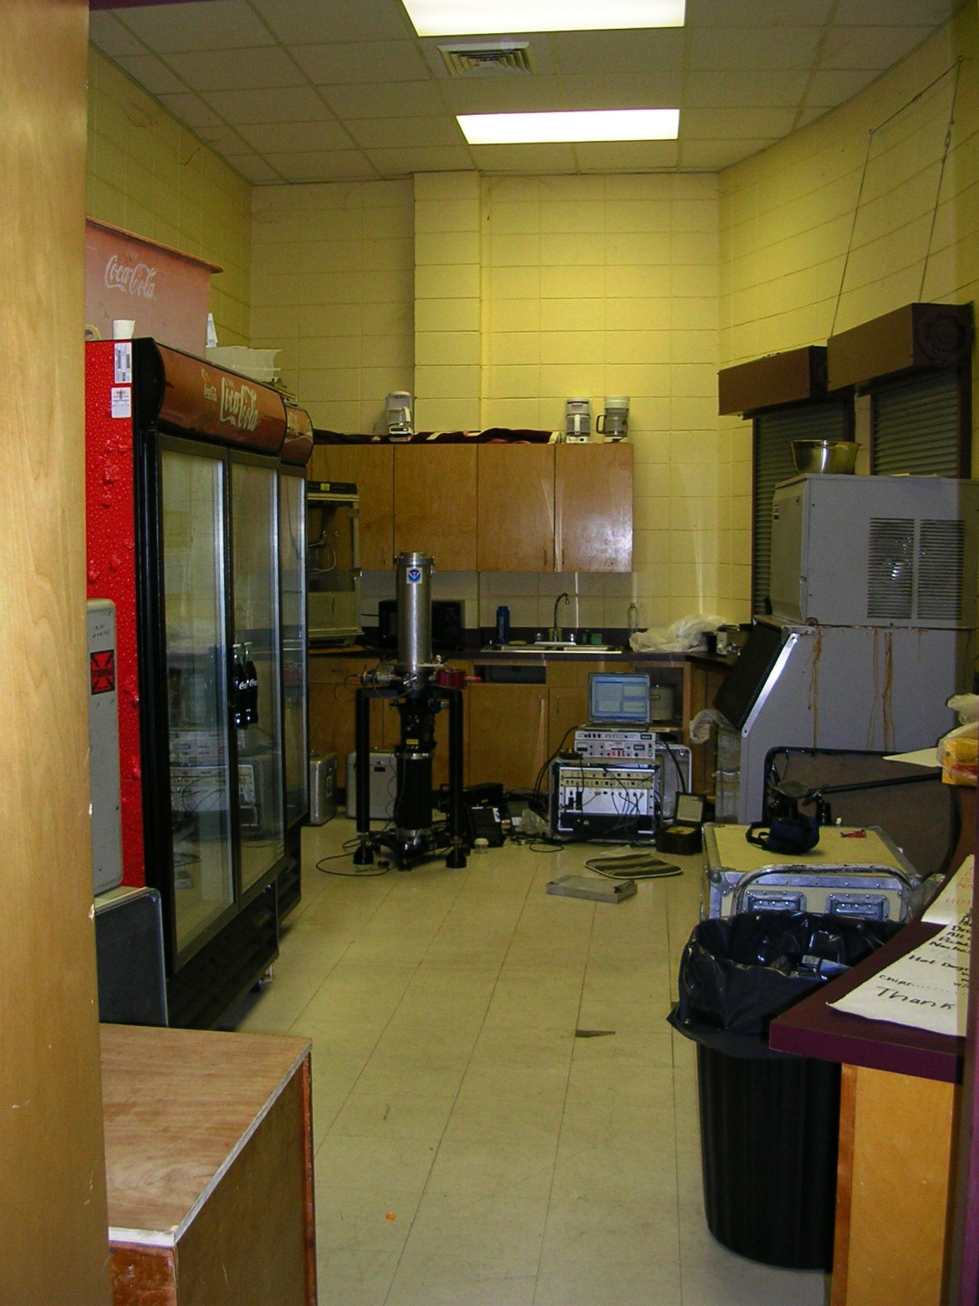
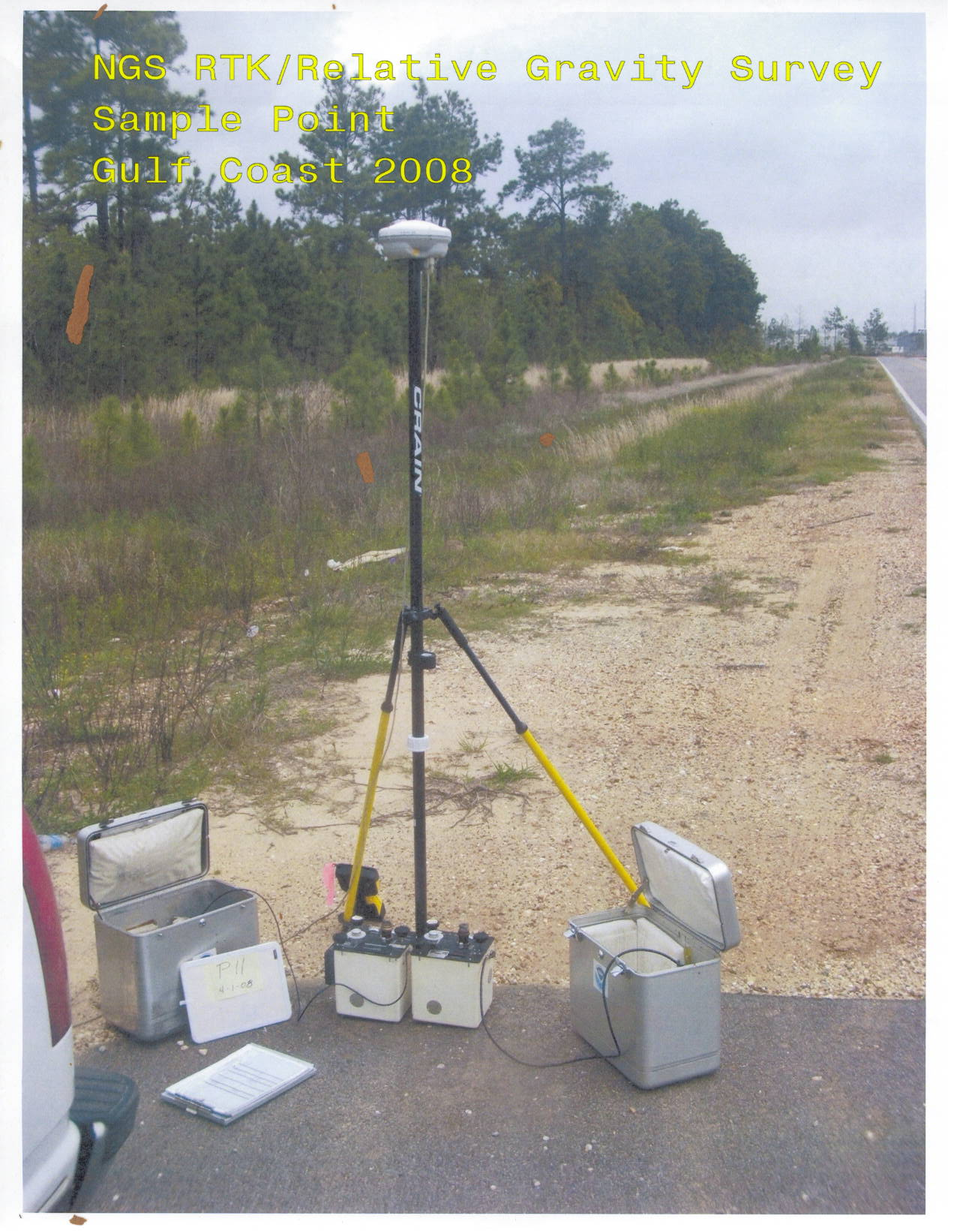
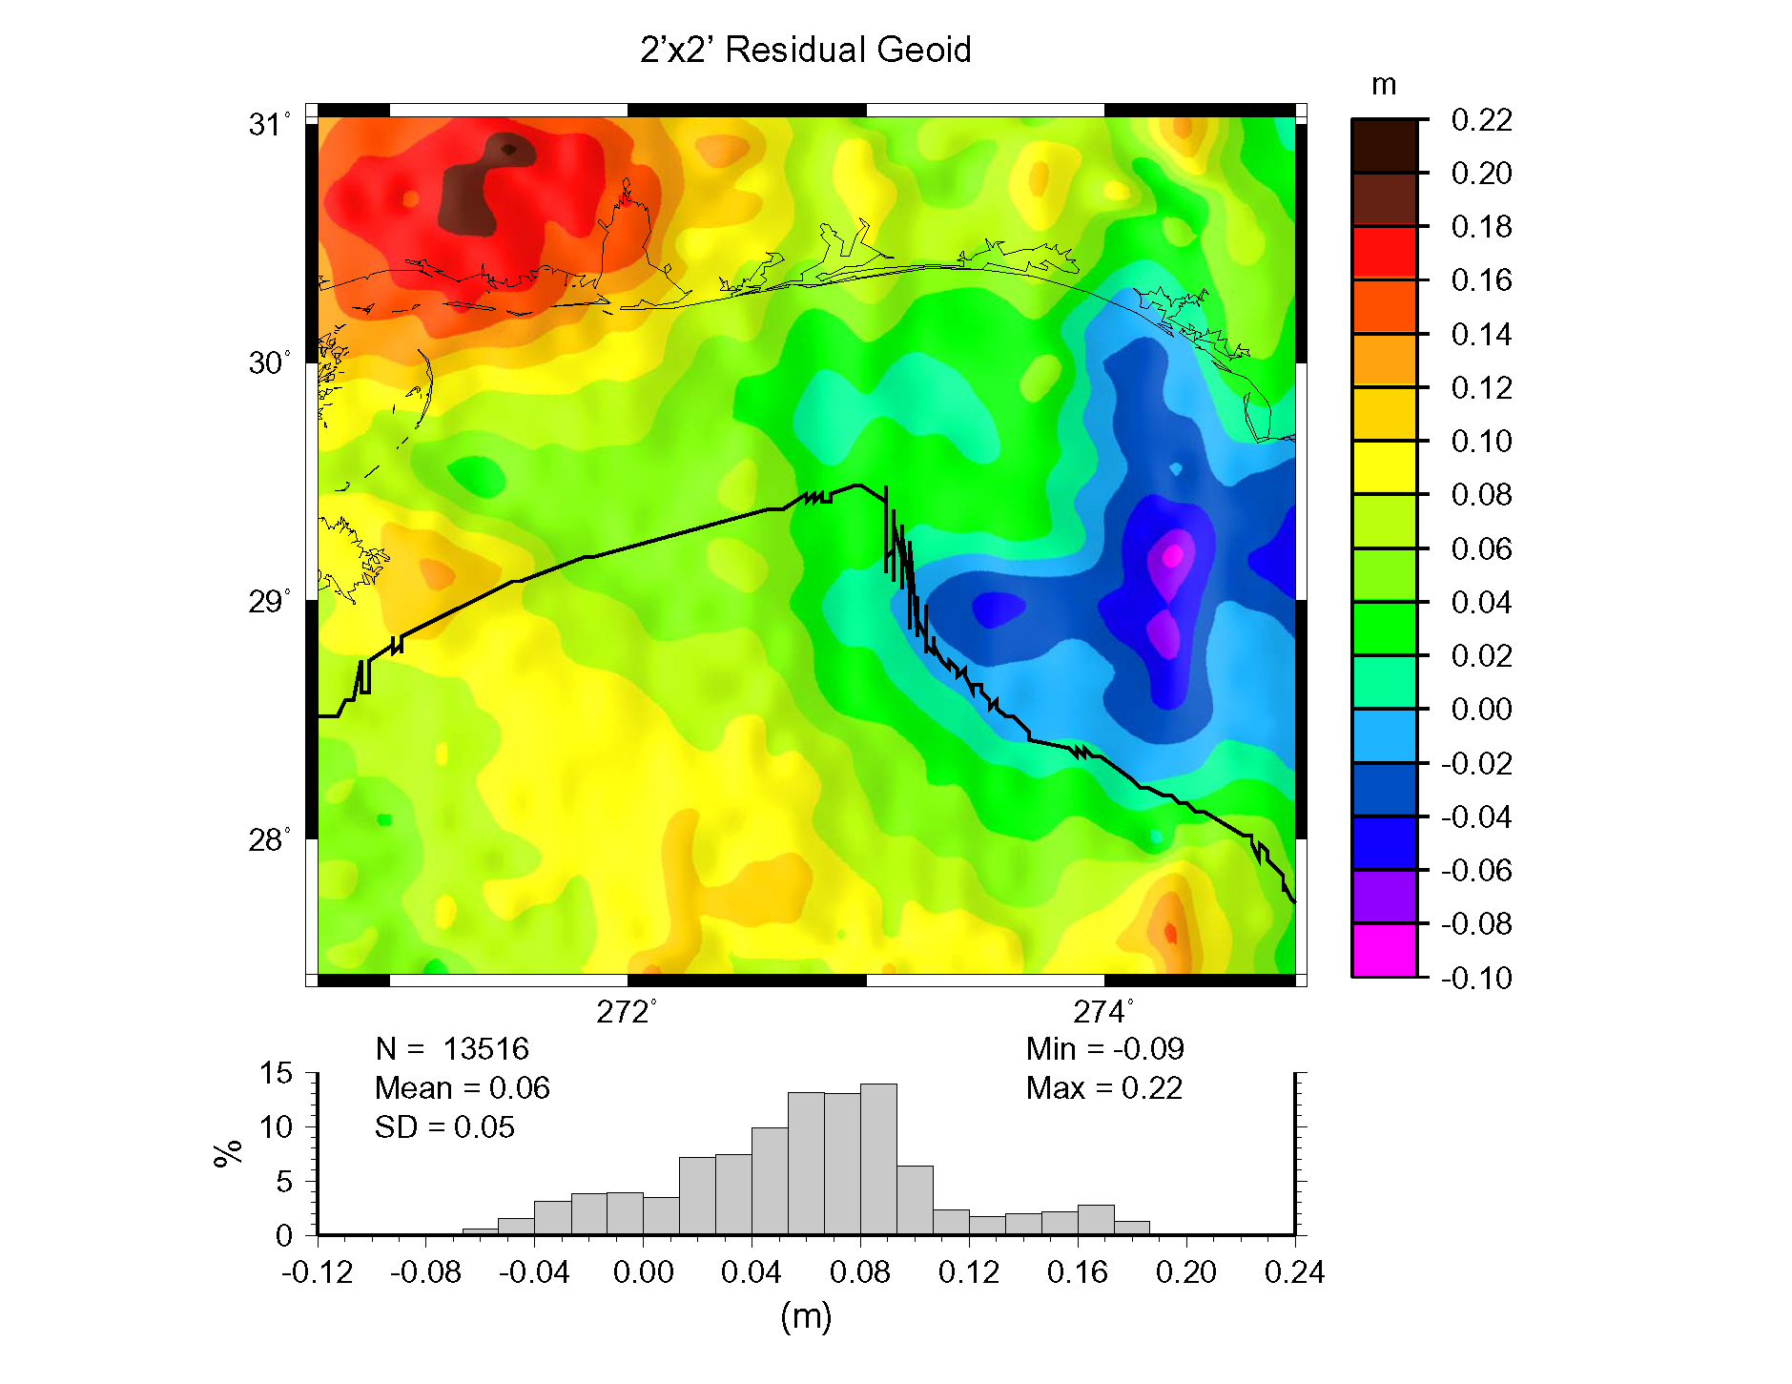
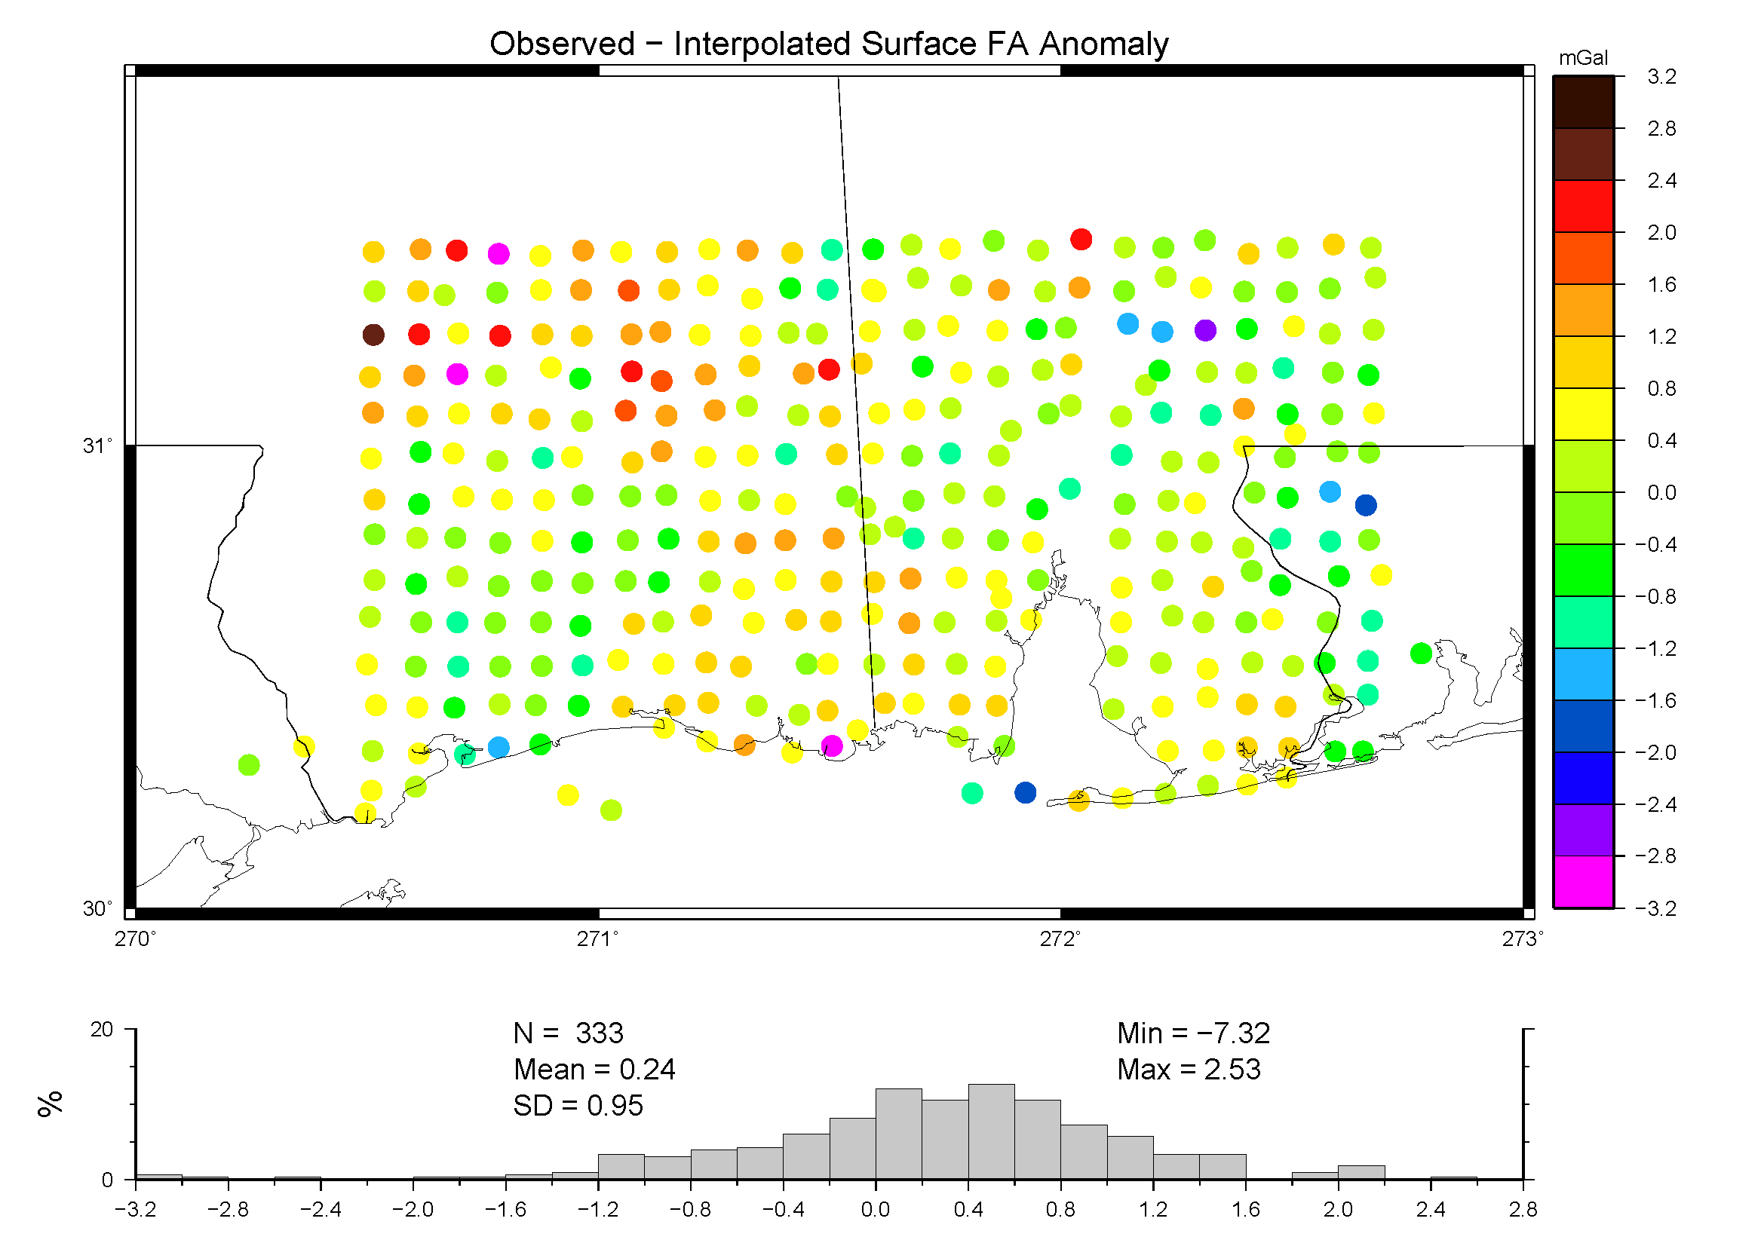
G41A-0789: Surface gravity observations define gravity field change over 30 years Daniel R Roman¹, Daniel Winester¹, Jarir Saleh² 1. Geosciences Research Division, NOAA's National Geodetic Survey, Silver Spring, MD, United States. 2. ERT, Inc., NOAA's National Geodetic Survey, Silver Spring, MD, United States.
INTRODUCTION AND BACKGROUND
The National Geodetic Survey (NGS) is responsible for maintaining the infrastructure and access to the National Spatial Reference System (NSRS). The NSRS contains both geometric & physical coordinates, with the gravity field and geoid heights being two such products. The geoid height models produced at NGS (Smith and Roman 2001, Roman et al. 2004, Wang et al. 2010) rely upon the integrity and accuracy of the gravity held in the NGS database (NGSIDB). Many suspect regions where vertical motion occur were hypothesized to have some level of impact on the resulting geoid height models.
This hypothesis was tested in 2006 when the Naval research Laboratory (NRL) put their airborne gravimeter onto the NOAA Citation II aircraft and collected gravity and lidar data (GLS06 study) over the northern Gulf of Mexico (Figure 1). This survey overflew data on land and sea (black lines) over the data archived in the NGSIDB. This archived gravity was and continues to be used to make geoid height models. This grid of gravity data was used to produce an upward continued grid at flight heights (35,000 ft or about 11 km). This grid of upward continued historical data was interpolated and the values removed from the aerogravity to produce residuals that were then gridded (Figure 2).
In Figure 2, the tracks remain quite clear after the gridding process including a couple very negative tracks in the middle right (one trending N-S and another E-W). More significantly, several tracks show 1-3 mGal residual signals all over the same geographic region. Flights were generally made in pairs (one down and one back) with one flight in the morning and one in the afternoon. It is unlikely these flights, which were relatively independent, exhibited across nearly 15 different profiles. Two being similar might indicate a problem with a flight but not for fifteen or so - all showing this trend over the same geographic region (highlighted by the red box) but nowhere else along the profiles. While the magnitude doesn't appear significant, the systematic nature of the residuals produces a significant feature in the related residual geoid height field.
In Figure 3, the data from Figure 2 were processed using a Stokes function to estimate the magnitude of the geoid change implied by the residuals between the aerogravity and NGSIDB gravity. The signal indicates a multi-dm level feature in the upper right that is unacceptable in light of the stated goal of cm-level of accuracy for a future NSRS envisioned in the NGS Ten Year Plan (). None of the tracks were crossover adjusted, so the large negative feature on the right appears to be a function of two suspect tracks. One other more moderate feature extends diagonally from the middle-left to middle-bottom and appears to be follow the Southern Louisiana Allochthon (Dokka et al. 2006).
In Figure 4, the misfit between the main N-S data flights and the E-W crossover flights indicates generally good agreement and no obvious systematic features. This implies that the aerogravity are at least internally consistent and that the source of the misfit is in the terrestrial data.
GULF COAST GRAVITY STUDY OF 2008
To study whether there was some systematic error in the terrestrial data, ideally a direct comparison would have been made to the archived NGSIDB data. However, most of those data do not have sufficient accuracy in their coordinates to recover them. Hence, an indirect comparison must be made by generating a grid from new data over the same region.
To that end, a new terrestrial survey was conducted in 2008 in the suspect region highlighted by the red box in Figures 2, 3 and 4. Ten absolute sites were set up (green diamonds in Figure 5) for control. These were then used in developing a 10 km grid spanning approximately 250 km by 150 km. A total of 324 relative stations (blue triangles) were collected to develop this grid. Since a FG-5 was used to collect absolute data, sites needed to be indoors and with a steady supply of power (Figure 6). Hence, the sites for absolute gravity were better controlled than those for relative gravity (Figures 7.a and 7.b). However, dual relative meters were employed for collection along with a GPS receiver to provide the best fidelity in the relative data. These were adjusted to the new absolute data to get the best overall agreement. As often as was practical, existing NGS monuments were occupied to aid in recovery for future comparisons.
Interpolated values from the gravity grid produced from the NGSIDB data were then subtracted from the new observations to form residual point values seen in Figure 8. The resulting SD of the differences (0.95 mGal) is similar to that seen in comparison between the aerogravity and the NGSIDB (0.87 mGal). More specifically, both show systematic features and not random errors. The region west of Mobile bay shows a high of between 1-3 mGals in both cases. This implies that the aerogravity and modern terrestrial gravity data are in agreement and that the archived NGSIDB data are incorrect.
CONCLUSIONS
Previously, the Southern Louisiana Allochthon had been mentioned. Dokka et al. (2006) had cited a possible 30 year slumping event there along this boundary. This would have started around 1970 and ended around 2000. The bulk of the data in the NGSIDB are between 40 and 70 years old. Hence, the NGSIDB data likely represent the gravity field prior to this geophysical change and cannot be relied upon to provide an accurate geoid height model reflecting the current spatial coordinate reference frame.
Earth Gravity Models determined from satellite missions such as GRACE (Tapley et al. 2005) or GOCE (Aguirre-Martinez and Cesare 1999) will not be sufficient to resolve such problems as was highlighted here. The scale of the features examined is under the spatial resolution of these models. However, the magnitude of the apparent systematic errors is such that some program must be put in place to account for such problematic data.
Since these data may be unreliable for this and other regions, the Gravity for the Redefinition of the American Vertical Datum (GRAV-D) was implemented to systematically collect gravity data across the country to detect and fix and other such problems (Smith 2007). This is in an effort to produce cm-level accurate geoid height models for use in improved geodetic applications such as flood plain mapping, coastal inundation, emergency planning, etc.
Figure 5. Distribution of 10 absolute gravity sites (green diamonds) and 324 relative gravity sites (blue triangles). This is roughly a 10 km grid meant to capture 20 km (full wavelength) signal for comparison to NGS archived gravity. The region is about 250 km by 150 km and covers the red box seen in Figures 2, 3 and 4.
Figure 1. Spatial distribution of surface gravity data held by NGS. Colors correspond to magnitude of gravity anomalies. Black lines show extents of GLS06 aerogravity flights.
Figure 6. Example of an Absolute Gravity site. An FG-5 was used to determine absolute gravity. Hence, the sites had to be well sheltered with a steady power supply.
Figure 2. Grid of differences between aerogravity from 35,000 ft (11 km) and upward-continued surface gravity data from Figure 1. Track lines are evident as is a systematic 1-3 mGal feature in NW corner (red box) that derives from 15 N-S running track lines.
Figure 7a and 7b. Set up of absolute gravity sites (7a) was on established pads, preferably sites that had been observed in the past. Set up for relative sites (7b) used two relative meters for tare detection situated at a GPS receiver for ease of recording geometric coordinates. These sites were generally not monumented though efforts were made to locate monuments to enable repeat observations in future work.
REFERENCES
Aguirre-Martinez, M., and Cesare, S. (1999). GOCE mission concept, error deviation and performances. Bollettino di Geofisica Teorica e Applicata. 40 (3-4), 295-302.
Dokka, R.K., Sella, G.F., and Dixon, T.H. (2006) Tectonic control of subsidence and southward displacement of southeast Louisiana with respect to stable North America, Geoph. Res. Lett., 33, L23308, doi:10.1029/2006GL027250
Smith, D. (2007). The GRAV-D Project: Gravity for the Redefinition of the American Vertical Datum, NOAA/National Geodetic Survey, Silver Spring MD 20910.
Smith, D.A., Roman, D.R. (2001). GEOID99 and G99SSS: One arc-minute models for the United States, J. Geod. 75:469-490.
Tapley B., Ries J., Bettadpur S., Chambers D., Cheng M., Condi F., Gunter B., Kang Z., Nagel P., Pastor R., Pekker T., Poole S., Wang F. (2005). GGM02 - An improved Earth gravity field model from GRACE, J. Geod. 79: 467-478.
Wang, Y.M., Saleh, J., Li, X.P., Roman, D.R. (2010). The US Gravimetric Geoid of 2009 (USGG2009): Model Development and Evaluation. In review.
Figure 3. The Stokes Function was used to generate equivalent residual geoid height implied at 11 km from data in Figure 2. The systematic feature in the NW is multi-dm. Feature in middle right is thought to be a function of two suspect tracks. Diagonal feature from middle-left to middle-bottom follows boundary of Southern Louisiana Allochthon.
Figure 4. Interpolated misfit between main N-S data lines and E-W crossover lines. Overall a good fit with RMS of 0.86 mGal implying 0.6 mGal on each line. No obvious systematic features, particularly in the NW corner. Crossovers indicate internal consistency between profile lines.
Figure 8. Differences between newly observed surface gravity and archived data held in NGS database, which are shown in Figure 1. The archived NGS data that had been gridded and upward continued in the comparison shown in Figure 2, are also interpolated here. Note the similar 1-3 mGal feature in the same geographic region as seen in comparison to the aerogravity in Figure 2. The aerogravity and the recent surface data both show similar levels of disagreement with the older archived NGS data.

