Slide 1
Federal Geodetic Control Subcommittee Update to Coordination Group
Juliana P. Blackwell
Subcommittee Chair
Director, National Geodetic Survey
Juliana.Blackwell@noaa.gov
September 11, 2018

Slide 2
Topics
FGCS Membership
Information on New Datums
Recent Activities
Geodetic Control Theme Personnel
Dataset Updates
FGCS Meetings
Next Steps
2

Slide 3
FGCS Membership
The Federal Geodetic Control Subcommittee helps coordinate the planning and execution of geodetic surveys, developing standards and specifications for these surveys, and exchanging geodetic survey data and technical information among Federal agencies.
https://www.fgdc.gov/organization/working-groups-subcommittees/fgcs
3

Slide 4
Information on “New Datums”
https://geodesy.noaa.gov/datums/newdatums/
What to expect
How to prepare
Track our progress
Related projects
Educational videos
Learn more
FAQs
Contact us
Sign up for updates
4

Slide 5
NSRS Modernization Industry Workshop
Industry needs and concerns in anticipation of Modernizing the National Spatial Reference System in 2022
Debrief of the Workshop given on June 7, 2018
Webinar Information
5

Slide 6
NGS Coordinate Conversion and Transformation Tool (NCAT)
NCAT combines several previously separate transformation tools into a single browser-based user interface that supports single- and multi-point conversions, web services, and downloadable software.
https://geodesy.noaa.gov/NCAT/

Slide 7
State Plane Coordinates for 2022
A Federal Register Notice solicited comments on Draft Policy and Draft Procedures documents concerning changes to the State Plane Coordinate System (SPCS).
SPCS 83 (tied to NAD 83) will be replaced by SPCS2022, which will be related to the 2022 Terrestrial Reference Frames.
https://geodesy.noaa.gov/SPCS/index.shtml

Slide 8
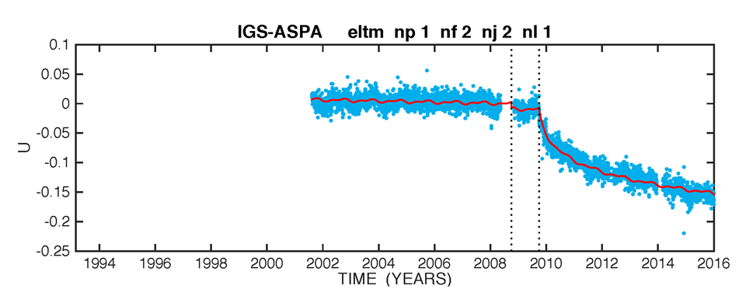
Geodetic Control in American Samoa
An earthquake occurred in 2009
All vertical control has been degraded by decimeters
The lone CORS site demonstrates magnitude
Recommendations: 1. Deprecate ASVD02 2. Investigate possible replacement

Slide 9
Geodetic Control Theme Leadership
FGCS Subcommittee Chair and Executive Champion
Juliana Blackwell, Director, National Geodetic Survey (NGS)
FGCS Secretariat
Erika Little, NGS (Acting while Brian Shaw is on extended leave)
Theme Lead
Dan Roman, NGS
Data Sets and Managers
Airborne Gravity – Jeffrey Johnson, NGS
Continuously Operating Reference Stations (CORS) – Kevin Choi, NGS
Geoid Models – Yan Wang, NGS
Geodetic Control Information on Passive Marks – Godfred Amponsah, NGS
9

Slide 10
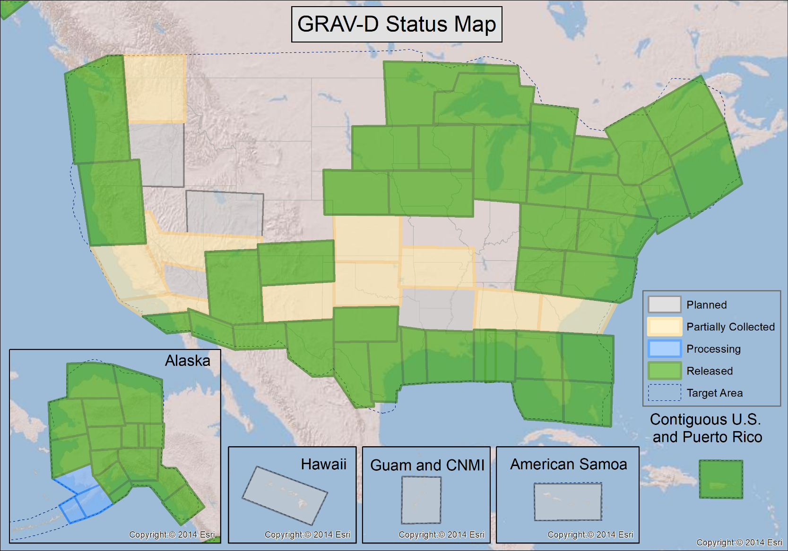
Geodetic Control Datasets – Airborne Gravity
Over 71% Data Collection Complete
10

Slide 11
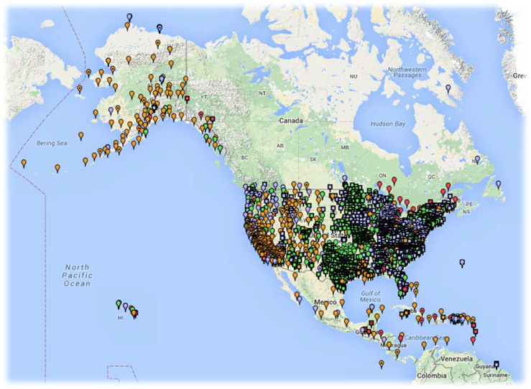
Geodetic Control Datasets - CORS
~1800 Continuously Operating Reference Stations
Run by more than 200 organizations (various government, academic, and private organizations)
Provide access to the U.S. National Spatial Reference System
11

Slide 12
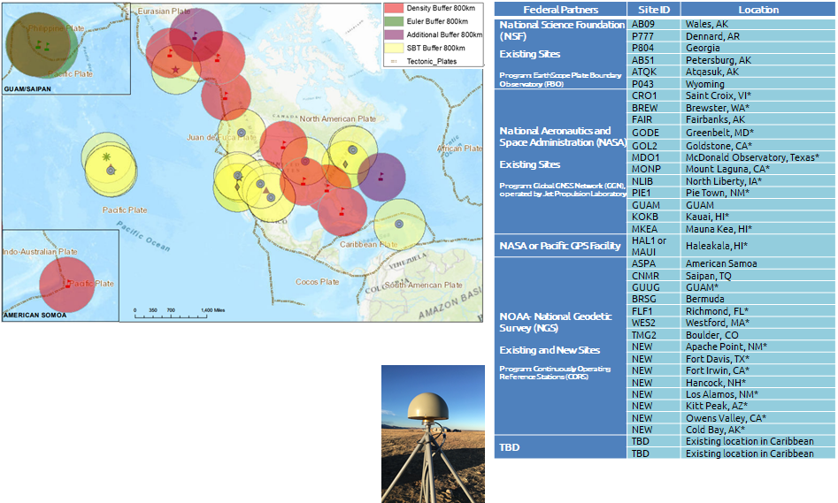
Foundation CORS
A set of federally-operated, ultra-high-quality, high-reliability stations with the longevity to guarantee citizens access to official NSRS positions and support international positioning consistency efforts.
12

Slide 13
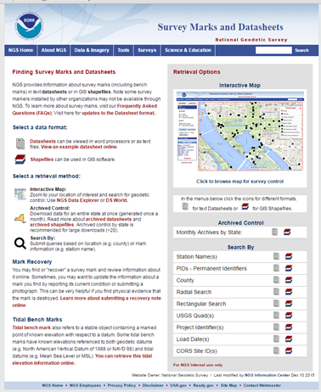
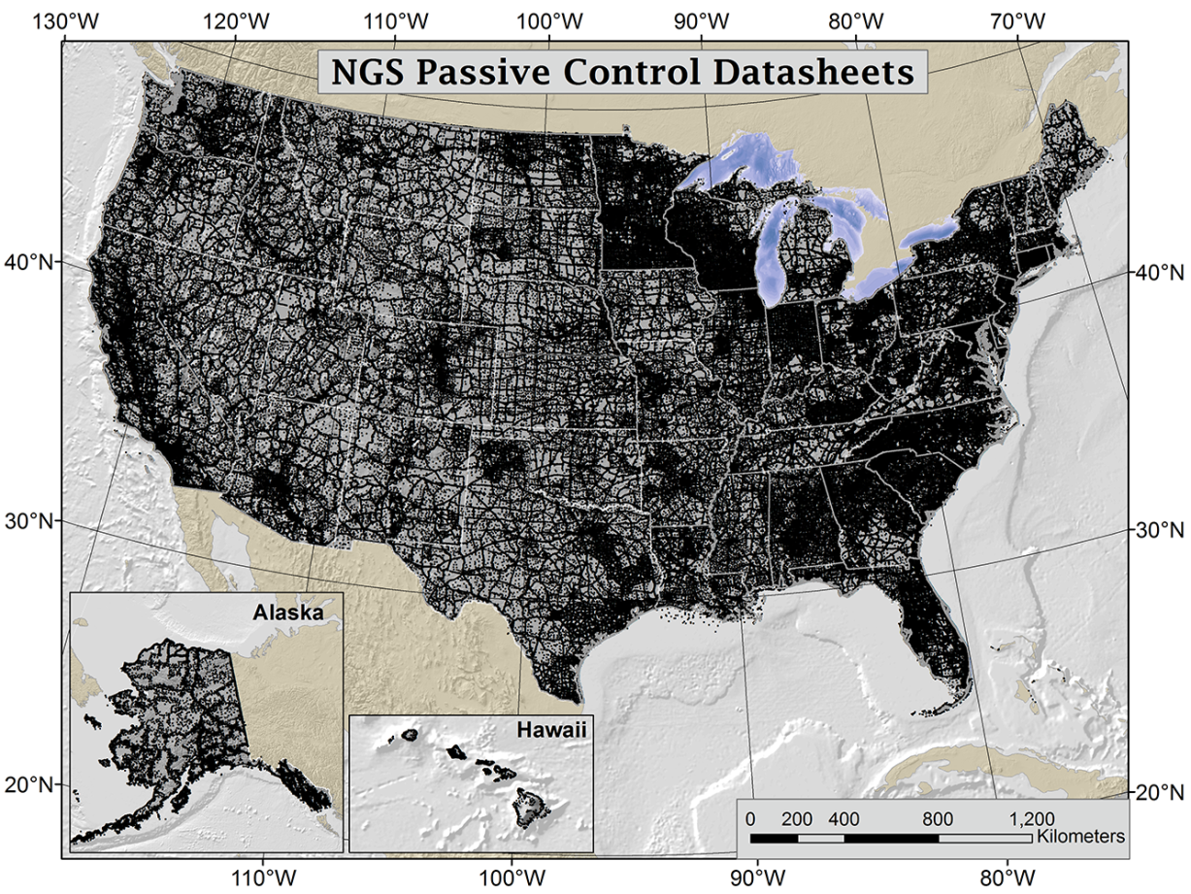
Geodetic Control Datasets – Passive Marks
Over 800,000 geodetic control datasheets
13

Slide 14
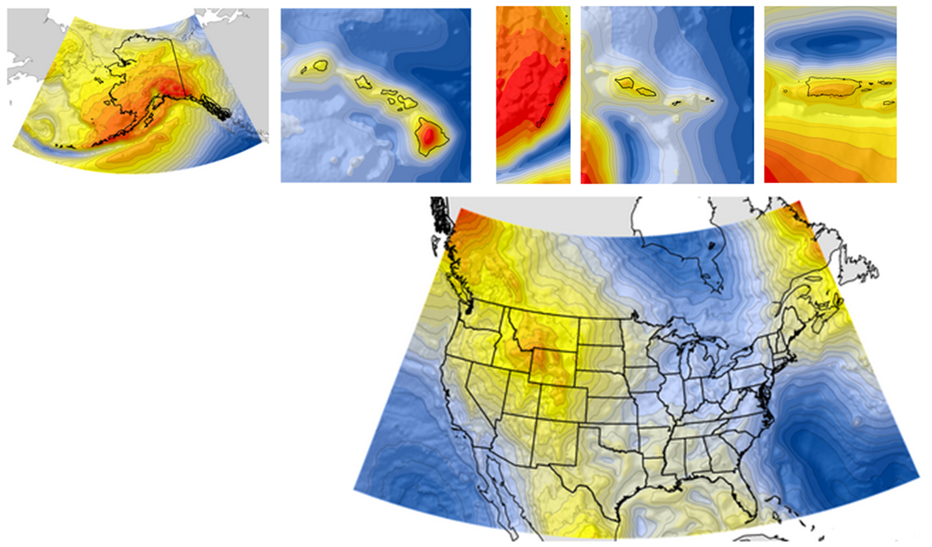
Geodetic Control Datasets – Geoid Models
CONUS
Alaska
Hawaii
American Samoa
Puerto Rico & US Virgin Islands
Guam and Northern Mariana Islands
14

Slide 15
Geodetic Control Datasets – Geoid Models
15

Slide 16
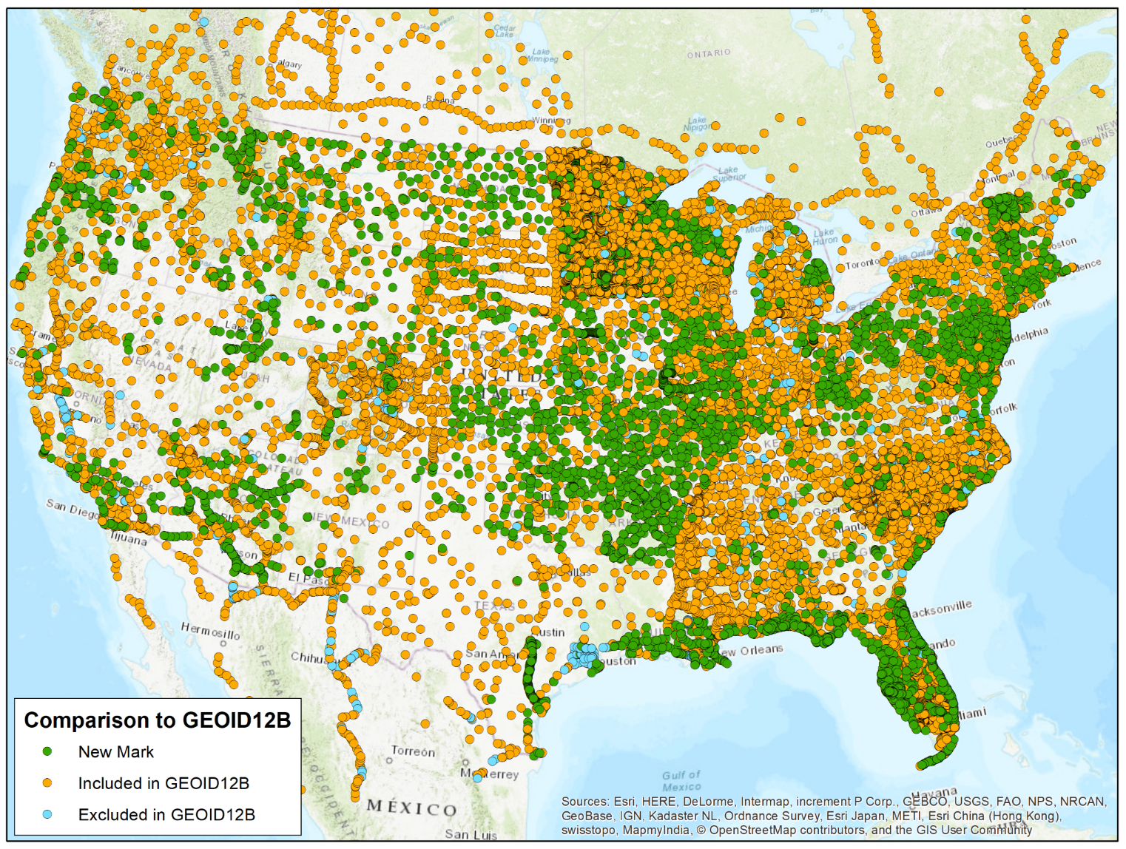
Geodetic Control Datasets – Geoid Models
Prototype Hybrid Geoid (v5.1)
Planned release 2019
Similar construction as GEOID12B
Gravimetric Geoid Model: xGEOID17B
GPS on bench marks
16

Slide 17
FGCS Meetings
The last FGCS meeting was February 22, 2018.
International coordination
NSRS modernization efforts
GEOID18 update
State Plane Coordinates for 2022
Discussion on NADCON approval
Work group discussions
The next FGCS meeting will be held October 25, 2018.
17

Slide 18
Next Steps
In the coming months, the FGCS plans to:
Continue to prepare for the new geometric and geopotential datums
Plan for next FGCS meeting
Continue to inform constituents about the new datums coming in 2022
Develop education lessons to help inform the public about geodetic principles
Deprecation of American Samoa Vertical Datum of 2002 (ASVD02)
18
Notes:
18

