Slide 1
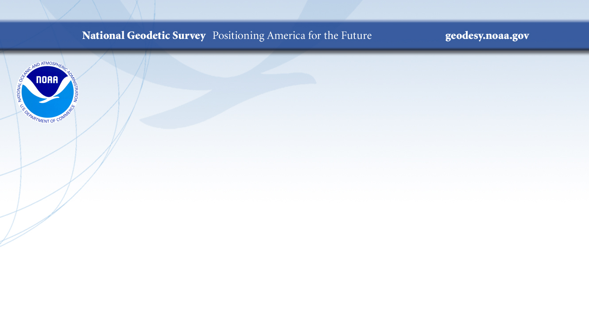
Strengthening the NOAA CORS Network (NCN)
Dr. Theresa Damiani*, Will Freeman, and the NGS CORS and Orbits Teams:
Francine Coloma, Don Haw, Phillip McFarland, Jarir Saleh, Lijuan Sun, and Dr. Sungpil Yoon
NOAA’s National Geodetic Survey (NGS)
Silver Spring, MD, USA
December 9, 2019
Session G11A- Reference Frames: Determination, Usage, and Application

Slide 2
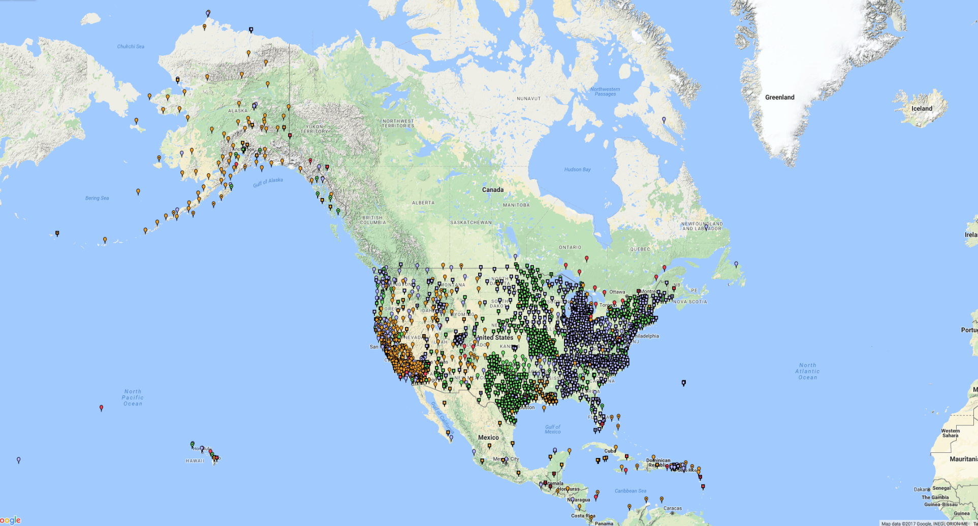
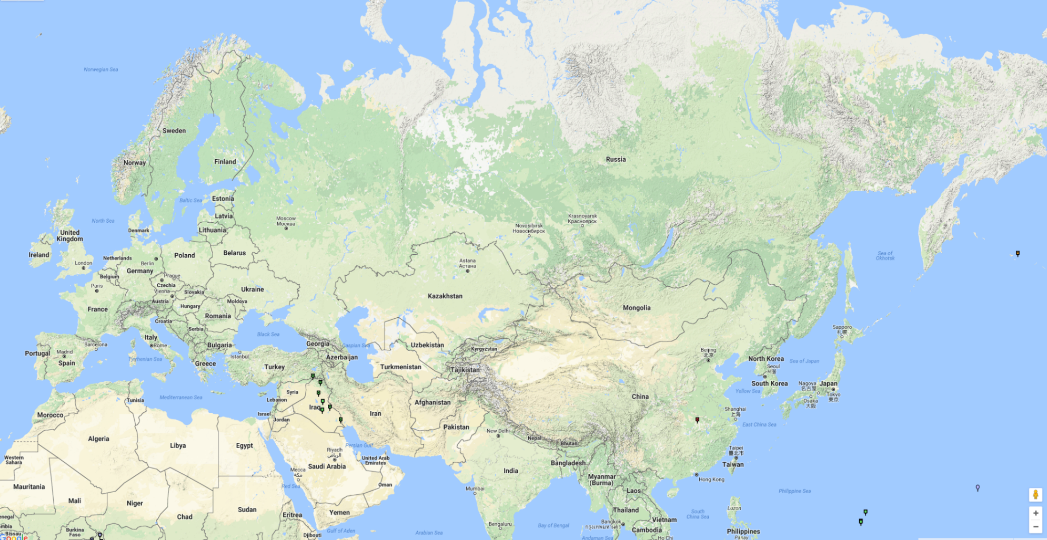
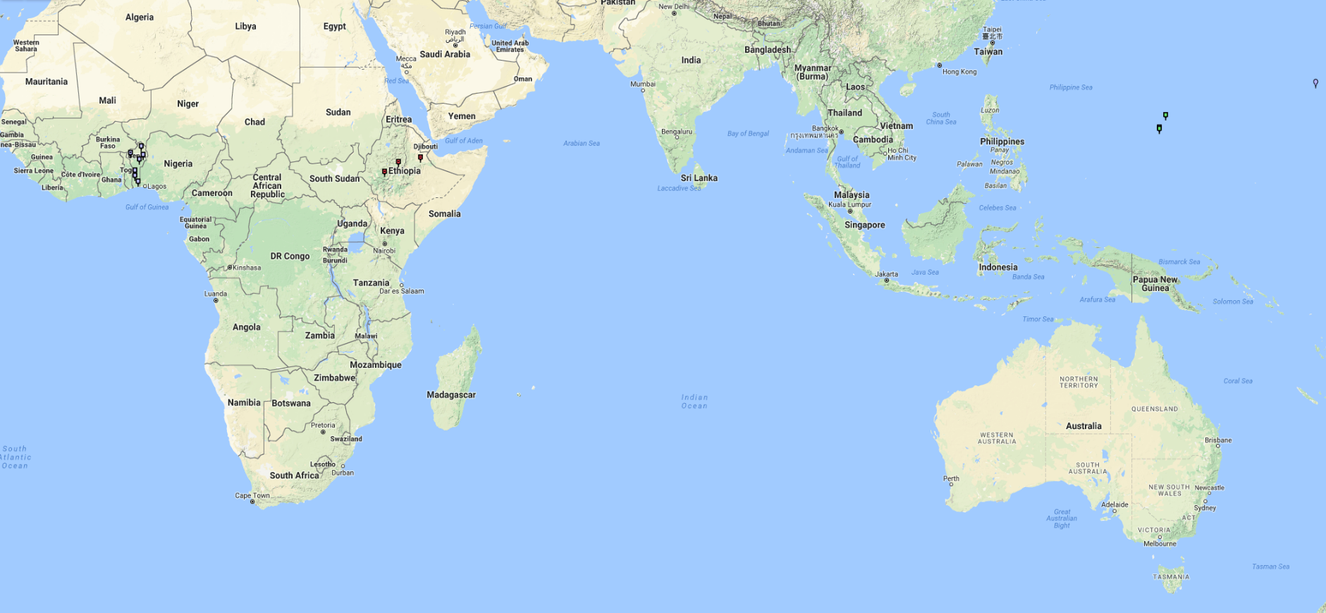
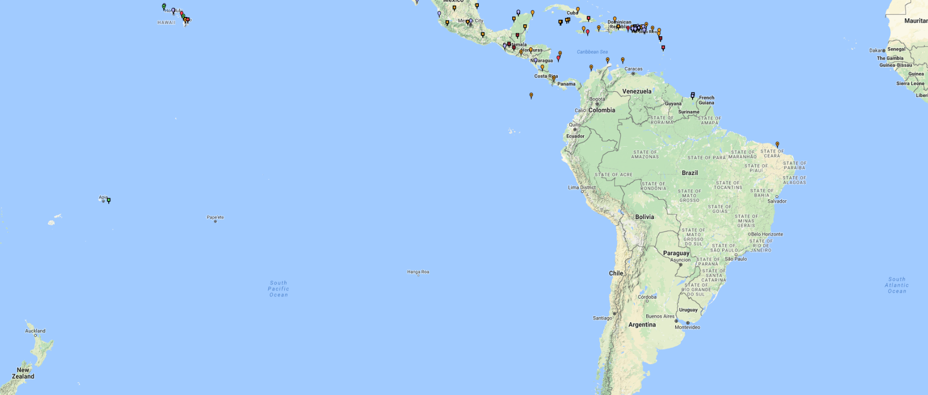
The NOAA Continuously Operating Reference Stations (CORS) Network
Top Efforts to Strengthen the NCN:
The NOAA Foundation CORS Network
The Multi-Year CORS Solution 2 (MYCS2)
IGS Orbit Analysis Center- IGS Repro 3 and New GNSS Software
GPS+GLO+GAL | 25%
GPS+GLO | 54%
GPS | 21%
A multi-purpose cooperative network of GNSS observations collected from ~ 200 government, academic, and private organizations. Each agency owns their own stations and shares the observation data with NGS.
NGS uses the network for the definition, maintenance, and access of U.S. civilian geodetic reference frames and support of NGS’ IGS satellite orbit analysis center. These activities are critical parts of the National Spatial Reference System (NSRS).

Slide 3

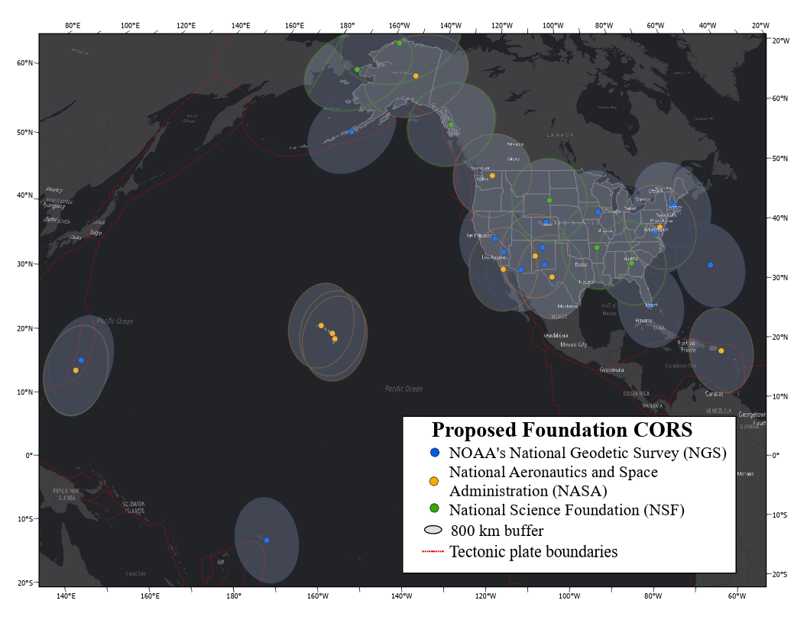
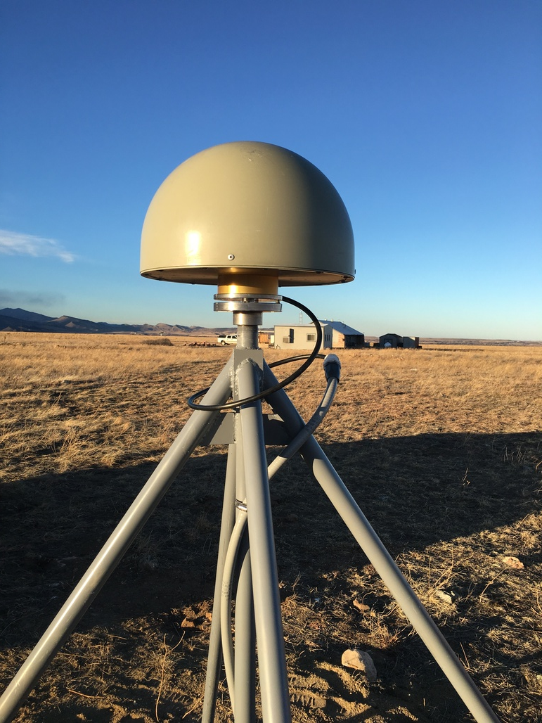
The NOAA Foundation CORS Network
U.S. Federal Partners | GNSS Site ID | Location | Existing IGS or ITRF Site
National Science Foundation (NSF) Existing Sites Program: Network of the Americas (NOTA) | AB09 | Wales, AK
 | AB51 | Petersburg, AK
 | ATQK | Atqasuk, AK
 | P043 | New Castle, WY
 | P777 | Dennard, AR
 | P804 | The Rock, GA
NSF Existing Sites Program: COCONet | CN11 | Pedro Cay, Jamaica
 | SAN0 | San Andres Island, Colombia
National Aeronautics and Space Administration (NASA) Existing Sites Program: Global GNSS Network (GGN) | BREW | Brewster, WA | ITRF
 | CRO1 | St. Croix, VI | ITRF
 | FAIR | Fairbanks, AK | IGS
 | TBD | Greenbelt, MD | IGS/ITRF
 | GUAM | Dededo, Guam | IGS
 | HAL1 | Haleakala, HI | IGS/ITRF
 | KOKB | Kauai, HI | IGS/ITRF
 | MDO1 | McDonald Observatory, TX | ITRF
 | MKEA | Mauna Kea, HI | IGS/ITRF
 | MONP | Mount Laguna, CA | IGS/ITRF
 | PIE1 | Pie Town, NM | IGS/ITRF
NOAA- National Geodetic Survey (NGS) Existing and New Sites Program: NOAA CORS Network | ASPA | Pago Pago, American Samoa | IGS
 | BRSG | St. George, Bermuda
 | CNMR | Saipan, Northern Mariana Islands | IGS
 | CORB | Woodford, VA
 | FLF1 | Richmond, FL | Proposed IGS/ITRF
 | GUUG | Mangilao, Guam | IGS/ITRF
 | TMG2 | Boulder, CO | Proposed IGS
 | WES2 | Westford, MA | IGS/ITRF
 | NEW | Apache Point, NM | ITRF
 | NEW | Fort Davis, TX | ITRF
 | NEW | Fort Irwin, CA | ITRF
 | NEW | Hancock, NH | ITRF
 | NEW | Los Alamos, NM | ITRF
 | NEW | Kitt Peak, AZ | ITRF
 | NEW | Owens Valley, CA | ITRF
 | NEW | Cold Bay, AK | ITRF
 | NEW | North Liberty, IA | ITRF
26 in North America, 4 in the Pacific,
3 in the Caribbean, and
3 in the Marianas.
A set of federally-operated, high quality, highly reliable stations with the longevity to guarantee citizens’ access to official National Spatial Reference System positions and support international positioning consistency efforts.

Slide 4
Goals of Foundation CORS Project
Federally-owned and operated “backbone”
Chosen for location, longevity, and high quality
Operational Goals:
  Non-operational time minimized for each station
  90% of NOAA Foundation CORS Network available
  at any time (no more than 4 stations non-operational)
  IERS-style site surveys every 5 years for ITRF definition
All stations are critical to some function of the new NSRS, including:
A geographic distribution no greater than 800 km to provide minimum 1.5 cm accuracy ellipsoidal height results through NGS’ OPUS tools anywhere in the U.S.
21 out of 36 stations are (currently or will be when built) co-located with other space geodetic stations supporting the IGS/ITRF, which the NSRS depends on
Deep-drilled, braced monument design for some new installations

Slide 5
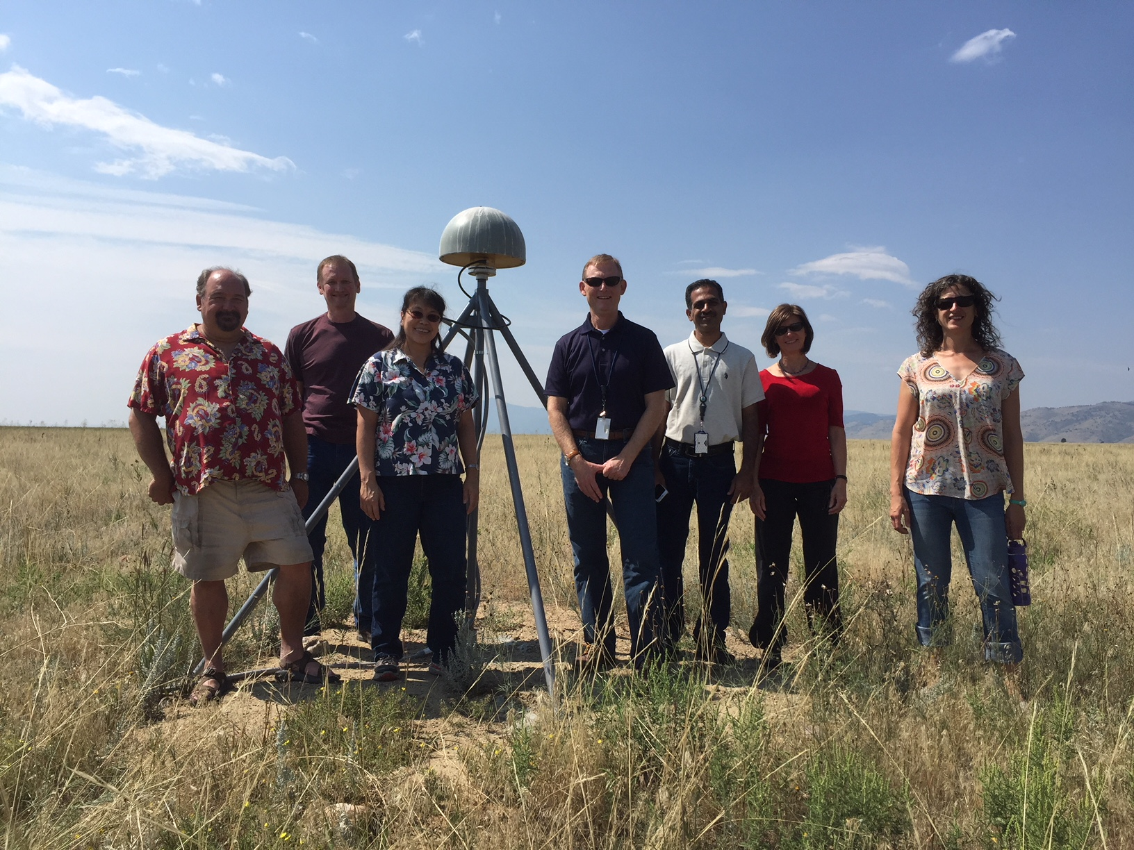
Three Ongoing Phases of Foundation CORS
Phase 1: Incorporate partner stations
Existing NASA and NSF stations brought into the Foundation CORS network.
[NASA Agreement being signed now.
Discussions ongoing with NSF.]
Phase 2: Upgrade existing NGS CORSs
Upgrades include fully-GNSS (“All in Sky”) capable equipment, RINEX3 support, and submission to IGS.
[RINEX3 creation, ingestion, and QC in development.
5 of 7 NGS Foundation CORS are fully-GNSS enabled]
Phase 3: Construct ~9 new stations
These NGS-owned stations will be co-located at sites with existing space geodetic techniques
Foundation CORS at NGS’ Table Mountain Geophysical Observatory in Boulder, CO, installed 2018 (ID: TMG2)
Notes:
CORS is a method-agnostic term, but common useage applies it to GPS/GNSS stations.

Slide 6
Multi-Year CORS Solution 2 (MYCS2) Released
How:
Detailed quality control and discontinuity detection via a weak elastic string method (Blake and Zisserman, 1987) on data collected by the NCN over 21 years (1996~2017 Jan).
Dual-step adjustment: 1. global/orbit adjustment to establish No-Net-Rotation frame, 2. CORS daily coordinate adjustment relative to NNR frame (Griffiths et al, 2010)
Stacking of weekly SINEX solutions using CATREF (Altamini et al, 2013): 3050 stations, 1100 weeks of data for all NCN stations installed before 2014 (active and decomm.), IGS, and NGA stations.
Uncertainties estimated with CATS (Williams, 2008) to address white noise, time-correlated noise, and annual/semi-annual loading effects.
What:
New robust coordinates and velocities in the IGS14 realization of ITRF2014 and NAD83(2011) epoch 2010.00 (a within-realization update) for all NCN stations installed before 2014.
~240 new NCN stations (<3 yrs old) have approximate coordinates and velocities “modeled” with OPUS-Net and HTDP
New GPS orbits to match with ITRF2014.
Updated OPUS online positioning software uses the new coordinates and velocities, and new GEOID18.
Notes:
CORS is a method-agnostic term, but common useage applies it to GPS/GNSS stations.

Slide 7
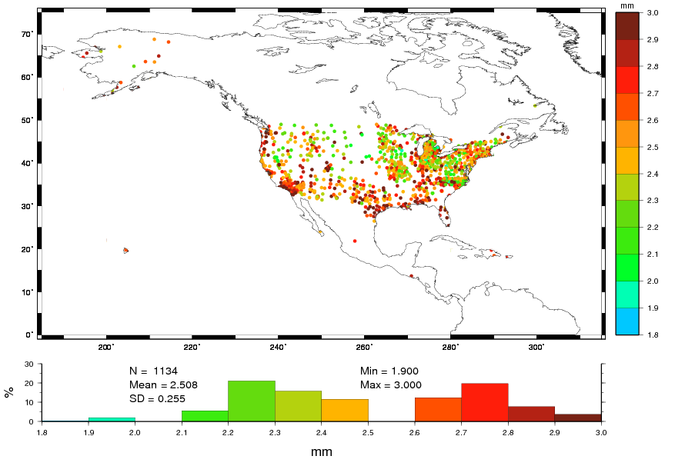
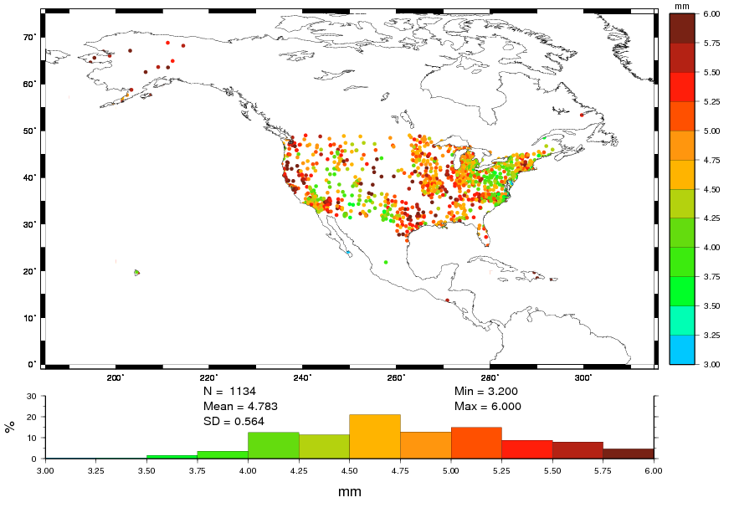
NOAA CORS Network Quality
% of Stations | # of Stations | Horizontal Motion | Vertical Motion
64% | 1139 | <= 3 mm | <= 6 mm
35% | 623 | <= 5 mm | <= 10 mm
1% | 16 | > 5 mm | > 10 mm
AND
AND
OR
Notes:
After calculating the new NAD83 velocities, these are the % and # of stations that have residual (remaining) unexplained motion in these ranges-- as of Repro2 end date in 2017. Note that there have been 2.5 years of motion since then and at least one major earthquake (Ridgecrest), so ~130 stations’ positions are now out of spec according to our old metrics (> 2cm horiz or >4 cm vert).

Slide 8
NGS’ IGS Orbit Analysis Center
IGS Repro3
Submitted ~ 130 station list to IGN to improve US and AK density to ~ 217 km and 282 km, respectively. ~ 30 stations are priority 8 or higher.
Preliminary test solution (year 2014) delivered to IGS last week. Final test solution to be completed next week.
Preparing NGS servers and potentially cloud servers for full scale solution calculation (years 1994 ~ 2019).
GNSS orbits, GPS Block III, and GPS Clocks
NGS plans to have GNSS data processing software available in 2021, to replace the GPS-only PAGES software. Starting this year, NGS will be preparing our orbit computation software to become multi-constellational.
Developed a model for GPS Block III satellites but solutions are not included in the operational product yet. We are waiting for more tracking data from the ground stations.
Postdoc at NGS is developing a software for research-level GPS clock solutions for NGS
Notes:
CORS is a method-agnostic term, but common useage applies it to GPS/GNSS stations.

Slide 9
Continued Modernization Efforts
Reference Frame Definition and Maintenance:
  Defining the rotation models that will be part of the new plate-fixed U.S. Terrestrial Reference Frames to be released around 2022. Working with IAG Subcommission 1.3c (NAREF).
  New intra-frame velocity model (IFVM), for regional motion. Possibly including GNSS data, InSAR, and/or geophysical models. Possible new Land Level Change product from InSAR with NASA and USGS collaboration.
  Research into implementing non-linear coordinate functions for station velocities
  Operationalizing robotic antenna calibrations with a view toward eventual GNSS calibrations
Better access to the National Spatial Reference System (NSRS)
  Goal: achieve sustained quality of 5 mm horizontal, 10 mm vertical – See Blueprint Part 3
  Nearly 75% BETTER than before
Increased cooperation with NOAA’s tide gauge program, especially for GLOSS stations that need geodetic GNSS measurements to remove land motion.
Notes:
Plan will look at ways to

Slide 10
More from the NOAA CORS Network Teams
At AGU:
  Poster, Monday PM. T13D-0301
  McFarland, et al. “Disentangling overprinted postseismic transient signals in GPS position time series”
  Poster, Tuesday AM. G21C-0750
  Stressler, et al. “Evaluation of the Quality of Multi-GNSS Observations Within the NOAA Foundation CORS Network”
  Session, Friday AM. G51A
  Integration of GNSS into Water Level Observation Networks: Priorities, Technologies, and Benefits I
Publications Coming:
  Jarir Saleh, et al. In preparation for: J of Geod.
  “New GPS position time series, velocities and quality measures for the NOAA CORS Network” (MYCS2)
  Jian Yao, et al.
  “Reverse GPS Processing for Precise Satellite Clock Observation” Submitted to: Proceedings of the 7th International Colloquium on Scientific & Fundamental Aspects of GNSS.
Online: https://www.ngs.noaa.gov/CORS Email: ngs.cors@noaa.gov
https://www.ngs.noaa.gov/CORS/foundation-cors.shtml theresa.damiani@noaa.gov
https://www.ngs.noaa.gov/CORS/coords.shtml
Notes:
CORS is a method-agnostic term, but common useage applies it to GPS/GNSS stations.

